Slide 1
Earth Science Applications of Space Based Geodesy
DES-7355
Tu-Th 9:40-11:05
Seminar Room in 3892 Central Ave. (Long building)
Bob Smalley
Office: 3892 Central Ave, Room 103
678-4929
Office Hours – Wed 14:00-16:00 or if I’m in my office.
http://www.ceri.memphis.edu/people/smalley/ESCI7355/ESCI_7355_Applications_of_Space_Based_Geodesy.html
Class 21

Slide 2
Interplate thrust faulting.
Co-seismic

Slide 3
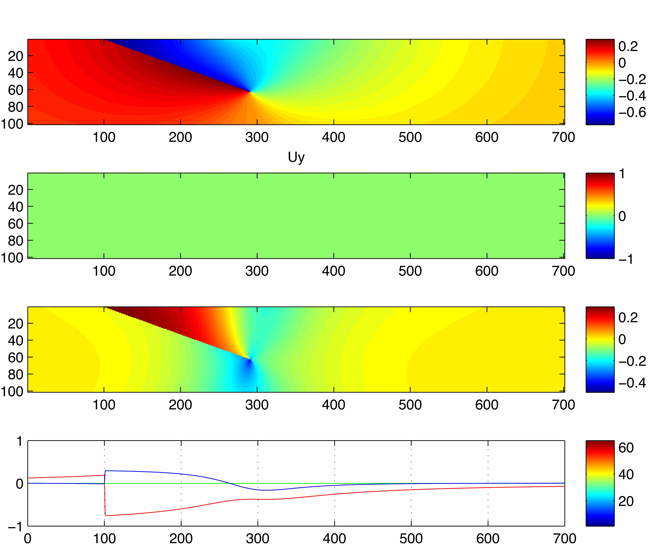
Co-seismic, no tectonics
Horizontal X
Horizontal Y
Vertical Z
+ red to right
+ red up
Blue – vertical, + up
Red – horizontal, + right

Slide 4
Interplate interseismic.
Two ways

Slide 5
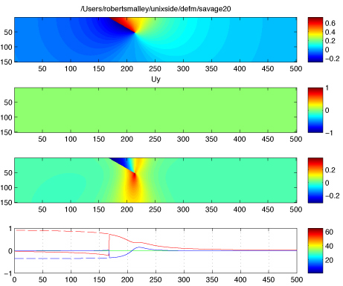
Savage back-slip model for interseismic
+ red to right
Horizontal X
Horizontal Y
Vertical Z
+ red up
Red – horizontal, + right
Blue – vertical, + up
Tectonic + Elastic perturbation

Slide 6
Run the earthquake “backwards”
+ red to right
Horizontal X
Horizontal Y
Vertical Z
+ red up
“fix”
Red – horizontal, + right
Blue – vertical, + up
Tectonic + Elastic perturbation (works for horizontal, not vertical)

Slide 7
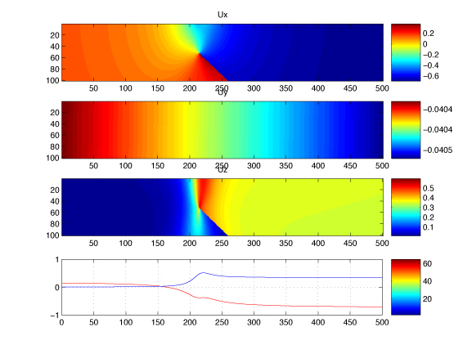
Down-dip slip model for interseismic
(does not have name)
Horizontal X
Horizontal Y
Vertical Z
+ red to right
+ red up
Blue – vertical
Red – horizontal – zero arbitrary, no change in sign

Slide 8
Down-dip slip model for interseismic
(based on idea of subducting plate continuing)
Horizontal X
Horizontal Y
Vertical Z
Locked
Freely slipping
+ red to right
+ red up
Blue – vertical
Red – horizontal – zero arbitrary, no change in sign

Slide 9
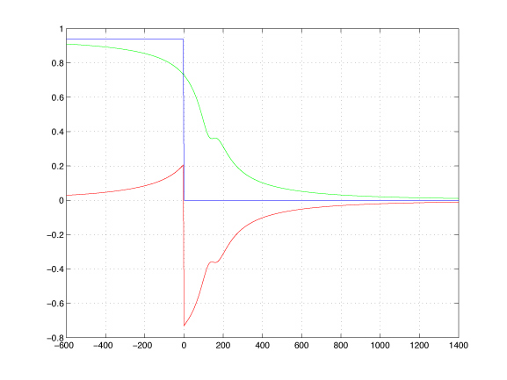
Blue: tectonic, + right. Sum of co- and inter-seismic (note – for plate rate on fault, get
cos(dip)*plate rate for “plate” on surface on lhs)
Green: interseismic-seismic, + right
Red: co-seismic, + right

Slide 10
Relative velocity across fault – broken into horizontal and vertical components, so don’t get v-plate along surface (the desired physics), get horizontal component.
<V plate=cos(dip)v_fault
Locked
Freely slipping
V plate
Blue – vertical
Red – horizontal – zero arbitrary, no change in sign

Slide 11
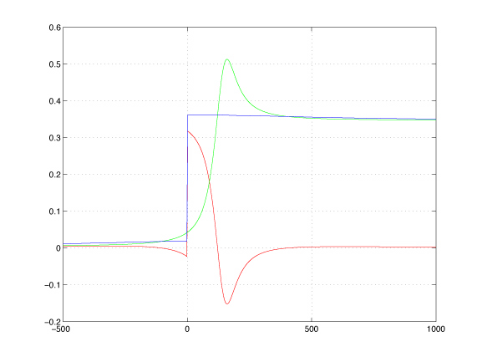
Vertical – inter-seismic and co-seismic
Green: interseismic-seismic, + up
Red: co-seismic, + up

Slide 12
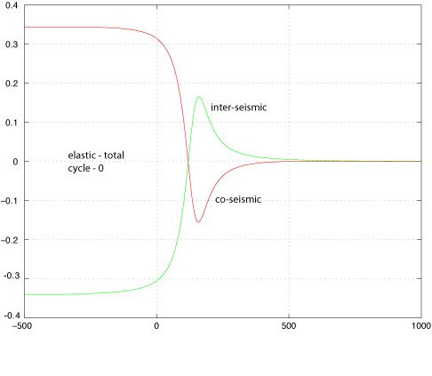
Vertical – inter-seismic and co-seismic, total cycle wrt far field upper plate.

Slide 13
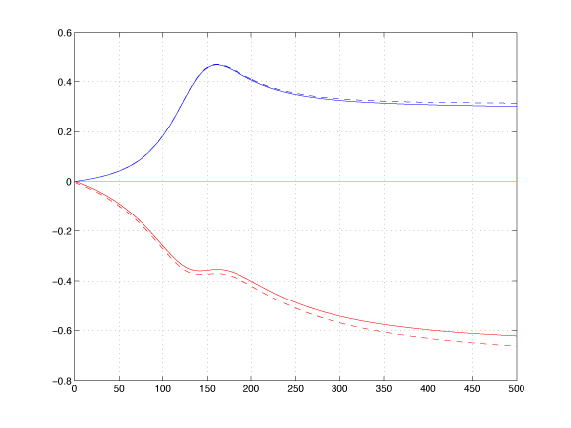
Compare Savage back-slip & down-dip extension model
Basically the same

Slide 14
Horizontal has tectonics without “fix” (but at cos of dip angle), but vertical has whole half of medium on hanging wall side going up (at sin of dip angle)

Slide 15
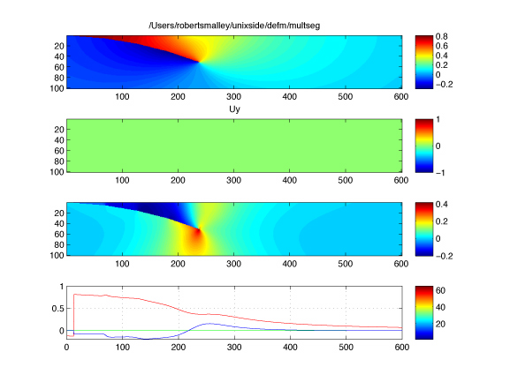
Popular variations – multi-segment interplate interface

Slide 16
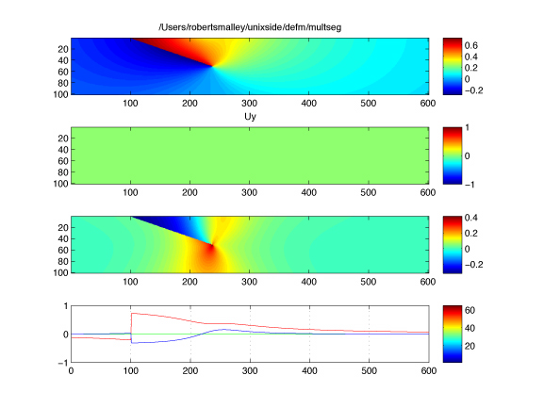
Compare to single-segment interplate interface

Slide 17
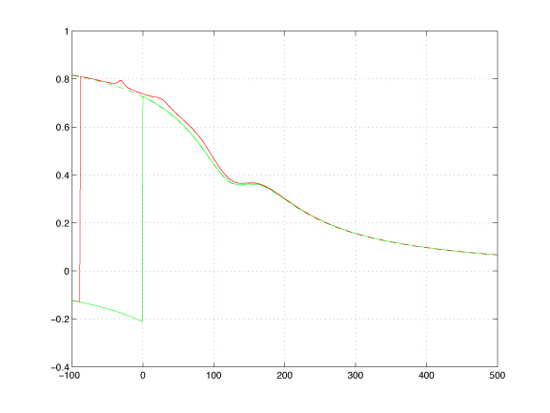
Compare single-, multi-segment
horizontal
Typical position of coast
Position of fault changes, otherwise almost the same
Certainly can’t tell difference with GPS, especially considering where have measurements on land.
Only have GPS measurements to right on land

Slide 18
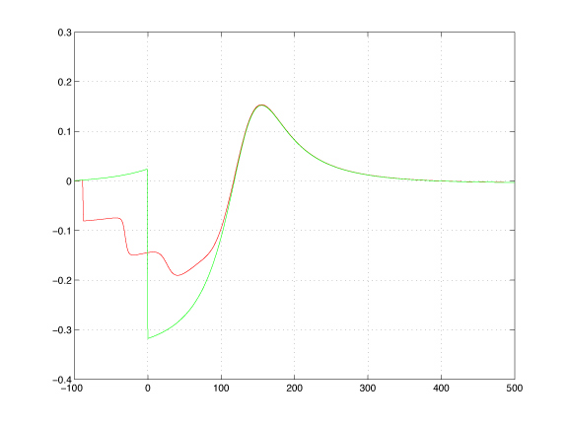
Compare single-, multi-segment
Vertical
Modeling problems (edge effects) – need more segments.

Slide 19
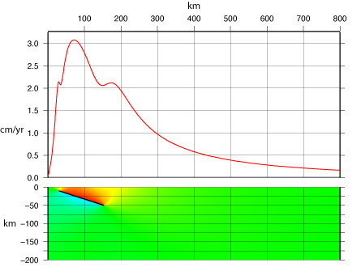
Popular variations – fault does not outcrop
(locked at top)
Typical position of coast
Geology, geophysics modeling support this, geodesy can’t see it.

Slide 20
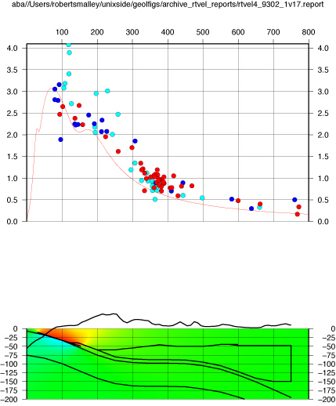
Going overboard
Single locked fault, does not match GPS data in central part of profile.
10x topography
Moho
Bottom South American Plate
Top and bottom of subducting plate and intervening asthenosphere.

Slide 21
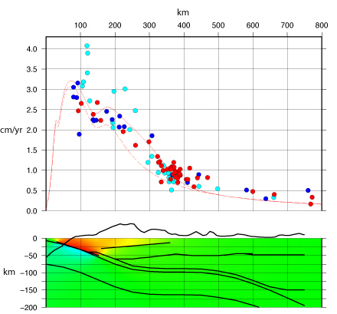
Add friction free fault representing decollement beneath thin-skinned thrust belt.

Slide 22
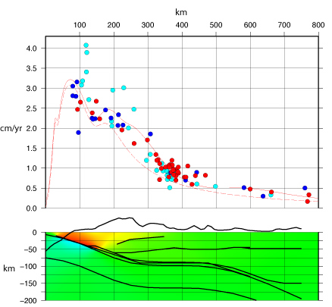
Add friction free fault representing decollement beneath thin-skinned thrust belt and “scoop” below main mountains (the dashed line geologists are wont to draw there).

Slide 23
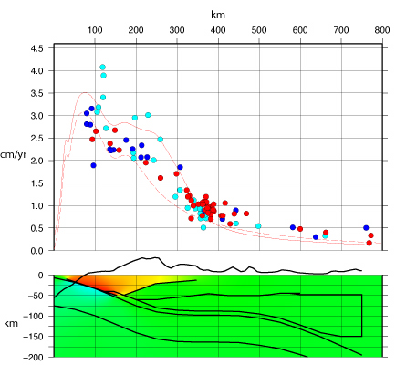
Send “scoop” all the way to the moho/intersection with subducted plate..

Slide 24
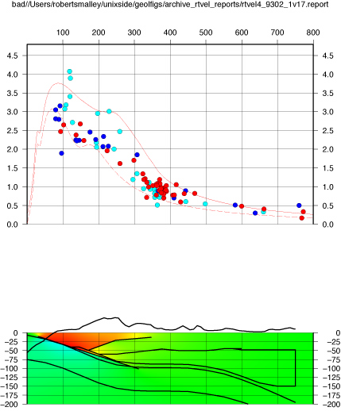
Add friction free extension of plate boundary.

Slide 25
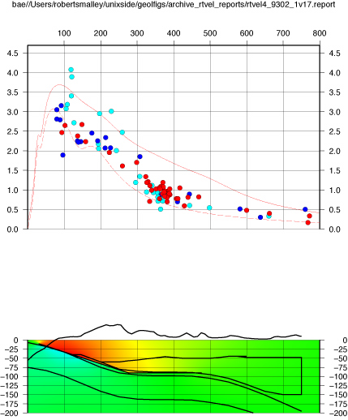
Add friction free extension of plate boundary and friction free base of upper lithosphere, not crustal structures.

Slide 26
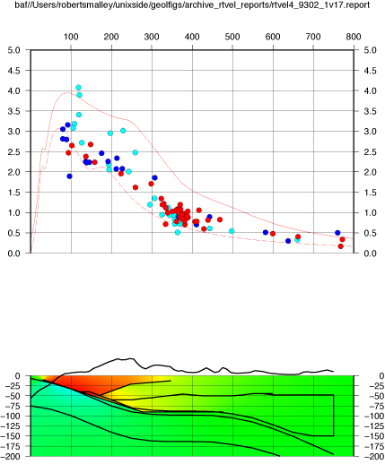
Friction free extension of plate boundary and friction free base of upper lithosphere, with crustal structures.

Slide 27
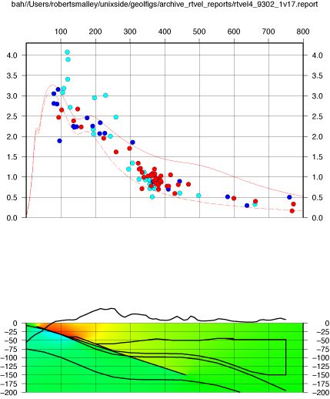
Friction free extension of plate boundary to 150 km depth.

Slide 28
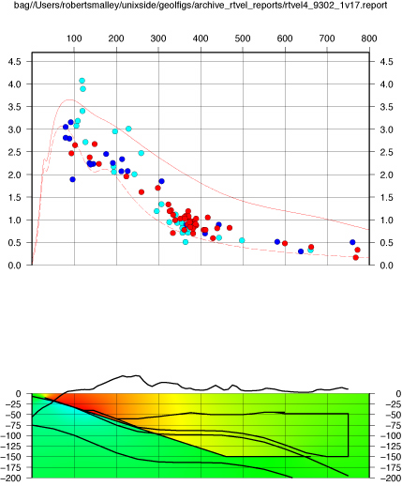
Friction free extension of plate boundary and friction free base of upper lithosphere at 150 km depth.

Slide 29
Add freely slipping décollement in back arc crust.
“sucks-up” deformation into crust above décollement to match GPS data.
Still too slow at greater distances.
Horizontal displacement

Slide 30
Add “push” from relative plate convergence (normal force only on dipping plate interfaces at >50 km depth).
“throws” deformation to greater distances.
Horizontal displacement

Slide 31
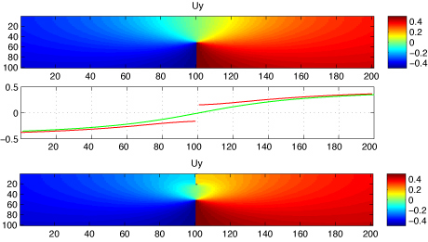
Other popular variant.
Creeping section at surface on otherwise locked fault.
Can do it by putting in fault with specified slip, or in a self-consistent manner by putting in frictionless fault and letting it find equilibrium.

Slide 32
Use physically based model (slip on fault starting at locking depth and going to “infinity) rather than backslip (top, green line), with friction free fault (bottom, red line).
Now have offset across fault trace (from creep).

Slide 33
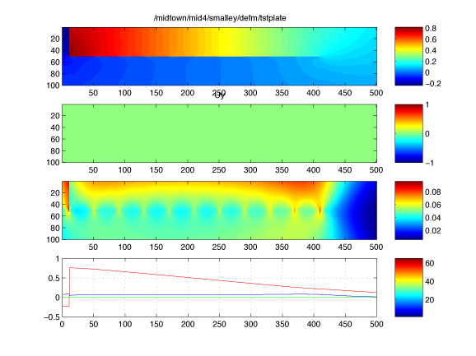
Random Stuff:
Simulate end loaded plate (right end not rigidly mounted). “smoothness” of result depends on number subelements.

Slide 34
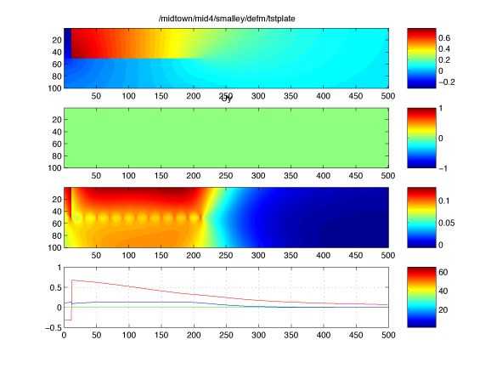
Smaller elements

Slide 35
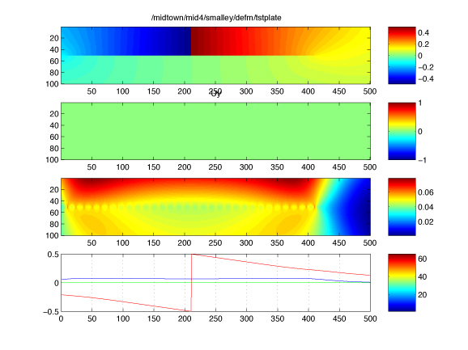
Push out

Slide 39
Notes:
3 Displacement-Strain.pdf, Also see - 4 State of Stress.pdf and - 5 Earth Materials.pdf -- sammonds

