Slide 1
Earth Science Applications of Space Based Geodesy
DES-7355
Tu-Th 9:40-11:05
Seminar Room in 3892 Central Ave. (Long building)
Bob Smalley
Office: 3892 Central Ave, Room 103
678-4929
Office Hours – Wed 14:00-16:00 or if I’m in my office.
http://www.ceri.memphis.edu/people/smalley/ESCI7355/ESCI_7355_Applications_of_Space_Based_Geodesy.html
Class 15

Slide 2
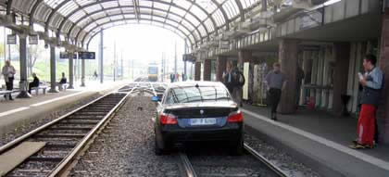
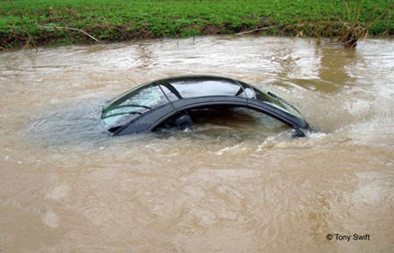
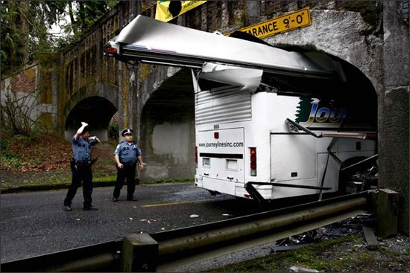
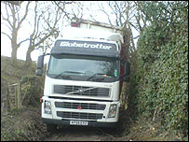
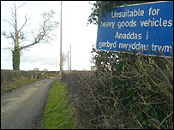
Does GPS make us dumber…?
Driver follows GPS directions onto train tracks…
GPS directions send Mercedes downstream…
Sat-nav lorry stuck in farm lane - Trucker drives past sign, becomes wedged in small
farm lane…
Bus driver follows GPS directions, ignores signs, plows into overpass…
http://www.engadget.com/tag/gps+crash/
http://news.bbc.co.uk/2/hi/uk_news/wales/north_east/7257555.stm

Slide 3
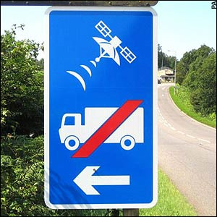
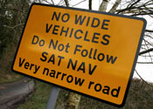
Does GPS make us dumber…?
http://www.engadget.com/tag/gps+crash/
http://news.bbc.co.uk/2/hi/uk_news/wales/north_east/7257555.stm

Slide 4
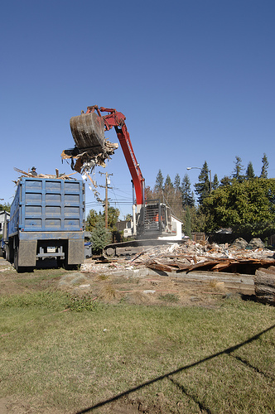
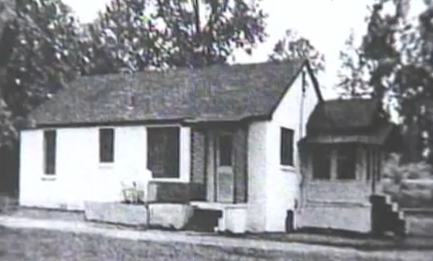
Does GPS make us dumber…?
Al Byrd’s three-bedroom home, built by his father on the western outskirts of Atlanta, was mistakenly torn down by a demolition company. “I said, ‘Don’t you have an address?’ ” a distraught Byrd later recounted. “He said, ‘Yes, my GPS coordinates led me right to this address here.’ ”
http://www.walrusmagazine.com/articles/2009.11-health-global-impositioning-systems/
http://www.calfinder.com/blog/calfinder-news/oops-how-gps-led-contractors-to-demolish-the-wrong-house/

Slide 5
More Hi-Rate GPS from “LARGE” earthquake.

Slide 6
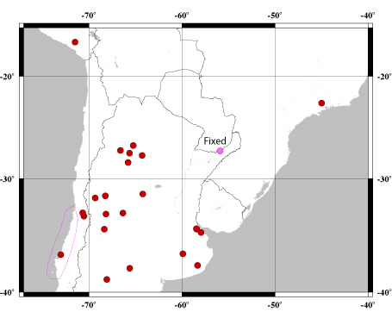
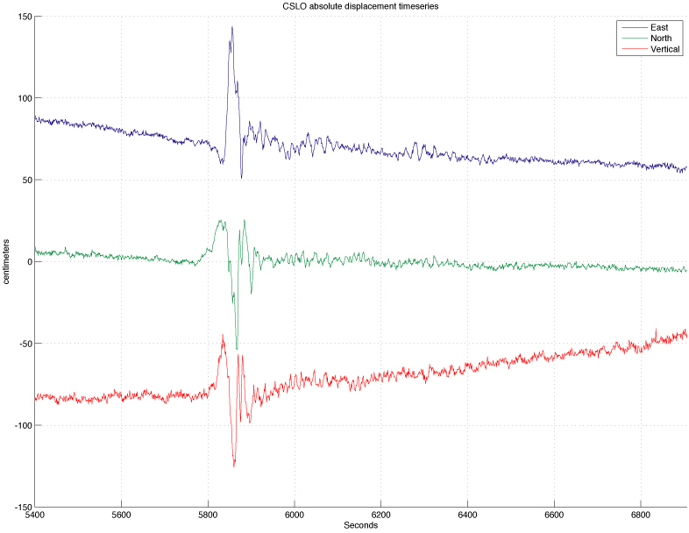
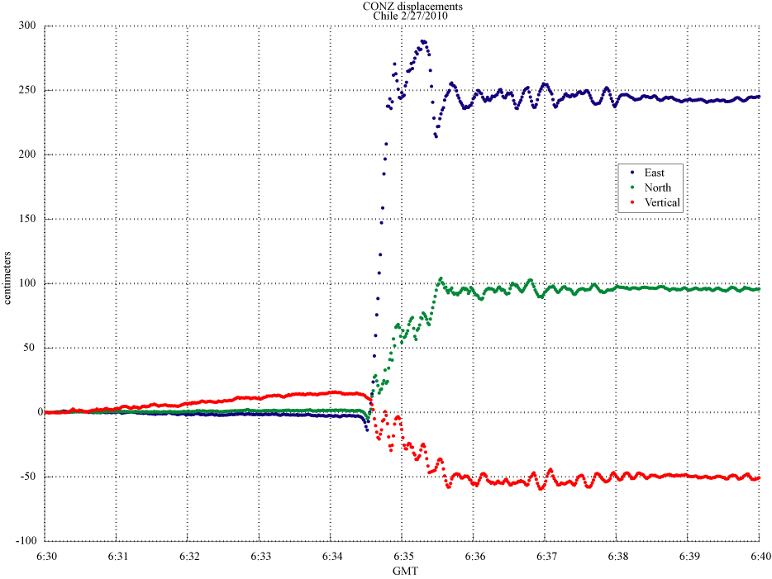
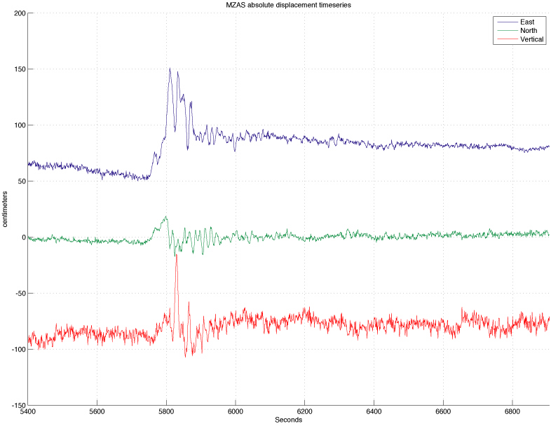
High-Rate GPS Seismograms from the 27 Feb. 2010, M=8.8, Maule Chile Earthquake.
Near-Field, absolute displacement time series with static displacements.
CONZ –absolute displacement coseismic time series
Davis and Smalley, 2009

Slide 7
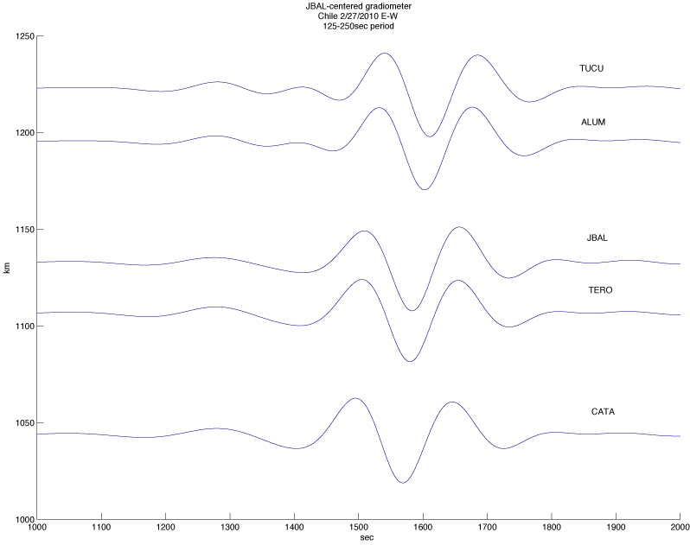
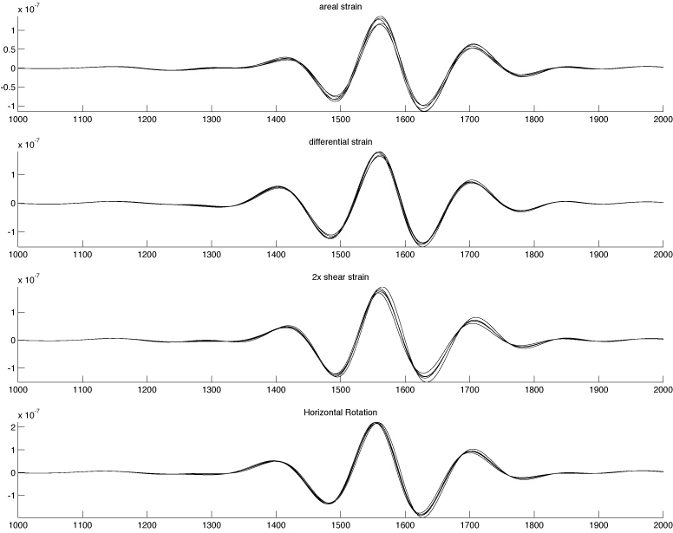
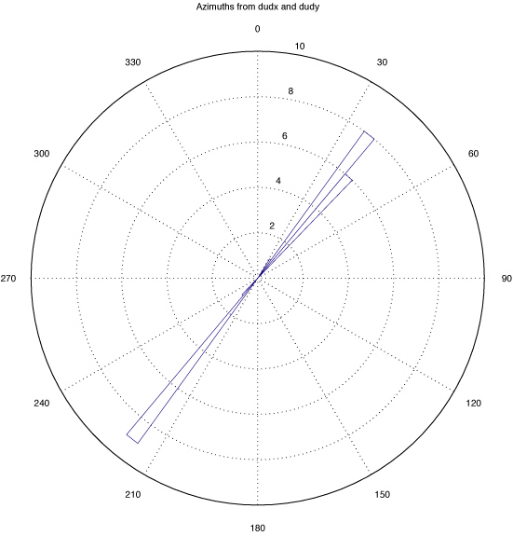
Absolute displacement, band passed (125-250 sec), phase matched filter for dispersion and gradiometry (“array” where wavelength>> spacing).
Gradiometry – dynamic strains, apparent velocity, azimuth.
time
Davis and Smalley, 2009

Slide 8
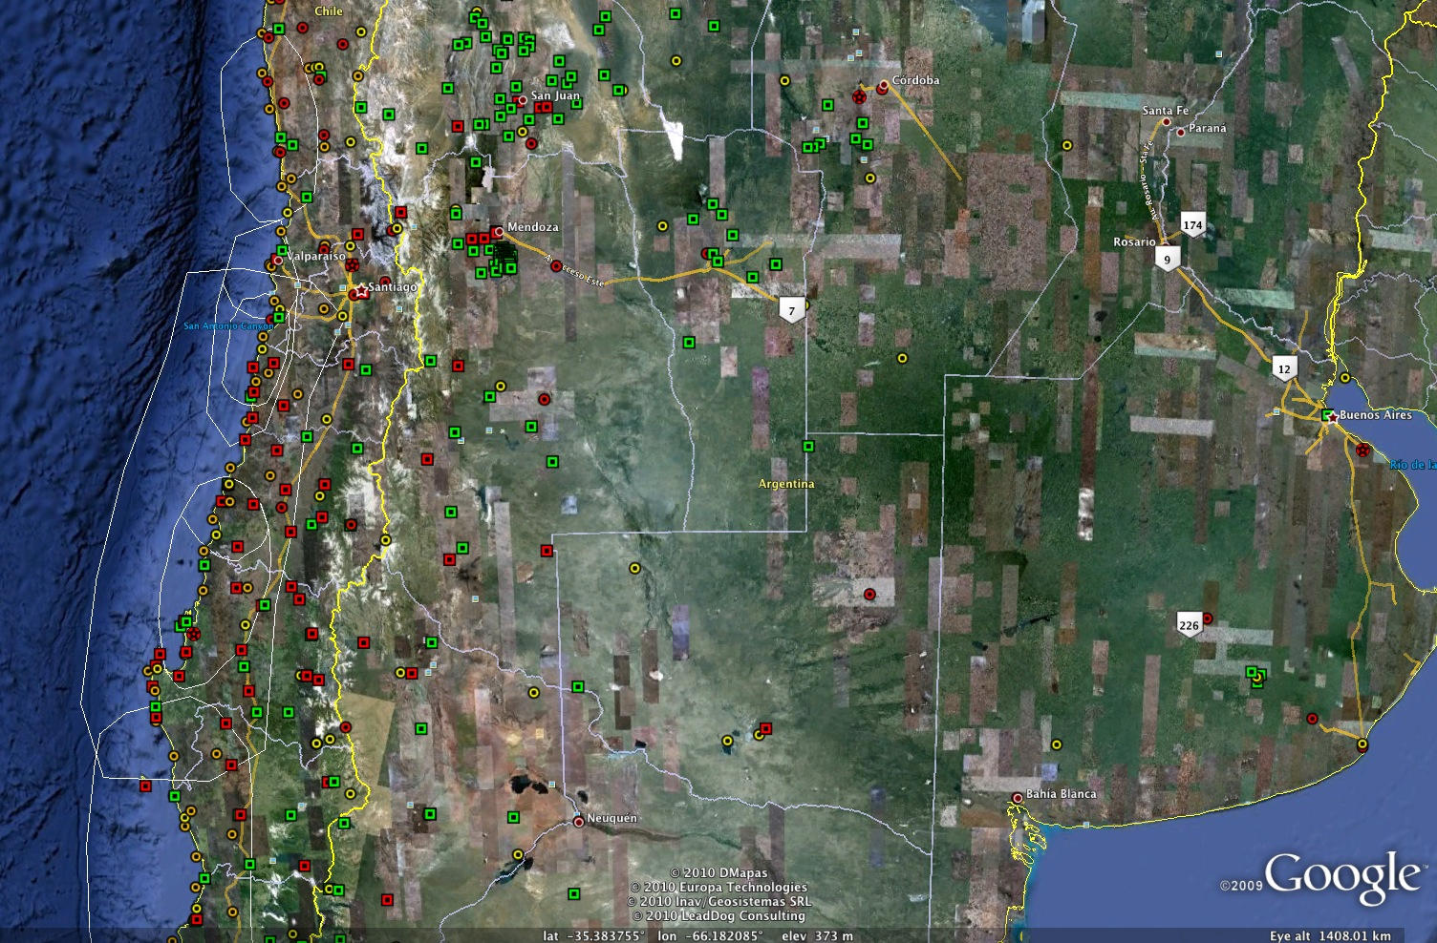
CSLO
CFAG
MZAE
MZAS
CONZ

Slide 9
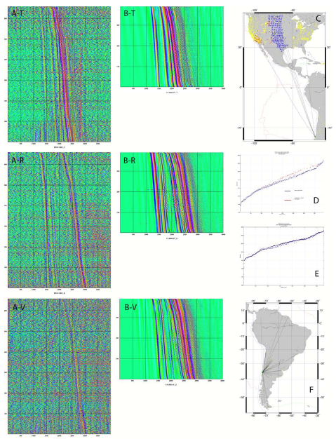
Three componet HRGPS displacement sesimograms (660) and USArray displacement seismograms (400) plotted (sorted by distance, not record section).
Seismic stations (red and blue) and GPS stations (yellow).
Davis and Smalley
Notes:
HRGPS (A) and seismic (B) displacement time series from the Maule event recorded in the
continental US. This is very preliminary processing of the HRGPS data for absolute displacements,
9
obtained using generalized spatial filtering (Davis and Smalley, 2009) and the time series have not been
sidereally or phase match filtered. The plots in A and B are also not record sections but are simply
ordered by distance (the trace counter goes from the farthest station at the bottom to the closest station at
the top). The secondary labels in parts A and B identify the transverse (T), radial (R), and vertical (V)
components. C) Map showing all the broadband seismic stations and HRGPS stations in the continental
US, the broadband sites are color-coded according to relative arrival time of the Love waves (red for
slow, blue for fast). Great circle paths from the earthquake to several HRGPS stations are shown. D) Plot
of the arrival times of the maximum of the Love wave train as a function of distance showing the distinct
separation between sites in the Basin and Range and eastern Rocky Mountain front (red) from sites in the
western Great Planes (blue). This distinct division of velocities by region is the source of the “chatter”
observed in A and B. E) Similar plot for HRGPS absolute displacement time series. One can see a similar
division, although we have not separated them yet. F) HRGPS sites in South America used in the
preparation of this proposal. The great circle ray paths to these sites are also shown.

Slide 10
Can see S (on transverse),
Shear coupled P_{L} (on Radial and Vertical,
Love (on transverse) and
Rayleigh (on Radial and Vertical)
waves.
Davis and Smalley
Notes:
HRGPS (A) and seismic (B) displacement time series from the Maule event recorded in the
continental US. This is very preliminary processing of the HRGPS data for absolute displacements,
9
obtained using generalized spatial filtering (Davis and Smalley, 2009) and the time series have not been
sidereally or phase match filtered. The plots in A and B are also not record sections but are simply
ordered by distance (the trace counter goes from the farthest station at the bottom to the closest station at
the top). The secondary labels in parts A and B identify the transverse (T), radial (R), and vertical (V)
components. C) Map showing all the broadband seismic stations and HRGPS stations in the continental
US, the broadband sites are color-coded according to relative arrival time of the Love waves (red for
slow, blue for fast). Great circle paths from the earthquake to several HRGPS stations are shown. D) Plot
of the arrival times of the maximum of the Love wave train as a function of distance showing the distinct
separation between sites in the Basin and Range and eastern Rocky Mountain front (red) from sites in the
western Great Planes (blue). This distinct division of velocities by region is the source of the “chatter”
observed in A and B. E) Similar plot for HRGPS absolute displacement time series. One can see a similar
division, although we have not separated them yet. F) HRGPS sites in South America used in the
preparation of this proposal. The great circle ray paths to these sites are also shown.

Slide 11
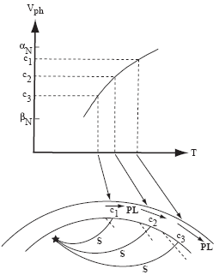
What is Shear (or S) coupled P_{L} ?
“L” stands for Leaky (originally stood for Long period, lucked out again).
S apparent velocity same as P_{L} velocity.
Teleseismic S enters crust, converts to P, which is trapped (supercritical), but when P reflects off Moho (total internal reflection) some converts to S and “leaks” out.
Pulliam et al., 2008 after Baag and Langston, 1985, after Chander et al., 1968, after Oliver, 1961.
Notes:
HRGPS (A) and seismic (B) displacement time series from the Maule event recorded in the
continental US. This is very preliminary processing of the HRGPS data for absolute displacements,
9
obtained using generalized spatial filtering (Davis and Smalley, 2009) and the time series have not been
sidereally or phase match filtered. The plots in A and B are also not record sections but are simply
ordered by distance (the trace counter goes from the farthest station at the bottom to the closest station at
the top). The secondary labels in parts A and B identify the transverse (T), radial (R), and vertical (V)
components. C) Map showing all the broadband seismic stations and HRGPS stations in the continental
US, the broadband sites are color-coded according to relative arrival time of the Love waves (red for
slow, blue for fast). Great circle paths from the earthquake to several HRGPS stations are shown. D) Plot
of the arrival times of the maximum of the Love wave train as a function of distance showing the distinct
separation between sites in the Basin and Range and eastern Rocky Mountain front (red) from sites in the
western Great Planes (blue). This distinct division of velocities by region is the source of the “chatter”
observed in A and B. E) Similar plot for HRGPS absolute displacement time series. One can see a similar
division, although we have not separated them yet. F) HRGPS sites in South America used in the
preparation of this proposal. The great circle ray paths to these sites are also shown.

Slide 12
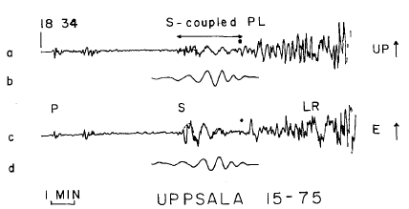
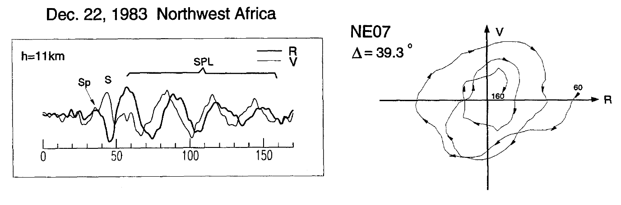
Particle motion of P_{L}
Prograde Elliptical.
Chander et al., 1968
Zhang and Langston, 1996

Slide 13
“Chatter” due to difference between crustal structure of Basin and Range (red slow), and Rocky mountains vs stable craton in eastern North America.
Davis and Smalley
Notes:
HRGPS (A) and seismic (B) displacement time series from the Maule event recorded in the
continental US. This is very preliminary processing of the HRGPS data for absolute displacements,
9
obtained using generalized spatial filtering (Davis and Smalley, 2009) and the time series have not been
sidereally or phase match filtered. The plots in A and B are also not record sections but are simply
ordered by distance (the trace counter goes from the farthest station at the bottom to the closest station at
the top). The secondary labels in parts A and B identify the transverse (T), radial (R), and vertical (V)
components. C) Map showing all the broadband seismic stations and HRGPS stations in the continental
US, the broadband sites are color-coded according to relative arrival time of the Love waves (red for
slow, blue for fast). Great circle paths from the earthquake to several HRGPS stations are shown. D) Plot
of the arrival times of the maximum of the Love wave train as a function of distance showing the distinct
separation between sites in the Basin and Range and eastern Rocky Mountain front (red) from sites in the
western Great Planes (blue). This distinct division of velocities by region is the source of the “chatter”
observed in A and B. E) Similar plot for HRGPS absolute displacement time series. One can see a similar
division, although we have not separated them yet. F) HRGPS sites in South America used in the
preparation of this proposal. The great circle ray paths to these sites are also shown.

Slide 14
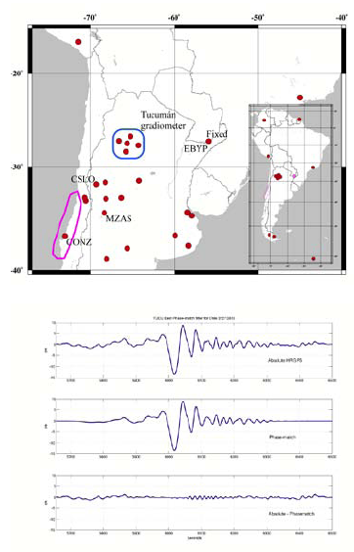
Phase match filtering to remove multipath.

Slide 15
How does phase match filtering work?

Slide 16
James is working on this for his thesis.
Further improvements to estimating HRGPS time series.
Additional applications (gradiometry).

Slide 17
Remote sensing with GPS.
Exploiting the noise in GPS data.

Slide 18
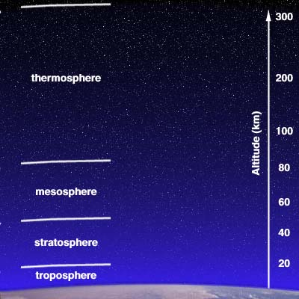
1500m
Ionosphere
http://www-gpsg.mit.edu/~tah
Notes:
Troposphere is where the temperature stops decreasing in the atmosphere. (~10 km altitude)
Ionosphere: free electrons due to the breaking away of electrons from atmospheric gases due to solar radiation
Effects different frequencies differently

Slide 19
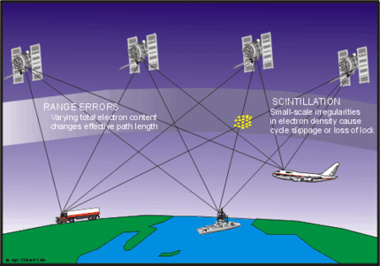
Ionosphere Effects on GPS
The ionosphere is defined as the region of the upper atmosphere where radio signal propagation is affected by charged particles.
Notes:
Code delay and phase advance result in range errors.
Small-scale irregularities in electron density cause cycle slips or loss of lock.

Slide 20
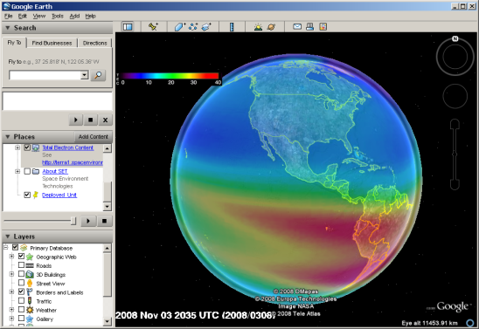
Ionospheric Effects…
Space ‘weather’ can effect the speed of GPS signal, and thus the accuracy of the location estimate of the receivers
  Solar flares, coronal holes, etc. producing
  strong geomagnetic storms
Measured in Total Electron Content (TEC)
of the Ionosphere
  See http://terra1.spacenvironment.net/%7Eionops/current_files/Google_TEC.kml
  Real time (10 min) TEC on Google Earth, Blue=good, Red = Bad
Degradation of GPS locations (more electrons = delay of signal)
  Especially in the mid-latitudes – and can be highly variable
  In severe cases, can prevent Satellite fix entirely
GPS receivers attempt to correct for effects
Can also use GPS error to measure Ionosphere (TEC)
GPS_intro.ppt from Huxley College

Slide 21
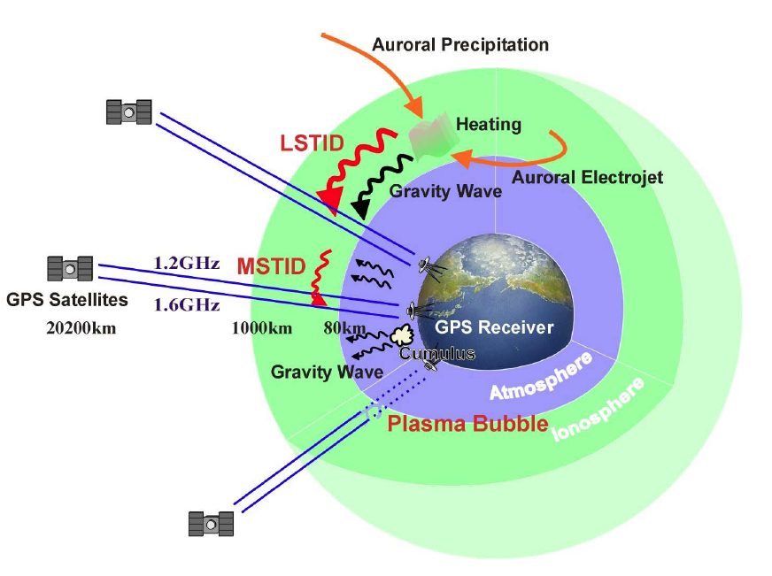
Tsugawa, 2006

Slide 22
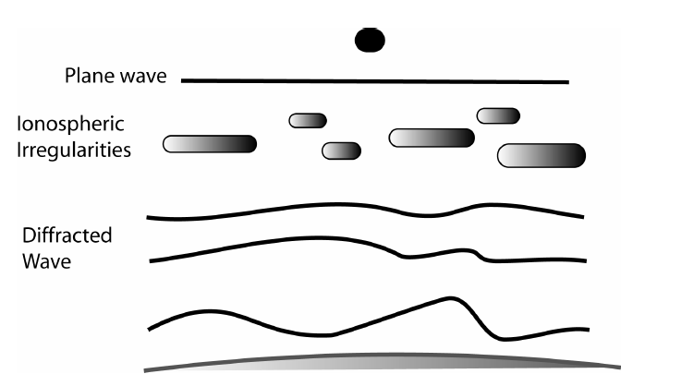
Dyrud et al., 2007

Slide 23
Ionospheric Delay
Measured range given by s = ∫n ds
  n is the refractive index
  ds is the path that the signal takes
The path delay is given by
  Δ_{ph}^{iono} = –(40.3/f²) ∫N_{e} ds₀ = –40.3/f² TEC
  Δ_{gr}^{iono} = (40.3/f²) ∫N_{e} ds₀ = 40.3/f² TEC
    Where TEC = ∫N_{e} ds₀ is the total electron content

Slide 24
Ionospheric Delay
Still need to know TEC
Can either
  Measure using observations
  Estimate using models
Note that with data on 2 frequencies, estimates of the unknowns can be made

Slide 25
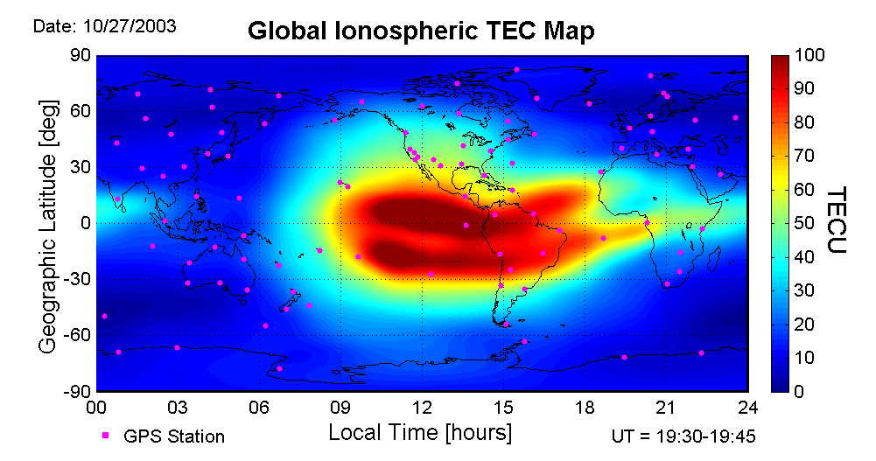
Latitudinal Variation of the Ionosphere A Concern at Low and Mid Latitudes
Locations where some detailed ionospheric
effects are assessed
FRE
L
P
Suborbital
& slant path (45°) are considered
A year similar to the target launch year - 2014
Dawn (ascending)
Dusk (descending)
Most of blue areas are not a concern for the Faraday rotation effect at L-band
Pi, 2006

Slide 26
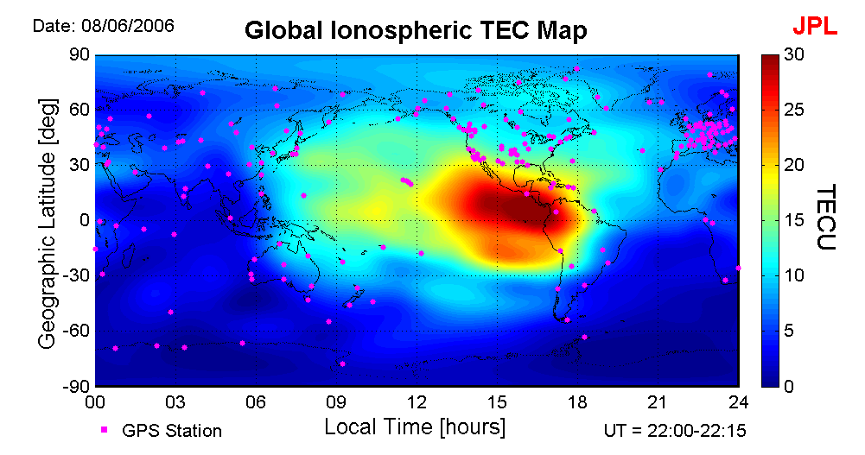
TEC Reduces Significantly in Low Solar Activity Years
L
FRE
P
Suborbital
& slant path (45°) are considered
In low solar activity years (e.g., 2006), ionospheric TEC can be a factor of 5 smaller than in high activity years, and the Faraday rotation effects on L-band SAR will be reduced to minimum.
Pi, 2006
Notes:
XPI@JPL: IWSSAR Strategy

Slide 27
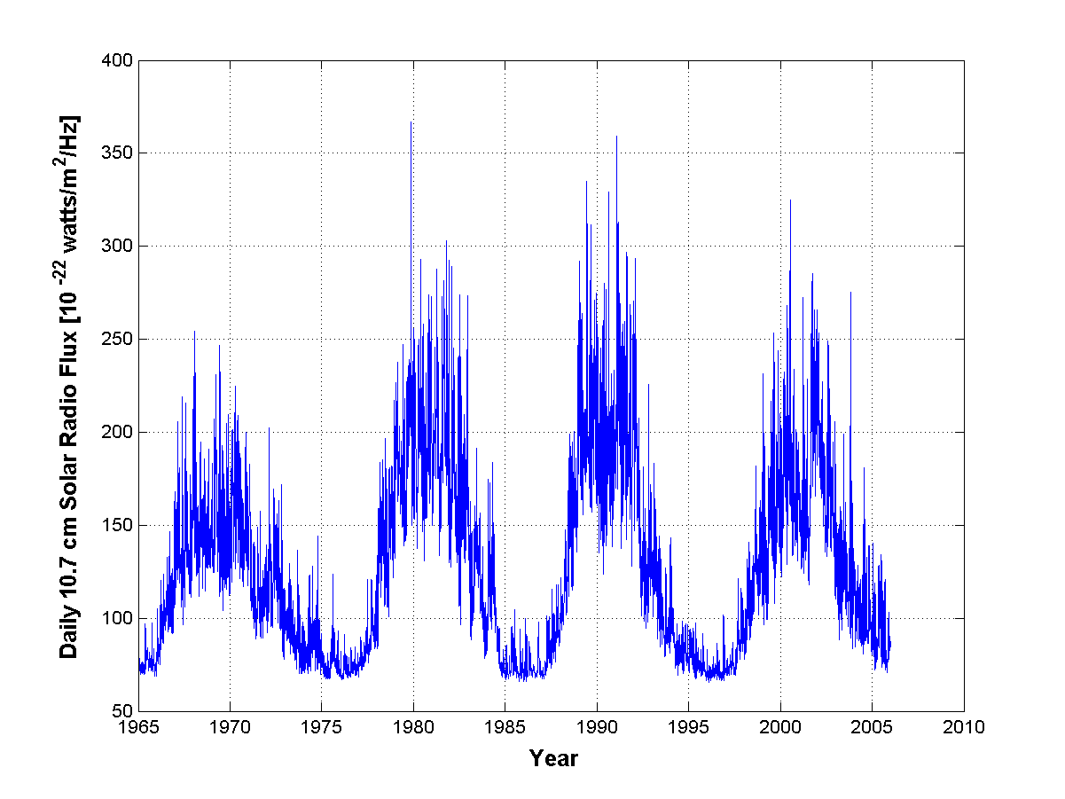
The Solar Cycle Phase of the Target Launch Year
Back Projection of 2014
Sunspot Maximum | 1979 | 1990 | 2001 | 2012 | 2023
Sunspot Minimum | 1985 | 1996 | 2007 | 2018 | 2029

Slide 28
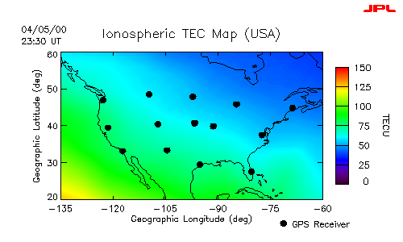
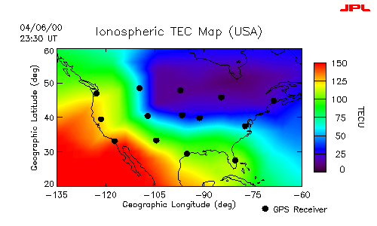
Ionospheric Spatial Structures during Storms
Quiet ionosphere
  Smooth
  Small gradient
Disturbed ionosphere
  Large gradient
  Curvature
  Irregular structures
Adjacent drop showing 50 TECU difference

Slide 29
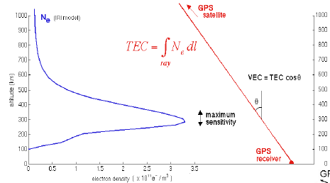
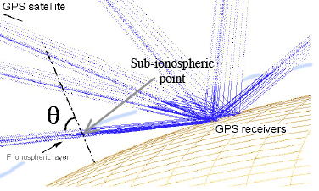
Ducic et al., 2003

Slide 30
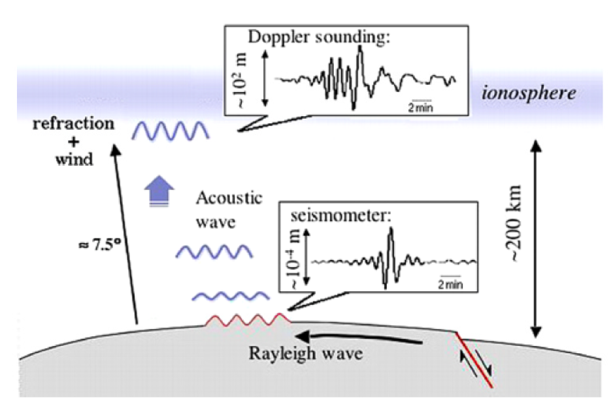
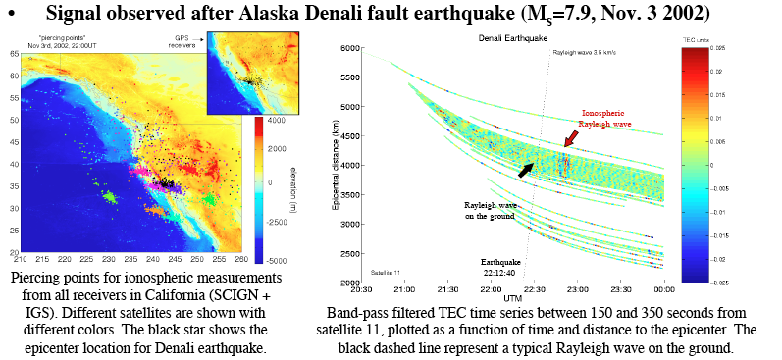
Ducic et al., 2003

Slide 31
Ionosphere Delay
Measured range given by s = ∫n ds
  n : refractive index
  ds : signal path
The path delay is given by
  Δ_{ph}^{iono} = –(40.3/f²) ∫N_{e} ds₀ = –40.3/f² TEC
  Δ_{gr}^{iono} = (40.3/f²) ∫N_{e} ds₀ = 40.3/f² TEC
    Where TEC = ∫N_{e} ds₀ is the total electron content
Brian Luzum, U Florida
Notes:
Troposphere is where the temperature stops decreasing in the atmosphere. (~10 km altitude)
Ionosphere: free electrons due to the breaking away of electrons from atmospheric gases due to solar radiation
Effects different frequencies differently

Slide 32
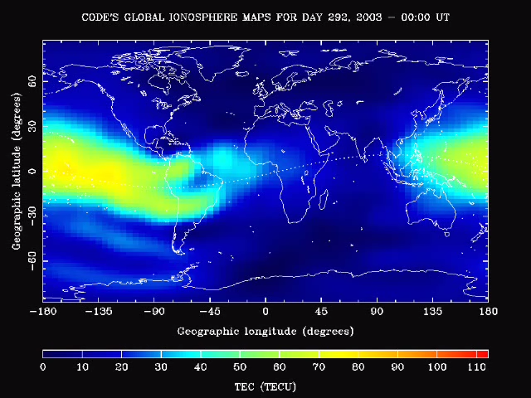
Ionosphere TEC
Notes:
- Epoch : year (2 digits), month,day,hour,min,sec
- Epoch flag 0: OK
1: power failure between
previous and current epoch
>1: Event flag
- Number of satellites in current epoch
- List of PRNs (sat.numbers) in current epoch
If more than 12 satellites: Continued
in next line with n(A1,I2)

Slide 33
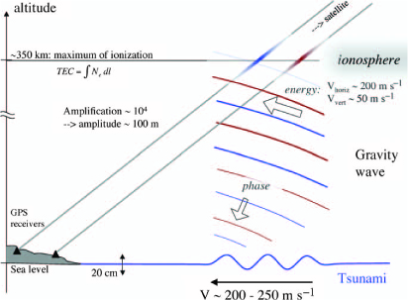
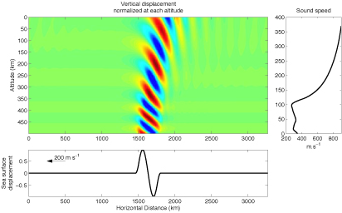
Artru et al., 2005

Slide 34
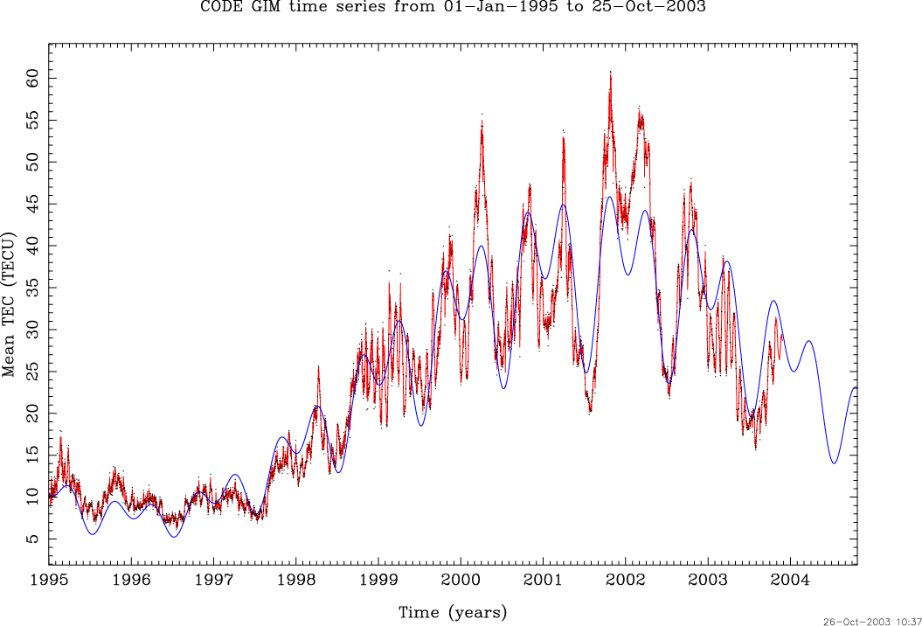
Ionosphere Variation
http://www.cx.unibe.ch/aiub/ionosphere.html
Notes:
Troposphere is where the temperature stops decreasing in the atmosphere. (~10 km altitude)
Ionosphere: free electrons due to the breaking away of electrons from atmospheric gases due to solar radiation
Effects different frequencies differently

Slide 35
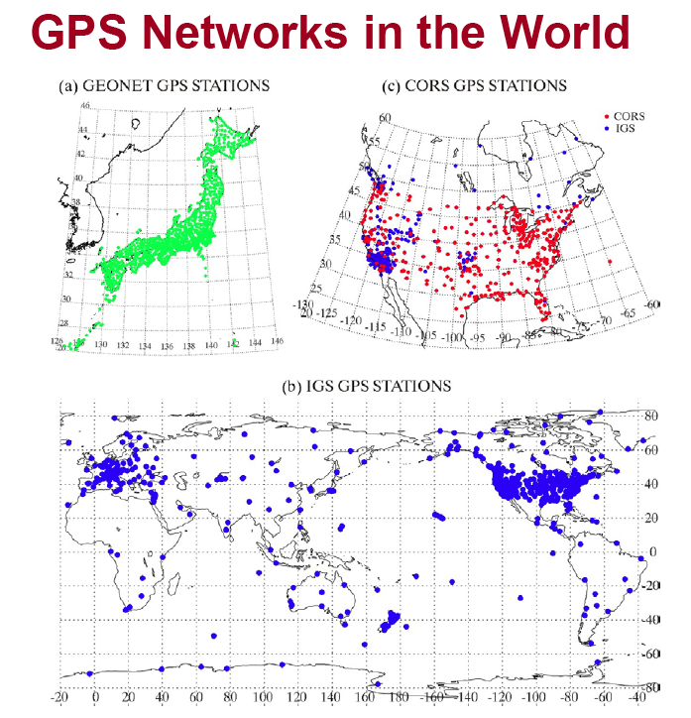
Tsugawa, 2006

Slide 36
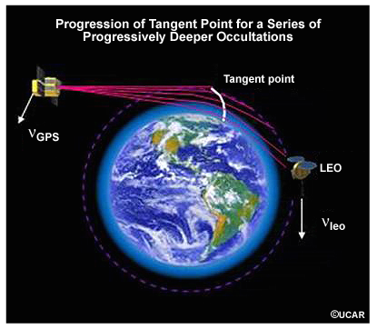
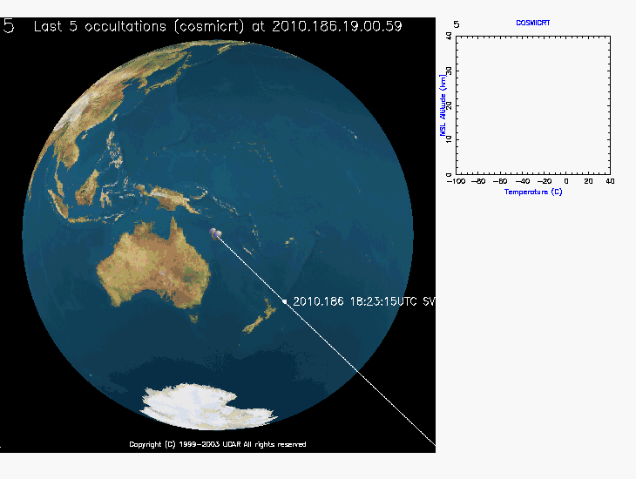
The LEO tracks the GPS phase
while the signal is occulted to determine the Doppler
The velocity of GPS relative to LEO must be estimated to ~0.2 mm/sec (20 ppb) to determine precise temperature profiles
Rocken
Notes:
… so once the orbits have been determined well it is possible to determine atmospheric profiles.
The lower right panel on this slide shows a birds-eye view of the CHAMP satellite in LEO. The white line indicates the ray to the GPS which is not shown and the while dot shows the location of the tangent point introduced in the top left panel.
As the tangent point descends through the atmosphere the temperature profile is shown in the little panel to the right of the globe.
The temperature profiles is obtained in post processing.

Slide 37
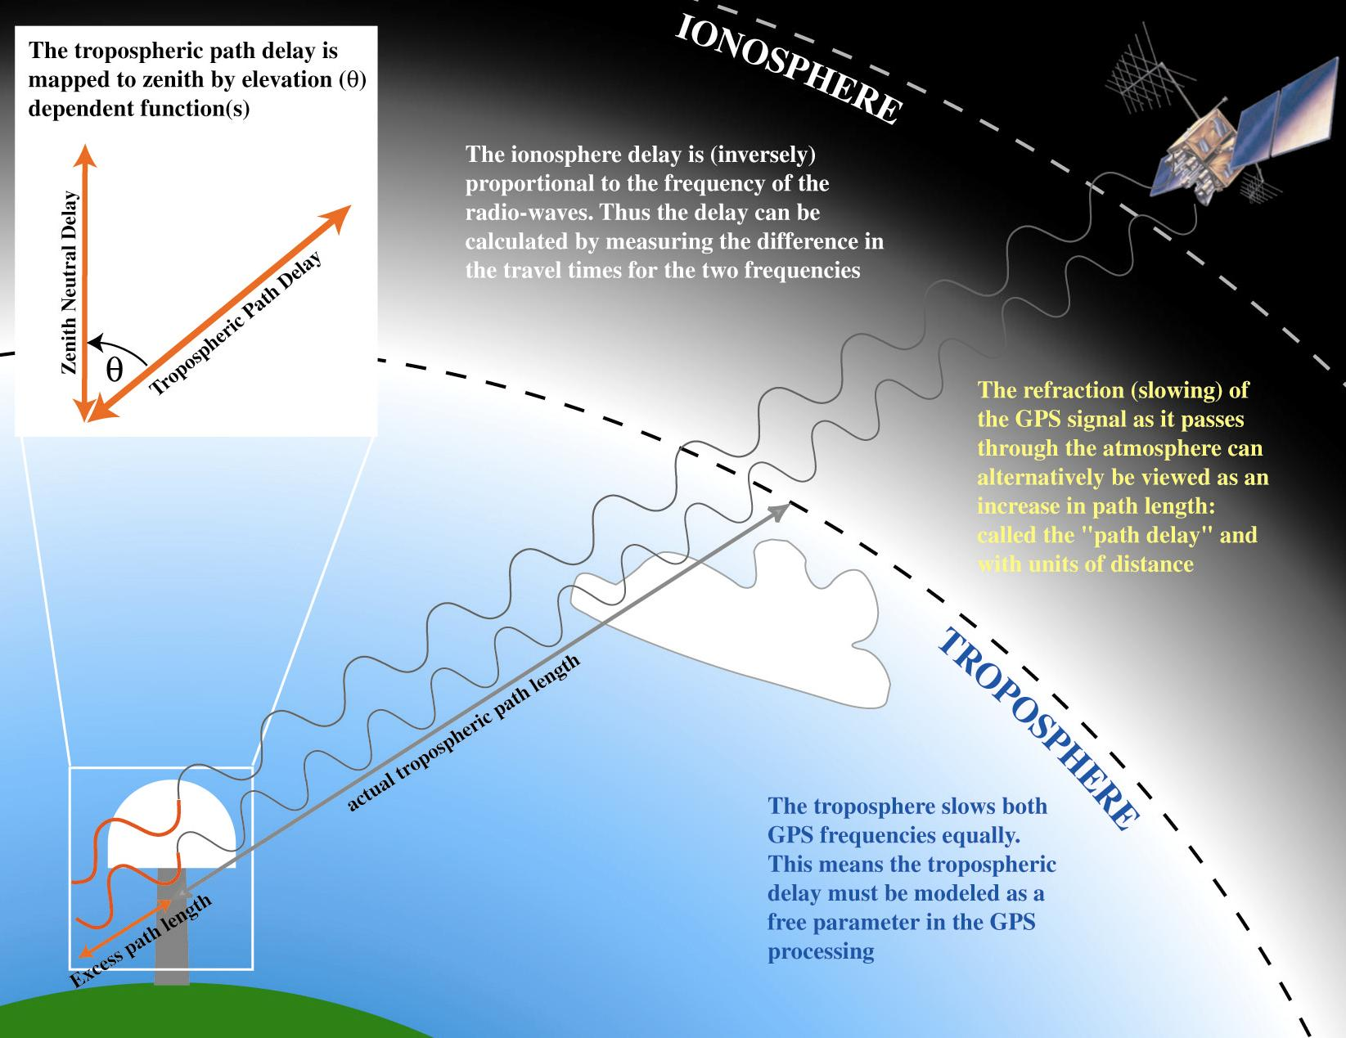
Zenith Neutral Delay
Tropospheric delays increase with decreasing elevation angle (more atmosphere to traverse)
James Foster, Univ. Hawaii
Notes:
The zenith delay is determined by the integration of refractivity vertically.
The atmospheric is very close to hydrostatic equilibrium meaning that surface pressure is given by the vertical integration of density. Since the first term in refractivity depends only on density, its vertical integration will depend only on surface pressure. This integral is called the “zenith hydrostatic delay (ZHD)”. (Often referred to as “dry delay” but this is incorrect because has water vapor contribution).

Slide 38
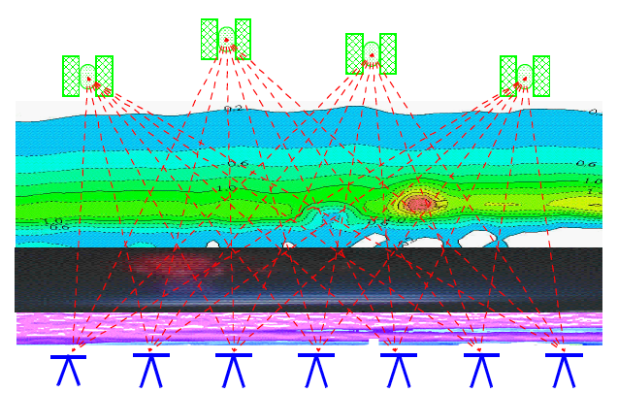
Ware et al., 2000

Slide 39
Tropospheric Delay
Caused by the neutral atmosphere, which is a nondispersive medium (as far as GPS is concerned)
  Troposphere extends up to 40 km
  Effects carrier phase and code ranges the same
Typically separate the effect into
  Dry component
  Wet component
Δ^{Trop} = 10⁻⁶∫N_{d}^{Trop} ds + 10⁻⁶∫N_{w}^{Trop} ds
  Where N is the refractivity
  ds is the path length

Slide 40
Tropospheric Delay
Dry component contributes 90% of the error
  Easily modeled
Wet component contributes 10% of the error
  Difficult to model because you need to know the amount of water vapor along the entire path

Slide 41
Tropospheric Delay
There are many models which estimate the wet component of the tropospheric delay
  Hopfield Model
  Modified Hopfield Model
  Saastamoinen Model
  Lanyi Model
  NMF (Niell)
  Many, many more

Slide 42
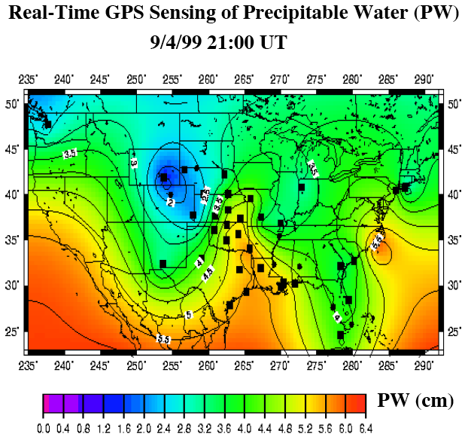
Ware et al., 2000

Slide 43
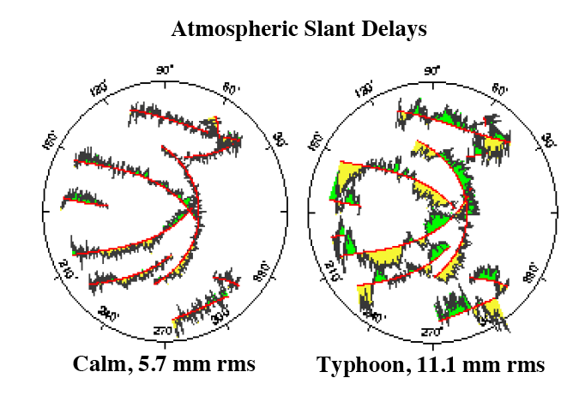
Ware et al., 2000

Slide 44
Multipath Errors
GPS assumes that the signal travels directly from the satellite to the receiver
Multipath results from signal reflecting off of surface before entering the receiver
  Adds additional (erroneous) path length to the signal
Difficult to remove; best to avoid

Slide 45
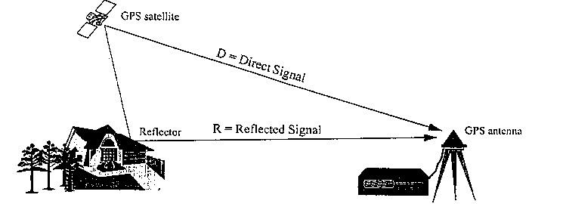
Multipath Illustration
From http://www.gmat.unsw.edu.au/snap/gps/gps_survey/chap6/6212.htm

Slide 46
Eric Calais’ GAMIT overview

