Slide 1
Earth Science Applications of Space Based Geodesy
DES-7355
Tu-Th 9:40-11:05
Seminar Room in 3892 Central Ave. (Long building)
Bob Smalley
Office: 3892 Central Ave, Room 103
678-4929
Office Hours – Wed 14:00-16:00 or if I’m in my office.
http://www.ceri.memphis.edu/people/smalley/ESCI7355/ESCI_7355_Applications_of_Space_Based_Geodesy.html
Class 14

Slide 2
Strain and slip partitioning
Linear system
Can look at each “component” independently
Sum effects
- Downdip
- Strike-slip

Slide 3
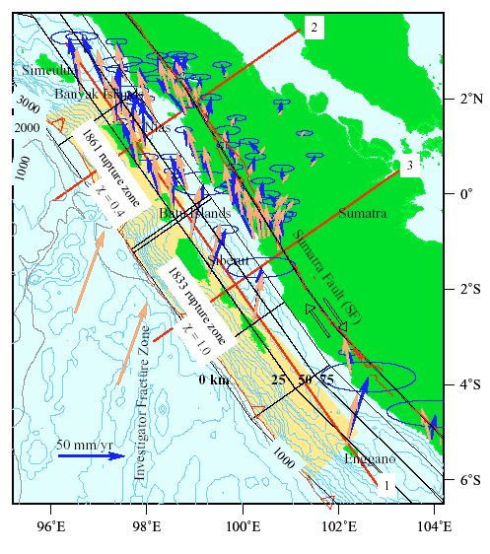
Oblique subduction in Sumatra
Strain partitioning poster child.
From McCaffrey, http://www.rpi.edu/~mccafr/sumatra04/

Slide 4
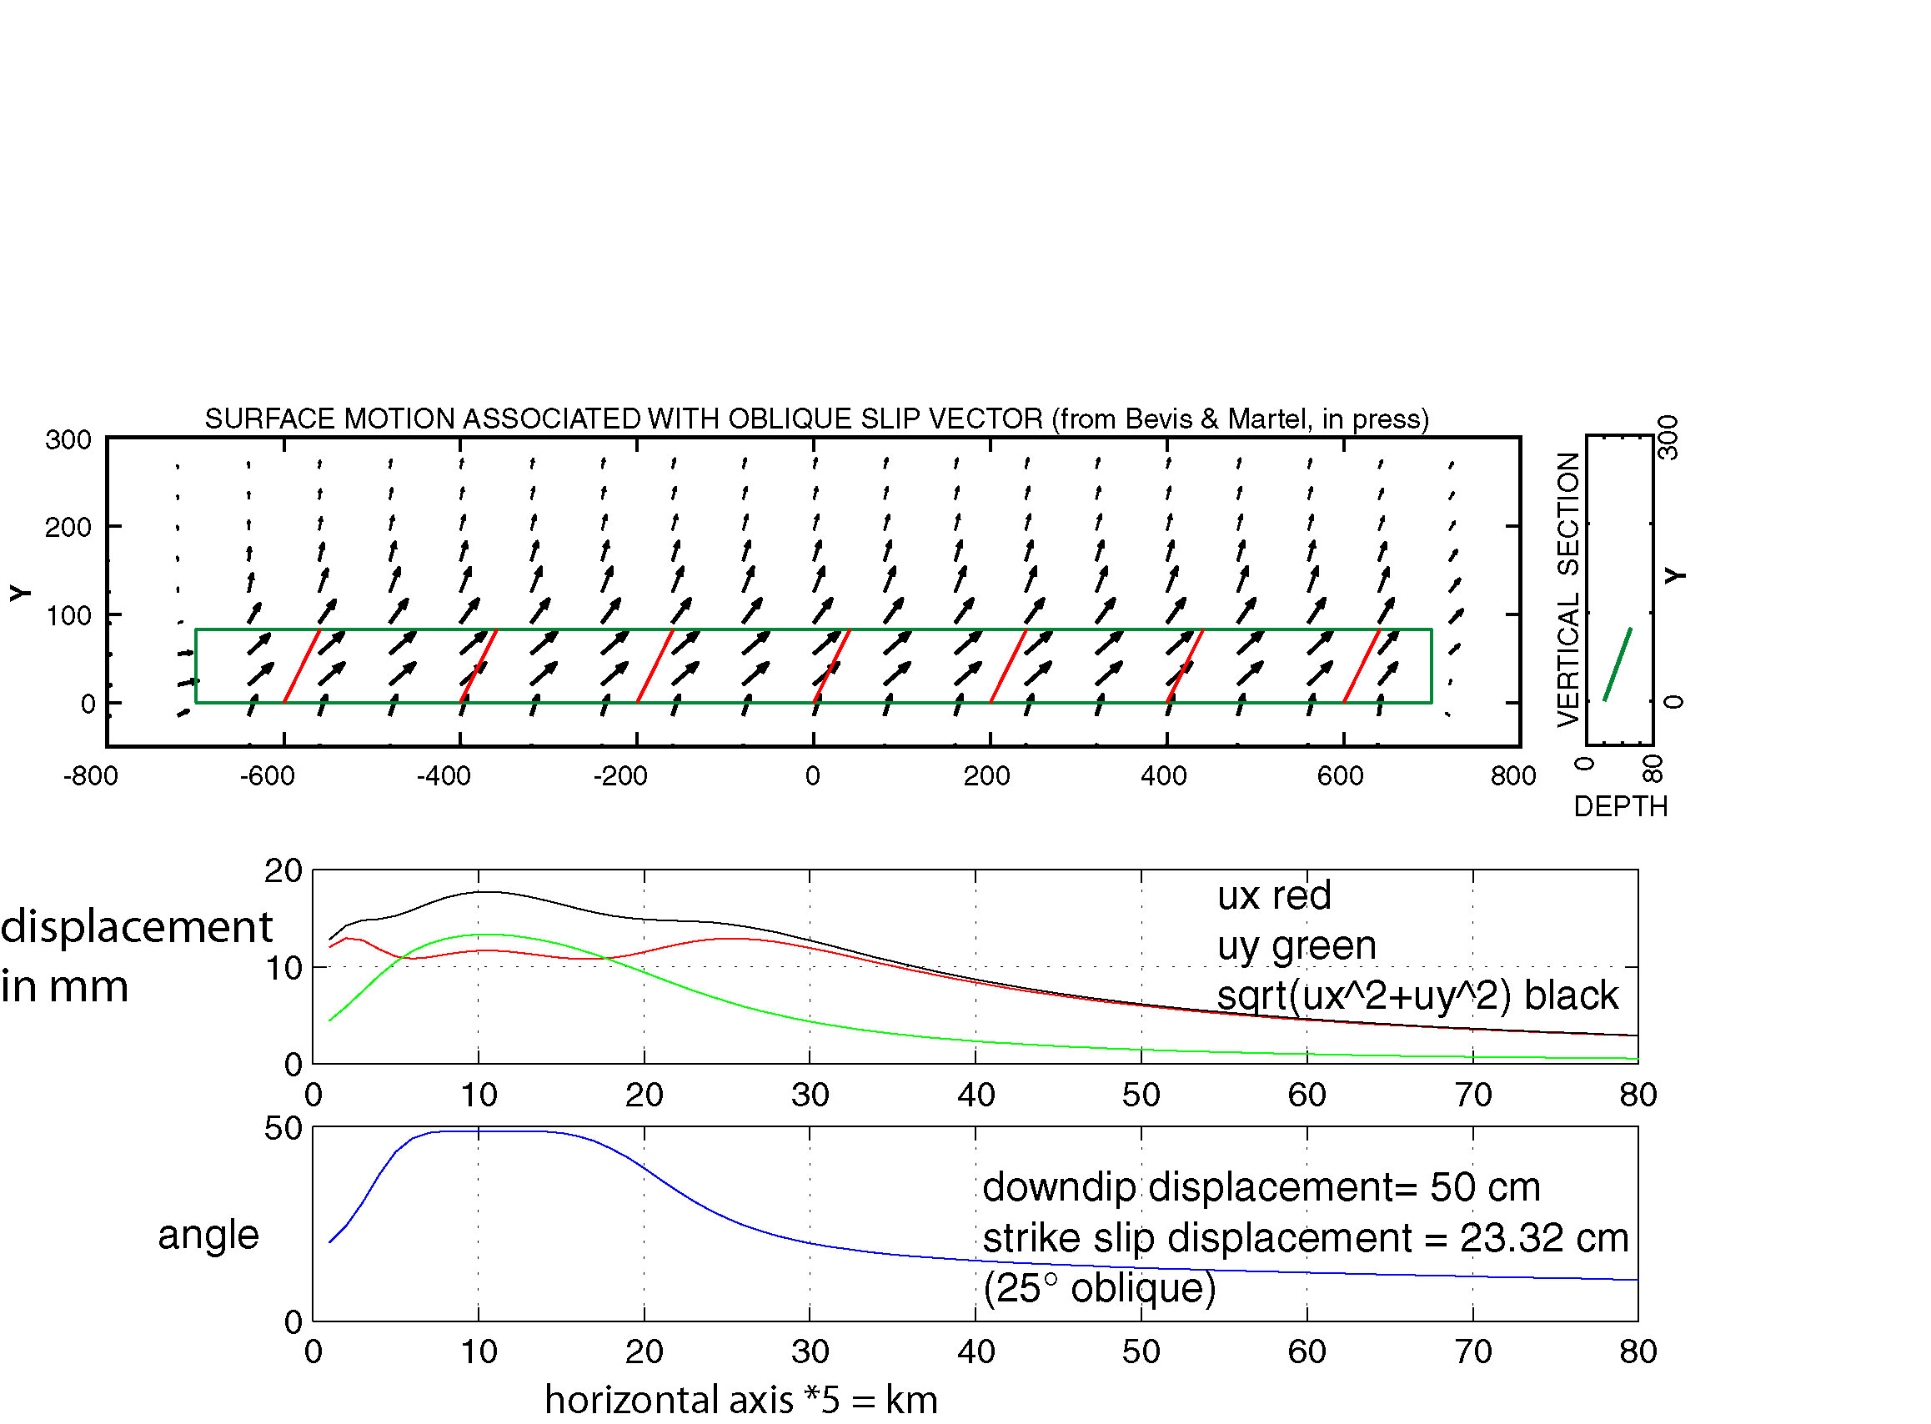
Oblique slip model - geometry of shortening controlled by trench orientation, not convergence direction.
distance across strike
distance along strike
after Bevis and Martel

Slide 5
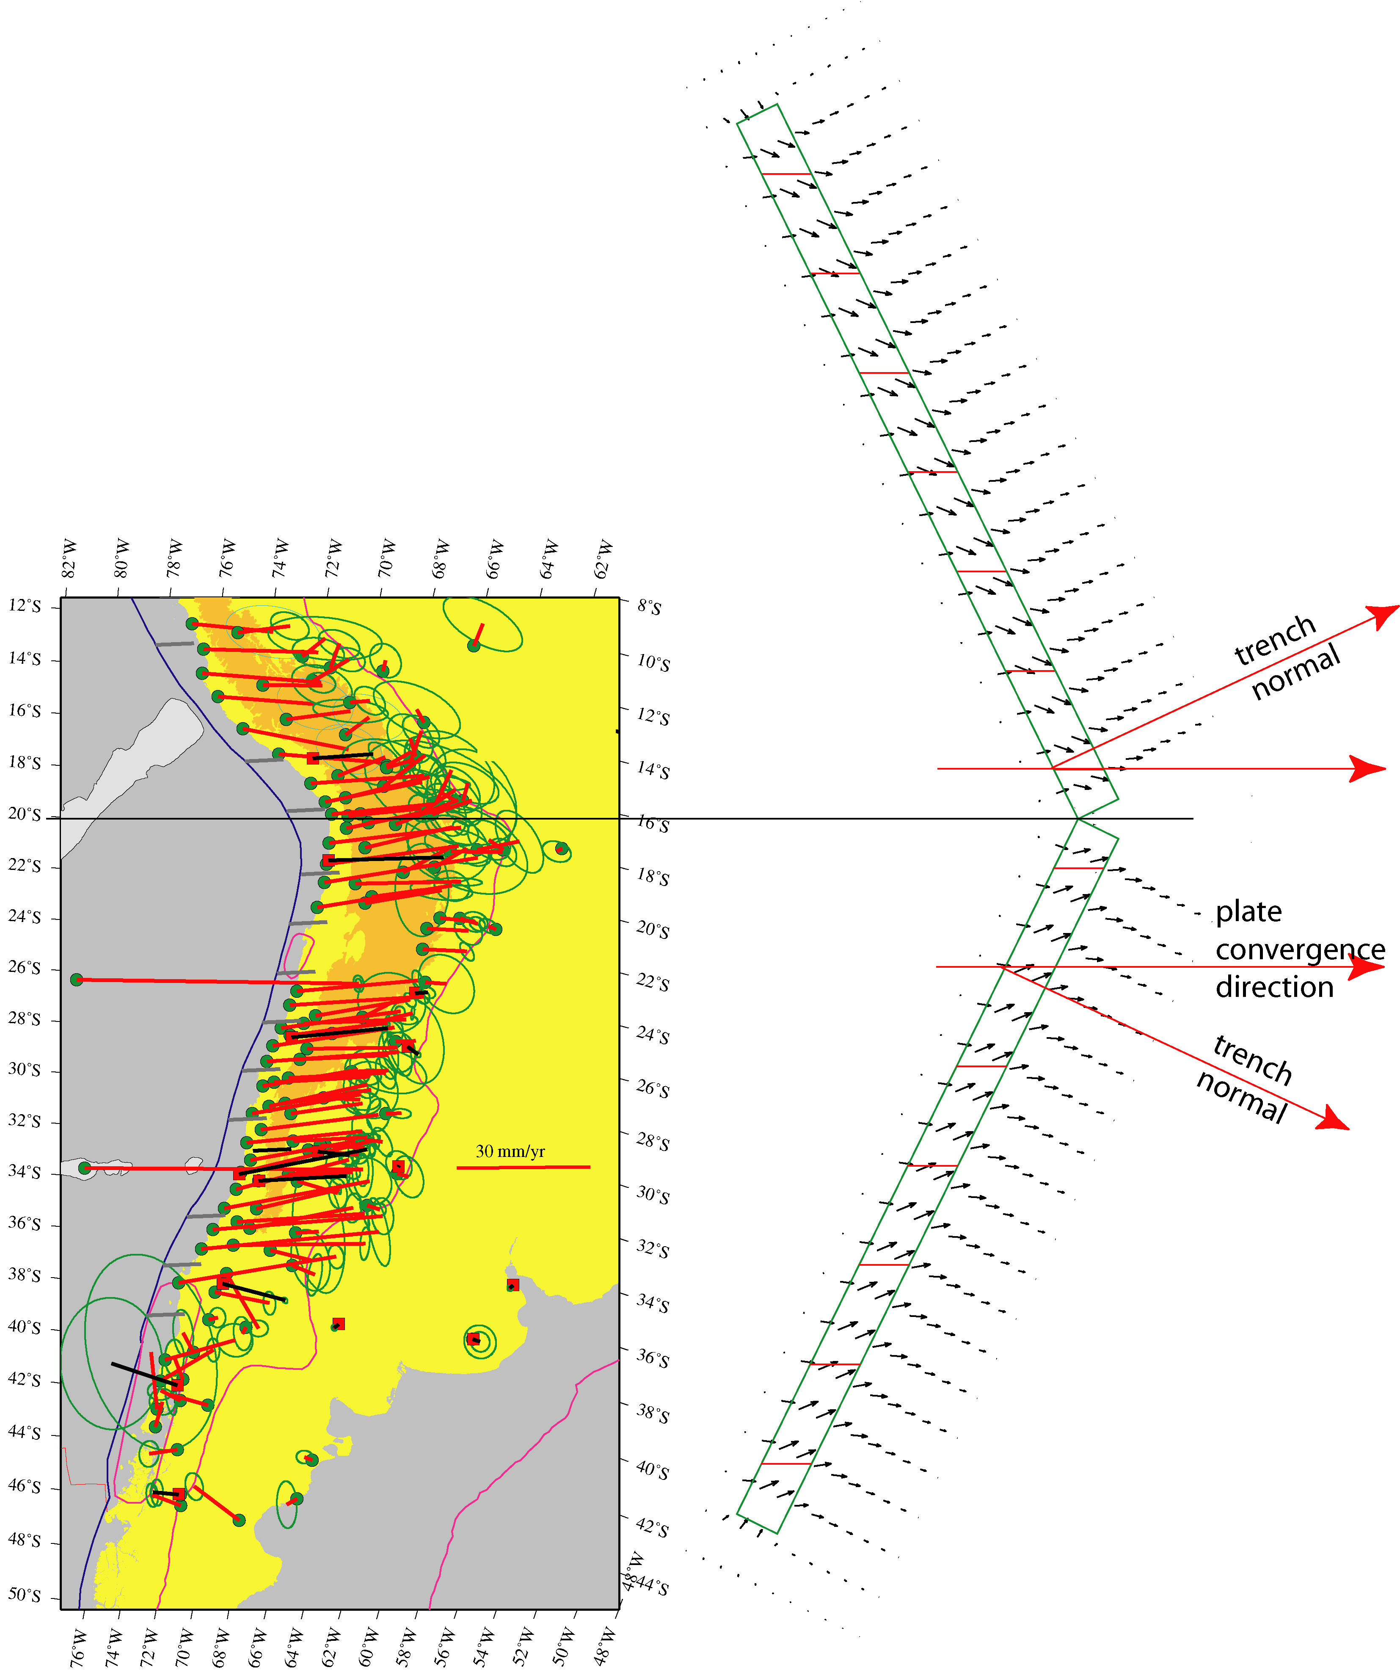
GPS determined surface velocity field with oblique slip model predictions.

Slide 6
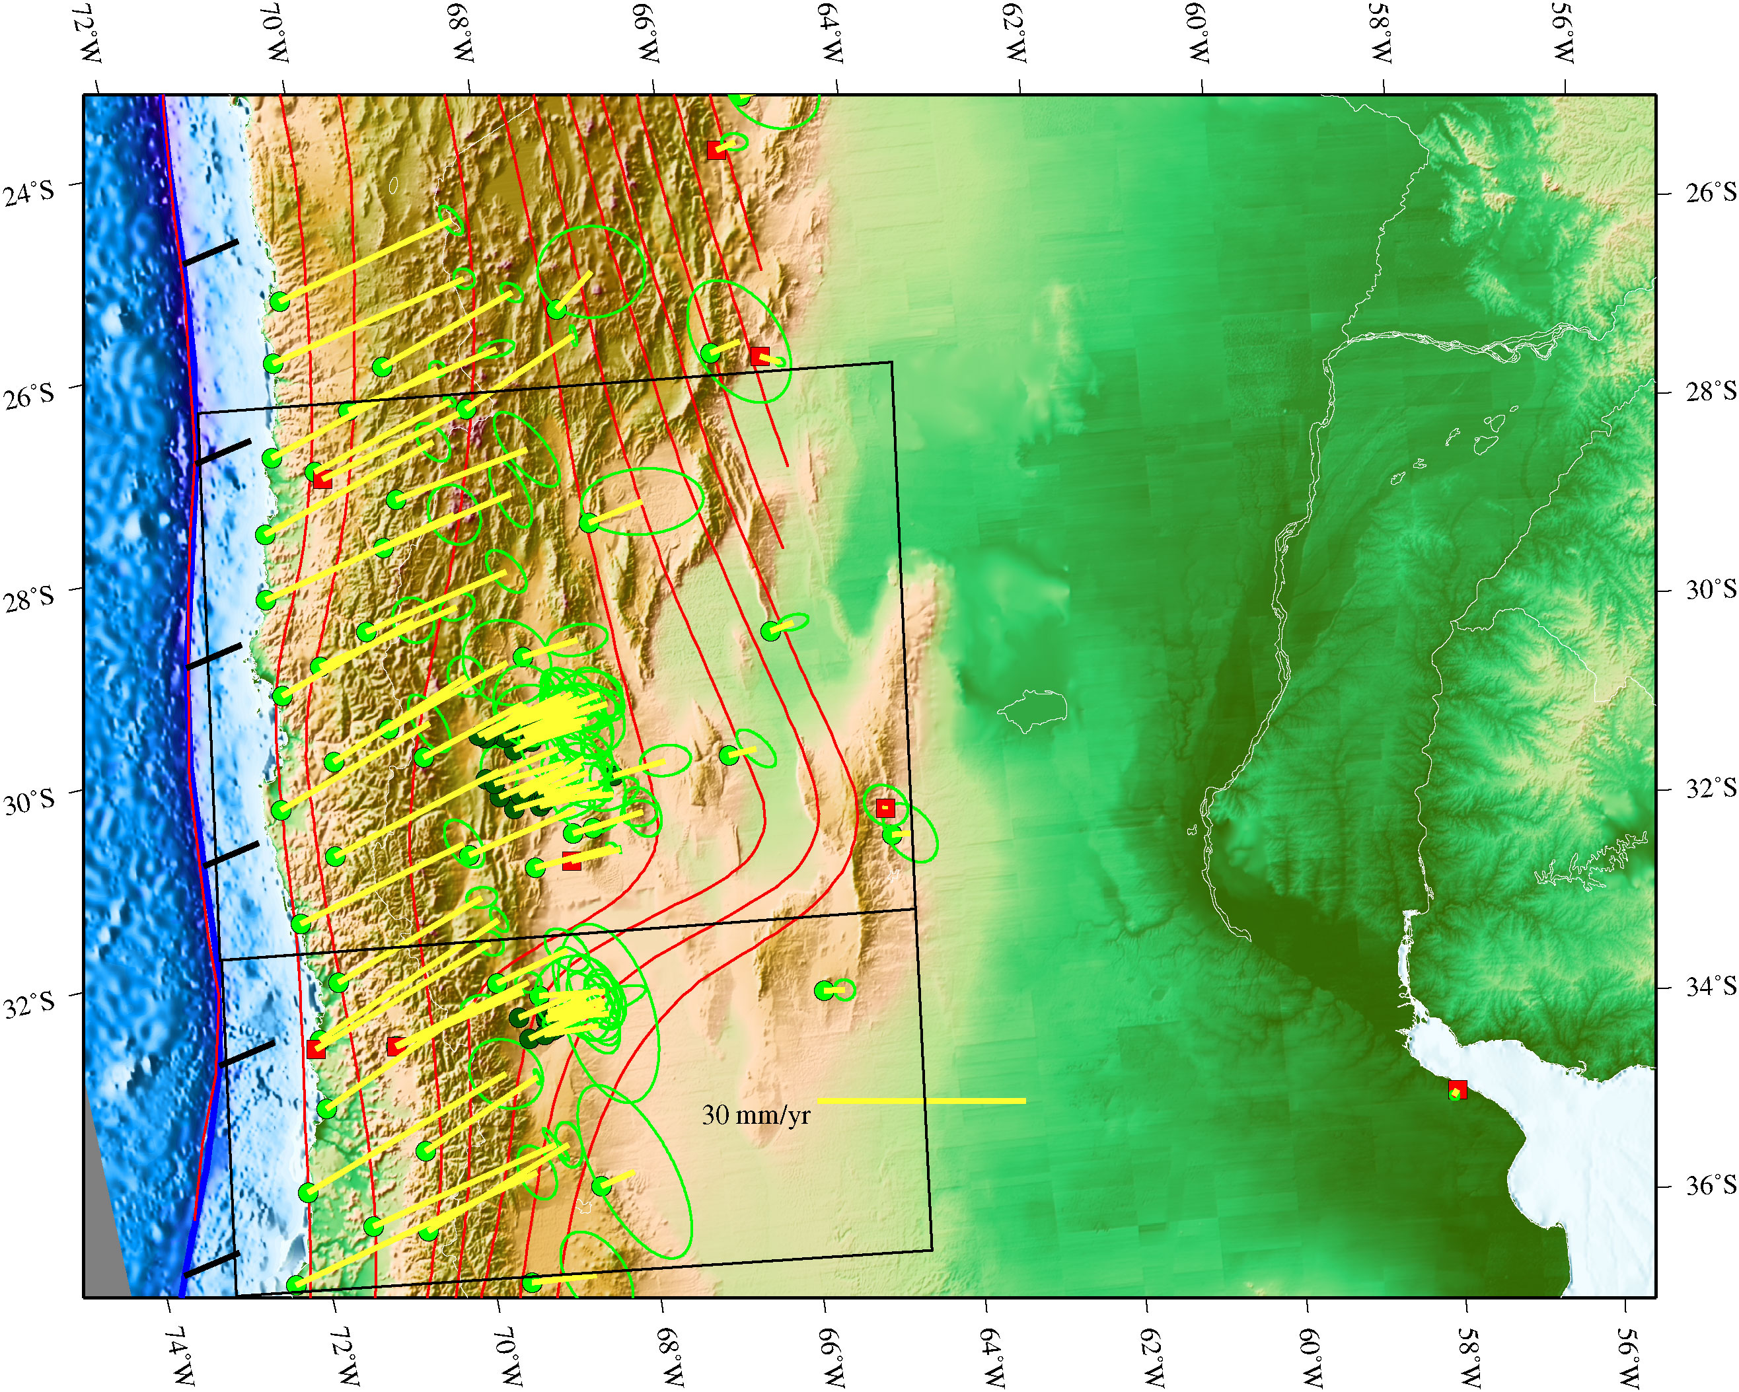
Oblique Mercator projection in which coast lies along a meridian.
Shows crustal velocity field for CAP and MATE networks
Note velocity gradient (deformation) across Andes
Note variation of obliquity from greater than plate convergence direction to approximately perpendicular to coast/plate boundary.

Slide 8
use
To solve for translation and deformation (strain + rotation)
(t_{x},t_{y}, d_{xx}, d_{xy}, d_{yx}, d_{yy}).

Slide 9
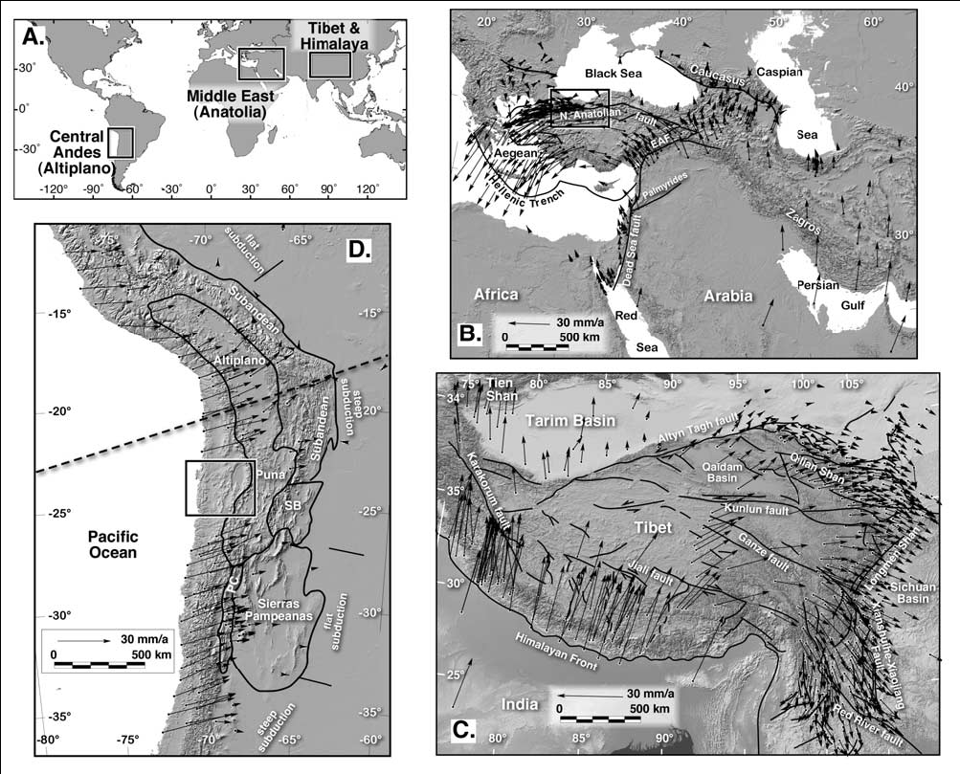
Start with velocities with respect to stable plates (deformations)
Allmendinger et al, 2007

Slide 10
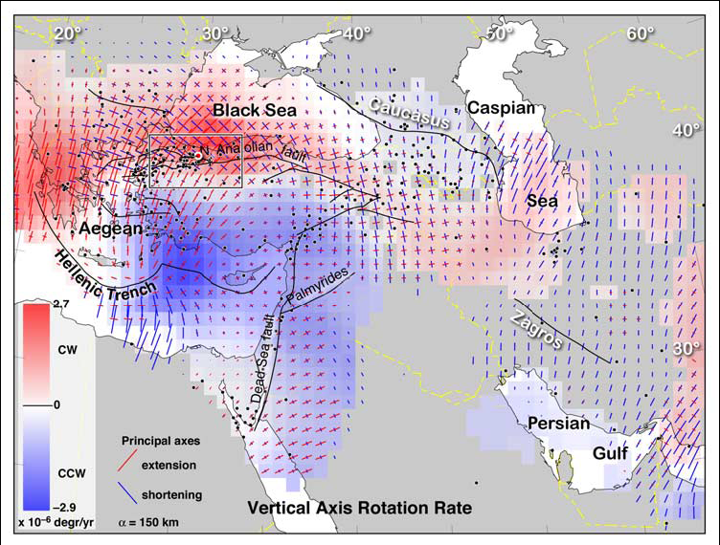
Calculate strains and rotations
Allmendinger et al, 2007

Slide 11
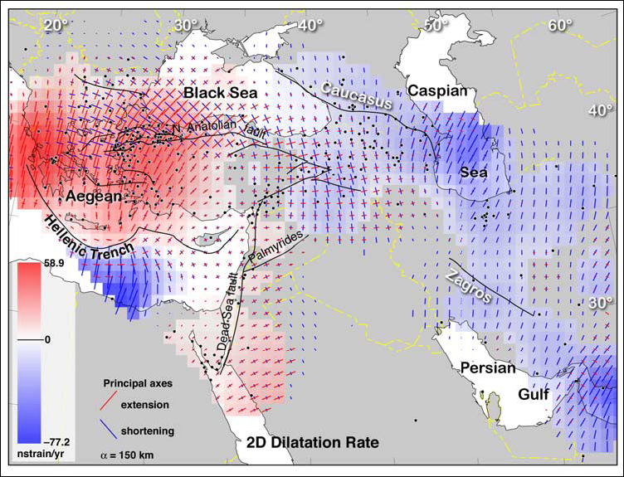
Allmendinger et al, 2007

Slide 12
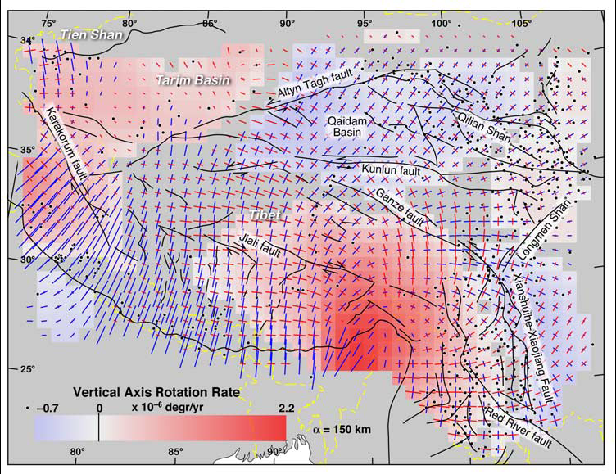
Allmendinger et al, 2007

Slide 13
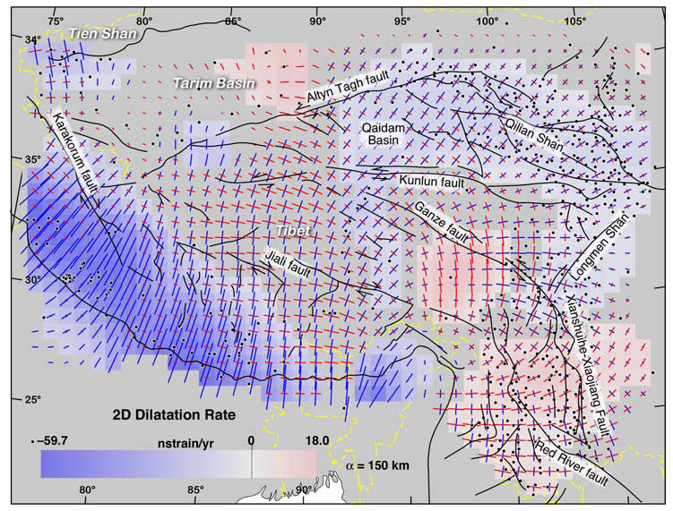
Allmendinger et al, 2007

Slide 14
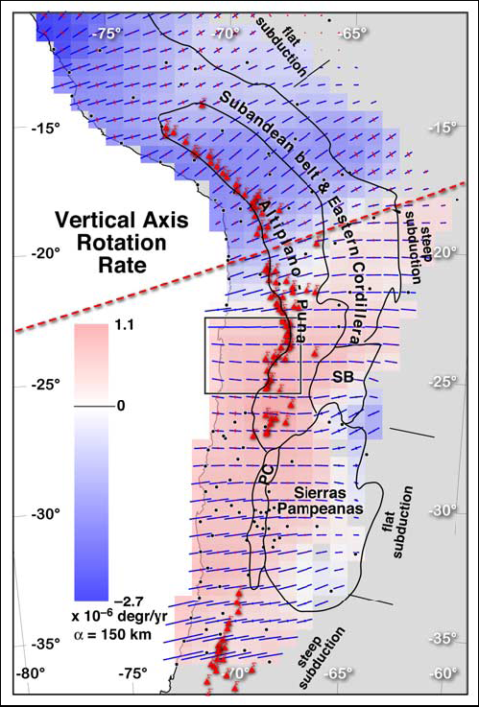
Allmendinger et al, 2007

Slide 15
Rotation rate tensor from GPS in central Andes –
real time observation of oroclinal bending?
From Allmendinger et al, 2005

Slide 16
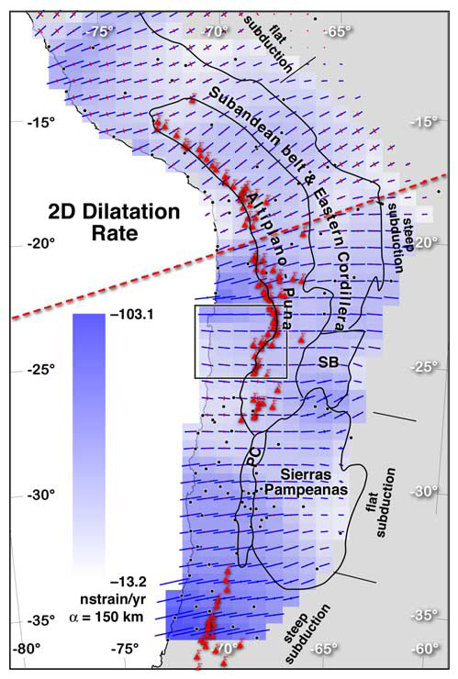
Allmendinger et al, 2007

Slide 17
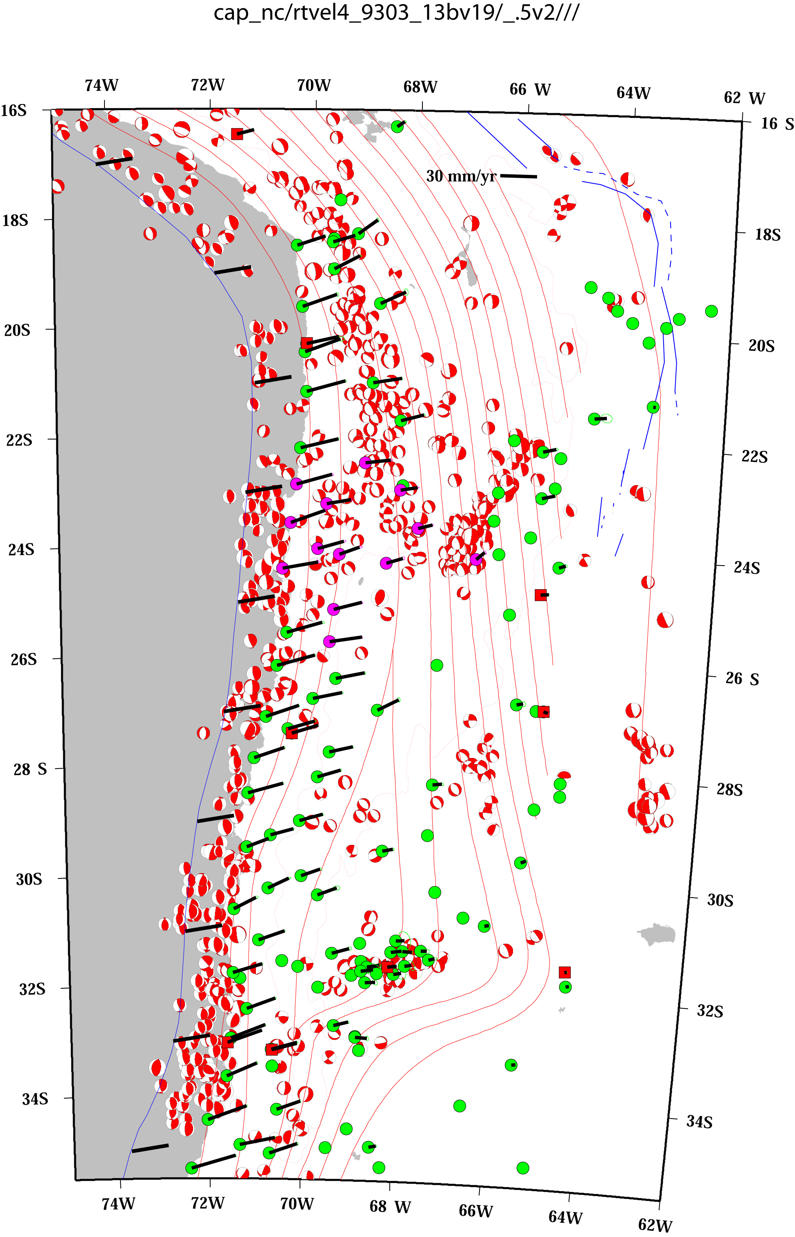
GPS plus focal mechanism data
Downdip compression at bottom of wbz
Downdip extension at intermediate depths
Thrust mechanisms along interplate boundary
Normal faulting on outer rise (3 of em)?

Slide 18
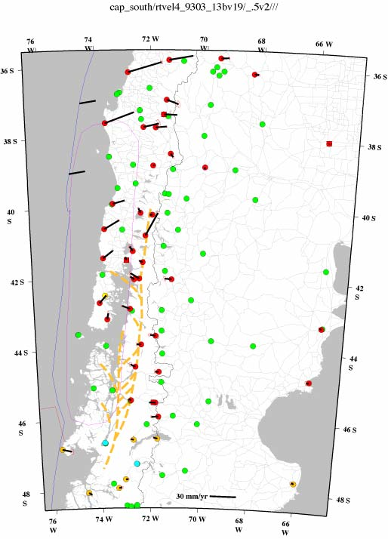
Region of 1960 M9.5 earthquake.
Something funny going on
Along coast – vectors show convergence, but slower than to north
inland – vectors reverse
Also – strike slip faulting along Liquine-Ofqui fault system.

Slide 19
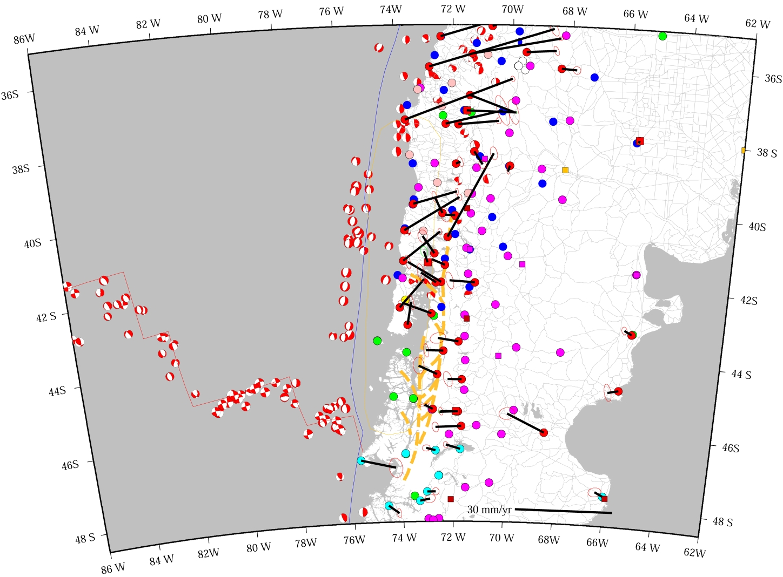
Earthquake activity –
Almost no interplate or wbz.
Lots of outer rise normal faulting events.

Slide 20
“normal”
1960 great Chilean earthquake
“normal”

Slide 21
Postseismic
Earthquake activity –
Almost no interplate or wbz activity
Lots of outer rise normal faulting events

Slide 22
1960 rupture zone
Reverses to east
Liquiñe-Ofqui fault
Subduction
of ridge at triple juncion at south end
- Post-seismic viscoelatic relaxation – mantle.

Slide 24
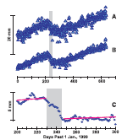
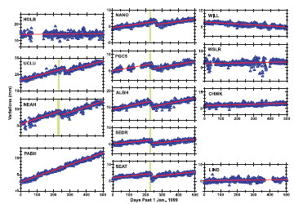
Silent slip in subduction zones
Non-secular GPS displacements
Coupled with seismic tremor
Dragert et al, 20013

Slide 25
Silent slip in subduction zones
Non-secular GPS displacements
Coupled with seismic tremor
Also observed (with different periods) in Mexico and Japan
(seem to be ubiquitous – if have dense continuous GPS network and broadband seismic network in subduction zone you will find them)
Rogers and Dragert, 2003

Slide 26
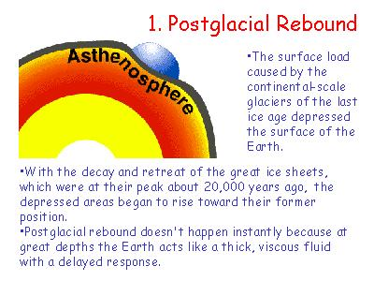
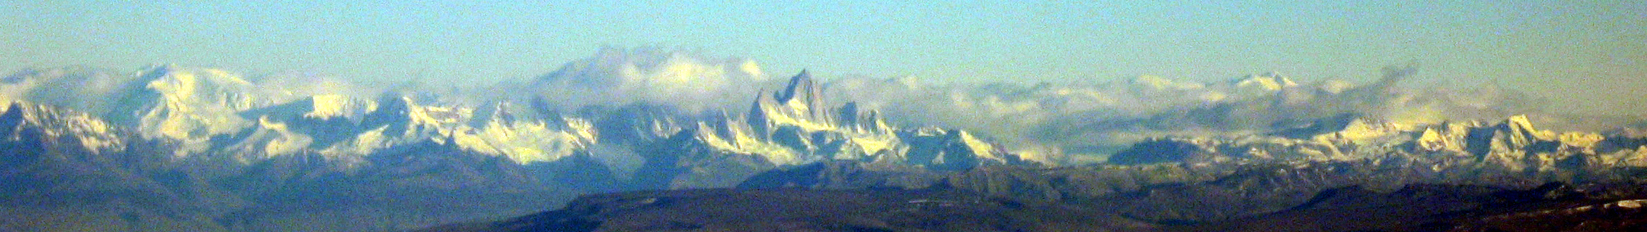
GlaCial IsOSTATIC Adjustment (GIA) old - Post Glacial Rebound (PGR)
An interplay between
Ice load history
Geomechanical structure of region
  Mantle viscosity profile
  Lithosphere thickness
Ice load history reflects climate (and topography/tectonics?).
Geomechanical structure reflects tectonic setting!

Slide 27
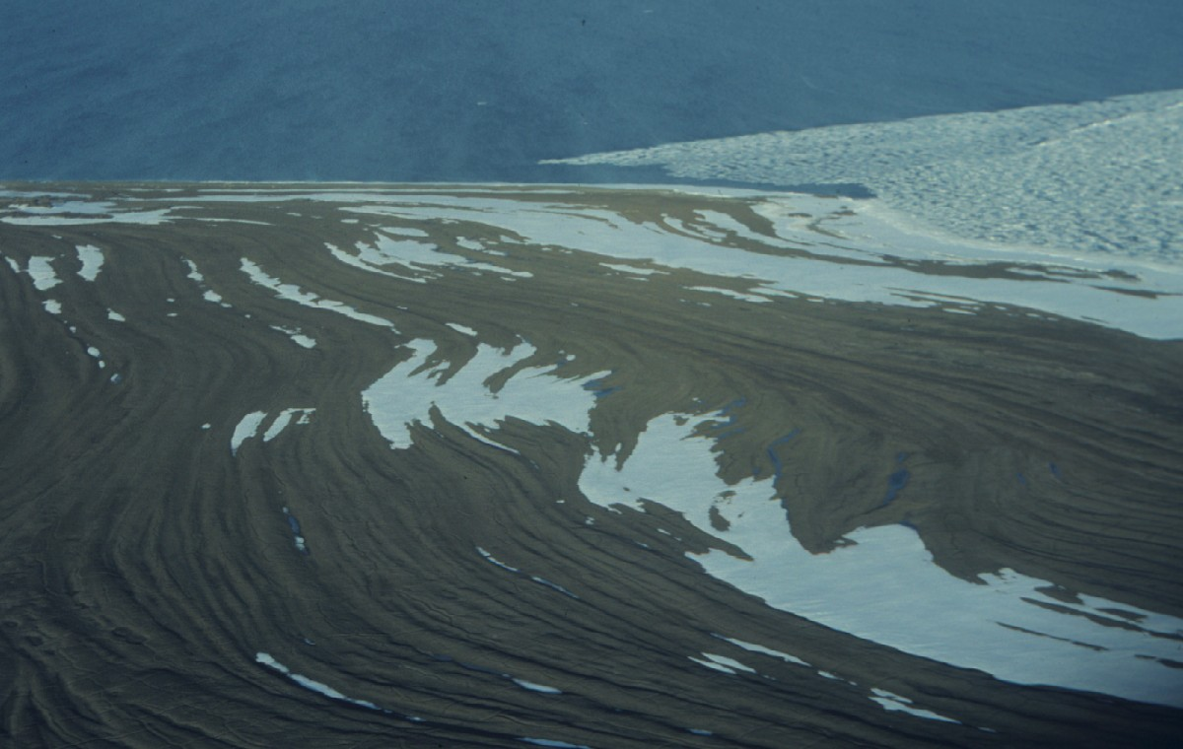
Raised beaches on Kongsøya, central-northern Barents Sea, where the highest marine limit on Svalbard occurs (110 m a.s.l.). The age of the marine limit is ca. 10,000 years. Photo: Ólafur Ingólfsson, 1991.

Slide 28
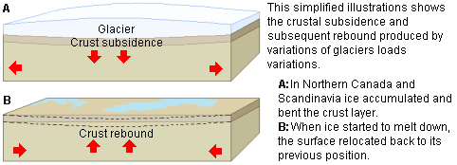

Slide 29
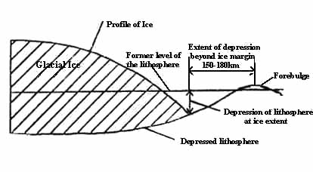
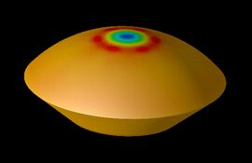

Slide 30
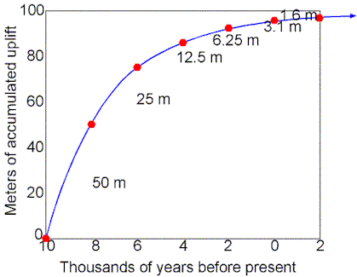

Slide 31
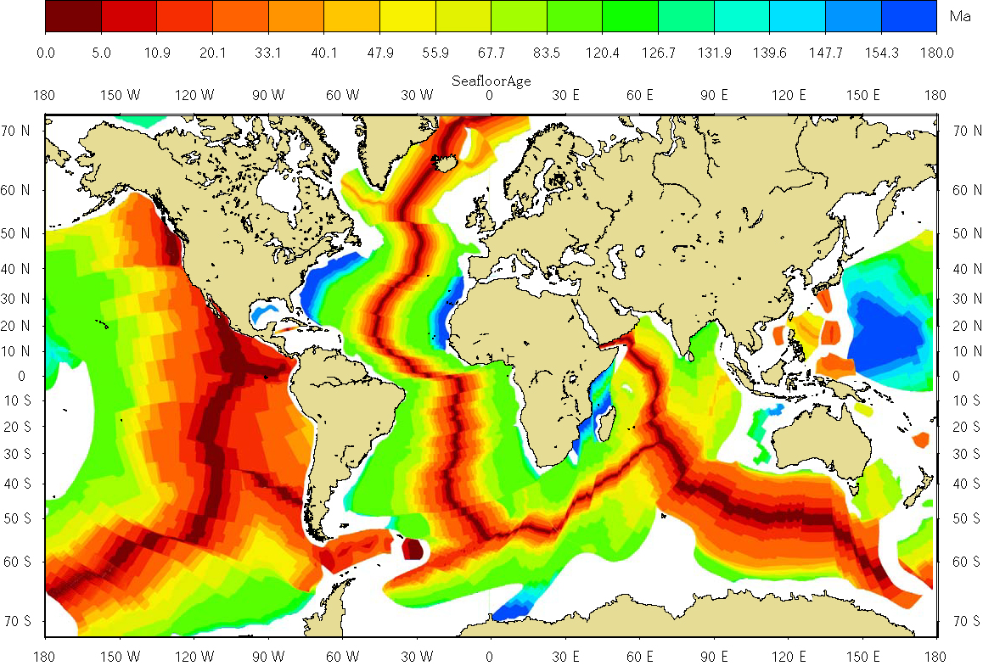
Oceanic Geomechanical structure
varies simply with age of Seafloor
Young – thin lithosphere and hot, low viscosity mantle
Old – thick lithosphere and cold, higher viscosity mantle
(after Muller et al, 1997)

Slide 32
Continental Geomechanical structure
Varies between two global extremes:
Fennoscandian (Stable Craton)
Lithosphere thickness > 75 km
U Mantle viscosity > 5 x 10²⁰ Pa s
L Mantle viscosity ~ 10²² Pa s
Basin and Range / Iceland/Other
Lithospheric thickness ~ 10 km
U Mantle viscosity < 1 x 10¹⁹ Pa s

Slide 33
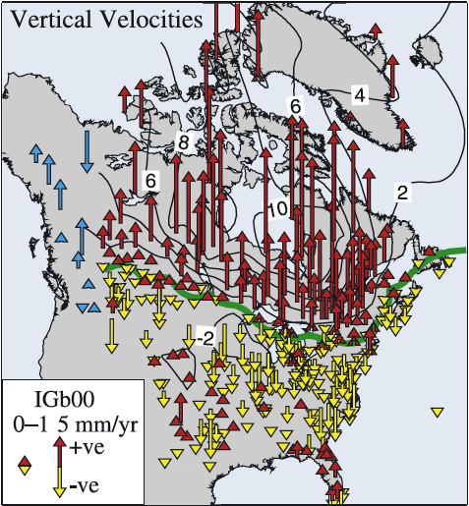
PGR North America
Sella et al., 2007

Slide 34
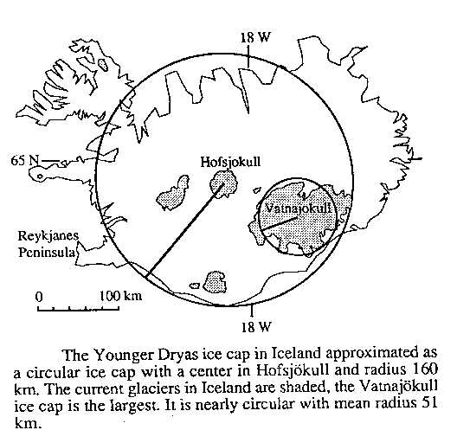
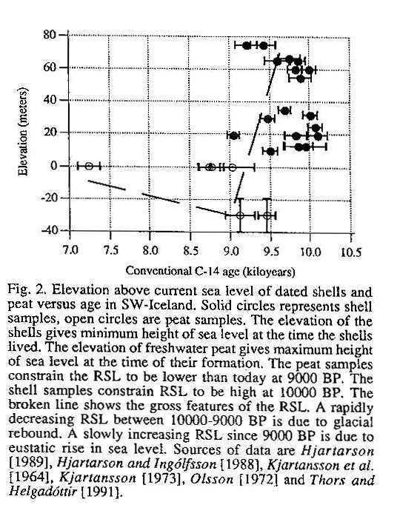
PGR in Iceland (young oceanic structure)
•Deglaciation following maximum at ~ 12000 yrsBP
• PGR in Iceland was completed in 1000 yrs
- U Mantle viscosity < 1 x 10¹⁹ Pa s
• Compare to Fennoscandia – PGR still occurring.
Sigmundsson (1991)

Slide 35
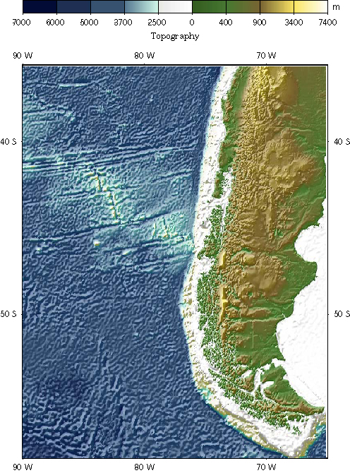
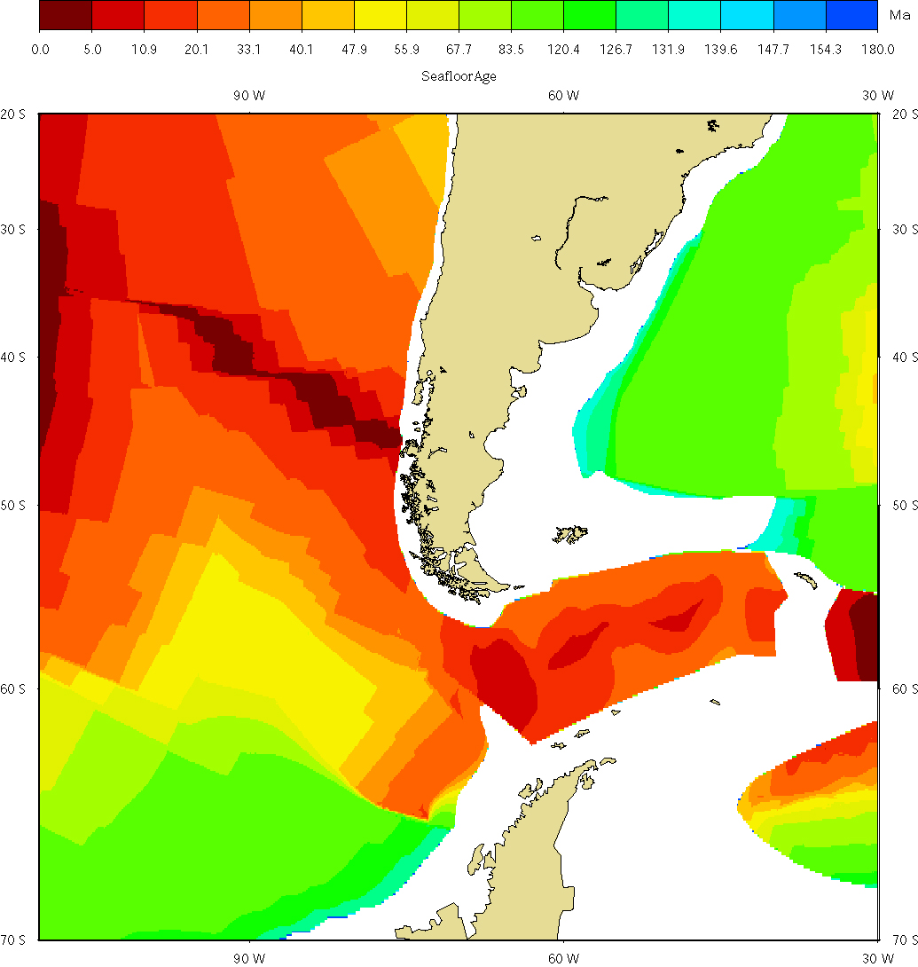
Geomechanical structure in Patagonia
-Taitao Triple Junction
- Ridge subduction
PGR in Patagonia?
Continental, but not Fennoscandia.
More like Basin and Range?

Slide 36
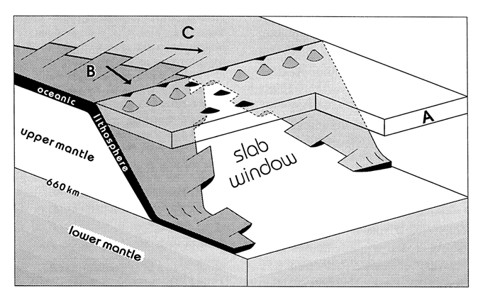
From Thorkelson (1996)
Formation of a slab window

Slide 37
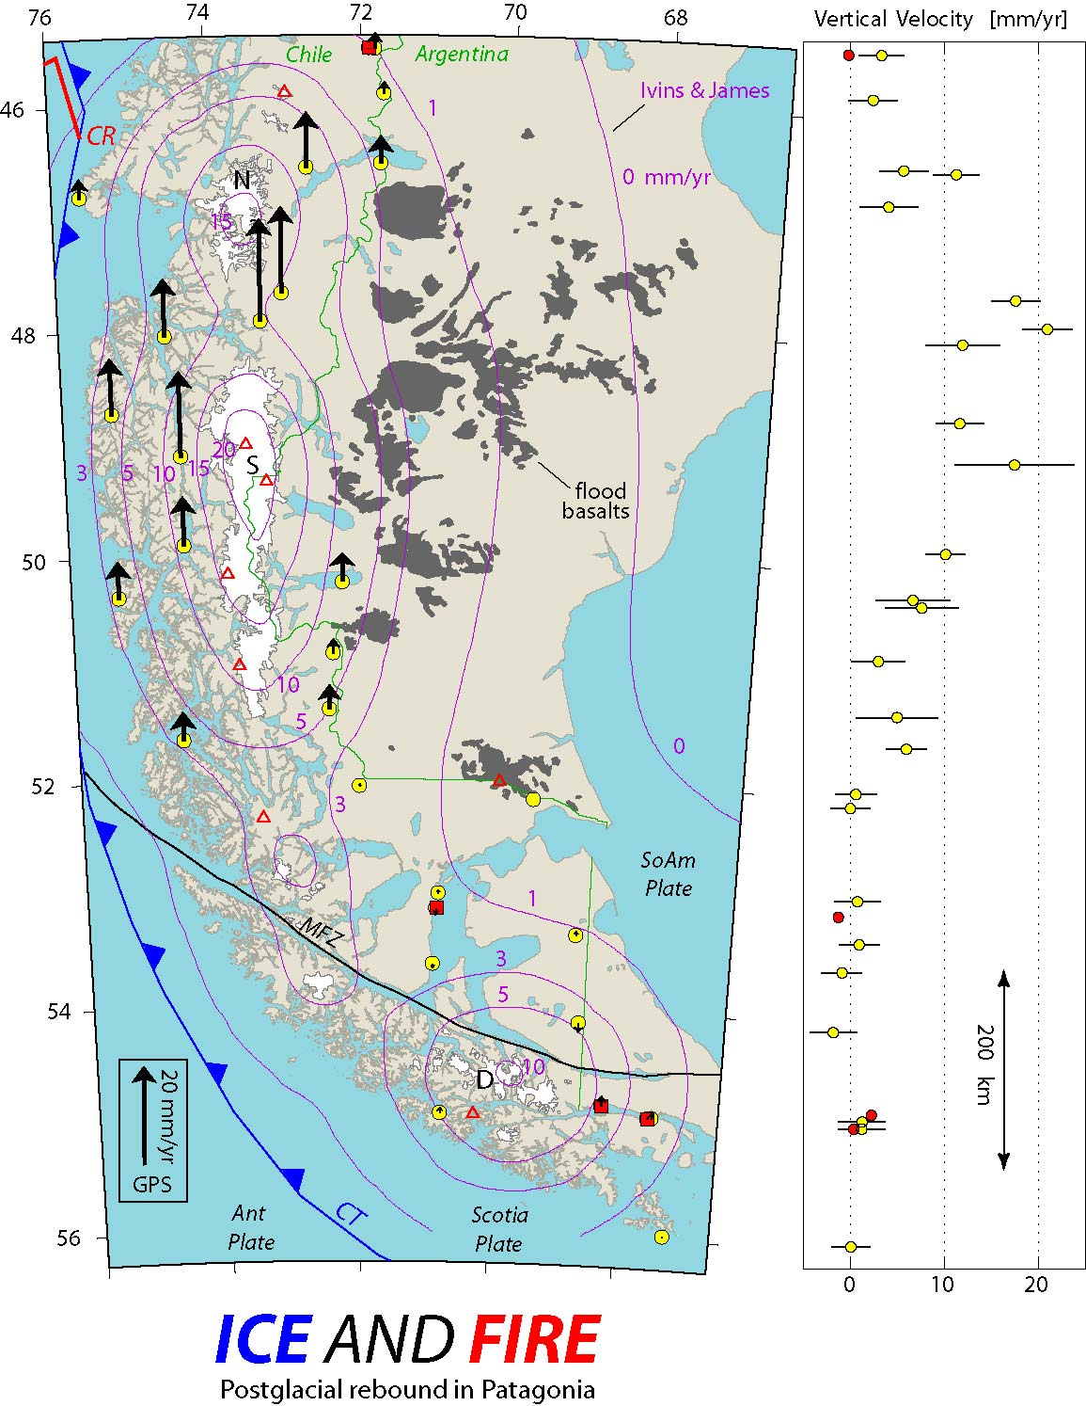
Crustal response to loads – ice
GPS Results
Uplift signal related to changes in ice mass in the Patagonian ice fields
2 components –
Post glacial rebound amplified by upper mantle modified by subduction of ridge.
Elastic compression of crust.

Slide 38
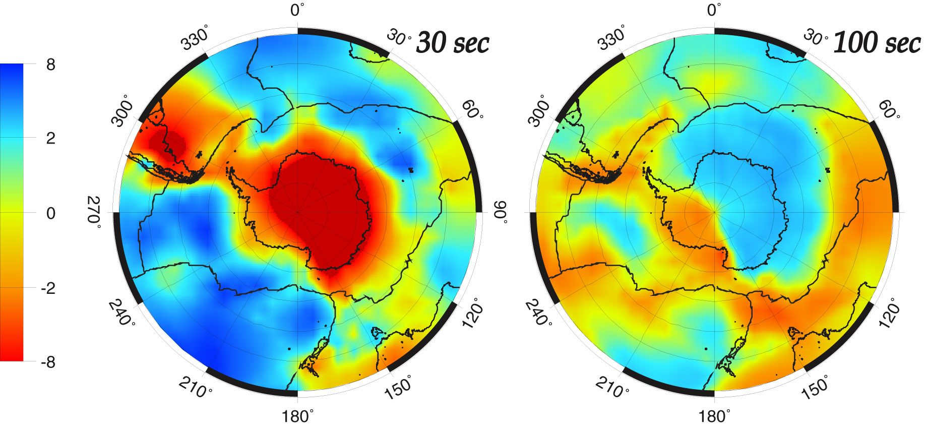
RayleighWave velocity
Geomechanical Structure of Antarctica: Part I
Rayleigh wave velocity
proxy for lithospheric thickness
- thin is “weak”
Determines wavelength and amplitude of isostatic response
Danesi & Morelli, 2001

Slide 39
Rayleigh Wave velocity
Geomechanical Structure of Antarctica: Part I
Rayleigh wave velocity
proxy for lithospheric thickness
- thin is “weak”
Determines wavelength and amplitude of isostatic response
Result -- West Antarctica thin
Danesi & Morelli, 2001

Slide 40
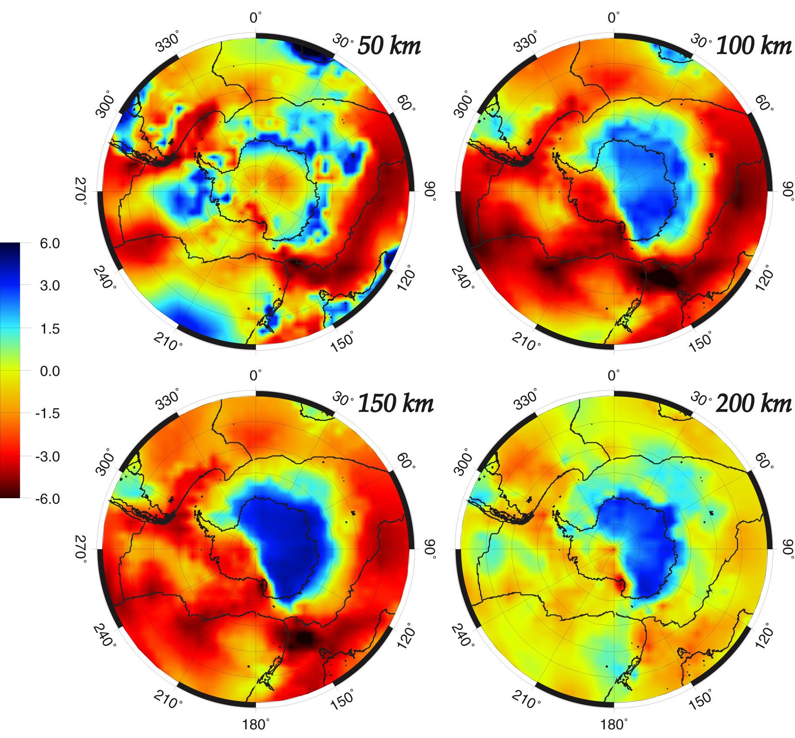
Geomechanical Structure of Antarctica: Part II
Sv velocity
proxy for temperature
- hot is lower viscosity (runny).
Determines speed of isostatic response.
Danesi & Morelli, 2001

Slide 41
Geomechanical Structure of Antarctica: Part II
Sv velocity
proxy for temperature
- hot is lower viscosity (runny).
Determines speed of isostatic response.
Result -- West Antarctica hot
Danesi & Morelli, 2001

Slide 42
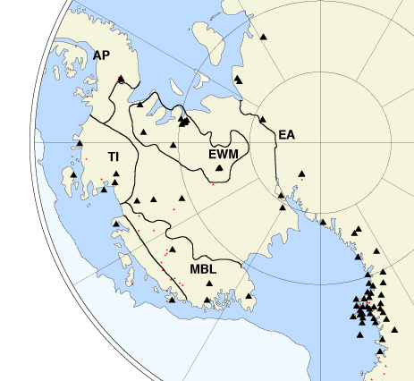

Slide 43
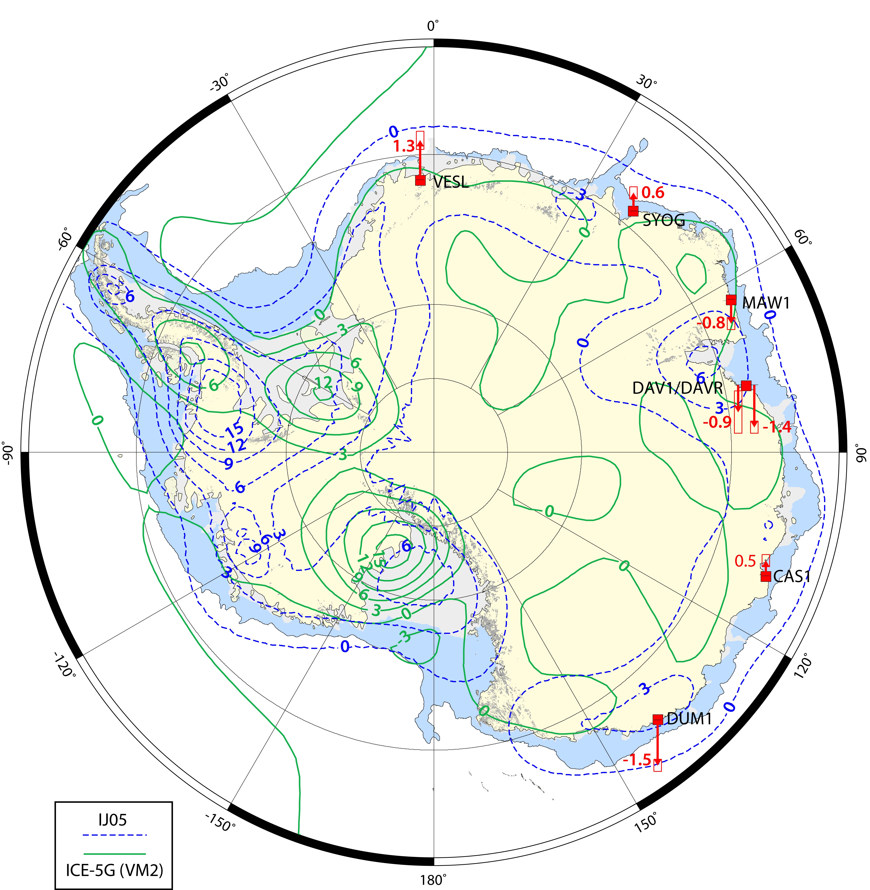

Slide 44
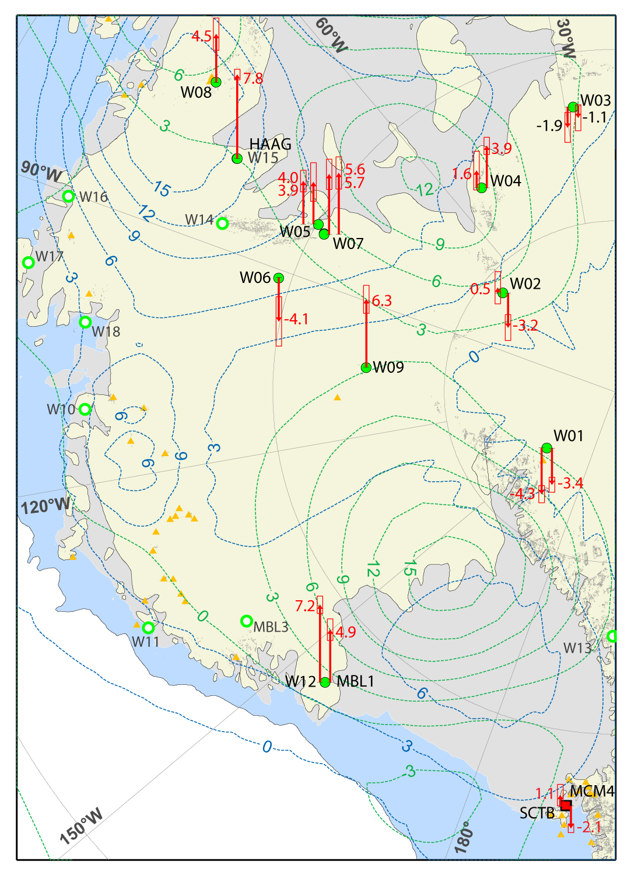

Slide 45
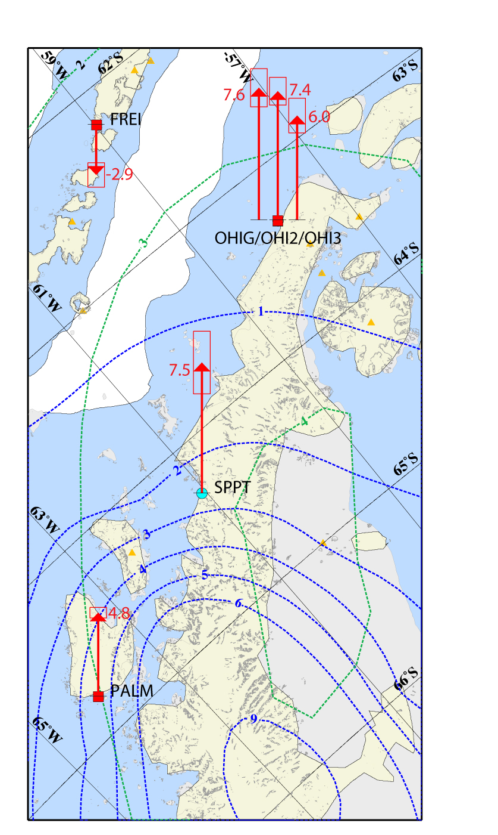

Slide 46
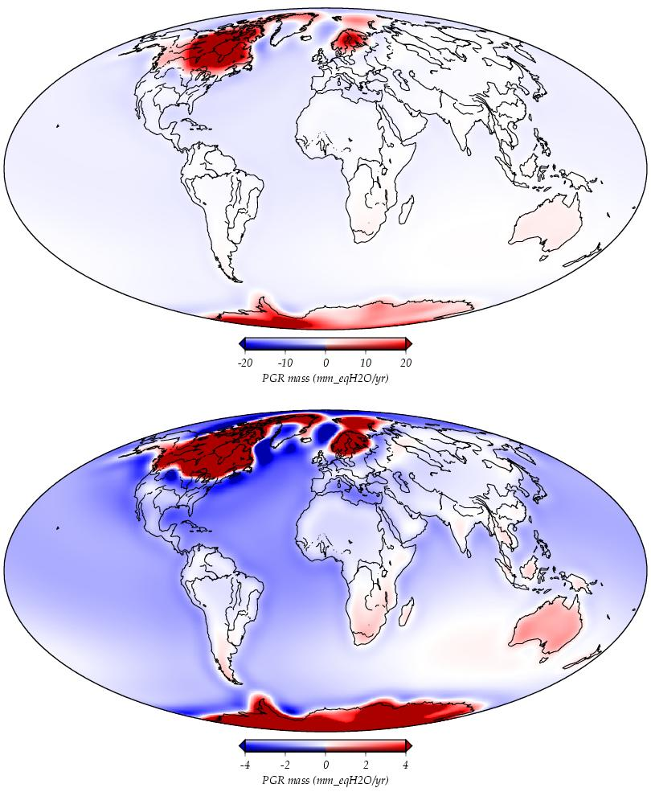
Model of present-day surface elevation change due to PGR and reloading of ocean basins with seawater. Red areas rising due to removal of ice sheets. Blue areas falling due to re-filling of ocean basins when ice sheets melted and because of collapse forebulges around the ice sheets.
Paulson, A., http://grace.jpl.nasa.gov/data/pgr

Slide 47
Crustal response to loads
Annual lake loading
Check for anelasticity – no time lag/phase shift -> elastic.

Slide 48
Crustal response to loads – Amazon River
Bevis et al, 2005

Slide 49
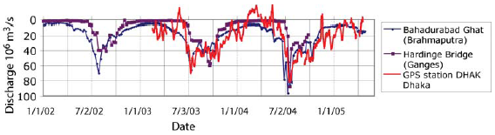
Response of crust to loading from Brahmaputra and Gandes
----------------
Requires continuous GPS to observe non-secular (in this case annual) signals.
www.unavco.org/pubs_reports/proposals/2007/facility2007/section3/UNV-GRID-SPREAD-TP_41.pdf
Notes:
Another example from passive continental-oceanic boundary.

Slide 50
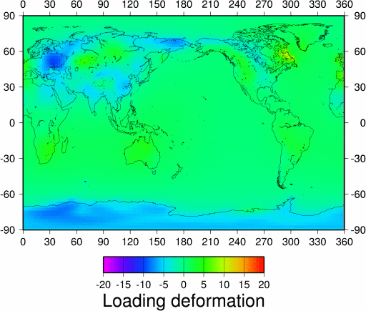
Elastic deformation in vertical from loading – complication or another interesting signal?
mm
Weather systems:
Aerial extent – thousands of square km.
Period – weeks.

Slide 51
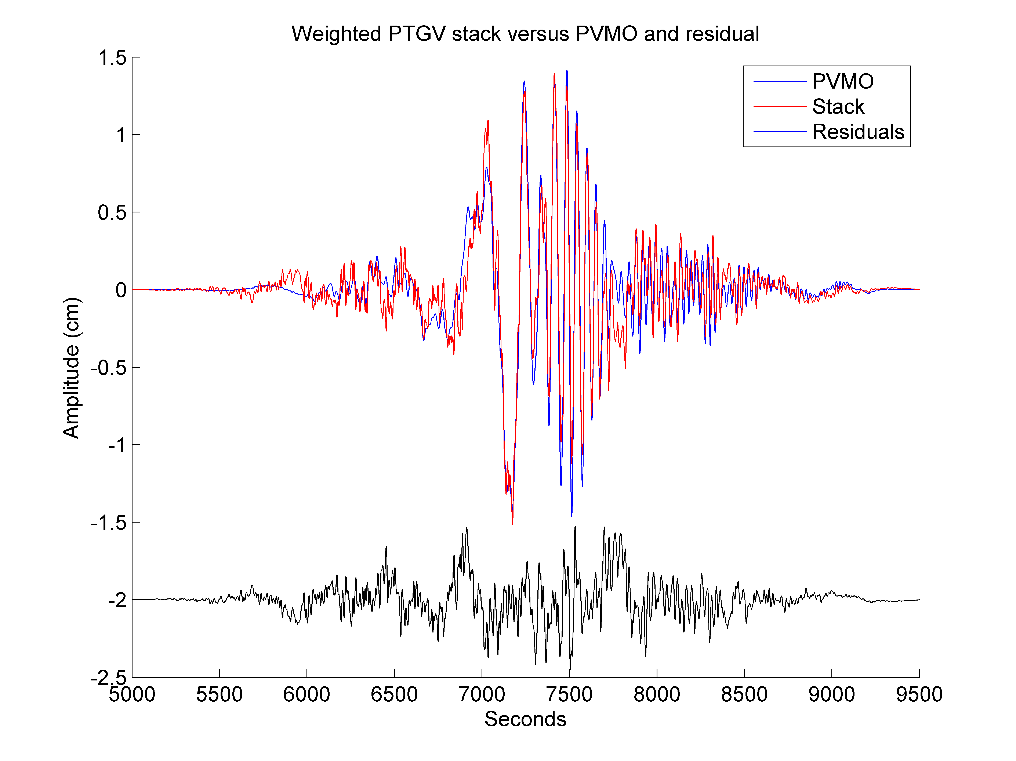
Kinematic GPS
GPS absolute displacement seismograms – Love wave of 2004 M9.0, Sumatra-Andaman earthquake in Portageville, AR.
Davis and Smalley, 2009

Slide 52
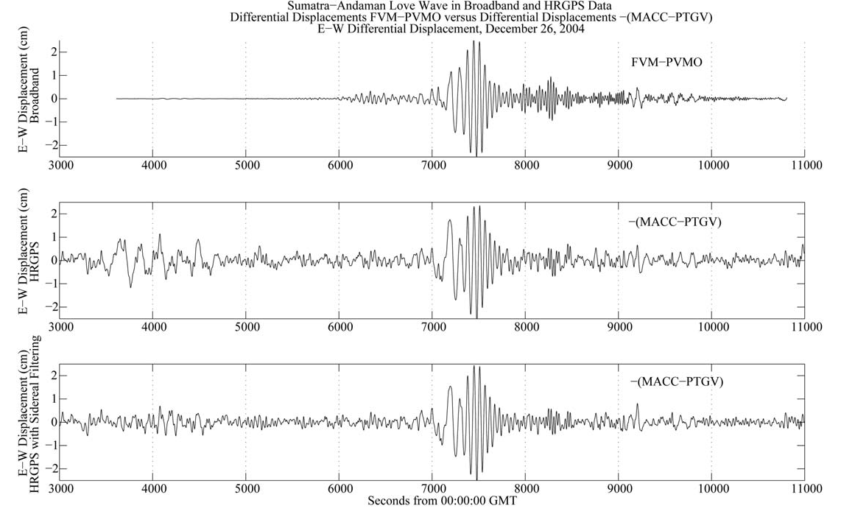
Kinematic GPS
Differential – difference in position between two GPS antennas, one assumed “fixed”. (PPP methods also exist, but are less precise)
Davis and Smalley, 2009

Slide 53
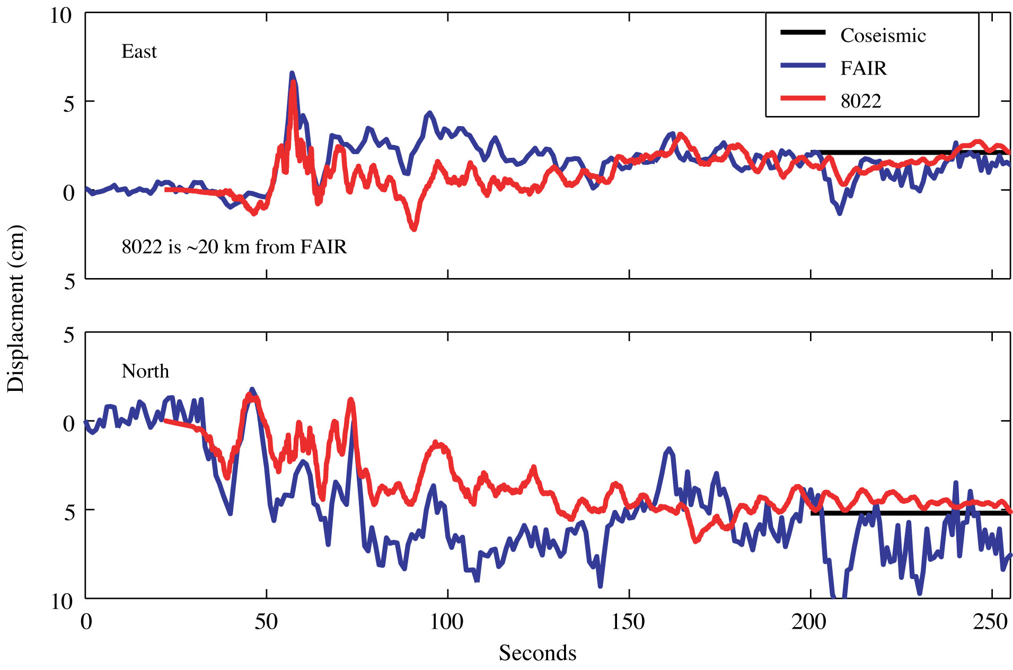
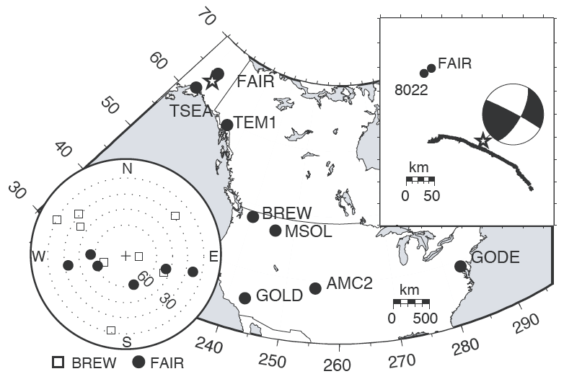
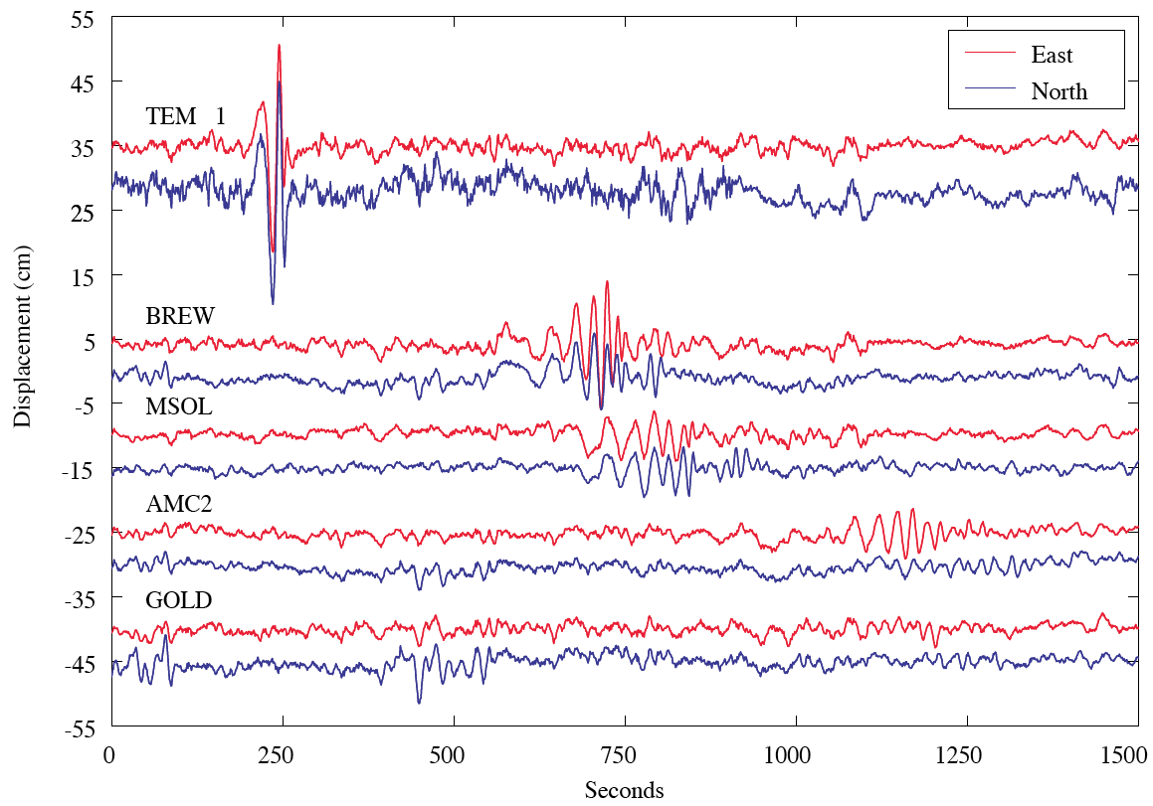
How to get absolute displacements?
Most popular way to have one of the two sites outside the region with displacements (site is “fixed”) – discovered GPS recorded surface waves at few thousand km.
Larson et al, 2003

Slide 54
Does not work for surface waves from really big earthquakes with long duration surface wave trains
can’t find “fixed” site.
(Fixed site has to be able to see common set satellites with kinematic site – since is differential.
The longer the baseline the fewer satellites are in common and the worse the overall location geometry. The signal may be of longer duration than the time it takes for the waves to travel from the kinematic to the fixed site.)

Slide 55
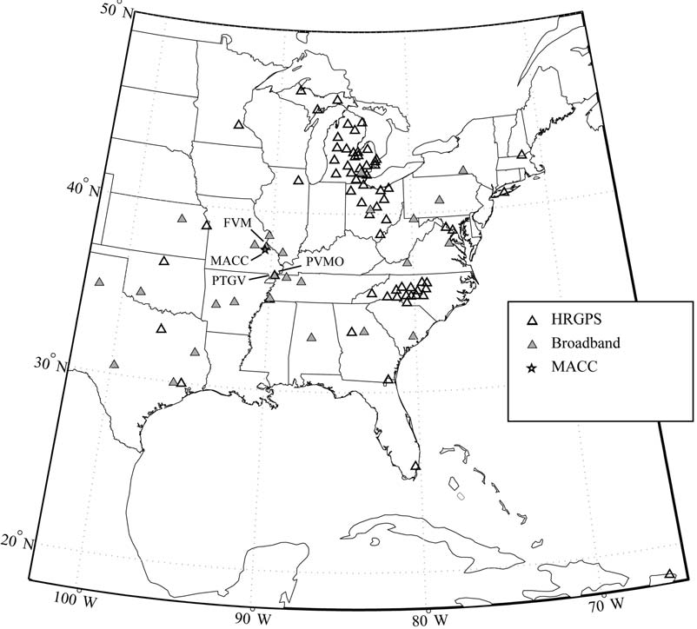
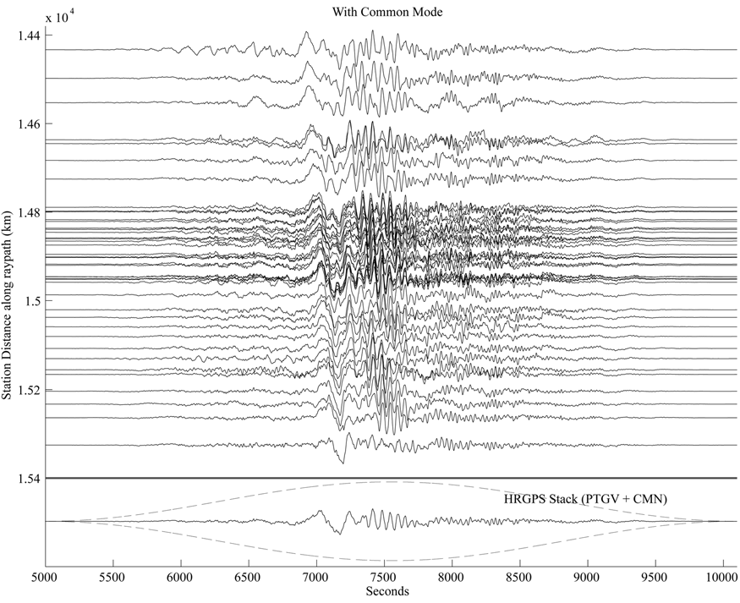
Calculate differential displacement seismograms for large number sites in central North America – using “fixed” site in central North America.
Difficult to tell are not absolute seismograms.
(Bottom trace is sum.)
Davis and Smalley, 2009

Slide 56
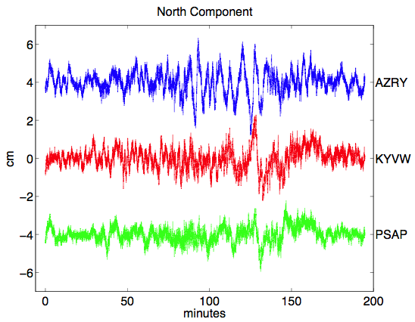
Sidetrack – Multipath
Multipath (reflected signals) is important (and doesn’t difference out). Looks like earthquake?
From Larson

Slide 57
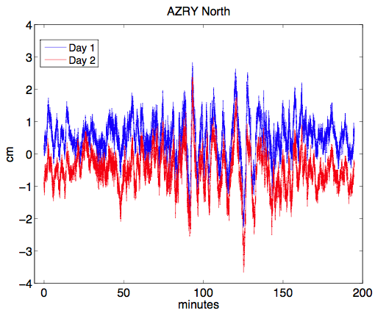
But look at day before or after – looks the same.
Multipath looks same from day to day – due to orbits repeating, generating same reflections, day to day.
From Larson

Slide 58
So the trick is to calculate the GPS displacement time series from the day before or after and subtract from the day with the earthquake. Have to shift by the ~4 minutes due to the “almost” part of the 2x/day GPS orbit.
From Larson

Slide 59
This is called Sidereal Filtering and it removes much of the multipath.
But it depends on the reflection environment remaining the same (no rain, snow, movement of nearby objects such as parked vehicles, etc.)
It also depends on getting the time shift right. Modification is to cross correlate between the two days to get a better time shift (each satellite’s orbit is nominally 4 minutes short – but they vary individually, which effects the locations, etc.).
This is called “modified sidereal filtering”

Slide 60
Sometimes done with average of a few days, but this low pass filters the sidereal filter time series.
Advantage – don’t need signal – can estimate multipath.
Multipath (approximately) stationary for a few days (when reflection environment stays same).

Slide 61
Note difference between middle and bottom traces – the bottom one has been sidereally filtered.
Davis and Smalley, 2009

Slide 62
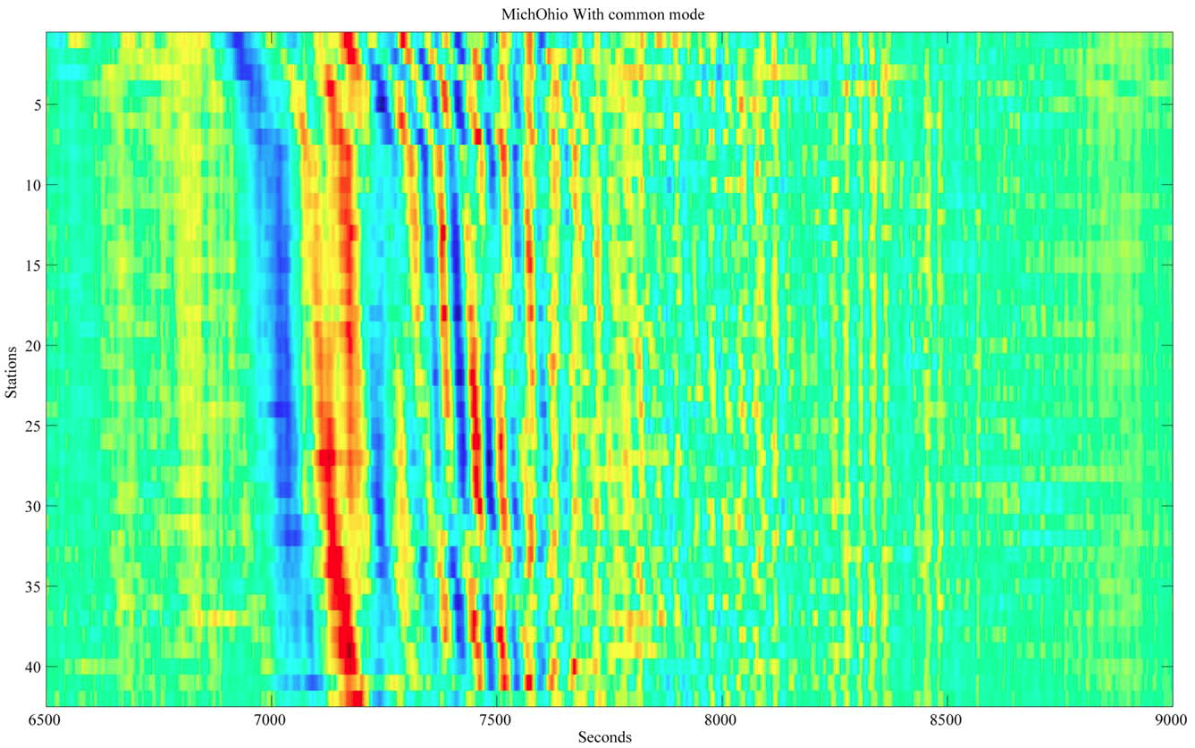
Differential seismograms plotted as surface.
Now is does not quite look “right” (eg. - vertical lines, no “move-out”)
Davis and Smalley, 2009

Slide 63

Bottom trace is sum of differential seismograms (fixed-kinematic). This is an estimate of the absolute displacement of the “fixed” site – the kinematic sites “cancel” out.
(Assume kinematic sites random with respect to one another)
Davis and Smalley, 2009

Slide 64
Subtracting the estimate of the absolute displacement time series of the fixed site (bottom trace) from the kinematic sites differential traces results in absolute displacement time series for the kinematic sites.
Davis and Smalley, 2009

Slide 65

Absolute seismograms plotted as surface.
Now looks “right” (“move-out”)
Davis and Smalley, 2009

Slide 66


Can also see by array processing (beam steering). Peaks show azimuth and slowness of plane waves crossing array. Peak in center (left) is infinite apparent velocity plane wave (everyone doing same thing at same time – the “fixed site”), the other peak is the surface wave.
After removing fixed site can see just the surface wave.
Davis and Smalley, 2009

Slide 67

Now use beam steering to measure slowness at different periods and determine dispersion curve.
Davis and Smalley, 2009

Slide 68
James is working on this for his thesis.
Further improvements to estimating HRGPS time series.
Additional applications (gradiometry).

Slide 69
Intro to GPS processing with GAMIT/GLOBK

Slide 70

"people who have trouble with typing commands should not be using a computer.”
(Response of the Unix community to criticism that Unix ignored the needs of the unsophisticated user.)
If you thought UNIX was user-hostile, you have not seen anything yet!

Slide 71
Homework for Thursday, Oct 28.
In your account on capybara, copy the “example” folder from /Users/ceri-gps/gamit to your directory, and name it “scal”
At the same level as the “scal” directory, make a soft link to /Users/ceri-gps/gg/tables.
Go into scal and follow the instructions in the README. (the tables directory they refer to in the README is the one in scal, not the one you did the soft link to above)
This should establish that everything is working.
Come see me, James, Wale, or John when it does not work!

