Slide 1
Global Seismology CERI-8105
Tu-Th 1:00-2:25pm
Lab - 3892 Central Ave. (Long building) , Room 110
-----------------------------------------------
Bob Smalley
Office: 3892 Central Ave, Room 103, 678-4929
Office Hours – when I’m in my office.
http://www.ceri.memphis.edu/people/smalley/CERI8105_GlobalSeismology.html
Tue., Sep 12, 2023 Meeting 5

Slide 2
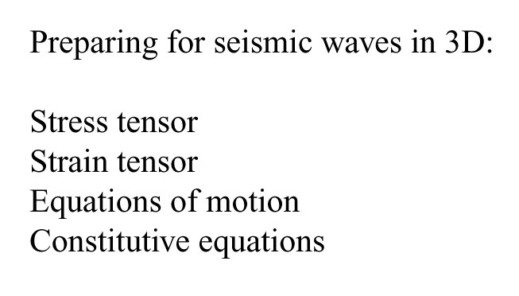

Slide 3
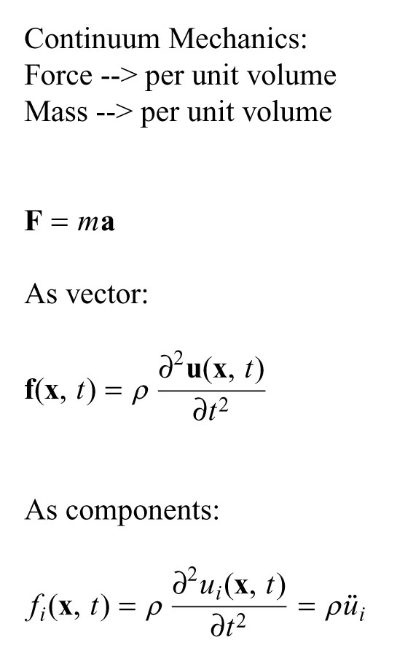
Notes:
Continuum mech – describes behavior continuous, deformable media
Density, force and displacement continuous and differentiable
Newtons law force/unit volume and density/unit volume
If densi;ty does not change with time – get newton's law is approx as we will see – density changes in P waves
In waves – both displacements and forces vary with space and time
Stress tensor – describes forces on deformable body
Equation of motioin – Newton's laws for continuous medium – relates stress to displacement

Slide 4
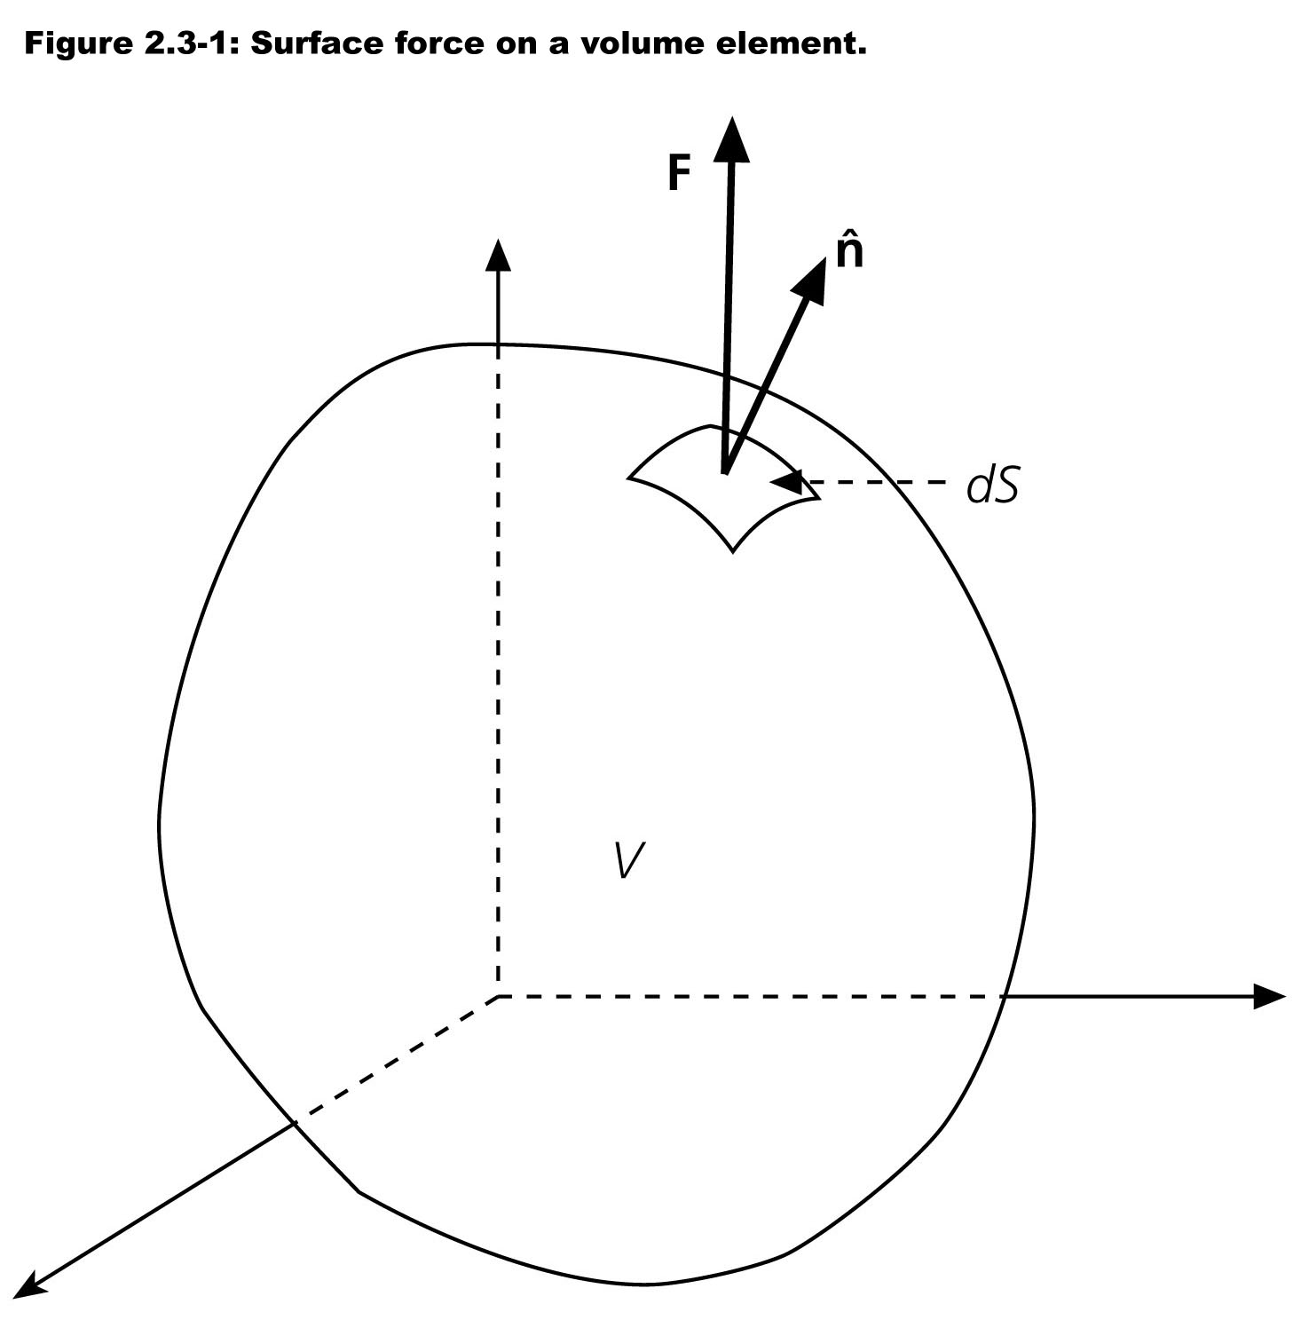
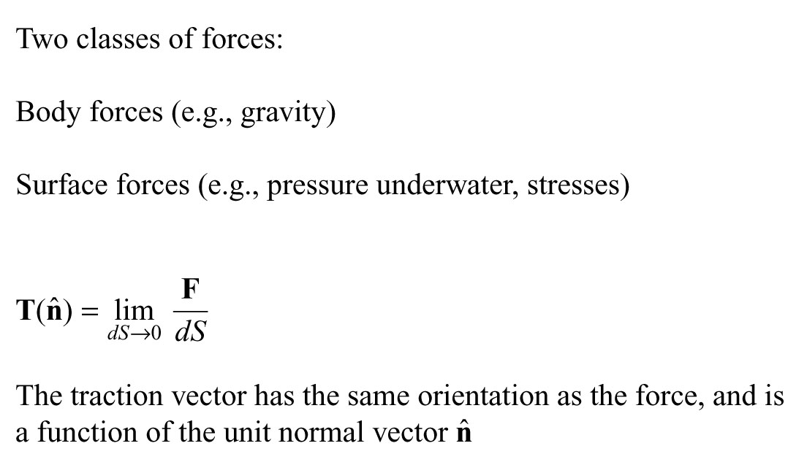
Notes:
Force – vector
Interaction with "body" – freshman physics
Interaction with surface – quantum leap in complexity

Slide 5
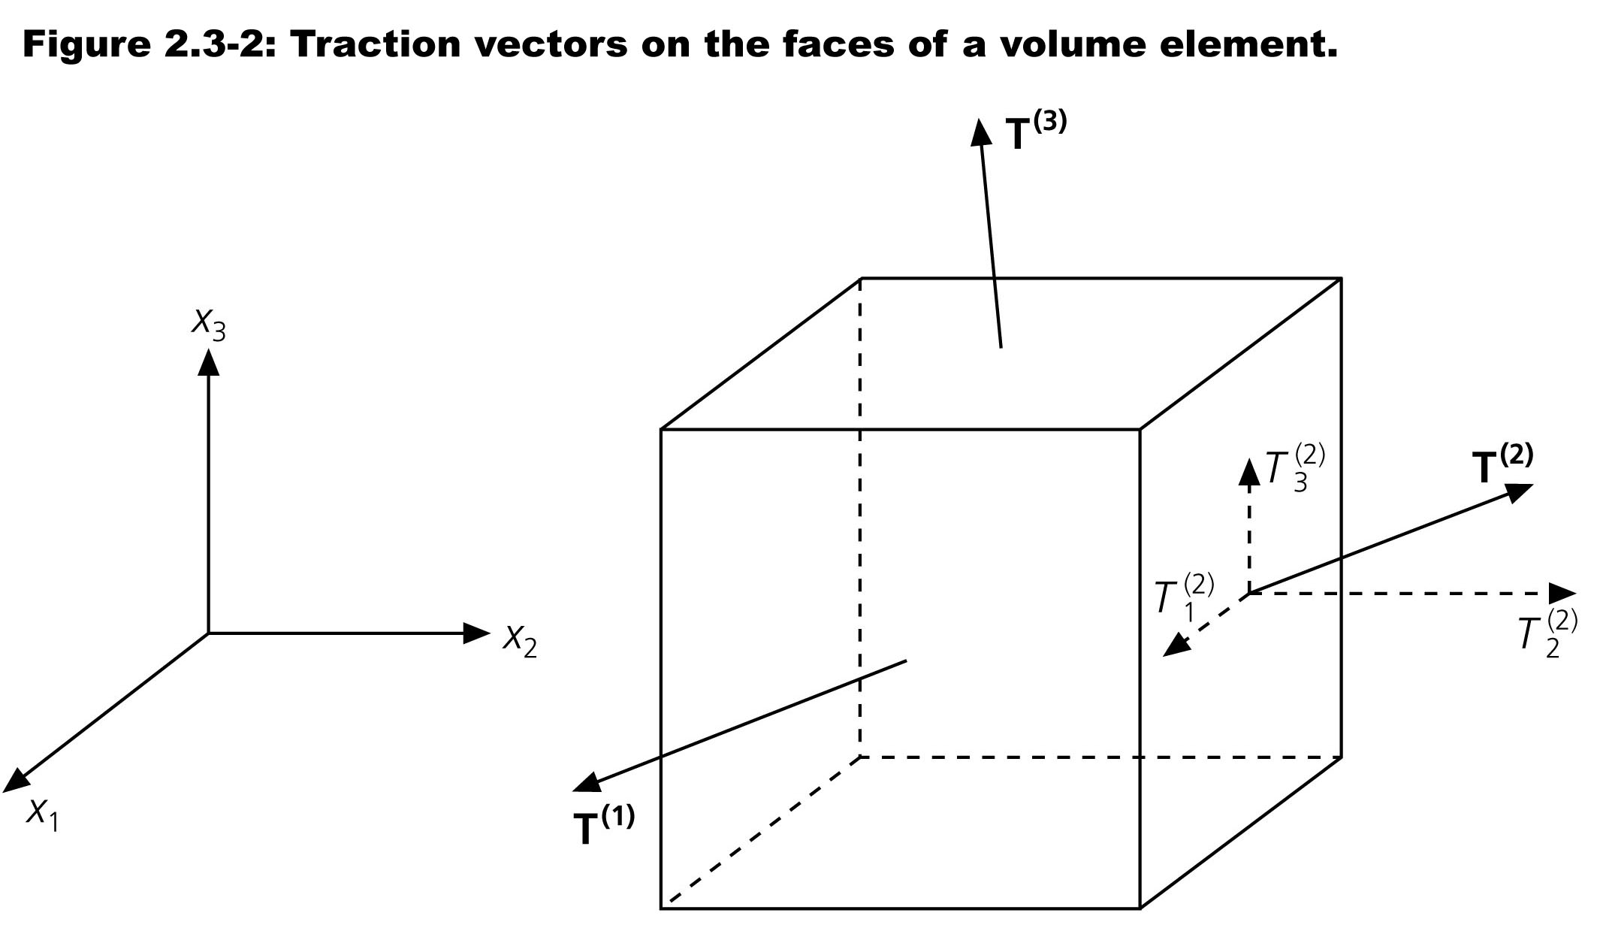

Slide 6
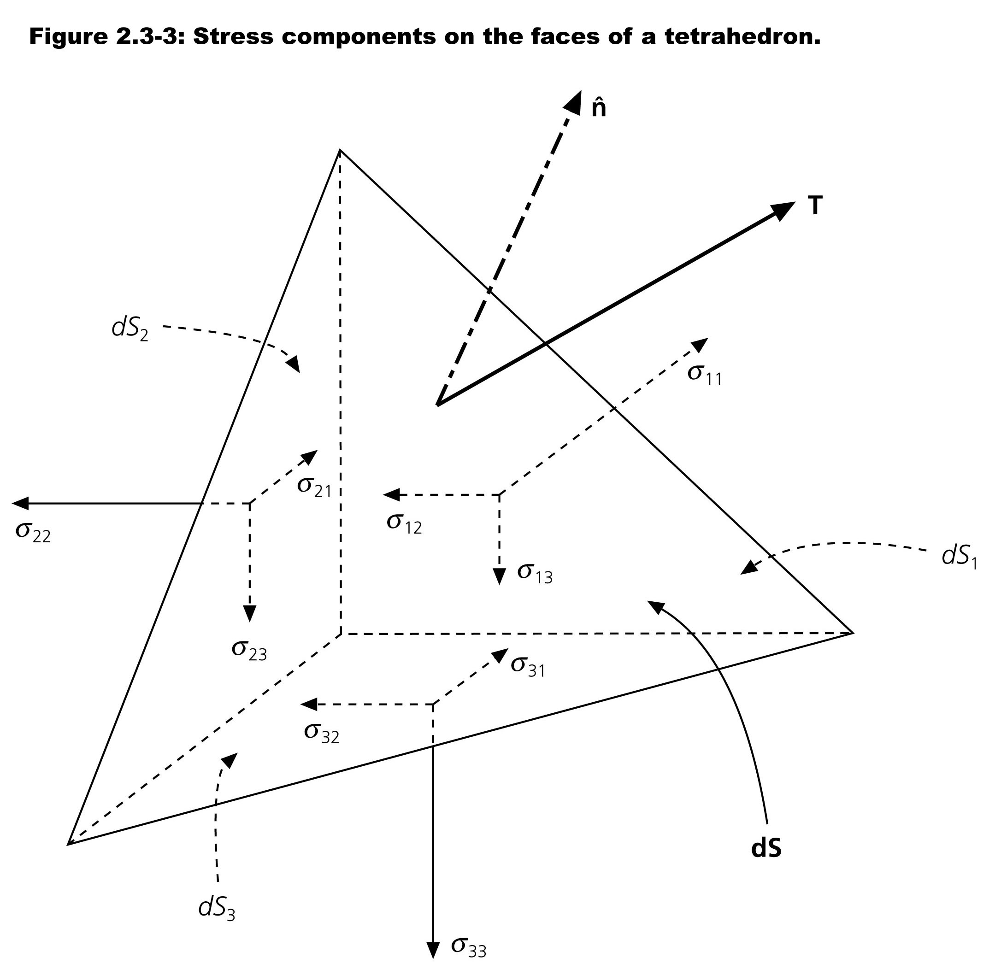
Notes:
Force on surface – traction
At some arbitrary orientation
Planar surface described by normal direction

Slide 7
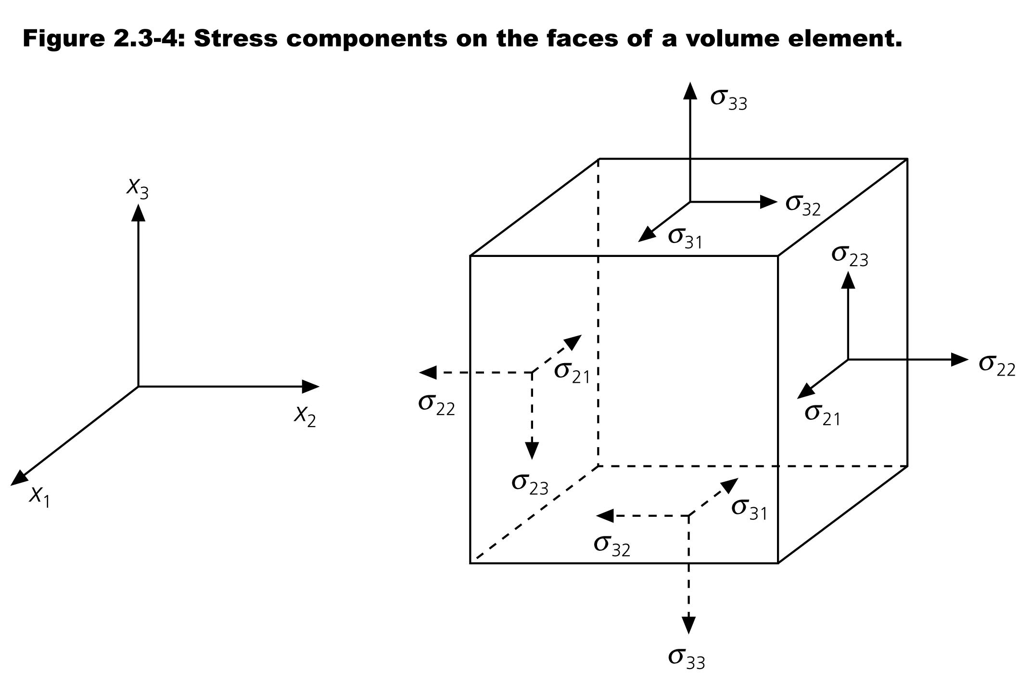
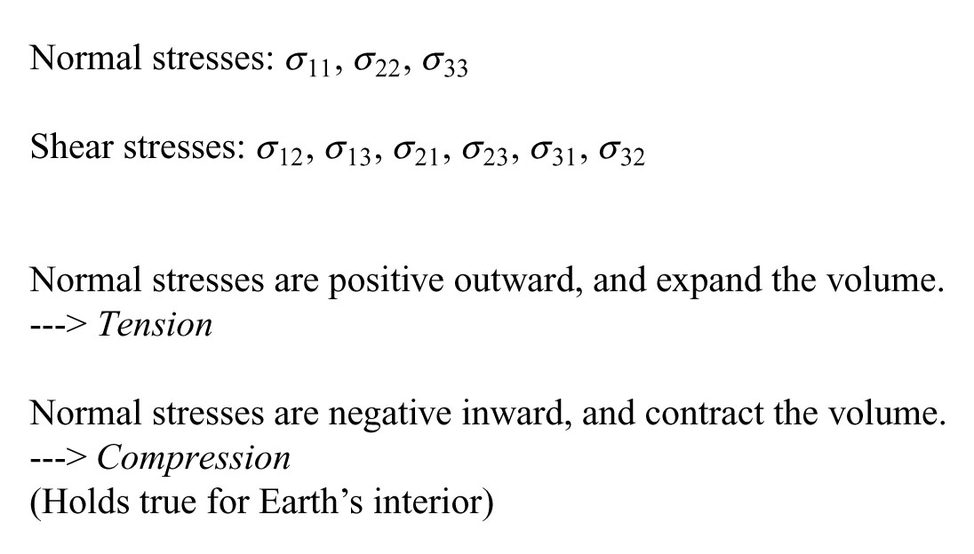
Notes:
Remember – sign of stress same as volume change due to that stress (in seismology, not universal)

Slide 8
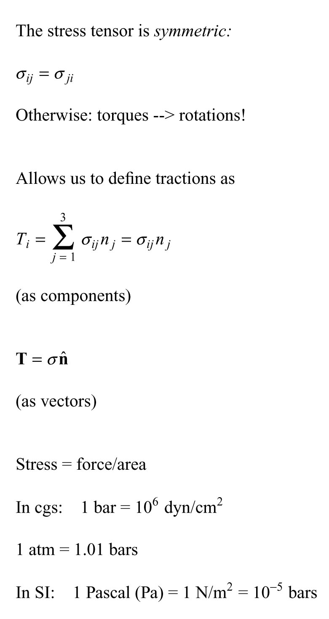
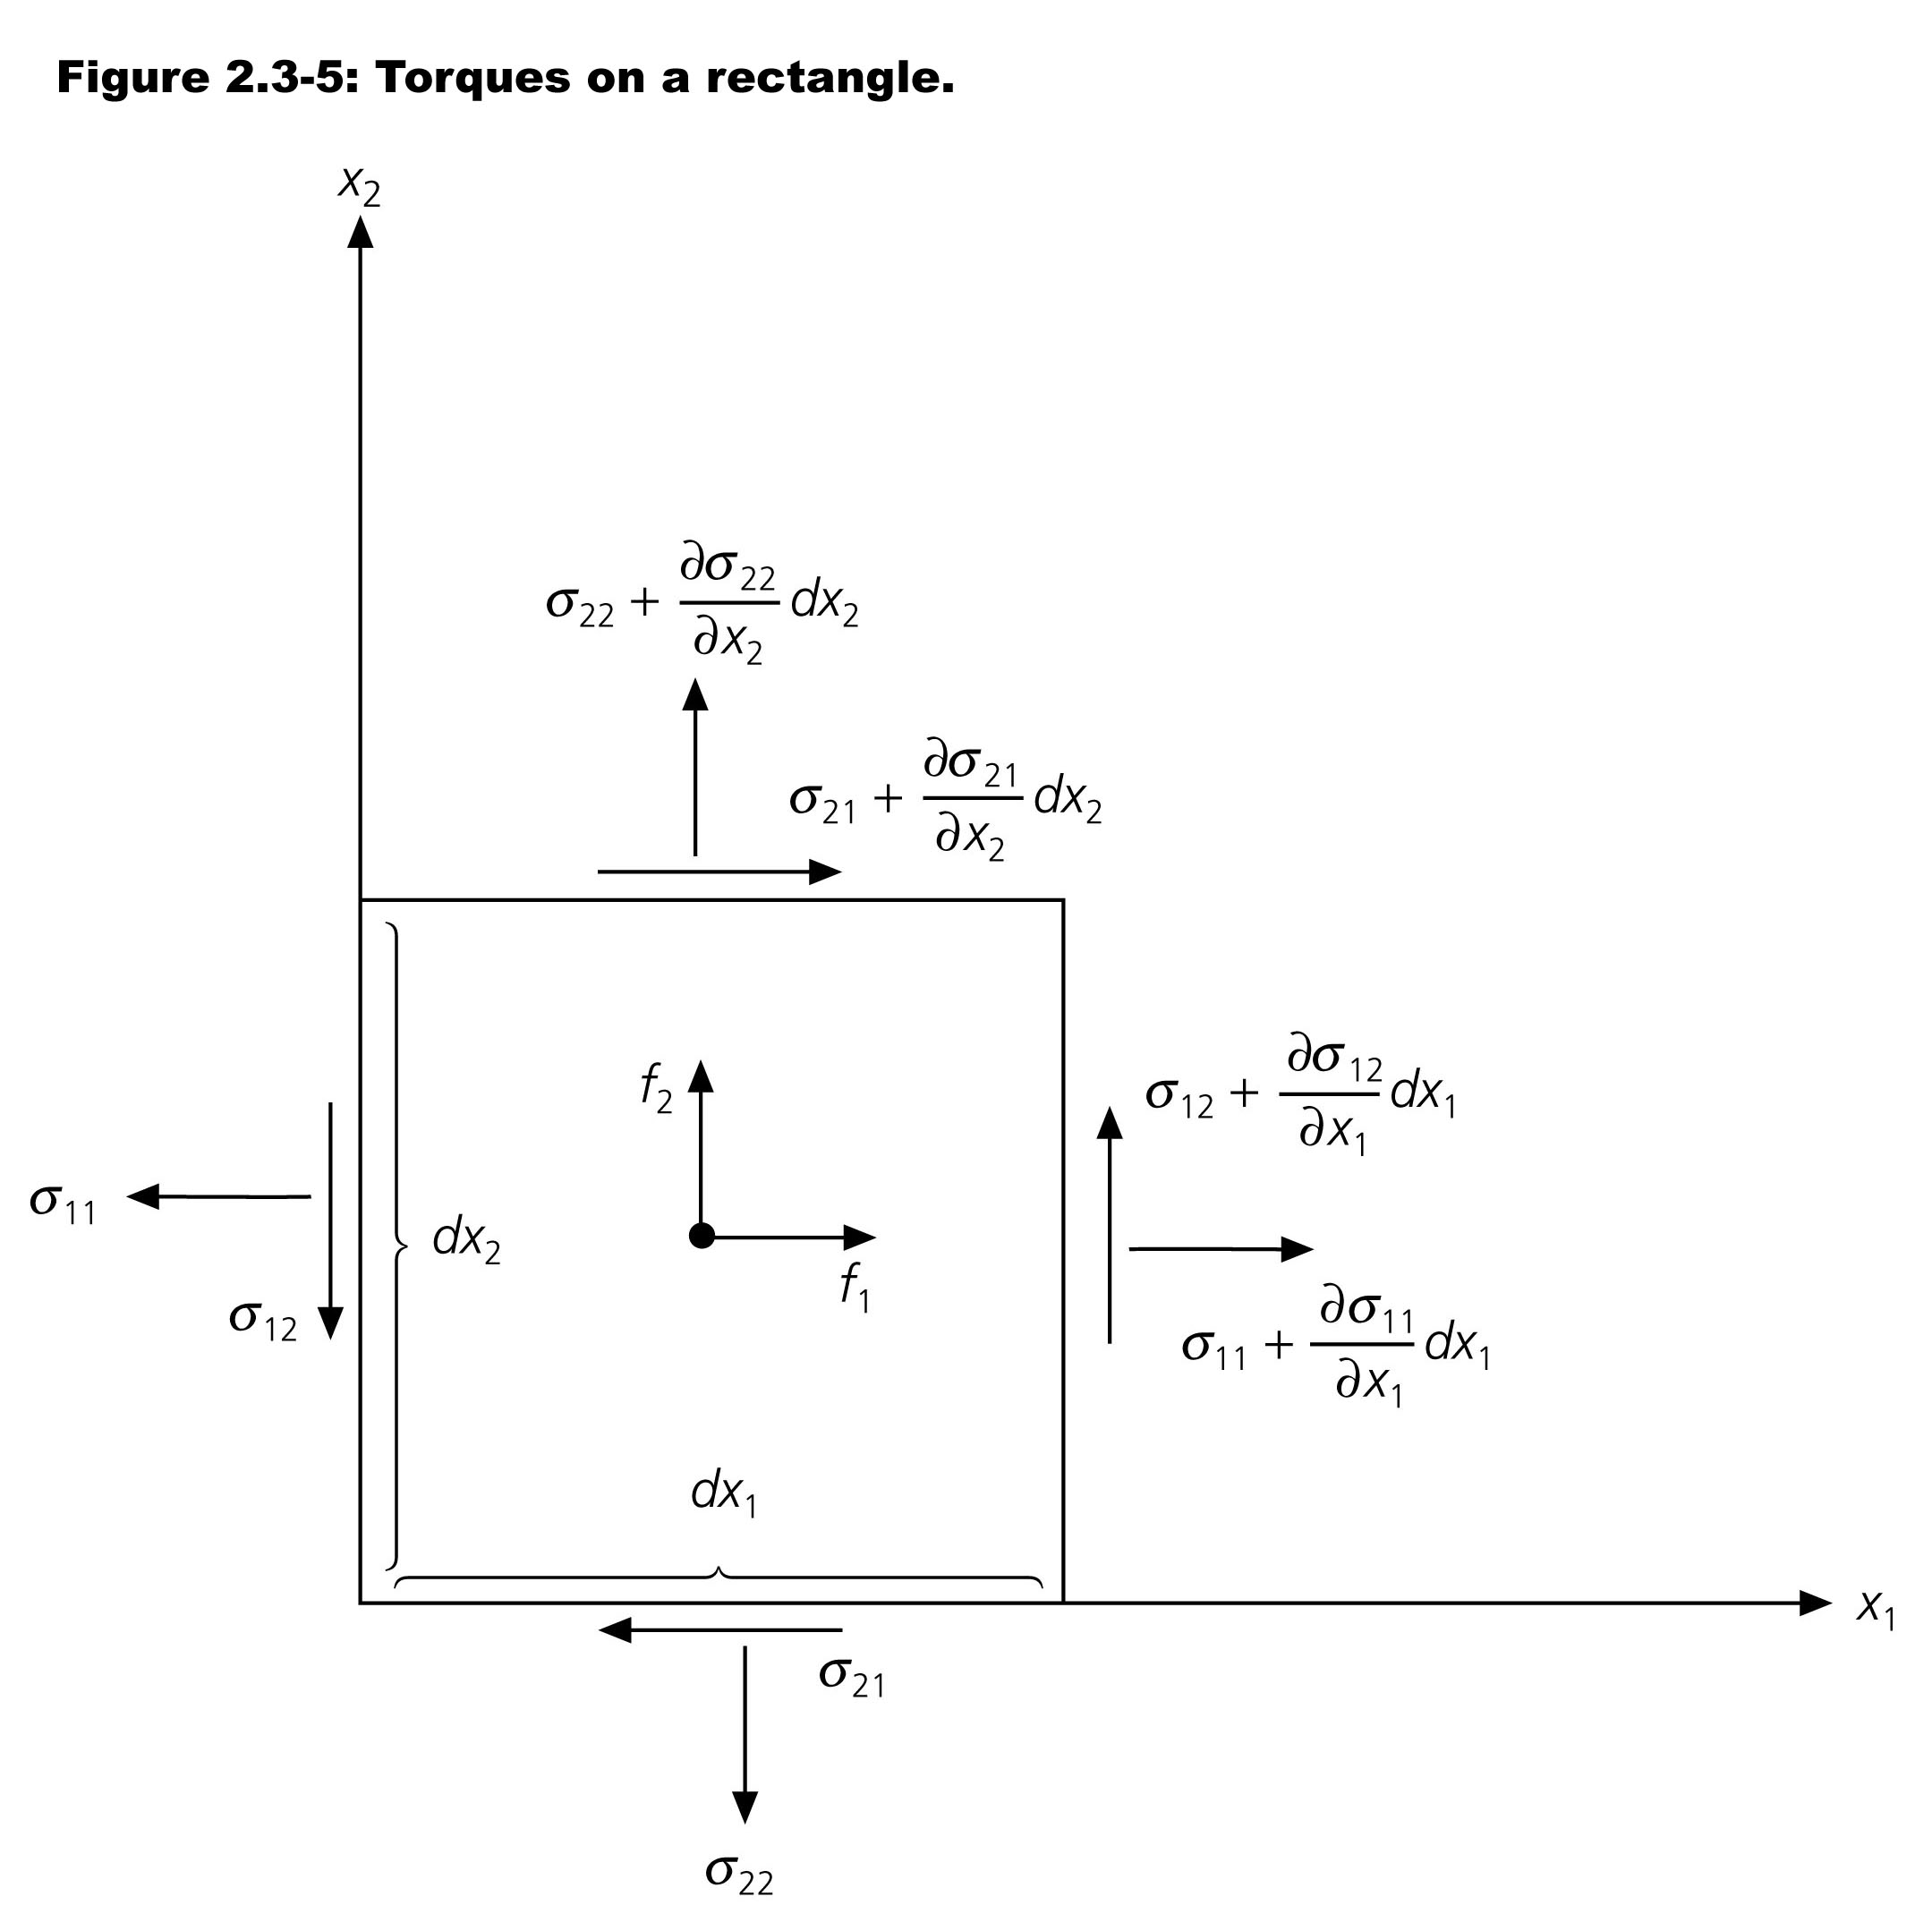
Notes:
In equilobrium - get some relationships

Slide 10
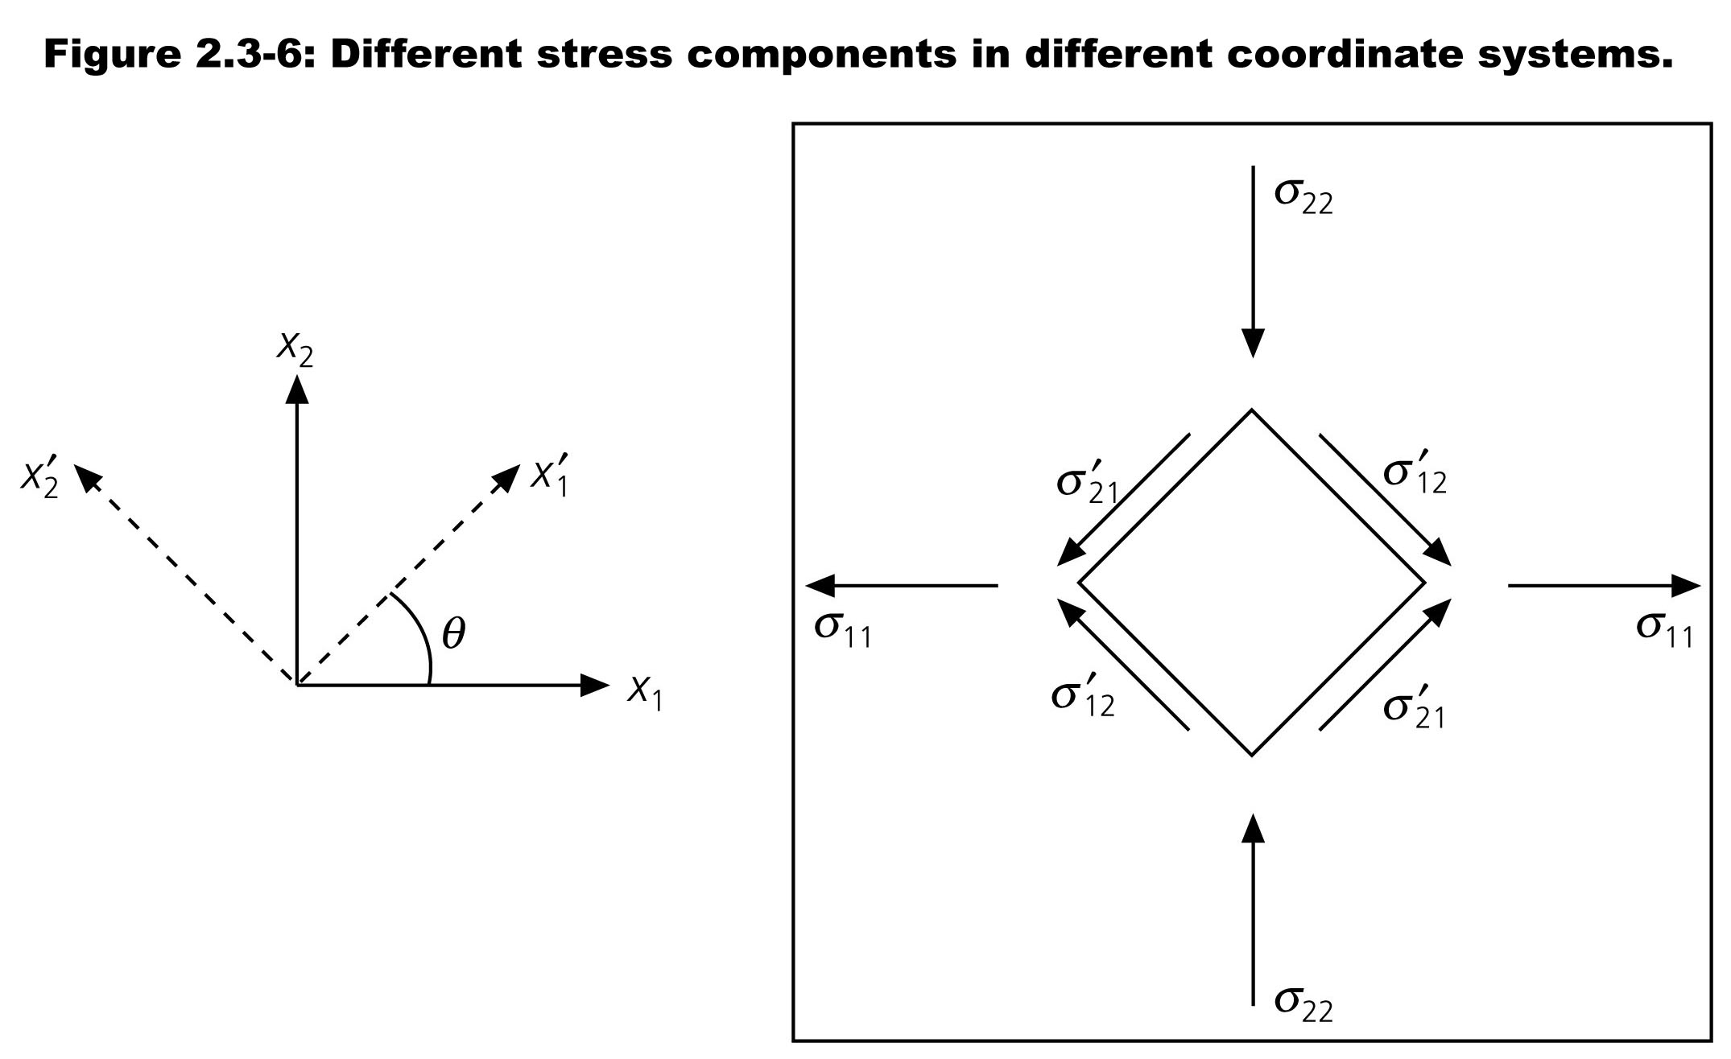

Slide 11
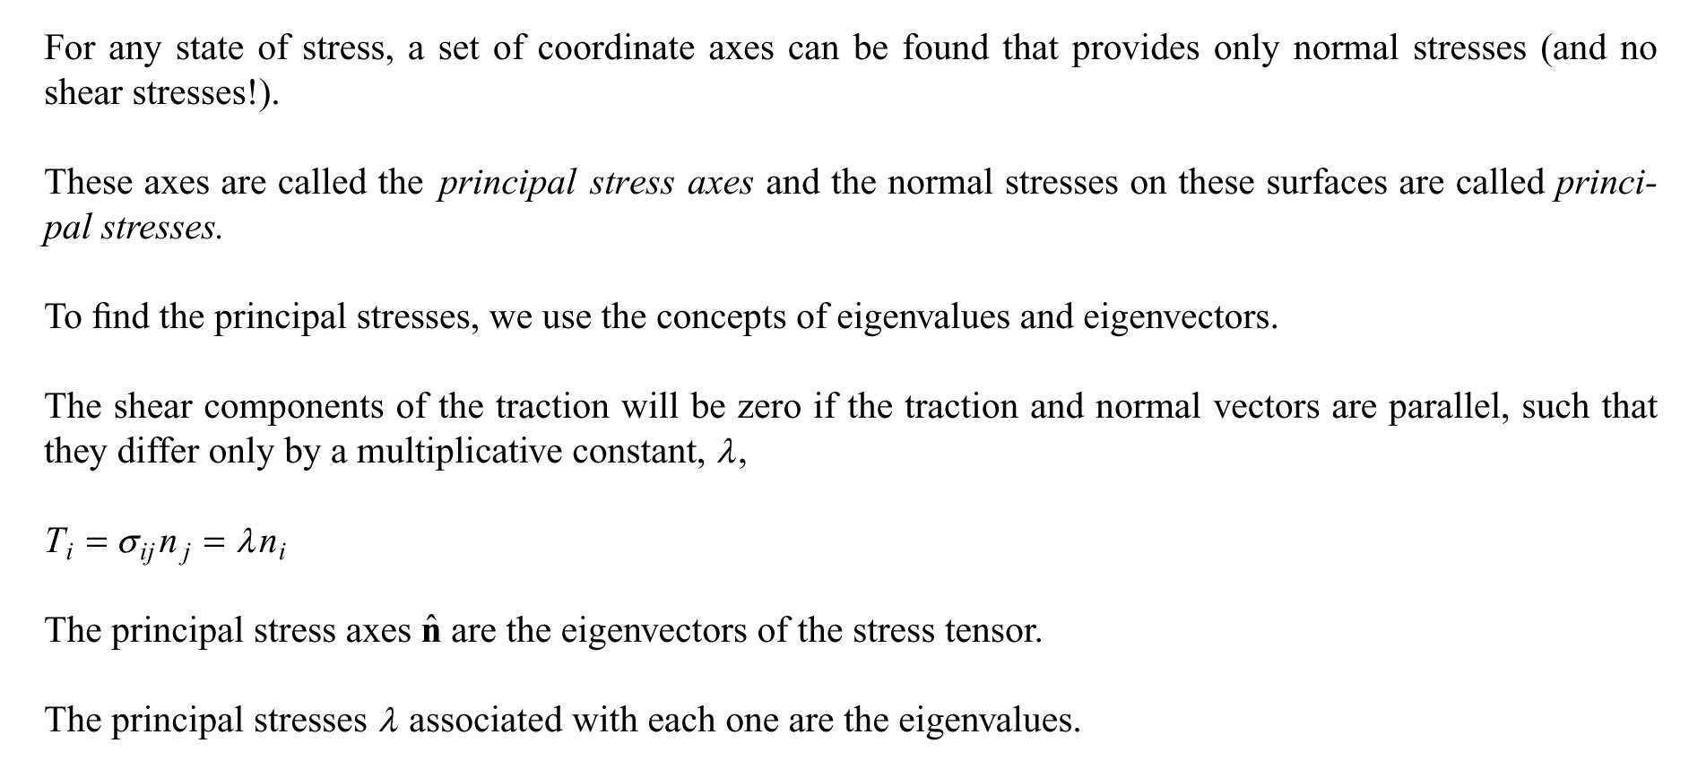

Slide 12
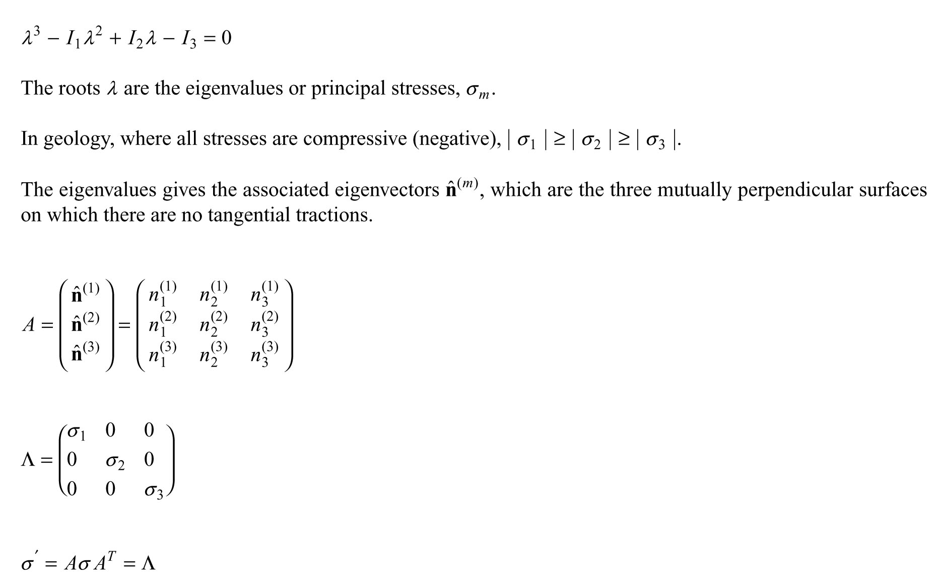

Slide 13
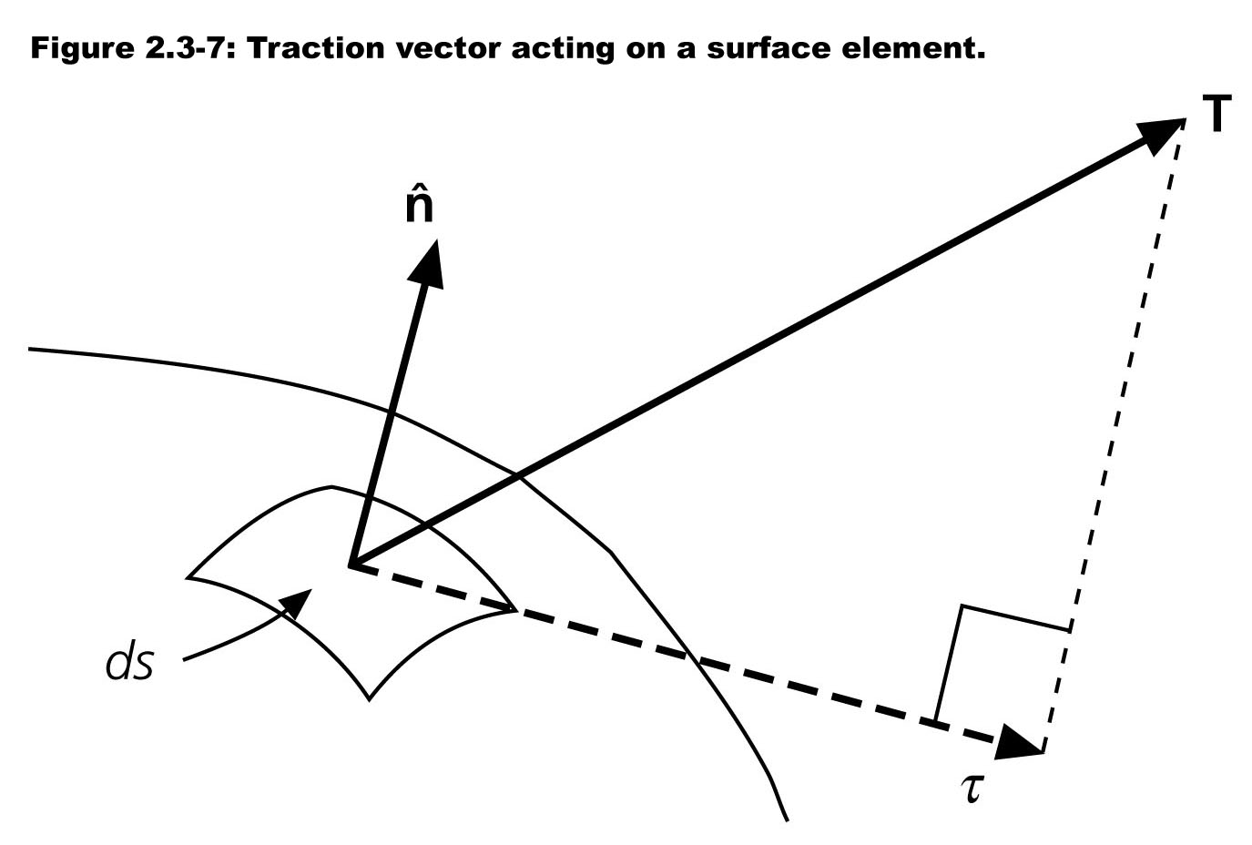

Slide 14
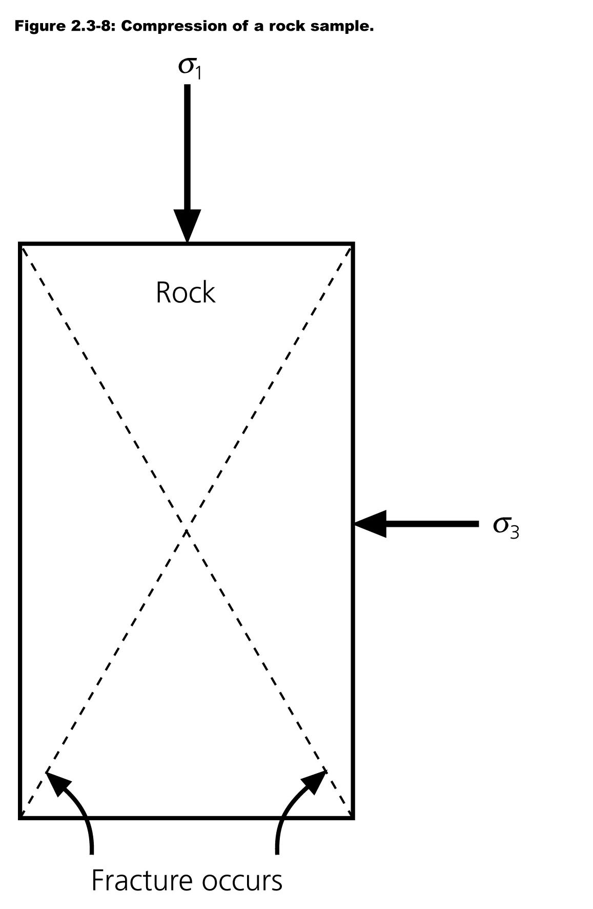

Slide 15
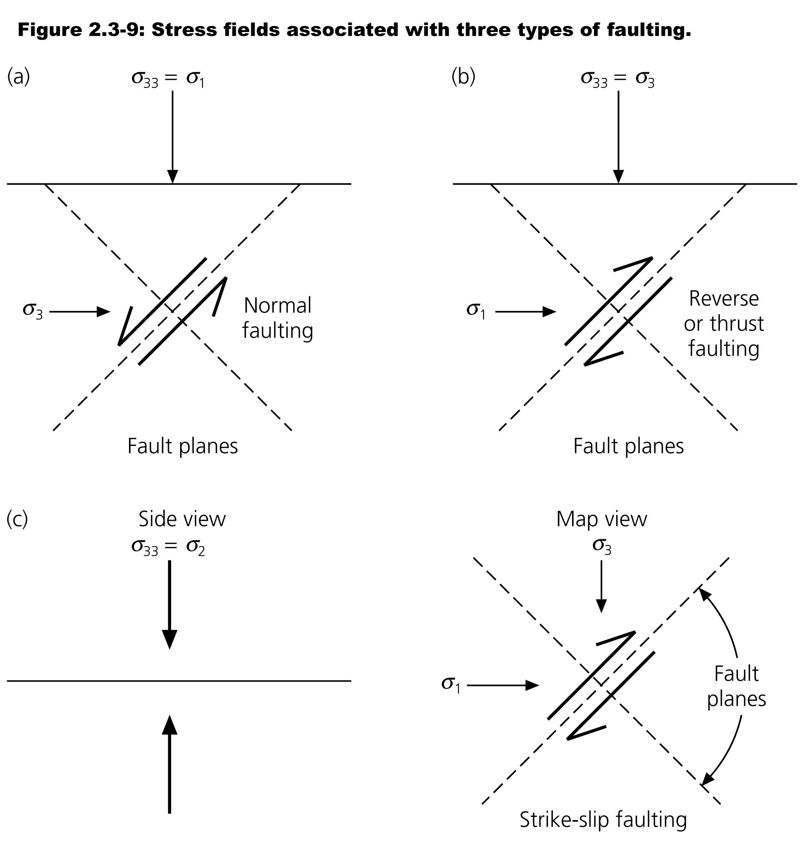

Slide 16
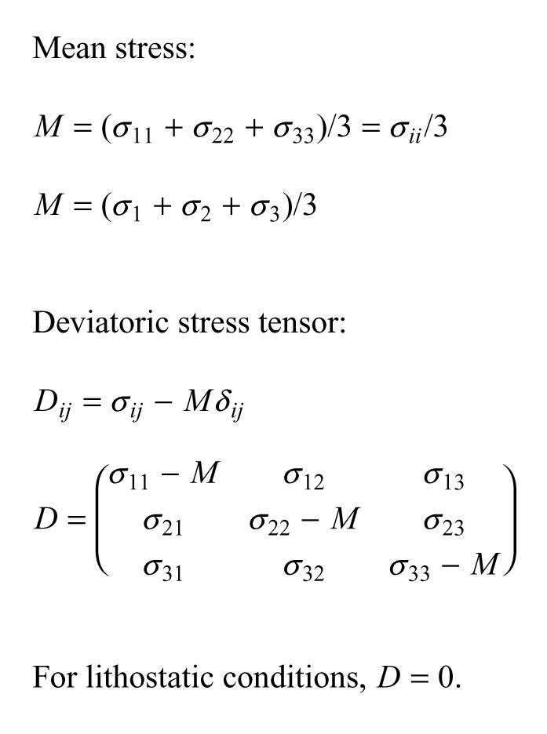

Slide 17
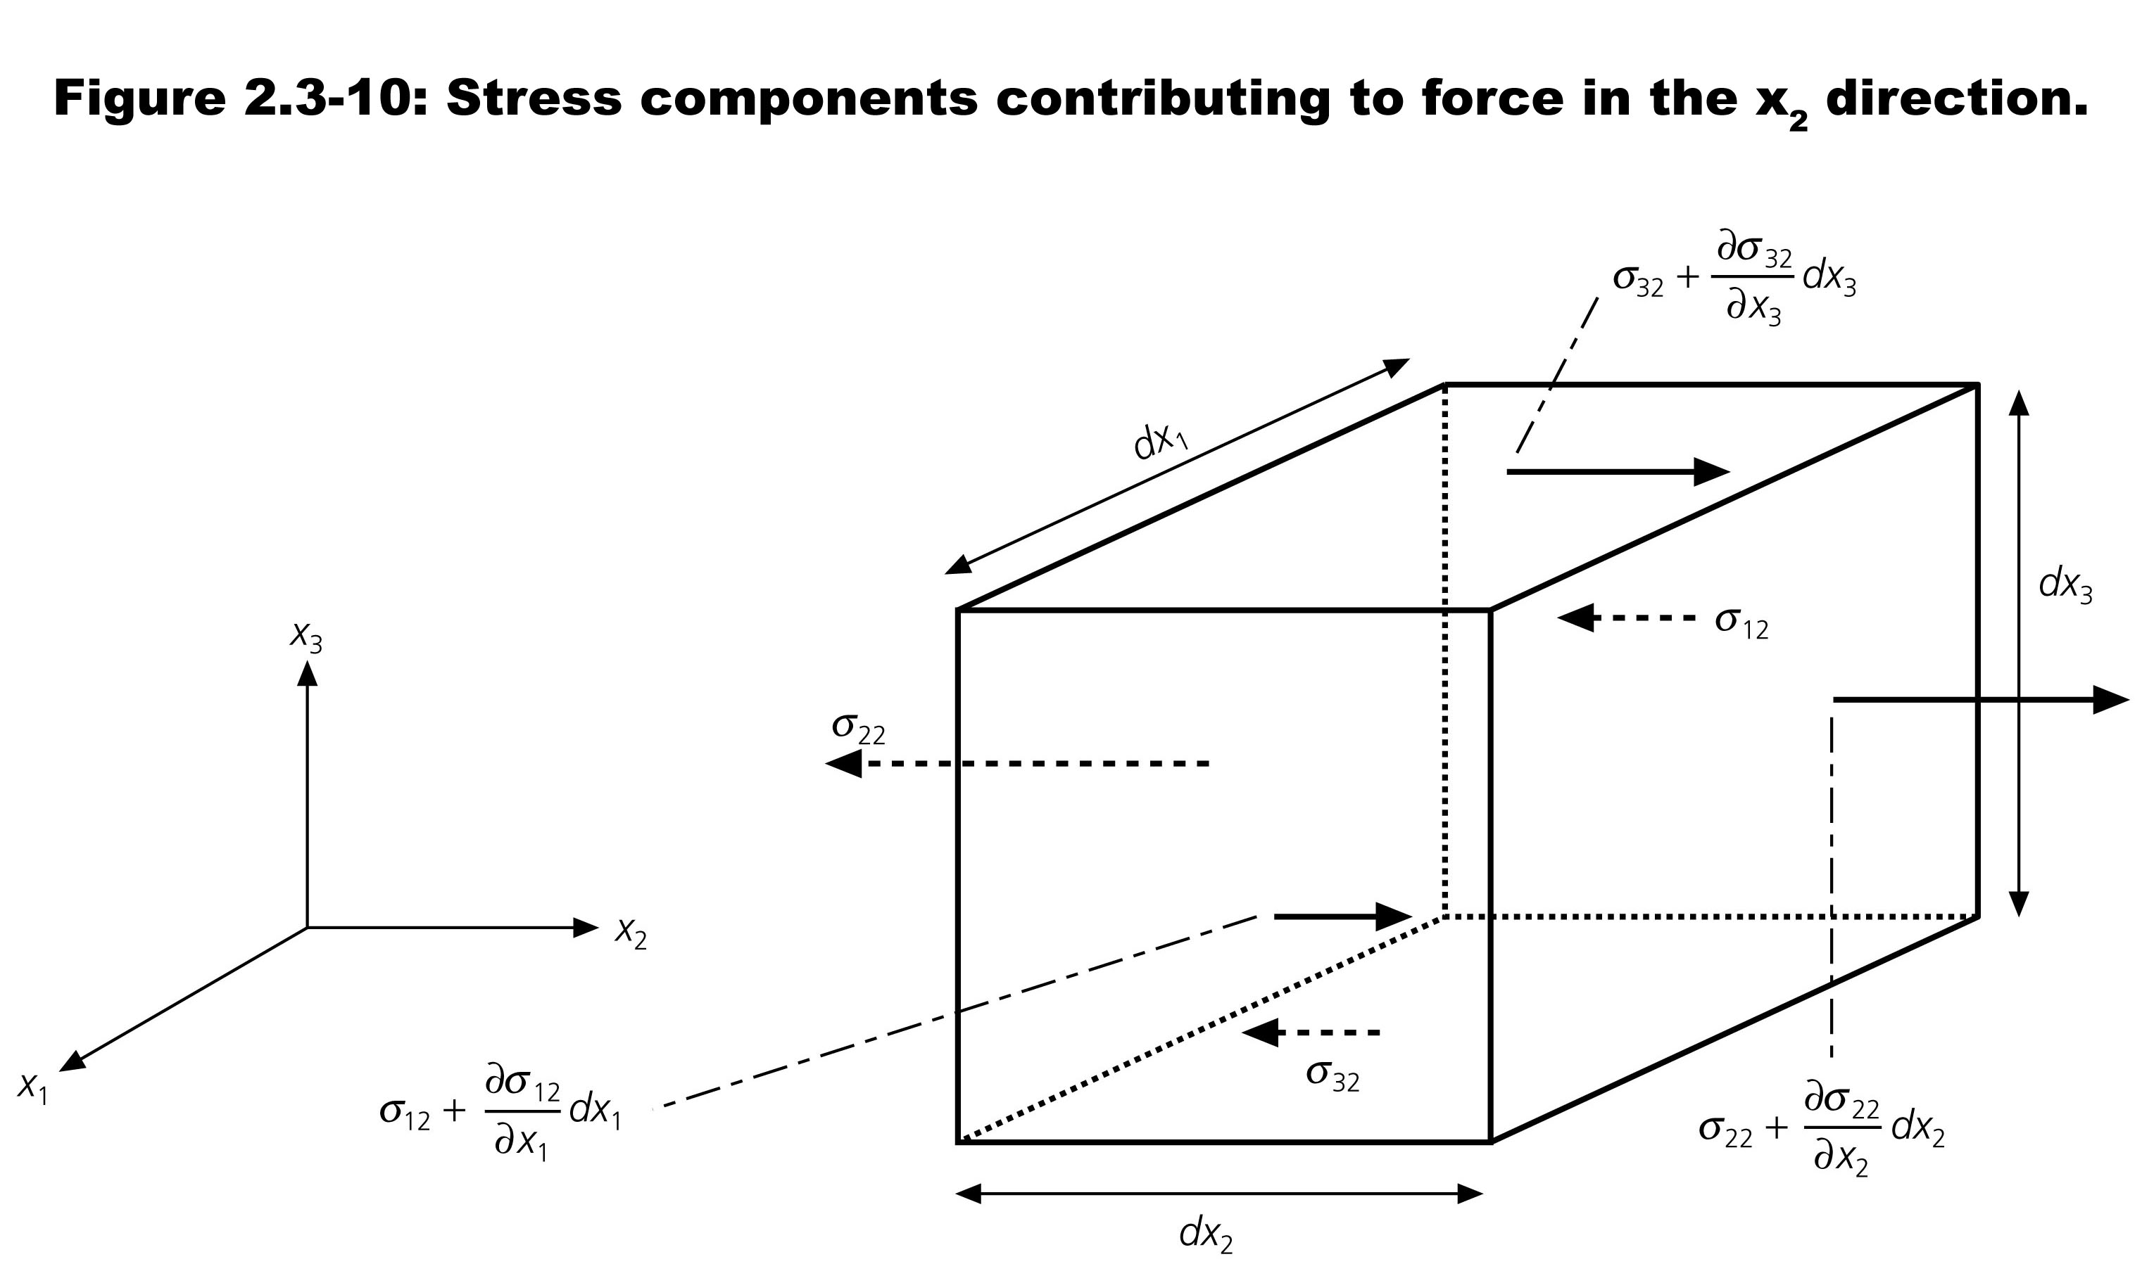
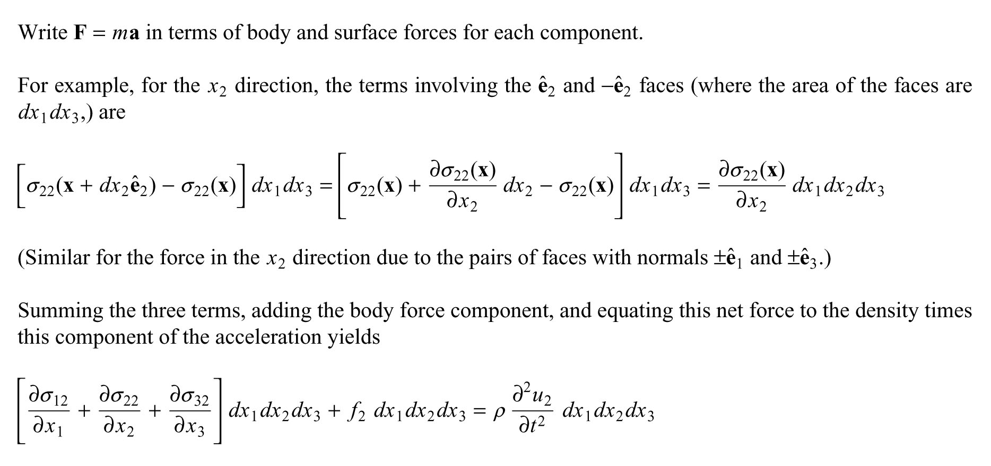

Slide 18
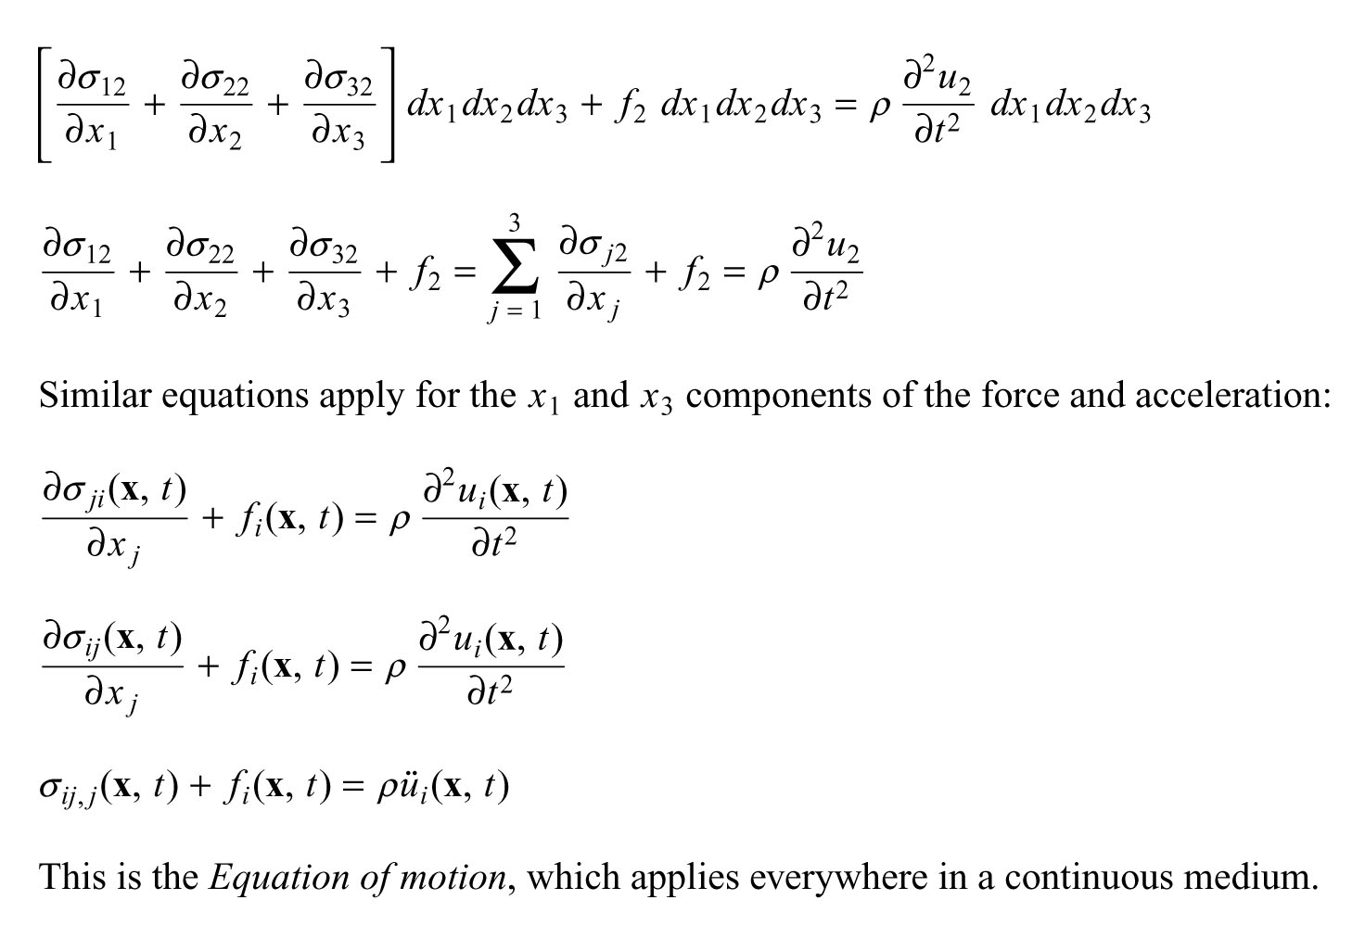

Slide 19
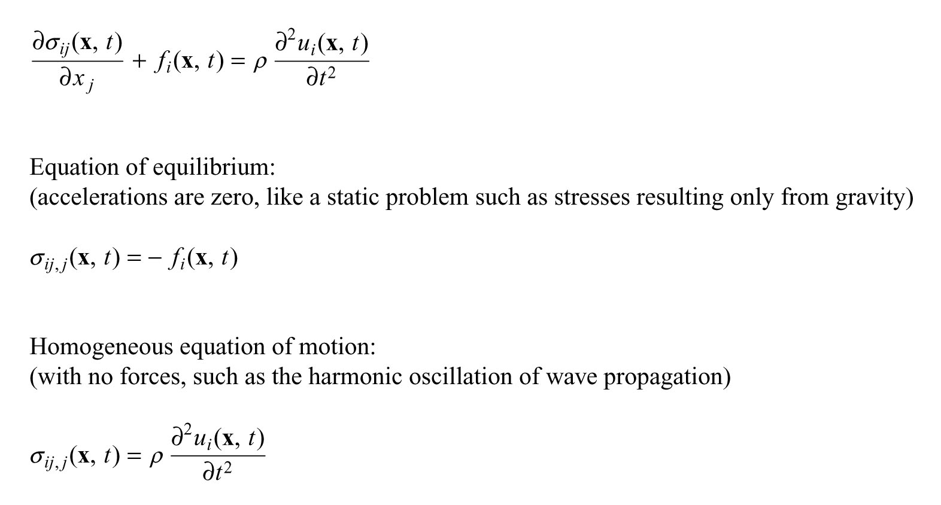

Slide 20
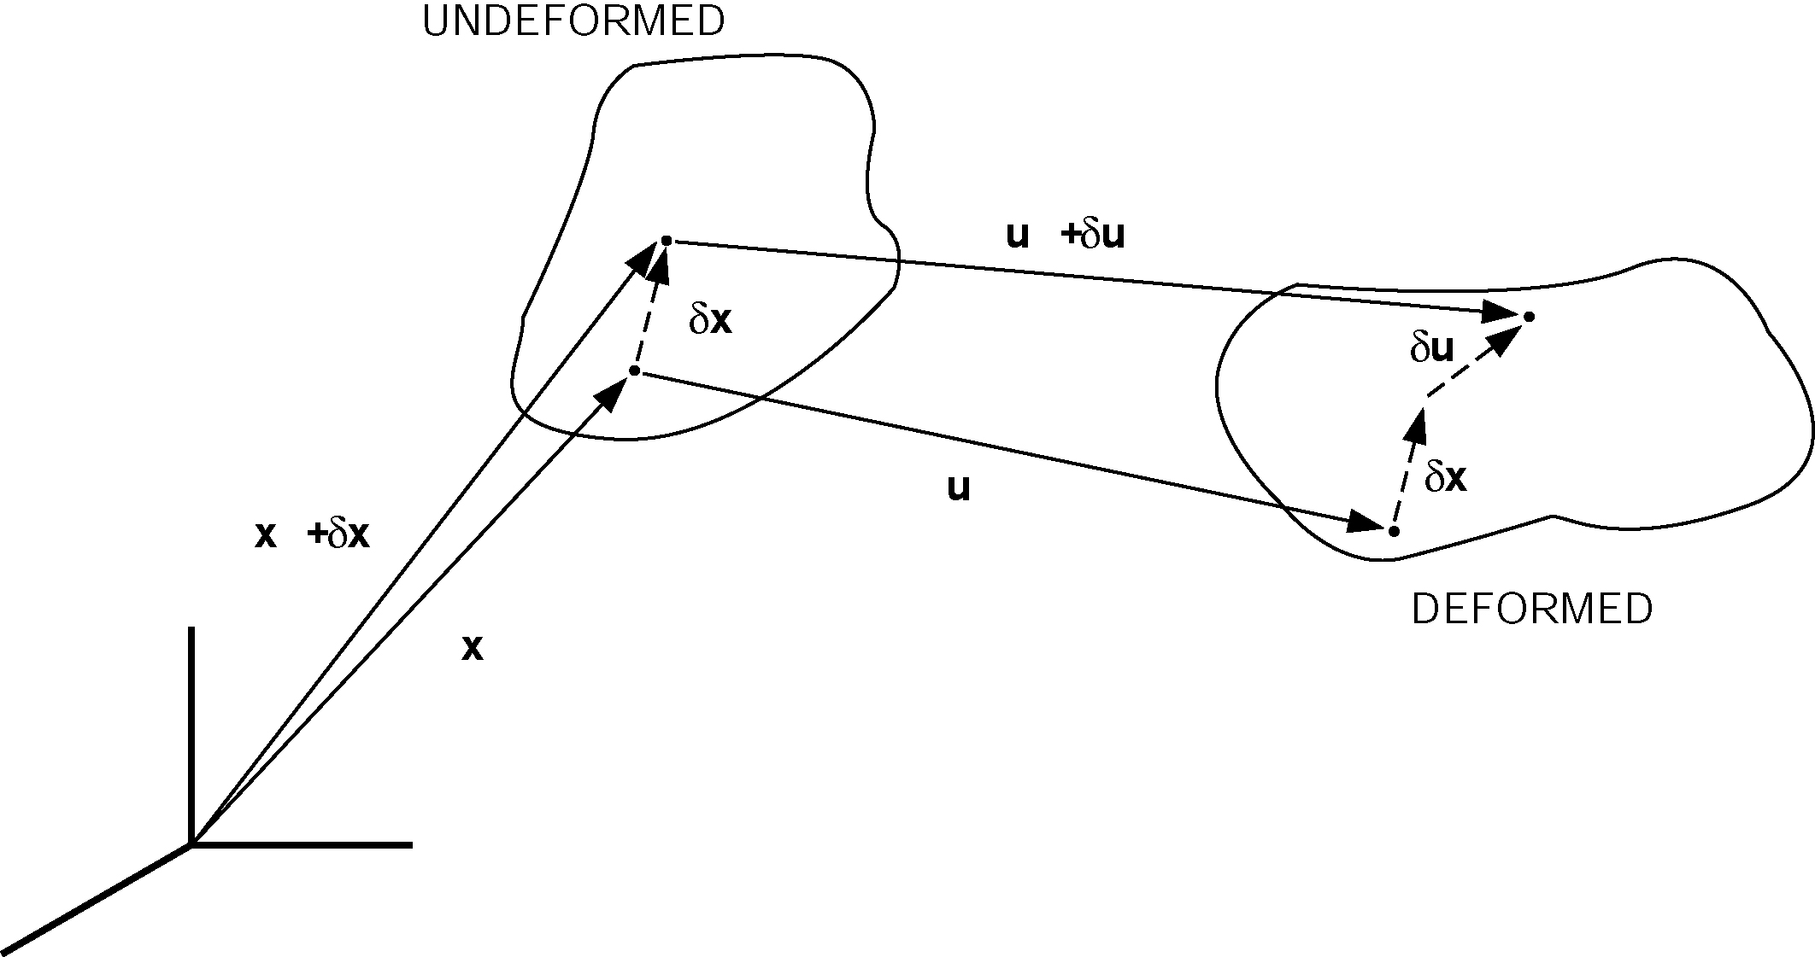
Figure 2.3-11: Change in relative displacement during deformation.

Slide 21
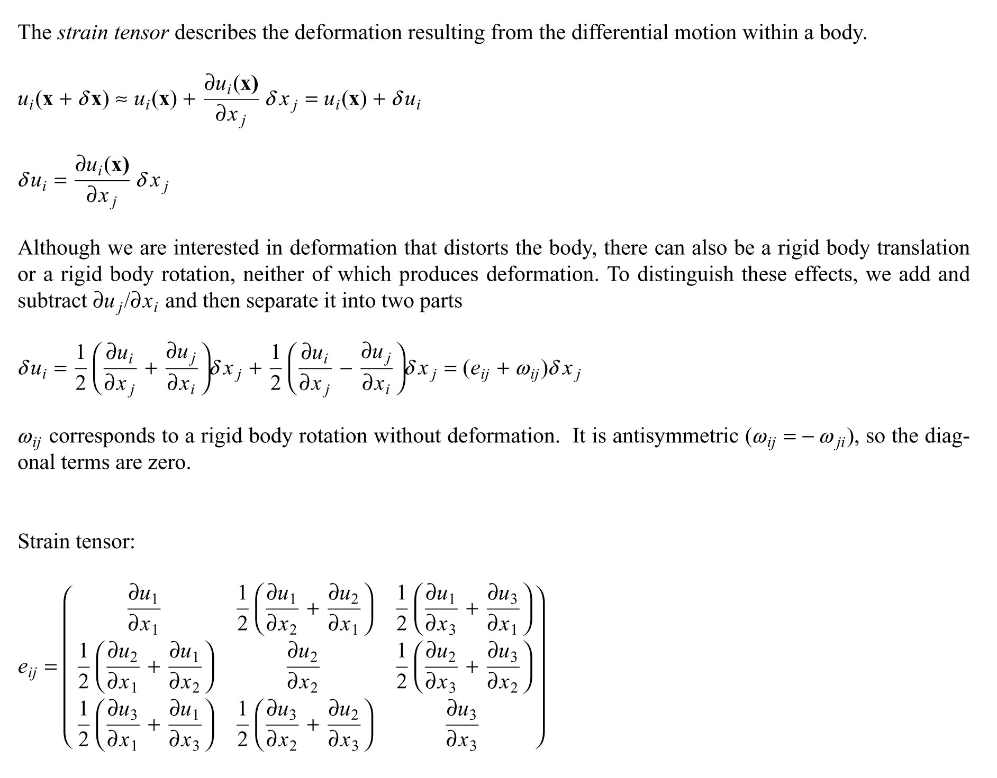

Slide 23
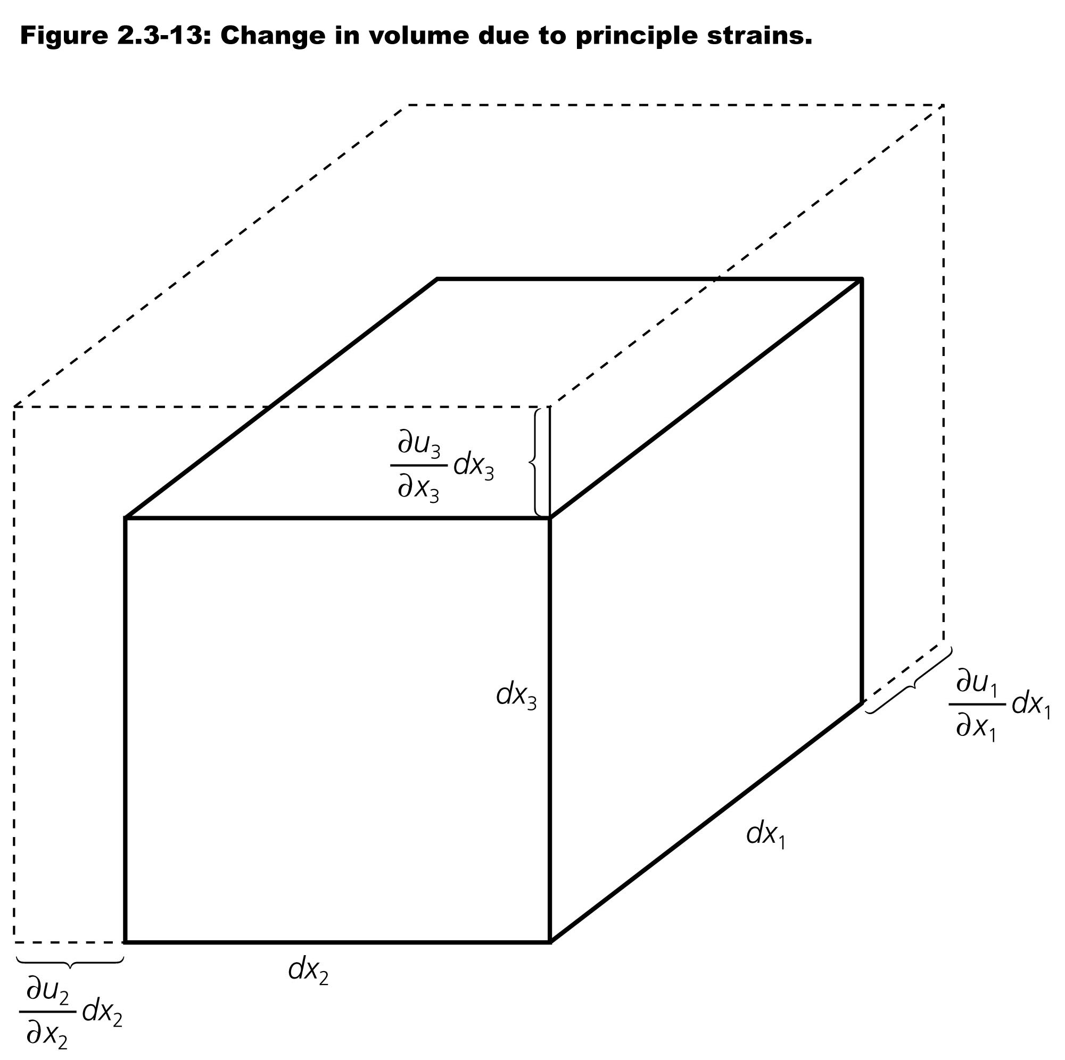
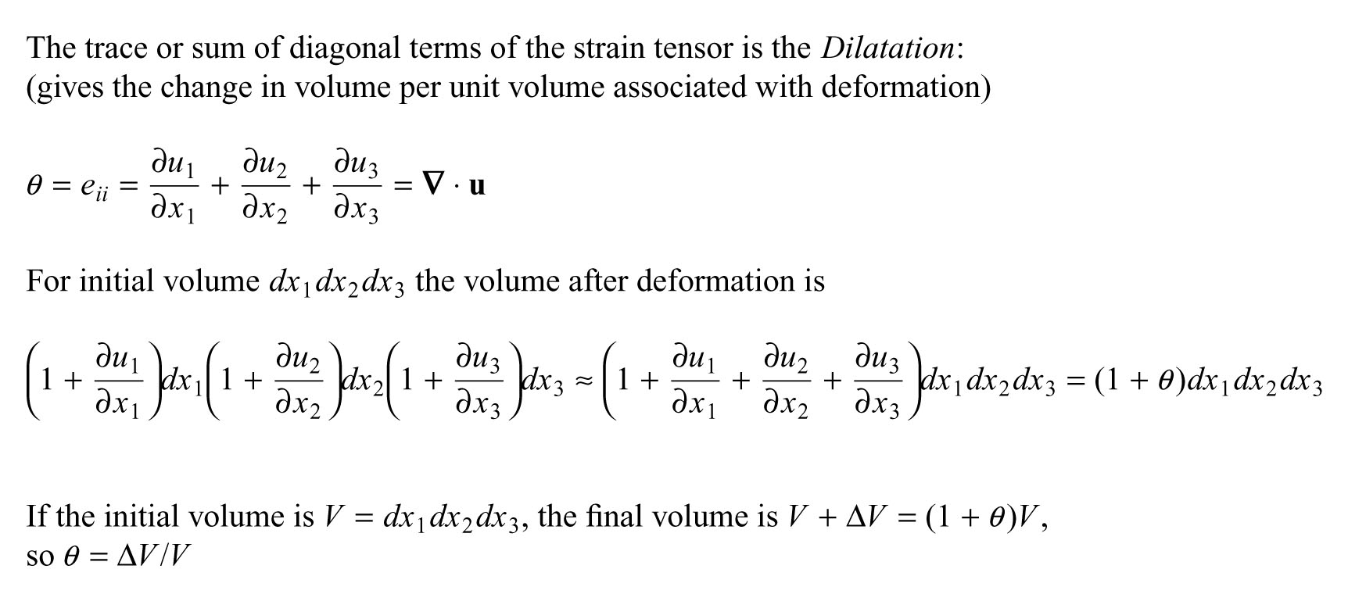

Slide 24
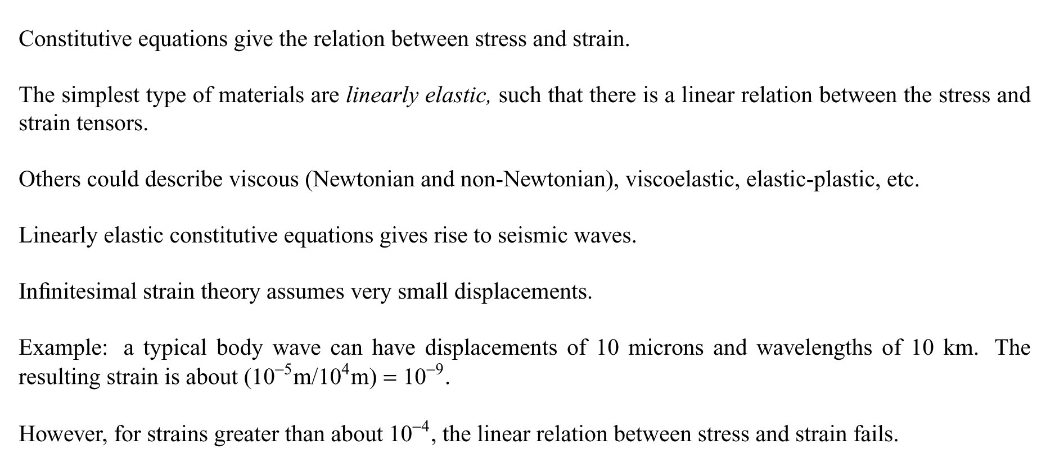

Slide 25
