Slide 1
Global Seismology CERI-8105
Tu-Th 1:15-2:40 pm
Lab - 3892 Central Ave. (Long building) , Room 110
-----------------------------------------------
Bob Smalley
Office: 3892 Central Ave, Room 103, 678-4929
Office Hours – when I’m in my office.
http://www.ceri.memphis.edu/people/smalley/CERI8105_GlobalSeismology.html
Tue., Nov 9, 2023 Meeting 21

Slide 2
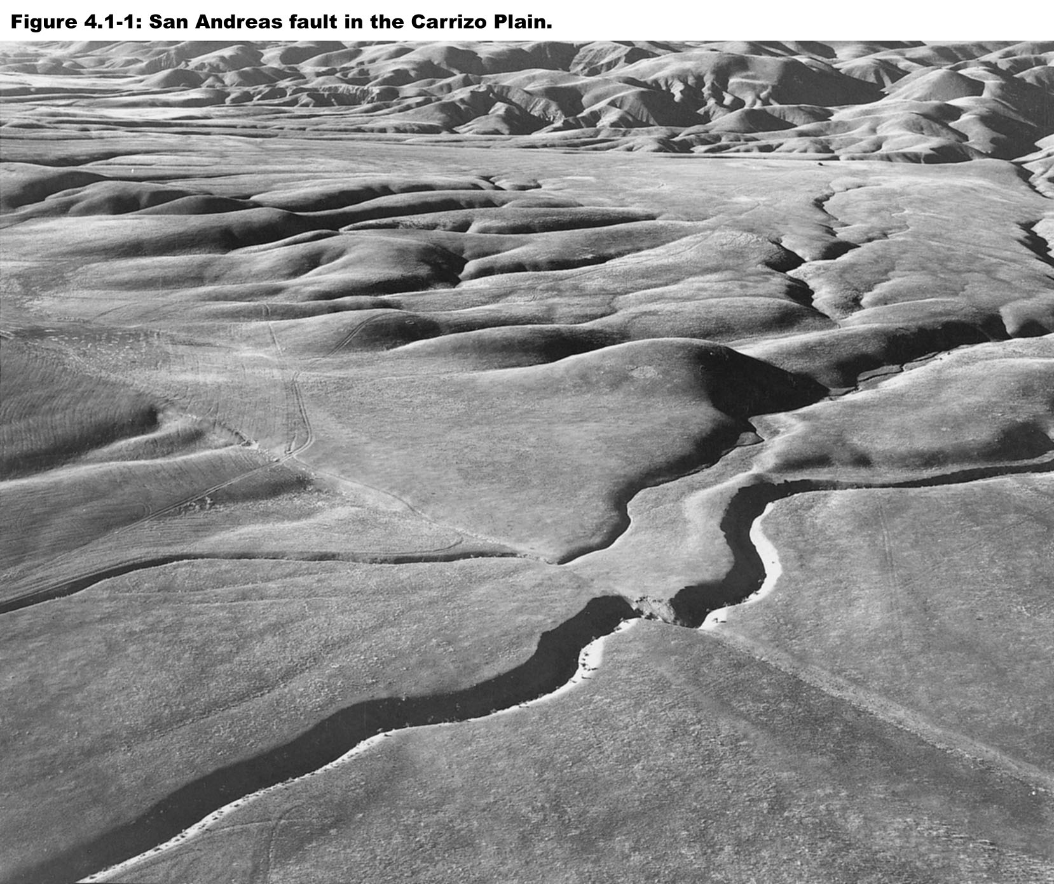
Downstream only part of offset streams
Offset streams
It took many offsets to move the top left streams to their current locations, and become cut off from their headwaters.

Slide 3
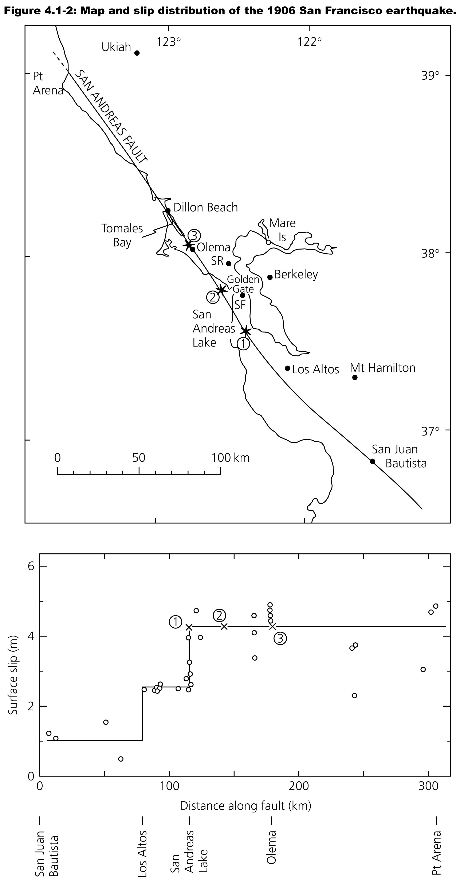

Slide 4
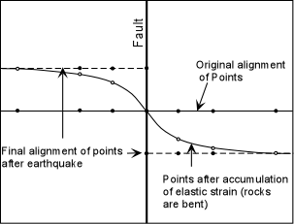
1. Focal mechanisms
Elastic Rebound
1
No strain in rocks
3
Elastic strain in rocks released
2
& just b4 eq

Slide 5
1. Focal mechanisms
No offset
Earthquake break
Fence that was built the day previous to earthquake (earth strained)(also no postseismc here – elastic)
Fence right after earthquake (earth's strain relaxed)
No offset
John R. Booker, University of Washington

Slide 6
1. Focal mechanisms
Volume decrease (compression)
Volume increase (dilation)
Volume increase (dilation)
Volume decrease (compression)
John R. Booker, University of Washington

Slide 7
1. Focal mechanisms
Direction of P-wave first motion
John R. Booker, University of Washington

Slide 8
1. Focal mechanisms
Direction of P-wave first motion – radially outward in yellow, max at arrow
Direction of P-wave first motion – radially inward in white, max at arrow
John R. Booker, University of Washington

Slide 9
1. Focal mechanisms
Nodal Plane
wave is neither in nor out – it has zero amplitude
John R. Booker, University of Washington

Slide 10
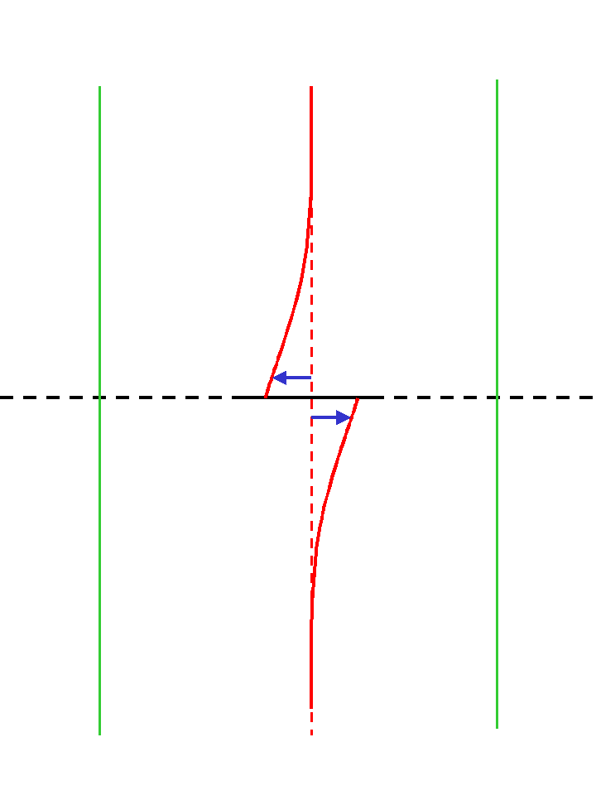
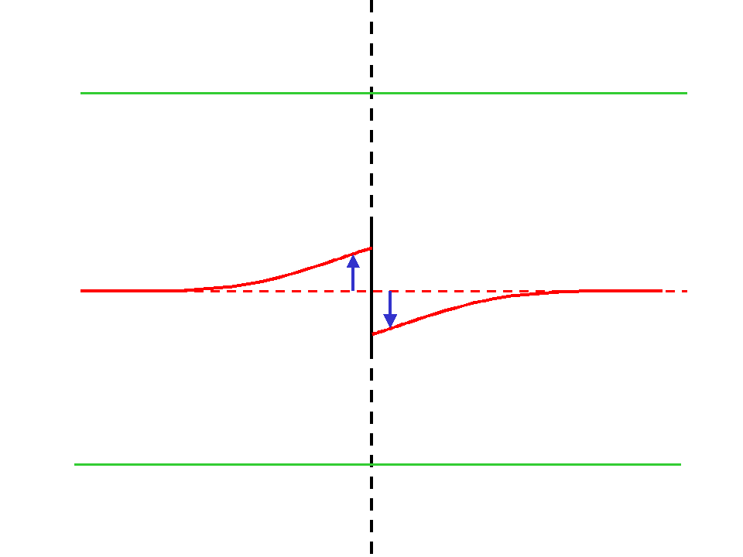
1. Focal mechanisms
Two different fault planes and motions produce the same C/D pattern
C
D
C
D
Left lateral
D
C
D
C
Right lateral
Right and left lateral earthquake sources with perpendicular fault planes have the same first motions
John R. Booker, University of Washington

Slide 11
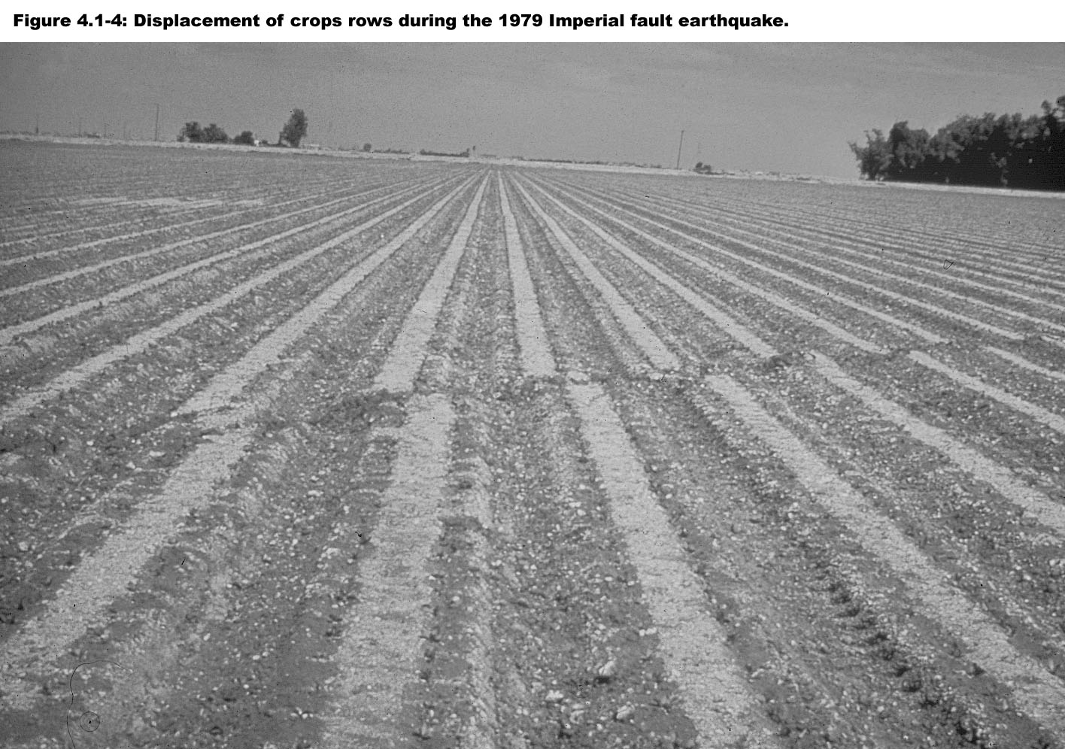
Slip appears to be left-lateral.
Imperial Valley earthquake was right lateral.
Could be on conjugate fault (would be left-lateral)
Notes:
Could also be "aliased"

Slide 12
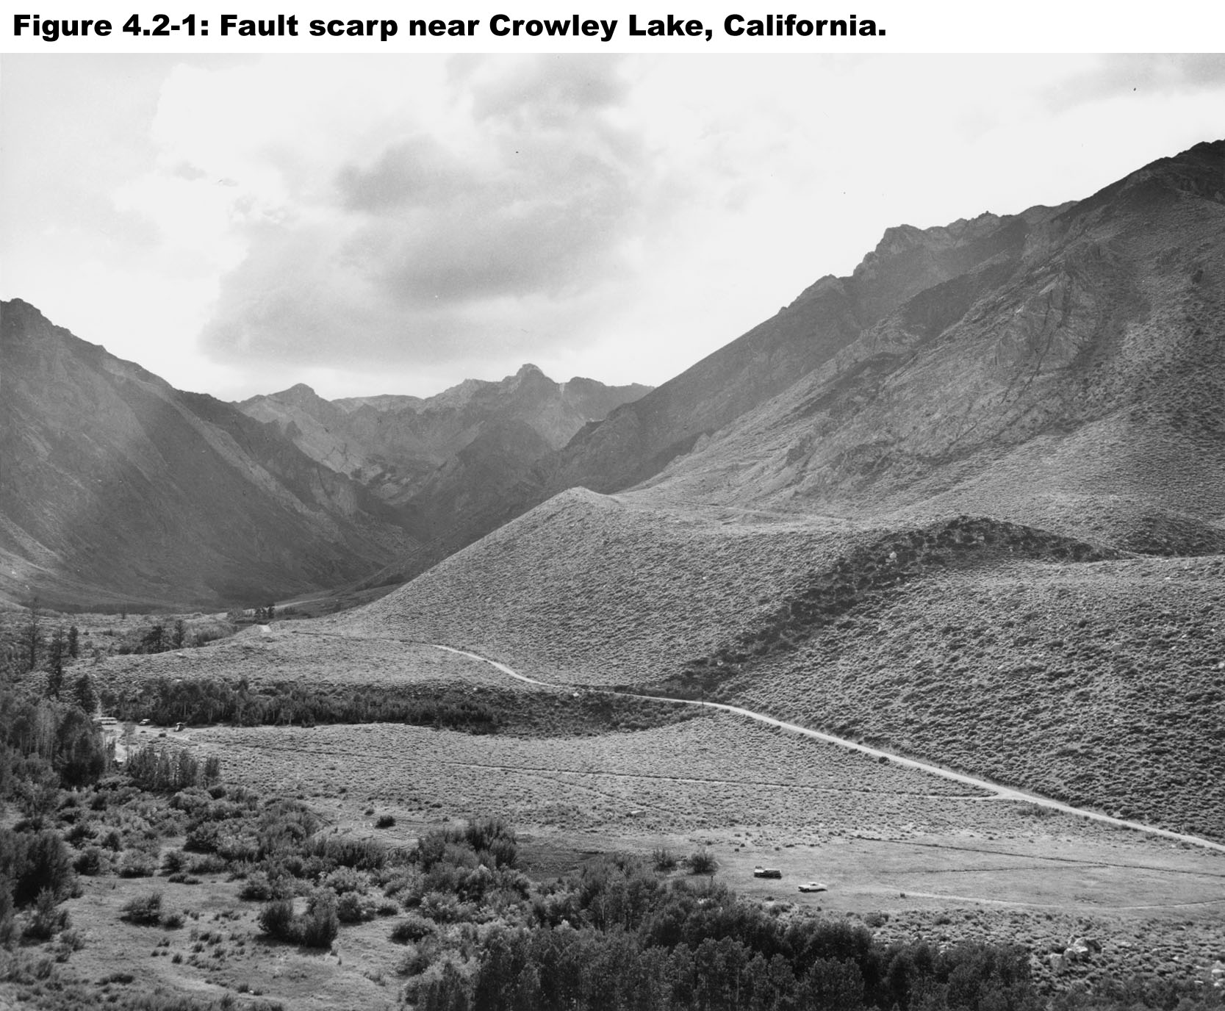

Slide 13
Notes:
Materials at distance on opposite sides of the fault move relative to each other, but friction on the fault "locks" it and prevents slip
Eventually strain accumulated is more than the rocks on the fault can withstand, and the fault slips in earthquake
Earthquake reflects regional deformation
The California Earthquake of April 18.1906, Report of the State Earthquake Investigation Commission, Volume I, Part 1, Andrew C. Lawson, Chariman, Tomales Bay to Bolinas Lagoon, G.K. Gilbert, p72

Slide 14
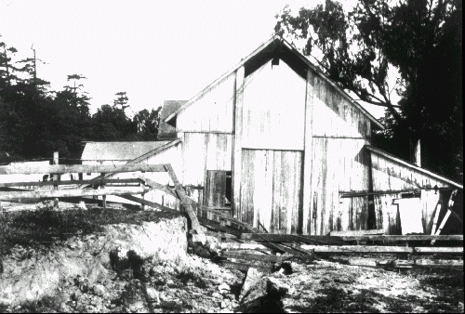
Notes:
Skinner’s barn from another angle
Photograph credit: U.S. Geological Survey (G.K. Gilbert).skinner
Eventually strain accumulated is more than the rocks on the fault can withstand, and the fault slips in earthquake
Earthquake reflects regional deformation

Slide 15
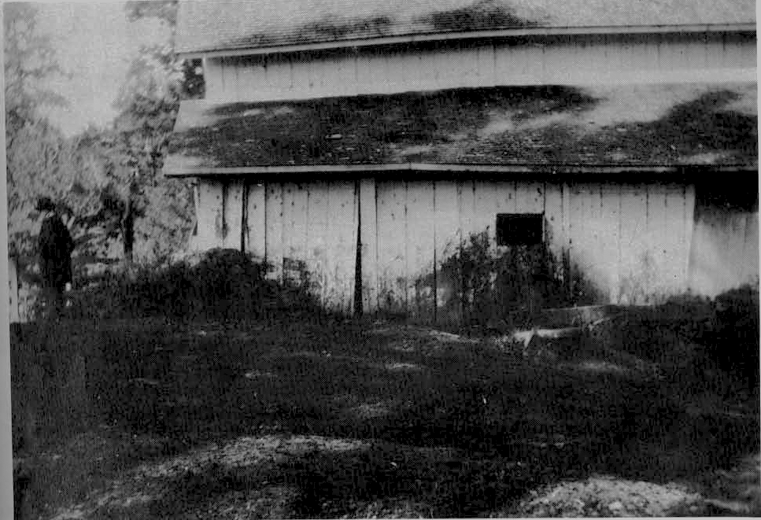
Notes:
Materials at distance on opposite sides of the fault move relative to each other, but friction on the fault "locks" it and prevents slip
Photograph credit: U.S. Geological Survey (G.K. Gilbert).
Eventually strain accumulated is more than the rocks on the fault can withstand, and the fault slips in earthquake
Earthquake reflects regional deformation

Slide 16
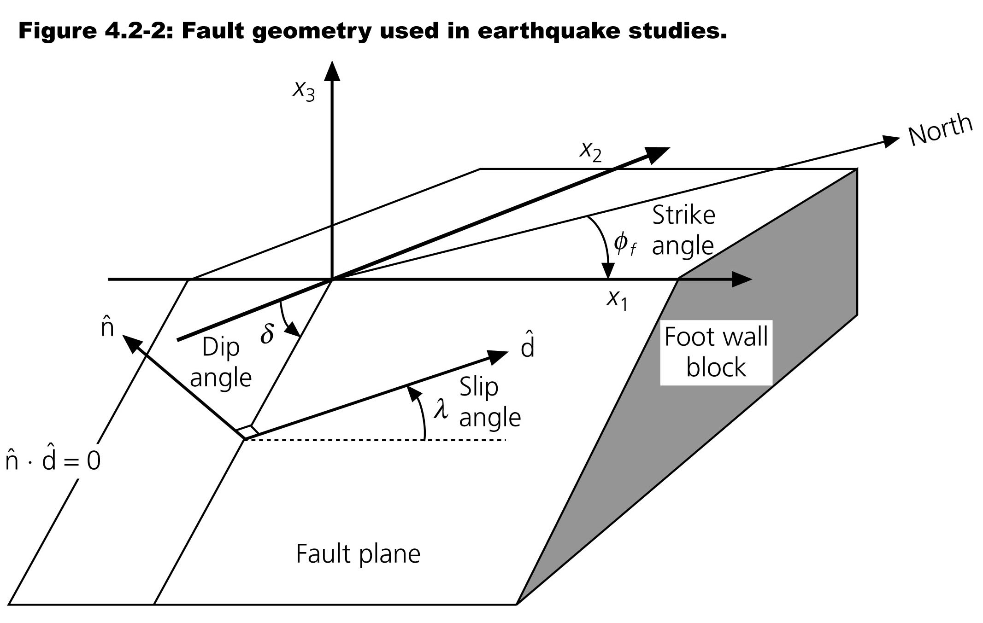

Slide 17
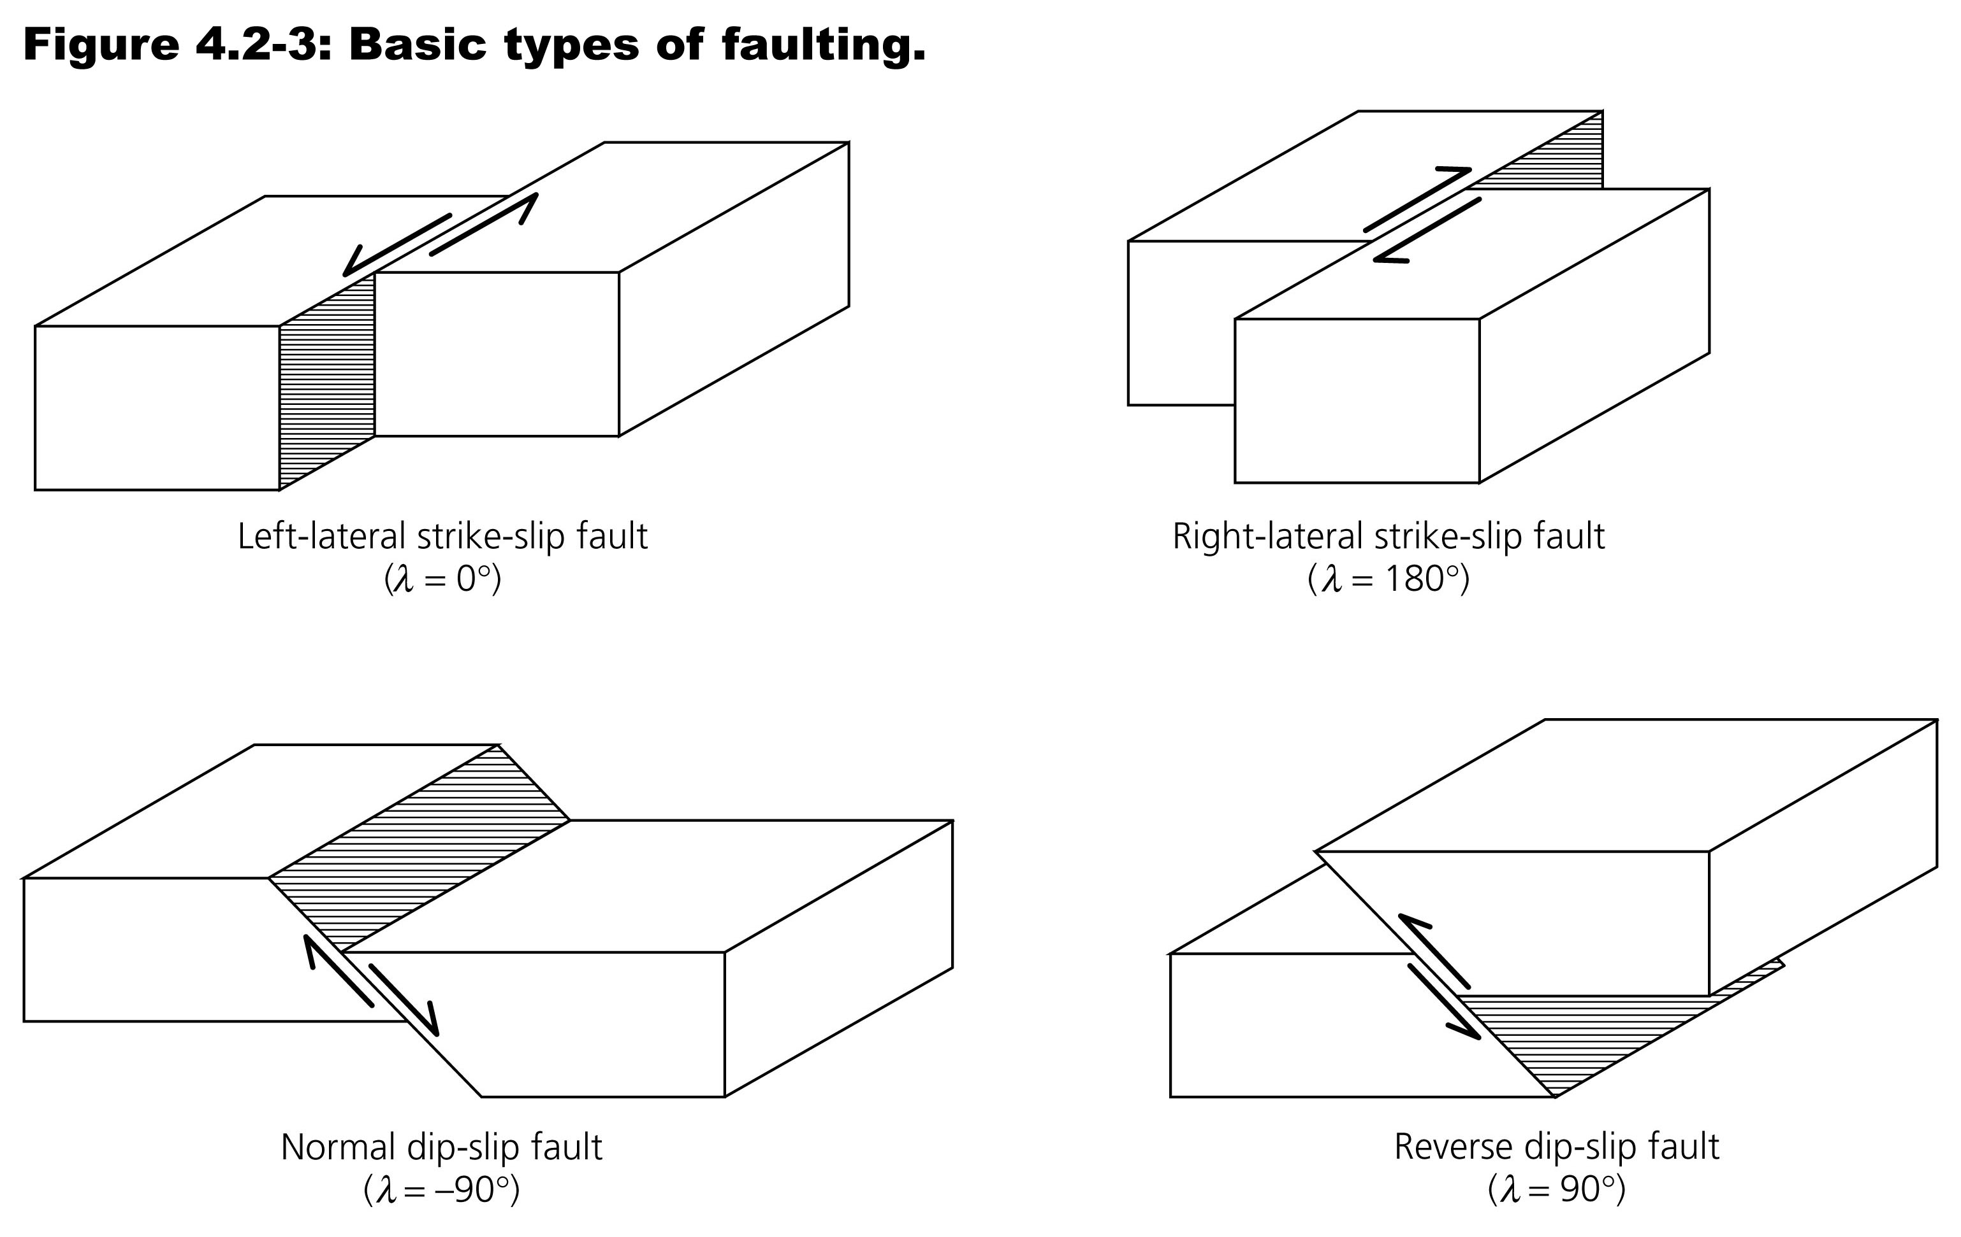

Slide 18
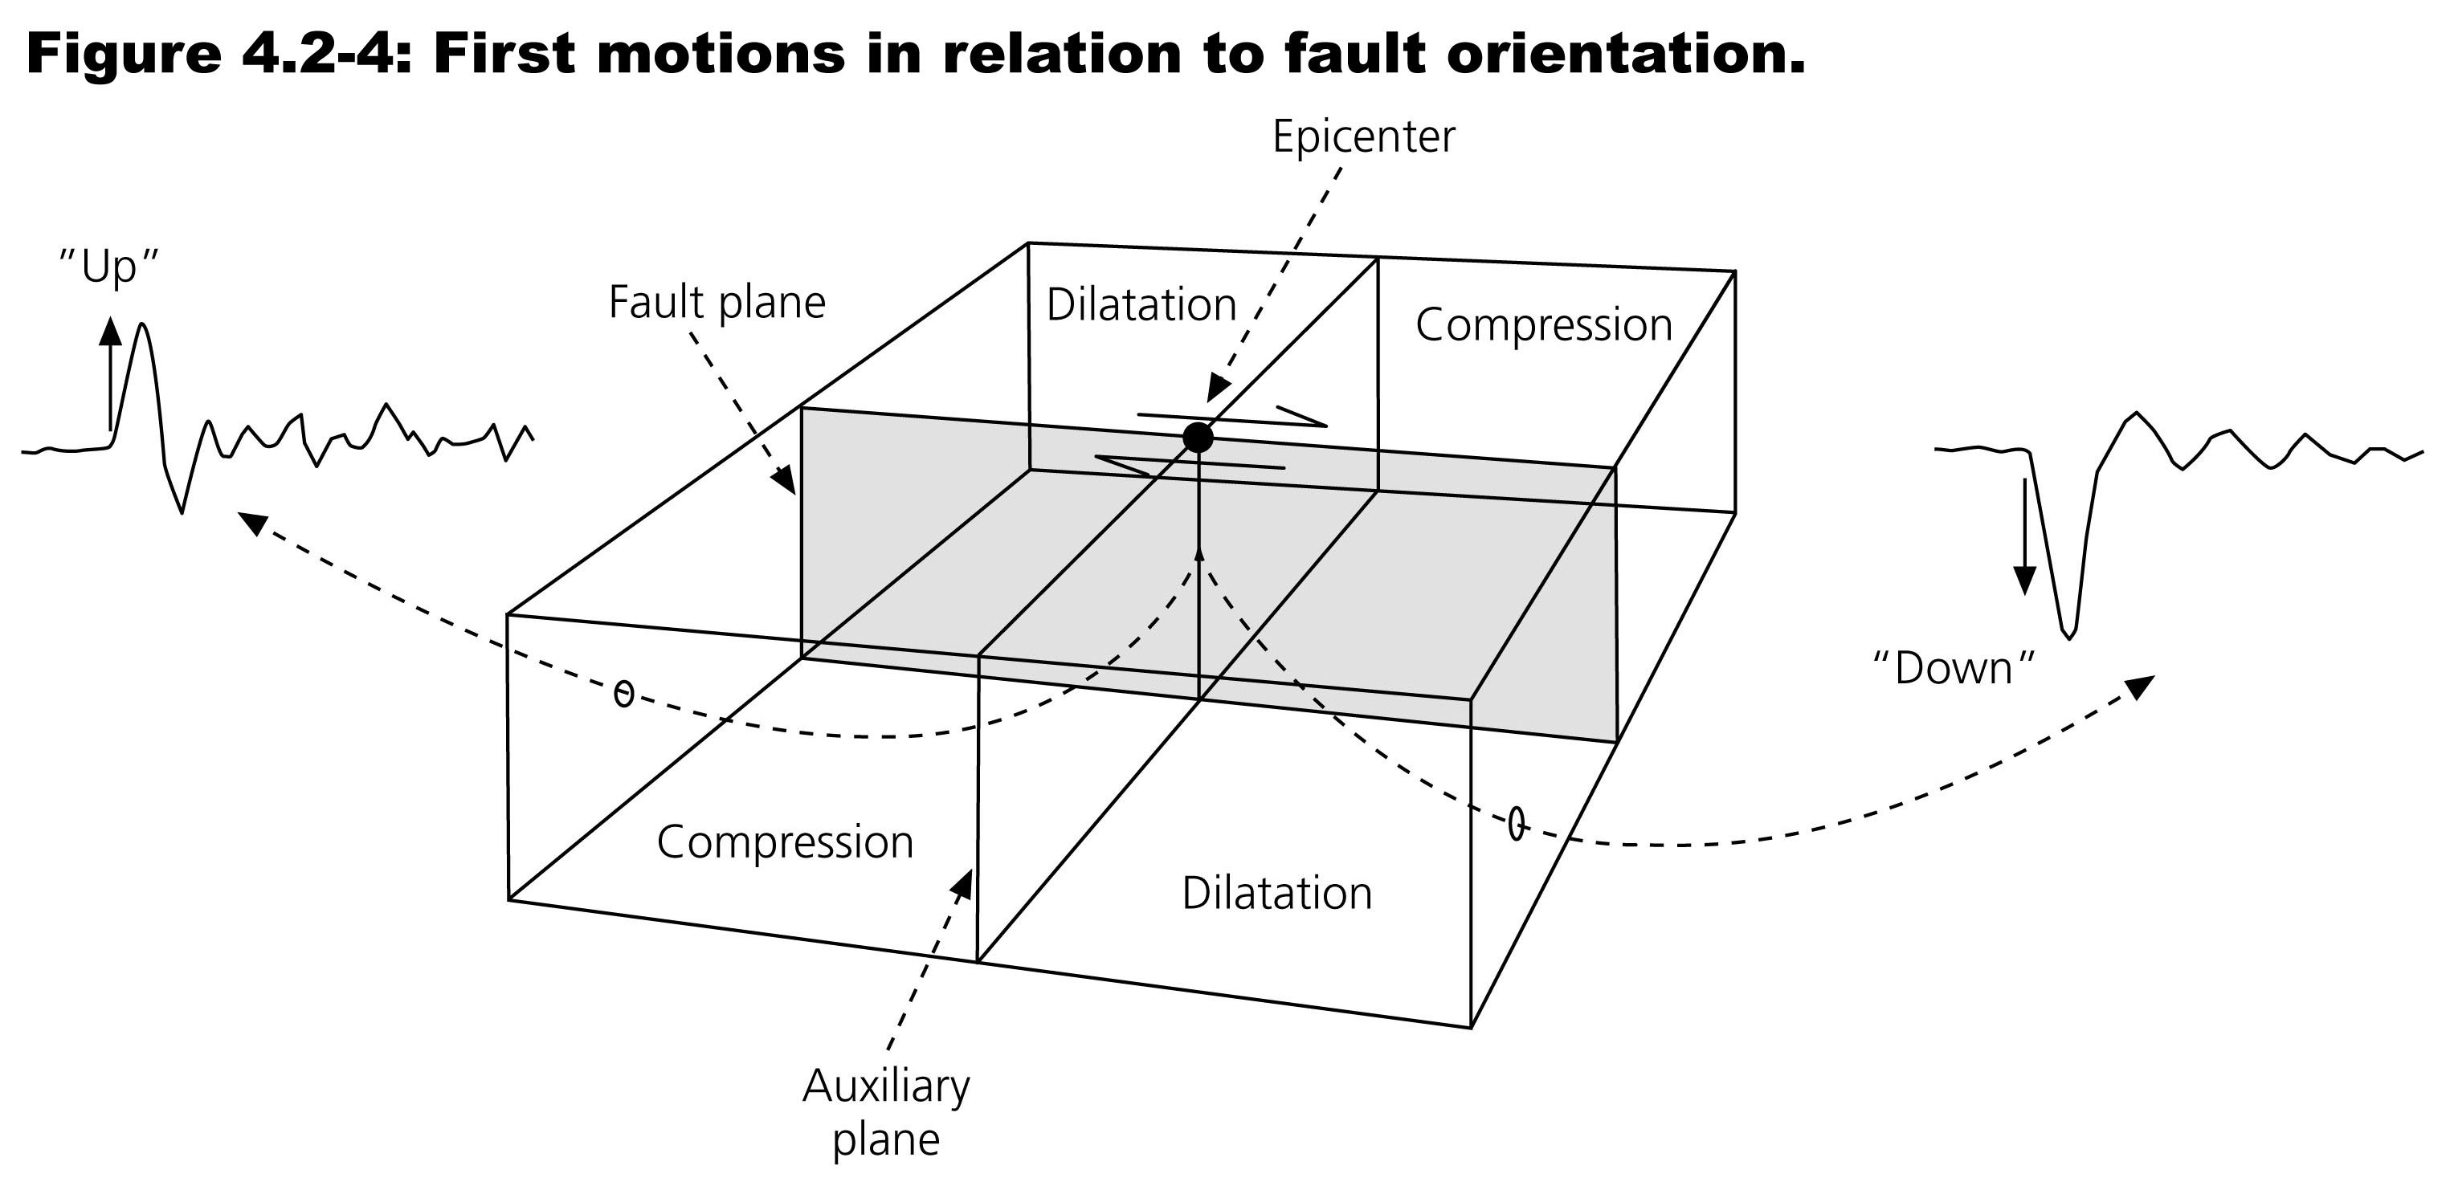

Slide 19
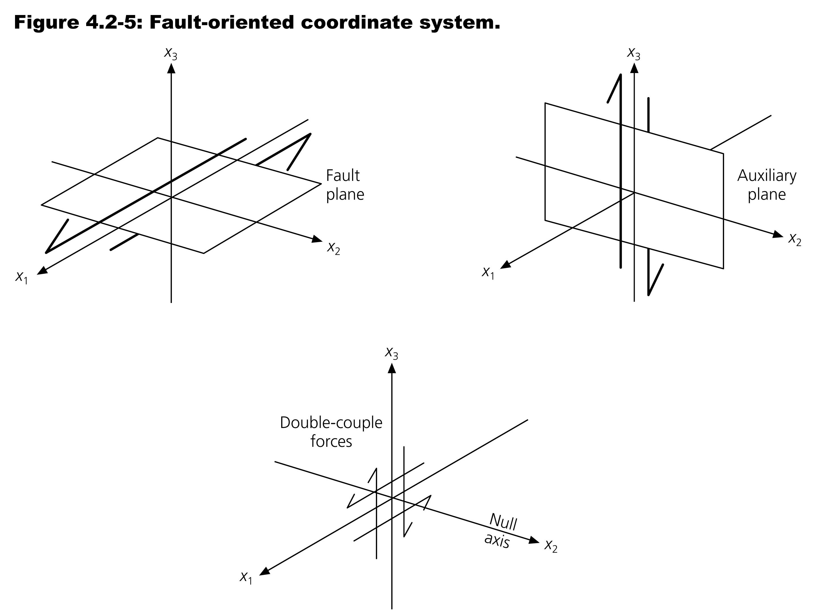

Slide 20
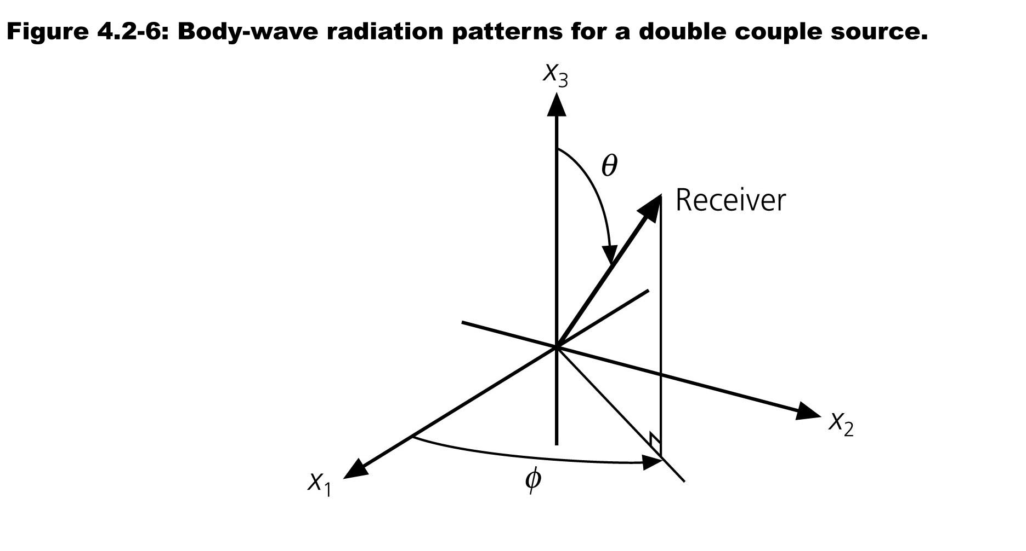
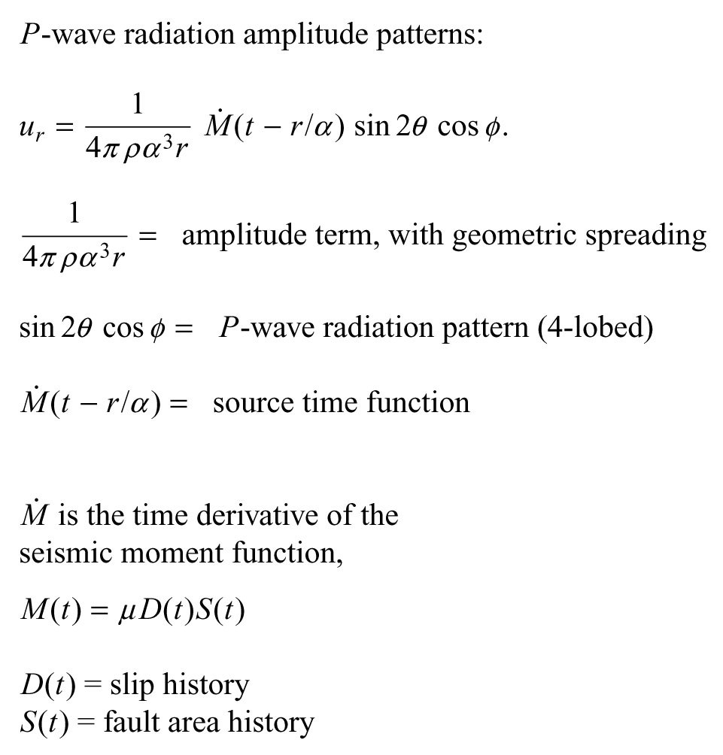
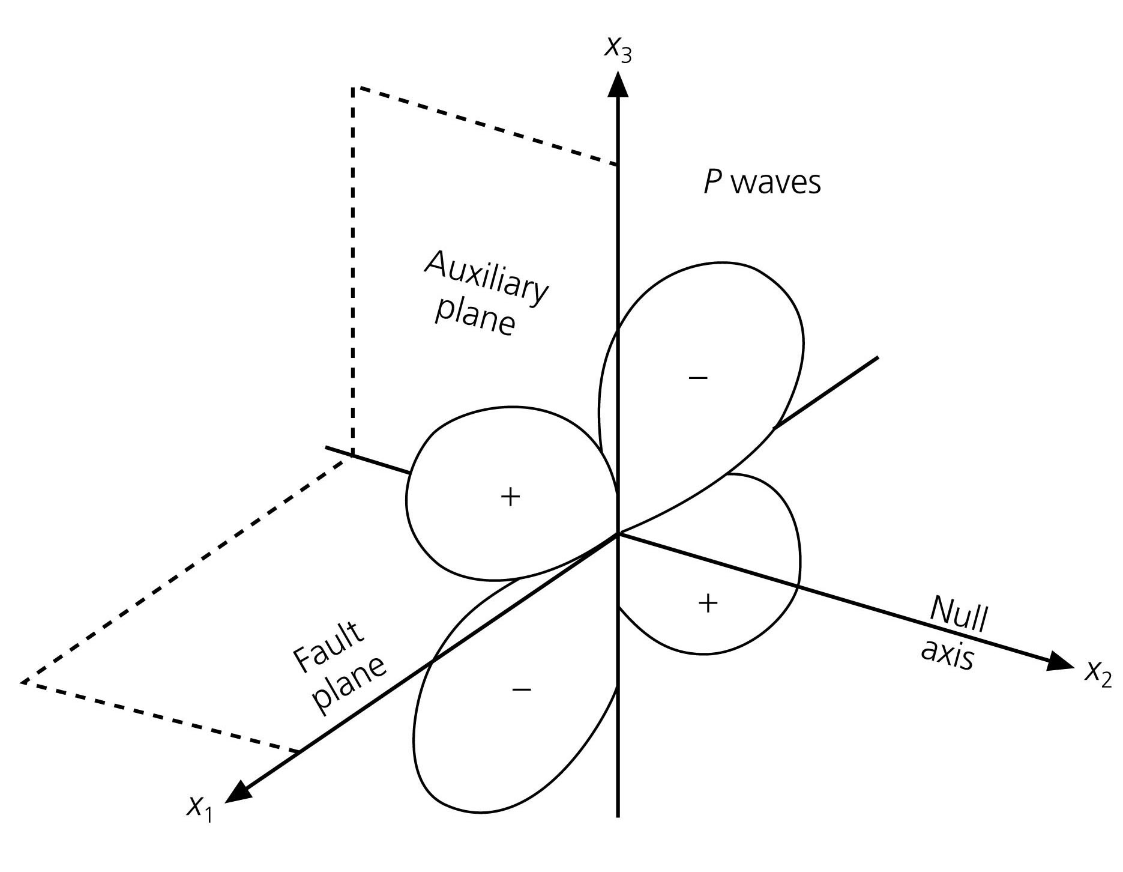

Slide 21
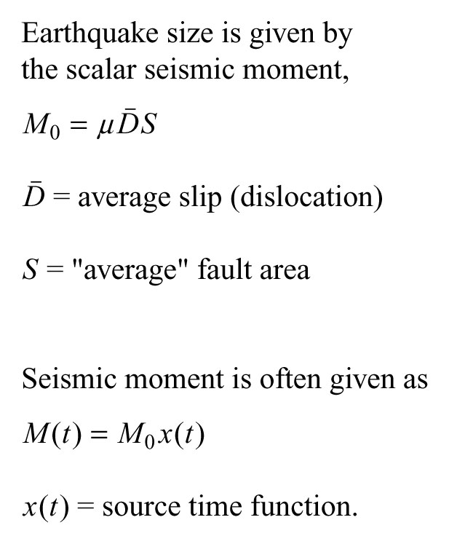

Slide 22
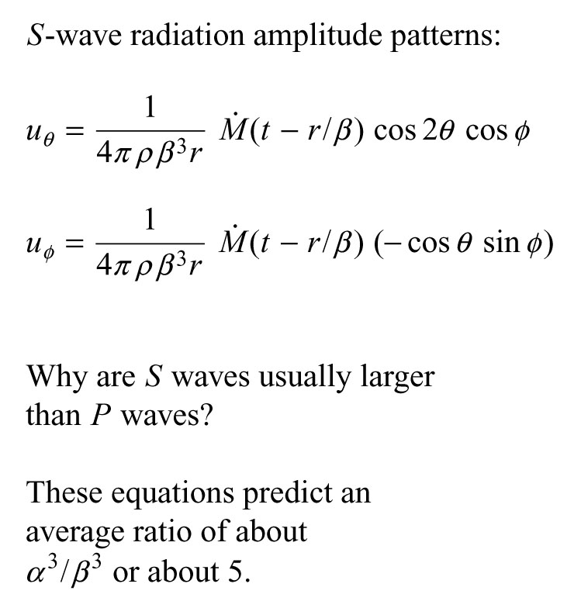
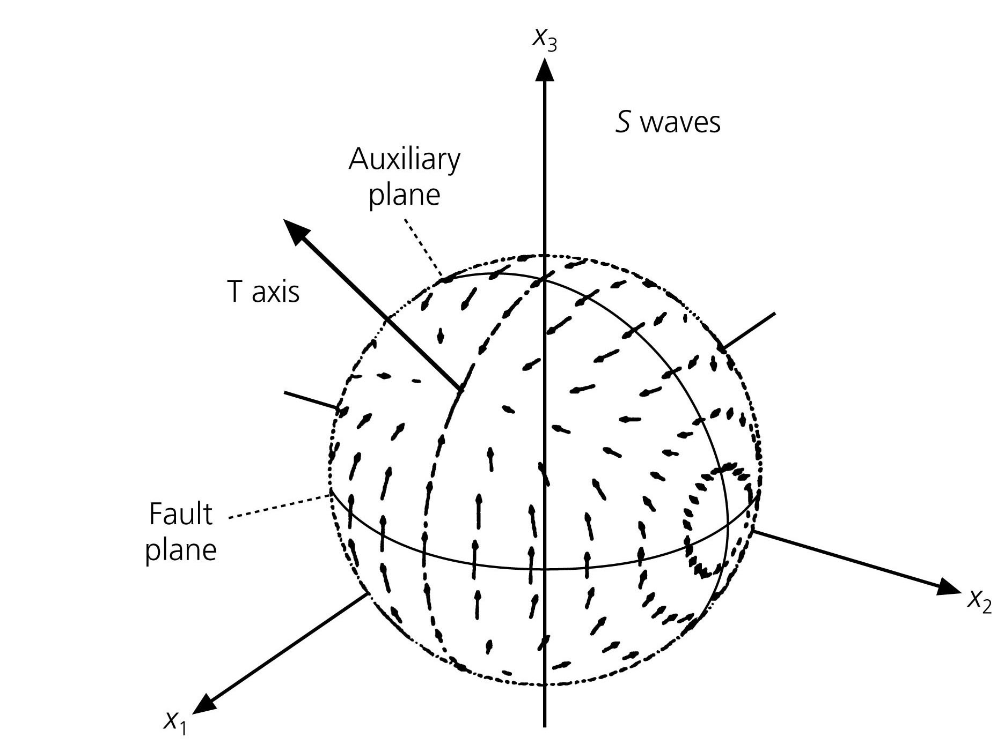

Slide 23
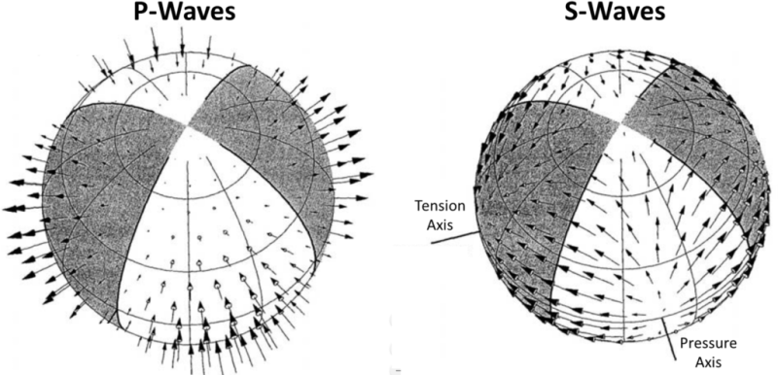
Motion parallel to fault on auxiliary fault/plane
Can reverse fault and auxiliary planes and sense of offset
https://mxrap.com/2019/07/26/moment-tensors-a-practical-guide/

Slide 24
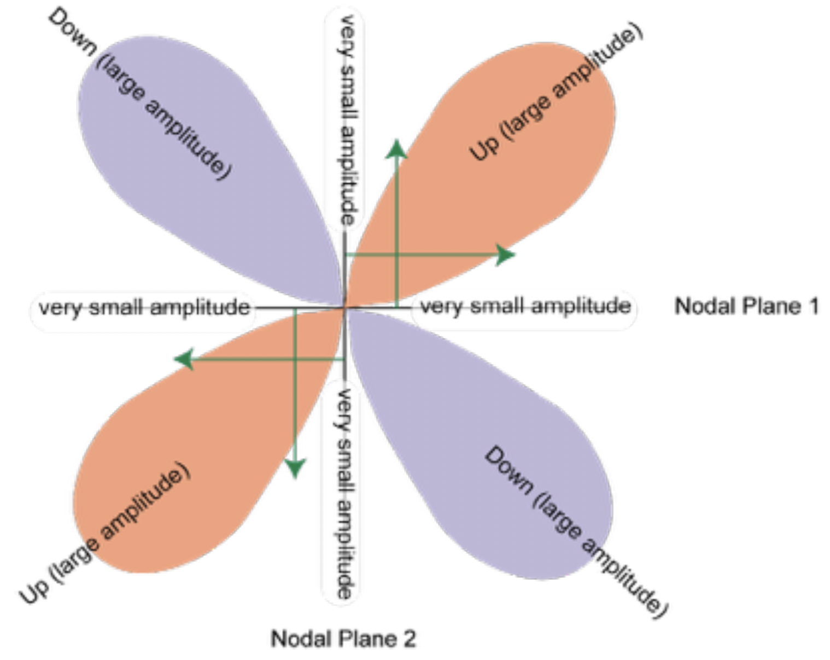
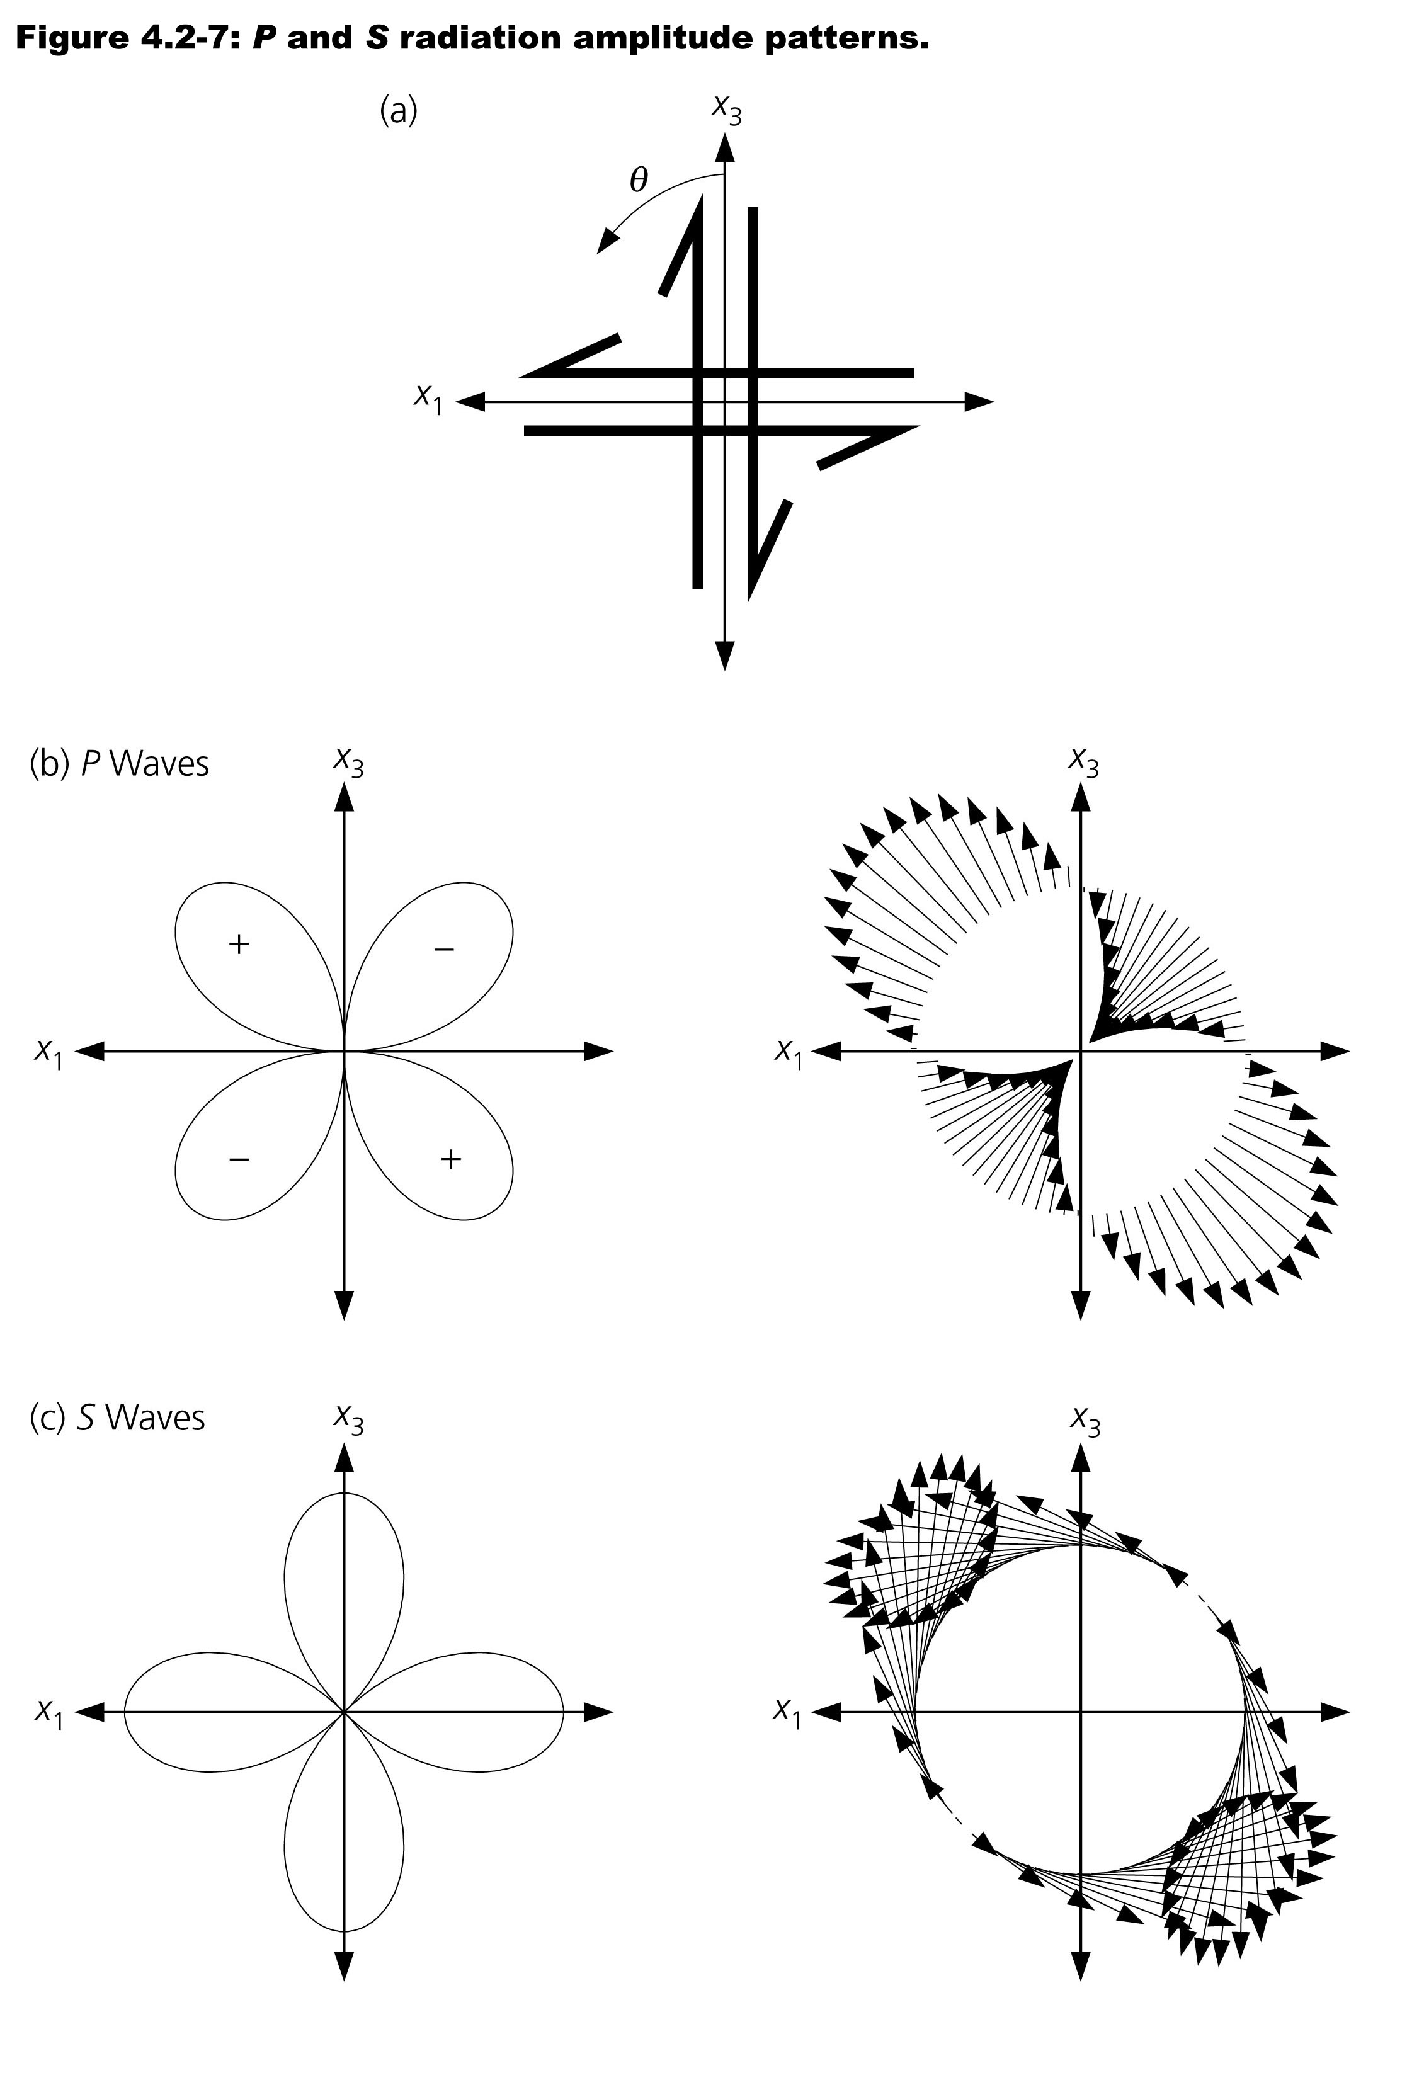
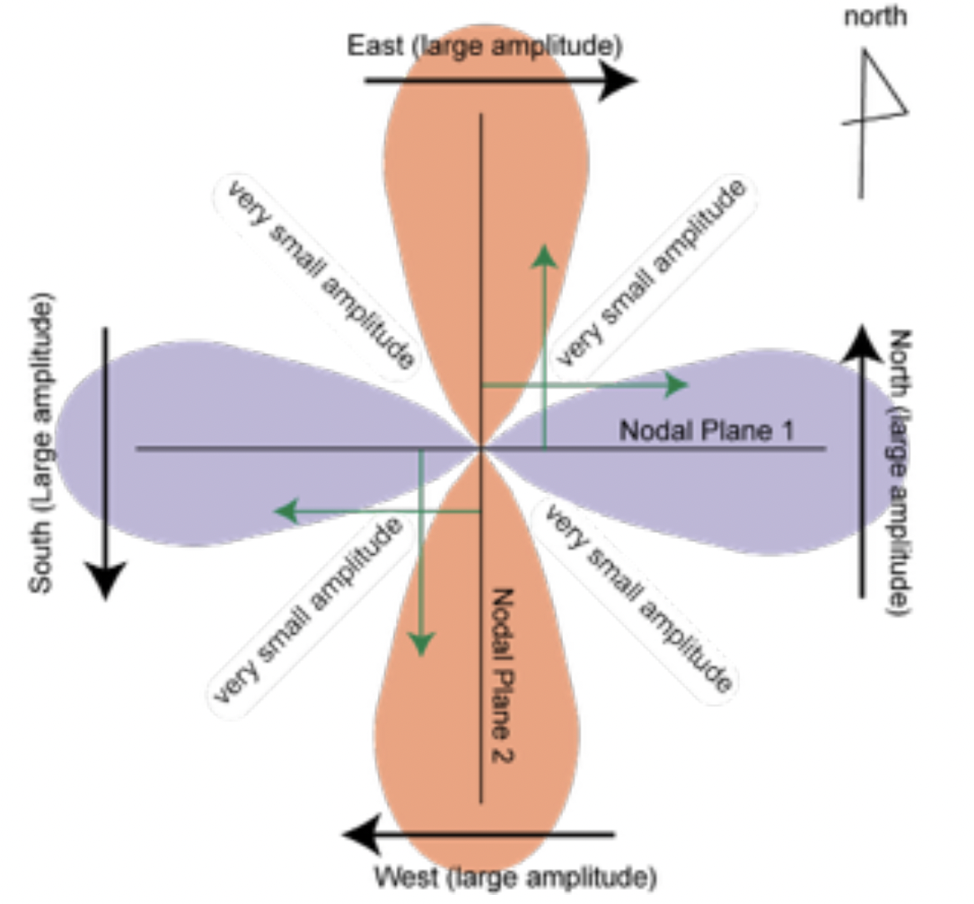
Yuji Yagi

Slide 25
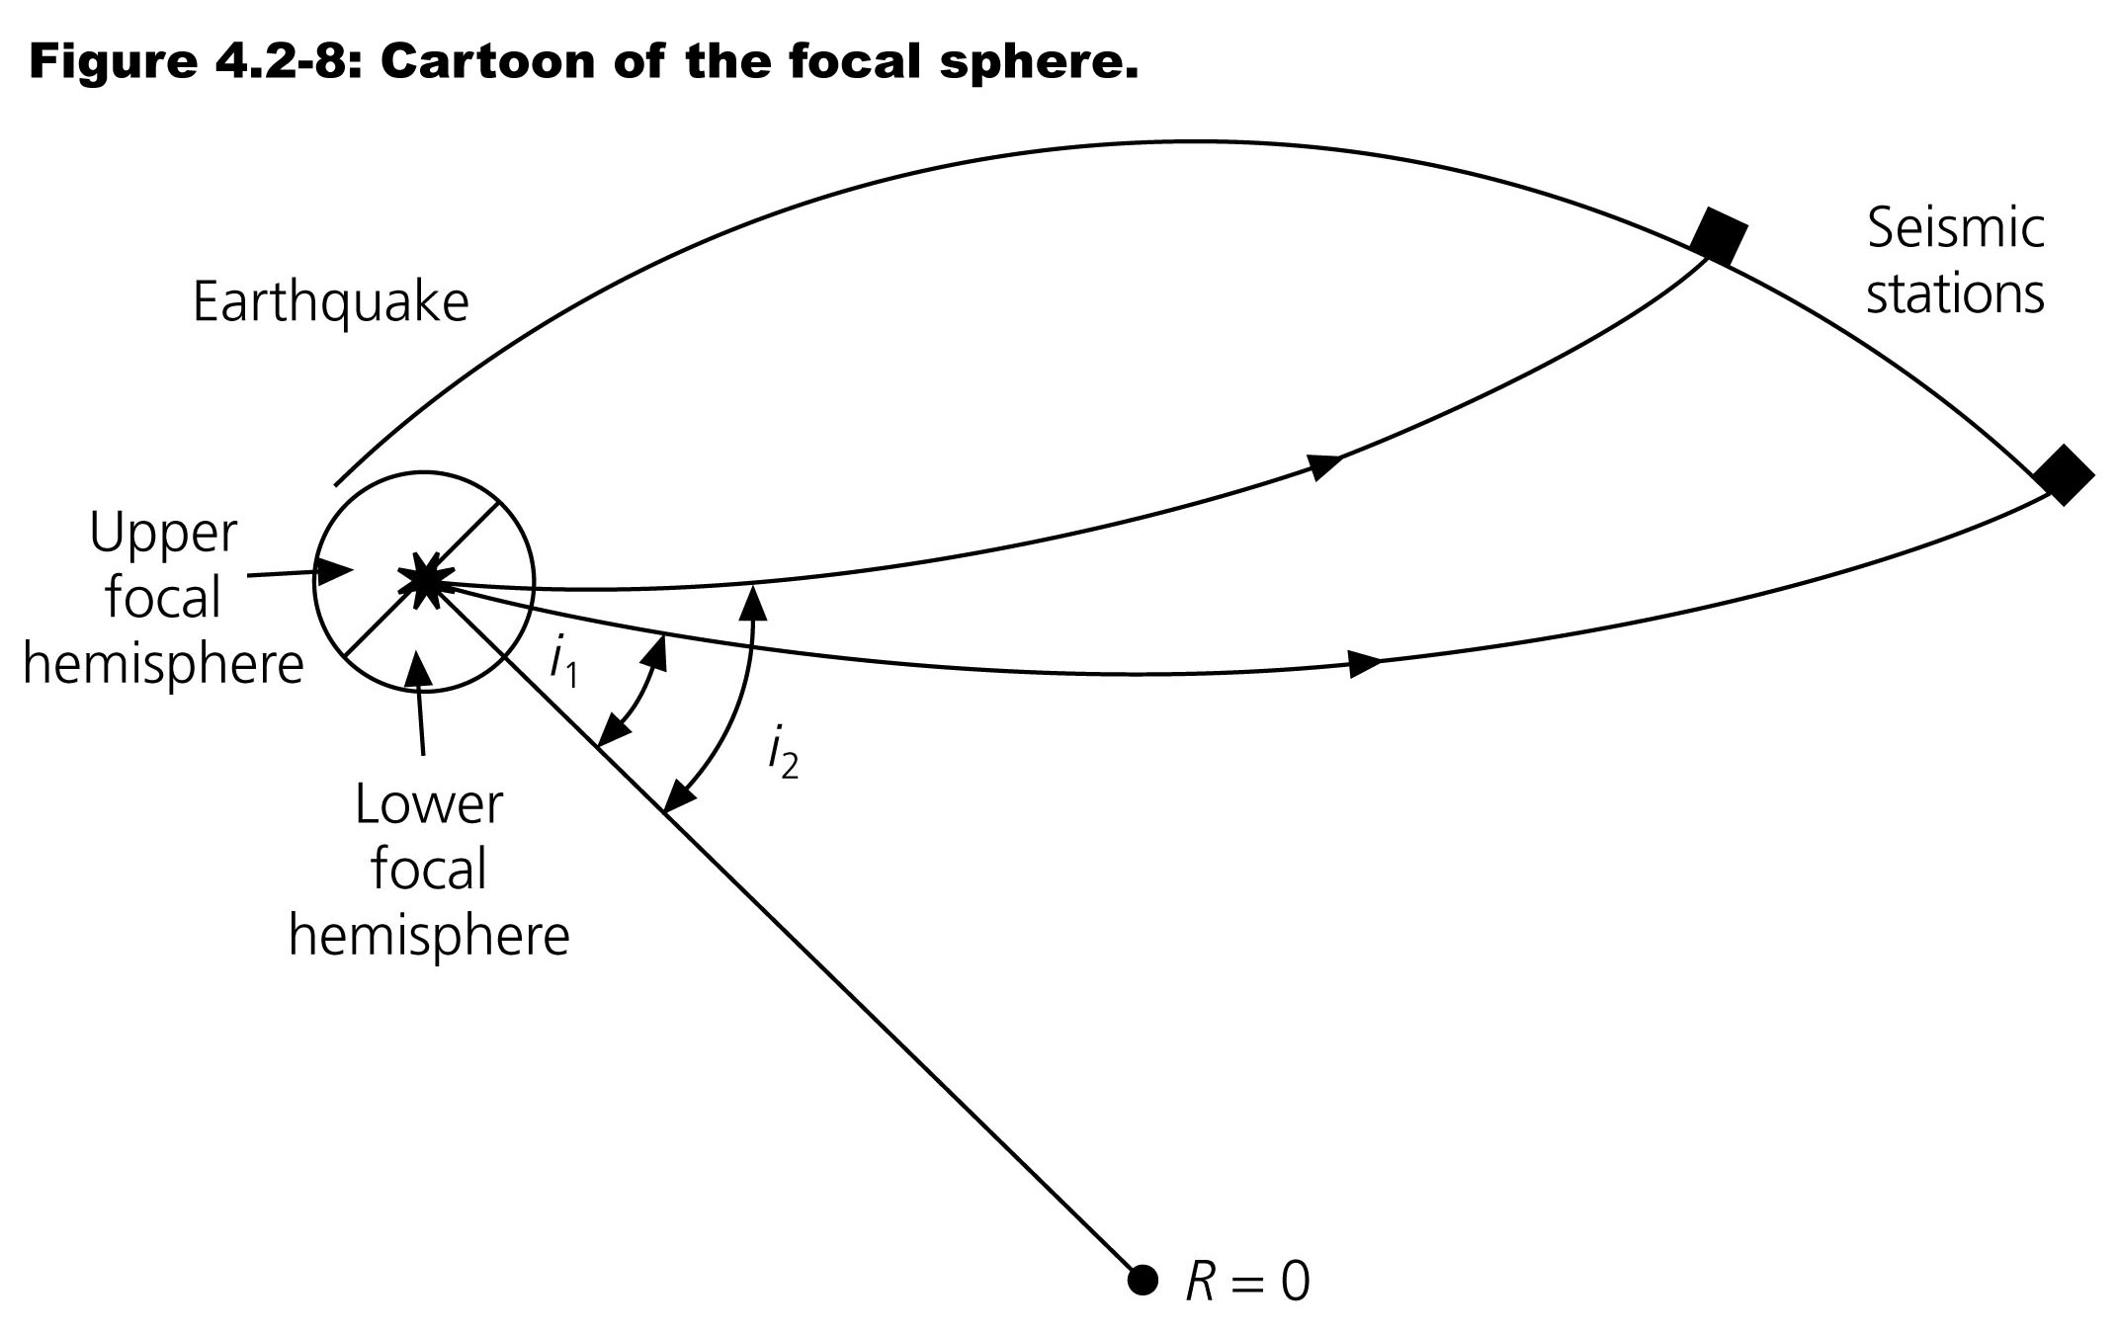
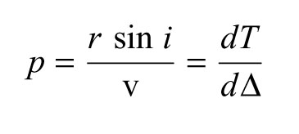

Slide 26
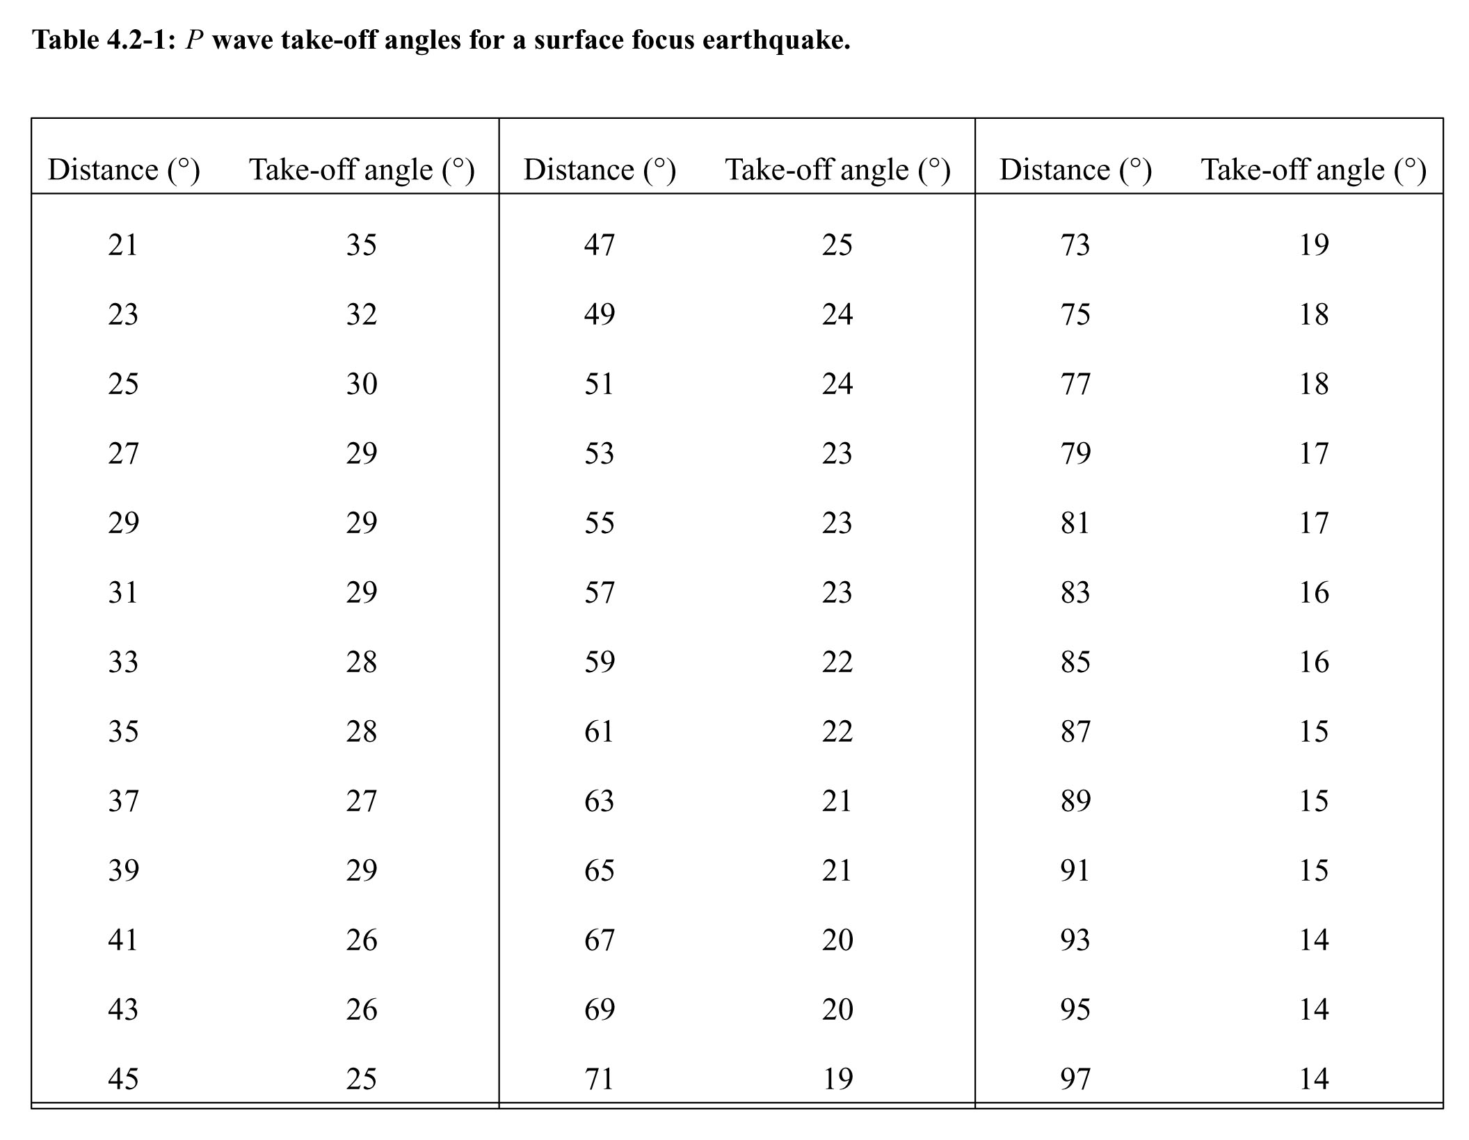

Slide 27
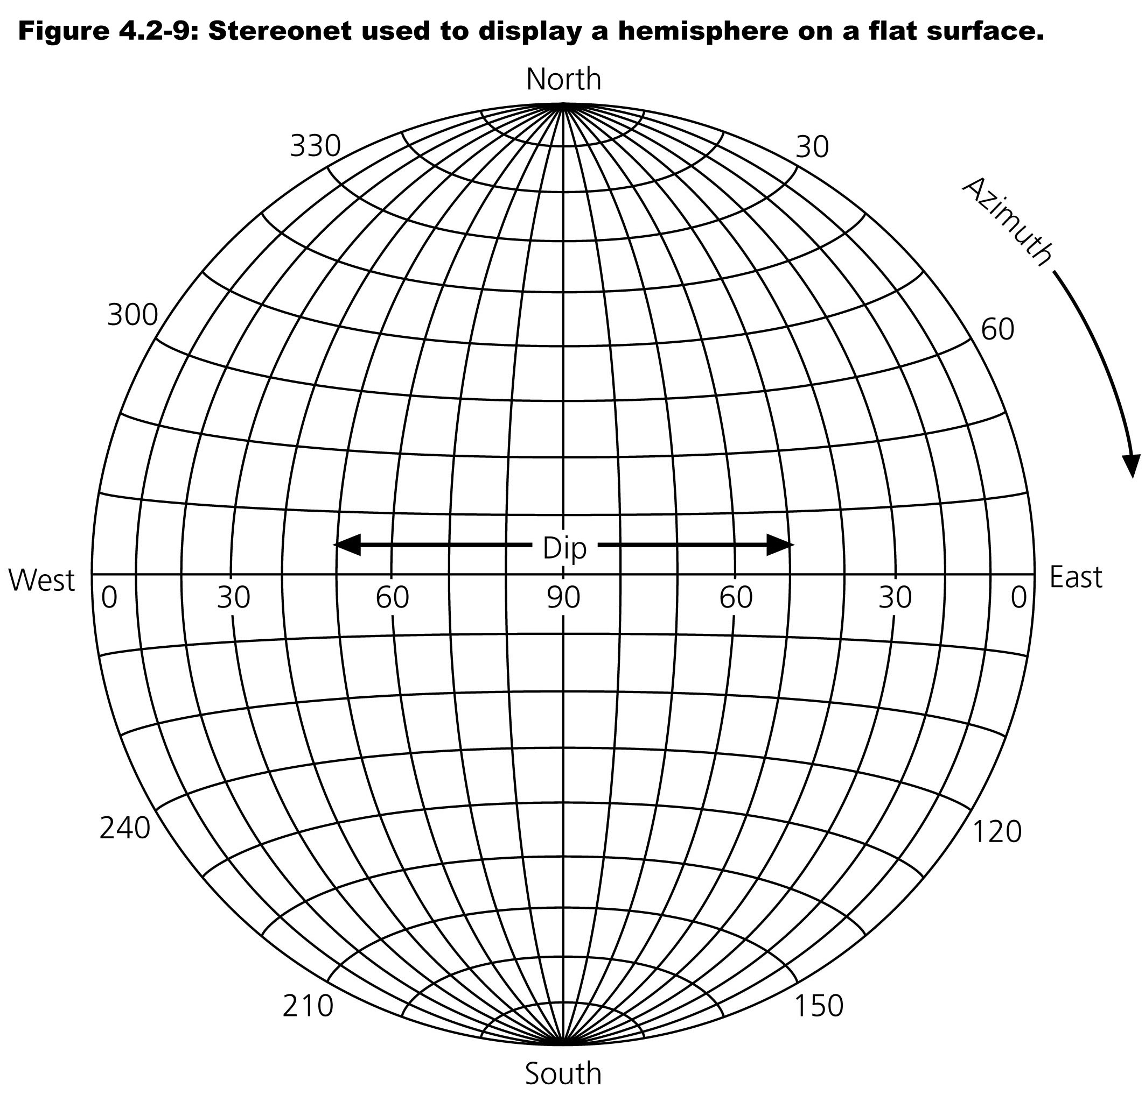

Slide 28
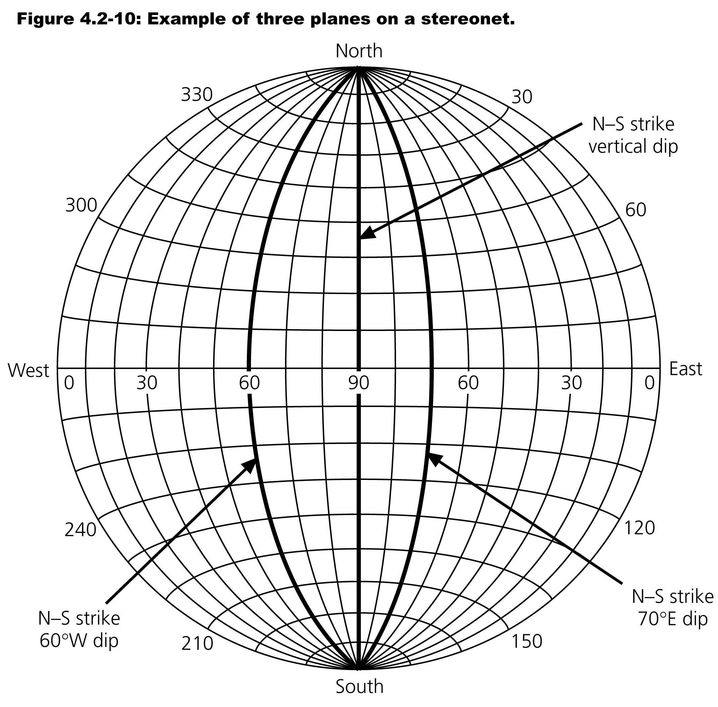

Slide 29
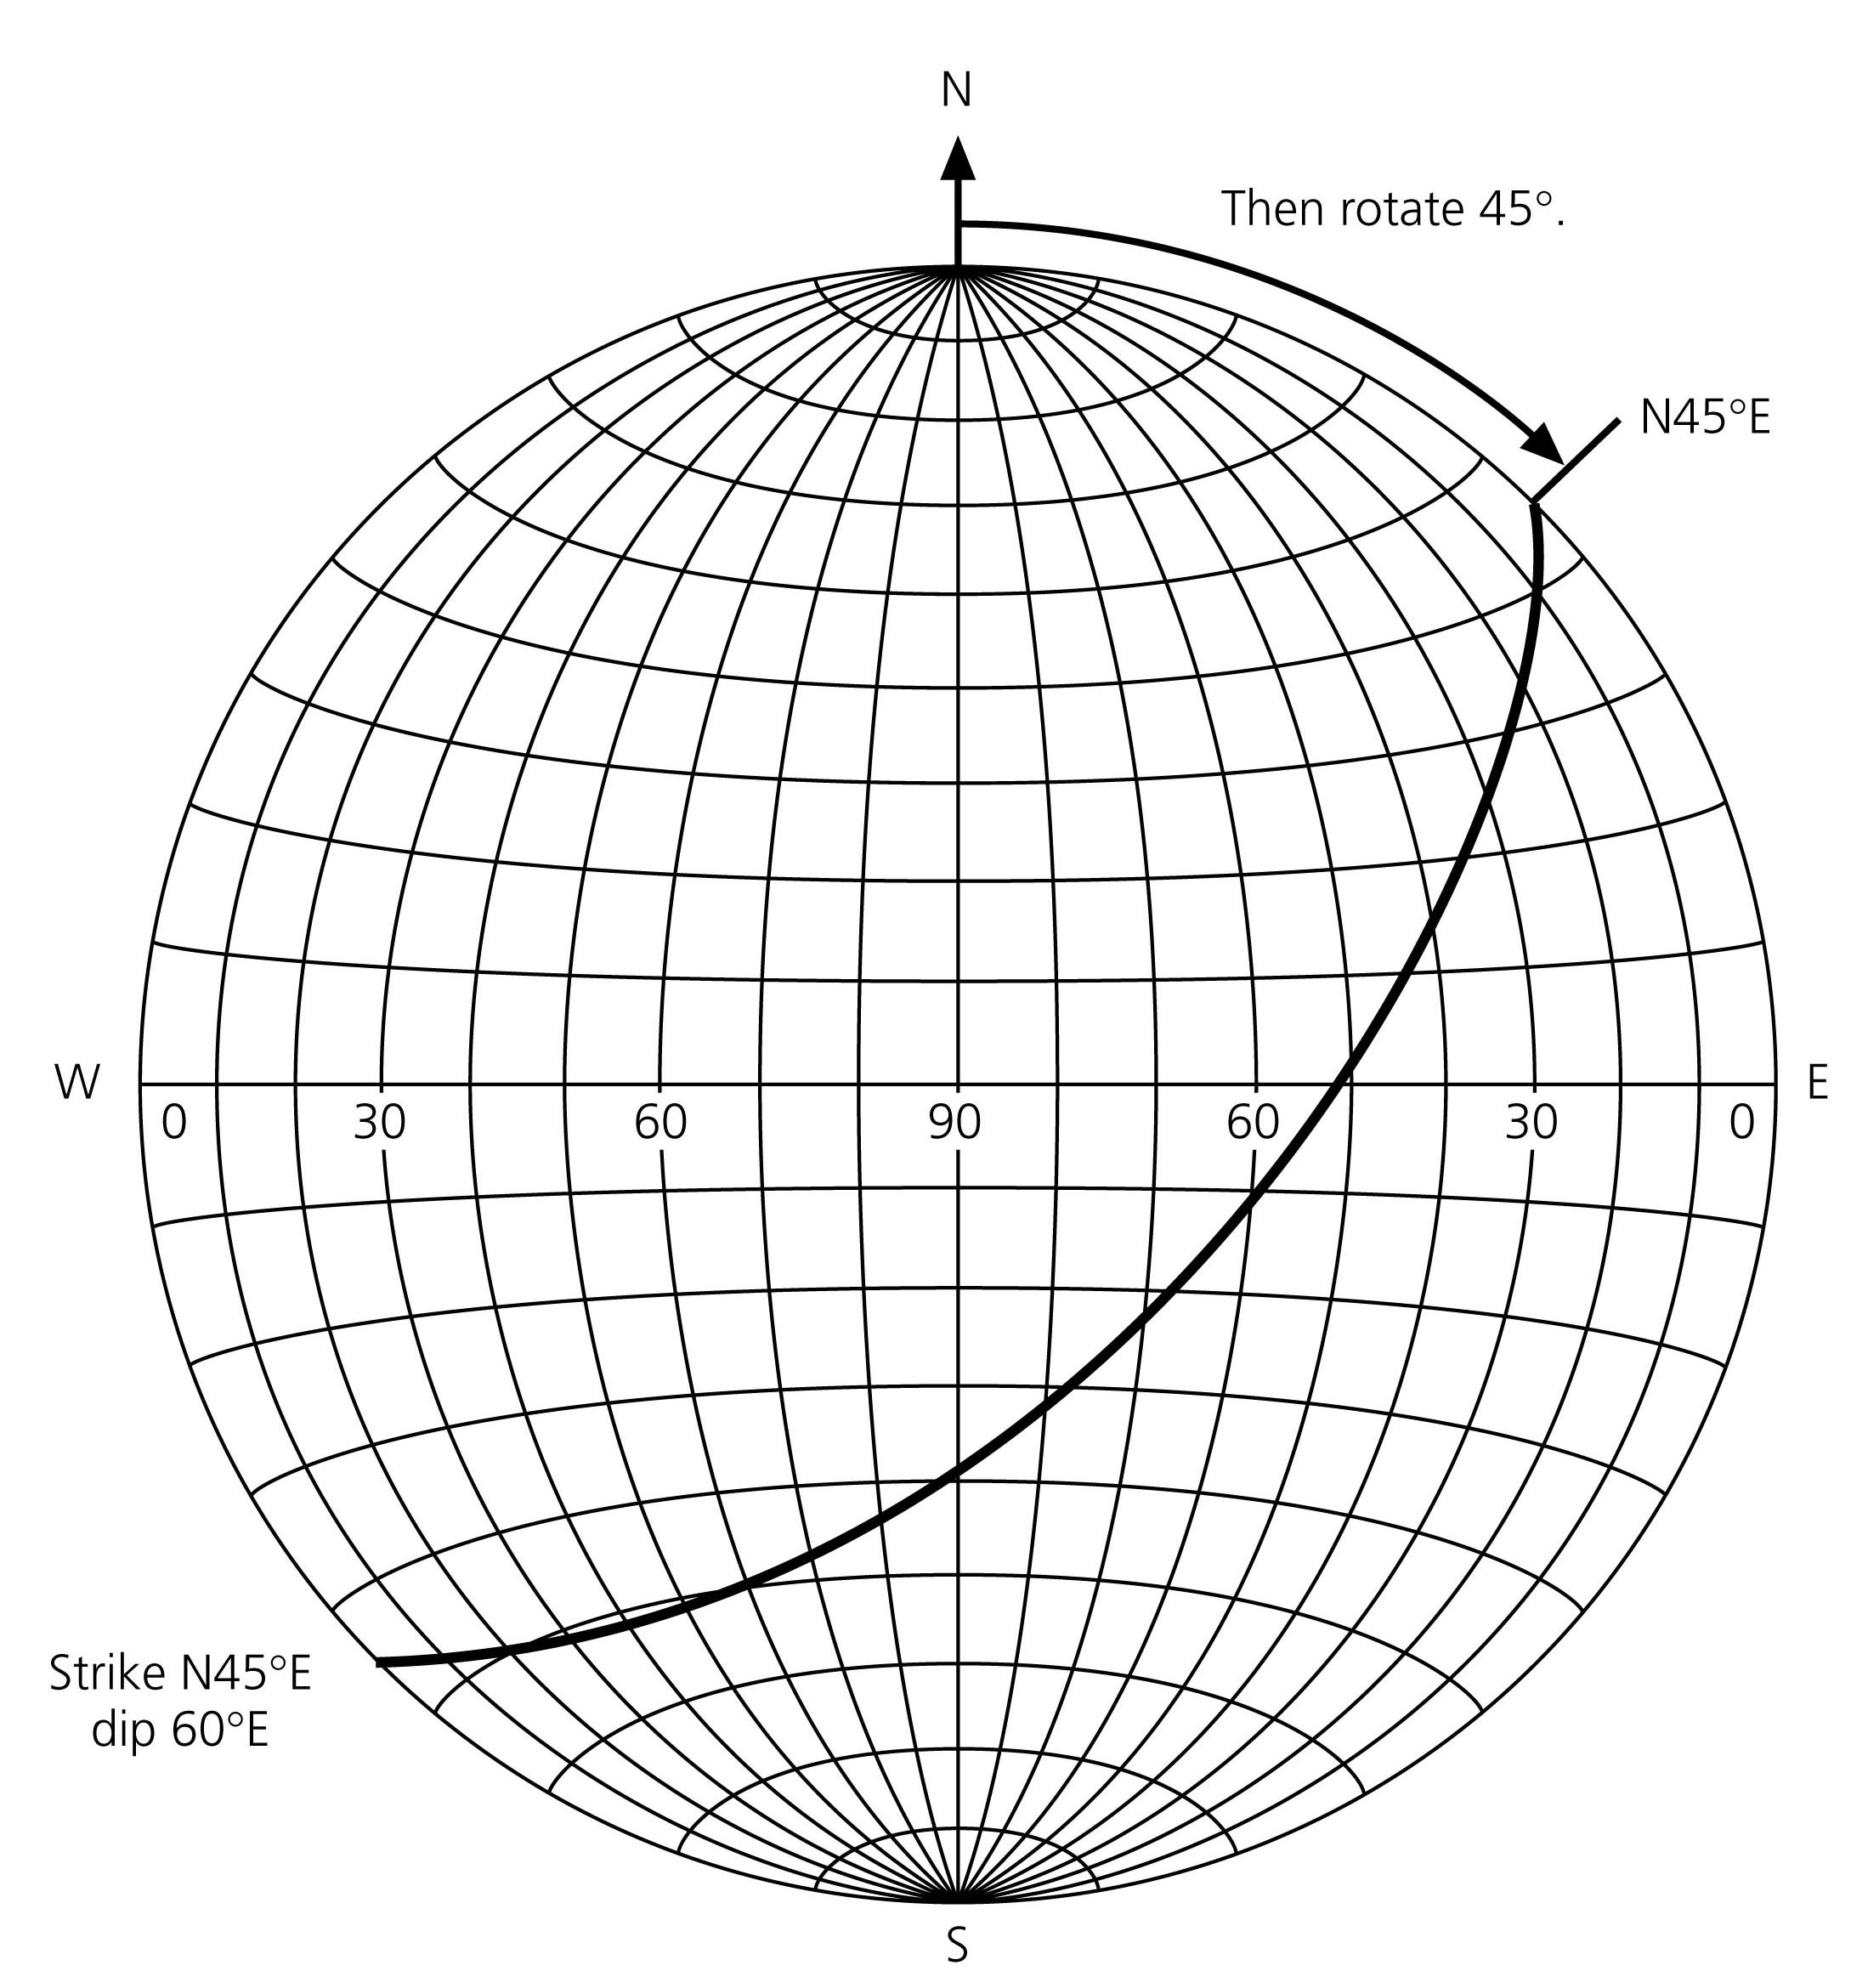
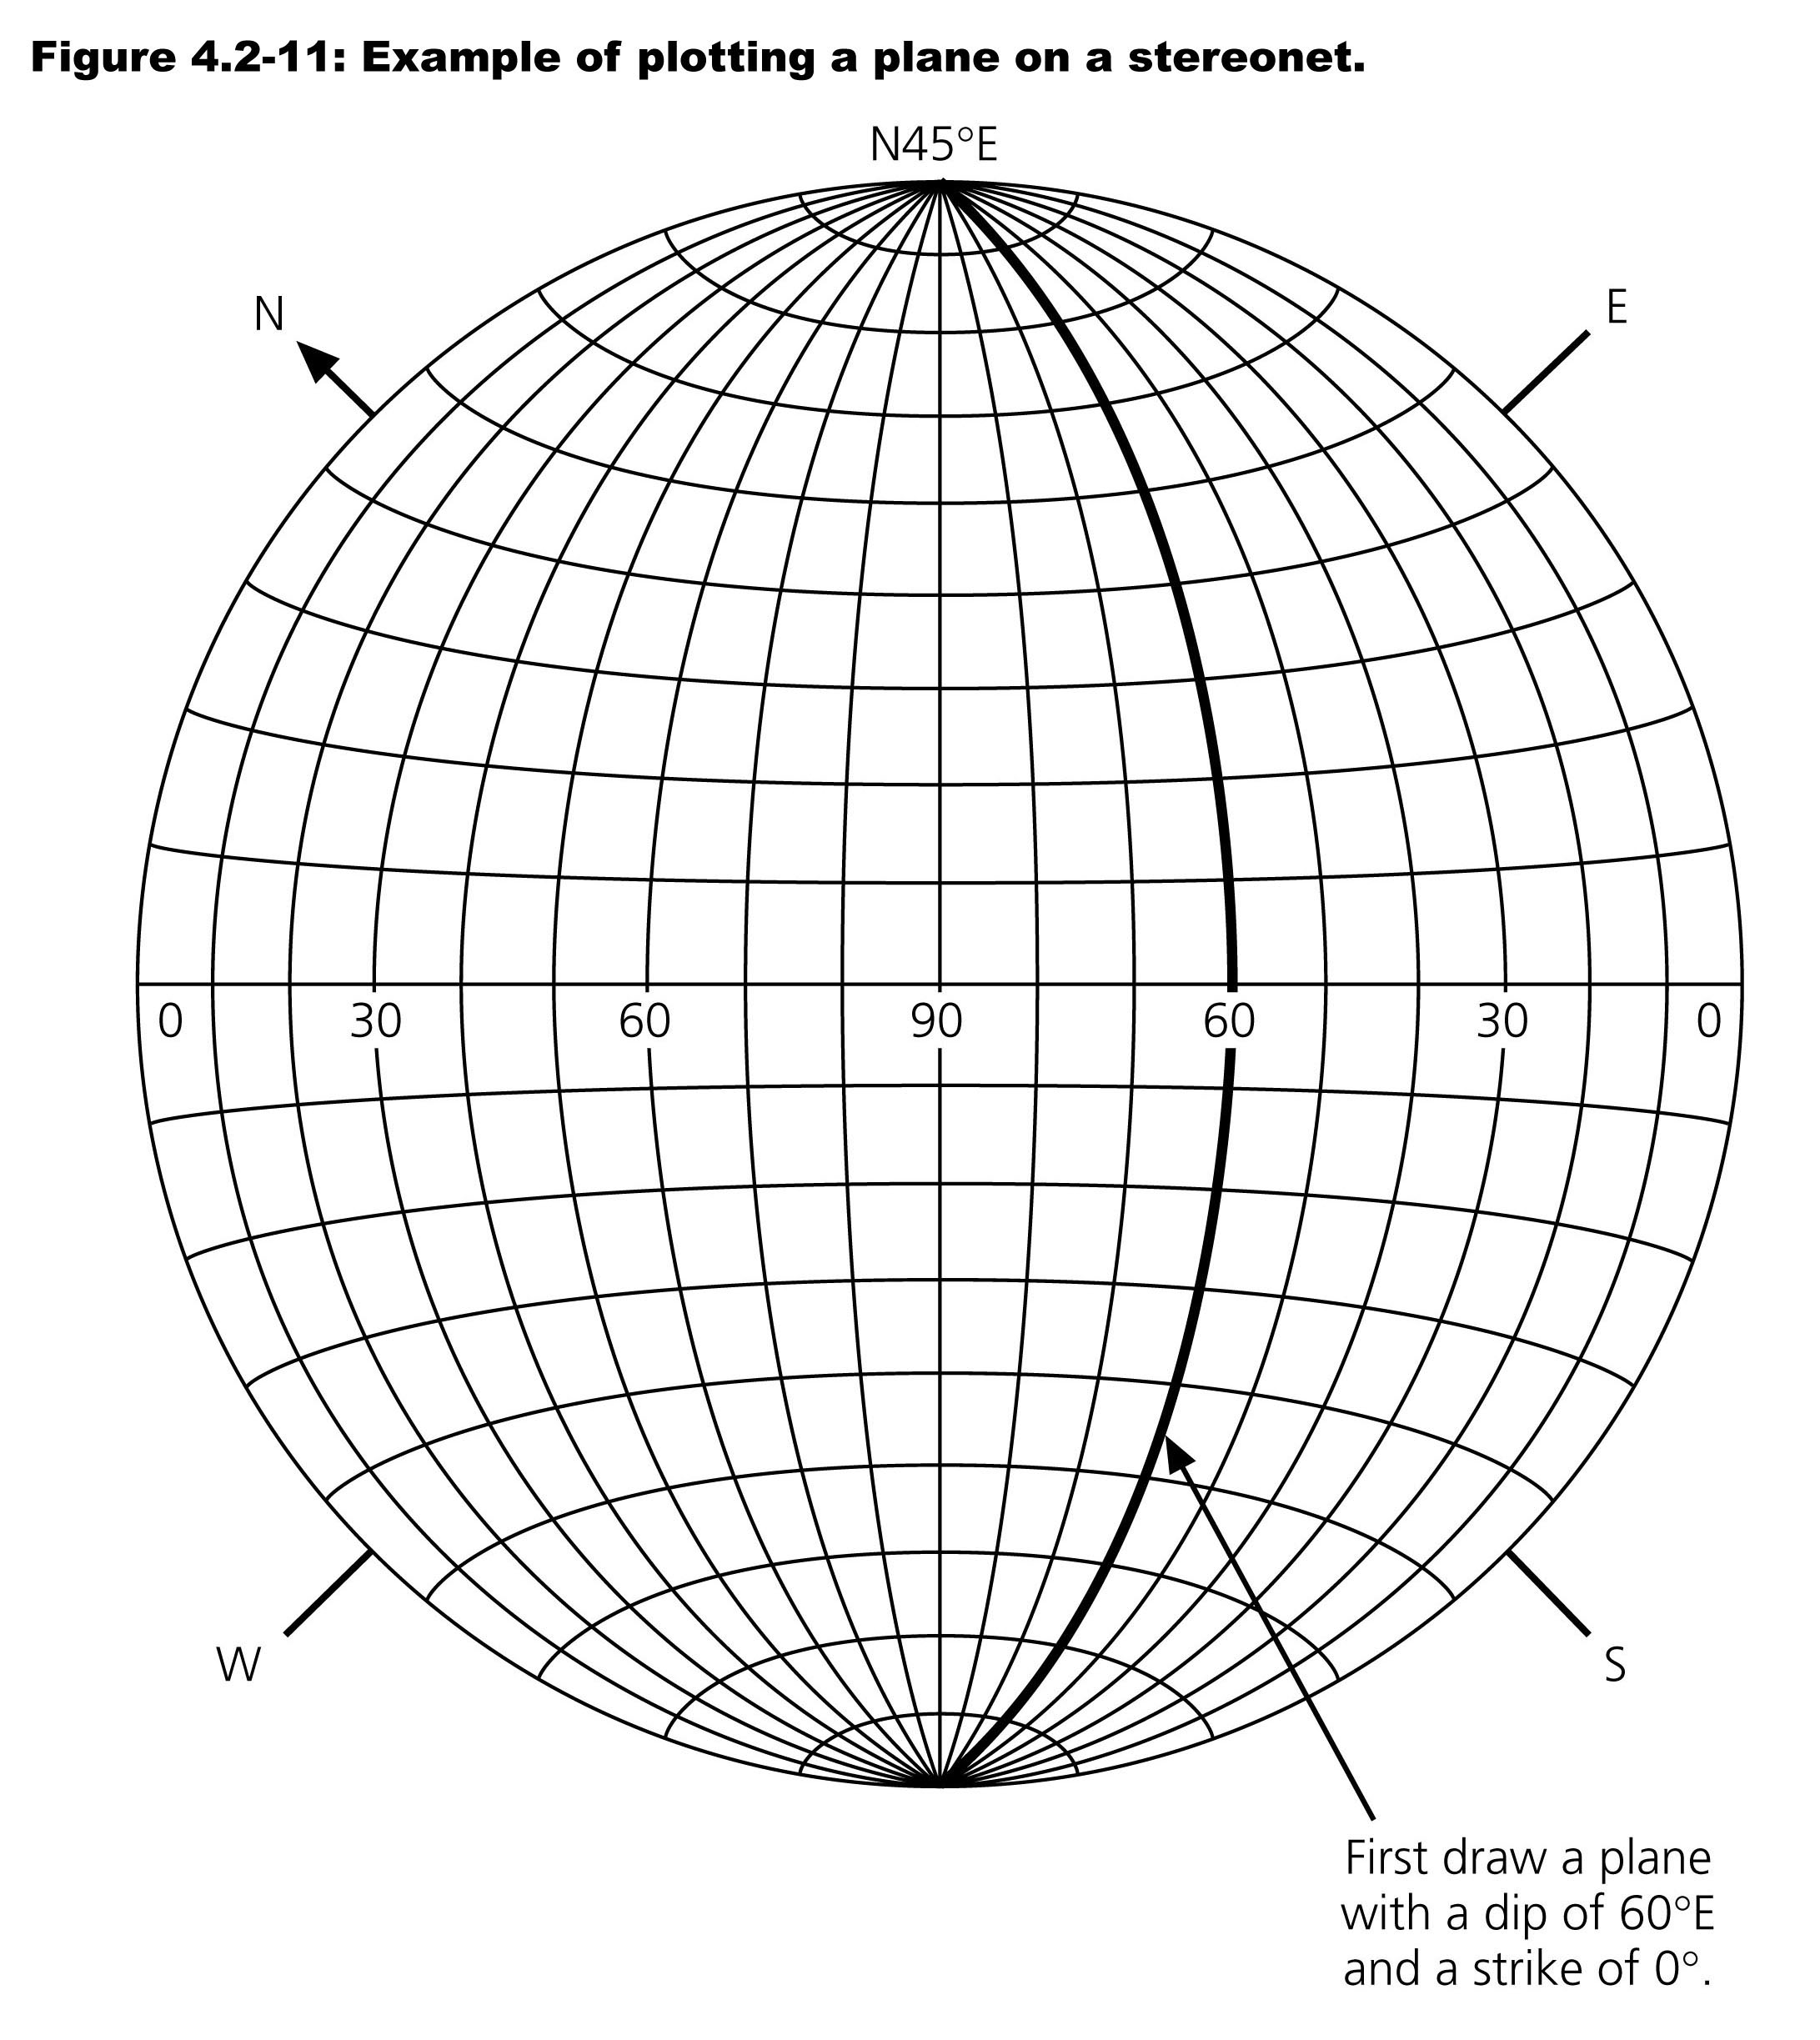

Slide 30
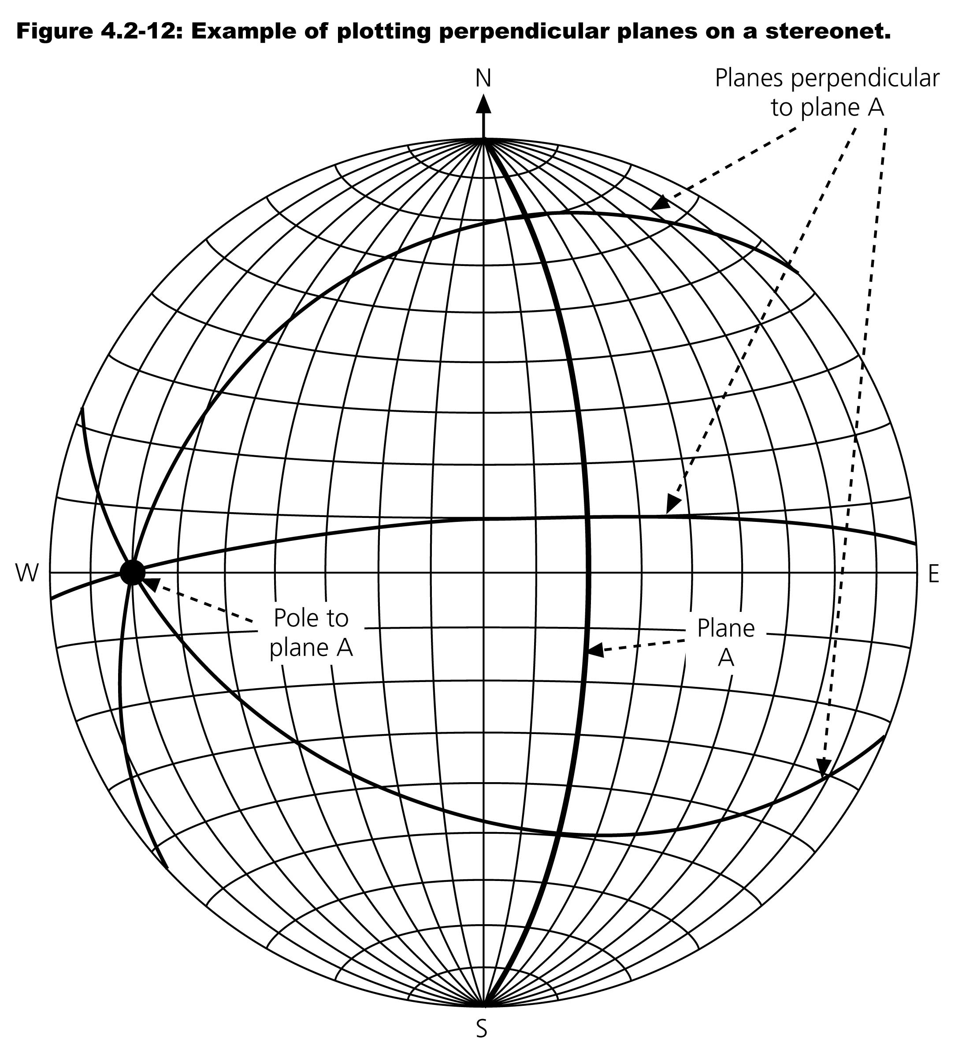

Slide 31
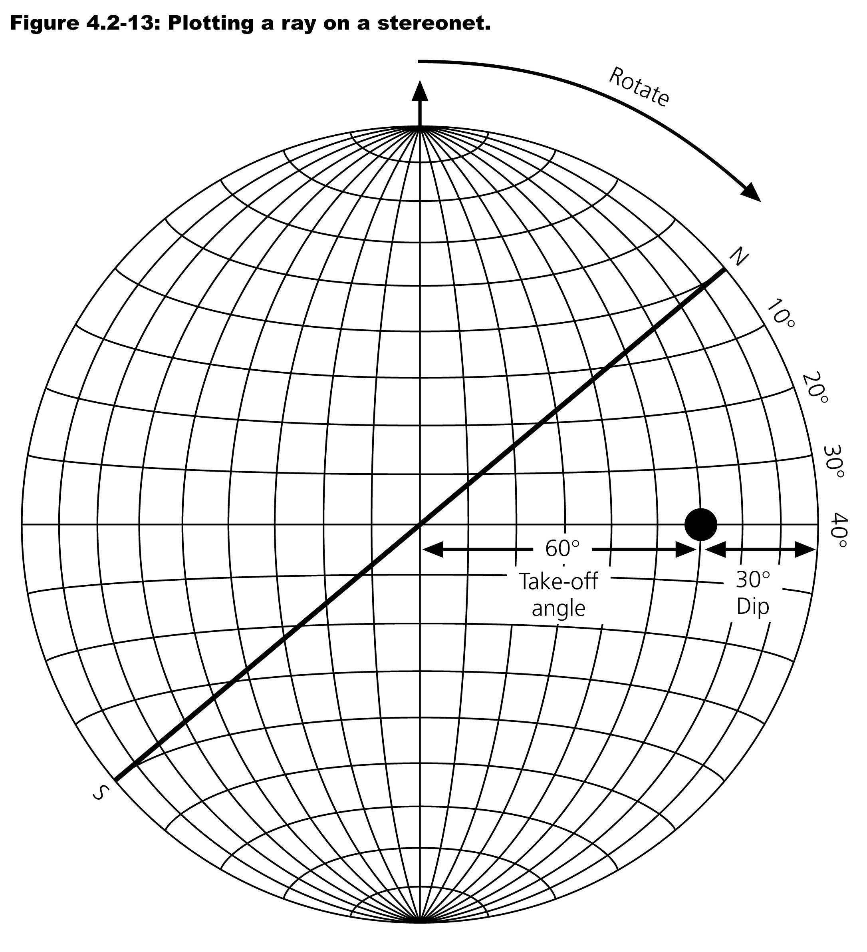
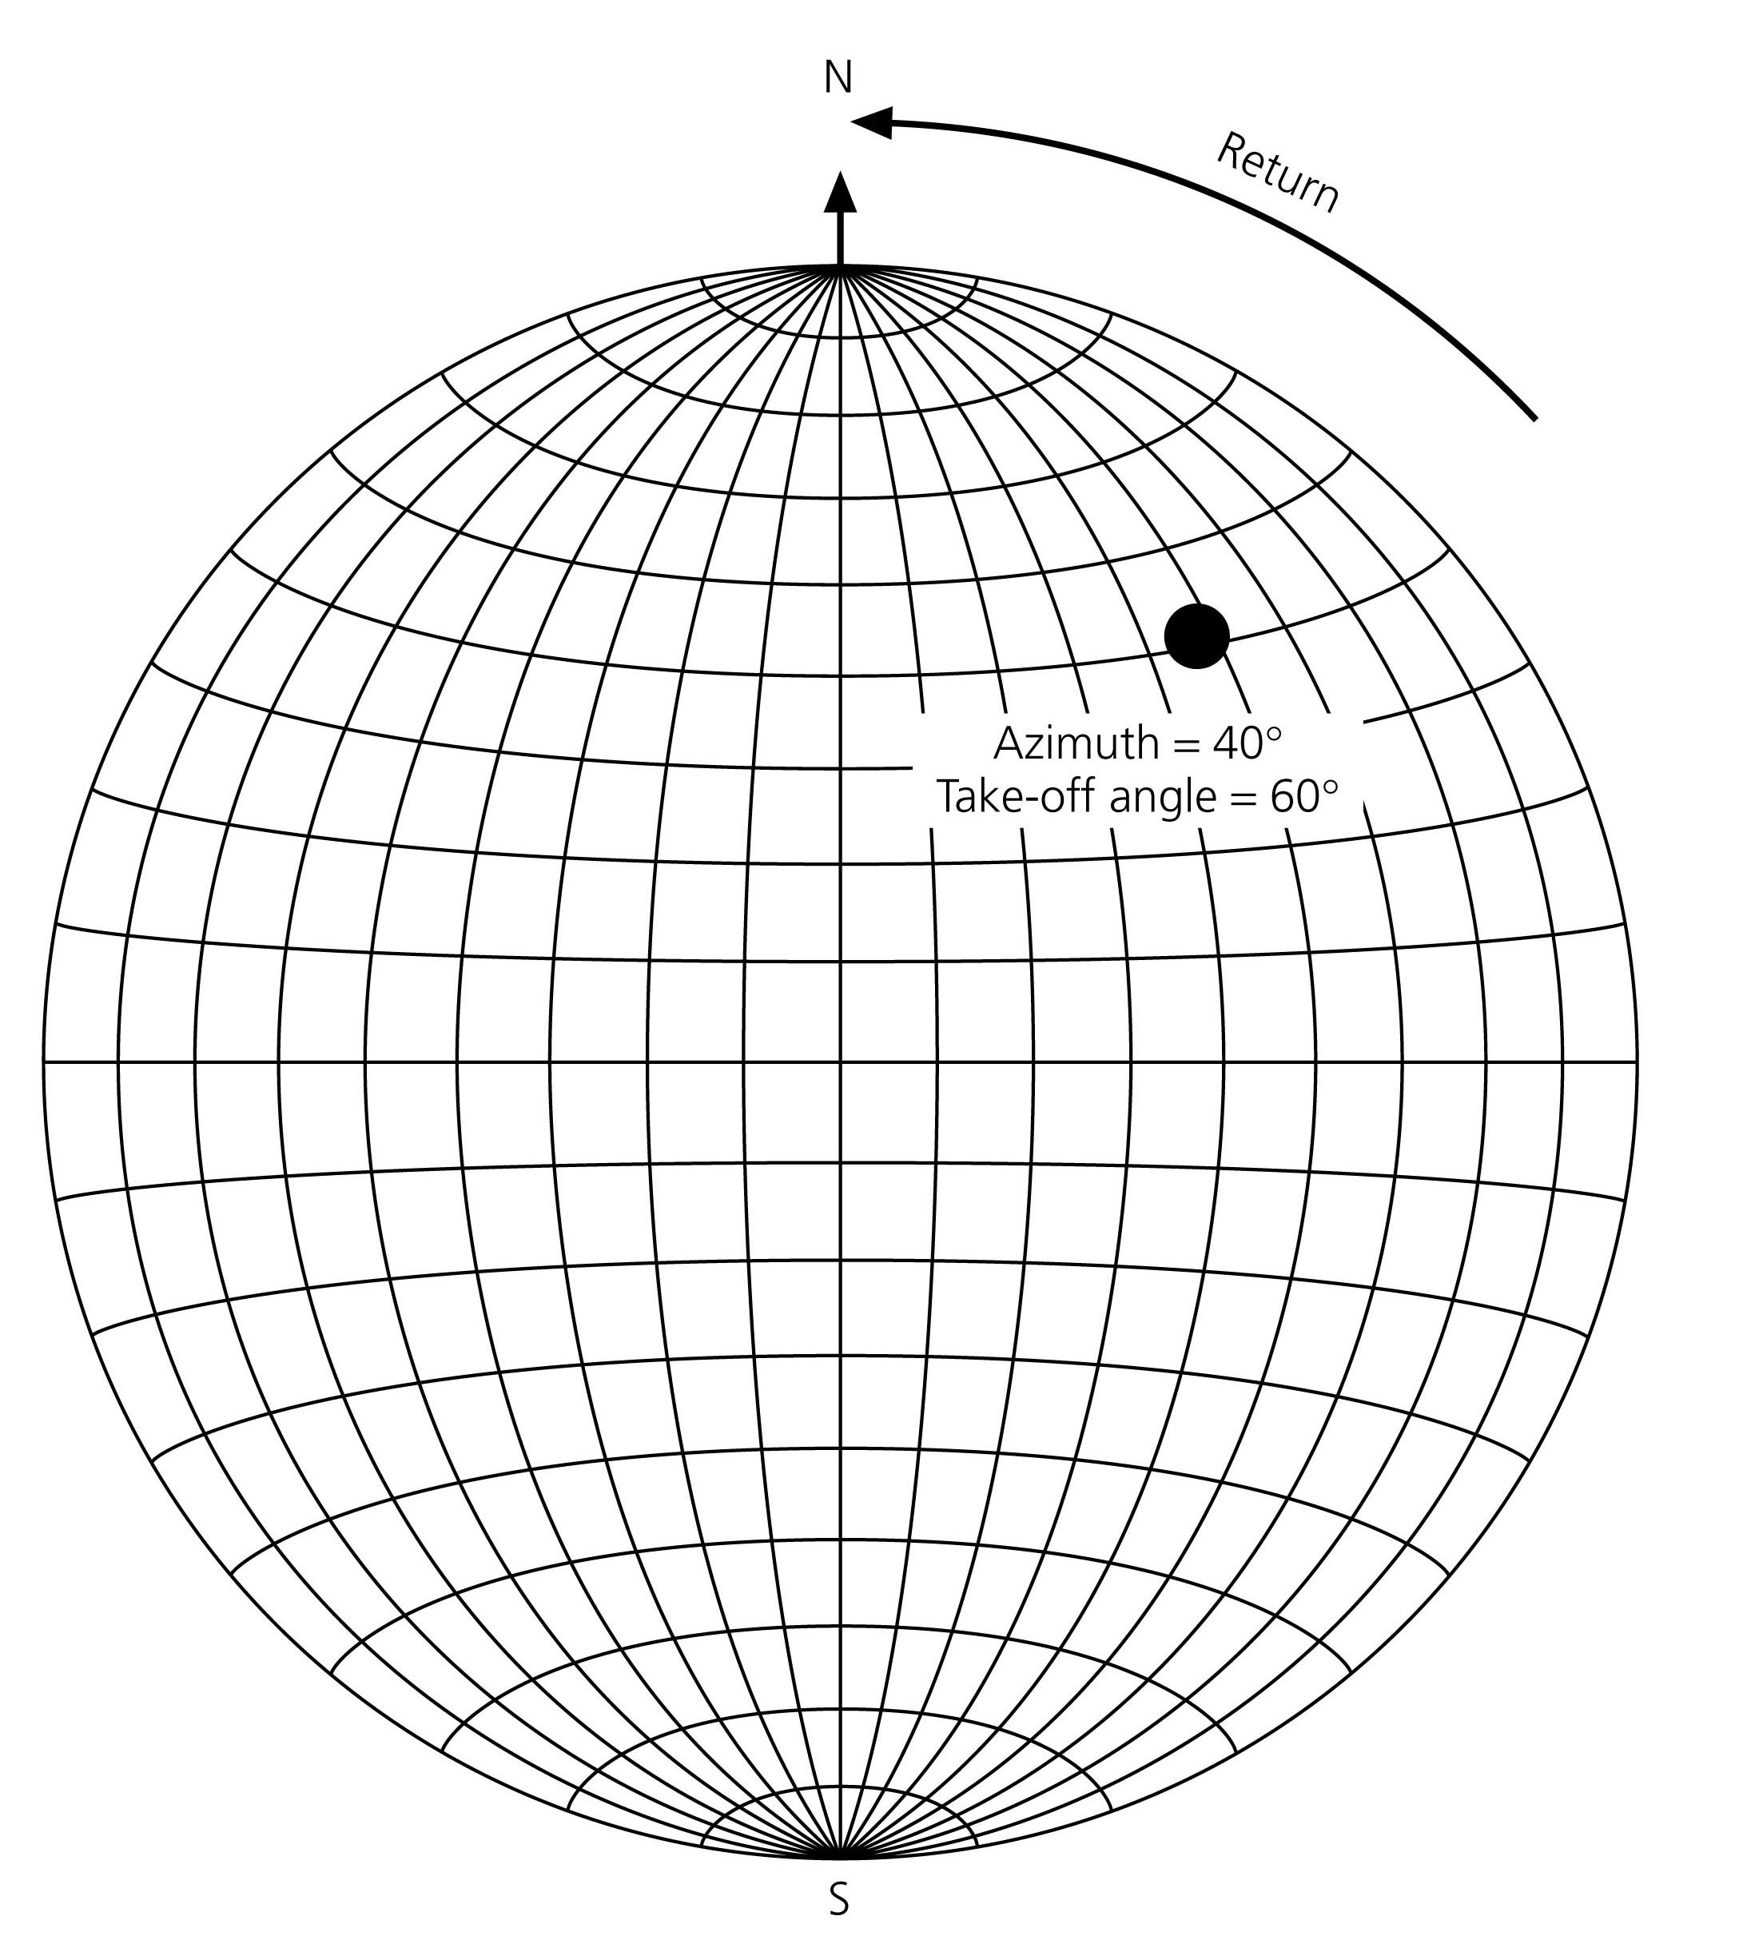
(50°)
(50°)

Slide 32
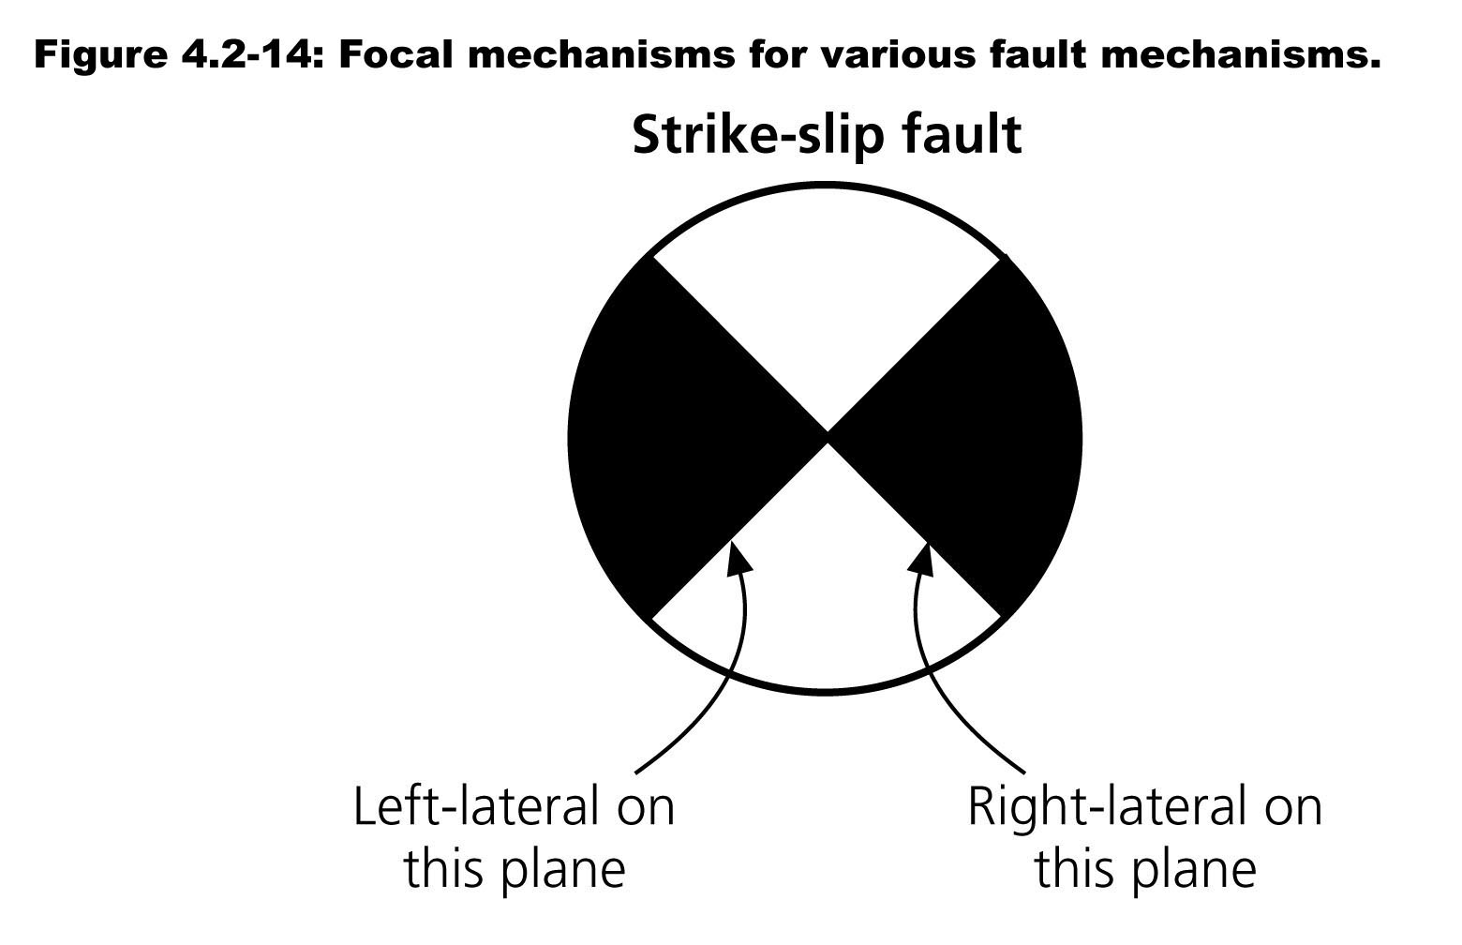
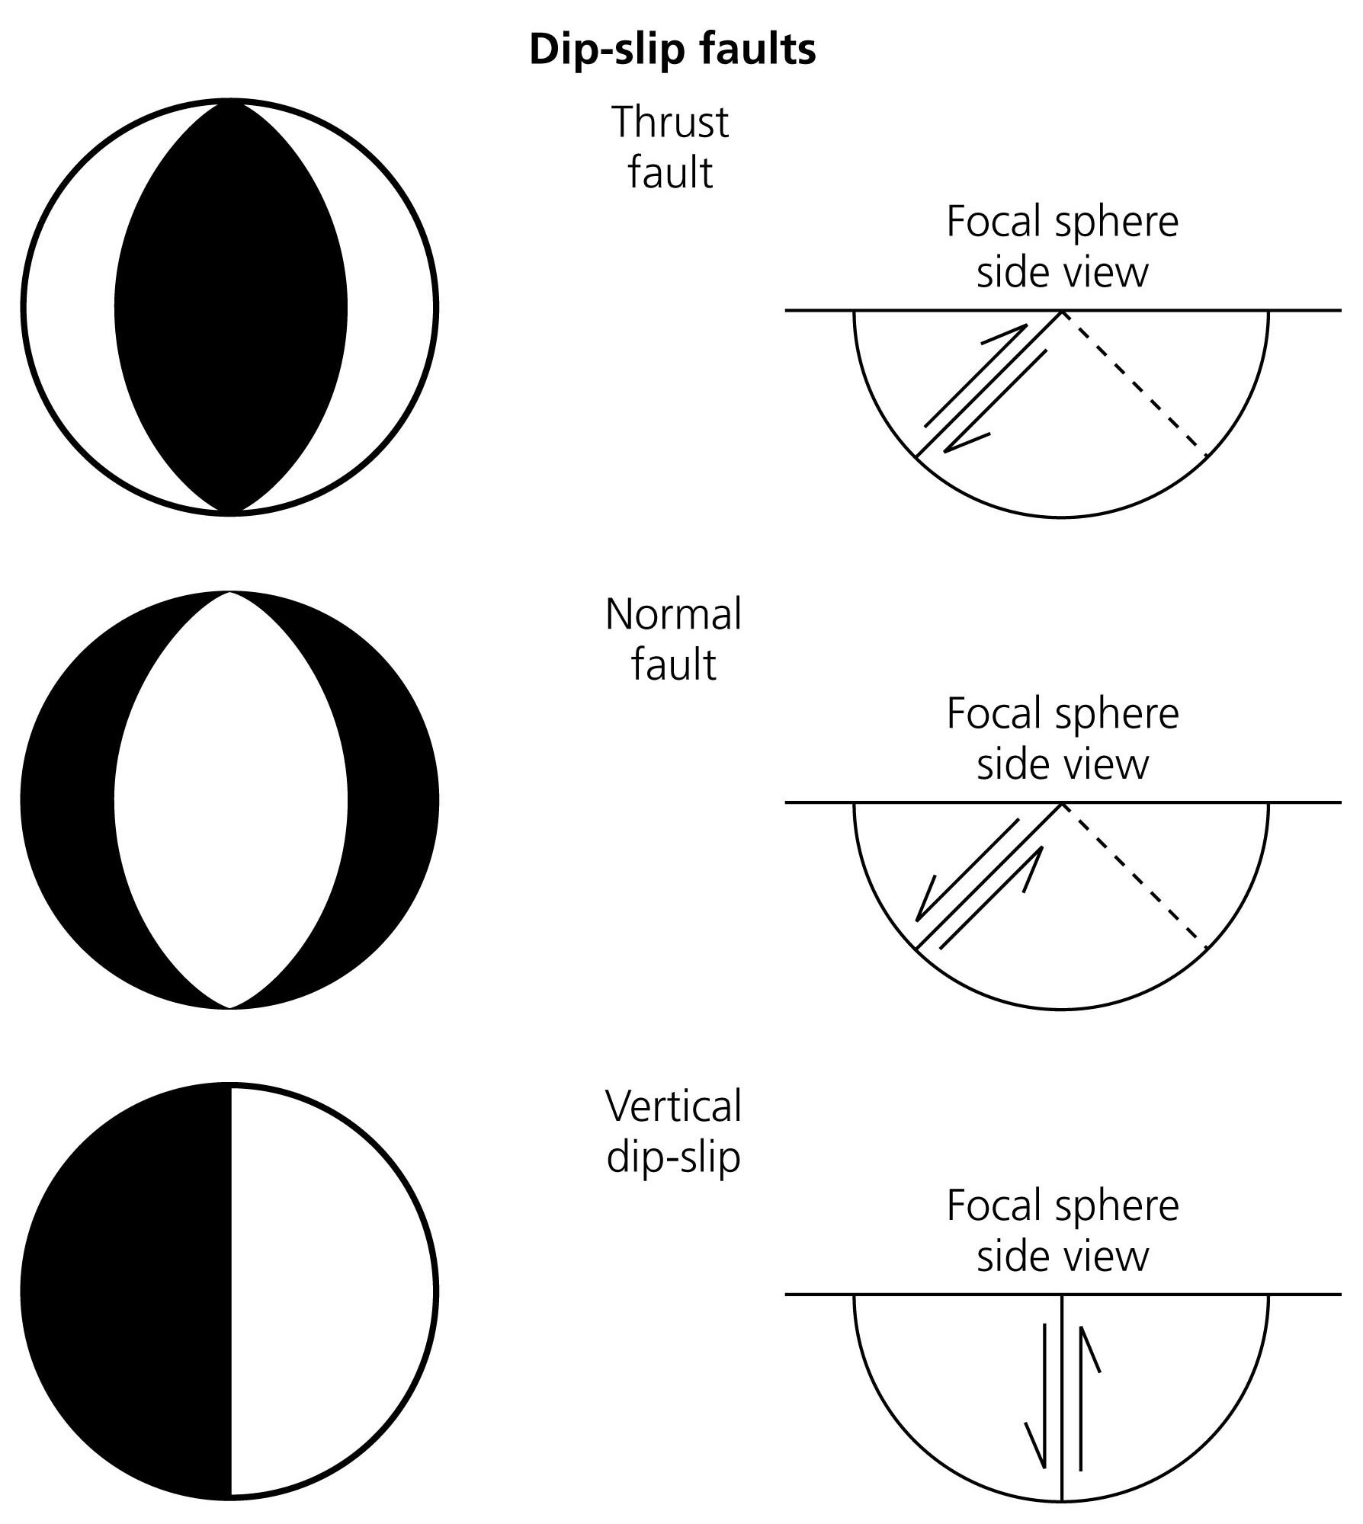
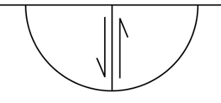
Four end member earthquakes
or horizontal
dip-slip

Slide 33
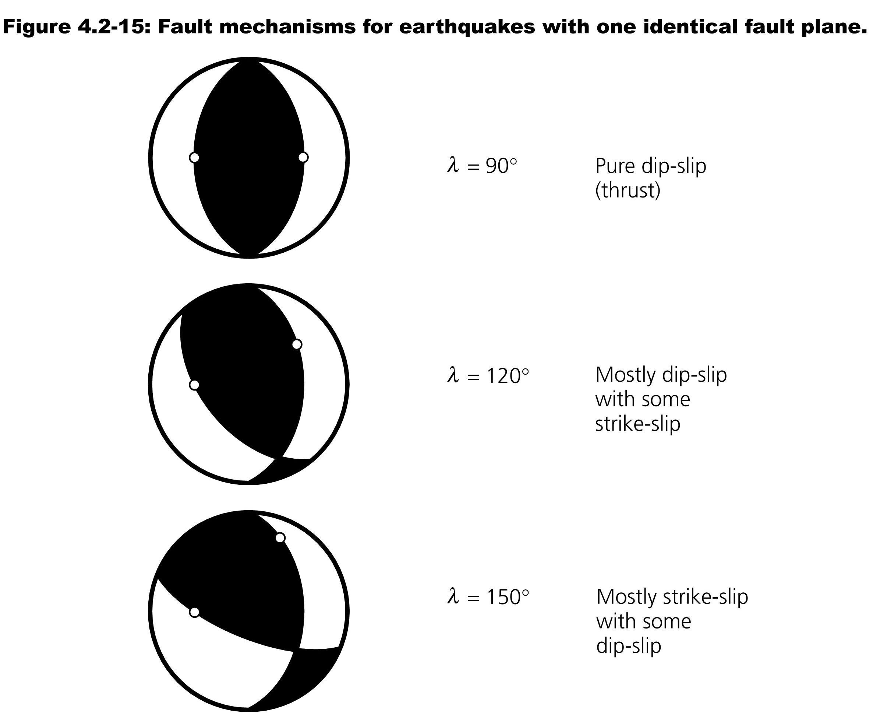
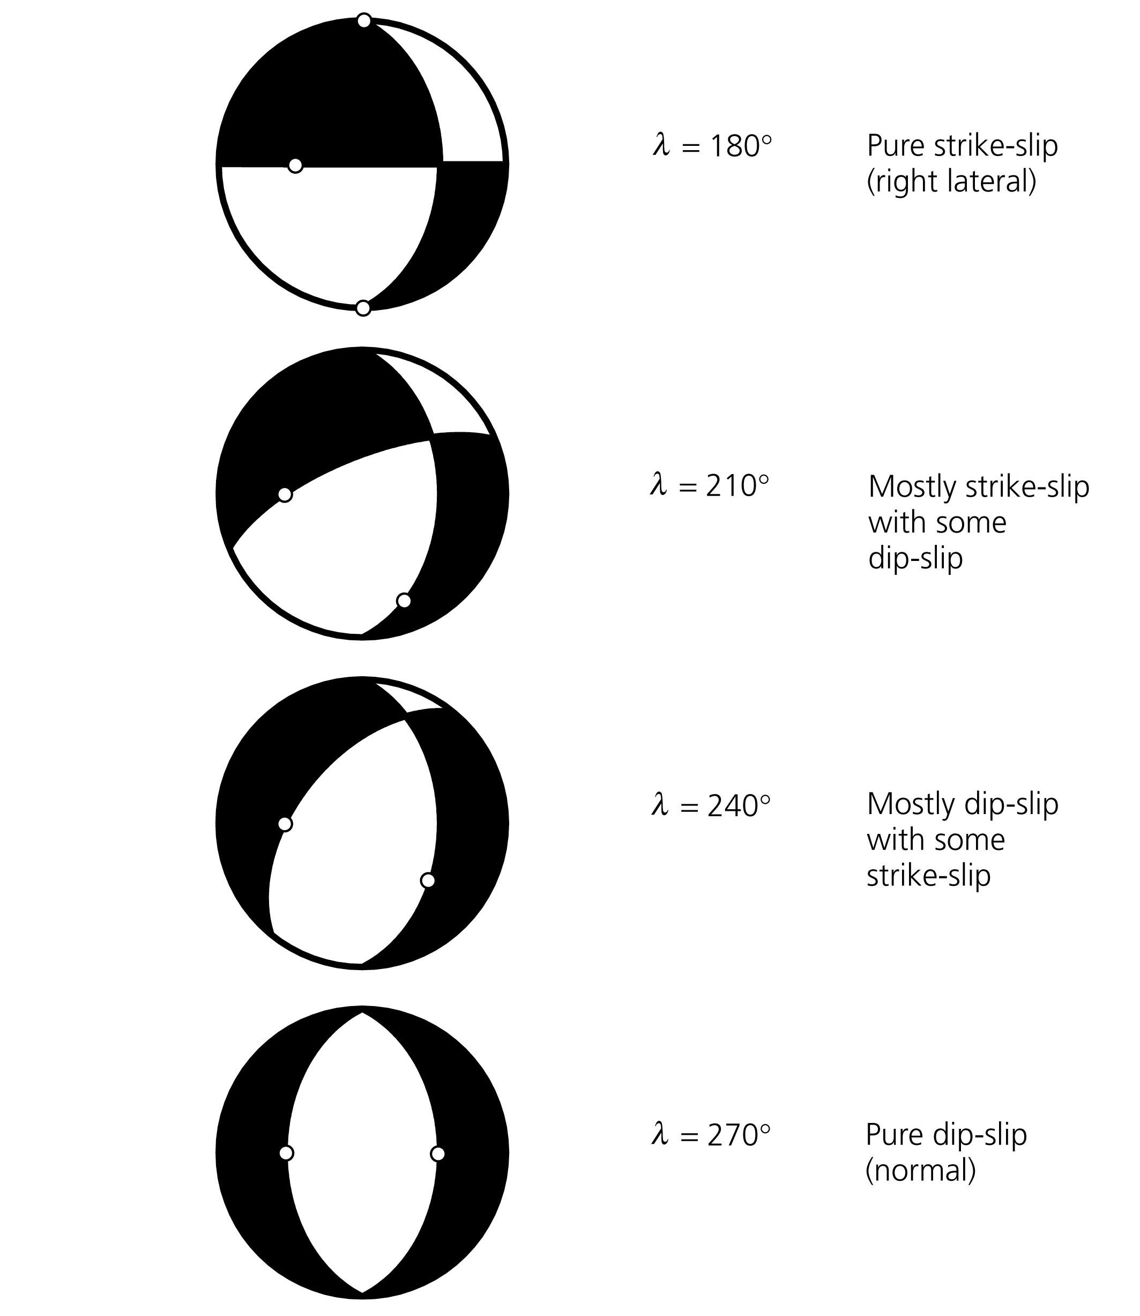
Red plane is constant, second plane steps through rake angles (0-180° in steps of 30°) as evolves from pure thrust to pure normal.

Slide 34
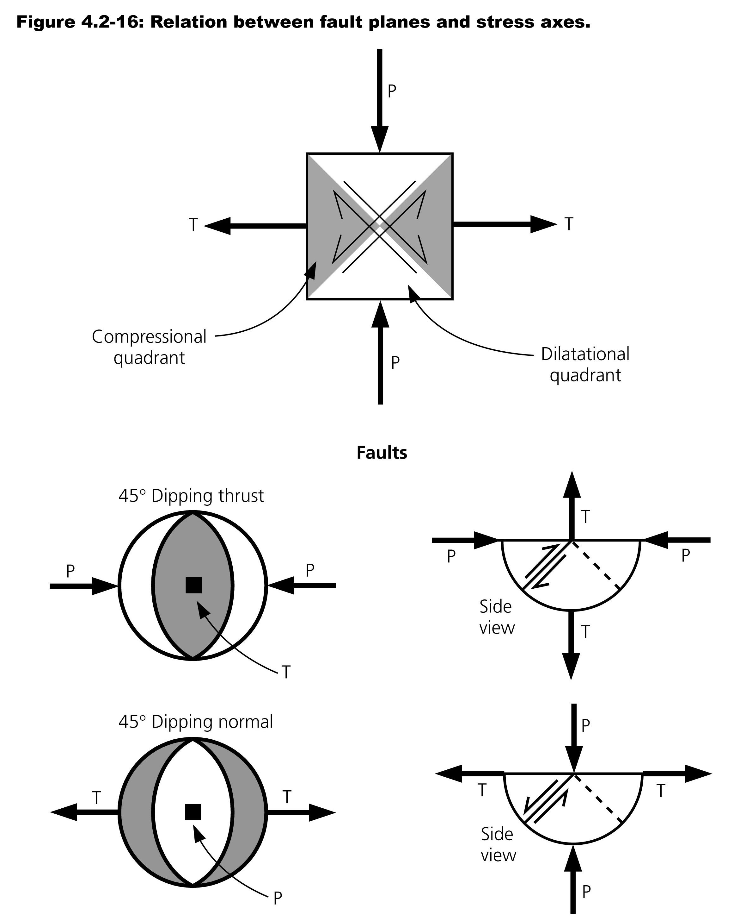
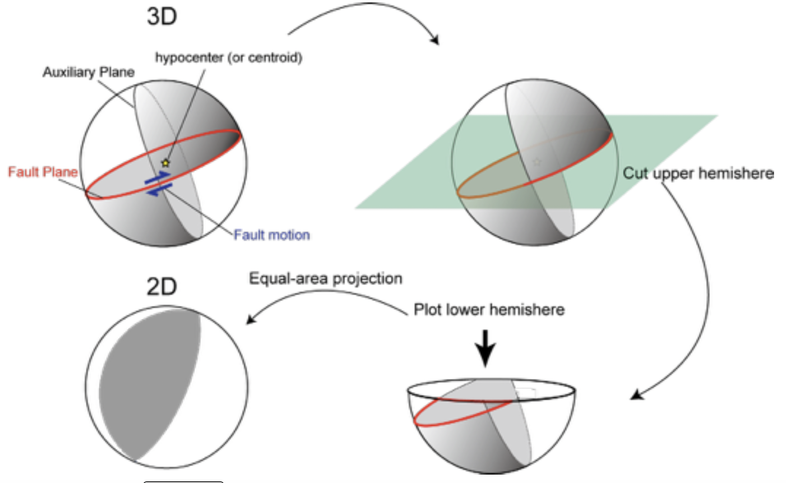
Yuji Yagi
To determine P polarity, look at deformation of focal sphere, pressure is positive inward.

Slide 35
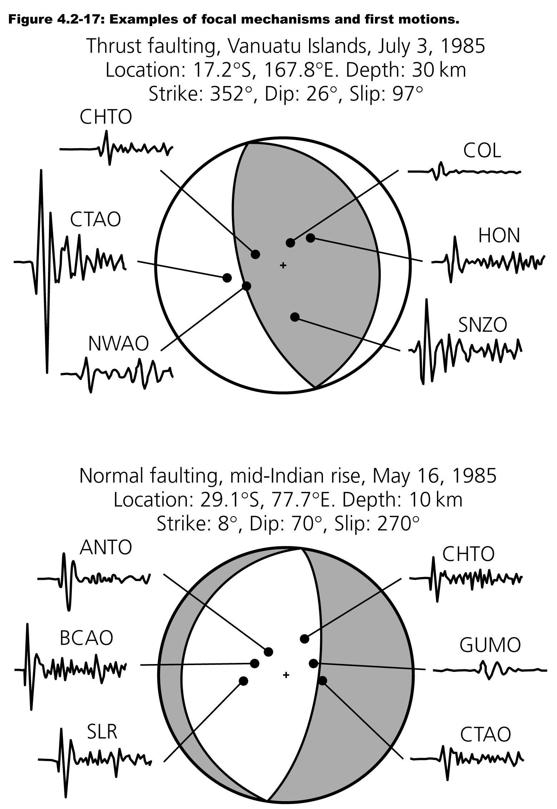
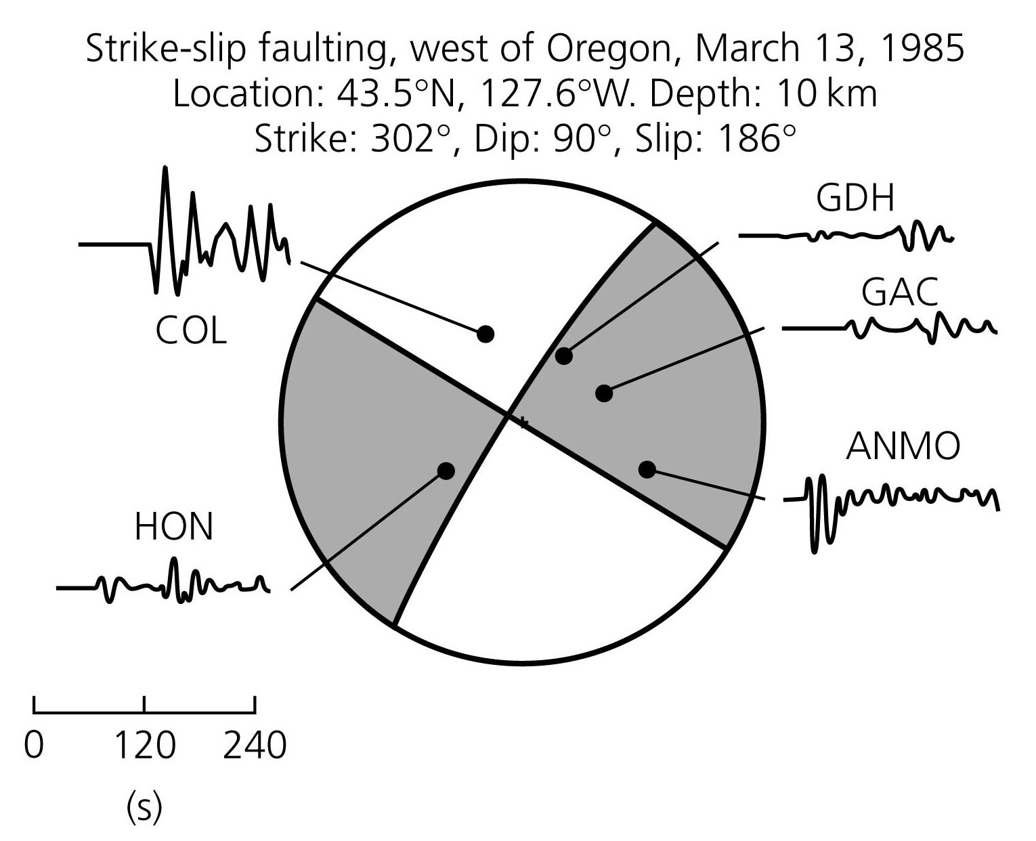
Solutions shown here depend constraining planes by both polarity AND amplitude of P waves.

Slide 36
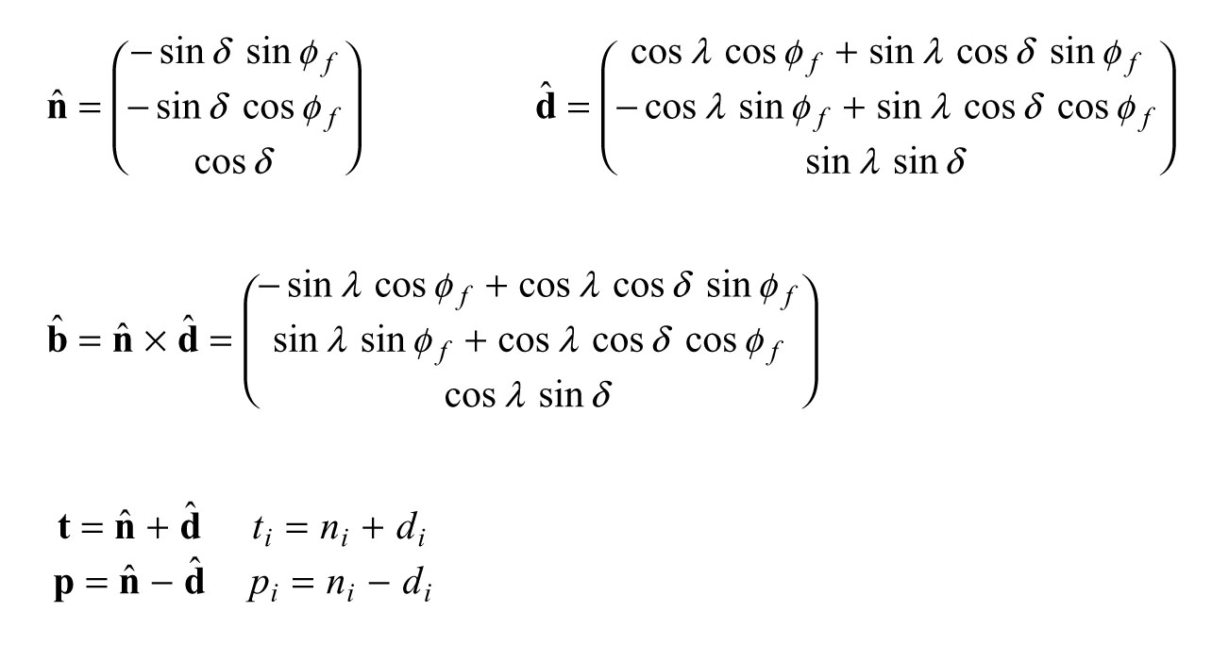
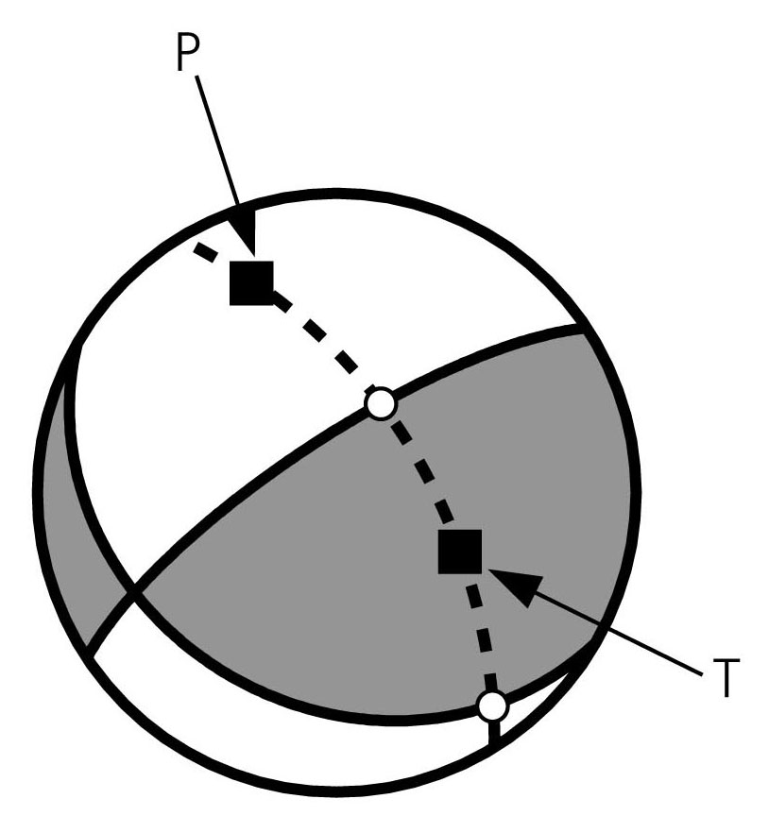
N1, D2
P and T are perpendicular, as are
(N1,D2), and (D1,N2).
All 4 are equally spaced (45° apart) on one of the planes who's normal is B.
B
D1, N2

