Slide 1
Global Seismology CERI-8105
Tu-Th 1:15-2:40 pm
Lab - 3892 Central Ave. (Long building) , Room 110
-----------------------------------------------
Bob Smalley
Office: 3892 Central Ave, Room 103, 678-4929
Office Hours – when I’m in my office.
http://www.ceri.memphis.edu/people/smalley/CERI8105_GlobalSeismology.html
Tue., Nov 7, 2023 Meeting 20

Slide 2
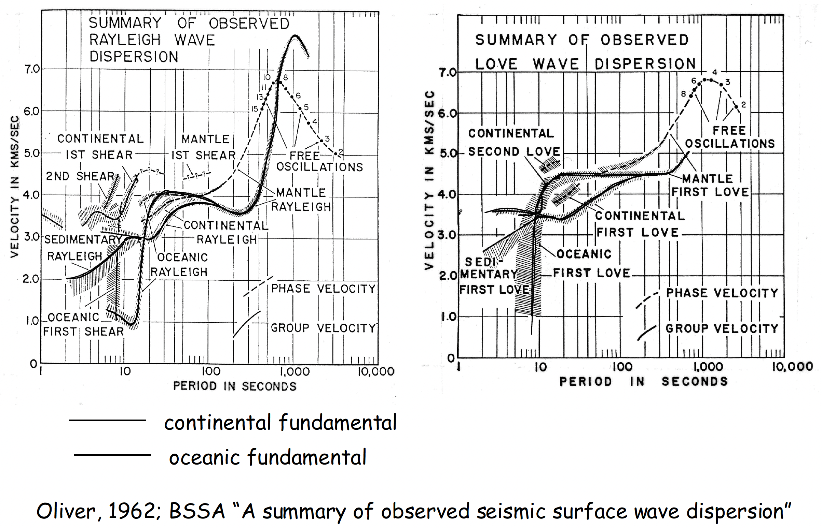
Early (pre-plate tectonic) summary of surface wave dispersion data that still describes the global picture.
Notes:
Notice, since the dispersion relation can be inverted for velocity structure (and infer temperature, and other properties) that these results indicate that continents and oceans have very different structures beneath them. Also, since parts of the dispersion curve are also related to properties like sediment thickness in the oceans and continents.
Plate tectonics gives an explanation for these observations and their interpretations.

Slide 3
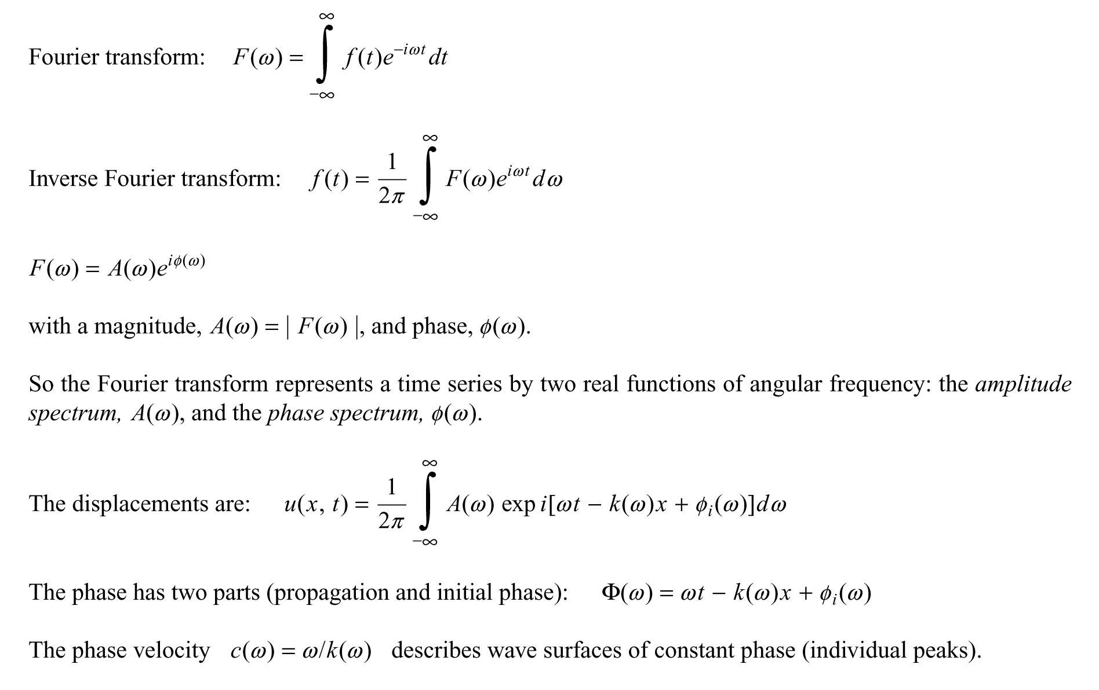
The math of the frequency domain derivation of phase and group velocity.

Slide 4
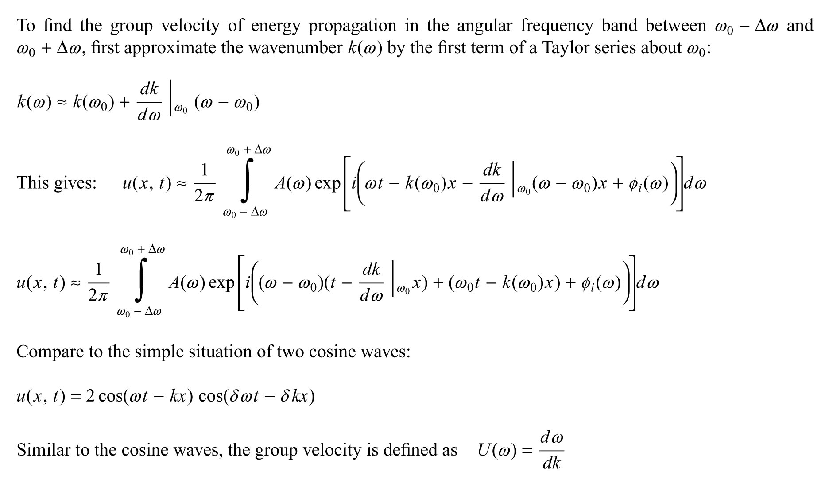

Slide 5
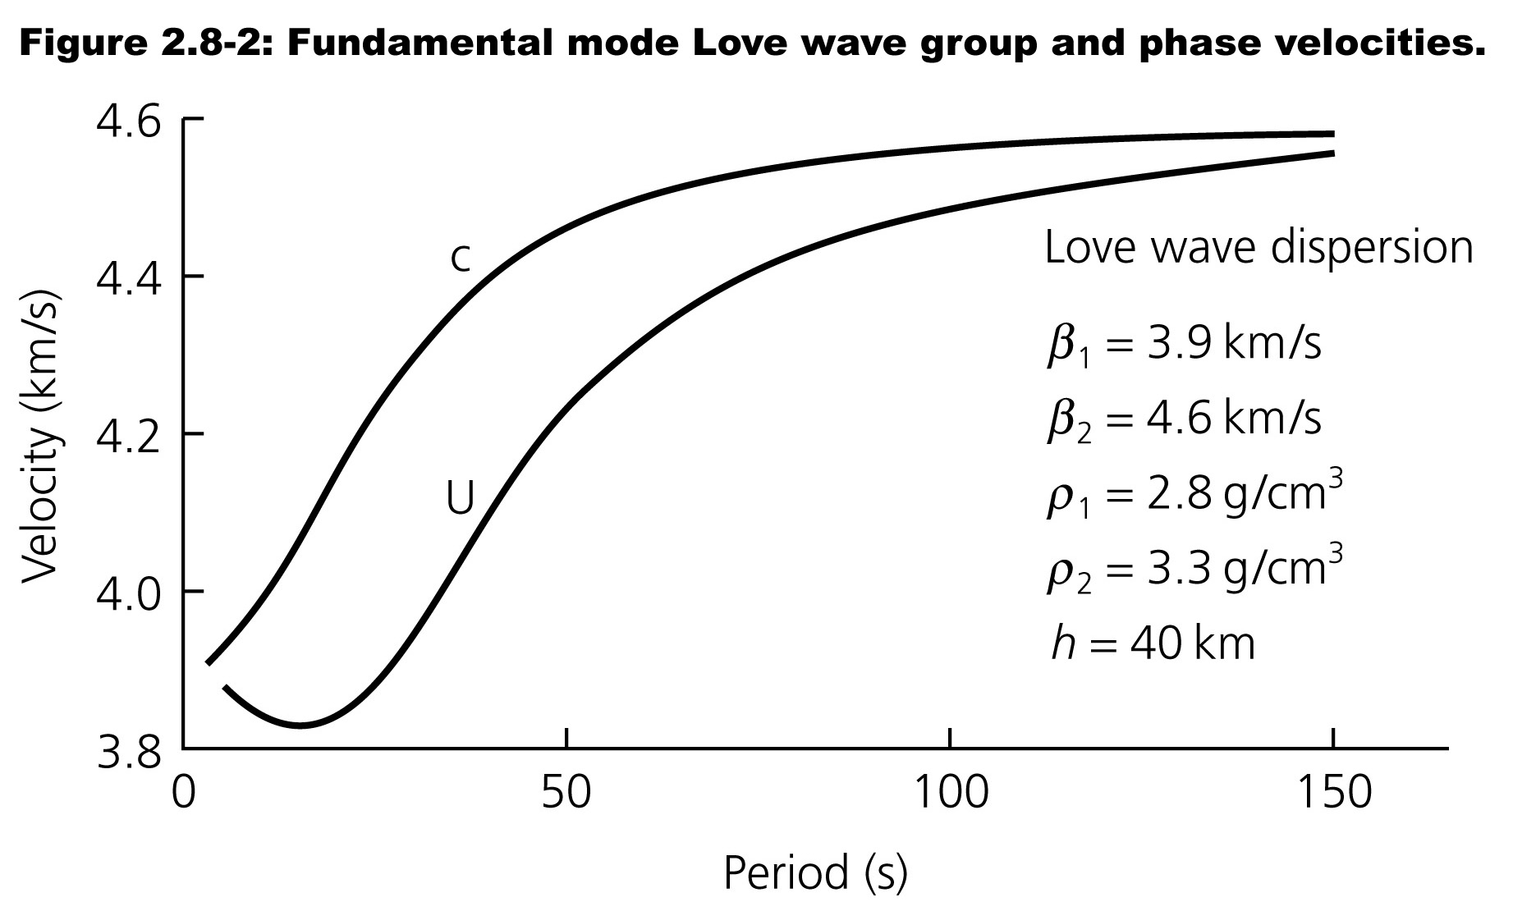
The group velocity is usually easier to measure directly from the seismograms.
The phase velocity is usually a bit harder to measure.

Slide 7
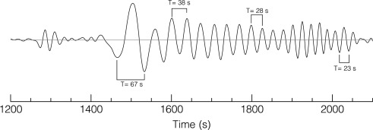
https://www.sciencedirect.com/topics/earth-and-planetary-sciences/group-velocity

Slide 8
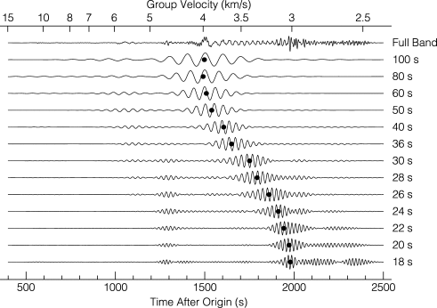
https://www.sciencedirect.com/topics/earth-and-planetary-sciences/group-velocity

Slide 9
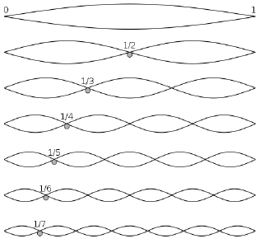
https://ds.iris.edu/media/workshop/2013/01/advanced-studies-institute-on-seismological-research/files/Surface_Waves_ASI.pdf

Slide 10
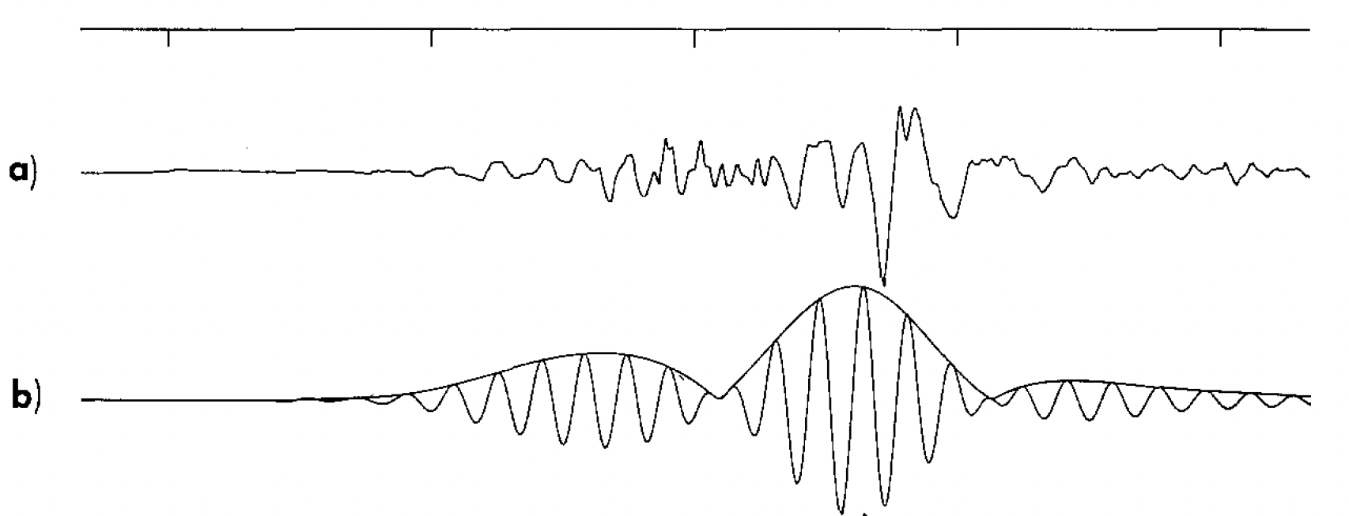
(Dziewonski et al., 1969, A Techniqe for the Analysis of Transient Seismic Signals)

Slide 11
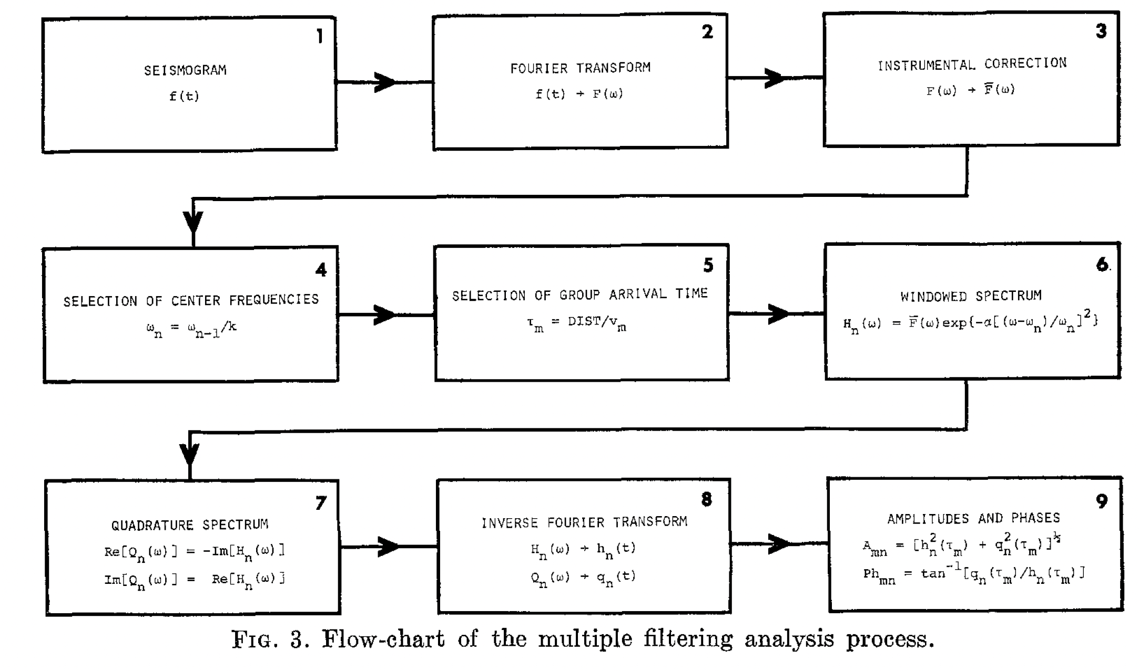
(Dziewonski et al., 1969, A Techniqe for the Analysis of Transient Seismic Signals)

Slide 12
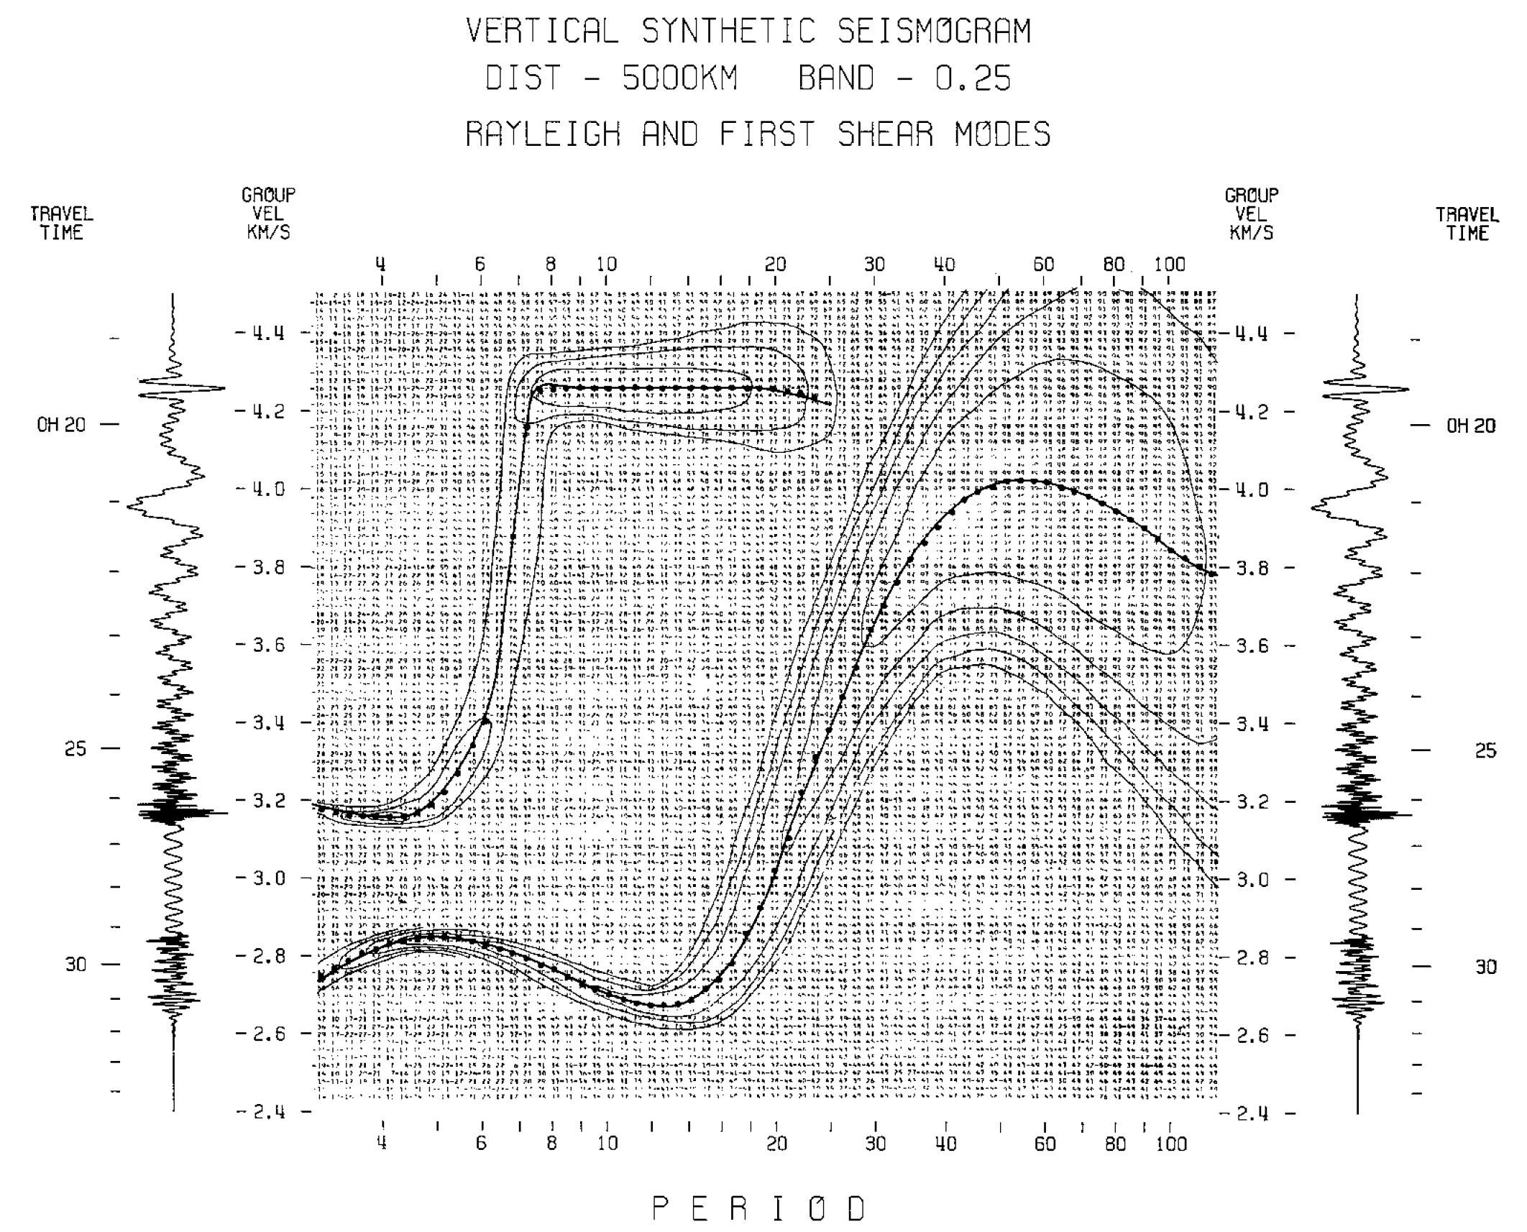
(Dziewonski et al., 1969, A Techniqe for the Analysis of Transient Seismic Signals)

Slide 13
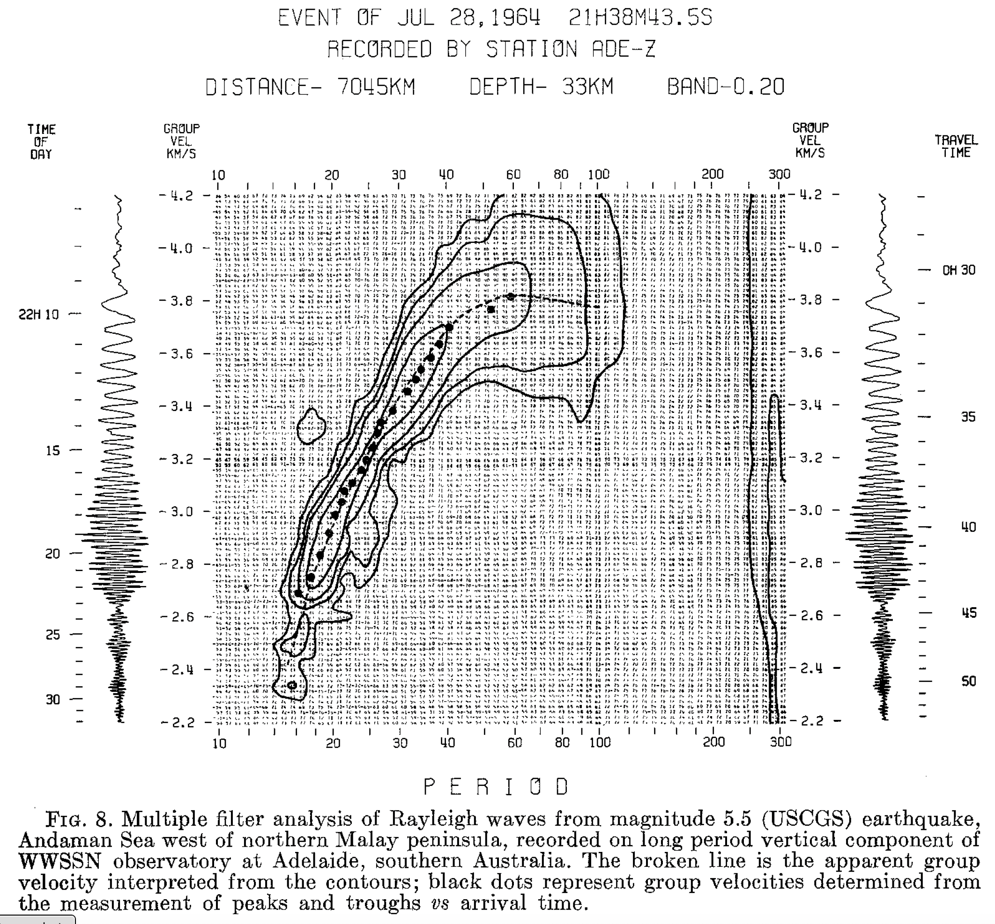
(Dziewonski et al., 1969, A Techniqe for the Analysis of Transient Seismic Signals)

Slide 14
Cartoon video showing integration of cosine waves into dispersing seismogram.
Blue line shows position of constant phase at time=0, and phase velocity.
Purple line shows group velocity.
"Camera" pans to follow dispersing wave.
Unpublished video R. Smalley
Notes:
Note "airy" phases at beginning where c=u as all the low frequency waves travel at the same velocity, at the highest frequencies where c=u as the high frequency waves also travel at the same frequency, and in the middle where the white and black lines become vertical, forming sections of stationary phase along the purple line (the group) velocity. Note Airy phase at place where there is a large section of stationary phase (where the "skirts" stop turning around.

Slide 15
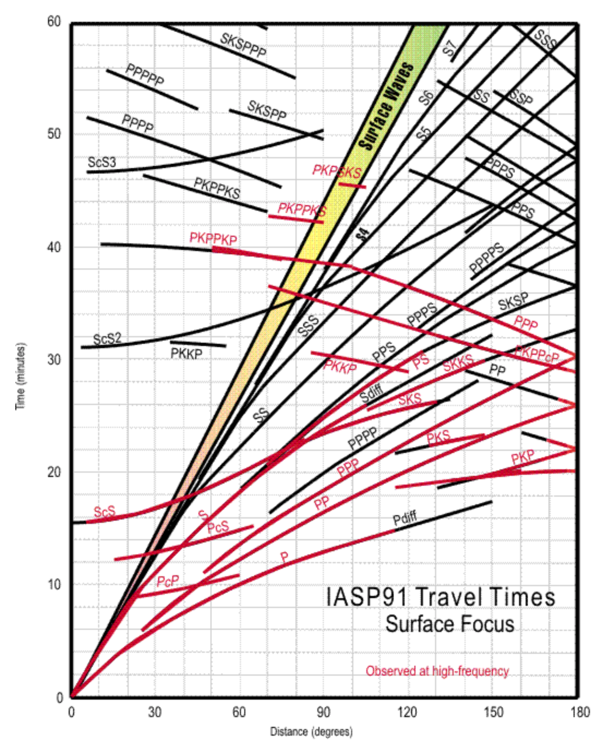

Slide 16
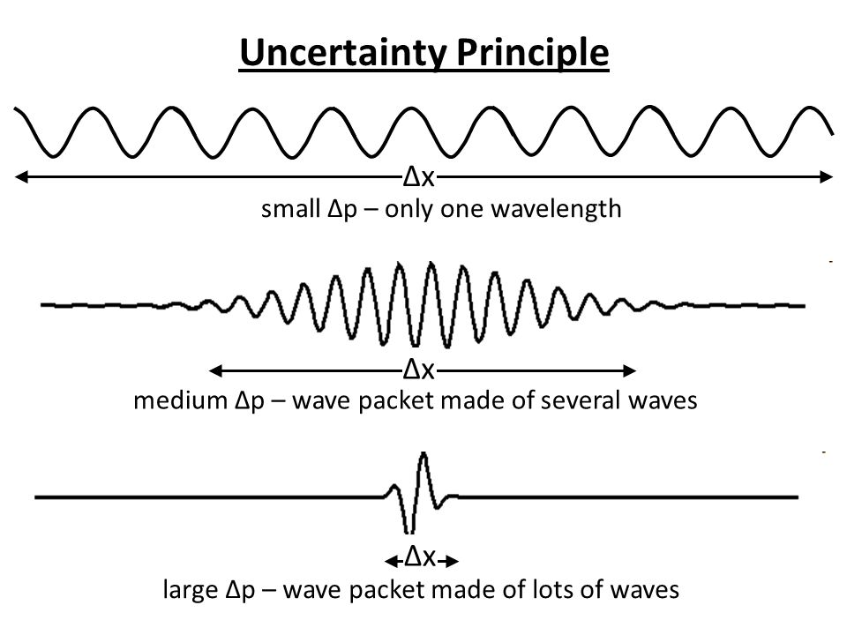
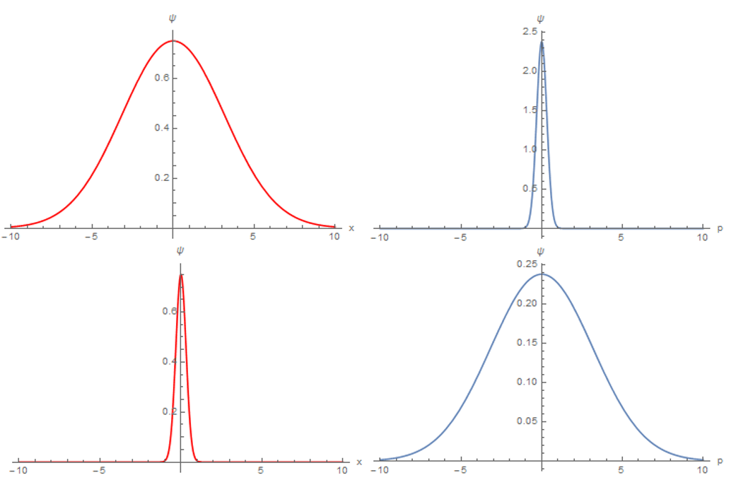
Dispersion
We have a mathematical definition.
We are now going to look at its strong, obvious effects on the seismogram and what we can learn from them
Reddit - How do you interpret Heisenberg's Uncertainty Principle for wave functions? : r/askscience
https://brilliant.org/wiki/heisenberg-uncertainty-principle/

