Slide 1
Global Seismology CERI-8105
Tu-Th 1:15-2:40 pm
Lab - 3892 Central Ave. (Long building) , Room 110
-----------------------------------------------
Bob Smalley
Office: 3892 Central Ave, Room 103, 678-4929
Office Hours – when I’m in my office.
http://www.ceri.memphis.edu/people/smalley/CERI8105_GlobalSeismology.html
Tue., Nov 2, 2023 Meeting 19

Slide 2
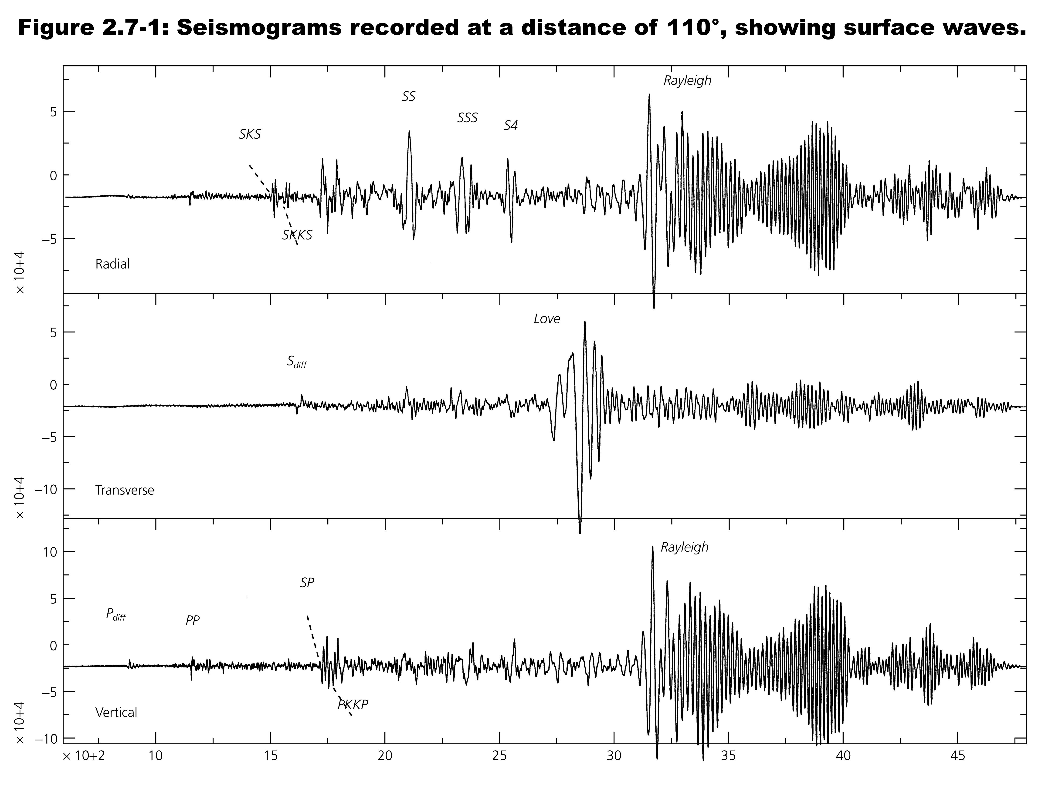
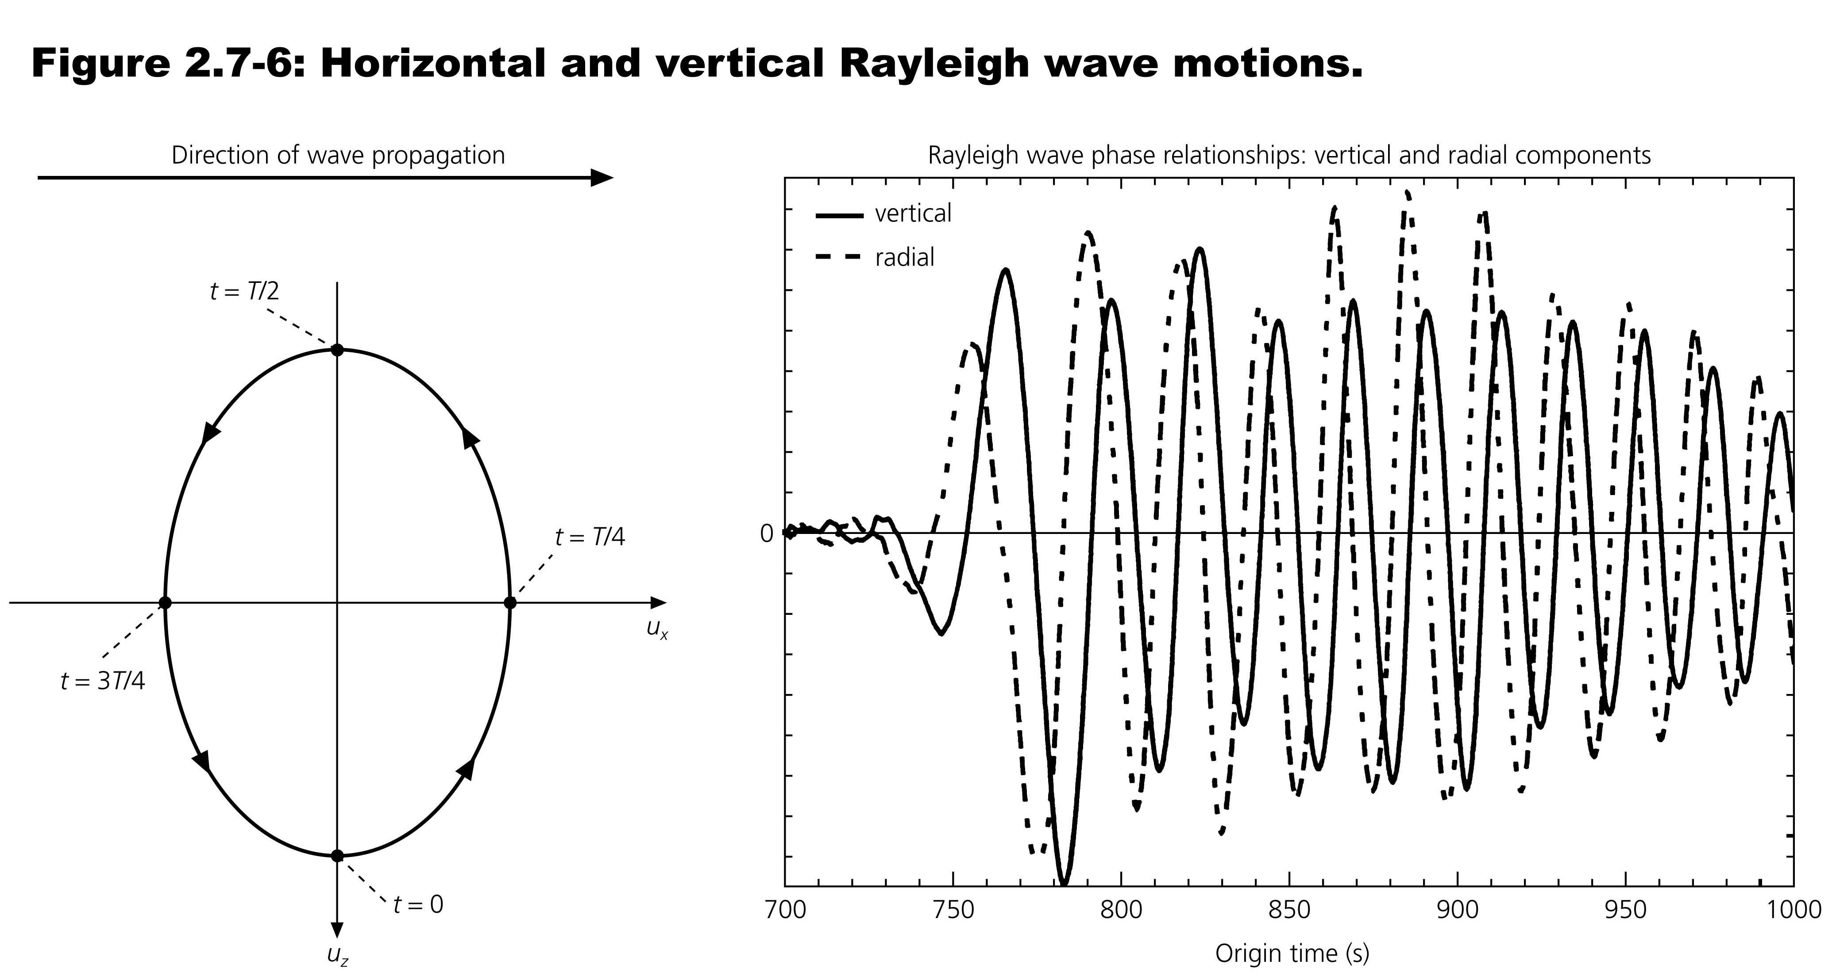
Notes:
While Rayleigh waves are not dispersive in a homogeneous half space, they are in the earth where there are layers with velocity increasing with depth and they also get trapped as waveguide waves.

Slide 3
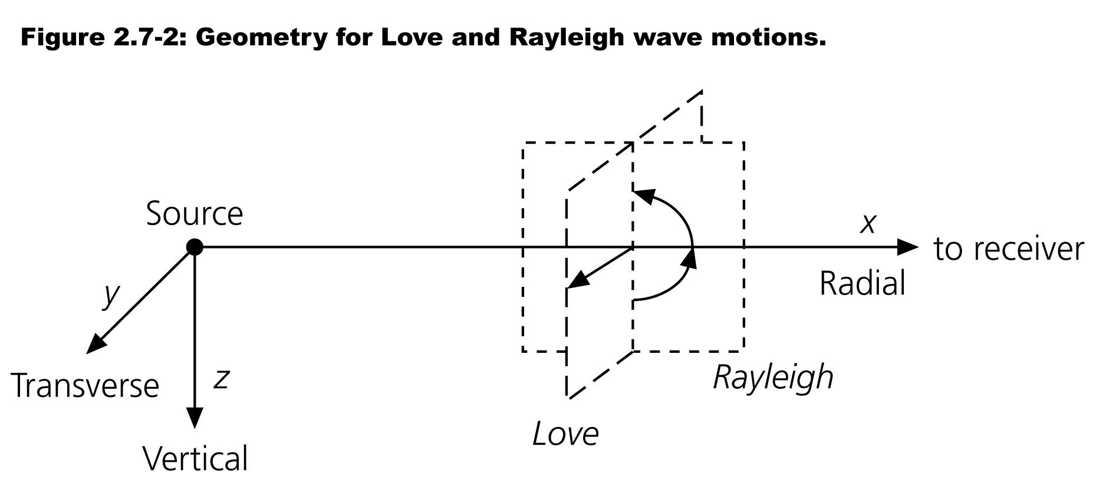
The direction the waves are traveling in this example are fortuitously lined up with the seismometer orientation, the radial direction is EW, and the transverse direction is NS.
Notes:
These recordings are said to be naturally polarized

Slide 4
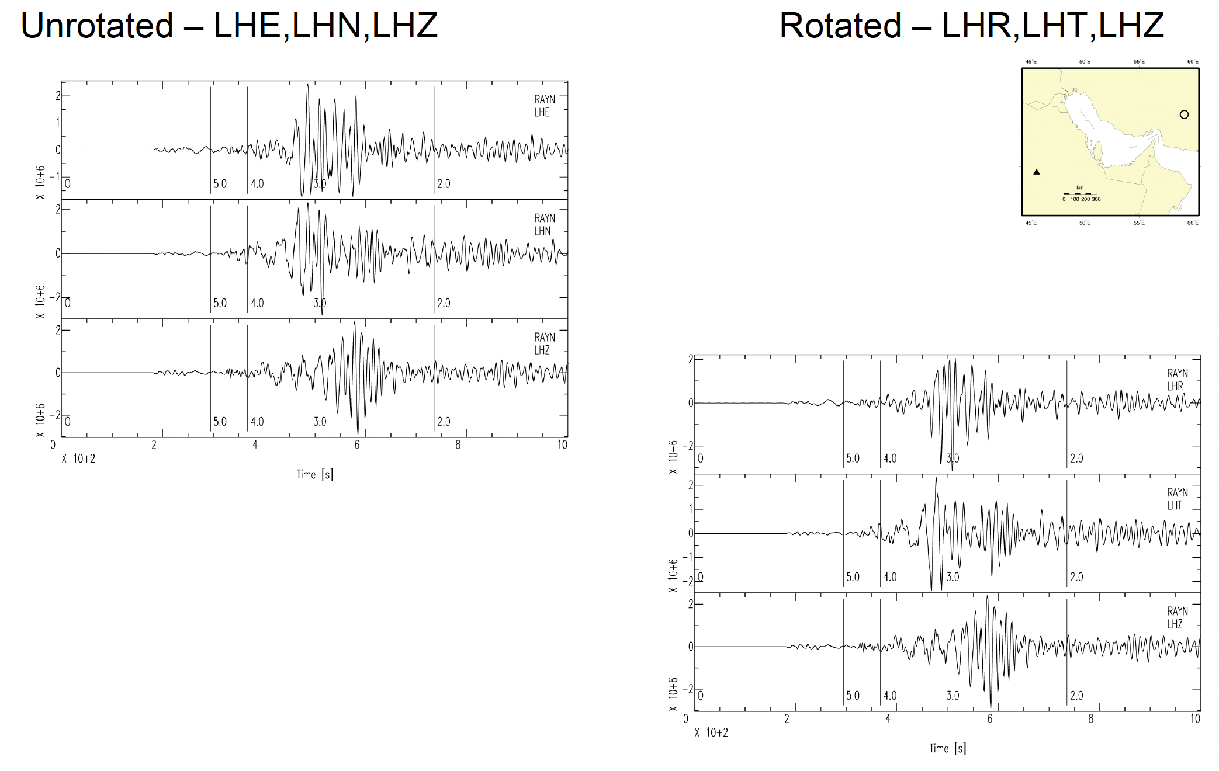
We are generally not so lucky and have to "rotate" the horizontal components from NS/EW (above) to R/T (right).

Slide 5
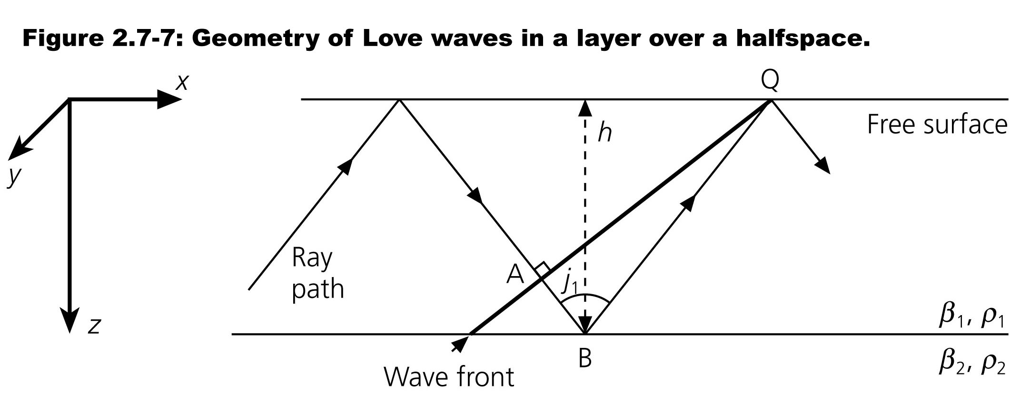
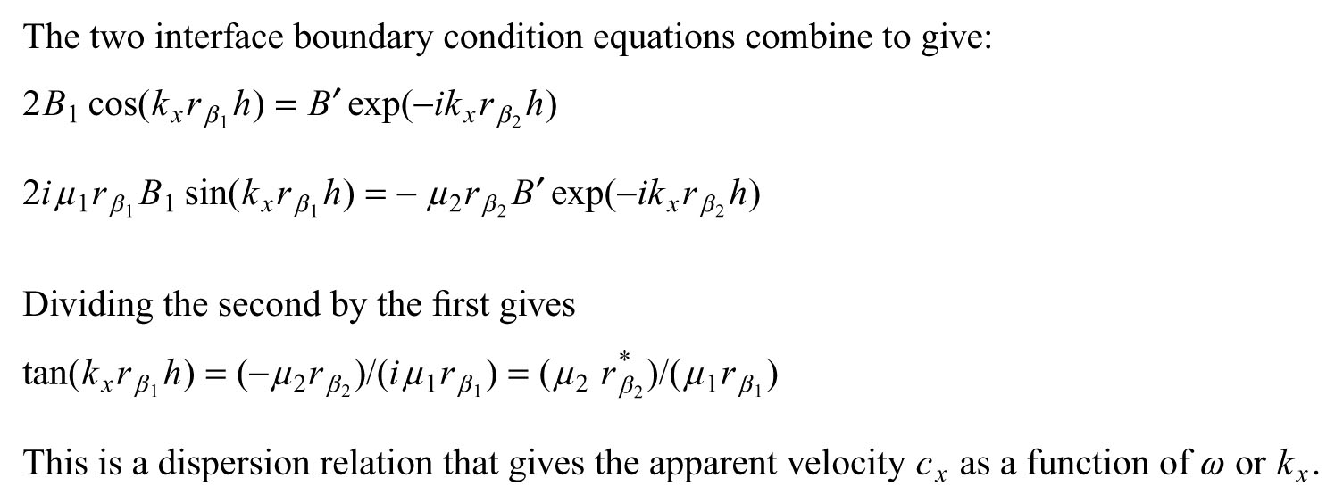

Slide 6
Dispersion
We have a mathematical definition.
We are now going to look at its strong, obvious effects on the seismogram and what we can learn from them

Slide 7
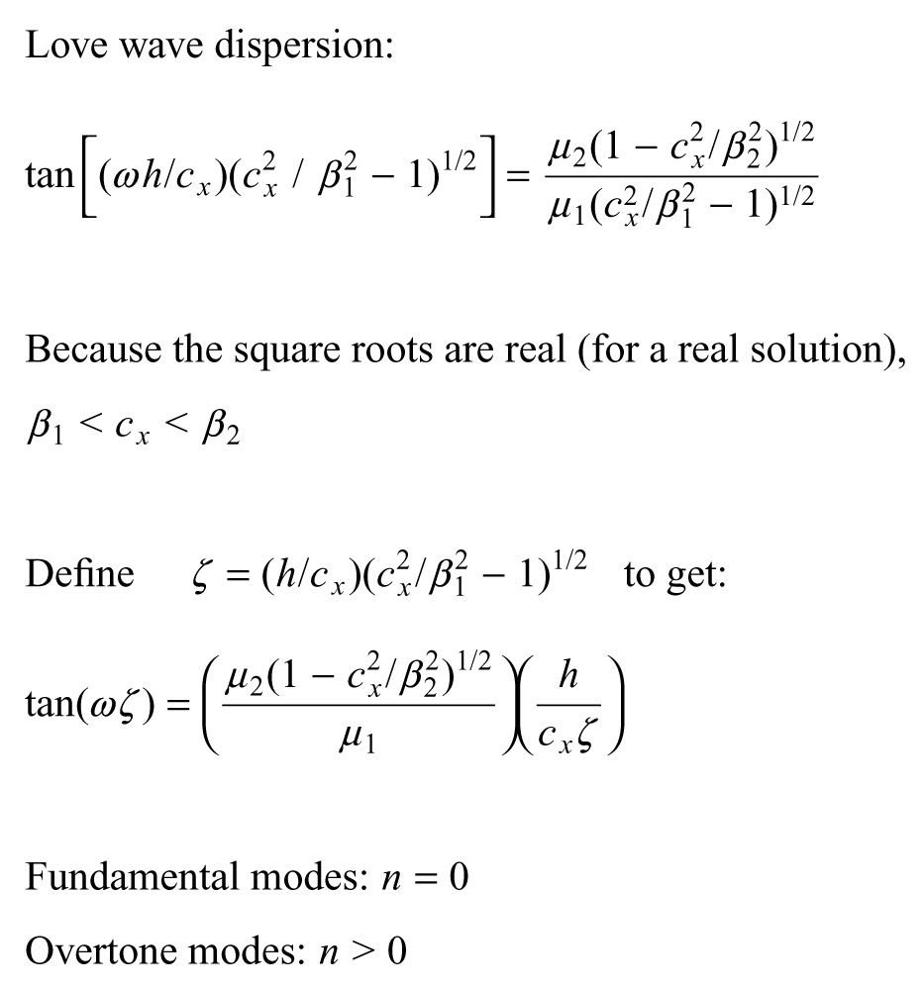
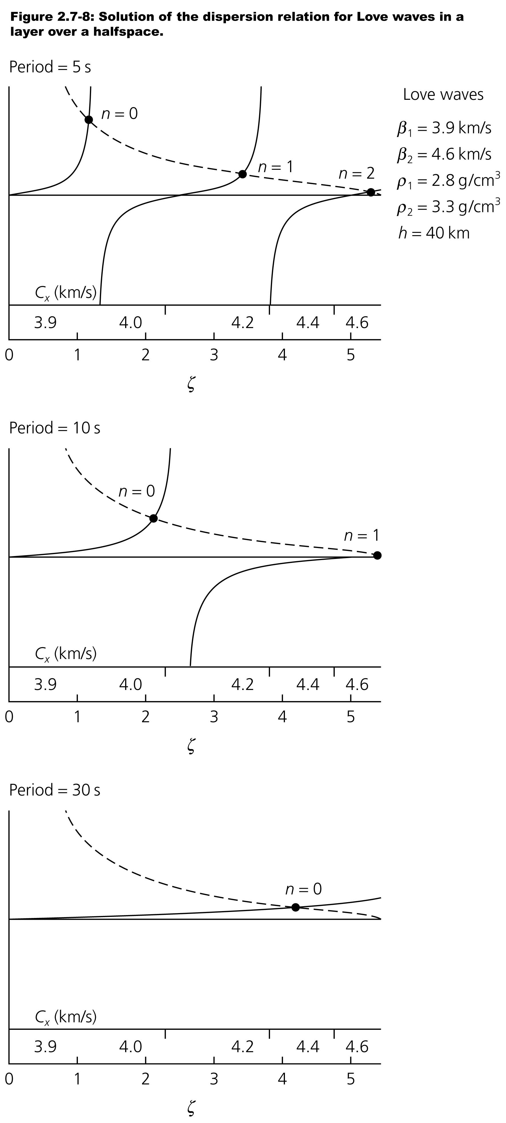
Notes:
Calclate both sides of the equation as a function of period and find where the two equations are equal – this gives us the Cx for each n.
The restriction that Cx has to be real puts limits (layer velocity is lower limit, underlying half space is upper limit) on the allowed solution space

Slide 8
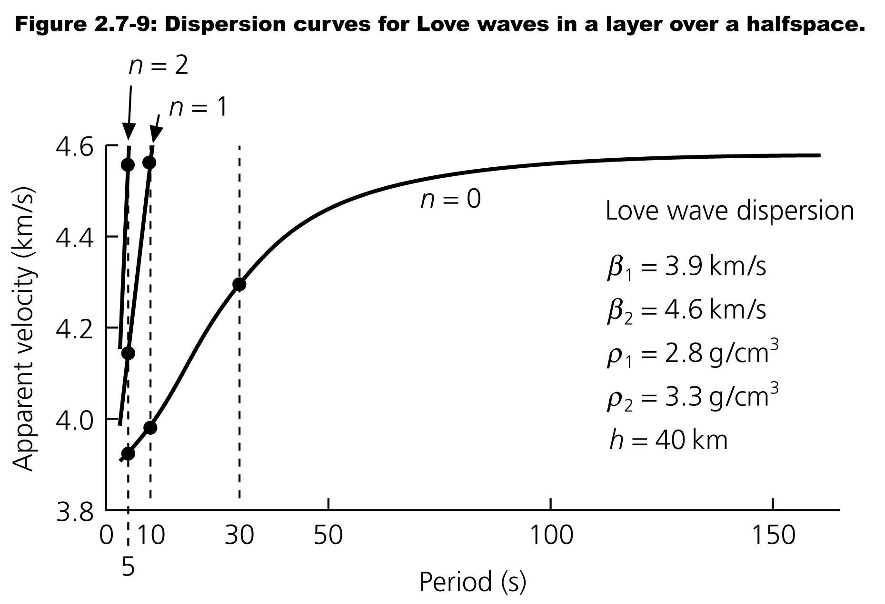
For Love waves dispersion is geometric, for Rayleigh waves dispersion is due to longer period/wavelength waves seeing deeper/faster (plus also geometric, same as Love waves)

Slide 9
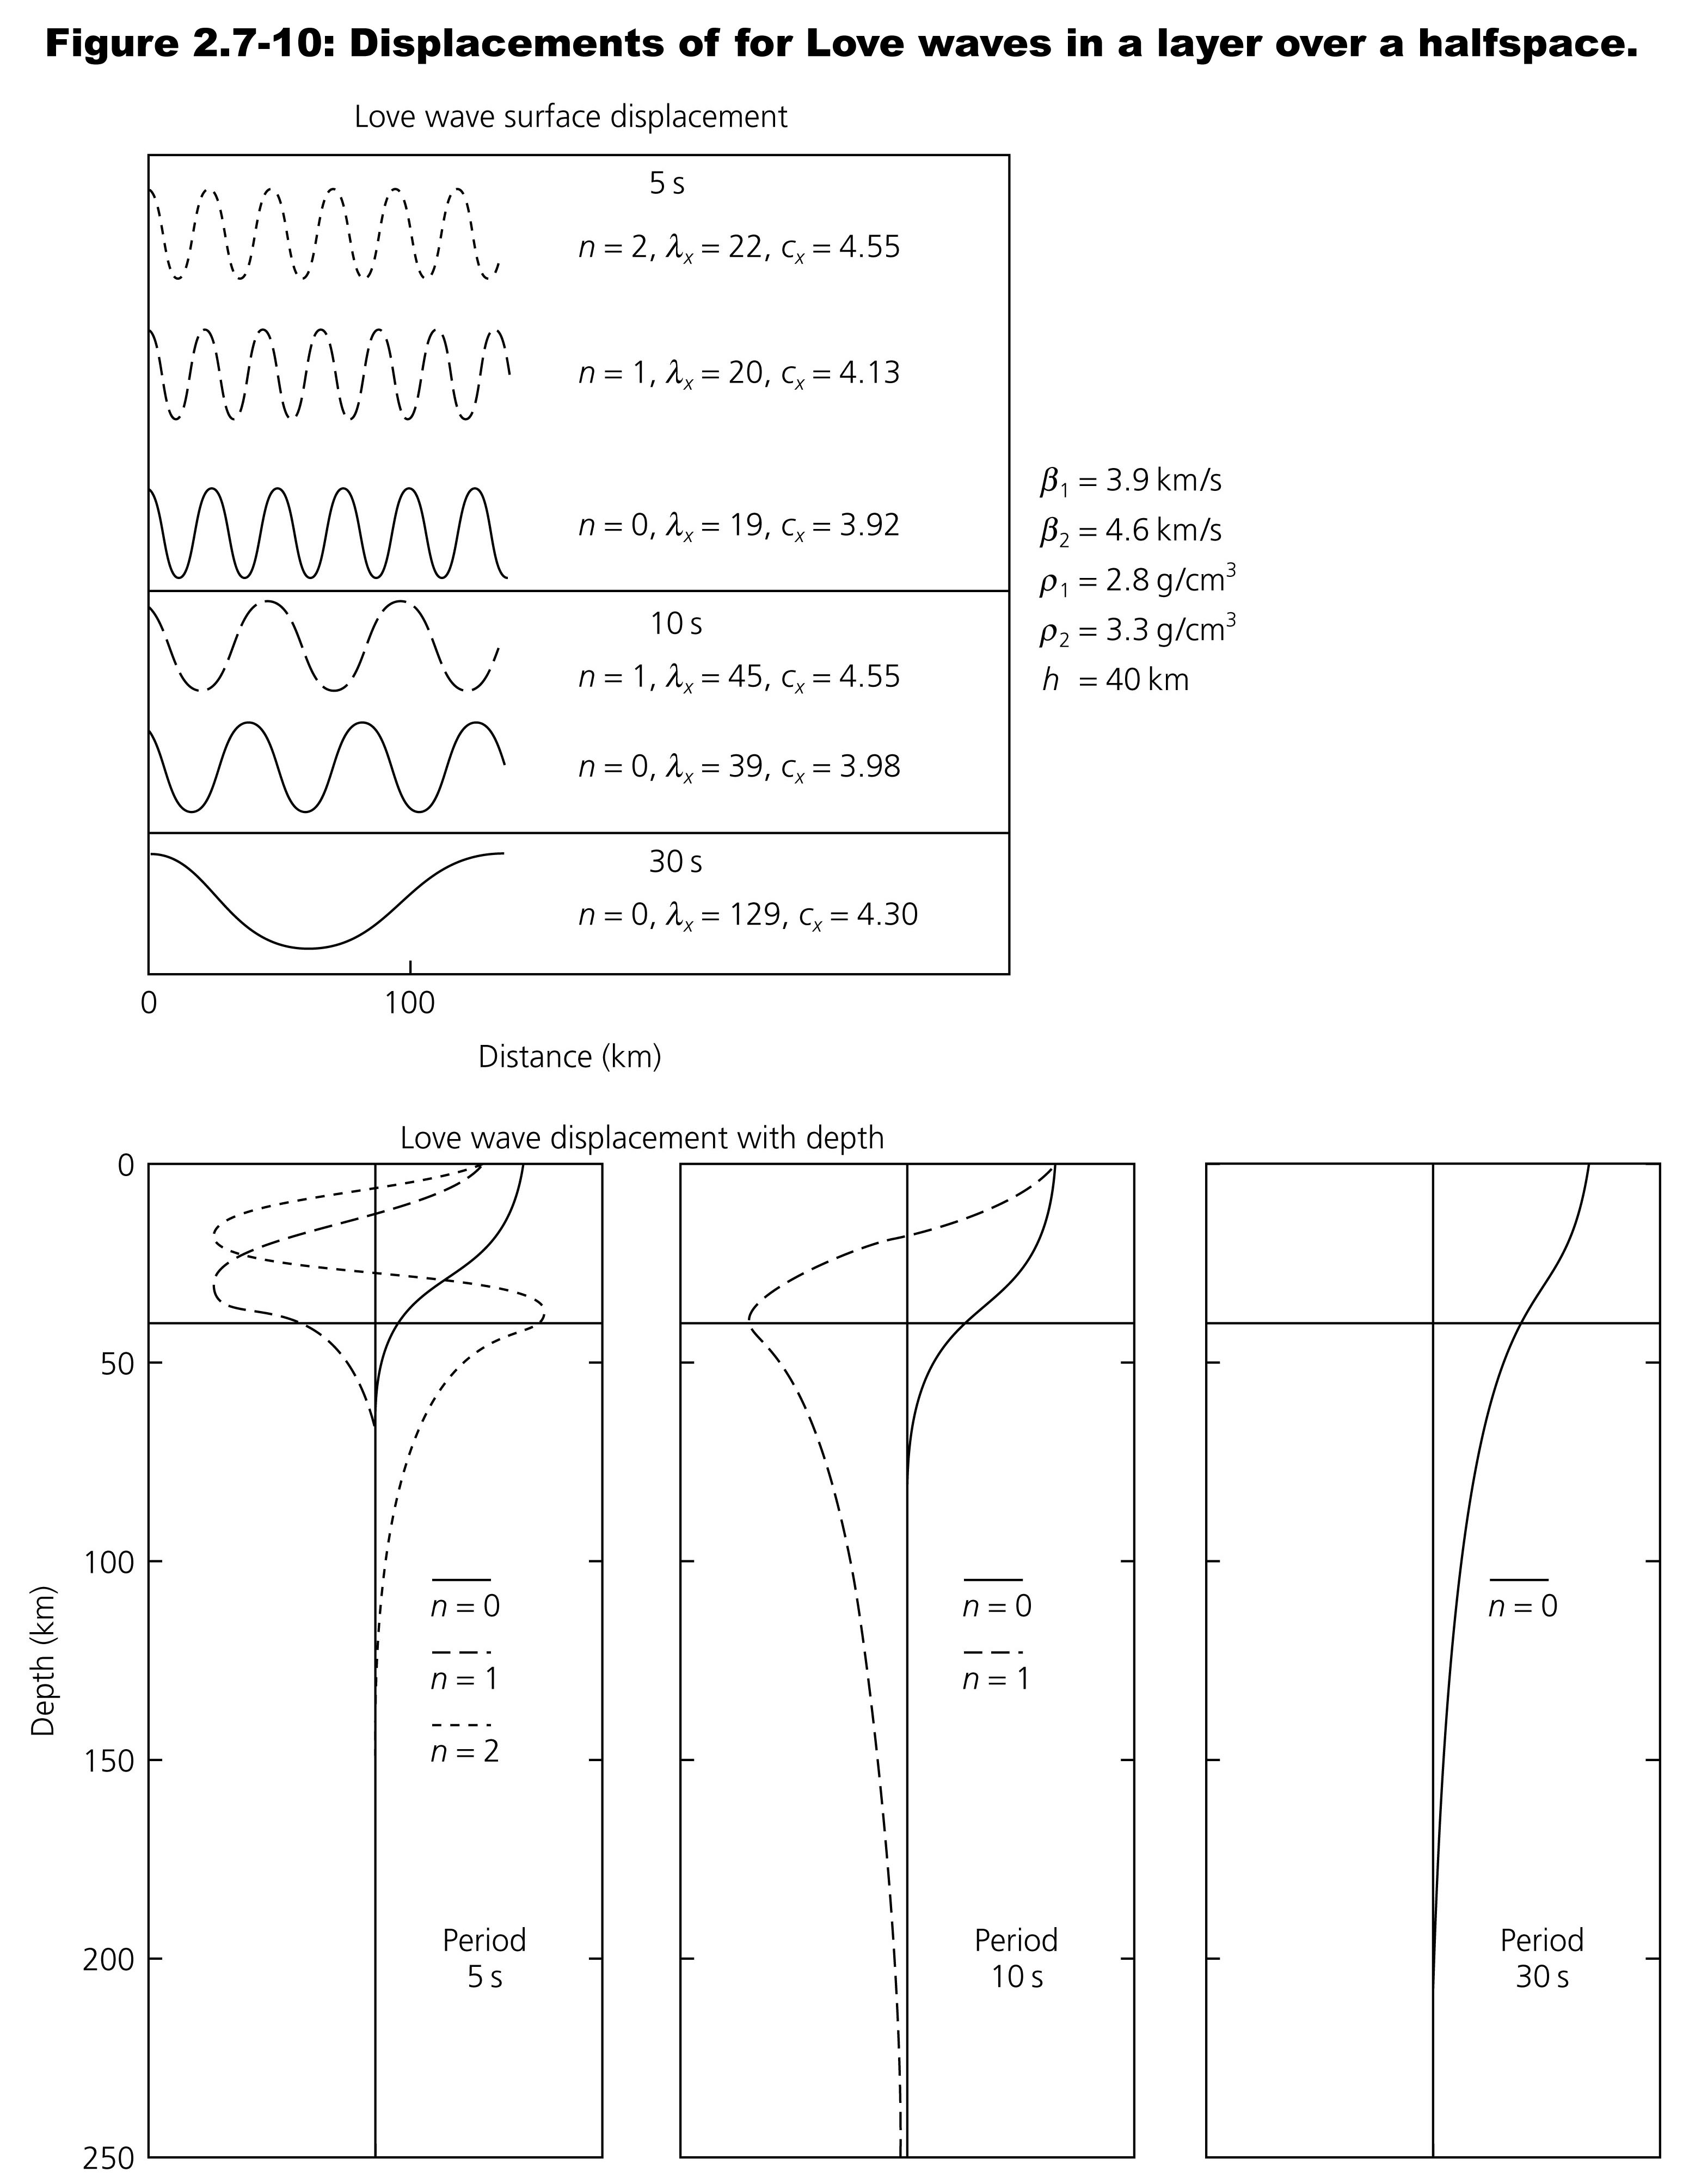
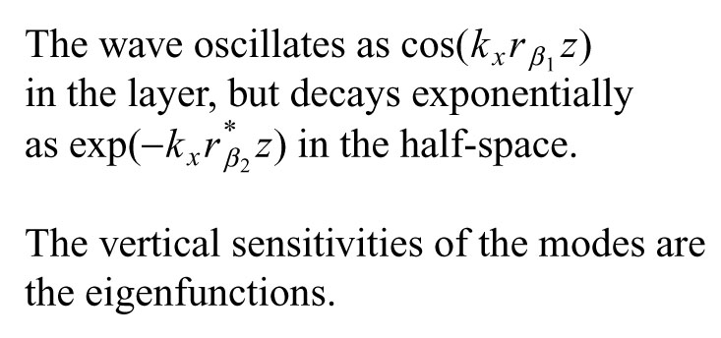

Slide 10
We are now going to look in detail what happens to signals composed of a range of frequencies and also different velocities.

Slide 11
First we have to look a bit at what happens when you add traveling waves with same speed but slightly different frequencies (so we are working in the Fourier/Frequency domain)
Top is 300 hz, middle 303 is hz,
Sum at bottom
We get "beats"
https://resource.isvr.soton.ac.uk/spcg/tutorial/tutorial/Tutorial_files/Web-hearing-beats.htm
Notes:
If you've ever been in a twin engine propeller plane and heard a wa-wa sound, that's due to the propellers rotating at slightly different speeds and the sound from them beats. You only notice it when the difference is small and you can hear the amplitude variation.

Slide 12
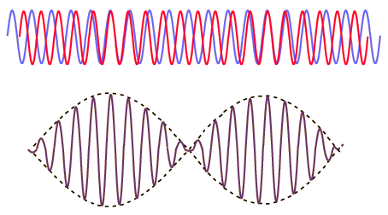
From High School trig we get
Sin A + Sin B = 2 sin [½ (A + B)] cos [½ (A - B)]
inside frequency is the average
Envelope frequency is half the difference
http://hyperphysics.phy-astr.gsu.edu/hbase/Sound/beat.html
Notes:
If you've ever been in a twin engine propeller plane and heard a wa-wa sound, that's due to the propellers rotating at slightly different speeds and the sound from them beats. You only notice it when the difference is small and you can hear the amplitude variation.

Slide 13
The frequencies you "hear" are called "subjective tones" as they don't really exist.
To see this, take the Fourier transform of sin(wt)+sin((w+dw)t) where where dw is << w.
http://hyperphysics.phy-astr.gsu.edu/hbase/Sound/beat.html
Notes:
When I take the FT I get 2 peaks, one for each of the 2 frequencies I'm adding (the blue and red signals), I don't get a peak at frequencies of the "envelope" (dashed, which is a sine wave and has a single frequency but represents the envelope not an actual signal) and the "inside" signal (heavy line, which as a constant time between zero crossings BUT IS NOT A SINE WAVE AND DOES NOT HAVE A SINGLE PEAK)

Slide 14
Sin A + Sin B = 2 sin [½ (A + B)] cos [½ (A - B)]
Notice we are ADDING on the LHS and MULTIPLYING on the RHS.
Sound/seismic waves when received by the ear/seismometer are ADDING the waves (they are linear systems, multiplication is not a linear system).
That's why the tones you hear are "sujbective"
http://hyperphysics.phy-astr.gsu.edu/hbase/Sound/beat.html

Slide 15
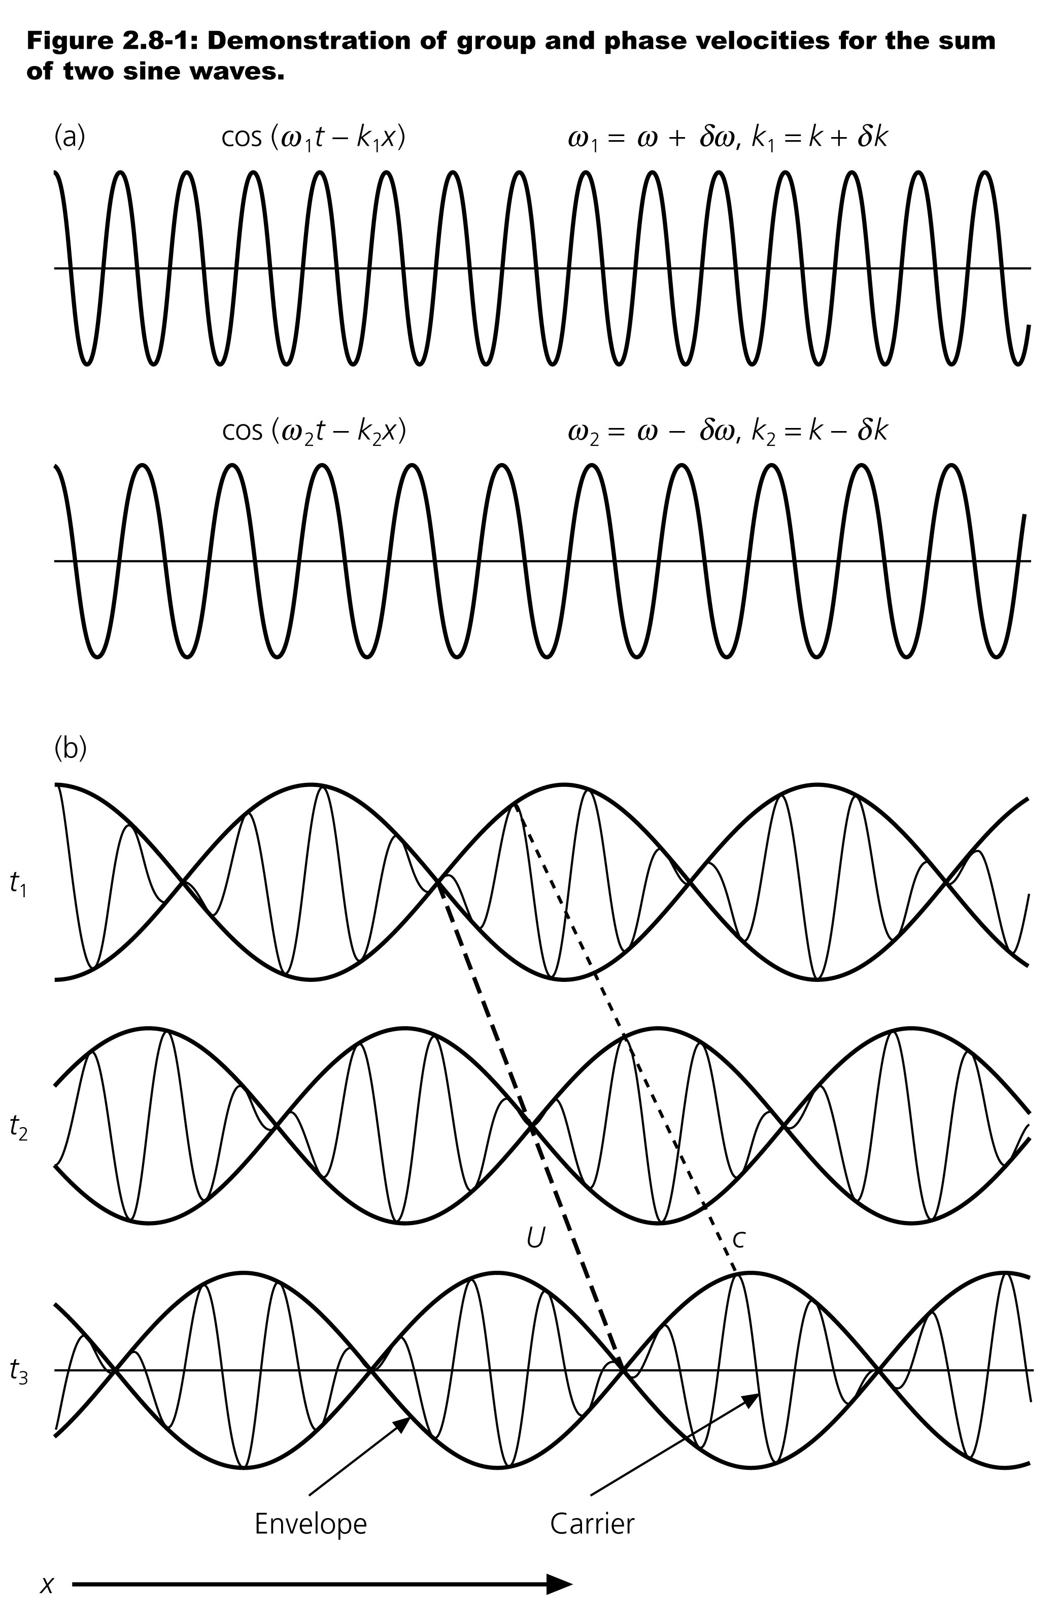
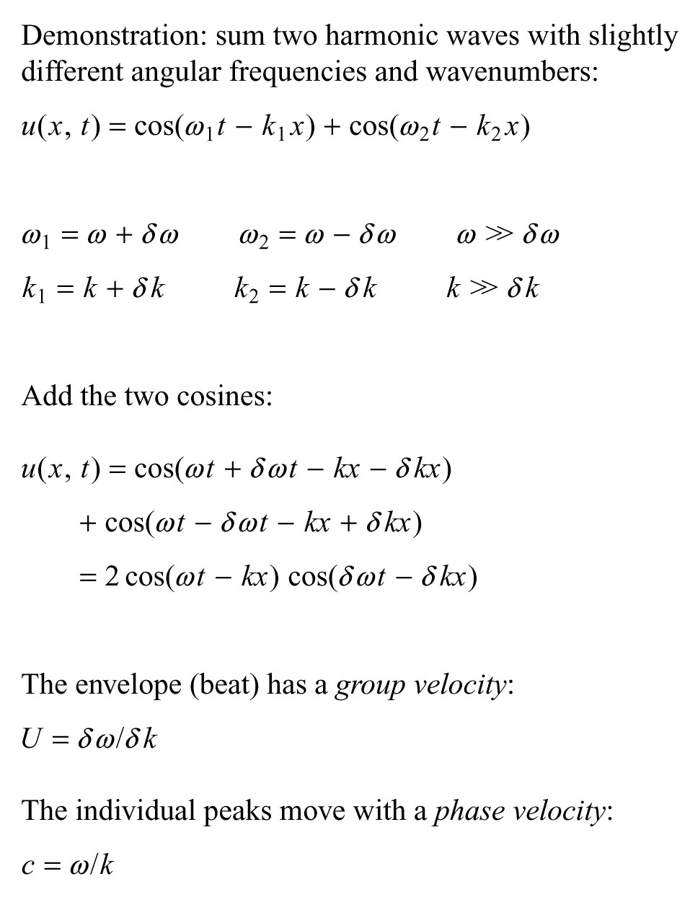
Now we will do the same analysis where the two waves travel at different speeds.
We can think of this as the product of two waves, one with a velocity of ω/κ and one with a velocity of δω/δκ.

Slide 16
Very important
On the RHS we are not SUMMING (SUPERPOSING, linear) the two waves. This is actually MODULATION, which using 2 different frequencies and wavenumbers, and is not linear
Energy moves at the group velocity
Notes:
Energy moves at the group velocity

Slide 17
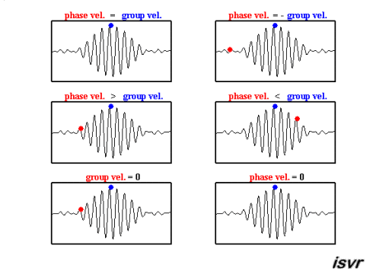
Various combinations of the component wave speeds produces different phase and group velocity relationships.
Watch the blue (group) and red (phase) dots.
https://i.stack.imgur.com/bYD0Q.gif

Slide 18
We are generally interested in the middle one on the left – where the phase velocity is greater than the group velocity.
Notice that the red dot (and the waves it is riding on) move forward through the pulse/envelope:
https://i.stack.imgur.com/bYD0Q.gif

Slide 19
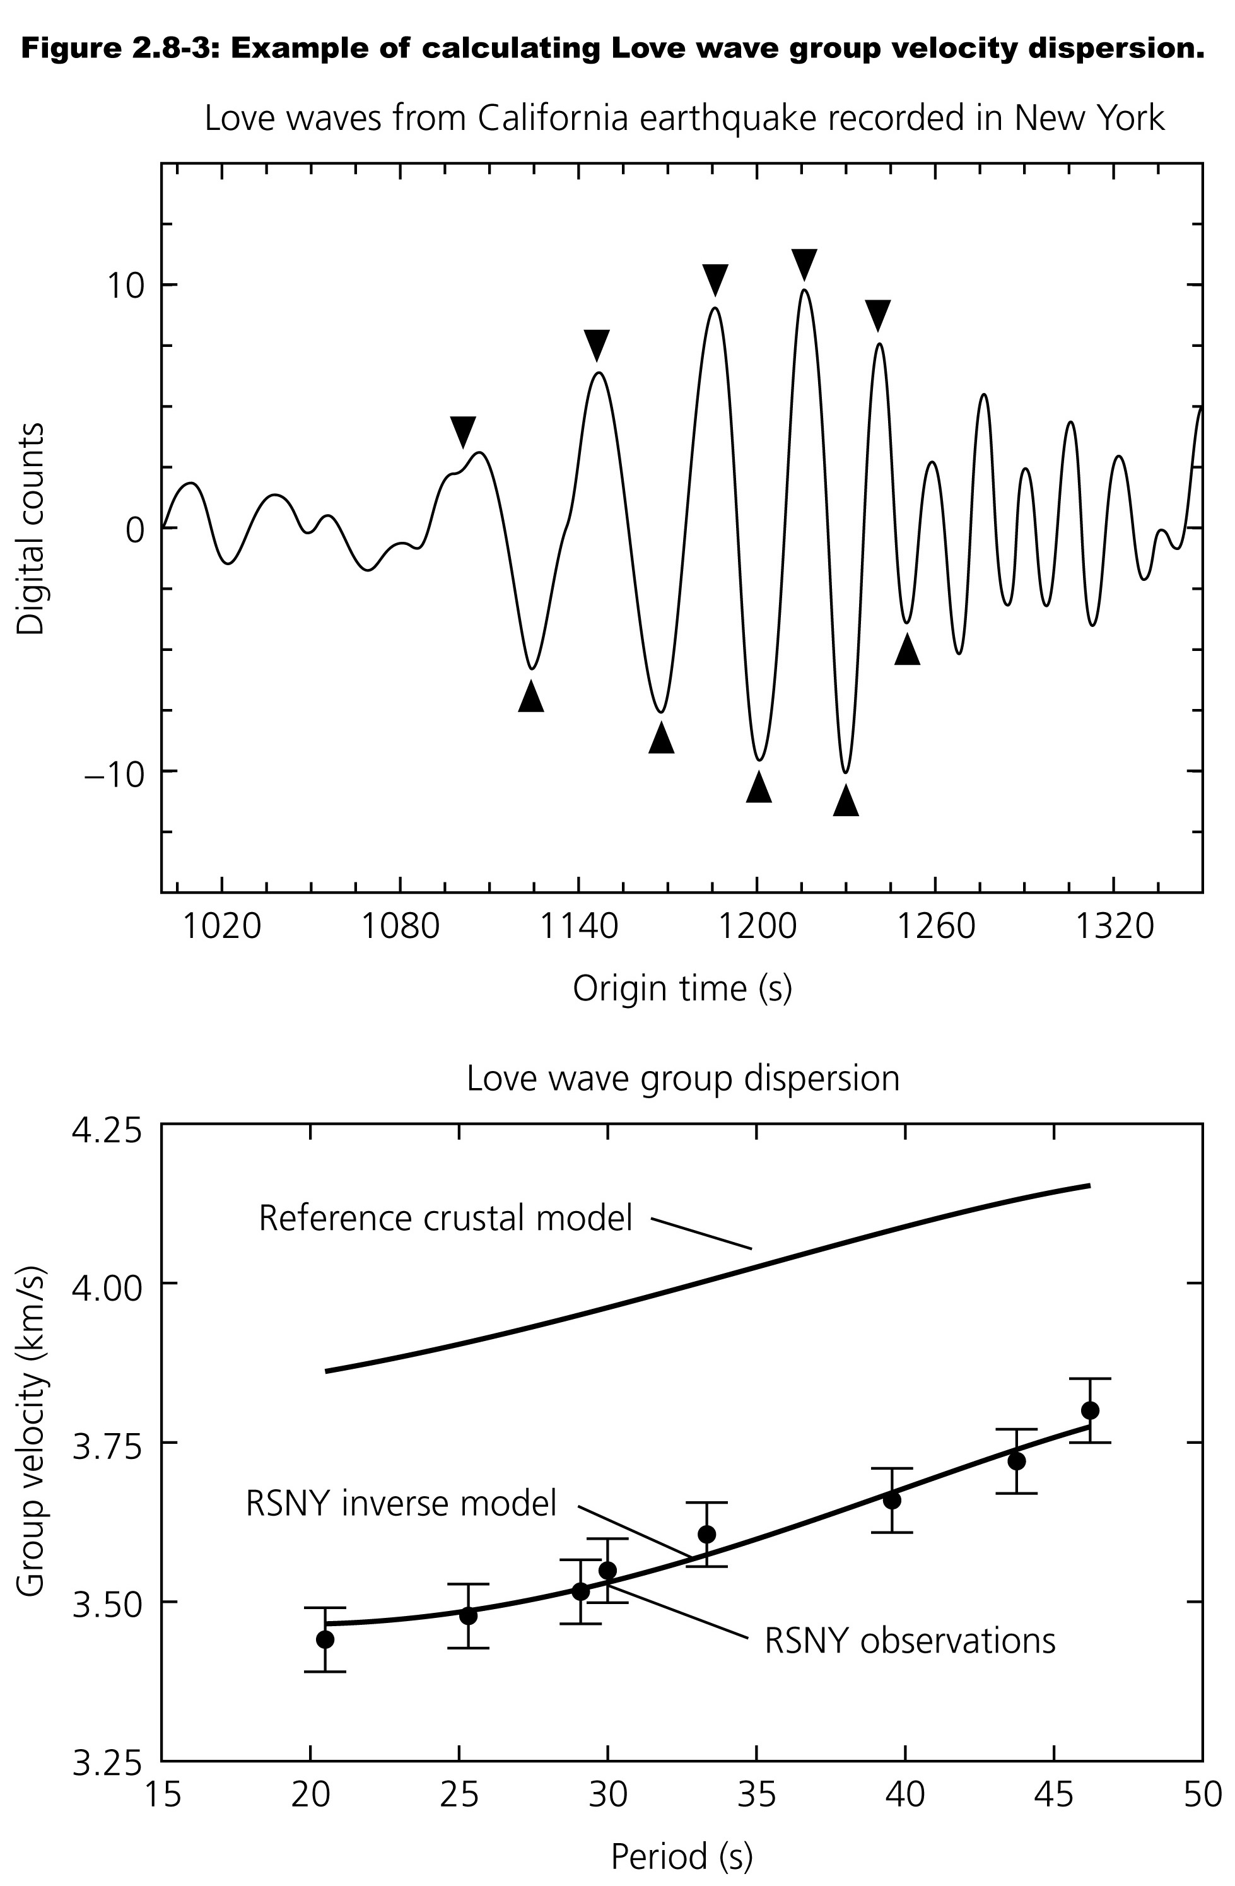
How do we calculate the group or phase velocity from the data (seismogram)?
One simple way is to measure the times of the peaks (or zero crossings) and plot them as a function of "index" (1st point, 2nd point, etc.).
The slope of this curve gives the period as a function of index.
The velocity is calculated using the distance to the source and the origin – arrival times.

Slide 20
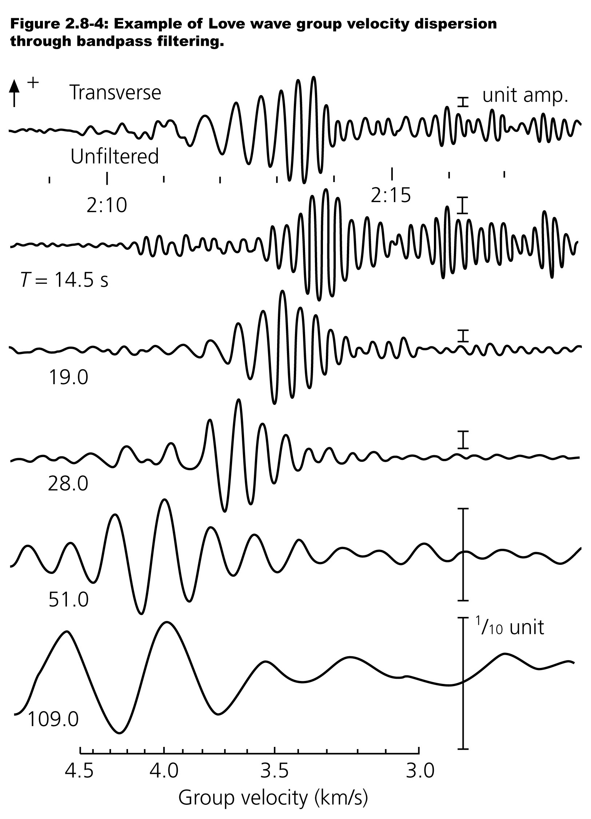
Another method is to band pass filter the seismogram to estimate the arrival time of the Fourier components in each of the wave "packets" the filter produces.
This produces the same kind of data – period and arrival time – to calculate the velocity.
Notice the wiggles in the "packets" are not symmetrical – you can see the frequency increase with time – this is dispersion.

Slide 21
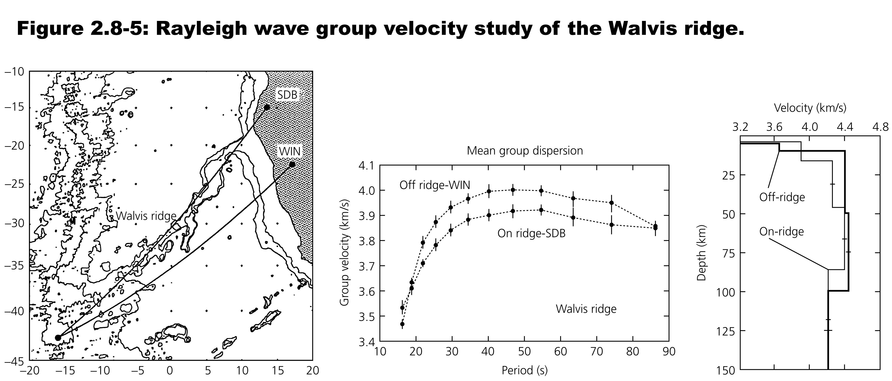
The dispersion curve can be inverted for the layered structure that generates it.
Profiles along the volcanic (hotspot track) Walvis ridge show a different velocity structure, with slower velocities, than profiles that subparallel it.

Slide 22
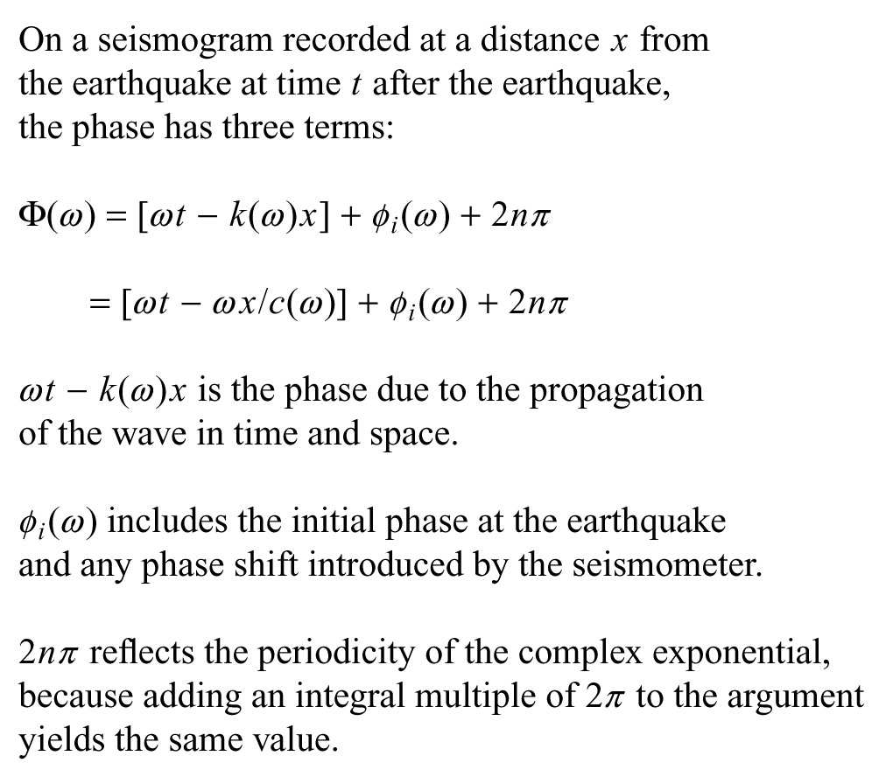
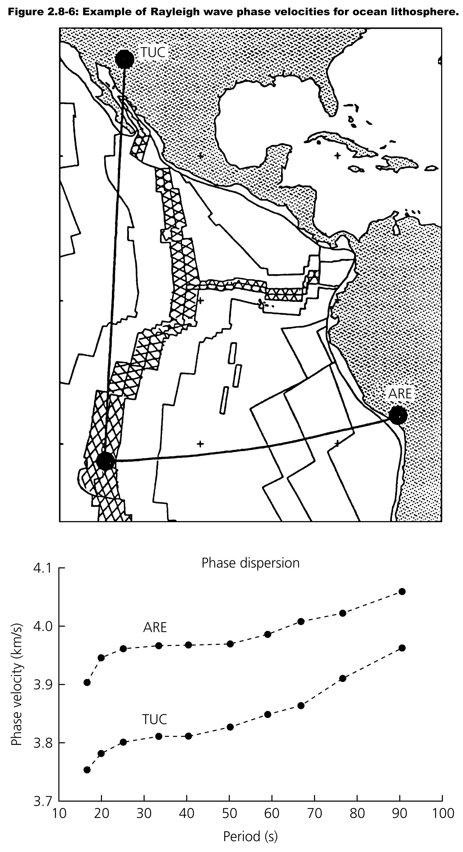
Using phase to measure distance (GPS does this) – each 2π change in phase represents one wavelenth of distance.
Notes:
Using one station (location known) and earthquake (location also known by other measurements)i can estimate the 2n π

Slide 23
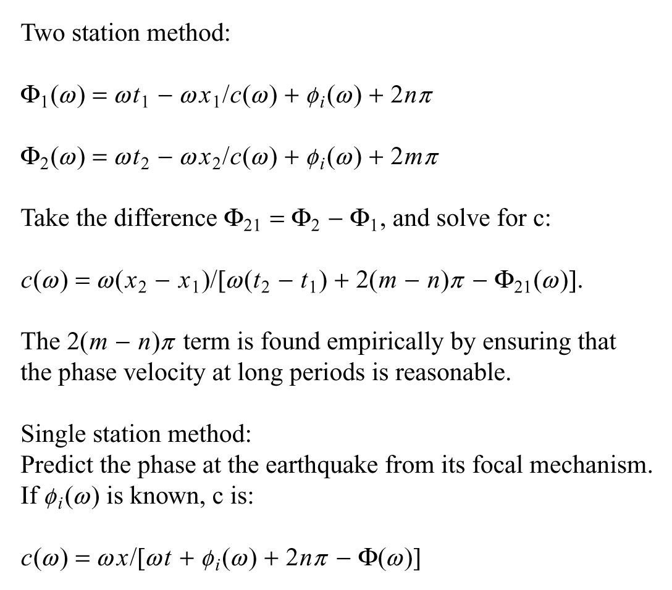
Here, for the same seismometer type, the source and seismometer terms go away.
If they are less than a wavelength apart, the "integer ambiguity" term also goes away

Slide 24
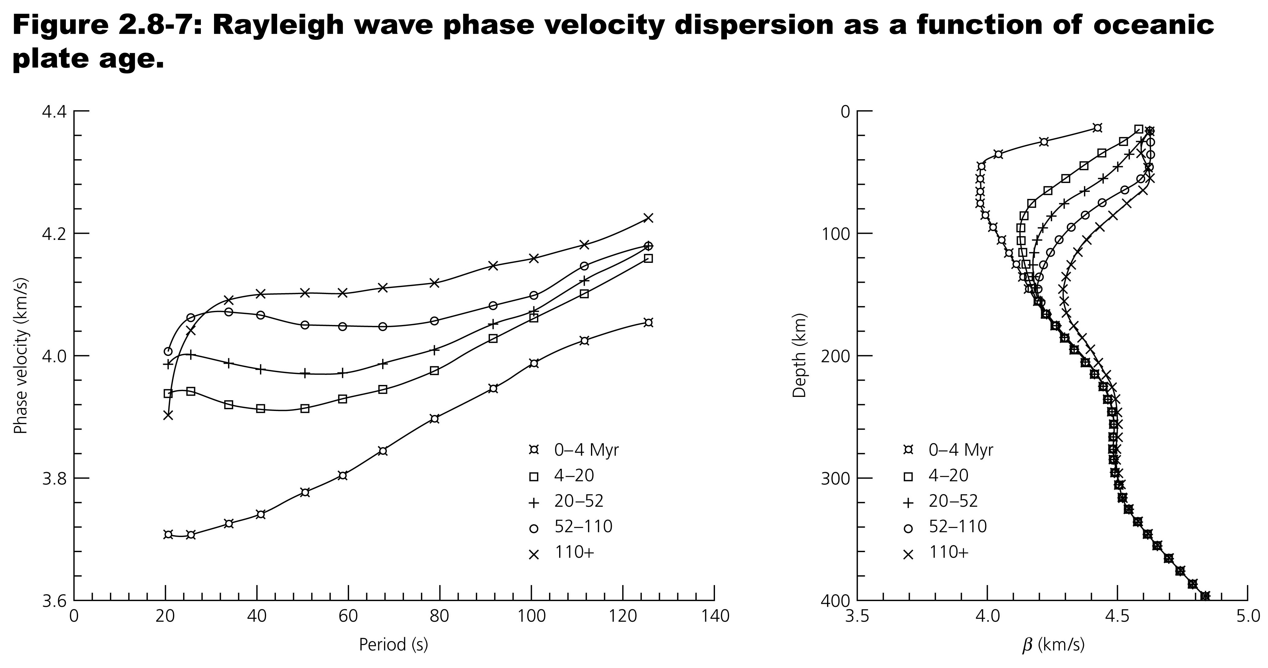
We can test the tenet of plate tectonics that the ocean lithosphere is a thermal boundary layer whose thickness is proportional to the square root of its age using Rayleigh wave dispersion.
Notes:
Rayleigh waves, unlike Love waves, don't need layers. They see some "average" of the velocity over the depth that they sample (skin depth, distance into the half space that the "see"/penetrate) so they can sample structure that is not layered.

Slide 25
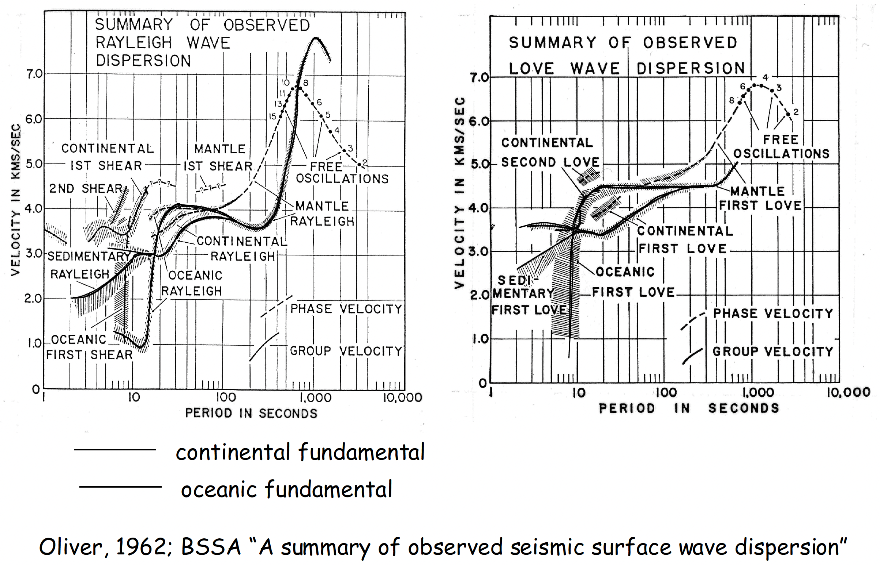
Early (pre-plate tectonic) summary of surface wave dispersion data that still describes the global picture.
Notes:
Notice, since the dispersion relation can be inverted for velocity structure (and infer temperature, and other properties) that these results indicate that continents and oceans have very different structures beneath them. Also, since parts of the dispersion curve are also related to properties like sediment thickness in the oceans and continents.
Plate tectonics gives an explanation for these observations and their interpretations.

Slide 26
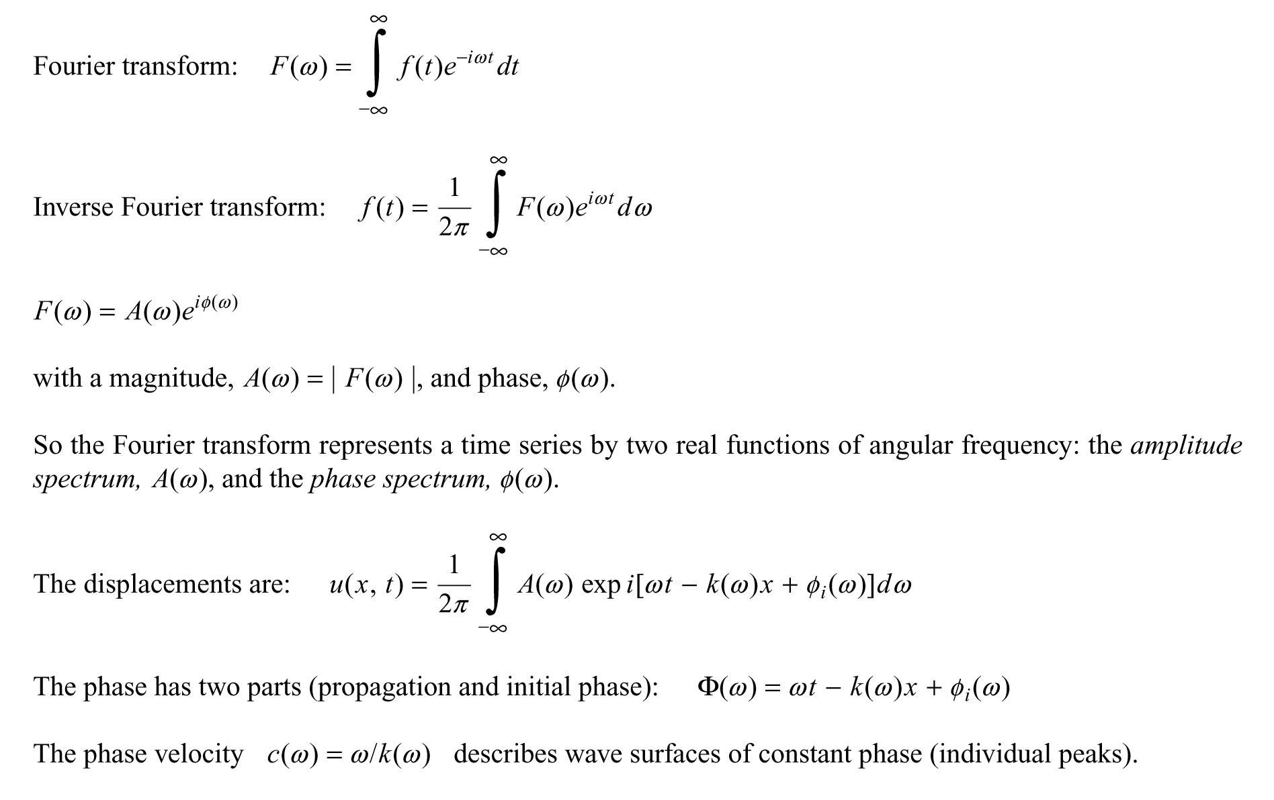
The math of the frequency domain derivation of phase and group velocity.

Slide 27
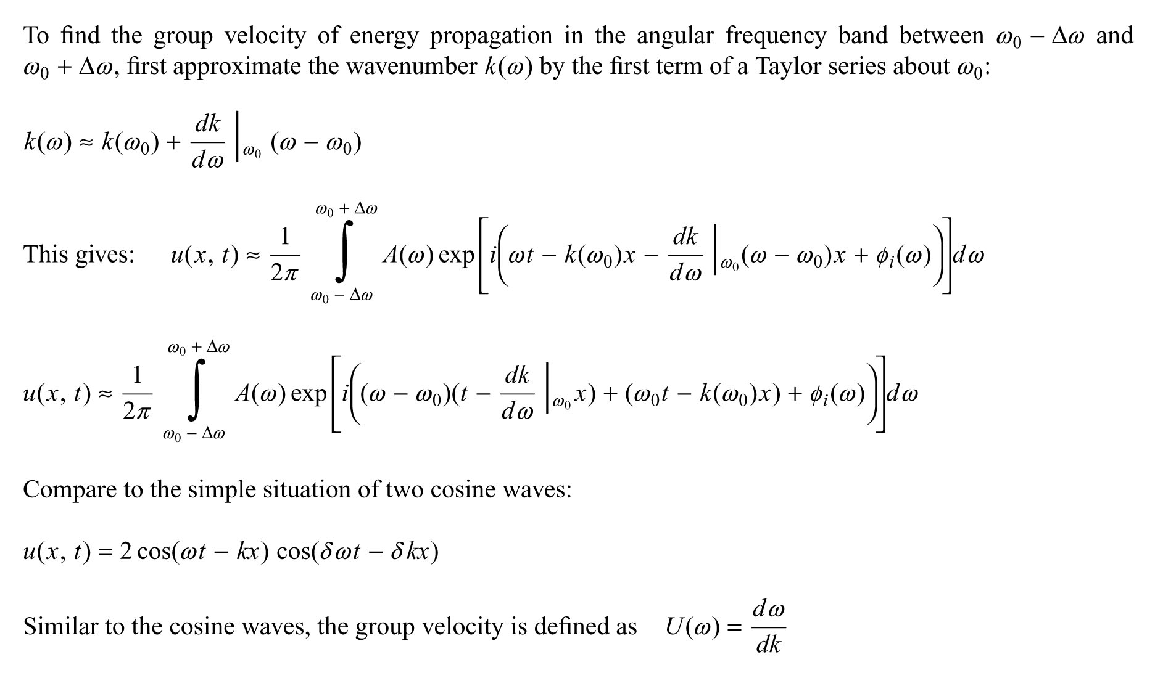

Slide 28
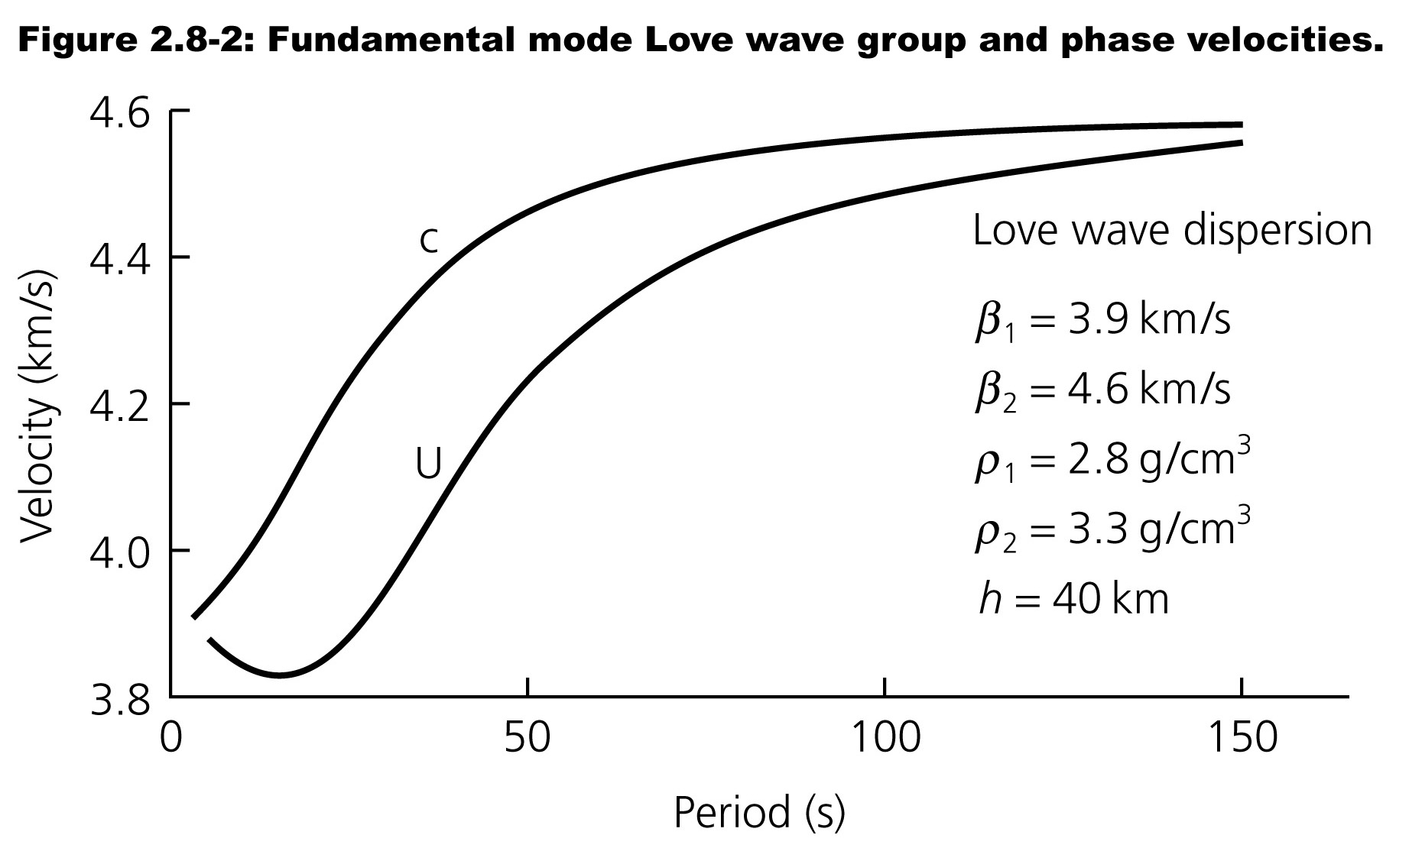
The group velocity is usually easier to measure directly from the seismograms.
The phase velocity is usually a bit harder to measure.

