Slide 1
Global Seismology CERI-8105
Tu-Th 1:15-2:40 pm
Lab - 3892 Central Ave. (Long building) , Room 110
-----------------------------------------------
Bob Smalley
Office: 3892 Central Ave, Room 103, 678-4929
Office Hours – when I’m in my office.
http://www.ceri.memphis.edu/people/smalley/CERI8105_GlobalSeismology.html
Thu., Oct 26, 2023 Meeting 17

Slide 2
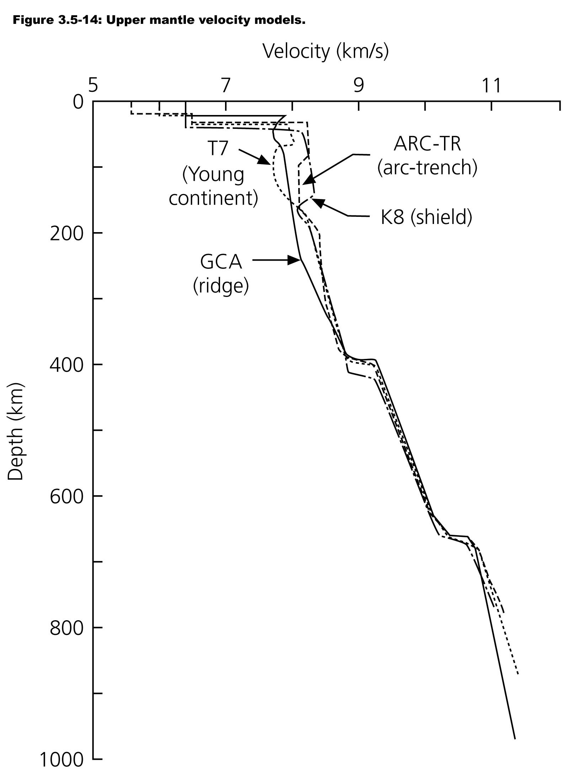

Slide 3
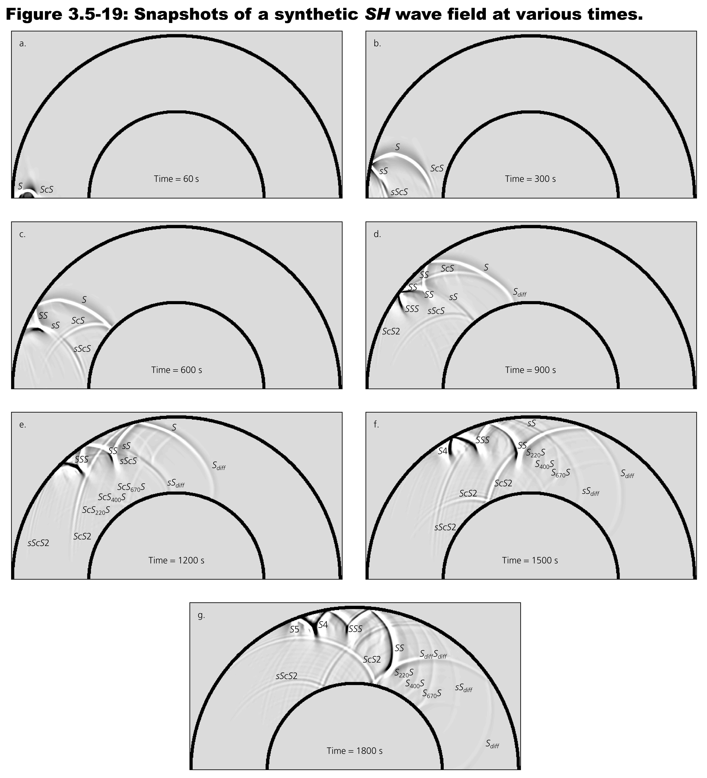

Slide 4
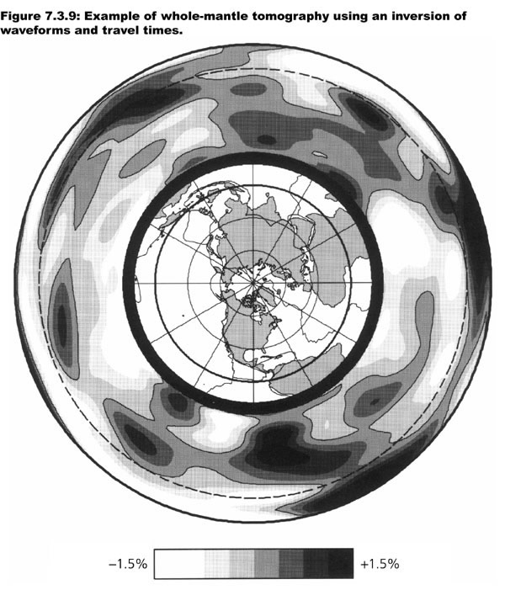

Slide 5
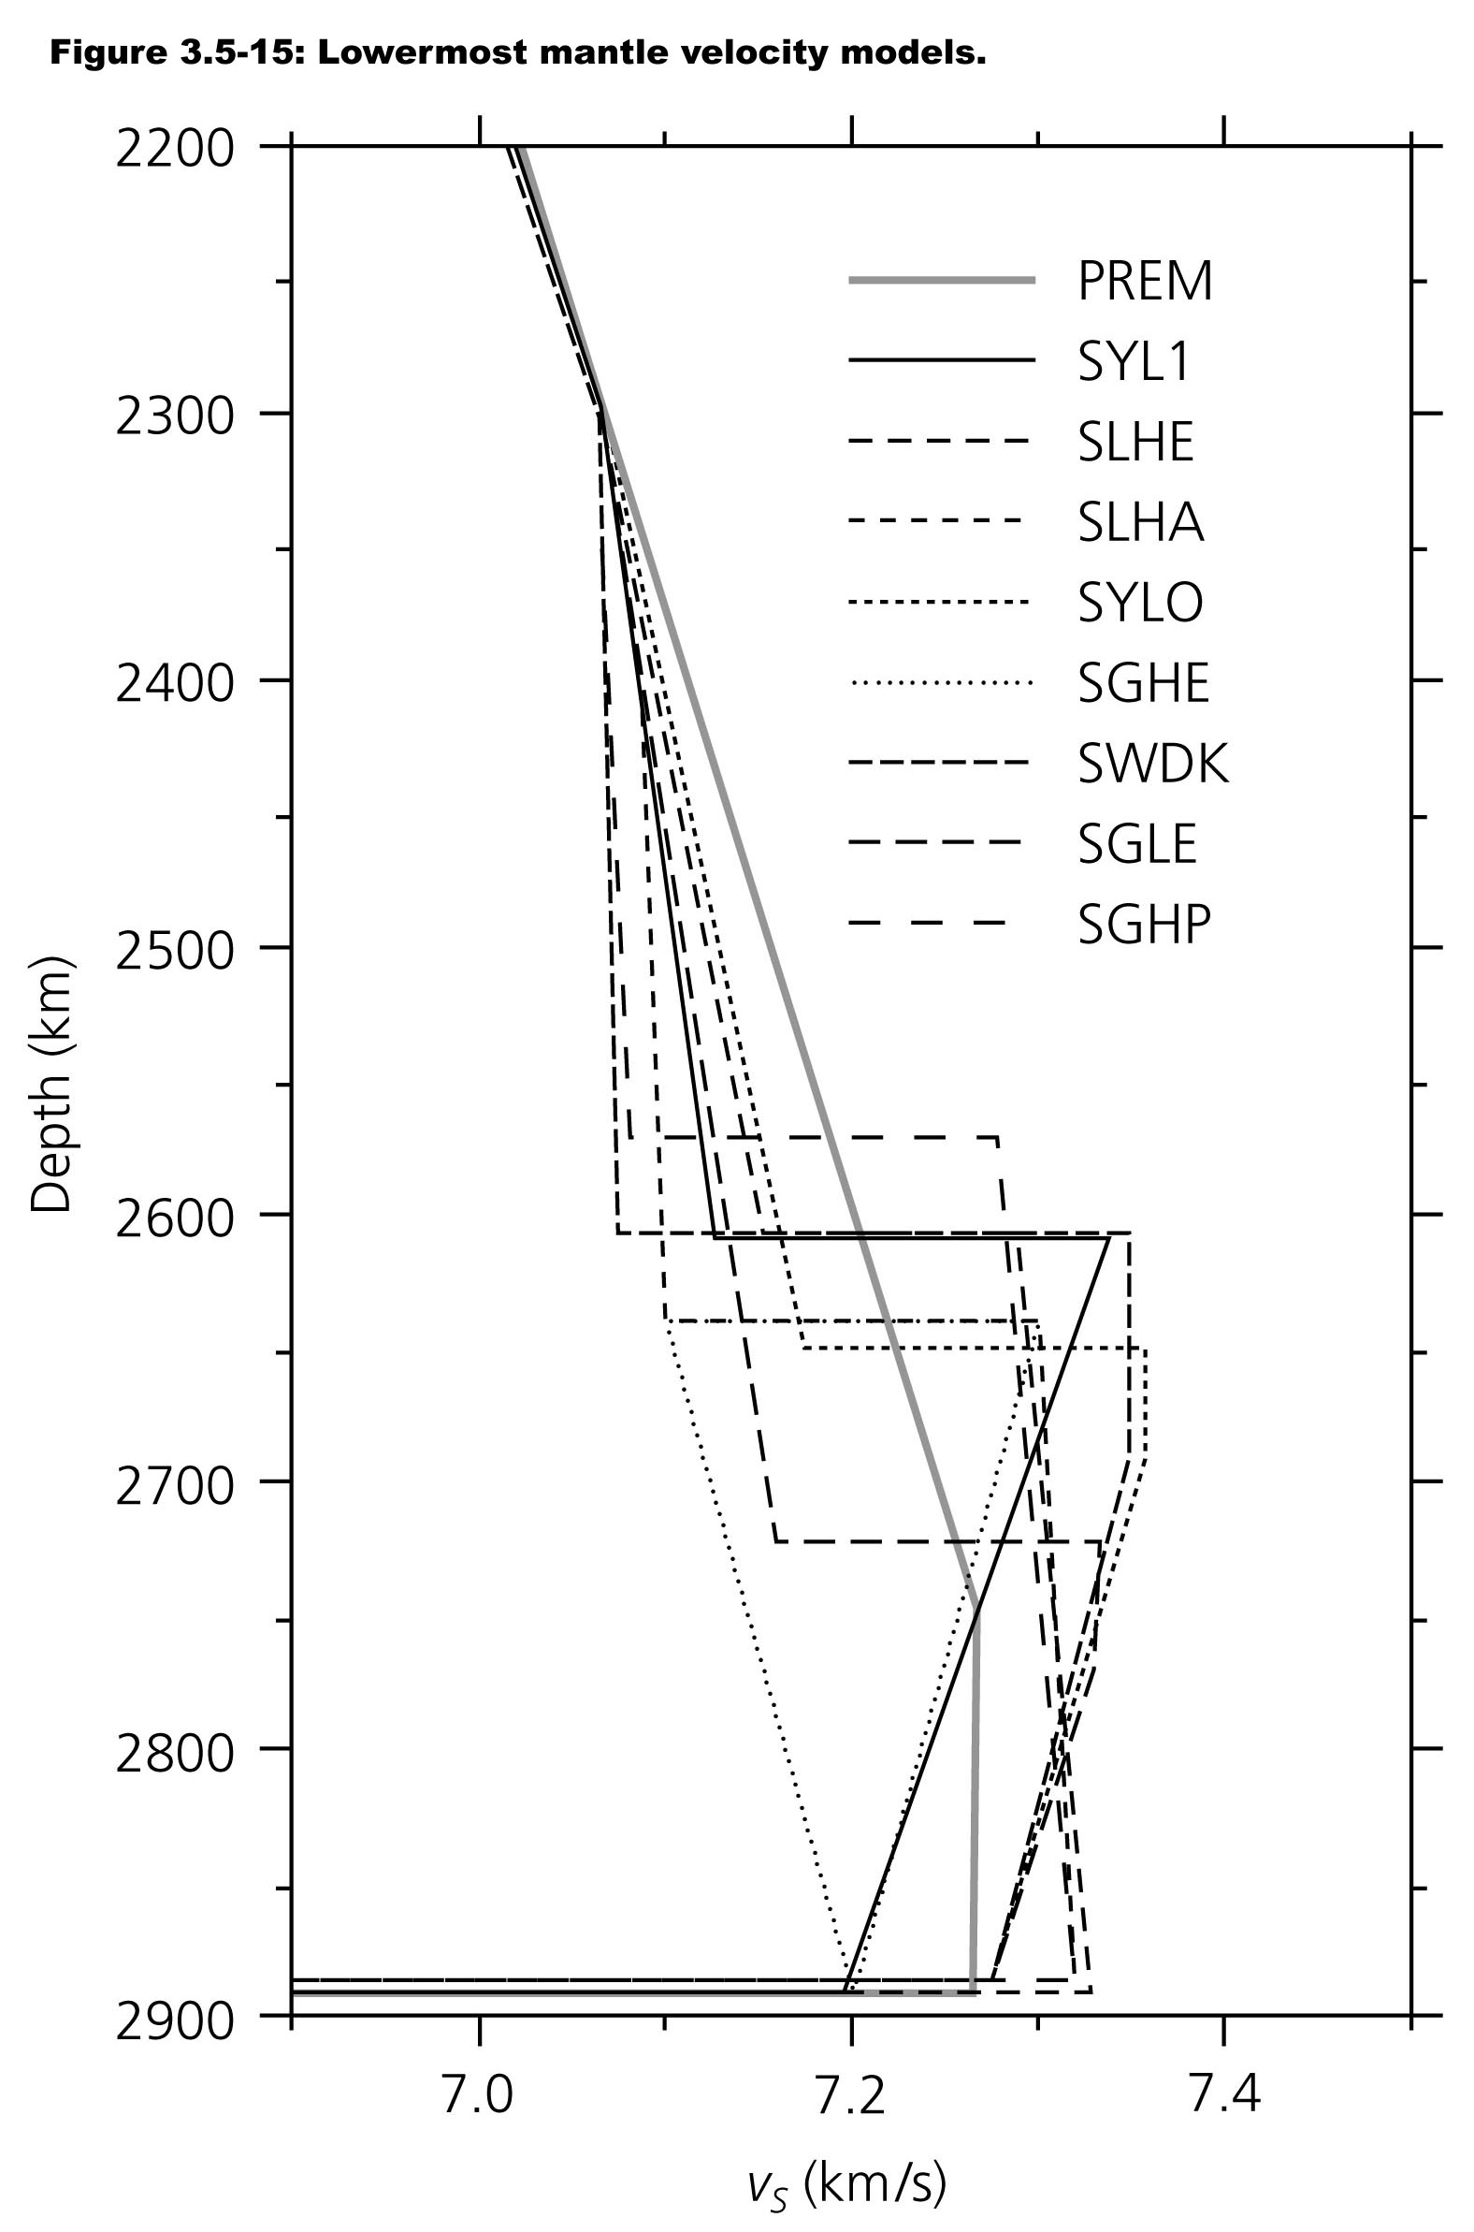

Slide 6
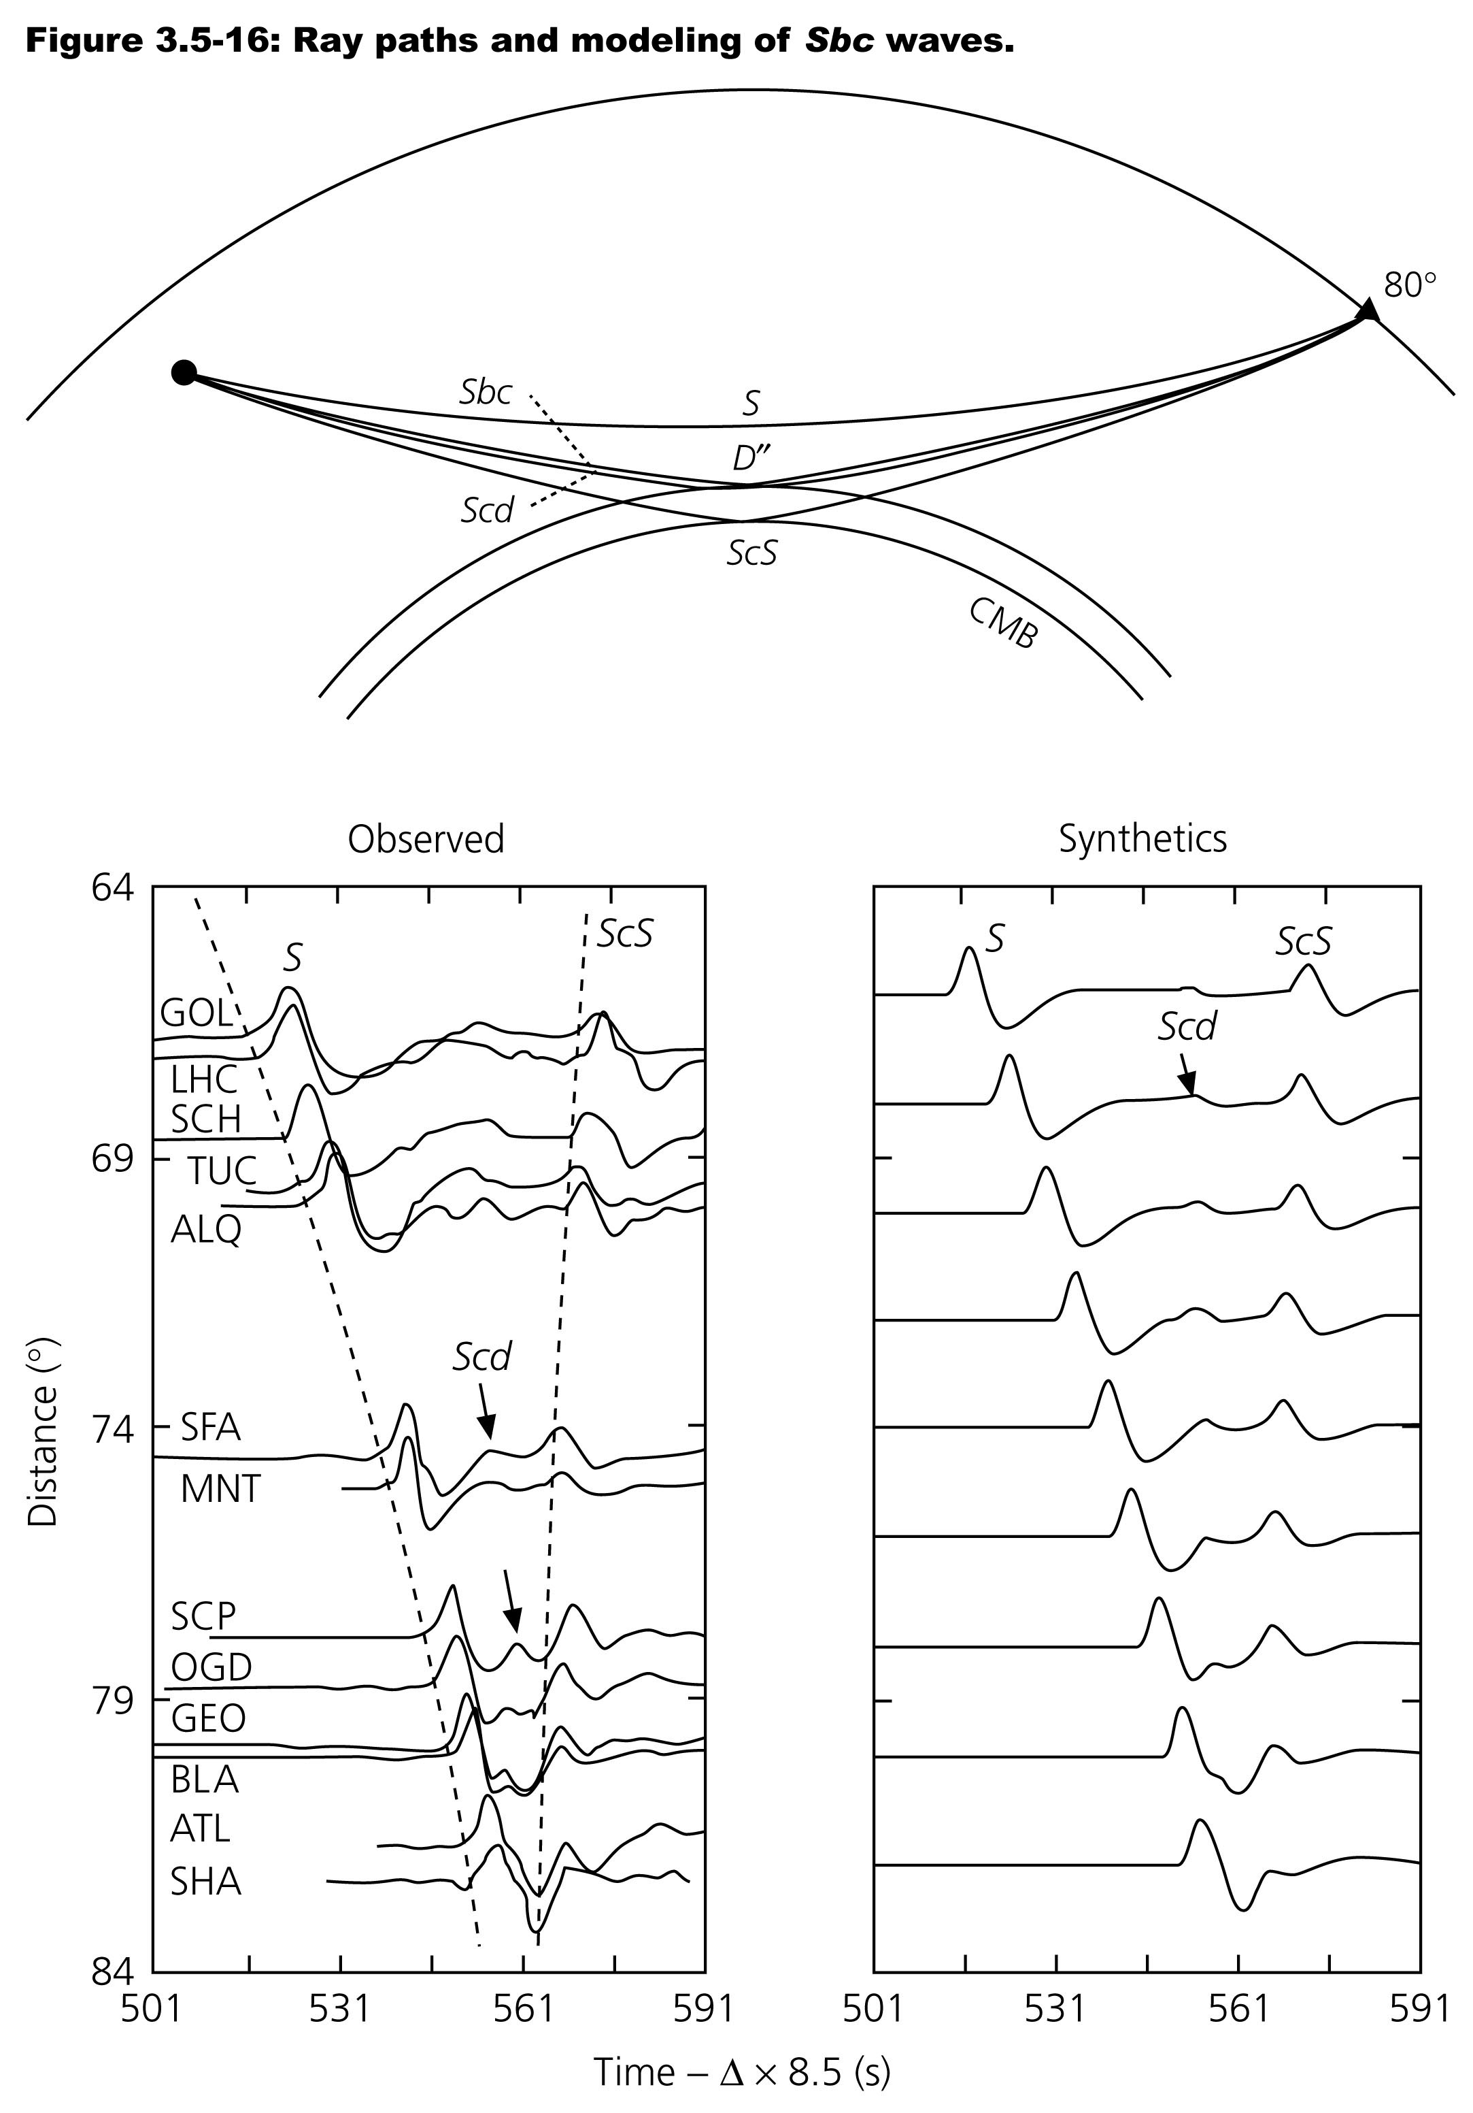

Slide 7
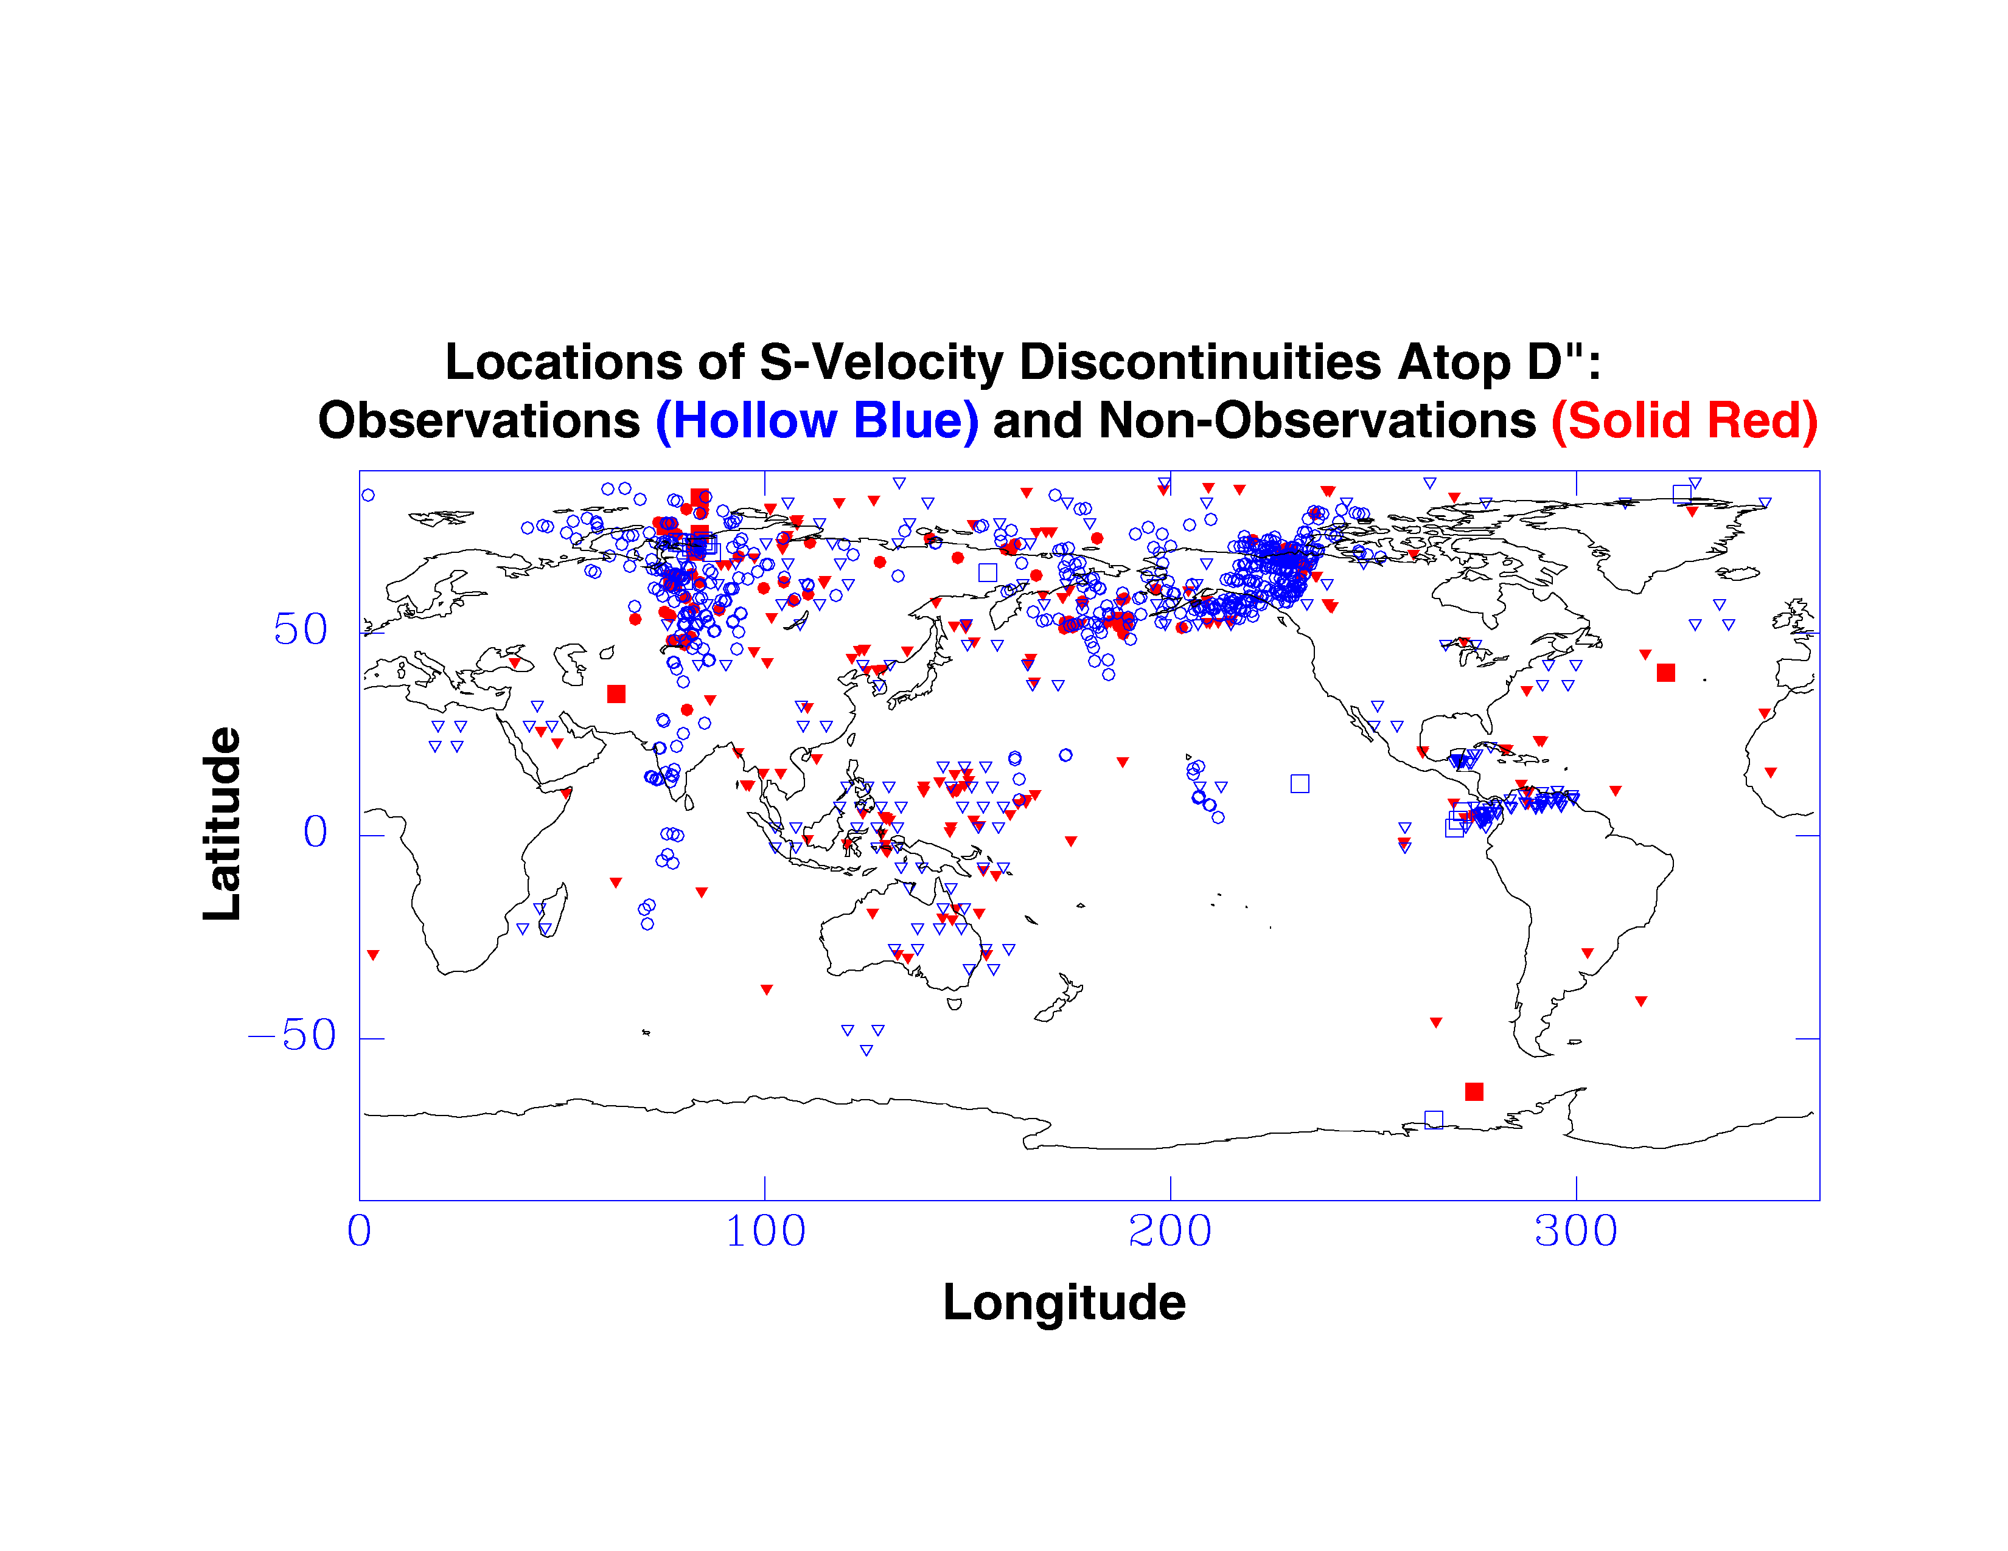
D″ Discontinuity
Is it intermittent?
Relation to slabs?
Due to anisotropy?
Due to phase change?
Due to CBL?

Slide 8
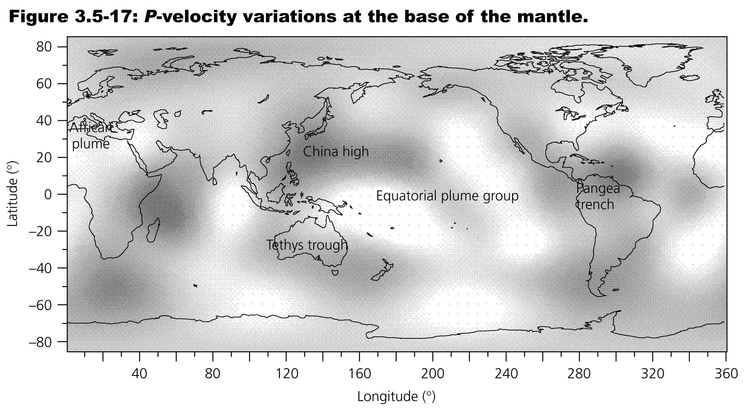

Slide 9
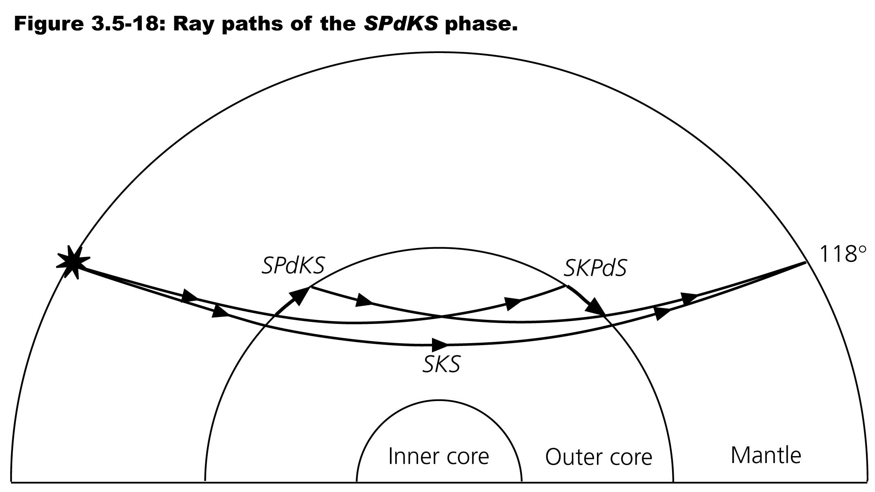

Slide 10
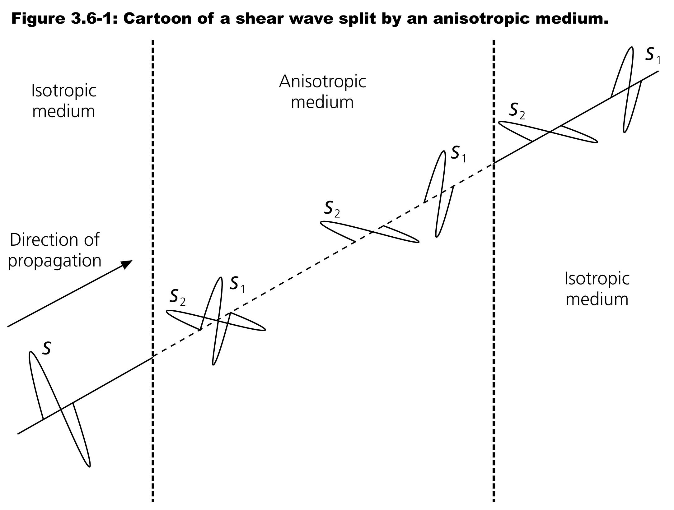

Slide 11
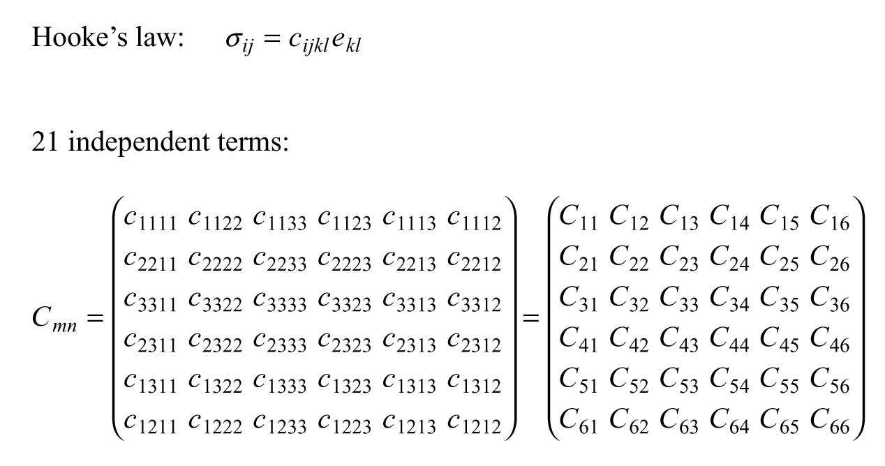

Slide 12
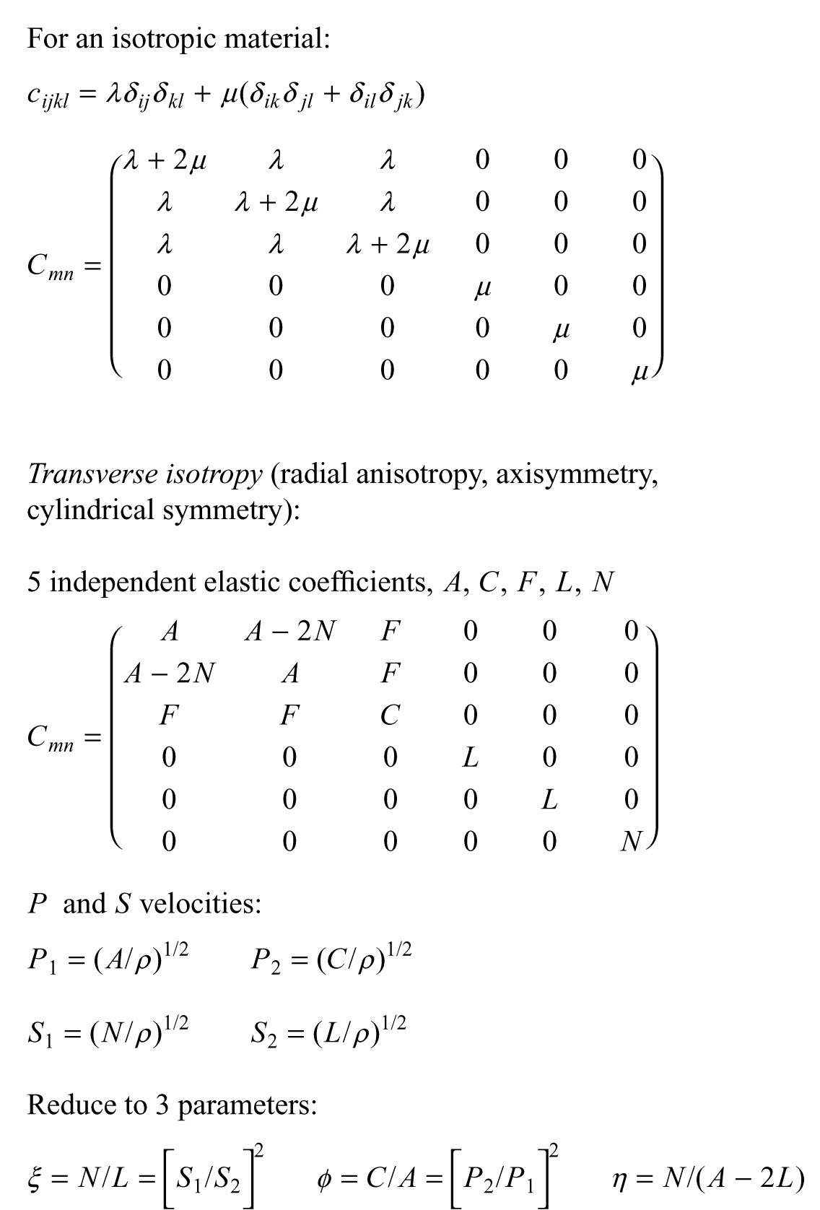
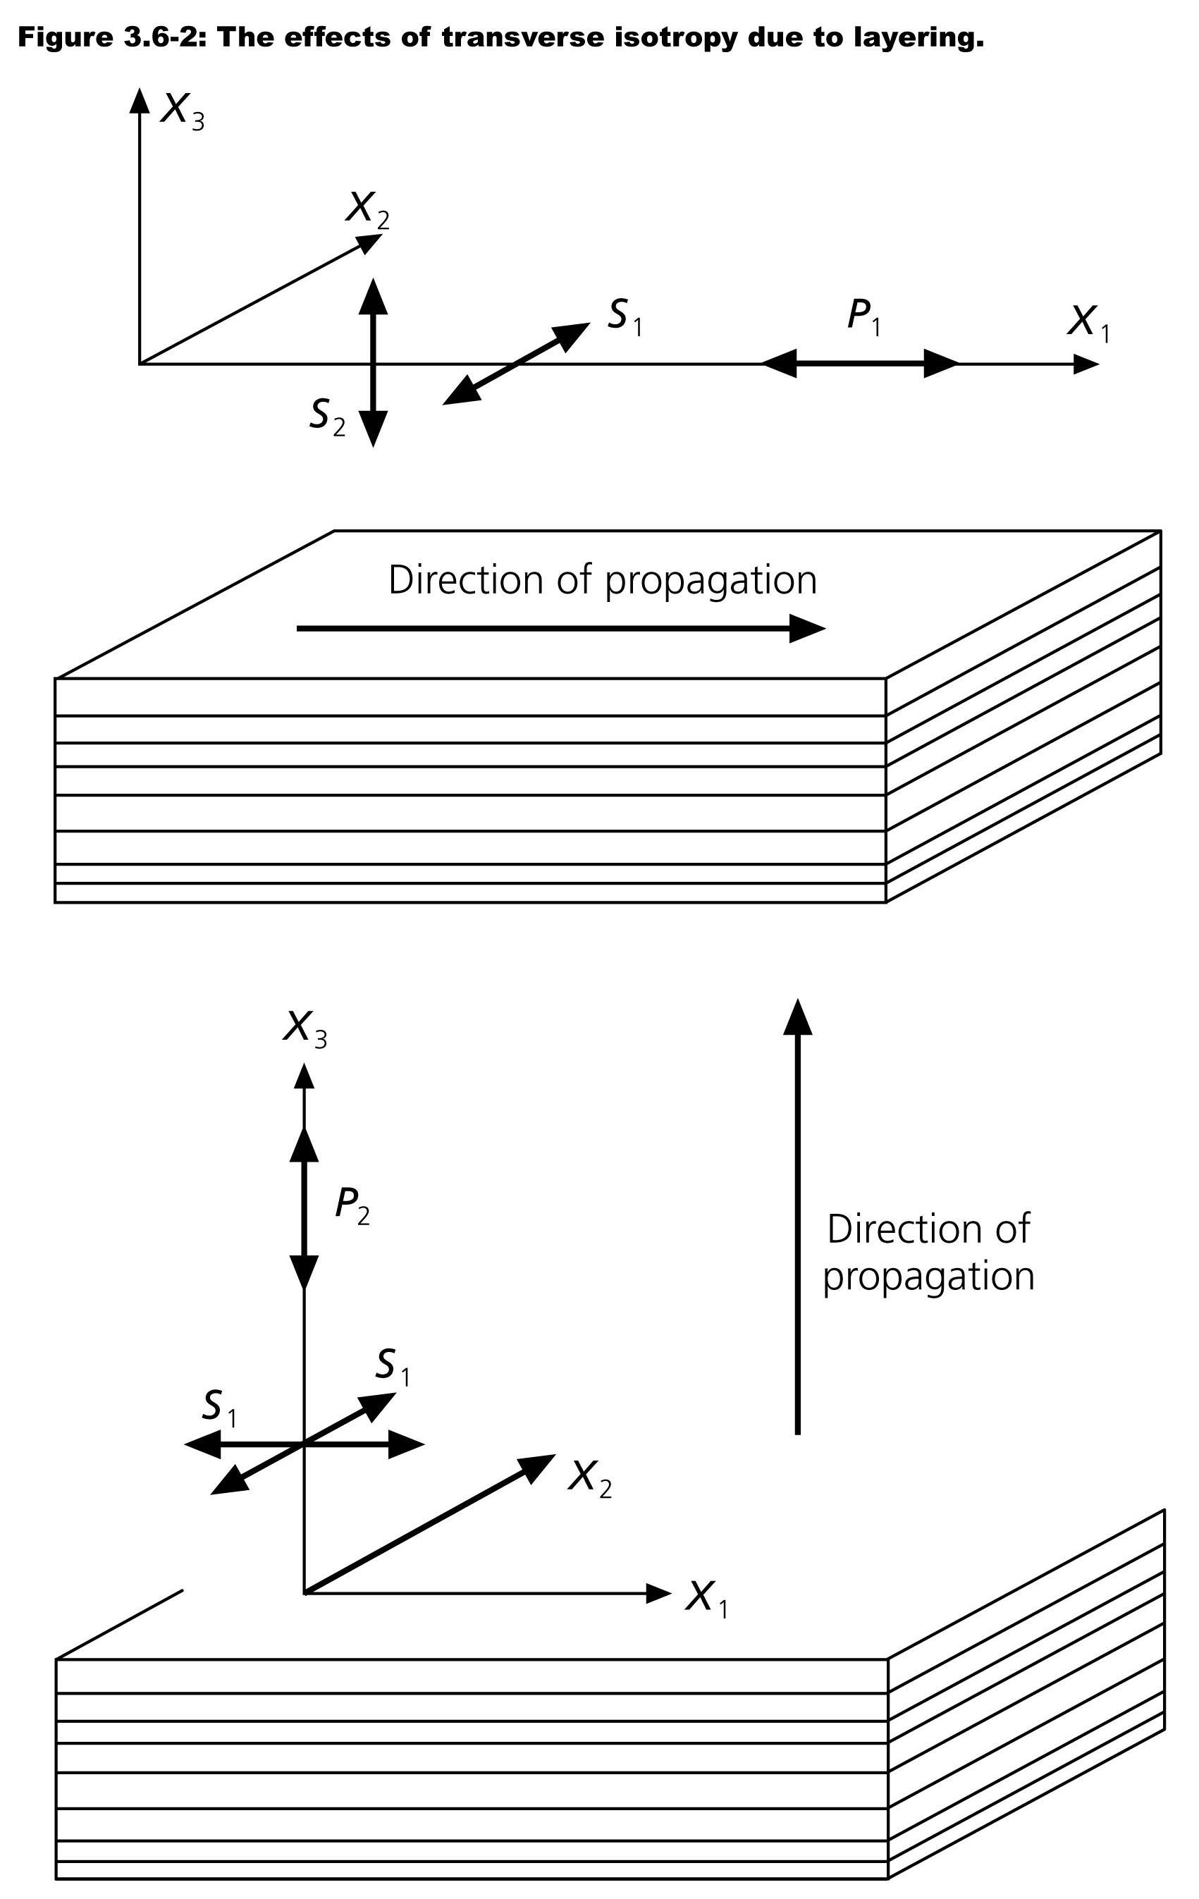

Slide 13
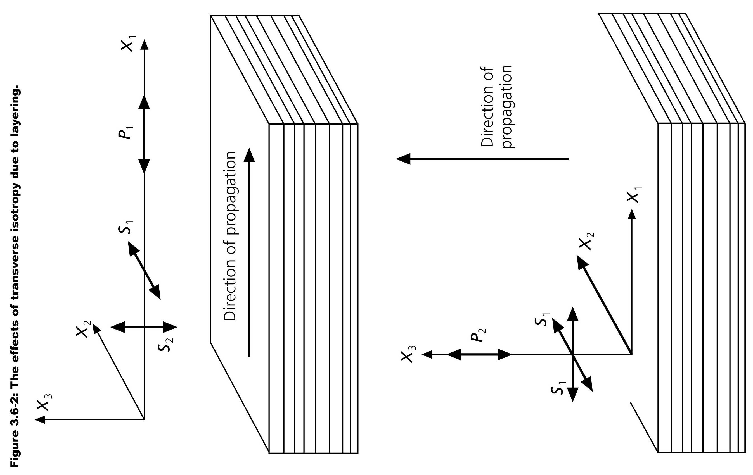
“Azimuthal” anisotropy: like transverse isotropy on its side

Slide 14
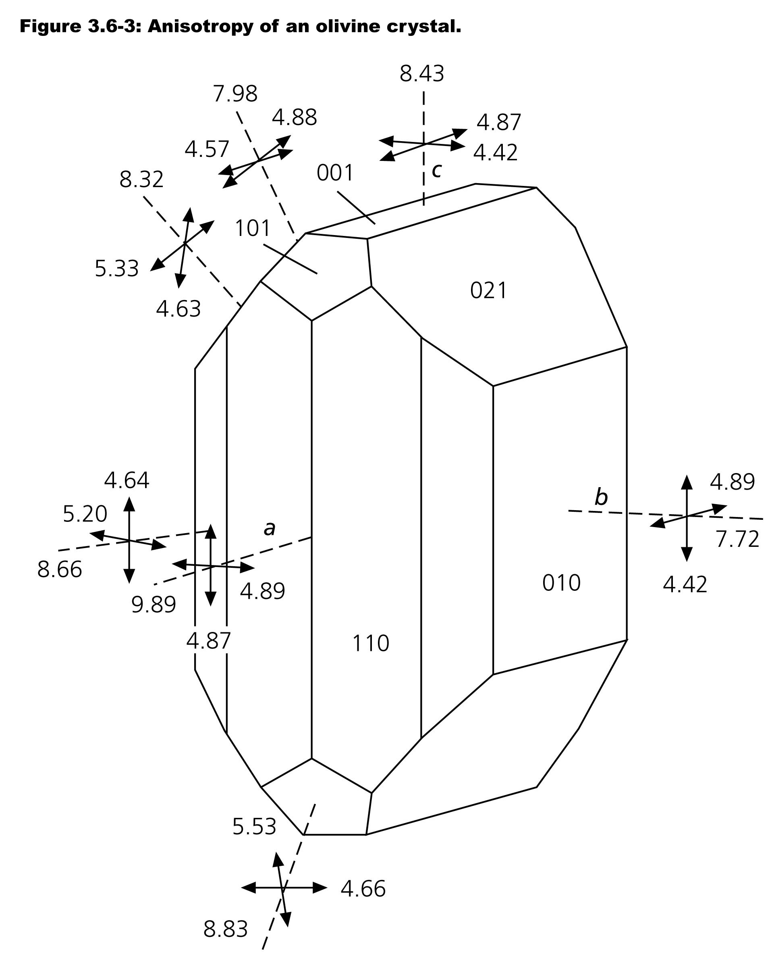

Slide 16
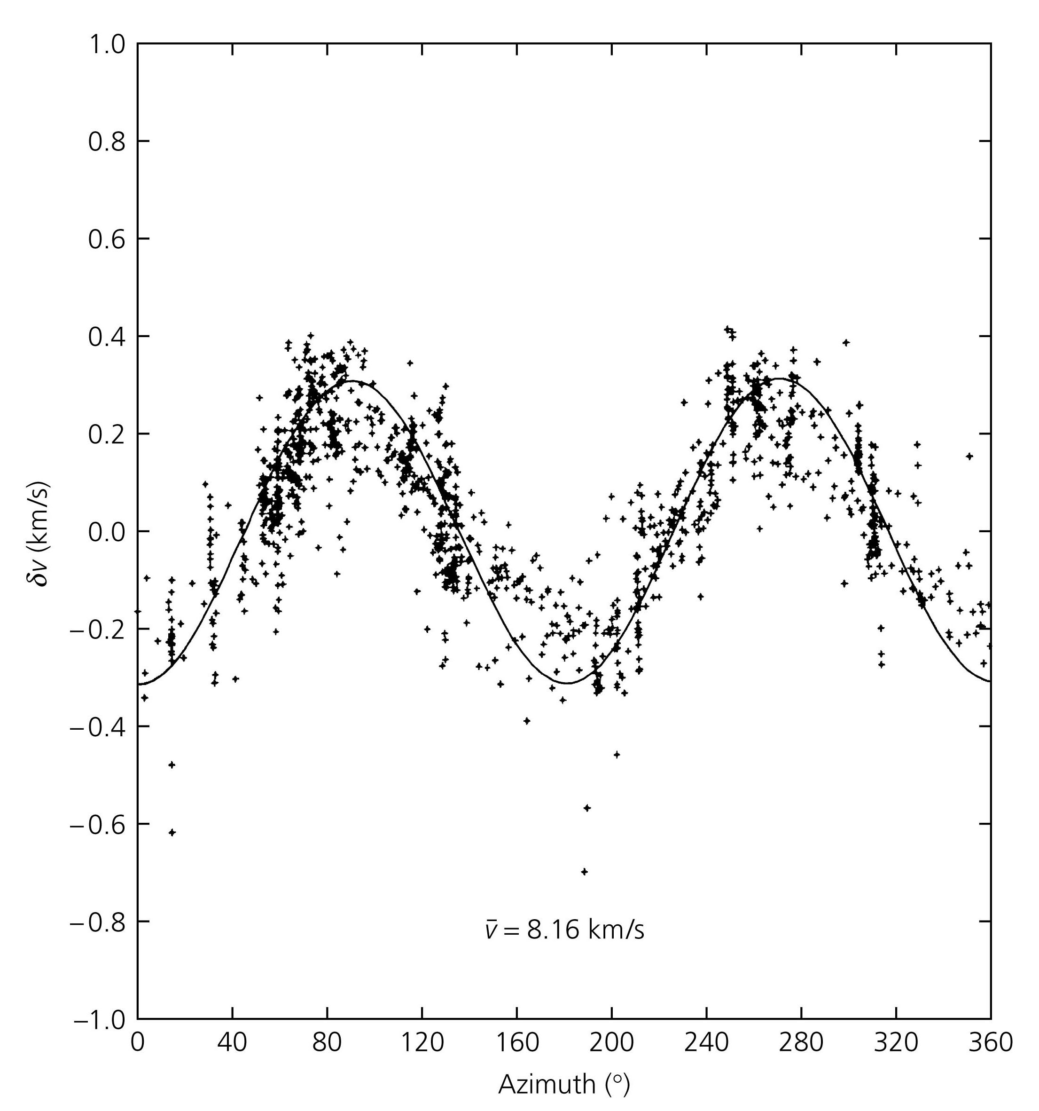
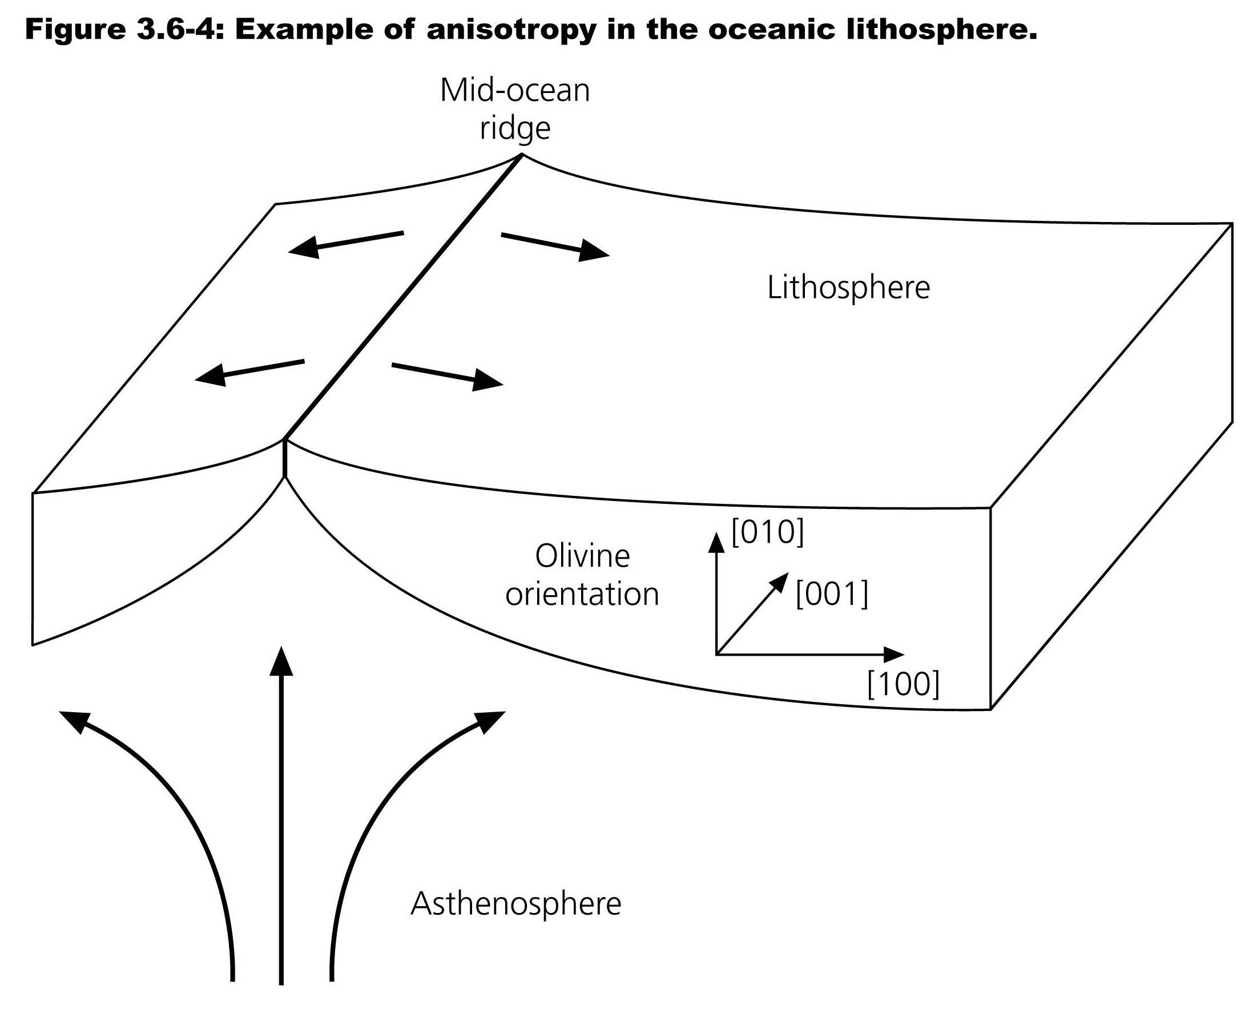

Slide 17
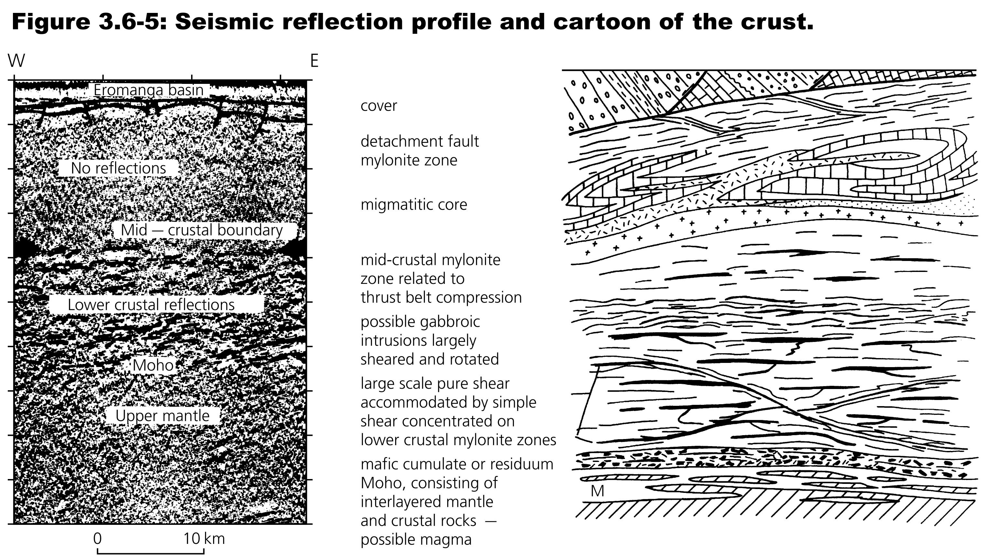

Slide 18
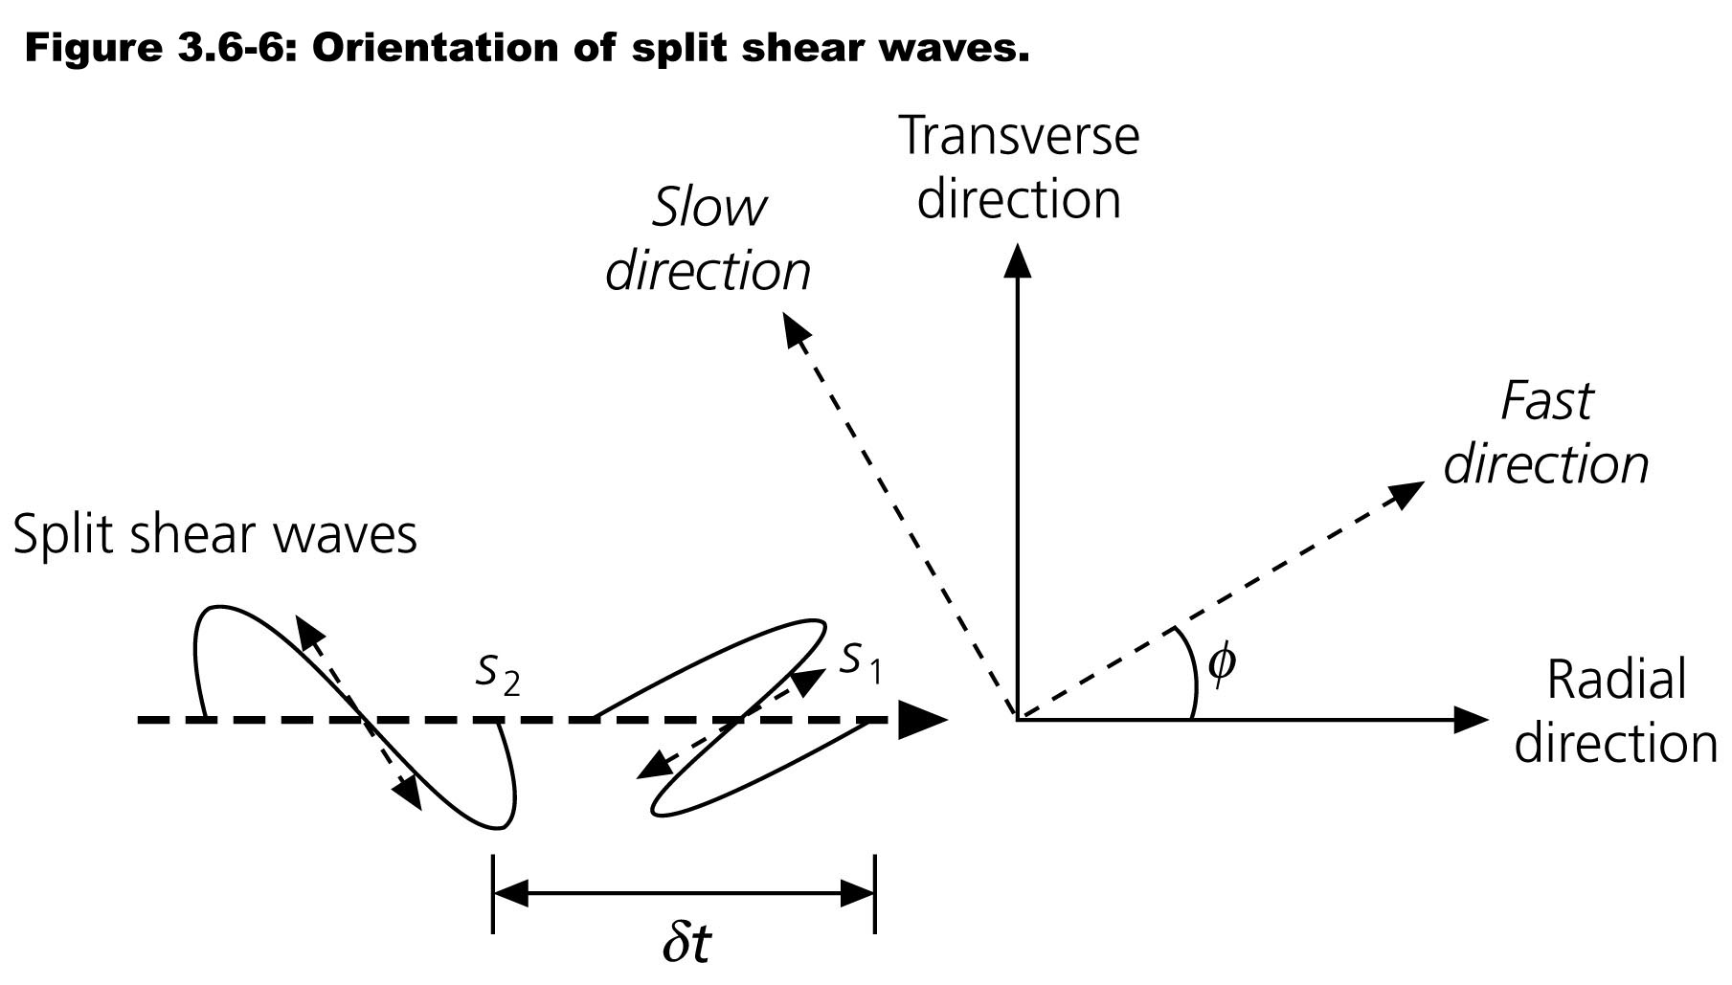
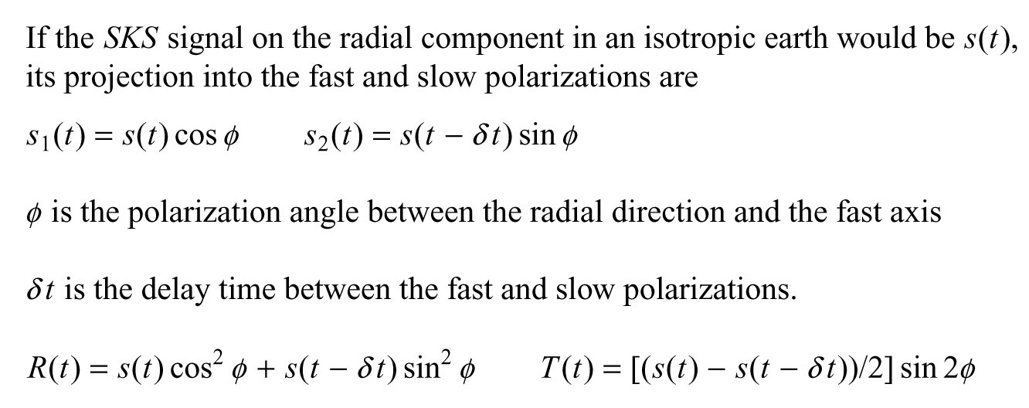

Slide 19
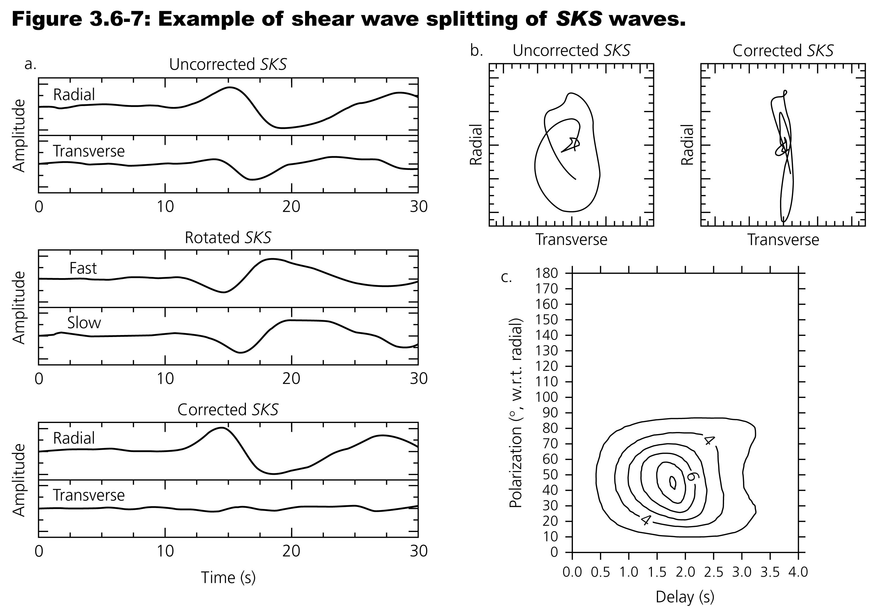

Slide 20
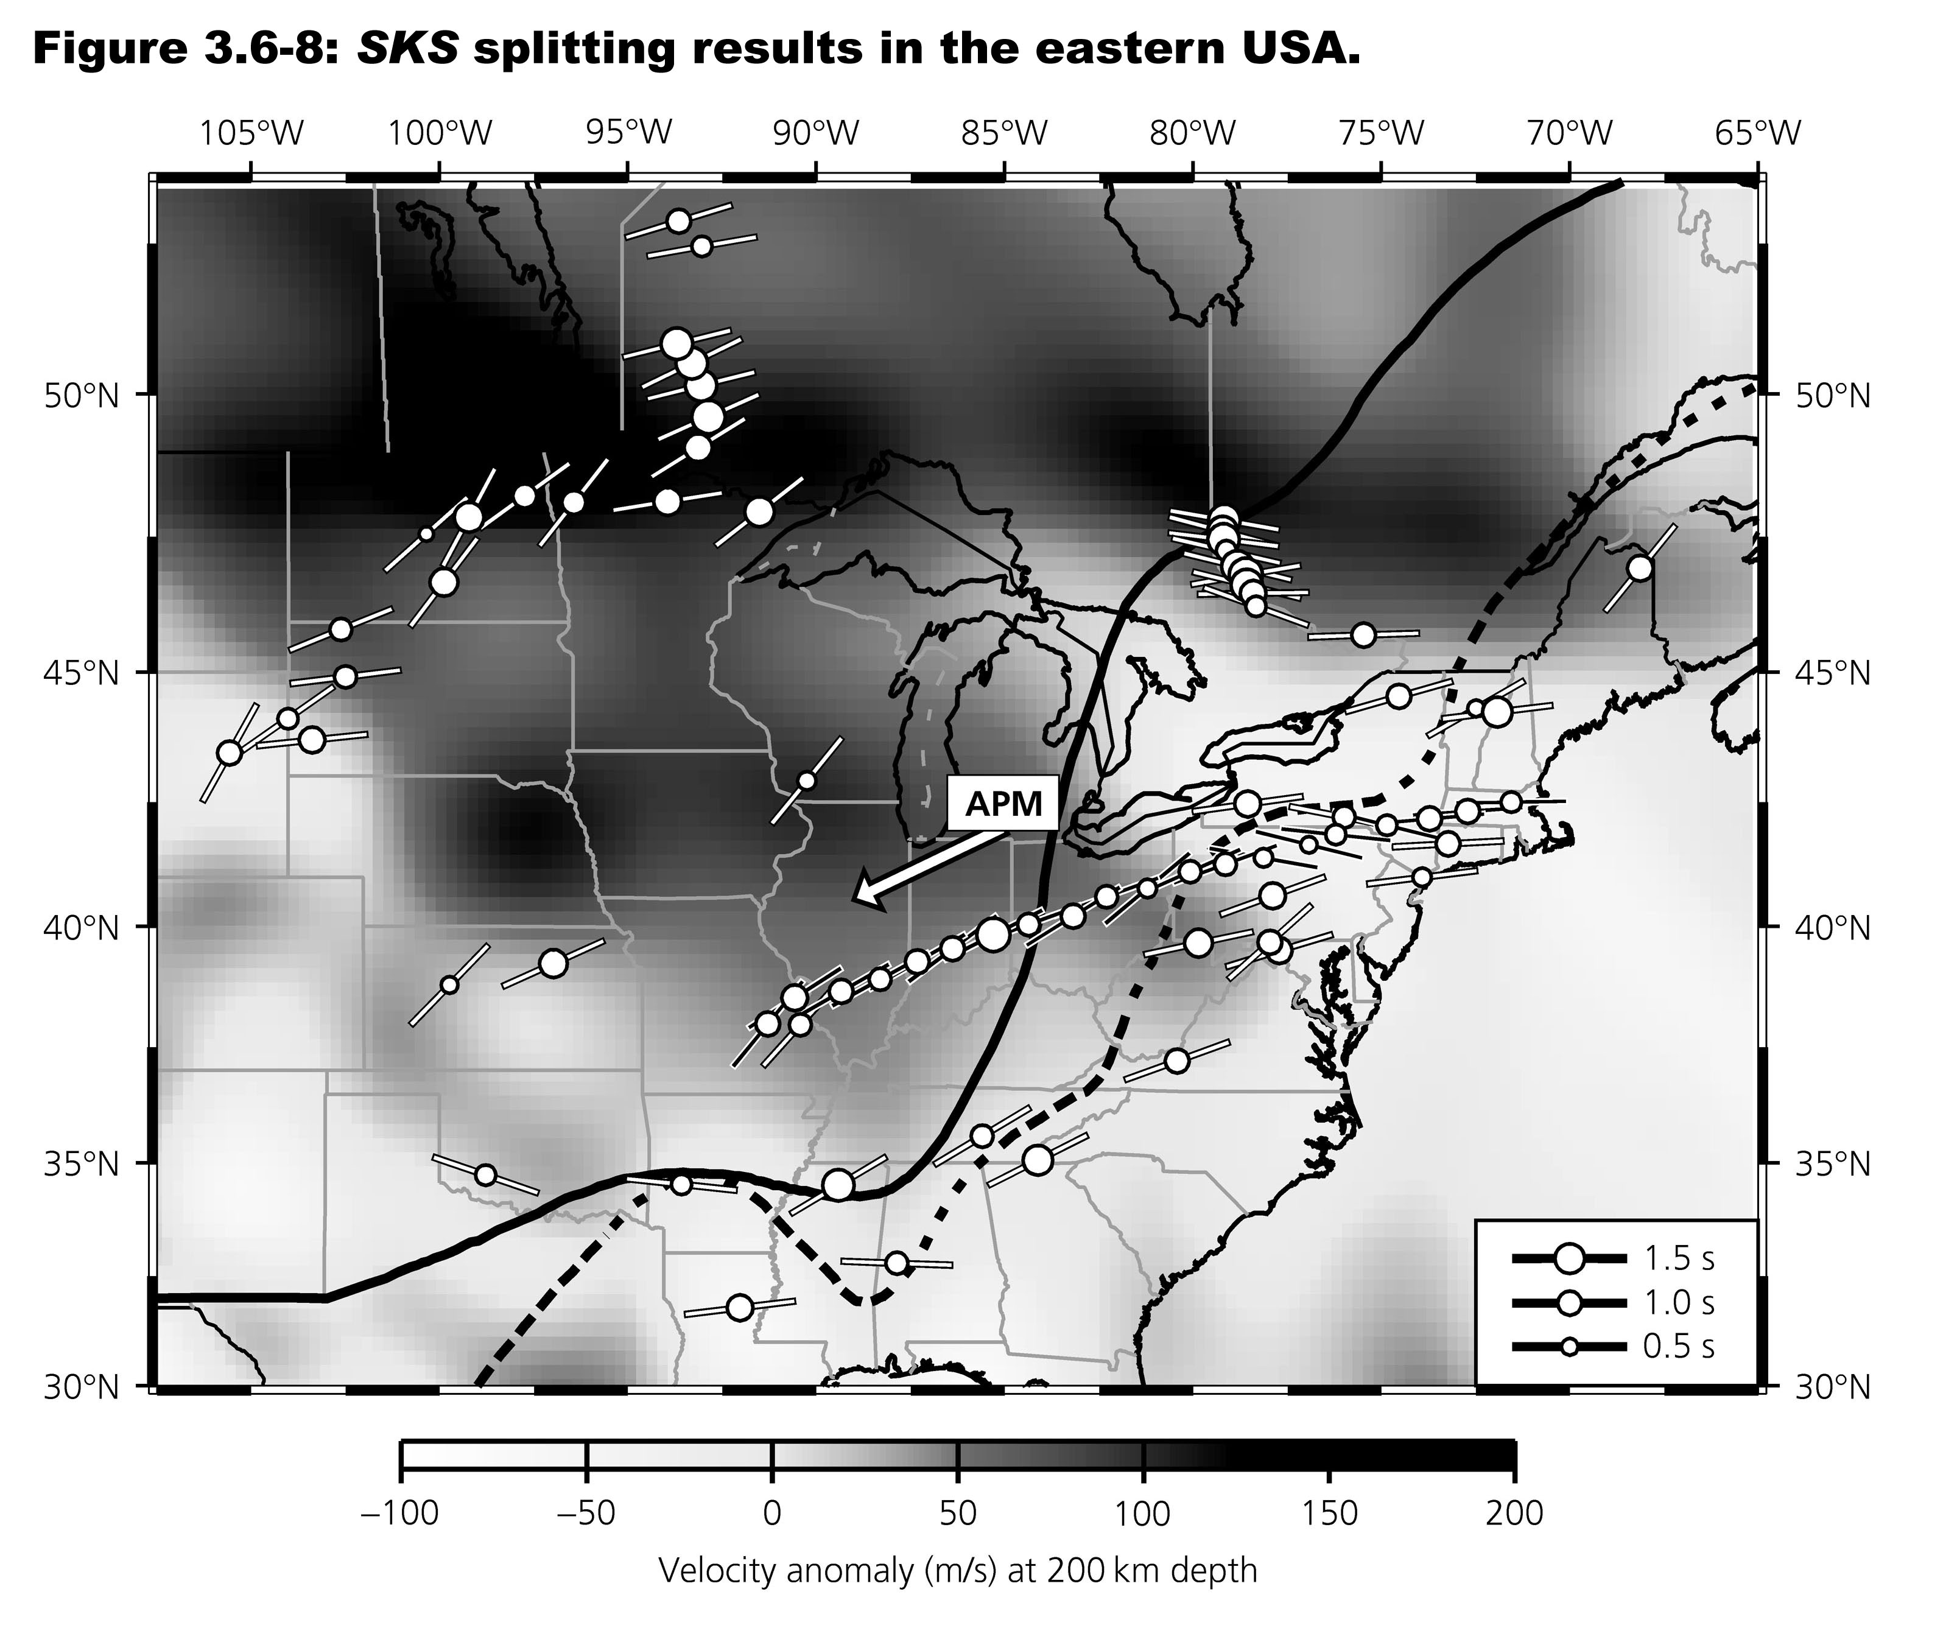

Slide 21
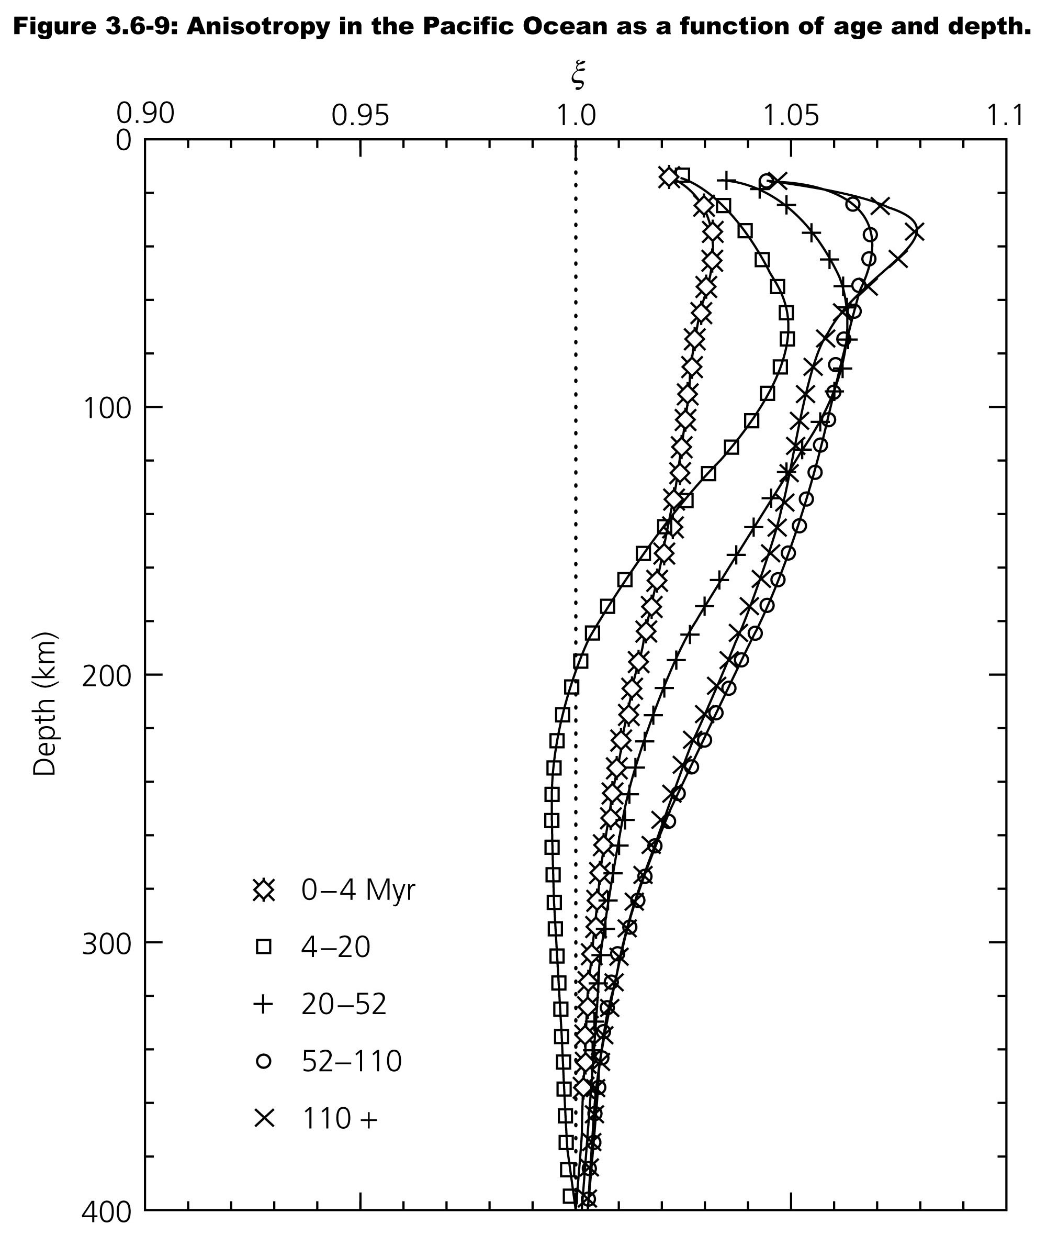

Slide 22
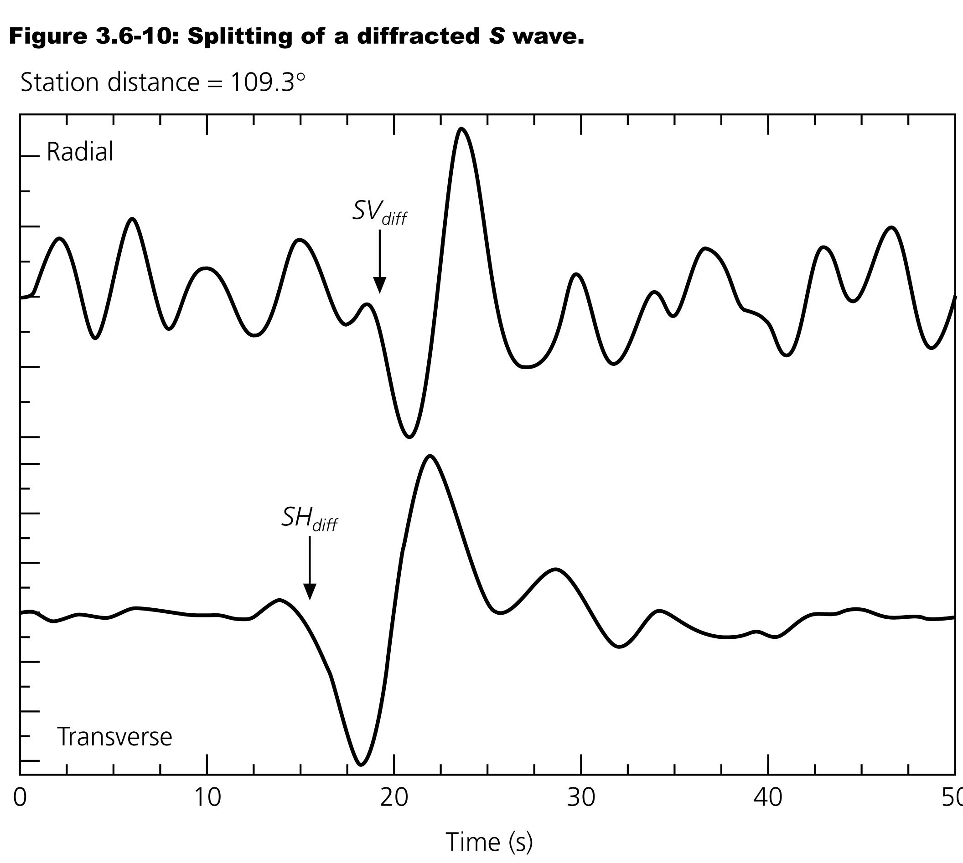

Slide 23
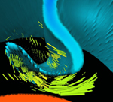
D″ Anisotropy
Lattice-Preferred Orientation (LPO)?
Shape-Preferred Orientation (SPO)?
Result of a Chemical Boundary Layer?
Related to Slabs?
McNamara, van Keken, and Karato [2002]

Slide 24
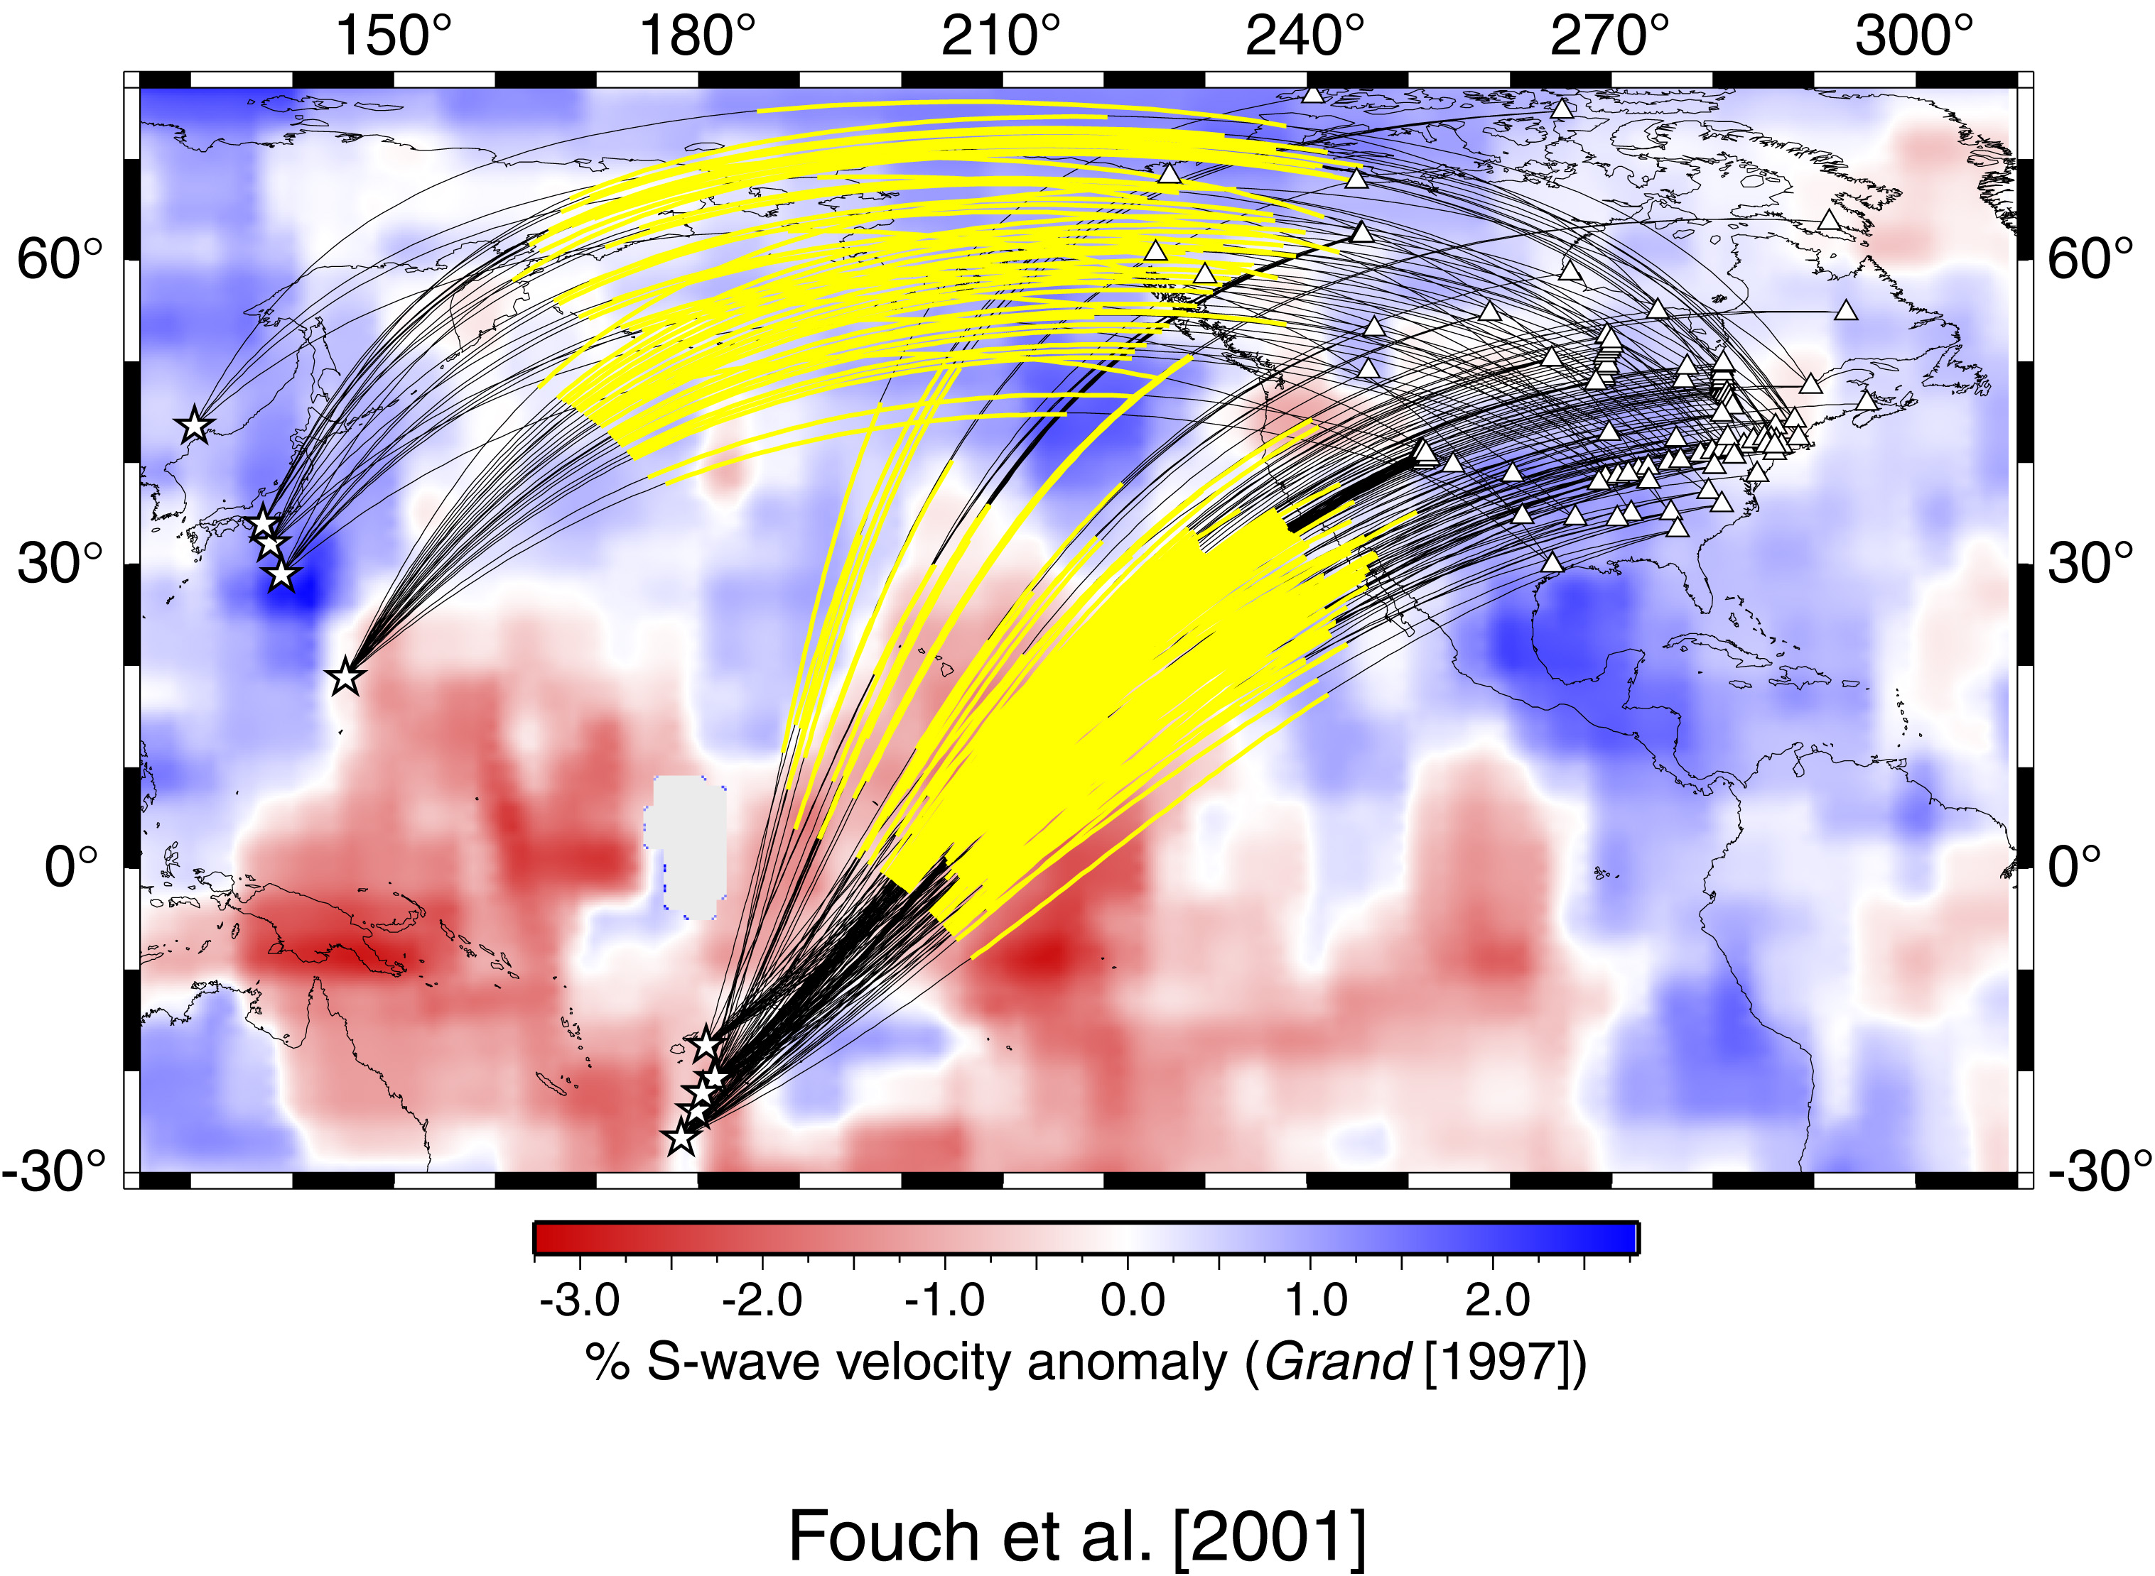
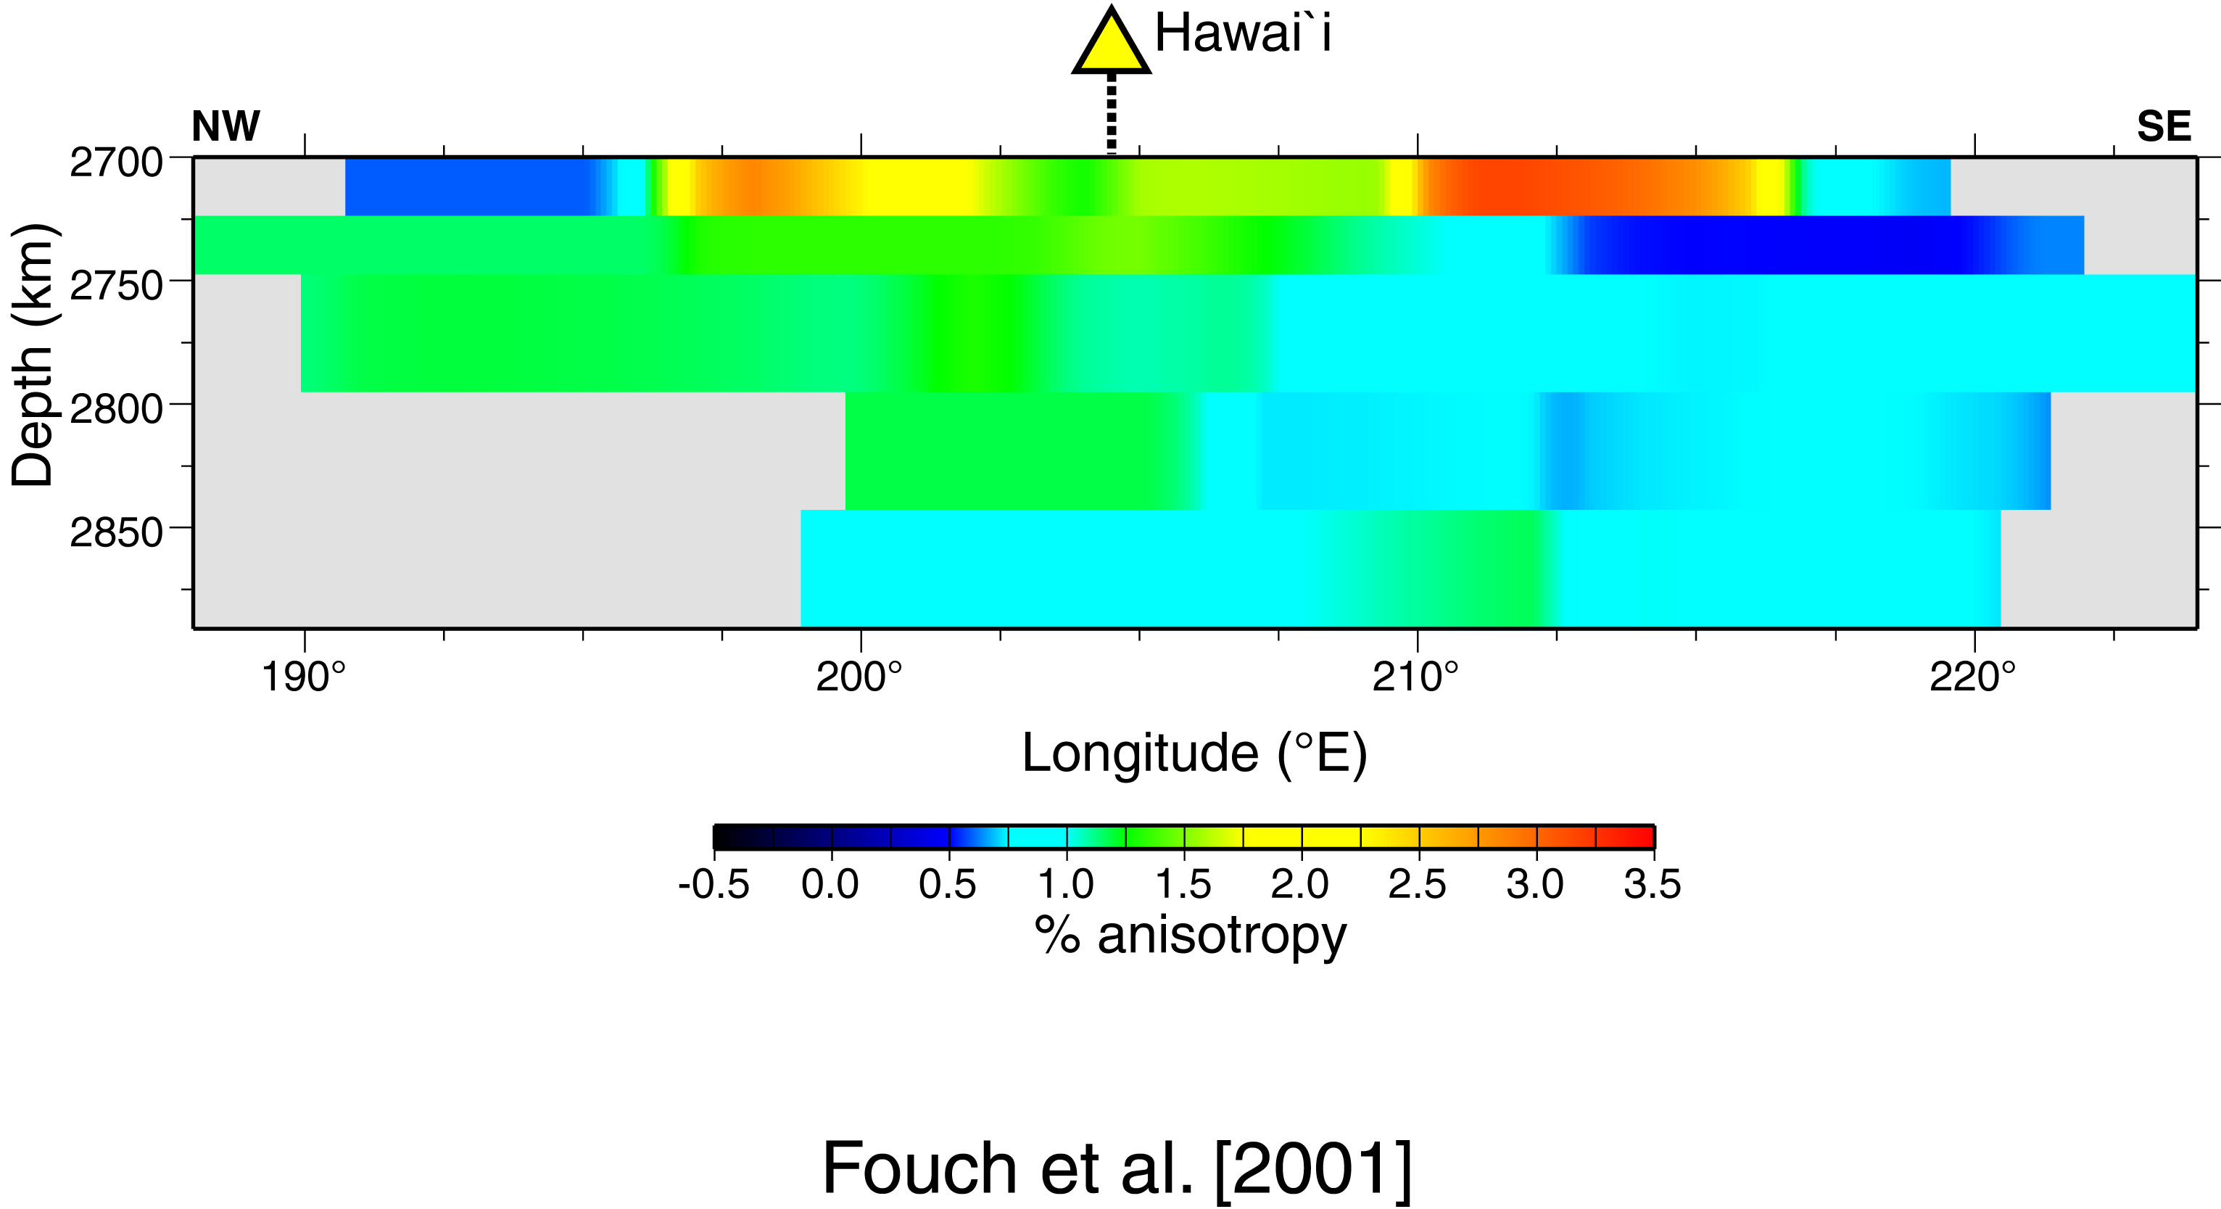
D″ Anisotropy
Often most intense at the top of D″.
Most always with SH faster than SV (→ transverse isotropy)
Shows large lateral variation.
Often associated with the D″ discontinuity.
Fouch et al. [2001]

Slide 25
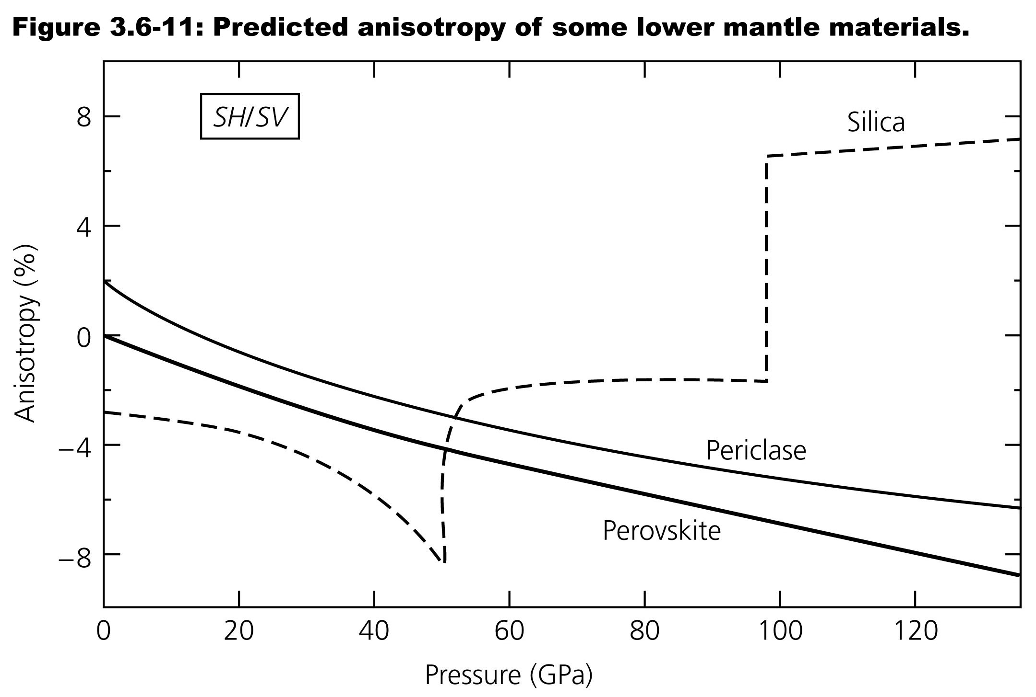

Slide 26
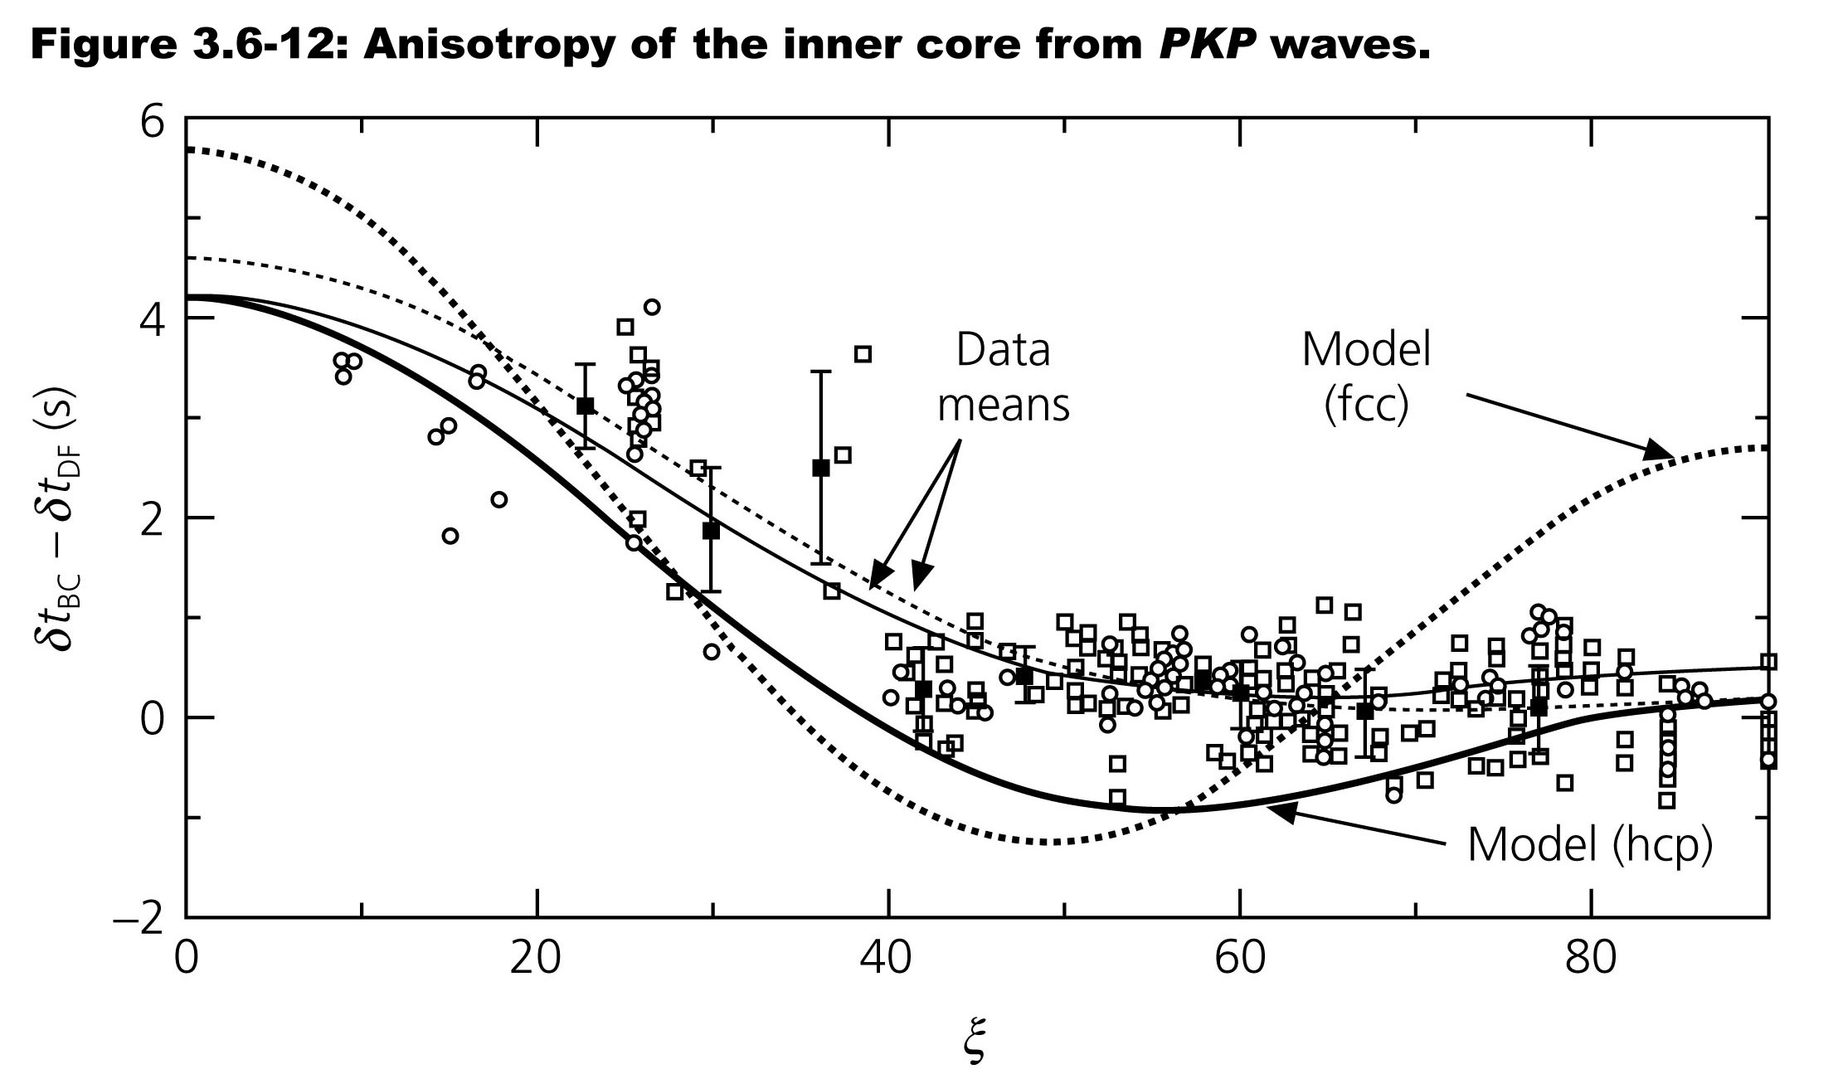

Slide 27
Heaviside function in material
Return to Ch 2 and Surface Waves

Slide 28
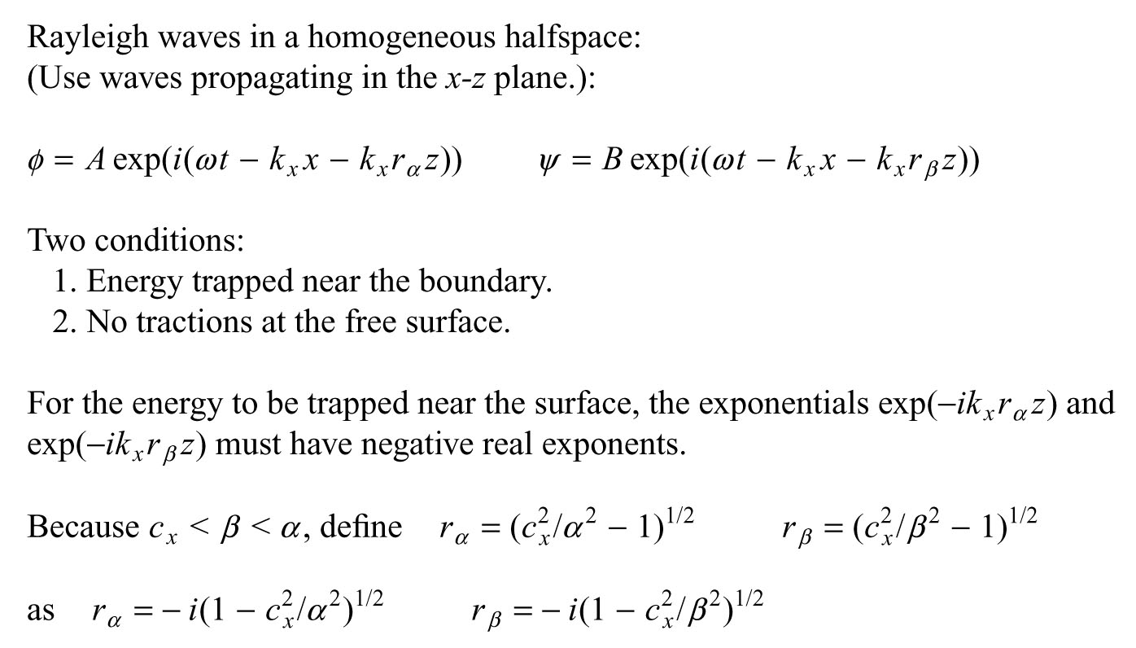

Slide 29
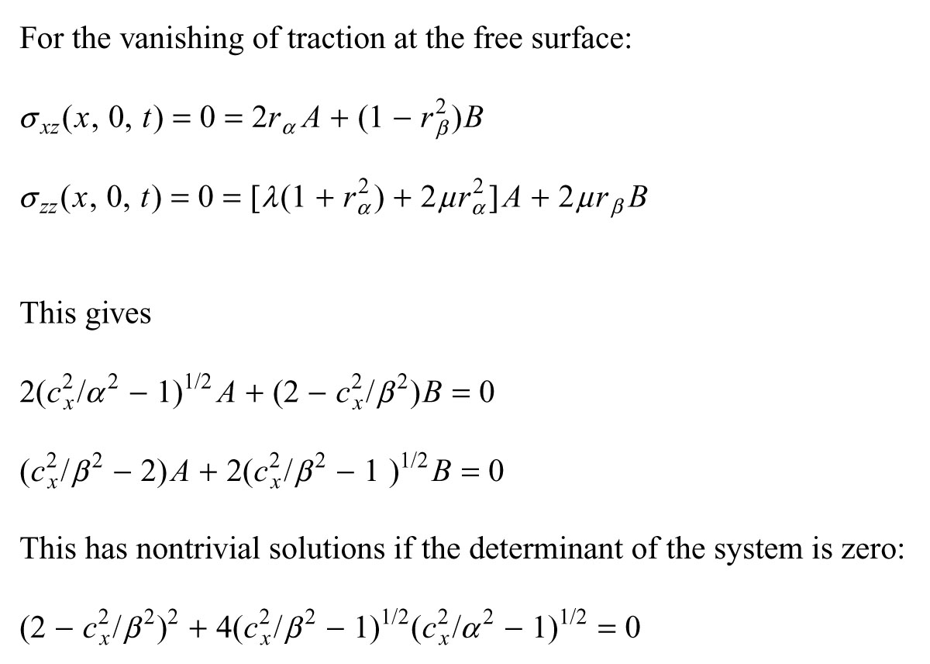

Slide 30
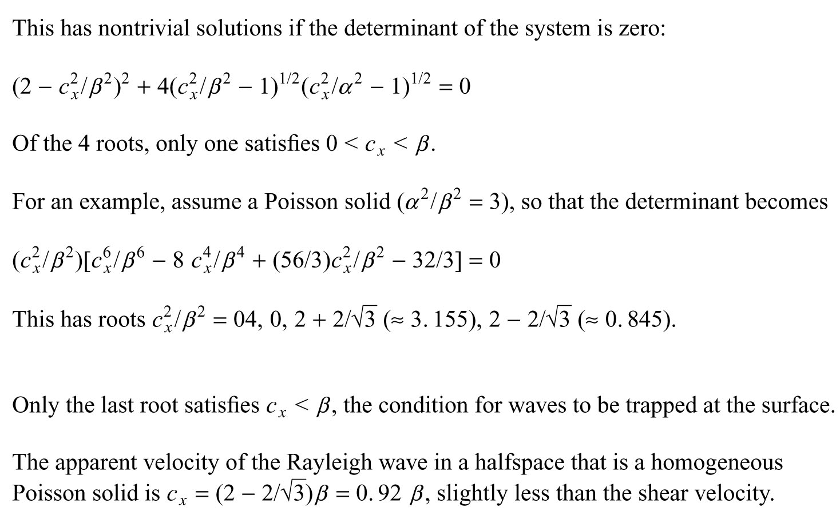

Slide 31
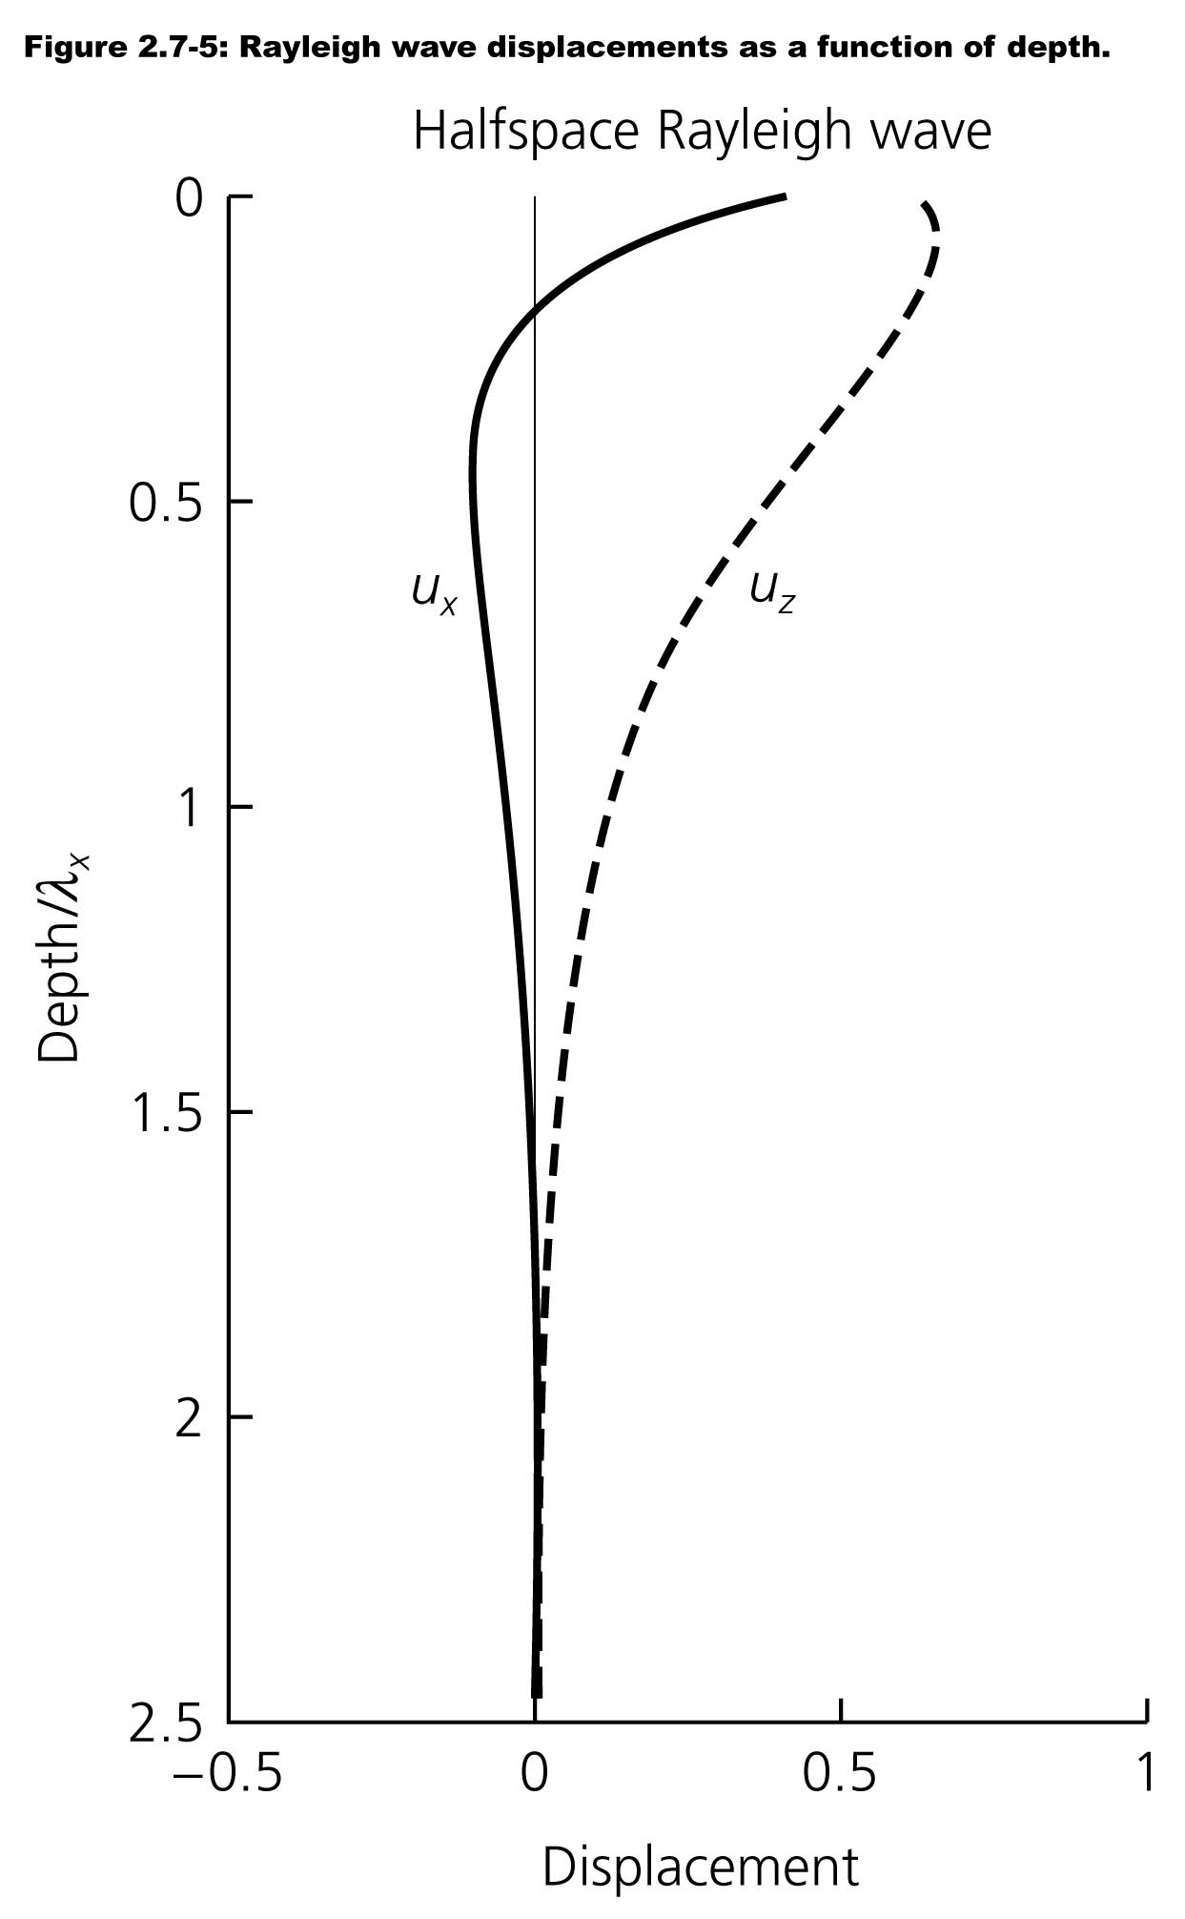
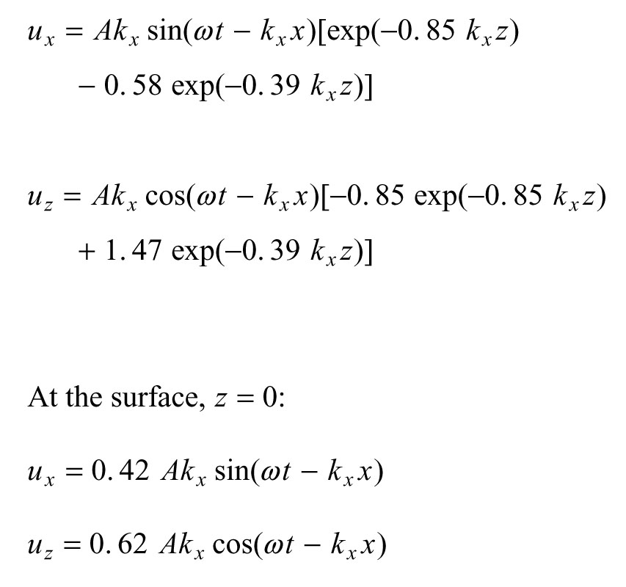

Slide 32
