Slide 1
Global Seismology CERI-8105
Tu-Th 1:15-2:40 pm
Lab - 3892 Central Ave. (Long building) , Room 110
-----------------------------------------------
Bob Smalley
Office: 3892 Central Ave, Room 103, 678-4929
Office Hours – when I’m in my office.
http://www.ceri.memphis.edu/people/smalley/CERI8105_GlobalSeismology.html
Thu., Oct 19, 2023 Meeting 15

Slide 2
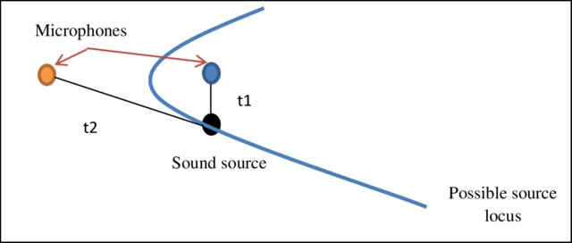
Notes:
https://www.researchgate.net/publication/315695379_Acoustic_Beamforming/figures?lo=1

Slide 3
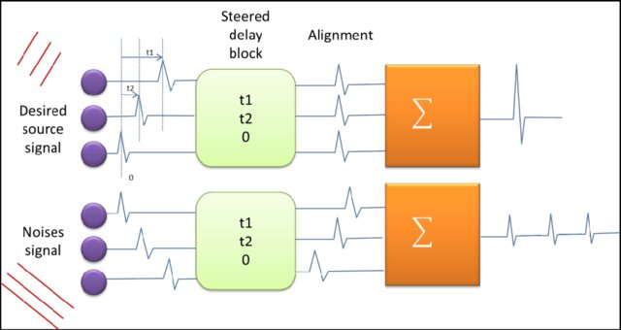
Notes:
https://www.researchgate.net/publication/315695379_Acoustic_Beamforming/figures?lo=1
Delay and sum beamforming approaches a microphone array time domain 1. Sound signals are multiplied by a weighting factor corresponding to each microphone. This calibrates the microphone to known noise in the test field.

Slide 4
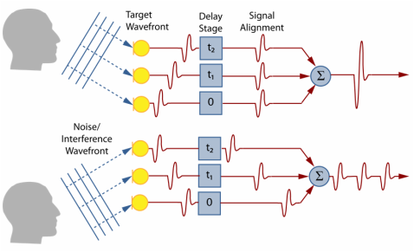
Notes:
https://beamforming-noise-cancellation.weebly.com/beamforming.html
Directional microphones improve speech quality by eliminating noise coming from all directions but a single direction of interest. One way to make a directional microphone is beamforming. This involves combining information from multiple sensors to make a single directional sensor [2]. Delay-Sum Beamforming uses artificial and natural delays to create patterns of constructive interference in the desired direction and destructive interference elsewhere.

Slide 5
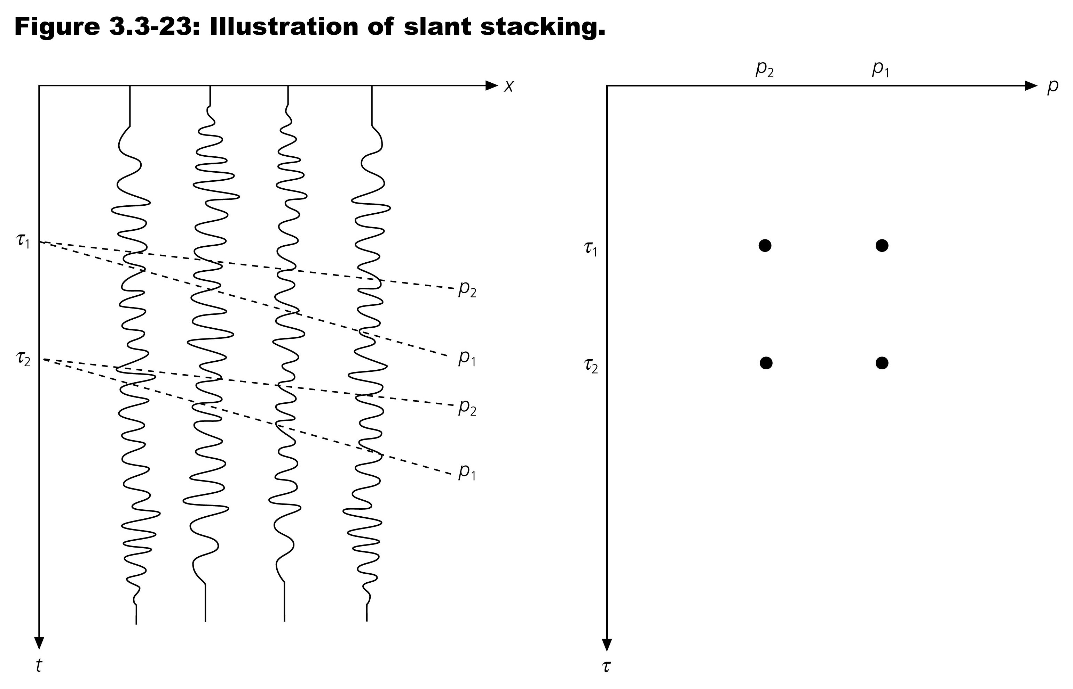
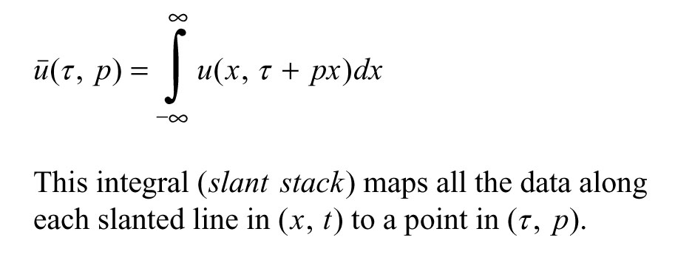
Notes:
Schematic illustartion of slant stacking, data are summed along lines in the x,t plane (left) corresponding th values of intercept tau and slope p snd yield points in the tau p plane to the right
Do this for all combinations of p (straight lines here) and t (intercepts) – so pick p and run it in steps down the axis. Do for some range of p's.

Slide 6
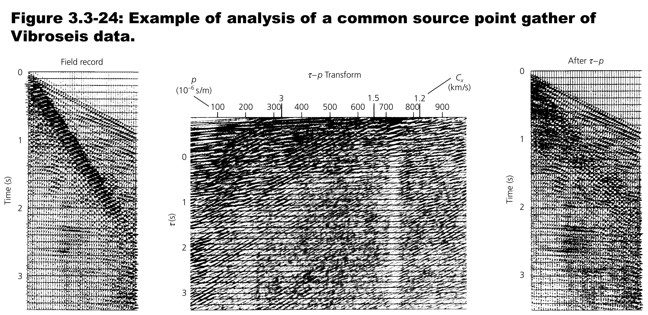
(Remove signals with p > 650 micro-s/m)
Notes:
Common source point gather – left, big surface wave noise, middle slant stack - big peak at tau=0 and p~740 us/m. right - inverse slant stack with surface wave noise surpressed
Slant stack it into tau p domain, zero out/filter out the surface wave, run the tau p stacking process backwards to produce filtered signal with surface waves removed

Slide 7
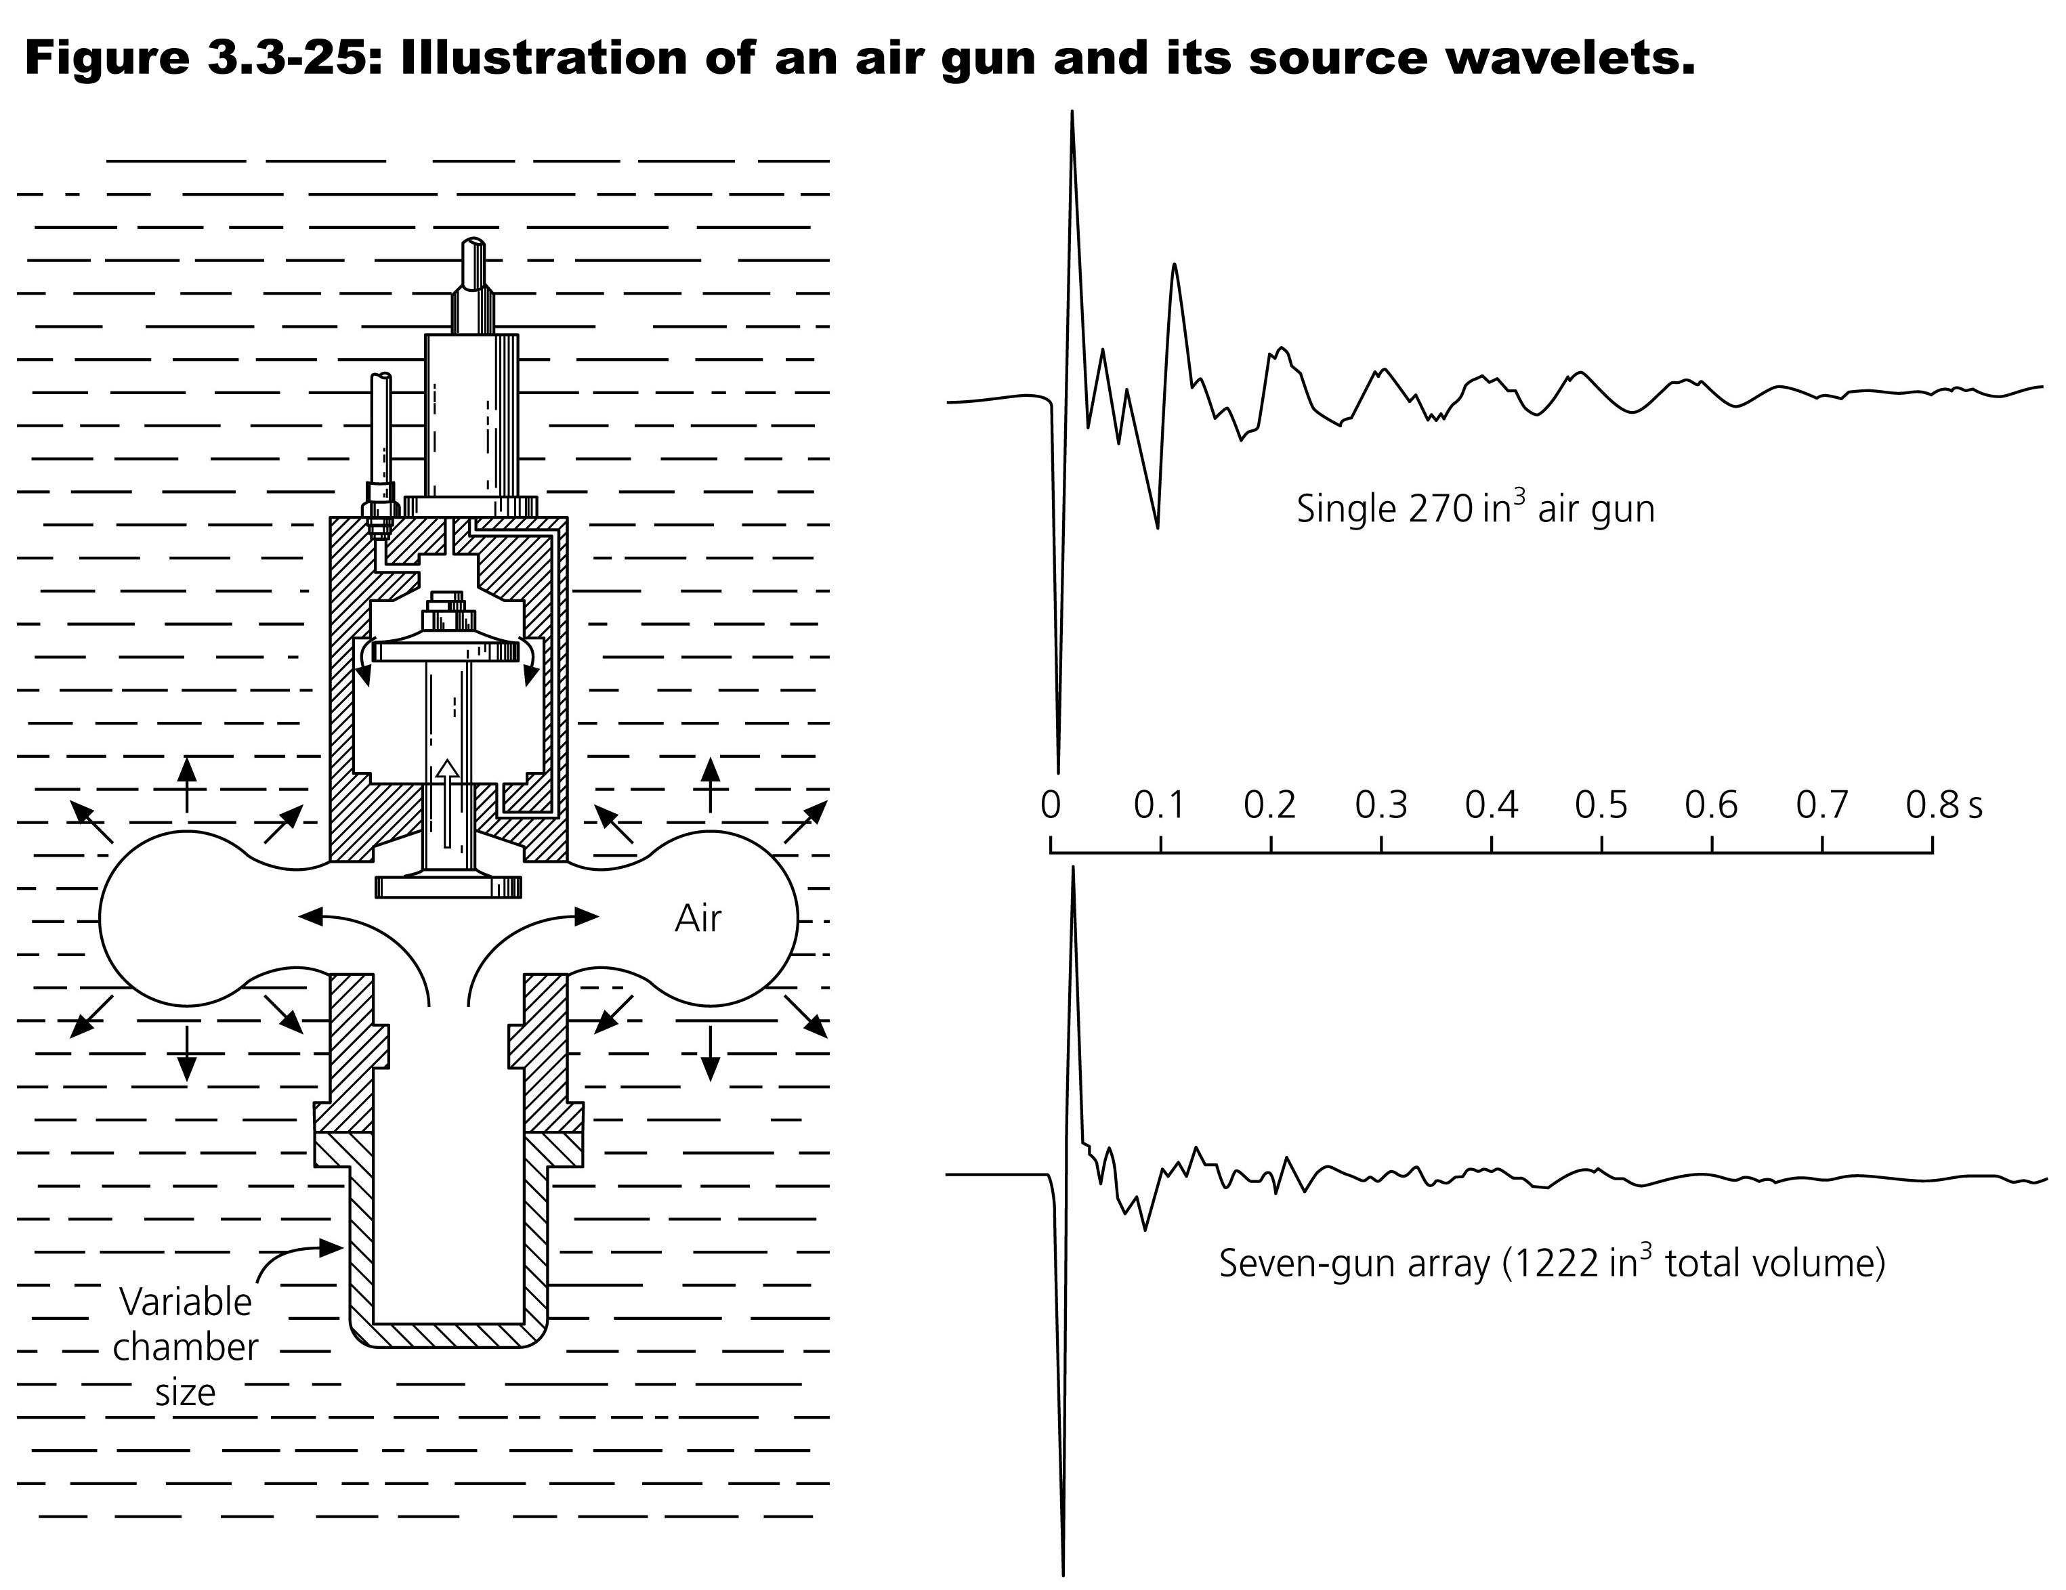
Notes:
Airgun and source wavelet
Used to do seismic reflectino In water
Bad for the fish, especially with dynamite
One bun vs 7 (constructive/destructive interference to get better signal – common adds constructively, random/noise adds destructively
Array reduces the bubble pulse and makes it more impulsive

Slide 8
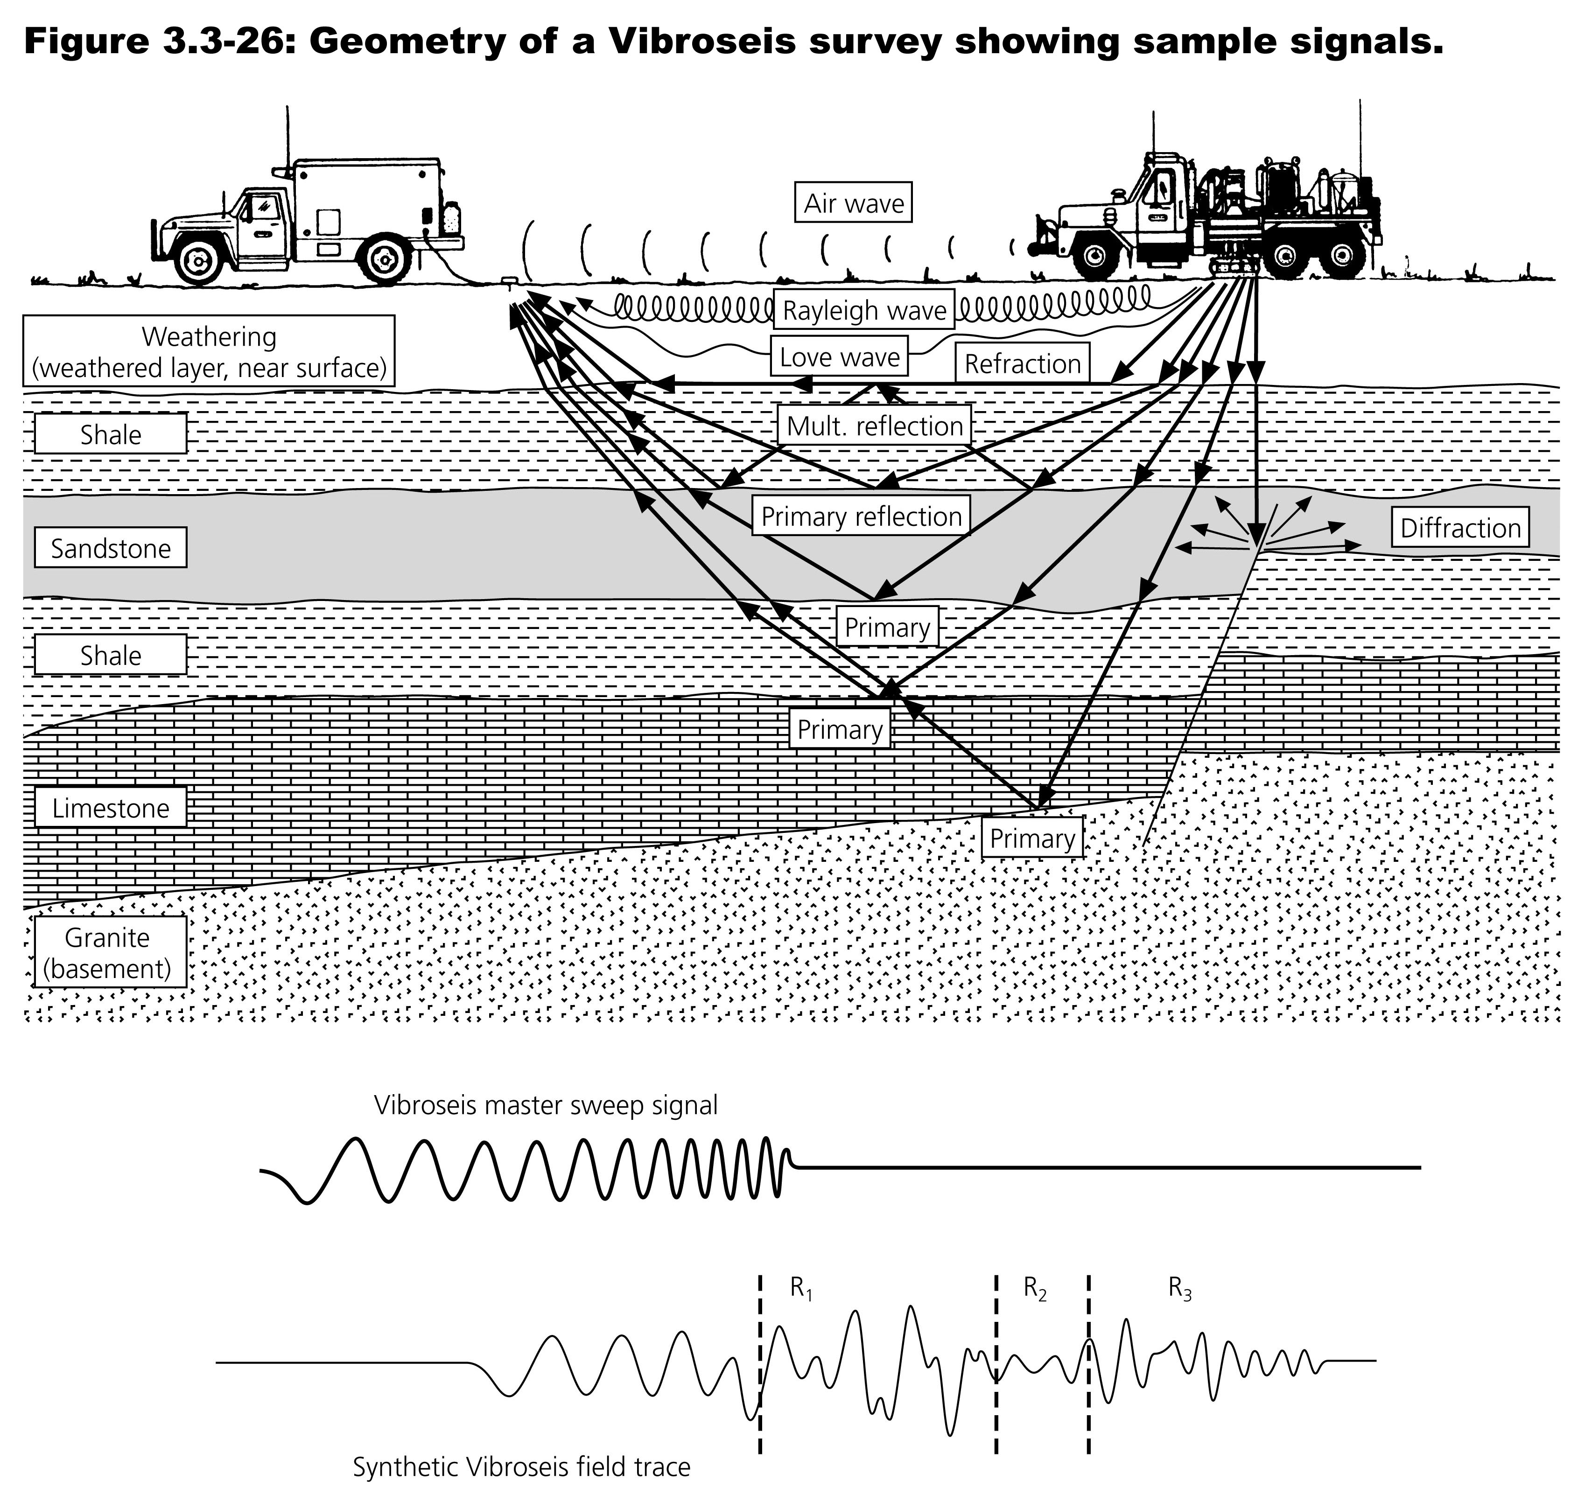
Notes:
Geoemetry of vibroseis (or dynamite) and sweep/chirp signal (not dynamite, which is impulse). Field records contain interfering reflections off various interfaces, and so require processing to identify individual reflections.
Get reflections off flat, dipping, non-planer surfaces, and faults (usually not reflections off steep faults, but get diffraction from discontinuities)
What are advantages of vibroseis – more energy by thumping longer rather than bigger explosion.
Correlate to get chirp into "spike"
Band of frequency/wavelengh (lower frequencies/longer wavelengths see deeper. (Oil companies only thump long enough to image as deep as they want to/can drill or to find oil. (except in Argentina in the 60s where they used dynamite to run seismic reflection surveys across almost the whole country (only stopped by severe topography) as a government job program, even where there was no hope of finding oil – and they found oil under overthrust basement. This was before plate tectonics and they had no idea how it got there, but they were very happy to produce it).

Slide 9
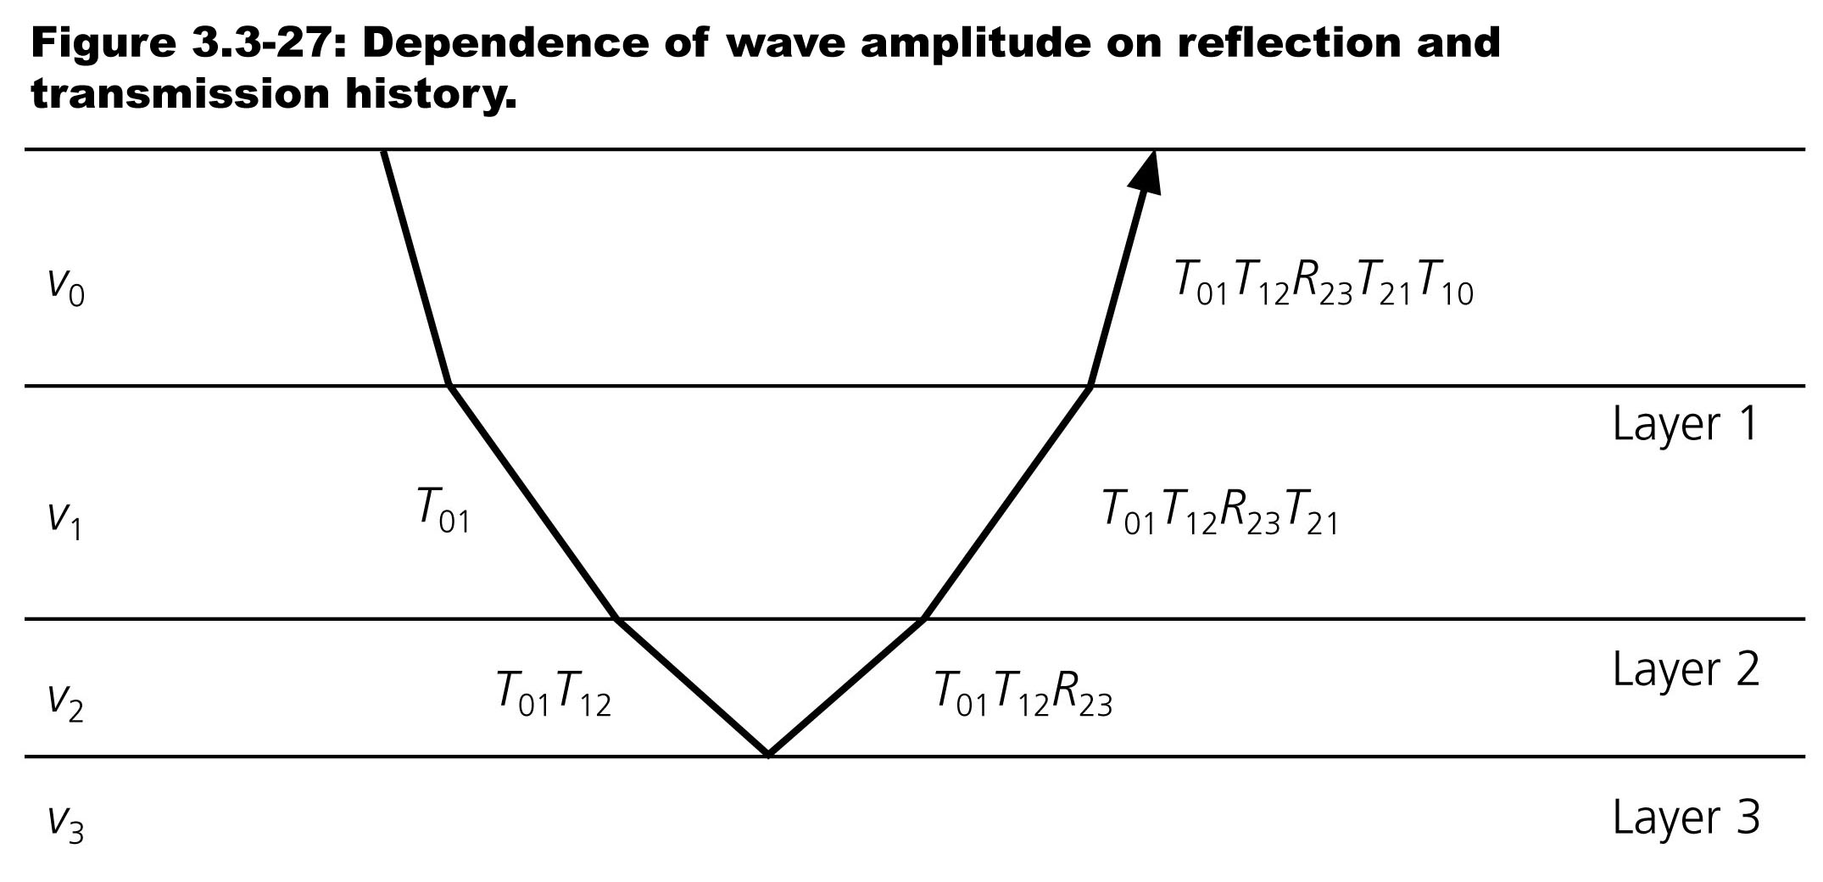
Notes:
Returns are pretty weak.
For vibroseis returns are coming in at the same time as the input chirp is still happening.
Two way gravel time, ~16 sec for 40 km deep moho, less than vibrioses chirp (up to 30 sec)

Slide 10
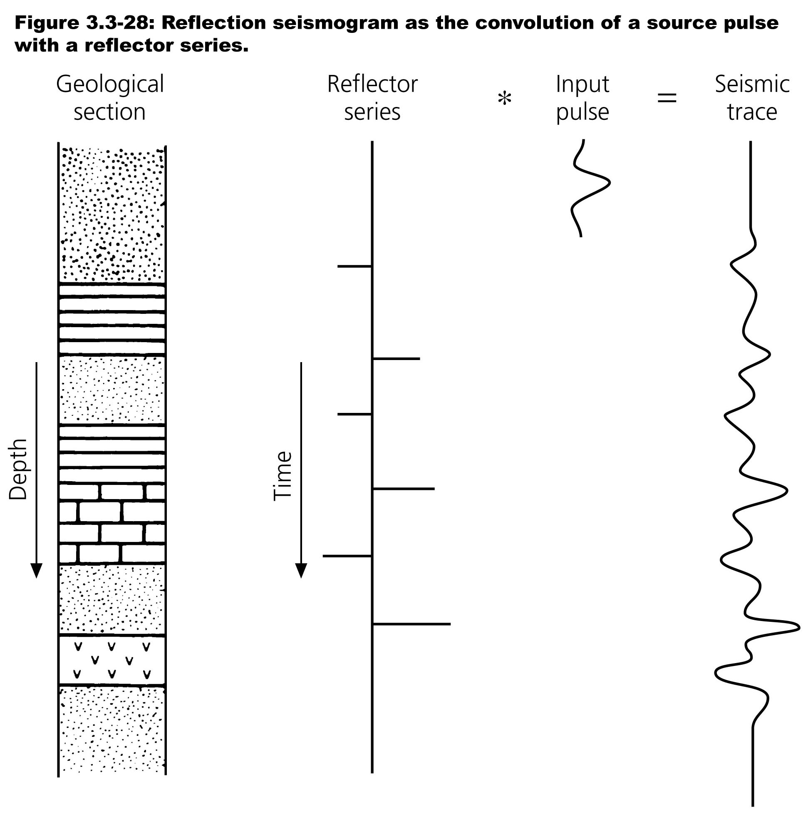
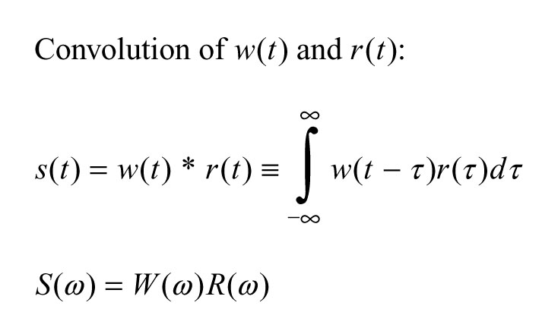
Notes:
The signal in the recorded seismic data is a convolution of the input signal with the string of transmission and reflection coefficients (time shifted, amplitudes and phases)

Slide 11
Notes:
But the raw signal is not very useful
Deconvolution usually implemented in the frequency domain since convolution is the product of the Fourier transforms (which is must faster and more accurate [less multiplies, less roundoff] than doing it in the time domain, so deconvolution is done with division of the Fourier transforms. Problem is when Fourier amplitude is small get large amplification of noise.

Slide 12
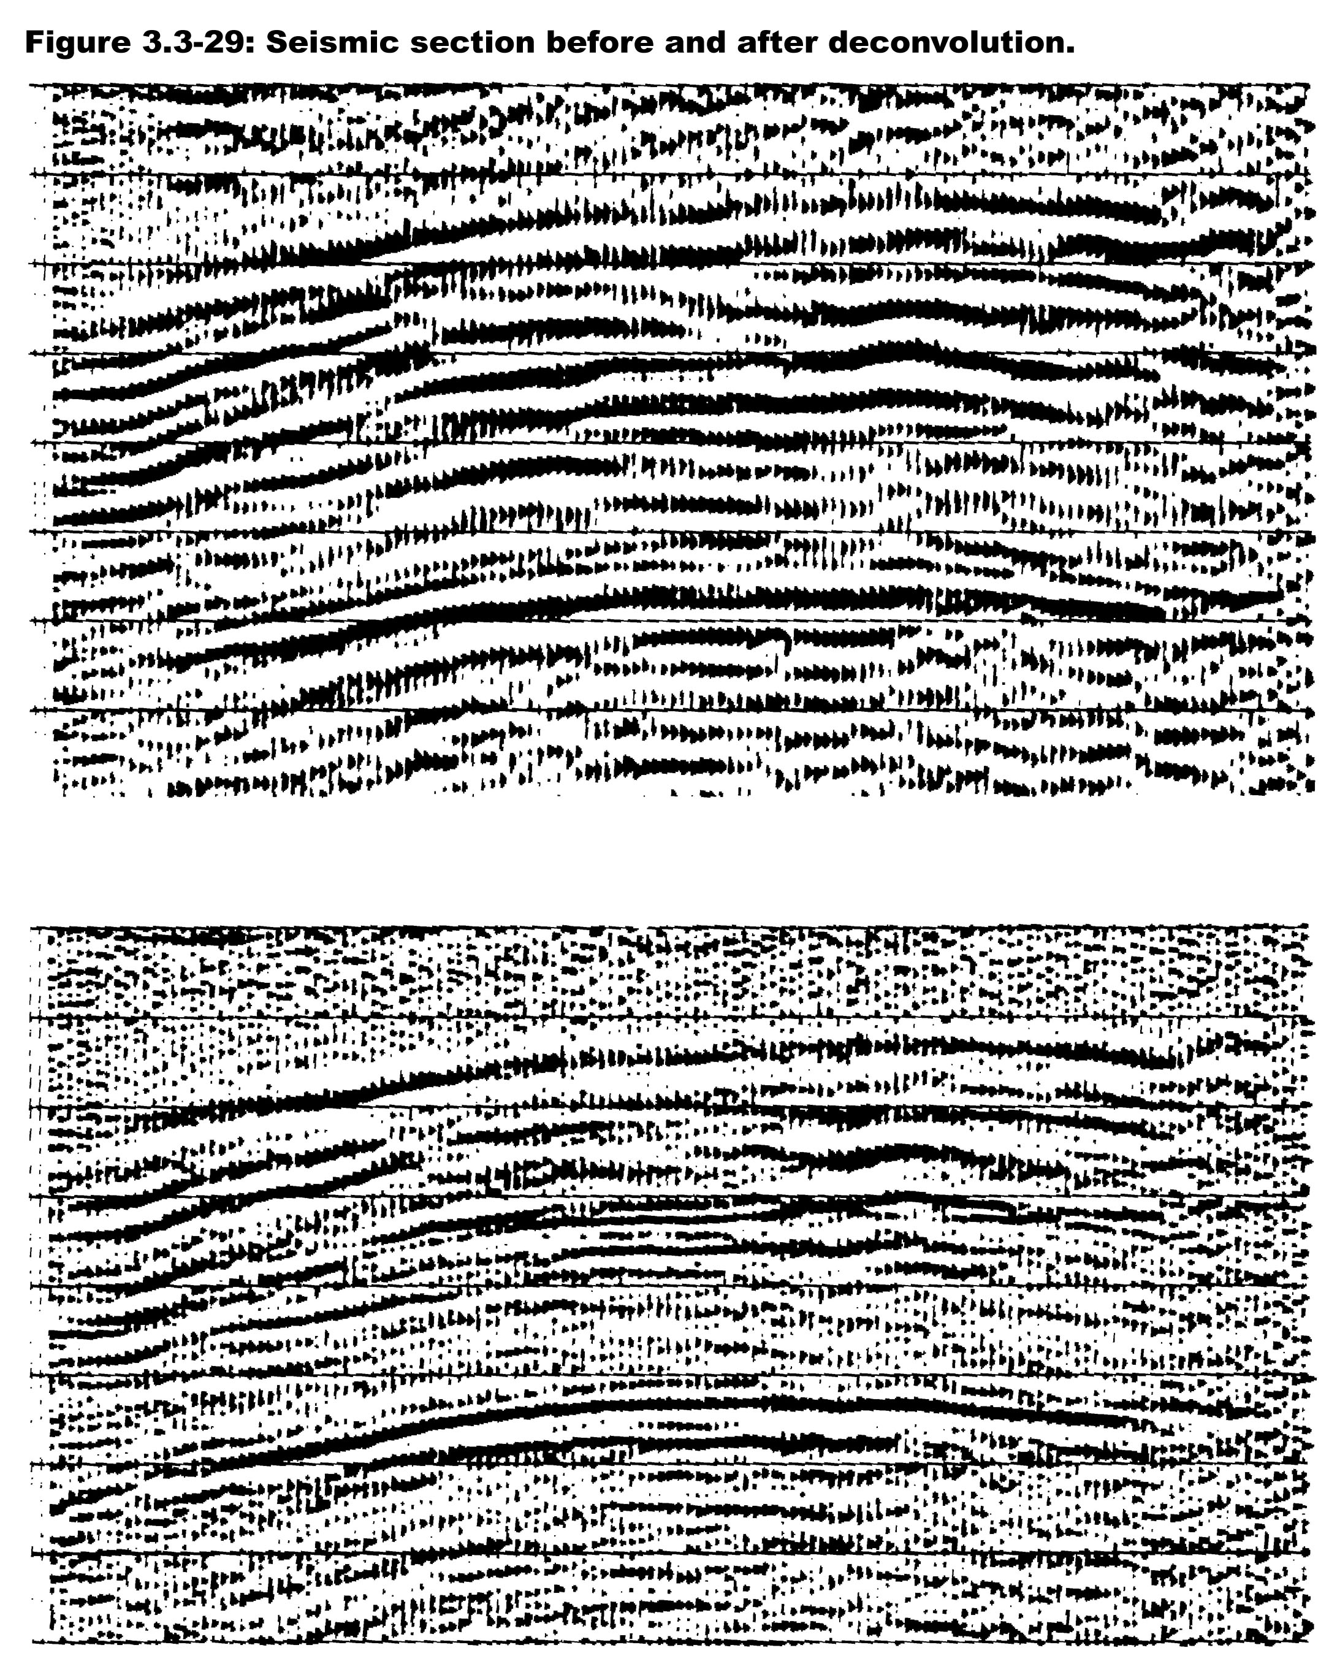
Notes:
After deconvolution get sha

Slide 13
Notes:
There is another way to get the reflection spikes when you have a long, known input (deconvolution will still work, but this new method is easier, but need deconvolution for dynamite)
Convolution is a measure of the effect of one signal on another – can be used to build signals
Correlation is a measure of the similarity of two siganls – can be used to find known signals
Convolution (in time domain) flips one signal, Correlation (in time domain) does not – the process however is exactly the same – shifting and adding,
In the frequency domain the flip is done with the complex conjugate.
Correlation finds similar signals – so one can correlate the input chirp with the recorded data – this does not have the divide by zero/small values problem

Slide 14
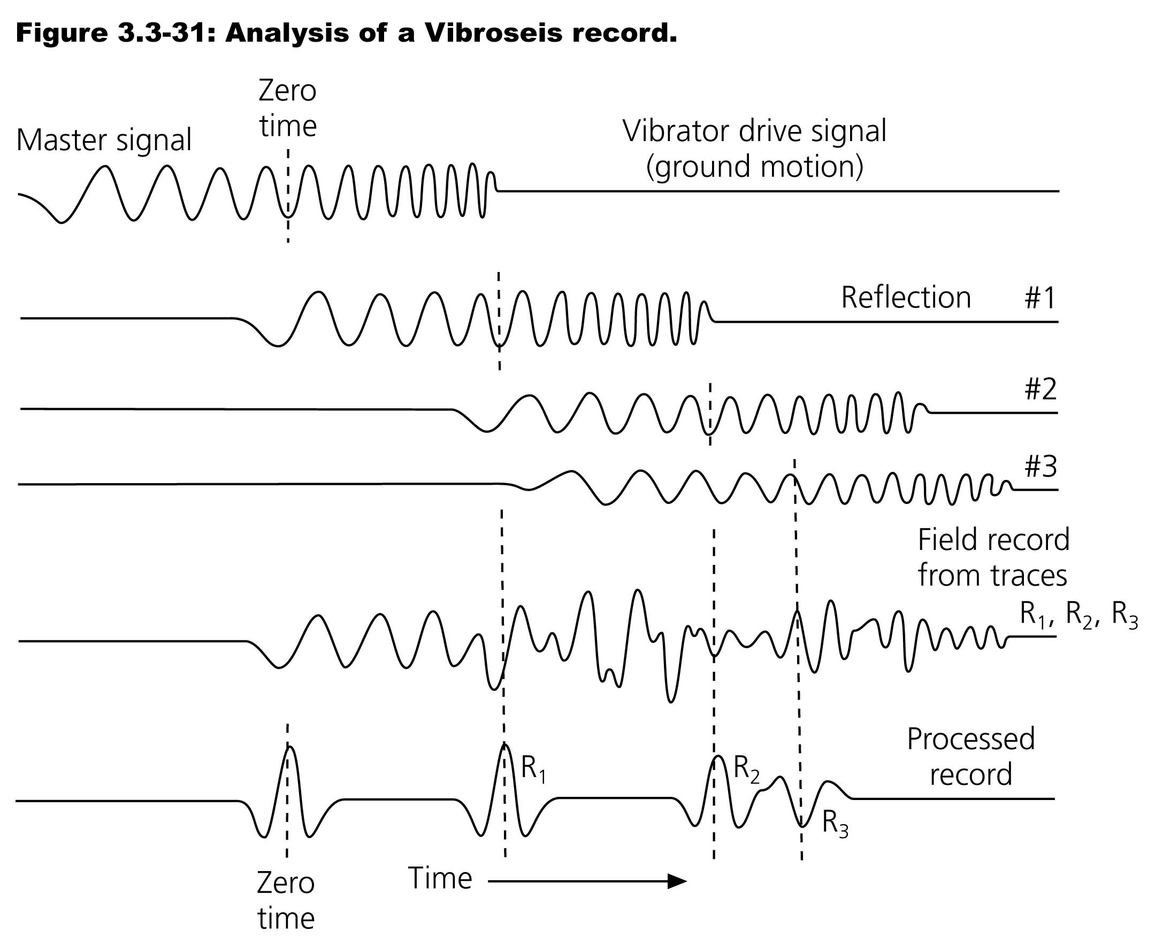
Notes:
Vibroseis signal
Several reflections (time delay, amplitude chages from attenuation and transmission/reflection coefficients, summing the signals to get the raw fifeld record, after convolution get peaks where the reflections are.
Compresses the chirp to a "delta"

Slide 15
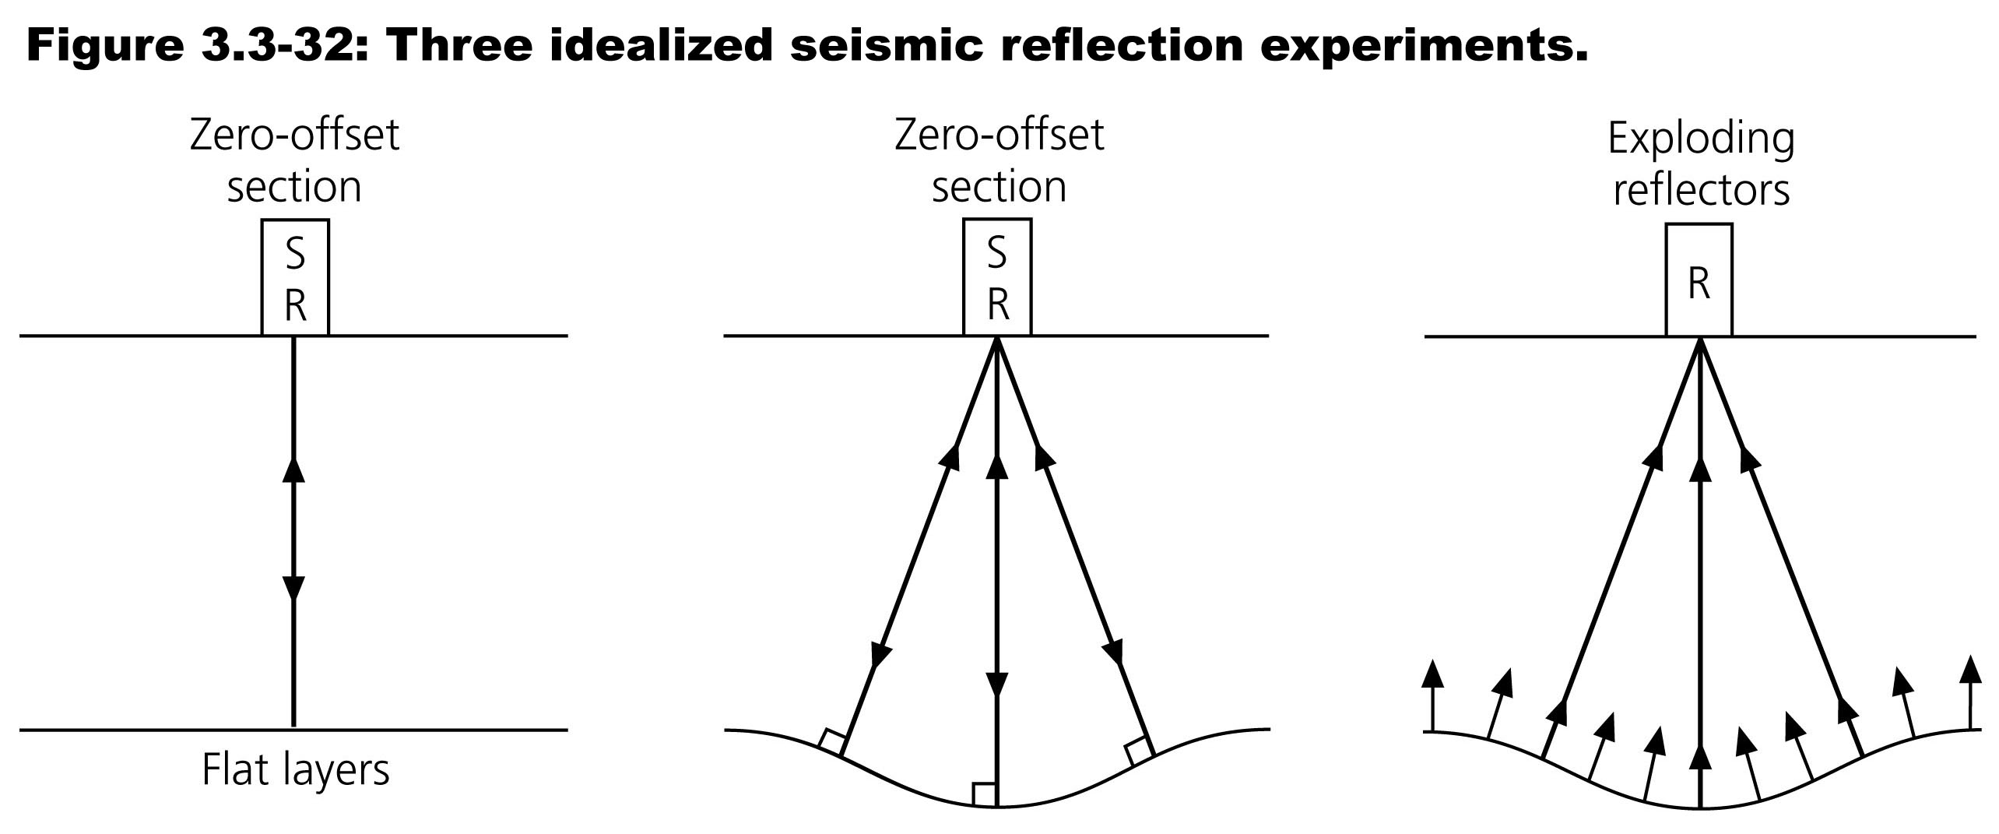
Migration tries to find surfaces in the case of non-horizontal layers – to remove the effects of point diffractors

Slide 16
Seismic migration is the process by which seismic events are geometrically re-located in either space or time to the location the event occurred in the subsurface rather than the location that it was recorded at the surface, thereby creating a more accurate image of the subsurface.
This process is necessary to overcome the limitations of geophysical methods imposed by areas of complex geology, such as: faults, salt bodies, folding, etc.
https://en.wikipedia.org/wiki/Sei

Slide 17
Migration moves dipping reflectors to their true subsurface positions and collapses diffractions, resulting in a migrated image that typically has an increased spatial resolution and resolves areas of complex geology much better than non-migrated images.
A form of migration is one of the standard data processing techniques for reflection-based geophysical methods (seismic reflection and ground-penetrating radar)
https://en.wikipedia.org/wiki/Sei

Slide 18
The need for migration has been understood since the beginnings of seismic exploration and the very first seismic reflection data from 1921 were migrated.
Computational migration algorithms have been around for many years but they have only entered wide usage in the past 20 years because they are extremely resource-intensive.
Migration can lead to a dramatic uplift in image quality so algorithms are the subject of intense research, both within the geophysical industry as well as academic circles.
https://en.wikipedia.org/wiki/Sei

Slide 19
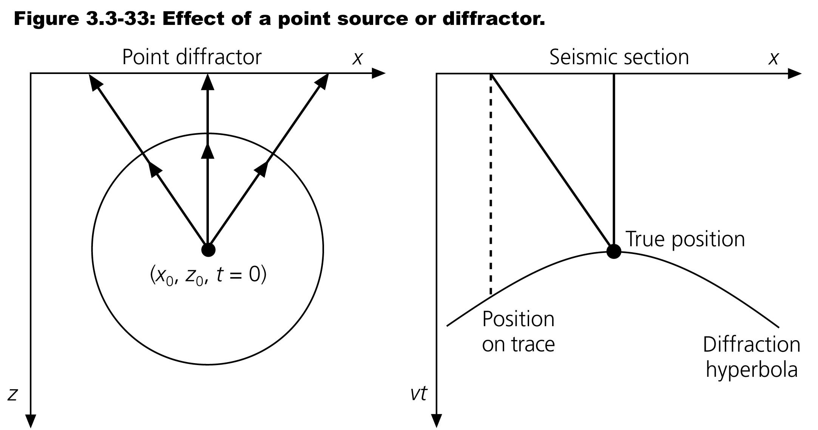

Slide 20
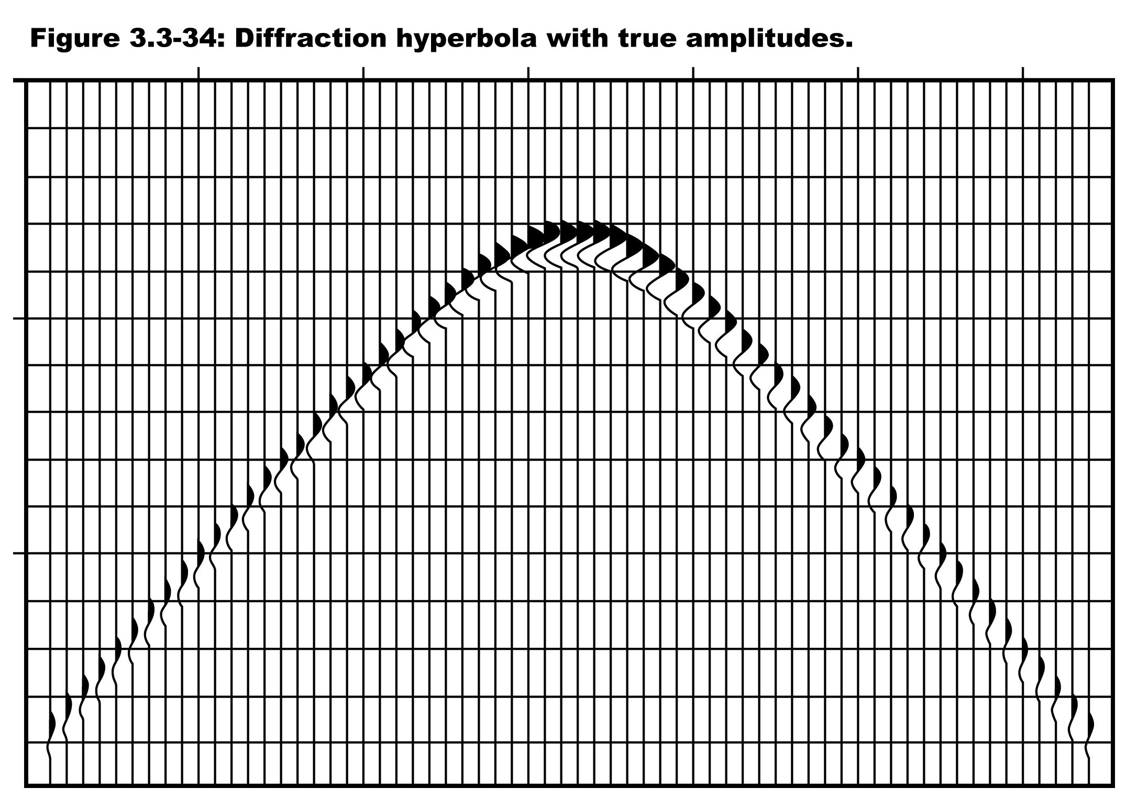

Slide 21
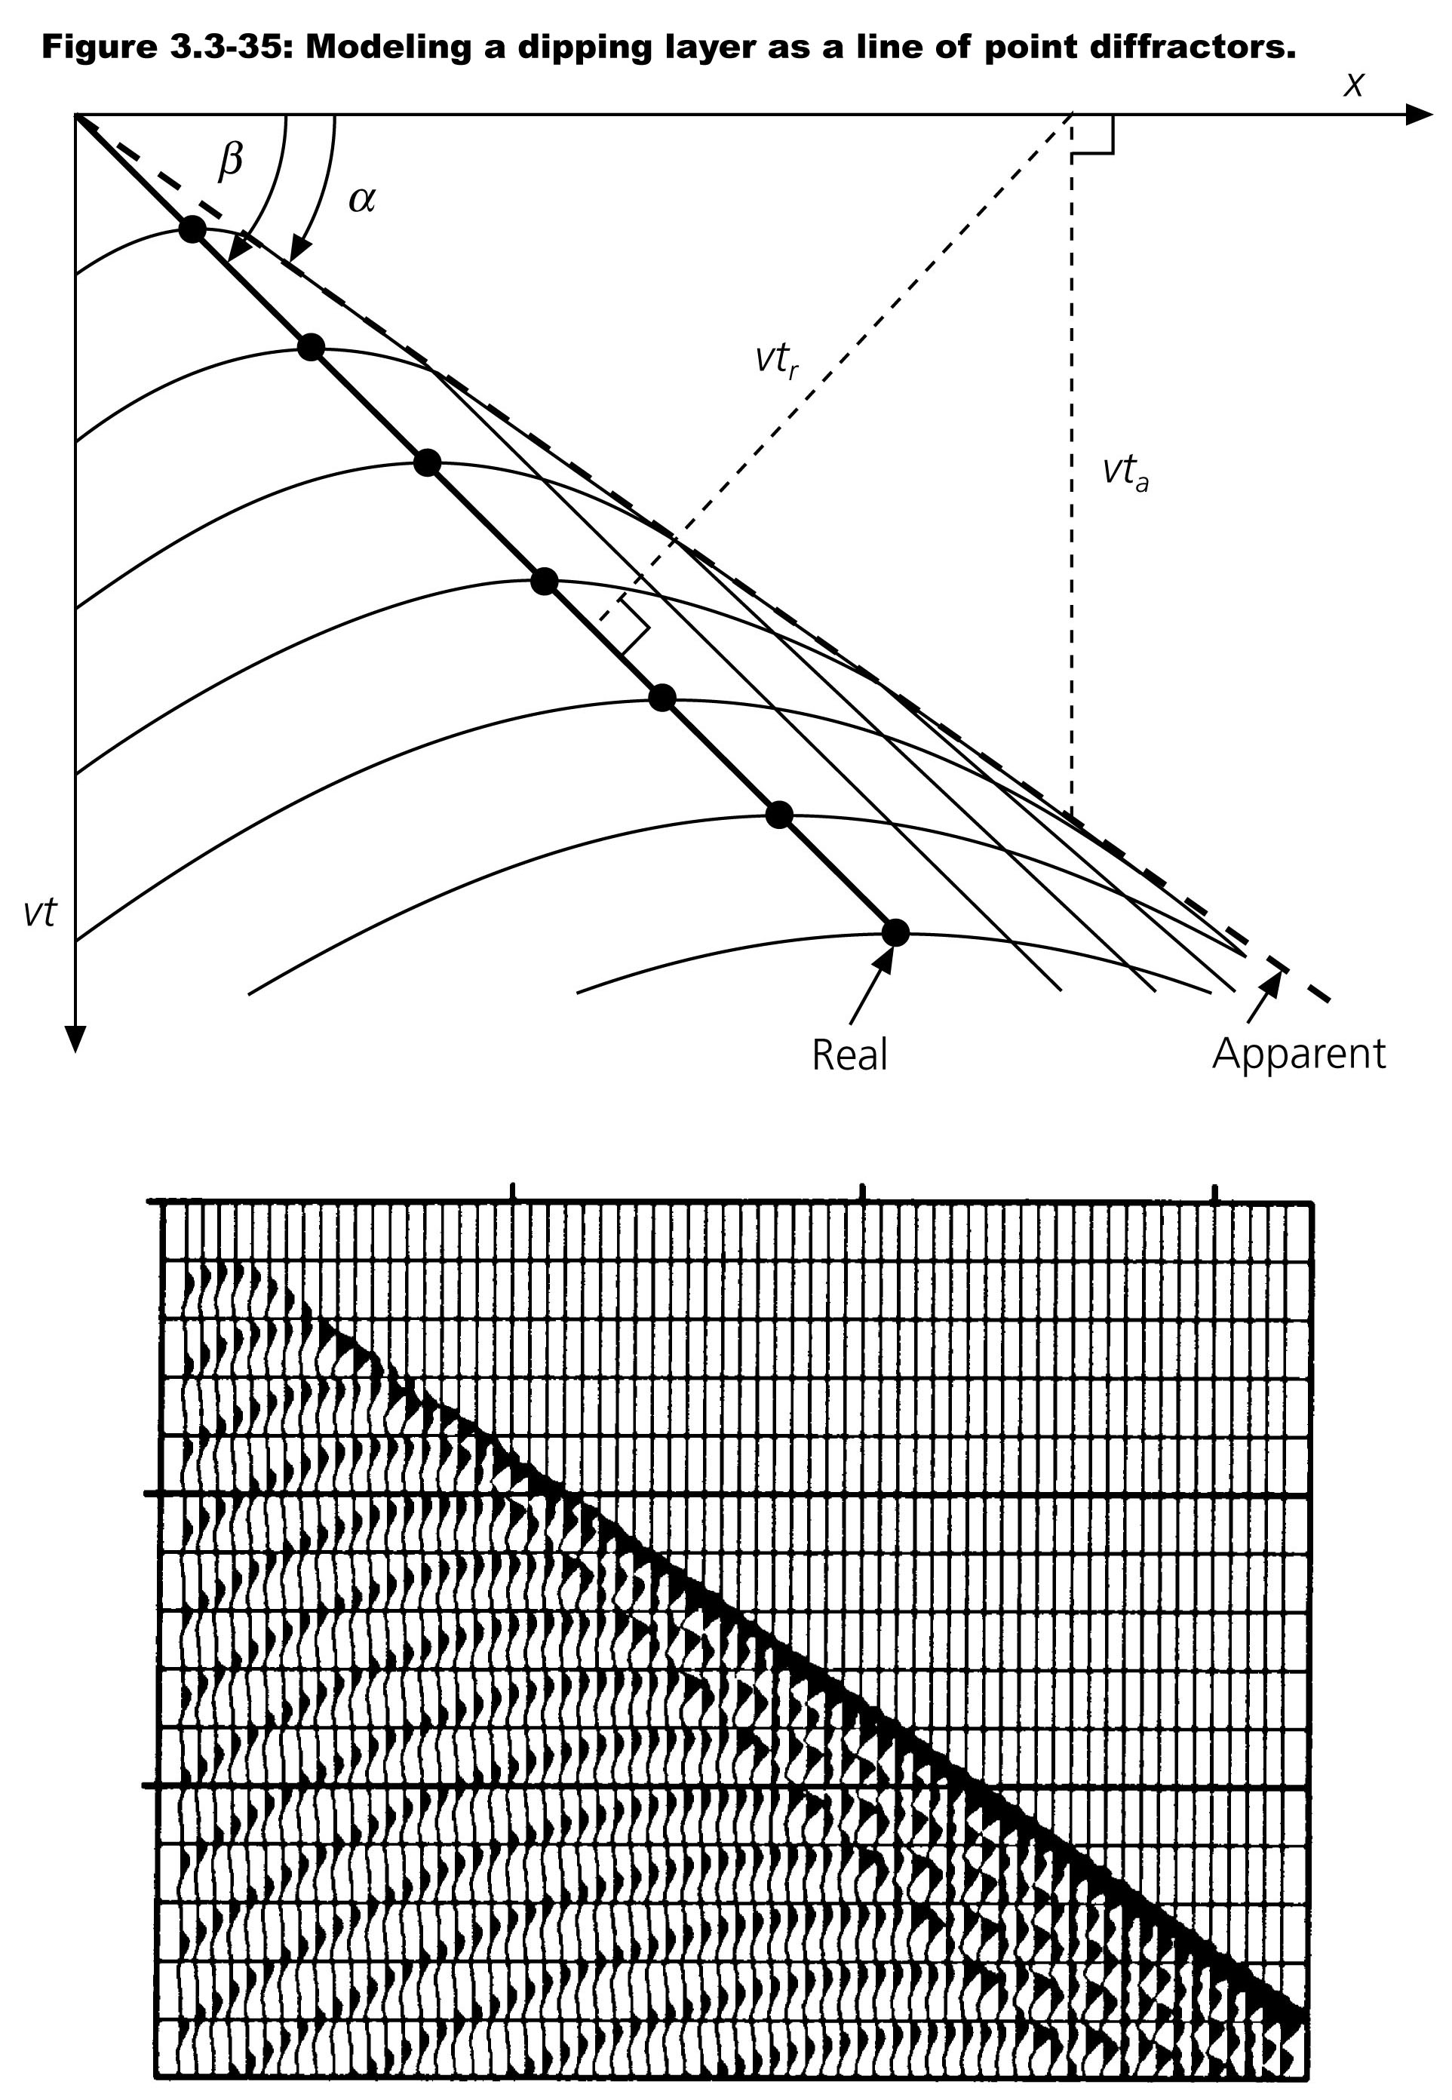

Slide 22
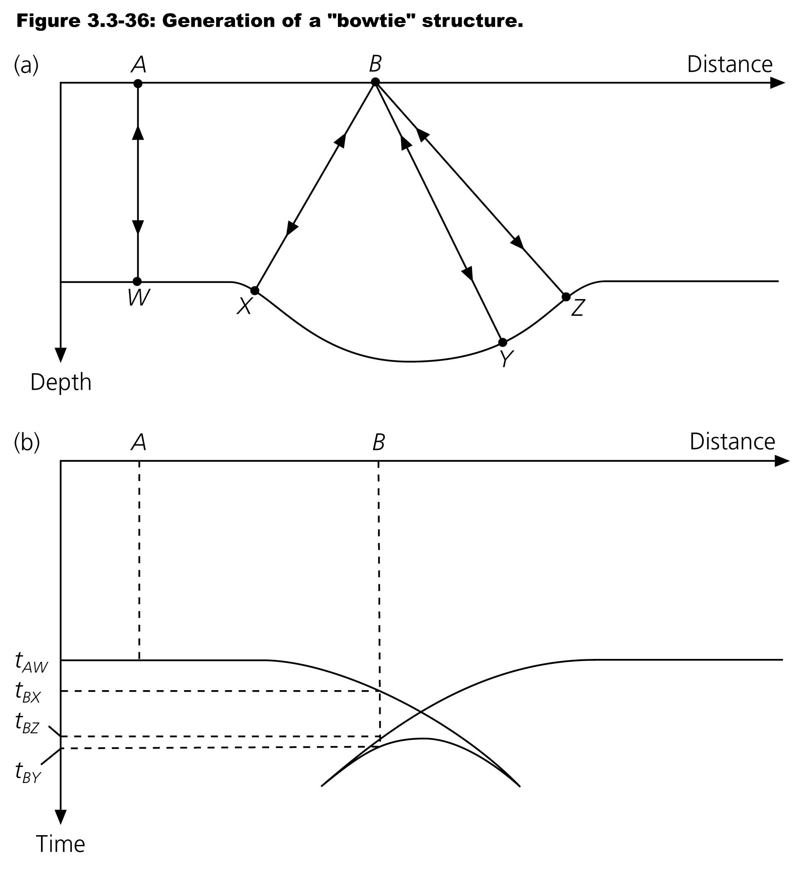

Slide 23
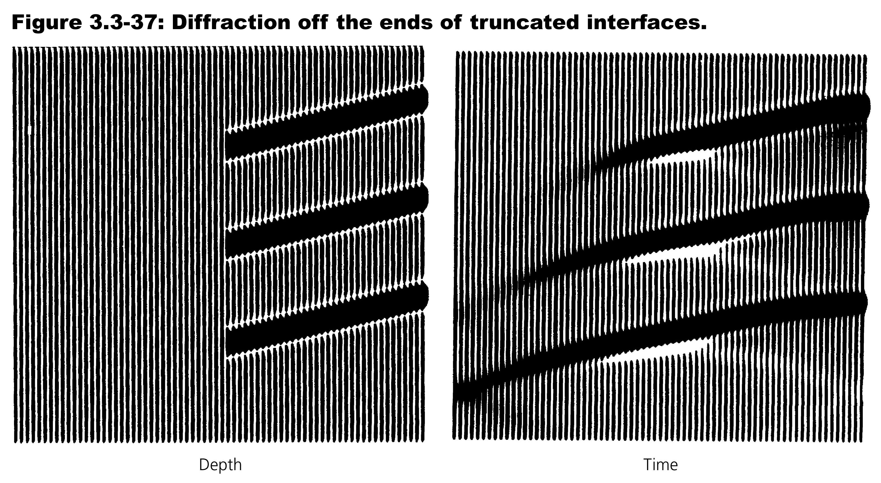

Slide 24
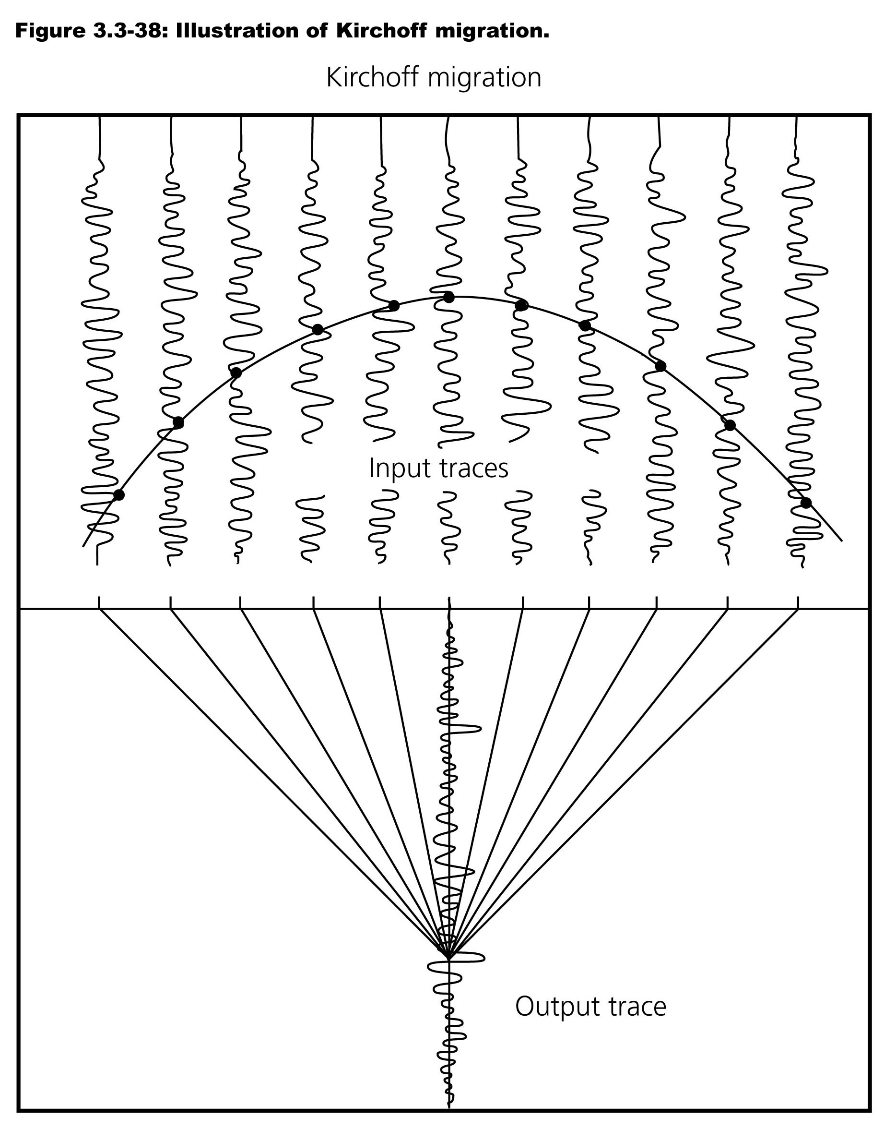

Slide 25
