Slide 1
Global Seismology CERI-8105
Tu-Th 1:15-2:40 pm
Lab - 3892 Central Ave. (Long building) , Room 110
-----------------------------------------------
Bob Smalley
Office: 3892 Central Ave, Room 103, 678-4929
Office Hours – when I’m in my office.
http://www.ceri.memphis.edu/people/smalley/CERI8105_GlobalSeismology.html
Thu., Oct 12, 2023 Meeting 14

Slide 2
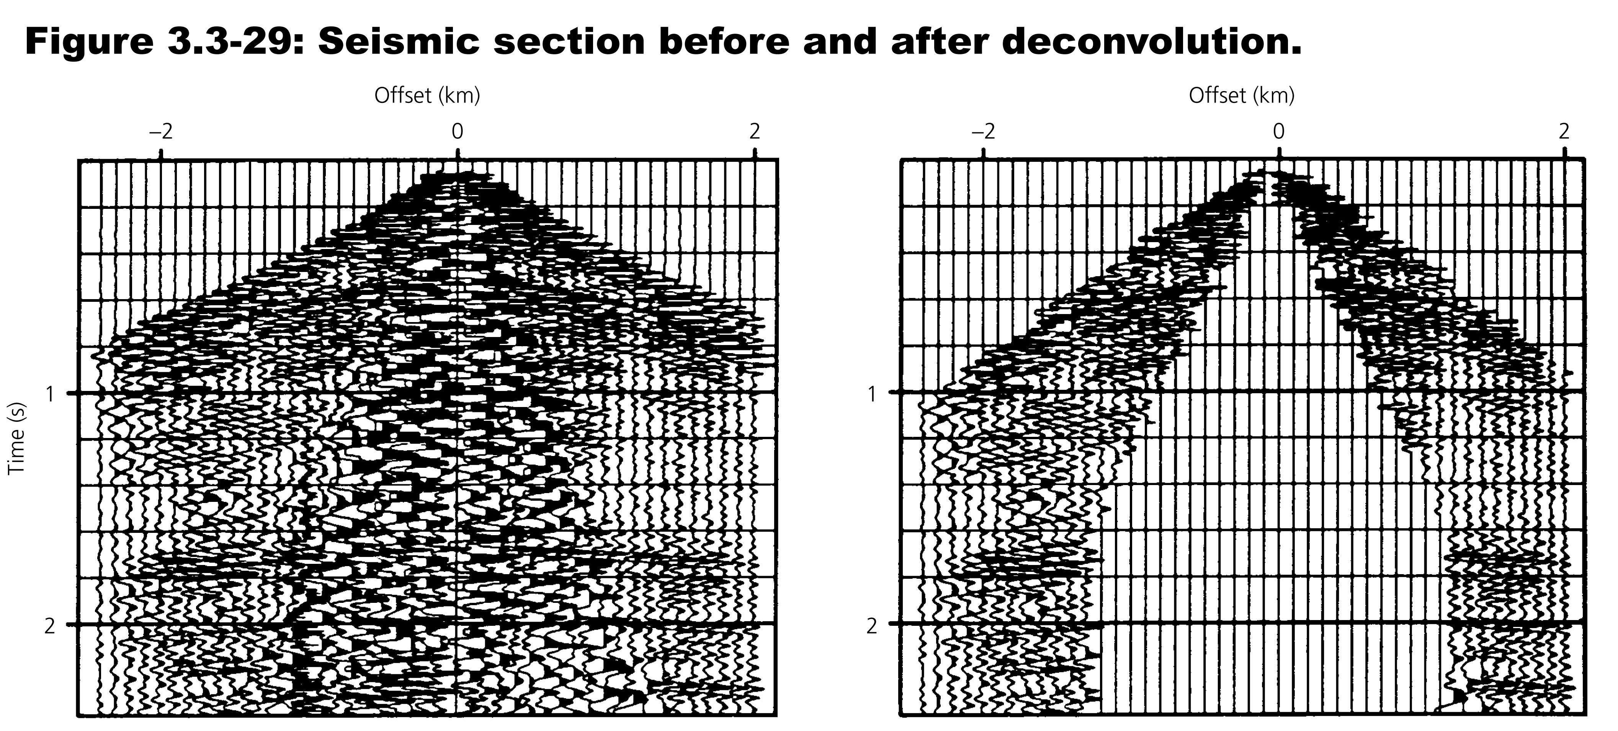
Eliminate head waves and surface waves to isolate reflections.
Notes:
Signal enhansement
Best way to remove noise etc – get rid of it before processing/stacking
- muting – remove stuff with low apparent velociteis – velocity filtering

Slide 3
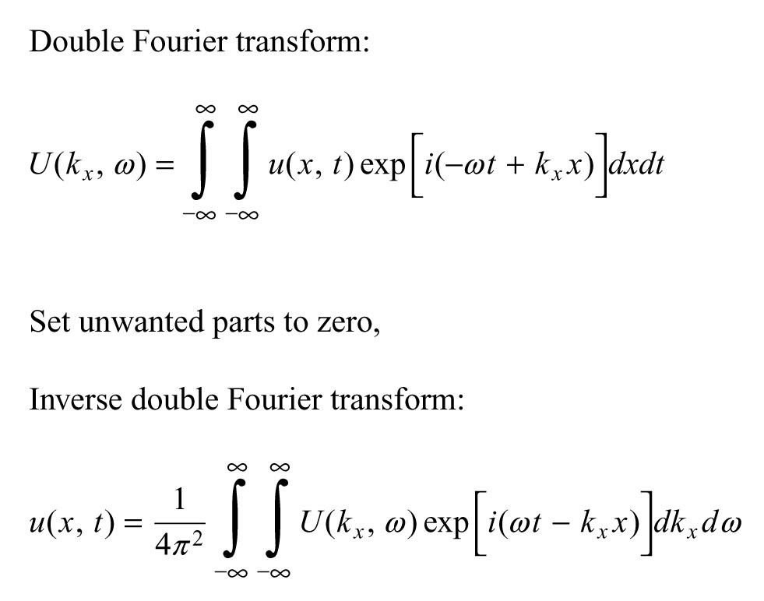
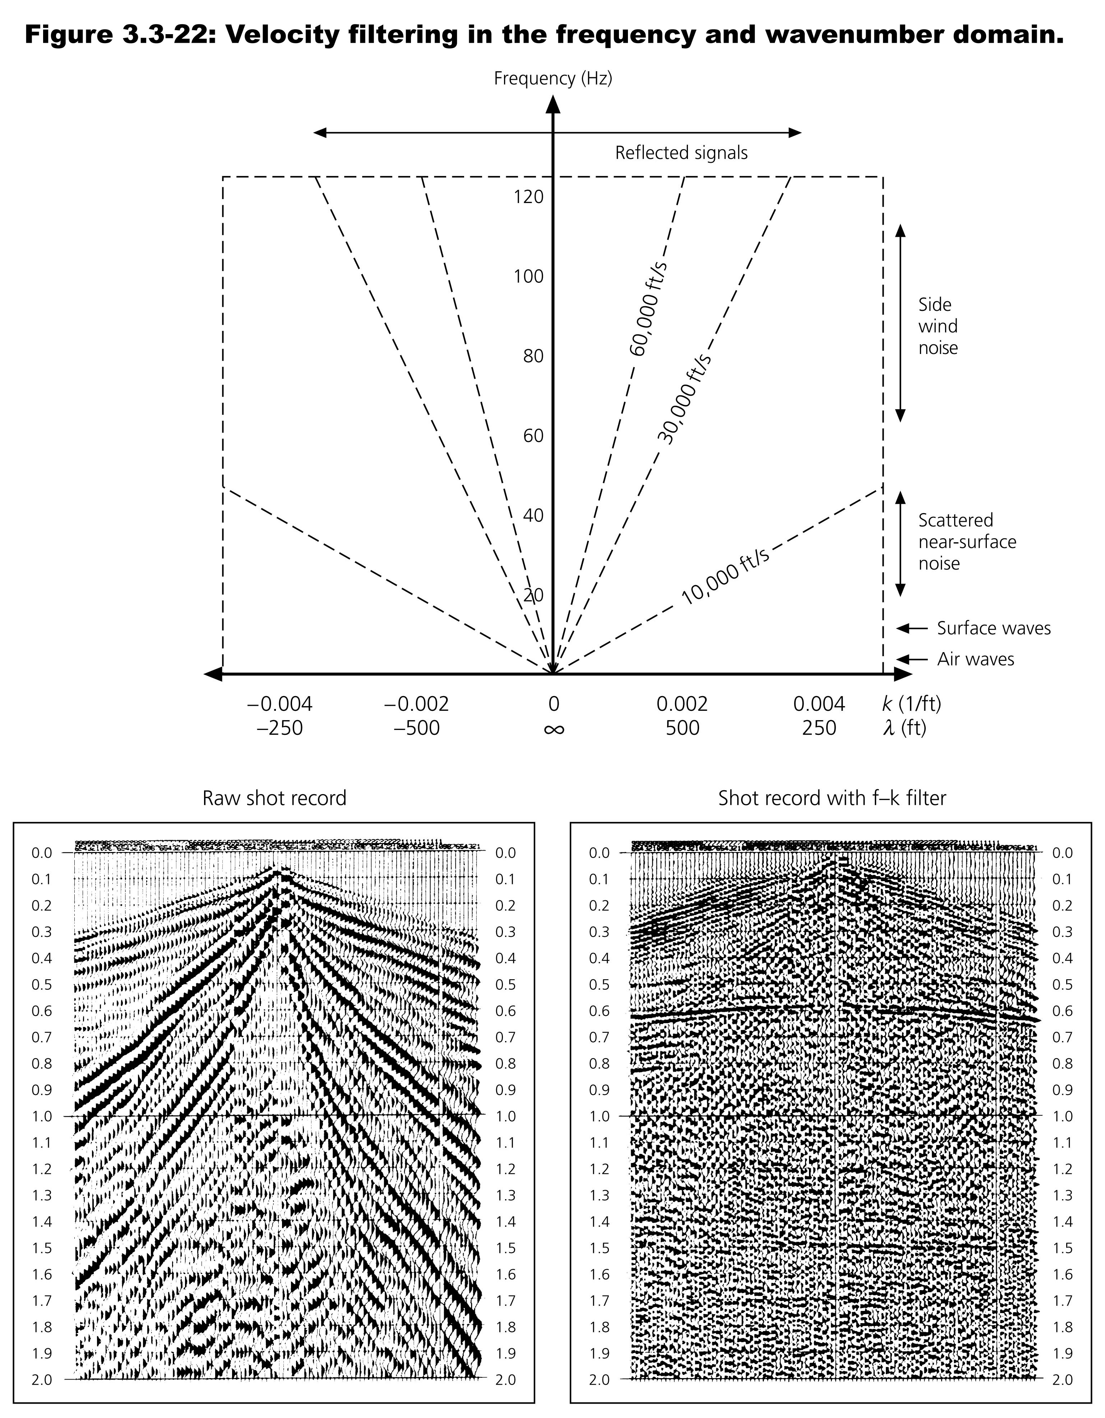
Notes:
Velocity filtering by 2d fourier transformation into horizontal frequency wavenumber frequency domain
Top right position of reflected, noise, airwaves, and surface waves in the fkx domain
Slopes of lines give apparent velocity (constant on the line)
Common source gather before (left) and after velocity filtering

Slide 5
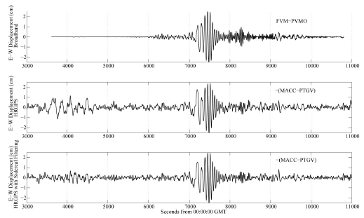
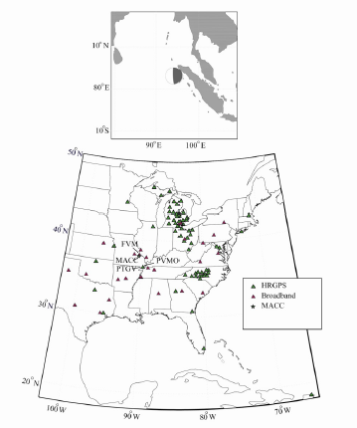

Slide 6
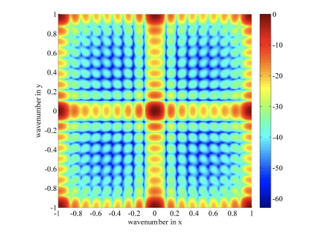

Slide 7
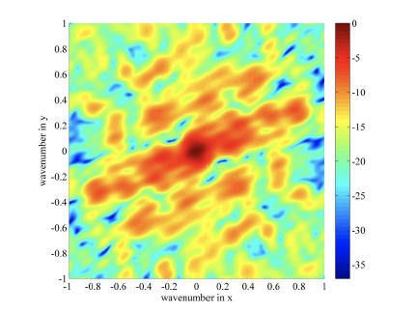

Slide 8
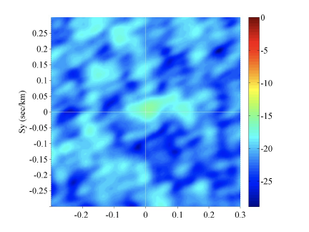

Slide 9
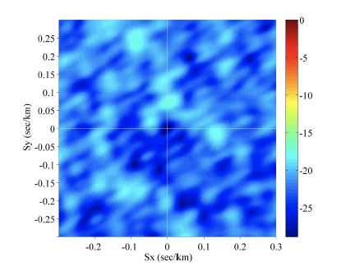

Slide 10
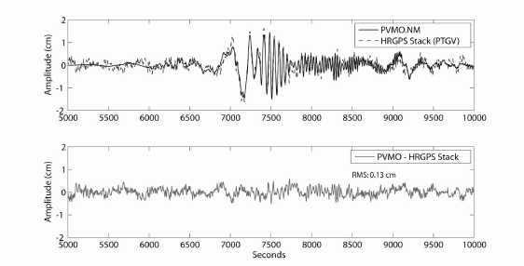

Slide 11
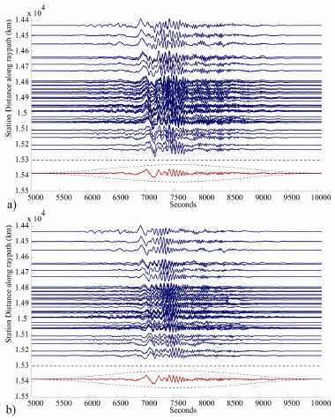

Slide 12
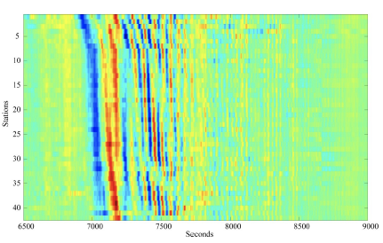

Slide 13
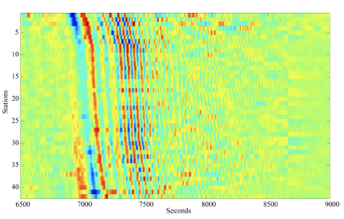

Slide 14
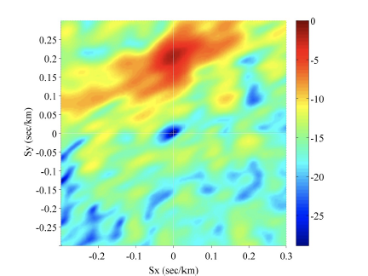

Slide 15
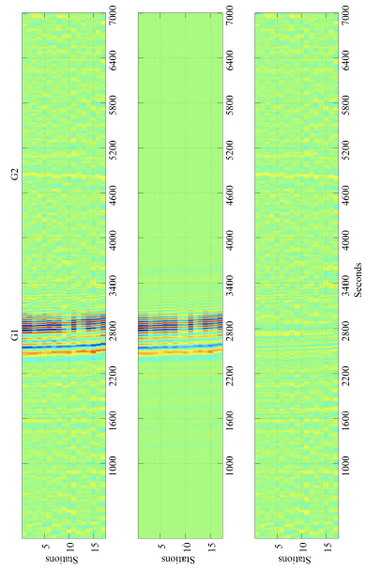
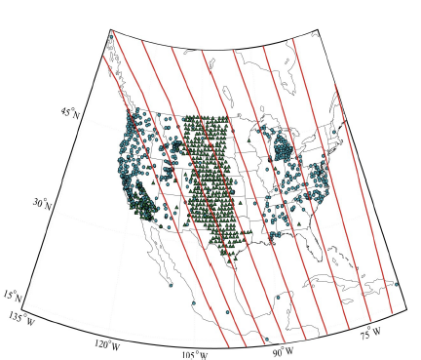

Slide 16
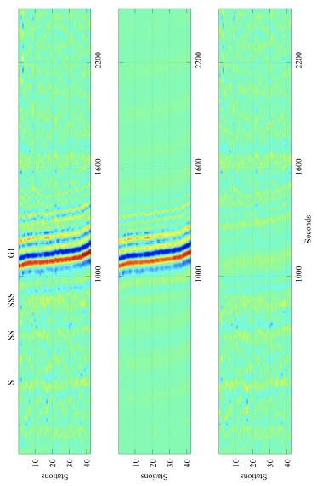

Slide 17
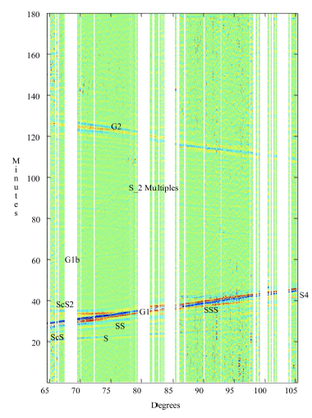
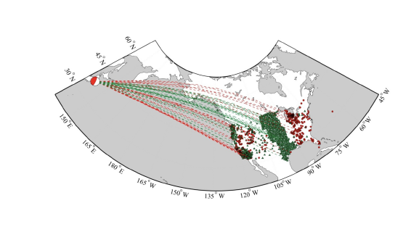

Slide 18
