Slide 1
Global Seismology CERI-8105
Tu-Th 1:00-2:25pm
Lab - 3892 Central Ave. (Long building) , Room 110
-----------------------------------------------
Bob Smalley
Office: 3892 Central Ave, Room 103, 678-4929
Office Hours – when I’m in my office.
http://www.ceri.memphis.edu/people/smalley/CERI8105_GlobalSeismology.html
Tue., Oct 5, 2023 Meeting 12

Slide 2
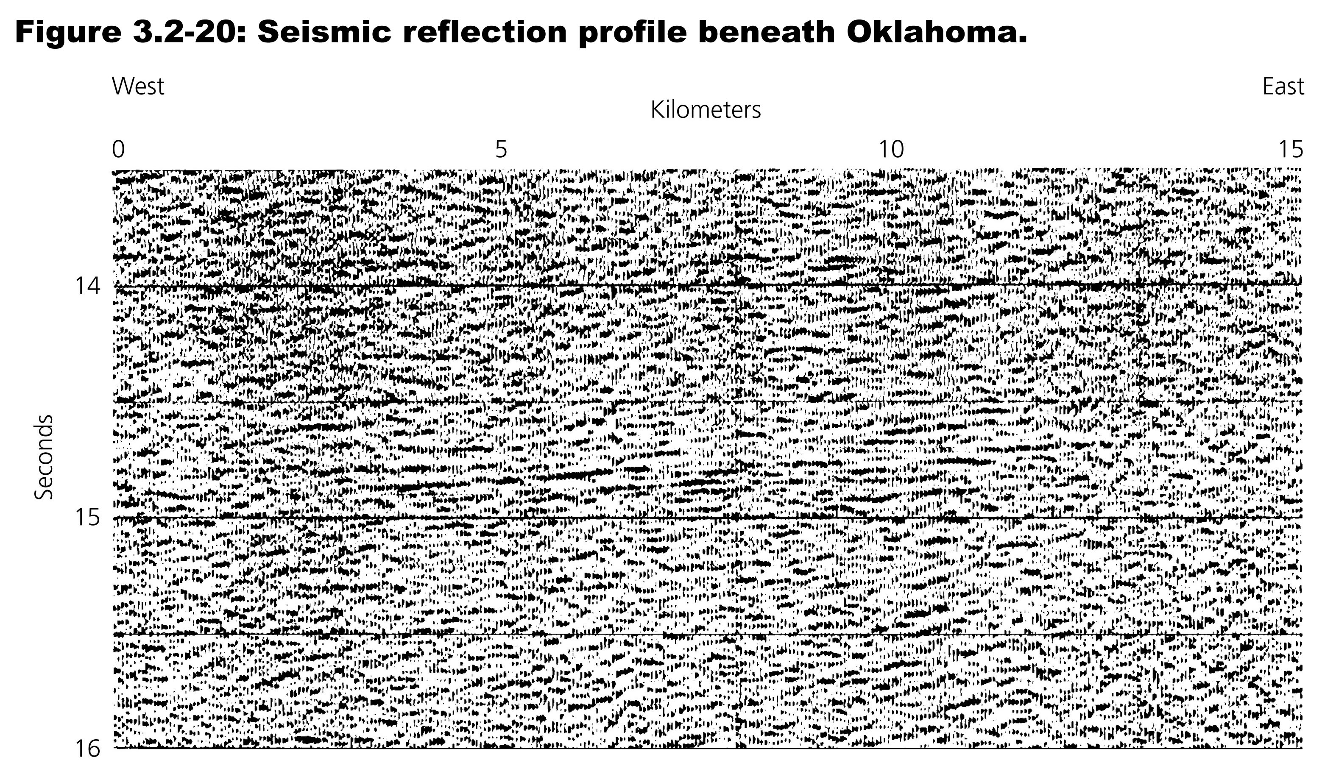

Slide 3
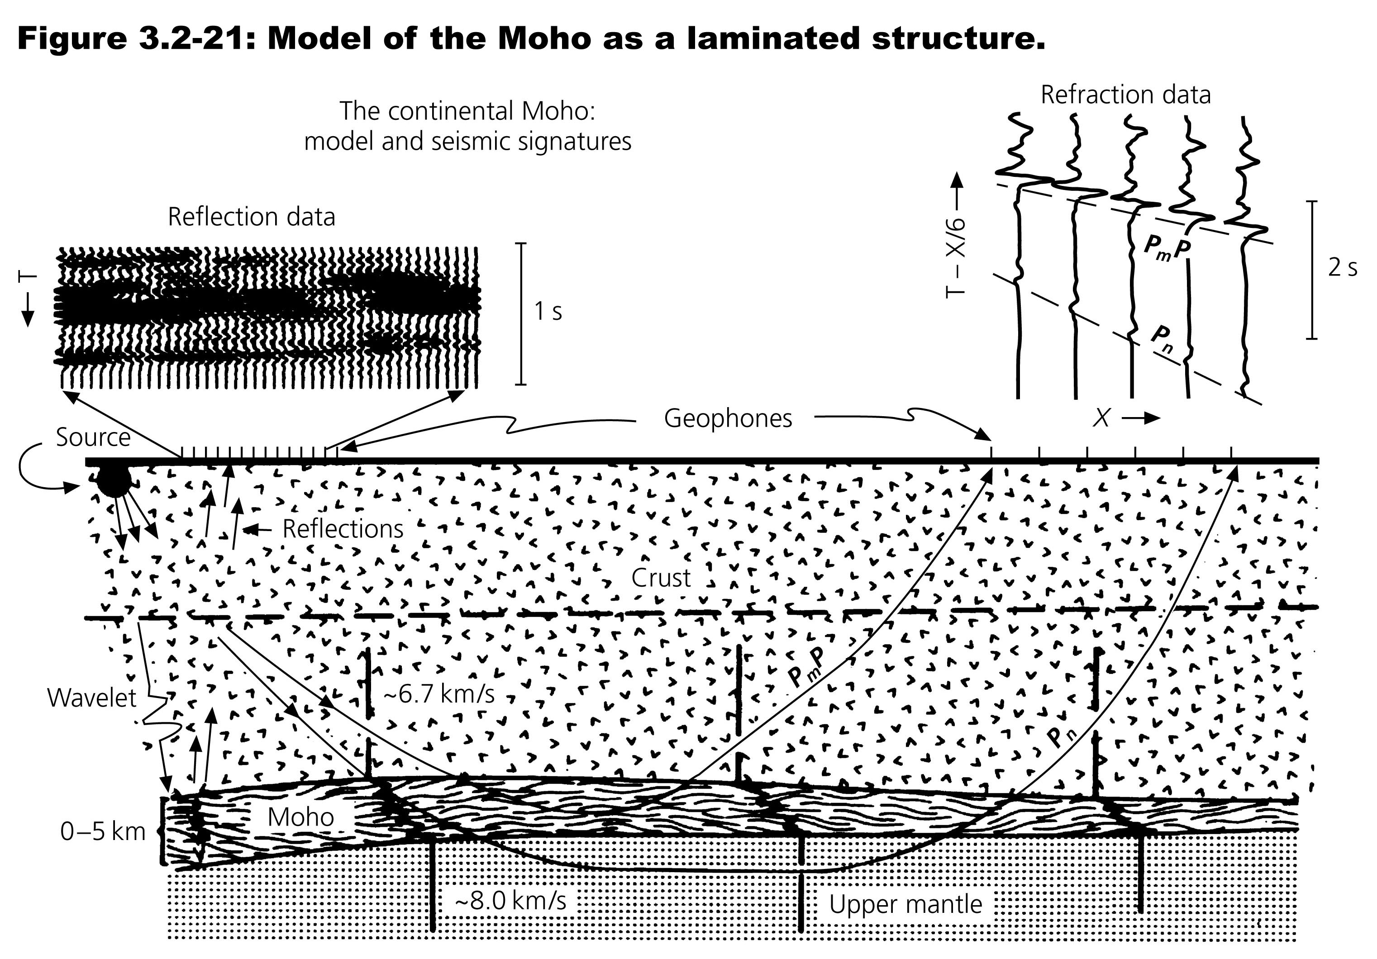

Slide 4
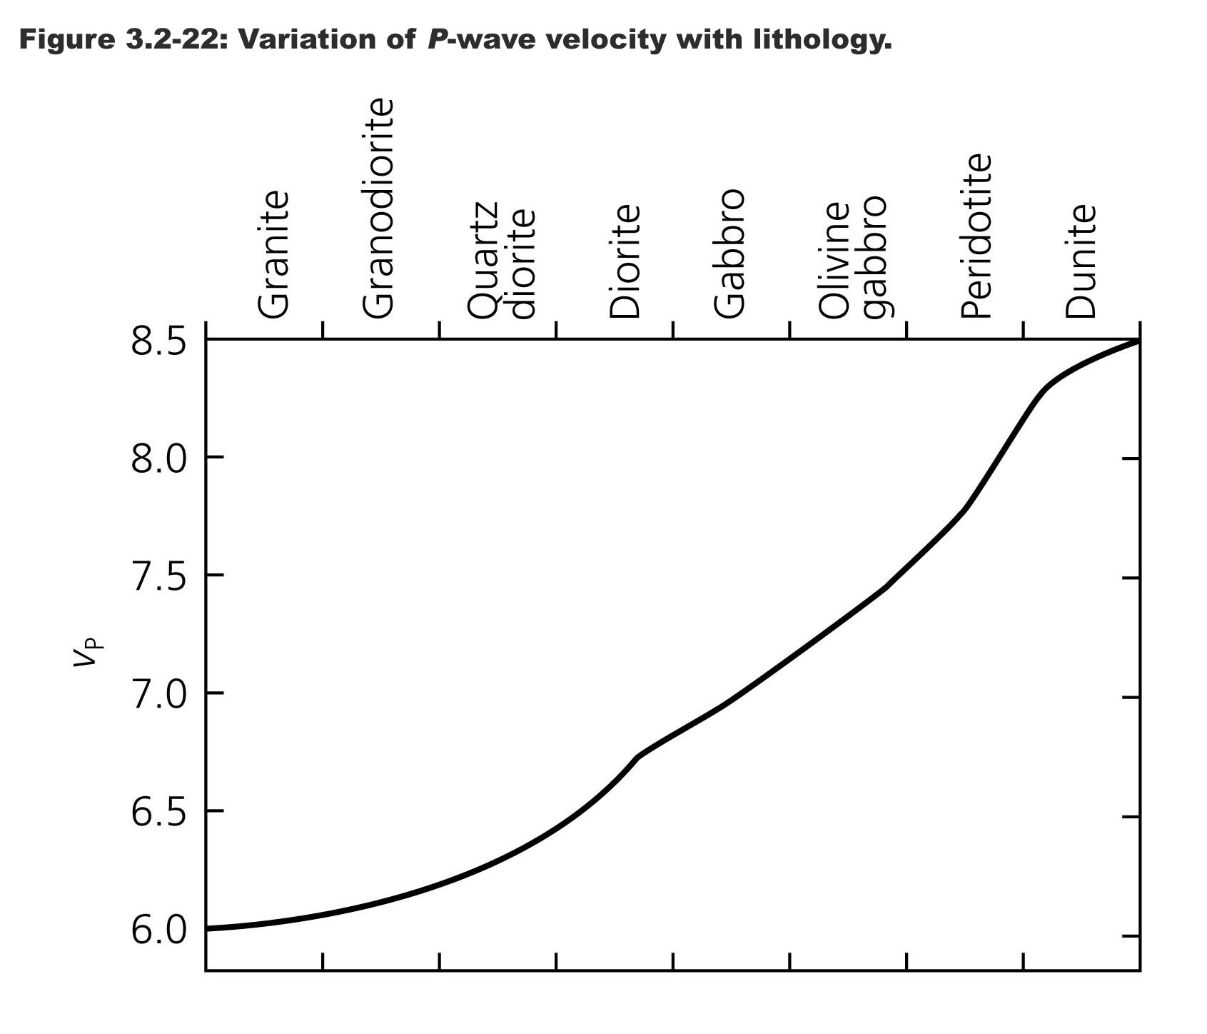

Slide 5
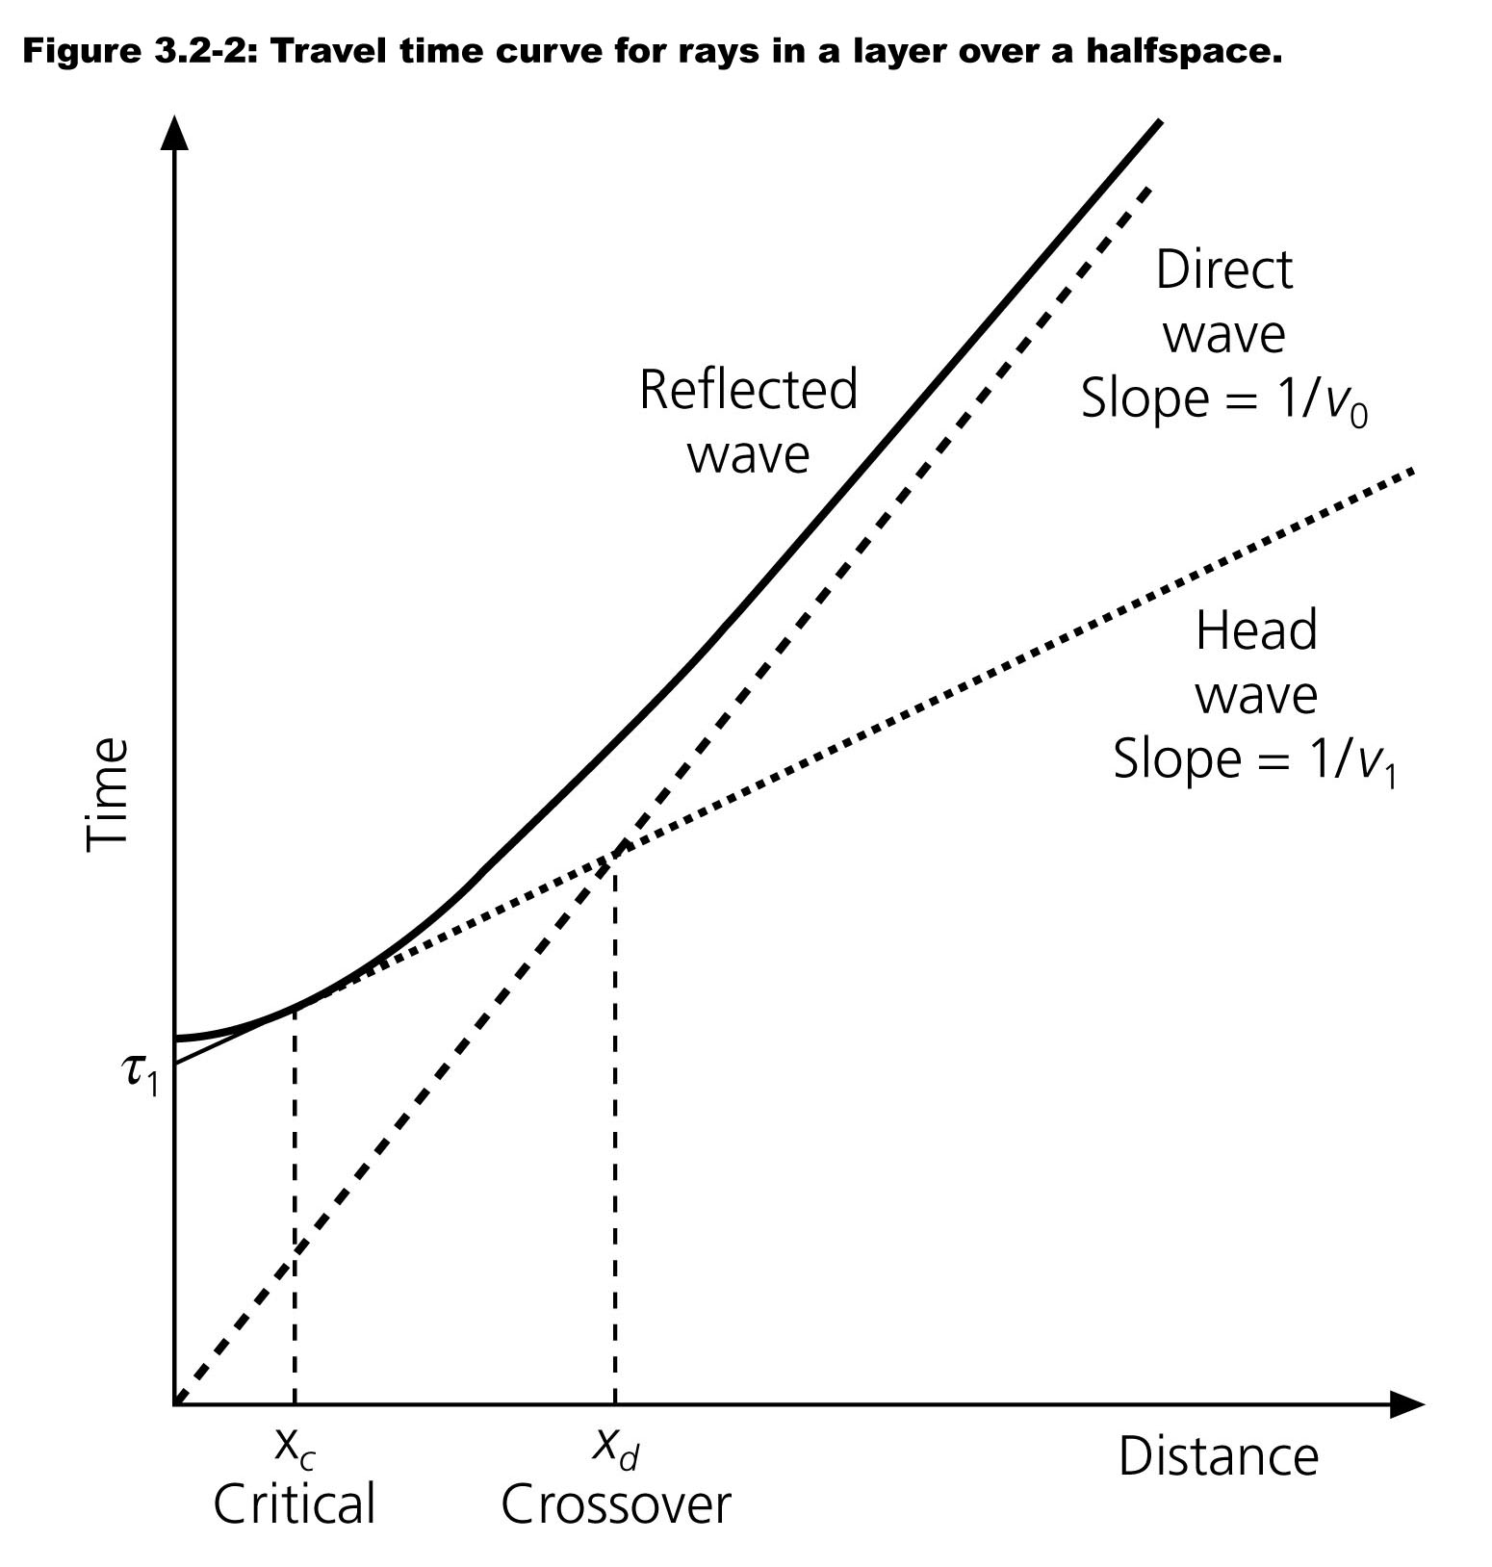
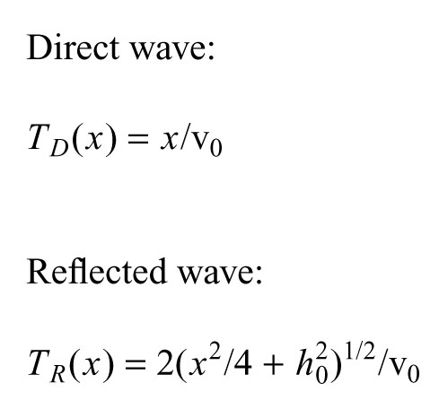
Notes:
Returning to last class – where we concentrated on the head wave part of this figure, we will not concentrate on the reflected wave part

Slide 6
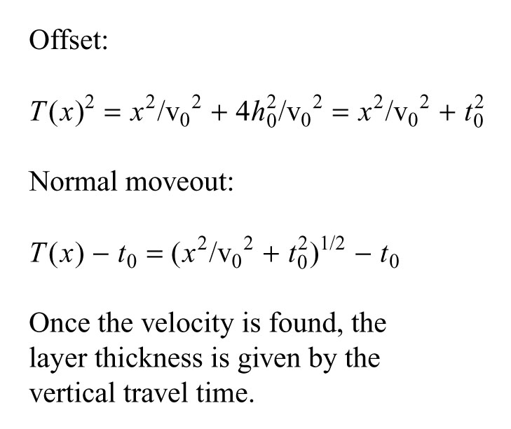
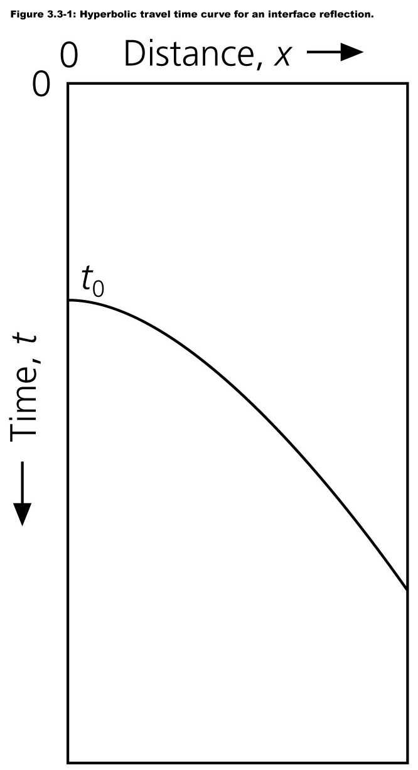
Notes:
Trael time cures for reflections
Here we are also typically concentrating on the reflections at very short distances compared to the scale in the last figure
Source to receiver distance for reflection seismology is usually <= depth of reflectors.
Is almost always shorter than critical distance.
Travel time curve is hyperbola – here drawn upside down wrt what we've seen before – this is done so "record sections" look like geologic cross sections (even though they are NOT).
The layer velocity is found from the slope of the hyperbola
Slope decreases with increasing velocity – flatter is faster
Plot here has slope 1/v^2 – 1st formula
The variation of travel time with offset, the travel time at some point wrt zero offset, is known as NORMAL MOVEOUT – NMO – 2nd formula
Once velocity is found, layer thickness given by vertilcal travel time

Slide 7
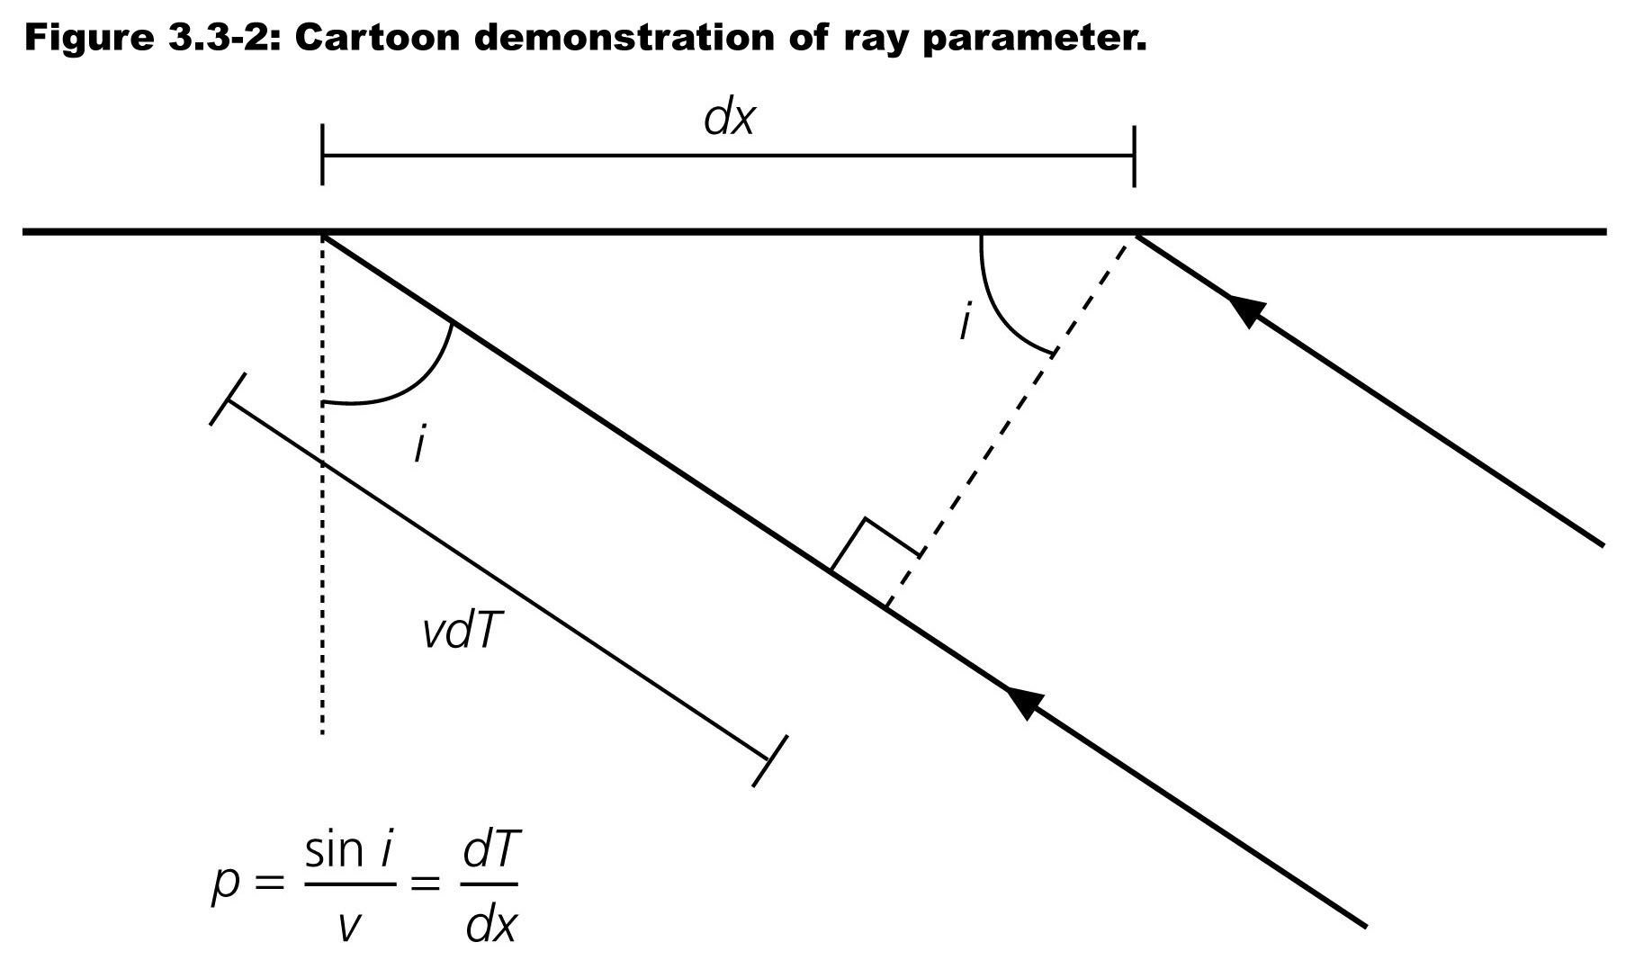
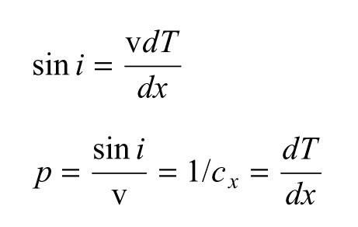
Notes:
Relation between travel time curves and raypaths
Angle incidence can be found from sin-1 of vdT (opposite side) diviided by dx (hypotenuse)
Insert ray parameter definition to find ray parameter is 1/apparent velocity is the slope of the travel time curve
Ray parameter and angle of incidence can be found from the slope of the travel time curve.

Slide 8
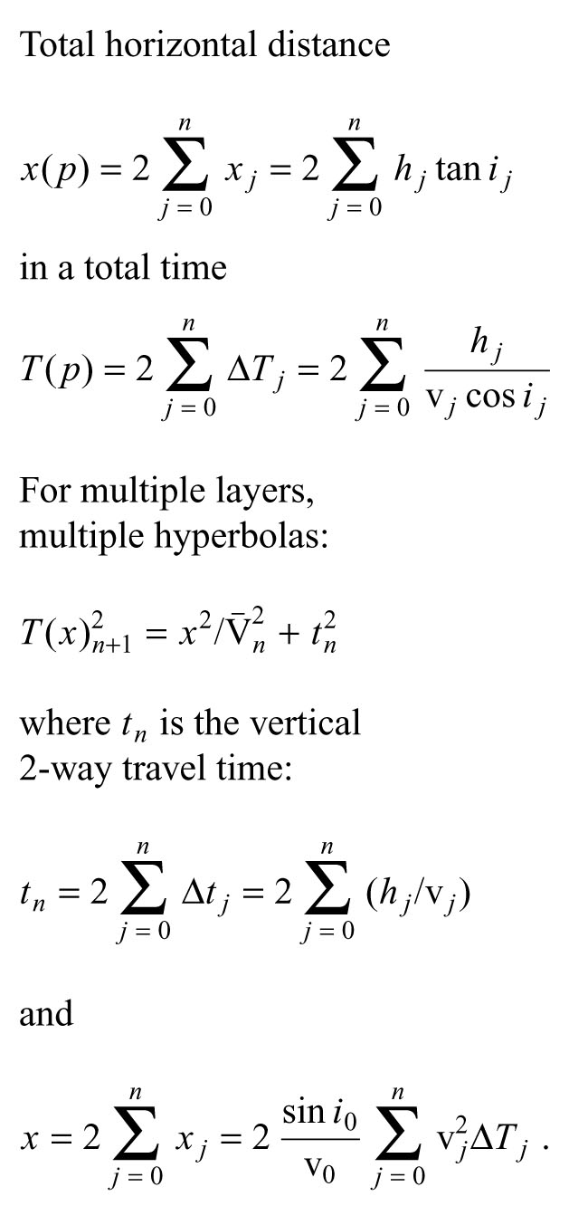
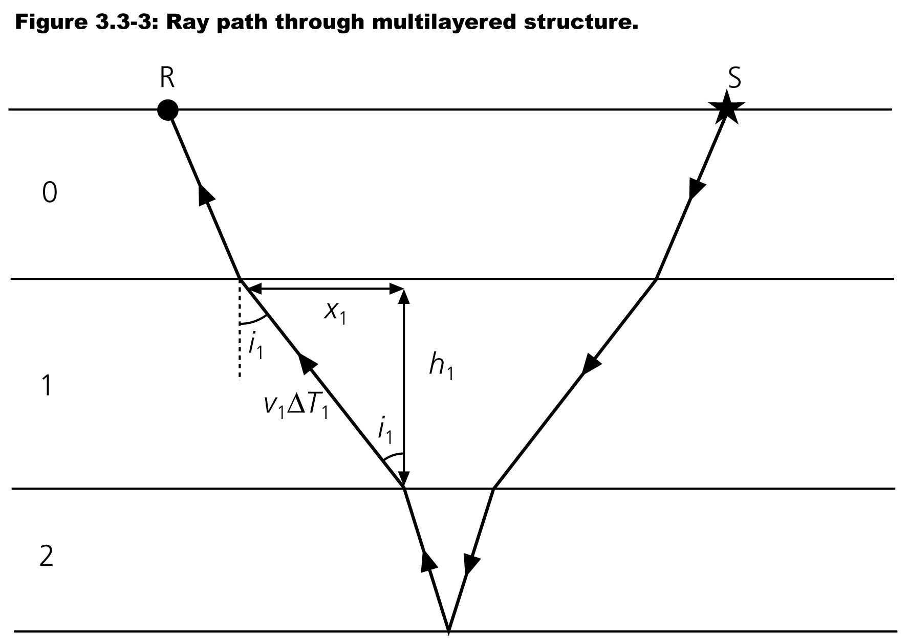
Notes:
This lets us find theRay parameter and angle of incidence can be found from the slope of the travel time curve.
This allows us to find travel time curves for geometry with multiple horizontal reflectors
Ray goes through N layers with thickness hN and velocity vN
hN/cos(iN) is hypotenuse, divide by vN to get time, add them up
Path with only one reflection known as prinary reflection
Ray parameter is constant along ray so
P=sin(iN)/vN=sin(i0)/v)
Horizontal ray travels xI during tI time going down and then again going up

Slide 9
Notes:
Add them all up
Write explicitly as function of p
To make the travel time curve, start with a single layer where x0 is x/2 and T(P) is second eq using the expression for cos(i0)
For multiple layers approximate the travel time curve for the reflection in that, nth, layer as a hyperbola
Now find tN and Vn
tN is "easy"

Slide 10
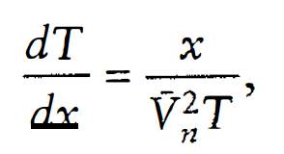
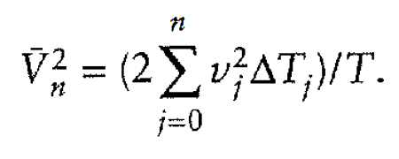
Notes:
vN is a bit tricker
From geometry distance in layer N (hypotenuse), using snell's law
So total distance twice that (so can get total time in layer)
Since ray parameter (that we have from layer 1, etc.) is constant the slope of the travel time curve can be found
From out hyperbolic approximation we also have an expression for the slope of the travel time curve
Now we can write for vN^2

Slide 11
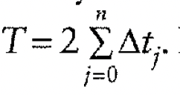
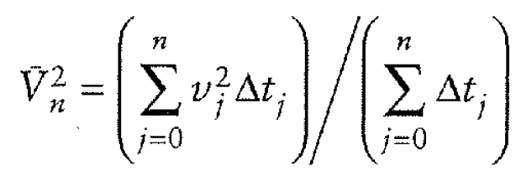
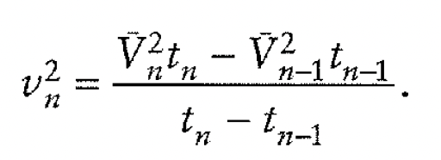
Dix Equation
Notes:
Now look at zero distance, vertical incidence
For the total travel time In each layer we get twice the one way travel time
So for ^ v^2 we get the average travel time curve is time weighted rms of first N layers
Now we can find the layer velocities from the travel time curves
Given a reflection from the top of the Nth layer, with vertical 2 way travel time t(N-1) and rms velocity ^v(n-1) and a reflection from top of N+1 layer with vertical two way travel time tN and rms velocity ^v(n+1), we can find the velocity in the Nth layer
This is the Dix Equation
Velocities known as "interval velocities"

Slide 12
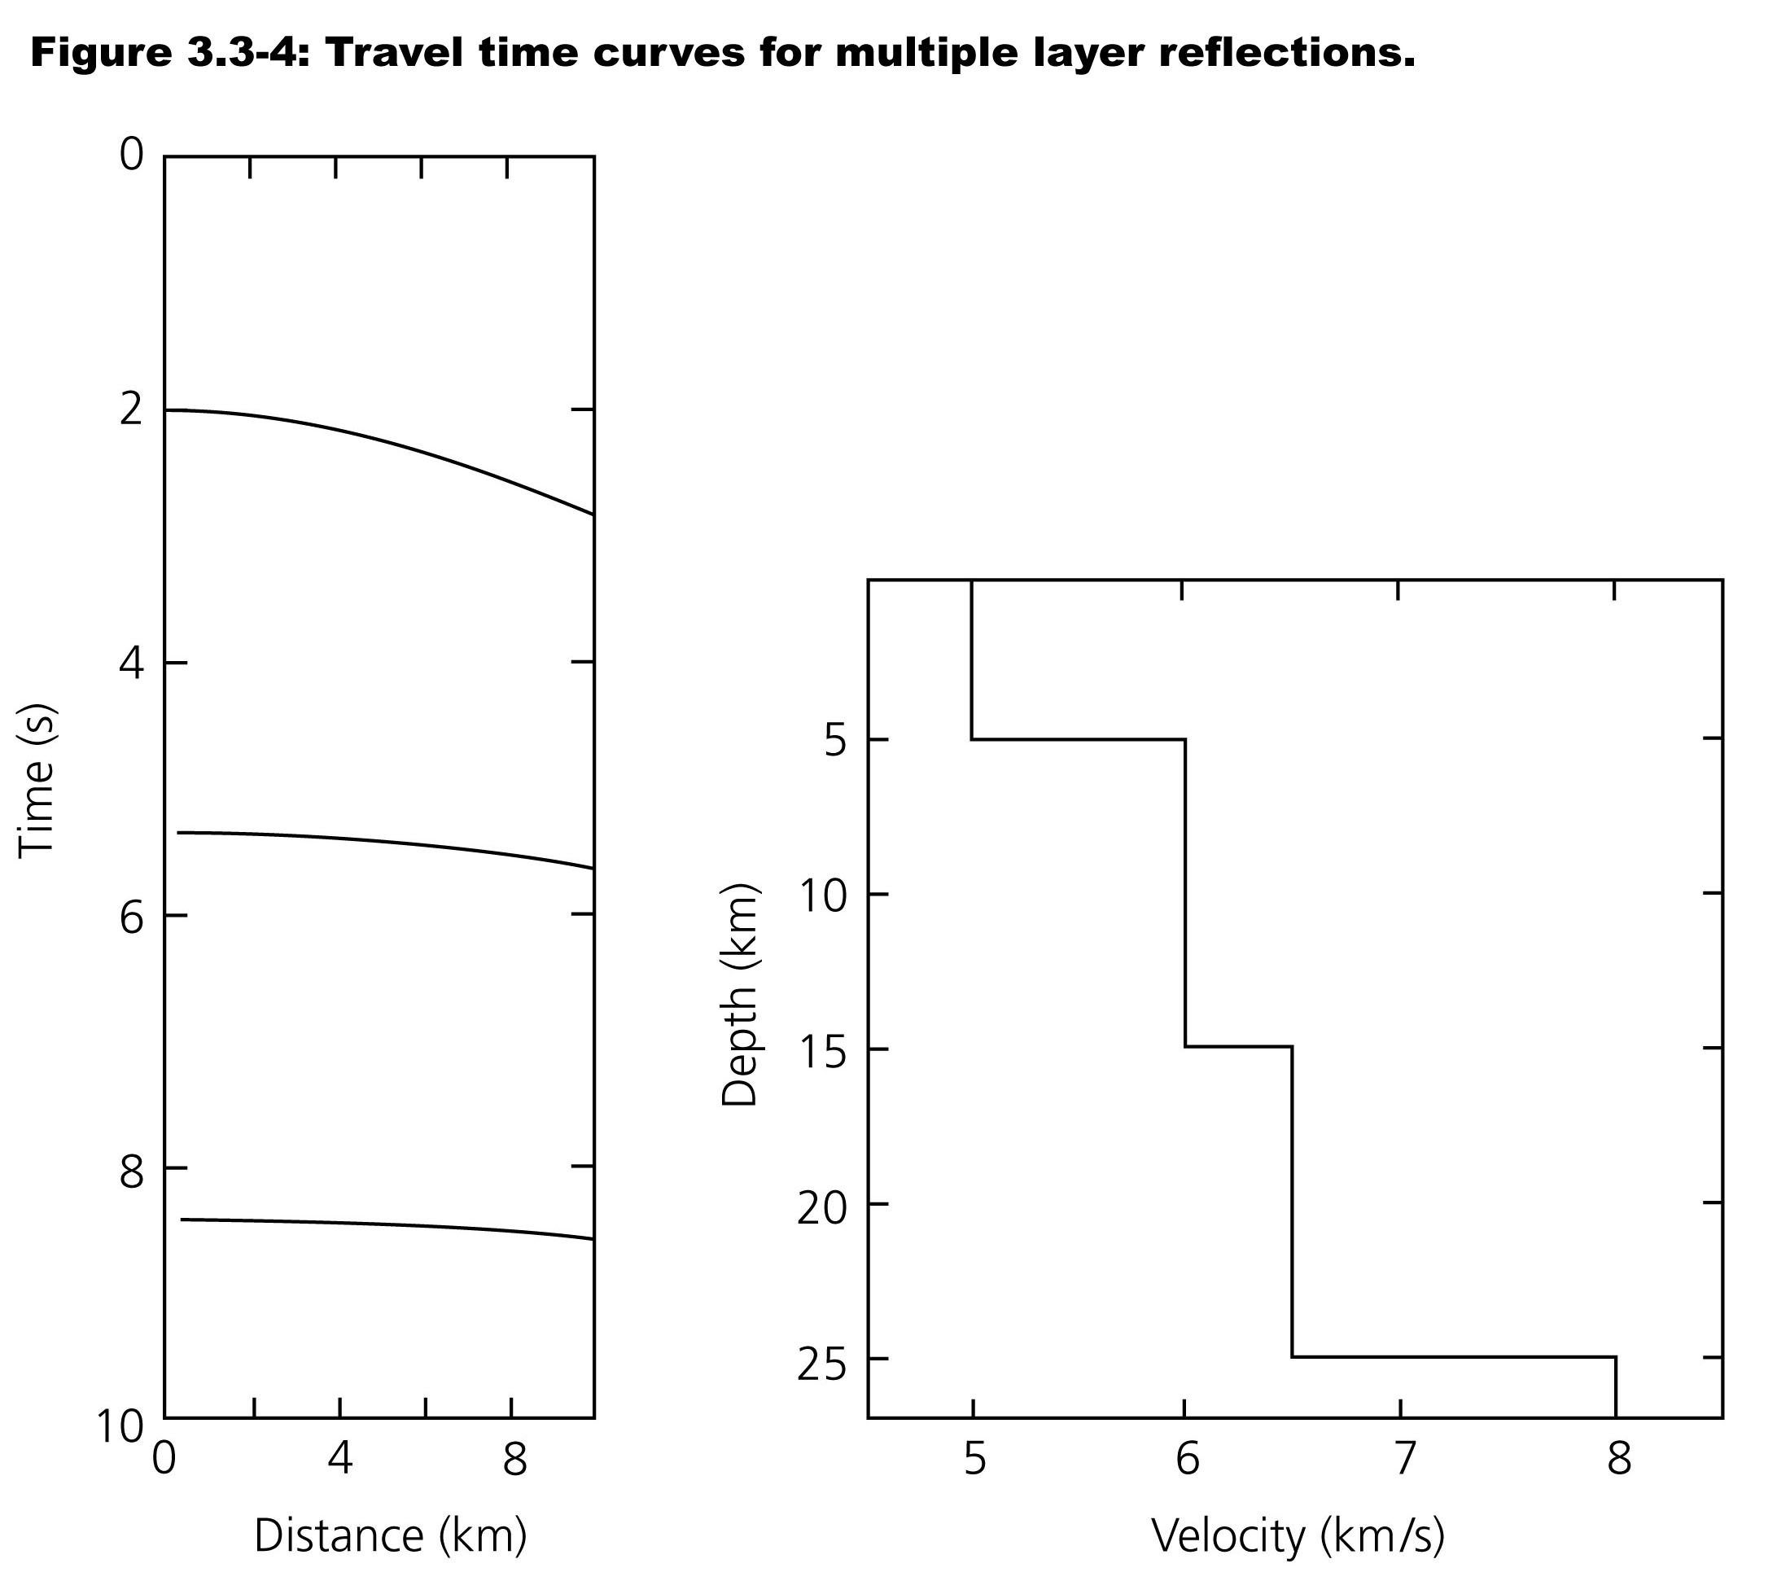

Slide 13
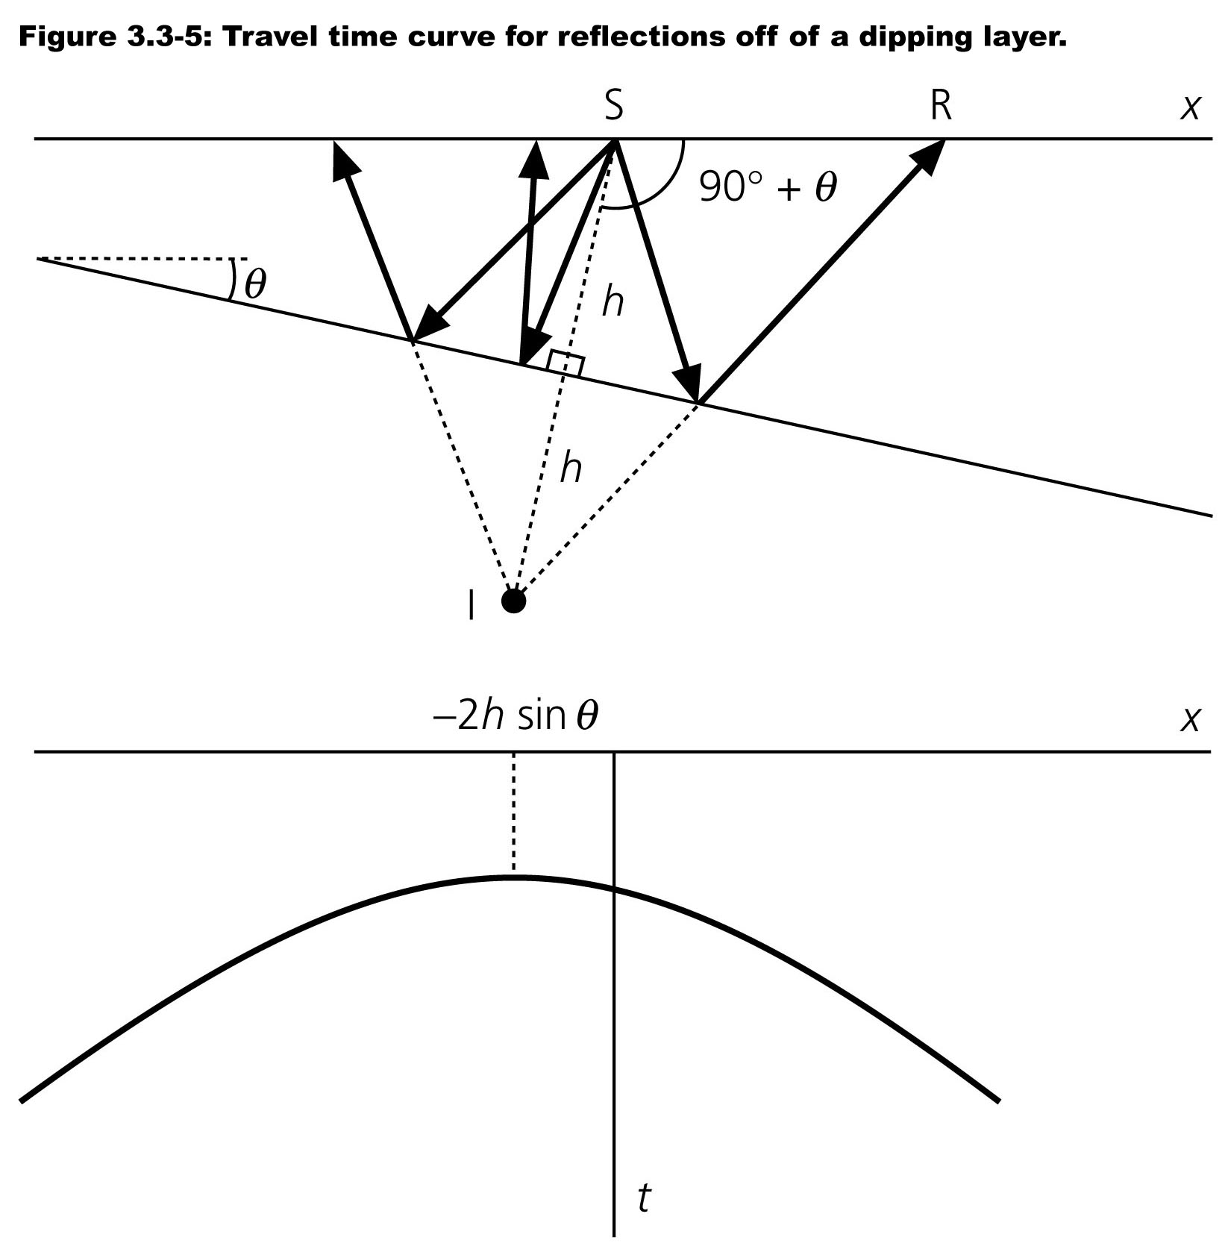
Notes:
For dipping layers is more complicated
Calculations simplified by using an imaginary source (image source) below the reflector, distance h perpendicular to reflector (continuation of normal incidence ray)
Assume is constant velocity half space so travel times from imaginary source is same as from real source.

