Slide 1
Global Seismology CERI-8105
Tu-Th 1:00-2:25pm
Lab - 3892 Central Ave. (Long building) , Room 110
-----------------------------------------------
Bob Smalley
Office: 3892 Central Ave, Room 103, 678-4929
Office Hours – when I’m in my office.
http://www.ceri.memphis.edu/people/smalley/CERI8105_GlobalSeismology.html
Tue., Sep 28, 2023 Meeting 10

Slide 2
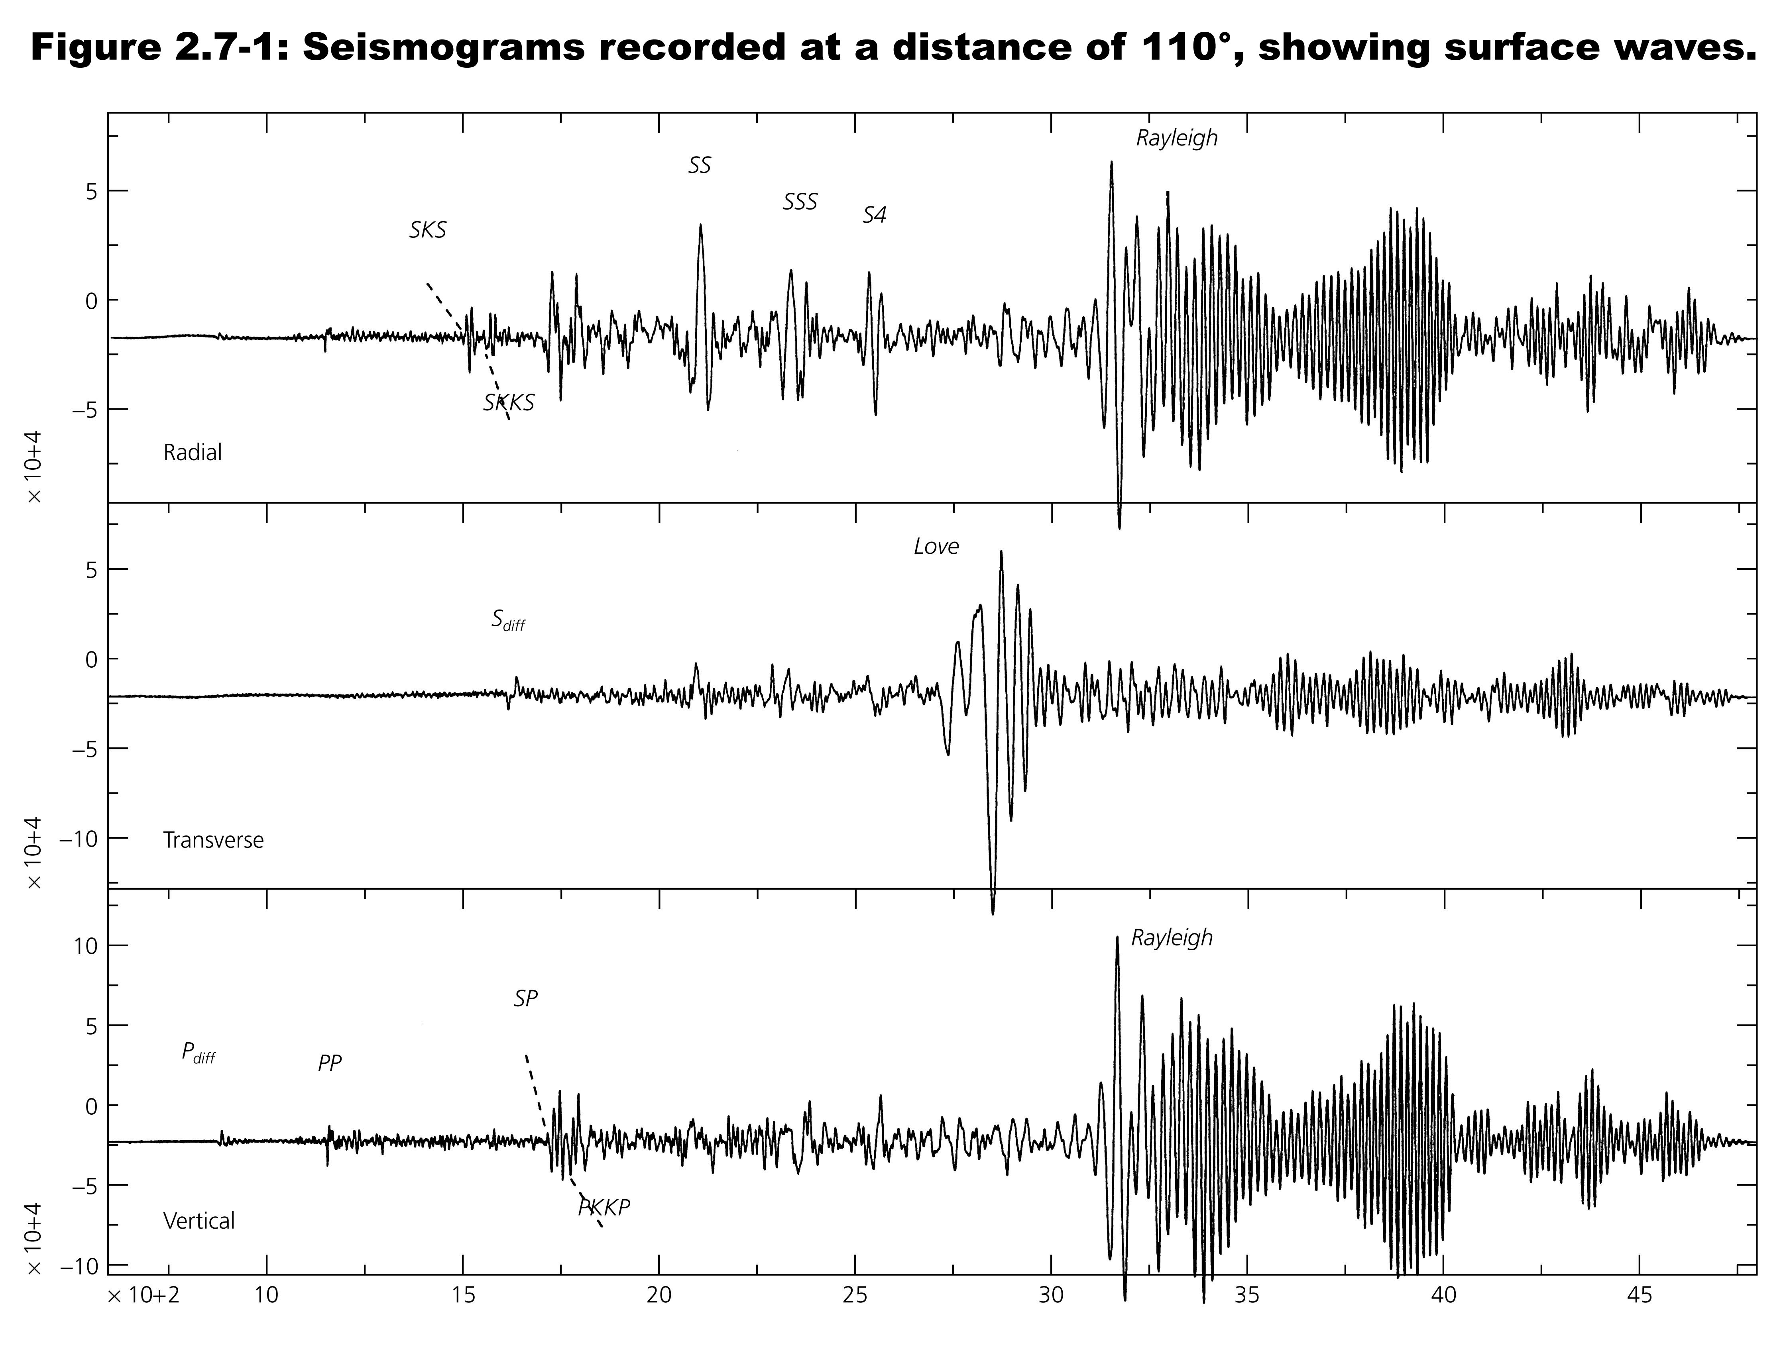

Slide 3
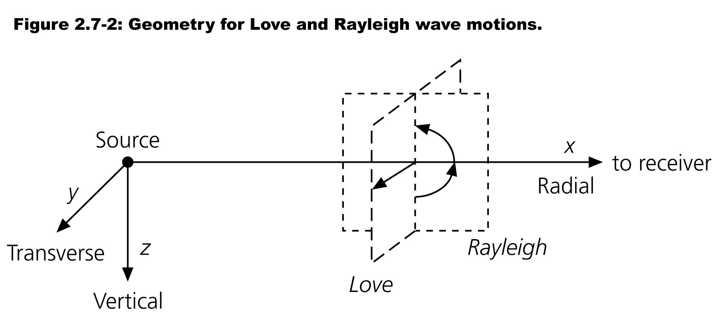

Slide 4
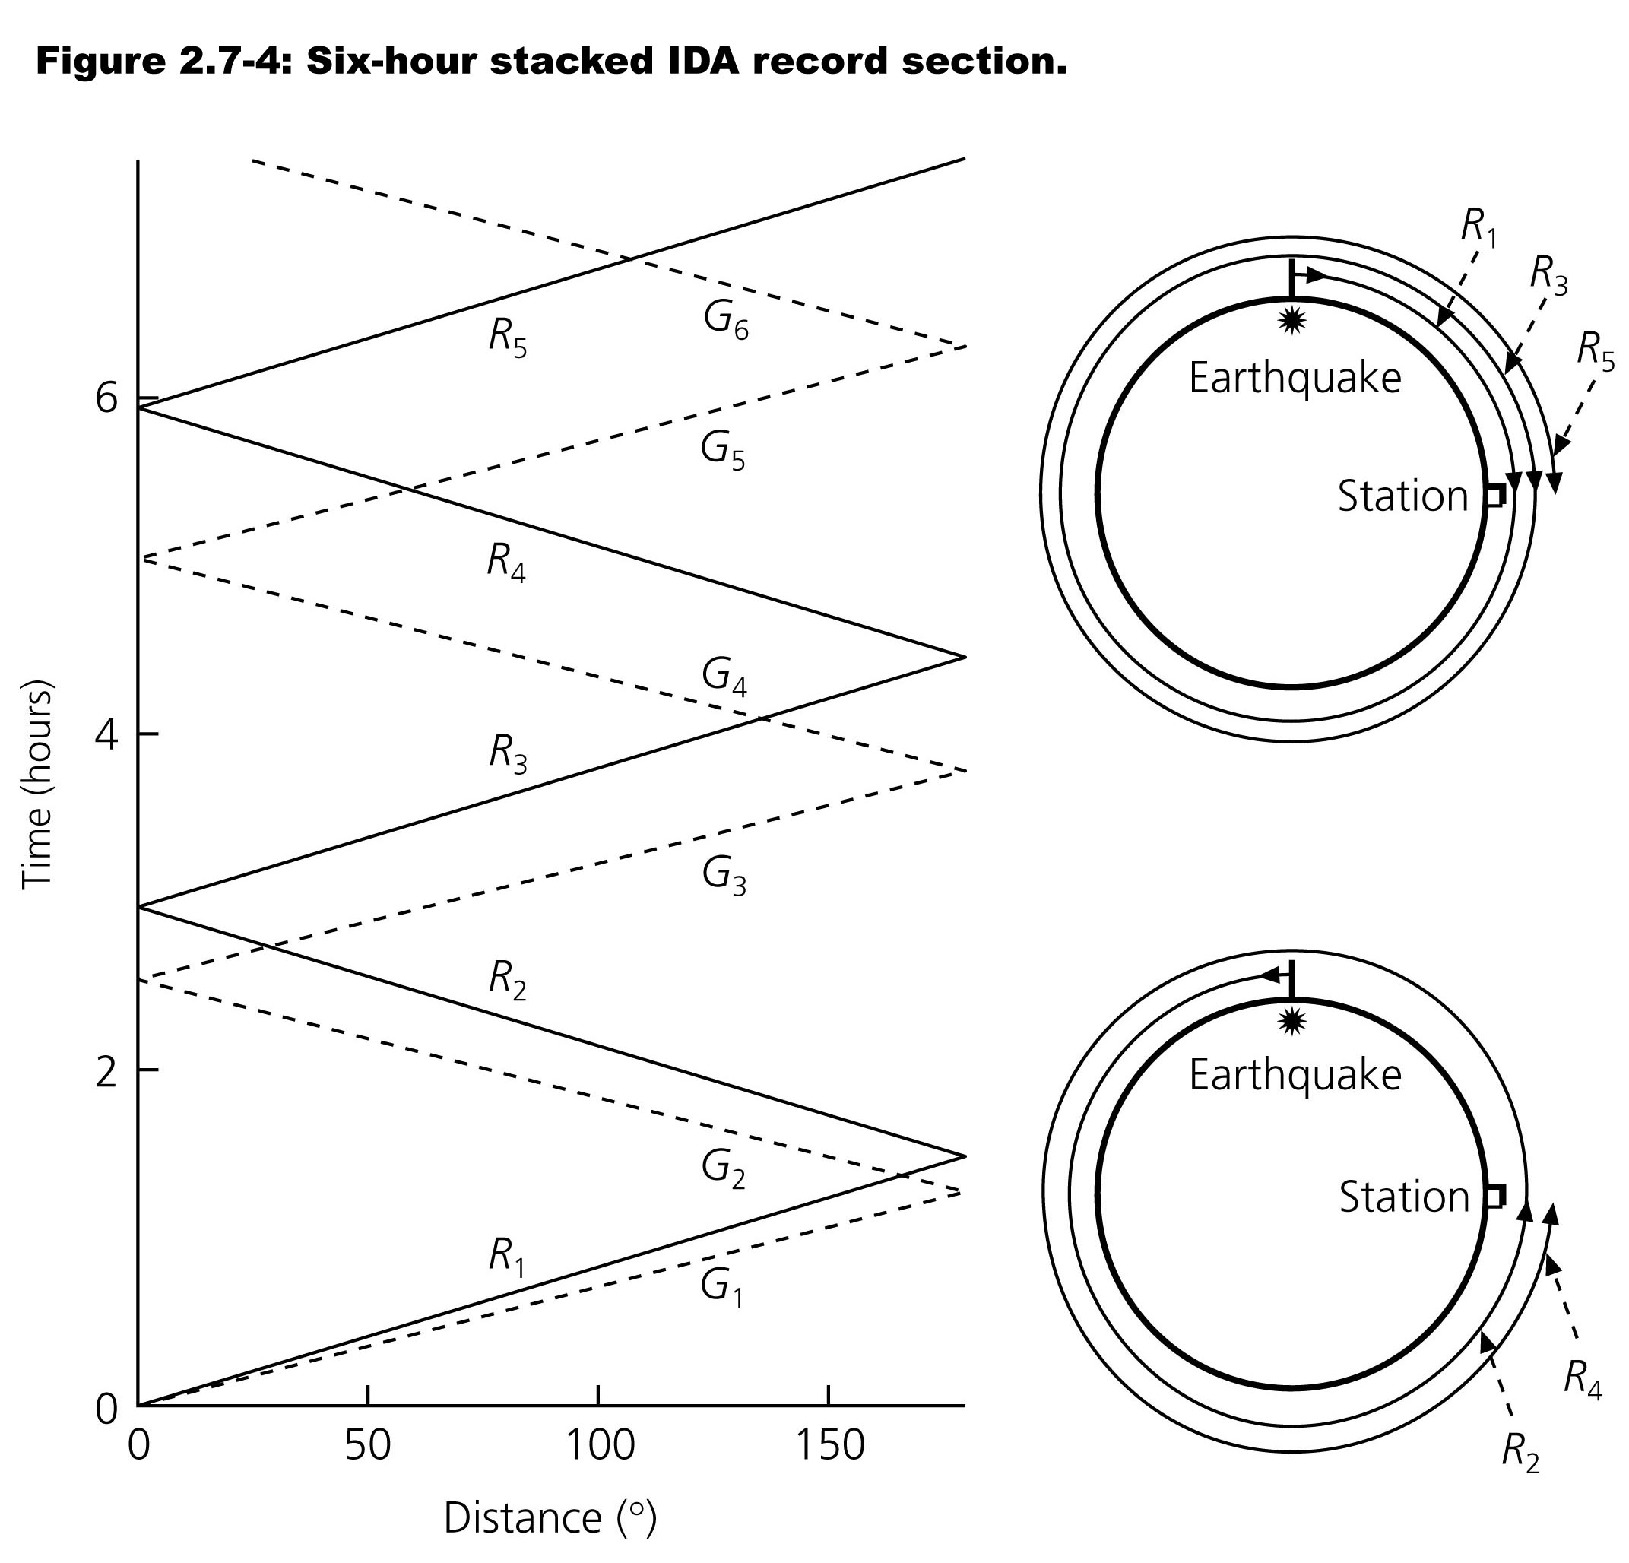
Figure 2.7-3: Multiple surface waves circle the earth.

Slide 5
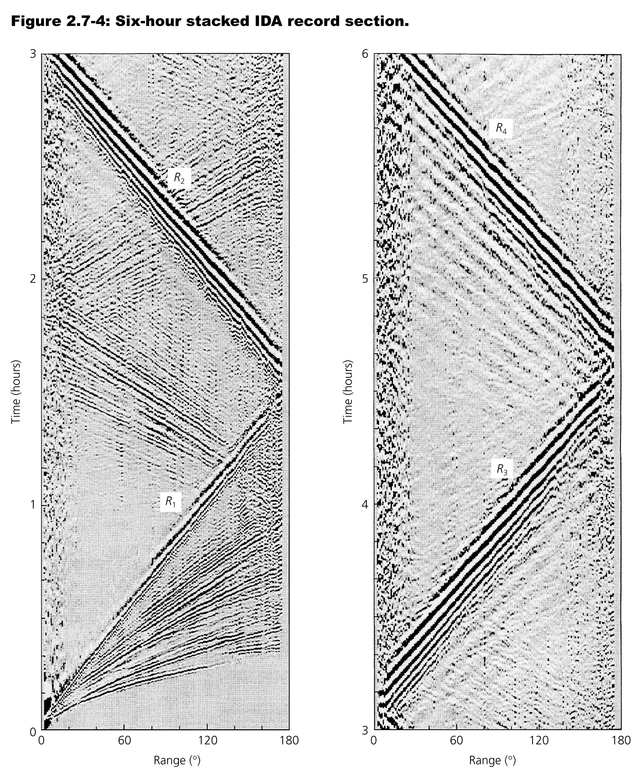

Slide 7
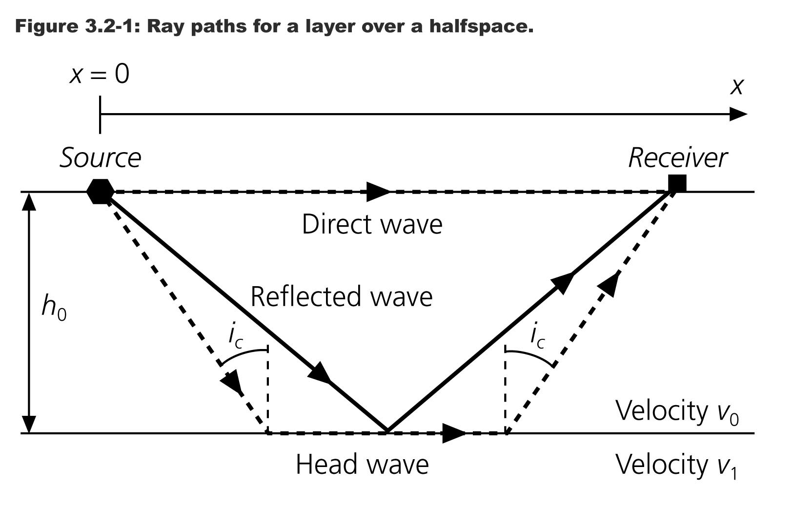

Slide 10
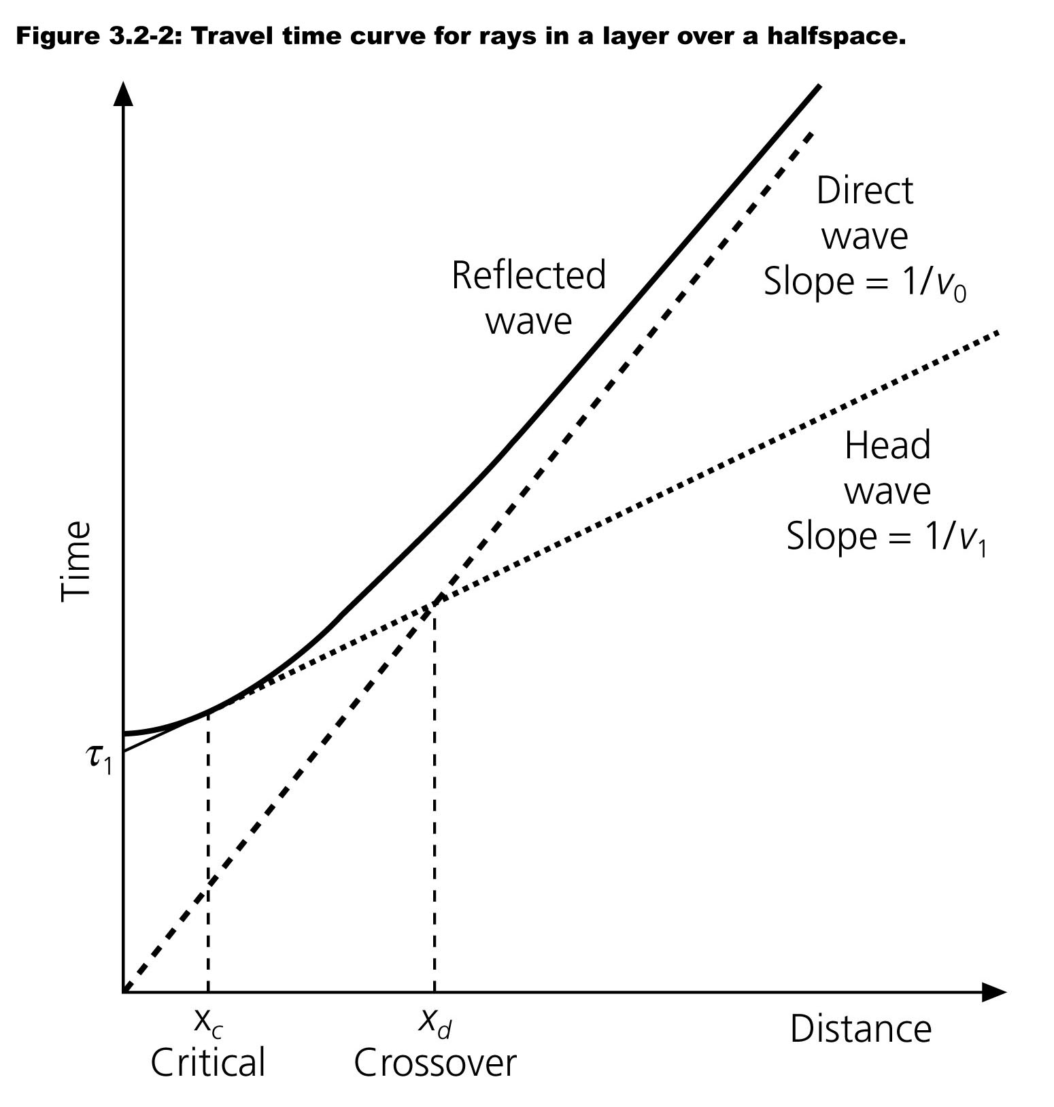
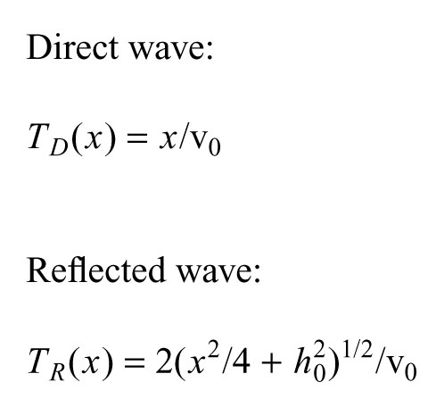

Slide 13
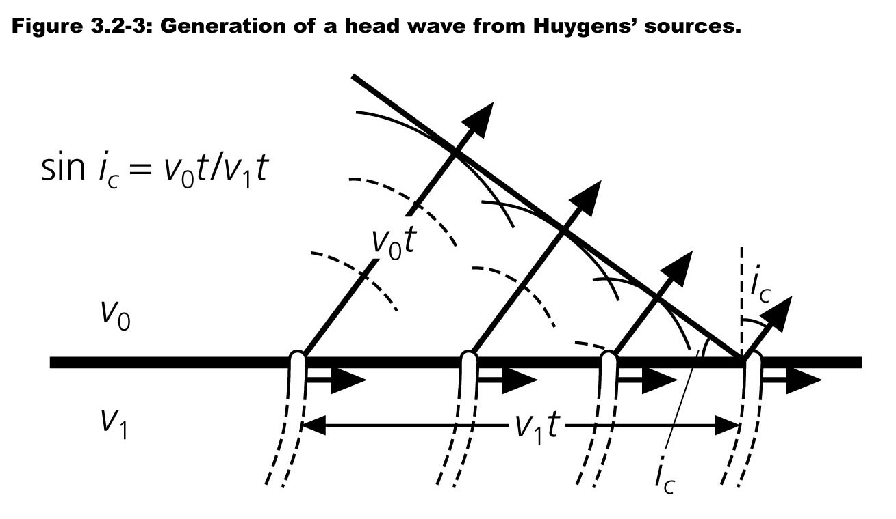

Slide 14
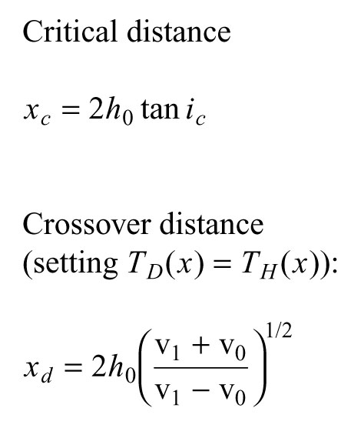

Slide 16
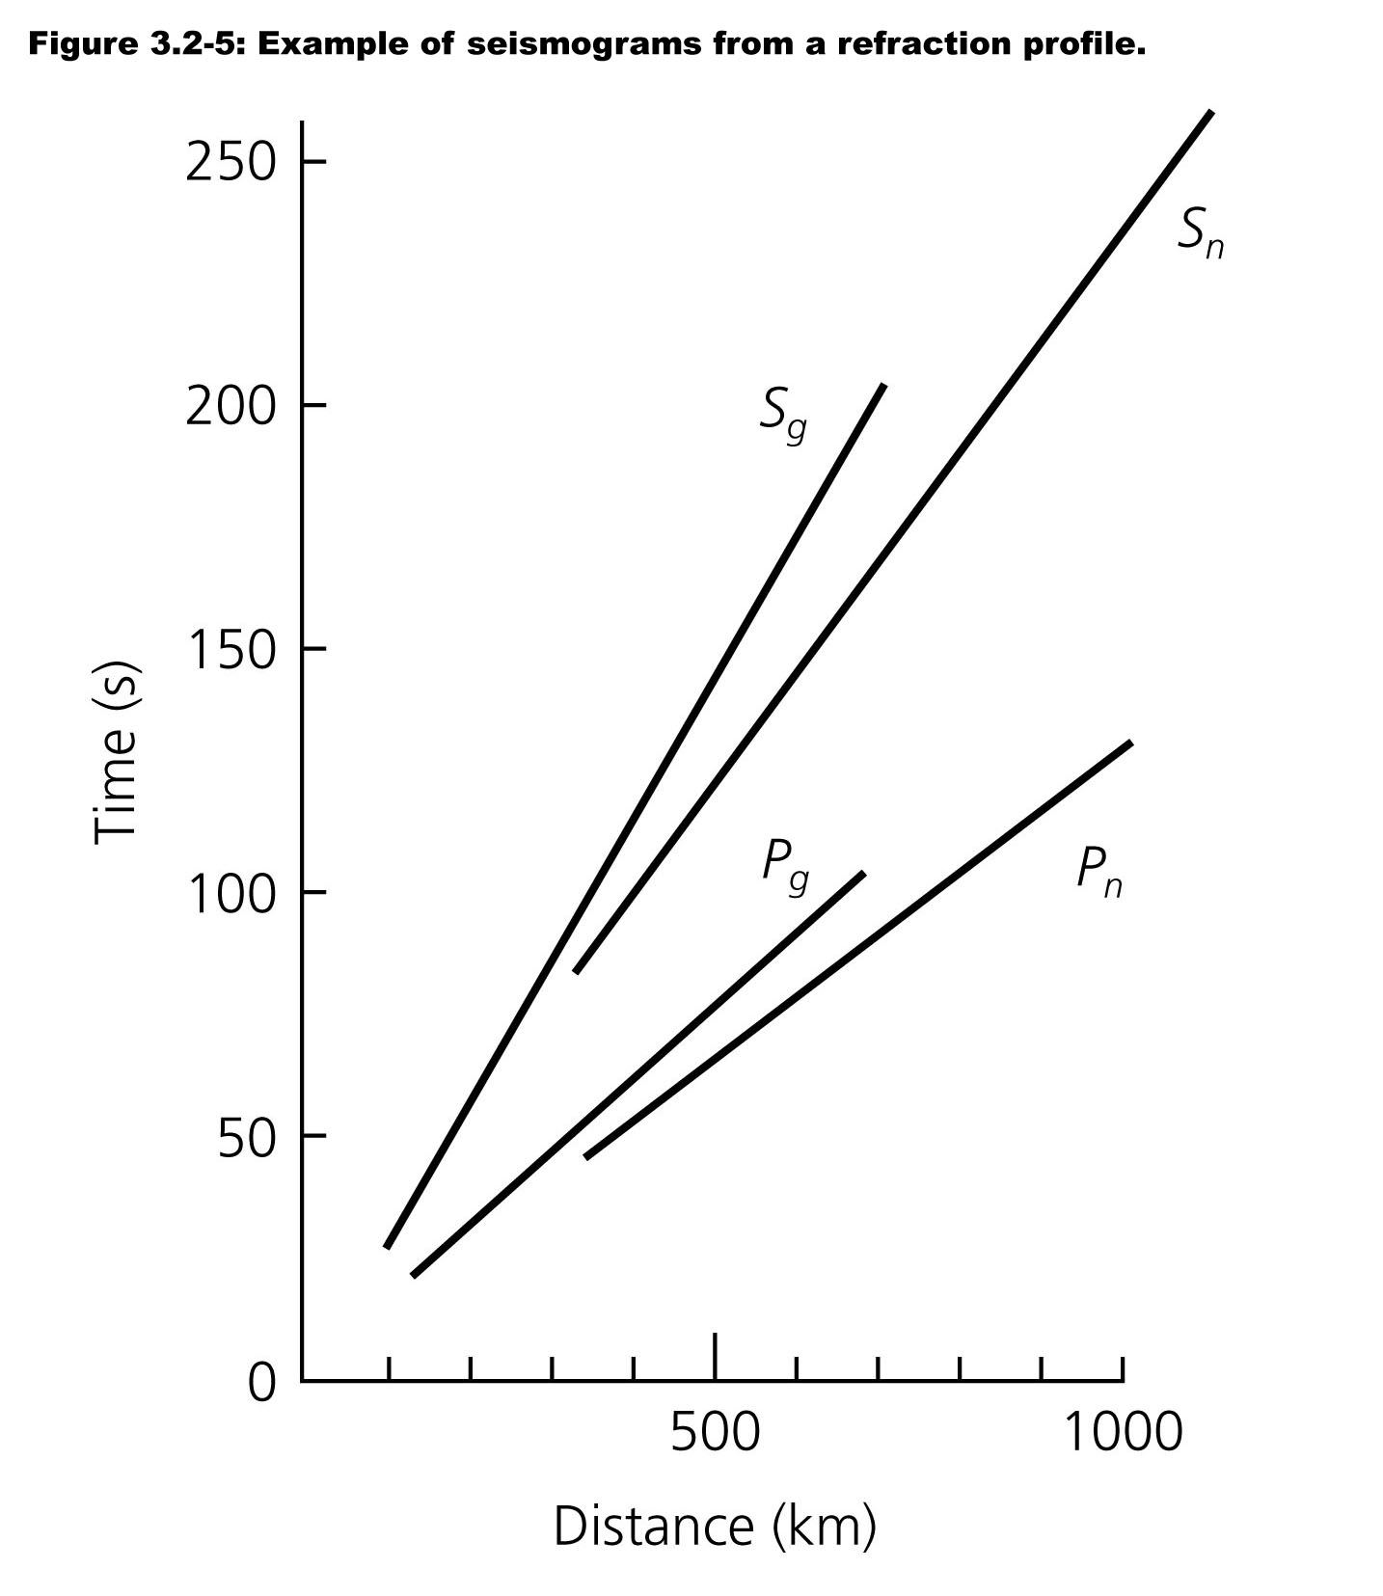
Figure 3.2-4 Mohorovičić’s results showing distinct mantle and crust

Slide 17
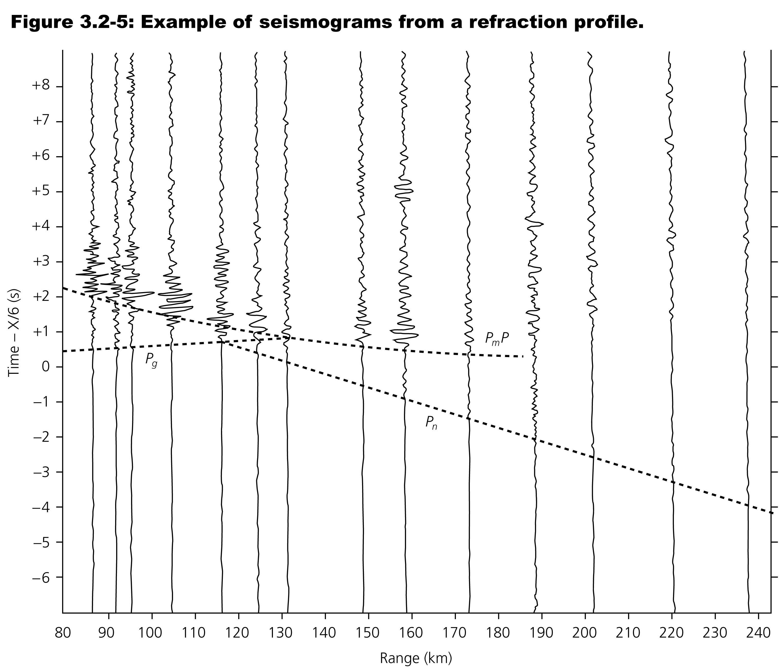

Slide 18
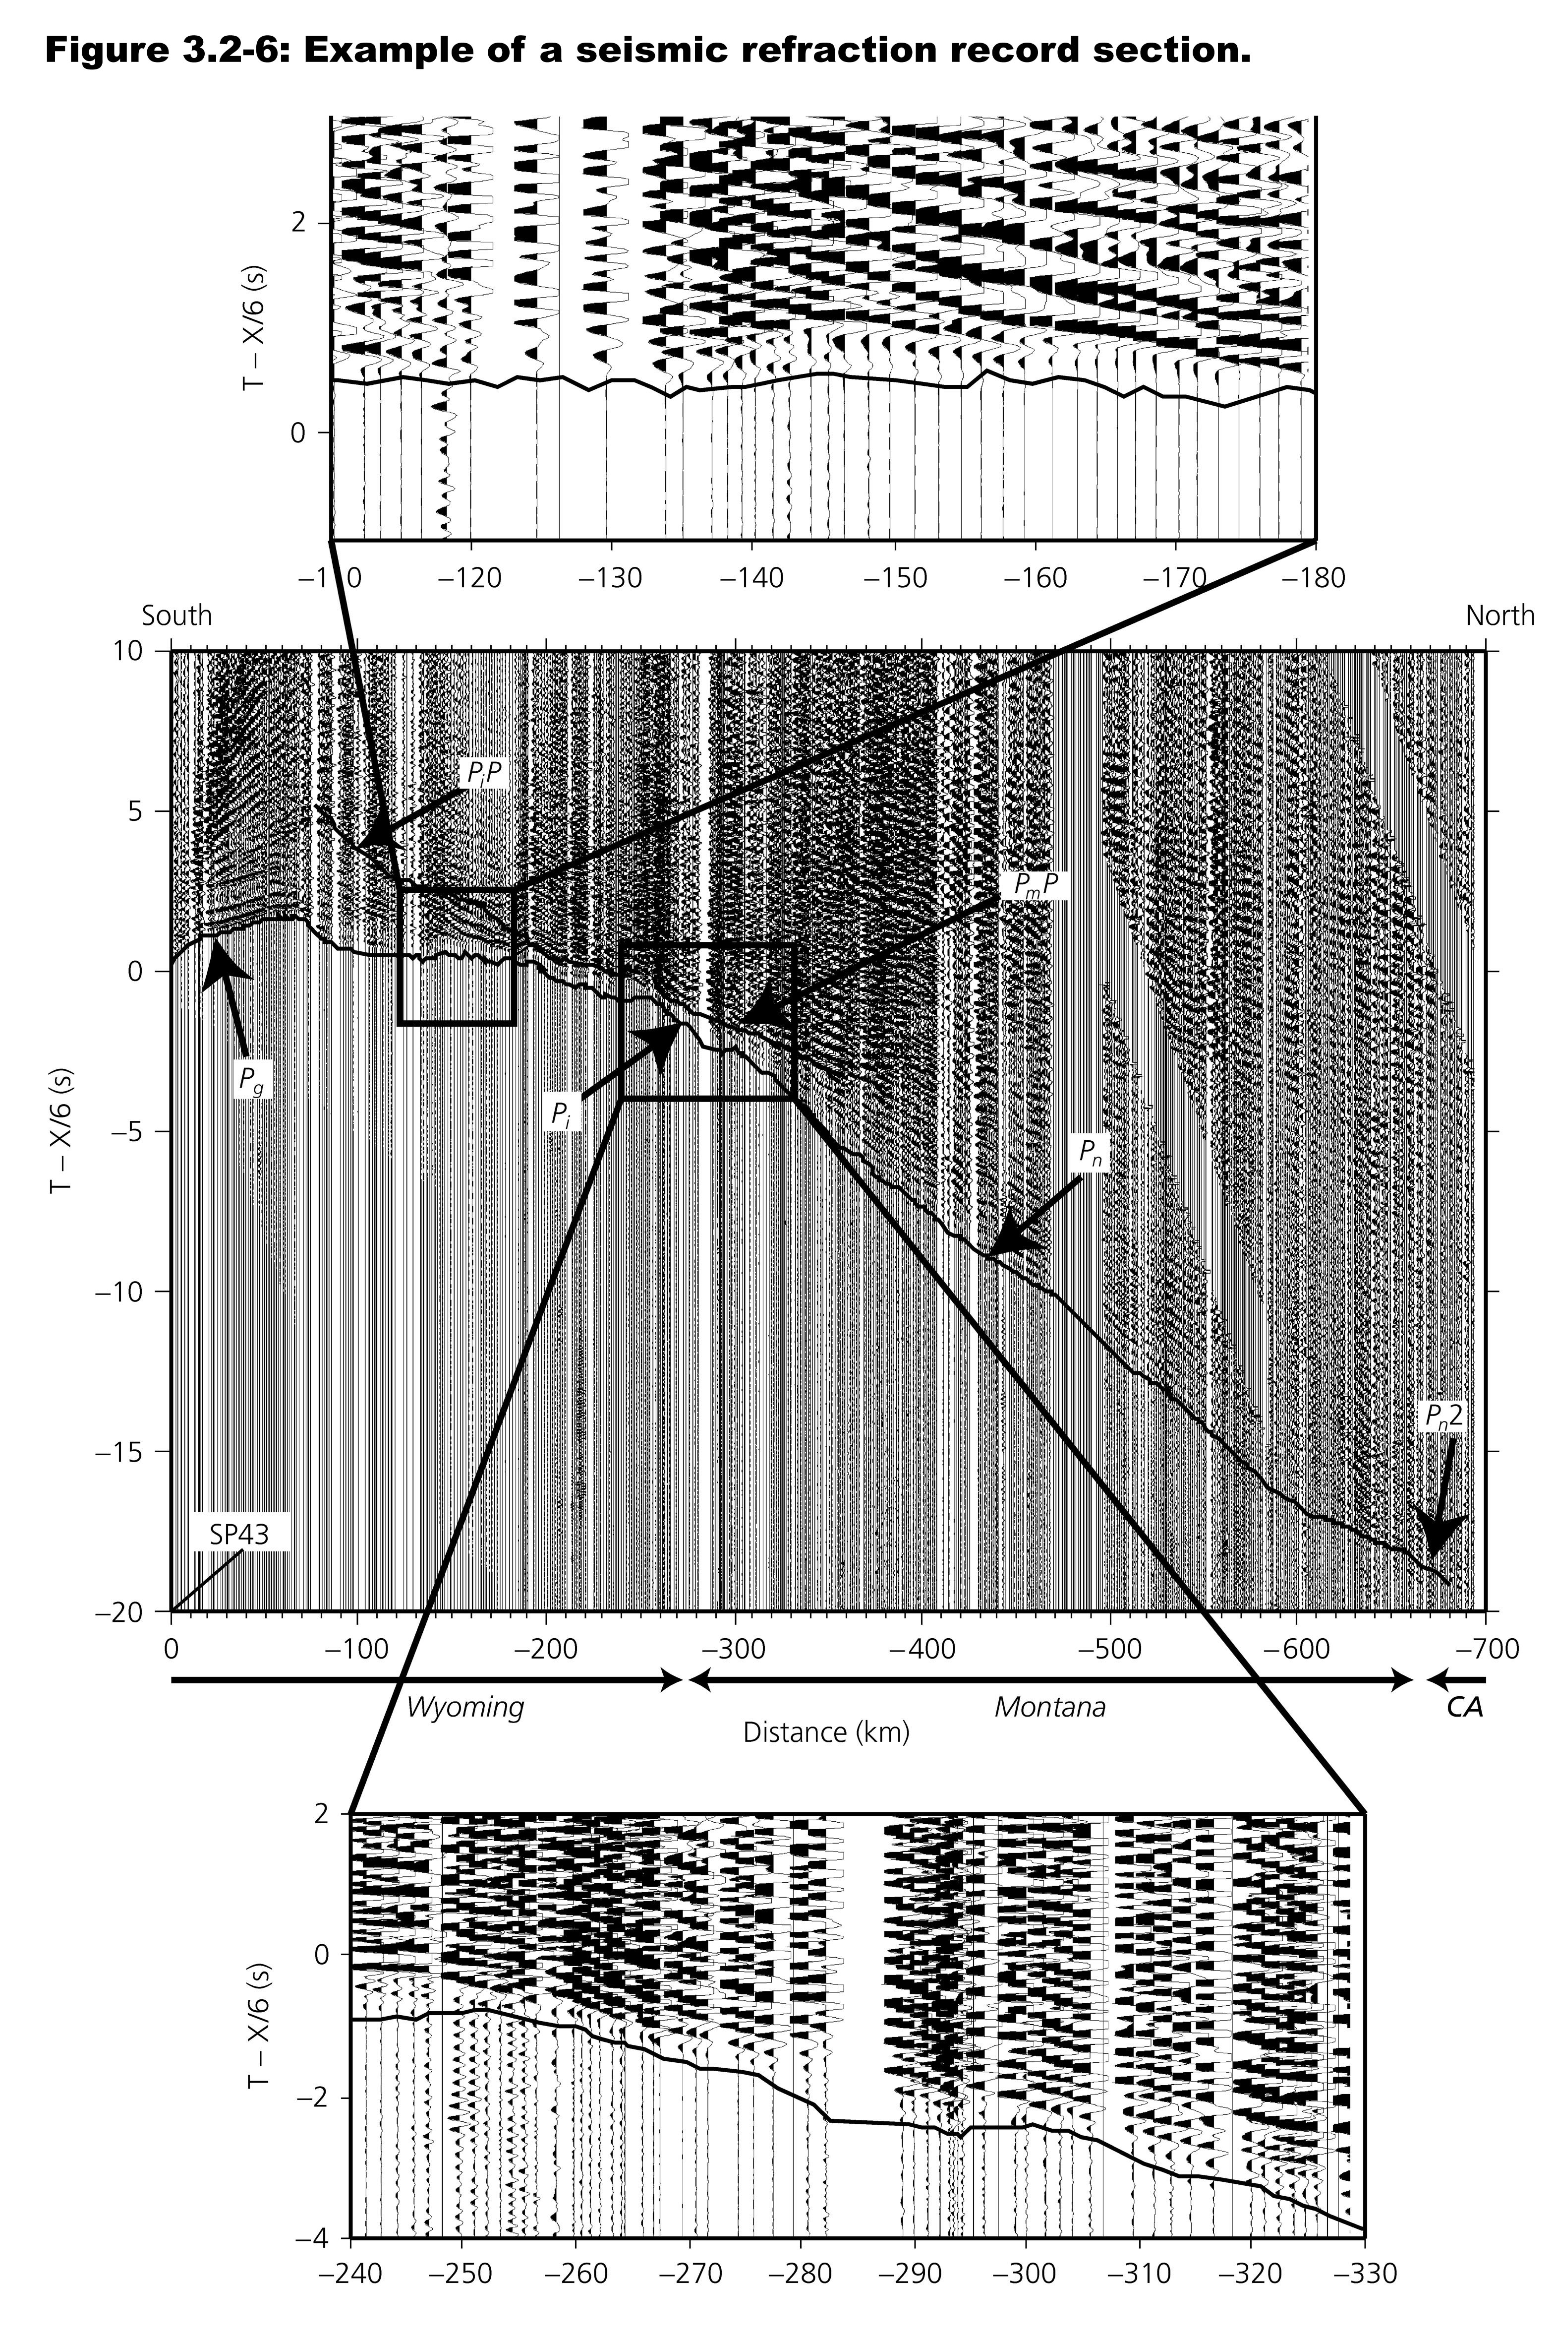

Slide 19
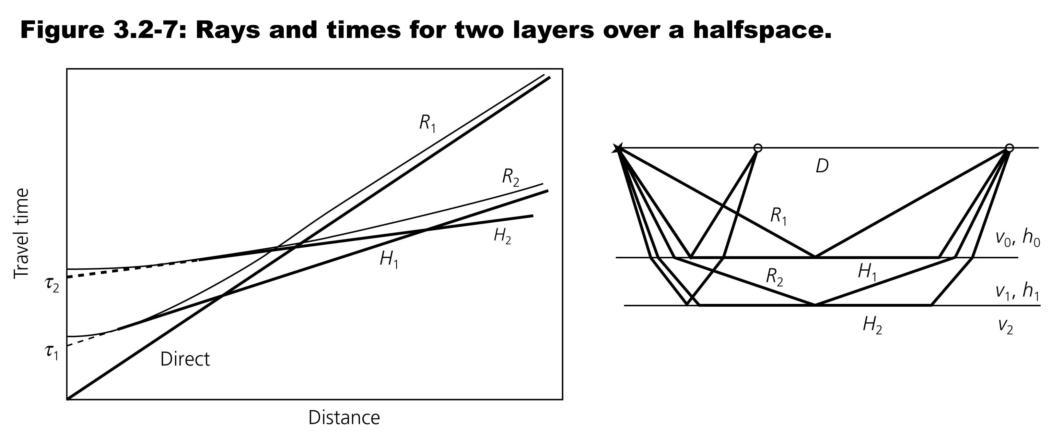
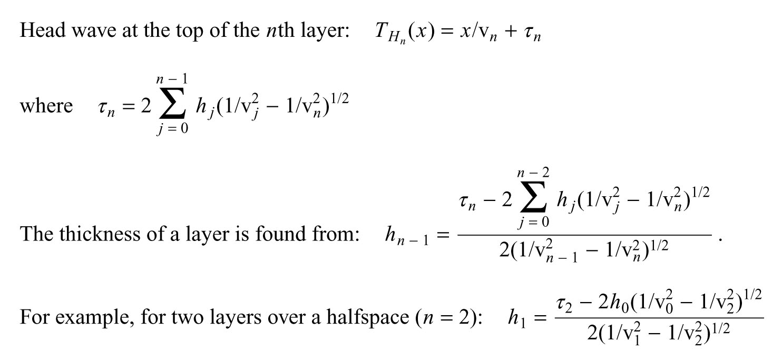

Slide 20
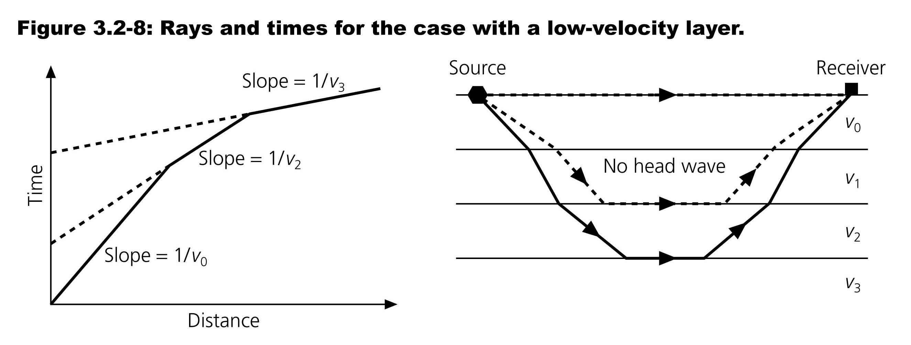

Slide 21
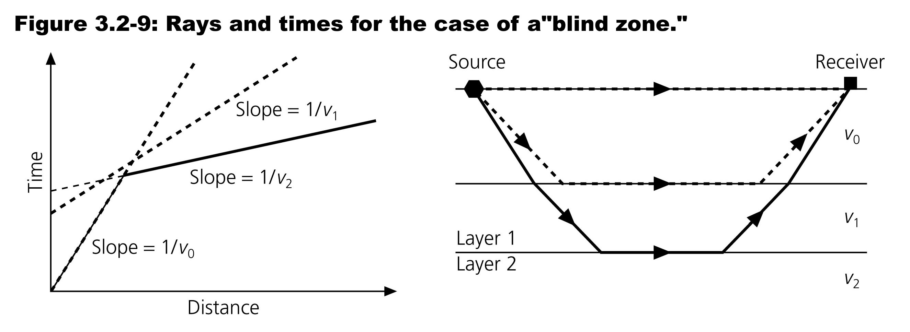

Slide 22
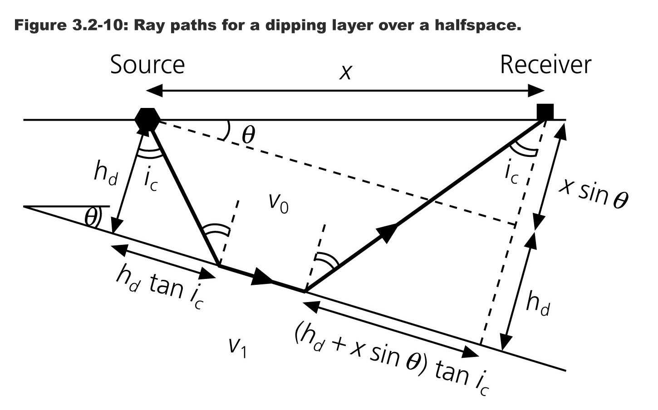

Slide 23
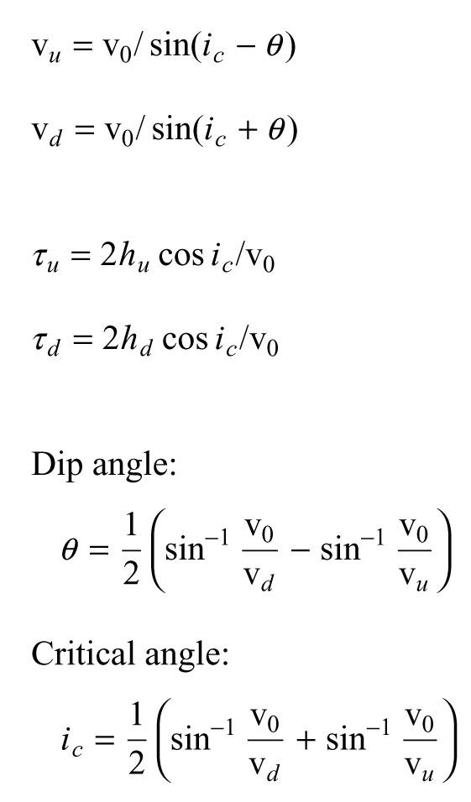
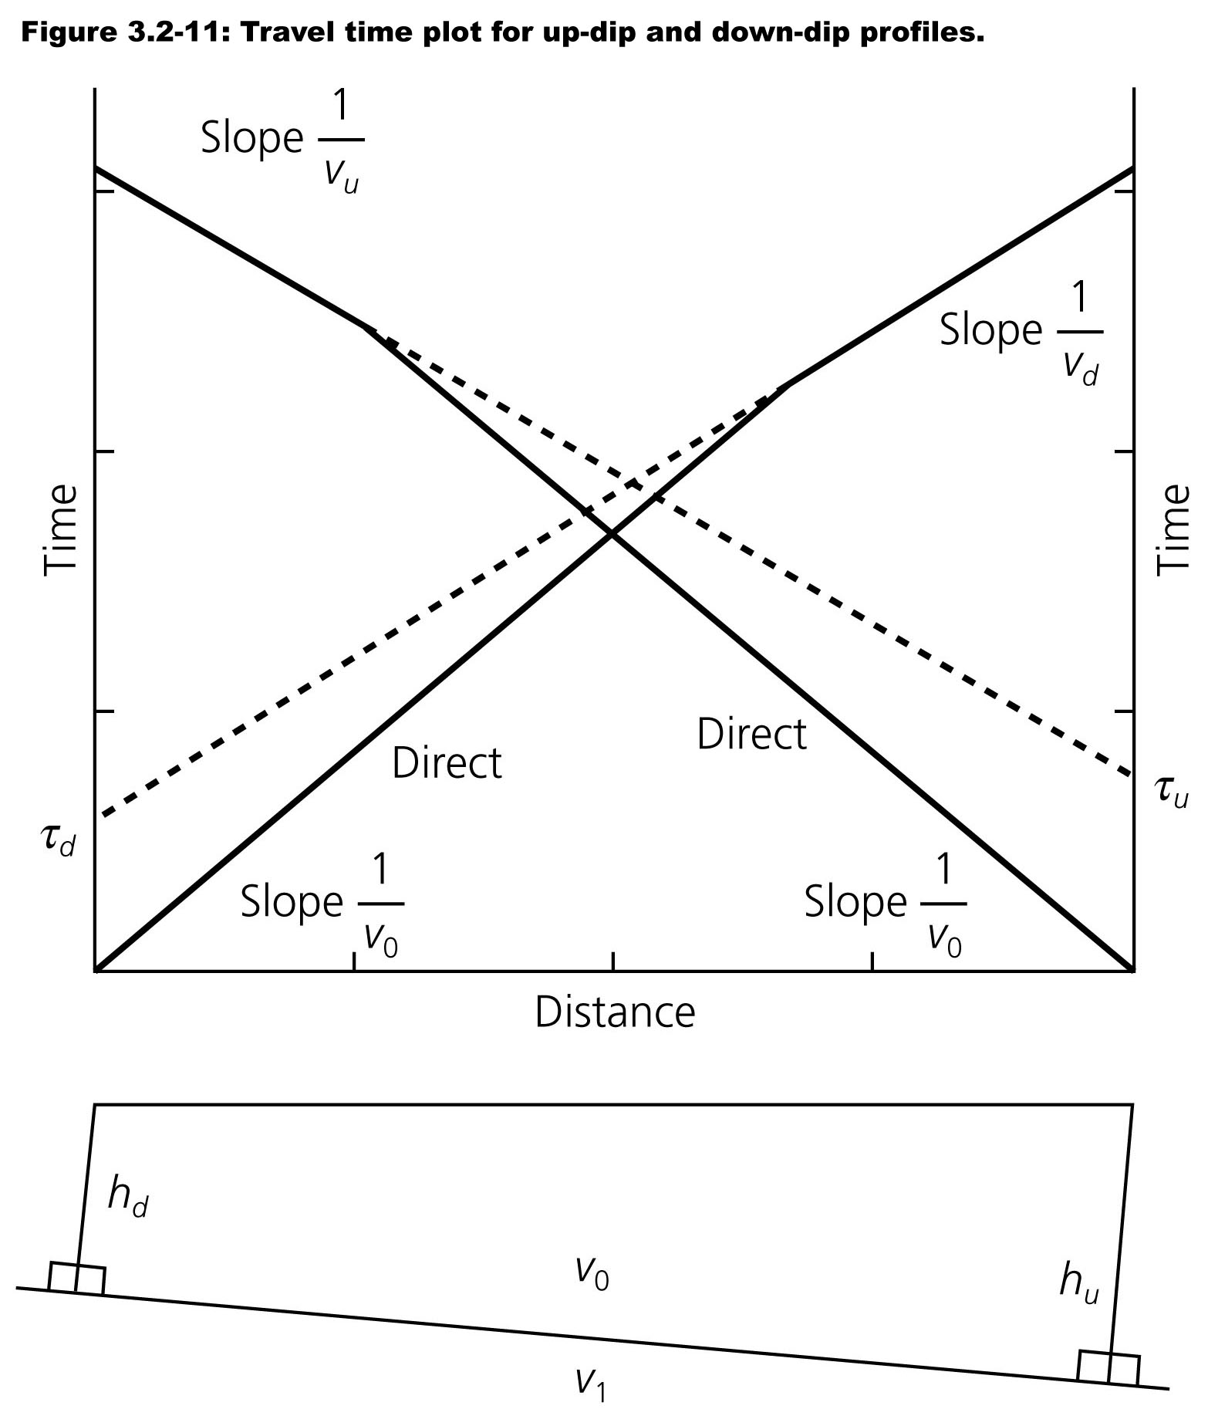

Slide 24
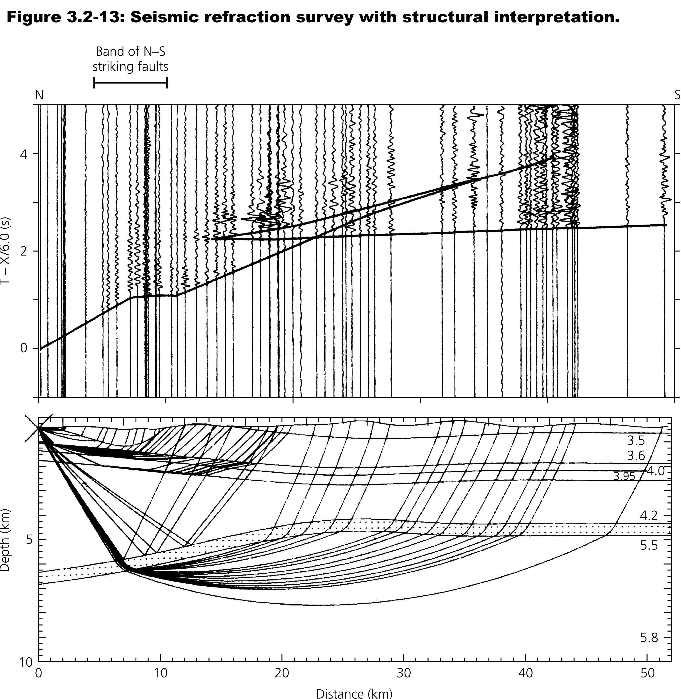

Slide 25
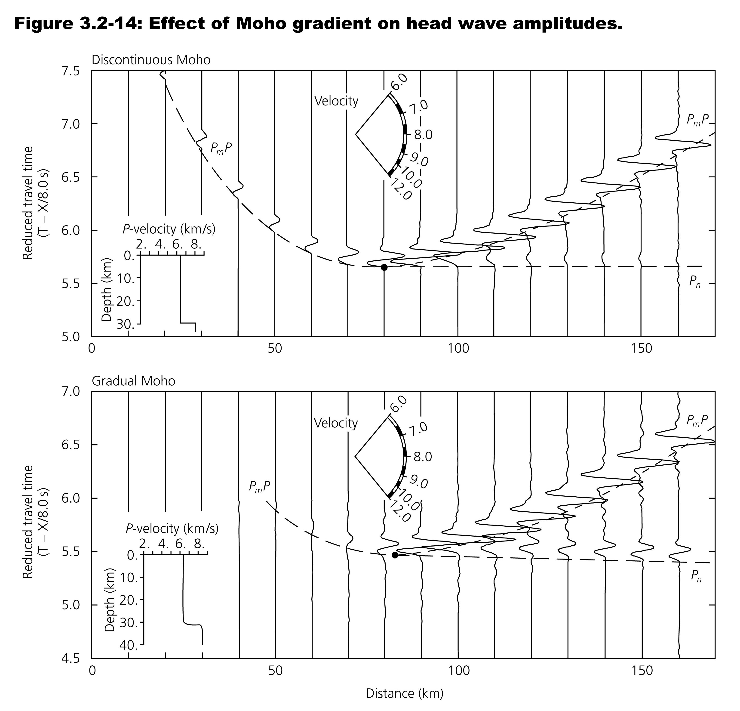

Slide 26
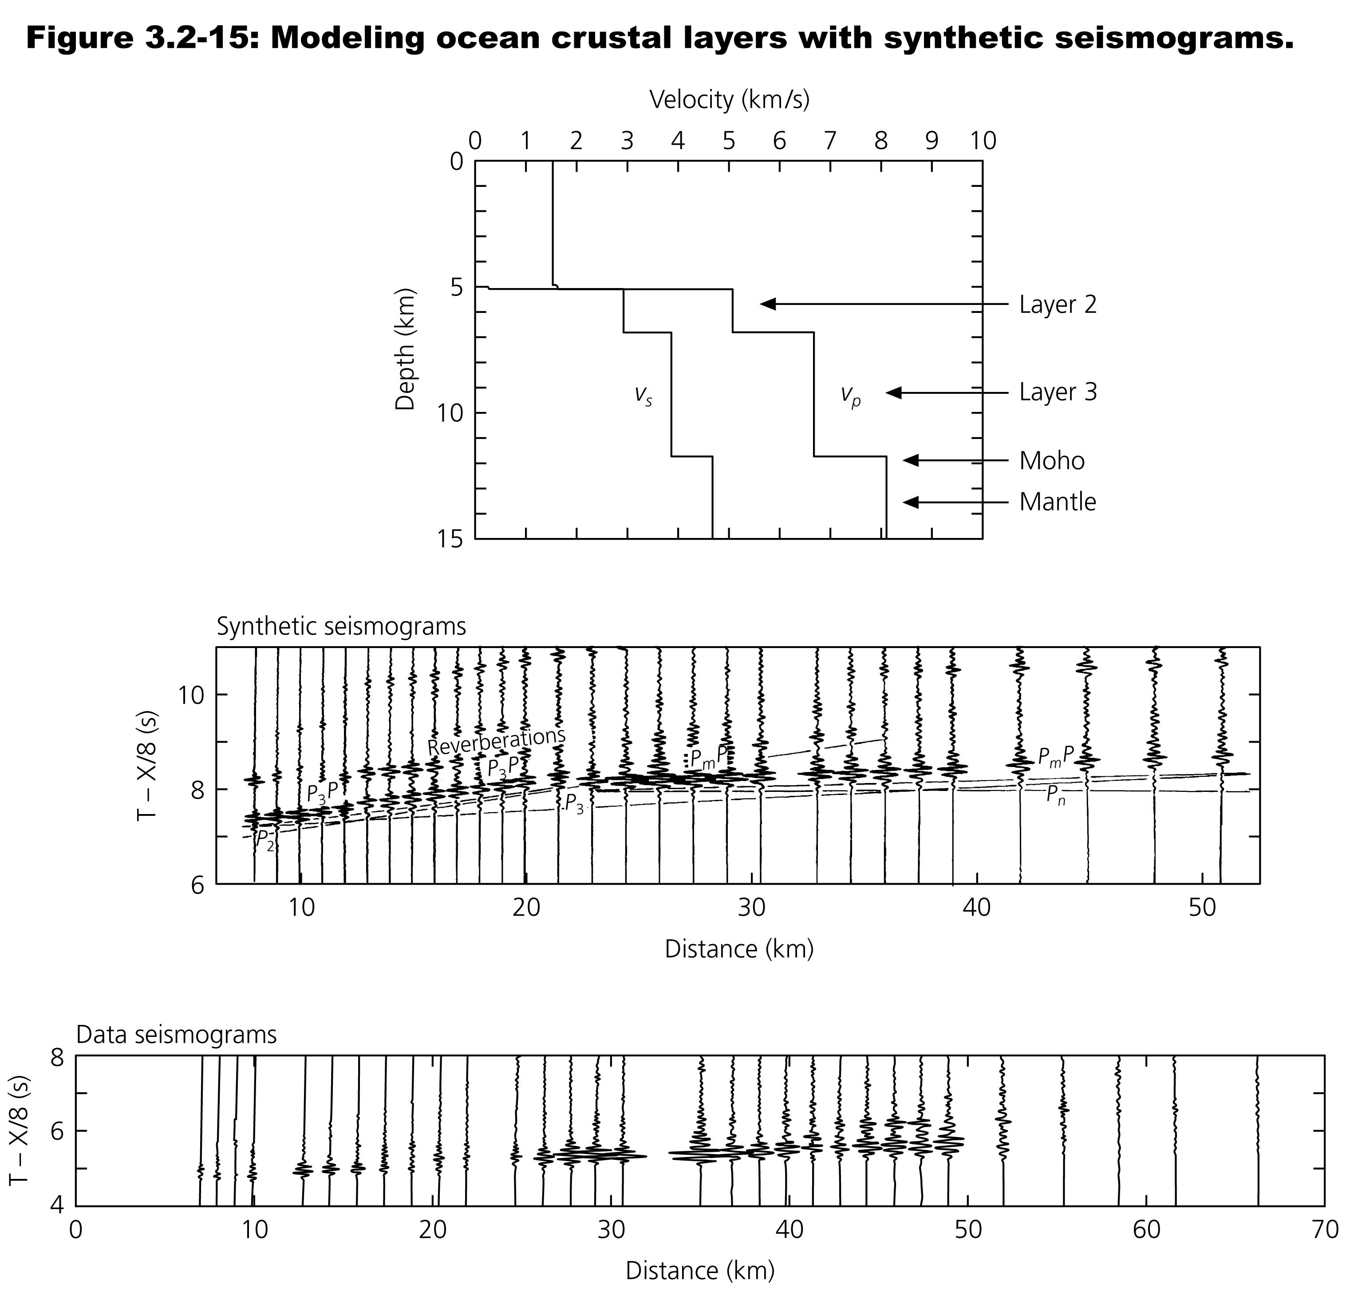

Slide 27
