Slide 1
Global Seismology CERI-8105
Tu-Th 1:00-2:25pm
Lab - 3892 Central Ave. (Long building) , Room 110
-----------------------------------------------
Bob Smalley
Office: 3892 Central Ave, Room 103, 678-4929
Office Hours – when I’m in my office.
http://www.ceri.memphis.edu/people/smalley/CERI8105_GlobalSeismology.html
Meeting Tu-Th: 1:00-2:45 pm
Tue., Sep 5, 2023 Meeting 3

Slide 2
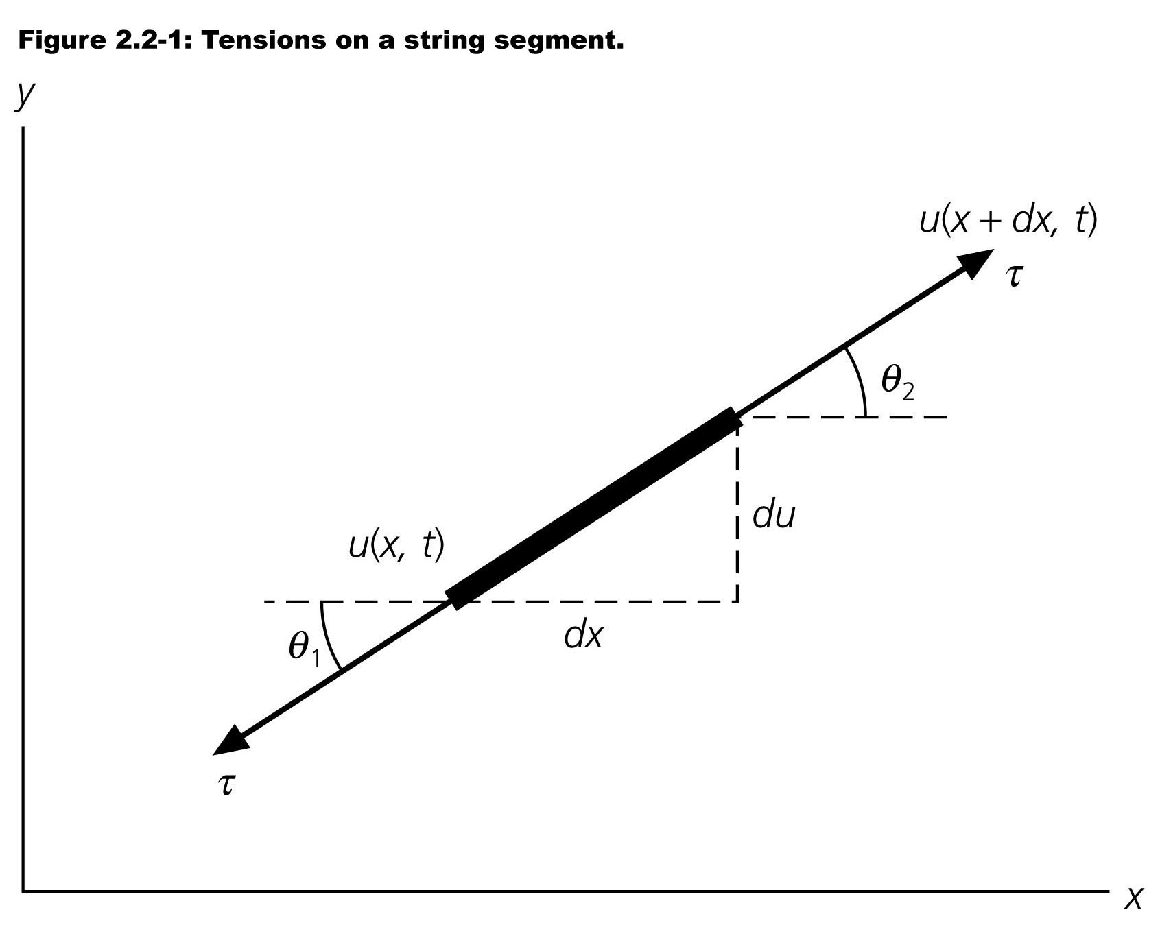
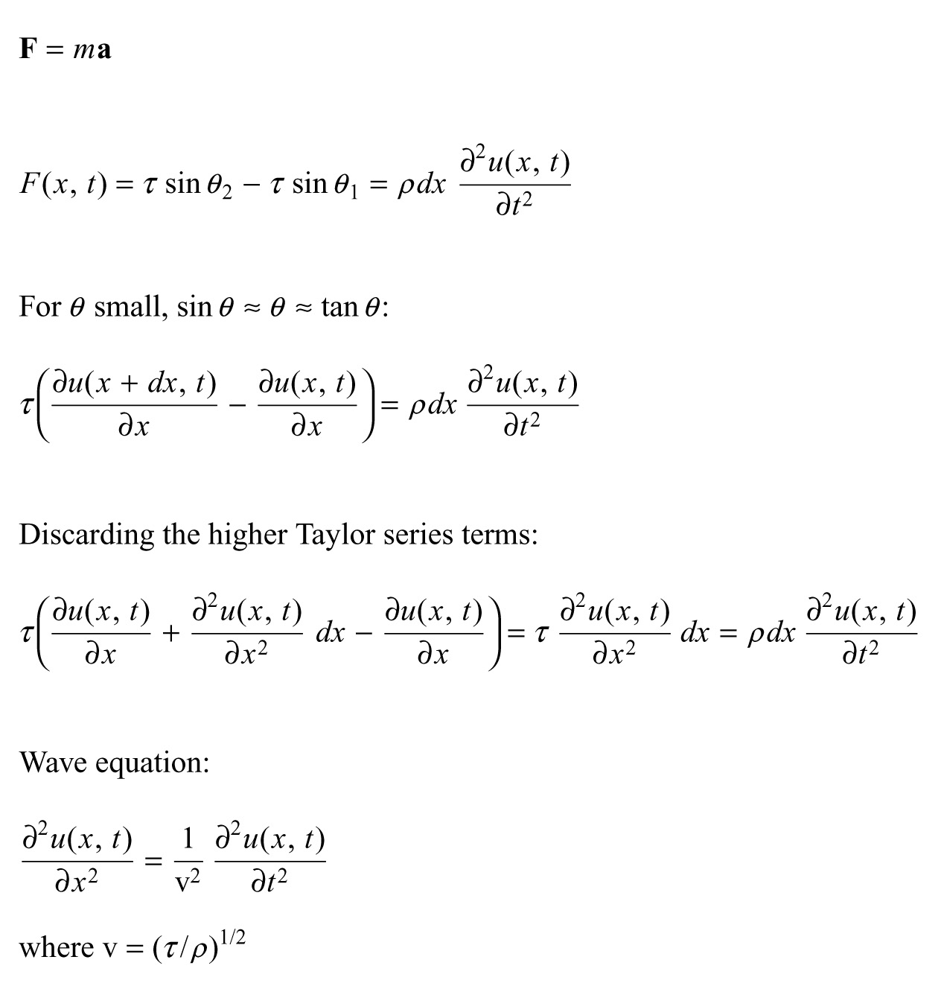
Notes:
Apply newton’s 2nd law f=ma to segment of deformed string (horizontal at equilibrium, net force restoring ±vertical

Slide 3
Notes:
Tension equal along string
Angles at ends slightly different, so restoring forces (vertical) slightly different and there is a net force towards the equilibrium position
The thing on the right is newton’s second law f=ma, mass is density/lenth * length, acceleration is 2nd time derivative of position.

Slide 4
Notes:
Now some approximations – be wise linearize
For small theta sin(theta)~theta~tan(theta)
Tan(theta) is opposite over adjacent so is du/dx
Endpoints at x+dx and s, take difference

Slide 5
Notes:
Linearize again, this time at the point x+dx using 1st 2 terms of taylor series

Slide 6
Notes:
Move all scaling terms to one side and get wave equation – 2nd derivative wrt distance and 2nd derivative with respect to time are proportional to one another – this is the wave equation

Slide 7
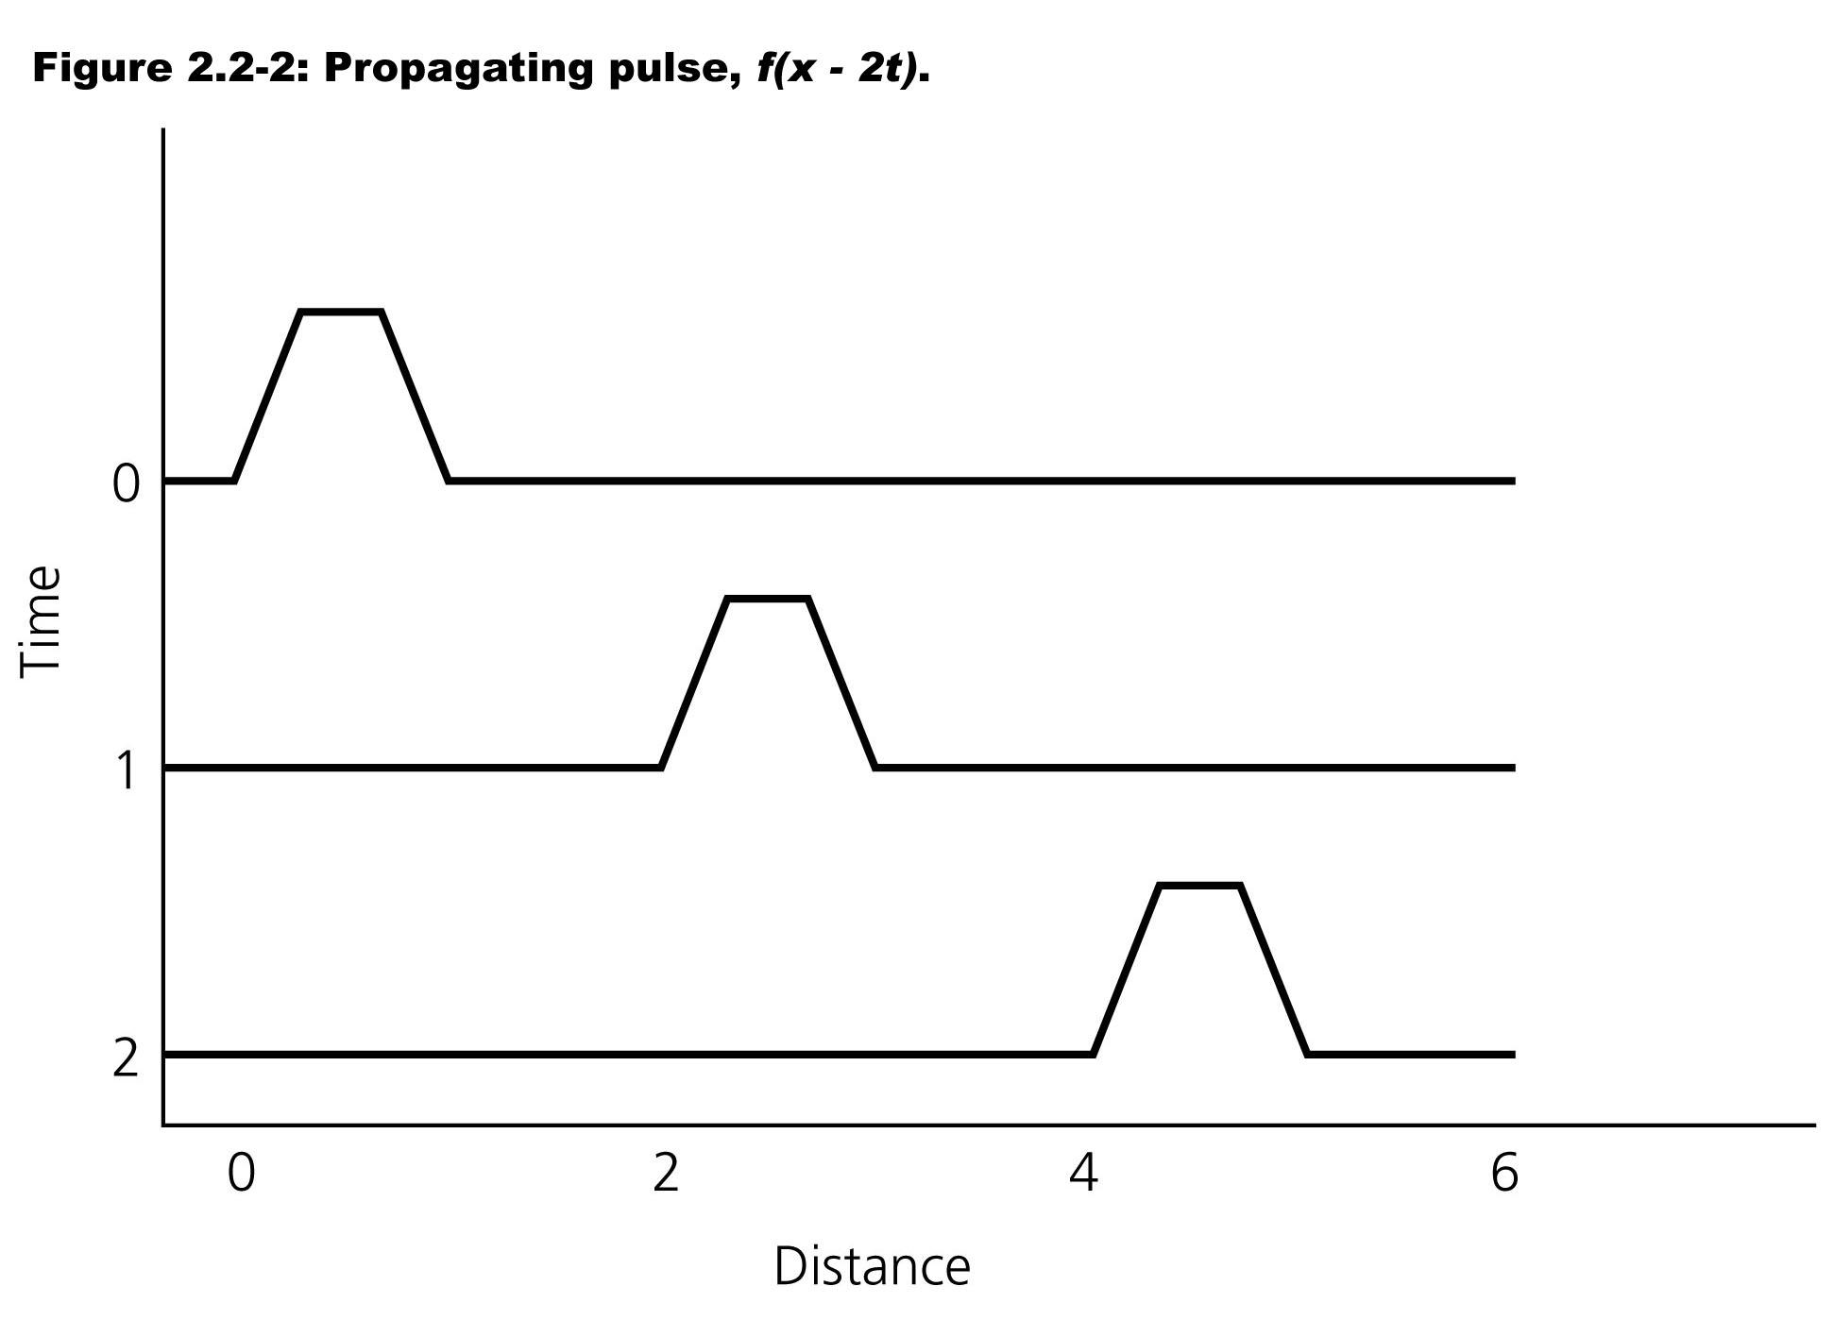
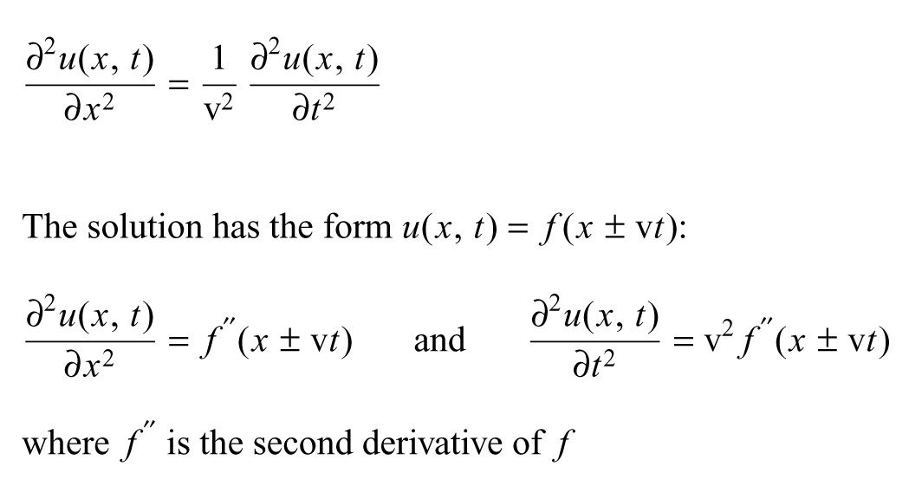
Notes:
What does second derivative tell us – something about the curvature (concave/convex up or down)
Easy to state solution – has the form f(x±vt) – f can be any function (as far as physicists concerned, any function that can represent something physical, not any function for Mathematians – e.g. a fractal as it is nowhere differentiable). What is drawn is also not allowed because is not differentiable at the bends.

Slide 8
Notes:
Take the derivatives and see immediately that it is a solution.
Moves back and forth in time and distance with constant shape. Shape is function of y(=x±vt) so just moves shape back and forth

Slide 9
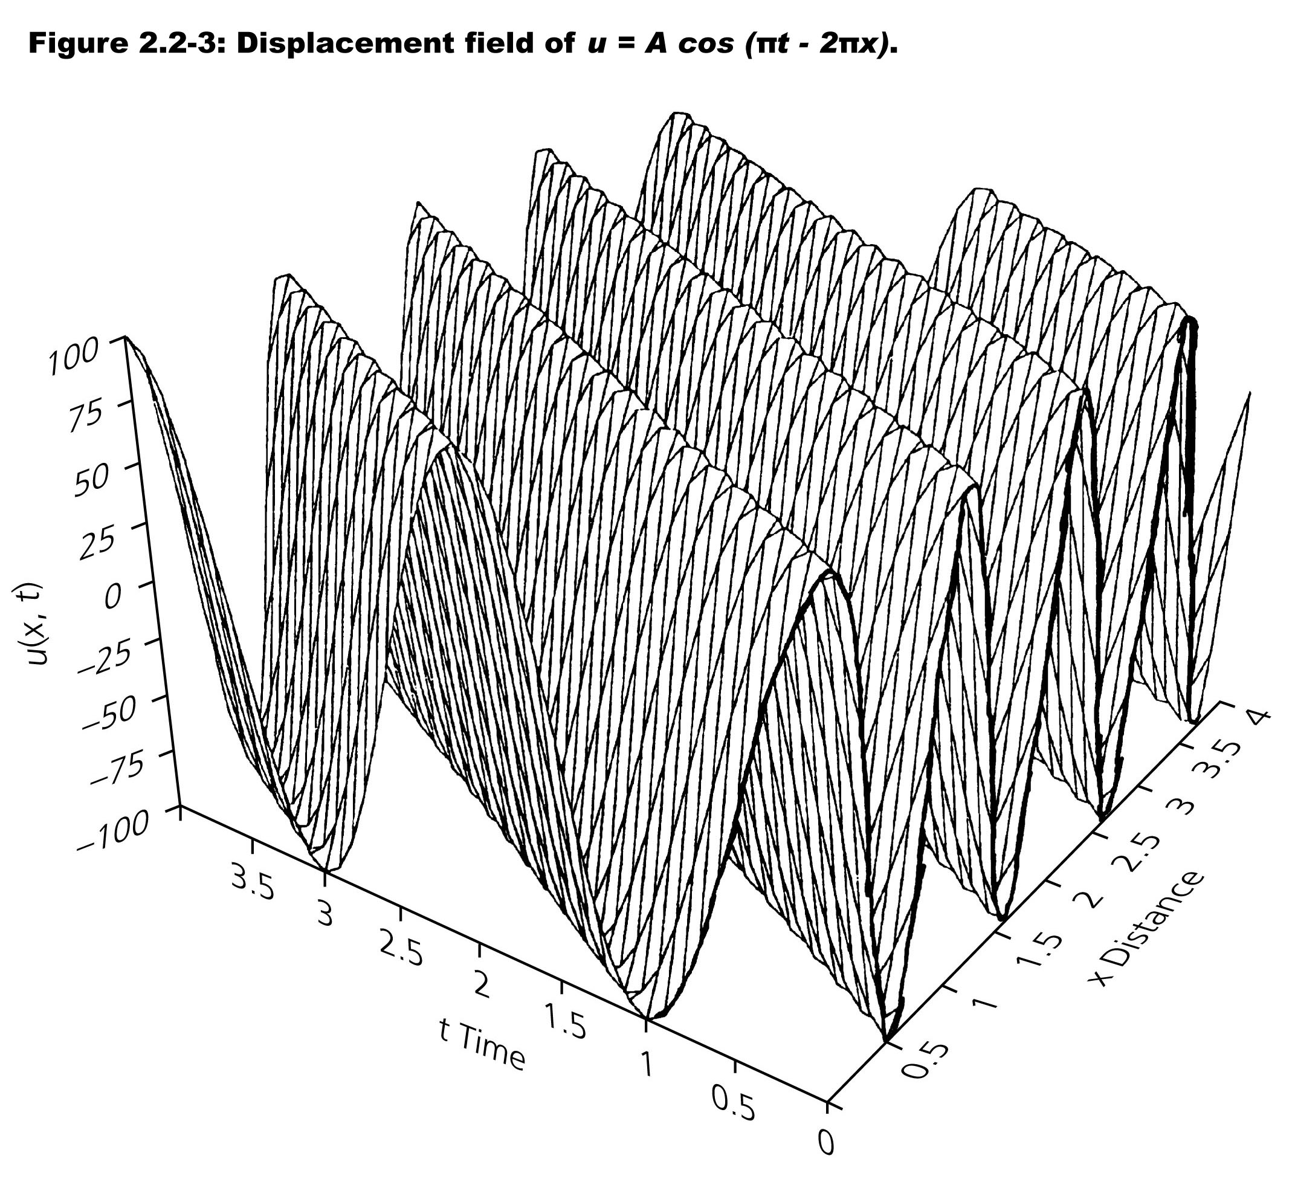
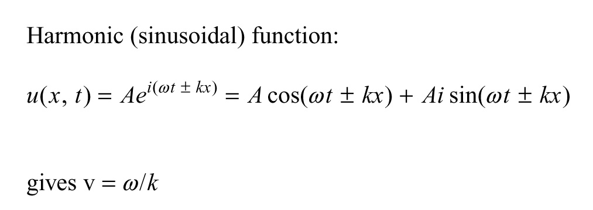
Notes:
Harmonic (complex – take real part) function.
Functions on lines parallel to or on axis are sines/cosines

Slide 10
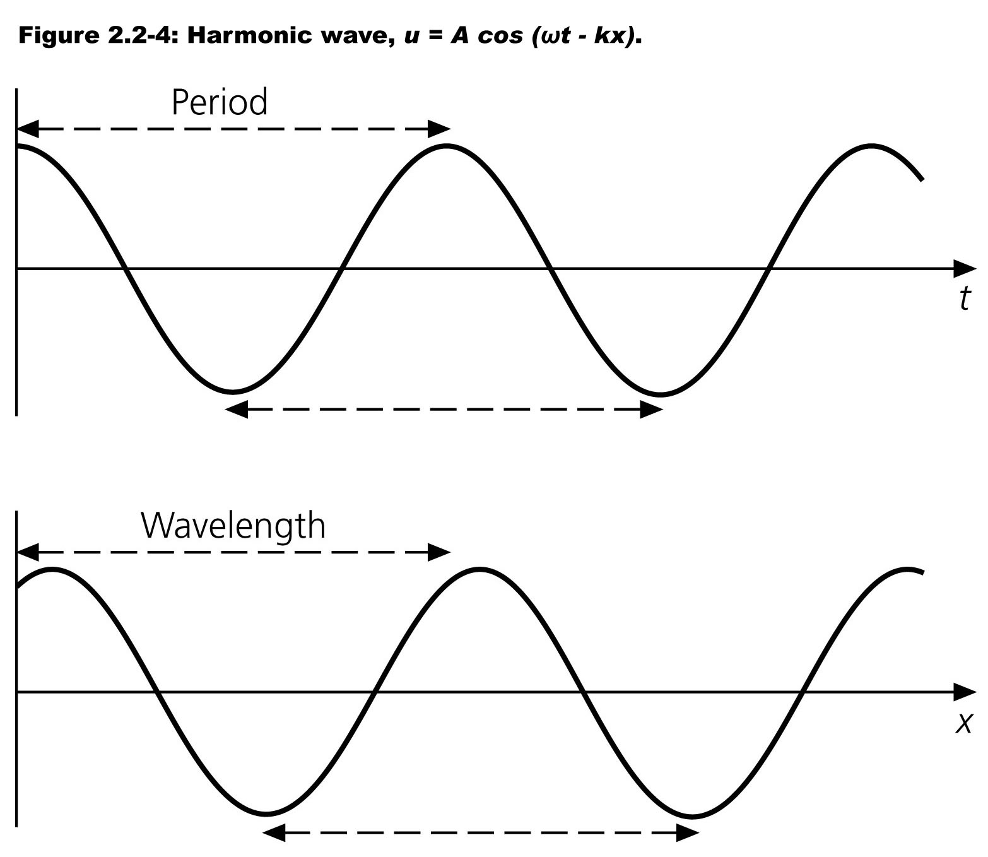
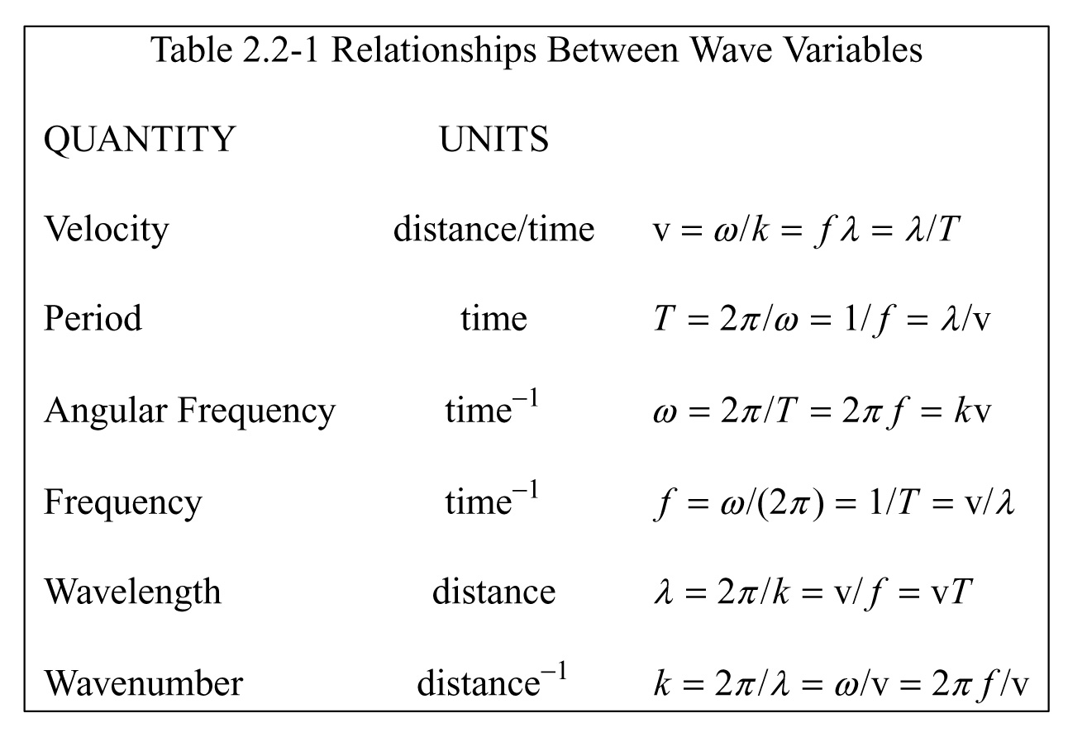
Notes:
“Ohm’s” law like relationship between the 6 parameters.
Notice have sine wave in time (seismogram) and sine wave in distance (picture/wavefield))

Slide 11
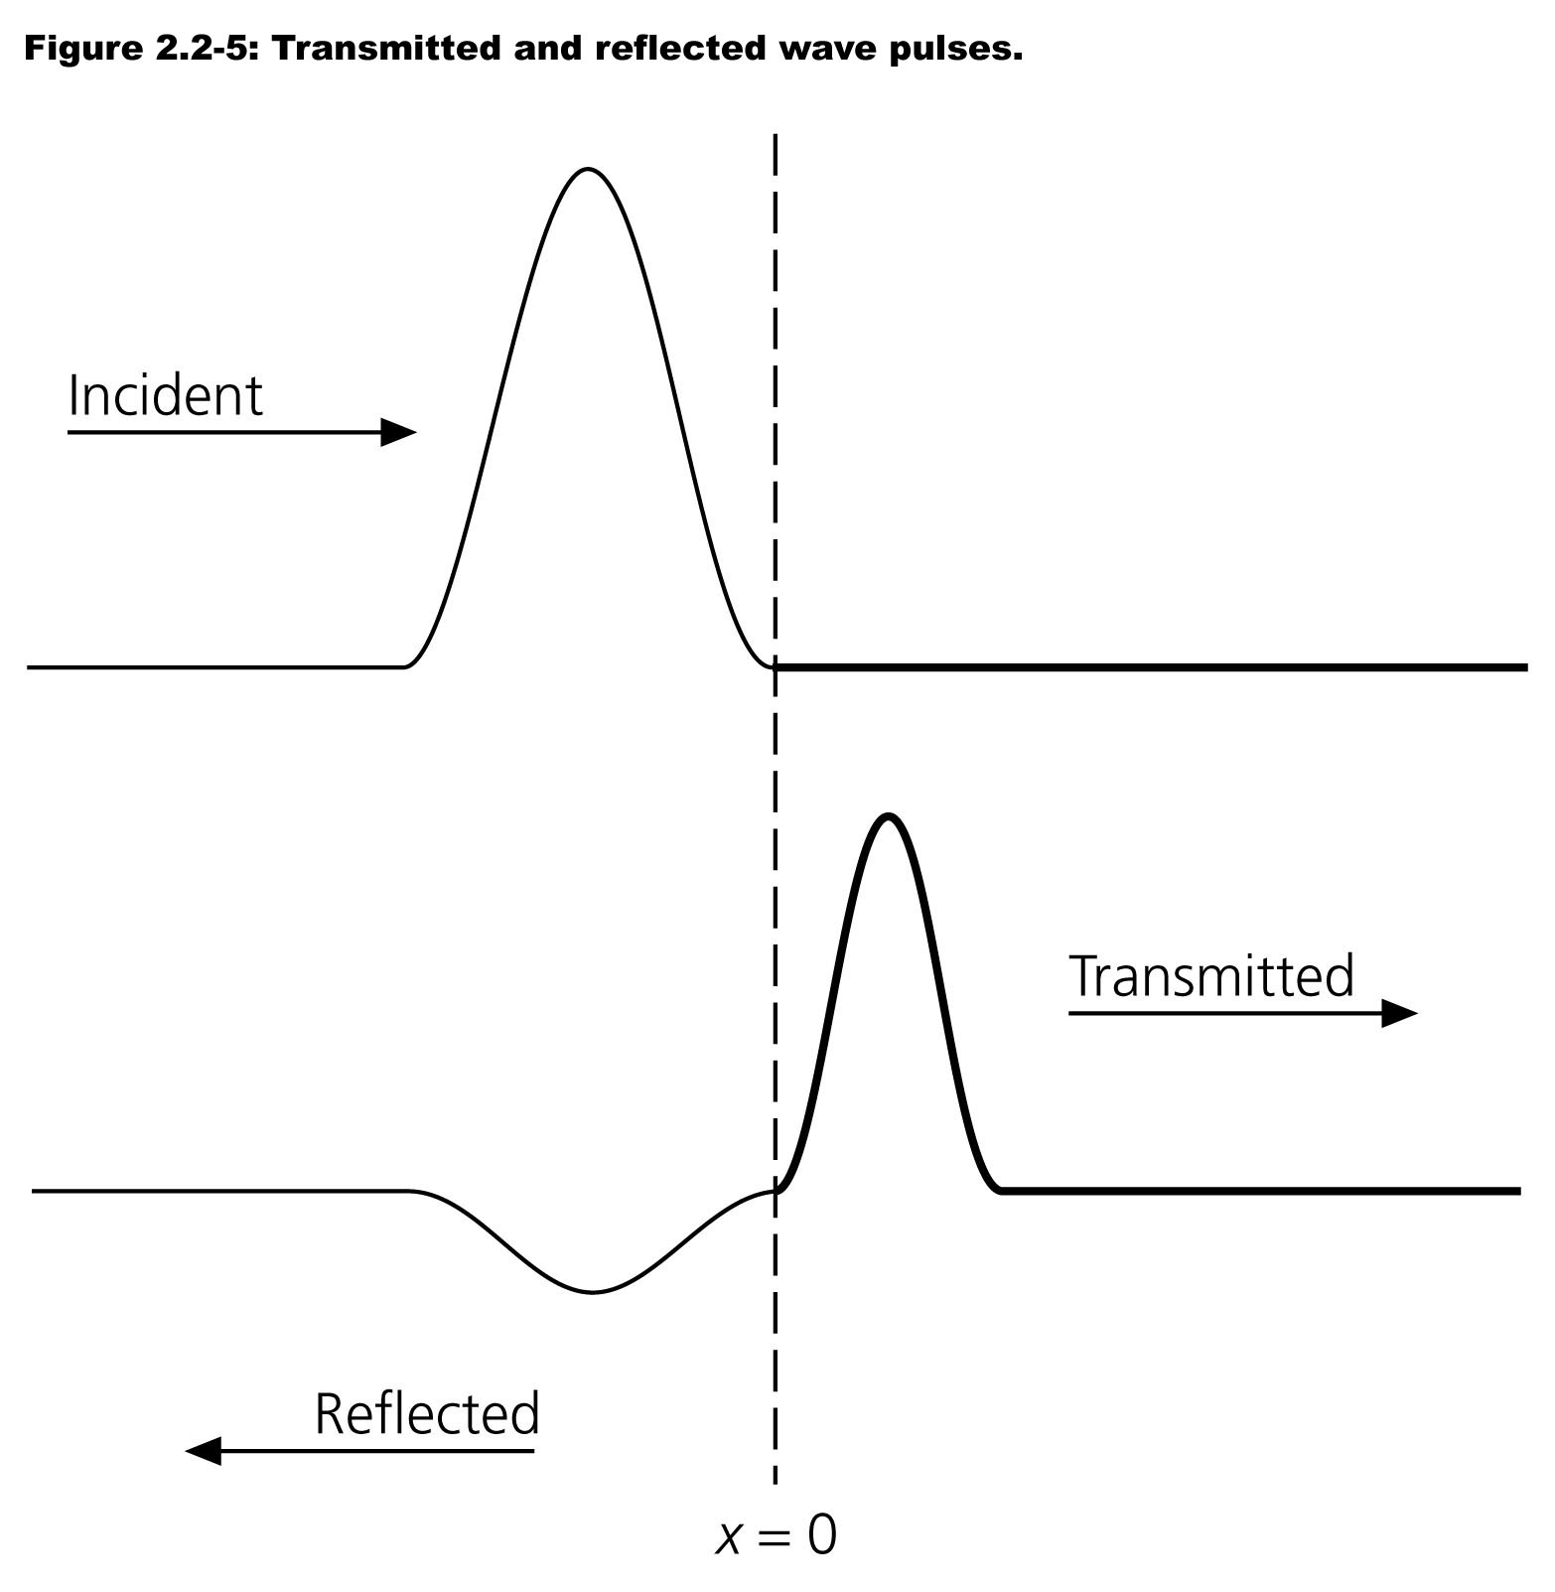
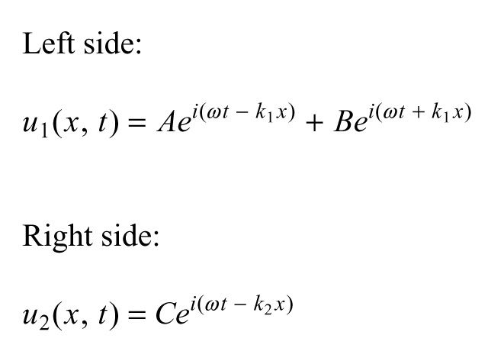
Notes:
What happens at ends (fixed, or free), or change in properties of string?
Tensiin still same everywhere along string.
Get reflection and transmission where properties change.
Heavier, more dense string goes slower, width of pulse gets shorter.
If side entering is slower, reflection is inverted.

Slide 12
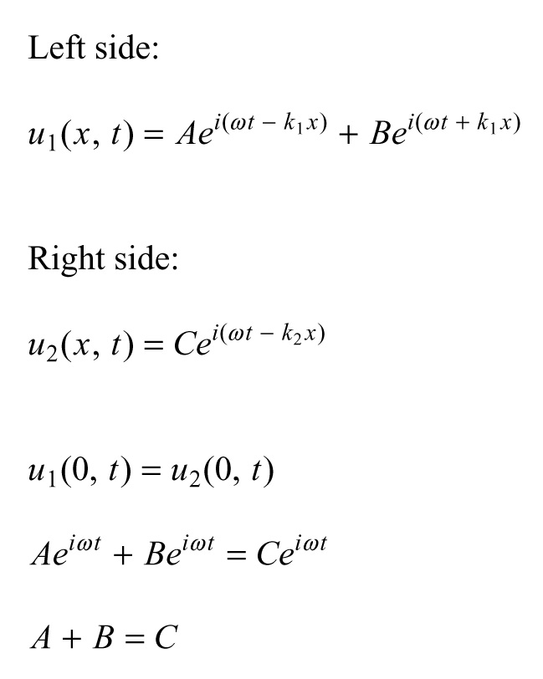
Notes:
Have to consider 3 waves at junction – incident, reflected, and transitted.
They each have an amplitude
A in incoming wave is has some amplitude and energy.
Have to find amplitudes for the reflected and transmitted waves.

Slide 13
Notes:
We also have to consider “boundary” conditions
If the string does not break, then the sum of the amplitudes of the incident and reflected waves have to equal the amlitude of and transmitted wave.
Is always 0 at the ends (vor all time)

Slide 14
Notes:
Setting the left and right sides equal (string is not broken) and bringing the exponents together we find A+B=C

Slide 15
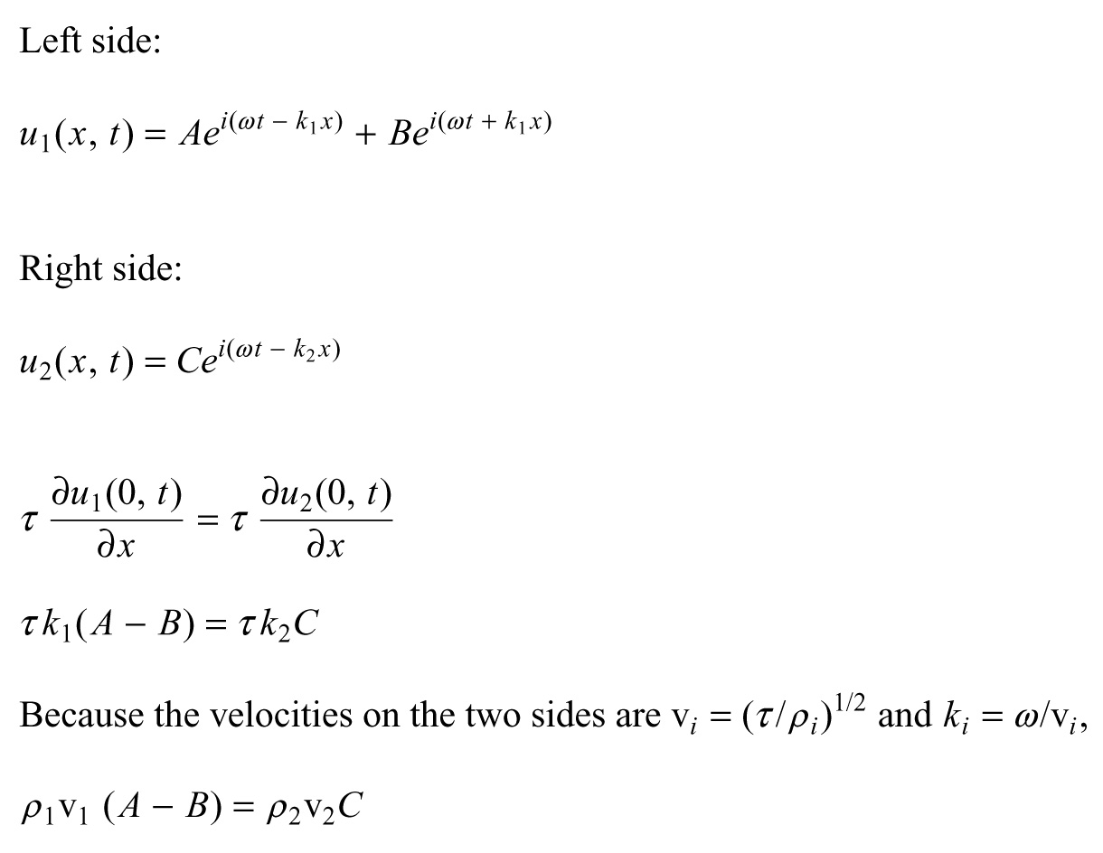
Notes:
Now we move onto the other conditions – that it has to be differentiable (no sharp changes in slope)

Slide 16
Notes:
We return to the vertical, restoring forces. Again the tension is the same.

Slide 17
Notes:
The tau’s cancel, put in the ki=w/vi (w is the same for both segments) to get equation in terms of density and velocity

Slide 18
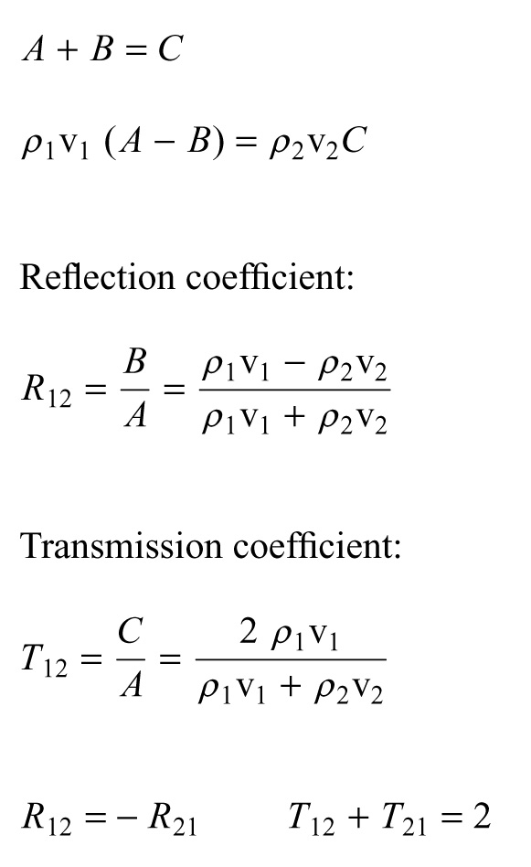
Notes:
To get the reflection and transmission coefficients

Slide 19
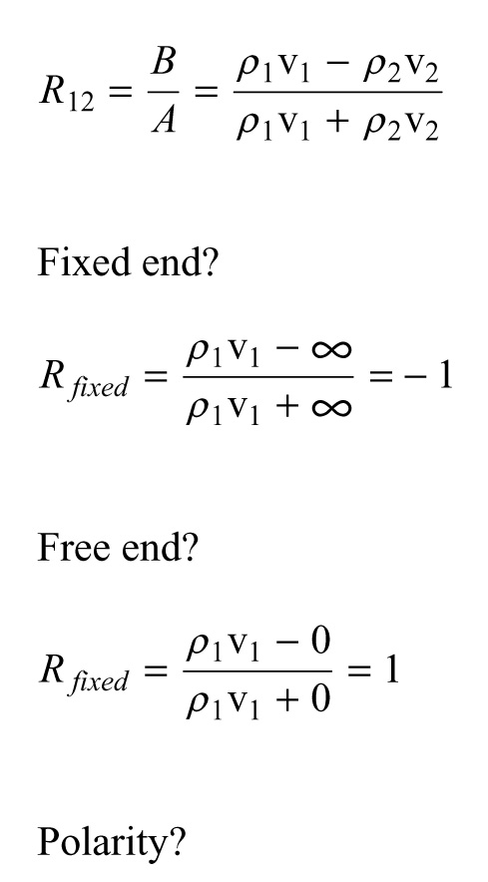
Notes:
For the reflection coefficients we therefore have

Slide 20
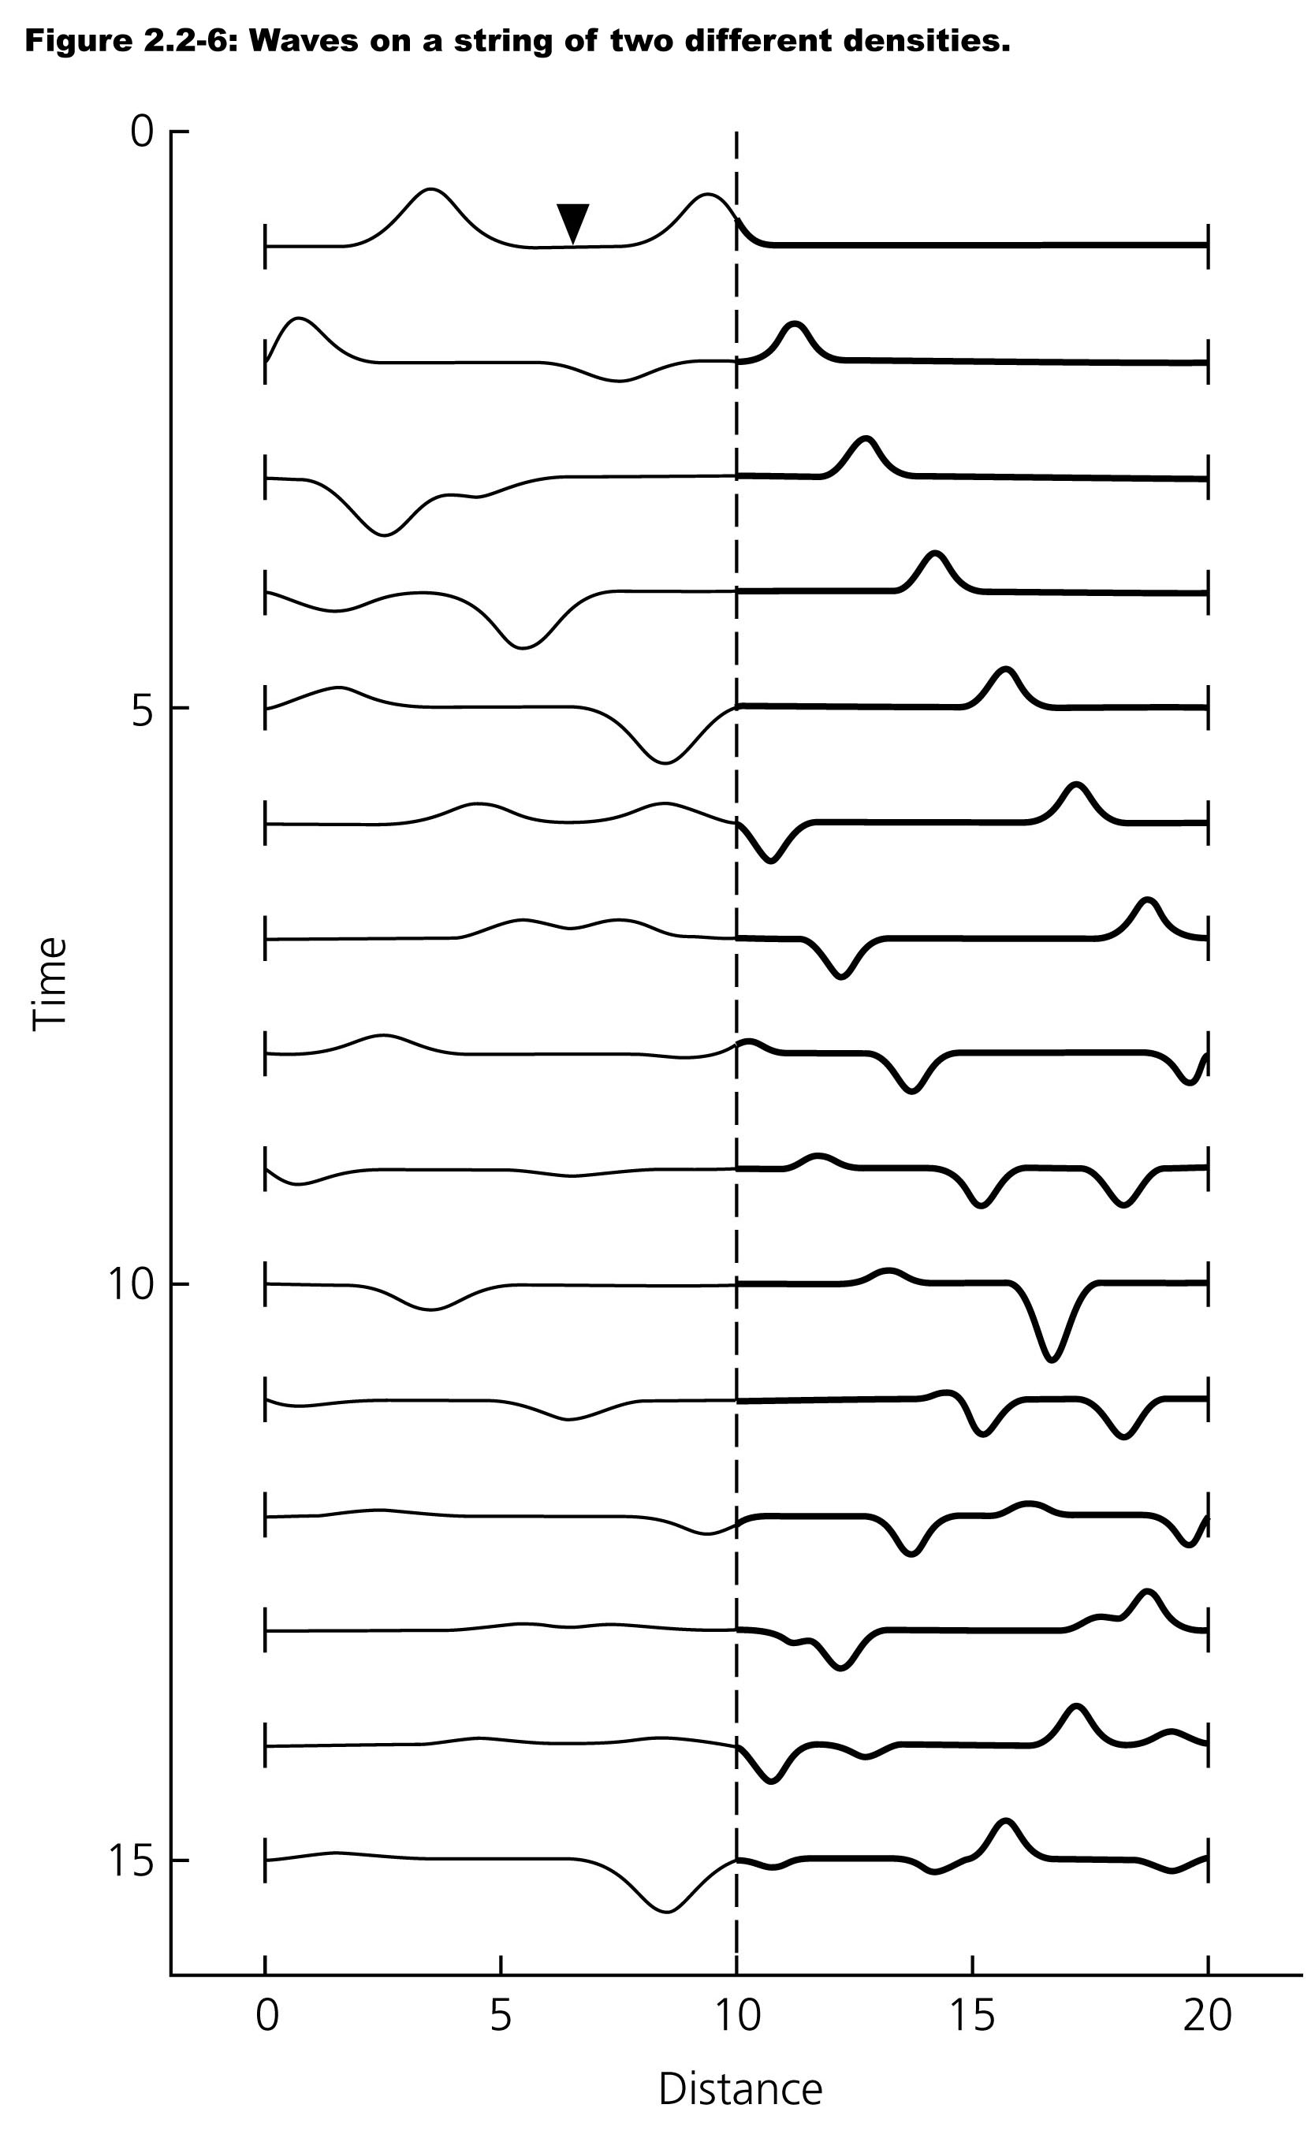

Slide 21
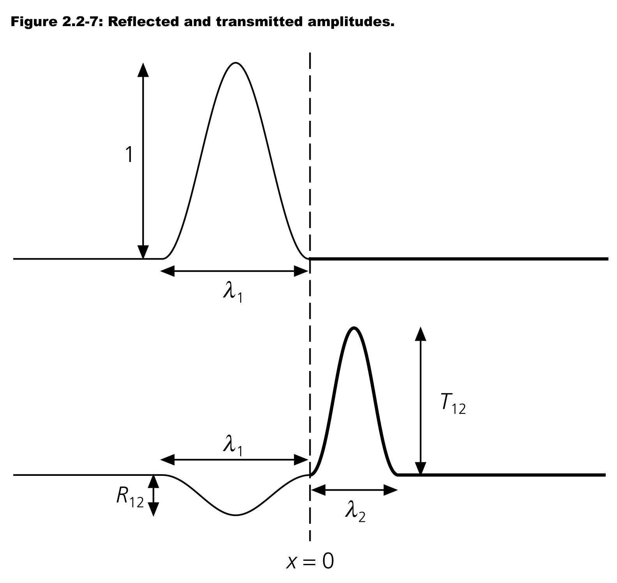

Slide 22
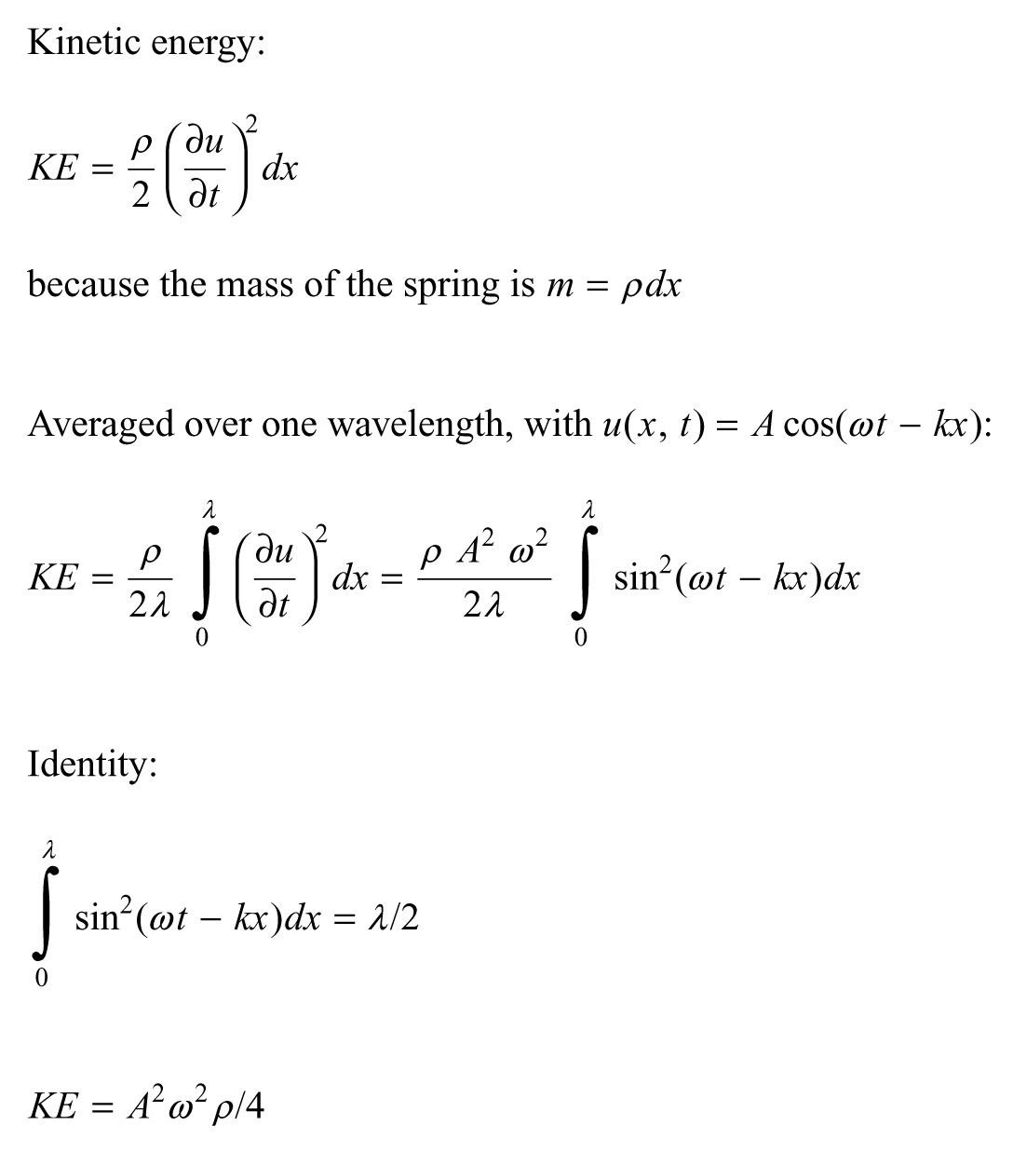

Slide 26
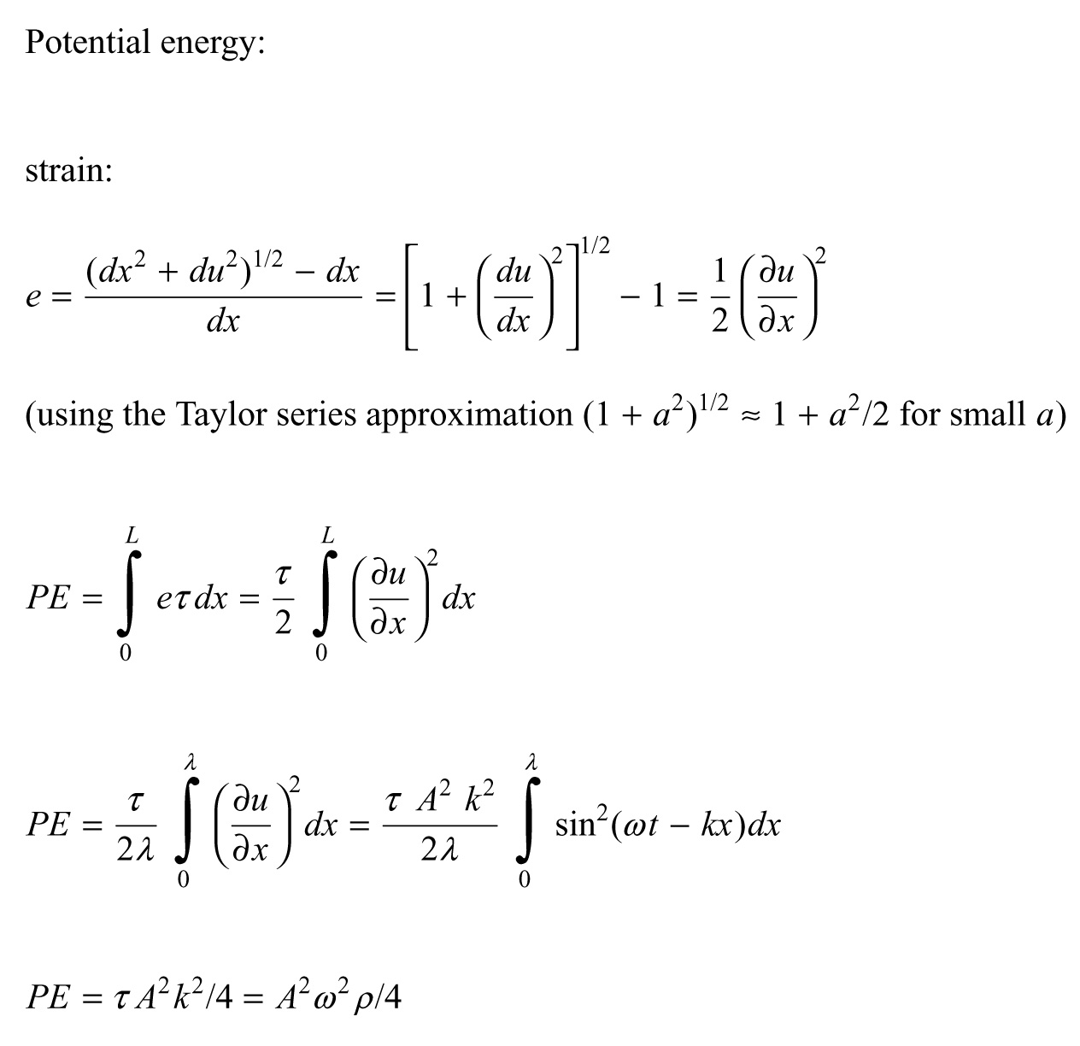

Slide 30
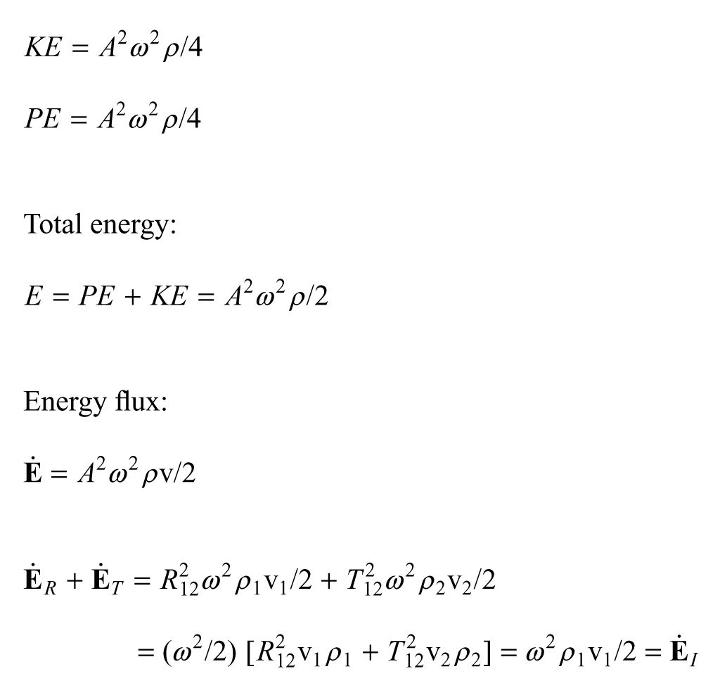

Slide 33
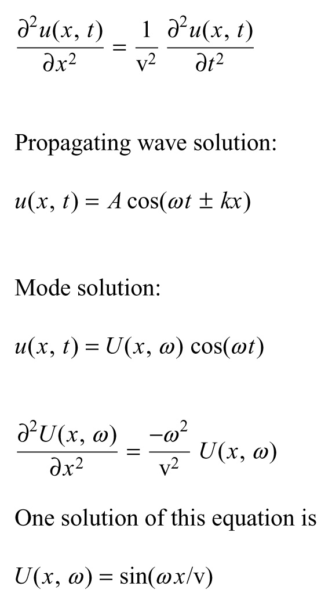

Slide 37
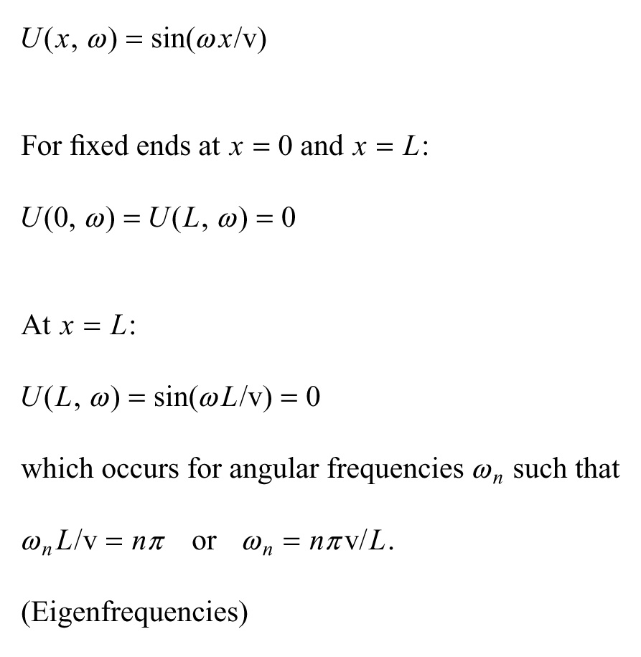

Slide 39
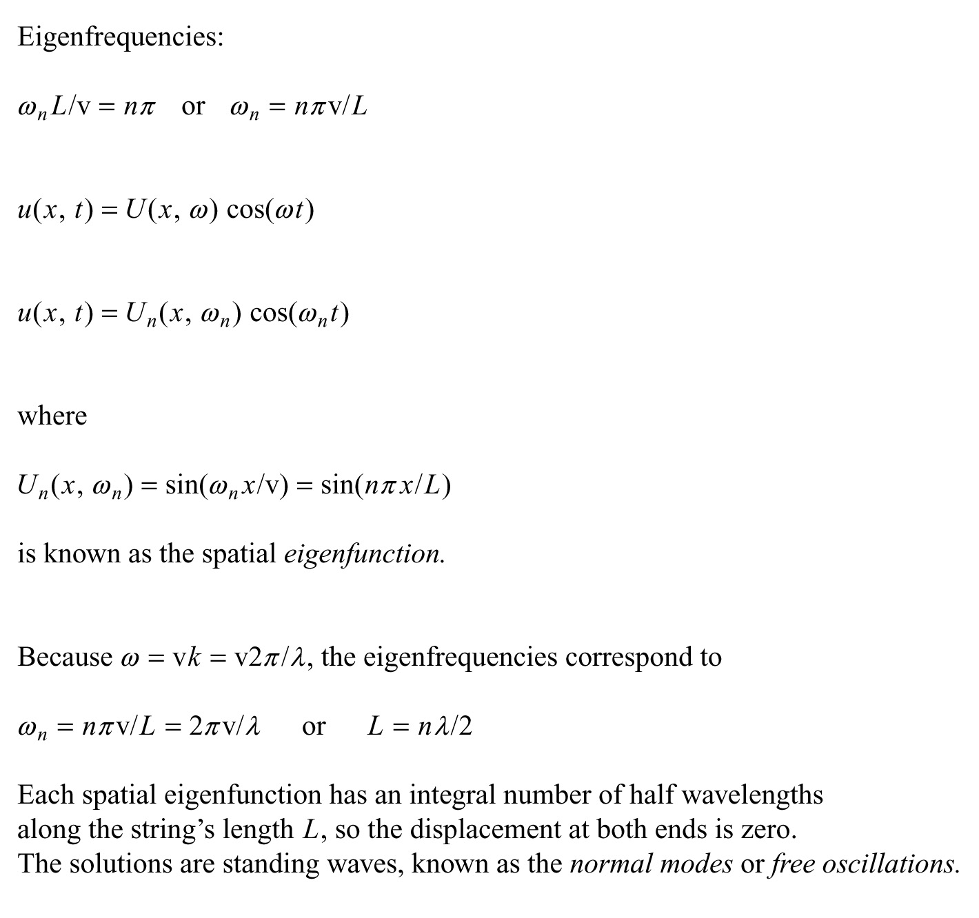

Slide 43
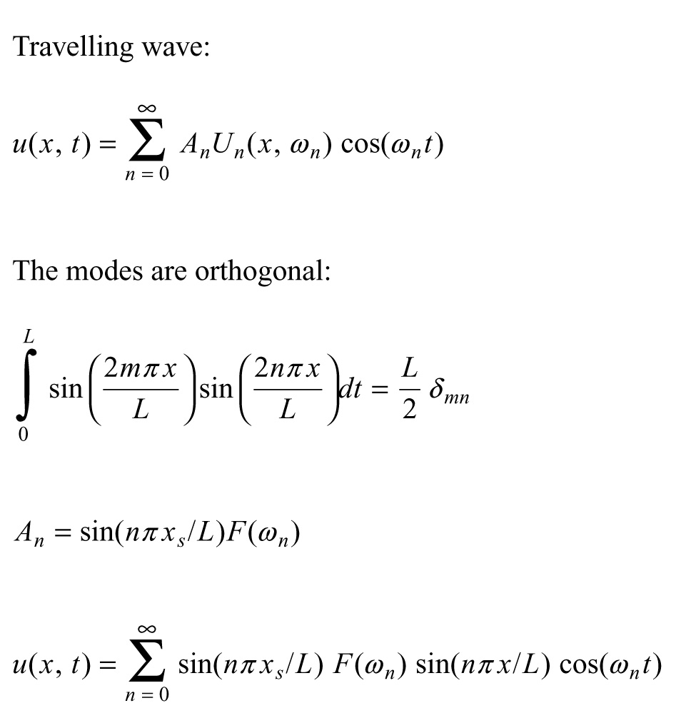

Slide 46
