Slide 1
CERI-8104 Data Analysis in Geophysics
Dr. Robert (Bob) Smalley
3892 Central Ave, Room 103
rsmalley@memphis.edu 678-4929
Fall 2023
Tu & Th 11:20 am -12:45 pm
Meeting 25 Tue. Nov 28, 2023
CERI New/Long Building: Student Computer Lab
Class webpage to be announced.
My homepage (has older versions of the course)
http://www.ceri.memphis.edu/people/smalley/

Slide 2

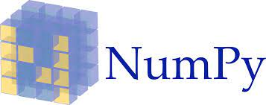

Python Modules for Scientific Computing

Slide 3

Function:
Python lets us define and use our own functions which we can use anywhere in our program.
One such example is the add() function .

Slide 4
Method:
A method is a piece of code that is associated with an object (e.g. Python Class) and operates upon the data of that object.
In most respects, a method is identical to a function.

Slide 5
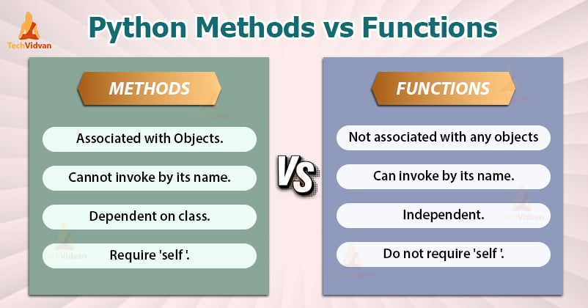
Python Methods vs Functions – What really differentiates them?
Both have one sole purpose in life, to perform some operation.
And both can return some value.
While they are effectively the same, they are not exactly the same.
Notes:
https://techvidvan.com/tutorials/python-methods-vs-functions/

Slide 6
Python Functions
A function is a series of steps executed as a single unit and “encapsulated” under a single name.
It is a group of statements capable of performing some tasks.
A function in a program can take arguments (that is, the data to operate on) and can optionally return some data after performing the intended task.
Creating a function is basically giving your computer well-defined instructions to perform a task.
You create a function using def myfunctionname followed by indented code, end it by ending the indent.
Notes:
https://techvidvan.com/tutorials/python-methods-vs-functions/

Slide 7
Python Methods
Objects in object-oriented programming have attributes, i.e. data values within them.
But how do we access these attribute values?
We access them through methods.
Notes:
https://techvidvan.com/tutorials/python-methods-vs-functions/

Slide 8
Methods represent the behavior of an Object.
A method is a piece of code that is associated with an object and operates upon the data of that object.
In most respects, a method is identical to a function.
Except for two major differences:
It is associated with an object and we call it ‘on’ that object.
It operates on the data which is contained within the class.
(Recall that class is a template and object is an instance of a class)
Notes:
https://techvidvan.com/tutorials/python-methods-vs-functions/

Slide 9
Since a method is associated with an object, defining and creating a method is little different from defining functions:
We always define a method inside a class.
A method definition always includes ‘self’ as its first parameter.
And lastly, we call a method on an object using the dot operator.
Notes:
https://techvidvan.com/tutorials/python-methods-vs-functions/

Slide 10
Difference between Python Methods vs Functions
METHODS | FUNCTIONS
Methods definitions are always present inside a class. | We don’t need a class to define a function.
Methods are associated with the objects of the class they belong to. | Functions are not associated with any object.
A method is called ‘on’ an object. We cannot invoke it just by its name | We can invoke a function just by its name.
Methods can operate on the data of the object they associate with | Functions operate on the data you pass to them as arguments.
Methods are dependent on the class they belong to. | Functions are independent entities in a program.
A method requires to have ‘self’ as its first argument. | Functions do not require any ‘self’ argument. They can have zero or more arguments.
Notes:
https://techvidvan.com/tutorials/python-methods-vs-functions/

Slide 11
In summary
Methods and Functions are like those two very similar options that appear in your Multiple Choice Questions.
They both appear to be similar when you see them but have key differences in what they actually are.
In a nutshell, both methods and functions perform tasks and may return some value.
But the difference lies in the fact that methods are ‘associated’ with objects, while functions are not.
Notes:
https://techvidvan.com/tutorials/python-methods-vs-functions/

Slide 12
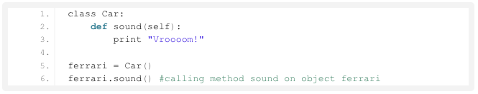
Note that Class names are commonly started with upper case letters, while methods and functions start with lowercase letters.

Slide 13
Module:
Python has a way to put definitions in a file and use them in a script or interactive instance in the interpreter.
Such a file is called a module; definitions from a module can be imported into other modules.
A module may be simply a compilation of several functions in a separate file.
A module is a file containing Python definitions and statements.

Slide 14
Library: - refers to reusable set of modules
Library and Package are essentially used synonymously for Python, but libraries may refer to several packages: e.g. Python’s scientific computing library may refer to NumPy, Matplotlib and SciPy

Slide 15
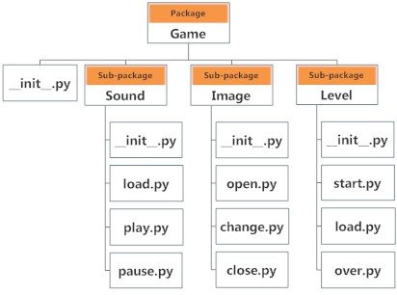

Slide 16
Ways to import modules
>>> import numpy.
>>> import numpy as np
>>> from numpy import array
>>> from numpy import *
Standard Import, dot notation to call functions in module numpy.XXXX
Import w/ alias, dot notation to call functions in module np.XXXX
Import only one function, call by name
Import all functions from module, call by name
Notes:
Have seen before

Slide 17
Loading Data Files
numpy.loadtxt
numpy.loadtxt(fname, comments='#', delimiter=None, converters=None, skiprows=0, usecols=None, unpack=False, ndmin=0, encoding='bytes', max_rows=None)
Load data from a text file.
Each row in the text file must have the same number of values.
numpy.genfromtxt
numpy.genfromtxt(fname, dtype=<class 'float'>, comments='#', delimiter=None, skip_header=0, skip_footer=0, converters=None, missing_values=None, filling_values=None, usecols=None, names=None)
Load data from a text file, with missing values handled as specified.
Each line past the first skip_header lines is split at the delimiter character, and characters following the comments character are discarded.
import scipy.io
scipy.io.loadmat( fname)
scipy.io.savemat( fname, py_dict)

Slide 18
Datetime module
from datetime import datetime, timedelta
t1 = datetime( 2019, 1, 3, 0, 0, 0)
t2 = datetime( 2019, 2, 3, 0, 0,0)
t3 = datetime( 2019, 1, 4, 6, 0, 0)
>>>print( t3-t1)
1 day, 6:00:00
>>>print( t2-t1)
31 days, 0:00:00
>>>(t2-t1).days, (t3-t1).seconds, (t3-t1).seconds/3600
31, 21600, 6.0
https://www.geeksforgeeks.org/python-datetime-module/

Slide 19
numpy array (method) attributes
Notes:
https://www.datacamp.com/tutorial/python-numpy-tutorial

Slide 20
Let's look at arrays
Arrays hold & represent any regular data in a structured way.
import numpy as np
# Define a 1D array
my_array = np.array([1, 2, 3, 4],
dtype=np.int64)
# Define a 2D array
my_2d_array = np.array([[1, 2, 3, 4],
[5, 6, 7, 8]],
dtype=np.int64)
# Define a 3D array
my_3d_array = np.array([[[1, 2, 3, 4],
[5, 6, 7, 8]],
[[1, 2, 3, 4],
[9, 10, 11, 12]]],
dtype=np.int64)
Notes:
https://www.datacamp.com/tutorial/python-numpy-tutorial

Slide 21
On a structural level, an array is basically nothing but pointers.
It’s a combination of a memory address, a data type, a shape, and strides:
The data pointer indicates the memory address of the first byte in the array.
The data type or dtype pointer describes the kind of elements that are contained within the array.
The shape indicates the shape of the array.
Notes:
https://www.datacamp.com/tutorial/python-numpy-tutorial

Slide 22
The strides are the number of bytes that should be skipped in memory to go to the next element.
If your strides are (10,1), you need to proceed one byte to get to the next column and 10 bytes to locate the next row.
In addition to the data, an array therefore contains information about the raw data, how to locate an element, and how to interpret an element.
Notes:
https://www.datacamp.com/tutorial/python-numpy-tutorial

Slide 23
Look at the arrays
# Print the 1D array
print("Printing my_array:")
print(my_array)
# Print the 2D array
print("Printing my_2d_array:")
print(my_2d_array)
# Print the 3D array
print("Printing my_3d_array:")
print(my_3d_array)
Printing my_array:
[1 2 3 4]
Printing my_2d_array:
[[1 2 3 4]
[5 6 7 8]]
Printing my_3d_array:
[[[ 1 2 3 4]
[ 5 6 7 8]]
[[ 1 2 3 4]
[ 9 10 11 12]]]
Notes:
https://www.datacamp.com/tutorial/python-numpy-tutorial

Slide 24
Now we try some of the (method) attributes
# Print out memory address
print(my_2d_array.data)
# Print out the shape of `my_array`
print(my_2d_array.shape)
# Print out the data type of `my_array`
print(my_2d_array.dtype)
# Print out the stride of `my_array`
print(my_2d_array.strides)
<memory at 0x12e4a32b0>
(2, 4)
int64
(32, 8)
Producing
Notes:
https://www.datacamp.com/tutorial/python-numpy-tutorial

Slide 25
Go through 'numpy_examples.py'

