Slide 1
CERI-8104 Data Analysis in Geophysics
Dr. Robert (Bob) Smalley
3892 Central Ave, Room 103
rsmalley@memphis.edu 678-4929
Fall 2023
Tu & Th 11:20 am -12:45 pm
Meeting 23 Tue. Nov 14, 2023
CERI New/Long Building: Student Computer Lab
Class webpage to be announced.
My homepage (has older versions of the course)
http://www.ceri.memphis.edu/people/smalley/

Slide 2
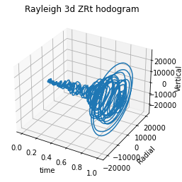
Continuing from last time.
Using the time to add a third dimension to see time evolution of the signal.

Slide 3
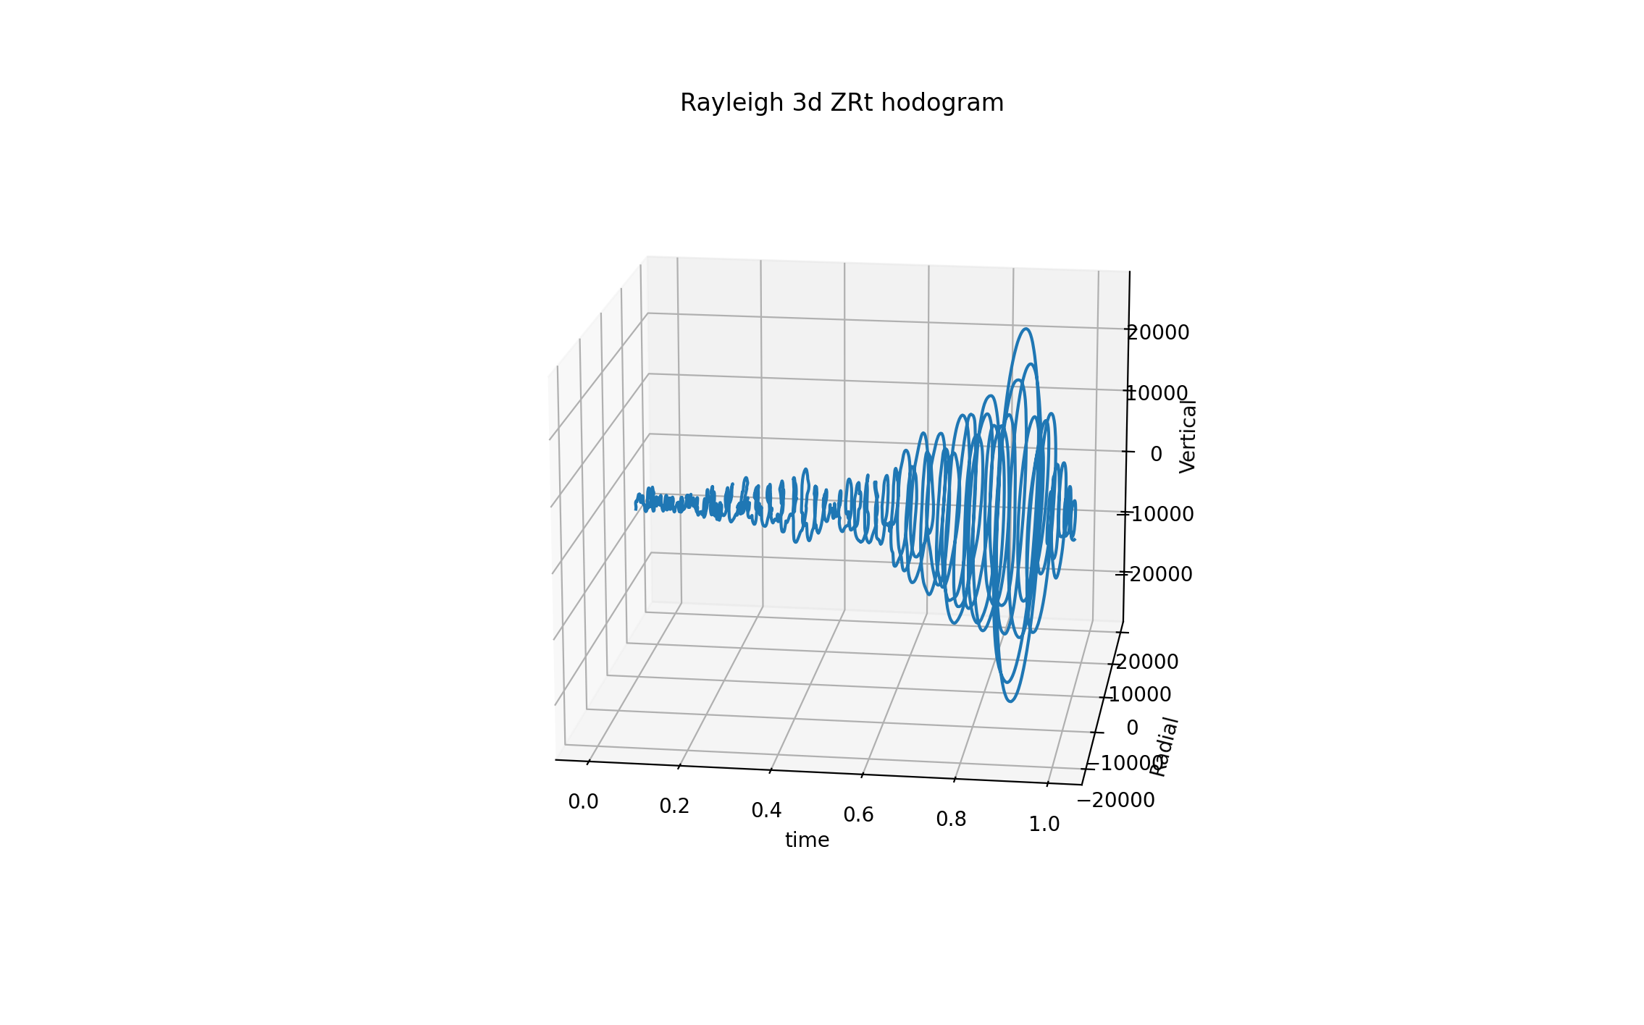
View from different angle to see return to center.
Needs the color also.
This and last image show some problems with python labeling. Not as professional as GMT.

Slide 4
Rest of class spent trying to make environment and install pygmt and then execute simple pygmt scripts.
Example codes are at
pygmt examples

Slide 5
First example from
global land-and-water map
import pygmt
fig = pygmt.Figure()
# Make a global Mollweide map with automatic ticks
fig.basemap(region="g", projection="W15c", frame=True)
# Plot the land as light gray, and the water as sky blue
fig.coast(land="#666666", water="skyblue")
fig.show()
pygmt is "Modern Mode" only.

Slide 6
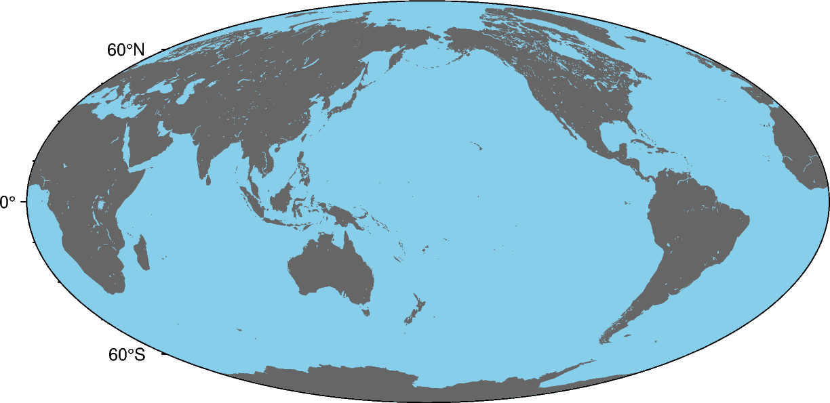
4 lines of code on previous page produces this plot

