Slide 1
CERI-8104 Data Analysis in Geophysics
Dr. Robert (Bob) Smalley
3892 Central Ave, Room 103
rsmalley@memphis.edu 678-4929
Fall 2023
Tu & Th 11:20 am -12:45 pm
Meeting 22 Mon. Nov 13, 2023
CERI New/Long Building: Student Computer Lab
Class webpage to be announced.
My homepage (has older versions of the course)
http://www.ceri.memphis.edu/people/smalley/

Slide 2
Continuing with where to get data programmatically
https://docs.obspy.org/packages/obspy.clients.fdsn.html
from obspy.clients.fdsn.header import URL_MAPPINGS
for key in sorted(URL_MAPPINGS.keys()):
print("{0:<11} {1}".format(key, URL_MAPPINGS[key]))
AUSPASS http://auspass.edu.au
BGR http://eida.bgr.de
EIDA http://eida-federator.ethz.ch
EMSC http://www.seismicportal.eu
ETH http://eida.ethz.ch
GEOFON http://geofon.gfz-potsdam.de
GEONET http://service.geonet.org.nz
GFZ http://geofon.gfz-potsdam.de
ICGC http://ws.icgc.cat
IESDMC http://batsws.earth.sinica.edu.tw
INGV http://webservices.ingv.it
IPGP http://ws.ipgp.fr
IRIS http://service.iris.edu
IRISPH5 http://service.iris.edu
ISC http://isc-mirror.iris.washington.edu
KNMI http://rdsa.knmi.nl
KOERI http://eida.koeri.boun.edu.tr
LMU http://erde.geophysik.uni-muenchen.de
NCEDC https://service.ncedc.org
NIEP http://eida-sc3.infp.ro
NOA http://eida.gein.noa.gr
ODC http://www.orfeus-eu.org
ORFEUS http://www.orfeus-eu.org
RASPISHAKE https://fdsnws.raspberryshakedata.com
RESIF http://ws.resif.fr
RESIFPH5 http://ph5ws.resif.fr
SCEDC http://service.scedc.caltech.edu
TEXNET http://rtserve.beg.utexas.edu
UIB-NORSAR http://eida.geo.uib.no
USGS http://earthquake.usgs.gov
USP http://sismo.iag.usp.br

Slide 3
Getting stations that may be operational during earthquake of interest (here Maule, Chile, M8.8, 2010-02-27 06:34:13 UTC)
https://docs.obspy.org/packages/autogen/obspy.clients.fdsn.client.Client.get_stations.html
from obspy import UTCDateTime
from obspy.clients.fdsn import Client
client = Client()
starttime = UTCDateTime("2010-02-27T00:00:00")
endtime = UTCDateTime("2010-02-27T23:59:59")
inventory = client.get_stations(network="IU", station="C*",
starttime=starttime, endtime=endtime)

Slide 4
Getting stations that may be operational during earthquake of interest (here Maule, Chile, M8.8, 2010-02-27 06:34:13 UTC)
https://docs.obspy.org/packages/autogen/obspy.clients.fdsn.client.Client.get_stations.html
print(inventory)
Inventory created at 2023-11-13T16:00:10.634700Z
Created by: IRIS WEB SERVICE: fdsnws-station | version: 1.1.52 http://service.iris.edu/fdsnws/station/1/query?starttime=2010-02-...
Sending institution: IRIS-DMC (IRIS-DMC)
Contains:
Networks (1):
IU
Stations (6):
IU.CASY (Casey, Antarctica)
IU.CCM (Cathedral Cave, Missouri, USA)
IU.CHTO (Chiang Mai, Thailand)
IU.COLA (College Outpost, Alaska, USA)
IU.COR (Corvallis, Oregon, USA)
IU.CTAO (Charters Towers, Australia)
Channels (0):)
#shows CCM as being operational during Maule eq, but it is NOT,
#Wilber search at SAGE/IRIS offers CCM but comes up with NO DATA

Slide 5
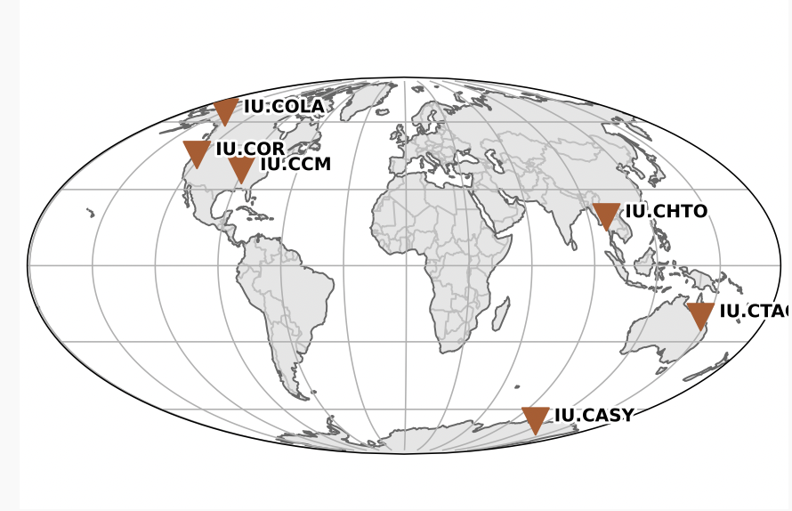
Getting stations that may be operational during earthquake of interest (here Maule, Chile, M8.8, 2010-02-27 06:34:13 UTC)
https://docs.obspy.org/packages/autogen/obspy.clients.fdsn.client.Client.get_stations.html
inventory.plot(outfile="MauleStnCxxList.ps")
#shows CCM as being operational during Maule eq, but it is NOT,
#Wilber search at SAGE/IRIS offers CCM but comes up with NO DATA
Makes map

Slide 6
Get data from IRIS, plot velocity seismogram, remove instrument response, plot displacement seismogram
"""
modified from https://docs.obspy.org/packages/autogen/obspy.clients.fdsn.client.Client.get_waveforms.html
"""
from obspy.clients.fdsn import Client
from obspy import UTCDateTime
t = UTCDateTime("2012-12-14T10:36:01.6Z")
st3 = client.get_waveforms("TA", "E42A", "*", "BH?", t+300, t+400,attach_response=True)
st3.plot()
st3.remove_response(output="DISP") #exmple has VEL, but is vel seismogram!!! no change
st3.plot()
st3.plot(outfile="displacement seismogram.ps")

Slide 7
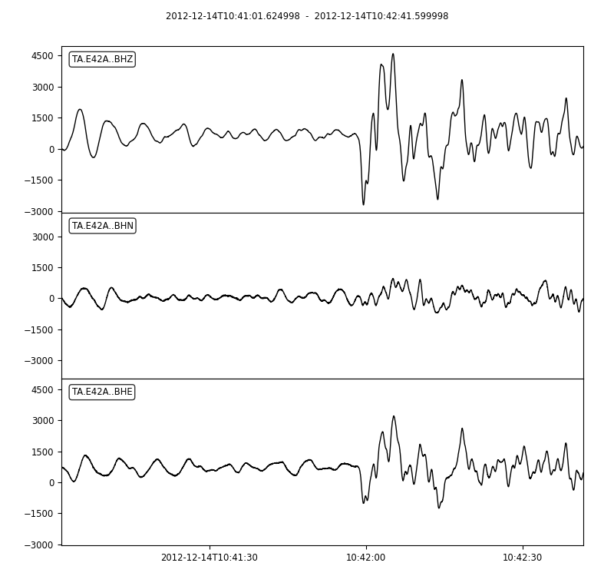
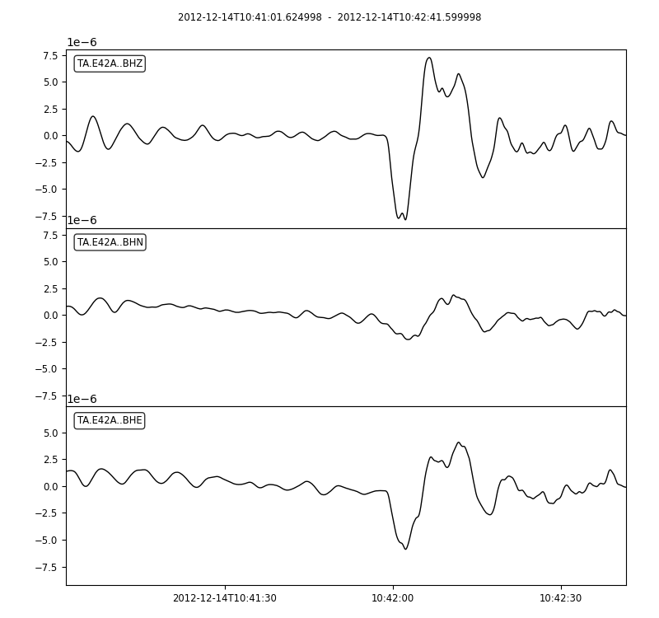
Velocity seismogram (left)
Displacement seismogram (right)
Notes:
The velocity and displacement seismograms here look different.

Slide 8
Another example, this time surface waves
from obspy import UTCDateTime
from obspy.clients.fdsn import Client
client = Client()
#t = UTCDateTime("1991-10-19T21:23:14") #event time, this for whole event
#drn=120 #duration in minutes
t = UTCDateTime("1991-10-19T22:12:00") #rayleigh wave only
drn=25 #duration in minutes
st = client.get_waveforms("IU", "CCM","*" , "BHZ", t, t + drn * 60, attach_response=True)
st.plot()
st.plot(outfile="india velocity seismogram.png")
st_irr=st.copy() #instrument response is done "in-place", trashes original, make copy
st_irr.remove_response(output="DISP")
st_irr.plot()
st_irr.plot(outfile="india displacement seismogram.png")

Slide 9
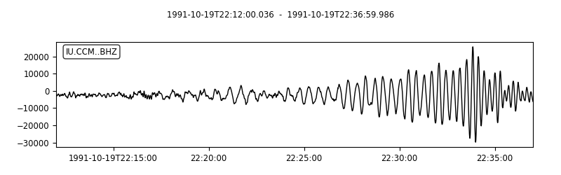
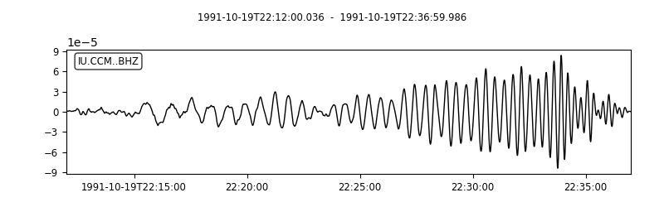
Velocity seismogram
Displacement seismogram
Notes:
Here they look very similar – since "sinusoidal" the derivative or integral just changes from sine to cosine and changes amplitudes

Slide 10
https://dobspy.clients.fdsn - FDSN web service client for ObsPyocs.obspy.org/packages/obspy.clients.fdsn.html
obspy.clients.fdsn.client.Client.get_stations
obspy.clients.fdsn.client.Client.get_waveforms
obspy.core.stream.Stream.trim
obspy.core.stream.Stream.detrend
https://docs.obspy.org/packages/autogen/obspy.core.trace.Trace.remove_response.html
obspy.core.stream.Stream.rotate
Notes:
Trim so only processing what you need – keeps noise outside window of interest from interfering with analysis
Maybe detrend before removing instrument response, remove response does some cleanup stuff
Remove the instrument response (if you need to) before rotating as the individual horizontal seismometers may be different

Slide 11
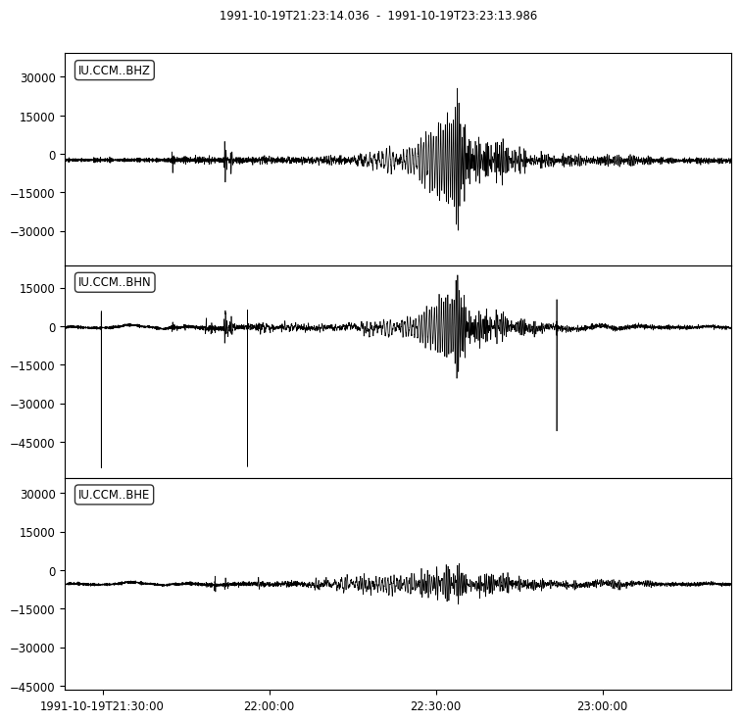
Earthquake in N. India along Himalayan front recorded at broadband station CCM in Missouri ~100° distant with a back azimuth of ~N (10° off) so it is naturally polarized.
Path is mostly continental showing continental Rayleigh and Love wave dispersion.

Slide 12
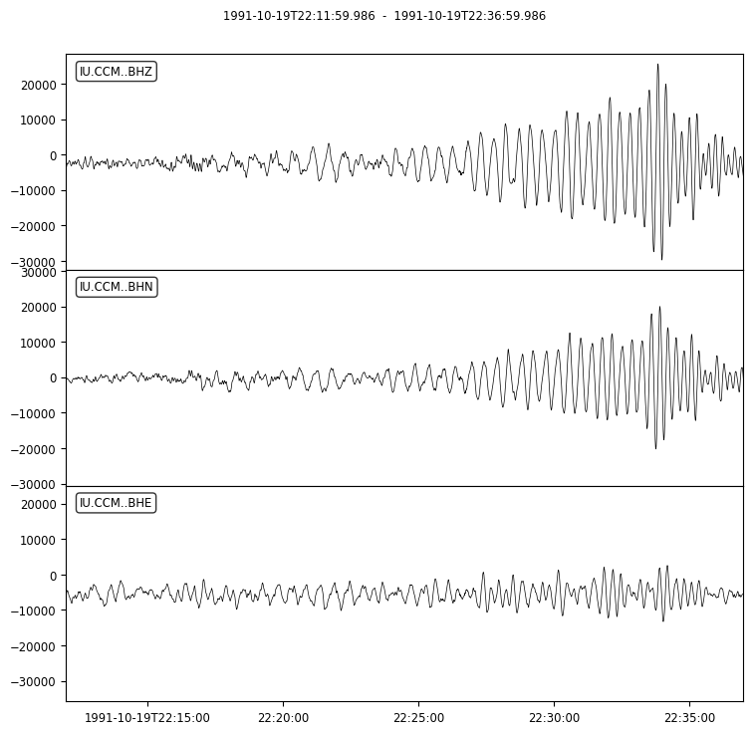
Zoom (trim) into the section with the Rayleigh wave

Slide 13

Slight improvement after rotation to great circle back azimuth.

Slide 14
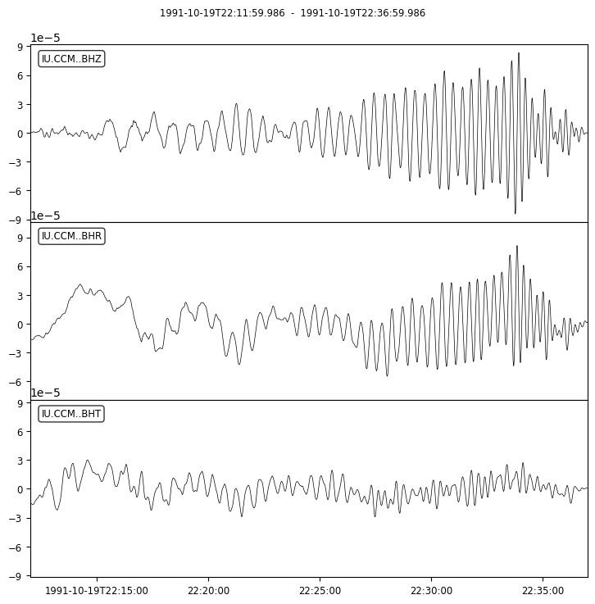
Removal of instrument response to displacement.
Needs "tweaking"
Vertical is OK, horizontals (typically) need some form of drift correction (long period oscillations on R and T look correlated, and inconsistent with polarization directions, suggesting they are not from the earthquake)

Slide 15
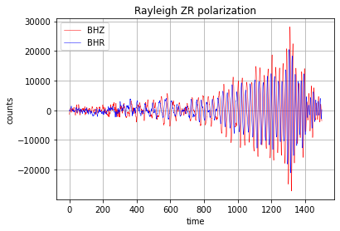
Radial (x) vs Vertical (y) showing 90° shift between them in the retrograde elliptical particle motion of Rayleigh waves.

Slide 16
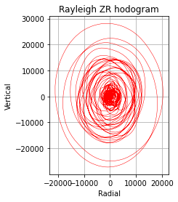
Elliptical particle motion of Rayleigh wave.
Pattern starts in the center (small signal before arrival of Rayleigh wave) and returns to center (back to where started after passage of surface wave – waves do not permanently displace the medium in which they travel)

Slide 17
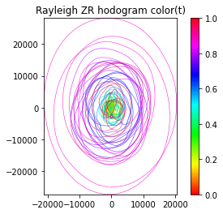
Same plot with color added to show the time evolution.
Can see it grow out of center and return.

Slide 18
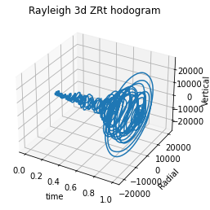
Using the time to add a third dimension to see time evolution of the signal.

Slide 19
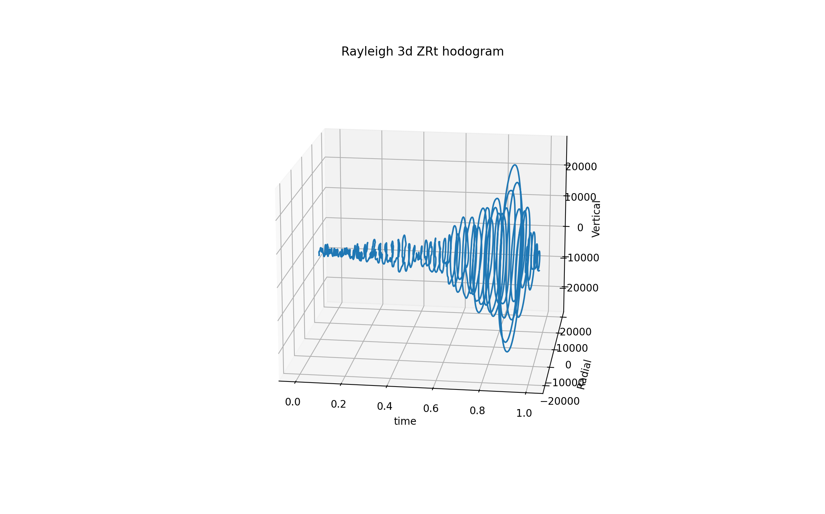
View from different angle to see return to center.
Needs the color also.
This and last image show some problems with python labeling. Not as professional as GMT.

