Slide 1
CERI-8104 Data Analysis in Geophysics
Dr. Robert (Bob) Smalley
3892 Central Ave, Room 103
rsmalley@memphis.edu 678-4929
Fall 2023
Tu & Th 11:20 am -12:45 pm
Meeting 21 Thu. Nov 9, 2023
CERI New/Long Building: Student Computer Lab
Class webpage to be announced.
My homepage (has older versions of the course)
http://www.ceri.memphis.edu/people/smalley/

Slide 2
How to find earthquake data
Search for earthquakes that meet specified conditions at
USGS earthquake catalog search
Returns information interactively or in a number of different file formats (interactive map and list, csv, kml, QuakeML, GeoJSON)

Slide 3
How to find earthquake data
Search for earthquakes that meet specified conditions at
SAGE (IRIS) Wilber
An interactive GUI interface with powerful tools to quickly and simply select seismic stations with data on "events" (generally earthquakes, but also has many other seismic sources).
There are also programmatic methods to suck up large amounts of data (including continuous for noise correlation studies).
Returns data in several, selectable, standard formats (e.g. sac, mseed and others)

Slide 4

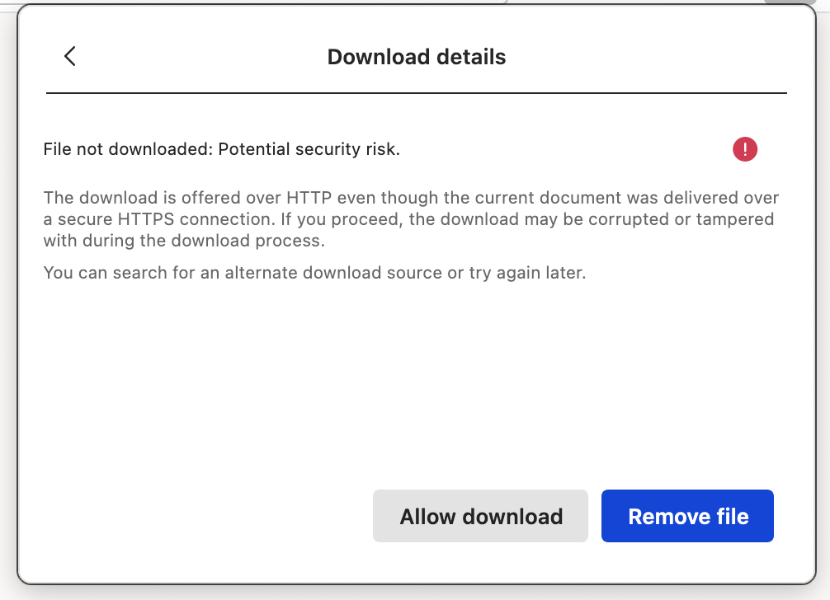
Note – Outlook and other email programs oftentimes block downloading of zip, gzipped tar, exe, and other binary files as they can be a security risk.
Click on the red dot on the warning,
then Allow download on the Download details box that comes up.
It is safe to do this as you requested this file and you can trust the sender.

Slide 5
How to find earthquake data
SAC files are the easiest to work with if you are processing the data yourself in MATLAB, Fortran, etc.
The data consists of a "stream" (data that's flowing, a sequence of data that's made available over time).
The stream is the continuous, uniformly sampled (no missing data) output of a seismometer.
The SAC file also has a header that gives the metadata such as sample rate, station location, earthquake location, distance in delta and km, forward and backward azimuths, etc.

Slide 6
How to find earthquake data
Getting a quick look, and simple processing, is easy to do in SAC if you have SAC files.
SAC is pretty powerful, but is not really up to processing "big data" sets.
It has a full suite of digital passive seismic (as opposed to active such as seismic reflection) data processing tools, but shows (suffers from) the limitations of the hardware that was available when it was written in the late 70's/early 80's.

Slide 7
How to find earthquake data
Getting seismic data (usually or default in mseed files) programmatically with PYTHON.
We will do this next time

Slide 8
How to find earthquake data
How to use Google Earth to find earthquake/station pairs that meet specified requirements such as being naturally polarized, having a specified path, etc.

Slide 9
How to find earthquake data
Download data using the Obspy package in Python
See example file

Slide 10
What is in the stream object?
print(dir(myStream))
'append',
'attach_response',
'copy',
'decimate',
'detrend',
'differentiate',
'filter',
'integrate',
List of attributes of myStream instance of stream object, with its data (traces), and methods (all the rest)
'interpolate',
'max',
'normalize',
'plot',
'remove_response',
'resample',
'reverse',
'rotate',
'select',
'simulate',
'slice',
'spectrogram',
'taper',
'traces',
'trim',
'write'

