Slide 1
CERI-8104 Data Analysis in Geophysics
Dr. Robert (Bob) Smalley
3892 Central Ave, Room 103
rsmalley@memphis.edu 678-4929
Fall 2023
Tu & Th 11:20 am -12:45 pm
Meeting 16 Tue. Oct 24, 2023
CERI New/Long Building: Student Computer Lab
Class webpage to be announced.
My homepage (has older versions of the course)
http://www.ceri.memphis.edu/people/smalley/

Slide 2
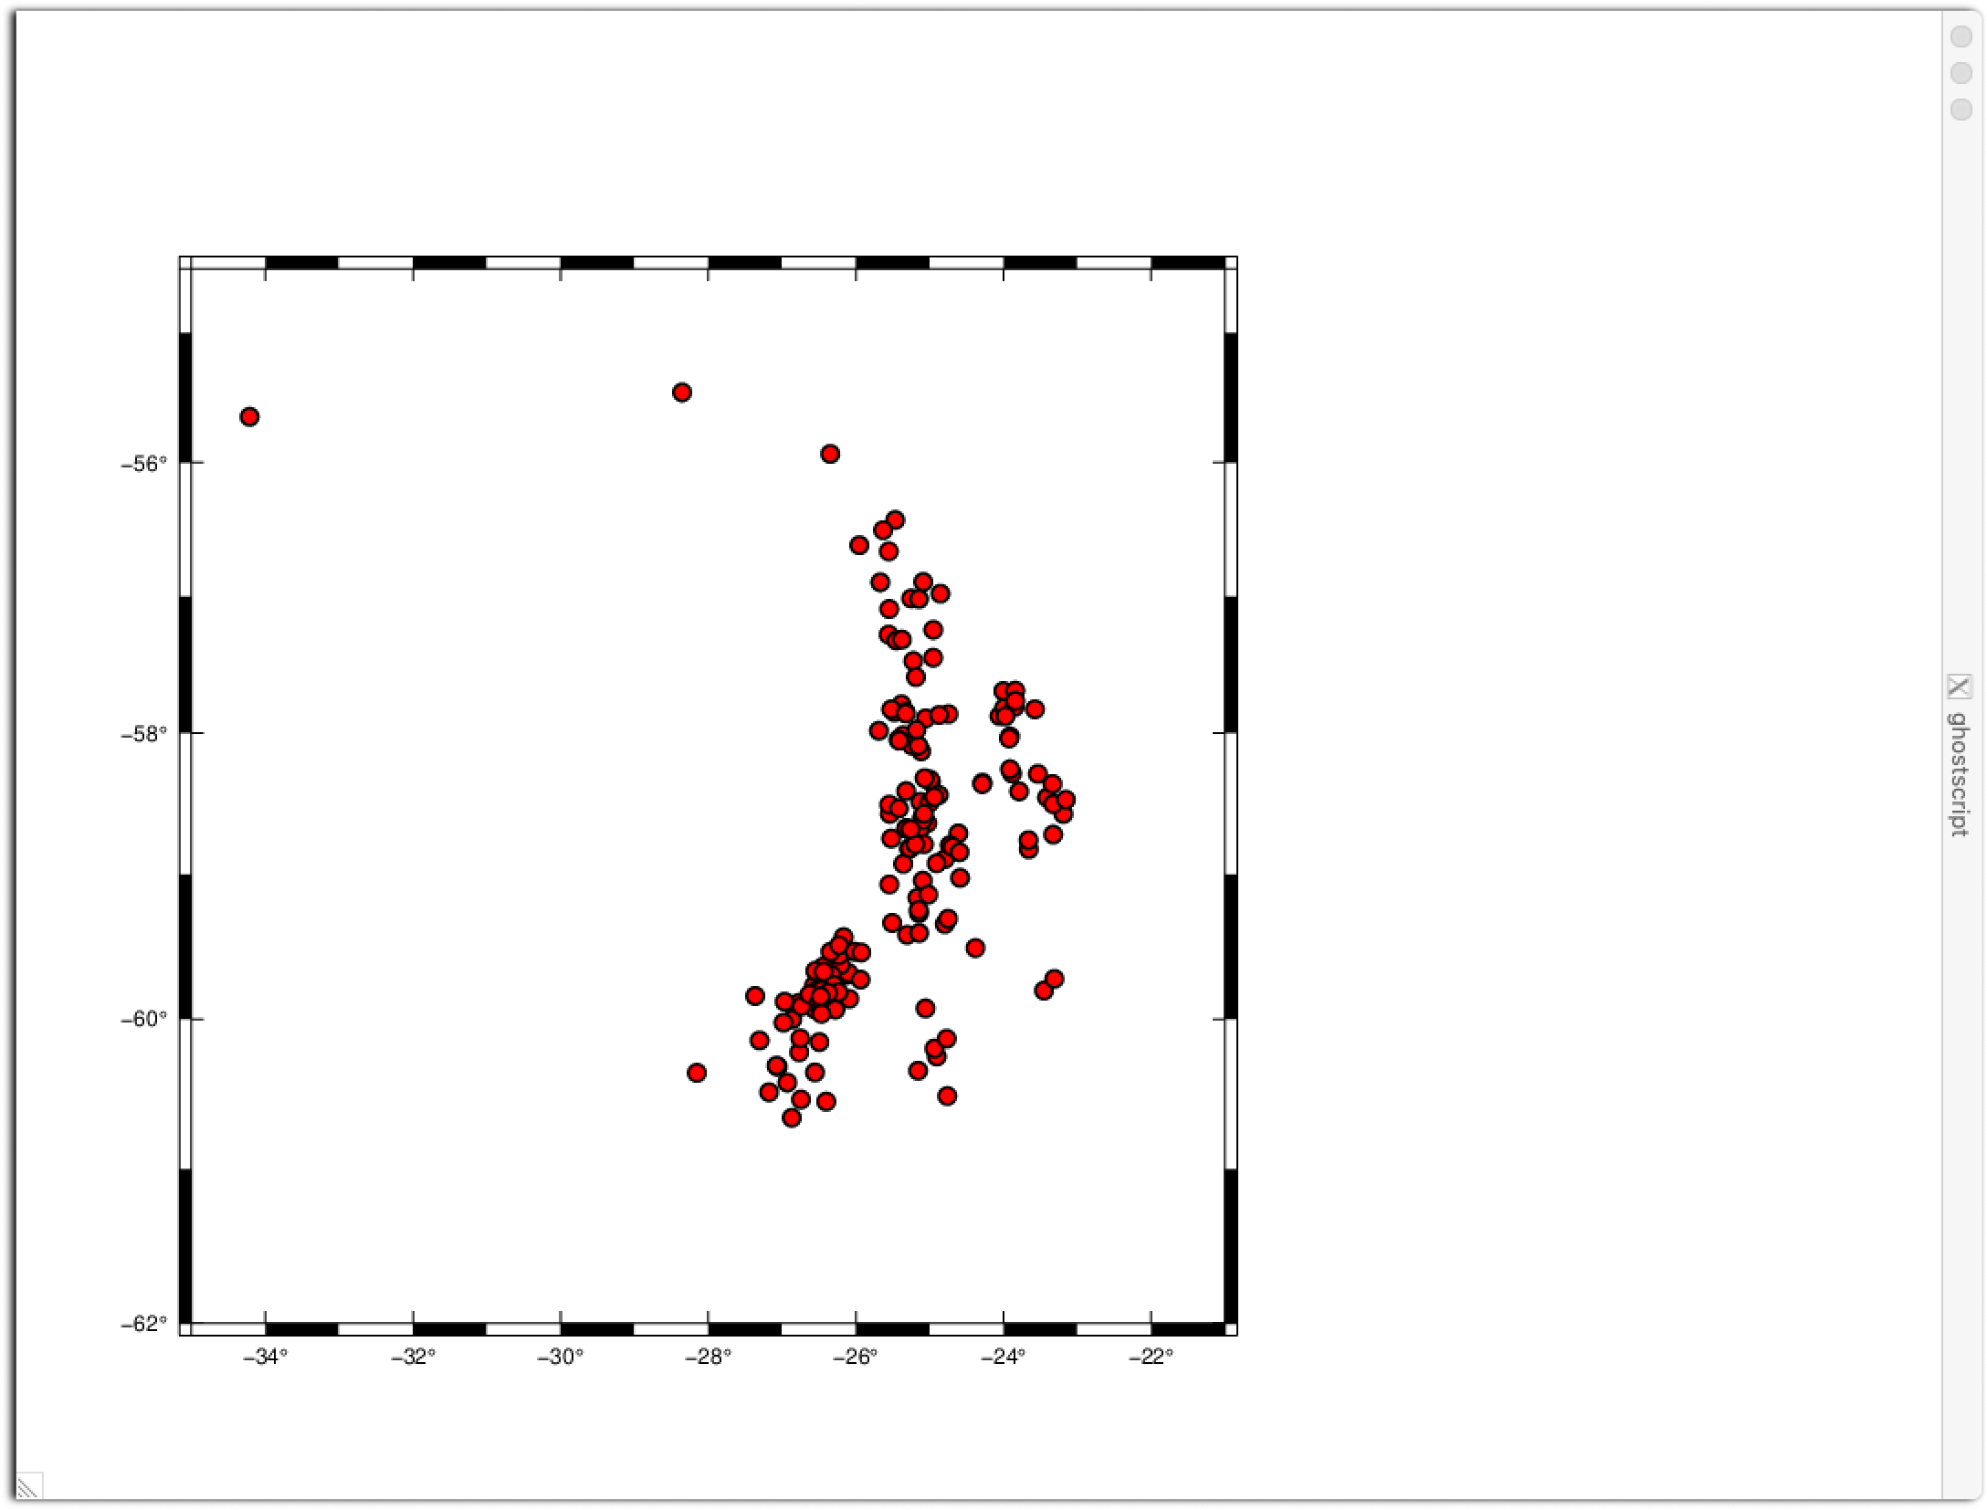
Last time we made this map with this
gmt psxy -R-35/-21/-62/-54.5 -JM15c -BWSen -Baf ssand_eqs.dat -Sc0.25c -W1,black -Gred -P > $0.p
command

Slide 3
We made the map with 1 line, albiet a pretty complicated one.
What if we wanted to plot other things – plate boundaries, faults, focal mechanisms, etc.
How do we do that?
Lets set it up so we make a basemap and then add the map features.
So now we'll have to make 2 calls, the first for the basemap and the second to plot the earthquakes.

Slide 4
We made the map with 1 line, albeit a pretty complicated one.
Now we want to make a map that is not a one liner.
Header - initialize
The figure shows the postscript file structure.
It has an initialization section
Followed by plotting commands
Followed by a closing section
and we now have the pleasure of controlling the initiallization and closing.
Plot stuff first part
Plot stuff second part
Footer - finish
Notes:
Each module that produces graphical ouput can make a plot with a one-line command, we have to turn the initializing and closing code on or off in each gmt module call.

Slide 5
As our first multiline GMT program let's make a basemap first and then plot the earthquakes.
#!/bin/bash
rm $0.ps
gmt psbasemap -R-35/-21/-62/-54.5 -JM15c -BWSen -Baf -P -Y5c -X1.5i -K > $0.ps
gmt psxy -R -J ssand_eqs.dat -Sc0.25c -W1,black -Gred -O >> $0.ps
The stuff in red is new and required.
The –K tells GMT to not do the finalization as more stuff follows.
The –O tells GMT to not do the initialization as I'm adding stuff.
The >> is standard UNIX to add the output to the file named.
The stuff in orange is new and just moves the position of the map up 5 cm and to the right 1.5 inches.
Notes:
This allows us to separate the basic map background and the data plotting. If I decide I want to plot more data, or plot focal mechanisms instead of earthquakes I only have to change the part that plots the data, not rewrite the whole command.

Slide 6
Some more UNIX stuff
It is a pain to have to keep typing in the command as we modify our shell script, so UNIX offers a number of ways to help
To rerun the last command – type "!!"
To rerun the last command that starts with a "g" type "!g<CR> "
If you have used more than one command that starts with a g then enter "!gm<CR> " or "!gmt<CR> ", etc. till it is unique.
This has worked since the birth of UNIX.
We can now also rerun commands using the arrow keys to move through the history of commands to find the one we want and then “enter”, or <CR>

Slide 7
Some more UNIX stuff
You can also reference the command history numerically
!-3<CR>
Executes the third command back in the history.
We can now also rerun commands using the arrow keys to move through the history of commands to find the one we want and then “enter”, or <CR>

Slide 8
Some more UNIX stuff
We have already introduced shell scripts – files with a “program”, as opposed to data, in them
Simplest version of a shell script would be a file with just one line
But they usually have more.

Slide 9
gmt6 psxy -R-35/-21/-62/-54.5 -JM15c -BWSen -Baf ssand_ eqs.dat -Sc0.25c -W1,black -Gred > ex1.sh.ps
To make this into a shell script –put the line above as the only line in the shell script file.
You will then have to make the file executable, which is done with the “change mode” command
Enter “chmod +x ex1.sh<CR>”
Then execute/run it. Is most likely not in your PATH, and you need to precede it with “./”
Enter “./ex1.sh” to run it, and it will make a map.

Slide 10
A bit more about standard UNIX "features"
When you run a program in UNIX, the "shell" passes the command line to the program. The shell language (zsh, sh, bash, csh, tcsh, etc) provides a way to parse the command line.
In this way, the program's behavior can be controlled or modified by the "switches"
Inside the shell script
$0 is the whole command line (0 is the name, $0 returns the value)
$1 is the first field, white space defines the breaks
$2 is the second field.
Etc.

Slide 11
So in my script, ex1.sh gets substituted for $0 and
gmt6 psxy -R-35/-21/-62/-54.5 -JM15c -BWSen -Baf ssand_eqs.dat -Sc0.25c -W1,black -Gred > $0.ps
becomes
gmt6 psxy -R-35/-21/-62/-54.5 -JM15c -BWSen -Baf ssand_eqs.dat -Sc0.25c -W1,black -Gred > ex1.sh.ps
(same as the initial example) and the output file is named ex1.sh.ps.
The output file name you give it is arbitrary. I usually use the shell script name as the “root” of the file name, so I know what shell script made the file.

Slide 12
So, ex1a.sh gets substituted into the script for $0 and
#!/bin/bash
rm $0.ps
gmt psbasemap -R-35/-21/-62/-54.5 -JM15c -BWSen -Baf -P -Y5c -X1.5i -K > $0.ps
gmt psxy -R -J ssand_eqs.dat -Sc0.25c -W1,black -Gred -O >> ${0}.ps
the output file is named ex1.sh.ps.
The output file name you give it is arbitrary.
I usually use the shell script name as the “root” of the file name, so I know what shell script made the file.
The ps tells me, but more importantly UNIX, it’s a postscript file.
Notes:
I've added curly brackets on the second one – they are unneeded here , but if there was some additional text following the variable 0 it would get strung together causing confusion.

Slide 13
Plotting just circles is great but not useful enough.
Say we want to plot the symbols such that they show the magnitude of the earthquake.
When getting earthquake data, a pretty common format is lat, long, depth, and magnitude (although our example input sets so far have geen in lon, lat for gmt).
Now we need to look at the GMT documentation.

Slide 14
psxy¶
Plot lines, polygons, and symbols in 2-D
…
Description¶
Reads (x,y) pairs from files [or standard input] and will plot lines, polygons, or symbols at those locations on a map. If a symbol is selected and no symbol size given, then it will interpret the third column of the input data as symbol size. Symbols whose size is <= 0 are skipped. If no symbols are specified then the symbol code (see -S below) must be present as last column in the input. If -S is not used, a line connecting the data points will be drawn instead. To explicitly close polygons, use -L. Select a fill with -G. If -G is set, -W will control whether the polygon outline is drawn or not. If a symbol is selected, -G and -W determines the fill and outline/no outline, respectively.

Slide 15
First thing to notice is that the symbol size is to be specified in column 3 and we want to set the size by the magnitude, which is in column 4 (column 3 has the depth).
-24.7934 -58.8957 21.73 4.8
-26.5665 -59.7692 80.92 5.2
The non-UNIX solution is to make a new input file that has the data in the correct input format.
-24.7934 -58.8957 4.8
-26.5665 -59.7692 5.2

Slide 16
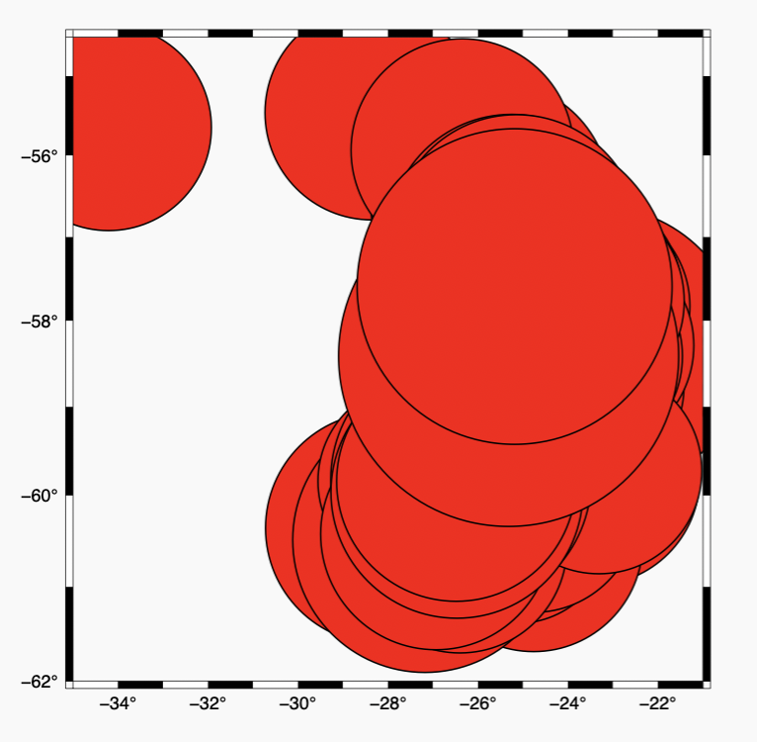
Doing that, and modifying the –S switch to –Sc
gmt psxy -R-35/-21/-62/-54.5 -JM15c -BWSen -Baf ssand_4mag.dat -Sc -W1,black -Gred -P -Y5c -X1.5i > $0.ps
We get this
Which is a good start, but needs some tweaking.

Slide 17
So it looks like we have to do something about the symbol sizes.
I could add fixing the symbol sizes to the program that remade the file to put the magnitude in column 3
or
We now introduce a new tool – awk – and use a pipe to input the data into GMT.
In its simplest use, awk reads an input file line by line and does the same thing to each line.

Slide 18
So, our one-liner becomes
awk '{print $1, $2, $4}' ssand_eqs.dat | gmt psxy -R-35/-21/-62/-54.5 -JM15c -BWSen -Baf -Sc -W1,black -Gred -P -Y5c -X1.5i > $0.ps
What does awk do?
It reads each line and prints out the 1st, 2nd and 4th columns (with the columns separated by spaces).
Also, and very important, we don't have to make a new file to send to gmt, we can pipe it in using the UNIX pipe tool "|" where standard input comes from another program.
So far we get the same output.

Slide 19
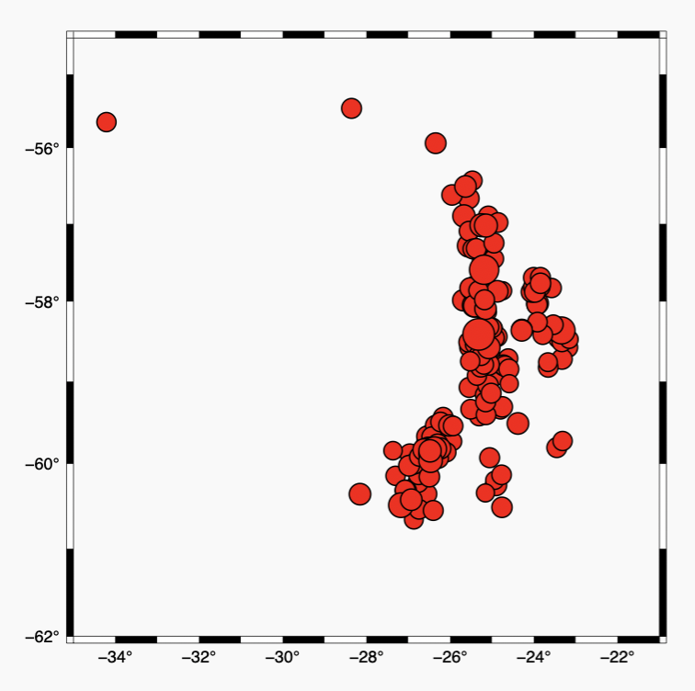
AWK, however, is a general purpose text processor and we can use it to also fix the symbol size problem.
AWK can do simple math, with trig, long, etc. functions.
Changing just the awk call we get
awk '{print $1, $2, $4/10}' ssand_eqs.dat | gmt psxy -R-35/-21/-62/-54.5 -JM15c -BWSen -Baf -Sc -W1,black -Gred -P -Y5c -X1.5i > $0.ps
Which is a lot better

Slide 20
One common source of seismic data is the USGS NEIC web page
(this is another goal of this course, how/where to find data)
Search for "neic pde"
will bring you to
https://earthquake.usgs.gov/earthquakes/search/
and it can return data in a number of formats, the most useful now being csv and kml/z.

Slide 21
The csv file that it returns looks like this!
time,latitude,longitude,depth,mag,magType,nst,gap,dmin,rms,net,id,updated,place,type,horizontalError,depthError,magError,magNst,status,locationSource,magSource
2023-10-24T10:10:07.647Z,5.798,-82.4066,10,5,mww,92,146,2.99,0.69,us,us7000l5yb,2023-10-24T10:29:54.040Z,"243 km SSW of Río Grande, Panama",earthquake,9.42,1.93,0.098,10,reviewed,us,us
1 2. 3 4 5
…
and we can use AWK to fix it
awk 'BEGIN {FS=","} {print $3, $2, $5/10}' neic_pde_ex.csv
which produces the following output
longitude latitude mag
-82.4066 5.798 0.5
The BEGIN tells awk to use the comma (instead of the space) as the field separator and the rest is the same.

Slide 22
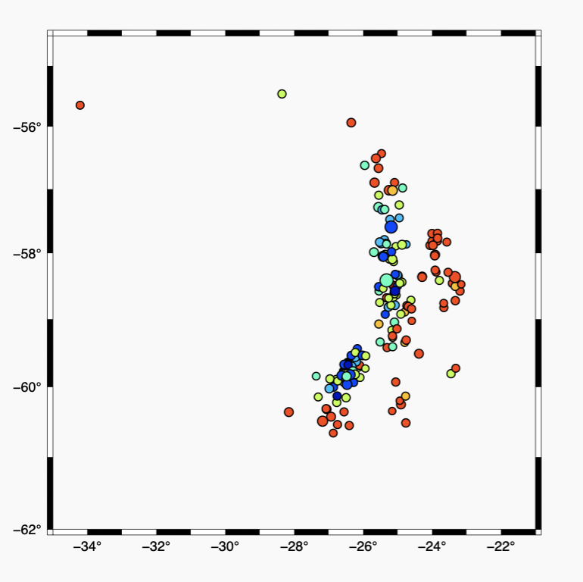
GMT also handles color, so let's color the events by their depth and size them by magnitude.
Specifing color modifies the input file strucutre (bad program design).
If -S is set, symbol fill color will be determined by the z-value in the third column. Additional fields are shifted over by one column (optional size would be 4th rather than 3rd field, etc.).
These kinds of inconveniences can be easily handled using AWK.

Slide 23
To add color, we have to give GMT a color map/table, which is done with the makecpt module of GMT, in which we scale color table to the data (-T sets this up going through the color table in 10 steps from 0 to 80 (km) in depth.
I'm also selecting the "jet" color table (GMT has "great" documentation on the commands, but is oftentimes weaker on the meta and non command docummentation)
For the moment I'm selecting these values. With a bit more programming the limits can be made automatically.
#!/usr/bin/env bash
rm $0.ps
gmt makecpt -Cjet -Ic -T0/80/10 > my.cpt

Slide 24
Now to make the map I have to tell GMT to color the data and the color table to use, both done with the –C flag/option.
We're also introducing a new way to provide input - showing how to use "standard-input" from inside a shell script (this simulates that you are entering data from the terminal).
The << END says that everything following this line, until it sees the character string "END" is going to standard-input.
Note the string to end the input can be anything you want, except something in the input.
gmt psxy -R-35/-21/-62/-54.5 -JM15c -BWSen -Baf -Sc -W1,black -Cmy.cpt -P -Y5c -X1.5i << END> $0.ps
`awk '{print $1, $2, $3, $4/10}' ssand_eqs.dat`
END

Slide 25
And to generate the input we are using the UNIX feature of command substitution.
This replaces the output of the command as if it were text in the file.
gmt psxy -R-35/-21/-62/-54.5 -JM15c -BWSen -Baf -Sc -W1,black -Cmy.cpt -P -Y5c -X1.5i << END> $0.ps
`awk '{print $1, $2, $3, $4/10}' ssand_eqs.dat`
END
It is as if I entered the output of the awk command
$ awk '{print $1, $2, $3, $4/10}' ssand_eqs.dat
-24.7934 -58.8957 21.73 0.48
-26.5665 -59.7692 80.92 0.52 …

Slide 26
This is useful if I have multiple datasets from different sources in different formats as you can repeat it.
gmt psxy -R-35/-21/-62/-54.5 -JM15c -BWSen -Baf -Sc -W1,black -Cmy.cpt -P -Y5c -X1.5i << END> $0.ps
`awk '{print $1, $2, $3, $4/10}' ssand_eqs.dat`
`process another data set and feed it to gmt`
END

Slide 27
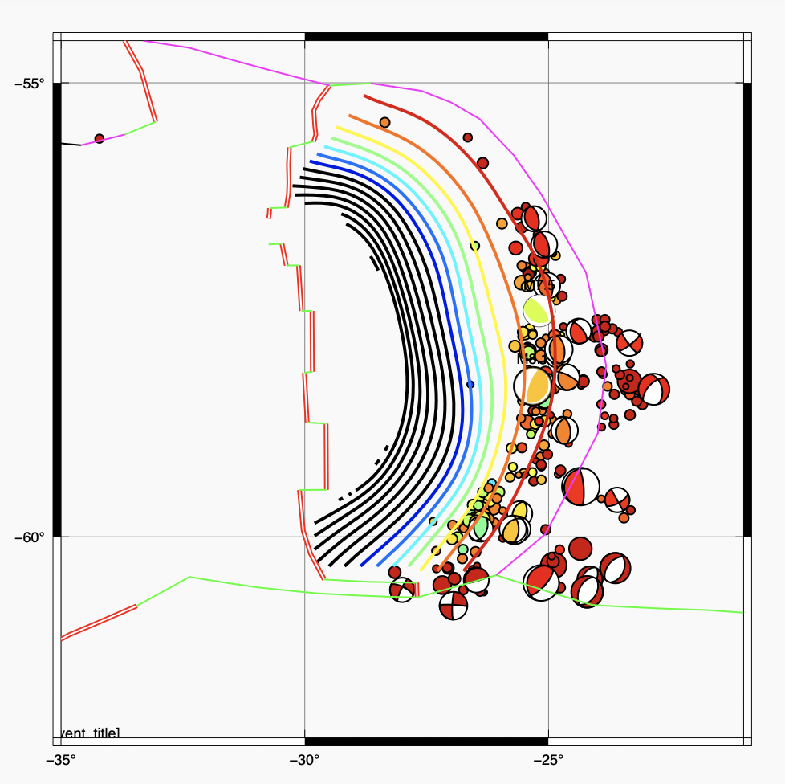
GMT can make very pretty, complex maps.
This shows the August, 2021, South Sandwich trench earthquake sequence colored by depth, showing focal mechanisms for events large enough for automatic determination of the moment tensor, the Wadati-Benioff zone depth contours, and the local plate boundaries.

Slide 28
We have been working in GMT "classic" (it has been around since the mid 1980's, it came out while I was a grad student).
There is a new version, known as GMT "modern" that has much more support for data sets, etc. that came out in the last 5 years.
Here's a basic map in the new interface (it is still command line and shell scripts).

