Slide 1
CERI-8104 Data Analysis in Geophysics
Dr. Robert (Bob) Smalley
3892 Central Ave, Room 103
rsmalley@memphis.edu 678-4929
Fall 2023
Tu & Th 11:20 am -12:45 pm
Meeting 15 Tue. Oct 19, 2023
CERI New/Long Building: Student Computer Lab
Class webpage to be announced.
My homepage (has older versions of the course)
http://www.ceri.memphis.edu/people/smalley/

Slide 2
UNIX documentation
UNIX intially had no documentation (as it was intuitive?!)
The manager at AT&T Bell Labs made the developers write a manual.
This devolved into a standard format for providing interactive documentation on (most) UNIX commands.
Introducing the man (manual) page

Slide 3
If you've had someone tell you to RTFM, depending on what software you are using, that manual might be a challenge to find.
On Linux, however, you'll find hundreds upon hundreds of manuals ready to view. (as usual UNIX is very proud of itself for this useful feature that helps the user, above propaganda from)
https://www.zdnet.com/article/what-are-man-pages-and-why-are-they-important-to-your-linux-education/
https://man7.org/linux/man-pages/man1/man.1.html

Slide 4
The structure of a man page
Man pages are all laid out with specific sections, which usually include (plus other stuff, but usually no examples as the man pages are clearly written and easy to understand):
NAME - name of command in question.
SYNOPSIS - structure of command.
DESCRIPTION - description of command.
OPTIONS - available options for command.
AUTHOR - the author.
REPORTING BUGS – how to reporting bugs to the developer(s).
COPYRIGHT - information about command license.
SEE ALSO - points to full documentation or related commands.
CONFIGURATION - configuration details for a command or device.
EXIT STATUS - possible exit status values.
Notes:
https://www.zdnet.com/article/what-are-man-pages-and-why-are-they-important-to-your-linux-education/

Slide 5
Let’s do our first programming example
We are going to use
Scenario Based Training
for the labs

Slide 6
What is Scenario-Based Training?
SBT is a training system.
  It uses a highly structured script of real world experiences to meet learning objectives in an operational environment.
System – concept is integrated throughout training.
Experiences – new and different experiences are important.
Operational environment – the real thing.

Slide 7
What is Scenario-Based Training?
Think of learning to play the piano:
  Learning to play notes on a scale is the foundation…
  …but playing a song requires constant rearrangement.

Slide 8
What is Scenario-Based Training?
Learning to program is very similar:
  Learning about program control (decision making, loops, etc.) is the foundation for writing programs.
  But writing correct, efficient programs requires combining those foundations to accomplish the specified task.

Slide 9
What is Scenario-Based Training?
SBT teaches programming in the context of what you will do in “real life" programming – i.e. by programming.
For example:
  For scientific data processing have the student plan and design programs to accomplish some specified tasks.
  Rather than just practicing each of the programming components separately.
Notes:
Tell Eniko Farkas story – write program to play hearts – was starting to write it and did not know how to play hearts!

Slide 10
We are going to cheat a bit here.
We will use the Mac GUI to create directories for now.
We will use the Mac text editor to edit files (save it as a “Unicode UTF-8 file, the default) for now.
I like to use the ”language” the script is written in as the extension (the last part of the name after the final period/dot) – here that would be “sh” or “bash”, so I use “sh”.
Open the text editor, enter “echo here I am”, and save it as “hereIam.sh”
Notes:
Unfortunate name for doing web searches

Slide 11
We now have to stop cheating and use the UNIX command line.
First - Open a terminal window.
Second go to the directory where you made the file (cd commands)
Next enter “ls –l” to see a list of the files in the directory and their properties.
We need to make the file we just created “executable”, i.e. give it permission to be run as a program.
Enter “chmod +x hereIam.sh<CR>”
Notes:
Unfortunate name for doing web searches

Slide 12
Finally run the program.
Enter “./hereIam.sh<CR>” on the command line.
It should print “here I am” in the terminal window.
NOTE --- UNIX/LINUX is CASE SENSITIVE.
In general, the Mac is not.
The Mac is case sensitive in the command line.
You have to be careful (all the time) to not name 2 files in the same directory something like “a.sh” and ”A.sh” as it will confuse OS X (you can set up your Mac so it is case sensitive – it is an option when you format the disk).
Notes:
Unfortunate name for doing web searches

Slide 13
Being seismologists - let’s make a map of earthquakes
There was a M8.1 earthquake recently in the South Sandwich subduction zone.
We are going to use a program written to produce maps and graphics in Earth Science named
“Generic Mapping Tools” or GMT
It will have features for plotting magnetic anomalies on ship tracks, focal mechanisms, faults, topography, contour lines, etc.
Notes:
Unfortunate name for doing web searches

Slide 14
So, what do we want to do
Plot some symbols on a map showing where the earthquakes happened
Notes:
Unfortunate name for doing web searches

Slide 15
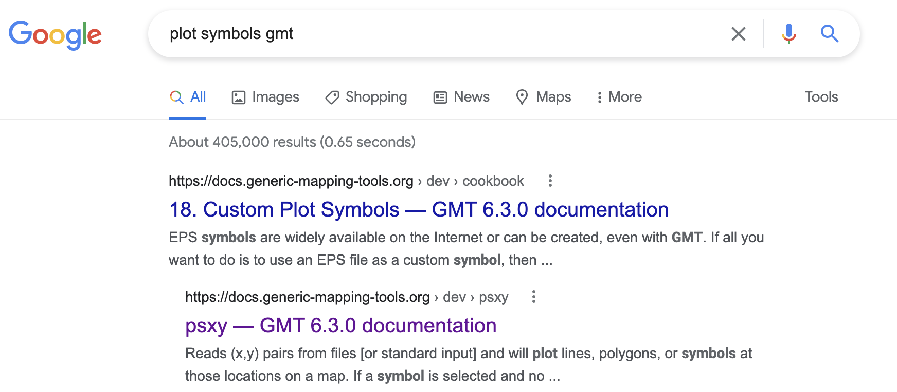
Notes:
so lets find out how to plot symbols using gmt

Slide 16
If you enter the command "gmt module_name", gmt will spit out the standard text only format UNIX man (for manual) page for the specified module.
% gmt psxy
gmt psxy [core] 6.2.0 [64-bit] - Plot lines, polygons, and symbols in 2-D
Program is gmt
Module is psxy
See for a prettier page with the same text (plus a few examples!!! and some nice color figures)
https://docs.generic-mapping-tools.org/latest/psxy.html
Notes:
This demonstrates lots of unix philosophy stuff

Slide 17
%gmt6 psxy
gmt psxy [core] 6.2.0 [64-bit] - Plot lines, polygons, and symbols in 2-D
usage: gmt psxy [<table>] -J<args> -R<west>/<east>/<south>/<north>[/<zmin>/<zmax>][+r]
[-A[m|p|x|y]] [-B<args>] [-C<cpt>] [-D<dx>/<dy>]
[-E[x|y|X|Y][+a][+c[l|f]][+n][+p<pen>][+w<width>]] [-F<arg>] [-G<fill>|+z] [-H[<scale>]]
[-I[<intens>]] [-K] [-L[+b|d|D][+xl|r|x0][+yb|t|y0][+p<pen>]] [-N[c|r]] [-O] [-P]
[-S[<symbol>][<size>]] [-T] [-U[<label>][+c][+j<just>][+o<dx>/<dy>]] [-V[<level>]]
[-W[<pen>][<attr>]] [-X[a|c|f|r]<xshift>] [-Y[a|c|f|r]<yshift>] [-Z<value>|<file>[+f|l]]
[-a<col>=<name>[,...]] [-bi[<ncol>][t][w][+l|b]] [-di<nodata>] [-e[~]<pattern>] [-f[i|o]<info>]
[-g[a]x|y|d|X|Y|D|[<col>]z<gap>[+n|p]]
[-h[i|o][<nrecs>][+c][+d][+m<segheader>][+r<remark>][+t<title>]]
[-i<cols>[+l][+d<divide>][+s<scale>][+o<offset>][,...][,t[<word>]]] [-l<label>[<mods>]]
[-p[x|y|z]<azim>[/<elev>[/<zlevel>]][+w<lon0>/<lat0>[/<z0>][+v<x0>/<y0>]]
[-q[i|o][~]<rows>[,...][+c<col>][+a|f|s]] [-t[<transp>[/<transp2>[+f][+s]]]
[-wa|y|w|d|p<period][/<phase>][+c<col>]] [-:[i|o]] [--PAR=<value>]
Usage shows all the switches (switch heaven or hell). Items in brackets “[…]” are optional, if no brackets are required.
We will not look at each switch.
Notes:
This shows the problem with switches – we are not following the paradigm of simple programs that do one thing well with no bells and whistles!! The "-" are the main swithces, the "+" are additional features.

Slide 18
gmt6 psxy -R-35/-21/-62/-54.5 -JM15c -BWSen -Baf ssand_ eqs.dat -Sc0.25c -W1,black -Gred –P > ex1.sh.ps
-R specifys coordinate range: 35°W to 21°W & 62°S to 54.5°S.
-R Specify the min/max coordinates of your data region in user units.
Use dd:mm[:ss] for regions given in arc degrees, minutes [and seconds].
Use -R<xmin/xmax/ymin/ymax>+u<unit> for regions given in projected coordinates.
with <unit> selected from e|f|k|M|n|u.
Use [yyy[-mm[-dd]]]T[hh[:mm[:ss[.xxx]]]] format for time axes.
Append +r if -R specifies the coordinates of the lower left and
upper right corners of a rectangular area.
Use -R<gridfile> to use its limits (and increments if applicable).
Use -Rg and -Rd as shorthands for -R0/360/-90/90 and -R-180/180/-90/90.
Derive region from closed polygons from the Digital Chart of the World (DCW):
Append a comma-separated list of ISO 3166 codes for countries to set region, i.e.,
<code1>,<code2>,... etc., using the 2-character ISO country codes (see pscoast -E+l for list).
To select a state of a country (if available), append .state, e.g, US.TX for Texas.
To select a whole continent, give =AF|AN|AS|EU|OC|NA|SA as <code>.
Use +r to modify the region from polygon(s): Append <inc>, <xinc>/<yinc>, or <winc>/<einc>/<sinc>/<ninc>
to round region to these multiples; use +R to extend region by those increments instead,
or use +e which is like +r but makes sure the region extends at least by 0.25 x <inc>.
Or use -R<code><x0>/<y0>/<n_columns>/<n_rows> for origin and grid dimensions, where
<code> is a 2-char combo from [T|M|B][L|C|R] (top/middle/bottom/left/center/right)
and grid spacing must be specified via -I<dx>[/<dy>] (also see -r).

Slide 19
As you can see, the switches can also be quite complicated and have a large amount of documentation.
As you can also see, the documentation also usually pretty terse and has undocumented syntax.
Remember the UNIX philosophy – small, lean, mean programs that do one thing well with no bells and whistles.

Slide 20
gmt6 psxy -R-35/-21/-62/-54.5 -JM15c -BWSen -Baf ssand_ eqs.dat -Sc0.25c -W1,black -Gred –P > ex1.sh.ps
Set the projection (-J), scale and other metadata such as projection center, standard meridians, etc.
Set projection to Mercator, -JM, setting the width (m goes with scale, M goes with width), and the units=cm.
-J Select map proJection. (<scale> in inch/degree, <width> in inch)
Append +dh for map height, +du for max (upper) or +dl for min (lower) map dimension [+dw for width].
Azimuthal projections set -Rg unless polar aspect or -R<...>+r is set.
-Ja|A<lon0>/<lat0>[/<hor>]/<scl> (or <radius>/<lat>)|<width> (Lambert Azimuthal EA)
-Jl|L<lon0>/<lat0>/<lat1>/<lat2>/<scl>|<width> (Lambert Conformal Conic)
-Jm|M[<lon0>/[<lat0>/]]<scl>|<width> (Mercator)
-Jn|N[<lon0>/]<scl>|<width> (Robinson projection)
-JZ|z For z component of 3-D projections. Same syntax as -JX|x, i.e.,
-Jz|Z<z-scl>|<height>[d|l|p<power>|t|T] (Linear, log, and power projections)

Slide 21
Set projection to Mercator, -JM, setting the width (m goes with scale, M goes with width), and the units=cm.
Previously one could only set the scale – as from a cartographer's point of view maps have scales, 1:100,000 for example.
The problem with this rigid interpretation for making maps is that those of us that are not serious cartographer's and want a map that fits on the page or a journal column. We just care about the overall dimensions and let the scale come out as necessary.
The authors of GMT finally decided to allow defining the map size (width) in some unit (cm in this case), and let the map be at an arbitrary scale.
Notes:
Previously had to play with scale, or do number crunching, to get map to fit on page.

Slide 22
gmt6 psxy -R-35/-21/-62/-54.5 -JM15c -BWSen -Baf ssand_ eqs.dat -Sc0.25c -W1,black -Gred –P > ex1.sh.ps
Plot a symbol, –S, a circle, “c”, with a size of 0.25 cm.
-S Select symbol type and symbol size (in inch). Choose between
-(xdash), +(plus), st(a)r, (b|B)ar, (c)ircle, (d)iamond, (e)llipse,
(f)ront, octa(g)on, (h)exagon, (i)nvtriangle, (j)rotated rectangle,
(k)ustom, (l)etter, (m)athangle, pe(n)tagon, (p)oint, (q)uoted line, (r)ectangle,
…
for many, many pages

Slide 23
gmt6 psxy -R-35/-21/-62/-54.5 -JM15c -BWSen -Baf ssand_eqs.dat -Sc0.25c -W1,black -Gred –P > ex1.sh.ps
Set symbol pen attributes with –W: width 1, (note – separator is a comma) and line color black (this is for the symbol outline)
-W Set pen attributes [Default pen is default,black]:
<pen> is a comma-separated list of three optional items in the order:
<width>[c|i|p], <color>, and <style>[c|i|p].
<width> >= 0.0 sets pen width (default units are points); alternatively a pen
name: Choose among faint, default, or [thin|thick|fat][er|est], or wide.
<color> = (1) <gray> or <red>/<green>/<blue>, all in range 0-255;
(2) #rrggbb, all in the range 0-255 using hexadecimal numbers;
(3) <c>/<m>/<y>/<k> in 0-100% range;
(4) <hue>-<sat>-<val> in ranges 0-360, 0-1, 0-1;
(5) any valid color name.
<style> = (1) pattern of dashes (-) and dots (.), scaled by <width>;
(2) "dashed", "dotted", "dashdot", "dotdash", or "solid";
(3) <pattern>[:<offset>]; <pattern> holds lengths (default unit points)
of any number of lines and gaps separated by underscores.
The optional <offset> shifts elements from start of the line [0].

Slide 24
gmt6 psxy -R-35/-21/-62/-54.5 -JM15c -BWSen -Baf ssand_ eqs.dat -Sc0.25c -W1,black -Gred –P > ex1.sh.ps
Set the fill color for the symbols, -G, then can use color names, or 0-255 for grey, or (0-255/ 0-255/ 0-255) for each of red/green//blue (now separator is slashes)
-G<fill> Specify color or pattern [no fill]. Specify <fill> as one of:
1) <gray> or <red>/<green>/<blue>, all in the range 0-255;
2) #rrggbb, all in the range 0-255 using hexadecimal numbers;
3) <c>/<m>/<y>/<k> in range 0-100%;
4) <hue>-<sat>-<val> in ranges 0-360, 0-1, 0-1;
5) any valid color name;
6) P|p<pattern>[+b<color>][+f<color>][+r<dpi>];
Give <pattern> number from 1-90 or a filename, optionally add +r<dpi> [0].
Optionally, use +f<color> or +b<color> to change fore- or background colors (no <color> sets transparency).
For PDF fill transparency, append @<transparency> in the range 0-100 [0 = opaque].
-G option can be present in all segment headers (not with -S).

Slide 25
gmt6 psxy -R-35/-21/-62/-54.5 -JM15c -BWSen -Baf ssand_ eqs.dat -Sc0.25c -W1,black -Gred –P > ex1.sh.ps
ssand_eqs.dat is the input file name, this file must exist in the directory from which you run the shell script (or you need to give path information also). This can go anywhere in the command.
% cat ssand_eqs.dat
-24.7934 -58.8957 21.73 4.8
-26.5665 -59.7692 80.92 5.2
Each line has Long, Lat, Depth, Magnitude separated by a space

Slide 26
gmt6 psxy -R-35/-21/-62/-54.5 -JM15c -BWSen -Baf ssand_ eqs.dat -Sc0.25c -W1,black -Gred –P > ex1.sh.ps
Module psxy takes x (long) and y (lat) from first 2 columns and plots appropriately (i.e. the -JM says to make a Mercator Projection of data in [assumed] long lat format).
We will use the other two columns shortly.

Slide 27
gmt6 psxy -R-35/-21/-62/-54.5 -JM15c -BWSen -Baf ssand_eqs.dat -Sc0.25c -W1,black -Gred –P > ex1.sh.ps
The –B switch is very complicated, confusing and most poorly documented (the documentation says to look for examples!), especially in which flags can be combined, and which need a separate –B switch.
The first –B says annotate on the West and Southern sides of the plot with the lat lons, and just draw the border on the East and North sides.

Slide 28
gmt6 psxy -R-35/-21/-62/-54.5 -JM15c -BWSen -Baf ssand_eqs.dat -Sc0.25c -W1,black -Gred –P > ex1.sh.ps
The –B switch is very complicated, confusing and most poorly documented (the documentation says to look for examples!), especially in which flags can be combined, and which need a separate –B switch.
The second –B says how to annotate (a) and fill (f) the standard wide border (this is the giveaway that the figure was made with GMT) letting GMT decide on the size of the divisions (nothing after the a or f).

Slide 29
gmt6 psxy -R-35/-21/-62/-54.5 -JM15c -BWSen -Baf ssand_ eqs.dat -Sc0.25c -W1,black -Gred –P > ex1.sh.ps
Changes from landscape to Portrait mode.
Try the line without the > ex1.sh.ps, it will spit a lot of ascii garbage (that is actually readable if you know how to read it) to the screen.

Slide 30
gmt6 psxy -R-35/-21/-62/-54.5 -JM15c -BWSen -Baf ssand_ eqs.dat -Sc0.25c -W1,black -Gred > ex1.sh.ps
Redirects output to a file named ex1.sh.ps
Try the line without the > ex1.sh.ps, it will spit a lot of ascii garbage (that is actually readable if you know how to read it) to the screen.

Slide 31
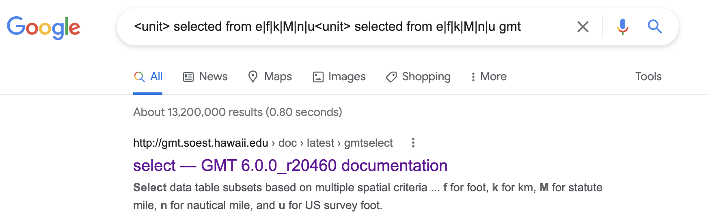
Select data set units if needed from e|f|k|M|n|u.
http://gmt.soest.hawaii.edu/doc/latest/gmtselect.html
Units¶
For map distance unit, append unit d for arc degree, m for arc minute, and s for arc second, or e for meter [Default], f for foot, k for km, M for statute mile, n for nautical mile, and u for US survey foot. By default we compute such distances using a spherical approximation with great circles. Prepend - to a distance (or the unit is no distance is given) to perform “Flat Earth” calculations (quicker but less accurate) or prepend + to perform exact geodesic calculations (slower but more accurate).

Slide 32
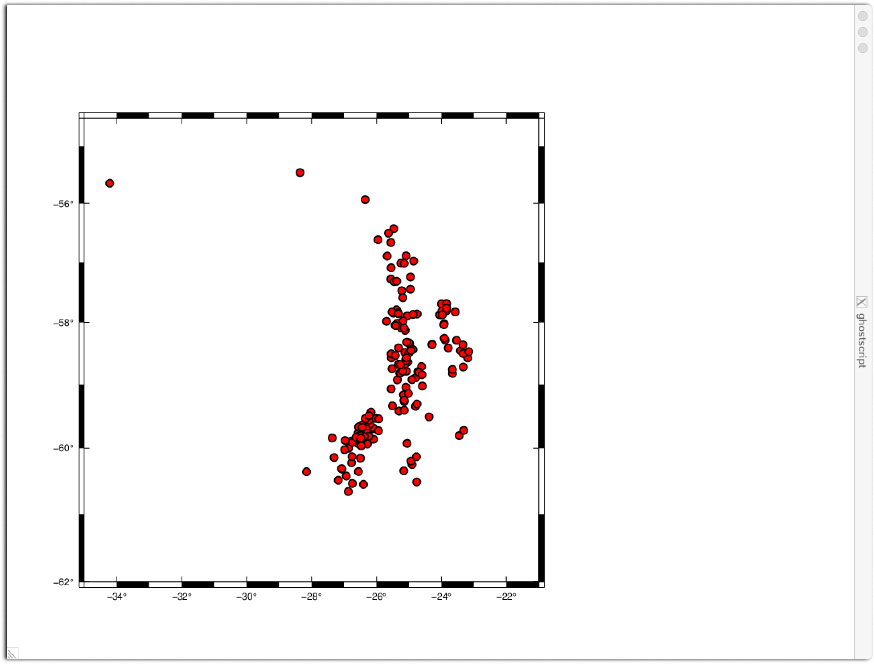
If we look in our directory, we now have 4 files
We started with 2 files
ex1.sh – our “program”, a shell script
ssand_eqs.dat – the data for our plot
% ls
ex1.sh ex1.sh.ps gmt.history ssand_eqs.dat
%

