Slide 1
CERI-8104 Data Analysis in Geophysics
Dr. Robert (Bob) Smalley
3892 Central Ave, Room 103
rsmalley@memphis.edu 678-4929
Fall 2023
Tu & Th 11:20 am -12:45 pm
Meeting (review 13+)14 Thu. Oct 12, 2023
CERI New/Long Building: Student Computer Lab
Class webpage to be announced.
My homepage (has older versions of the course)
http://www.ceri.memphis.edu/people/smalley/

Slide 2
Review: Dynamic Function Creation with Anonymous and Nested Functions
Useful to create functions on-the-fly so that you can customize them at run-time without having to define them in files beforehand.
Anonymous functions let you define a function on-the-fly at the command line or in M code, without an associated file.
Nested functions are functions in M-files that are nested inside other functions and which can see the parent function’s workspace.
You can pass nested and anonymous functions to optimization or integration routines, known as function functions in MATLAB

Slide 3
Symbolic Math
clear
close all
syms a b rx rz l p define symbolic vari a, b , rx, rz, l and p
rx=[1 0 0; 0 cos(a) sin(a);0 -sin(a) cos(a)]
rz=[cos(b) sin(b) 0;-sin(b) cos(b) 0; 0 0 1]
xyz2enuab=rx*rz
syms x
f = sin(x)^2;
dydx=diff(f)
intgl=int(f)
Will do n^{th} derivatives, indefinite integrations, etc.

Slide 4
>> symbolic_math_ex_4class
rx =
[1, 0, 0]
[0, cos(a), sin(a)]
[0, -sin(a), cos(a)]
rz =
[ cos(b), sin(b), 0]
[-sin(b), cos(b), 0]
[ 0, 0, 1]
xyz2enuab =
[ cos(b), sin(b), 0]
[-cos(a)*sin(b), cos(a)*cos(b), sin(a)]
[ sin(a)*sin(b), -cos(b)*sin(a), cos(a)]
f = sin(x)^2
dydx = 2*cos(x)*sin(x)
intgl = x/2 - sin(2*x)/4

Slide 5
How do I evaluate the symbolic math equations ?
First assign values to the symbolic variables a and b
>> a=pi/4
a = 0.785398163397448
>> b=pi/3
b = 1.047197551196598
Then use the function subs
>> subs(xyz2enuab)
ans =
[ 1/2, 3^(1/2)/2, 0]
[-(2^(1/2)*3^(1/2))/4, 2^(1/2)/4, 2^(1/2)/2]
[ (2^(1/2)*3^(1/2))/4, -2^(1/2)/4, 2^(1/2)/2]
See https://www.mathworks.com/help/symbolic/use-subs-to-evaluate-expressions-and-functions.html

Slide 6
See https://www.mathworks.com/help/symbolic/use-subs-to-evaluate-expressions-and-functions.html

Slide 7
varargin
Variable-length input argument list
https://www.mathworks.com/help/matlab/ref/varargin.html
varargin is an input variable in a function definition statement that enables the function to accept any number of input arguments.
Specify varargin using lowercase characters.
After any explicitly declared inputs, include varargin as the last input argument .

Slide 8
When the function executes, varargin is a 1-by-N cell array, where N is the number of inputs that the function receives after the explicitly declared inputs.
If the function receives no inputs after the explicitly declared inputs, then varargin is an empty cell array.

Slide 9
>> acceptVariableNumInputs
Number of input arguments: 0
>> acceptVariableNumInputs(ones(3),'some text',pi)
Number of input arguments: 3
varargin{1} =
1 1 1
1 1 1
1 1 1
varargin{2} = some text
varargin{3} = 3.141592653589793

Slide 10
function [filename, dataout] = readfile(varargin)
%general file read (compressed hatanaka rinex, sac, json, matlab, ...)
%call with [filename, dataout]=readfile('uthw0010.16d.Z')
%or [fn dataout]=readfile for gui entry of filename
if (nargin >1 )
warn_msg=strcat("illegal number calling parameters - bailing ");
disp(warn_msg + nargin)
return
end
%puts up file reading gui if no file name given in call
%based on file extension, will read sac, json, mat, or tabular numerical files (matrix format, no characters, headers, etc.)
if nargin == 0
[filename, pathname, filterindex] = uigetfile( {'*.*'}, 'Pick a file');
fname=strcat(pathname,filename);
disp(strcat("Filename [",fname,"]"))
else %here nargin==1
filename=varargin{1};
fname=filename;
pathname='';
end
end
.

Slide 11
Combo defined and varargin inputs
function definedAndVariableNumInputs(X,Y,varargin)
disp("Total number of input arguments: " + nargin)
formatSpec = "Size of varargin cell array: %dx%d";
str = compose(formatSpec,size(varargin));
disp(str)
end
Call with various inputs
definedAndVariableNumInputs(7,pi,rand(4),datetime('now'),'hello')
Total number of input arguments: 5
Size of varargin cell array: 1x3
Notice above,Matlab variable nargin, total number inputs.

Slide 12
Combo defined and varargin inputs
Call with only defined inputs
>> definedAndVariableNumInputs(13,42)
Total number of input arguments: 2
Size of varargin cell array: 0x0

Slide 13
varargout
Variable-length output argument list
https://www.mathworks.com/help/matlab/ref/varargout.html
varargout is an output variable in function definition enabling the function to return any number of output arguments.
Specify using lowercase, and include as last output argument after any explicitly declared outputs.
When the function executes, varargout is a 1-by-N cell array, where N is the number of outputs requested after the explicitly declared outputs.
.

Slide 14
function [s,varargout] = returnVariableNumOutputs(x)
nout = max(nargout,1) - 1;
s = size(x);
for k = 1:nout
varargout{k} = s(k);
end
end
Output s contains the dimensions of the input array x. Additional outputs correspond to the individual dimensions within s.

Slide 15
Call function with 3-dimensional array, request 3 outputs.
A = rand(4,5,2);
[s,rows,cols] = returnVariableNumOutputs(A)
s = 4 5 2
rows = 4
cols = 5
Call again with 4-dimensional array, request 4 outputs, now does not return individual 4th dimension.
A = zeros(1,4,5,2);
[s,dim1,dim2,dim3] = returnVariableNumOutputs(A)
s = 1 4 5 2
dim1 = 1
dim2 = 4
dim3 = 5

Slide 16
Call the function once more on A and request one output.
Now the function returns the dimensions of A and no varargout.
s = returnVariableNumOutputs(A)
s = 1 4 5 2

Slide 17
Can do both – varargin and varargout, and don't need required input or output
function varargout = variableNumInputAndOutput(varargin)
disp(['Num of provided inputs: ' num2str(length(varargin))])
disp(['Num of requested outputs: ' num2str(nargout)])
for k = 1:nargout
varargout{k} = k;
end
end
[d,g,p] = variableNumInputAndOutput(6,'Nexus')
Number of provided inputs: 2
Number of requested outputs: 3
d = 1
g = 2
p = 3
num2str converts number to string to put in array & print
variableNumInputAndOutput
Number of provided inputs: 0
Number of requested outputs: 0

Slide 18
Some languages allow you to skip defined input or output parameters.
Something like this
Function [a,b,c]=myfun(d,e,f)…
Then
[x,,z]=myfun(u,,w)
Matlab does not.
Have to use varargin and varargout

Slide 19
Can mix defined and varargin and varargout arguments (the variable part is always at end)
function [a varargout] = variableNumInputAndOutput(b,varargin)
disp(['Number provided inputs: ' num2str(length(varargin))])
disp(['Number requested outputs: ' num2str(nargout)])
for k = 1:nargout
varargout{k} = k;
end
end

Slide 20
Course Description
Introduction to UNIX

Slide 21
Why learn Unix/Linux?
Powerful, flexible, and small
Hardware independent
(these two points are much more important to manufacturers and designers than general users, i.e. us)
Notes:
Only thing true is SMALL. Is powerful but will not do many things by design (e.g. is not real-time, egalitarian - share equally). Flexible, you will change to do it the way UNIX requires (Will it do this? No, but it is UNIX – synonymous with powerful – and you can write a program. Hardware independent – complete myth.
Real OS – DEC RT-11, VMS, IBM, Prime, etc. – 100’s man years to develop OS. UNIX – 6 months for single engineer to port to new hardware . One way to do this Is that the OS does almost nothing!

Slide 22
The real reason why to learn Unix/Linux?
Because you have no choice
(“Resistance is futile”, The Borg, Star Trek).
It is what is running in most geophysics departments.
As most geophysics tools (SAC, GMT, GAMIT/GLOBK, Gipsy, GMTSAR, etc.) only run on Unix
(although there is a Windows version of GMT).
(~89% of the worlds computers run some form of Windows, ~9% run some form of the Mac OS, and ~2% run some flavor of Unix.)
Notes:
UNIX/LINUX strong point is SERVERS – the web runs on UNIX based machines.
If you want to do something besides run a server – UNIX is probably not the way to go.

Slide 23
Relation to Windows
None.
Windows
Early version built on MS-DOS (which is not really an operating system, it is a file system), which has nothing to do with Unix and everything to do with Microsoft.
Cygwin – UNIX/LINUX like Windows program that pretends to be UNIX/LINUX. It is not a virtual machine (VM) or environment, is a Windows program.
You need to build everything from source (hard).
(Not recommended.)

Slide 24
Relation to Windows
The differences between the Unix Philosophy and the Windows Philosophy … can be boiled down into a question of smarts … .
Unix and Windows store the smarts in different places.
Unix stores the smarts in the user.
Windows stores the smarts in the OS.

Slide 25
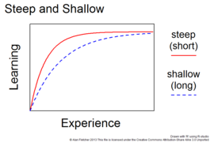
Learning curves
Unix has an inherently steep learning curve,
and Windows has a very shallow one.
or hill to climb, steeper=harder
The expression "steep learning curve" has 2 opposite meanings. Most sources, including the Oxford Dictionary of English, the American Heritage Dictionary of the English Language, and Merriam-Webster's Collegiate Dictionary, define a learning curve as the rate at which skill is acquired, so a steep increase would mean a quick increment of skill. However, the term is often used in common English with the meaning of a difficult initial learning process.
The common English usage aligns with a metaphorical interpretation of the learning curve as a hill to climb. (A steeper hill is initially hard, while a gentle slope is less strainful, though sometimes rather tedious.
Notes:
http://www.over-yonder.net/~fullermd/rants/winstupid/winstupid2.php
Figure and learning curve from https://en.wikipedia.org/wiki/Learning_curve#:~:text=The%20common%20English%20usage%20aligns,total%20amount%20of%20work%20required.

Slide 26
Windows
Our Microsoft brethren have taken the approach of making the shallowest possible learning curve.
To take a cue from the fast food industry, Windows is the "under-3" toy of the OS world.
The ultimate goal is to flat-out destroy any barrier to entry by removing any requirement for initial knowledge or learning of how and why, and of making the system simplistic enough that it can be used without any understanding of how it works.
Notes:
http://www.over-yonder.net/~fullermd/rants/winstupid/winstupid2.php

Slide 27
Unix
The Unix crowd has taken the opposite, and they think superior, approach.
Notes:
http://www.over-yonder.net/~fullermd/rants/winstupid/winstupid2.php

Slide 28
Unix
Unix has a steep learning curve (Unix fans use the easy to learn interpretation, the rest of the world uses the steep hill to climb interpretation); it doesn't shield the user from complexity; rather, it revels in the complexity.
It recognizes that a general-purpose computer is a fiendishly complicated device capable of doing an unbelievable assortment of things.
Notes:
http://www.over-yonder.net/~fullermd/rants/winstupid/winstupid2.php

Slide 29
Unix
It recognizes that the computer is a tool of the user, and so takes a tool-building philosophy.
Make a lot of tools, and make each tool specific.
Let the user select the tool they think is appropriate, and let the user combine the tools however they want.
It's not aimed at making things easy; it's aimed at making things possible (among the faithful).
Notes:
http://www.over-yonder.net/~fullermd/rants/winstupid/winstupid2.php

Slide 30
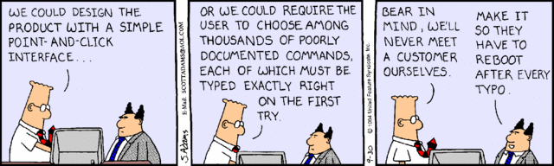
UNIX Philosophy
(Mac) (Unix)
“Dilbert” by, Scott Adams, Sep 30, 1994.

Slide 31
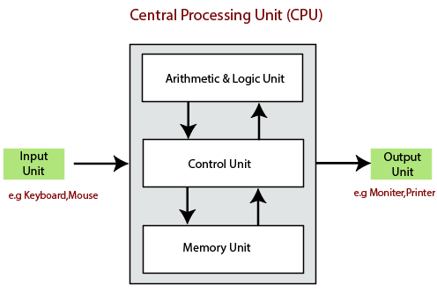
https://www.tutorialandexample.com/block-diagram-of-a-computer/
Notes:
Pretty simple – arithmetic and logic basically does AND, OR, NOR, NOT, and CARRY, control unit takes stuff from input and memory – puts in arithmetic and logic unit, tells it what to do, and saves in memory and sends to output.

Slide 32
Hardware – the physical computer.
Kernel – program, usually hardware dependent, that runs the core or key components of the operating system (process, memory, file, device, and network management).
Programs/Applications – (sort of) hardware independent – unix commands, compilers, applications.
Shell – hardware independent - how the user interacts with the Programs/Applications layer.
Notes:
Sort of due to stuff eventually having to get into machine code.
There are programming languages that run on everything --- but only because there is a program between them and the hardware doing the translation.

Slide 33
The Shell
The UNIX user interface is called the shell.
The shell does 4 jobs repeatedly:
As far as UNIX/LINUX is concerned, the shell is just another program, equal to all others.
display
prompt
read
command
execute
command
the shell
process
command

Slide 34
We will now take a short detour to examine the Unix philosophy.
The UNIX philosophy will keep returning to haunt us (you will know when this happens when the explanation of a code starts with mentioning the UNIX philosophy).
But if you understand it, it will make the process less painful.

Slide 35
What is the “Unix Philosophy”?
(can computer operating systems have a “philosophy”?)
According to Doug McIlroy
Make each program do one thing well.
So, to do a new job, build afresh rather than complicate old programs by adding new features (otherwise known as “bells and whistles”).

Slide 36
What is “Unix Philosophy”?
Machine shop vs. appliance
(UNIX gives you the tools and you to make appliance)

Slide 37
What is “Unix Philosophy”?
Advantage
POWERFUL

Slide 38
What is “Unix Philosophy”?
Disadvantages
Lots of reinventing the wheel (everybody has to make their own tools)
Requires a (much) more educated user
Requires more work from the user (UNIX is “user hostile”) rather than the developer

Slide 39
What is “Unix Philosophy”?
Typical question asked of UNIX guru: can UNIX do this?
Typical answer: NO, but YOU can write a program!
Unix enthusiasts think this is the answer the average user wants to hear!

Slide 40
Caricature of UNIX vs Windows
If you need to wash clothes
Windows provides simple washing machine (1 setting, you shouldn’t wash your cashmere sweater, but there are no operating instructions [it’s intuitive] so you probably don’t know not to wash the sweater and ruined it.)
UNIX gives you a machine shop - you better know
1) how wash different types of clothes and
2) how to design and build a machine to do it.
Notes:
http://www.over-yonder.net/~fullermd/rants/winstupid/winstupid2.php

Slide 41
Another comparison of OSes
An Apple, a Linux, and a Windows User all need to change a light bulb (it’s always a light bulg) in their respective homes.
They split up, and the Windows and Apple users reunite 10 minutes later.
Windows User: Did you manage to get it fixed?
Apple User: No, it can't be changed, so now I need to find a new house. How about you?
Windows User: Yeah, I managed to change it, but now my toilet won't flush.
Apple User: Where's the Linux User? He hasn't come back yet.
Worried, they head over to his apartment, and find him sitting in the middle of the floor, with a set of instructions and a box of parts.
Windows User: Hey, did you manage to change your light bulb?
Linux User: What does it look like I'm doing? This light bulb isn't going to build itself!
Notes:
https://ivanteh-runningman.blogspot.com/2021/07/users-change-light-bulb.html

Slide 42
Quotes for the day:
“Software stands between the user and the machine” - Harlan D. Mills
Software can help the user in their daily endeavors or stand in the way.

Slide 43
“UNIX Philosophy”
(ii) Expect the output of every program to become the input to another, as yet unknown, program.
- Don't clutter the output with extraneous information that might be useful to the user, but not needed by the input for next program.
Notes:
So if you ask for a list of the files in a directory and it is empty – unix returns nothing (although it breaks the rule and usually goes to the next line on the teletype – so it returns a newline! In a pipe it returns nothing.).
Some OS (DEC’s VAX VMS) do different things depending on how called – send “no files found” to terminal, but nothing to “pipe”.

Slide 44
“UNIX Philosophy”
Notice that, except for saying programs should not have output solely to help the user, the user is not mentioned.
Unfortunately, this may make things confusing for the uninitiated user.
The output is for “next program” (in a “pipe”), not the user.

Slide 45
“UNIX Philosophy
What happens when you ask for a listing of files in an empty directory?
$ ls<CR>
$
Returns to prompt ($)without any other output.
(there are no files to list, so Unix just outputs a new prompt and waits for a new command, is that reasonable?).
(Works differently in a shell script, no prompt)
Notes:
Colors – orange - computer prompt, black – stuff you type, <CR> is carriage return/enter, later – blue – computer output. If there are no files, you get no result (zero length character string). Now I can send this to any other program – will only have list of files, no extraneous information (on VMS the directory command gave you the name of the directory, the list of files and a summary about the number of files – the arbitrary next program would have to figure this out for every possible previous commands output format.)

Slide 46
“UNIX Philosophy”
What happens (or should happen) when you enter
$ echo<CR>
The command echo, “echoes” what you type between the end of the command (the work “echo” and the following space that separates it from what is to be echoed) and the <CR> (carriage return or enter).
You did not type anything.
What should it do?
Notes:
Unix geeks get into these kind of discussions.
On modern terminal cursor marked by blinking underline.

Slide 47
“UNIX Philosophy”
Some argue it should do nothing (i.e. just sit there)!
What about a new prompt on same line?
It usually goes to next line and prints the prompt on the screen as in the previous example (break with philosophy because philosophy too confusing
But it does what is expected, nothing (it follows philosophy), in a shell script.
Notes:
Unix geeks get into these kind of discussions.
On modern terminal cursor marked by blinking underline.

Slide 48
“UNIX Philosophy”
(iii) Idea of “filter” –
Every program takes its input from Standard IN (originally a teletype, now a keyboard),
does something to it (“filters” it) and
sends it to Standard OUT (originally a teletype, now a screen)
(notice that the “user” is not part of this model).

Slide 49
“UNIX Philosophy”
This brings up another issue – commands sometimes behave differently in shell scripts than they do “interactively”
Typically the difference is that they are more “chatty” when interactive.
This kind of stuff can make for confusion when debugging. Works from screen, does not work in shell script.

Slide 50
“UNIX Philosophy”
It is pretty easy to see these are not good assumptions (Stnd IN, Stnd OUT) for many tasks and many Unix commands break this philosophy/convention.

Slide 51
“UNIX Philosophy”
Idea/use of – redirection (“<“, “<<“ and “>”, “>>”)
- Take input from somewhere rather than Standard IN
Send output to somewhere rather than Standard OUT
(Unix treats everything like a “file”, even hardware).
Symbols “<“ and “>” are called suck and spit.
(for completenss “!” is “bang”, “*” is “splat”, “#” is “hash”, and “#!” is “shebang”)

Slide 52
“UNIX Philosophy”
redirection
- Take input from a file “<“ rather than Standard IN
Send output to a file “>” rather than Standard OUT.
If you have an existing file with that name – guess what UNIX does with it?
Notes:
Symbols called “suck” and “spit”. We will cover all of the options shortly.
What does “treats everything like a file mean” – means that user does not have to worry about details of where file going - /dev/mt0 is tape drive for example, but “looks like” a file. On DEC RT-11, which was a real-time OS, everything looked like “hardware” – had an “address”. This made it very easy to write programs to control real-time hardware (real-time means computer can measure, analyze, and respond fast enough to control something in the real worlk, like driving a car – when the hardware needs CPU time it takes it in some hierarchical order. Unix is more egalitarian, shares resources equally among users, car will crash because you have given it a new address and it does not prioritize).

Slide 53
“UNIX Philosophy”
“>” sends output to file rather than Standard OUT
If you have an existing file with that name
UNIX ERASES it (without asking, you told it to do that) and creates a new empty file for your output!
Note well: UNIX creates the output file first – “cobbering” any existing file of that name – before running the program.
Notes:
Talk about landing gear/flap controls and pilot error. Same plastic knob, same color, next to one anohter. Now diferent colors and knobs (but can stil forget).

Slide 54
The response from your UNIX guru will be “you were told that’s what would happen!”
(and in the thought balloon – “you idiot”)
UNIX dutifully did what you told it to do!!
(even though you did not realize that.)
UNIX does not take “human factors” into account in its design – the user is completely responsible for all errors.
(UNIX has advanced a bit to protect you from easily erasing the whole disk, but it is still possible to do accidentally – beware the “*” wildcard - do it on most UNIX systems)
Notes:
Talk about landing gear/flap controls and pilot error. Same plastic knob, same color, next to one anohter. Now diferent colors and knobs (but can stil forget).
No human factors design

Slide 55
“UNIX Philosophy”
Redirection
- Take input from what follows “<< END“ (in shell script, or Standard IN), till it finds the character string END
Append output to an existing file “>>” rather than Standard OUT or (erasing and) creating a new file.

Slide 56
“UNIX Philosophy”
Idea/use of – pipes (“|”)
Sends output to the next program (instead of “standard out” or a file)
And
Takes input from the previous program (instead of “standard in” or a file)
Notes:
Pipes existed in DOS (copied from unix)

Slide 57
“UNIX Philosophy”
Example: we have 2 files with a name and ID on each line.
There are some duplicates (i.e. exact same line, character for character, in both files).
Want one file, in alphabetical order, with duplicates removed.
cat file1 file2 | sort –u > file3
Use the UNIX command "cat" (for concatenate)
Notes:
We will go over all the commands later. For now introducing pipes and output file redirection – without “> file3” comes to screen.
Uses pipe, the “|”, and a switch, -u for unique, then redirects into a file (else goes to screen where visible but not available on computer).

Slide 58
“UNIX Philosophy”
cat file1 file2 | sort –u > file3
cat, short for “concatenate”, does not require input file redirection [does not follow philosophy], it will take a list [redirection does not even work with more than one file], but does need output redirection else comes to screen.
The cat utility serves a dual purpose: concatenating and printing. … printing a single file to the terminal is a special use-case of this concatenation program. Yet, this is its most common use.
In UNIX you have to think of all the side effects of a command and note it they are useful
Notes:
We will go over all the commands later. For now introducing pipes and output file redirection – without “> file3” comes to screen.
Uses pipe, the “|”, and a switch, -u for unique, then redirects into a file (else goes to screen where visible but not available on computer).

Slide 59
“UNIX Philosophy”
In UNIX you have to think of all the side effects of a command and note it they are useful for what you want to do.
This way the developers of UNIX don't have to write another program to print!
With UNIX you have to read the documentation very carefully and figure out what are the implications of each command.
It does what it says (which is oftentimes not obvious).
Notes:
We will go over all the commands later. For now introducing pipes and output file redirection – without “> file3” comes to screen.
Uses pipe, the “|”, and a switch, -u for unique, then redirects into a file (else goes to screen where visible but not available on computer).

Slide 60
Write programs to handle text streams, because that is a universal interface.
(fine if you’re a system programmer, not always so useful for scientific data crunching.
Good example of a real problem that does not follow this model is earthquake location.
You typically have one text file for station locations, another text file for the velocity model, and a final text file with station names and arrival times for an earthquake. This does not fit the serial, filter model.
Another example, binary seismic, topo, etc. data.)

Slide 61
“UNIX Philosophy”
Continued
(iv) Avoid stringently columnar (e.g. Fortran Hollerith card format) or binary input formats.
But a lot of UNIX tools work on fields – defined as ”stuff between spaces” so if you have city names then states
Memphis TN
New York NY
it ain’t gonna work
Notes:
GMT follows the Unix philosophy – to a “T” – will see switches in spades.
Columnar input – from Fortran – from Hollerith cards or paper tape, did not have to punch zeros. Another advantage – reading lines with varying numbers entries. (e.g. arrival times – have P but no S for some stations).

Slide 62
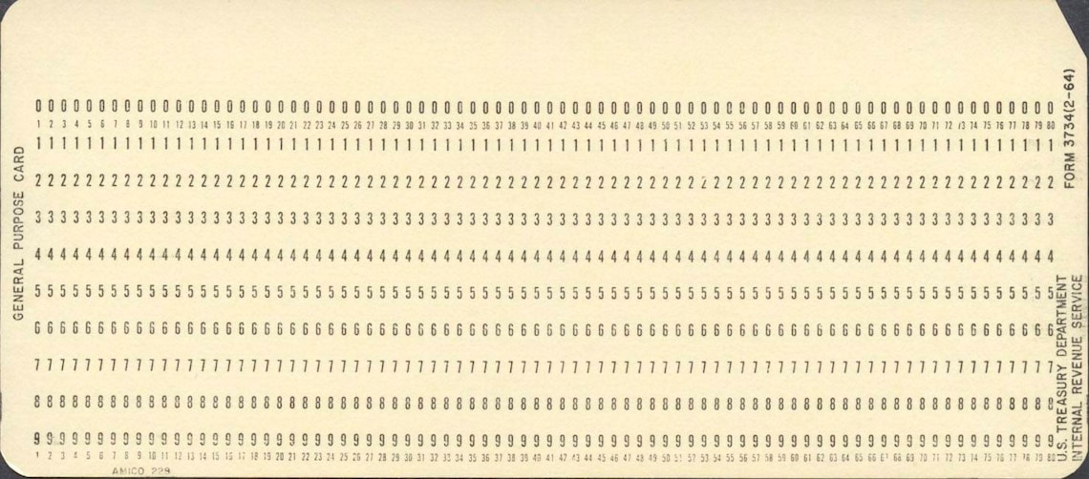
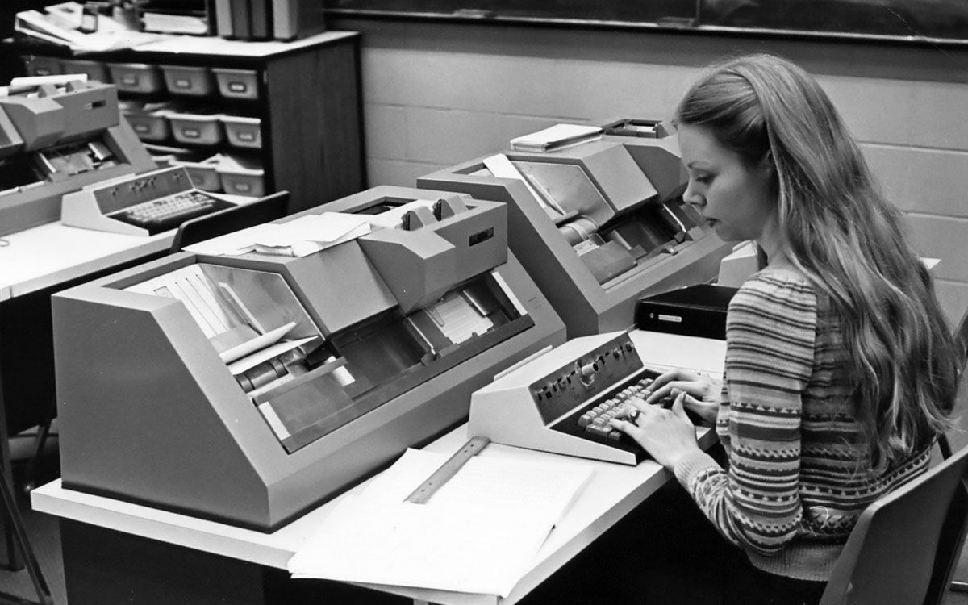
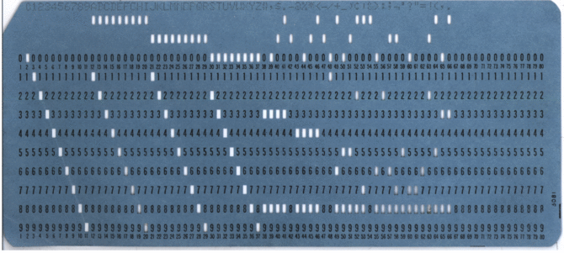

Slide 63
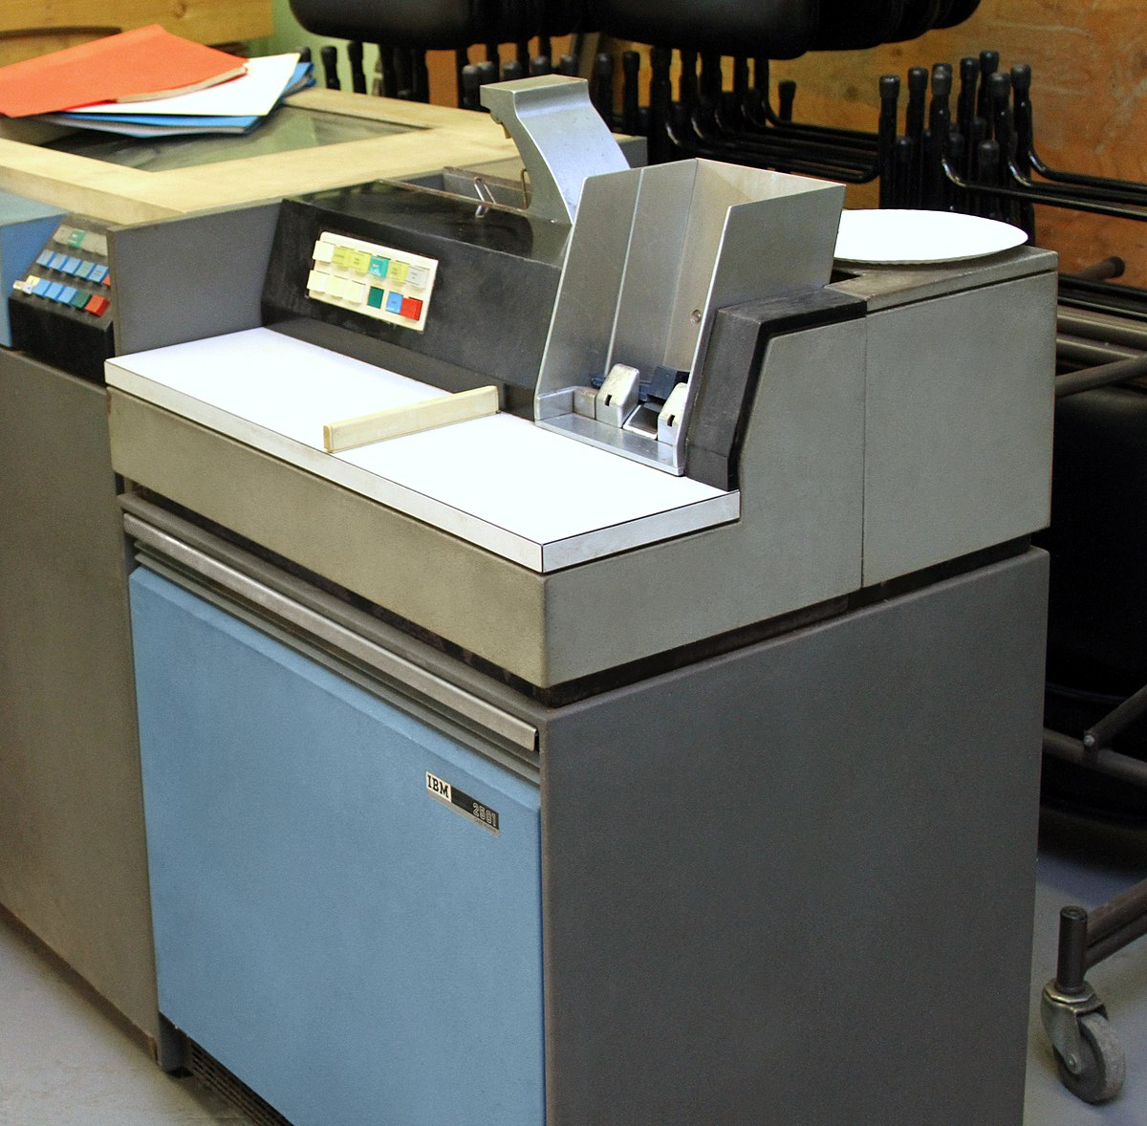

Cards like this, along with paper clips, staples, etc. were death to the card reader.

Slide 64
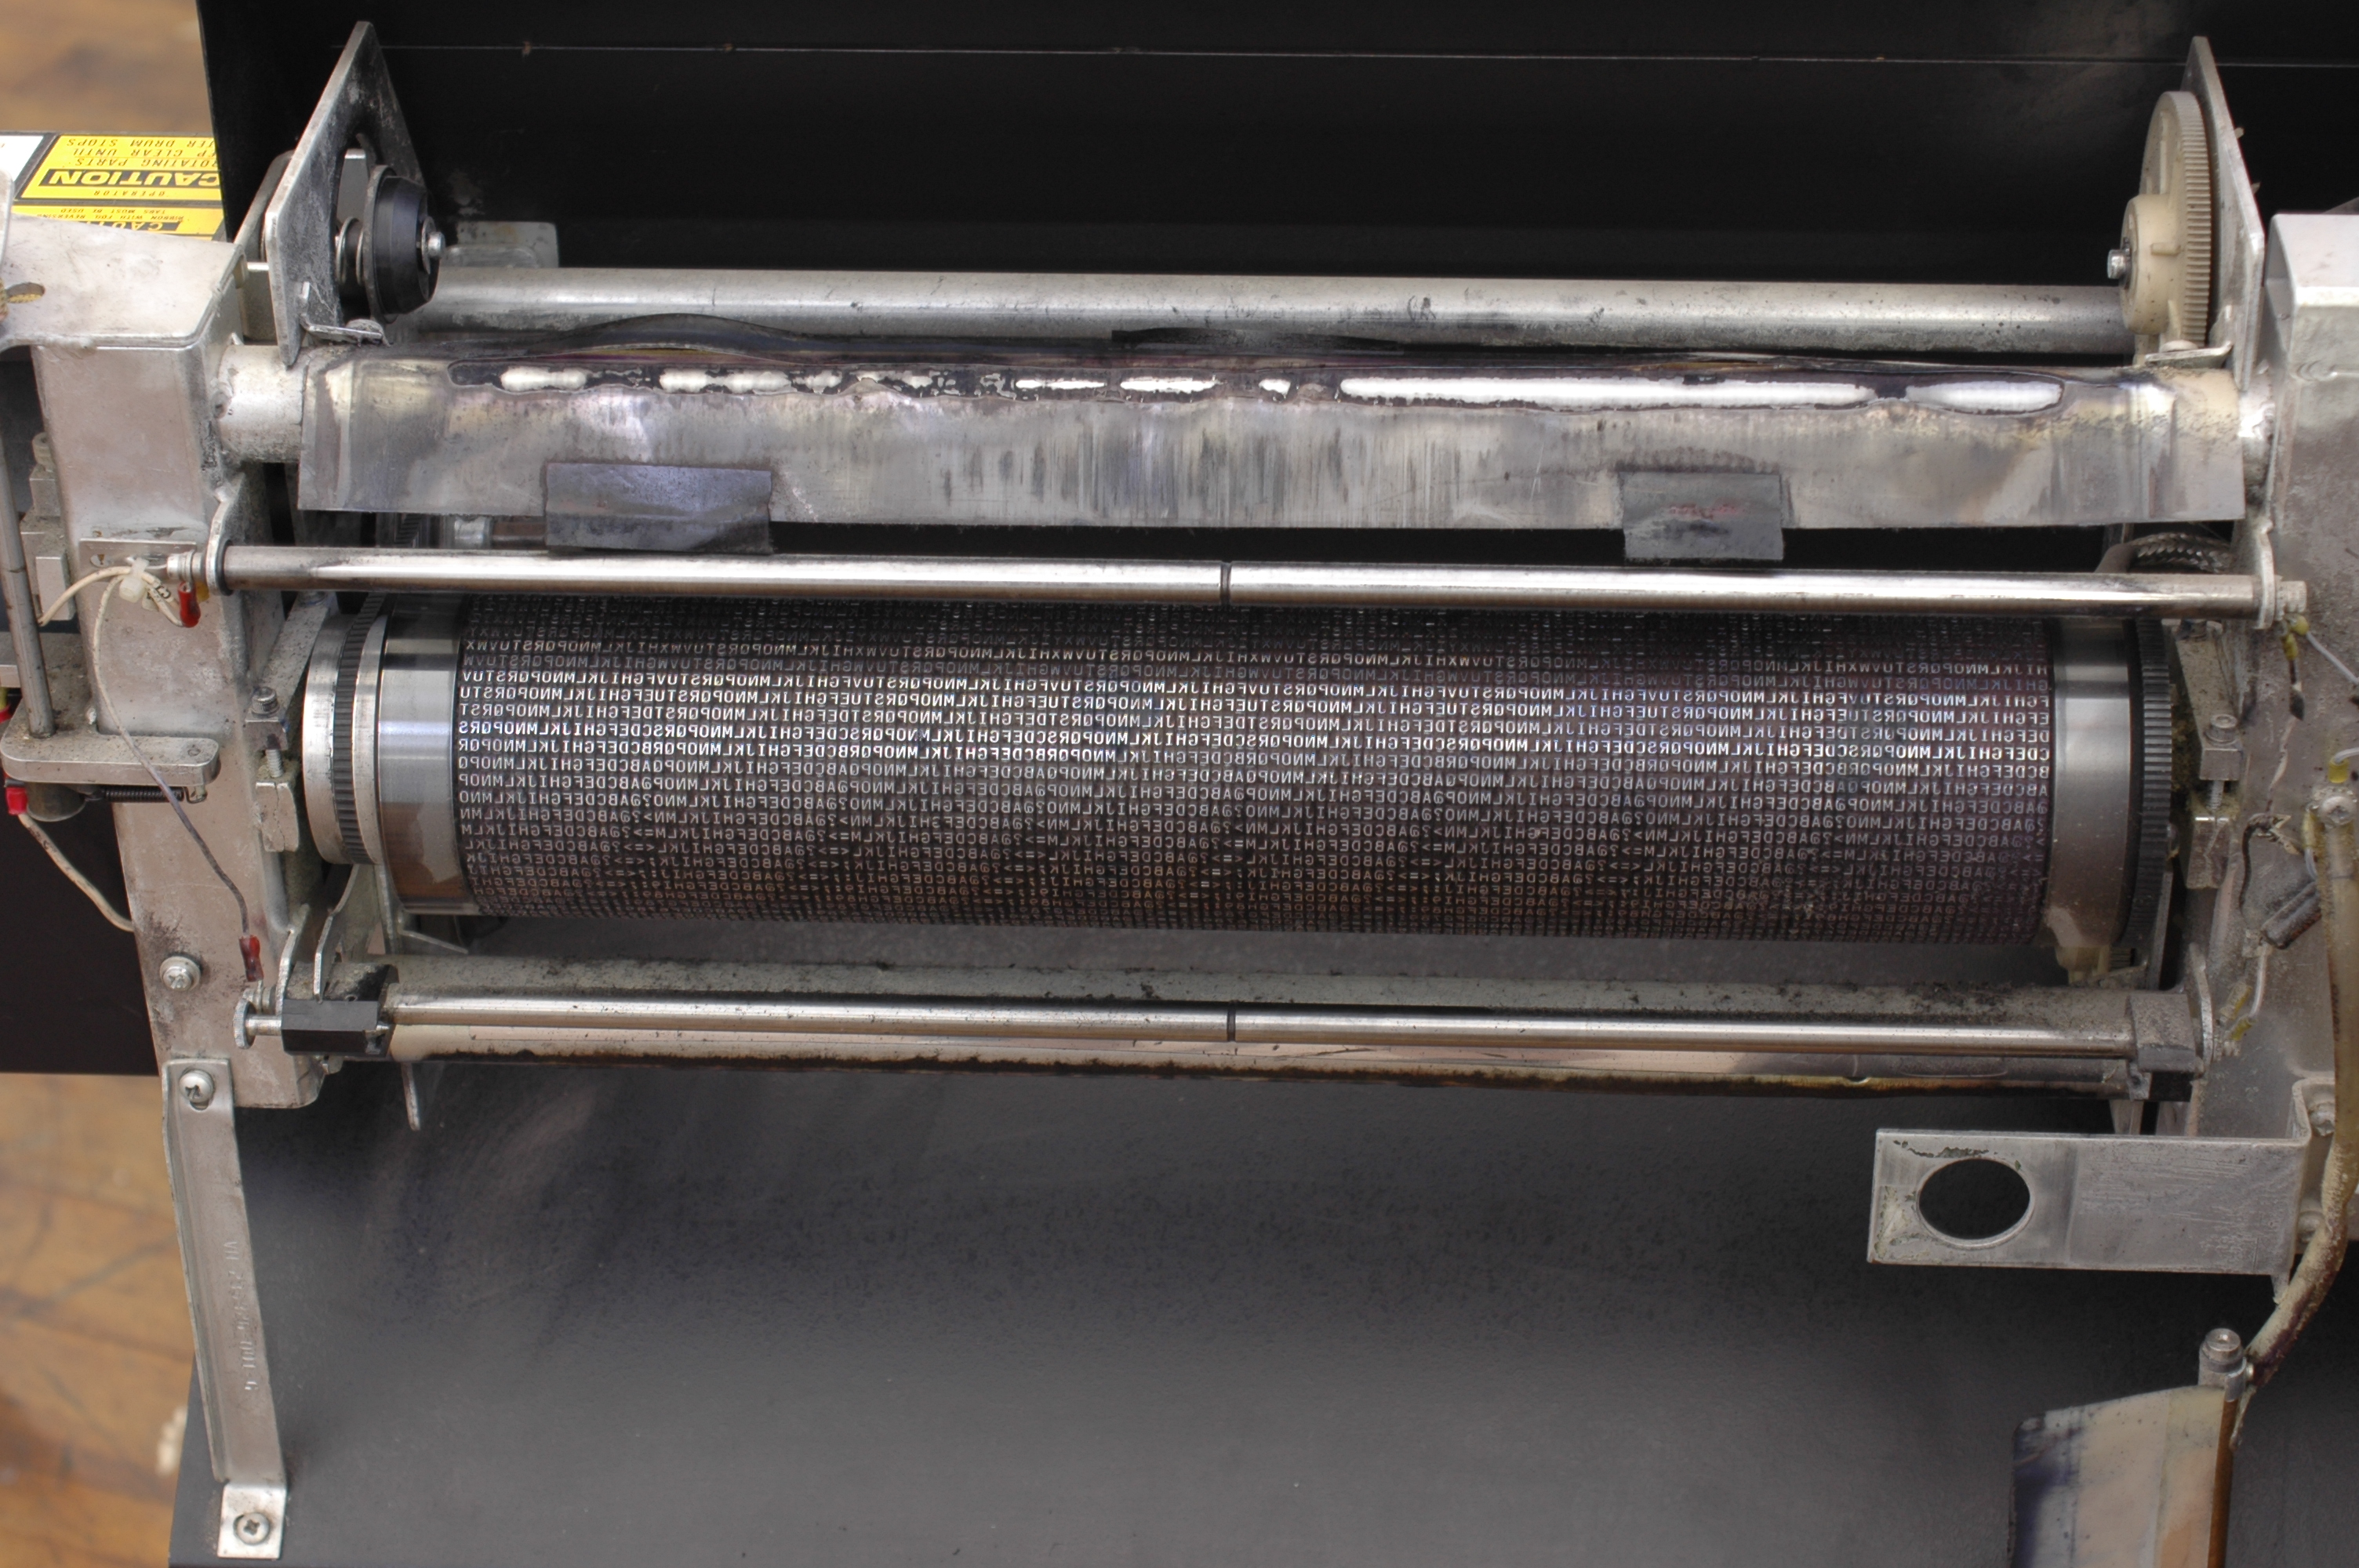

Slide 65
“UNIX Philosophy”
Continued
Don't insist on interactive input.
(Does not fit in with use of pipes.)
Instead, control is implemented by use of “command line switches”
(We will see a horror show of switches pronto.)
Notes:
GMT follows the Unix philosophy – to a “T” – will see switches in spades.
Columnar input – from Fortran – from Hollerith cards or paper tape, did not have to punch zeros. Another advantage – reading lines with varying numbers entries. (e.g. arrival times – have P but no S for some stations).

Slide 66
“UNIX Philosophy”
Put lots of (simple, easy to write) single minded programs in a row (with pipes) to do what you need.
(Don’t use temporary/intermediate files – use a pipe).
Notes:
Don’t write out a file and then read it in (unless you need the information a number of times in different programs).

Slide 67
“UNIX Philosophy”
New concept
command substitution (`…`)
(uses “backwards” or French grave accent)
Use the output of a command as ‘some sort of input’ to another command.
Notes:
What does this mean. We can use it to generate input, instead of StndIN or a file, or parts of a command!

Slide 68
command substitution example.
Print something while controlling the orientation – landscape or portrait.
ORIENT=<CR> Or ORIENT=-P<CR>
Then
print `echo $ORIENT` < INFile<CR>
substitutes nothing, for ORIENT=<CR>, or “-P”, for ORIENT=-P<CR>, into the print command as if that is what you typed
(this is not how you would actaully do this – it is a ginned up example)
Notes:
Don’t worry about how variable ORIENT is set, or how it is referenced (how one specifies what one wants – the string “ORIENT”, the value of the variable, etc.) – we will get to that pronto. For now concentrate on what command substitution does. It is very powerful (and therefore complicated) and hard to debug because you don’t generally know beforehand what it is going to be.
Al;so this is NOT the way you would actually do this – would just put in $ORIENT.

Slide 69
REVIEW
Write programs that do one thing and do it well.
(lean and mean [especially mean])
Write programs to work together.
(pipes)

Slide 70
“the UNIX operating system, a unique computer operating system in the category of help, rather than hindrance.”
Introducing the UNIX System
McGilton and Morgan, 1983.
or
The trouble with UNIX: The user interface is horrid
Norman, D. A. Datamation, 27, No. 12, 139-150.
Notes:
Cheerleading vs reality

Slide 71
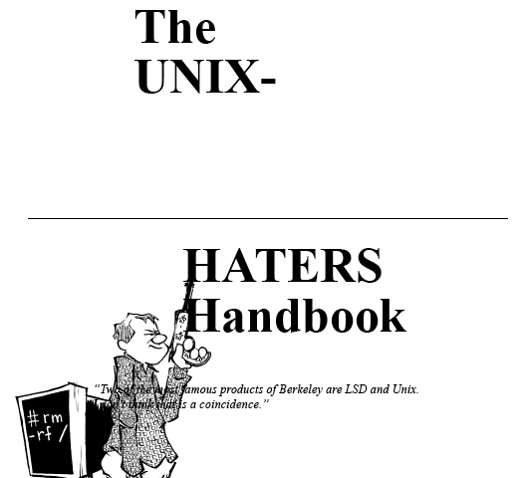
"Two of the most famous products of Berkeley are LSD and Unix.
I don't think that this is a coincidence.”
Anonymous

Slide 72
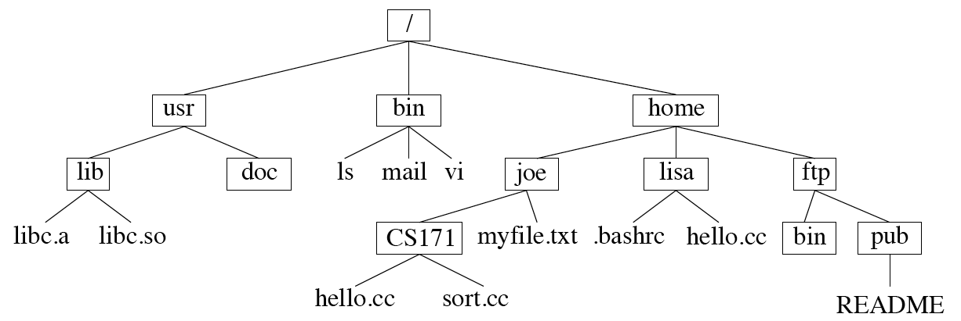
Before looking at more Unix commands, we will first look at the FILE STRUCTURE (how files [called documents on Mac and Windows] are stored/organized).
Unix uses a hierarchical file system (as does Mac and Windows/DOS).

Slide 73
Looks like an upside-down tree.
Starts at top with “/”, called “root”.
Unix uses the “/” to separate directories (known as folders on Mac or Windows)
Top Level Directories
Directories
Notes:
They were on LSD when they designed this and got it upside down.
Looks like a root system.

Slide 74
File names – the “separator is “/”.
root (first slash) then path and filename
/usr/lib/libc.a
Notes:
How to understand filenames – composed of two parts - where the file lives, and it’s name.

Slide 75
This is the full name from root (works from any directory), if you were “in” usr, you only need
lib/libc.a
(no leading slash)

Slide 76
And if you were in the directory lib, you only need
libc.a
(no leading slash)

Slide 77
The “/” (slash or forward slash) in Unix is roughly equivalent to the “\” (backslash) in Windows/DOS.
Notes:
Roughly equivalent since DOS does not use” “/ for root and in unix don’t have “disk:” where disk is A, B, C…

Slide 78
Some commands:
pwd – print working directory (an obvious/intuitive choice for the command name) – tells us where we are in the directory tree.
$ pwd<CR>
/usr
$
Notes:
(notice logical, intuitively obvious, command name.

Slide 79
Moving between directories – going up and down the directory tree–
To go down to the directory doc we use the “change directory” = “cd” command
$ cd doc<CR>
$
Notes:
Again logical, intuitively obvious command name.

Slide 80
Now in
$ pwd<CR>
/usr/doc
$

Slide 81
Some details of the prompt
you can control all this - the prompt can be programmed to tell us a bunch of stuff! (power of unix.)
Machine name, Directory name (w/out full path), User name, prompt
smalleys-imac-2:usr smalley$
Notes:
(notice logical, intuitively obvious, command name.

Slide 82
Aside:
Unix sub philosophy –
Minimize typing (on teletype) – so use short (2, in extreme cases 3 character) command names constructed from description of the command.
e.g. “cd” for “change directory”
(Unix fans claim this is a “feature” of Unix, compared to other O/Ses)

Slide 83
Aside:
Unix sub philosophy –
Side effects:
Don’t need a type or print command as “cat” puts things out to Standard Output.
Don’t need a rename command, just move,the file changing the name to another , mv old_name new_name!!! (no change in path)
These are examples of the genius of the UNIX design and philosophy, and how you need to think to use it effectively.
Notes:
You need to think and you need to think a certain way!!

Slide 84
We can also go up the directory structure.
To return to usr from doc.
doc$ cd ..<CR>
usr$

Slide 85
This is a little strange ---
The double dot (“..”) signifies the directory directly above you (up) in the directory structure (tree).
And the single dot (“.”) is where you are.

Slide 86
We can also go directly to anywhere in the directory structure using the full path.
To go to usr (from doc or anywhere, such as pub)
doc$ cd /usr<CR>
usr$

Slide 87
Notice that you have to know where you are in the tree and what subdirectories are contained there to navigate down.
Unix does not provide a display of the picture below. You need to have it in your head.
(But you could write such a tool if you want!!)

Slide 88
How do we go from doc to lib?
We could do this using the full path.
doc$ cd /usr/lib<CR>
lib$

Slide 89
How do we go from doc to lib?
But here’s an easier (?) way – we have to go up one level; then down one level. This can be done with the command.
doc$ cd ../lib<CR>
lib$
Notes:
Another thing to notice – Unix is full of trickiness like this.

Slide 90
Say we want to go to “pub”
lib$ cd ../../home/ftp/pub<CR>
We went up two, then down three.

Slide 91
Say we want to go to “pub”
We could also have done (and is simpler) this with the full path.
pub$ cd /home/ftp/pub<CR>

Slide 92
Go directly to “root” directory (“/”)
lib$ cd /<CR>
/$

Slide 93
Go from anywhere directly to your “home” directory using “~” (assume I’m “lisa”).
CS171$ cd ~<CR>
lisa$
uses tilde “~”
Notes:
tilda is a users “home” directory, don’t need to know the full path down to home directory.
Yours – just tilda, or if you need more, slash then whatever follows
Somebody else - ~name

Slide 94
Go from anywhere directly to someone else's home directory (assume I’m lisa)
lisa lisa$ cd ~joe<CR>
/home/joe lisa$
also uses tilde “~”
Notes:
Going back to a prompt showing working directory and user

Slide 95
The tilde character “~”
refers to your home directory when by itself,
or that of another user when used with their home directory name (the same as their user name).
(The shell expands the “~” into the appropriate character string for the full path - “/home/joe” or “/home/lisa”)

Slide 96
Review - specifying file names
full path /usr/lib/libc.a
relative path
(if in directory lib) libc.a
(if in another directory next to it, e.g. doc
../lib/libc.a

Slide 97
Review - specifying file names
abbreviations
(if I am joe) ~/CS171/hello.cc
(if I am not joe) ~joe/CS171/hello.cc

Slide 98
You have to keep track of the file structure in your head
or have a way to find out what files are in the working directory.

