Slide 1
CERI-8104 Data Analysis in Geophysics
Dr. Robert (Bob) Smalley
3892 Central Ave, Room 103
rsmalley@memphis.edu 678-4929
Fall 2023
Tu & Th 11:20 am -12:45 pm
Meeting 12 Oct 9, 2023 (makeup from Oct 5, 2023)
CERI New/Long Building: Student Computer Lab
Class webpage to be announced.
My homepage (has older versions of the course)
http://www.ceri.memphis.edu/people/smalley/

Slide 2
Quick look at some advanced MATLAB stuff.

Slide 3
Objects and Handles in Matlab.
There are several places where "objects" and "handles" are used in MATLAB.
We will start with graphics objects and handles.

Slide 4
Matlab graphics are Objects.
So, one must use the ideas of Object-Oriented Programming to deal with graphics at the lowest level.
For now, objects are abstractions that define the object by its data and "methods".
Where "methods" are things that the object can do with the data.
Data are like "nouns", while methods are like "verbs".

Slide 5
A handle refers to a specific instance of a graphics object. Use the object handle to set and query the values of the object properties.
When you create instances of graphics objects, you can save the handle to the object in a variable.
Notes:
https://www.mathworks.com/help/matlab/creating_plots/how-to-work-with-graphics-objects.html

Slide 6
To put it simply, a graphics object handle is a unique identifier assigned to every single graphics object.
The term "handle" is appropriately descriptive in that it is analogous to handles of everyday objects found around the home (such as doors, frying pans, luggage, etc.).
Just as these common handles provide you with means of gaining access, holding on to, and opening-up everyday objects, graphics handles provide a means of both specifying and viewing the contents of MATLAB generated graphics objects.
Notes:
http://what-when-how.com/graphics-and-guis-with-matlab/graphics-objects-handles-matlab/

Slide 7
Handle graphics refers to MATLAB's low-level graphics functions that control graphic objects.
Handle graphics functions are useful for detailed program control of MATLAB plots
There are two ways to view and change properties of graphic objects:
Interactively using the icons for various tools across the top of the window.
Under program control (programmatically) using the get() and set() functions.
Notes:
http://cse.unl.edu/~sincovec/Matlab/Lesson%2026/CS211%20Lesson%2026%20-%20Handle%20Graphics.htm

Slide 8
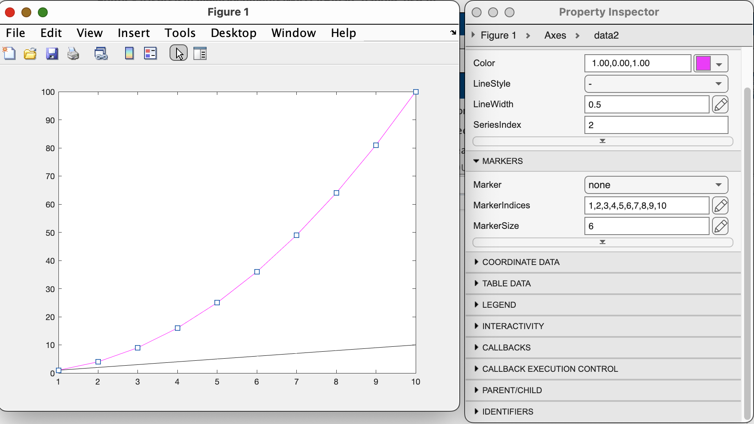
Interactively using the icons for various tools across the top of the window.
Click on edit (gray), then double click what you want to edit (it will get highlighted with the boxes, make changes in box.
Notes:
http://cse.unl.edu/~sincovec/Matlab/Lesson%2026/CS211%20Lesson%2026%20-%20Handle%20Graphics.htm

Slide 9
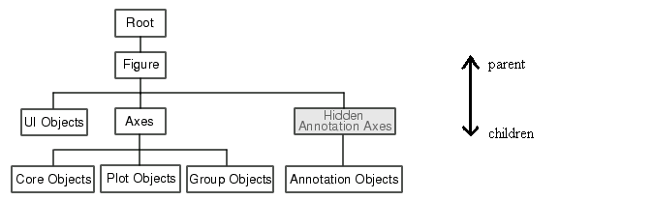
All graphic objects are organized into a "hierarchy of handle graphic objects." A diagram of such a hierarchy is shown below.
Each rectangle represents a graphic object type. You cannot change or manipulate this hierarchy of objects, but if you know the handle to a single graphics object, then you can use the hierarchy to access related graphic objects.
Notes:
http://cse.unl.edu/~sincovec/Matlab/Lesson%2026/CS211%20Lesson%2026%20-%20Handle%20Graphics.htm

Slide 10
major graphical object types:
  Root
    The single object corresponding to the computer's screen on which graphics may be displayed.
    There is only one (1) root object.
    The handle to the root is always zero (0).
Notes:
http://cse.unl.edu/~sincovec/Matlab/Lesson%2026/CS211%20Lesson%2026%20-%20Handle%20Graphics.htm

Slide 11
major graphical object types:
  Figure
    A figure window on the graphic screen.
    There can be zero (no figures on the screen) or more figure objects (each a child of the root).
Notes:
http://cse.unl.edu/~sincovec/Matlab/Lesson%2026/CS211%20Lesson%2026%20-%20Handle%20Graphics.htm

Slide 12
major graphical object types:
  Axes
    A rectangular coordinate system within a figure window.
    There can be zero or more axes objects per figure object. (Remember the subplot() function?)
    The parent object of an axes object is always a figure object.
Notes:
http://cse.unl.edu/~sincovec/Matlab/Lesson%2026/CS211%20Lesson%2026%20-%20Handle%20Graphics.htm

Slide 13
major graphical object types:
  line (an example of a Plot Object)
    A Line drawn within an axes.
    There can be zero or more Line objects per axes object.
    The parent object of a line object is always an axes object.
Notes:
http://cse.unl.edu/~sincovec/Matlab/Lesson%2026/CS211%20Lesson%2026%20-%20Handle%20Graphics.htm

Slide 14
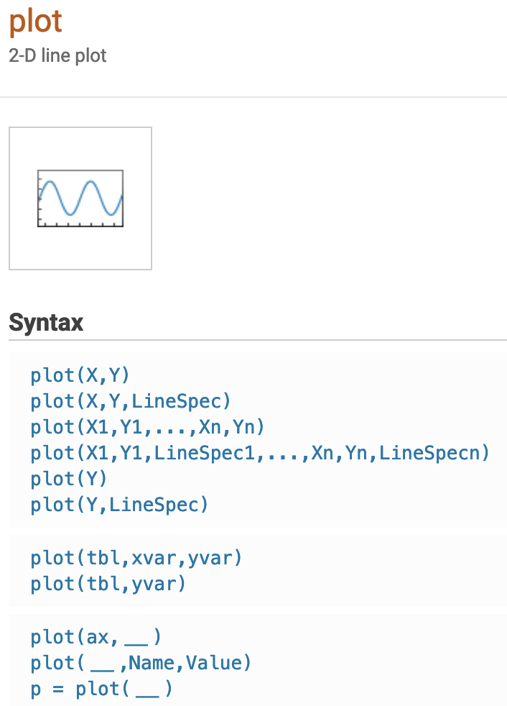
We usually don’t know (or care) that Matlab graphics is object-oriented.
We just call the "function" plot with some parameters.
But if you look at the documentation for plot the last line of the syntax shows it returning something.
plot returns a chart line object with the "handle" p.

Slide 15
>> x=0:.1:1;
>> y=x.^2;
>> p=plot(x,y)
p = Line with properties:
Color: [0 0.447000000000000 0.741000000000000]
LineStyle: '-'
LineWidth: 0.500000000000000
Marker: 'none'
MarkerSize: 6
MarkerFaceColor: 'none'
XData: [0 0.100000000000000 0.200000000000000 0.300000000000000 0.400000000000000 … ] (1×11 double)
YData: [0 0.010000000000000 0.040000000000000 0.090000000000000 0.160000000000000 … ] (1×11 double)
Show all properties
If we put a variable on the LHS when we call plot we get handle with a copy of the object.
It has the data (XData, YData), and (meta?)data on the plot such as the LineStyle, LineWidth, etc.

Slide 16
AffectAutoLimits: on
AlignVertexCenters: off
Annotation: [1×1 matlab.graphics.eventdata.Annotation]
BeingDeleted: off
BusyAction: 'queue'
ButtonDownFcn: ''
Children: [0×0 GraphicsPlaceholder]
Clipping: on
Color: [0 0.447000000000000 0.741000000000000]
ColorMode: 'auto'
ContextMenu: [0×0 GraphicsPlaceholder]
CreateFcn: ''
DataTipTemplate: [1×1 matlab.graphics.datatip.DataTipTemplate]
DeleteFcn: ''
DisplayName: ''
HandleVisibility: 'on'
HitTest: on
Interruptible: on
LineJoin: 'round'
LineStyle: '-'
LineStyleMode: 'auto'
LineWidth: 0.500000000000000
Marker: 'none'
MarkerEdgeColor: 'auto'
MarkerFaceColor: 'none'
MarkerIndices: [1 2 3 4 5 6 7 8 9 10 11]
MarkerMode: 'auto'
MarkerSize: 6
Parent: [1×1 Axes]
PickableParts: 'visible'
Selected: off
SelectionHighlight: on
SeriesIndex: 1
SourceTable: [0×0 table]
If we click on
show All Properties
We get a display of the object to the screen (note - only shows an example if something is too long.
Tag: ''
Type: 'line'
UserData: []
Visible: on
XData: [0 0.100000000000000 0.200000000000000 0.300000000000000 0.400000000000000 … ] (1×11 double)
XDataMode: 'manual'
XDataSource: ''
XVariable: ''
YData: [0 0.010000000000000 0.040000000000000 0.090000000000000 0.160000000000000 … ] (1×11 double)
YDataMode: 'manual'
YDataSource: ''
YVariable: ''
ZData: [1×0 double]
ZDataMode: 'auto'
ZDataSource: ''
ZVariable: ''

Slide 17
In this case we are getting an "instance" of the object in the "handle" p.
(The object has an abstract definition, an "instance" of the object is the collection of data and methods in memory following that abstract definition).

Slide 18
Finding the class of an object (don't know why not identified in object).
>> plotclass=class(p)
plotclass = 'matlab.graphics.chart.primitive.Line'
Finding the methods of the class
>> methods(class(p))
Methods for class matlab.graphics.chart.primitive.Line:
Line addprop eq get java reset addlistener double … findobj isprop ne set
Static methods:
Loadobj
Methods of matlab.graphics.chart.primitive.Line inherited from handle.

Slide 19
We can get the "data" items out of an instance of the object using the handle and addressing them like a structure
>> p.XData
ans = Columns 1 through 6
0 0.100000000000000 0.200000000000000 0.300000000000000 0.400000000000000 0.500000000000000
Columns 7 through 11
0.600000000000000 0.700000000000000 0.800000000000000 0.900000000000000 1.000000000000000
>> p.LineStyle
ans = '-'

Slide 20
We can use the handle p, like a structure, to change the properties of the plot by changing the data in the object.
(You an also use set if you like to type)
p.LineStyle='-.';

Slide 21
x = linspace(-2*pi,2*pi);
y1 = sin(x);
y2 = cos(x);
p = plot(x,y1,x,y2);
>> p
p =
2×1 Line array:
Line
Line
>>
p(1).LineWidth = 2;
p(2).Marker = '*';
plot call makes 2 Line objects in an array.
Change the properties of the plots.
Here the first element of h has the sin, and the second the cos.
(we will see shortly this implies plot plots them from right to left, y2, then y1)

Slide 22
>> p=plot(1:10);
hold on
plot([1:10].^2);
h = findobj('Type','line')
h = 2×1 Line array:
Line
Line
>> h(1)
ans = Line with properties:
Color: [0.850000000000000 0.325000000000000 0.098000000000000]
LineStyle: '-'
LineWidth: 0.500000000000000
Marker: 'none'
MarkerSize: 6
MarkerFaceColor: 'none'
XData: [1 2 3 4 5 6 7 8 9 10]
YData: [1 4 9 16 25 36 49 64 81 100]
Show all properties
If you forget to set the handle, you can get a list of (new) handles for all the graphics objects with findobj.
>> h(2)
ans =
Line with properties:
Color: [0 0.447000000000000 0.741000000000000]
LineStyle: '-'
LineWidth: 0.500000000000000
Marker: 'none'
MarkerSize: 6
MarkerFaceColor: 'none'
XData: [1 2 3 4 5 6 7 8 9 10]
YData: [1 2 3 4 5 6 7 8 9 10]
Show all properties

Slide 23
>> p=plot(1:10);
hold on
plot([1:10].^2);
h = findobj('Type','line');
whos
Name Size Bytes Class
p 1x1 8 matlab.graphics.chart.primitive.Line
h = findobj('Type','line');
>> whos
Name Size Bytes Class
h 2x1 16 matlab.graphics.chart.primitive.Line
p 1x1 8 matlab.graphics.chart.primitive.Line
h(1).Color='m';
h(2).Color='k';
Use the(new) handles to set data values.
p is the only variable.
Now we also have the 2x1 vector h.
Change the line colors
NOTICE: Numbers go "backwards", go by most recently drawn is (1), next most (2), etc. It is a stack - block on top is #1.
Notes:
Line drawn first, then quadratic, but when colors changes h(1) is quadratic, and h(2) is line

Slide 24
Here a is a structure.
It is not a handle to the object.
Here we have to use get.
Here can also do p.Linewidth=3 unless you just like to type as in example.
The set changes the plot
p = plot(1:10);
a=get(p)
>> a.LineWidth
ans = 0.500000000000000
get(p,"LineWidth")
p.LineWidth
ans = 0.500000000000000
set(p,"Linewidth",3)
>> whos a
Name Size Bytes Class
a 1x1 9614 struct

Slide 25
>> clear
close all
x = linspace(0,7);
y = ones(length(x),9);
for i = 1:9
y(:,i) = sin(x-i/5)';
end
plot(x,y)
ax = gca;
ax.LineStyleOrder = {'-','--',':'};
>> clear
close all
x = linspace(0,7);
y = ones(length(x),9);
for i = 1:9
y(:,i) = sin(x-i/5)';
end
plot(x,y)
colororder({'red','green','blue'})
ax = gca;
ax.LineStyleOrder = {'-','--',':'};
>>
colororder seems to have precedence over LineStyleOrder
Top figure goes through the default color order, then the line style.
Bottom goes through 3 colors then to next line style.
Get current axis handle
Notes:
gca gets handle of current axis
https://www.mathworks.com/help/matlab/ref/findobj.html

Slide 26
Most plotting functions support name-value pair arguments, and an un-named argument (one of r,g,b,m,c,y,k,w – for red, green, blue, magenta, cyan, yellow, black, and white, and LineStyle as one of '-', the default, '- -', for dashed, '.-', for dot-dash, ':', for dotted, 'o', for unfilled circles, '+', for plus sign, and '*', for asterisk) to specify color.
plot(1:10,1:10,'b-.','LineWidth',3)

Slide 27
Handles are pass by reference, not pass by value.
Changes are "shared" with calling routine/everybody.
When the argument is a handle variable, the function copies only the handle, not the object identified by that handle.
Both handles (original and local copy) refer to the same object.
When the function modifies the data referred to by the object handle, those changes are accessible from the handle variable in the calling workspace without the need to return the modified object.
Notes:
https://www.mathworks.com/help/matlab/matlab_oop/handle-objects.html

Slide 28
load gong
whos
Name Size Bytes Class
Fs 1x1 8 double
y 42028x1 336224 double
gongSound = audioplayer(y,Fs);
play(gongSound)
>> gongSound2 = gongSound;
>> disp(gongSound.SampleRate);
8192
>> disp(gongSound2.SampleRate);
8192
>> gongSound.SampleRate = gongSound.SampleRate*2;
>> disp(gongSound.SampleRate);
16384
>> disp(gongSound2.SampleRate);
16384
not like functions, where changing parameters in the function do not affect values of varaibles in the calling routine.
Notes:
https://www.mathworks.com/help/matlab/creating_plots/how-to-work-with-graphics-objects.html

Slide 29
What You Cannot Do with Handles
Handles variables are objects.
Do not attempt to perform operations involving handles that convert handles to a numeric, character, or any other type.
For example, you cannot:
Perform arithmetic operations on handles.
Use handles directly in logical statements without converting to a logical value.
Rely on figure handles numeric values (integers) in logical statements.
Combine handles with data in numeric arrays.
Convert handles to character vectors or use handles in character vector operations.
Notes:
https://www.mathworks.com/help/matlab/creating_plots/how-to-work-with-graphics-objects.html

Slide 30
Determine if an Object Is a Handle
Handle objects are members of the "handle" class.
Therefore, you can always identify an object as a handle using the isa function.
isa returns logical true (1) when testing for a handle variable:
load gong
Fs y
gongSound = audioplayer(y,Fs); isa(gongSound,'handle')
To determine if variable is valid handle object, use isa & isvalid:
if isa(gongSound,'handle') && isvalid(gongSound) ... end

Slide 31
For interactive analysis can make figures with tabs.
White background tab is active, grey is inactive,
select tab to view by clicking/selecting with cursor.
figure
tab1 = uitab('Title','Tab1');
ax1 = axes(tab1);
plot(ax1,1:10)
tab2 = uitab('Title','Tab2');
ax2 = axes(tab2);
surf(ax2,peaks)
Notes:
https://www.mathworks.com/help/matlab/ref/findobj.html
This code uses deprecated functions
Warning: In a future release, UI components will not be included in the output. To include UI components, use the exportapp
function.

Slide 32
t = uitab creates a tab inside a tab group and returns the Tab object.
If there is no tab group available, Matlab calls the figure function to create a figure.
It then creates a tab group in that figure and places the tab inside the tab group.
See - https://www.mathworks.com/help/matlab/ref/uitab.html
Notes:
https://www.mathworks.com/help/matlab/ref/uitab.html

Slide 33
Return all objects in the current figure and its descendants.
h = findobj(gcf)
gcf is a function to "get current figure"'s handle.
Findobj has lots properties – look at documentation.
Notes:
https://www.mathworks.com/help/matlab/ref/findobj.html
This code uses deprecated functions
Warning: In a future release, UI components will not be included in the output. To include UI components, use the exportapp
function.

Slide 34
>> h = findobj(gcf)
h = 8×1 graphics array:
Figure (1)
TabGroup
Tab (Tab1)
Tab (Tab2)
Axes
Axes
Line
Surface
Find all objects in the current figure.
There are 8 handles, h, with various graphics objects.
Notes:
https://www.mathworks.com/help/matlab/ref/findobj.html
This code uses deprecated functions
Warning: In a future release, UI components will not be included in the output. To include UI components, use the exportapp
function.

Slide 35
>> >> h(7)
ans = Line with properties:
Color: [0 0.447000000000000 0.741000000000000]
LineStyle: '-'
LineWidth: 0.500000000000000
Marker: 'none'
MarkerSize: 6
MarkerFaceColor: 'none'
XData: [1 2 3 4 5 6 7 8 9 10]
YData: [1 2 3 4 5 6 7 8 9 10]
>> h(7).LineWidth
ans = 0.500000000000000
>> h(7).LineWidth=10;
>> h(7).LineWidth
ans = 10
The seventh is the plot of the Line.
Big hint is that it is the only Line object.
Notes:
https://www.mathworks.com/help/matlab/ref/findobj.html
This code uses deprecated functions
Warning: In a future release, UI components will not be included in the output. To include UI components, use the exportapp
function.

Slide 36
TeX and LaTex
The default interpreter (thing that takes text and draws it on screen) during graphics is TeX, but it also understands LaTex.
The red gibberish is LaTeX code for the title, legend, and math.
Title is Greek letter
More Greek letters
Typeset Math
Draw shapes
clear
close all
plot(exp(2*pi*i*[0:.1:1]))
title('$\hat{\psi}$','Interpreter','latex')
hold on
plot([0:1])
legend('$\hat{\psi}$','$\hat{\chi}$','Interpreter','latex') % R2018b and later
elps = annotation('ellipse',[.625 .49 .045 .055]) %
str={'$\int_a^bu\frac{d^2v}{dx^2}\,dx =\left.u\frac{dv}{dx}\right|_a^b -\int_a^b\frac{du}{dx}\frac{dv}{dx}\,dx.$'}
annotation('textbox','interpreter','latex','String',str);
grid on
Notes:
https://www.mathworks.com/help/matlab/matlab_prog/insert-equations.html
https://stackoverflow.com/questions/36347303/adjusting-graphical-latex-text-size-in-matlab#:~:text=There%20is%20another%20method%20that,Latex's%20lower%20level%20font%20specification.&text=The%20first%20command%20%5Cfontsize%7B%7D,the%20rest%20of%20the%20text.

Slide 37
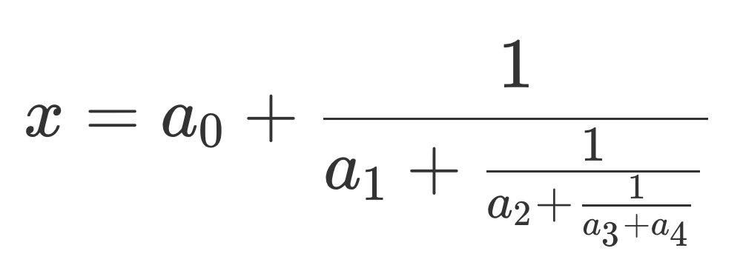
Typesetting continued fractions is easy:
str={'${a_0+\frac{1}{a_1+\frac{1}{a_2+\frac{1}{a_3+a_4}}}}$'}
annotation('textbox',[.5 .5 .2 .2],'interpreter','latex','String',str);
This is pretty much the antithesis of the WYSIWYG (an acronym for ”What You See Is What You Get”) philosophy of MS Word, Pages (Apples version of Word). etc.

Slide 38
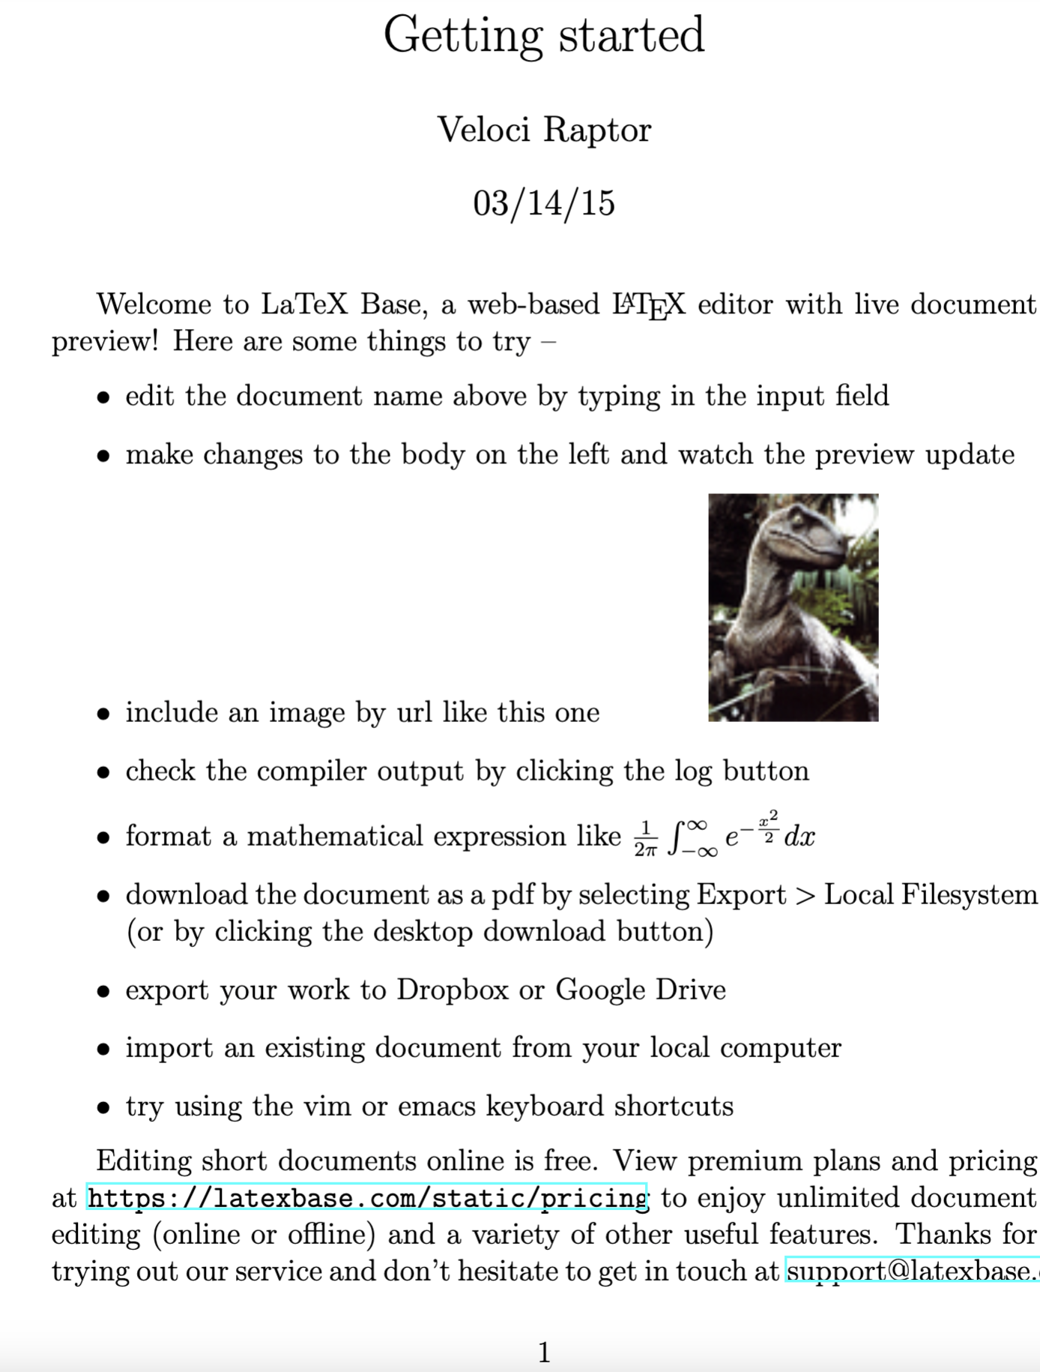
\documentclass[12pt]{article}
\usepackage{amsmath}
\usepackage{graphicx}
\usepackage{hyperref}
\usepackage[latin1]{inputenc}
\title{Getting started}
\author{Veloci Raptor}
\date{03/14/15}
\begin{document}
\maketitle
Welcome to LaTeX Base, a web-based \LaTeX{} editor with live document preview!
Here are some things to try --
\begin{itemize}
\item edit the document name above by typing in the input field
\item make changes to the body on the left and watch the preview update
\item include an image by url like this one
\hspace*{3em}
\includegraphics{https://latexbase.com/images/raptor.jpg}
\item check the compiler output by clicking the log button
\item format a mathematical expression like
$\frac{1}{2\pi}\int_{-\infty}^{\infty}e^{-\frac{x^2}{2}}dx$
\item download the document as a pdf by selecting Export $>$ Local
Filesystem (or by clicking the desktop download button)
\item export your work to Dropbox or Google Drive
\item import an existing document from your local computer
\item try using the vim or emacs keyboard shortcuts
\end{itemize}
Editing short documents online is free. View premium plans and pricing at
\url{https://latexbase.com/static/pricing} to enjoy unlimited document editing
(online or offline) and a variety of other useful features. Thanks for trying
out our service and don't hesitate to get in touch at
\href{mailto:support@latexbase.com}{support@latexbase.com}!
\end{document}
The gibberish on the left will make the pretty output on the right.

Slide 39
Problems with TeX interpreter interpreting the underscore (_)
These two work with no warnings or errors
title('This_title has an underline', 'Interpreter', 'none');
title('This\_title has an underline','Interpreter','latex')
This works, but throws a warning
title('This_title has an underline')
This prints out the "\", no warning
title('This\_title has an underline')
What happens also depends on the "state" as it is effected by what was done previously.
Notes:
“escape” means turn off some default behavior signified by a character and take the character as is and print it.
We will see this use of “escape” with unix, where many non-letters have some special meta-character meaning – as a wildcard, etc.

Slide 40
groot
groot refers to the graphics root object.
Use groot to access root properties.
For a list of properties, see Root Properties.
Notes:
https://www.mathworks.com/help/matlab/ref/groot.html

Slide 41
groot
r = groot
stores the graphics root object (matlab.ui.Root) handle.
To set root properties using dot notation, you must store the handle first.
r_structure=get(groot) this returns a structure not what we want
Notes:
https://www.mathworks.com/help/matlab/ref/groot.html

Slide 42
r =
Show all properties
CallbackObject: [0×0 GraphicsPlaceholder]
Children: [1×1 Figure]
CurrentFigure: [1×1 Figure]
FixedWidthFontName: 'Courier New'
HandleVisibility: 'on'
MonitorPositions: [1 1 2048 1280]
Parent: [0×0 GraphicsPlaceholder]
PointerLocation: [293 254]
ScreenDepth: 32
ScreenPixelsPerInch: 72
ScreenSize: [1 1 2048 1280]
ShowHiddenHandles: off
Tag: ''
Type: 'root'
Units: 'pixels'
UserData: []

Slide 43
groot
Now can set stuff using dot notation or set
r.ShowHiddenHandles = 'on';
Use the graphics root object to set default values on the root level for other types of objects.
For example, set the default colormap for all future figures to the summer colormap.
set(groot,'DefaultFigureColormap',summer)
Notes:
https://www.mathworks.com/help/matlab/ref/groot.html

Slide 44
New problem – finding the names of things.
Where did 'DefaultFigureColormap' come from?
Notes:
https://www.mathworks.com/help/matlab/ref/groot.html

Slide 45
Specify Default Values
Define default property value using character vector with 3 parts:
'default' ObjectType PropertyName
The word default
The object type (for example, Figure)
The property name (for example, Colormap)
A character vector specifying default line Colormap would be:
'DefaultFigureColormap'
Notes:
https://www.mathworks.com/help/matlab/creating_plots/default-property-values.html

Slide 46
Look at the root figure object
r=groot
Show all its properties
You will see one named "CurrentFigure", look at it, show all properties (an easier way to get all the properties programattically is to use rstruc=get(groot), this gives you all the info, but is not a handle to the object)
r.CurrentFigure you need the r=groot for this
You will see a property "Colormap"
If you look at that, r.CurrentFigure.Colormap, it will dump a colormap array to the screen
Notes:
Make a simple plot – plot([1:10]) and do above

Slide 47
groot
To restore a property to its original Matlab default, use the 'remove' keyword.
set(groot,'DefaultFigureColormap','remove')
Notes:
https://www.mathworks.com/help/matlab/ref/groot.html

Slide 48
Setting defaults for plotting
"Problems"
• linewidth on plots is too thin for figures.
• grid is too hard to see on figures.
• Etc.
Tired of setting "linewidth", etc.
Use get/set or groot to see and set properties of the root object.
These properties are inherited by all figures – so they set the defaults.
Notes:
https://www.mathworks.com/help/matlab/ref/groot.html

Slide 49
Set default LineWidth
Set(groot,'DefaultLineLineWidth',2)
I'm unable to figure out where the name DefaultLineLineWidth is constructed
Notes:
https://www.mathworks.com/help/matlab/ref/groot.html

Slide 50
Examples of setting some defaults:
set(groot,'defaultaxesfontname','Helvetica')
set(groot,'defaulttextfontname','Helvetica')
set(groot,'defaultaxesfontsize',15)
set(groot,'defaultaxesfontweight','Bold')
set(groot,'defaulttextfontsize',15)
set(groot,'defaulttextfontweight','Bold')
set(groot,'DefaultLineLineWidth',1.2)
set(groot,'DefaultFigureColor', 'white');
set(groot,'defaultAxesXGrid','on')
set(groot,'defaultAxesYGrid','on')
set(0,'defaultAxesYGrid','on') Also legal (handle #)
Notes:
https://www.mathworks.com/matlabcentral/answers/521914-is-there-any-way-to-have-grid-on-as-default
Notice format "default" "object type" "property name"

Slide 51
But
This works
set(groot,'DefaultLineLineWidth',1.2)
This does not (does not complain, so setting something legally, but getting overrided further down in the hierarchy of objects)
set(groot,'DefaultLineLineStyle',{'-.'})
Notes:
https://www.mathworks.com/matlabcentral/answers/521914-is-there-any-way-to-have-grid-on-as-default
Notice format "default" "object type" "property name"

Slide 52
Startup
startup executes user-specified commands when starting Matlab.
Matlab executes any file on the search path named startup that has an executable file extension.
Examples of an executable file extension are .m, .mlx, and .mlapp.
Notes:
https://www.mathworks.com/help/matlab/ref/startup.html

Slide 53
Startup
Create a startup.m file in the userpath folder, which is on the Matlab search path.
Add commands you want executed at startup.
For example, your code might include physical constants, defaults for graphics properties, engineering conversion factors, or anything else you want predefined in your workspace.
Notes:
https://www.mathworks.com/help/matlab/ref/startup.html

Slide 54
Example – my Startup.m
%format compact
format long
%this will turn off latex interpration (which was interpreting underscores
%to make following character a subscript)
set(groot, 'DefaultTextInterpreter', 'none')
%grid uses transparency, not line thickness, to set how "strong" it shows
%up, default is too weak (1 is no transparency, 0 is 100% transparency).
%this set will do it globally (including subroutines)
set(groot,'DefaultAxesGridAlpha',1);
%reset line width so can see lines
set(groot,'DefaultLineLineWidth',2)
%turn on grid, does by axis
set(groot,'defaultAxesXGrid','on')
set(groot,'defaultAxesYGrid','on')
Notes:
https://www.mathworks.com/help/matlab/ref/startup.html

Slide 55
How to set default property values
https://www.mathworks.com/help/matlab/creating_plots/default-property-values.html
How to see predefined graphics object properties
https://www.mathworks.com/help/matlab/graphics-object-properties.html
Notes:
https://www.mathworks.com/help/matlab/creating_plots/default-property-values.html

Slide 56
This web page has the documentation for all the graphics object properties
https://www.mathworks.com/help/matlab/graphics-object-properties.html
Go there to see how it is organized.

