Slide 1
CERI-8104 Data Analysis in Geophysics
Dr. Robert (Bob) Smalley
3892 Central Ave, Room 103
rsmalley@memphis.edu 678-4929
Fall 2023
Tu & Th 11:20 am -12:45 pm
Meeting 8 Sep 21, 2023
CERI New/Long Building: Student Computer Lab
Class webpage to be announced.
My homepage (has older versions of the course)
http://www.ceri.memphis.edu/people/smalley/

Slide 2
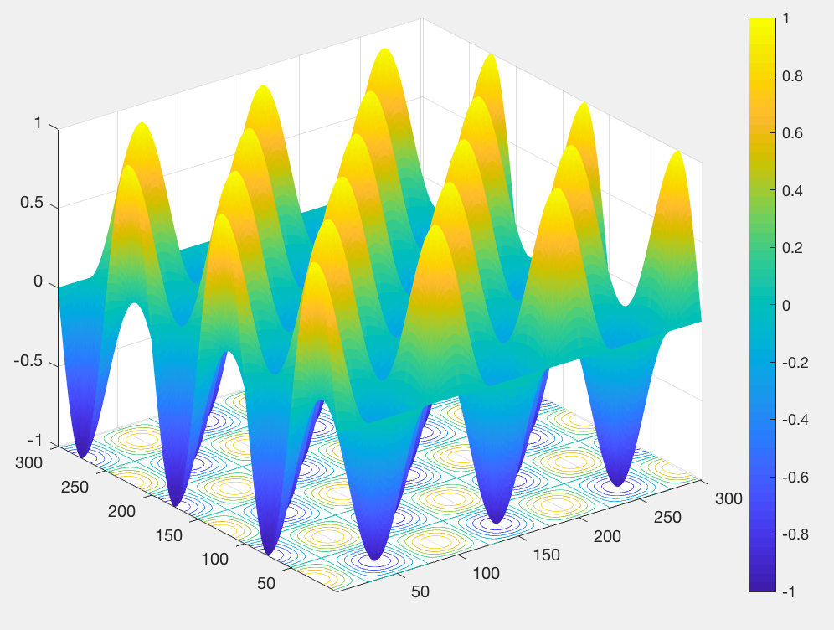
Can plot 3-d view with contour plot on xy plane.
Interactive, can rotate, sample, etc. this figure also
sc=surfc(xy,'EdgeColor','none')
colorbar

Slide 3
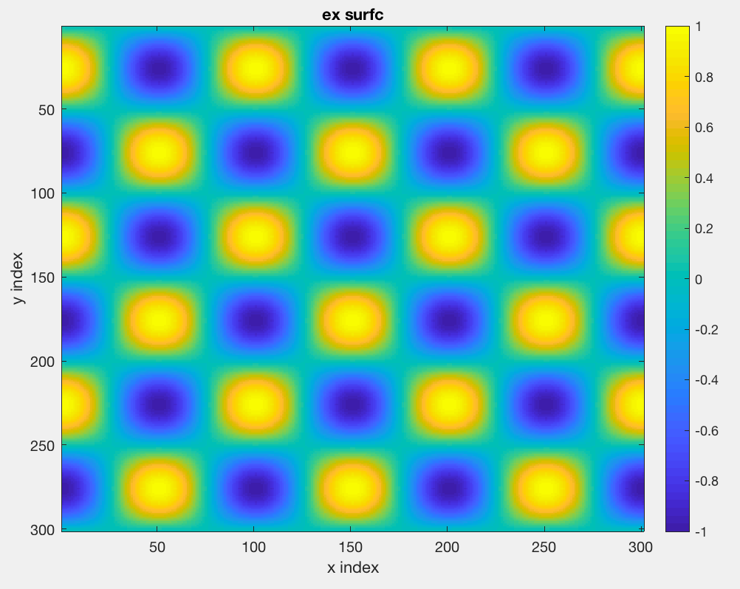
th=[0:300]/100*2*pi;
x=sin(th);
y=cos(th);
xy=x'*y;
imagesc(xy)
colorbar
xablel('x index')
ylabel('y index')
title('ex surfc’)
imagesc does not rotate.

Slide 4
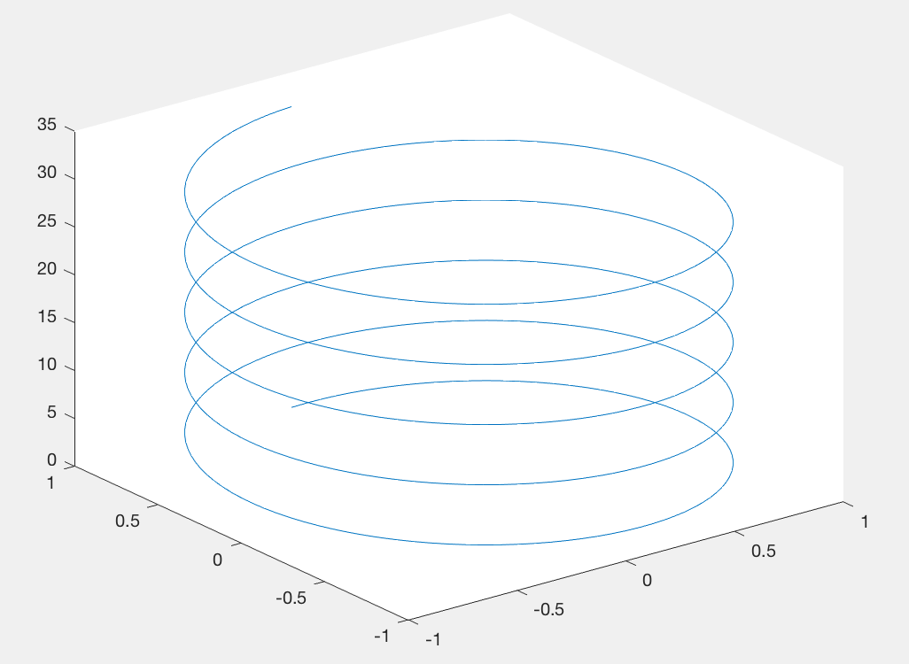
Plot in 3-d
t = 0:pi/50:10*pi;
plot3(sin(t),cos(t),t);
This is also interactive

Slide 5
Beyond simple array variables
Structures
Structures are like a suitcase, they contain lots of separate distinct things that you can take out and put in individually, and you can also pass the whole suitcase with its contents around.

Slide 6
Beyond simple array variables
A structure is a data type that groups related data using data containers called fields.
Each field can contain data of any type or size.
They are a very powerful way to organize data in your program.

Slide 7
Beyond simple array variables
The different fields of a structure can contain variables of different types, so if one gives the fields a meaningful name this becomes a great way to keep track of what’s there (self documenting).
In MATLAB one can define a structure (as any other variable) as one goes along, it adds memory as it needs it.

Slide 8
Can put any legal Matlab “thing” in a structure
Scalar,
Matrix,
Character vector,
String,
String vector,
Cell Array,
Structure,
Object,
Etc.
Notes:
Structure has character vector and matrix fields, and the character vectors and matrices are different sizes.

Slide 9
Structures
A structure is created by referring to the structure name and then the element name on the left hand sice.
The format is structure_name.field_name
S.name = 'Ed Plum';
S.score = 83;
S.grade = 'B+'
creates a scalar structure, S, with three fields:
S =
name: 'Ed Plum'
score: 83
grade: 'B+'
Notes:
With just one element it prints out all values of fields
Note the fields are different types of data, different length.

Slide 10
Structures
Ex: You could make a structure to control plotting
myplot.type='linear'; myplot.type='log'
myplot.color='r'; myplot.color='g';
myplot.line='+'; myplot.thick='2';
myplot.face='g'; myplot.outl='r';
Then in the plotting function, check for fields and their values to build the stuff you need.
Notes:
If no quotes on the field name, then matlab looks for a variable with that nam

Slide 11
To test for the existence of a field name
isfield(structure_name,'field_name')
NOTICE the quotes on the field name.
myplot.line=1;
myplot.type=2;
myplot
myplot =
struct with fields:
line: 1
type: 2
Returns logical
isfield(myplot,'type')
ans =
logical
1
isfield(myplot,'color')
ans =
logical
0

Slide 12
Structures
Can check for existence of multiple fields using cell array (cell arrays are next – use curly brackets { & } ) and character vectors
myplot.line=1;
myplot.type=2;
myfields={'line' 'color' 'type’} %not part structure
myfields = 1×3 cell array
{'line'} {'color'} {'type'}
isfield(myplot,myfields) %looking for these in myplot
ans = 1×3 logical array
1 0 1
reports myplot.line and myplot.type exist
Notes:
Need cell arrays because you need character vectors to define the fields.

Slide 13
Can make array (vector, matrix) of the of the structure
a collection of the "suitcases".
(note that the array indexing – parentheses with the index - is right after the structure name and before the ".")
S(2).name = 'Toni Miller'; %array is on S, not its elements
S(2).score = 91;
S(2).grade = 'A-’;
Notes:
Will see later that the elements of the structure can also be arrays and have a way to address the elements of these arrays (the elements of a structure can also be other structures – just keep producing more index references (index) ).
Does not print out whole structure – just summarizes its structure.
Note the field “name” is a different length than in S(1).

Slide 14
Getting more complicated
A struct array has the following properties:
All structs in the array have the same number of fields.
All structs have the same field names.
BUT
Fields of the same name in different array elements can contain different types or sizes of data.
Any unspecified fields for new structs in the array contain empty arrays.

Slide 15
Character strings can be different lengths for each element of S.
We started structure with
S.name = 'Ed Plum’;
(don’t need S(1).name %starts as scalar, makes matrix when add element)
S(2).name = 'Toni Miller'; %array on S, not its elements
S(2).score = 91;
S(2).grade = 'A-’;
Notes:
Will see later that the elements of the structure can also be arrays and have a way to address the elements of these arrays (the elements of a structure can also be other structures – just keep producing more index references (index) ).
Does not print out whole structure – just summarizes its structure.
Note the field “name” is a different length than in S(1).

Slide 16
Final way to add element to vector/matrix structure
can add an entire array element in a single statement
S(3) = struct('name','Jerry Garcia','score',70,'grade','C')
S =
1x3 struct array with fields:
name
score
grade
So now we have 3 "suitcases" with the data for 3 students.

Slide 17
Getting stuff out of vector/matrix structure
Sometimes get description of structure to the terminal
>> S
S = 1×3 struct array with fields:
name
score
grade
Sometimes get contents/data in structure to the terminal
>> S(1)
ans = struct with fields:
name: 'Ed Plum'
score: 83
grade: 'B+'
>> S(2)
ans = struct with fields:
name: 'Toni Miller'
score: 91
grade: 'A-'

Slide 18
Getting stuff out of vector/matrix structure
>> S(1:2)
ans =
1×2 struct array with fields:
name
score
grade
>>
Just the description to the terminal.
There is a problem with what to return to the terminal in terms of a data type and volume of information.

Slide 19
Used as a varaible, works as expected
>> SS=S
SS = 1×3 struct array with fields:
name
score
grade
>> S(1)
ans = struct with fields:
name: 'Ed Plum'
score: 83
grade: 'B+'
>> SS(1)
ans = struct with fields:
name: 'Ed Plum'
score: 83
grade: 'B+'
>>

Slide 20
Follows usual rules for indices
>> a=S(1:2)
a = 1×2 struct array with fields:
name
score
grade
Just description to terminal
But does what expected
Makes new vector/matrix
structure with copy of contents
>> a(1)
ans = struct with fields:
name: 'Ed Plum'
score: 83
grade: 'B+'
>> a(2)
ans = struct with fields:
name: 'Toni Miller'
score: 91
grade: 'A-'
Shows data in each "suitcase"

Slide 21
Fields can have different kinds of data in them.
Use student number rather than name
S(4) = struct('name',13245,'score',85,'grade','B=');
>> S.name
ans = 'Ed Plum'
ans ='Toni Miller'
ans = 'Jerry Garcia'
ans = 13245
By using just the structure name and field name it returns a list of the field values to the terminal.
More on this later.

Slide 22
Unfortunately, structure arrays don’t behave as one might expect. (hope?)
The following does not work
>> avg_score = sum(S.score)/length(S.score)
Error using sum
Invalid option. Option must be 'double', 'native', 'default', 'omitnan', 'includenan', 'omitmissing' or 'includemissing'.
Notes:
What does work is sum(S(n).score) – this will sum the vector/array score in the nth element of S.

Slide 23
The reason why it does not work is that it returns a “list” of the elements, each in a varaible named ans that gets reset as each element is returned.
It does not reutrn a vector of the elements.
>> s.score
ans =
83
ans =
91
ans =
70
Notes:
What does work is sum(S(n).score) – this will sum the vector/array score in the nth element of S.

Slide 24
To fix this, you have to make a vector out of what is returned
You make it a vector as you do any other list of elements
(NOTE – you hae to follow the rules for making vectors, all the fields have to be the same kind of varaible, size, etc.)
scores = [S.score] %scores is vector
83 91 70
avg_score = sum(scores)/length(scores)
81.3333
avg_score = mean([S.score]) % pull out “directly” into vector
avg_score =
81.3333
Notes:
What does work is sum(S(n).score) – this will sum the vector/array score in the nth element of S.

Slide 25
Example of structure and its use.
image.data=[1 2 3; 4 5 6; 7 8 9];
image.date='13-Jan-2008’;
image.blank=NaN;
image.ra=13.3212;
image.dec=43.3455;
Address element of structure using structure name, decimal point, and element name.
image.date
ans = '13-Jan-2008'

Slide 26
Example of structure and its use.
Operate on the fields as you would with any variable of that particular type.
This is an array element of the structure, not an array of structures.
Only get one ans, and it is an array
>> image.data
ans =
1 2 3
4 5 6
7 8 9

Slide 27
Example of structure and its use.
Ex., to invert the data matrix (reference works without the [] since this is a scalar structure (not a structure array), problem only when it is a vector and trying to be “vectorized”)
inv(image.data).

Slide 28
>> inv(image.data)
Warning: Matrix is close to singular or badly scaled. Results may be inaccurate. RCOND = 1.541976e-18.
ans =
1.0e+16 *
-0.4504 0.9007 -0.4504
0.9007 -1.8014 0.9007
-0.4504 0.9007 -0.4504
>> image.data*ans
ans =
2 0 2
8 0 0
16 0 8
>> image.data=rand(3)
image =
struct with fields:
data: [3×3 double]
date: '13-Jan-2008'
>> inv(image.data)
ans =
0.1431 -0.1931 1.1386
-2.6232 2.2081 -1.1955
1.3042 -0.0277 -0.2785
>> image.data*ans
ans =
1.0000 0.0000 -0.0000
0 1.0000 -0.0000
-0.0000 0.0000 1.0000

Slide 29
Structures can contain nested structures
patient(1).test=myplot;
patient(1)
ans =
struct with fields:
name: 'John Doe'
billing: 127
test: [1×1 struct]
patient(1).test
ans =
struct with fields:
type: 1
line: 2
Access suitcases within suitecases with same "." structure
patient(1).test.line
ans =
2

Slide 30
Structures can contain arrays (as we already saw)
ary=magic(3);
ary =
8 1 6
3 5 7
4 9 2
Make structure containing ary
a.b=ary;
Access elements of ary in usual manner
a.b(3,:)
ans =
4 9 2

Slide 31
Structures can contain arrays
Each array field in a vector/array strucutre is independent, the arrays in the fields can be a different size
ary(2).b=magic(4)
a =
1×2 struct array with fields:
b
a(2).b
ans =
16 2 3 13
5 11 10 8
9 7 6 12
4 14 15 1
>> ary.b
ans =
8 1 6
3 5 7
4 9 2
ans =
16 2 3 13
5 11 10 8
9 7 6 12
4 14 15 1

Slide 32
Structures can contain arrays
Each field of array is independent, the type of data in each field can be different
>> a.a=[1 2;3 4]; %1st, no index
>> a(2).a=[1 2 3; 4 5 6]
a = 1×2 struct array with fields:
a
>> a(1).a
ans =
1 2
3 4
>> a(2).a
ans =
1 2 3
4 5 6
>> a(3).a='ab';
a= 1×3 struct array with fields:
a
>> a.a
ans =
1 2
3 4
ans =
1 2 3
4 5 6
ans =
'ab'

Slide 33
Can access as vector when structure elemets are of different sizes when "consistent"
>> ary.mat=eye(2)=
ary = struct with fields:
mat: [2×2 double]
>> ary(2).mat=reshape(eye(4),2,8)
ary =
1×2 struct array with fields:
mat
>> ary(1)
ans = struct with fields:
mat: [2×2 double]
>> ary(2)
ans = struct with fields:
mat: [2×8 double]

Slide 34
>> ary.magik=magic(3)
ary = struct with fields:
magik: [3×3 double]
>> ary(2).magik=ary.magik'
ary = 1×2 struct array with fields:
magik
>> ary
ary = 1×2 struct array with fields:
magik
>> ary.magik
ans =
8 1 6
3 5 7
4 9 2
ans =
8 3 4
1 5 9
6 7 2
>> c=[ary.magik]
c =
8 1 6 8 3 4
3 5 7 1 5 9
4 9 2 6 7 2
Have to be careful – see what does when make vectors/matrices from structures
>> a=ary(1).magik
a =
8 1 6
3 5 7
4 9 2
>> b=ary(2).magik
b =
8 3 4
1 5 9
6 7 2
>> cc=[a b]
cc =
8 1 6 8 3 4
3 5 7 1 5 9
4 9 2 6 7 2

Slide 35
Can then do normal matrix ops to get the original matrices
>> c3d=reshape(cc,3,3,2)
c3d(:,:,1) =
8 1 6
3 5 7
4 9 2
c3d(:,:,2) =
8 3 4
1 5 9
6 7 2

Slide 36
Can access as vector when structure elements are of different sizes when "consistent"
>> ary.mat
ans =
1 0
0 1
ans =
1 0 0 0 0 1 0 0
0 0 1 0 0 0 0 1
>> [ary.mat]
ans =
1 0 1 0 0 0 0 1 0 0
0 1 0 0 1 0 0 0 0 1

Slide 37
Sometimes need to experiment to see what happens

