Slide 1
CERI-8104 Data Analysis in Geophysics
Dr. Robert (Bob) Smalley
3892 Central Ave, Room 103
rsmalley@memphis.edu 678-4929
Fall 2023
Tu & Th 11:20 am -12:45 pm
Meeting 7 Sep 18, 2023
CERI New/Long Building: Student Computer Lab
Class webpage to be announced.
My homepage (has older versions of the course)
http://www.ceri.memphis.edu/people/smalley/

Slide 2
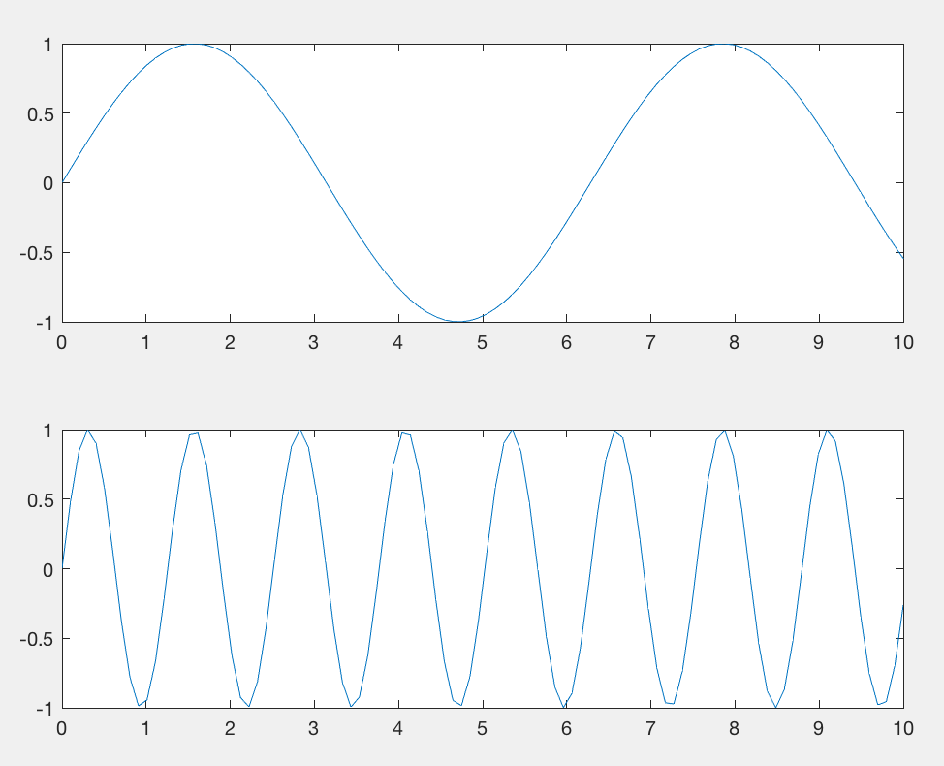
Multiple plots on one figure
Subplot has 3 inputs, the number of rows, columns, and the “position”. The position the row major index into the grid (matrix) defined by the rows and columns. To plot into multple grids use
a vector to specify the grids.
subplot(2,1,1);
x = linspace(0,10);
y1 = sin(x);
plot(x,y1)
subplot(2,1,2);
y2 = sin(5*x);
plot(x,y2)
<- 1 ->
1
^
|
2
|
v
2
Notes:
First 2 numbers are the number of rows and columns, third number is the figure number. Here 1 is top figure and 2 is bottom. Figure numbers go across, then down 1, across, etc.

Slide 3
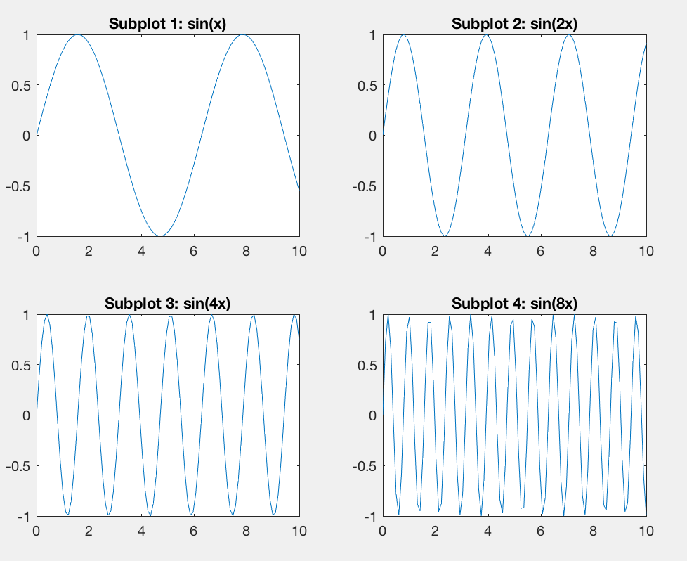
Multiple plots on one figure - symmetric
subplot(2,2,1)
x = linspace(0,10);
y1 = sin(x);
plot(x,y1)
title('Subplot 1: sin(x)')
subplot(2,2,2)
y2 = sin(2*x);
plot(x,y2)
title('Subplot 2: sin(2x)')
subplot(2,2,3)
y3 = sin(4*x);
plot(x,y3)
title('Subplot 3: sin(4x)')
subplot(2,2,4)
y4 = sin(8*x);
plot(x,y4)
title('Subplot 4: sin(8x)')
Divided 2x2, count plots from upper left to right, and down, then keep going.
1 2
3 4
<- 2 ->
^
|
2
|
v
Notes:
In subplot – first 2 numbers are #rows and columns – so this is 2x2. Then count across top, across next, etc.

Slide 4
Multiple plots on one figure not-symmetric, plus legend
subplot(2,2,1);
th=[0:300]/100*2*pi;
x=sin(th);
y=cos(th);
xy=x'*y;
imagesc(xy)
subplot(2,2,2);
surfc(xy)
sc=surfc(xy,'EdgeColor','none’)
subplot(2,2,[3,4]);
x = linspace(-3.8,3.8);
y_cos = cos(x);
y_poly = 1 - x.^2./2 + x.^4./24;
plot(x,y_cos,'b’,x,y_poly,’g’, …
‘Linewidth’,2);
legend({'cos' 'y_poly’})
grid on
<- 1 ->
1
2
^
|
2
|
v
3
[3,4]
4
Notes:
To combine plot positions.
Top right still interactive!

Slide 5
To get rid of variables and figures
clear variable list %clears listed variables from workspace
clear %clear all variables in workspace
(“clear all“ clears all the variables, unless there is a vaiaible “all”, in which case it clears only the variable “all”. )
“clear name_of_non_exisant_variable” does nothing (no msg)
clf %clears current figure
close all %closes all figures

Slide 6
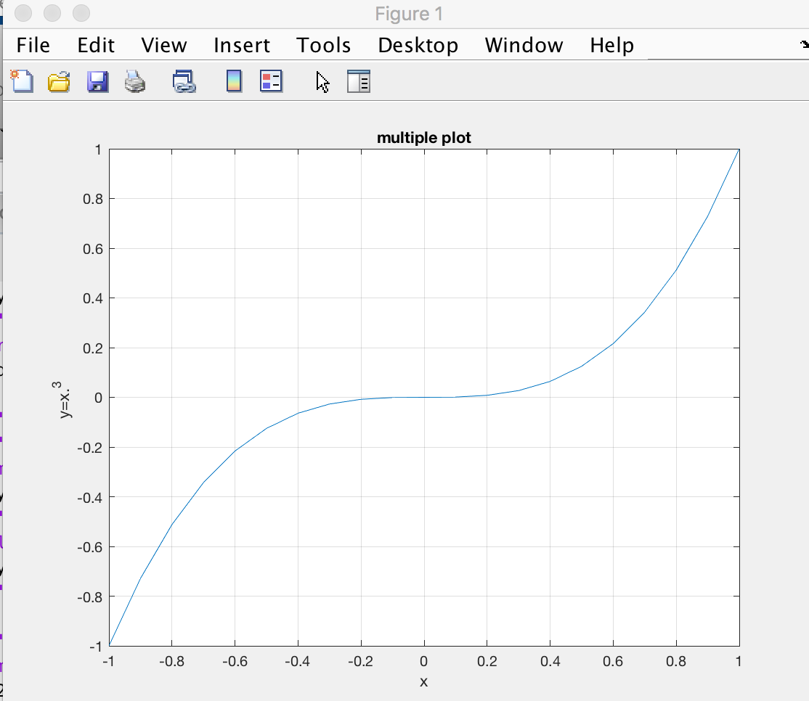
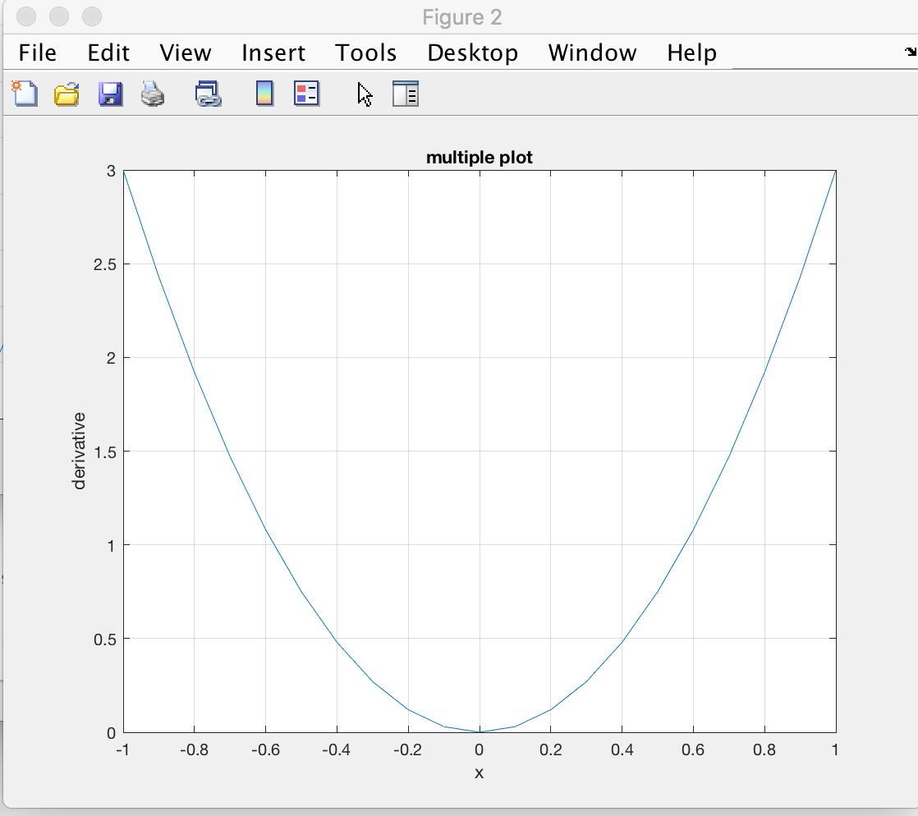
Multiple figures
x=-1:.1:1; y=x.^3; dy=3*x.^2;
plot(x,y)
ylabel('y=x.^3 ')
grid
xlabel('x')
title('multiple plot')
figure(2)
plot(x,dy)
grid
xlabel('x')
ylabel('derivative’)
title('multiple plot')
Notes:
Figure windows named figure 1 and figure 2 (all your figure windows so far were labeled figure 1)
Click on figure to bring it to top.
If you can’t see it, type figure(N) to bring figure(N) to top or use Windows drop down menu
You don't need the specify the first figure.
You must call figure to open new figures, Matlab will keep track of numbers or you can.
If you reuse a. number is will draw in that figure, whether or not is erases the existing figure depends on the hold state for that figure.

Slide 7
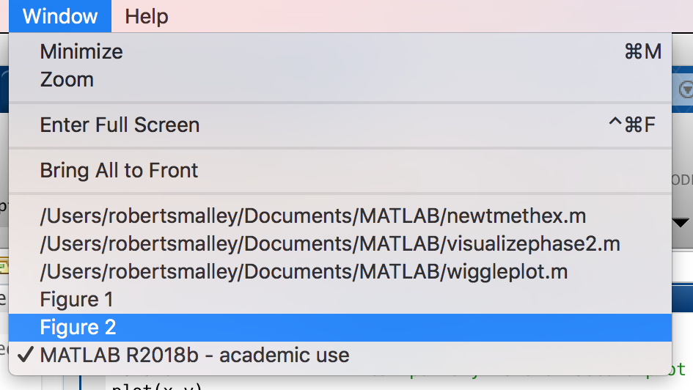
Multiple figures
x=-1:.1:1; y=x.^3; dy=3*x.^2;
plot(x,y)
ylabel('y=x.^3 ')
grid
xlabel('x')
title('multiple plot')
figure(2)
plot(x,dy)
grid
xlabel('x')
ylabel('derivative’) title('multiple plot')
Notes:
Figure windows named figure 1 and figure 2 (all your figure windows so far were labeled figure 1)
Click on figure to bring it to top.
If you can’t see it, type figure(N) to bring figure(N) to top or use Windows drop down menu
You probably don't remember what is in the figures by number, so which do you pick to veiw, or modify?

Slide 8
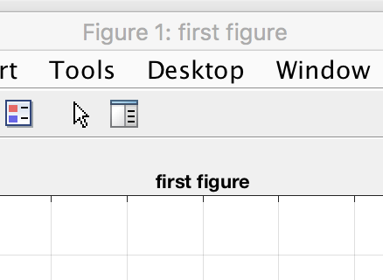
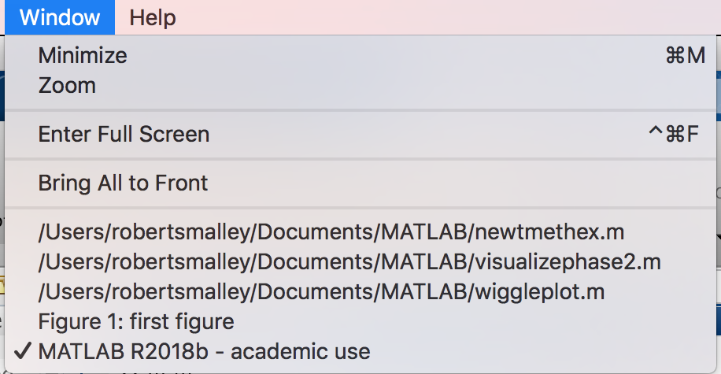
Multiple figures
figname="first figure";
f(1)=figure('Name',figname); %the handle f(1) is optional
plot(x,y)
ylabel('y=x.^3 ');
grid; xlabel('x')
title(figname)
Notes:
Now have figure window title, figure name, and pull down under windows all the same so you don’t get lost selecting one of many figures – and you can find the code that made the figure looking for the name.
You can save the handle for further manipulation of the figure.
We now have a title (bottom most) and the figure is both numbered and named.
The name can be different than the title.
We get the figure names in the dropdown menu.

Slide 9
Multiple figures
If you used the f(1) you now have a vector f, of structures, whose first element has metadata for this figure.
f(1)=figure('Name',figname);
f(1)
ans =
Figure (1: first figure) with properties:
Number: 1
Name: 'first figure'
Color: [0.9400 0.9400 0.9400]
Position: [440 378 560 420]
Units: 'pixels’
Show all properties

Slide 10
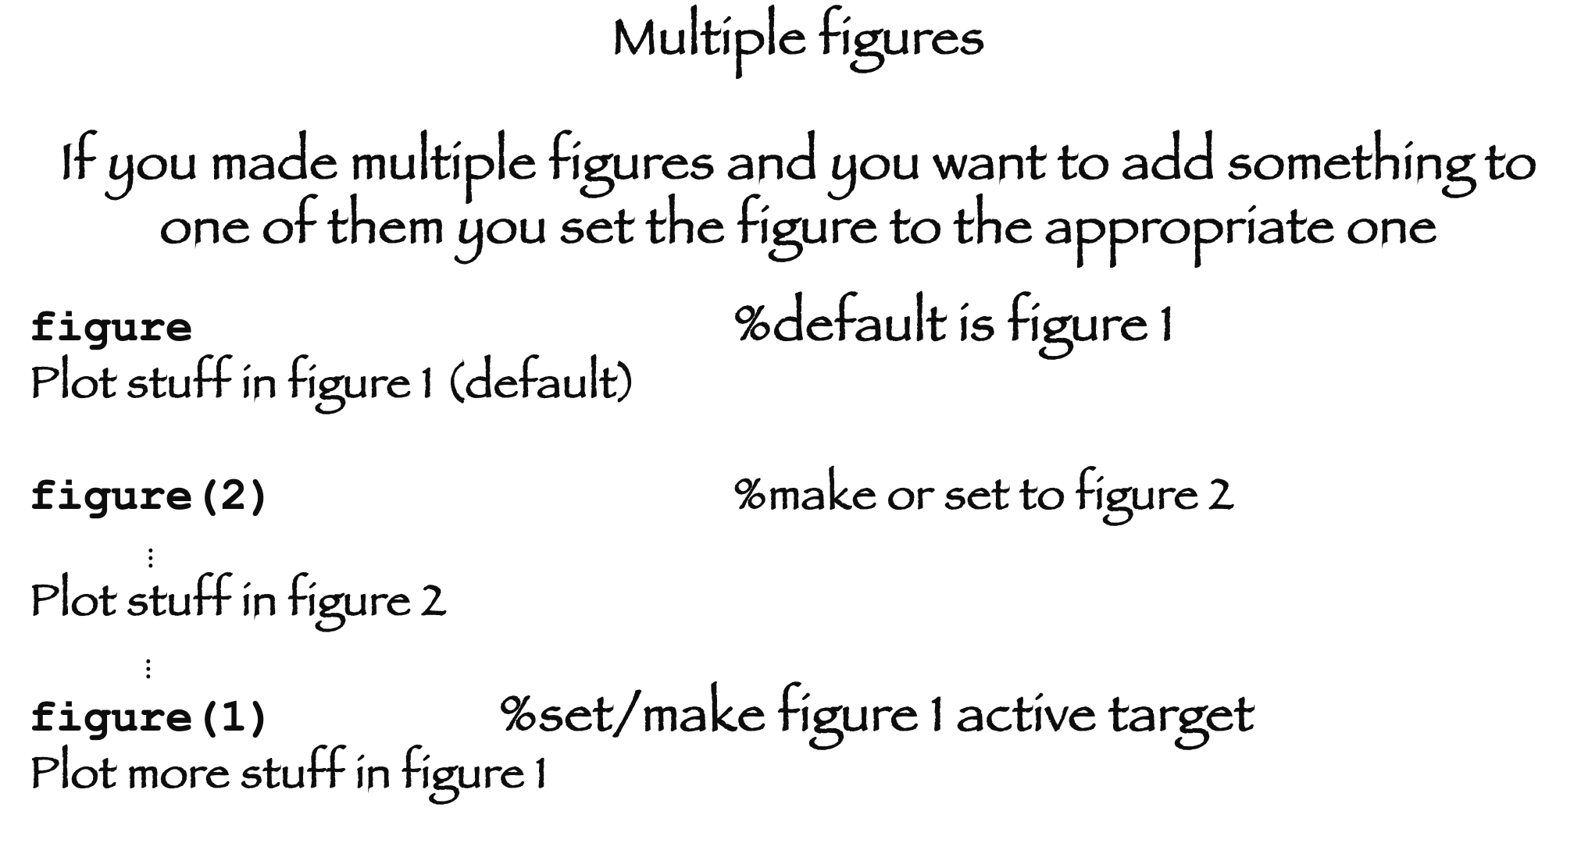
Multiple figures
If you made multiple figures and you want to add something to one of them you set the figure to the appropriate one
figure %default is figure 1
Plot stuff in figure 1 (default)
figure(2) %make or set to figure 2
$⋮$
Plot stuff in figure 2
$⋮$
figure(1) %set/make figure 1 active target
Plot more stuff in figure 1

Slide 11
Multiple figures
Can use variables for the figure counting
figno=1;
Figure(figno)
Plot stuff in figure figno (=1)
figno=figno+1;
figure(figno)
Plot stuff in figure figno (now =2)
selfig=2;
figure(selfig) %make figure selfig=2 active
Plot more stuff on figure selfig=2
Notes:
This way the program keeps track of the figure numbering – don’t have to start at 1.

Slide 12
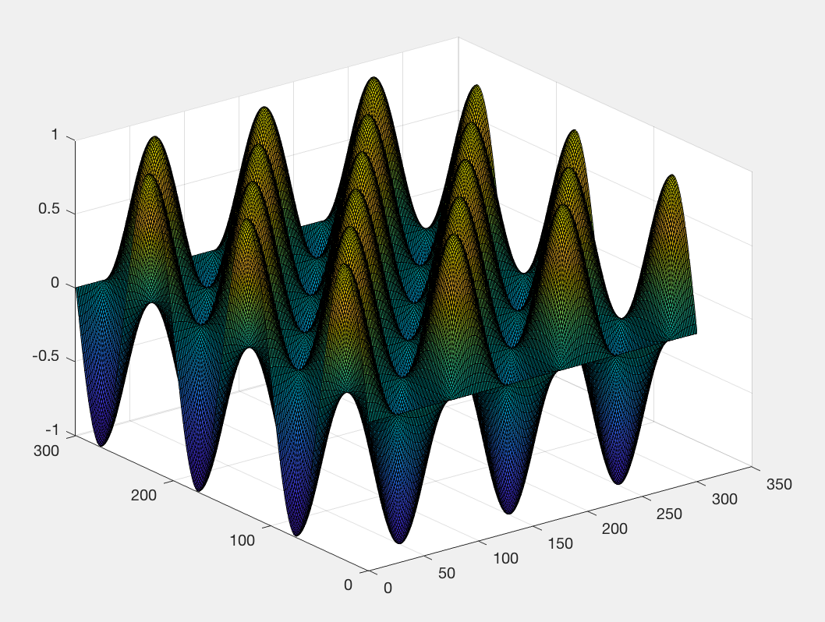
Make vari th with 3 cycles with step of.01.
x=sin(th);
y=cos(th);
xy=x'*y;
s=surf(xy) s is fig
handle
surface plot is
Interactive –
you can
rotate it in
3-d, examine
data points.
But pretty ugly! (too dark)
Notes:
Dark because drawing black lines on edges to all the little facets and they are very small.
Notice the s= on the surf call.
s = surf(___) returns the chart surface object.
https://www.mathworks.com/help/matlab/ref/surf.html?searchHighlight=surf&s_tid=doc_srchtitle
Use s to modify the surface after it is created. For a list of properties, see Surface Properties.
https://www.mathworks.com/help/matlab/ref/matlab.graphics.chart.primitive.surface-properties.html
See here for LOTS of stuff you can change!

Slide 13
>>s
s =
Surface with properties:
EdgeColor: [0 0 0]
LineStyle: '-'
FaceColor: 'flat'
FaceLighting: 'flat'
FaceAlpha: 1
XData: [1×301 double]
YData: [301×1 double]
ZData: [301×301 double]
CData: [301×301 double]
Show all properties
To “fix” look at properties using figure handle
This is the culprit, draws black lines around faces/facets.
Notes:
Is too dark because of the black lines drawing the edges

Slide 14
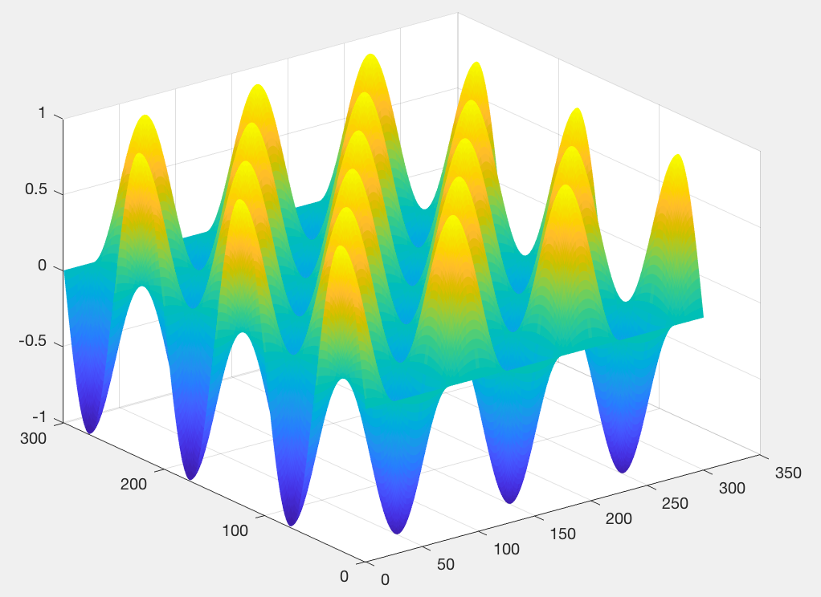
Use s to access and modify properties of the surface object after it is created.
For example, the culprit here is the edge color. Hide the edges by setting the EdgeColor property.
s.EdgeColor = 'none';

Slide 15
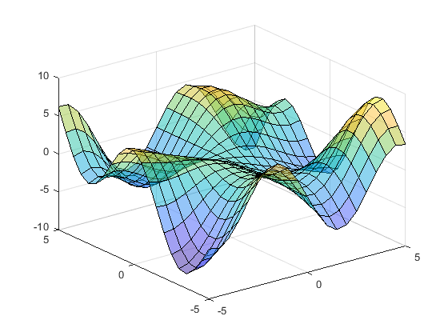
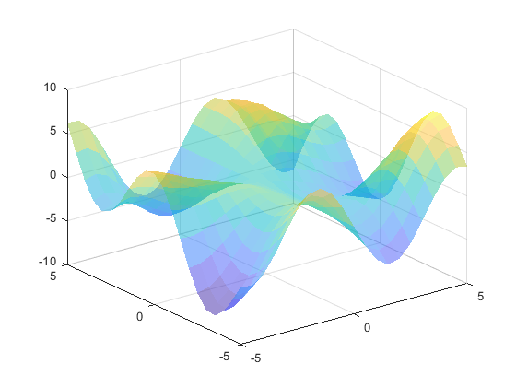
If the facets in your plot were bigger you would see them nicely
With facets edges outlined
With facet edges turned off. (can still see facets)

Slide 16
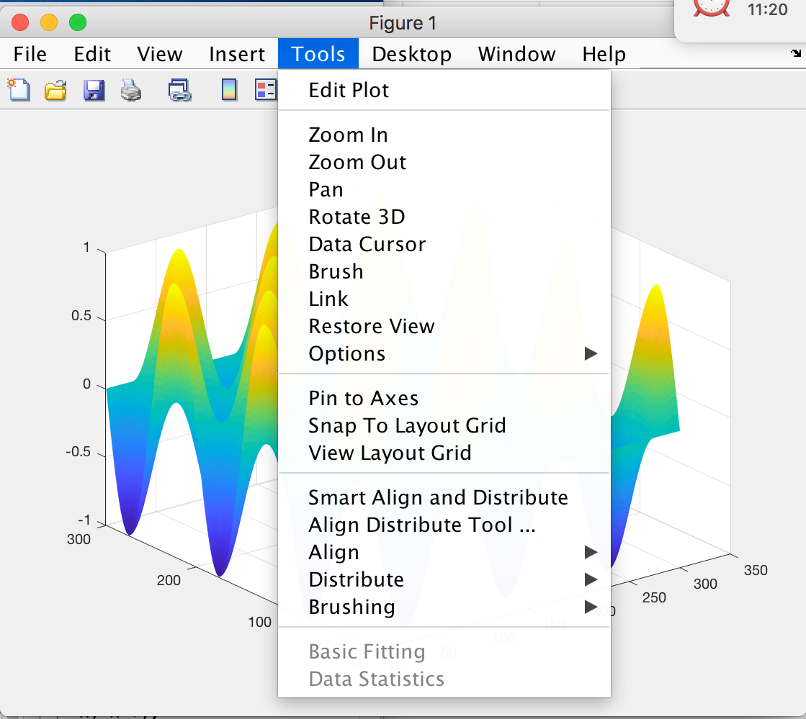
This figure is interactive – you can do lots of stuff with it.
Notes:
Drop down menu for interacting with figure --

