Slide 1
CERI-8104 Data Analysis in Geophysics
Dr. Robert (Bob) Smalley
3892 Central Ave, Room 103
rsmalley@memphis.edu 678-4929
Fall 2023
Tu & Th 11:20 am -12:45 pm
Meeting 6 Sep 14, 2023
CERI New/Long Building: Student Computer Lab
Class webpage to be announced.
My homepage (has older versions of the course)
http://www.ceri.memphis.edu/people/smalley/

Slide 2
Returning to Functions after vectorization discussion
Simple function – starts with “function”, then function_output=function_name(function_input)
function expval = exponent(x, y)
%% raises elements of input x to
%the power y (default is 2)
%inputs are scalar numbers
if nargin == 1
y = 2;
end
expval = x^y;
end
Notes:
Using variable number of inputs to function
nargin has the number of arguments

Slide 3
Functions
This function has a major weakness
It does not follow MATLAB philosophy of working with MATRICES and is not vectorized.
How do we fix this?
First we have to define what we want it to do.
Raise all elements to same power?
Raise each element to specified power?
Raise matrix to a specified power”
Choose what to do depending on input?

Slide 4
Functions
Let’s vectorize our function.
Decide to do element by element (“.”)
function expval = exponent_vec(x, y)
%raises input x to the power y (default is 2)
%inputs are vectors of matching length or matrices of
%matching size, an n x 1 vector by a 1 x m vector will
%produce an n x m matrix output, or if short one dimension
%built in singleton expansion
%undefined for greater than 2 dimensions
if nargin == 1
y = 2;
end
expval = x.^y;
end
Notes:
What if first argument is a matrix?
No second argument – y is scalar and can so x.^scalar
Second argument is scalar – same as default
Second argument is vector – if matrix MxN matches Mx1 or 1xN, does it column or row wise
Second argument is matrix – has to be same size MxN (cant be 1xNM or NMx1)
NOTE – in function don't need %% to indicate start help doc string, help function name will pull out first comment block

Slide 5
Functions
Let’s fix it to check the input
function expval = exponent_vec(x, y)
% raises input x to the power y (default is 2)
%inputs are vectors of matching length or matrices of
%matching size, an n x 1 vector by a 1 x m vector will
%produce an n x m matrix output, or if short one dimension
%built in singleton expansion
%undefined for greater than 2 dimensions
if nargin == 1
y = 2;
elseif nargin > 2
error('Wrong number input arguments, must be 1 or 2')
end
assert(isnumeric(x), 'x not numeric')
assert(isnumeric(y), 'y not numeric’)
expval = x.^y;
end
Notes:
Red – doing something useful
Green – overhead – documentation
Blue – proecessing errors
Blue – overhead – testing

Slide 6
Functions
Let’s fix it to check the input
There is much more checking we could do here
- Check both parameters are numbers
- Check sizes of matrices are legal/consistent
Notes:
Red – doing something useful
Green – overhead – documentation
Blue – proecessing errors
Blue – overhead – testing

Slide 7
Pulling values out of matrices.
Say I want to find all the elements in a vector/matrix that meet a condition.
There are several ways to do this.

Slide 8
Testing/Pulling values out of matrices.
>> a=rand(3)
a =
0.296675873218327 0.507858284661118 0.801014622769739
0.318778301925882 0.085515797090044 0.029220277562146
0.424166759713807 0.262482234698333 0.928854139478045
>> b=a<.5
b =
3×3 logical array
1 0 0
1 1 1
1 1 0
>> c=a(b)
c =
0.296675873218327
0.318778301925882
0.424166759713807
0.085515797090044
0.262482234698333
0.029220277562146
Applies the test to each element of a and returns a matrix of logical values with the result of the test: true=1 false=0.
To get the values out – can use matrix b.
Note output is vector with only the data that met the condition in same order as in matrix.
Can’t get back to the elements (index) of the original vector.
Notes:
Applies the test to each element of a and returns a matrix of logical values with the result of the test: true=1 false=0
To get the values – can use matrix b
Note output is vector and possibly a different size.
I can’t get back to the elements (index) of the original vector.

Slide 9
Testing/Pulling values out of matrices.
Do directly.
>> a=rand(3)
a =
0.296675873218327 0.507858284661118 0.801014622769739
0.318778301925882 0.085515797090044 0.029220277562146
0.424166759713807 0.262482234698333 0.928854139478045
>> b=a(a<=.5)
b =
0.296675873218327
0.318778301925882
0.424166759713807
0.085515797090044
0.262482234698333
0.029220277562146
Applies the test to each element of a and returns the ones that pass.
Note output is vector with only the data that met the condition in same order as in matrix.
Can’t get back to the elements (index) of the original vector.
Notes:
Applies the test to each element of a and returns the ones that pass.
Note output is vector and possibly a different size.
I can’t get back to the elements (index) of the original vector.

Slide 10
If I want to get the indices so I can keep track of where they came from in 2d
>> [row col]=find(a<=.5)
row =
2
2
1
2
col =
1
2
3
3
Unfortunately
a(row,col)
is not going to get these elements back out.
It gives all combinations of the values in row and col (singleton expansion)
Notes:
Unfortunately this is for your own edification as you can’t use row and col directly to get the elements!!
Applies the test to each element of a and returns the ones that pass.
Note output is 2 vectors.
Row column used to do something useful – gave back elements row(k),col(k), now does singleton expansion and gives back all combos.
Have to use linear form

Slide 11
If you try to use vectors to specify row and col pairs to pull elements out of a this is what you get
>> a
0.964888535199277 0.800280468888800 0.959492426392903
0.157613081677548 0.141886338627215 0.655740699156587
0.970592781760616 0.421761282626275 0.035711678574190
0.957166948242946 0.915735525189067 0.849129305868777
0.485375648722841 0.792207329559554 0.933993247757551
>> a([1 2 3 3] ,[1 1 1 2])
0.964888535199277 0.964888535199277 0.964888535199277 0.800280468888800
0.157613081677548 0.157613081677548 0.157613081677548 0.141886338627215
0.970592781760616 0.970592781760616 0.970592781760616 0.421761282626275
0.970592781760616 0.970592781760616 0.970592781760616 0.421761282626275
Elements from rows
[1 2 3 3] and column 1
Same as first column, but second index now next element here (is same)
Same as first column, but second index now next element here (is still the same)
Elements from rows
[1 2 3 3] and second index now says column 2 (is different)
Notes:
Unfortunately this is for your own edification as you can’t use row and col directly to get the elements!!
Applies the test to each element of a and returns the ones that pass.
Note output is 2 vectors.
Row column used to do something useful – gave back elements row(k),col(k), now does singleton expansion and gives back all combos.
Have to use linear form

Slide 12
Pulling values out of matrices
Matlab can usually only pull things out of vectors
This done this using linear indices in matrices
>> a=rand(3)
a =
0.033603836066429 0.530864280694127 0.819981222781941
0.068806099118051 0.654445707757066 0.718358943205884
0.319599735180496 0.407619197041153 0.968649330231094
>> lindx=find(a<.5)
lindx =
1
2
3
6
>> a(lindx)
ans =
0.033603836066429
0.068806099118051
0.319599735180496
0.407619197041153
1 4 7 index in red
2 5 8
3 6 9
find – with one output, returns the linear indices corresponding to the nonzero entries of the array X. X may be a logical expression.
Notes:
Find with one output returns vector with linear index index into memory storage order

Slide 13
Pulling values out of matrices
Matlab can also do by row col index.
>> [row col]=find(a<.5)
row =
1
2
3
3
col =
1
1
1
2
>> a(sub2ind(size(a),row,col))
ans =
0.033603836066429
0.068806099118051
0.319599735180496
0.407619197041153
With 2 outputs returns the row and column of elements that meet the condition.
But need to calc linear index to get contents. First value –number of rows has to be correct, second value must be ≤ to number of columns.
Notes:
If you have vectors of row – column pairs you have to change them into linear indices
Index=(row-1)*Nrows+col(row)

Slide 14
Pulling values out of matrices
Matlab can only do this using linear indices.
>> sub2ind(size(a),row,col)
ans =
1
2
3
6
>> (col-1)*nrows+row get nrows from size(a)
ans =
1
2
3
6
Let matlab do it
Do it yourself
Notes:
Use sub2ind or calculate it yourself (a la C).

Slide 15
Pulling values out of matrices
Find reports position of non-zero elements
>> X = [1 0 4 -3 0 0 0 8 6];
>> [row col val]=find(X)
row =
1 1 1 1 1
col =
1 3 4 8 9
val =
1 4 -3 8 6
>> [row col val]= find(X~=0)
row =
1 1 1 1 1
col =
1 3 4 8 9
val =
1×5 logical array
1 1 1 1 1
With 3 outputs, find returns row column indices of values meeting condition (≠0), and the corresponding value.
Here the item being tested is the logical array X~=0, so the values ≠0 are the logical values 1
Notes:
Find returns non zero linear index, row column indices, and corresponding value
Why do I get different answers for val?
First case – is testing matrix X
Second case – is testing logical matrix, whose values are 0 and 1, resulting from X==0 test

Slide 16
Resetting values in matrix based on test
>> a=rand(3)
0.796183873585212 0.335356839962797 0.721227498581740
0.098712278655574 0.679727951377338 0.106761861607241
0.261871183870716 0.136553137355370 0.653757348668560
>> a(a<.5)=NaN
0.796183873585212 NaN 0.721227498581740
NaN 0.679727951377338 NaN
NaN NaN 0.653757348668560
>> a(isnan(a))=0
0.796183873585212 0 0.721227498581740
0 0.679727951377338 0
0 0 0.653757348668560
Test elements of matrix a , then set elements of matrix a meeting the test to NaN
Test elements of matrix a , then set elements of matrix a that are NaN to 0
Notes:
Finds elements meeting the condition and sets them equal to rhs.

Slide 17
Resetting values in matrix based on test
For a and b the same size
>> a=rand(2,3)
0.706046088019609 0.276922984960890 0.097131781235848
0.031832846377421 0.046171390631154 0.823457828327293
>> b=rand(2,3)
0.694828622975817 0.950222048838355 0.438744359656398
0.317099480060861 0.034446080502909 0.381558457093008
>> a(b<.5)=0
0.706046088019609 0.276922984960890 0
0 0 0
Notes:
Finds elements meeting the condition and sets them equal to rhs.

Slide 18
Pulling values out of matrices
Using colon operator
>> a=rand(4)
a =
0.814723686393179 0.632359246225410 0.957506835434298 0.957166948242946
0.905791937075619 0.097540404999410 0.964888535199277 0.485375648722841
0.126986816293506 0.278498218867048 0.157613081677548 0.800280468888800
0.913375856139019 0.546881519204984 0.970592781760616 0.141886338627215
>> b=a(2:3,2:3)
b =
0.097540404999410 0.964888535199277
0.278498218867048 0.157613081677548
>> b=a(1:2:end,1:2:end)
b =
0.814723686393179 0.957506835434298
0.126986816293506 0.157613081677548
Notes:
Pull stuff out of middle

Slide 19
Pulling values out of matrices
Have already seen this.
>> a=rand(4)
0.814723686393179 0.632359246225410 0.957506835434298 0.957166948242946
0.905791937075619 0.097540404999410 0.964888535199277 0.485375648722841
0.126986816293506 0.278498218867048 0.157613081677548 0.800280468888800
0.913375856139019 0.546881519204984 0.970592781760616 0.141886338627215
>> u=[3 2];
>> v=[4 1];
>> b=a(u,v)
0.800280468888800 0.126986816293506
0.485375648722841 0.905791937075619
3rd row, 4th and 1st columns
2nd row, 4th and 1st colimns
Notes:
U and v can be single variables or vectors
Note – with u and v being 1x2 you get 4 outputs – not 2. See previous discussion

Slide 20
Colon use
Common indexing expressions that contain a colon are:
A(:,n) is the nth column of matrix A, a column vector.
A(m,:) is the mth row of matrix A , a rowvector.
A(:,:,p) is the pth page of three-dimensional array A , a 2d matrix.
A(:) treats A as a single column vector.
Has no effect if A is already a column vector.
Does not change A.

Slide 21
Colon use
Common indexing expressions that contain a colon are:
A(:,:) reshapes all elements of A into a 2-dimensional matrix. Has no effect if A is already matrix or vector.
A(j:k) uses vector j:k to index into A and is therefore equivalent to the vector [A(j),A(j+1),..., A(k)].
A(:,j:k) includes all subscripts in the first dimension but uses the vector j:k to index in the second dimension. This returns a matrix with all the rows and columns [A(:,j),A(:,j+1),...,A(:,k)].

Slide 22
Colon use
“Collapse”/"Squeeze" a dimension
>> a=rand(2,2,2)
a(:,:,1) =
0.421761282626275 0.792207329559554
0.915735525189067 0.959492426392903
a(:,:,2) =
0.655740699156587 0.849129305868777
0.035711678574190 0.933993247757551
>> a(2,2,:)
ans(:,:,1) =
0.959492426392903
ans(:,:,2) =
0.933993247757551
>> a(:,2,2)
ans =
0.849129305868777
0.933993247757551
>>
shows 1st “layer”
shows 2nd “layer”
Returns the 2,2 element from each page
Returns all elements from (go backwards) 2nd page, 2nd column

Slide 23
Some unix commands (pwd, ls, ???) “work” in matlab (they are actually matlab commands)
a=pwd;
b=ls;
Some MATLAB commands have the same names as UNIX commands, but are not the same
But “cat” is a MATLAB command that concatenates matrices (not files)
MATLAB does not pass things it does not understand to the OS to see if they are OS commands.
Notes:
Said it wrong last time – does not pass unrecognized commands through to OS (was thinking did same as PRIME OS – which had a command interpreter that did that – nice).

Slide 24
help
Built into matlab
help “command”
To get help on the command “command”

Slide 25
Problem when you don’t know the name of the command
Just type “help”
>> help
HELP topics:
Documents/MATLAB - (No table of contents file)
matlab/general - General purpose commands.
matlab/ops - Operators and special characters.
matlab/lang - Programming language constructs.
matlab/elmat - Elementary matrices and matrix manipulation.
matlab/randfun - Random matrices and random streams.
Lists topics of help available

Slide 26
Then to get contents of topics type : help “topic”
>> help elmat
Elementary matrices and matrix manipulation.
Elementary matrices.
zeros - Zeros array.
ones - Ones array.
eye - Identity matrix.
repmat - Replicate and tile array.
linspace - Linearly spaced vector.
logspace - Logarithmically spaced vector.
freqspace - Frequency spacing for frequency response.
meshgrid - X and Y arrays for 3-D plots.
accumarray - Construct an array with accumulation.
: - Regularly spaced vector and index into matrix.
Basic array information.
size - Size of array.

Slide 27
>> help zeros
ZEROS Zeros array.
ZEROS(N) is an N-by-N matrix of zeros.
ZEROS(M,N) or ZEROS([M,N]) is an M-by-N matrix of zeros.
ZEROS(M,N,P,...) or ZEROS([M N P ...]) is an M-by-N-by-P-by-... array of
zeros.
ZEROS(SIZE(A)) is the same size as A and all zeros.
ZEROS with no arguments is the scalar 0.
ZEROS(M,N,...,CLASSNAME) or ZEROS([M,N,...],CLASSNAME) is an
M-by-N-by-... array of zeros of class CLASSNAME.
Note: The size inputs M, N, and P... should be nonnegative integers.
Negative integers are treated as 0.
Example:
x = zeros(2,3,'int8');
See also eye, ones.
Reference page in Help browser
doc zeros
Help on individual command

Slide 28
Create constant matrix
This is something that shows up a lot.
>> val=pi
3.1416
>> siz=[2 2 2]
2 2 2
>> x=repmat(val,siz)
x(:,:,1) =
3.1416 3.1416
3.1416 3.1416
x(:,:,2) =
3.1416 3.1416
3.1416 3.1416
Notes:
Could also do linearly then reshape (problem with that is that it uses up 2x the memory – once in the linear array and once in the repeated copy)
Here using variable – an array/matrix – to define the repmat (or reshape) – so can do under program control

Slide 29
Other ways (seems more roundabout, showing for completeness)
>> xx(prod(siz))=val very obscure, weird way - but works, prod size =8=2x2x2
xx = sets 8th element of xx to variable “val” (makes vector in process
0 0 0 0 0 0 0 3.1416
>> xx(:)=xx(end) now set all values in xx to the last value
xx =
3.1416 3.1416 3.1416 3.1416 3.1416 3.1416 3.1416 3.1416
>> xx=reshape(xx,siz) now reshape (does not change memory) to 2x2x2
xx(:,:,1) =
3.1416 3.1416
3.1416 3.1416
xx(:,:,2) =
3.1416 3.1416
3.1416 3.1416
Notes:
Not so good – somebody outdid themselves with respect to trickiness
Wtf does - xx(prod(siz))=val do? siz is the vector [2 2 2], prod siz takes the product of the elements of the vector – which is 8, then set xx(8)=val (this makes the first 7 elements also, with zero)
(can be smart aleck and use this trick to initialize a matrix to zero xx(prod(siz))=0 – or just use zeros command! How boring.)

Slide 30
Another way (m, n and o have to be scalar variables, again for completeness)
>> m=2
2
>> n=2
2
>> o=2
2
>> x(1:m,1:n,1:o)=val
x(:,:,1) =
3.1416 3.1416
3.1416 3.1416
x(:,:,2) =
3.1416 3.1416
3.1416 3.1416
>> x(1:m*n*o)=val
Also works using single dimension addressing
Notes:
Not so good - too "hard-wired"
Also note – using vector defined – the 1:m - range as a subscript – can write as 1:m or [1 m]
So far is just careful reading of rules of matlab – is "trivial", too basic to explain.

Slide 31
Another way (the most popular, this is known as Tony's trick!)
(val has to be a scalar variable, this syntax populates the array with val)
>> x=val(ones(siz))
x(:,:,1) =
3.1416 3.1416
3.1416 3.1416
x(:,:,2) =
3.1416 3.1416
3.1416 3.1416
>>
Avoid using
X = val * ones(siz);
since it does unnecessary multiplications (versus just storing, above) and only works for classes for which the multiplication operator is defined.
Notes:
This is Tony's trick – but with scalar, val, rather than vector (so the only allowed index value is 1, val(1), val(1,1), etc.), and uses multi-dimensional array – here 2-d – to pull out elements (always element 1, set by the ones call) associated with the vector – same as val( [1 1; 1 1]) which says pull out val(1) and place in output array with shape of array inside ().
You will see this a lot – so understand it!
Array indices can be individual numbers, or vectors – if a vector is same as loop over elements one by one till have all you want

Slide 32
How Tony's trick works
What does this do? How does it work?
First look at
>> x=val([1 1 1; 1 1 1])
We know what x=val(1) does.
We know what x=val(1,1) does.
We know (or can find out) that x=val(1,2) does not work.
What about x=val([1])?
From there easy to generalize a matrix as index.
What about x=val([1 1])?
Notes:
Note this is all "trivial", following the rules of matlab to a "T"

Slide 33
How Tony's trick works
>> x=val([1 1 1; 1 1 1])
x =
3.141592653589793 3.141592653589793 3.141592653589793
3.141592653589793 3.141592653589793 3.141592653589793
Tony's trick just replaces the matrix definition
[1 1 1; 1 1 1] above with ones(2,3)
>> x=val(ones(2,3))
x =
3.141592653589793 3.141592653589793 3.141592653589793
3.141592653589793 3.141592653589793 3.141592653589793
Notes:
It pulls out the requested element into each position of the new variable on the LHS.
Do something nifty, useful, opaque, and intuitively obvious - and get it named after you!

Slide 34
Names -- A few things to remember:
- Cannot use spaces in names of matrices (variables, everything in matlab is a matrix) or filenames
cool x=[1 2 3 4 5]
- Cannot use the dash sign (-) because it represents a subtraction.
cool-x=[1 2 3 4 5]
- Don’t use a period (.) unless you want to create something called a structure.
cool.x=[1 2 3 4 5]. This is field x of the structure cool
Notes:
http://www.brown.edu/Courses/PY0107/MatlabTutorialMatrix.htm

Slide 35
A few things to remember:
- Your best option, is to use the underscore ( _ ) if you need to assign a long name to a matrix
my_cool_x = [1 2 3 4 5]

Slide 36
Operators – review and completeness
Arithmetic operators.
plus - Plus +
uplus - Unary plus +
minus - Minus -
uminus - Unary minus -
mtimes - Matrix multiply *
times - Array (element by element) multiply) .*
mpower - Matrix power ^
power - Array (element by element) power .^
mldivide - Backslash or left matrix divide \
mrdivide - Slash or right matrix divide /
ldivide - Left array (element by element) divide .\
rdivide - Right array (element by element) divide ./
kron - Kronecker tensor product kron
Notes:
Strange ones .*, .^, ./ and .\

Slide 37
Operators – review and completeness
Relational operators.
eq - Equal ==
ne - Not equal ~=
lt - Less than <
gt - Greater than >
le - Less than or equal <=
ge - Greater than or equal >=
Logical operators.
and - Logical AND &
or - Logical OR |
not - Logical NOT ~
xor - Logical EXCLUSIVE OR xor(A,B)
any - True if any element is nonzero any(A)
all - True if all elements are nonzero all(A)
Notes:
Look up any and all for more input arguments on google.

Slide 38
Some useful relational operators for whole matrices include the following commands:
isequal : tests for equality
isempty: tests if an array is empty
These return 1 if true and 0 if false

Slide 39
Checking for special elements (NaN, Inf)
isnan(a) Returns 1 for every NaN in array a.
isinf(a) Returns 1 for every Inf in array a.
isfinite(a) Returns 1 for every finite number (not a (Nan or Inf)) in array a.
isreal(a) Returns 1 for every non-complex number array a.

Slide 40
Using special elements to your advantage.
Since NaNs propagate through calculations (answer is NaN if there is a NaN somewhere in the calculation), although it is sometimes useful to throw NaNs out of operations like taking the mean.
(A handy trick to ignore stuff you don’t want while you continue calculating.)

Slide 41
Example of NaNs propagating through calculation (answer is NaN if there is a NaN somewhere in the calculation)
>> a=1:4
a =
1 2 3 4
>> b=10:-1:7
b =
10 9 8 7
>> a(2)=NaN
a =
1 NaN 3 4
>> a+b
ans =
11 NaN 11 11
>>

Slide 42
It is sometimes useful to be able to throw NaNs out of operations like taking the mean.
(A handy trick to ignore stuff you don’t want while you continue calculating.)
So the function that identifies NaNs can be very useful:
>> a
1 NaN 3 4
>> ix=find(~isnan(a))
1 3 4
>> m=mean(a(ix))
2.6667
>>
finds all values of a that are not NaNs and averages them (denominator is number of elements averaged, not total number of elements).
Notes:
Ix is vector of indicies, a(ix) is new, possibly shorter, vector

Slide 43
Programs need input and output to files, not just the keyboard and screen

Slide 44
The load function
reads binary files containing matrices (generated by earlier MATLAB sessions), or text files containing numeric data.
The text file should be organized as a rectangular table of numbers, separated by blanks, with one row per line, and an equal number of elements in each row.
NO ALPHA CHARACTERS!
>> cat magik.dat
16.0 3.0 2.0 13.0
5.0 10.0 11.0 8.0
9.0 6.0 7.0 12.0
4.0 15.0 14.0 1.0
>> A=load(‘magik.dat’) #places matrix in variable A
>> load magik.dat #places matrix in variable magik
Notes:
Typing unix command in matlab – if matlab does not recognize the command as a matlab command it passes it to the OS, so "cat magik.dat" gets passed to UNIX and answer comes up in matlab command window.
Several ways to call – and name it.

Slide 45
The save function
Writes files containing matrices (from memory).
Default format – matlab binary file.
>> save saves workspace to default name "matlab.mat"
>> myfile='my_file.mat’ saves workspace to my_file.mat
>> save(myfile)
>> save('my_file.mat','a','b’)saves vari a & b to my_file.mat
>> save(myfile,'a', '-ascii') saves vari a & b to ascii file
save(FILENAME,VARIABLES)
save(FILENAME, , ...,FORMAT)
save(FILENAME, ..., '-append')
'-mat' Binary MAT-file format (default).
'-ascii' 8-digit ASCII format.
'-ascii', '-tabs' Tab-delimited 8-digit ASCII format.
'-ascii', '-double' 16-digit ASCII format.
'-ascii', '-double', '-tabs' Tab-delimited 16-digit ASCII format

Slide 46
Matlab is particularly difficult to use if data files do not fit this format (varying number columns for example).
Matlab is also particularly difficult to use for processing character data.
Will return to this later.

Slide 47
We already know about “m-files”
Text files with MATLAB code (instructions).
Use MATLAB Editor (or any text editor) to create files containing the same statements you would type at the MATLAB command line.
Save the file with a name that ends in .m
% vim magik.m
i
A = [ 16.0 3.0 2.0 13.0
5.0 10.0 11.0 8.0
9.0 6.0 7.0 12.0
4.0 15.0 14.0 1.0 ];
(esc)wq
in matlab, to execute the m-file magik.m
>> magik #places matrix in A don’t need the “.m”

Slide 48
Functions
Are also stored in m-files.
The file name should be the name of the function.
Function stored in file readsac.m
function [t,a,p]=readsac(sacfile,varargin)
Call with
[t,a,p]=readsac(sacfilename)

Slide 49
Flipping vectors or matrices (not the same as the transpose).
>> a=[1 2;3 4]
1 2
3 4
>> fliplr(a) and equivalent to flipdim(a,2)
2 1
4 3
>> flipud(a) and equivalent to flipdim(a,1)
3 4
1 2
>> a=[1:3;4:6]
1 2 3
4 5 6
>> rot90(a) and equivalent to flipud(a’)
3 6
2 5
1 4

Slide 50
How to represent “nothing”
Empty array or string
Array = []
String = ‘’
Useful for defining a name to be used on LHS.
Size and length are zero.
Notes:
you can then go filling these in --- but
While matlab can dynamically allocate memory, it is not very efficient about it. For large datasets one should pre-allocate memory and feed data into it as needed. You can get rid of any excess space when you are done filling it in.
Matlab is pretty bad with respect to garbage collection – cleaning up after itself, freeing up unneeded memory, etc.

Slide 51
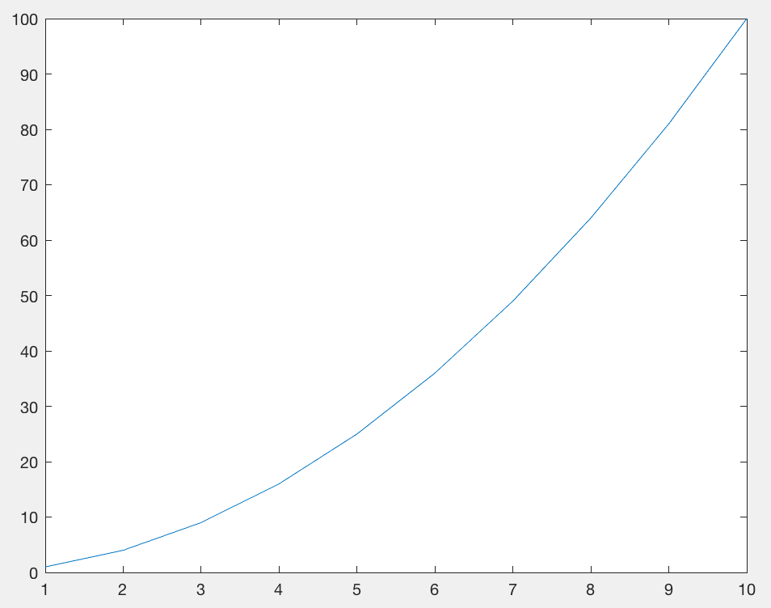
PLOTTING
We have already seen some basic plotting.
Make a vector, x, from 0 to 10 in steps of 0.1.
Make a vector y that has the square of x.
Plot y vs x.
x=[1:10];
y=x.^2;
plot(x,y)
Notes:
But this is lacking lots of stuff – axis labels, title, point values, grid, etc.

Slide 52
PLOTTING - Symbols
PLOTTING - colors
r red
g green
b blue
c cyan
m magenta
y yellow
k black
w white
o Circle
x cross
+ plus sign
. dots
* asterisk
‘s’ or ‘square’
‘d’ or ‘diamond’
^ upward pointing triangle
‘v’ downward pointing triangle
> rightward pointing triangle
< leftward pointing triangle
‘p’ or ‘pentagram’ 5 pointed star
‘h’ or ‘hexagram’ 6 pointed star
PLOTTING - lines
- line (default)
-- dashed line
: dotted line
-. dash- dotted line
.- plots points & line together

Slide 53
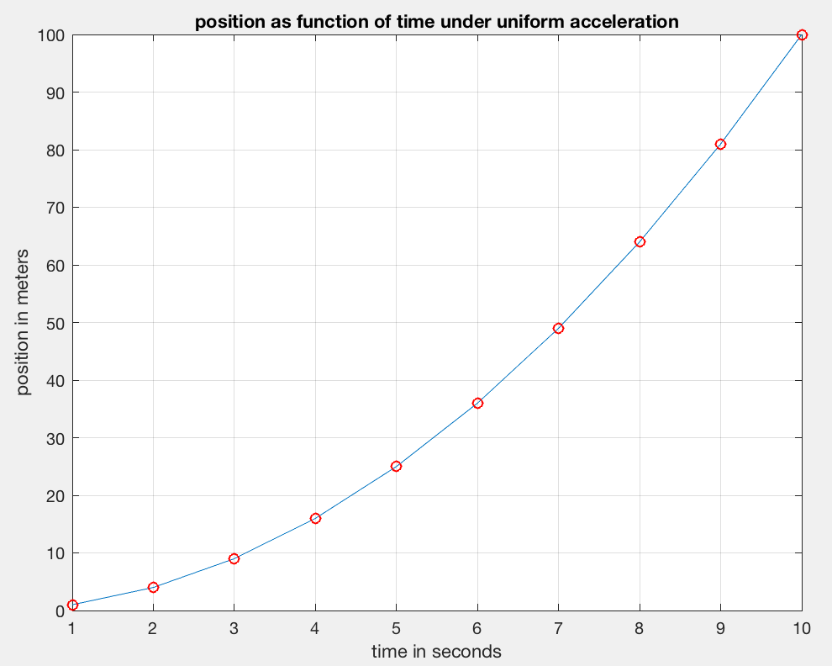
PLOTTING
Now lets pretty it up. LABEL axes, etc.
x=[1:10];
y=x.^2;
plot(x,y)
xlabel('time in seconds')
ylabel('position in meters')
grid
title('position as function of time under uniform acceleration')
hold on
plot(x,y,'ro')
Notes:
Fixing it up a little

Slide 54
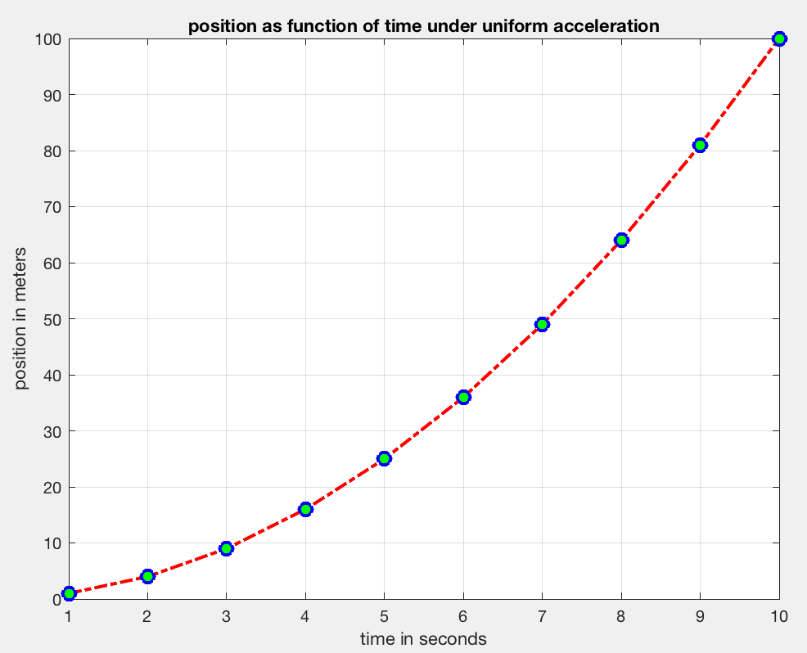
PLOTTING – other parameters
LineWidth width (in points) of the line.
MarkerEdgeColor color of the marker or the edge color for filled markers.
MarkerFaceColor —color of the face of filled markers.
MarkerSize size of the marker in points (must be greater than 0).
One method to set plot parameters – include
in call
plot(x,y,'ro-.','LineWidth', 2, …
'MarkerEdgeColor',’b’, …
'MarkerFaceColor',’g’,…
'MarkerSize',8)

Slide 55
Multiple plots on same axis
The default is for each plot command to clear the figure and draw a new one.
To stop this behavior use the hold command
hold on turns hold on (will plot on same figure)
hold off turns hold off (will erase it and draw new figure)
hold switches state from off to on and vice-versa. Best to avoid this use
Notes:
Best to state what you want, rather than switch states

Slide 56
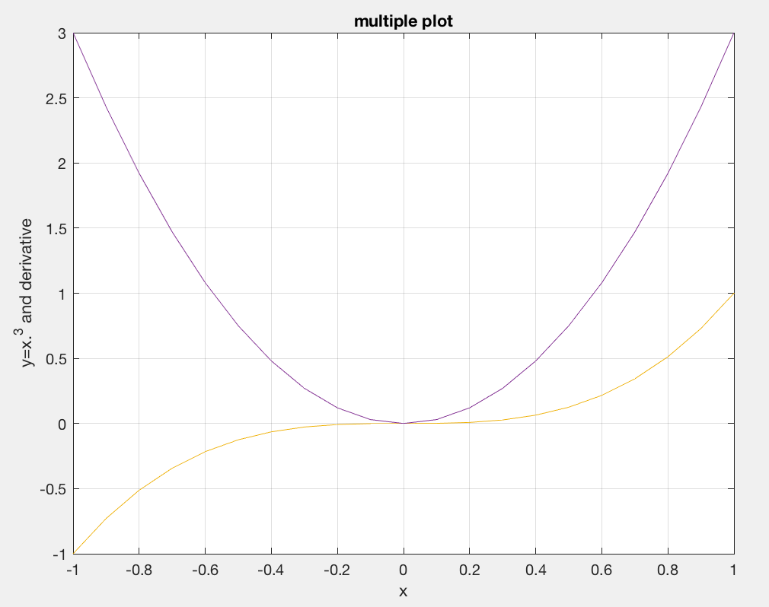
Plot x cubed and its derivative between -1 and 1
x=-1:.1:1; y=x.^3; dy=3*x.^2;
plot(x,y)
hold on
plot(x,dy)
grid
xlabel('x')
ylabel('y=x.^3 and derivative')
title('multiple plot')
These will also work
plot(x,y,x,dy)
yy=[y; dy];
plot(x,yy)
This “squishes” the plot vertically due to the larger y range
Notes:
With hold on, or the alternate forms below, will cycle through colors automatically

Slide 57
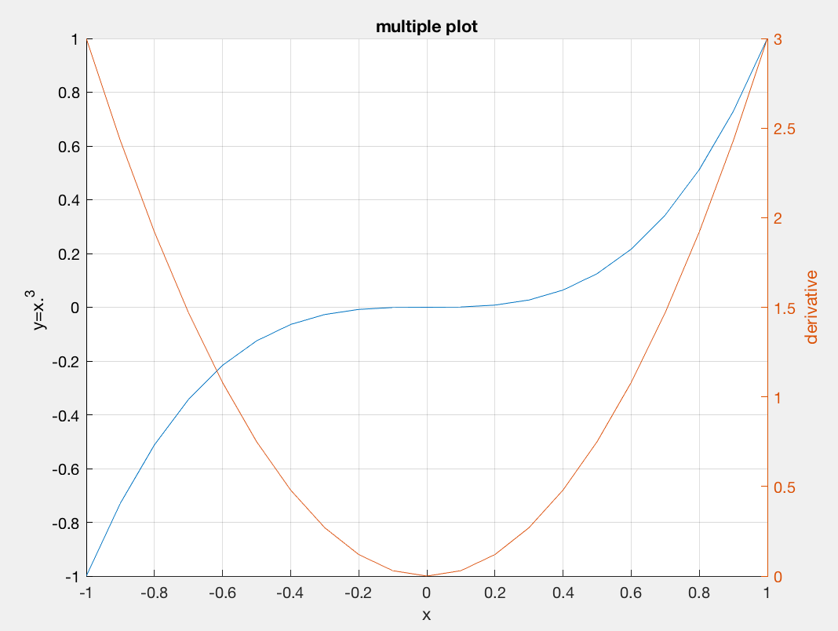
Use different left and right axes.
x=-1:.1:1; y=x.^3; dy=3*x.^2;
hold on %can put anywhere b4 second plot
yyaxis left %is default – don’t need, but works
plot(x,y)
ylabel('y=x.^3 ')
yyaxis right
plot(x,dy)
grid
xlabel('x')
%have to do y labels separately
ylabel('derivative')
title('multiple plot')

Slide 58
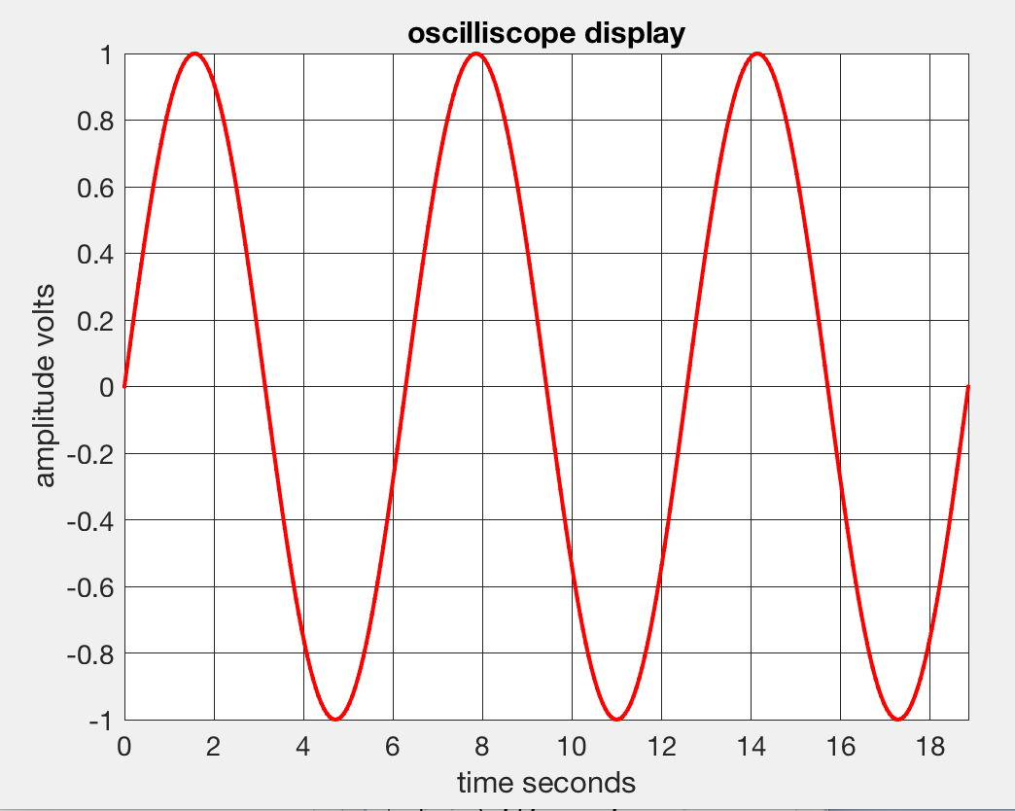
Making plots “prettier” (more readable)
Lines too thin, numbers too small, etc.
x=[0:300]/100*2*pi;
y=sin(x);
plot(x,y,'r.-') %points and line
plot(x,y,'r.-','LineWidth',2)
axis tight
Grid
set(gca,'FontSize',14) %gca is “handle” to current figure
ax=gca; %get axis handle
ax.GridAlpha=1; %grid line problem is transpanency, not width
xlabel('time seconds')
ylabel('amplitude volts')
title('oscilliscope display’)

