Slide 1
CERI-8104 Data Analysis in Geophysics
Dr. Robert (Bob) Smalley
3892 Central Ave, Room 103
rsmalley@memphis.edu 678-4929
Fall 2023
Tu & Th 11:20 am -12:45 pm
Meeting 5 Sep 12, 2023
CERI New/Long Building: Student Computer Lab
Class webpage to be announced.
My homepage (has older versions of the course)
http://www.ceri.memphis.edu/people/smalley/

Slide 2
Functions
Functions are a very useful concept
They help to organize your code.
They should be general purpose so you can use them wherever you need that operation (think sin, cos, etc.).

Slide 3
Functions
Group statements into separate units of code that "go together".
Parameterize the set of statements for use multiple times with different parameters.
Should use functions when code is repeated – repeat something by calling the function multiple times, not cutting-and-pasting multiple times.
(similar to using a loop – re-execute same code)

Slide 4
Functions
To communicate with the calling program , information has to be passed to and from the function.
This is done with variables.
As usual, there are several ways to do this.
But first, to define a function
function [x, y …] = myfunction(a, b…)
… code…
end

Slide 5
Functions
When you call a Function, ex. sin(x), what happens to the variable x?
Matlab passes the value of x, i.e. a copy of x, to the function.
This is known as pass by value.
Under pass by value variables in the function and calling program are isolated from one another.

Slide 6
Functions
>> x=30
x = 30
>> sind(x)
ans = 0.500000000000000
>> x
x = 30
>> y=sind(x)
y = 0.500000000000000
>> x
x = 30

Slide 7
Functions
In the calling code
.
.
.
y=myfunction(x)
.
.
.
In the function definition.
Can use the same variable names
function y=myfunction(x)
.
Use variable names x and y in here
.
end
Or not
function a=myfunction(b)
.
Use variable names a and b in here
.
end

Slide 8
Functions
There is another choice for passing variables to a function.
Pass the address in memory of x to the function.
This is known as pass by reference.

Slide 9
Functions
In this type of variable passing, any changes made to the variable in the function are seen by the calling program afterwards.
The function gets the address, where the variable is in memory, so changing the name of the variables in the function definition does not change this behavior.
In pass by reference, variables are actually pointers to the memory location, not the value of the variable.

Slide 10
Functions
Most languages have a default method, usually pass by value, and some allow pass by reference by offering pointer variables
(C has pointers, Matlab can be forced to do it ).
Some languages use both, either explicitly or implicitly (Matlab passes regular variables by value, but handles by reference [will cover handles later]).
Some languages pass arrays/matrices by reference (so don’t run out of memory copying large arrays).

Slide 11
Functions
Under pass by value, variables in functions are not seen by the calling (or called) functions.
The range of where a variable "exists" (where you can read/change it [some languages allow defining "constants"], variables whose value cannot be changed) is called its "scope".

Slide 12
Functions
Exceptions
global variables, that are available everywhere.
They must be declared as global in all scripts/functions that use them.
(generally frowned upon nowadays)

Slide 13
Functions
global variables
function setGlobalx(val)
global x
x = val;
end
function r = getGlobalx
global x
r = x;
end
function r = sqx
global x
r=x.^2
end
To use it in script/function
global x
…
setGlobalx(3)
r = getGlobalx
r = 3
rs=sqx
rs=9
As above x only defined in functions/scripts. To use x from the command line, have to declare it there.

Slide 14
Functions
persistent variables
Assume we need some variable in a function that does not change, outside the function, between multiple calls of that function by the calling script/function.
We can set that variable the first time into the function, and it will remember it when the function is called again.
This way we don't have to keep passing the varaible.

Slide 15
Functions
persistent variables
Example: count the number of times the function is called
function myFun()
persistent n
if isempty(n)
n = 0;
end
n = n+1
end
function myFun(m)
persistent n
if nargin==0
if isempty(n)
n = 0;
end
else
n=m;
end
n = n+1
end
myFun
n=1
myFun
n=2
myFun
n=3
Here introduce nargin

Slide 16
Functions
We already saw a function definition but did not dwell on it.
function f=my_factorials(n)
m=1;
f=1;
while m<=n
f=f*m;
m=m+1;
end
display(f)
Notes:
Advantages of functions –
Encapsulated – m, f not known outside of function – don’t interfere with variables in the calling routine named m or f
Easier to write and debug because can concentrate on one specific task (one theory of programing says nothing should be longer than a page – good idea, but then you have thousands of files – you win some and loose some)

Slide 17
Functions
When you call a function that has a return value (most do!), f in the factorial definition
function f=my_factorials(n),
the variable name in the calling program is independent of the names of variables in the function
smallfactorial=my_factorials(3);
bigfactorial=my_factorials(20);

Slide 18
Functions
Can define functions (<plural) inside functions – but they are only available inside that function's m file.
function f=my_factorials(n)
m=1;
f=1;
while m<=n
f=f*m;
m=m+1;
mp1=increment(m)
end
end
function pp1=increment(p)
pp1=p+1
end
Now need to have end statements closing all the functions
Notes:
The two end statements in gray are optional. You need both or none – can’t mix.

Slide 19
More on vectorization.
MATLAB is a vectorized high level language
Requires a change in programming style
(if one already knows a non-vectorized programming language such as Fortran, C, Pascal, Basic, etc.)
Vectorized languages allow operations over arrays using simple syntax, essentially the same syntax one would use to operate over scalars.
(looks like math again.)

Slide 20
What is vectorization?
(with respect to Matlab)
Vectorization is the process of writing code for MATLAB that uses matrix operations or other fast built-in functions instead of using explicit loops.
The benefits of doing this are usually sizeable.
The reason for this is that MATLAB is an interpreted language.
Function calls have very high overhead.
Indexing operations (inherent in a loop operation) are not particularly fast.

Slide 21
Vectorized vs Loop versions of same code.
New commands “tic” and “toc” - time the execution of the code between them.
>> a=rand(1000);
>> tic;b=a*a;toc
Elapsed time is 0.012027 seconds.
>> tic;for k=1:1000,for l=1:1000,c(k,l)=0;for m=1:1000, c(k,l)=c(k,l)+a(k,m)*a(m,l);end; end; end; toc
Elapsed time is 4.695545 seconds.
>> 4.695545/0.012027
ans =
3.904169784651202e+02
Factor ~400 difference in time for multiplication of 10³x10³ matrix!
Introduce "tic" and "toc"
Notes:
Compare matrix multiplication using matlab vectorized implementation, to fortran/c style triple nested do loop implementation
Answers about the same (e-13 max difference).

Slide 22
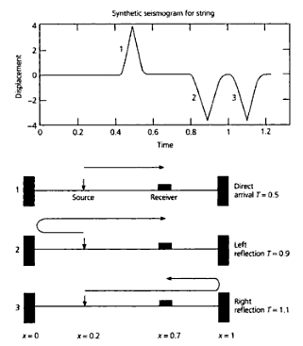
Vectorization of synthetic seismogram example from
Stein and Wysession
Intro to Seismology and Earth Structure.
Section on scientific programming

Slide 23
Start by just "translating" the Fortran code into Matlab.
Skip a close look at the math, we have a formula so we will work with that to calculate u(x,t).

Slide 24
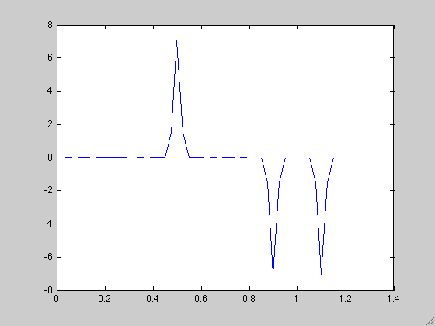
Synthetic seismogram produced by Matlab code translated from Fortran.

Slide 25
Let's return to the original problem and try to understand what is going on.
We will use this understanding to fully vectorize (speed up) the code.

Slide 26
This is the Fourier domain representation for waves on a string with fixed ends
Weight a_{n} - no dependence on x or t, only ω_{n,} τ, and x_{s}.
Going left Going right
Standing wave made from 2 versions of the same wave traveling in opposite directions. Amplitude varies with time, but does not "move"
Notes:
Rearrange
Put all constant stuff together
Look at space and time varying parts
Turn into traveling and standing waves
Weights change by factor of ½ between last two lines

Slide 27
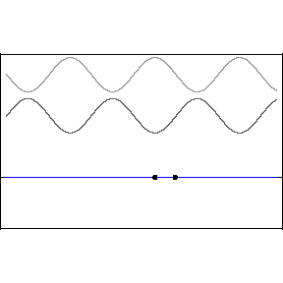
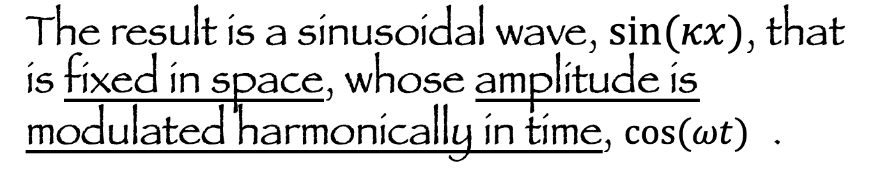
Normal Mode (and combination of traveling waves to make standing wave) formulation for displacement of a string
The result is a sinusoidal wave, $sin(κx)$, that is fixed in space, whose amplitude is modulated harmonically in time, $cos(ωt)$ .

Slide 28
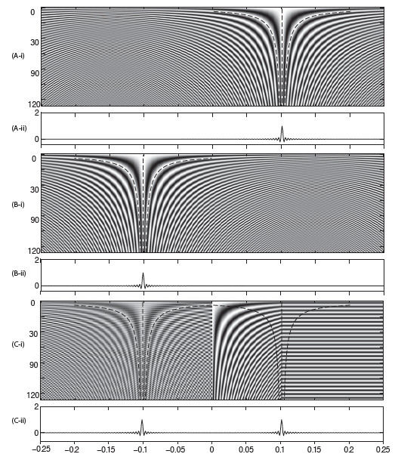
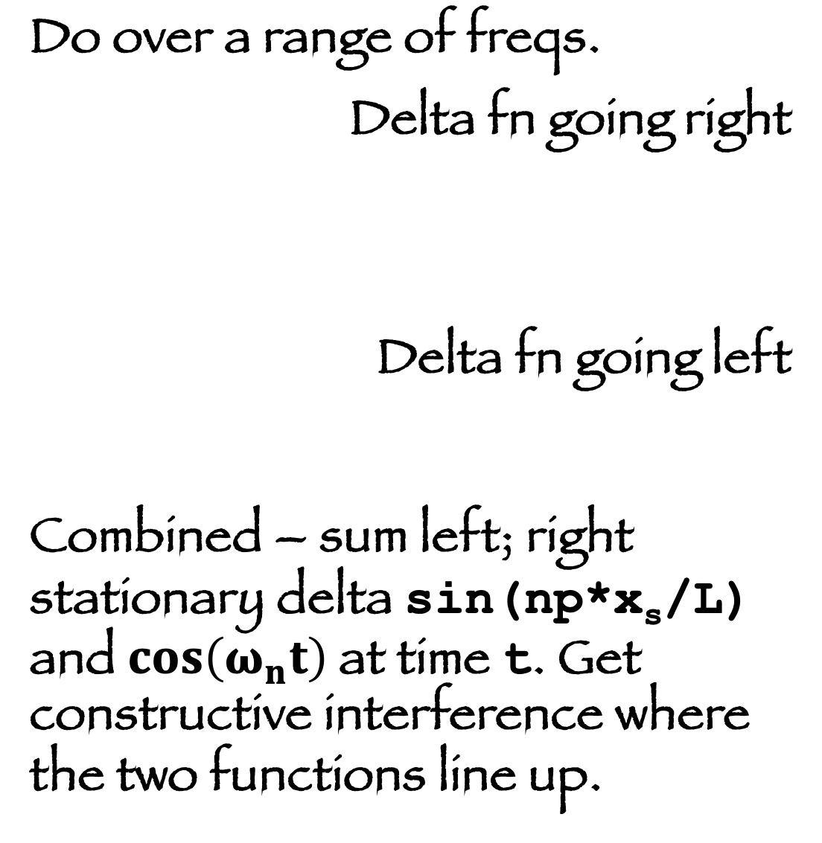
Do over a range of freqs.
Delta fn going right
Delta fn going left
Combined – sum left; right stationary delta sin(np*x_{s}/L) and$cos\left(ω_{n}t\right)$at time t. Get constructive interference where the two functions line up.
Notes:
Constructive interference where cos(ωt)=cos(kx) phases agree – stationary phase.
Space part constant, time part chages with time – the two line up at different spot at different times, get constructive interferenece there only!

Slide 29

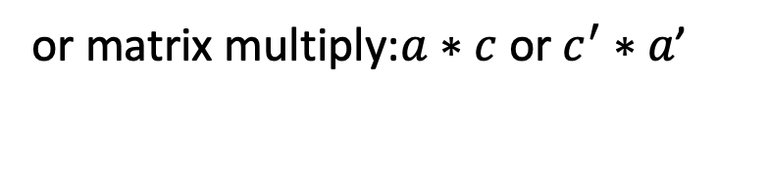
Look at the basic element of Fourier series, weighted sum of sin and cos functions
(look at cos only to see how works).
DC offset, ignore
Dot product
or matrix multiply:$a∗c \text{or}{ c}^{′}∗a\text{’}$
Add more columns to matrix c
…
$$ω$$
t
matrix multiply, to make full seismogram
Notes:
Calculate at one time – first 3 lines
Transpose between 3rd and 4th lines
Calculate for lots of times – bottom 2 lines
Final – have cosins basis functions of Fourier series in the columns (time series in t), times column vector of weights.

Slide 30
Look at the basic Fourier series
At constant time (rows), weighted sum of cosines at different frequencies at that time.. Leaving off DC term.
basis functions are constant frequency cosines as function of time in the columns.
Multiplication of a matrix (with cosines across and down) times vector with the Fourier series weights.

Slide 31
Now look at how to build the matrix (vectorized)
First notice that every term is the cos of something.
Take the cos away and look at the argument to the cos only.
We will take the cos of the argument matrix after building it.
Notice time constant across rows, while frequency increments through range (w₀ is DC, the average, and has been dropped). There are k/2 frequencies & weights for cos, & same for sin).
Notice frequency is constant in the columns, while time grows .

Slide 32
Remember that
and letting t_{m}=dt, the t terms become Mdt, where dt is the sampling interval and M goes from 1 to k.
Factoring out the common terms we have
Note on # of elements – the matrix had k rows, where k is the # of points in the time series (let it be even), & k/2 columns, & a has k/2 rows to match the # of columns). When we include the sine terms the matrix will be k by k (sine brings another k by k/2 matrix) & the weight vector will grow to k with the sine weights.

Slide 33
So the argument matrix can be built quite simply in a vectorized form from this matrix (call it C)

Slide 34
Putting it all together we have – for the cos part
and something similar for the sine part (there are a few details being swept under the rug at DC and Nyquist [the highest frequency]) and we get
where S is the foundation of the sin argument matrix, the two matrices are put together to make a square matrix and the weight vectors are put together to match.

Slide 35
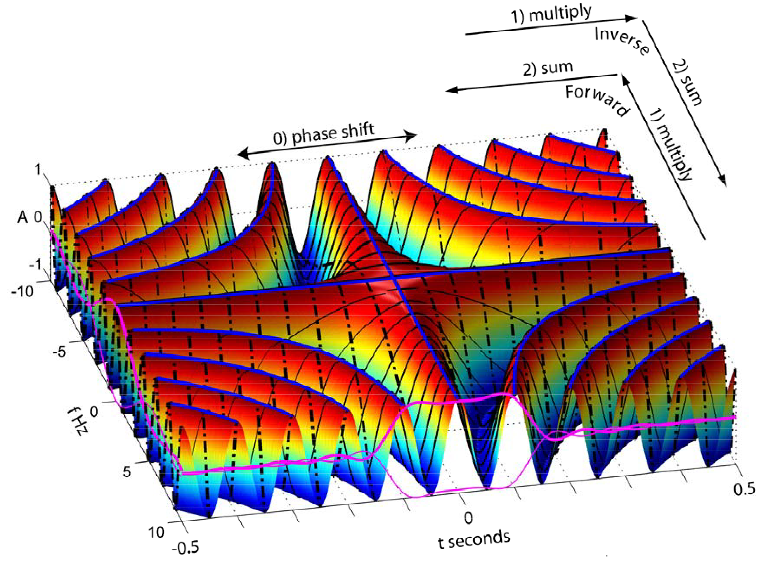
We have just vectorized the equations for the Fourier series!
Notes:
The surface is composed of cosines in time or frequency as per the matrix on the last slide (start with plotting matrix on last slide as surface).
They are multiplied by the fourier weights (the red lines in front, to make this picture) and summed across to make the Fourier series to make the time domain function – red line at the right

Slide 36
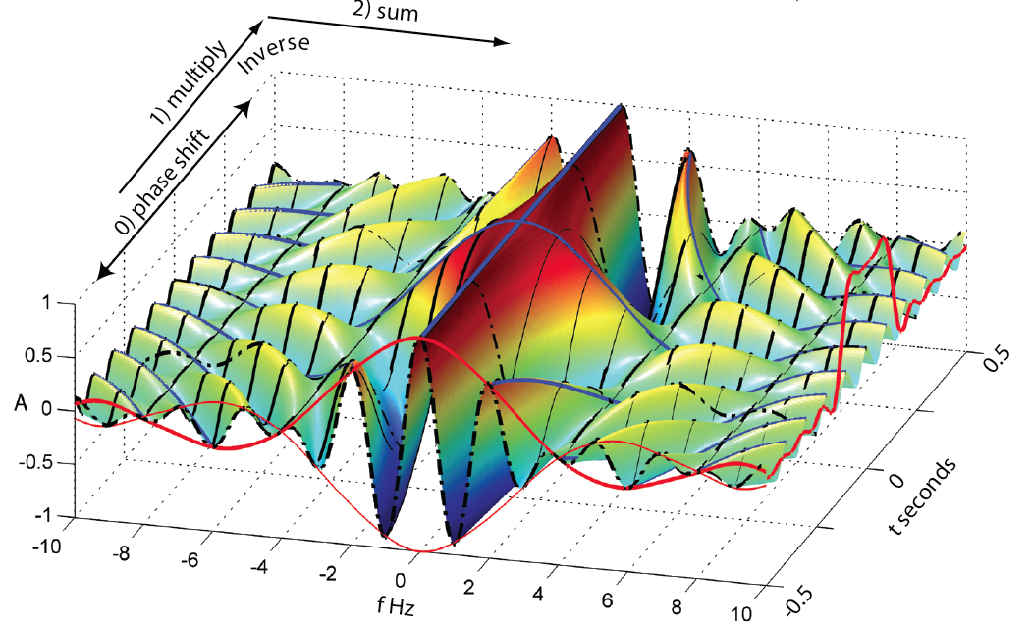
We have just vectorized the equations for the Fourier series!
Notes:
The surface is composed of cosines in time or frequency as per the matrix on the last slide (start with plotting matrix on last slide as surface).
They are multiplied by the fourier weights (the red lines in front, to make this picture) and summed across to make the Fourier series to make the time domain function – red line at the right

Slide 37
Even though this is a major improvement over doing this with for loops, and is clear conceptually,
it is still not considered "computable" as it takes O(N²) operations (and therefore time) to do it.
This is OK for small N, but quickly gets out of hand.
Fourier analysis is typically done using the Fast Fourier transform (FFT) algorithm – which has O(N log2 N) operations and is significantly faster for large N.
(for N=1 million, the brute force method above needs proportional to 10¹² multiplies, while N log2 N = 2*10⁷ )
Notes:
Big O is for "order" as in order of magnitude.

Slide 38
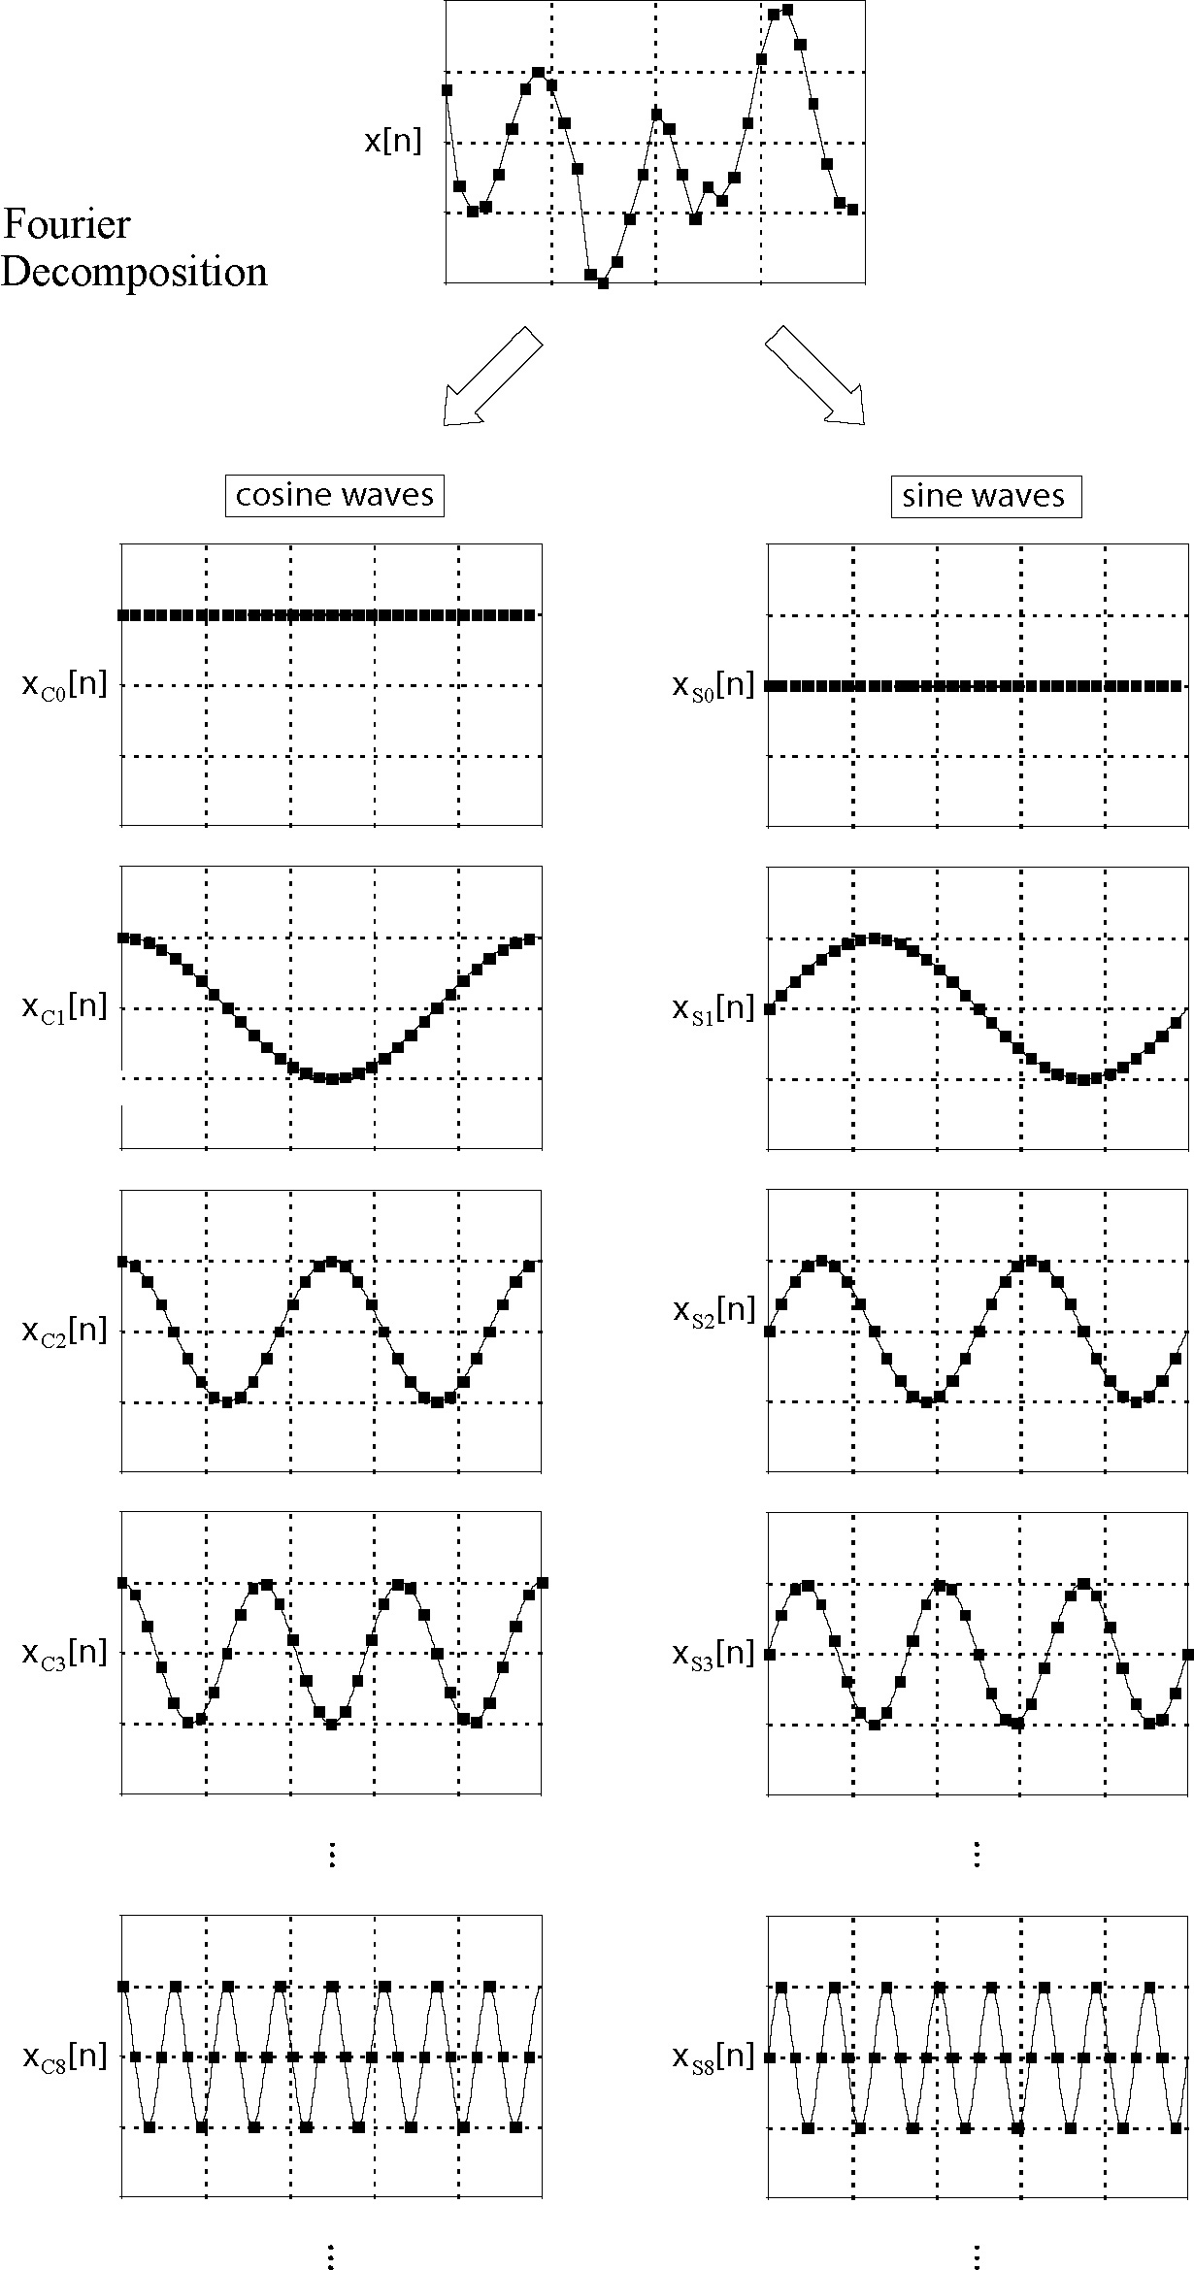
Fourier decomposition.
“Basis” functions are the sine and cosine functions.
Notice that first sine term is all zeros (so don’t really need it) and last sine term (not shown) is same as last cosine term, just shifted one – so will only need one of these). [this is the detail we swept under the rug earlier.]
Figure from Smith

Slide 39
Fourier transform (actually discrete time, discrete frequency – DTDF - Fourier series)
The Fast Fourier Transform (FFT) depends on noticing that there is a lot of repetition in the calculations – each higher frequency basis function can be made by selecting points from the w₀ function. The weight value is multiplied by the same basis function value an increasing number of times as w increases.
Figure from Smith
Notes:
Second cos/sin term is "basis"
Third is every other point from first
Fourth is every third point from first
Etc.

Slide 40
FFT
The FFT uses regularities of the calculation to calculate the basis functions and then basically does each unique multiplication only once, stores it, and then does the bookeeping to add them all up correctly.
The points in the trace at the top are made from vertical sums of the weighted points at the same time in the cos and sin traces in the bottom.
Figure from Smith
Notes:
Notice that a1 is multiplied by the same basis value 2x (2 cycles) (4x if you include +/- values)
a2 is multiplied by the same basis value several times, etc.
Savings from 2 places – computing the basis functions and multiplications of basis functions by same values.

Slide 41
FFT
The FFT uses the following symmetry properties
Symmetry
Periodicity
FFT requires that the number points = power of 2.
Figure from Smith

Slide 42
In the synthetic seismogram calculation there are 200 columns for the 200 (M) frequencies
There are 50 rows for the 50 (N) samples in the seismogram time series.
How do we make the elements (k,l) of the matrix?
Use fact that values needed are proportional to k and l.

Slide 43
Make appropriate vectors for time and frequency.
How big is each?
Combine them to make the trig argument matrix
Multiply elements of the matrix by dt and w₀.
Take cosine of matrix.
Calculate the weights.
Note the weights depend on n, and w₀,but not t.
All t dependence is in the matrix of cosine elements.

Slide 44
This is not the way Fourier analysis is typically done (although some people still do it the "Fortran" way) as it is still O(N²).
The Matlab matrix multiplication method is faster than the Matlab loop method.
(a good Fortran compiler will beat the pants off either implementation in Matalb).
We did it this way for educational purposes.
Typically, it is done using the FFT (Fast Fourier Transform) algorithm which avoids duplication of effort in the multiplications and results in O(N log2 N) multiplications.

Slide 45
For a time series of length 2¹⁶=65,536
(FFT needs number of points = power of two, this is pretty typical number of points in seismogram, about 10 minutes at 100 Hz sampling)
We need O(16 * 216)=1,048,576 multiplies for the FFT
vs
4,294,967,296 for the matrix * vector method
Multiplications (slow)
(FFT is 4094.5 times faster!!)

Slide 46
Two lessons
1) Vectorizing MATLAB (loops go into matrix operations) makes MATLAB go lots faster.
Should do it.
Vectorizing in general
- is not algorithmic
- is case specific
- can give gigantic speed improvements (much more than simple vectorizing of 1-d vectors and using matrix multiplies).
2) But is lots of work (and can be time consuming) - an art!
The FFT combines both art (reducing the number of multiplies making something non-computable, computable [is also vectorizable]) and brute force parallelism (better than vectorization by using lots of processors).
Notes:
Simplest vectorizing is to do stuff in parallel that you can – speed up by factor of however many jobs/cpus you can run/get ahold of.
Some problems need the FFT type solution to be useful.

Slide 47

Get same figure as before.

Slide 48
Is it worth vectorizing?
Say you are doing something and
A) it takes you 1 hour to code it with loops and 30 mins to run it
vs
B) 4 hours to figure out how to vectorize it and 0.5 seconds to run it.
If you are going to do it once – A wins (unless you are doing it to learn vectorizing).
If it is part of the code to drive your car automatically you need the results faster than every 30 minutes and it is worth investing the time to vectorize it (your life depends on it calculating fast enough).

Slide 49
Both matrix multiplication and the FFT are parallelizable.
Matrix multiplication is the dot product of the rows of the matrix on the left with the columns of the matrix on the right – each of these is independent.
One can therefore send each off to get calculated separately (on different cores, computers, etc.)
The FFT calculation is based on 2 multiplies and an add (called a butterfly).
They are also independent.
You can send them off to be calculated separately.
Both vectorization and parallelization depend the art of figuring out a parallelizable algorithm, if one exists.
Notes:
Big O is for "order" as in order of magnitude.

