Slide 1
Stable continental regions
No major tectonism, magmatism, basement metamorphism or anorogenic intrusion since
the Cretaceous. No rifting, major extension or transtension since the Paleogene
Schulte and Mooney (2005)

Slide 2
Proposed models for intraplate seismicity:
Localized stress around intrusions
Intersecting faults
Ductile shear zones in the lower crust
Fluids in the crust
Weak lower crust
Stress perturbations due to buried rift pillows
Elevated temperature at depth
A disturbance of the hydraulic properties of the lower crust
Perturbation of regional stress by flexure following deglaciation
Gravitational forces at structural biundaries
Sediment loading
Sediment unloading

Slide 3
Rifts: black
Possible rifts: stippled
Rifted margin: striped
Possible rifted
margin: grey
Non-rifted: white
M>4.5
M>6
M>7
seismic
moment
release

Slide 4
Rifted margins. Red – Precambrian; blue-Paleozoic; green – Mesozoic; brown -Cenozoic

Slide 5
Interior rifts/taphrogens

Slide 6
Non-extended crust

Slide 7
Kutch
China
CENA
Europe

Slide 8
27% occur in the interior rifts/taphrogens; 25% in rifted continental margins;
36% in non-rifted SCR; 12% uncertain. Similar to the results of Johnston.
Within continental interiors (away from rifted margins) an equal amount of
events may be located outside of rifted crust than inside (36% versus 27-37%).
A larger % of large earthquakes (>6) occur in rifted crust also greater amount of
moment release.
Concentration of seismicity is particularly strong for earthquakes that are associated
With interior rifts and taphrogens. 12 rifts worldwide account for 74% of the
earthquakes and 98% of the total moment release.

Slide 9
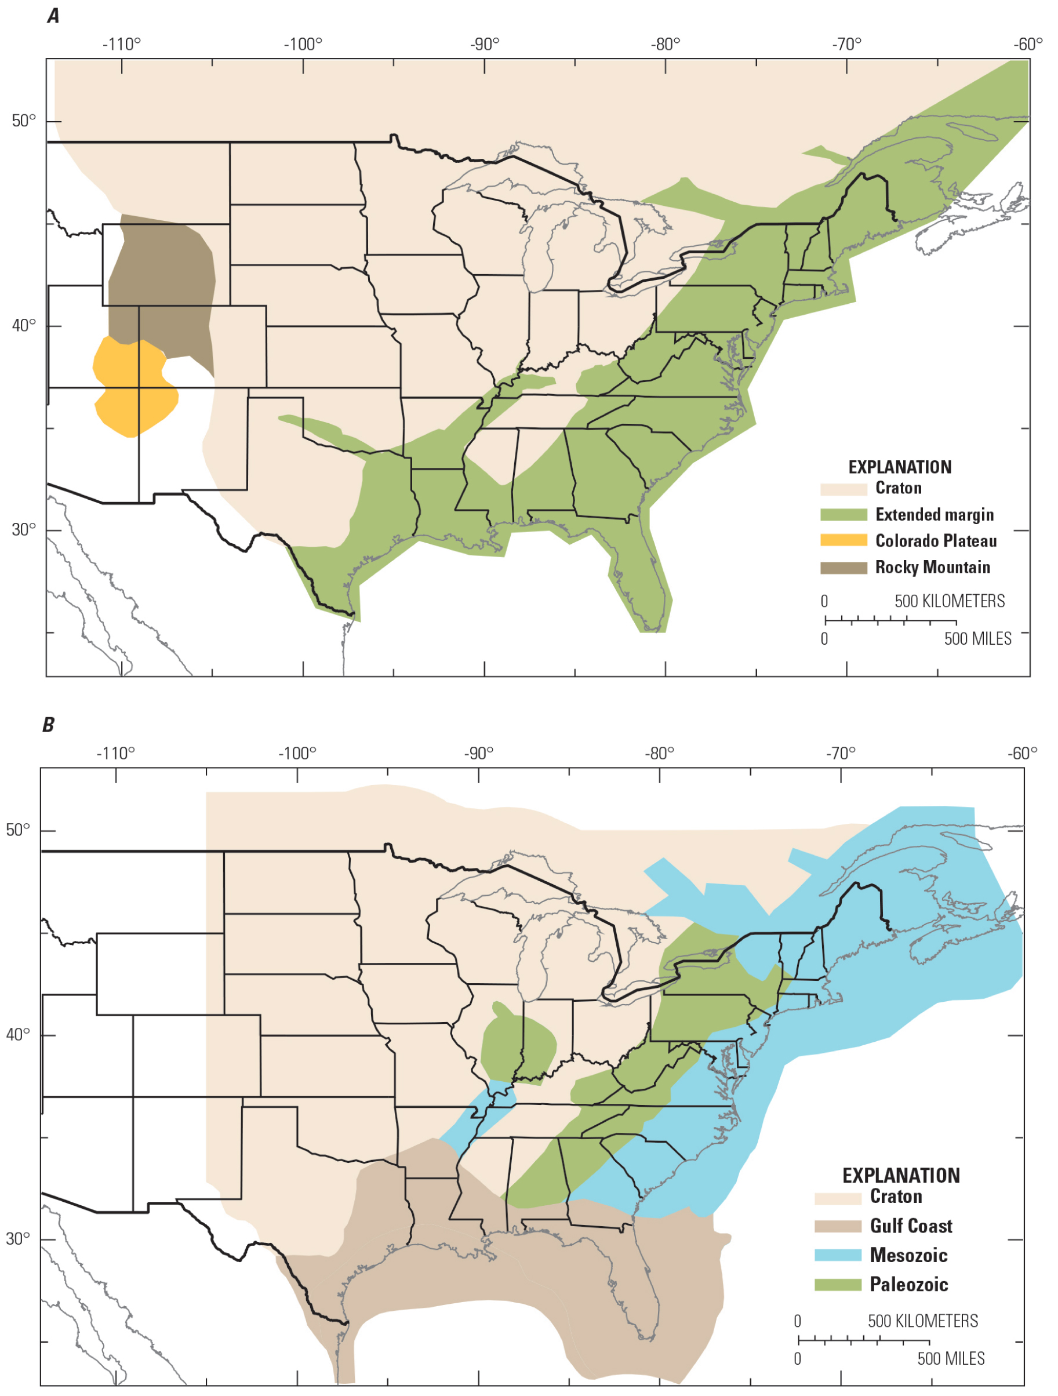
USGS seismic hazard maps “Seismicity
Based Background Seismic Source
Model” for the CEUS
Seismotectonic zones used to
develop Mmax and seismicity rates
(a values)
Charlevoix
Giles Co.
National Seismic Hazards
Mapping Program
NSHMP 2008
ETSZ
Weighted Mmax for the
Craton is 7.1
CEUS Seismic Source
Characterization Project
CEUS-SSCn (2012)

Slide 11
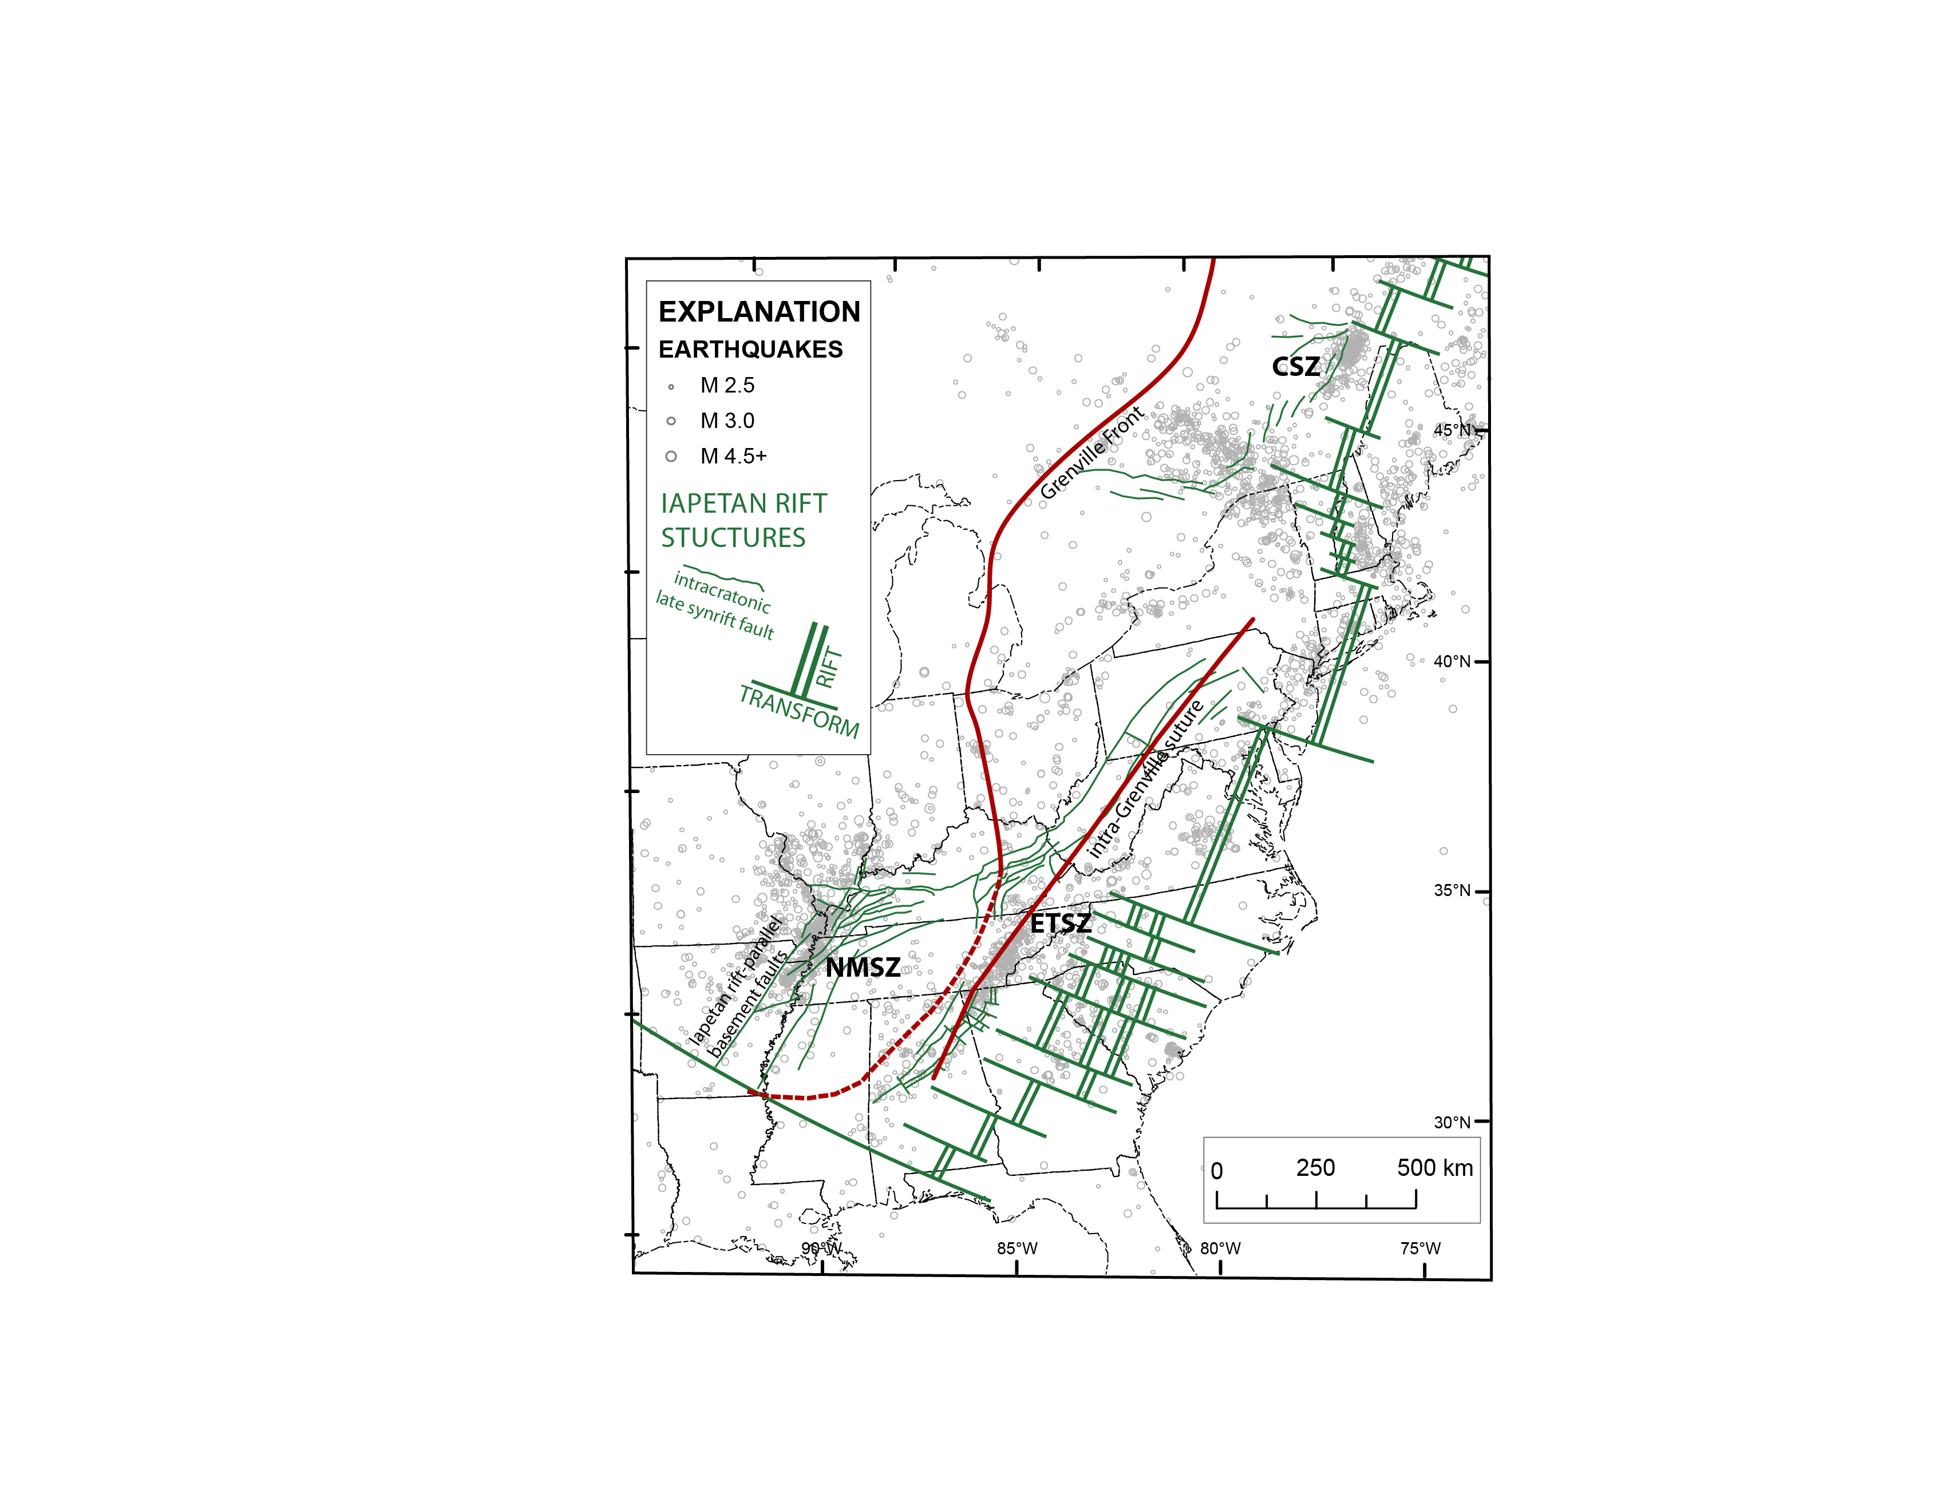
Ancient basement structure
shown in red and green
Three active seismic zones:
CSZ: Charlevoix
ETSZ: Eastern Tennessee
NMSZ: New Madrid

