Slide 1
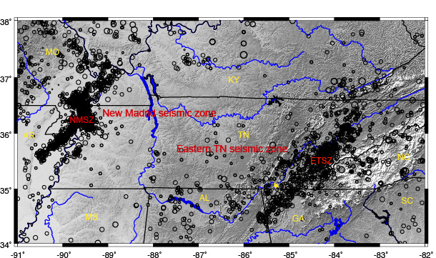
The Eastern Tennessee Seismic Zone
Memphis
Intraplate Workshop CERI, 2015

Slide 2
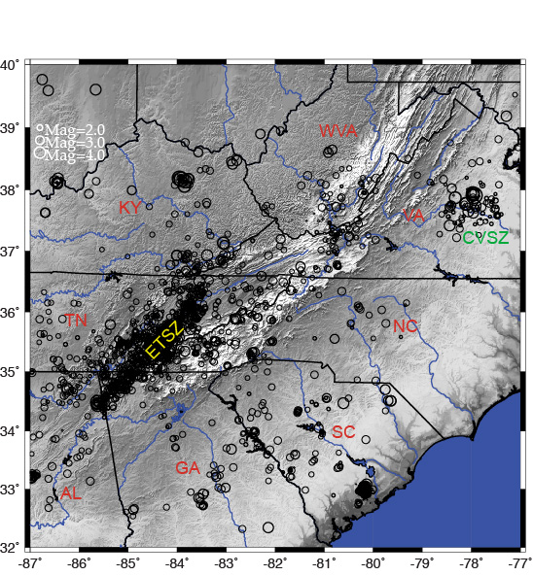
Eastern Tennessee Seismic Zone
300 km long; 50 km wide;
100 recorded earthquakes/year
Largest recorded earthquakes:
4.6 Maryville,TN 1973
4.6 Fort Payne, AL 2003

Slide 3
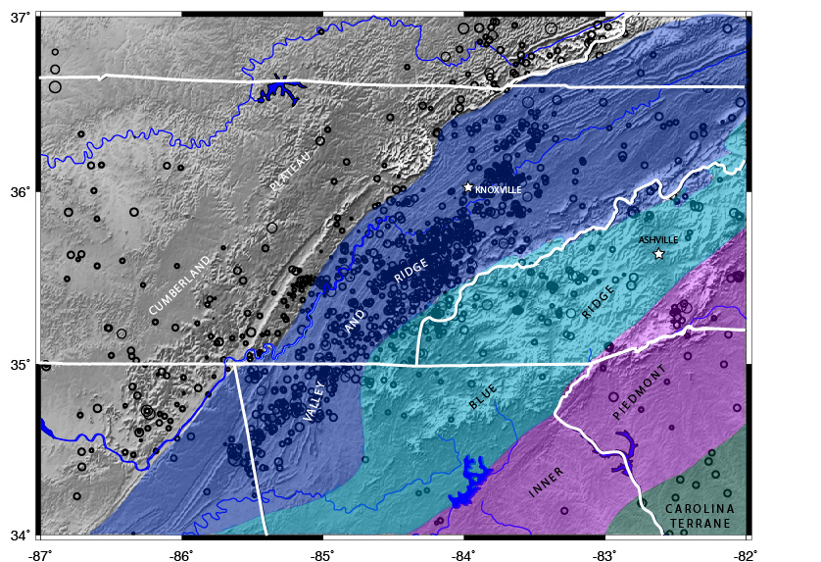
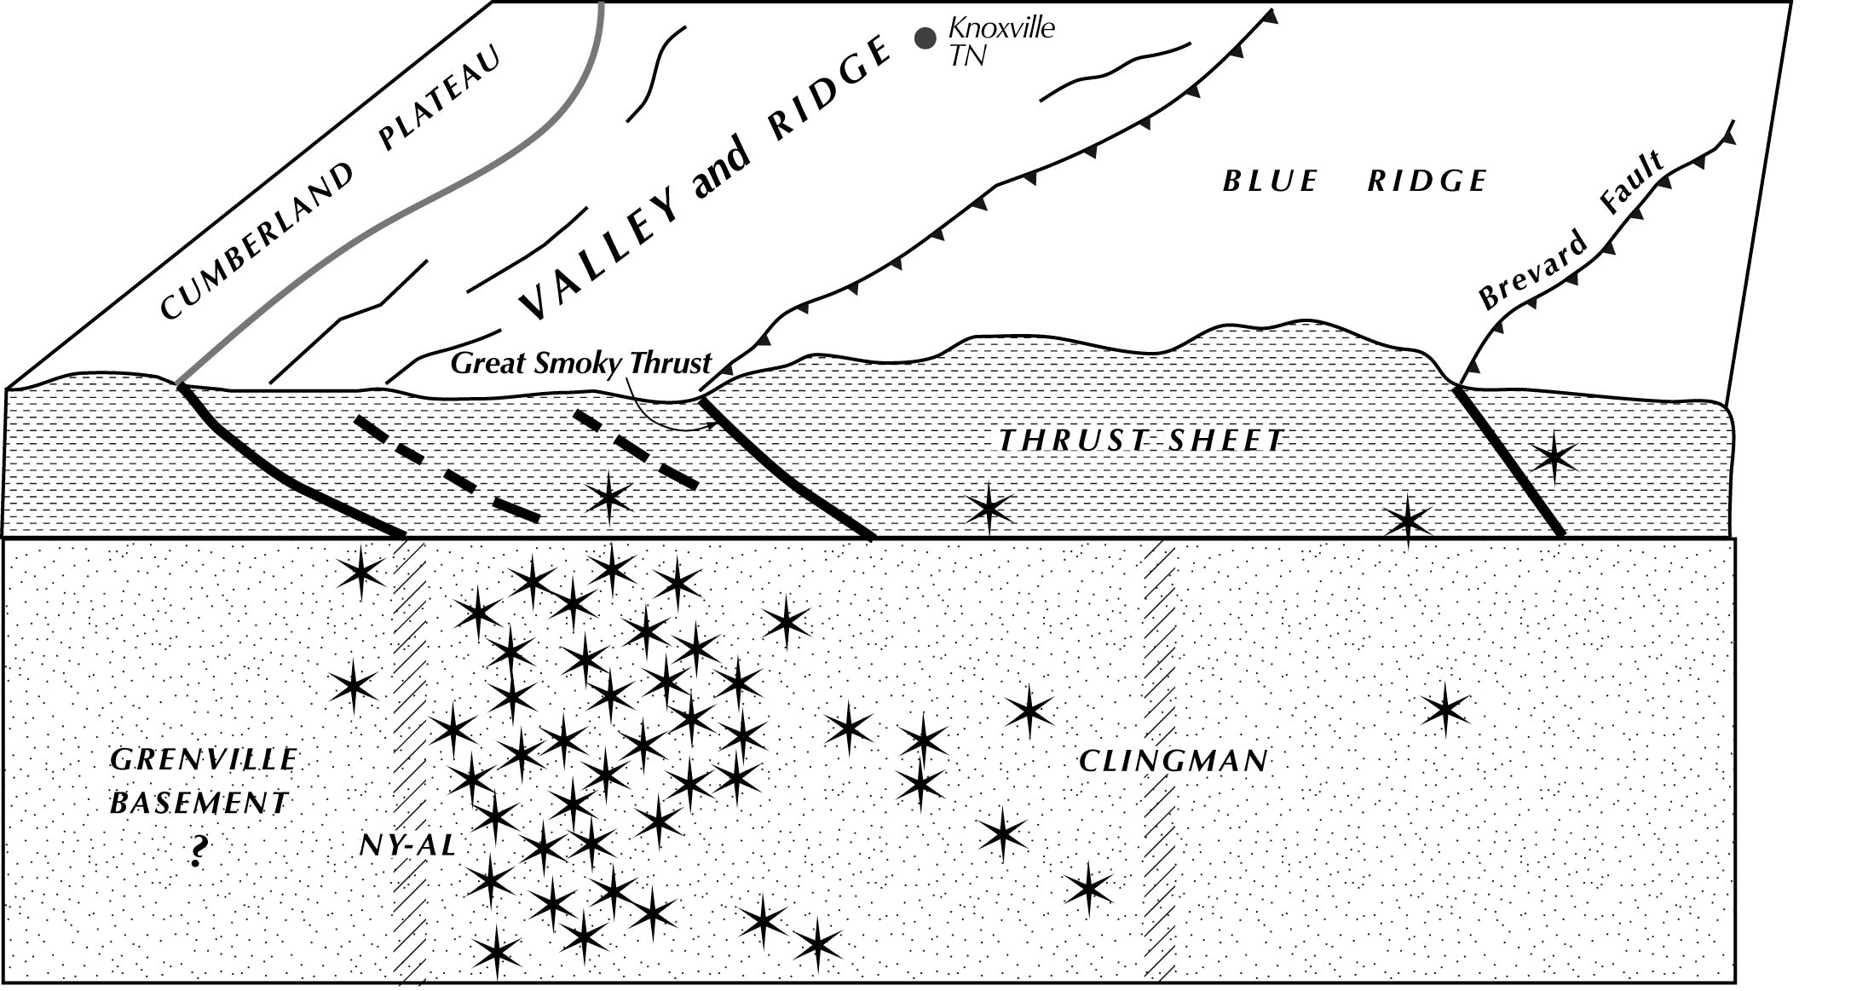
Geologic setting
Most epicenters are located in
the Valley and Ridge province
Earthquakes occur below the
Appalachian thrust sheets in
Grenville basement rocks.
These rocks preserve Grenville
age structural features.

Slide 4
What sources of information can be used to understand why
the seismic zone exists?
Tectonic history
Potential field data (gravity and magnetics)
Local earthquake tomography
Focal mechanisms

Slide 5
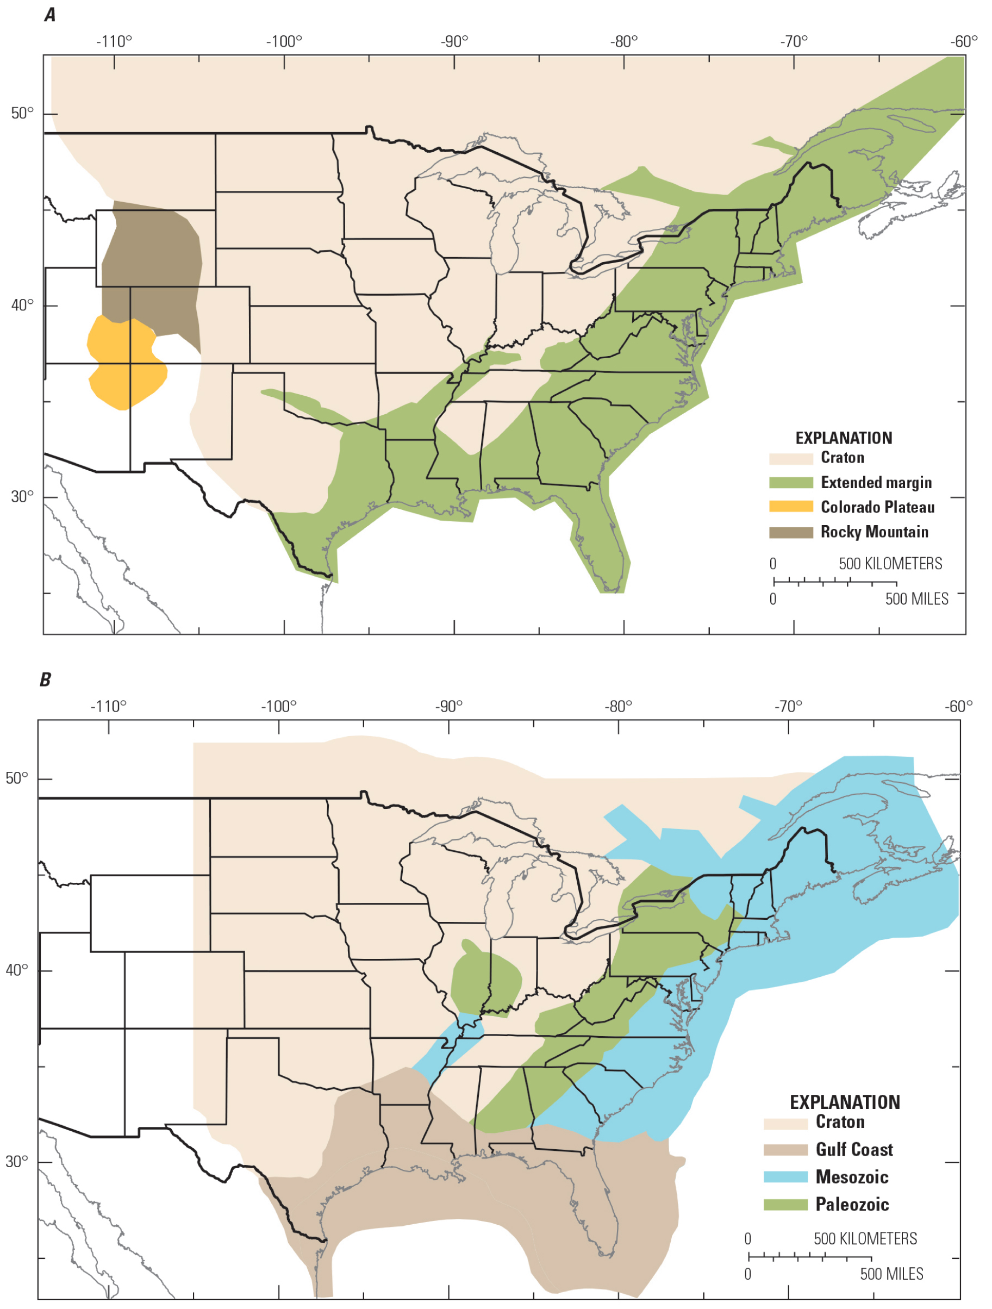
Prior work: ETSZ is located
in rifted crust – extended
margin of the Iapetus Ocean
Charlevoix
Giles Co.
USGS seismic hazard maps “Seismicity
Based Background Seismic Source
Model” for the CEUS
Seismotectonic zones used to
develop Mmax and seismicity rates
(a values)
ETSZ
CEUS Seismic Source
Characterization Project
CEUS-SSCn (2012)

Slide 6
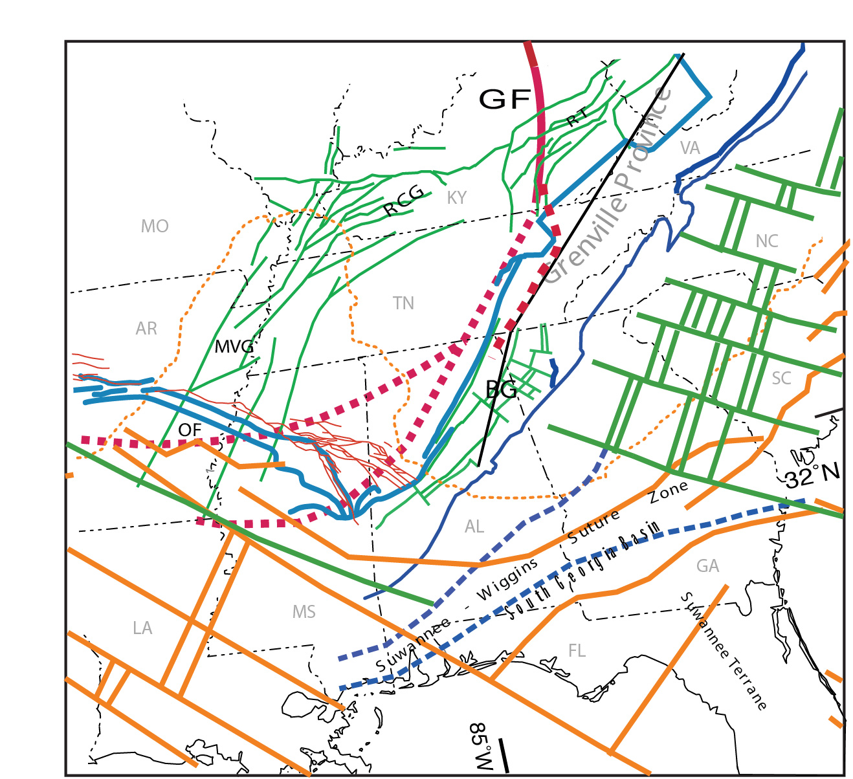
Unlike other intraplate seismic
zones, the ETSZ may not be
associated with rifted crust.
NY-AL
Green lines: rifts associated
with the opening of the
Iapetus Ocean (ca. 530 Ma.)
MVG: Mississippi Valley Graben
RCG: Rough Creek Graben
RT: Rome Trough
BG: Birmingham Graben
Map created by Bill Thomas

Slide 7
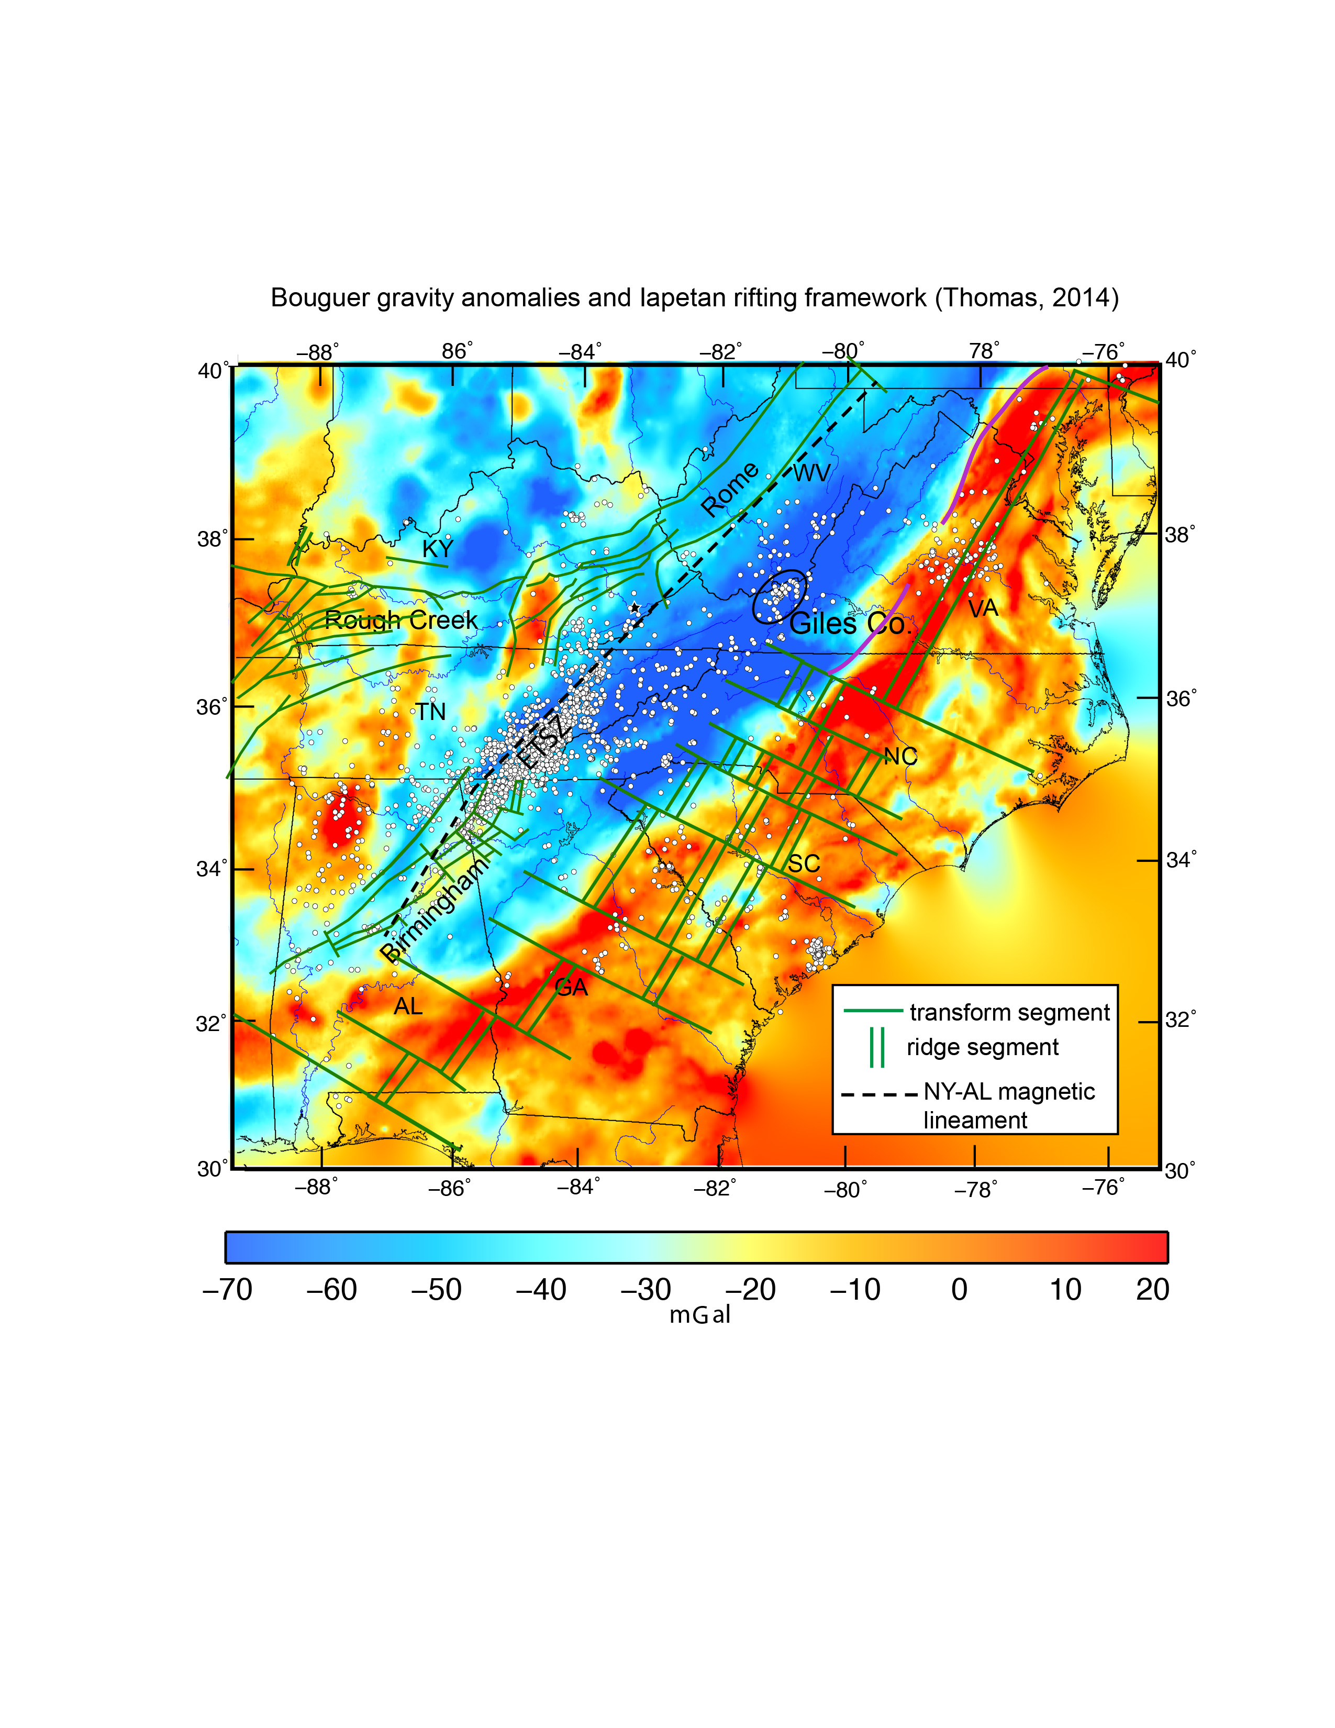
Evidence for thick crust below the southern and central Appalachians
Lack of major rifts
Bouguer gravity anomalies
Receiver functions
Wide angle reflections

Slide 8
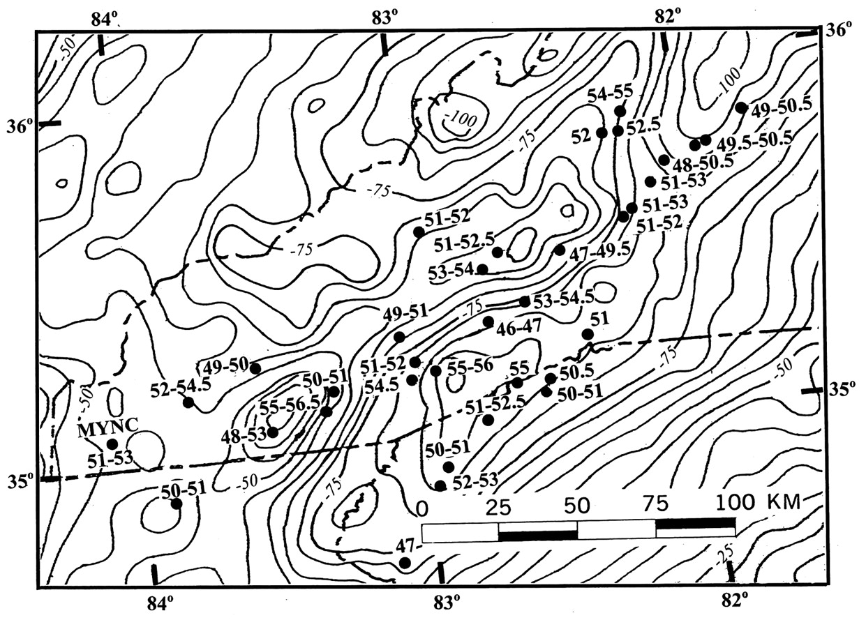
TN
NC
SC
GA
Crustal thickness values determined using wide-angle reflection arrivals. Contours
are Bouguer gravity anomalies. From Hawman (2012).

Slide 9
Receiver function Moho depths (km)
TN
NC
GA

Slide 10
A
Geophysical setting:
strong association
with potential field
anomalies
A
New York – Alabama
lineament:
High magnetics
Low gravity
Intrusion A:
High magnetics
High gravity
Notes:
Aeromagnetics and Bouguer gravity NY-AL; mag high grav low associated with NY-AL. Earthquake distribution to the SE of the NY-AL lineament

Slide 11
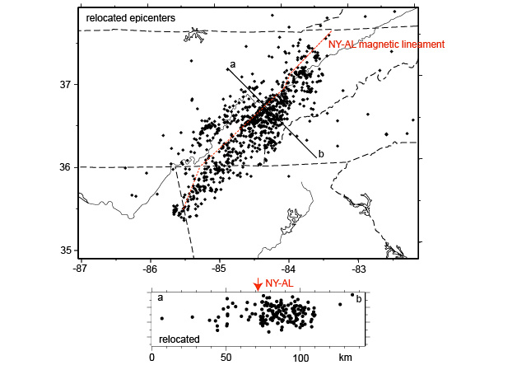
Magnetic lineament associated with a basement feature that bounds a region
of high seismicity
Notes:
Magnetic anomaly associated with a basement structural feature that bounds a region of high seismicity

Slide 12
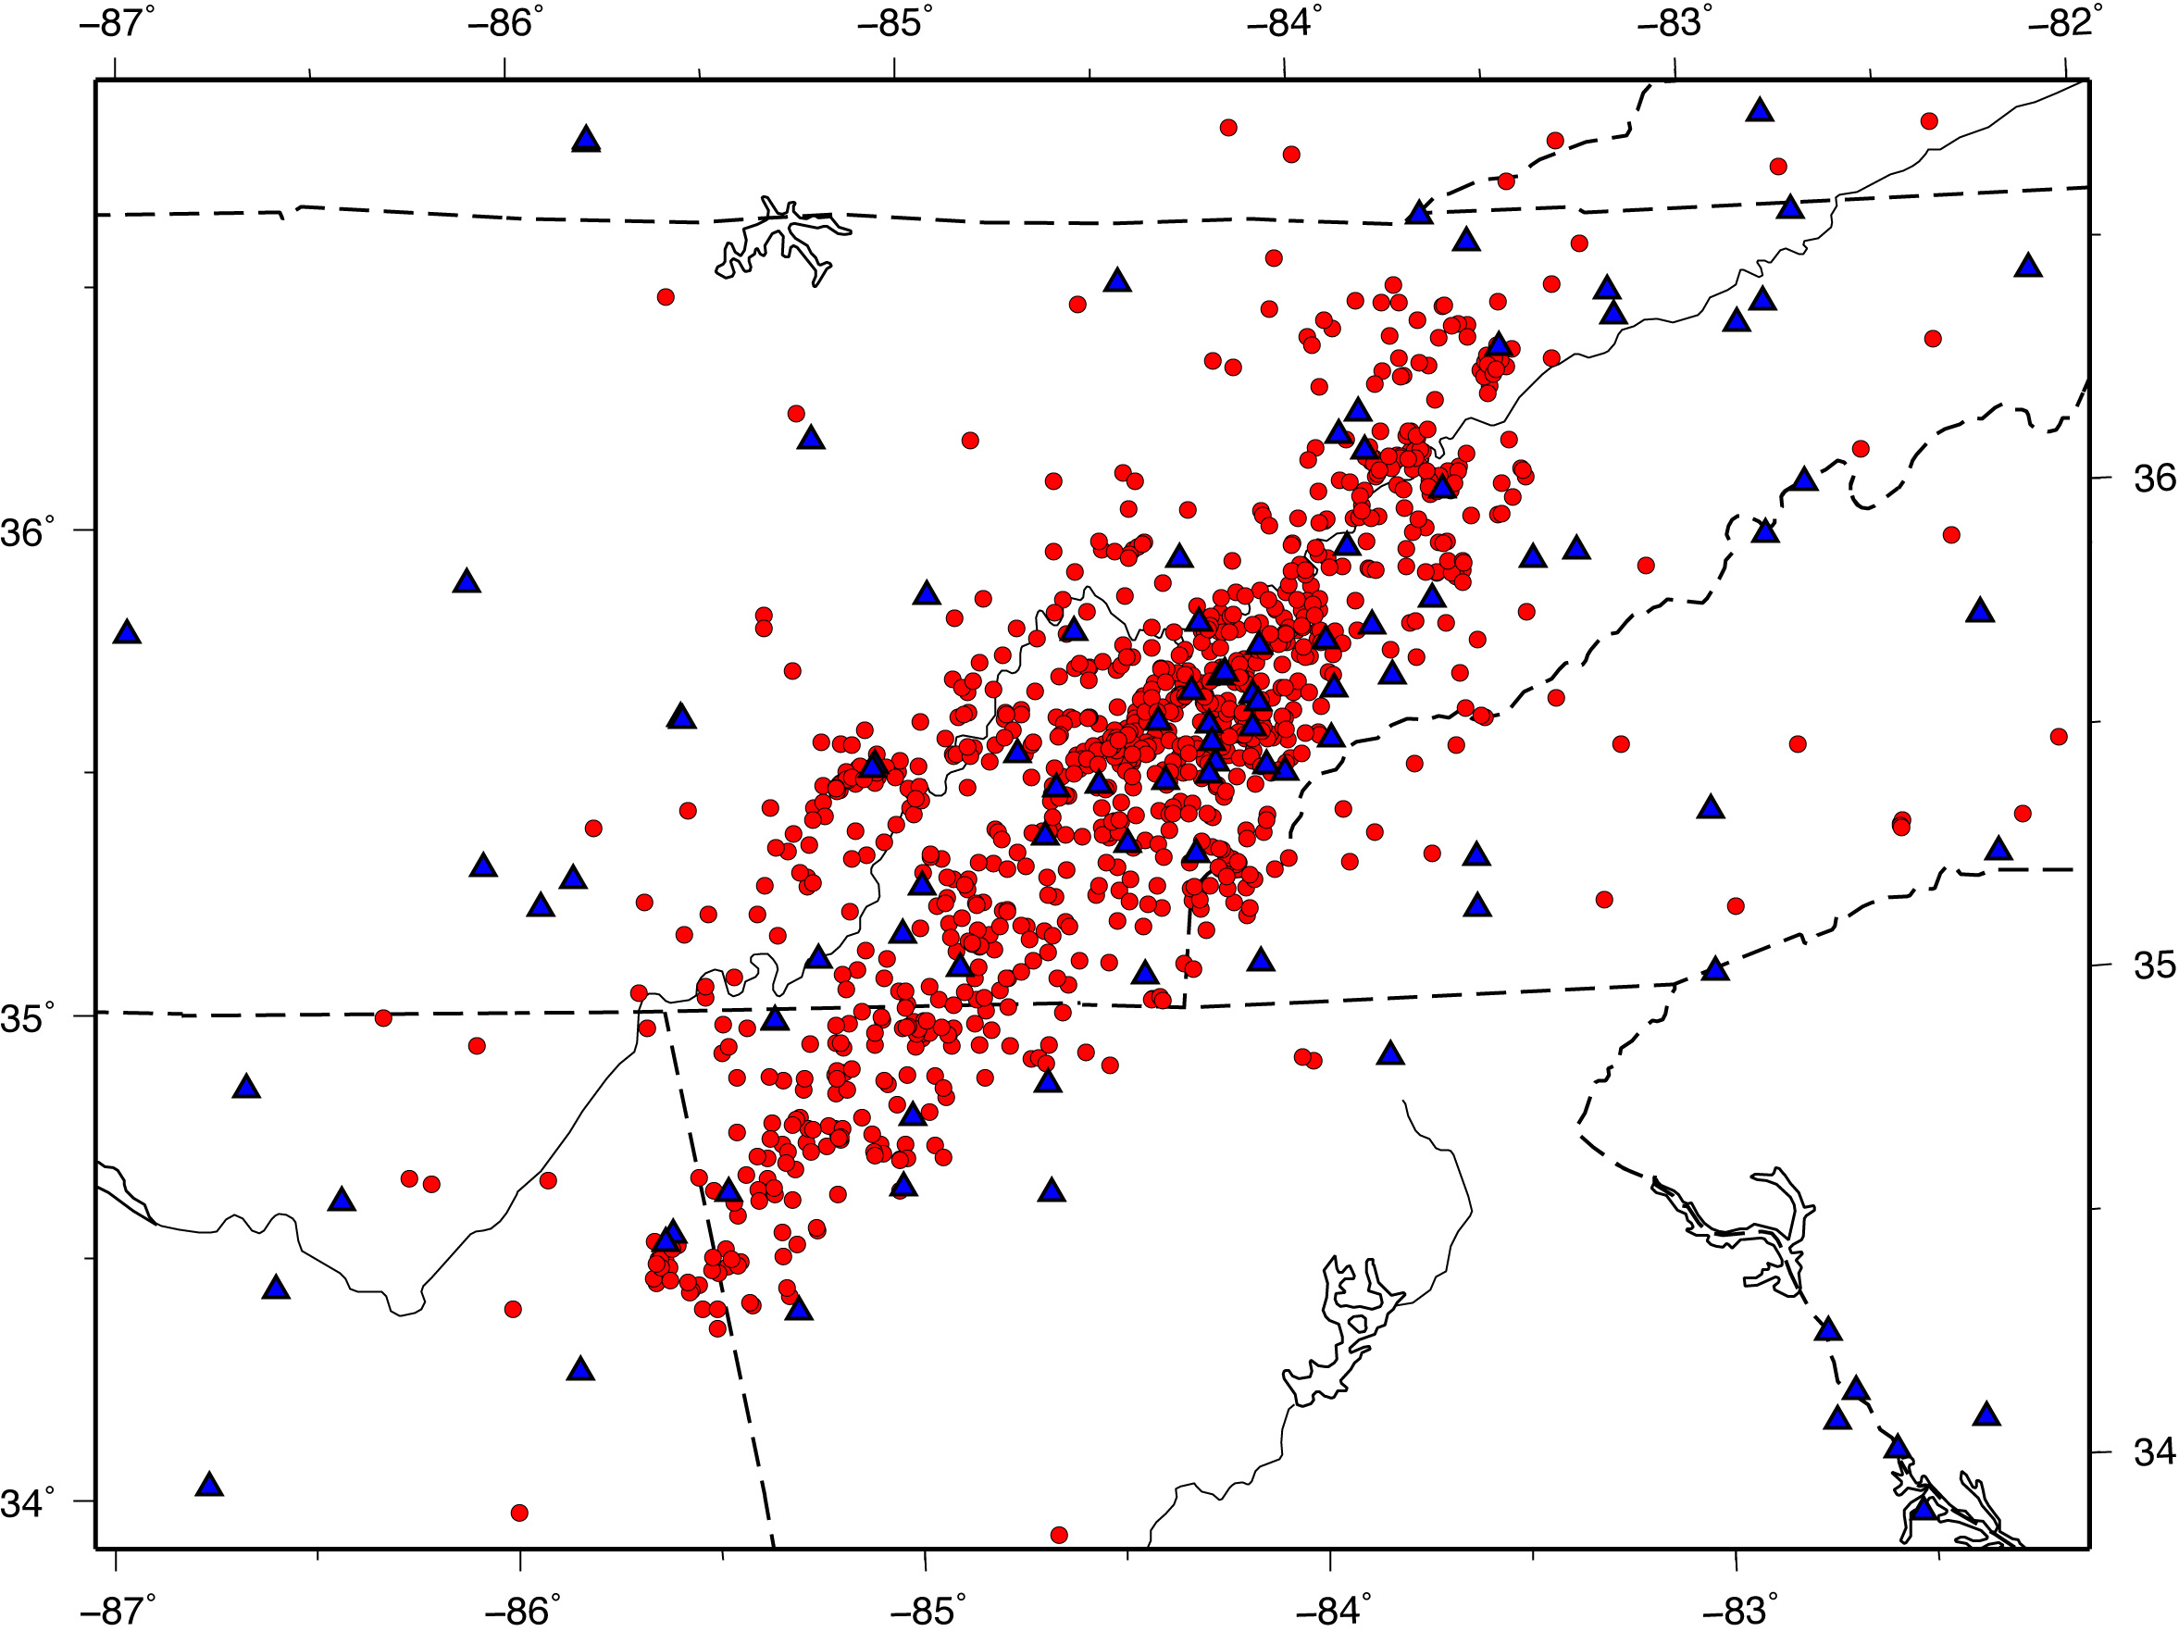
Local earthquake tomography
travel time residuals are inverted
for velocity variations in the crust
simultaneous inversion for 3D
P-wave (Vp) and S-wave (Vs)
velocity models and hypocenter
relocation
station
earthquake
1250 earthquakes; 10,343 P-wave 7,220 S-wave arrivals
Block size 12x12 km horizontal; 4 km vertical
Resolution good to 24 km depth

Slide 13
P wave velocity solution
Anomalous blocks
+/- 5% change from 1D
36x36 km block size
placed in depth range
4 to 16 km
Notes:
Smearing of anomalies above and below. P wave resolution better than S in Blue Ridge

Slide 14
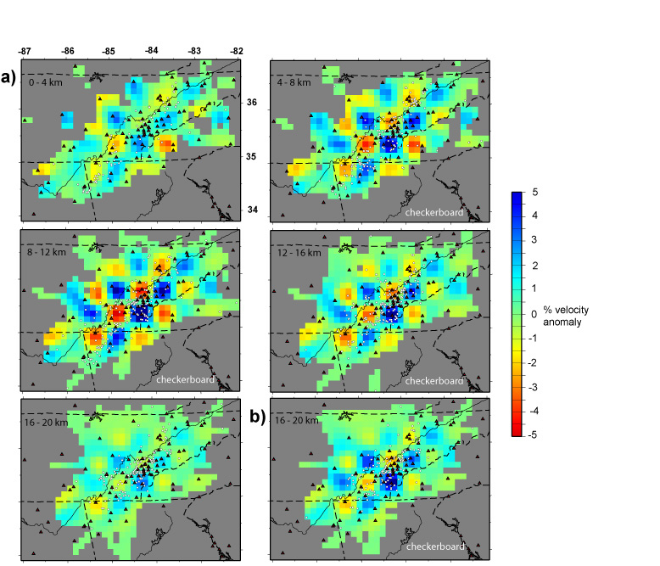
S wave velocity solution
Checkerboard resolution
Test
Checkerboard 4-16 km
Checkerboard 4-20 km
Notes:
When the checkerboard is put in the deeper layer (16-20 km) can see some of it. As depth increases, resolution decreases.

Slide 15
H1
Real Solution layers 0-4 and 4-8 km expressed as % change from starting model.

Slide 18
Absolute velocities in the depth range 16-20 and 20-24 km
Dot in the velocity scale is the starting 1D value

Slide 19
Consistent features in the Vp and Vs velocity solutions
Vp solution
Vp solution

Slide 20
Earthquakes
within 12 km
of the profile
Note events
lining up in
vertical planes
Notes:
Cross sections with eqs +/- 12 km from profile plotted. Eq changes from original 0.5 km hor 1.5 km vert

Slide 21
What is producing the anomalies? Different rock types most likely.
Vp solution
Depth slice 8-12 km
Vp solution
Notes:
L3 is important for the interpretation of the velocity structure

Slide 22
What are the basement rocks?
*Synthetic modeling of select
features helped to determine
the real absolute velocities.
Trial and error procedure.
*Compare results to laboratory
measurements of rock velocities.
Provides a range of possible rock
types.
Notes:
Error of +/- 1% usually when both P and S velocities can be modeled

Slide 23
A
Geophysical setting:
strong association
with potential field
anomalies
A
New York – Alabama
lineament:
High magnetics
Low gravity
Intrusion A:
High magnetics
High gravity
Notes:
Aeromagnetics and Bouguer gravity NY-AL; mag high grav low associated with NY-AL. Earthquake distribution to the SE of the NY-AL lineament

Slide 24
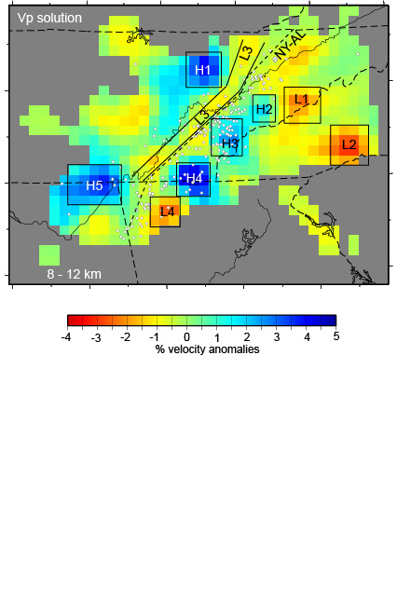
M magnetic anomaly
BG Bouguer gravity anomaly
H1: >> M, BG, diorite, gabbro
(mafic intrusion)
H2 and 3: < M, BG
Felsic granulite
H4: < M, BG
Mafic granulite
H5: < M, BG anorthosite
L1 and L2: < M, << BG
Granite gneiss
L3: >> M, < BG, cataclasite mylonite
with thin mafic flows
Use potential field vales to narrow the range
of possible rock types

Slide 25
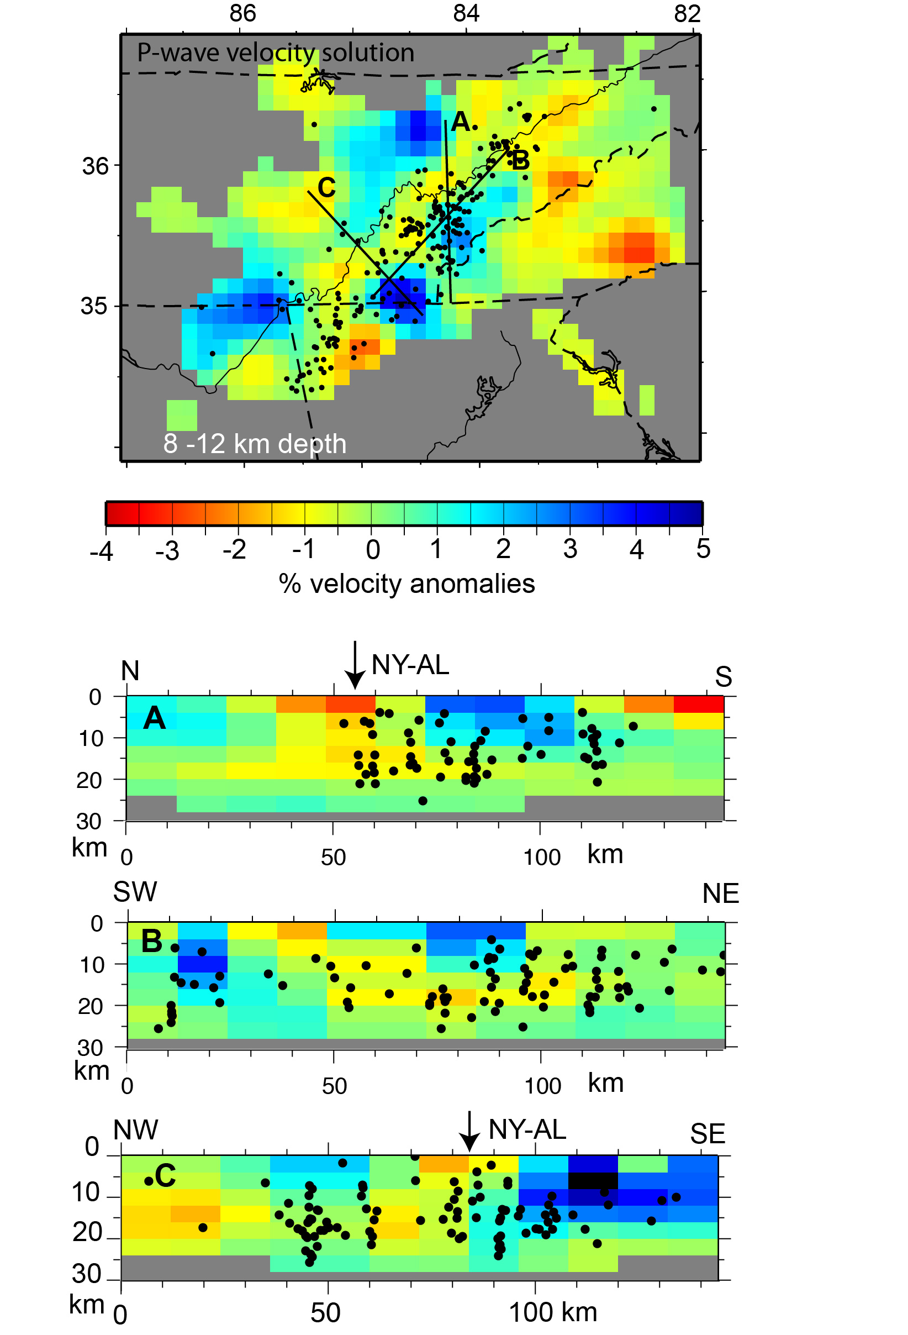
Hypocenter distribution
for the relocated earthquakes
A and B: Earthquakes align in vertical planes trending WNW. Earthquakes within 3 km of the profile plotted.
C: Earthquakes align in planes trending NE-SW. Earthquakes within 12 km of the profile plotted.
Suggests the presence of
conjugate faults

Slide 26
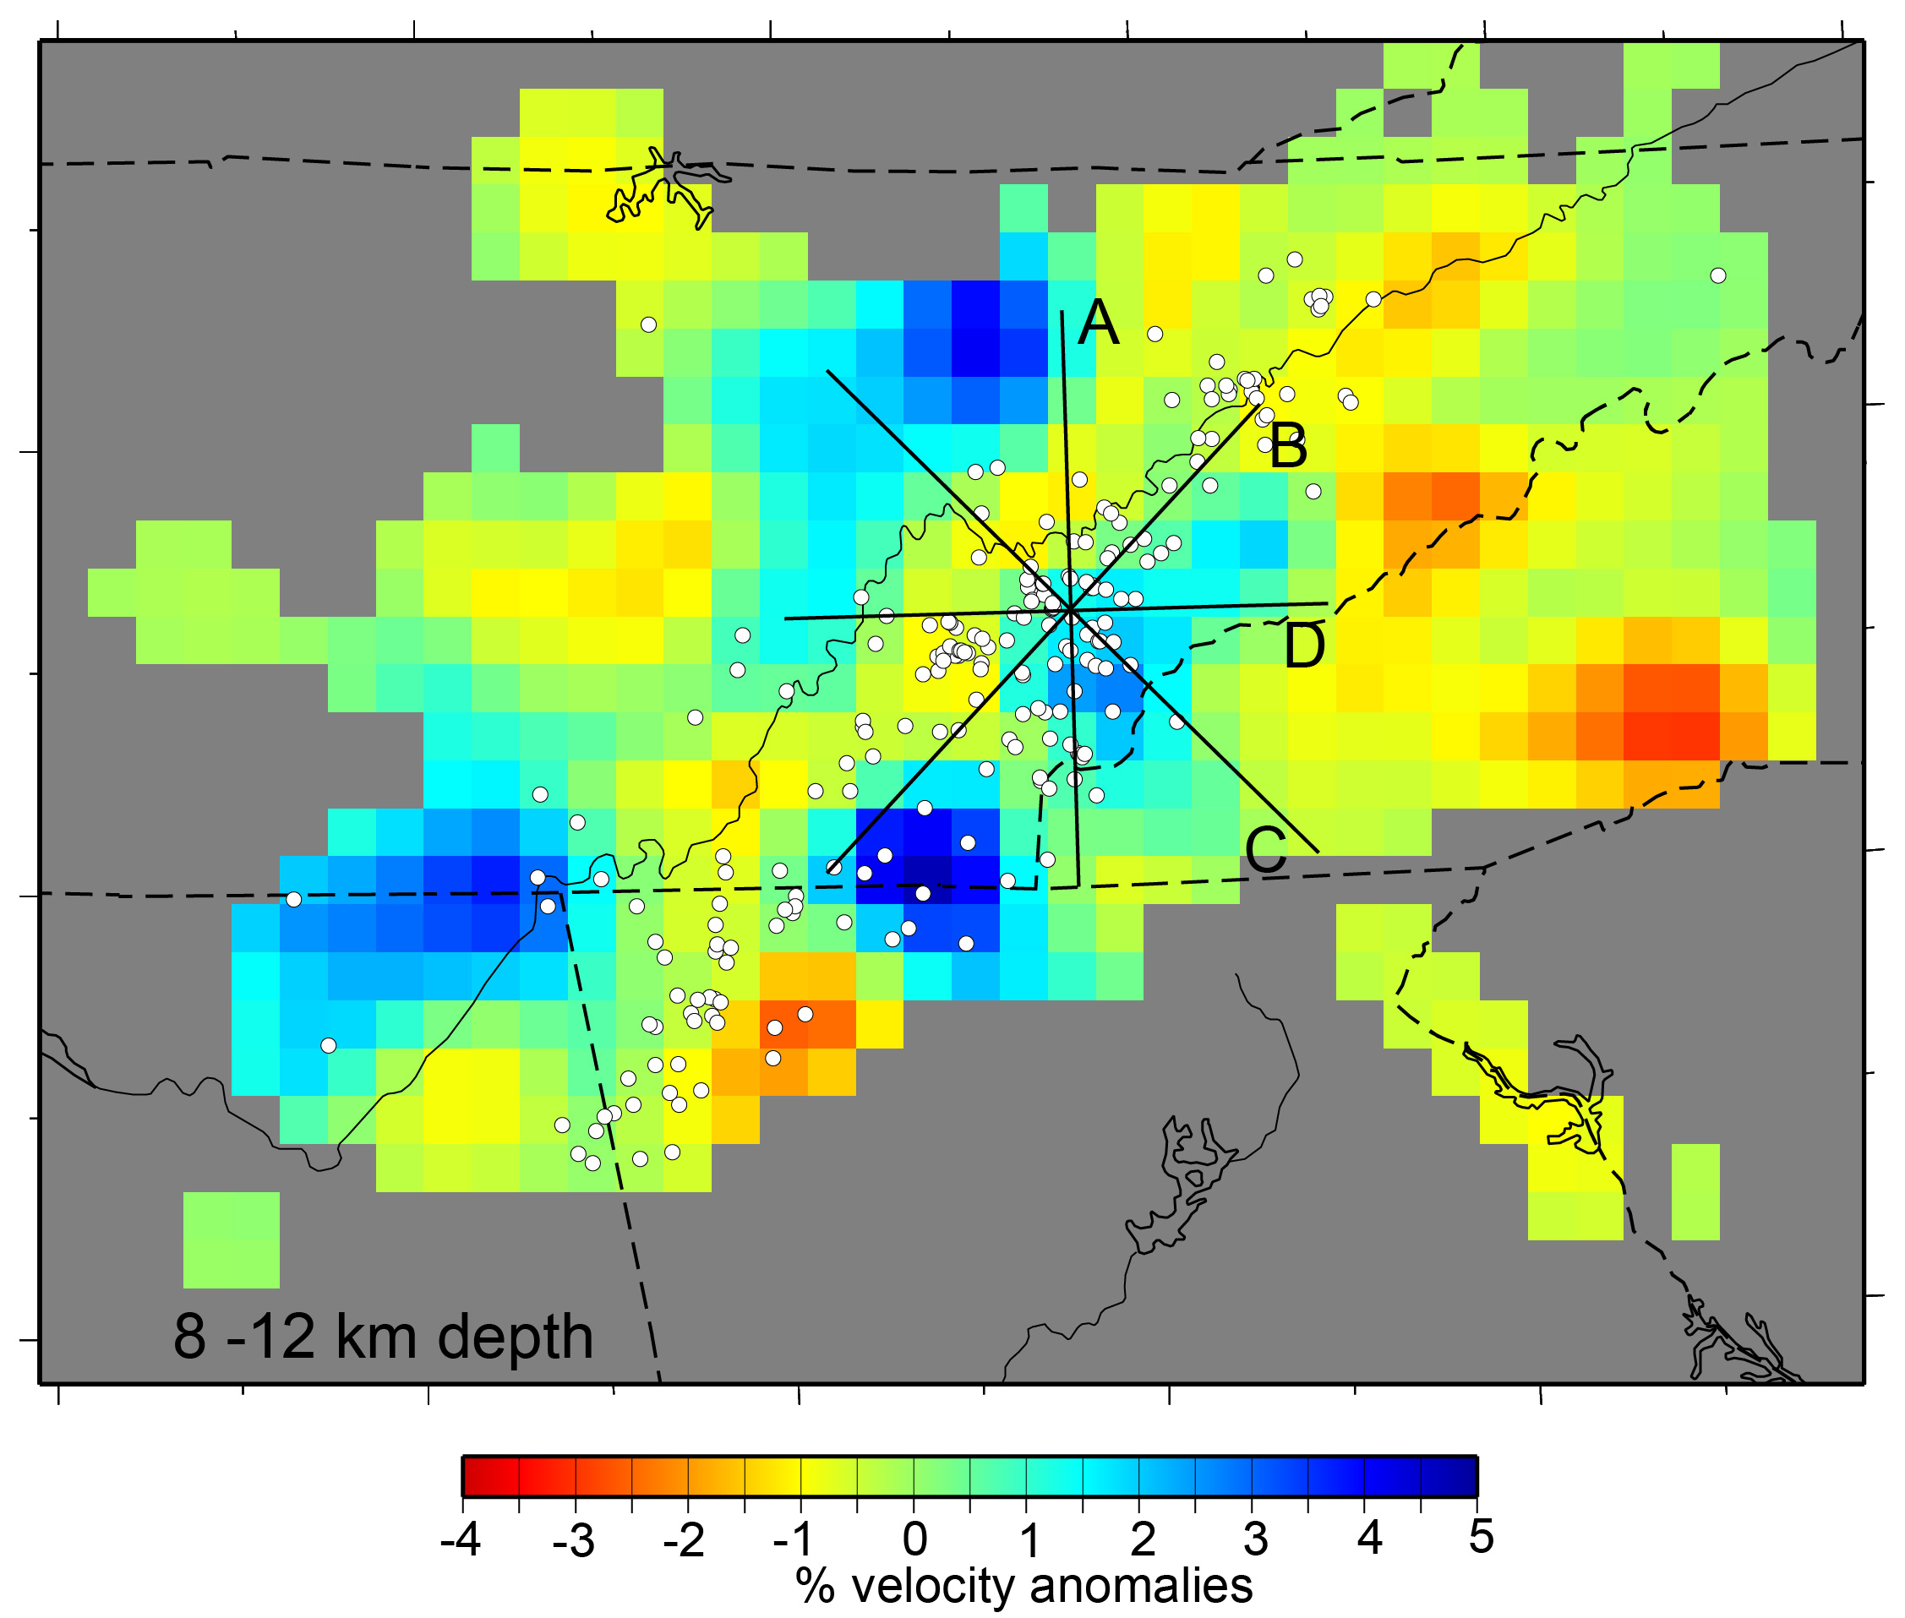
See E to ESE trending, vertical faults
Notes:
Faults strike ~EW to SE Dip ~ vertical ESE trend on vertical faults

Slide 27
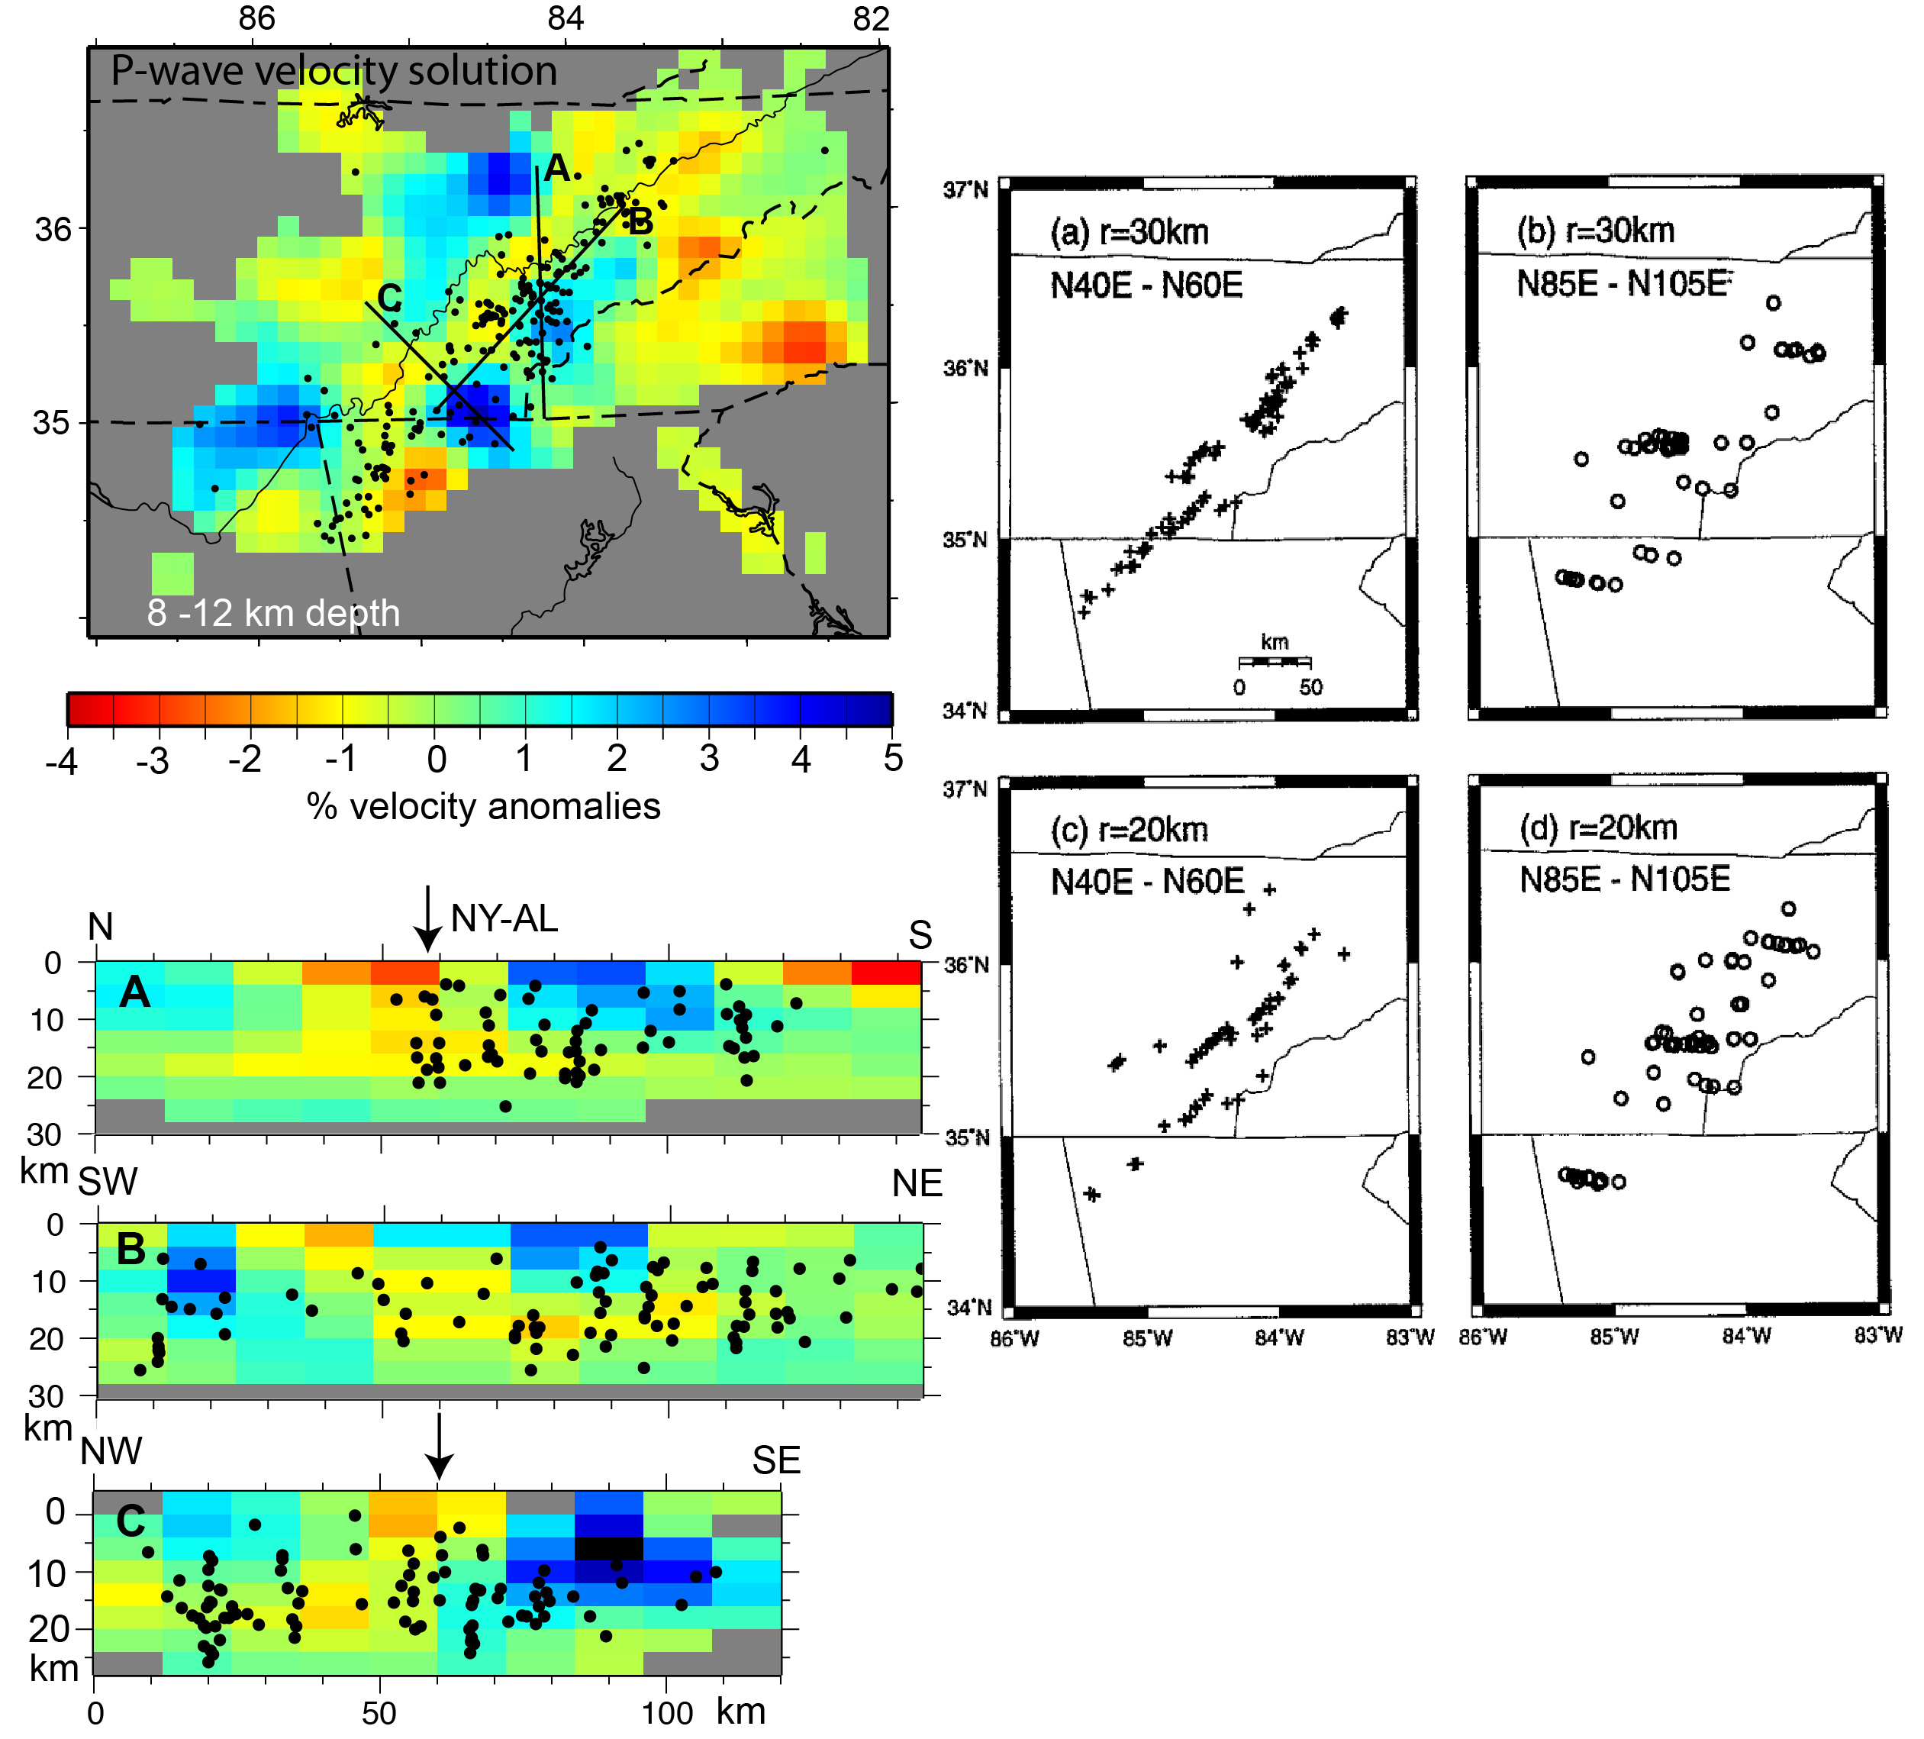
Earthquake distribution
WNW trending
planes
WNW trending
planes
Statistical alignment of
epicenters.
(Chapman et al. 1997)
NE trending
planes

Slide 28
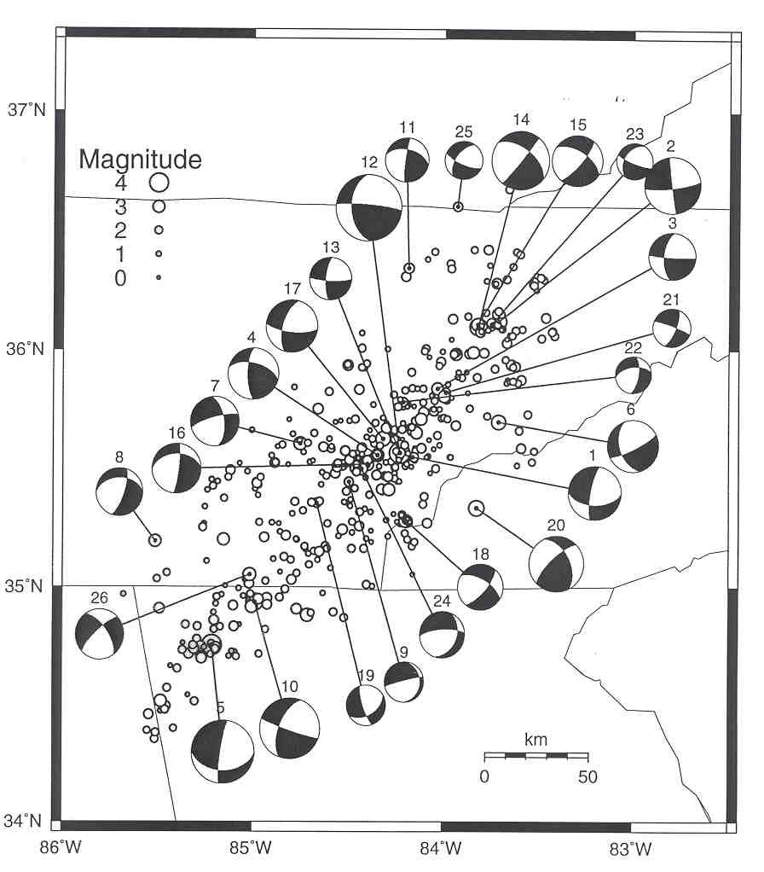
Focal mechanisms for
1983-1993. Compressional
quadrants are shaded.
Strike-slip motion on
steeply dipping fault planes
trending E-W (or N-S) and
NE-SW (or NW-SE).
Hypocenter alignment
and focal mechanism
solutions suggest
strike-slip faulting on
a conjugate set of
vertical faults.
Chapman et al. (1997)

Slide 29
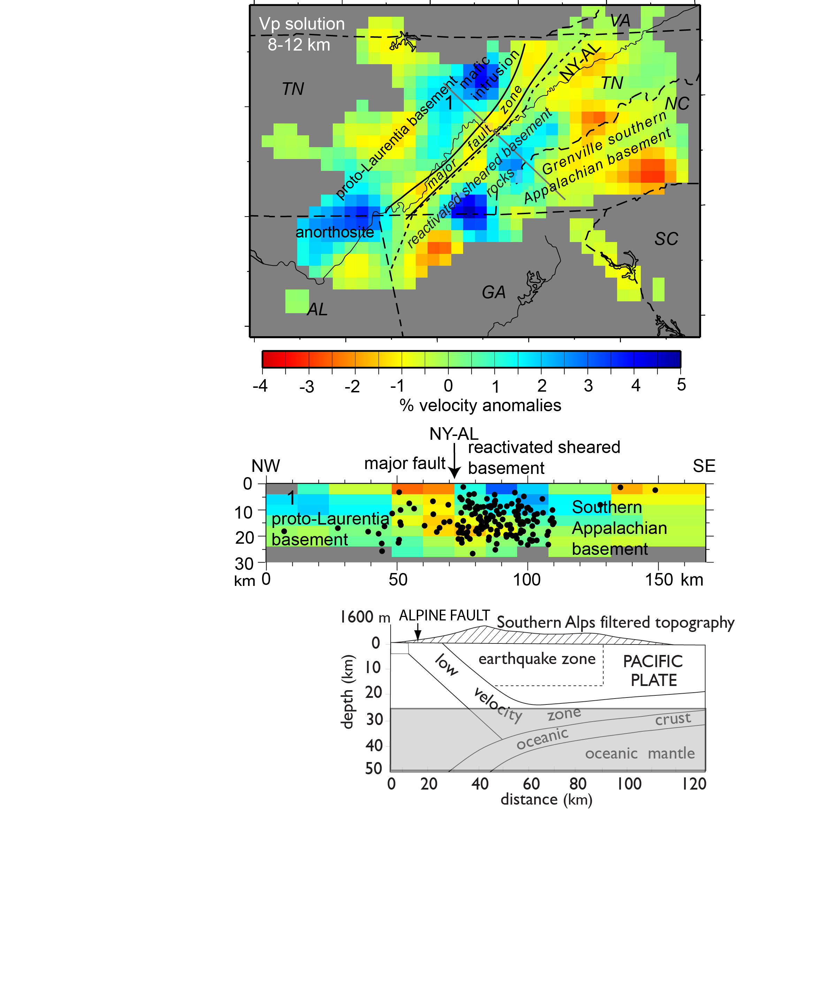
Seismotectonic model for the ETSZ
Earthquakes in the ETSZ
represent reactivation
of a major strike slip fault
established about 1 billion
years ago during formation of
Rodinia.
A modern analogy
may be the Alpine fault in
New Zealand.

Slide 30
Supporting evidence:
Basement velocity structure
Earthquake locations
Focal mechanisms
Paleomagnetics
Geology of part of the Amazon craton
Blue Ridge basement massifs
Isotopic data
SKS splitting

Slide 31
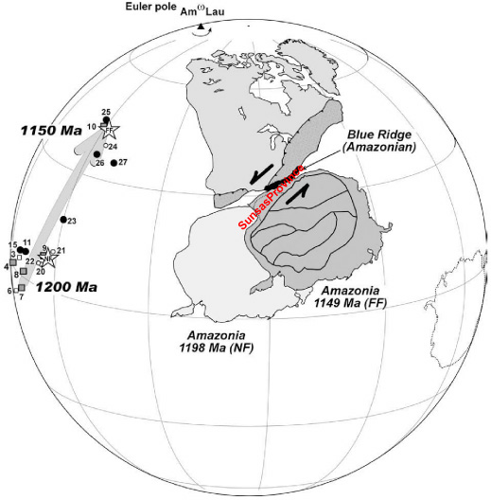
paleomagnetic polar wander curve
Poles
- Amazonia
- Laurentia
- Greenland
Paleomagnetic evidence for the 2000 km along-strike migration of the Amazon craton
relative to proto-Laurentia during the formation of Rodinia. Gray arrow is the apparent
polar wander path for proto-North America. Transpressional motion brought the Sunsas
Province of the Amazon craton in contact with Laurentia. Taken from D’Agrella-Filho et al.
(2008).

Slide 32
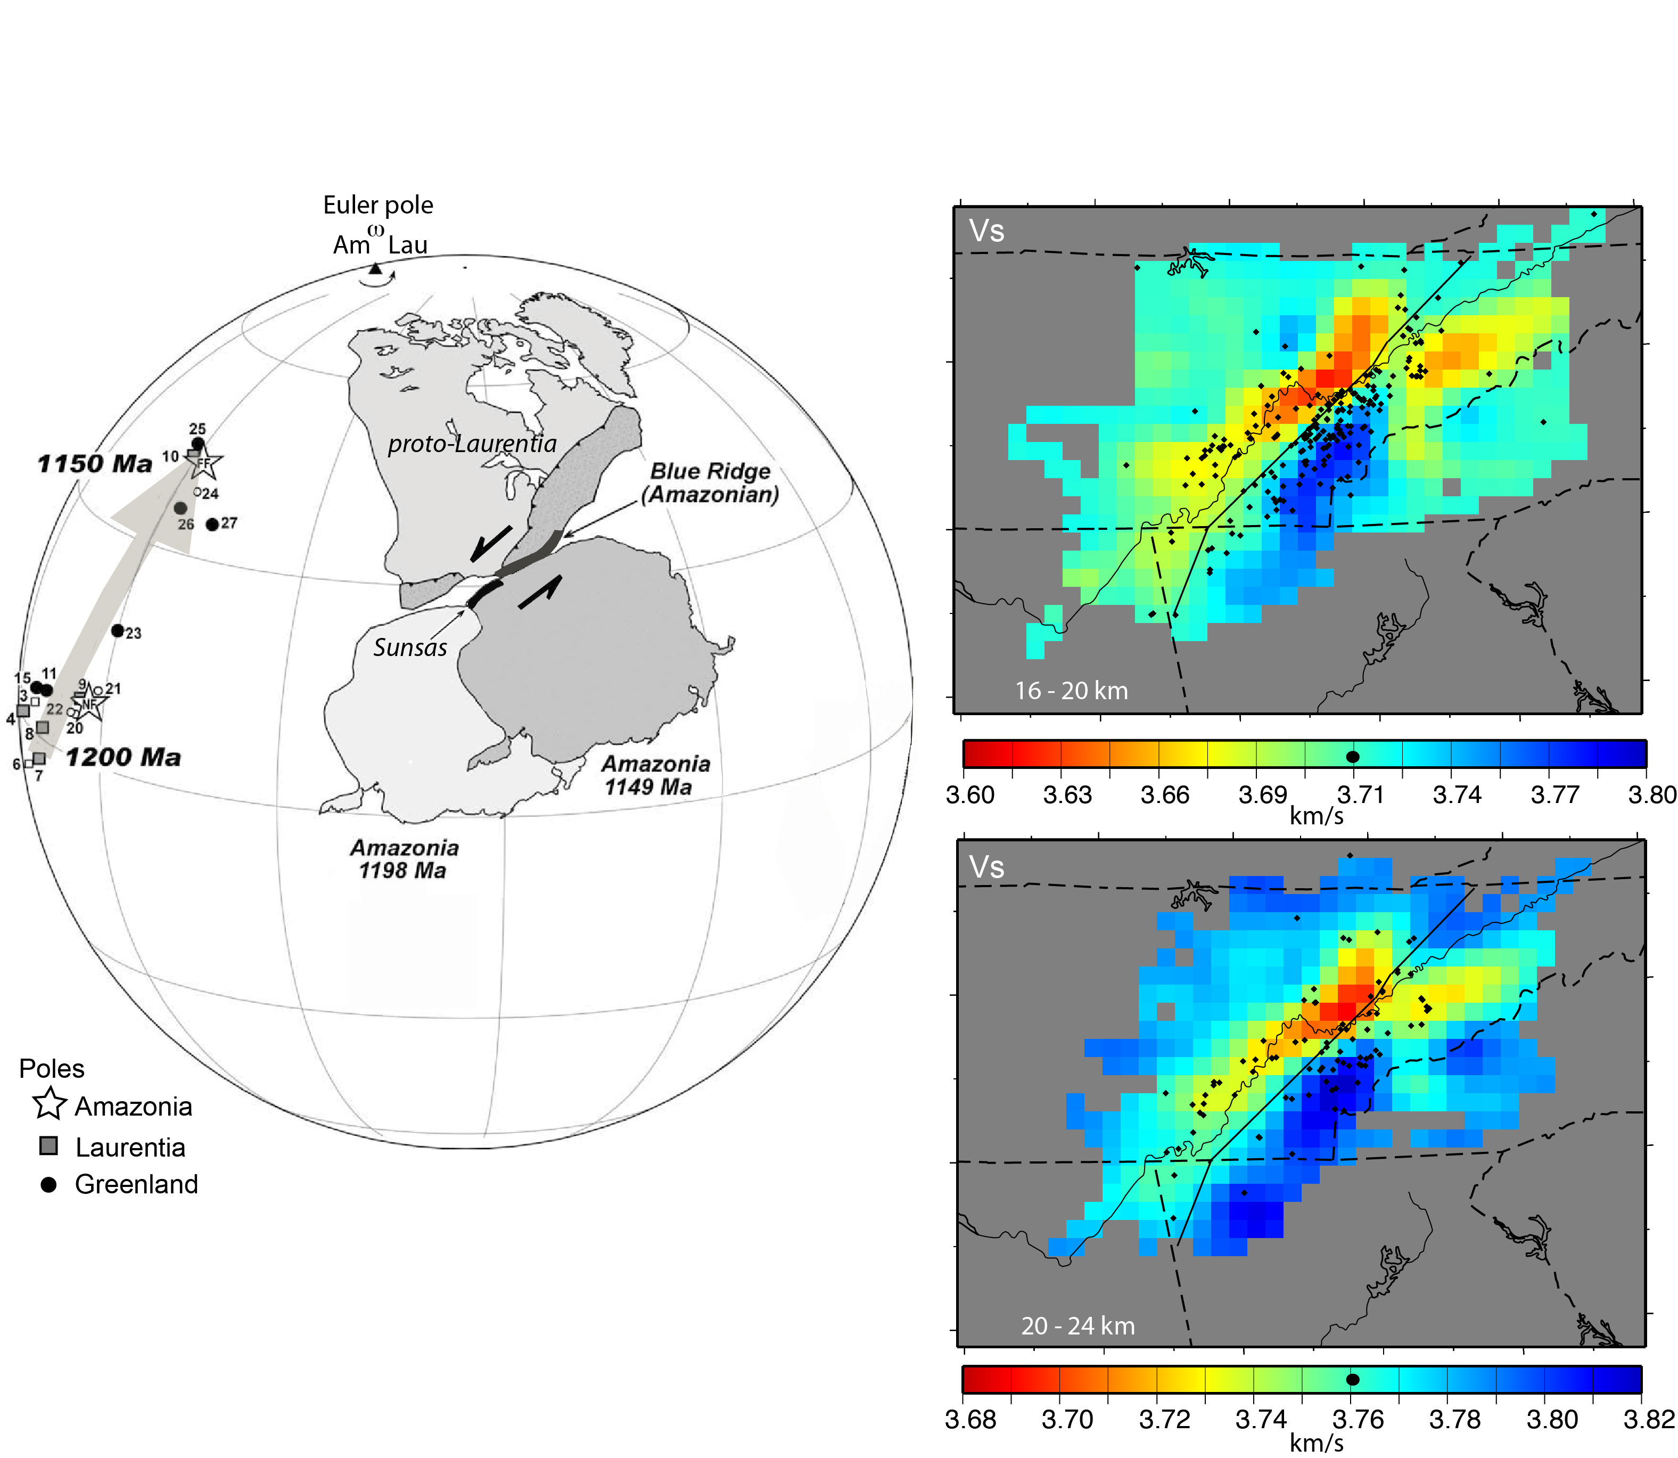

Slide 33
“Sunsas orogeny”

Slide 34
Isotopic Data:
Sm-Nd isotopic data provide an estimate of the time when crustal material was extracted
from a mantle source. (Depleted mantle ages TDM). If this age agrees with the U-Pb
zircon age of the rock (within 100 m.y.) then the TDM does provide the time of crust-mantle
differentiation and the rock is called “juvenile”. If TDM is much greater than the U-Pb zircon
age then the rock was at least partially derived from pre-existing crust.
Pb isotopic data provide information on the mantle source region that the crustal rocks
came from. Different parts of the mantle have different U/Pb ratios so there are different
Pb isotopic reservoirs. Usually, Pb data are plotted as ratios ²⁰⁷Pb/²⁰⁴Pb versus ²⁰⁶Pb/²⁰⁴Pb
Rocks from the same Pb isotopic source will fall in the same region of the plot.

Slide 35
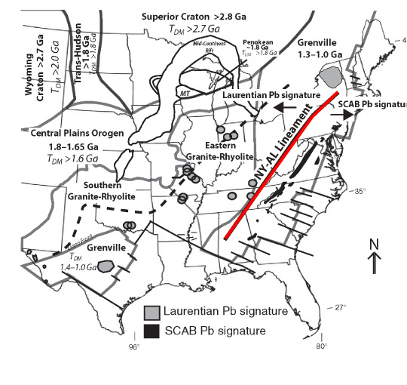
Isotopic Data
Whole rock Pb and Sm-Nd isotopic
data indicate that exposed Grenville
basement located east of the NY-AL
magnetic lineament was part of a
different “parent” craton when they
formed and was accreted to Laurentia
during the Grenville orogeny (1.1 Ga).
The tomography results link these
rocks to basement SE of the NY-AL
lineament and supports the concept
that the lineament marks the suture
between Laurentia and the southern
Appalachian provinces.
Distribution of Proterozoic Laurentian (Granite Rhyolite) and southern and central
Appalachian basement (SCAB) Pb isotope signatures compared with the location of the
NY-AL lineament. From Fisher et al. (2010).
Southern and central Appalachian basement Pb isotopic data are strikingly similar to
Pb data from ~1 Ga rocks located in the southwest part (Sunsas Provence) of the
Amazon Craton.

Slide 36
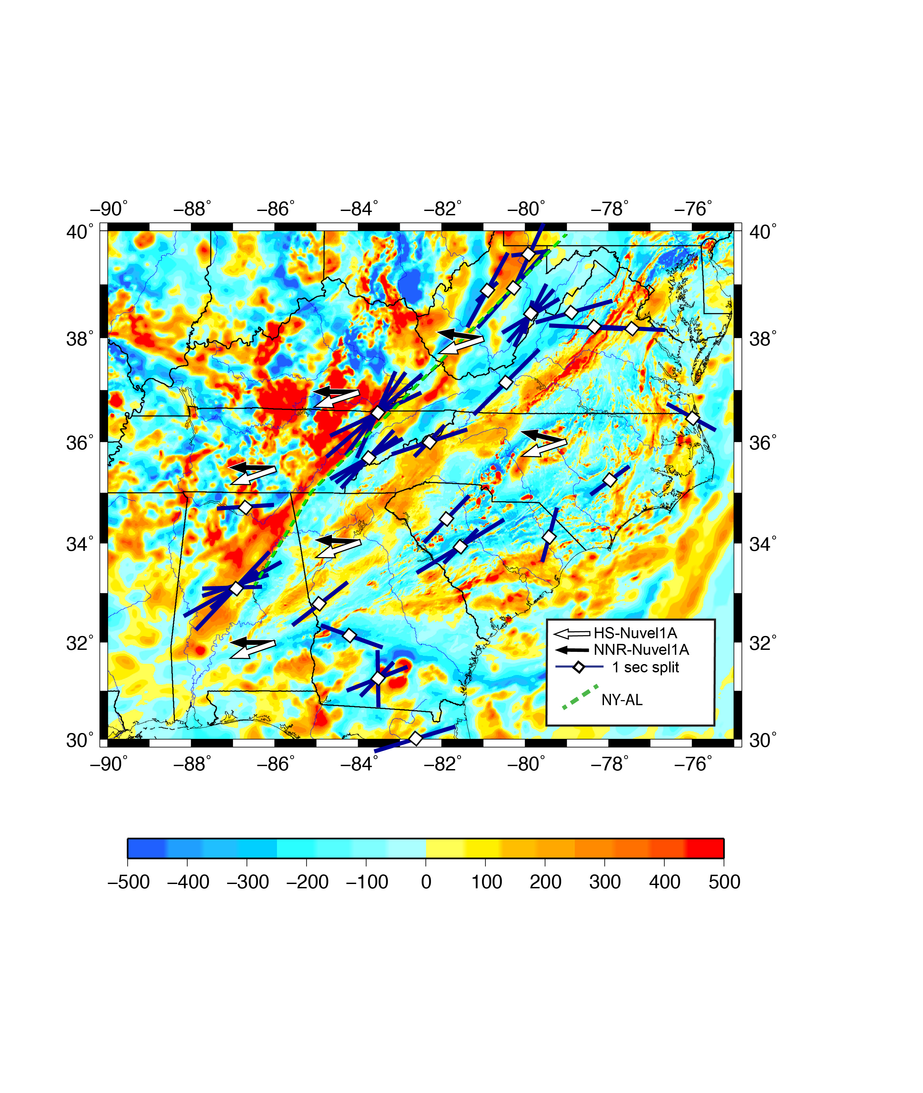
SKS splitting results from Wagner et al. (2012)

Slide 37
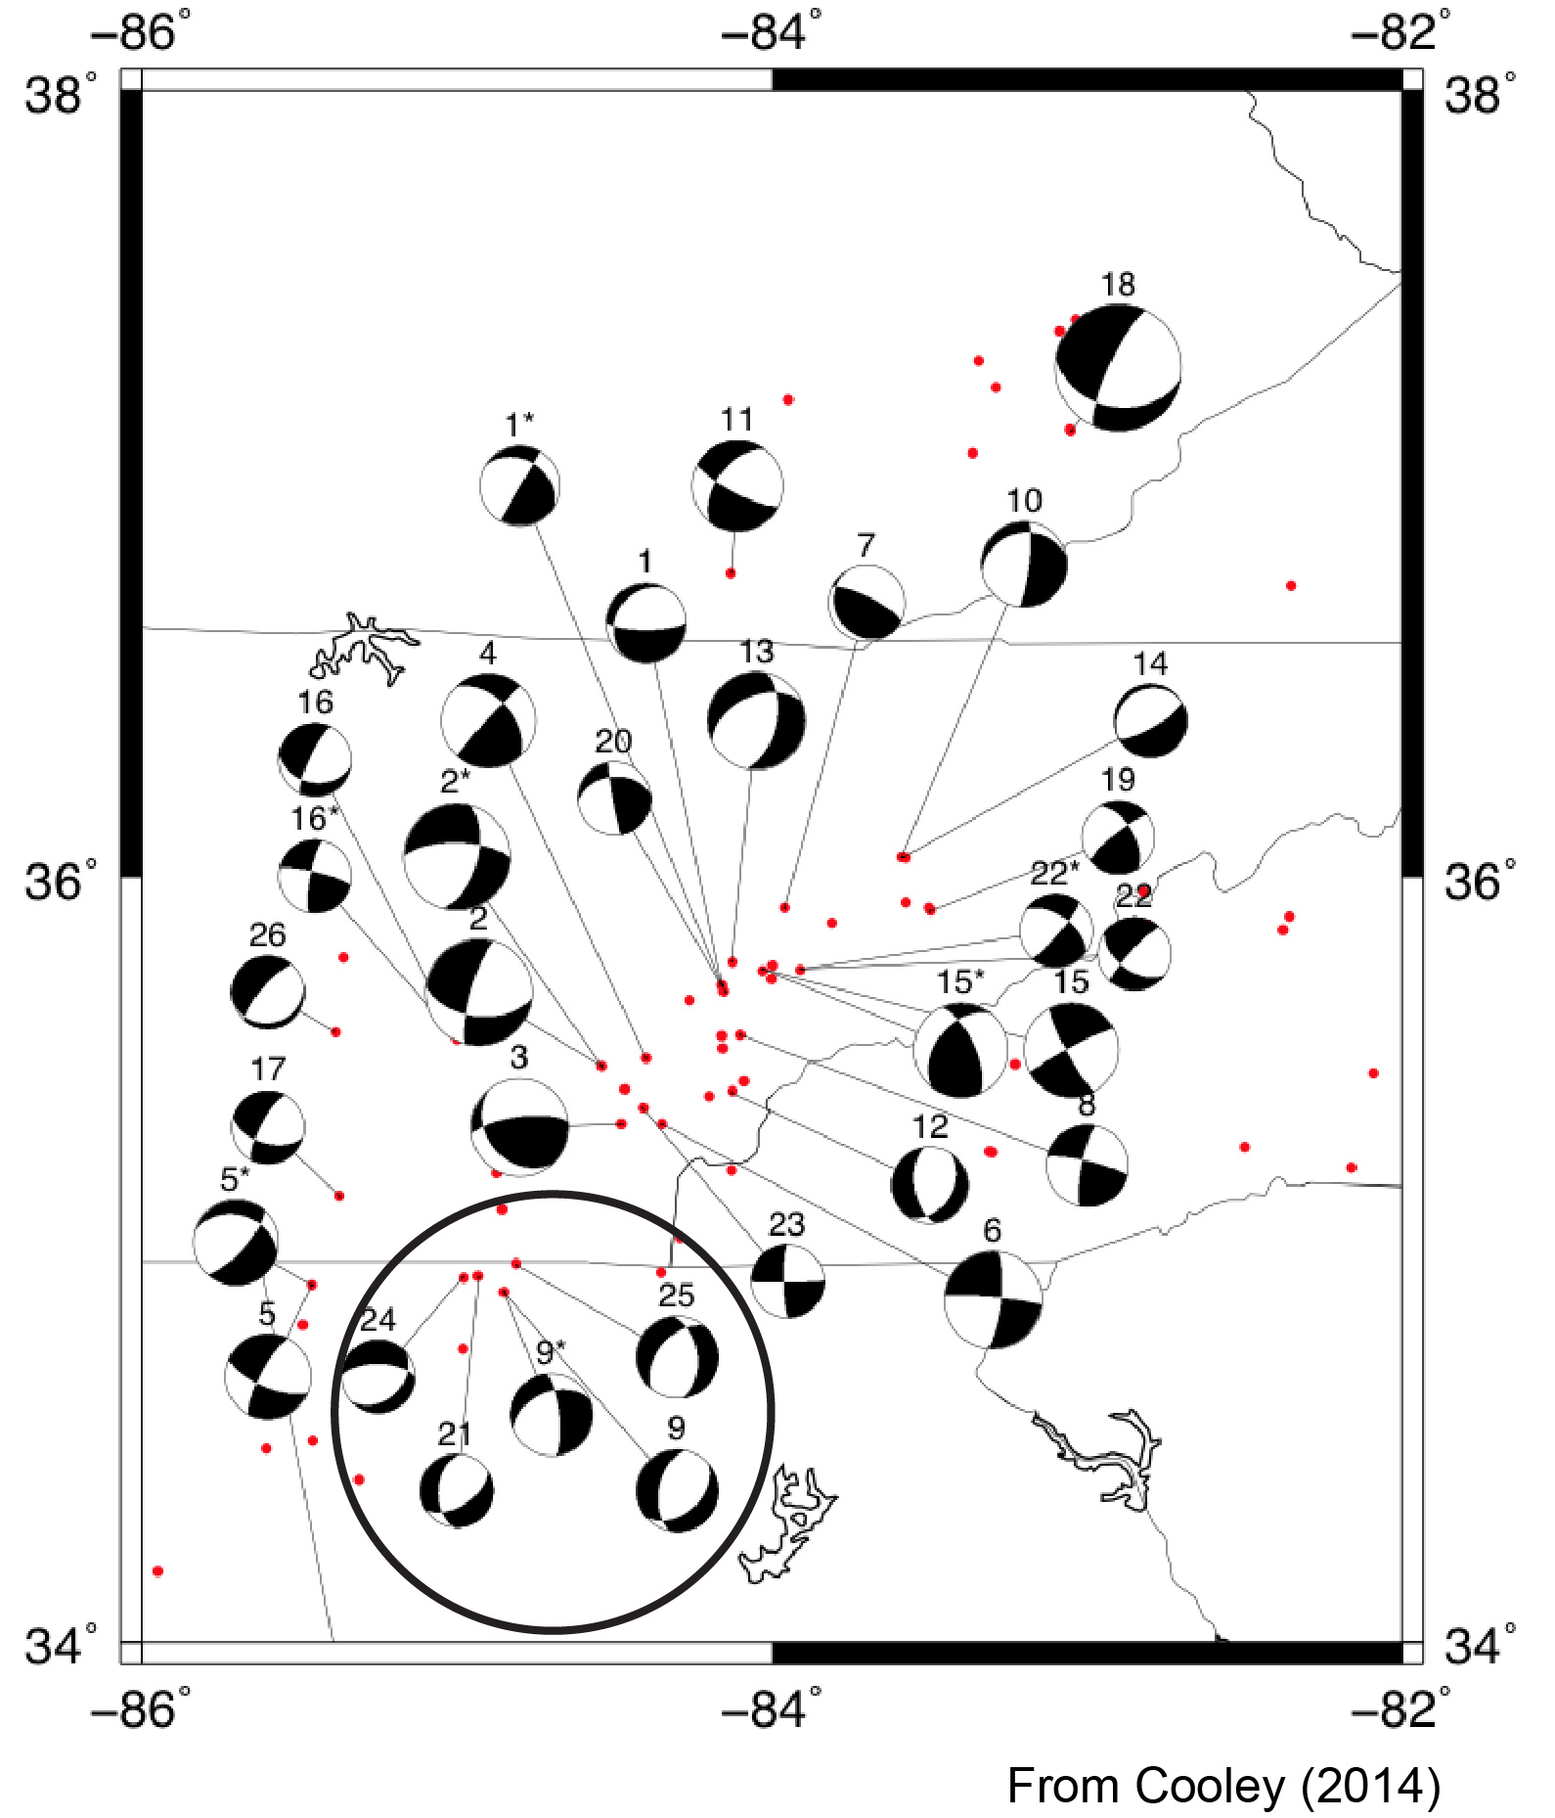
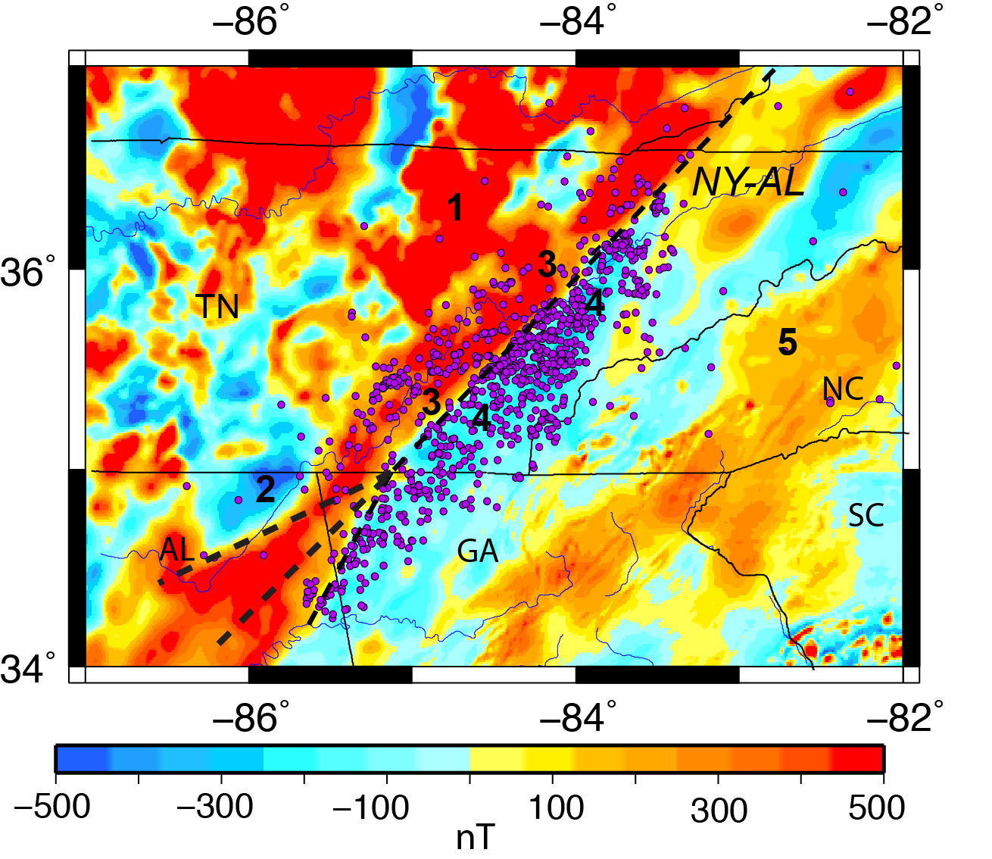
Southern portion of the ETSZ

Slide 38
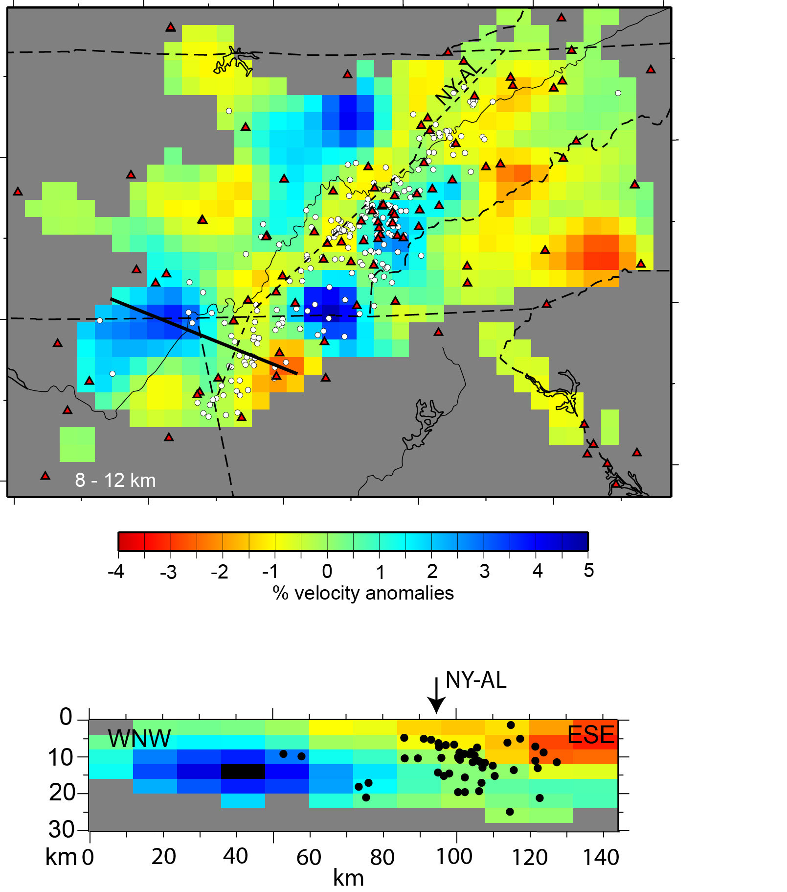
Vp

Slide 40
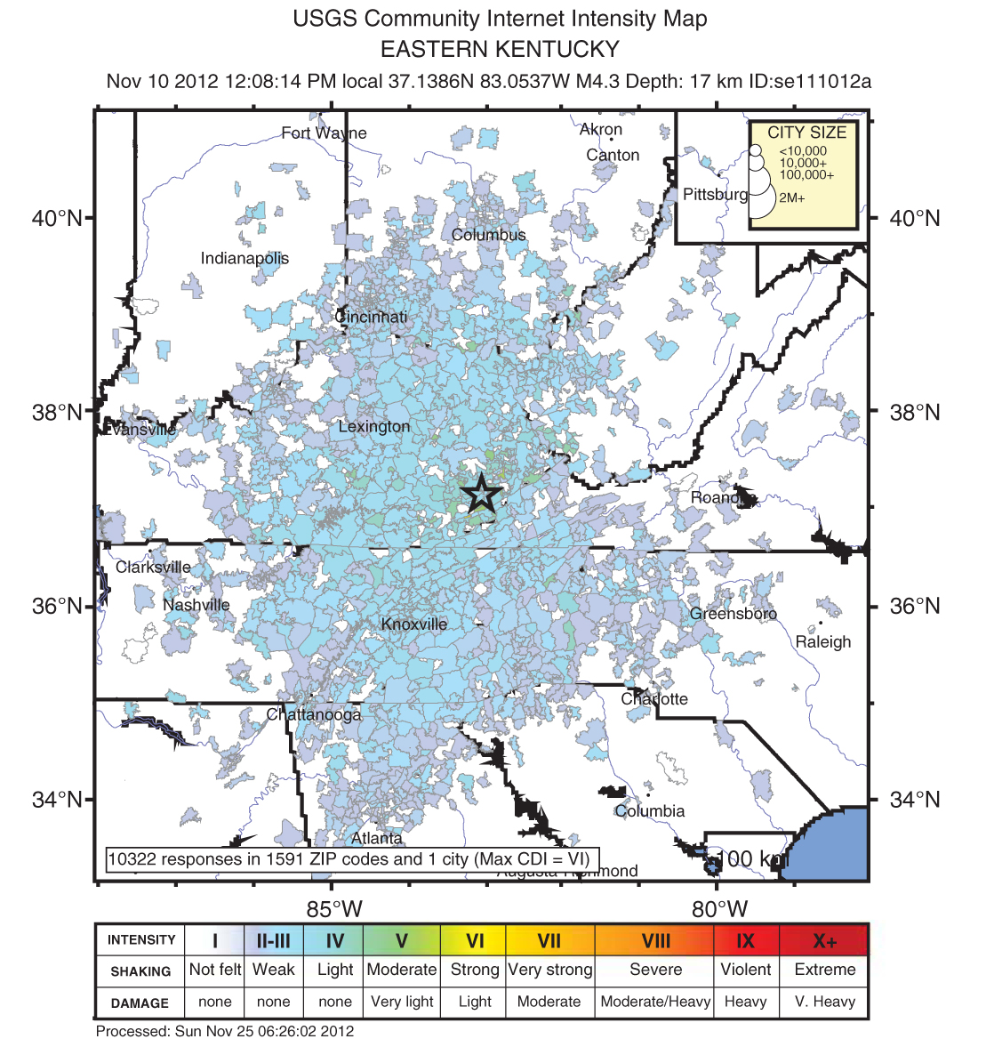
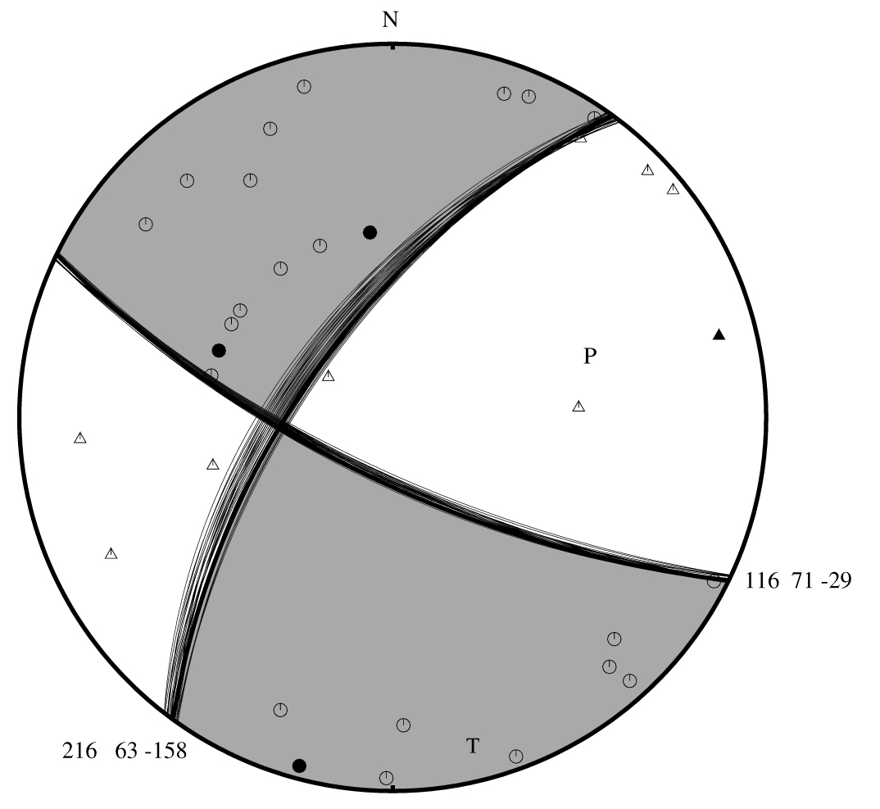
Can we extend the basement structure associated with the ETSZ into Kentucky?
Mw 4.2 Perry County Kentucky earthquake
Focal depth 17 km
Strike-slip faulting on steeply dipping
fault planes trending NE-SW or NW-SE
From Carpenter et al. (2014)
Is this earthquake part of the ETSZ?

Slide 41
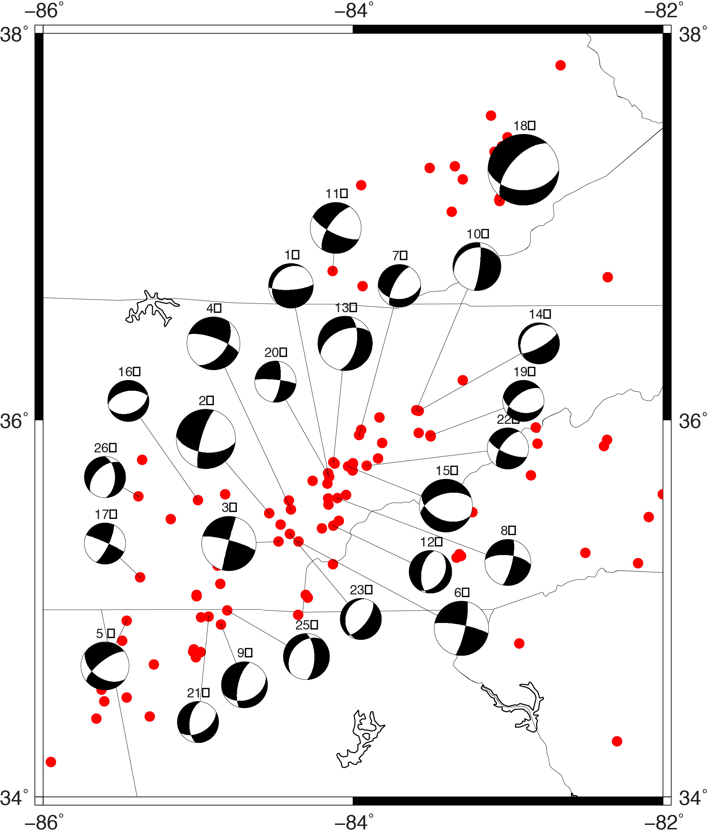
Matt Cooley
focal mechanisms
magnitude >2.5

