Slide 1
CERI-7104/CIVL-8126 Data Analysis in Geophysics
Continue Introduction to Matlab
Plotting.
Structures
Miscellaneous stuff
Lab – 6a, 09/12/19

Slide 2
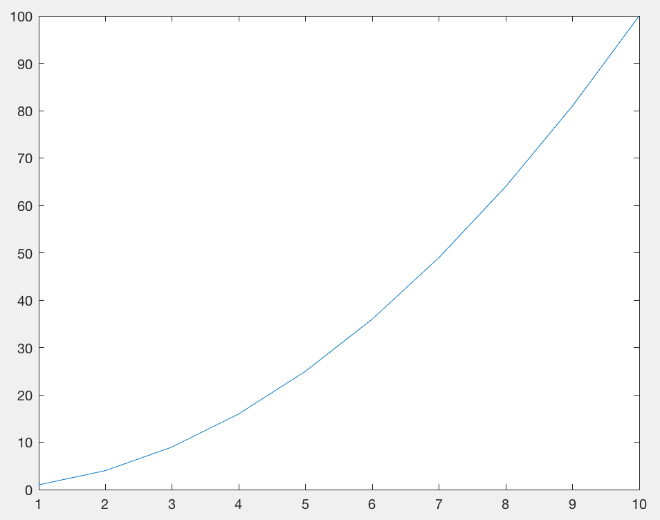
PLOTTING
We have already seen some basic plotting.
Make a vector, x, from 0 to 10 in steps of 0.1.
Make a vector y that has the square of x.
Plot y vs x.
x=[1:10];
y=x.^2;
plot(x,y)
Notes:
But this is lacking lots of stuff – axis labels, title, point values, grid, etc.

Slide 3
PLOTTING
Now lets pretty it up. LABEL axes, etc.
x=[1:10];
y=x.^2;
plot(x,y)
xlabel('time in seconds')
ylabel('position in meters')
grid
title('position as function of time under uniform acceleration')
hold on
plot(x,y,'ro')
Notes:
Fixing it up a little

Slide 4
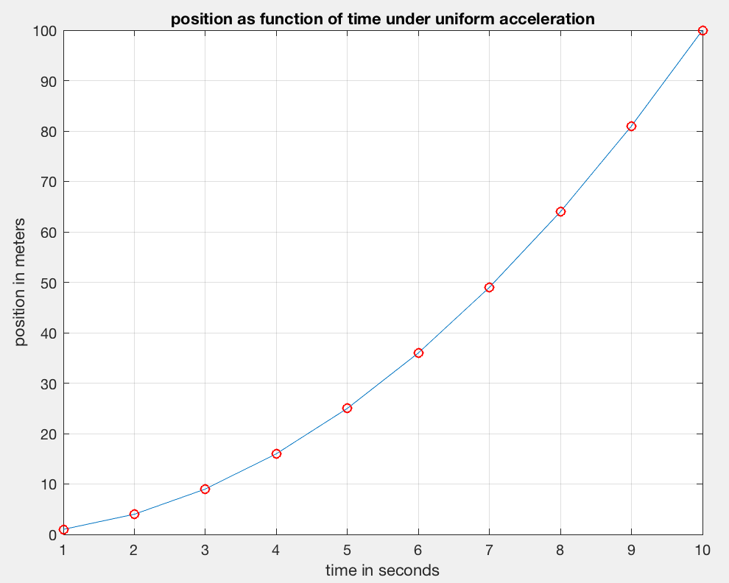
PLOTTING
Now lets pretty it up. LABEL axes, etc.
x=[1:10];
y=x.^2;
Notes:
Fixing it up a little

Slide 5
o Circle
x cross
+ plus sign
. dots
* asterisk
‘s’ or ‘square’
‘d’ or ‘diamond’
^ upward pointing triangle
‘v’ downward pointing triangle
> rightward pointing triangle
< leftward pointing triangle
‘p’ or ‘pentagram’ 5 pointed star
‘h’ or ‘hexagram’ 6 pointed star
PLOTTING - Symbols

Slide 6
r red
g green
B blue
c cyan
m magenta
y yellow
k black
w white
PLOTTING - colors

Slide 7
- line (default)
-- dashed line
: dotted line
-. dash- dotted line
(.- plots points
on a line –
combo of the
two symbols)
PLOTTING - lines
Notes:
Fixing it up a little

Slide 8
PLOTTING – other parameters
LineWidth width (in points) of the line.
MarkerEdgeColor color of the marker or the edge color for filled markers.
MarkerFaceColor —color of the face of filled markers.
MarkerSize size of the marker in points (must be greater than 0).

Slide 9
One method to set plot parameters – include in call
plot(x,y,'ro-.','LineWidth', 2, …
'MarkerEdgeColor','b','MarkerFaceColor','g',…
'MarkerSize',8)
grid
xlabel('time in seconds')
ylabel('position in meters')
title('position as function of time under uniform acceleration')
Notes:
The three dots (ellipsis …) mean continue on next line.

Slide 10
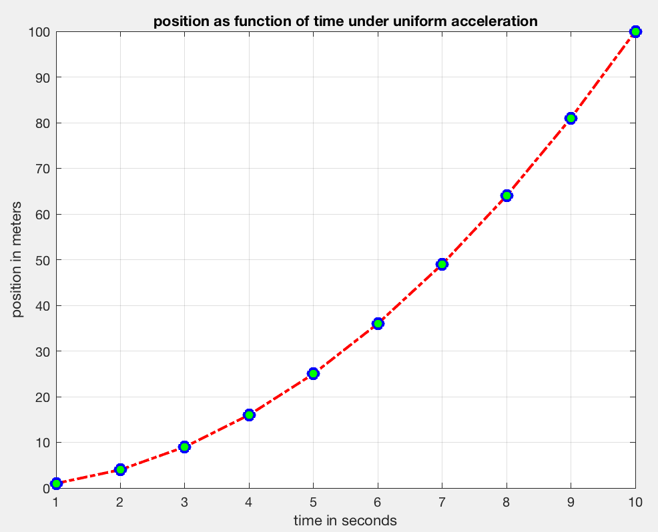
One method to set plot parameters – include in call

Slide 11
Multiple plots on same axis
The default is for each plot command to clear the figure and draw a new one.
To stop this behavior use the hold command
hold on turns hold on (will plot on same figure)
hold off turns hold off (will erase it and draw new figure)
hold switches state from off to on and vice- versa.
Notes:
Best to state what you want, rather than switch states

Slide 12
Plot x cubed and its derivative between -1 and 1
x=-1:.1:1; y=x.^3; dy=3*x.^2;
plot(x,y)
hold on
plot(x,dy)
grid
xlabel('x')
ylabel('y=x.^3 and derivative')
title('multiple plot')
These will also work
plot(x,y,x,dy)
yy=[y; dy];
plot(x,yy)
Notes:
With hold on, or the alternate forms below, will cycle through colors automatically

Slide 13
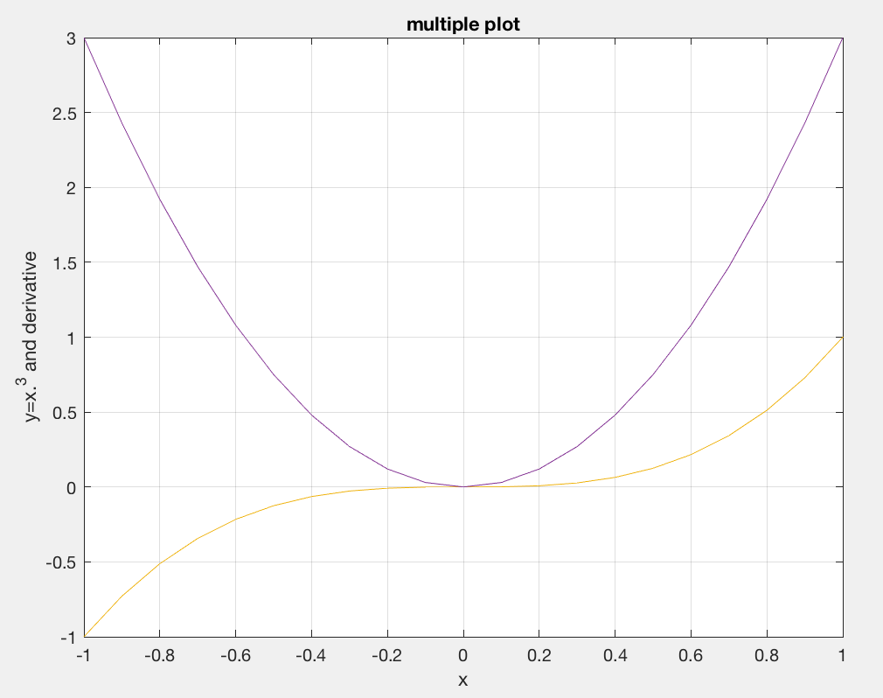
Plot x cubed and its derivative between -1 and 1
This “squishes” the plot vertically due to the larger y range

Slide 14
Use different left and right axes.
x=-1:.1:1; y=x.^3; dy=3*x.^2;
hold on %can put anywhere b4 second plot
yyaxis left %is default – don’t need, but works
plot(x,y)
ylabel('y=x.^3 ')
yyaxis right
plot(x,dy)
grid
xlabel('x')
ylabel('derivative') %have to do y labels separately
title('multiple plot')

Slide 15
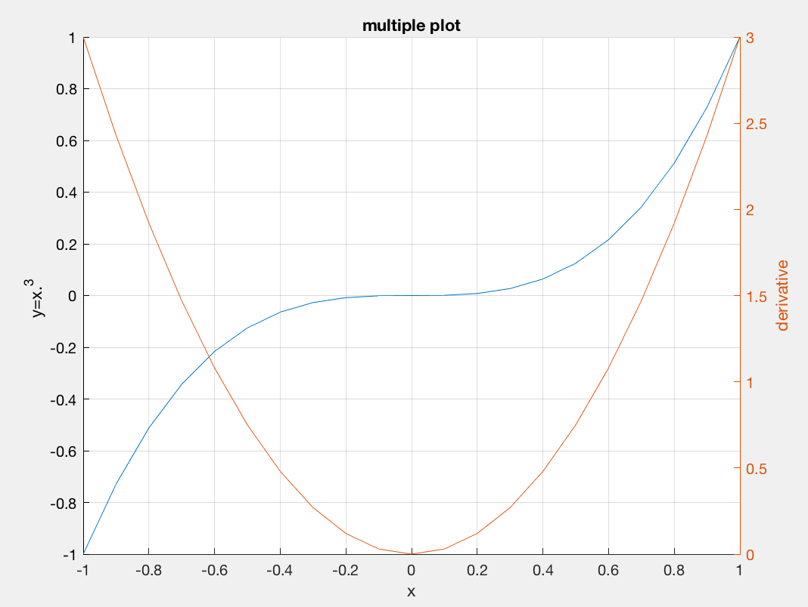
Use different left and right axes.

Slide 16
Making plots “prettier” (more readable)
Lines too thin, numbers too small, etc.
x=[0:300]/100*2*pi;
y=sin(x);
plot(x,y,'r.-') %points and line
plot(x,y,'r.-','LineWidth',2)
axis tight
grid
set(gca,'FontSize',14) %gca is “handle” to current figure
ax=gca; %get axis handle
ax.GridAlpha=1; %grid line problem is transpanency, not width
xlabel('time seconds')
ylabel('amplitude volts')
title('oscilliscope display’)

Slide 17
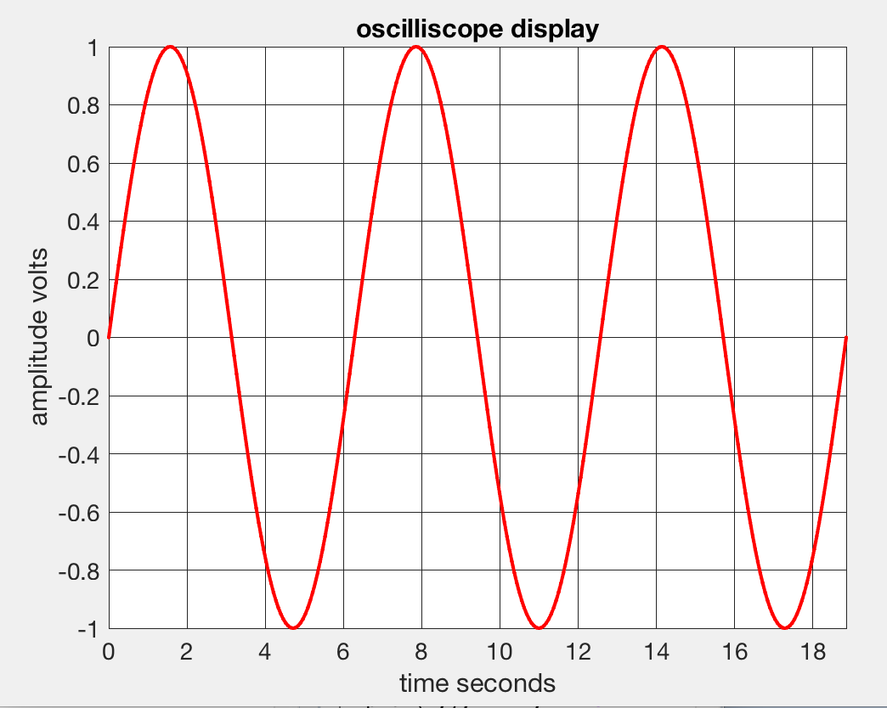
Making plots “prettier” (more readable)
Lines too thin, numbers too small, etc.
Notes:
Can also change font type and lots other stuff

Slide 18
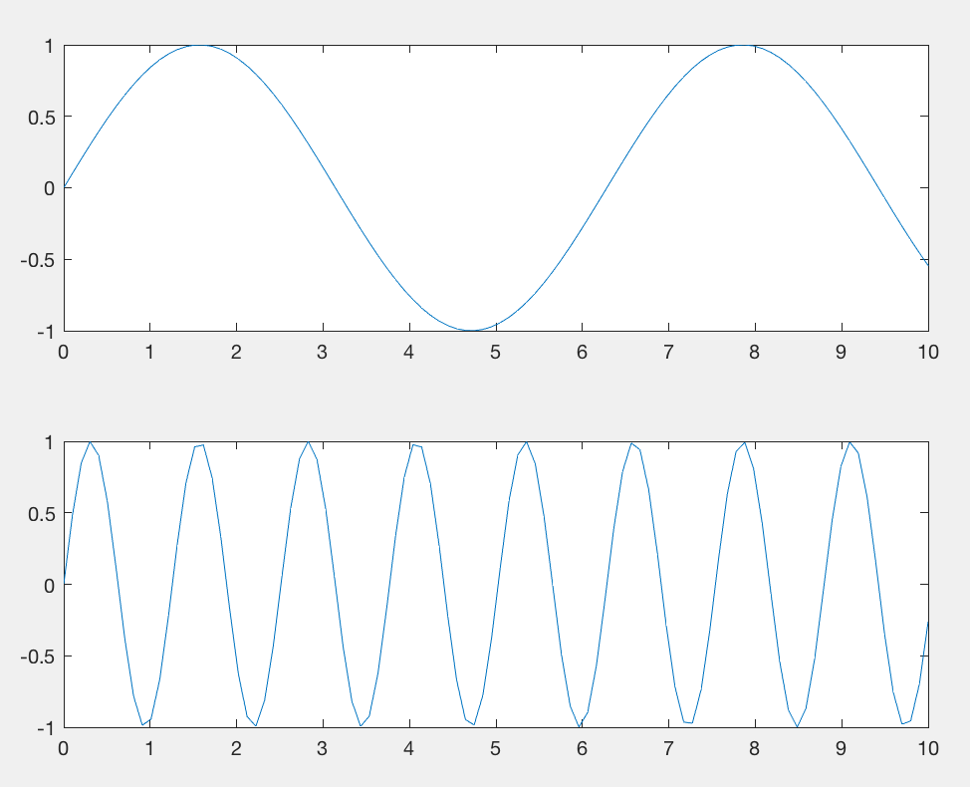
Multiple plots on one figure
subplot(2,1,1);
x = linspace(0,10);
y1 = sin(x);
plot(x,y1)
subplot(2,1,2);
y2 = sin(5*x);
plot(x,y2)
Notes:
First 2 numbers are the number of rows and columns, third number is the figure number. Here 1 is top figure and 2 is bottom.

Slide 19
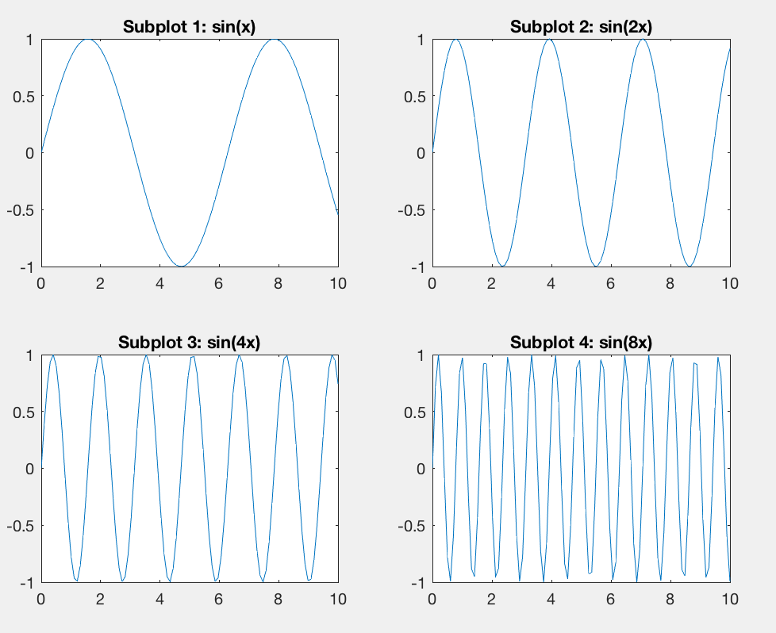
Multiple plots on one figure
subplot(2,2,1)
x = linspace(0,10);
y1 = sin(x);
plot(x,y1)
title('Subplot 1: sin(x)')
subplot(2,2,2)
y2 = sin(2*x);
plot(x,y2)
title('Subplot 2: sin(2x)')
subplot(2,2,3)
y3 = sin(4*x);
plot(x,y3)
title('Subplot 3: sin(4x)')
subplot(2,2,4)
y4 = sin(8*x);
plot(x,y4)
title('Subplot 4: sin(8x)')
Divided 2x2, count plots from upper left to right,down and keep going.
1 2
3 4
Notes:
In subplot – first 2 numbers are #rows and columns – so this is 2x2. Then count across top, across next, etc.

Slide 20
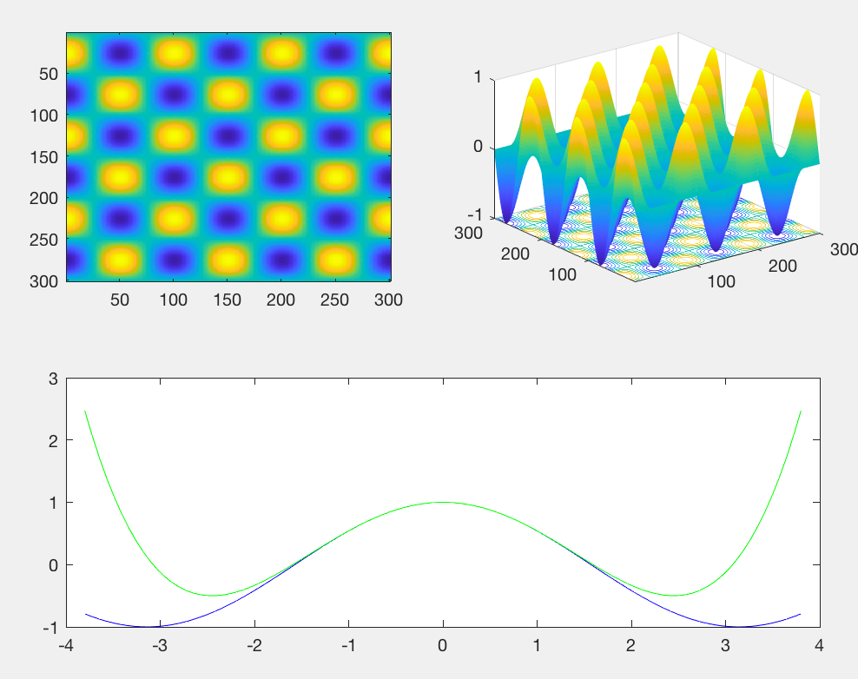
Multiple plots on one figure
subplot(2,2,1);
th=[0:300]/100*2*pi;
x=sin(th);
y=cos(th);
xy=x'*y;
imagesc(xy)
subplot(2,2,2);
surfc(xy)
sc=surfc(xy,…
'EdgeColor','none')
subplot(2,2,[3,4]);
x = linspace(-3.8,3.8);
y_cos = cos(x);
y_poly = 1 - x.^2./2 + x.^4./24;
plot(x,y_cos,'b',…
x,y_poly,'g');
Notes:
To combine plot positions.
Top right still interactive!

Slide 21
To get rid of variables and figures
clear variable list %clears listed variables from workspace
clear %clear all variables in workspace
clf %clears current figure
close all %closes all figures

Slide 22
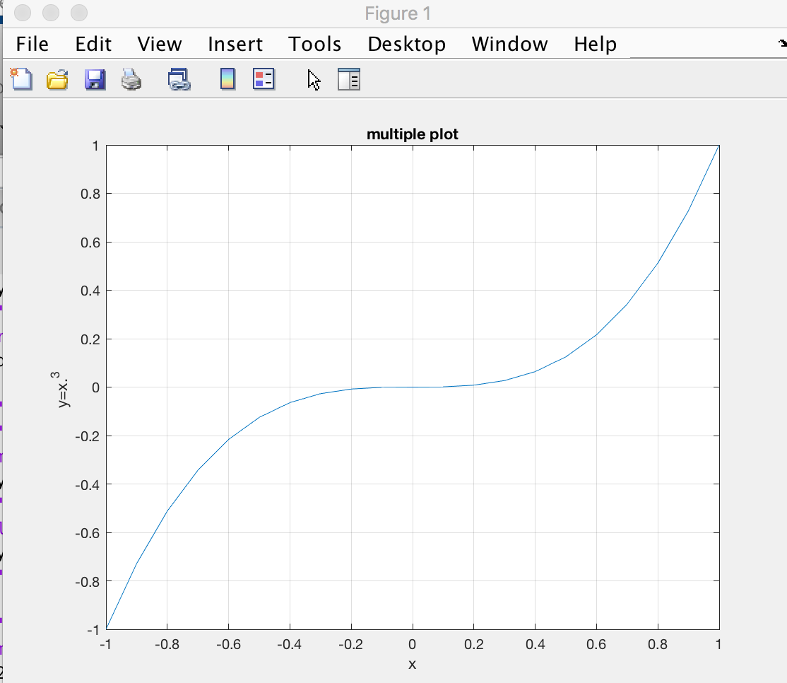
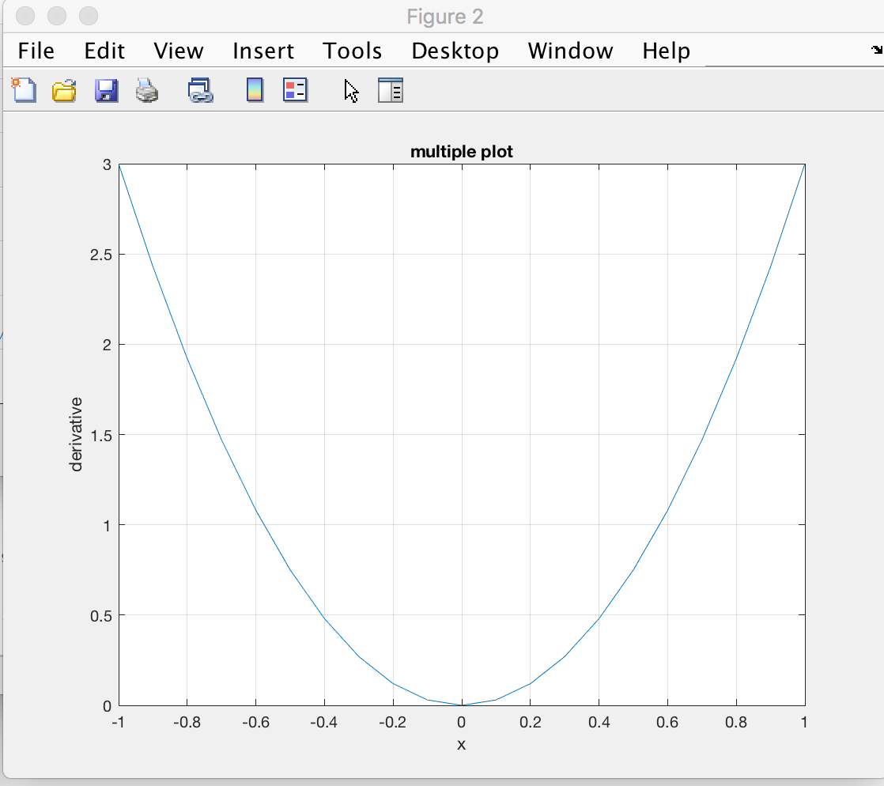
Multiple figures
x=-1:.1:1; y=x.^3; dy=3*x.^2;
plot(x,y)
ylabel('y=x.^3 ')
grid
xlabel('x')
title('multiple plot')
figure(2)
plot(x,dy)
grid
xlabel('x')
ylabel('derivative’)
title('multiple plot')
Notes:
Figure windows named figure 1 and figure 2 (all your figure windows so far were labeled figure 1)
Click on figure to bring it to top.
If you can’t see it, ype figure(N) to bring figure(N) to top or use Windows drop down menu

Slide 23
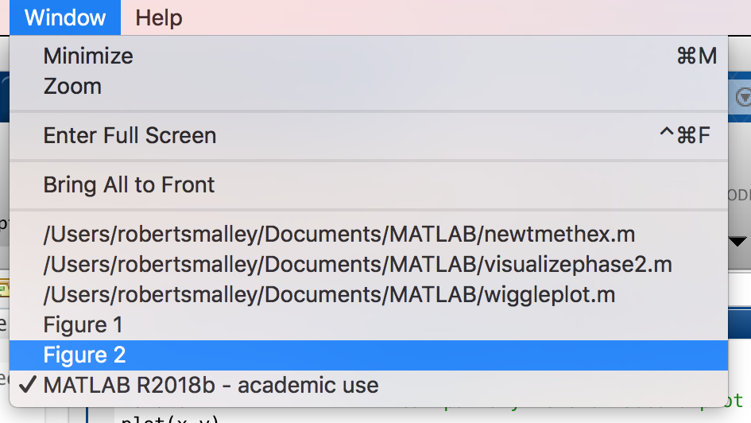
Multiple figures
x=-1:.1:1; y=x.^3; dy=3*x.^2;
plot(x,y)
ylabel('y=x.^3 ')
grid
xlabel('x')
title('multiple plot')
figure(2)
plot(x,dy)
grid
xlabel('x')
ylabel('derivative’) title('multiple plot')
Notes:
Figure windows named figure 1 and figure 2 (all your figure windows so far were labeled figure 1)
Click on figure to bring it to top.
If you can’t see it, ype figure(N) to bring figure(N) to top or use Windows drop down menu

Slide 24
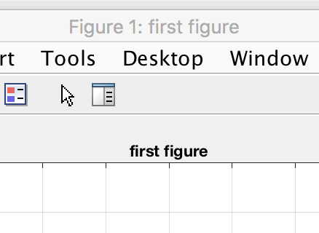
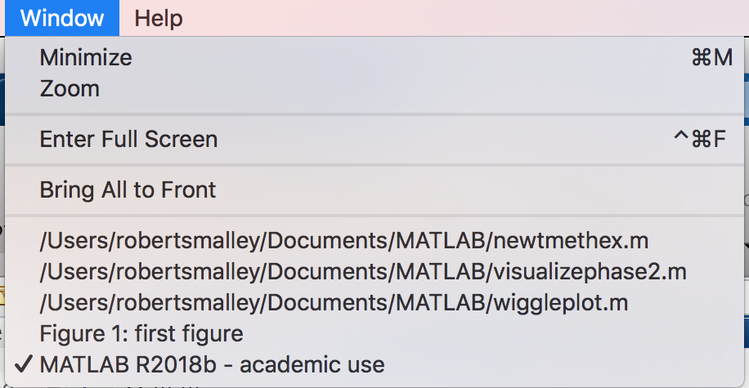
Multiple figures
figname="first figure";
f(1)=figure('Name',figname); %the f(1) is optional
plot(x,y)
ylabel('y=x.^3 ');
grid; xlabel('x')
title(figname)
Notes:
Now have figure window title, figure name, and pull down under windows all the same so you don’t get lost selecting one of many figures – and you can find the code that made the figure looking for the name.

Slide 25
Multiple figures
If you used the f(1) you now have a vector f whose first element has metadata for this figure.
f(1)=figure('Name',figname);
f(1)
ans =
Figure (1: first figure) with properties:
Number: 1
Name: 'first figure'
Color: [0.9400 0.9400 0.9400]
Position: [440 378 560 420]
Units: 'pixels’
Show all properties

Slide 26
Multiple figures
If you made multiple figures and you want to add something to one of them you set the figure to the appropriate one
figure %default is 1
Plot stuff
figure(2)
Plot stuff
figure(1) %make figure 1 active target
Plot more stuff on figure 1

Slide 27
Multiple figures
Can use variables for the figure counting
figno=1;
Figure(figno)
Plot stuff
figno=figno+1;
figure(figno)
Plot stuff
selfig=2;
figure(selfig) %make figure selfig active
Plot more stuff on figure selfig
Notes:
This way the program keeps track of the figure numbering – don’t have to start at 1.

Slide 28
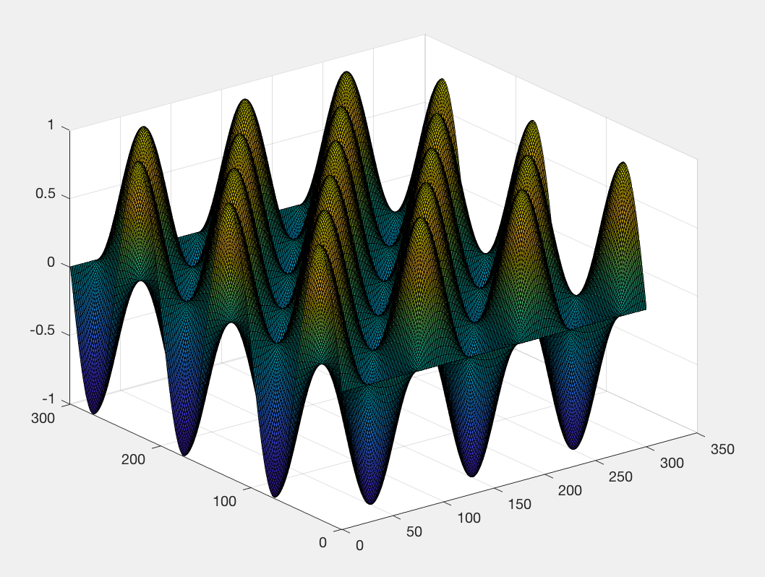
th=[0:300]/100*2*pi; Make vari th with 3 cycles with step of .01.
x=sin(th);
y=cos(th);
xy=x'*y;
s=surf(xy)
This plot is
Interactive –
you can
rotate it in
3-d, examine
data points.
But pretty ugly! (too dark)
Notes:
Dark because drawing black lines on edges to all the little facets and they are very small.
Notice the s= on the surf call.
s = surf(___) returns the chart surface object.
https://www.mathworks.com/help/matlab/ref/surf.html?searchHighlight=surf&s_tid=doc_srchtitle
Use s to modify the surface after it is created. For a list of properties, see Surface Properties.
https://www.mathworks.com/help/matlab/ref/matlab.graphics.chart.primitive.surface-properties.html
See here for LOTS of stuff you can change!

Slide 29
To “fix” look at properties
>>s
s =
Surface with properties:
EdgeColor: [0 0 0]
LineStyle: '-'
FaceColor: 'flat'
FaceLighting: 'flat'
FaceAlpha: 1
XData: [1×301 double]
YData: [301×1 double]
ZData: [301×301 double]
CData: [301×301 double]
Show all properties
Notes:
Is too dark because of the black lines drawing the edges

Slide 30
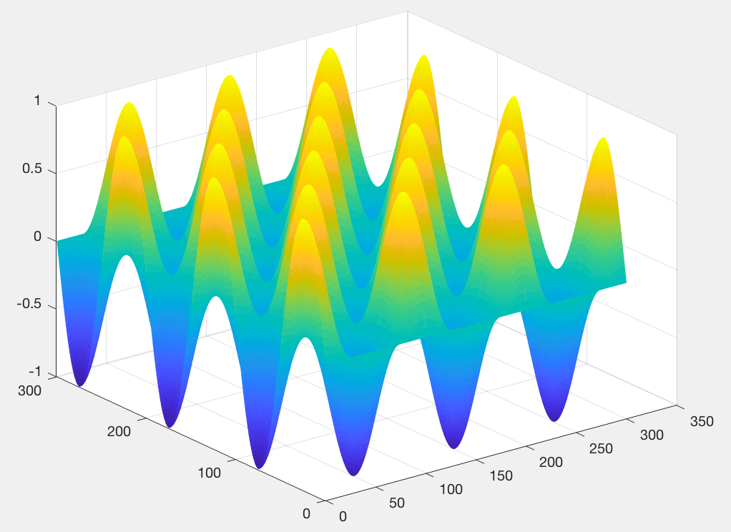
Use s to access and modify properties of the surface object after it is created. For example, hide the edges by setting the EdgeColor property.
s.EdgeColor = 'none';

Slide 31
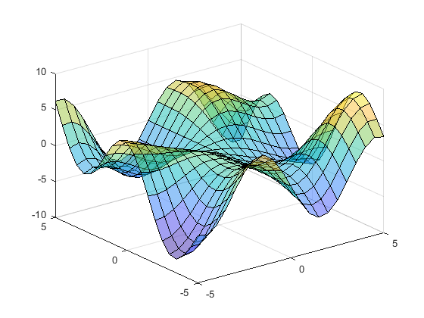
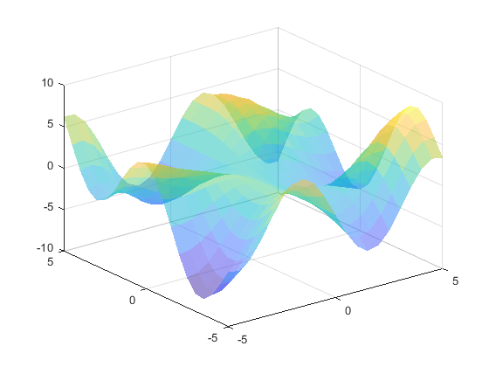
If the facets in your plot were bigger you would see them
With facets
edges
outlined
with facet edges turned off. (can still see facets)

Slide 32
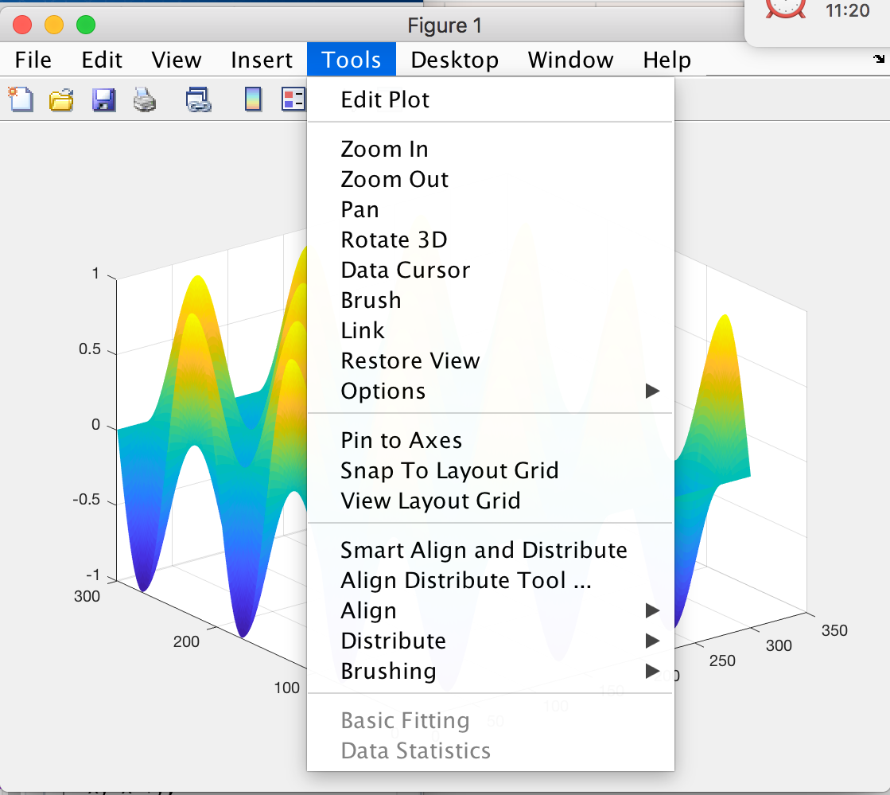
This figure is interactive – you can do lots of stuff with it.
Notes:
Drop down menu for interacting with figure --

Slide 33
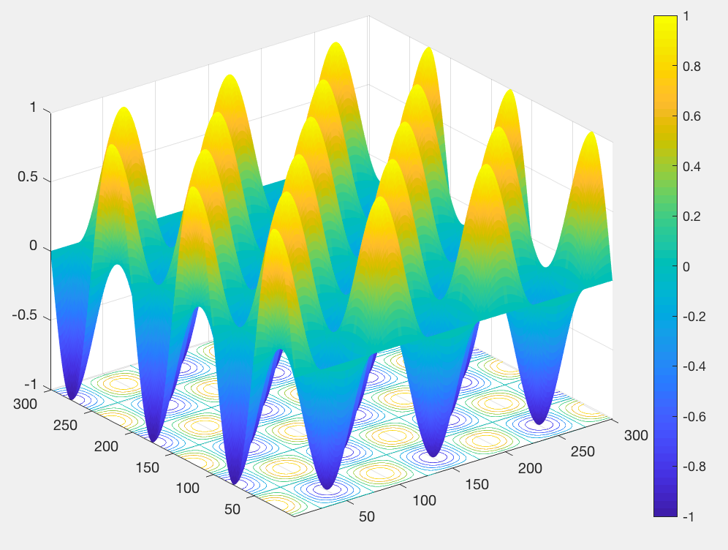
Can plot 3-d view with contour plot on xy plane.
Interactive, can rotate, sample, etc. this figure also
sc=surfc(xy,'EdgeColor','none')
colorbar

Slide 34
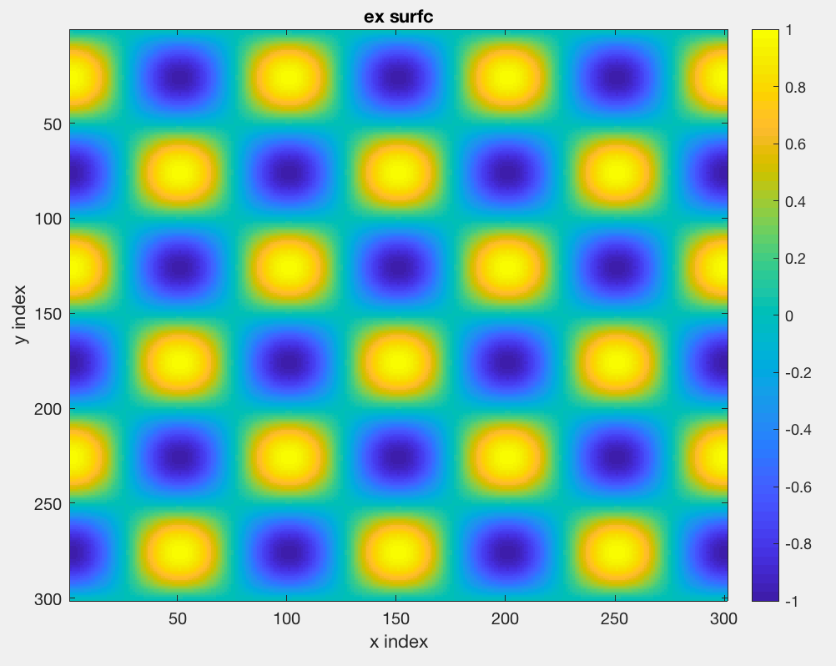
th=[0:300]/100*2*pi;
x=sin(th);
y=cos(th);
xy=x'*y;
imagesc(xy)
colorbar
xlabel('x index')
ylabel('y index')
title('ex surfc')

Slide 35
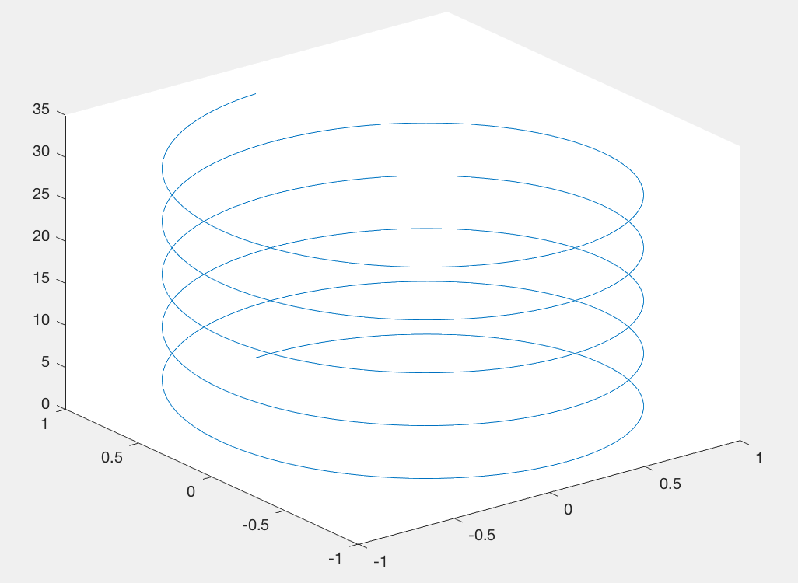
Plot in 3-d
t = 0:pi/50:10*pi;
plot3(sin(t),cos(t),t);
This is also interactive

