Slide 1
CERI-7104/CIVL-8126 Data Analysis in Geophysics
Intro to Matlab
Continued

Slide 2
Sample data processing and selection exercise.
Make a sample random noise data set.
Find the mean, standard deviation and select the data between mean±standard deviation
(no loops or explicit if statements)

Slide 3
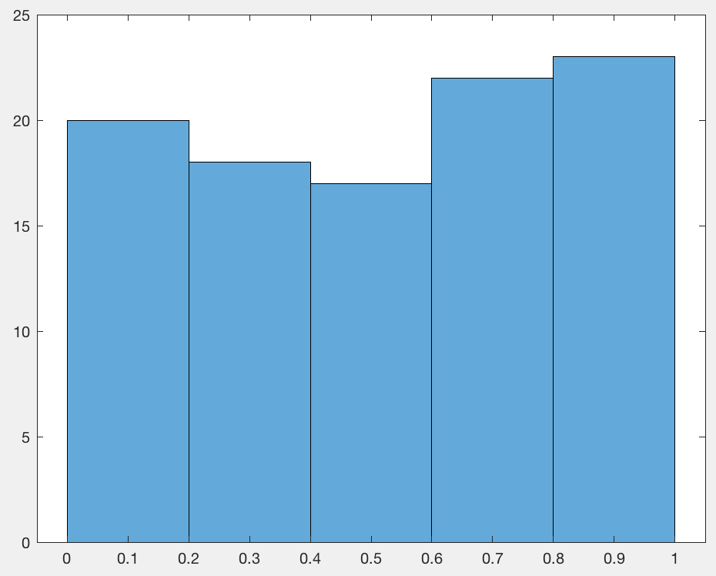
Make synthetic “data”
a=rand(100,1);
Plot histogram to see distribution
hist(a)
Notes:
Rand makes random number uniformly distributed 0 to 1.

Slide 4
Now calculate the mean and standard deviation
m=mean(a)
s=std(a)
Plot data, line for mean, lines for mean±standard dev
plot(a,'.')
hold on
plot([0 100],[m m],'r')
plot([0 100],[m+s m+s],'g')
plot([0 100],[m-s m-s],'g')
indx=find(m-s<a&a<m+s);
plot(indx,a(indx),'*')

Slide 5
Now find all the points whose value is within one standard deviation of the mean using the matlab find function.
This returns the index numbers of the points selected.
indx=find(m-s<a&a<m+s);
Now plot the selected points using the index as the x value (data is plotted against index) and the selected points.
plot(indx,a(indx),'*')

Slide 6
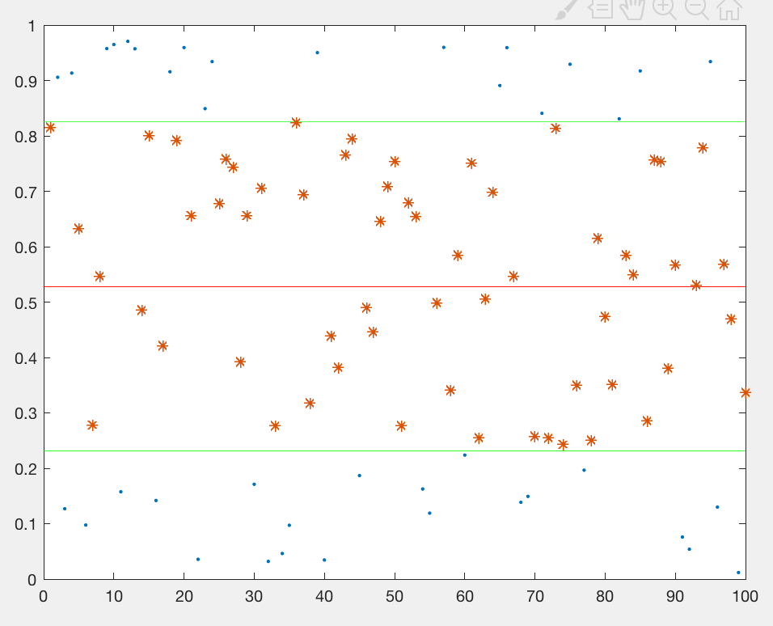
Data - blue dots.
Mean – red line
Mean±standard devaition – green lines
Selected data - red asterisks.

Slide 7
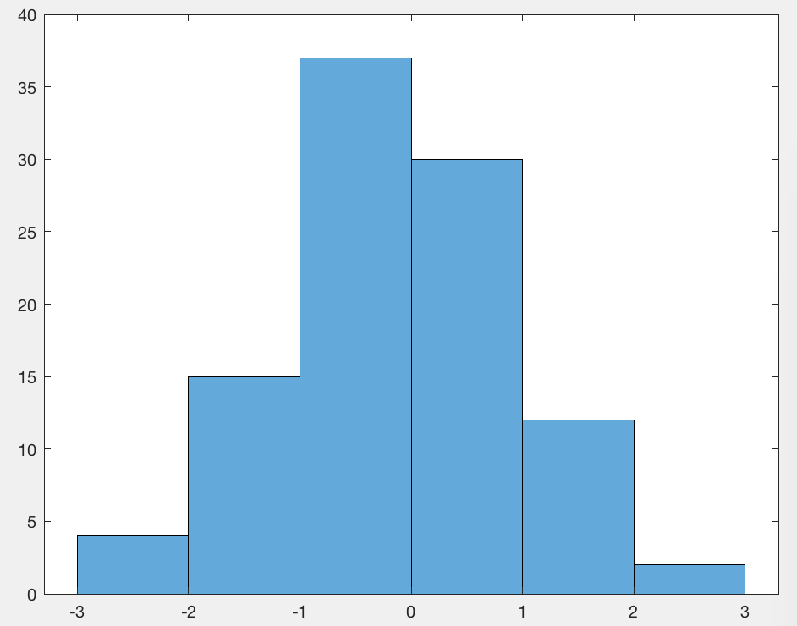
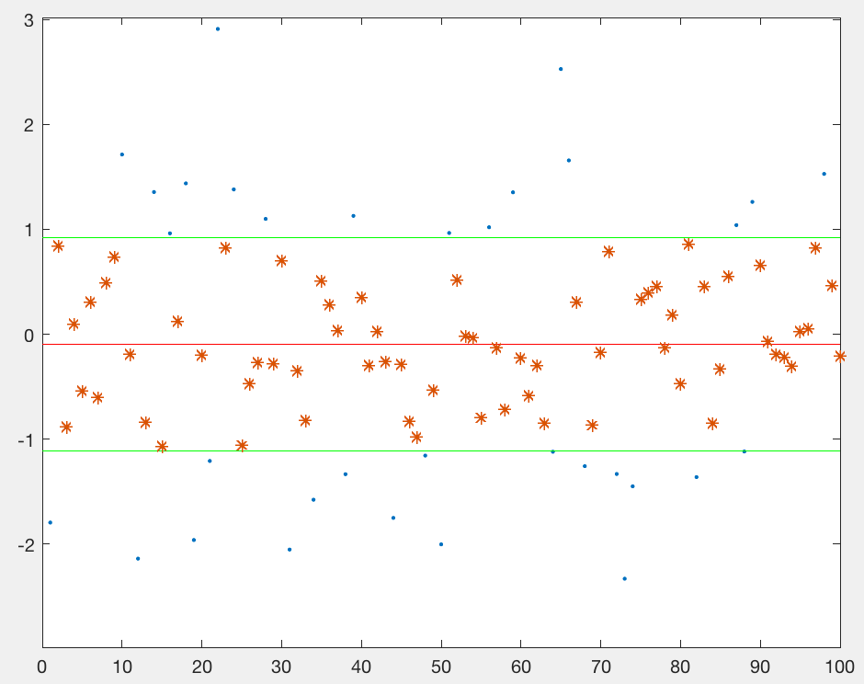
Redo with normal distribution around zero.
NO LOOPS
NO EXPLICIT IFs
Fully Matlab vectorized.

