Slide 1
CERI-7104/CIVL-8126 Data Analysis in Geophysics
Continue with - Intro “Seismic Analysis Code” - SAC
Lab – 22, 11/12/19
Finish some signal processing
Blackboard variables
Sac macros
Phase picking
Plot SAC files in GMT – pssac
Plot SAC files in MATLAB –
Waveform x-corr, stacking, remove inst resp, f-k filt, hilbert
Graphics
Notes:
It does not return the original input time series. The interpretation is there is a spike at the time of the maximum amplitude. This works well for the first 2, pretty good for the third, and not so good for the 4th . (to be fair, the delta t’s in 4 are half the period of the response, so the spikes are going to sort of cancel out.

Slide 2
SAM: other commands
hilbert
applies a Hilbert transform (90º phase shift of all frequencies of the signal in the frequency domain).
Applied twice, this flips the sign of the amplitude.
envelope: computes the envelope function (for a sine input is sin²+cos²=1) using a Hilbert transform.
Notes:
Exercize – do for sine wave in SAC.
In Matlab taking the hilbert transform of a real signal puts the HT in the imaginary part – one can then get the envelope from the magnitude of the complex number s + I H(s).

Slide 3
Example using MATLAB
Notes:
What do I get when I take sqrt(re^2+im^2)?

Slide 4
Example using SAC
Notes:
Does something funny at end
Input has to be at least 200 something points long.
In both SAC and MATLAB the cosine seems to lag the sine – so it is changing sines into -1*cosine.

Slide 5
Example using SAC
SAC> r ntkl.z
SAC> hilbert
SAC> plot <<to see what it looks like
SAC> read more ntkl.z <<re-read seismogram
SAC> color on inc on list black red <<read documentation
SAC> xlim 200 1100
SAC> p2
RED – original seismogram, Black – Hilbert transform
Notes:
Surface waves and other relatively simple oscillatory shapes just seem to shift in time, ”phases” that require constructive interference to produce the localized signals can change a lot.
HT seems to be “delayed”

Slide 6
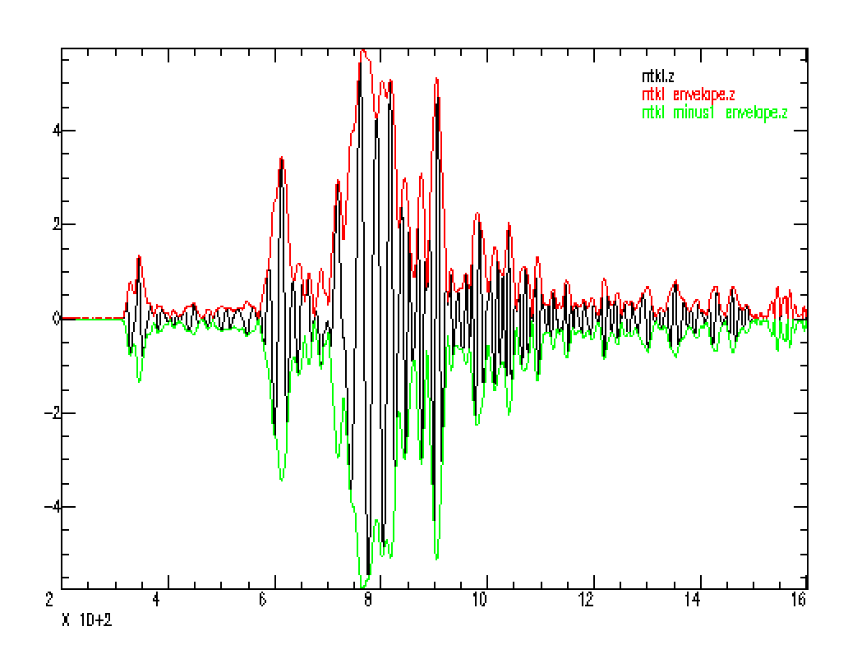
SAC> datagen sub teleseismic ntkl.z
SAC> rtrend
SAC> write sac ntkl.z
SAC> envelope
SAC> write sac ntkl_envelope.z
SAC> mul -1
SAC> write sac ntkl_minus1_envelope.z
SAC> r ntkl*
ntkl.z ntkl_envelope.z ntkl_minus1_envelope.z
SAC> qdp off
SAC> color on inc on
SAC> p2
What is Hilbert transform useful for? Displaying ENVELOPE.
Notes:
Red and green are envelope around the seismogram in black.
Envelope is magnitude of Hilbert transform output (sqrt of sum of squares of real and imag parts)

Slide 7
Can see this a little better showing both original and Hilbert transform along with the envelope.
Notes:
Red and green are envelope around the seismogram in black.
Envelope is magnitude of Hilbert transform output (sqrt of sum of squares of real and imag parts)

Slide 8
Spectral Analysis Module
There is a set of Infinite Impulse Response (IIR) filters.
lowpass (lp) passes signal below a high corner cutoff.
highpass (hp) passes signal above a low corner cutoff).

Slide 9
bandpass (bp) pass signal within the low and high corner cutoffs.
bandrej (br) band reject filter, also known as a notch filter, does the opposite of a bandpass.

Slide 10
Several built in filters to choose from.
These digital filters are all based upon classical recursive analog designs
Butterworth: a good choice for most applications, since it has a fairly sharp transition from pass band to stop band, and its group delay (phase) response is moderate. This is the default.
Bessel: best for those applications which require linear phase without two-pass filtering. It's amplitude response is not very good however.

Slide 11
Chebyshev type I & Chebyshev type II:
for situations which require very rapid transitions from pass band to stop band.
Does horrible things to the phase.

Slide 12
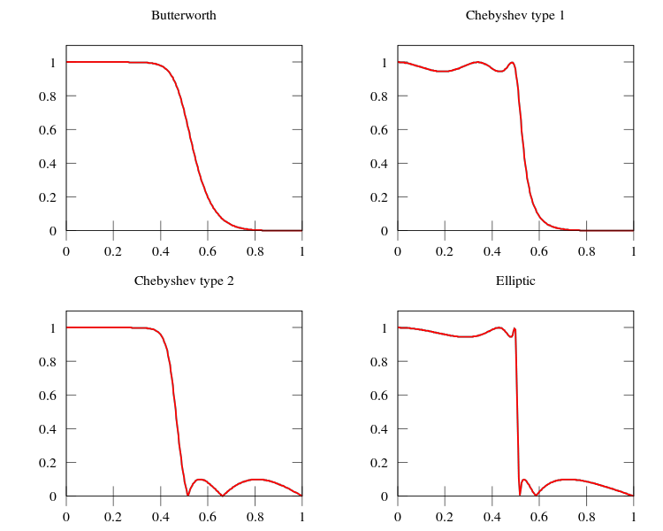
The Butterworth filter rolls off more slowly around the cutoff frequency than the Chebyshev filter or the Elliptic filter, but without ripple.

Slide 13
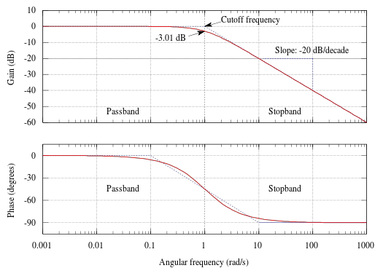
The Butterworth filter is relatively nice with the phase.

Slide 14
The Butterworth and Bessel are the easiest to set up
BANDPASS {BUTTER|BESSEL|C1|C2},{CORNERS v1 v2},{NPOLES n},{PASSES n},{TRANBW v},{ATTEN v} sac> funcgen seismogram sac> rmean sac> taper sac> bp butter co 1 3 using default values passes (p) 1 num poles (n) 2
Notes:
Note is decimated data – this only effects the display – not the data in memory

Slide 15
Other filters
Finite Impulse Response filter (FIR).
Adaptive Wiener filter.
(It tailors itself to be the “best possible filter” for a given dataset.).
Two specialized filters
(BENIOFF & KHRONHITE).
(lowpass filter is a digital approximation of an analog filter which was a cascade of two fourth-order Butterworth lowpass filters. This lowpass filter has been used with a corner frequency of 0.1 Hz to enhance measurements of the amplitudes of the fundamental mode Rayleigh wave (Rg) at regional distances.)

Slide 16
Blackboard variables and SAC macros.
Do together as macros are the major application of BB variables.

Slide 17
Blackboard variables.
The blackboard feature can be used to temporarily store and retrieve information.
A blackboard entry consists of a name and a value.
They are used extensively in macros

Slide 18
SAC macros
A SAC macro is a file that contains a set of SAC commands to be executed together.
The simplest SAC macro is just a copy of what you type into the command line.
As well as regular commands and inline functions, a SAC macro file can contain references to SAC header variables and blackboard variables that are evaluated and substituted into the command before it is executed.

Slide 19
There are two ways to run/execute sac macros, from within sac use the “macro” command.
%sac
sac> macro plot1.macro
or from the command line (two ways)
%sac plot1.macro (may not work on UNIX, did on Prime)
%sac < plot1.macro (standard UNIX method)
I usually name my SAC macros with the extension “.macro” so I know that that file is a SAC macro.

Slide 20
Blackboard entries are created using the SETBB and EVALUATE commands.
You can also substitute the value of a blackboard variable directly into other
commands by preceding its name with a percent sign (“%”).
Default is to print to terminal.
SAC> qdp off
SAC> r ntkl.z
SAC> setbb c1 .01
SAC> evaluate to c2 %c1 * 3
SAC> bp butter co %c1 %c2
SAC> p
SAC> r more
SAC> color on increment on list red black
SAC> p2
Notes:
No “standardization” in using non-numeric characters (rarely used ones) for special meaning, SAC not developed in UNIX world so does not use UNIX variables convenetions.
Uses % to give value instead of $ (but will see that use the $ to get UNIX variables into SAC macros)
Can do math with evaluate
Here we used blackboard variables to set up the parameters for the bandpass filter

Slide 21
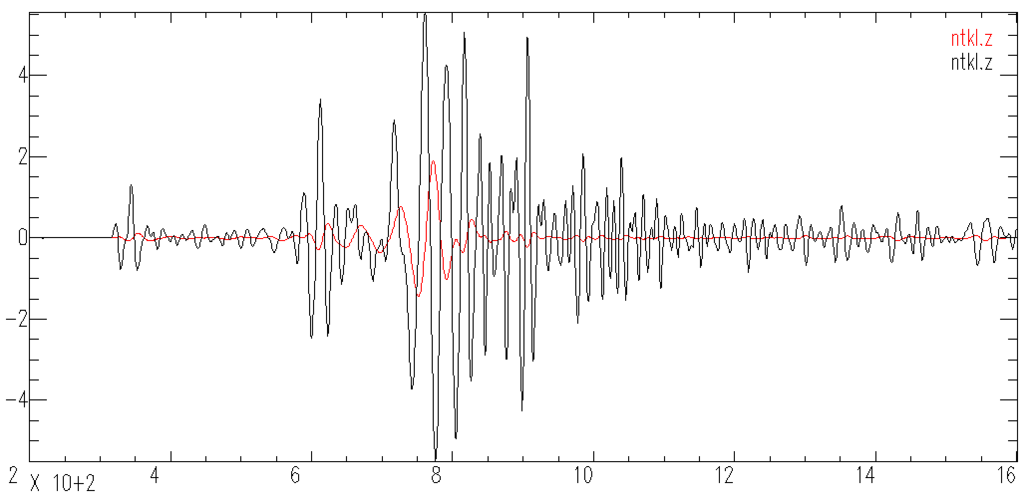
Produces this output
Black is input seismogram, red is bandpass filtered seismogram
Notice the shift to later time of the filtered data – ;this is because the filter disperses the signal as it passes through the filter (due to the phase response of the filter) - not good if doing dispersion studies – want the only dispersion to be that caused by the earth.

Slide 22
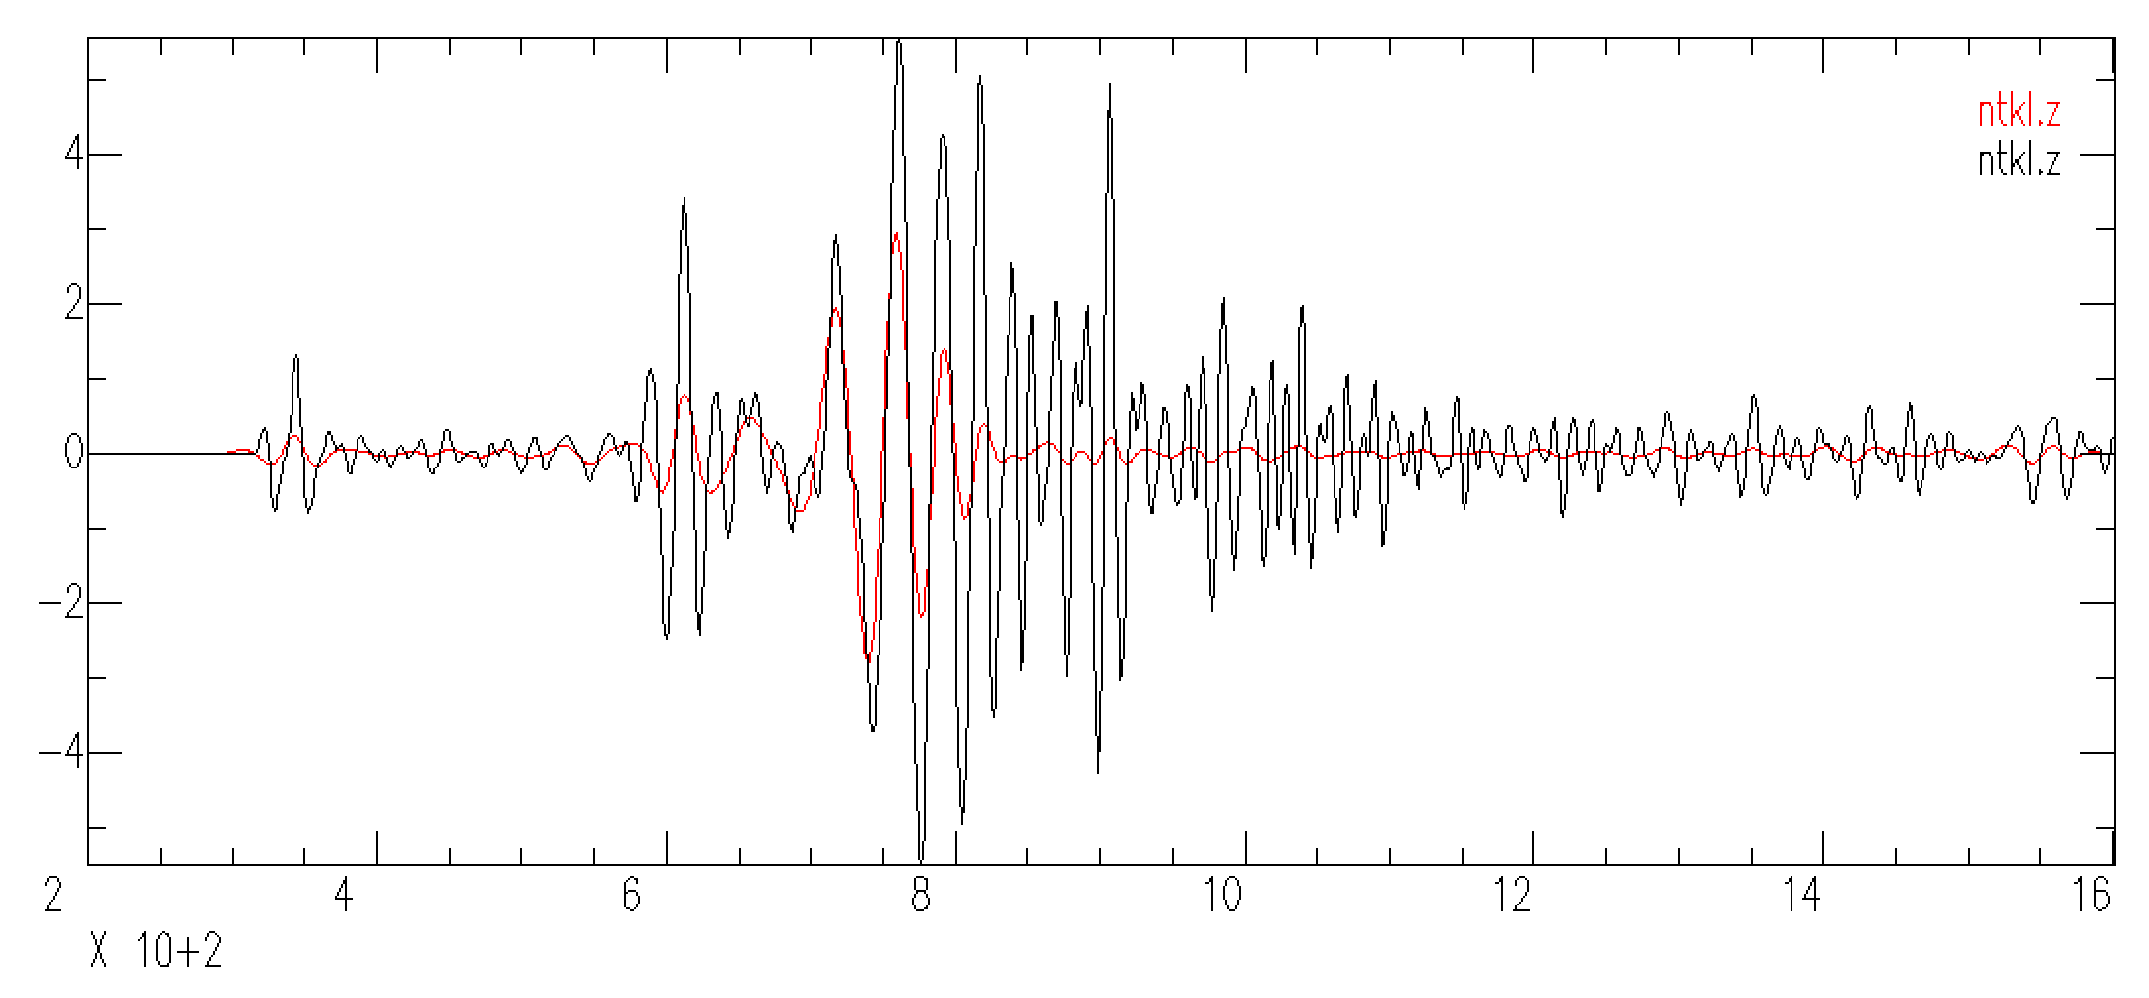
How to ”fix” problem of filter introduced dispersion.
Run filter twice (2 passes), SAC inverts the time series between passes – which effectively applies the dispersion “backwards”, removing it.
Notes:
Now it looks like what you image a low pass filter does – it removes the higher frequencies while leaving the underlying signal where is was.

Slide 23
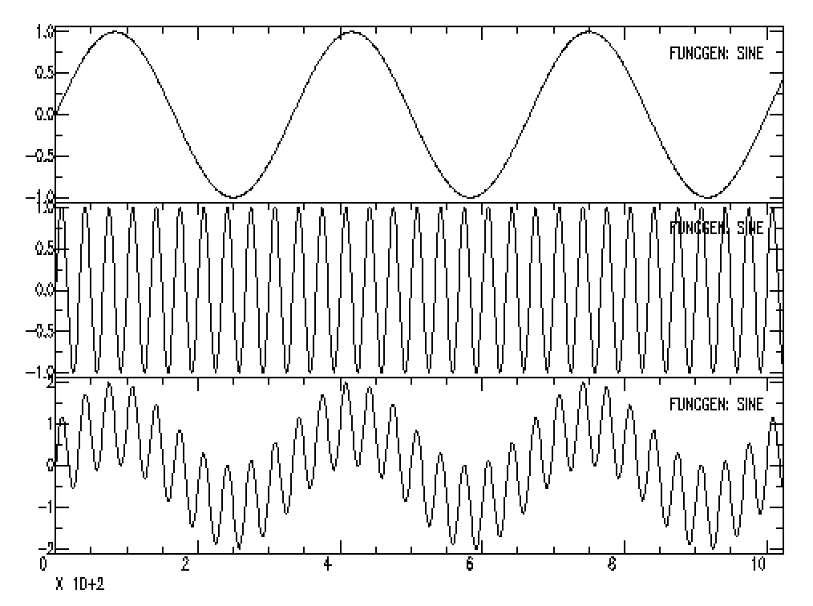
Tangent about filtering
We have two signals added together
We would like to “separate” them (recover one or both by themselves)
Notes:
Now it looks like what you image a low pass filter does – it removes the higher frequencies while leaving the underlying signal where is was.

Slide 24
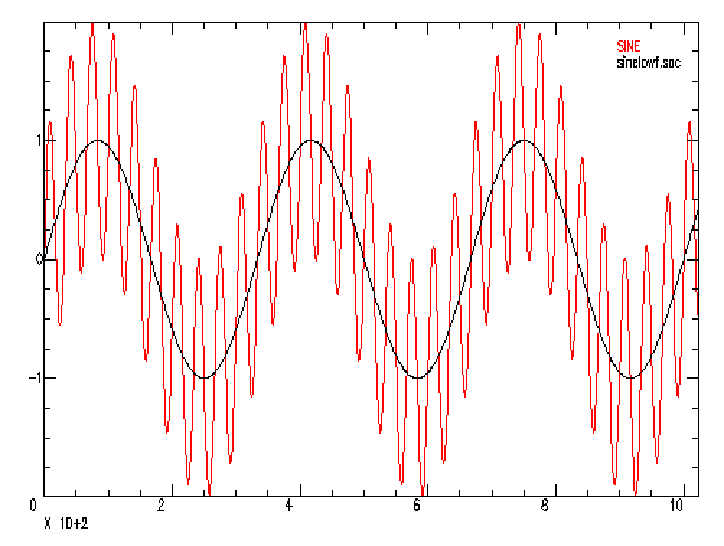
Tangent about filtering
We have two signals added together
We would like to get the black signal (or the red one) back – exactly.
Notes:
Now it looks like what you image a low pass filter does – it removes the higher frequencies while leaving the underlying signal where is was.

Slide 25
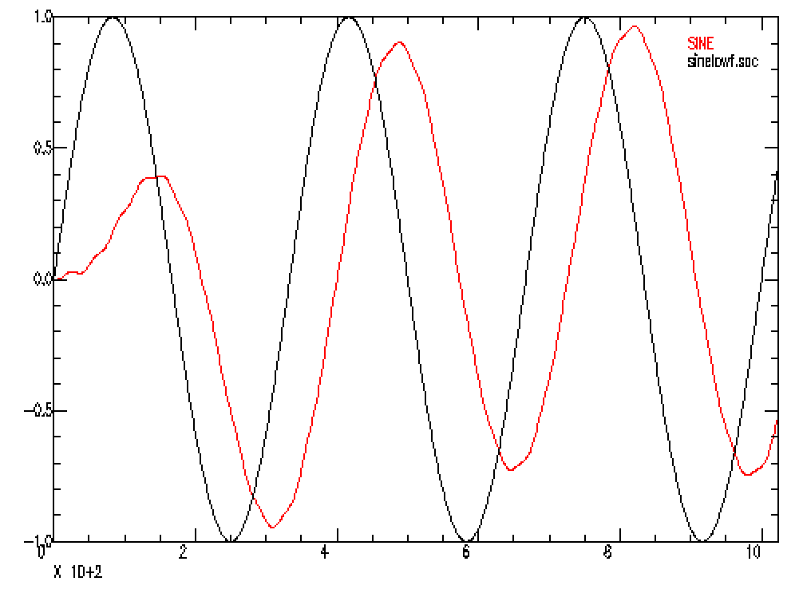
Tangent about filtering
qdp off
fg sine 0.003 0 npts 1024
w sinelowf.sac
fg sine 0.03 0 npts 1024
w sinehif.sac
addf sinelowf.sac
w sinehilowf.sac
rtrend
bp co .0005 .0035
r more sinelowf.sac
color on increment on list red black
P2
Black is what we want, filtered version is similar but shifted in time.
Notes:
Now it looks like what you image a low pass filter does – it removes the higher frequencies while leaving the underlying signal where is was.

Slide 26
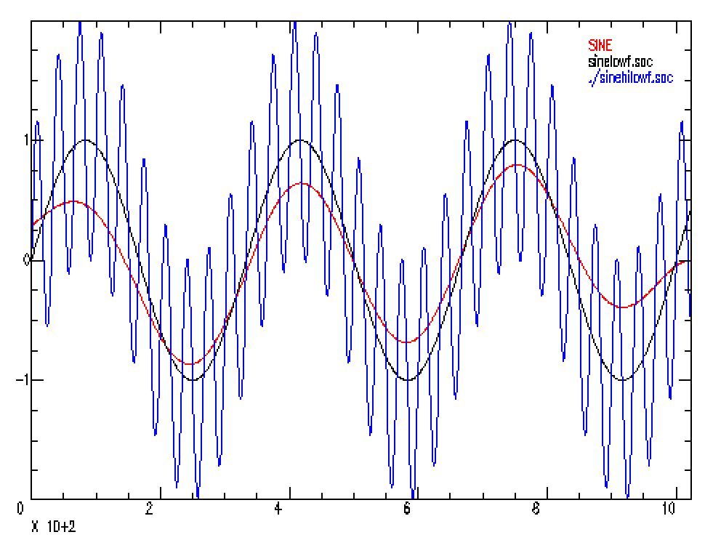
Tangent about filtering
qdp off
fg sine 0.003 0 npts 1024
w sinelowf.sac
fg sine 0.03 0 npts 1024
w sinehif.sac
addf sinelowf.sac
w sinehilowf.sac
rtrend
bp co .0005 .0035 p 2
r more sinelowf.sac
color on increment on list red black
P2
This is what we want – red (is not perfect, some edge effects and a ”slope/trend”).

Slide 27
Returning to BB variables
The value of a blackboard variable can be obtained using the GETBB command.
sac> getbb c1 c2
c1 = 2.45
c2 = 4.9000001e+00

Slide 28
Blackboard variables can also be saved in a disk file using
WRITEBBF
and later restored (SAC2000) using
READBBF.
There is also
a function called
UNSETBBV
which deletes a variable from the blackboard.

Slide 29
In addition to bb variables, SAC macros can also have arguments that are evaluated as the macro is executed.
Here they are order dependent (the $1 gets matched up with the first command line argument [after the macro file name], etc.)
656:> vi prt.macro
r $1 $2 $3
xvport 0.1 0.6
qdp off
xlim t1 -5 50
title on "demo"
xlabel on "Time"
ylabel on "Digital Counts"
bd sgf
p1
ed sgf
sgftops f001.sgf plot1.ps 1 y
Notes:
The $n are similar to UNIX command line variables – but within sac
So the read command (first line with “r”) will read the three files specified in the command line – this is similar to the way variables are passed into shell scripts.
Here we also introduce some additional graphics features – setting the graphics device begindevices, abbreviated “bd” – default is the terminal (xwindows), there is one other setting SGF for SAC Graphics Device (file, name ends in sgf, files are named fNNN.sgf where NNN is the file number – the number gets reset each time you run sac, so it is a good way to clobber files). Then enddevices (”ed”) to go back to default. Finally the program sgftops (can be run from within SAC or from Terminal command line) will convert the sgf file to a postscript file.

Slide 30
Now to execute/run the macro, do as before adding the files you want to plot
649:> sac
SAC> macro prt.macro AREN.BHZ AREN.167 AREN.257
SAC> quit
650:> ls *.ps
plot1.ps
Note: we are within SAC, not at the SHELL command line.

Slide 31
Can also pass command line arguments as keywords (in macro call)
%vim plot3.macro
$keys files plot
r $files
xvport 0.1 0.6
qdp off
xlim t1 -5 50
title on "Sumatra Event 2/13/2005 1:22:09 at BJT”
xlabel on "Time, sec”
ylabel on "Digital Counts”
bd sgf
P1
ed sgf
sgftops $plot plot3.ps 1 y
sac>macro plot3.macro files BJT.BHZ.SAC BJT.BHN.SAC BJT.BHE.SAC plot f001.sgf
Notes:
Keywords used on call of macro – will substitue by matching stuff on calling line to stuff in macro

Slide 32
Default keyword arguments (in macro call)
% vim plot3.macro
$keys files plot
$default plot f001.sgf
r $files
xvport 0.1 0.6
qdp off
xlim t1 -5 50
title on "Sumatra Event 2/13/2005 1:22:09 at BJT”
xlabel on "Time, sec”
ylabel on "Digital Counts”
bd sgf
P1
ed sgf
sgftops $plot plot3.ps 1 y
sac> macro plot3.macro files BJT.BHZ.SAC BJT.BHN_SAC BJT.BHE.SAC plot f001.sgf

Slide 33
Missing Keyword arguments (in macro call)
Argument query
If you fail to enter a value for an argument on the SAC macro execute line and it has no default value, SAC will ask you to enter a value from the terminal.
SAC> macro plot3.macro
files? BJT.BHZ.SAC BJT.BHN.SAC BJT.BHE.SAC

Slide 34
Header variables.
SAC header variables can also be evaluated and substituted directly in commands much like blackboard variables.
You must specify which file (by name or number) and which variable to be evaluated.
    You must precede this specification with an ampersand (“&”)
    and you must separate the file and variable names with a comma.

Slide 35
Header variables.
The first example is referenced by file name, the second by file number.
sac> read ABC
sac> evaluate to temp1 &ABC,a + 10
sac> evaluate to temp2 &1,depmax * 2
sac> chnhdr t5 %temp1
sac> chnhdr user0 %temp2
Notes:
Add 10 to header variable a of file ABC in bbvari
Multiply the depmax by 2 in file 1 in bbvari (which in this case is ABC since only one file read in)
Then change t5 and user0 header values using the bbvaris

Slide 36
Concatenation
To prepend simply concatenate the text string with the argument or variable.
sac> setbb temp BJT.BHZ.SAC
sac> w XYZ.%temp
XYZ.BJT.BHZ.SAC
Notes:
Need % to get value

Slide 37
Concatenation
To append you must repeat the delimiter ($, %, or &) after the argument or variable (surround the string you are appending with the delimiter) and before the text string.
sac> setbb temp BJT.BHZ.SAC
sac> w %temp%.XYZ
BJT.BHZ.SAC.XYZ
Notes:
Need to tell when variable name ends, so repeat the % (or $ or &)

Slide 38
Using various programs to write SAC macros.
SAC macros are essentially just a set of SAC commands and therefore
you can create SAC macros using other programs
(shell scripts, Fortran, c, Matlab, etc.).

Slide 39
This shell script is in a file called sta.csh. The shell script runs sac independently for each file matching the name (*${sta}*z) and appends the output of the sac listhdr command to the sta.log file (loop in shell, not sac).
668:> vi sta.csh
#!/usr/bin/csh
# Script to report b, e and t1 sac header values for a given station
# usage: sta.csh [NAME]
\rm sta.log
set sta=$1
foreach file ( *${sta}*BH* )
sac <<EOF >> sta.log
r $file
lh b e t1
q
EOF
end
Notes:
Runs sac independently for each file – file name expansion done by csh.

