Slide 1
CERI-7104/CIVL-8126 Data Analysis in Geophysics
Intro “Seismic Analysis Code” - SAC
Lab – 21, 11/07/19
Notes:
Retiina display – 220 pixels/inch

Slide 2
SAC online documentation
https://ds.iris.edu/files/sac-manual/manual.html
Notes:
Retiina display – 220 pixels/inch

Slide 3
Can color traces (this is an addition since the TEK401X days – when it was green or nothing).
SAC> color on increment on
SAC> p2
Sac> p2 rel
Notes:
New command p2 – plots all traces on one plot (p plots individually, p1 plots multiple plots on one page, p2 plots all data on one plot).
Read in the three components of TUL1, cut it between 1200 and 1800 and then plot in color
Read in the N and Z components of the india earthquake, plot in color. What do you notice about the relationship between the two traces?
Read more the E component and replot the three in color. What do you notice about the relationship between the third trace and the first two?

Slide 4
Spectral Analysis Module (SAM):
Spectral/Fourier Transform analysis.
You can do a discrete Fourier transform
fft
and an inverse Fourier transform
ifft
You can also compute the amplitude and unwrapped phase of a signal (“unwrap”). This is an implementation of the algorithm due to Tribolet.

Slide 5
The fft and
unwrap
commands produce spectral data in memory.
You can plot this spectral data
plotsp

Slide 6
You can also perform
- integration with
divomega
and
- differentiation with
mulomega
directly in the frequency domain.

Slide 7
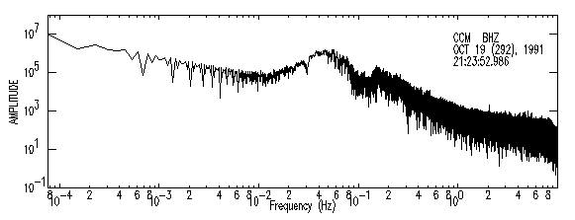
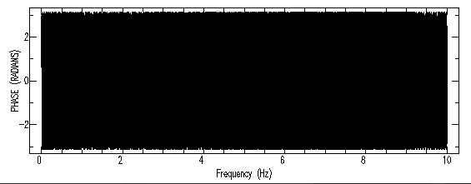
sac> funcgen seismogram sac> fft sac> plotsp
Plots amplitude
Then the phase after a <CR>

Slide 8
SAC> cut 3000 5000 SAC> read *india*bhz* SAC> qdp off SAC> p SAC> rtrend SAC> UNWRAP FILL OFF INTTHR 10 PVTHR 5 DC level after DFT is 53.572 SAC> psp
UNWRAP
Plots amplitude
Then the unwrapped phase after a <CR>

Slide 9
You can write it to disk as
writesp
and
read in back in again
readsp
You have to know the data/file is spectral data. SAC will not figure it out.

Slide 10
Spectral Analysis Module (SAM):
Spectral/Fourier Transform analysis.
You can also correlate
correlate
and convolve
convolve
Has lots of options – see online man page
https://ds.iris.edu/files/sac-manual/commands/correlate.html

Slide 11
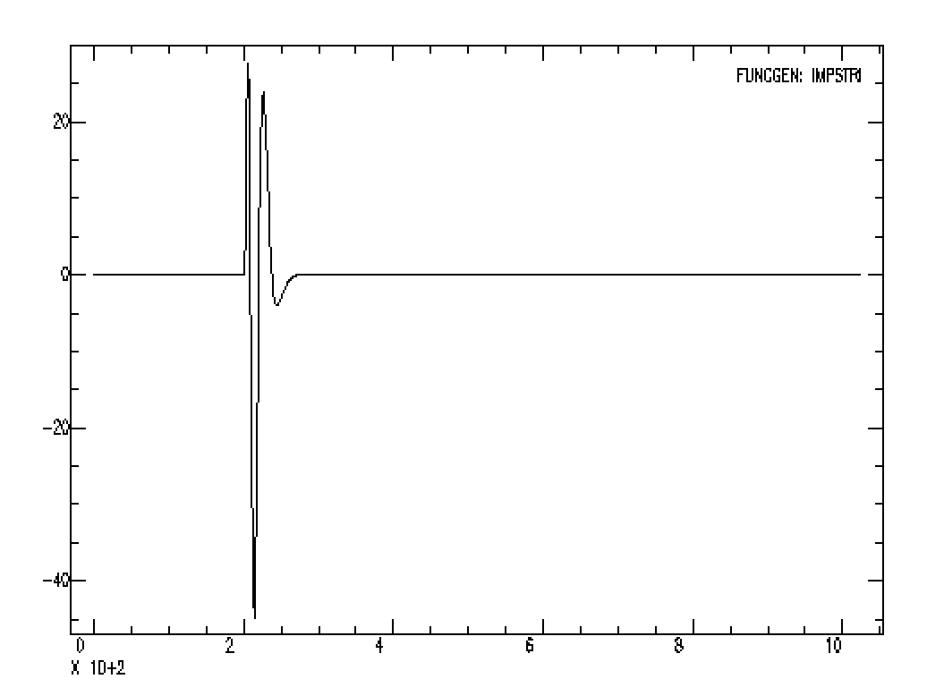
Convolution ex.
Start with DWWSSN ”impulse response” – IR – what the seismometer records if you apply an impulse.
Notes:
Say x axis is seconds, there are 1024 seconds in the trace

Slide 12
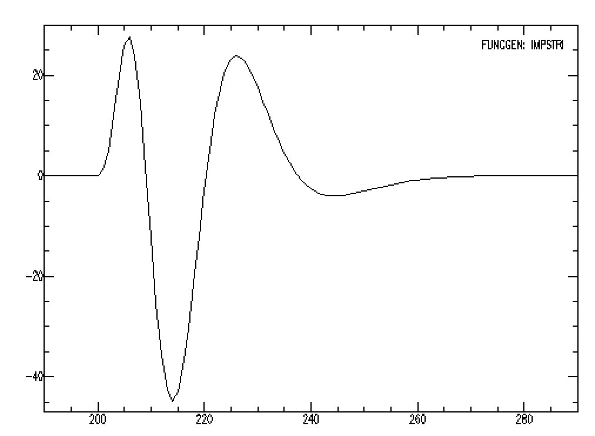
Convolution ex.
If we zoom in we can see that the IR starts at 200 seconds and is done by 270 seconds.
Notes:
The natural period of the DWWSSN long period seismometer is 15 seconds, but takes about 20 to make a complete cycle after the impulse. It is completely “done” – no memory of having been hit by the impulse after 70 seconds. This is similar to what happens when you hit a pothole in your car, it oscillates a few times and damps out.

Slide 13
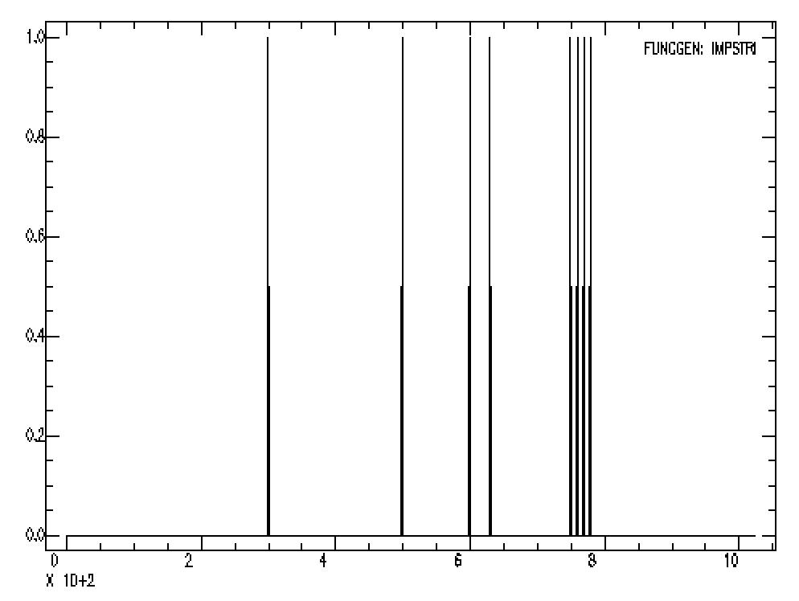
Convolution ex.
Now make a series of impulses and save them.
fg impstrin 300 500 600 630 750 760 770 780 n 1024

Slide 14
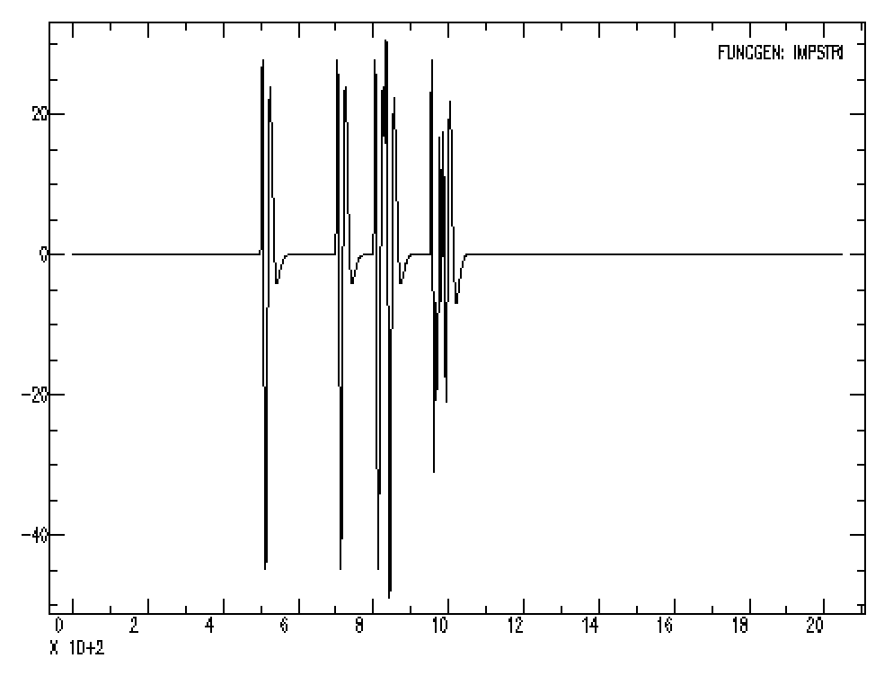
Convolution ex.
Read in file with IR & file with series of impulses and convolve them. Result is sum of series of weighted, shifted IRs.
Notes:
Practically what this does Is make a copy of the IR at each spike. Here they are all 1, but in general they are any value (+ or -), so the effect is to add weighted copies at the appropriate time shifts. The first 2 are just copies of the IR, as they are more than 70 seconds apart. The third “signal” is more complicated as it comes from two impulses that are closer than 70 seconds, and the 4th has 4 impulses that are 10 seconds apart.

Slide 15
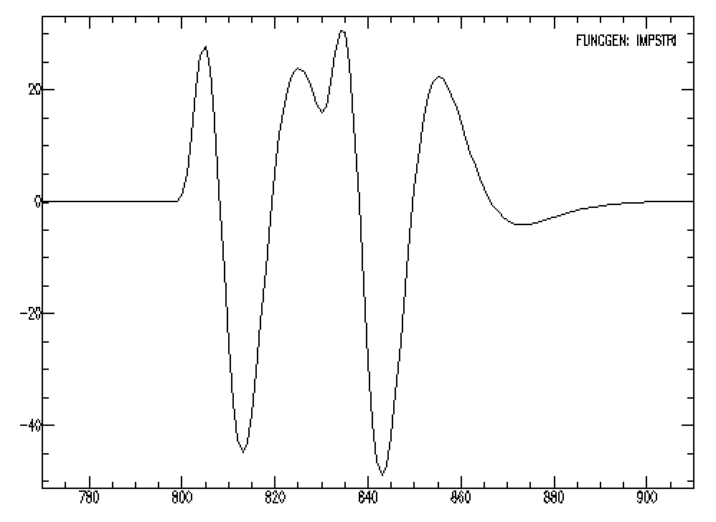
Convolution ex.
Zoom into the third signal.
Notes:
It is the response only from 800 to 830 when the second one starts and then they add together.

Slide 16
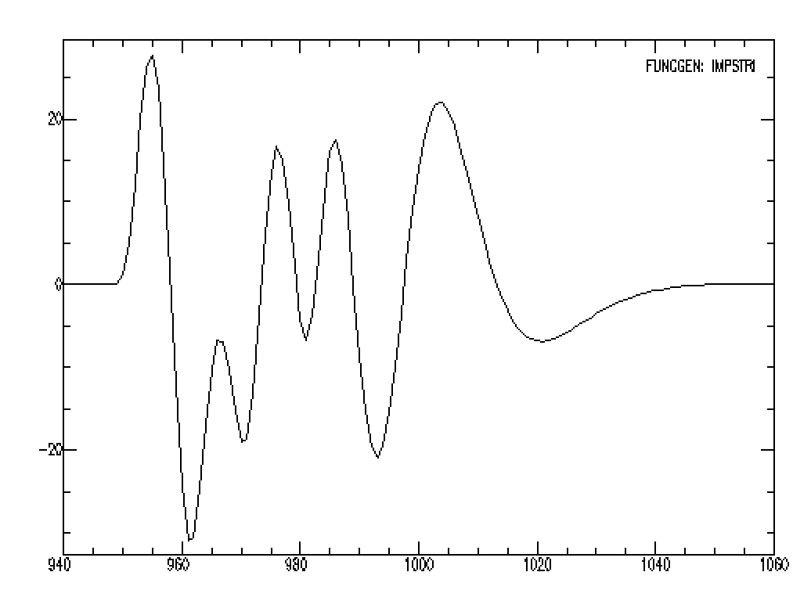
Convolution ex.
Zoom into the fourth signal.
SAC> fg impstrin 200 n 1024
SAC> transfer to DWWSSN
SAC> w sac ir_200_l1024.sac
SAC> fg impstrin 300 500 600 630 750 760 770 780 n 1024
SAC> w sac imps.sac
SAC> read ir_200_l1024.sac imps.sac
SAC> convolve
look at it, then zoom in
SAC> xlim 770 910
look at it, then zoom again
SAC> xlim 940 1060
SAC> w sac ximps.sac 8imps.sac
Notes:
This is the result from 4 impulses 10 seconds apart.
Save it (we don’t need ximps.sac)

Slide 17
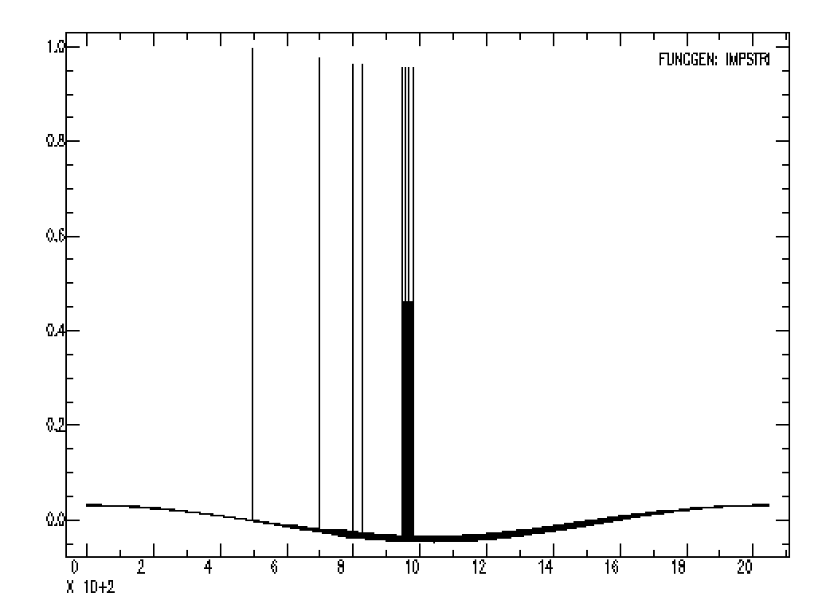
We can use the transfer command to “remove” the IR and recover the input to the seismometer.
SAC> transfer from DWWSSN to none
Notes:
Get back “approximation” of the input, notice the low frequency funniness. Removing mean or trend does not help.

Slide 18
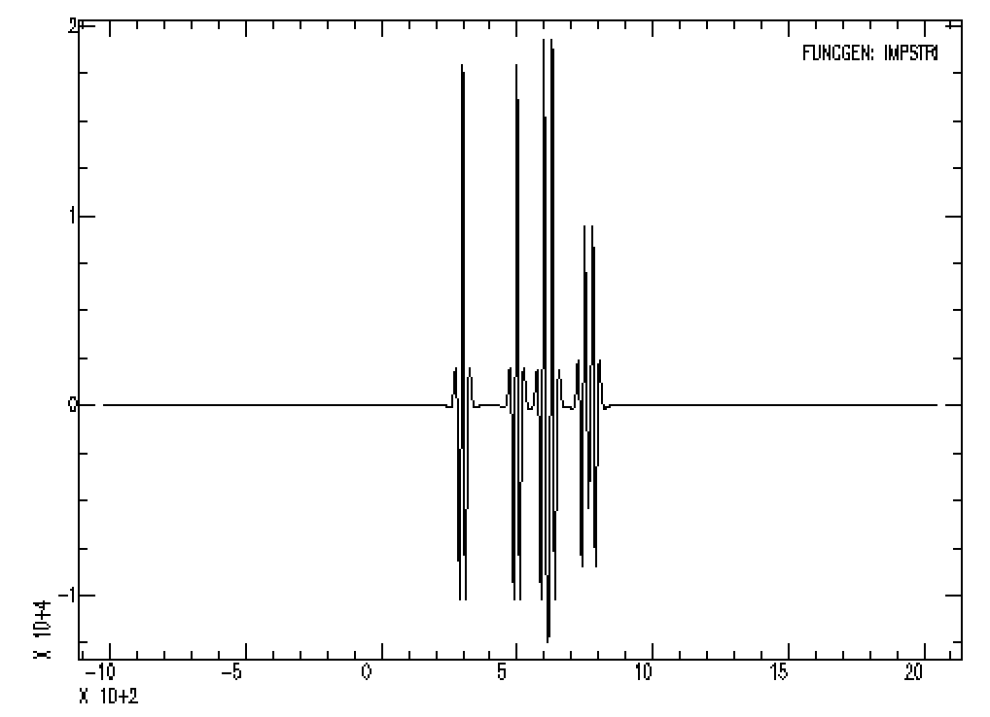
Correlation ex.
Correlation “looks for” one signal in another. Look for IR in the “seismograms”. It returns a set of weighted, shifted peaked functions.
Notes:
It does not return the original input time series. The interpretation is there is a spike at the time of the maximum amplitude. This works well for the first 2, pretty good for the third, and not so good for the 4th . (to be fair, the delta t’s in 4 are half the period of the response, so the spikes are going to sort of cancel out.

Slide 19
Signal Correction Module
These commands let you perform certain signal correction operations.
rmean: removes the mean from data.
rtrend: removes linear trend (and mean) from data.
Notes:
Have been using these

Slide 20
- rglitches: removes glitches and timing marks.
taper: applies a symmetric taper to each end of the data and SMOOTH applies an arithmetic smoothing algorithm.
linefit: computes the best straight line fit to the data in memory and writes the results to header blackboard variables.
- reverse: reverses the order of data points.
Notes:
Sneaks in new term – blackboard variable - later

Slide 21
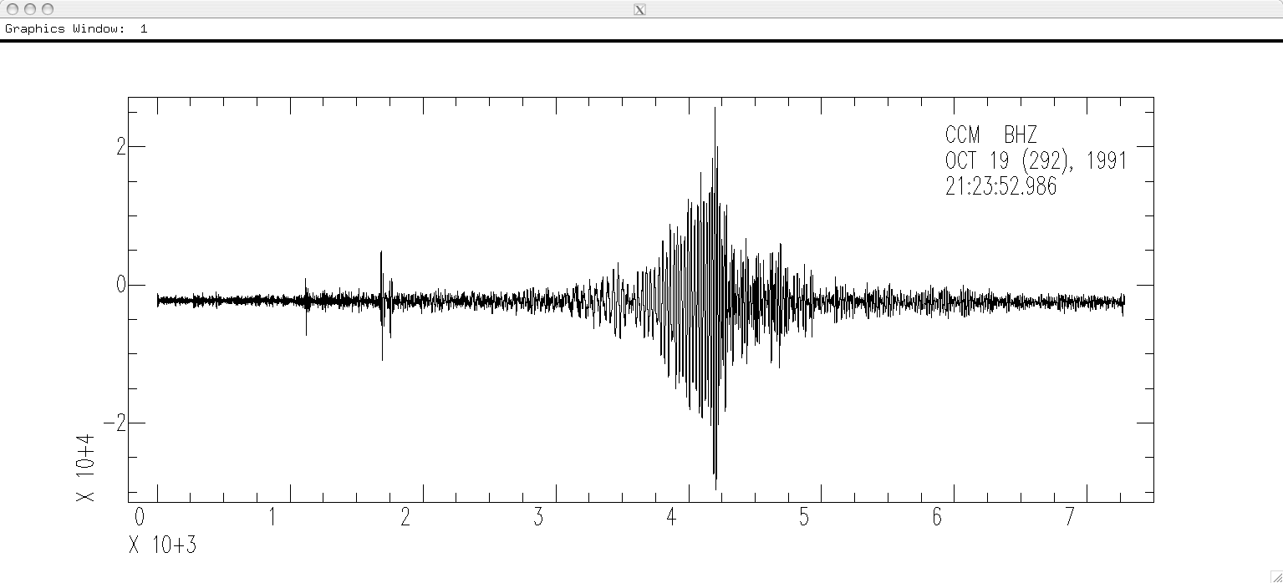
Integration – to change from acceleration to velocity, and velocity to displacement.
SAC> r ccm_india_.bhz
SAC> qdp off
SAC> plot

Slide 22
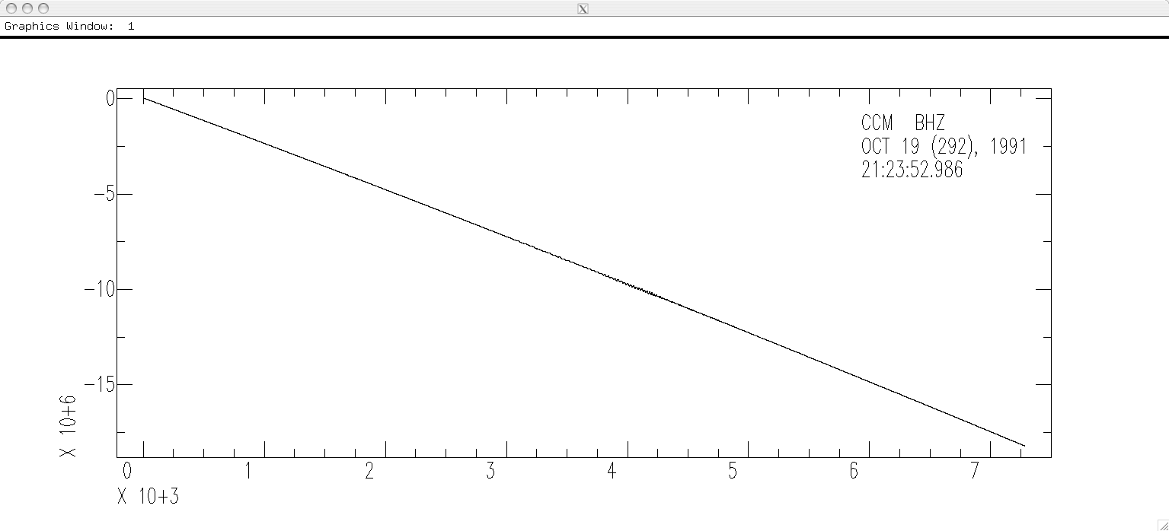
Integrate it (original data was vel, integrate to disp).
SAC> int
SAC> p
OOPS!

Slide 23
What is the problem?
(do you agree that there is a problem?!)

Slide 24
Integral of constant is a straight sloping line.
The seismic data has a (small) DC offset (a constant).
So remove the mean.

Slide 25
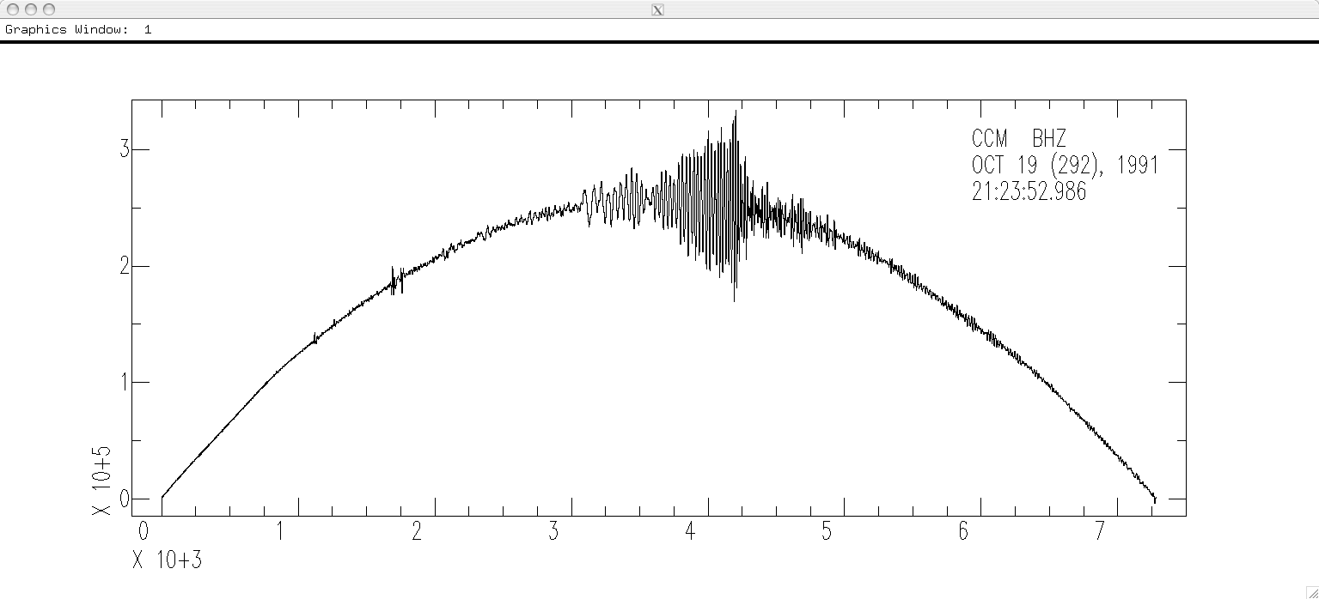
Try again.
SAC> r
SAC> rmean
SAC> int
SAC> p
OOPS again!

Slide 26
Is this an improvement?
Are we getting any better?
What’s the problem now?

Slide 27
Integral of linear fn (line) is a quadratic fn (parabola).
So data has a linear trend - remove trend (line) from data
(y=mx+b)
(this will also remove the mean through the intercept b).

Slide 28
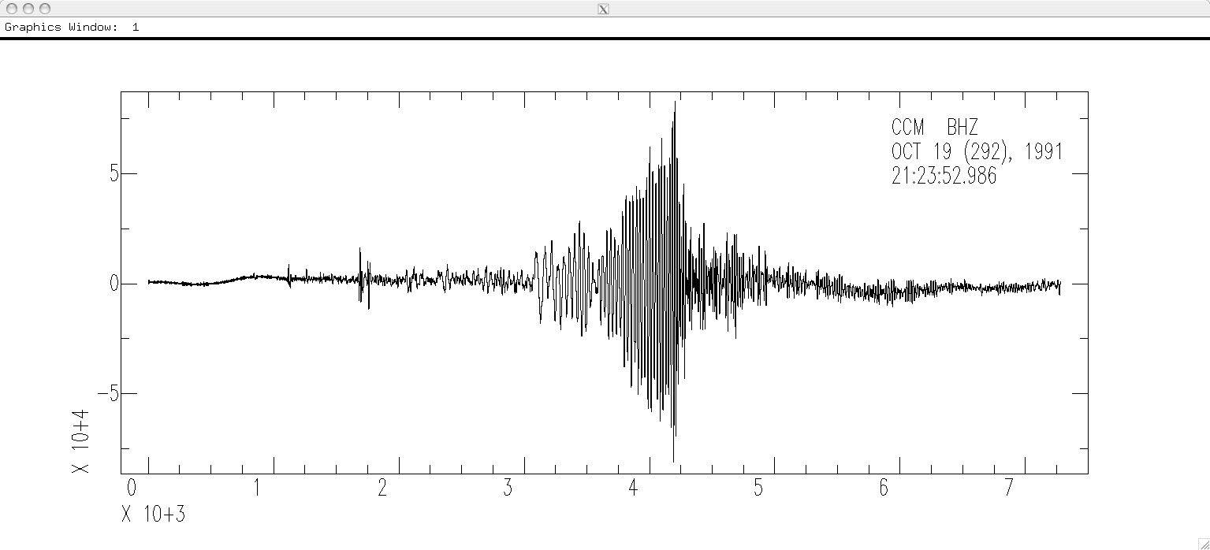
Remove trend (line) with rtrend, this removes y=mx+b – both the line and the DC offset
SAC> r
SAC> rtrend
Slope and standard deviation are: -0.038705 0.0037565
Intercept and standard deviation are: -2365.1 15.788
Data standard deviation is: 3010.9
Data correlation coefficient is: 0.026988
SAC> int
SAC> p
Notes:
Could just remove trend (removed mean for teaching purposes). Still have some little quadratic sections – looks like piecewise linear drift.

Slide 29
Removing the line will also remove the mean if it is not zero.
So don’t really need to do the rmean first.

Slide 30
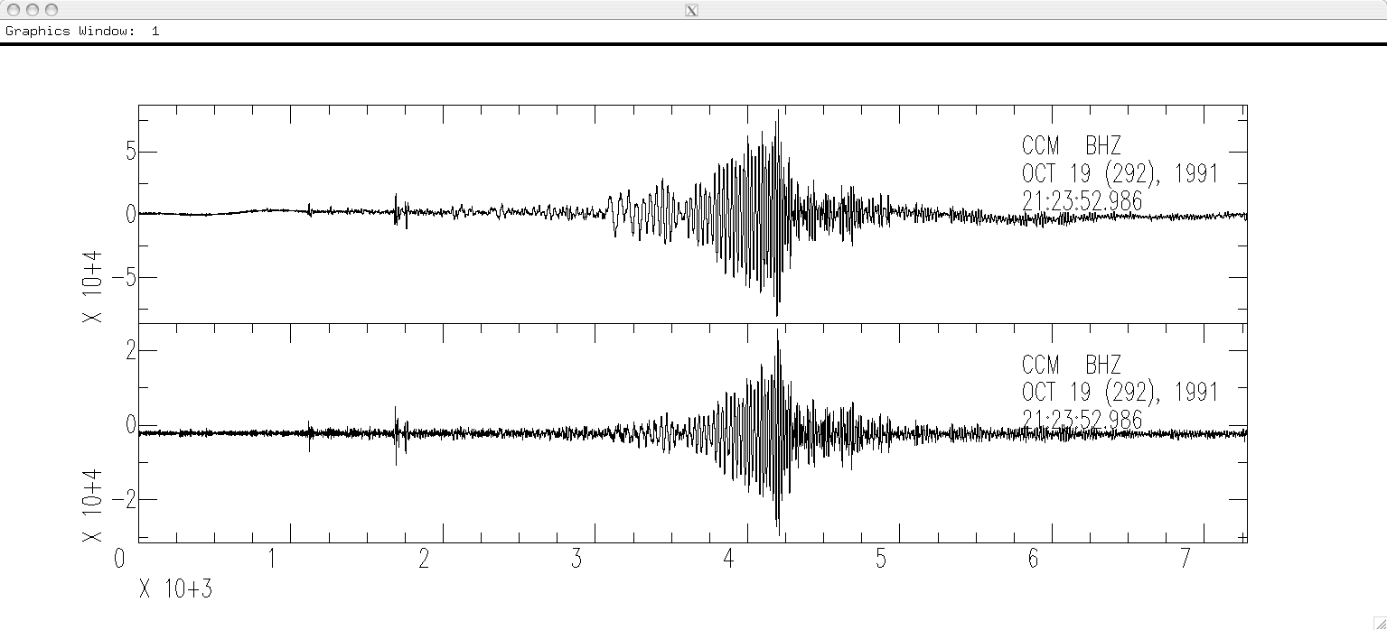
There is still some “drift”, but this seismogram might be useful for displacement analysis.
SAC> r
SAC> rtrend
Slope and standard deviation are: -0.038705 0.0037565
Intercept and standard deviation are: -2365.1 15.788
Data standard deviation is: 3010.9
Data correlation coefficient is: 0.026988
SAC> int
SAC> r more
SAC> p1
SAC> r more
SAC> p1
displacement
velocity
Notes:
Lots of problems due to long period "baseline" drift is trying to use acceleration data to calculate co-seismic offset – theory good, practice ?? (integration still better than differentiation when it comes to noise, but noise can get us either way).
This also has more constraints than site with coseismic displacement – here acceleration, velocity and displacement all return to zero after the passage of the earthquake waves. In case of coseismic offset, acceleration and velocity have to return to zero, but the displacement does not.

Slide 31
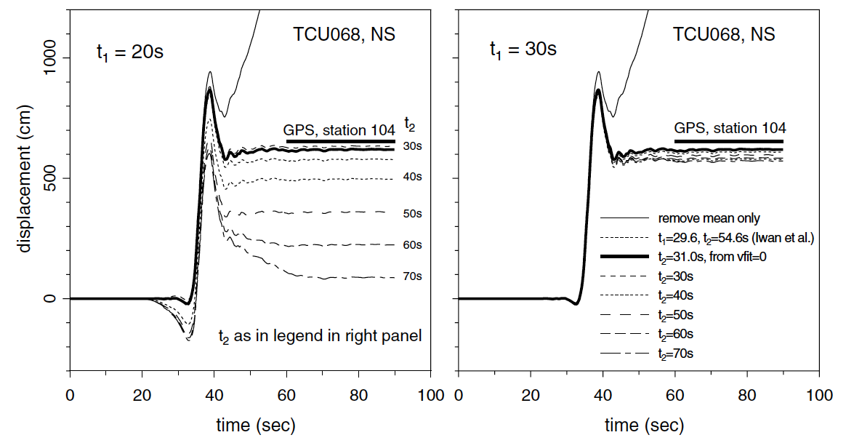
Big problems with "baseline" drift when trying to integrate acceleration up to displacement to when trying to obtain/estimate co-seismic static displacement.
Boore, 2001
Notes:
Significant problem as the principle strong motion/coseismic offset data is acceleration data (regular seismometers clip) (GPS to the rescue more recently - can give "directly" – BUT only works outside, in place with acceptable sky view, has own set of problems – multipath, need high rate for time history/dynamic as opposed to just static – no such thing as a free lunch).

Slide 32
Differentiation - default is 2 point difference y=(x1-x0)/delta. sac> funcgen impulse delta 0.01 npts 100 sac> dif sac> p

Slide 33
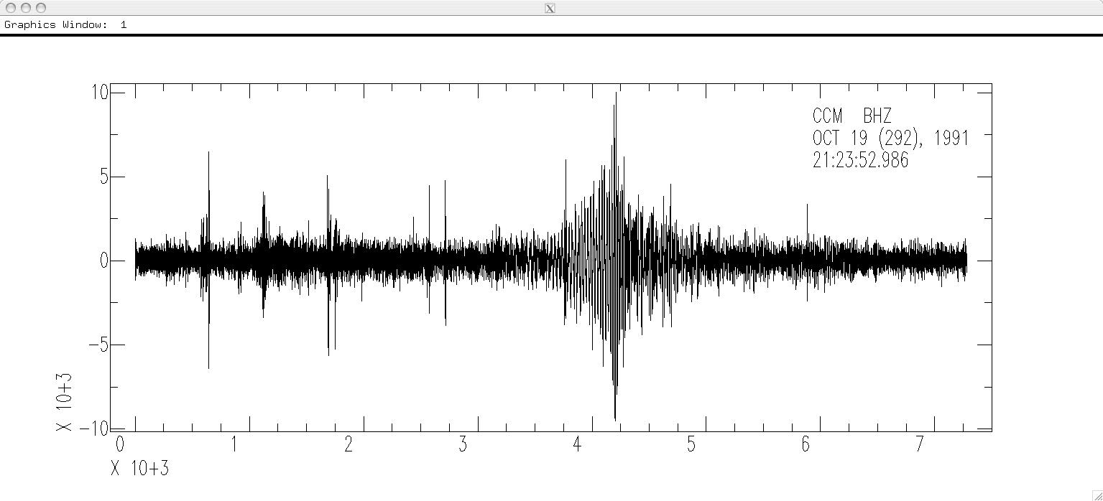
Differentiate velocity to acceleration.
SAC> r
SAC> dif
SAC> p
Notes:
Noisier (high freq noise)

Slide 34
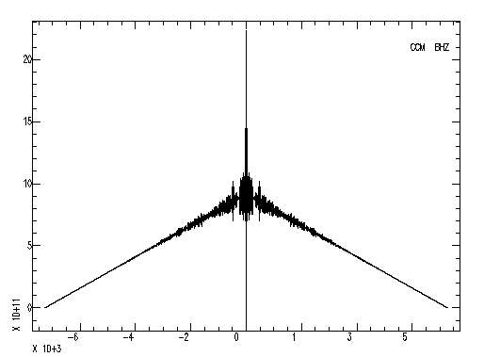
More on correlation
SAC> r *india*z
SAC> correlate
SAC> p
What’s wrong here?
Notes:
This is autocorrelation

Slide 35
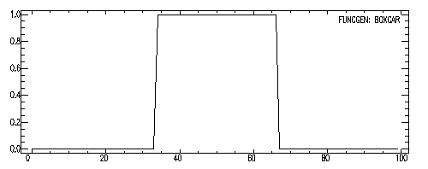
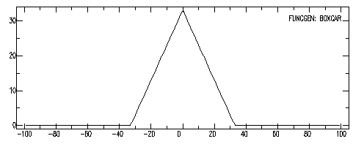
More on correlation
SAC> fg boxcar
SAC> p
SAC> correlate
SAC> p
Boxcar
Signal
Correlation
There is a DC offset
Notes:
Waveform crosscorrelation. Read in bunch, cross correlate all (including first) with first – so top one on bottom is autocorrelation, others are cross correlations.
Note horizontal axis – 2x on bottom

Slide 36
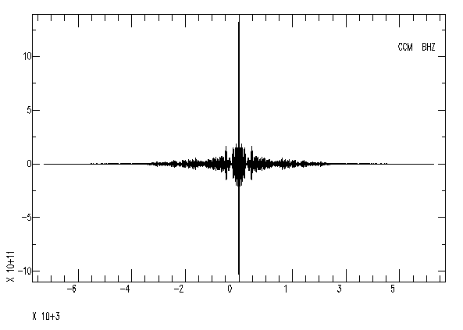
More on correlation
SAC> r *india*z
SAC> rtrend
SAC> correlate
SAC> p
Fix by removing mean with rmean, or better yet, remove trend (gets mean and linear) with rtrend.

Slide 37
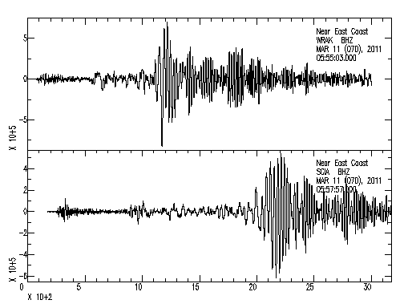
More on correlation
SAC> r US.WRAK..BHZ.M.2011.070.055503.SAC *SCIA*Z*
SAC> p1

Slide 38
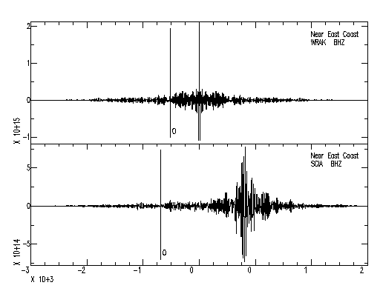
More on correlation
SAC> rtrend
SAC> correlate
SAC> p1

Slide 39
Binary Operations Module
These commands perform operations on pairs of data files.
merge: merges (concatenates) a set of files to the data in memory.

Slide 40
Binary Operations Module
addf: Adds a set of data files to data in memory.
READ FILE1 FILE2
ADDF FILE3 FILE4
READ FILE1 FILE2 FILE3
ADDF FILE4
subf: subtracts a set of data files from the ones in memory.
Notes:
If second set smaller than first, uses last file in second set to add to remaining files in first set – so 2nd one is example of that.
Files have to be same length and have same sampling interval.
Use binoperr (binary operator error) to overide same number or points and sampling interval restriction.

Slide 41
mulf: multiplies the data in memory by a set of data files.
divf: divides the data in memory by a set of files.
- binoperr: controls errors that can occur during these binary operations. Can use to override the requirement for the same number of points and/or the same sampling interval.

Slide 42
sac> funcgen impulse delta 0.01 npts 100 sac> w impulse1.sac sac> div 2 sac> w impulse2.sac sac> r impulse1.sac sac> addf impulse2.sac
Notice you have to write intermediate stuff out to disk.

Slide 43
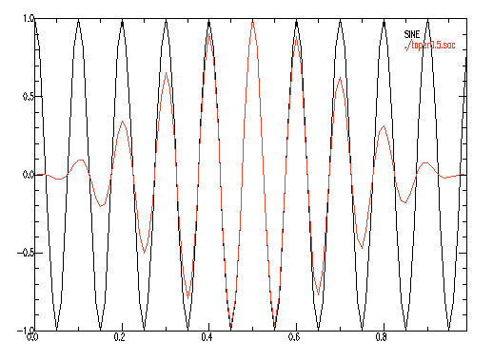
Windowing
SAC> funcgen sine 10 90 delta 0.01 npts 100
SAC> TAPER TYPE HANNING WIDTH 0.5
SAC> w sac taper0.5.sac
SAC> funcgen sine 10 90 delta 0.01 npts 100
SAC> r more ./taper0.5.sac
SAC> color on increment on
SAC> p2

Slide 44
More
stretch
upsamples data, including an optional interpolating FIR filter.
decimate
downsamples data, including an optional anti-aliasing FIR filter (this is what qdp does without the filter).
Interpolate
interpolate evenly or unevenly spaced data to a new sampling interval using the interpolate command.

Slide 45
More
quantize
converts continuous data into its quantized equivalent.
rotate
pairs of data components through a specified angle.
(we have already seen this one)
rq
removes the seismic Q factor from spectral data.

