Slide 1
CERI-7104/CIVL-8126 Data Analysis in Geophysics
More on Shell Scripts
AWK
GMT – topo
Lab – 18, 10/29/19
Notes:
Retiina display – 220 pixels/inch

Slide 2
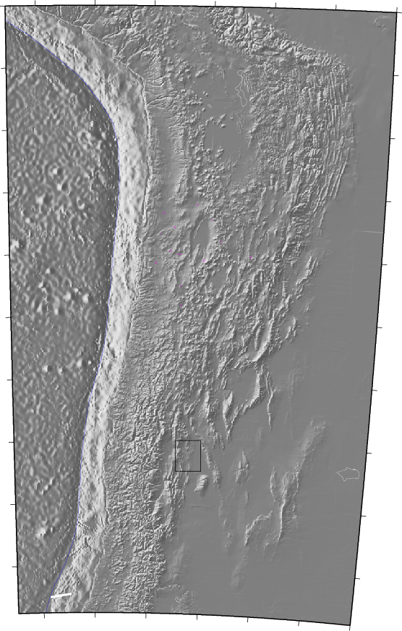
ETOPO -5
global
(5 min)
GTOPO-30
Land only
(30 sec)
(These were combined using technique presented)
SRTM
Land only
(3 sec)
Notes:
5 min – 12 x 12 data points/degree
30 sec – 120 x 120 data points/degree

Slide 3
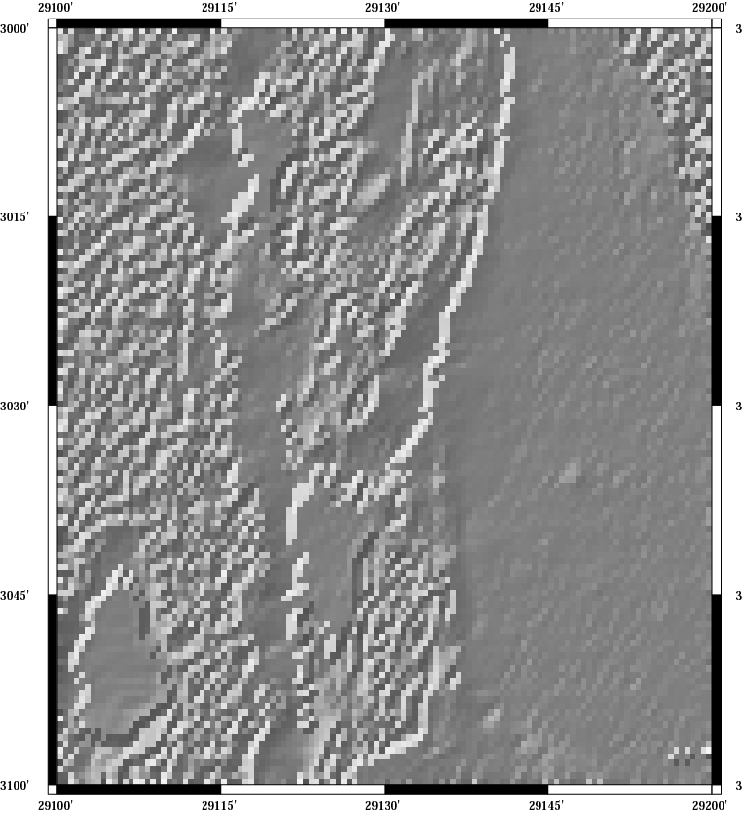
GTOPO-30
Notes:
30 sec gets blocky at 1 sq degree

Slide 4
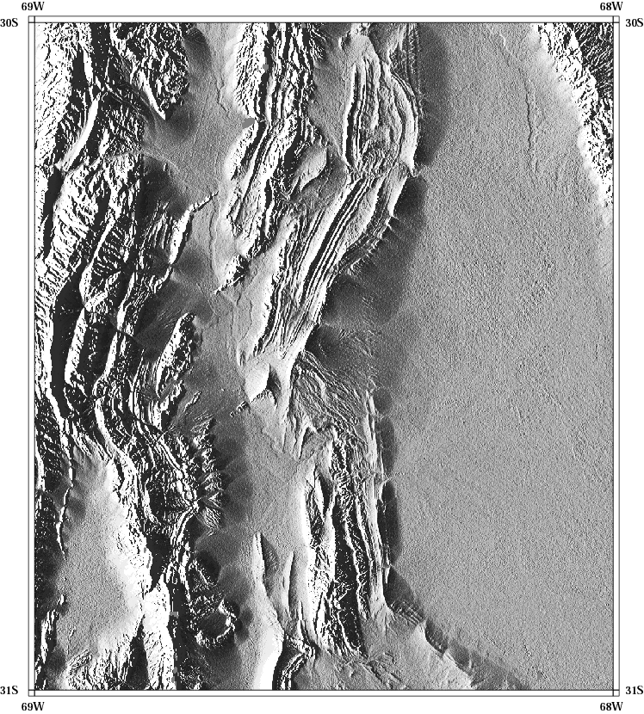
GTOPO-30”
SRTM-3”
Notes:
3 sec is 1200 x 1200 data points/degree
Don’t have example yet – but recently released srtm 1” – 3600 x 3900 data points/degree

Slide 5
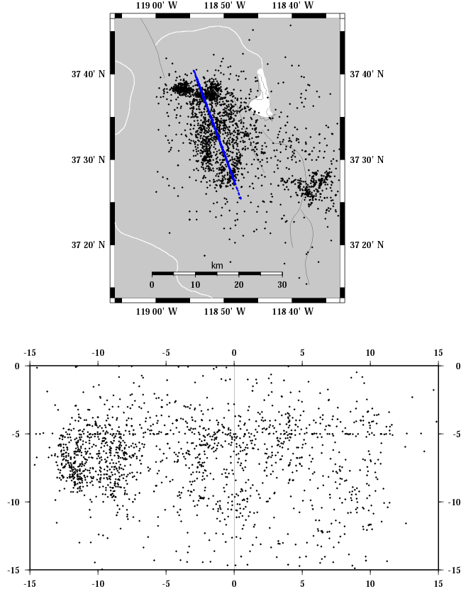
Make a cross section
(2 parts, draw map, draw cross section)
Data and non working version of shell script from
http://www-geology.ucdavis.edu/~gps/GMT/LONG_VALLEY/hypocenter.html
Notes:
Updated version at
http://mygeologypage.ucdavis.edu/gps/GMT/LONG_VALLEY/epicenter.html

