Slide 1
CERI-7104/CIVL-8126 Data Analysis in Geophysics
Continue start UNIX.
Lab – 13, 10/8/19

Slide 2
Some programing observations from the Homeworks
What does this do?
%function Circular_Sin = Circulars(R,m)
R=4;
m=10;
…
How about this?
function my_circleplot=XY_plot(R,W)
r=R;
w=W;
Notes:
I was asked to go over some examples from the homeworks of programming problems
First - What does this do? Why might you do it (testing – don’t want to have to keep typing in R and m)? BUT - Probably better replace lines 2 and 3 wit code to set defaults if no values given in call.
Matlab does not have direct way to set defaults in function definition or inside function – have to write several lines of code. Relatively easy if leave stuff off end, harder at beginning or middle.
Second – don’t need to create new varis.

Slide 3
function c=my_circle(R,T)
…
theta = 0 :pi/100:T*2*pi;
x = R * cos(theta);
…
theta=0:pi/1000:pi*2;
X=R.*cos(theta)+sin(T*theta).*cos(theta);
…
the=0:pi/100:2*pi;
…
for k=1:length(the)
xe(k)=R.*cos(the(k))+sin(T*the(k)).*cos(the(k));
…
end
end
Notes:
Unnecessary duplication
No loops!

Slide 4
On the square root exercise
How to initialize the iteration.
There were several ways to do it.
Set initial guess to one half X.
Set initial guess to 2eN or 7eN, where N was half the number of digits in X.
But there was confusion on how to “set” it.
You want your function to make the guess – you don’t want to do it yourself and send it to the function.
Notes:
So you have to code up the guess part.

Slide 5
On the square root exercise
Another question was about the speed of convergence.
Here you have either write 2 functions and compare the “times” to run, or write both ways into the function (effectively 2 functions) and compare the “times” to run.

Slide 6
On the square root exercise
How do we measure “time”?
One way is to count iterations to converge.
So you need a counter in your loop.
This is a pretty good comparison as long as the two methods are doing the same, or close to the same thing.

Slide 7
On the square root exercise
So we could write a function that took X and the starting value, XGuess, and returned sqrt(X) and the number of iterations N.
Now call it with the two different methods of generating Xguess and compare the value of N.
The only difference between the two calls is the starting value.

Slide 8
On the square root exercise
Once we have decided which way is faster/preferred we take the XGuess input parameter out of our final function and put the XGuess generation code into it.

Slide 9
On the square root exercise
It is a bit more complicated if the function is different for the two methods.
Say for example that we used the Babylonian method to get the new estimate on each iteration?
Now we have to take into account that each method will take a different amount of “time” (measured on computer steps) per iteration in addition to the number of iterations.

Slide 10
Timing
There are tools to measure how long something takes to do.
tic and toc – tic starts a timer/stopwatch and toc stops it and reports the elapsed time.
If you loop over the same calculation a number of times and look at the elapsed times you will notice that they can vary quite a lot (sometimes an order of magnitude)

Slide 11
Timing
This is due to a number of things.
We are looking at elapsed time, not the time devoted by the CPU to our code.
Since we are on a multitasking, multiuser system we have to share, so each run will be different depending on what else the computer had to do.
There are some hidden tasks (e.g. garbage collection) that run “as needed”, that may or may not have been done during every run.

Slide 12
Timing
There is another routine called timeit that calls a function handle and returns how long it takes (same measurement – elapsed time)
timeit runs the function a number of times (it decides how many), takes into account overhead associated with calling the function and tic and toc (so it uses them internally) and provides an average.

Slide 13
Optimizing
Making your code go faster.
Compare various methods of doing calculation
Loop
Vectoriztion if possible
Recursion
Any of above with memory preallocation.
Something out of left-field.

Slide 14
Optimizing
See this series of web pages for calculating the Fibonacci sequence.
https://blogs.mathworks.com/loren/2013/09/22/timing-code/
https://blogs.mathworks.com/loren/2006/05/17/fibonacci-and-filter/

Slide 15
Optimizing
Running code from these pages, for first 102 terms (their example) we get
>> time_fibs
Compare Times (in milliseconds)
loop prealloc recursive filter
0.032925915 0.001971634 0.083387566 0.003825890
And the preallocation method wins.
Going to larger lengths, the preallocation method continues to “win”. (I would have guessed that the filter method – something-out-of-left-field would have won as the sequence got longer).
Notes:
Many engineering solutions are the something-out-of-left field type – e.g. abs brakes.

Slide 16
What to avoid
function [xsq]=mysqrt(s) %s is our input value here
if (s<0) %giving a loop when the input is negative
s=abs(s);
x0=intgr(s); %calling my guess function
while (abs((x0^2-s))>10^(-4)) %loop for babylonian square root
x2=(x0+s/x0)/2;
x0=x2;
end
x0=x0*i; %provide output of negative value as imaginary number
else
x0=intgr(s); %for positive 's' value
while (abs((x0^2-s))>10^(-4)) %babylonian square root value
x1=(x0+s/x0)/2;
x0=x1;
end
end
xsq=x0;
end
What is the coding “inefficiency” here?
Notes:
Magenta parts are effectively the same!
6 were like this.

Slide 17
What to avoid
Variations on the theme
- Don’t calculate for zero
elseif S==0 % Square-root for Zero
X=0;
X1=X;
Saving here is minimal
- Just take abs value and ignore that the result can be imaginary
- If imaginary do this
if S<0
x1=sqrt(abs(S))*1i;
Notes:
First one – same as before with extra testing for little to no efficiency gained.
Second one – incorrect design
Third one – Not using the iterative method – not supposed to use matlab sqrt function. Matlab’s sqrt function works with negative (and complex) inputs.
The second and third covers the 2 that did not repeat the code.

Slide 18
How to fix
function [xsq]=mysqrt(s) %s is our input value here
if (s<0)
fix=i;
s=abs(s); << this does not change s in calling routine
else
fix=1;
end
xsq =intgr(s); %calling my guess function << this is good!
while (abs((xsq ^2-s))>10^(-4))
x2=(xsq +s/ xsq)/2;
xsq =x2;
end
xsq=xsq*fix;
end

Slide 19
HW 4
Many of the problems were due to not understanding what needed to be done.
Checking inputs
What are limits for Longitude?
assert(( -180 <= Eq_lo) && (Eq_lo <= 180),'Eq_lo values not within appropriate ranges’)
or
if E(2)<0||E(2)>360
Which one, or neither, is correct?

Slide 20
HW 4
Checking inputs
What are limits for Latitude?
if eq(1)<0 || 180<eq(1)
disp('There is a problem. Lat should be between 0 and 180 degree')
delta='Nan'
return
What is wrong here?

Slide 21
Part of programming is testing your program (if possible) with inputs that give known answers or against other programs that do the same thing.
Matlab has these functions and they are vectorized!
distance (actually will optionally also give azimuth)
azimuth (only gives azimuth)
So you can compare your results with known good results.

Slide 22
HW 4
If need to do something multiple times – make it a function (can put in script file).
DON’T cut and paste to repeat code.
Hard to debug and maintain.
% checking range of the input values for earthquake
if E(1)<-90||E(1)>90||E(2)<0||E(2)>360
fprintf('%s\n','few input values are out of range');
del=NaN(1,n,'single');
return
end
% checking range of the input values for stations
if((minlongS < 0) || (maxlongS > 360) || (minlatS < -90) || (maxlatS > 90))
fprintf('%s\n','few input values are out of range');
del=NaN(1,n,'single');
return
end
Notes:
Two tests of the same thing done differently (one does lat first then lon, other does lon first then lat) and both use incorrect logic on lon - so have to fix 2 places.

Slide 23
HW 4
Basic blunders
if (-90<Lat1)&&(Lat1<0)
L1=90+abs(Lat1);
This produces value for latitude > 90° if the input is negative.
Notes:
Two tests of the same thing done differently (one does lat first then lon, other does lon first then lat) and both use incorrect logic on lon - so have to fix 2 places.

Slide 24
HW 4
Understanding the “physics”
What is the difference between
azimuth (direction from source to station, and/or direction the wave is going at the station)
and
Back-azimuth (direction at the station from which the wave is coming.)

Slide 25
HW 4
In general the back-azimuth is not computable from the azimuth.
Specifically it is not the azimuth-180 (or the azimuth- 360 – which is the same).
We will play with a globe for this.
Find cases where the back-azimuth is the azimuth-180, cases where the back-azimuth is equal to the azimuth, and the general case where there is no simple relationship.

Slide 26
HW 4
Easy vs hard way to do things.
In the “old” days trig functions only took radians for their arguments (except FORTRAN that always took both radians and degrees).
Now, most languages will take degrees(although it seems C is still holding out and does not offer it).
sin(x) takes x in radians
sind(x) takes x in degrees.
The computer is a labor saving device – make it do the work!

Slide 27
HW 4
Since the output of sin and cos are not single valued, to get the azimuth and back-azimuth you have to figure out what input value produced the output value.
With only one of them (sin or cos) you can’t do this.
You need both as there are 4 combinations of signs of the sin and cos (0 to north, +CW).
sc sc sc sc
++ +- -- -+
NE SE SW NW

Slide 28
HW 4
Look at getting correct quadrant from sin and cos
>> th=[45 135 -135 -45]
th =
45 135 -135 -45 answer from atand(2) comes in this
form (not 0-360)
>> sth=sind(th)
sth =
0.707106781186548 0.707106781186548 -0.707106781186548 -0.707106781186548 breaks into hemispheres: E+ and W-
>> cth=cosd(th)
cth =
0.707106781186548 -0.707106781186548 -0.707106781186548 0.707106781186548 breaks into hemispheres: N+ and S-
>> tth=sth./cth
tth =
1 -1 1 -1
>> atand(tth)
ans = 45 -45 45 -45 breaks into hemispheres: E+ and W-
>> atan2d(sth,cth)
ans = 45 135 -135 -45 breaks into quadrants: what we need

Slide 29
Doing tests on matrices

Slide 30
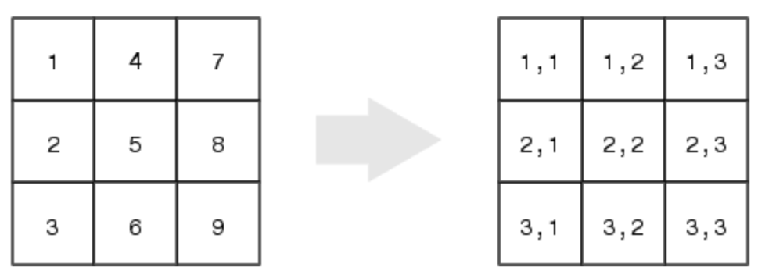
Review of storage for 2-D matrix

Slide 31
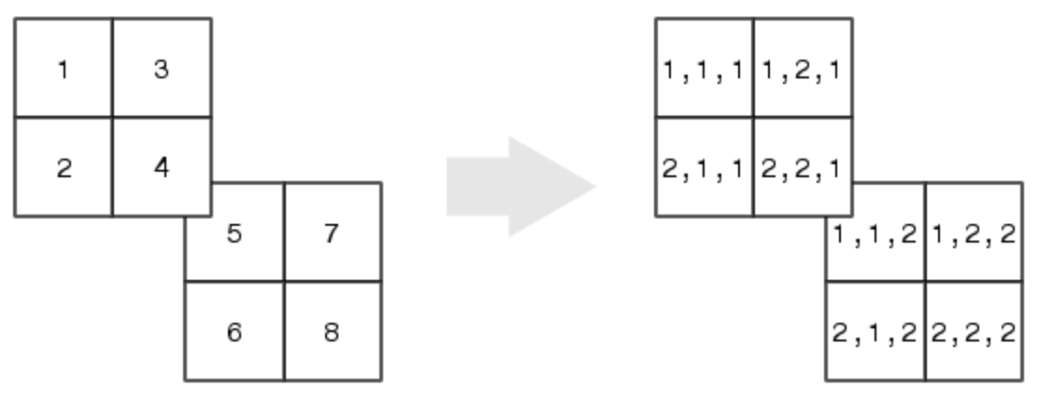
Review of storage for 3-d matrix

