Slide 1
CERI-7104/CIVL-8126 Data Analysis in Geophysics
Finish Introduction to Matlab
Start UNIX.
Lab – 10, 9/26/19

Slide 2
This web page has the documentation for all the graphics object properties
https://www.mathworks.com/help/matlab/graphics-object-properties.html
Go there to see how it is organized.

Slide 3
How to prevent the quotes problem (browser putting in “smart” quotes [the kind you see here – they “open” and ‘close’] )
Use ftp
For now – the macs in the lab have a GUI ftp program called Cyberduck. We will see it again later in UNIX.
Use it to download the file how2handlegraphics.m.
Then bring it into the editor in Matlab and it should not have any red stuff.
Notes:
Have to use sftp. Test that anybody can get into public_html directory.

Slide 4
How to prevent the quotes problem.
Or use the dropdown menu to save the file directly (does not go though the browsers interpreter).
Notes:
Right click to select the file (goes dark blue) and brings up menu box and save link directly.

Slide 5
You can also give handles to functions, this allows you to pass functions as arguments to other functions
f = @(x) x.^3 -3*x+1;
Then call f(3.4) etc., (like sin, cosine, etc.)
This also makes function handles – so you can pass functions to other functions
X=linspace(0,2);
Plot(x,f(x))

Slide 6
How turn off underscore signifying next character is a subscript (default intrepreter is TEX).
This way you don’t have to escape the underscore (“\_”) to get it to be an underscore.
This is needed when the text is not “hard coded”, eg. a file name.
Set the Interpreter property for that field to 'none'; the default for text() fields is TEX.
title('This_title has an underline', 'Interpreter', 'none');
Notes:
“escape” means turn off some default behavior signified by a character and take the character as is and print it.
We will see this use of “escape” with unix, where many non-letters have some special meta-character meaning – as a wildcard, etc.

Slide 7
Make flow chart of script to read the files
mixedin1.dat and mixedin2.dat
These files have earthquake data.
Most earthquake data files have a mixture of numbers and text (the first file) and time formatted data, and a header (that typically identifies the data columns (the second file).

Slide 8
Course Description
Introduction to UNIX

Slide 9
What is an operating system
(OS or O/S)?
Interface between Hardware and User.
See: http://en.wikipedia.org/wiki/Operating_system
Notes:
Hardware, software, firmware
Hardware – usually physical, you can touch it. Software – “soft”, changeable, can’t put your finger on it. Goes away when you turn it off. Firmware – software (program) in rom (read only memory) so more stable than software, does not go away when you turn it off, but can change it (change rom chip, or eprom).

Slide 10
What is an operating system
(OS or O/S)?
Interface between Hardware and User.
It is a program (software) designed to manage and coordinate activities and resources of the computer.
See: http://en.wikipedia.org/wiki/Operating_system
Notes:
Hardware, software, firmware
Hardware – usually physical, you can touch it. Software – “soft”, changeable, can’t put your finger on it. Goes away when you turn it off. Firmware – software (program) in rom (read only memory) so more stable than software, does not go away when you turn it off, but can change it (change rom chip, or eprom).

Slide 11
What is an operating system
(OS or O/S)?
Controls the hardware (physical part of the computer - memory allocation, fan control, internal and external drive input/output, keyboard and mouse interactions, etc.) and other software.
Controls how other applications (=programs) are implemented.
See: http://en.wikipedia.org/wiki/Operating_system
Notes:
Hardware, software, firmware
Hardware – usually physical, you can touch it. Software – “soft”, changeable, can’t put your finger on it. Goes away when you turn it off. Firmware – software (program) in rom (read only memory) so more stable than software, does not go away when you turn it off, but can change it (change rom chip, or eprom).

Slide 12
OS’s at CERI
Mac OS X (Darwin/UNIX)
UNIX plus Mac GUI
Macs in Student Comptuer Lab in Long Building
many faculty and student offices.

Slide 13
OS’s at CERI
Various flavors of Linux
Popular, open source version of UNIX (often described as “UNIX-like”, but is UNIX).
Found on a number of machines at CERI, but not officially supported at CERI.
Notes:
You are on your own with linux – have to be your own sys admin, guru/wizard.

Slide 14
OS’s at CERI
Windows
Student Computer Lab in Long Building, many student offices, UM computer labs and other un-enlightened places.
Notes:
The university is not an early adopter, UM usually does not standardize on an OS until it is deprecated – fancy computer scientist jargon for a program or feature that is considered obsolescent and in the process of being phased out, usually in favour of a specified replacement.
UM has standardized on the Windows OS.

Slide 15
Why learn Unix/Linux?
Designed to be multi-user (from the dark ages when all computers were shared), interactive (as opposed to “batch”), and multi-tasking (sharing again).
Invented by and for computer scientists/system programmers (not users or scientific programmers, unfortunately).
Notes:
Interaction was through a teleytype

Slide 16
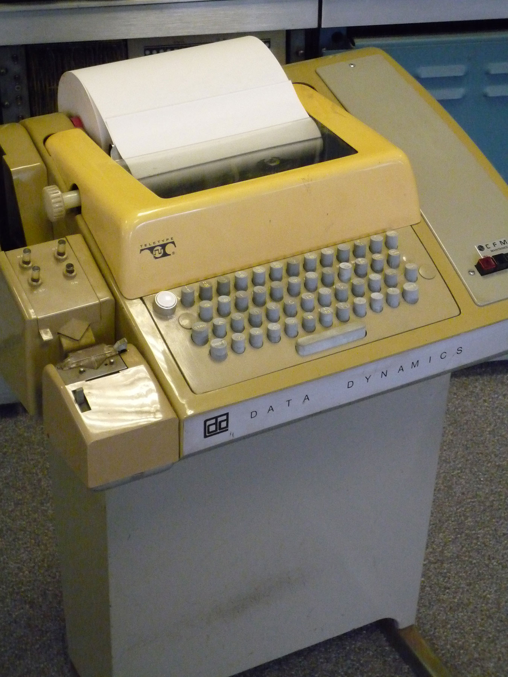
This was how you “interacted” with the computer.
A teletype.
Even today, UNIX assumes you are using a teletype!
Notes:
Interaction was through a teleytype – just letters and numbers, no arrow keys, numeric keypad, etc. This one has a paper tape reader/punch. You can still see the assumption that one is working from a teletype in UNIX!

Slide 17
Why learn Unix/Linux?
Powerful, flexible, and small
Hardware independent
(these two points are much more important to manufacturers and designers than general users, i.e. us)
Notes:
Only thing true is SMALL. Is powerful but will not do many things by design (e.g. is not real-time, egalitarian - share equally). Flexible, you will change to do it the way UNIX requires (Will it do this? No, but it is UNIX – synonymous with powerful – and you can write a program. Hardware independent – complete myth.
Real OS – DEC RT-11, VMS, IBM, Prime, etc. – 100’s man years to develop OS. UNIX – 6 months for single engineer to port to new hardware . One way to do this Is that the OS does almost nothing!

Slide 18
Why learn Unix/Linux?
“Free” (this is why is it still around) from Bell Labs and Berkley.
Open source – “free” – applications, including compilers.
Most common free applications designed as part of the GNU Project (GNU’s Not Unix)
It is what is running in most geoscience (both university and corporate) labs.
Notes:
Universities would buy a computer but not the OS, they would put UNIX on it. Engineering students learned it, and when the IC came along it was the only OS that could be rushed to market. (6 months for a handful of guys to design the computer around IC, needed OS fast – one guy could “port” UNIX to new hardware in 6 mos).

Slide 19
The real reason why to learn Unix/Linux?
Because you have no choice
(“Resistance is futile”, The Borg, Star Trek).
It is what is running in most geophysics departments.
Most geophysics tools (SAC, GMT, GAMIT/GLOBK, etc.) only run on Unix (although there is a Windows version of GMT).
(~89% of the worlds computers run some form of Windows, ~9% run some form of the Mac OS, and ~2% run some flavor of Unix.)
Notes:
UNIX/LINUX strong point is SERVERS – the web runs on UNIX based machines.
If you want to do something besides run a server – UNIX is probably not the way to go.

Slide 20
Why learn Unix/Linux?
“Free” in the sense you don’t buy it from AT&T or Berkley
But there is no such thing as a “Free Lunch”. Not “Free” in the sense that you must hire a system programmer/manager otherwise known as a UNIX Wizard or Guru.
(another UNIX myth shot down)

Slide 21
A bit of history
Originally developed at AT&T in the late 60s/early 70s.
Freely given to universities in the 70s.
Berkeley scientists continued to develop the OS as BSD Unix in parallel with AT&T (AT&T eventually licensed it for commercial use).
Much development, branching, and combining has led to the most common variants of Unix (“flavors” or “distributions” in Unix speak).
See http://www.bell-labs.com/history/unix/

Slide 22
Common flavors at CERI
Mac OSX
Distributed by Apple, runs on Mac Hardware.
Derived from BSD Unix OS on a Mach kernel - Darwin.
Linux
Free* and commercial# versions available built on a Linux kernel.
Flavors most likely to hear about are RedHat#, Ubuntu*, Fedora*, Debian*, Suse*,….

Slide 23
Does this matter?
No, the differences between the various flavors of the Unix operating system should not severely affect your work in this class or even much of your research at CERI.
BUT

Slide 24
Does this matter?
Yes, you need to be aware of OS differences
When file sharing with others (this is more of a hardware, rather than an OS, issue).
When compiling source code (the executable file is married to OS and hardware).
If sharing programs, shell scripts, etc. with others.
Or if moving between the different systems at CERI.

Slide 25
Relation to Windows
None.
Windows
Early version built on MS-DOS (which is not really an operating system, it is a file system), which has nothing to do with Unix and everything to do with Microsoft.
Cygwin – unix/linux like environment for windows. Have to build everything from source.

Slide 26
Relation to Windows
The differences between the Unix Philosophy and the Windows Philosophy … can be boiled down into a question of smarts … .
Unix and Windows store the smarts in different places.
Unix stores the smarts in the user.
Windows stores the smarts in the OS.

Slide 27
Learning curves
Enter the concept of the “Learning Curve”. …
A "steep" learning curve generally refers to something that requires a lot of initial learning to do anything, even something very simple.
A "shallow" learning curve is exactly the opposite; can do simple stuff easily immediately.
Notes:
http://www.over-yonder.net/~fullermd/rants/winstupid/winstupid2.php -- good set of web pages

Slide 28
Learning curves
Armed with those definitions, it's fairly simple to then go ahead and say that
Unix has an inherently steep learning curve,
and Windows has a very shallow one.
Notes:
http://www.over-yonder.net/~fullermd/rants/winstupid/winstupid2.php

Slide 29
Windows
Our Microsoft brethren have taken the approach of making the shallowest possible learning curve.
Notes:
http://www.over-yonder.net/~fullermd/rants/winstupid/winstupid2.php

Slide 30
Windows
To take a cue from the fast food industry, Windows is the "under-3" toy of the OS world.
The ultimate goal is to flat-out destroy any barrier to entry by removing any requirement for initial knowledge or learning of how and why, and of making the system simplistic enough that it can be used without any understanding of how it works.
Notes:
http://www.over-yonder.net/~fullermd/rants/winstupid/winstupid2.php

Slide 31
Unix
The Unix crowd has taken the opposite approach.
Notes:
http://www.over-yonder.net/~fullermd/rants/winstupid/winstupid2.php

Slide 32
Unix
Unix has a steep learning curve; it doesn't shield the user from complexity; rather, it revels in the complexity.
It recognizes that a general-purpose computer is a fiendishly complicated device capable of doing an unbelievable assortment of things.
Notes:
http://www.over-yonder.net/~fullermd/rants/winstupid/winstupid2.php

Slide 33
Unix
It recognizes that the computer is a tool of the user, and so takes a tool-building philosophy.
Make a lot of tools, and make each tool specific, and let the user select the tool they think appropriate, and let the user combine the tools however they want.
It's not aimed at making things easy; it's aimed at making things possible.
Notes:
http://www.over-yonder.net/~fullermd/rants/winstupid/winstupid2.php

Slide 34
UNIX Philosophy
(Mac) (Unix)
“Dilbert” by, Scott Adams, Sep 30, 1994.

Slide 35
Backing up a bit to illustrate some concepts.
User
Other Application/ System Software
User
Shell
Unix Commands
Shell
Hardware
Database Packages
Internet Tools
Kernel
Shell
Compilers
Shell
User
User

Slide 36
Hardware – the physical computer.
Kernel – program, usually hardware dependent, that runs the core or key components of the operating system (process, memory, file, device, and network management).
Programs/Applications – hardware independent – unix commands, compilers, applications
Shell – hardware independent - how the user interacts with the Programs/Applications layer.

Slide 37
The Shell
The UNIX user interface is called the shell.
The shell does 4 jobs repeatedly:
display
prompt
read
command
execute
command
the shell
process
command

Slide 38
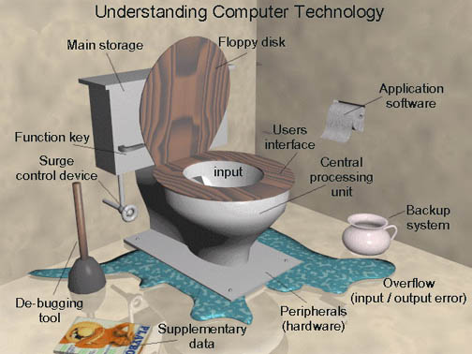
Final Model

Slide 39
We will now take a short detour to examine the Unix philosophy.
It will keep returning to haunt us, but if you understand it, it will make the process less painful.

Slide 40
What is the “Unix Philosophy”?
(can computer operating systems have a “philosophy”?)
According to Doug McIlroy
Make each program do one thing well.
So, to do a new job, build afresh rather than complicate old programs by adding new features (otherwise known as “bells and whistles”).

Slide 41
What is “Unix Philosophy”?
Machine shop vs. appliance
(gives you the tools and you to make appliance)

Slide 42
What is “Unix Philosophy”?
Advantage
POWERFUL

Slide 43
What is “Unix Philosophy”?
Disadvantages
Lots of reinventing the wheel
Requires a more educated user
Requires more work from the user rather than the developer

Slide 44
What is “Unix Philosophy”?
Typical question: can UNIX do this?
Typical answer: NO, but YOU can write a program!
Unix enthusiasts think this is the answer the average user wants to hear!

Slide 45
Caricature of UNIX vs Windows
If you need a washing machine
Windows gives you a simple washing machine (only one 1 setting, you shouldn’t wash your cashmere sweater, but there are no operating instructions[its intiutive] so you probably don’t know not to wash the sweater and ruined it.)
UNIX gives you a machine shop - you better know
1) how wash different types of clothes and
2) how to design and build a machine to do it.
Notes:
http://www.over-yonder.net/~fullermd/rants/winstupid/winstupid2.php

Slide 46
Quotes for the day:
“Software stands between the user and the machine” - Harlan D. Mills
Software can help the user in their daily endeavors or stand in the way.

Slide 47
“UNIX Philosophy”
(ii) Expect the output of every program to become the input to another, as yet unknown, program.
- Don't clutter the output with extraneous information that might be useful to the user, but not needed by the input for next program.
Notes:
So if you ask for a list of the files in a directory and it is empty – unix returns nothing (although it breaks the rule and usually goes to the next line on the teletype – so it returns a newline! In a pipe it returns nothing.).
Some OS (DEC’s VAX VMS) do different things depending on how called – send “no files found” to terminal, but nothing to “pipe”.

Slide 48
“UNIX Philosophy”
Unfortunately this may make things confusing for the uninitiated user.
The output is for “next program” (in a “pipe”), not the user.

Slide 49
“UNIX Philosophy”
What happens when you ask for a listing of files in an empty directory?
Robert-Smalleys-MacBook-Pro:untitled folder robertsmalley$ ls<CR>
Robert-Smalleys-MacBook-Pro:untitled folder robertsmalley$
Returns to prompt without any other output. (there are no files to list, so Unix just outputs a <CR> [and a new prompt], is that reasonable?).
(Works differently in shell script, no <CR>)
Notes:
Colors – orange - computer prompt, black – stuff you type, <CR> is carriage return/enter, later – blue – computer output. If there are no files, you get no result (zero length character string). Now I can send this to any other program – will only have list of files, no extraneous information (on VMS the directory command gave you the name of the directory, the list of files and a summary about the number of files – the arbitrary next program would have to figure this out for every possible previous commands output format.)

Slide 50
“UNIX Philosophy”
What happens when you enter
Robert-Smalleys-MacBook-Pro:documents robertsmalley$ echo<CR>
The command echo, “echoes” what you type.
Should do nothing! (what about a new prompt on same line?)
(i.e. it should just sit there, with the “cursor”, which was invisible on a teletype after the <CR>, after the <CR> waiting for input)
Notes:
Unix geeks get into these kind of discussions.
On modern terminal cursor marked by blinking underline.

Slide 51
“UNIX Philosophy”
What happens when you enter
Robert-Smalleys-MacBook-Pro:documents robertsmalley$ echo<CR>
Usually goes to next line and prints the prompt on the screen as in the previous example(break with philosophy because philosophy too confusing
But does what expected, nothing (it follows philosophy), in a shell script.
Notes:
Unix geeks get into these kind of discussions.
On modern terminal cursor marked by blinking underline.
In shell script this nice because can put something or nothing into an output, without a <CR>

Slide 52
“UNIX Philosophy”
Idea of “filter” –
Every program takes its input from Standard IN (originally a teletype, now a keyboard),
does something to it (“filters” it) and
sends it to Standard OUT (originally a teletype, now a screen)
(notice that the “user” is not part of this model).

Slide 53
“UNIX Philosophy”
This brings up another issue – commands sometimes behave differently in shell scripts than they do “interactively”
Typically more “chatty” when interactive.
This kind of stuff can make for confusion when debugging. Works from screen, does not work in shell script.

Slide 54
“UNIX Philosophy”
It is pretty easy to see these are not a good assumptions (Stnd IN, Stnd OUT) for many tasks and many Unix commands break this convention.

Slide 55
“UNIX Philosophy”
Idea/use of – redirection (“<“, “<<“ and “>”, “>>”)
- Take input from somewhere rather than Standard IN
Send output to somewhere rather than Standard OUT
(Unix treats everything like a “file”, even hardware)

Slide 56
“UNIX Philosophy”
redirection
- Take input from a file “<“ rather than Standard IN
Send output to a file “>” rather than Standard OUT
(note that this will create the file first – before running the program. If you have an existing file with that name – guess what UNIX does with it?
Notes:
Symbols called “suck” and “spit”. We will cover all of the options shortly.
What does “treats everything like a file mean” – means that user does not have to worry about details of where file going - /dev/mt0 is tape drive for example, but “looks like” a file. On DEC RT-11, which was a real-time OS, everything looked like “hardware” – had an “address”. This made it very easy to write programs to control real-time hardware (real-time means computer can measure, analyze, and respond fast enough to control something in the real worlk, like driving a car – when the hardware needs CPU time it takes it in some hierarchical order. Unix is more egalitarian, shares resources equally among users, car will crash because you have given it a new address and it does not prioritize).

Slide 57
“UNIX Philosophy”
Send output to a file “>” rather than Standard OUT
(note that this will create the file first – before running the program. If you have an existing file with that name – guess what UNIX does with it?
UNIX ERASES it!
The response form your UNIX guru will be “you were told that’s what would happen!”
UNIX dutifully did what you told it to do!!

Slide 58
“UNIX Philosophy”
Redirection
- Take input from what follows “<< END“ (in shell script, or Standard IN, till finds character string END )
Append output to an existing file “>>” rather than Standard OUT

Slide 59
“UNIX Philosophy”
Idea/use of – pipes (“|”)
Sends output to the next program (instead of “standard out” or a file)
And
Takes input from the previous program (instead of “standard in” or a file)
Notes:
Pipes existed in DOS (copied from unix)

Slide 60
“UNIX Philosophy”
Example: we have two files with a name and student ID on each line.
There are some duplicates (i.e. exact same line, character for character, in both files).
We want one file, in alphabetical order, with duplicates removed.
cat file1 file2 | sort –u > file3
(cat does not require input file redirection, it will take a list, redirection does not even work with more than one file)
Notes:
We will go over all the commands later. For now introducing pipes and output file redirection – without “> file3” comes to screen.
Uses pipe, the “|”, and a switch, -u for unique, then redirects into a file (else goes to screen where visible but not available on computer).

Slide 61
Write programs to handle text streams, because that is a universal interface.
(fine if you’re a system programmer, not always so useful for scientific data crunching.
Good example of a real problem that does not follow this model is earthquake location. You typically have one static text file for station locations, another stationary one for the velocity model, and a final text file with station names and arrival times for an earthquake. This does not fit the serial, filter model.
Another example, binary seismic, topo, etc. data.)

Slide 62
“UNIX Philosophy”
Continued
Avoid stringently columnar or binary input formats.
(Avoid, but sometimes necessary. Not closely followed by many programs.)
Don't insist on interactive input.
(Does not fit in with use of pipes.)
Instead, control is implemented by use of “command line switches”
Notes:
GMT follows the Unix philosophy – to a “T” – will see switches in spades.
Columnar input – from Fortran – from Hollerith cards or paper tape, did not have to punch zeros. Another advantage – reading lines with varying numbers entries. (e.g. arrival times – have P but no S for some stations).

Slide 63
“UNIX Philosophy”
Put lots of (simple, easy to write) single minded programs in a row (with pipes) to do what you need.
(Don’t use temporary/intermediate files – use a pipe).
Notes:
Don’t write out a file and then read it in (unless you need the information a number of times in different programs).

Slide 64
“UNIX Philosophy”
New concept
use of – command substitution (`…`)
(uses “backwards” or French grave accent)
Use the output of a command as ‘some sort of input’ to another command.
Notes:
What does this mean. We can use it to generate input, instead of StndIN or a file, or parts of a command!

Slide 65
command substitution example.
Suppose I want to print something and would like to control its orientation – landscape or portrait.
ORIENT=<CR>
Or
ORIENT=-P<CR>
Then
print `echo $ORIENT` < INFile<CR>
Puts in nothing, in case of ORIENT=<CR>, or “-P”, in case of ORIENT=-P<CR>, into the command as if that is what you typed
(this is not how you would actaully do this – it is a ginned up example)
Notes:
Don’t worry about how variable ORIENT is set, or how it is referenced (how one specifies what one wants – the string “ORIENT”, the value of the variable, etc.) – we will get to that pronto. For now concentrate on what command substitution does. It is very powerful (and therefore complicated) and hard to debug because you don’t generally know beforehand what it is going to be.
Al;so this is NOT the way you would actually do this – would just put in $ORIENT.

Slide 66
REVIEW
Write programs that do one thing and do it well.
(lean and mean)
Write programs to work together.
(pipes)

Slide 67
“the UNIX operating system, a unique computer operating system in the category of help, rather than hindrance.”
Introducing the UNIX System
McGilton and Morgan, 1983.
or
The trouble with UNIX: The user interface is horrid
Norman, D. A. Datamation, 27, No. 12, 139-150.
Notes:
Cheerleading vs reality

Slide 68
"Two of the most famous products of Berkeley are LSD and Unix. I don't think that this is a coincidence.”
Anonymous

Slide 69
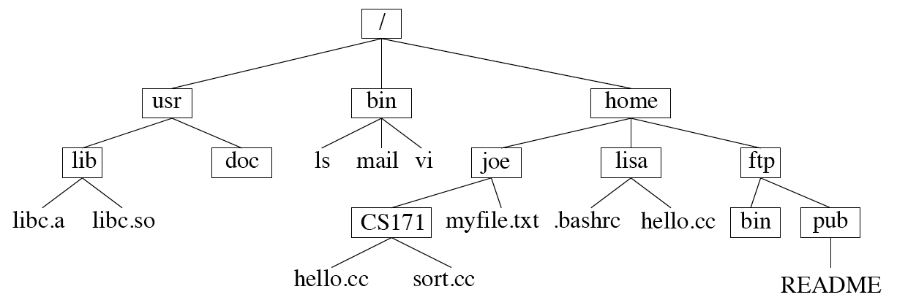
Before looking at more Unix commands, we will first look at the FILE STRUCTURE (how files [called documents on Mac and Windows] are stored/organized).
Unix uses a hierarchical file system (as does Mac and Windows/DOS).

Slide 70
Looks like an upside down tree.
Starts at top with “/”, called “root”.
Unix uses the “/” to separate directories (known as folders on Mac or Windows)
Top Level Directories
Levels of sub Directories
Notes:
They were on LSD when they designed this and got it upside down.

Slide 71
File names – the “separator is “/”.
root (first slash) then path and filename
/usr/lib/libc.a
Notes:
How to understand filenames – composed of two parts - where the file lives, and it’s name.

Slide 72
This is the full name from root (works from anywhere – i.e. any directory), if you were in the directory usr, you only need
lib/libc.a
(no leading slash)

Slide 73
And if you were in the directory lib, you only need
libc.a
(no leading slash)

Slide 74
The “/” (slash or forward slash) in Unix is roughly equivalent to the “\” (backslash) in Windows/DOS.
Notes:
Roughly equivalent since DOS does not use” “/ for root and in unix don’t have “disk:” where disk is A, B, C…

Slide 75
Some commands:
pwd – print working directory – tells us where we are in the directory tree.
smalleys-imac-2:usr smalley$ pwd<CR>
/usr
smalleys-imac-2:usr smalley$
Notes:
(notice logical, intuitively obvious, command name.

Slide 76
How to move between directories – going up and down the directory tree–
To go down to the directory doc we use the “change directory” = “cd” command
smalleys-imac-2:usr smalley$ cd doc<CR>
smalleys-imac-2:doc smalley$
Notes:
Again logical, intuitively obvious command name.

Slide 77
Now
smalleys-imac-2:usr smalley$ pwd<CR>
/usr/doc
smalleys-imac-2:doc smalley$

Slide 78
Some details of the prompt
you can control all this - the prompt has been programmed to tell us a bunch of stuff! (power of unix.)
Machine
Directory name (in this case without full path)
User name
Text string
smalleys-imac-2:usr smalley$
Notes:
(notice logical, intuitively obvious, command name.

Slide 79
Aside:
Unix sub philosophy –
Minimize typing (on teletype) – so use short (2, in extreme cases 3 character) command names constructed from description of the command.
e.g. “cd” for “change directory”
(Unix fans claim this is a “feature” of Unix, compared to other O/Ses)

Slide 80
We can also go up the directory structure.
To return to usr from doc.
doc$ cd ..<CR>
usr$

Slide 81
This is a little strange ---
The double dot (“..”) signifies the directory directly above you (up) in the directory structure (tree).

Slide 82
We can also go directly to anywhere in the directory structure using the full path.
To go to usr (from doc or anywhere, such as pub)
doc$ cd /usr<CR>
usr$

Slide 83
Notice that you have to know where you are in the tree and what subdirectories are contained there to navigate down.
Unix does not provide a display of the picture below. You need to have it in your head.

Slide 84
How do we go from doc to lib?
We could do this using the full path.
doc$ cd /usr/lib<CR>
lib$

Slide 85
How do we go from doc to lib?
But here’s an easier (?) way – we have to go up one level; then down one level. This can be done with the command.
doc$ cd ../lib<CR>
lib$
Notes:
Another thing to notice – Unix is full of trickiness like this.

Slide 86
Say we want to go to “pub”
lib$ cd ../../home/ftp/pub<CR>
We went up two, then down three.

Slide 87
Say we want to go to “pub”
We could also have done (and is simpler) this with the full path.
pub$ cd /home/ftp/pub<CR>

Slide 88
Go directly to “root” directory (“/”)
lib$ cd /<CR>
/$

Slide 89
Go from anywhere directly to your “home” directory (assume I’m “lisa”).
CS171$ cd ~<CR>
lisa$
uses tilde “~”
Notes:
tilda is a users “home” directory, don’t need to know the full path down to home directory.
Yours – just tilda, or if you need more, slash then whatever follows
Somebody else - ~name

Slide 90
Go from anywhere directly to someone else's home directory (assume I’m lisa)
lisa lisa$ cd ~joe<CR>
/home/joe lisa$
also uses tilde “~”
Notes:
Going back to a prompt showing working directory and user

Slide 91
The tilde character “~”
refers to your home directory when by itself,
or that of another user when used with their home directory name (the same as their user name).
(The shell expands the “~” into the appropriate character string for the full path - “/home/joe” or “/home/lisa”)

Slide 92
Review - specifying file names
full path
/usr/lib/libc.a
relative path
(if in directory lib) libc.a
(if in another directory next to it, e.g. doc
../lib/libc.a

Slide 93
Review - specifying file names
abbreviations
(if I am joe) ~/CS171/hello.cc
(if I am not joe) ~joe/CS171/hello.cc

Slide 94
You have to keep track of the file structure in your head
or have a way to find out what files are in the working directory.

