Slide 1

Nuevas aplicaciones geodésicas en la agrimensura moderna.
Universidad de Buenos Aires
Marzo-Mayo, 2018
Dr. Robert Smalley
Fulbright Scholar
Reunión 10 Mayo 31, 2018

Slide 2
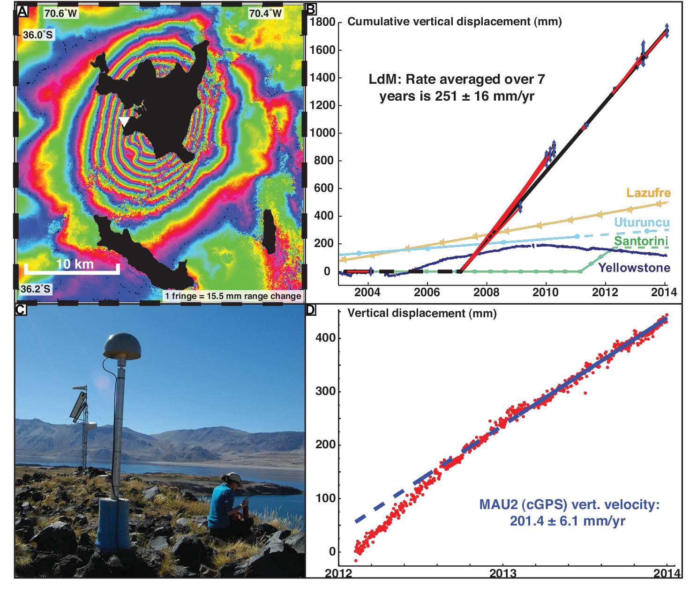
Otra fuente de deformaciones verticales (y horizontales)
Notes:
Volcanes
Inyección de magma en el volcán.
Y ahora una nueva técnica de agrimensura – INSAR.
InSAR interferogram entre 14 abr. 2013 hasta 25 ene. 2014. una “fringe” representa 15,5 mm de cambio de rango/distancia por la línea de vista entre el satélite y la tierra durante este tiempo
Serie de tiempo de desplazamientos verticales en varios volcanes calculado por modelos InSAR y GPS. Laguna de Maule es mucho mas rápido, y empezó de básicamente cero entere 2003 y 2007.
Vista hacia el este de la estación continua MAU2.
Series de tiempo entre 2012 y 2014 de desplazamiento vertical de MAU2 con respecto a America del Sur y el mejor ajuste.
Velocidad promedio de 20 cm/año.
Nota las discontinuidades lineales en los “fringes” – esas son fallas que han tenido movimiento/desplazamientos entre los dos pasos del satélite.

Slide 3
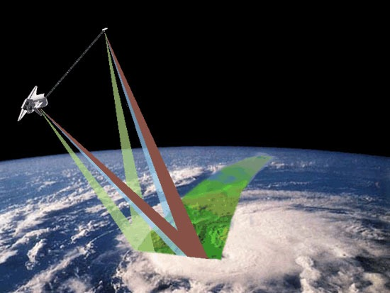
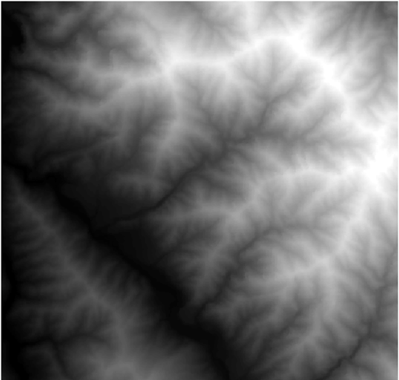
Técnicas de mediciones satelital.
Parte I – determinación de elevación por radar.

Slide 4
¿Que mide el radar?
Nos da dos tipos de información.
Cambios de tiempo de vuelo entre la fuente y el blanco.
Información del superficie que dispersa las ondas de radio.
Notes:
Nos da dos tipos de información.
Cambios de tiempo de vuelo entre la fuente y el blanco.
Esa es la información primaria y mas fácil medir/cuantificar y interpretar.
Información del superficie que dispersa las ondas de radio
-- la energía que vuelve al satélite no es por reflexión, es dispersión
por la fuerza, intensidad, cambios de fase, polarización, etc.
Esa información es secundaria y mucho mas difícil medir y interpretar .

Slide 5
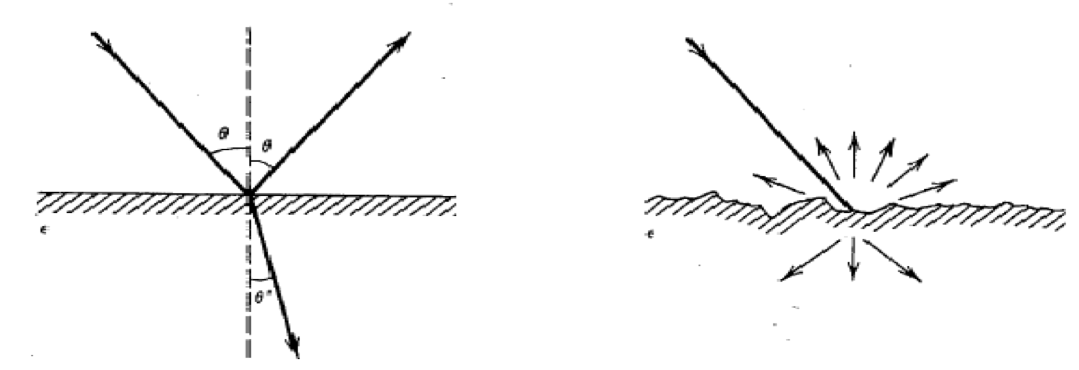
¿cómo funciona las mediciones?
Reflexión vs dispersión
Superficie lisa genera reflexión especular.
Por lo general no vuelve al satélite.
Superficie accidentada.
Energía desparramado.

Slide 6
La señal que vuelve depende en:
La pendiente del superficie
La aspereza del superficie
El constante dieléctrica del superficie.

Slide 7
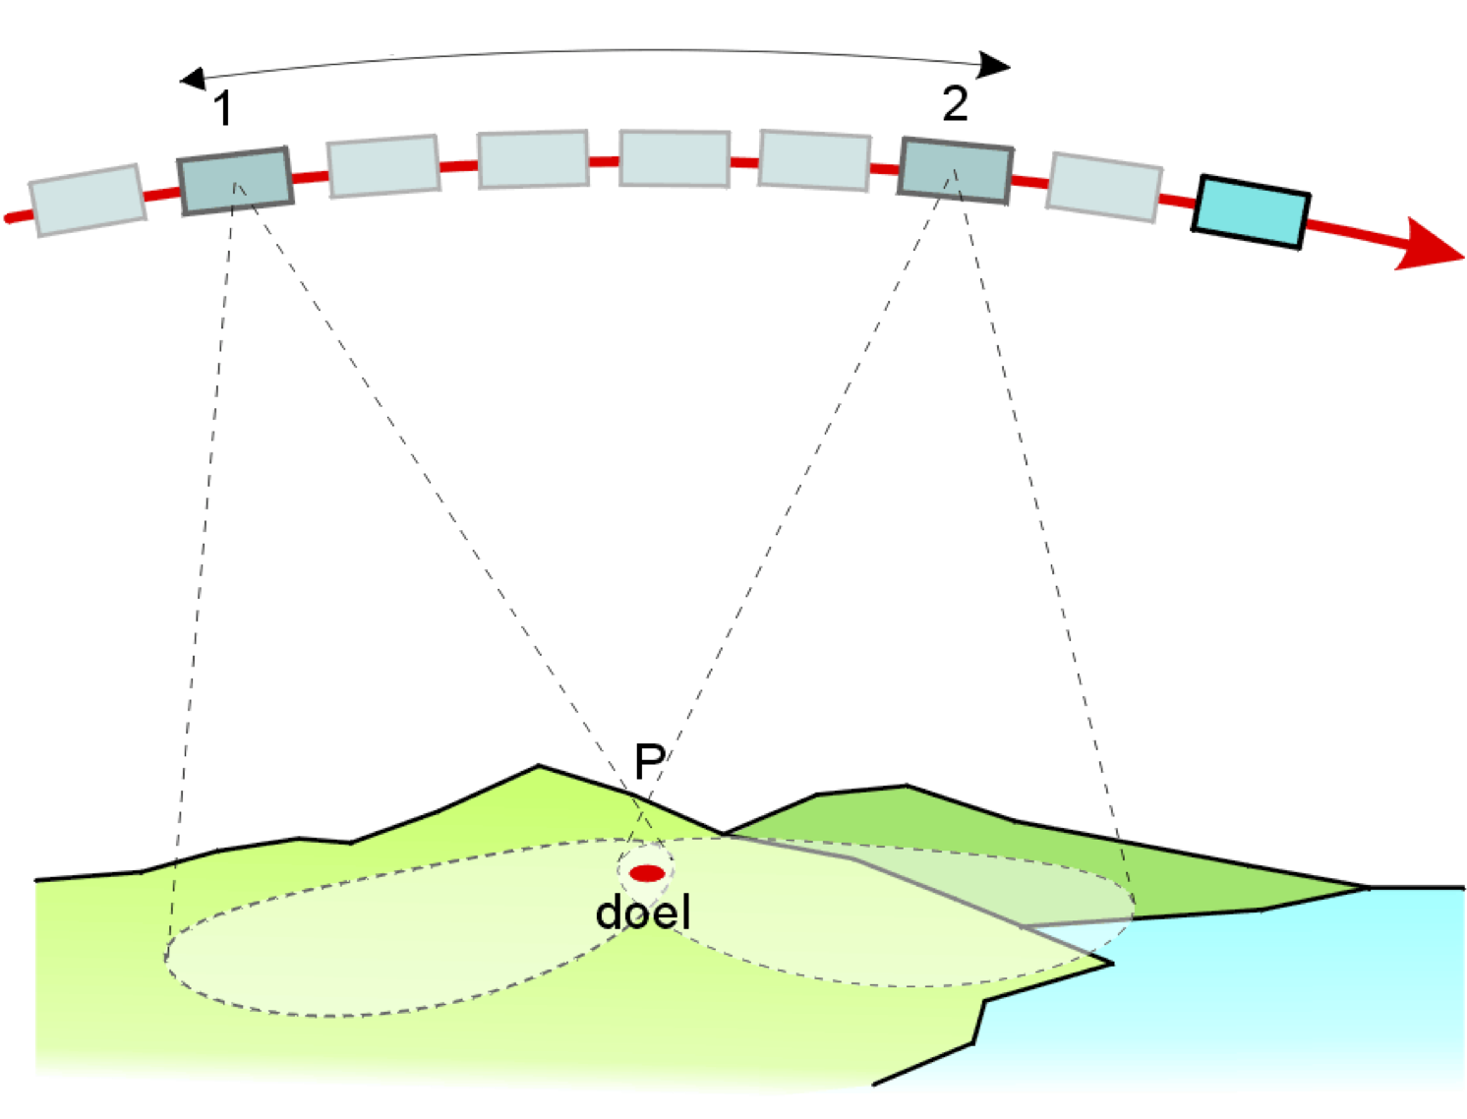
Mejoramiento de la resolución de seguimiento por apertura sintética
Apertura sintética
Apertura física/real
celda de resolución

Slide 8
Apertura real versus apertura sintética
Apertura real :
resolucion ~ Rλ/L
apertura sintética:
resolucion ~ L/2
Irrespective of R
Smaller, better?!
- Carl Wiley (1951)
Notes:
R – rango
L – proyección de la antenna perpendicular de la dirección de vista

Slide 9
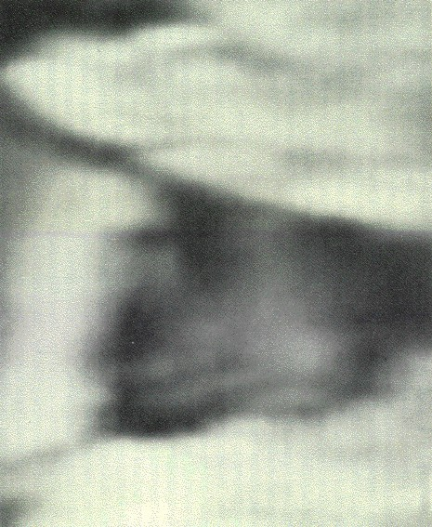
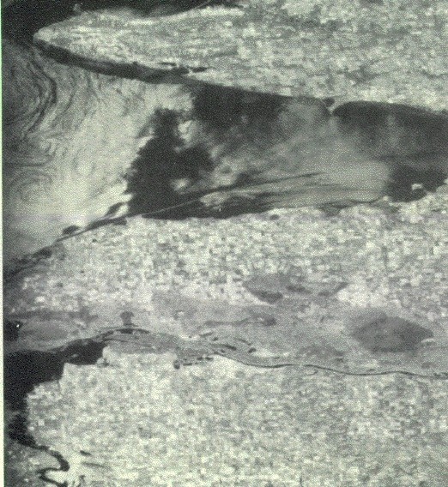
Mejoramiento de resolución, Crimea Ucrania
apertura real apertura sintética
5x14 km pixels
4x20 m pixels
Massonnet and Feigl, 1998

Slide 10
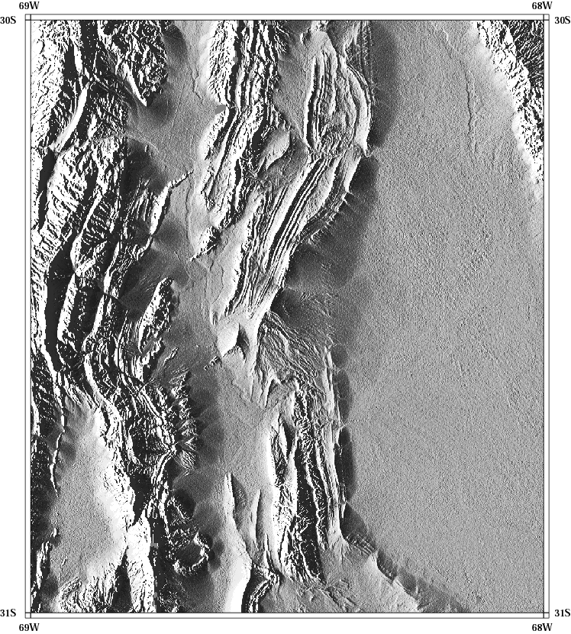
Modelos de elevación digital.
SRTM (3 seg)
Misión del transbordador espacial de topografía por radar
Notes:
Con un solo paso del sistema de SAR (no interferometria) se puede sacar un modelo de elevaciones digitales.
El transbordador de los EEUU voló una misión especial con un radar para obtener datos de todo el mundo entre 60°N y 54°S de latitud para hacer un modelo de elevaciones digitales de la tierra (no funciona sobre el agua).
Los datos fueron procesados y publicados abiertos en 2 resoluciones (30 segundos y 3 segundos – 90 m) inicialmente y recientemente en su máximo resolución de 1 segundo (30 m).
120, 1200 y 3600 puntos por grado.

Slide 11
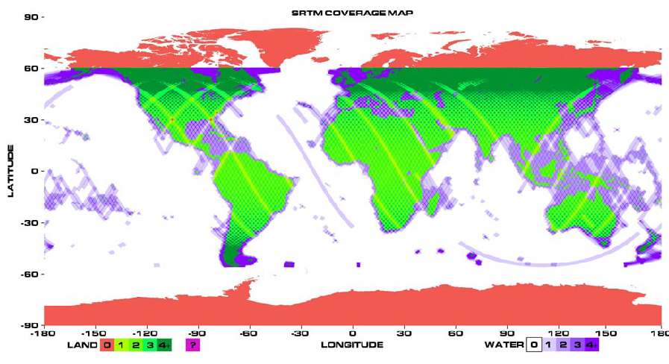
SRTM coverage map
To download from here http://seamless.usgs.gov/
Hongjie

Slide 12
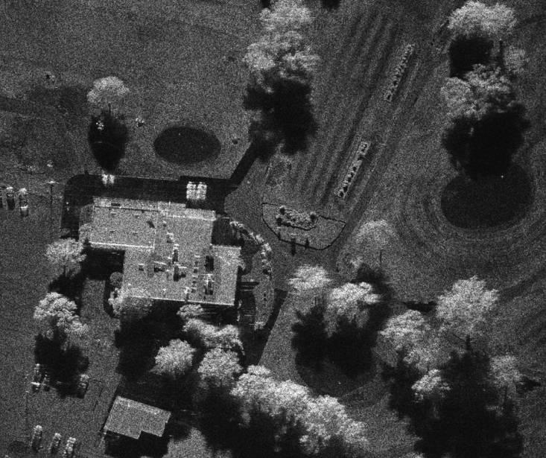
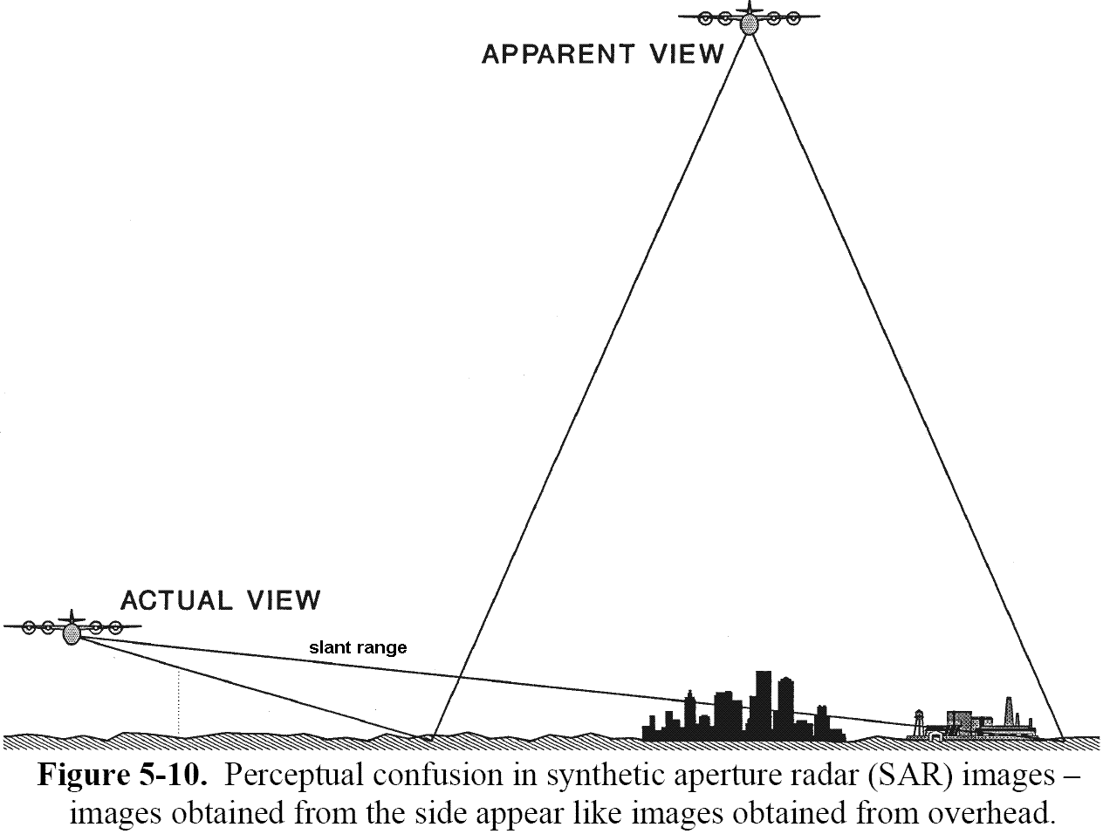
Confusión perpetua de la interpretación de las imagenes SAR

Slide 13
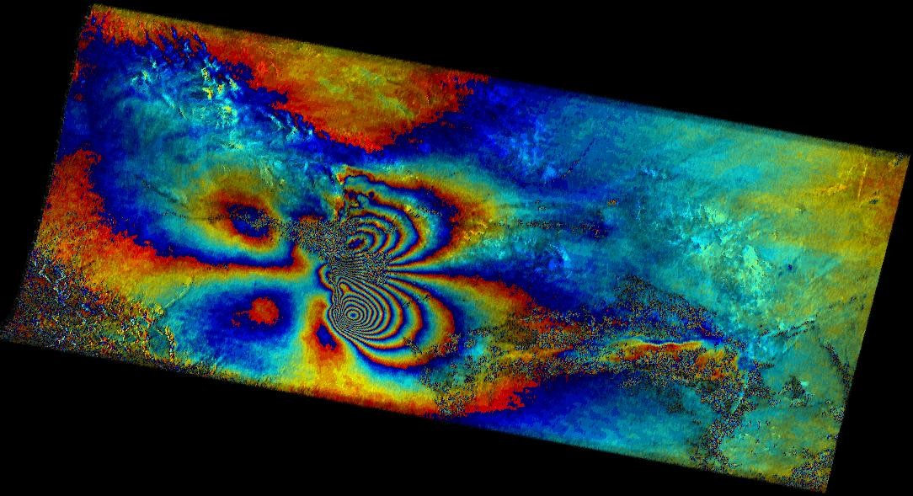
Con múltiples pasos podemos hacer Interferometría.
Notes:
Lindo imagen1

Slide 14
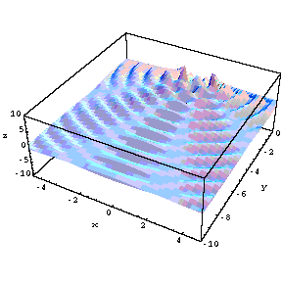
¿Que es Interferometría?
Notes:
La Interferometría es el efecto de la interacción de ondas.
Si los ondas son ondas de viaje el padrón de interferencia es dinámica.

Slide 15
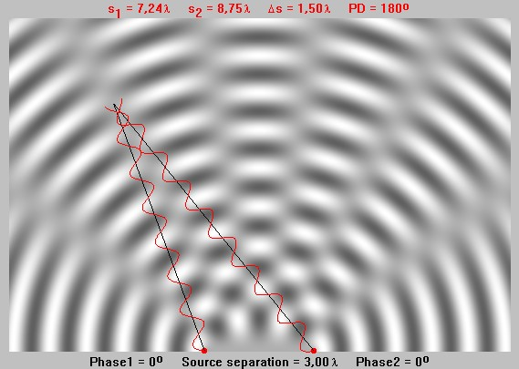
¿qué es Interferometría?
Notes:
Suma total constructiva y destructiva.

Slide 16
¿qué es Interferometría?
|D1-D2|=(2n+1)λ/2
Notes:
En el punto donde las dos líneas negras intersectan (7.25 y 8.75 largos de onda de sus fuentes) una de las ondas es -1, y la otra es +1 – suma total destructiva a 0.
Por toda la linea azul, las diferencias desde sus fuentes son (2n+1)λ/2 en distancia o (2n+1)pi en fase y cancelan.

Slide 17
¿qué es Interferometría?
|D1-D2|=nλ
Notes:
Por toda la linea azul, las diferencias desde sus fuentes son nλ en distancia o 2npi en fase y cancelan.
Nota que no importa la distancia absoluta – solo la diferencia modulo 2pi.
Si mides la diferencia en fase solamente hay una ambigüedad de 2pi entre la medición y la diferencia “actual”.
Eso pasa con el GPS, VLBI, etc. – todas la técnicas de interferencia de ondas.
Nota que – podemos sacar el campo de las ondas de la fuente de la izquierda en un momento, y el campo de las ondas de la fuente de la derecha en otro momento (mientras que los fuentes tienen al misma fase – relativa a 2pi).

Slide 18
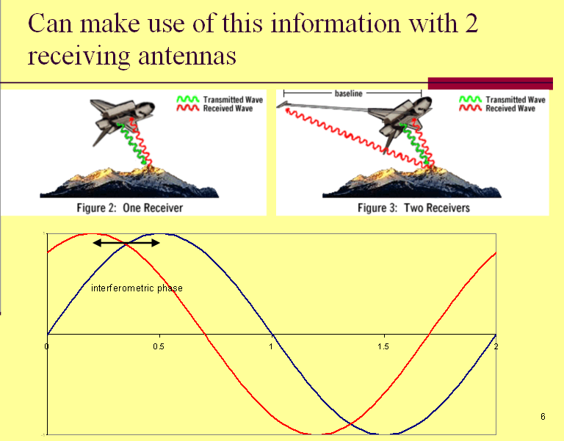
Diferencia en fase llamado “fase Interferometríca” – es determinado por restando la fase medido en cada fin de cada línea de base. Es la diferencia en distancia desde la antena al mismo

Slide 19
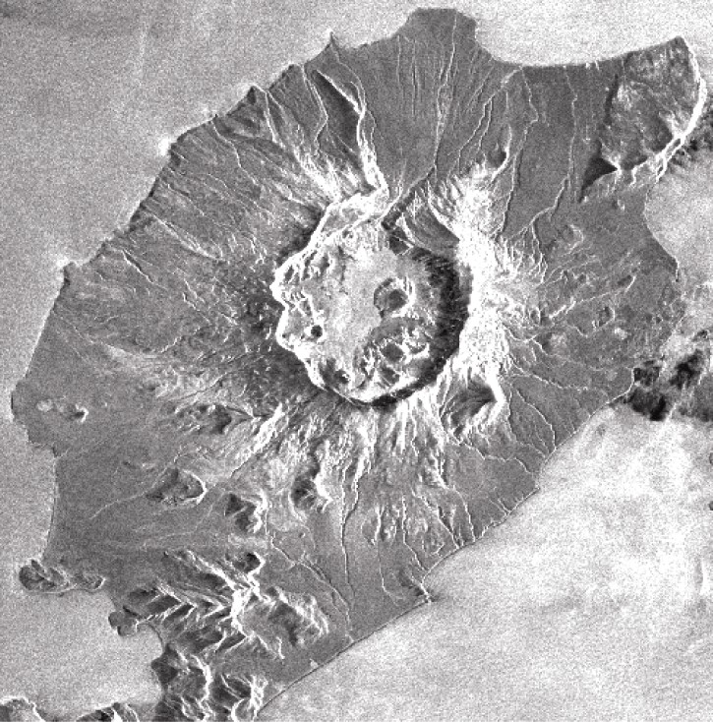
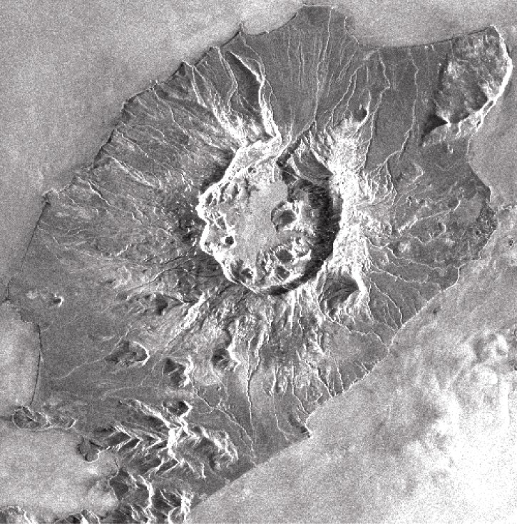
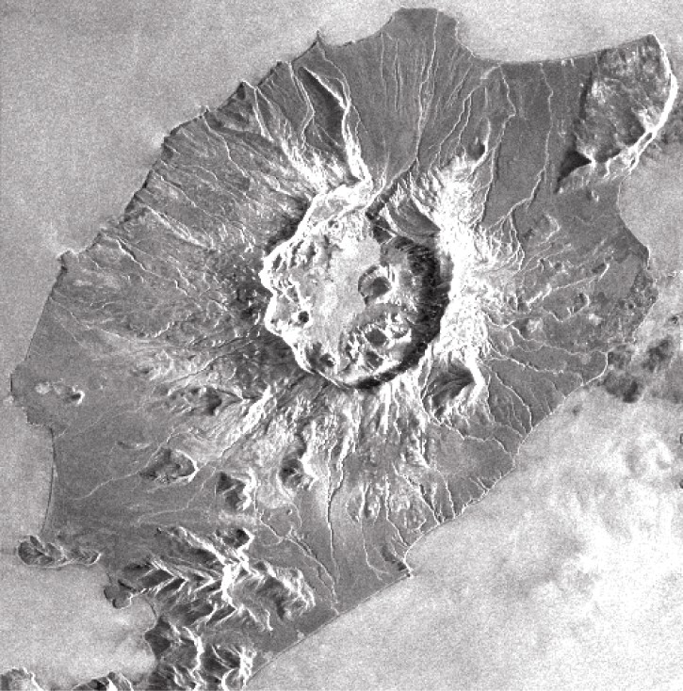


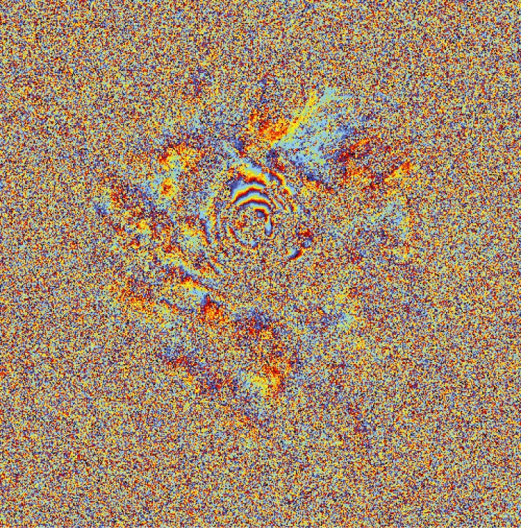
Interferometría de radar de apertura sintética (InSAR).
Amplitud 1
Amplitud 2
Amplitud promedio
fase 1
fase 2
fase interferometríca
Notes:
Entonces podemos sacar dos imágenes mas (necesita la primera para darnos el modelo de elevaciones digitales) con un lapso de tiempo entre los imágenes.
Si algo ha cambiado – una deformación en el superficie – vertical o horizontal – por ejemplo entre la colección de los nuevos imágenes, podemos ver este cambio en la fase del señal (que es proporcional al cambio de distancia en la línea de vista).

Slide 20
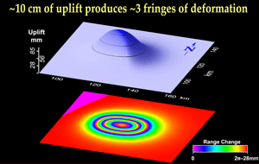
Usan colores para mostrar los cambios de fase en un interferograma. Los colores mapa en el cambio de altura.
Frangas– cada franja significa desplazamiento de un λ.

Slide 21
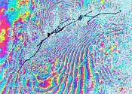
El primeo0 interferograma tectónica del sismo de Landers, California, en 1992.

Slide 22
InSAR puede resolver deformaciones superficiales de la tierra con precisión centmétrica, con una resolución espacial de decenas de metros, y resolución temporal de mensual por satélite.
Tiene cobertura (casi) global, día y noche, por todo tipo de tiempo.

Slide 23
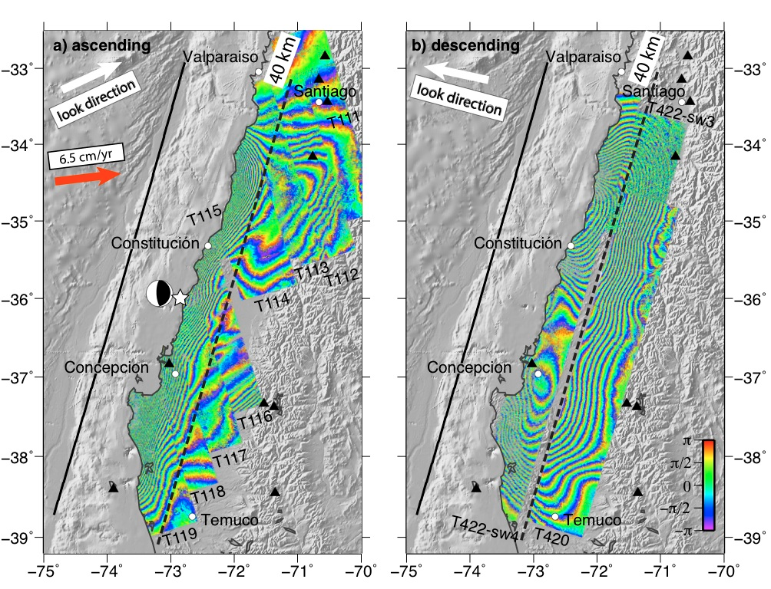
Técnicas de mediciones satelital - InSAR – interferometría.
Parte II – Deformaciones.
Notes:
Deformaciones en la dirección de la vista.
Muy precisa (mm, cada ciclo de color [“fringes” en ingles] representa ~2.5 cm de desplazamiento)
Necesita ciertas condiciones, que no siempre existen, para funcionar

Slide 24
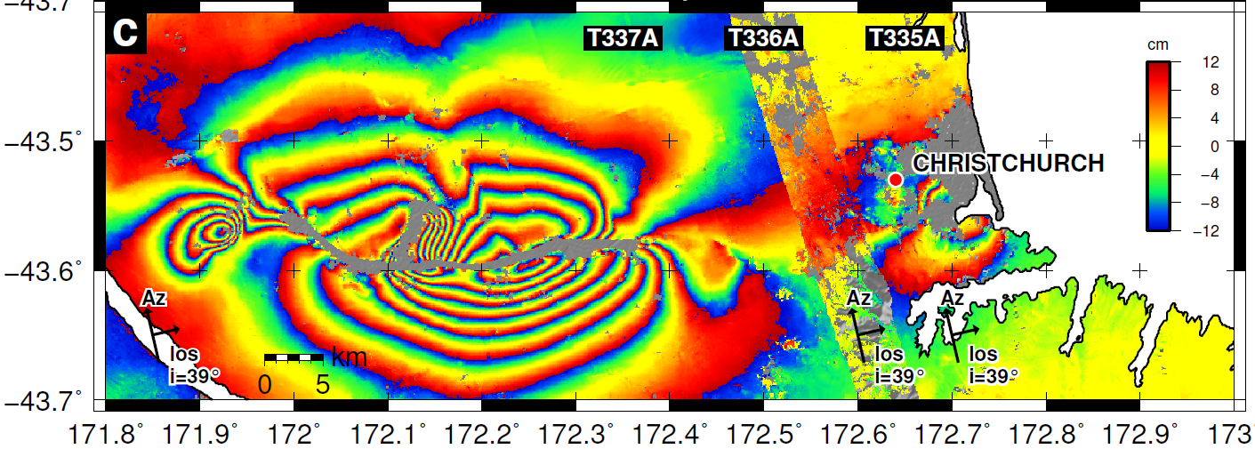
Q. Time dependent Hazard?
New Zealand Earthquakes 2010-11
3 September 2010: Darfield, M7.1
21 February 2011: Christchurch, M6.3

Slide 25
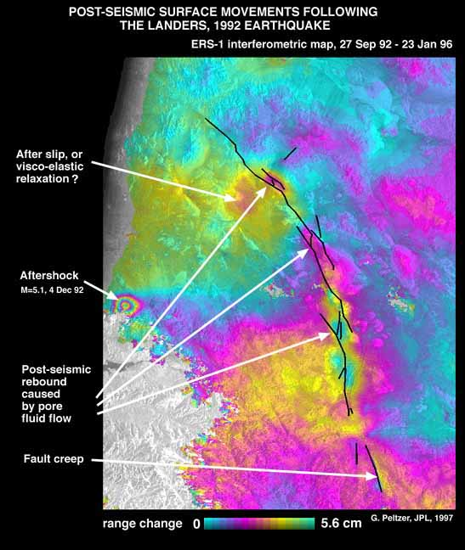
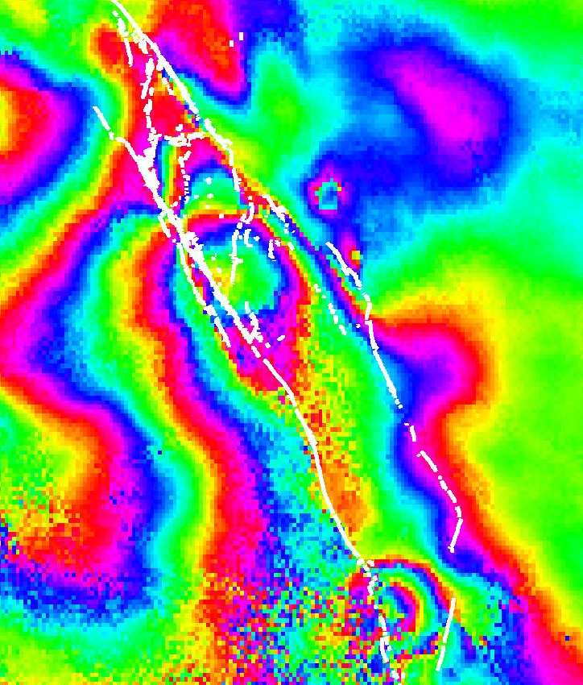
Postseismic - 1992 Landers
Up by 4 cm
Peltzer et al., 1998
Notes:
Releasing stepovers (pull aparts) rebound, afterslip or v-e relaxation, aftershock, creep.

Slide 26
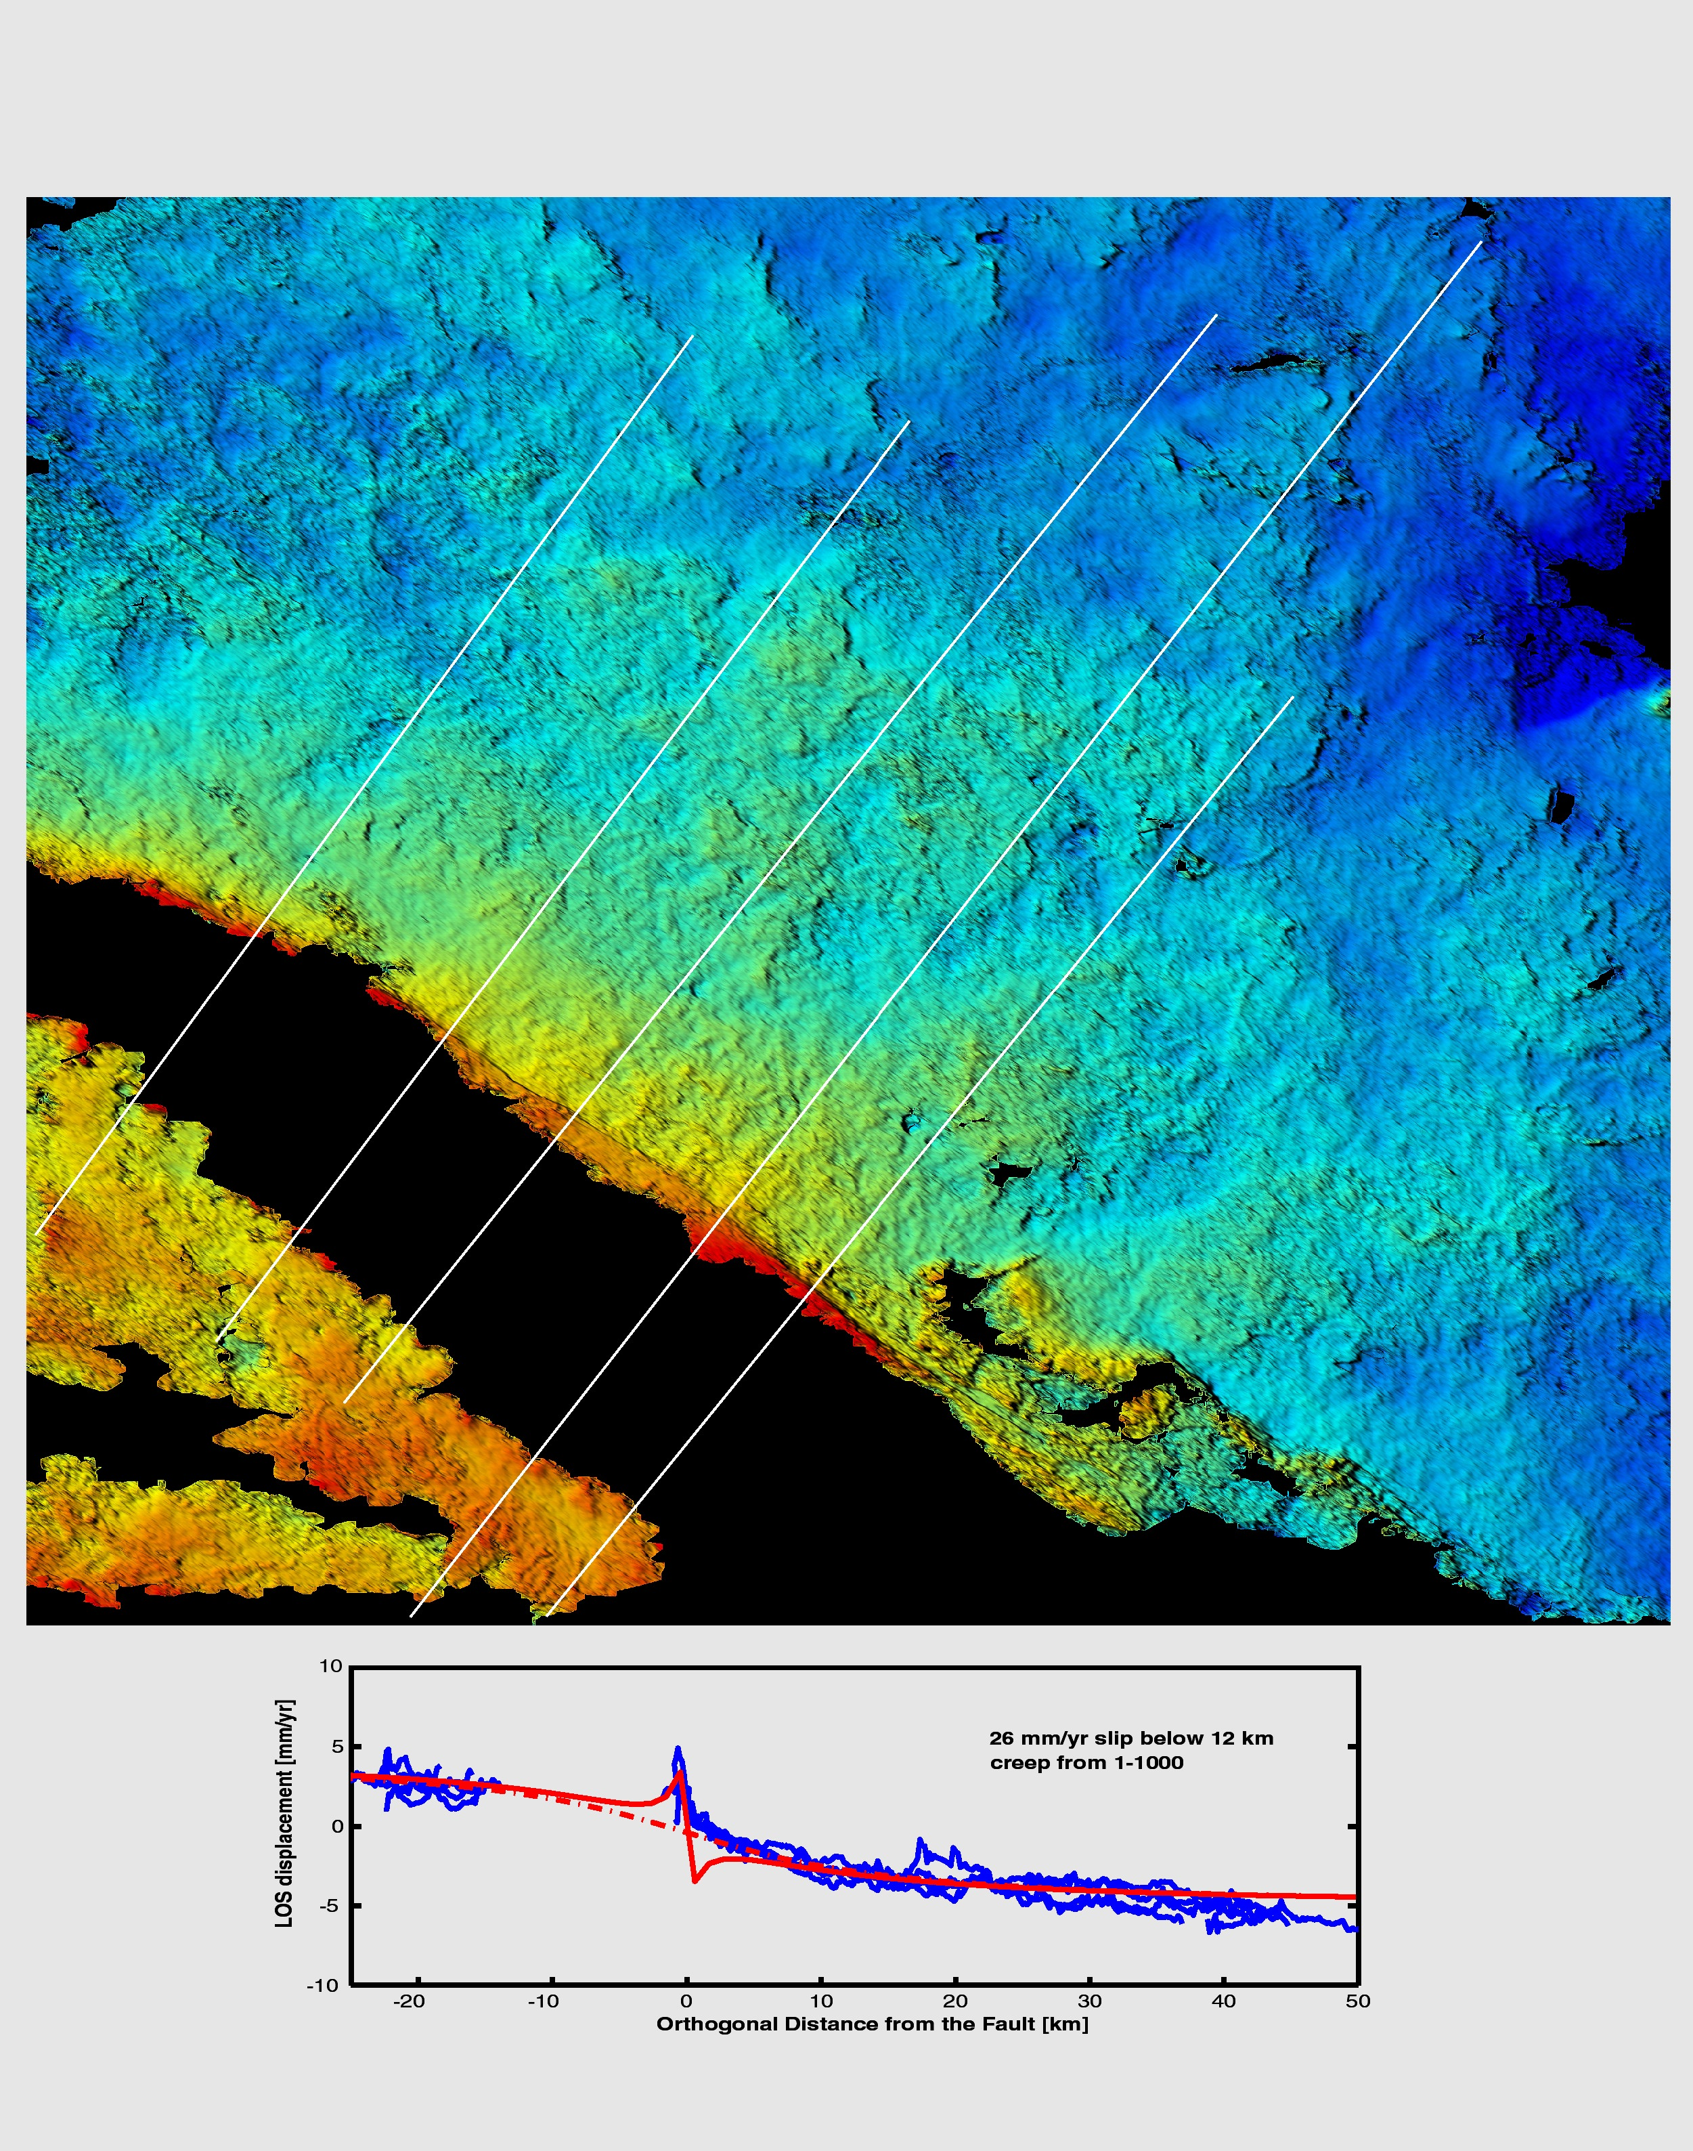
Interseismic - Southern SAF
(Lyons, S. and Sandwell, JGR, 2003)

Slide 27
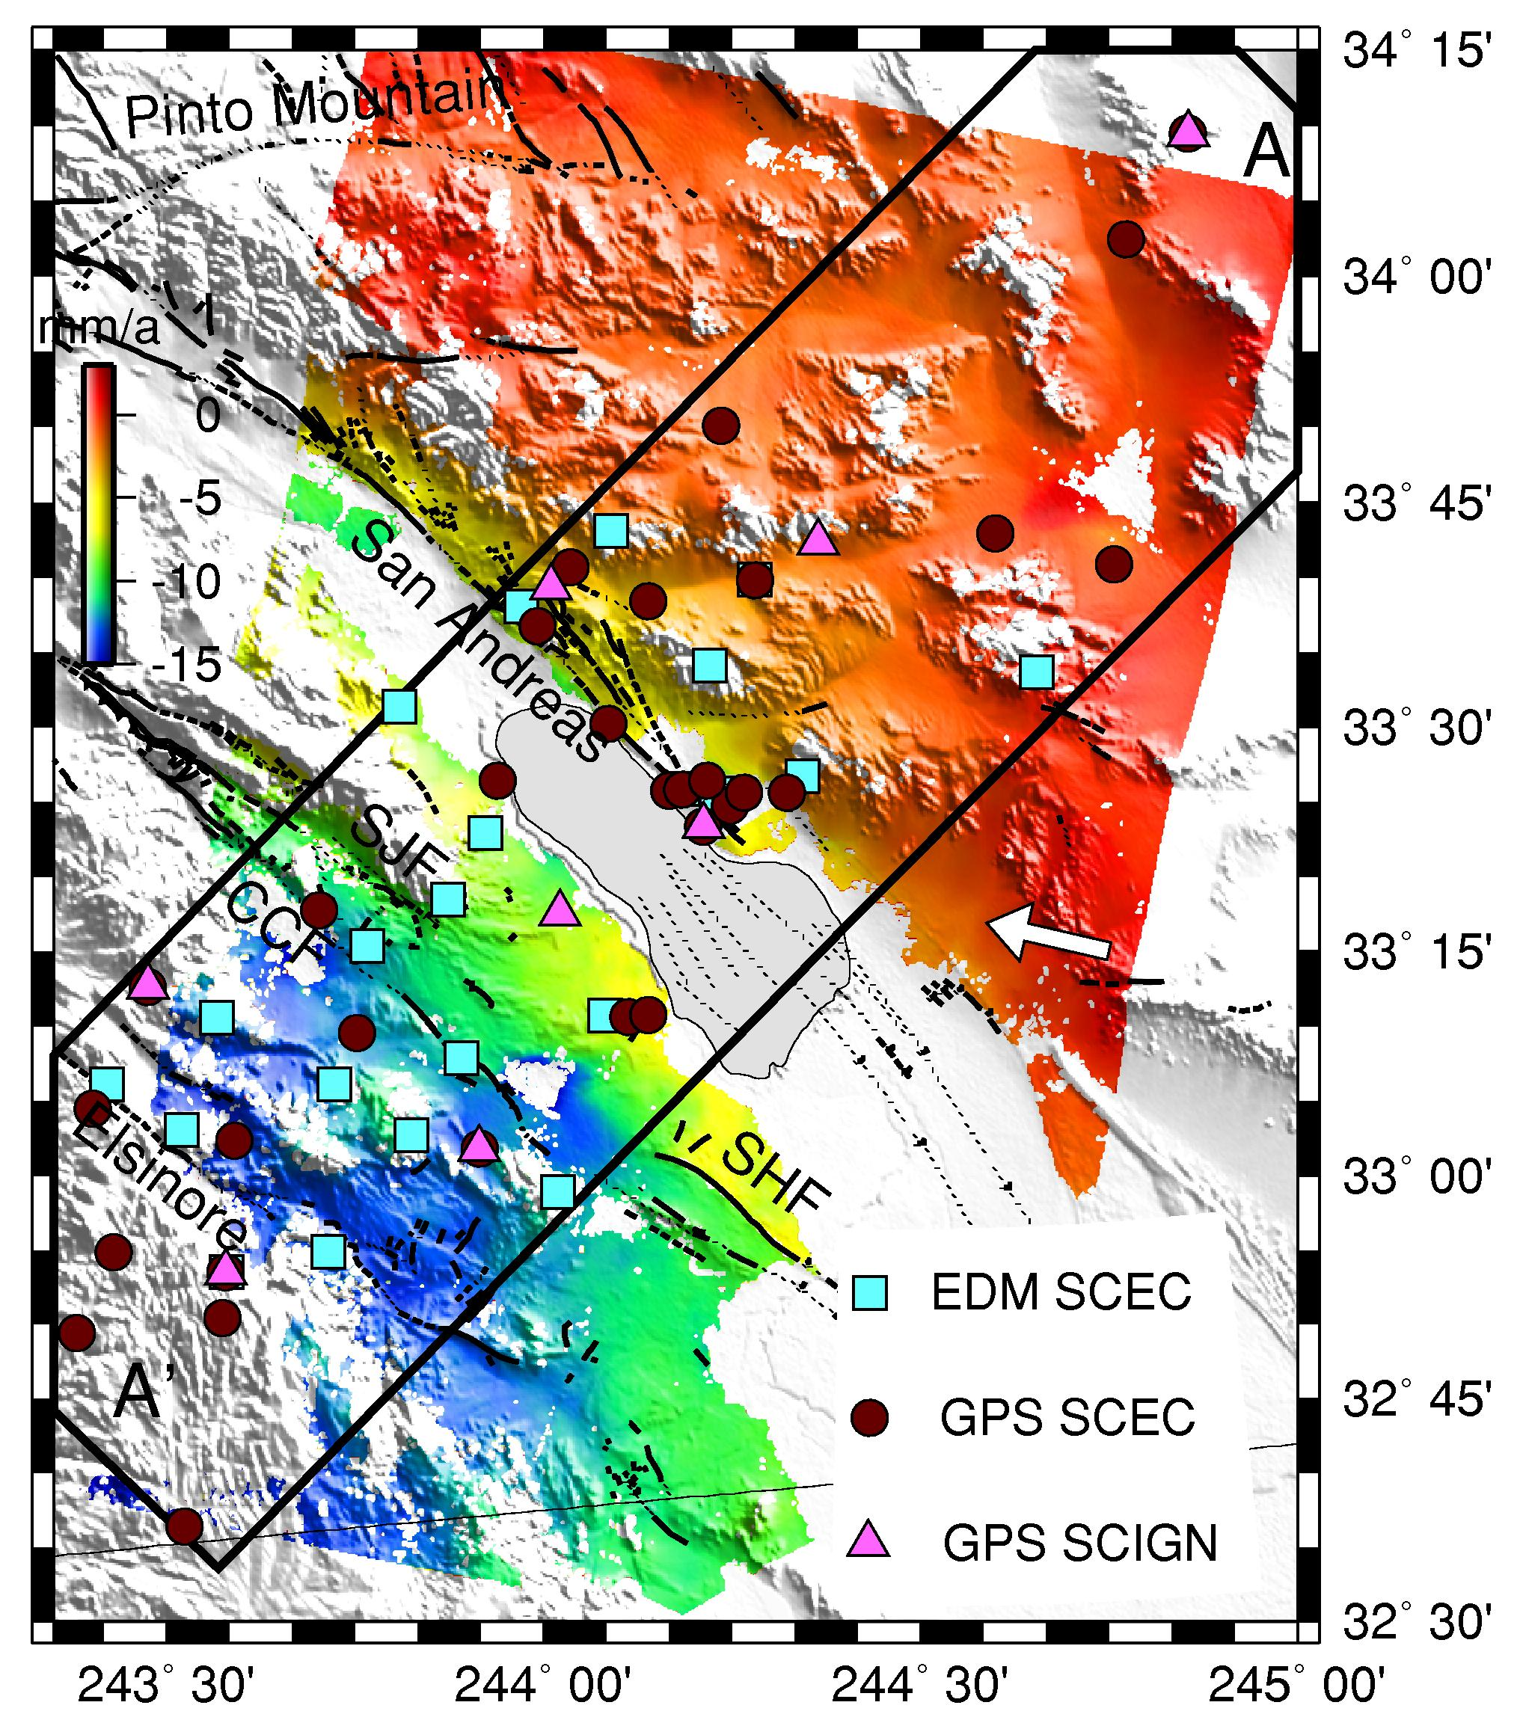
Line of sight
velocities from
stacked InSAR
data
35 interferograms
Epoch: 1992-2000
Fialko, Nature 2006

Slide 28
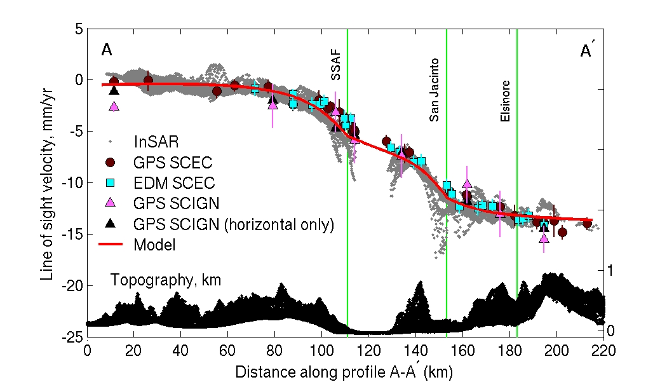
Fialko, Nature 2006

Slide 29
Actividad magmática:
Detección y interpretación
Locación y geometría de embalses de magma
Dinámica de la fuente de magma
Fenómenos precursores – intrusiones
Erupciones

Slide 30
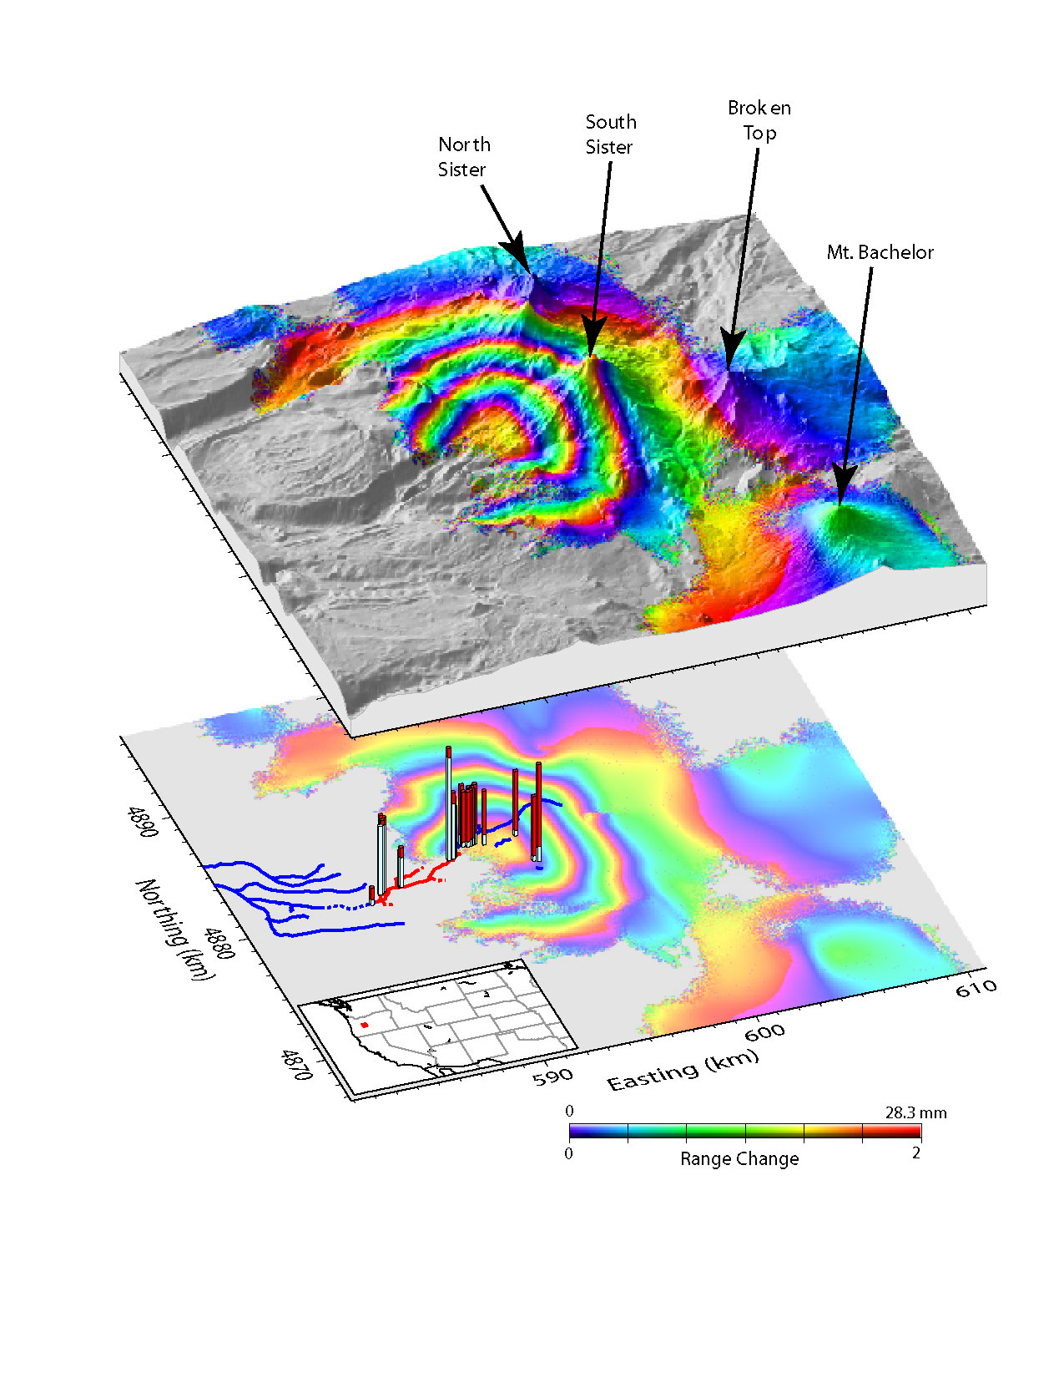
Inflación Volcánica
Tres Hermanas
Cascadas

Slide 31
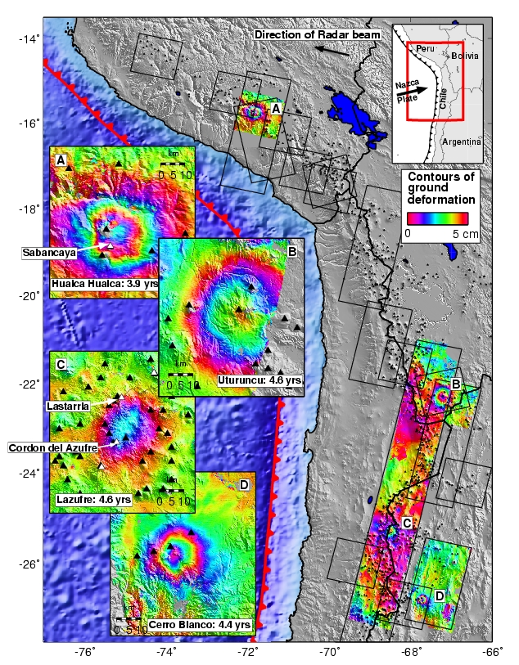
Inflación Volcánica
en los Andes
Matt Pritchard
Notes:
Es muy dinamico esto actividad – la deformación en el Volcan de Maule no ha emezado cuando hicieron este estudio.

Slide 32
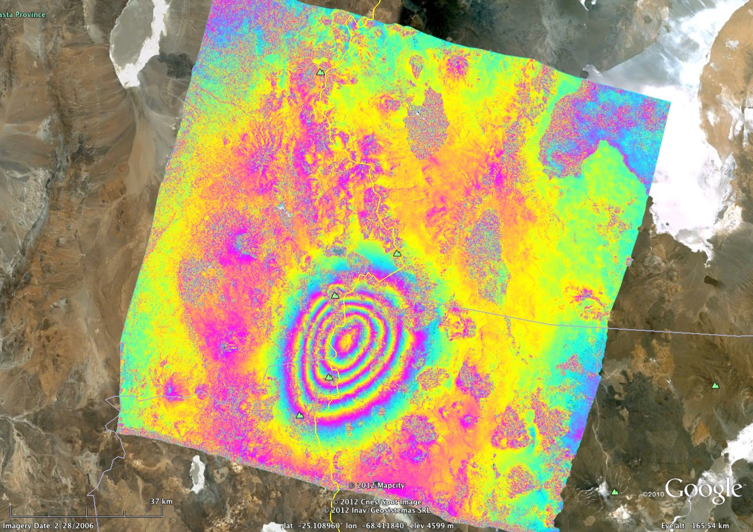
Notes:
Lastarria

Slide 33
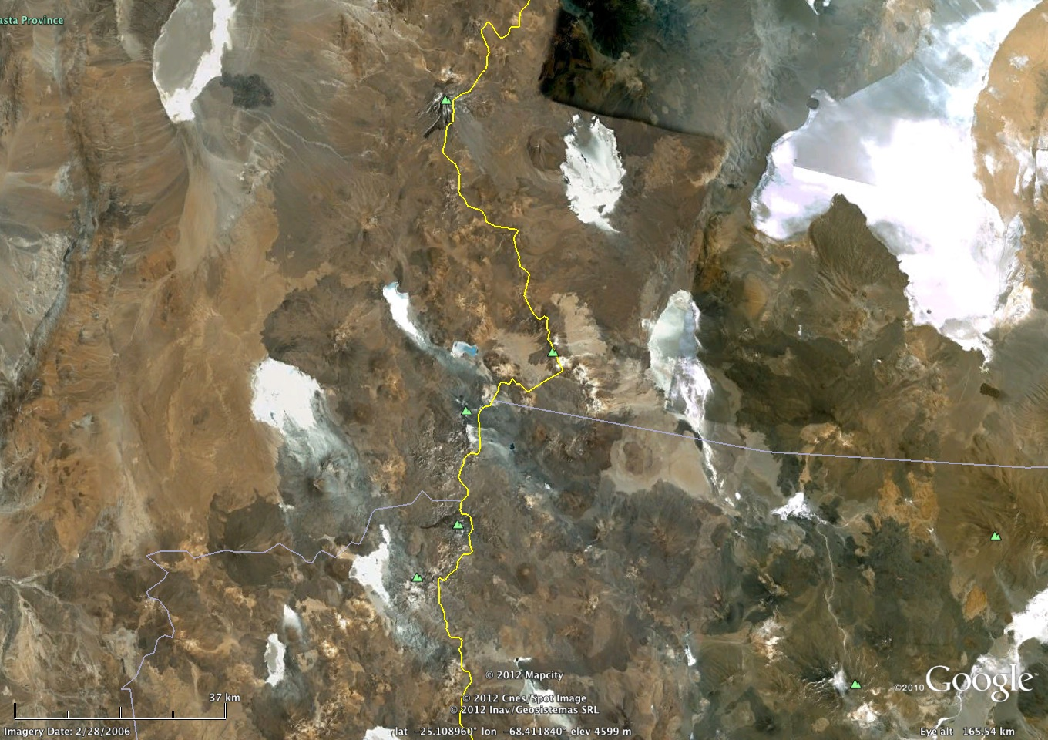
Notes:
Lastarria

Slide 34
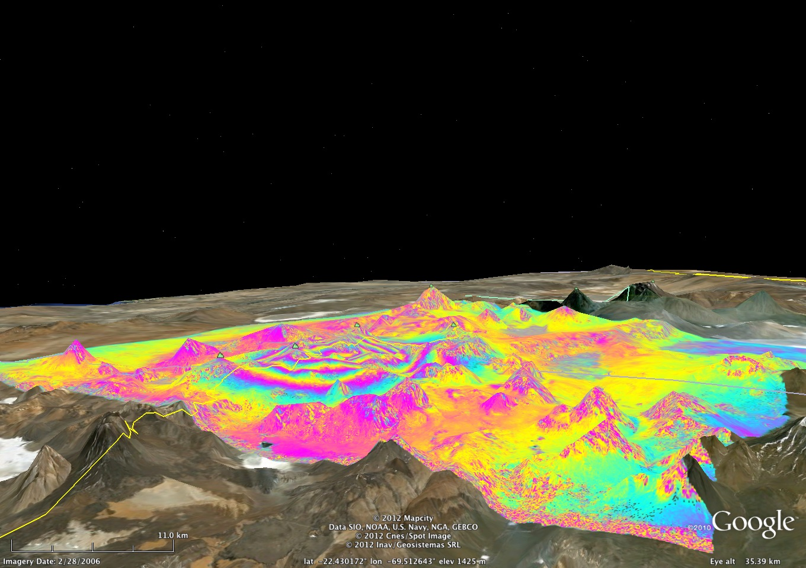
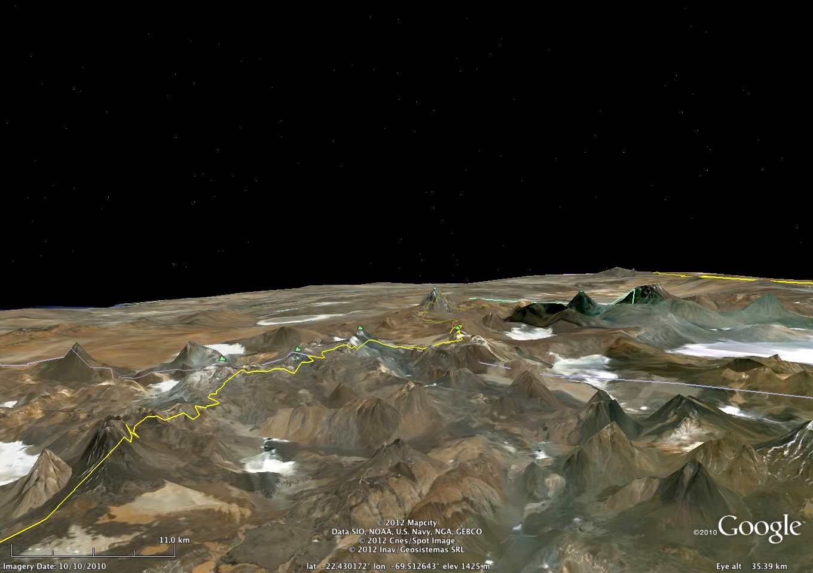
Matt Pritchard - unpublished
Notes:
Lastarria – uplift not associated with single volcano/mountain

Slide 35
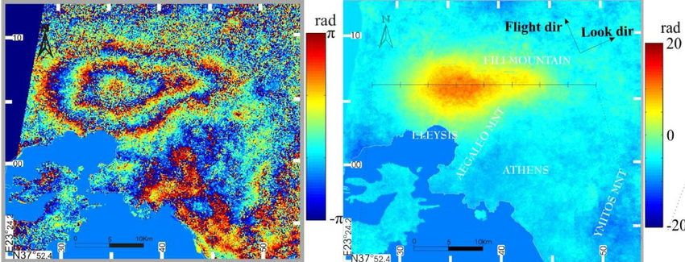
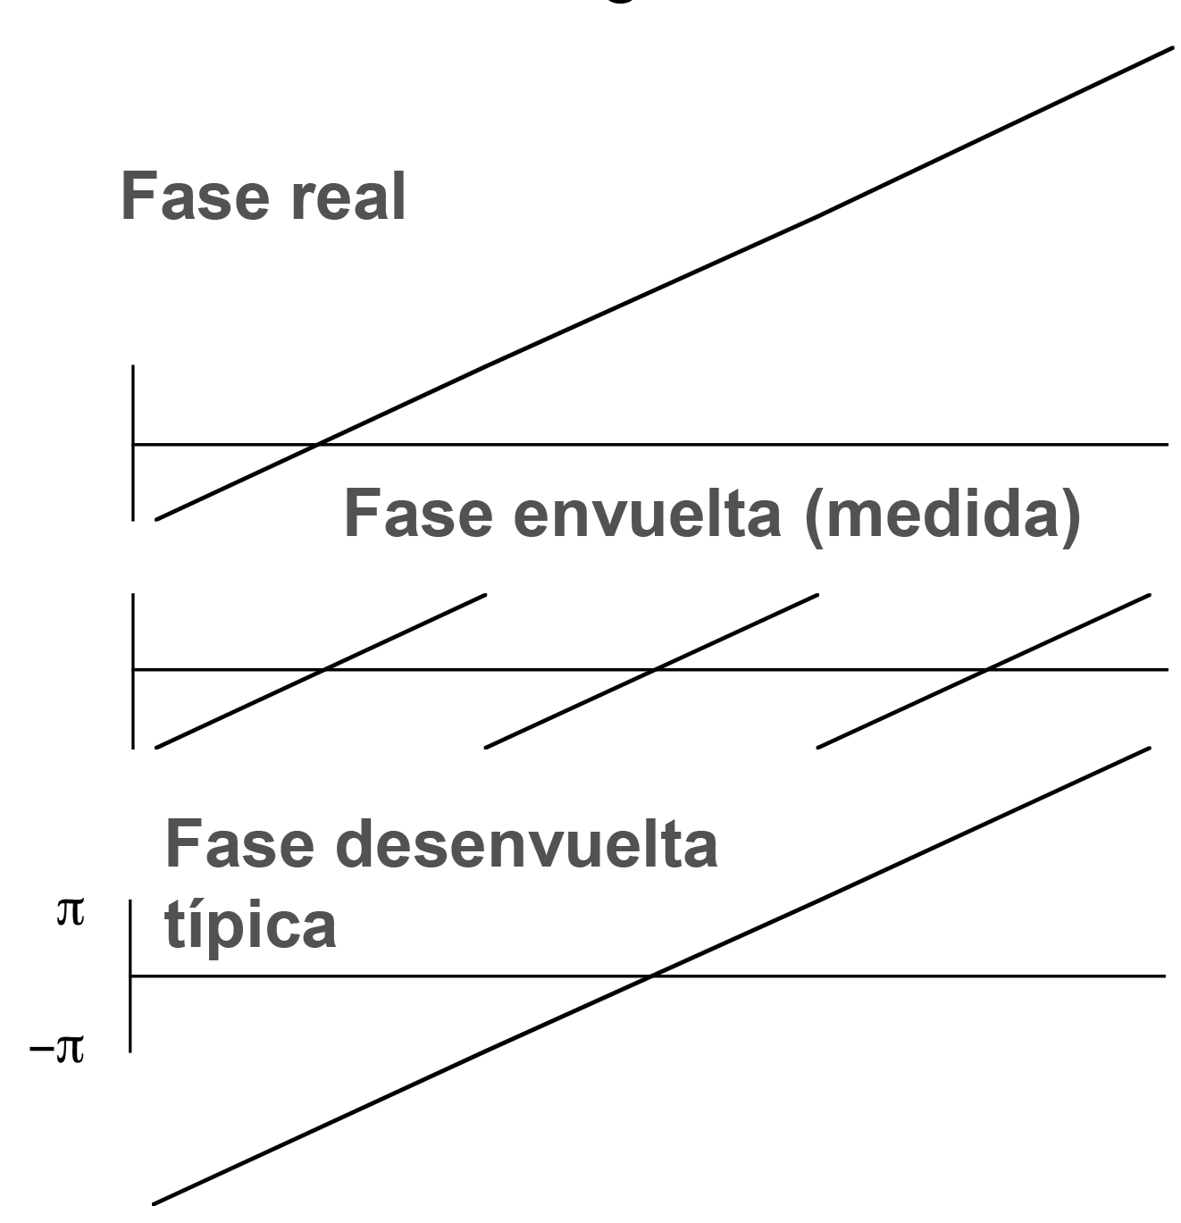
Fase envuelta fase desenvuelva
La fase desenvuelva tiene ±2π adicional por ciclo o ±λ en distancia.
Notes:
Desenvuelva es la integración del fase envuelta.

Slide 36
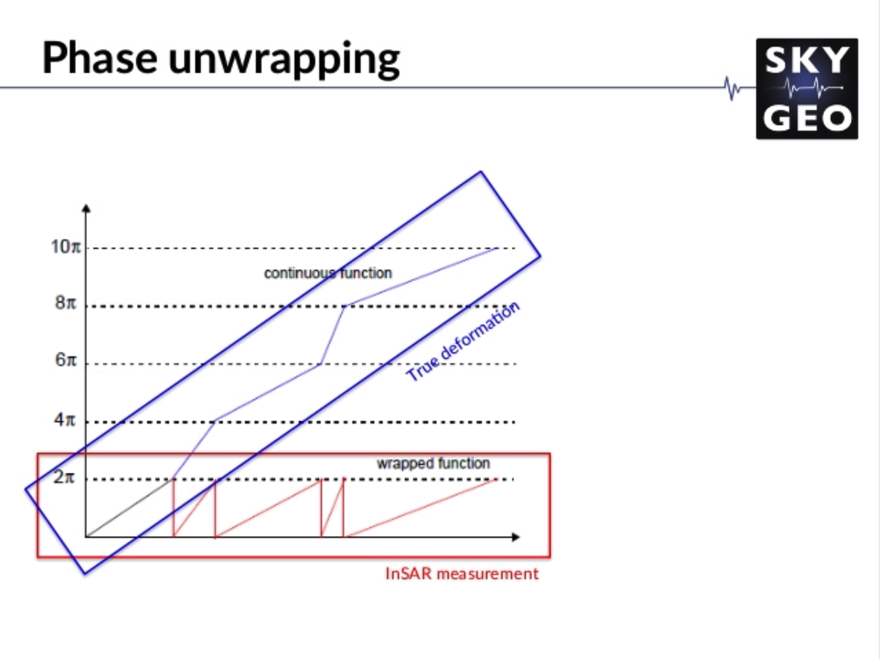
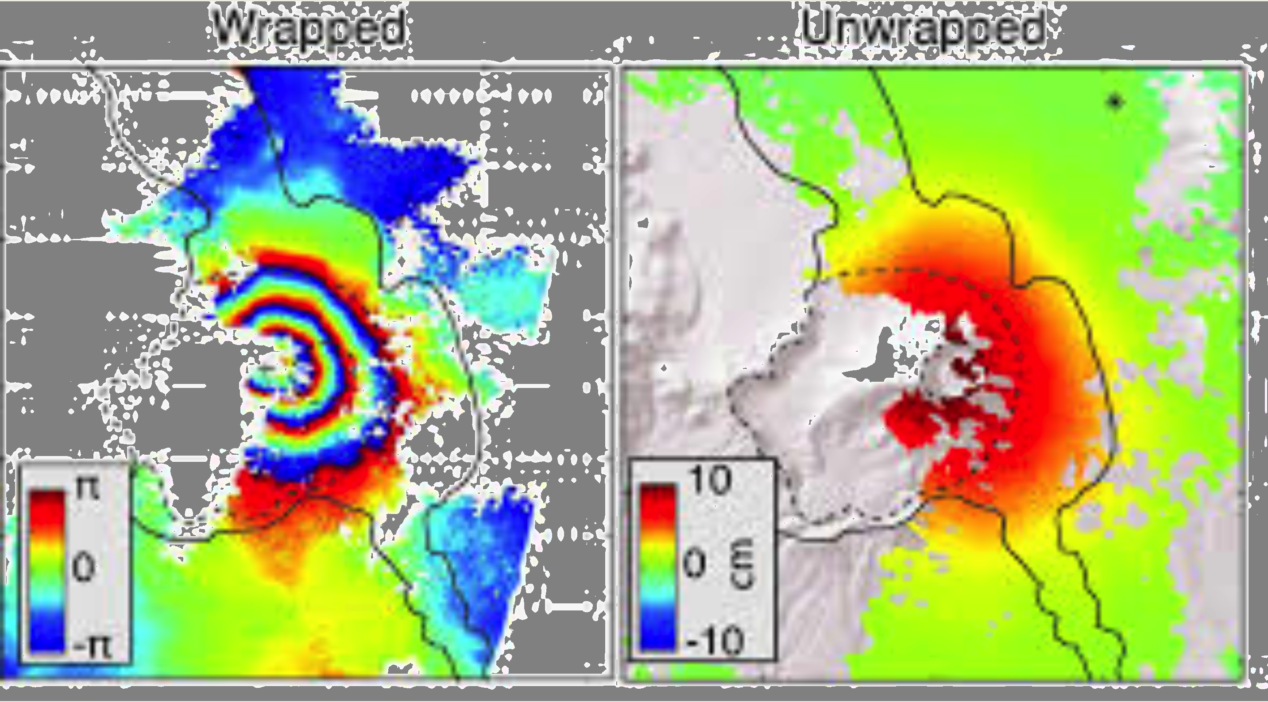
Notes:
Desenvuelva es la integración del fase envuelta.

Slide 37
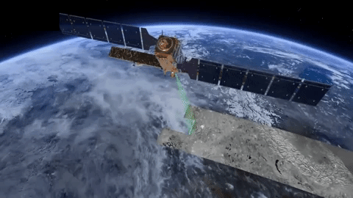
Notes:
sentinel

Slide 38
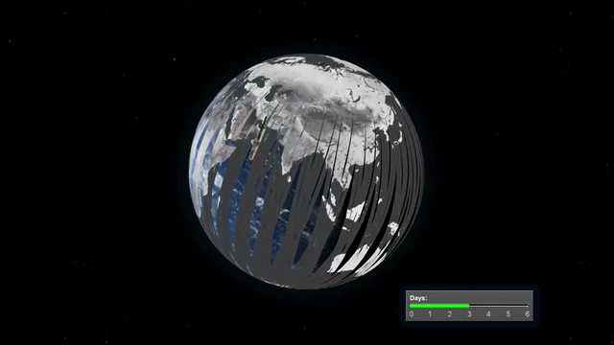
Notes:
sentinel

Slide 39
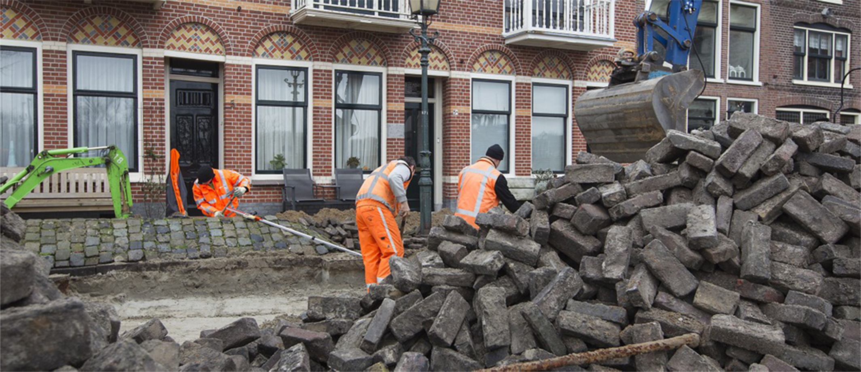
City of Diemen saves € 200.000 annually
on maintenance with Subsidence Map.
City of Diemen: infrastructure maintenance using satellite imagery
Notes:
Problem not unique to Diemen – whole of Holland and especially Amsterdam.

Slide 40
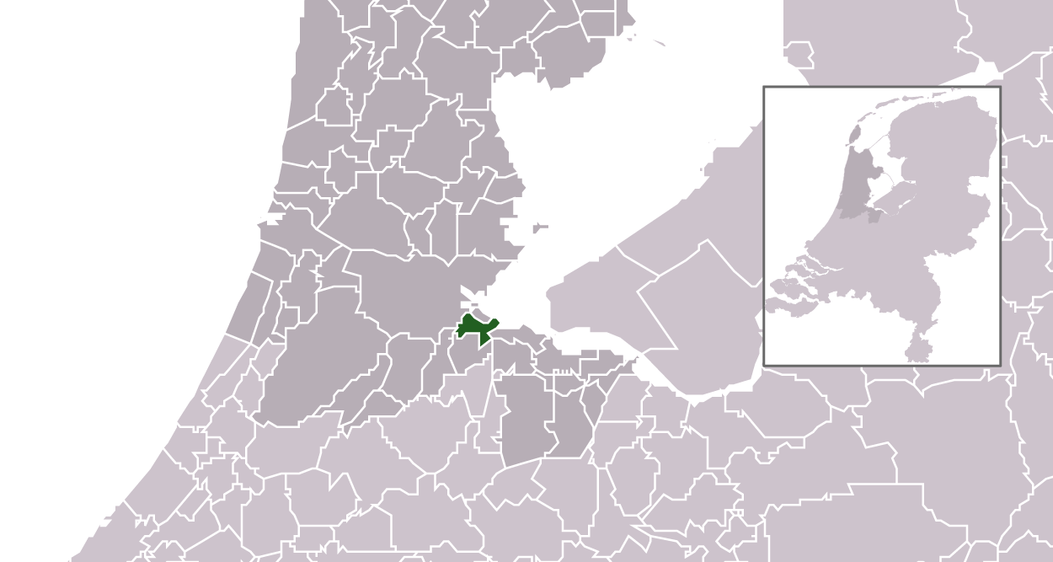
Diemen is a town and municipality with a population of 27,734 in the province of North Holland, Netherlands.
Notes:
By Michiel1972 (talk) 22:31, 24 January 2009 (UTC) - own work , using CBS data, CC BY-SA 3.0, https://commons.wikimedia.org/w/index.php?curid=5783732

Slide 41
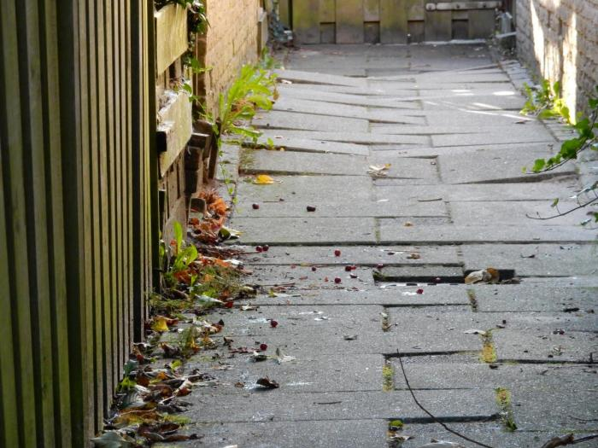

Slide 42
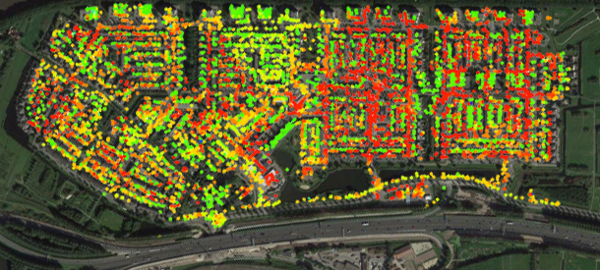
Notes:
Subsidence Map of Diemen. Subsidence varies drastically from street to street.

Slide 43
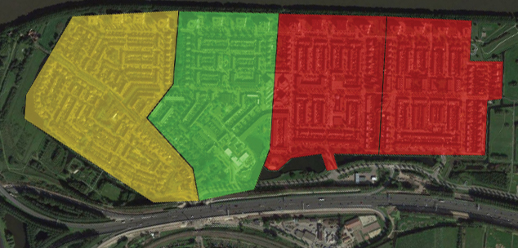
Notes:
Aggregation of subsidence data from picture above. The 20 percentile points are converted to a map with an indication of the mean time before failure in years.

Slide 44
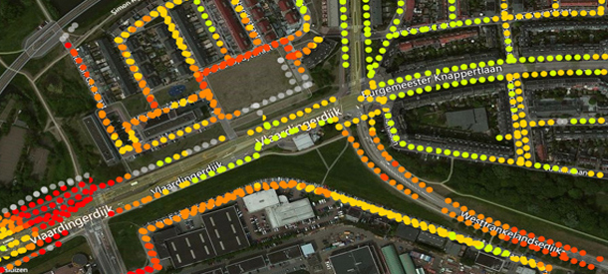
Notes:
Differential settlements in a sewage system by projection of subsidence data on the pipelines.

Slide 45
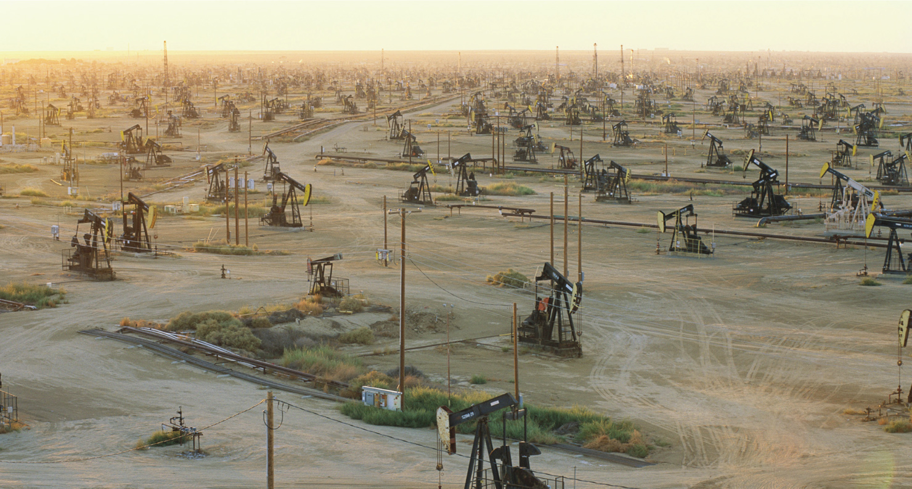
InSAR Monitoring for Oil & Gas
Detect and understand subsidence with high accuracy and regular updates.

Slide 46
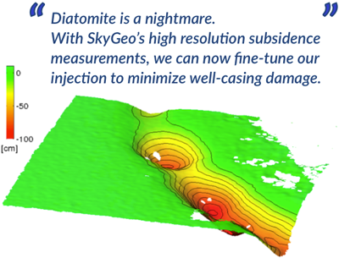
Notes:
Enhanced recovery
The tightly spaced Belridge diatomite in California has historically seen high subsidence rates up to 30 cm / year. Our customer has optimized waterflooding strategy in this field. Injection in the high-porosity, low-permeability diatomite has notoriously unpredictable and dynamic effects. Our product provides continuous updates on subsidence and uplift with millimeter precision over the entire field. Insights in regional and local under-, or overshooting gets converted into continuous adjustments in injection flow rates with high granularity. The payback of this approach has been immediate in the form of reduced incidence of well-casing damage in the field.

Slide 47
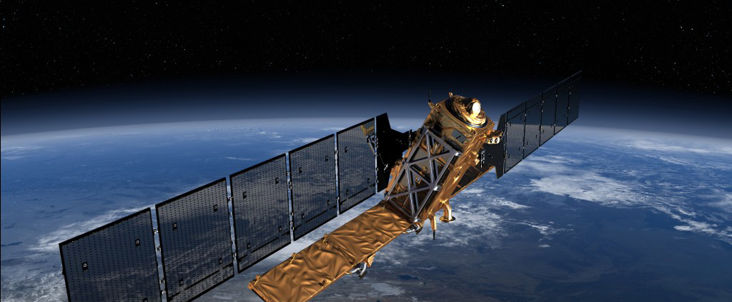
MEASURE AND MONITOR SURFACE MOVEMENTS WITH HIGH ACCURACY AND REGULAR UPDATES.
Notes:
Sentinel 1

Slide 48
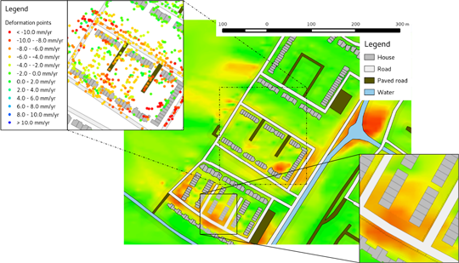

Slide 49

Subsidence due to ground water withdrawal. (presentation has extreme vertical exaggeration)
I think this is from Amelung

Slide 50

Notes:
Figure 7. (A) Multicolor interferogram and (B) 1993 Landsat image, with subsidence bowls and areas with recurring localized displacement, Las Vegas Valley, Nevada. Figure 1 shows the extent of these images. The interferogram corresponds to number 3 in table 1.

Slide 51


Notes:
Silicon Valley Subsides. An 8-month interferogram (Jan.–Aug. 1997) shows seasonal subsidence of about 30 mm near San Jose and corresponds to about a 10-m decline in water levels.
InSAR Finds New Fault Strand
The B–B' cross section (right) shows a steep subsidence gradient in an area where there are no mapped faults, revealing a previously
unrecognized structure or fault that also acts as a ground-water flow barrier. Mapping faults and geologic structures in an aquifer system is crucial for understanding ground-water flow, regional subsidence patterns, and potential seismic hazards.

Slide 52
What is LIDAR?
LIght Detection And Ranging
Una tecnología de teledetección óptico capaz de medir la distancia (tiempo de vuelo), u otra propiedad (estudios de las propia des del señal que vuelve), de un blanco por iluminación con luz, típicamente por pulsos de laser.

Slide 53
Sistemas de LIDAR systems
Como se recoge datos lidar –
Basado en la tierra
Basado en el aire
Basado en el espacio
Notes:
After Ben Kravitz

Slide 54

Escaneo láser aéreo
ALS/LiDAR es un tecnología de teledetección activa que mide distancia por el tiempo de vuelo de luz de un laser.
Notes:
1st developed in 1960 by Hughes Aircraft inc.
Modern computers and DGPS make it practical.
Typically used in very accurate mapping of topography.
New technologies and applications are currently being developed.

Slide 55

Terresterial/Tripod Laser Scanner
(TLS)

Slide 56
Why is LIDAR better than photogrammetry?
(It’s the trees)
Suppose timber allows 1 of 3 arbitrary rays to reach ground; 1/3 of ground can be surveyed by LIDAR
Photogrammetry requires 2 separate views of a point; only 1/9 of ground will be locatable

Slide 57

DEM sombreado

Slide 58
Precisión general
Posición (X,Y,Z) de cada “vuelta” 1-46 cm horizontal y 6-30 cm vertical
Superficie de tierra (superficie de la tierra desnuda)
  Que es el superficie de tierra (pasto, roca, ojas)?
Alturas de arboles
  Típicamente subestima las alturas de los árboles por 0.5 to 2 m y el error depende en el especies.
Notes:
Accuracy depends on pulse rate, flying height, GPS configuration, location of ground stations, and position of the scanner with respect to nadir
Laser footprint on ground ≤ 0.50 meters
Typical density is 0.5 to 20+ pulses/m²
2 to3 returns/pulse in forest areas
Surface/canopy models typically 1 to 5m grid
Large volume of data
5,000 to 60,000+ pulses/hectare
10 to100+ thousands of returns/hectare
0.4 to 5.4+ MB/hectare
Intensity and Multiple returns
Most units today have the ability to measure multiple returns and the intensity of the returned signal for each.
This enables specialized applications using the LIDAR data.

Slide 59
Multiple LIDAR Returns
Notes:
Mark E. Meade, PE, PLS, CP
Photo Science, Inc.

Slide 60

Análisis de forma de onda de LIDAR
Grafico de la intensidad de la energía en la forma de onda.
Sigue la distribución de biomasa en el árbol.

Slide 61


Slide 62

Datos discretos de devolución:
Milliones de puntos X,Y,Z (se llama un nube de puntos)
Area is approximately: 1 X 0.75mi. includes ~ 440,000 returns
Notes:
Aaron Smith
Forest Resources Remote Sensing and GIS Lab
University of Idaho
For intensity – millions of intensity "time series"

Slide 63

Desde nubes de puntos a modelos de superficies en 3-D.
Notes:
Points are used to create 3D surface models for applications.
Triangular Irregular Networks (TIN)s are used to classify the points and to develop Digital Elevation Models (DEM)s.
Points must be classified before use: “bare earth” points hit the “ground”; other point categories include tree canopy and buildings.
Correct identification of “bare earth” is critical for any lidar mapping application.

Slide 64
Modelo de tierra desnuda
"Bare Earth" model
Edición significativa debe ser empleada para crear un modelo de tierra desnuda.
Tiene que sacar edificios, otras etructuras antropológicas (pila de troncos en un aserradero por ej.)
Mucha imaginación.
Notes:
Mark E. Meade, PE, PLS, CP
Photo Science, Inc.

Slide 65

Notes:
Crudo – arboles, autos, puentes, edificios, etc.

Slide 66

Notes:
Teirra desnuda

Slide 67

Notes:
imagen

Slide 68

Notes:
Tierra desnuda

Slide 69


USGS DEM (SRTM 1 sec?) vs LiDAR DEM
Notes:
Lidar puede producir mas precisión que SRTM. (es común pixeles de 1 m).

Slide 70

Wallace Creek, Carrizo Plain
Notes:
the B4 LiDAR image (0.25 m topo grid)

Slide 71

Geology
Mapping Faults (Puget Sound LiDAR Consortium)

Slide 72

Otros Aplicaciones
Medir cambio de volumen de minas de cielo abierto.

Slide 73

Encontrando fallas
30 km
Notes:
In some places, it is easy to see where the active faults are.

Slide 74

15 km west of Seattle
Toe Jam Hill
fault scarp
Waterman Point
scarp
beach uplifted
during 900 AD
earthquake

Slide 75

landslides
southern Bainbridge Island

Slide 76


Slide 77

Notes:
High-resolution topographic map of the Oso landslide and surrounding terrain. An older large slide similar to the Oso event is seen immediately to the right of the 2014 landslide. Credit: Joseph Wartman with data provided by the Puget Sound LIDAR Consortium, CC BY-ND
Read more at: https://phys.org/news/2016-03-weve-deadly-oso-washington-landslide.html#jCp
There are several types of landslides, but most dangerous are flows, which occur when saturated ground transforms into a liquid-like state and inundates downslope areas within minutes. Flow landslides, such as the one at Oso, become disasters when they quickly spill into communities, leaving people virtually no time to escape.
Landslides occur worldwide, including in every U.S. state – the U.S. Geological Survey estimates that, on average, landslides kill 25 to 50 people across the country each year.
The global toll is much worse. During the seven-year period ending in 2010, landslides killed over 32,000 people worldwide, mostly in densely populated mountainous areas with intense rainfall, such as in Asia and Latin America. Knowing that some regions are more susceptible than others, can we minimize the potential damage from future landslides?
Do human actions contribute to landslides?
We've learned a lot about the geologic aspects of the Oso landslide, but aside from nature, could human activities also have played a role? We know that human actions can contribute to landslides, especially when natural topography is altered to create oversteepened, unstable landscapes, as was the case in a recent disaster in China.
For many decades, anecdotal evidence has suggested that logging on or near hill slopes contributes to their collapse by reducing reinforcement from roots and by altering ecosystems to allow more precipitation to enter the ground. As early as 1930, after a slide occurred in the Oso region, Washington state's game director noted that "Many people feel that this earth movement was triggered by the intense logging of the forest cover of the land and resulting erosion." A 1988 study of the area found that timber harvesting does increase surface water infiltration to the ground, which can destabilize hillsides.
Yet it is clear that landslides bearing a striking resemblance to the 2014 event in Oso have occurred in the region for at least 2,000 years – long before large-scale timber harvesting began. Though indications are that logging can make some slopeside regions more susceptible to landslides, geologic evidence of earlier slides near Oso makes it unclear what role, if any, timber harvesting played in this event.
Living in harm's way
Regardless of whether human action has a hand in setting off a particular landslide, its effects may be felt by anyone who lives downslope.
And we still don't have a good grasp on the interconnected human, social and political factors that lead people to put down roots in dangerous places. Is it because of their lack of scientific understanding or access to incomplete information? Or is existing knowledge simply incomprehensible to public officials and ordinary citizens?
At Oso, the Steelhead Haven community, which was established in the early 1960s, continued to expand even as smaller landslides occurred there during the 1990s and 2000s. In the face of continued threats from landslides, how did residents weigh risk against the cost of abandoning property – and the cherished community that bound them together?
The issue is not unique to Oso; in the decade since a landslide killed 10 people in La Conchita, California, that community, too, has continued to grow. As a La Conchita resident recently lamented, "Where else am I going to go? This is my home."
So even as our understanding of the natural science aspects of the Oso landslide increases, there is still much we don't know about the interface between landslides and people. Questions of this nature are complex, multidisciplinary, sometimes contentious and not easy to answer. But they're important and go beyond scientific curiosities. Indeed, they touch upon issues that are central to land-use planning, resource management and public safety.
There is no doubt that some of these questions will soon be raised in the Washington state courts, where these issues – alleged destabilization from logging and siting a community in a hazardous area – are central to some of the pending litigation; however, juries are often not ideal arbiters of scientific issues.
Questions about logging and land-use in hazardous terrain lie at the intersection of the natural, social and applied sciences, so multidisciplinary research will be needed to better understand these issues. And understanding alone will not be enough to save lives and reduce losses. We must also have the political will to translate knowledge into practice through effective public policies.
Images by Harvey Greenberg Department of Earth & Space Sciences University of Washington Data from Washington Department of Transportation Tulalip Tribes (2013) NASA (2003) through the Puget Sound LiDAR Consortium April 8, 2014

Slide 78

Notes:
Images by Harvey Greenberg Department of Earth & Space Sciences University of Washington Data from Washington Department of Transportation Tulalip Tribes (2013) NASA (2003) through the Puget Sound LiDAR Consortium April 8, 2014

Slide 79

Notes:
Images by Harvey Greenberg Department of Earth & Space Sciences University of Washington Data from Washington Department of Transportation Tulalip Tribes (2013) NASA (2003) through the Puget Sound LiDAR Consortium April 8, 2014

Slide 80

Notes:
Images by Harvey Greenberg
Department of Earth & Space Sciences
University of Washington
Data from
Washington Department of Transportation
Tulalip Tribes (2013)
NASA (2003)
through the
Puget Sound LiDAR Consortium
April 8, 2014

Slide 81

Notes:
Images by Harvey Greenberg
Department of Earth & Space Sciences
University of Washington
Data from
Washington Department of Transportation
Tulalip Tribes (2013)
NASA (2003)
through the
Puget Sound LiDAR Consortium
April 8, 2014

Slide 82

Notes:
Images by Harvey Greenberg Department of Earth & Space Sciences University of Washington Data from Washington Department of Transportation Tulalip Tribes (2013) NASA (2003) through the Puget Sound LiDAR Consortium April 8, 2014

Slide 83

Notes:
On March 22, 2014, a hillside above Oso, Washington collapsed, unleashing a torrent of mud and debris that buried the community of Steelhead Haven. Forty-three people lost their lives, making it one of the single deadliest landslide disasters in U.S. history.
Read more at: https://phys.org/news/2016-03-weve-deadly-oso-washington-landslide.html#jCp

Slide 84

Notes:
Importante en tiempo real por respueta en emergencias.

Slide 85

Notes:
Topografia muy presisa

