Slide 1
Earth Science Applications of Space Based Geodesy
DES-7355
Tu-Th 9:40-11:05
Seminar Room in 3892 Central Ave. (Long building)
Bob Smalley
Office: 3892 Central Ave, Room 103
678-4929
Office Hours – Wed 14:00-16:00 or if I’m in my office.
http://www.ceri.memphis.edu/people/smalley/ESCI7355/ESCI_7355_Applications_of_Space_Based_Geodesy.html
Class 23

Slide 2
Imaging Radar - General
RADAR = RAdio Detection and Ranging
Uses the microwave region of the electromagnetic spectrum.
Wavelengths used in imaging radar range between 1 mm and 1 m
Longer wavelengths are used for communication and navigation.
Murchison

Slide 3
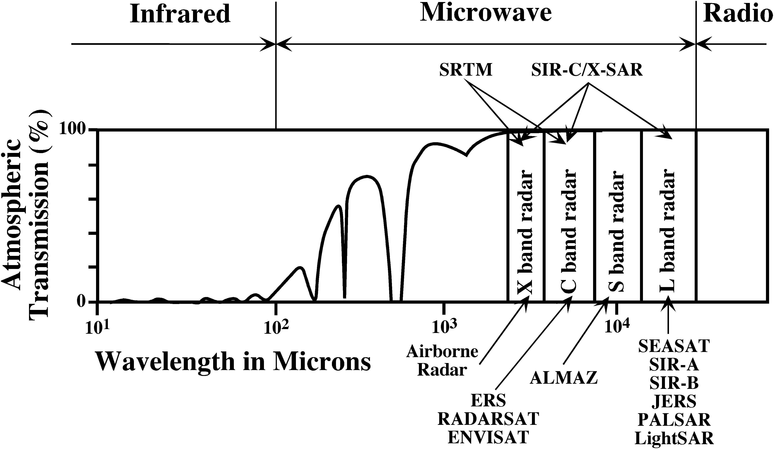
Microwave Region
Murchison

Slide 4
Radar Bands
Wavelength Range and Descriptions
Ka, K, and Ku Bands
  very short wavelengths used in early airborne radar systems but uncommon today
X-band
  used extensively on airborne systems for military reconnaissance and terrain mapping.
C-band
  on many airborne research systems (CCRS Convair-580 and NASA AirSAR) and spaceborne systems (including ERS-1 and 2 and RADARSAT).
S-band
  used on board the Russian ALMAZ satellite.
L-band
  used onboard American SEASAT and Japanese JERS-1 satellites and NASA airborne system.
P-band
  longest radar wavelengths, used on NASA experimental airborne research system
Murchison

Slide 5
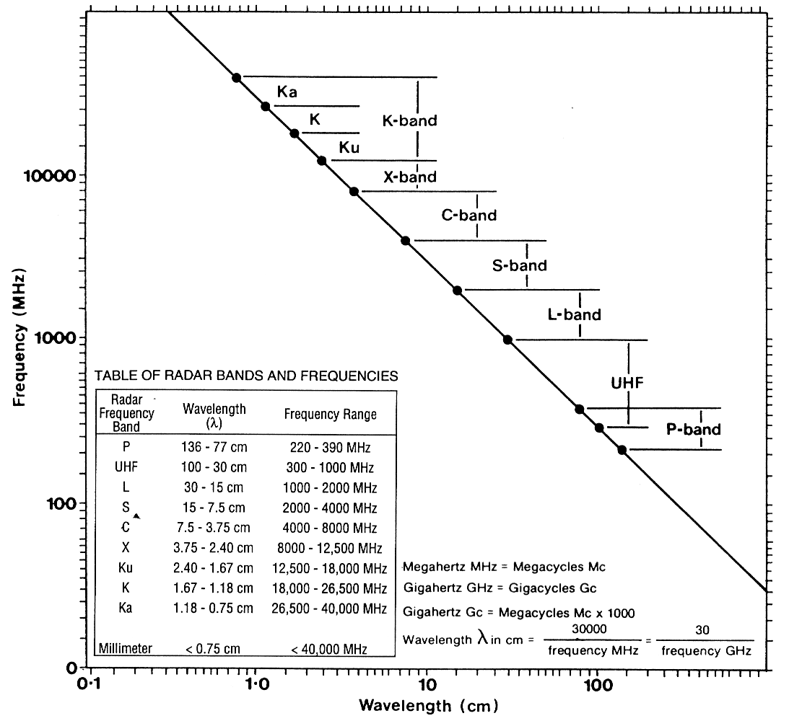
Radar
Bands
Murchison

Slide 6
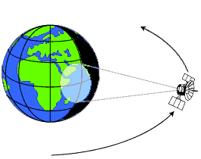
Imaging Radar - Advantages
Active system (works day or night).
  There is also passive microwave imaging (radiometer) mode. This senses surface radio-emission, which can be converted to radiant temperatures.
Not affected by cloud cover or haze if λ > 2 cm. It operates independent of weather conditions. Water clouds have a significant effect on radar with wavelength λ < 2 cm.
Unaffected by rain λ > 4 cm.
Can penetrate well-sorted dry sand in hyper-arid regions to a depth of about 2 m.
Murchison

Slide 7
Terminology
RAR: Real Aperture Radar
SAR: Synthetic Aperture Radar
SLAR: Side-looking airborne radar (could be RAR or SAR).
SIR: Shuttle imaging radar (a SAR)
  3 missions: SIR-A (1981), SIR-B (1984) and SIR-C (1994)
INSAR: Interfereometric SAR. Can be satellite or airborne.
SRTM: Shuttle Radar Topography Mission (an INSAR mapping mission)
Murchison

Slide 8
Aperture
Synthetic Aperture Radar – Systems and Signal Processing
Optics : Diameter of the lens or mirror. The larger the aperture, the more light a telescope collects. Greater detail and image clarity will be apparent as aperture increases.
2.4m Hubble Space Telescope
10m Keck, Hawaii
16.4m VLT (Very Large Telescope), Chile
50m Euro50
100m OWL (OverWhelmingly Large T.)
이 훈 열

Slide 9
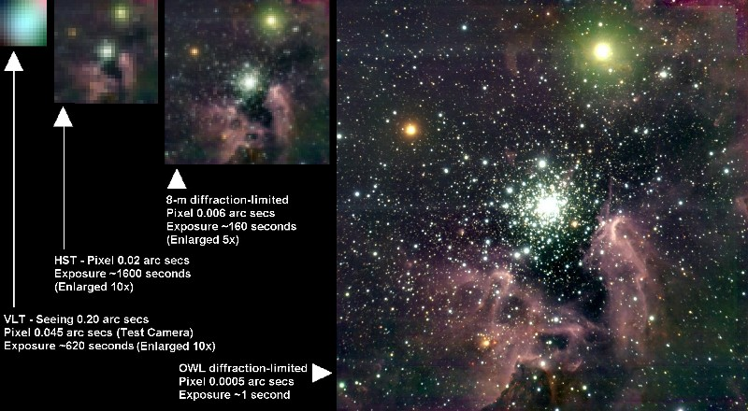
OverWhelmingly Large Telescope
이 훈 열

Slide 10
What is InSAR?
Method using an orbiting satellite that emits and receives radio energy in the form of waves
Carries two types of information.
    Information about surface from which radio waves reflected carried in strength and intensity of signal
    Changes in roundtrip distance seen through phase changes of the radio waves.
Pablo, Mattioli,Jansma

Slide 11
Real Aperture vs. Synthetic Aperture
Synthetic Aperture Radar – Systems and Signal Processing
Real Aperture :
resolution ~ Rλ/L
Synthetic Aperture:
resolution ~ L/2
Irrespective of R
Smaller, better?!
- Carl Wiley (1951)
이 훈 열

Slide 12
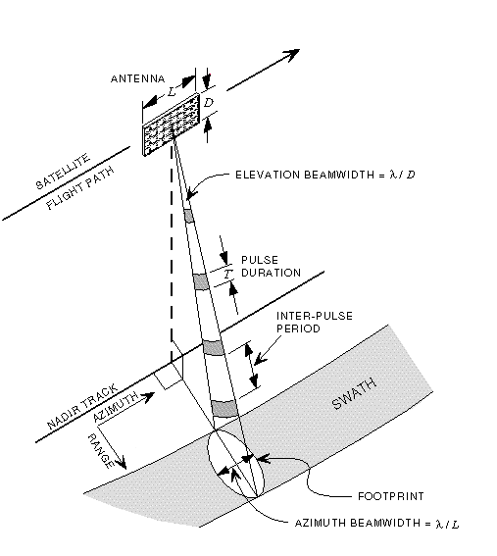
Image Acquisition
ERS–1/2 SAR
L: 10 m, D: 1 m
Altitude: 785 km, sun-synchronous orbit
Ground Velocity: 6.6 km/s
Look Angle: Right 17°-23° (20.355° mid-swath)
Slant Range: 845 km (mid-swath) Frequency: C- Band (5.3GHz, 5.6 cm)
Footprint : 100 km x 5 km
Incidence Angle: 19 ° – 26 ° (23 ° mid-swath)
Sampling Rate: 18.96 MHz
Pulse duration: 37.1 μs
Range gate: ~ 6000 μs
Sampling Duration: ~ 300 μs (5616 samples)
Inter-pulse period: ~ 600 μs ( upto 10 pulses)
Pulse Repetition Frequency: 1700 Hz
Data Rate: 105 Mb/s (5 bits/sample)
이 훈 열

Slide 13
SAR Systems
Spaceborne SAR
SEASAT-A (USA, 1978), SIR-A (USA, 1981), SIR-B (USA, 1984), SIR-C/X-SAR (USA, Germany, Italy, 1994), ALMAZ-1 (Russia, 1991-1993), ERS-1(EU, 1991-2000), ERS-2 (EU, 1995-), JERS-1 (Japan, 1992-1998), Radarsat-1 (Canada, 1995-), SRTM (USA/Germany, 2000), ENVISAT (EU, 2002),
RADARSAT-2 (Canada, 2005), PALSAR (Japan, 2004), LightSAR (US)*, TerraSAR (Germany)*, MicroSAR(EU)*
Airborne SAR
TOPSAR (JPL, USA), IFSARE(ERIM/Intermap, USA), DO-SAR(Donier,Germany), E-SAR(DLR, Germany), AeS-1(Aerosensing, Germany), AER-II (FGAN, Germany), C/X-SAR (CCRS, Canada), EMISAR (Denmark), Ramses (ONERA, France), ESR (DERA, UK)
Planetary SAR
Magellan (US, 1990-1994), Titan Radar Mapper (US, 2004), Arecibo Antenna, Goldstone antenna
* Under development
이 훈 열

Slide 14
SAR System Modes
Target – the Earth or planets
Vehicle – stationary, airborne, satellite, or spaceship
Mode – monostatic and/or bistatic
Carrier frequency – X, C, S, L, and/or P bands
Polarisation – HH, VV, VH, HV (single-pol, dual-pol, full-pol)
Imaging geometry – strip, scan, spot
<examples>
SIR-C/X-SAR: space shuttle, mono, L/C/X, full-pol.
ERS-1/2, Envisat: Earth satellite, mono, C, VV.
SRTM: space shuttle, mono/bistatic, C/X, HH/VV.
Arecibo Antenna: planetary, stationary, mono/bi, multi-bands, multi-pol.
Magellan, Cassini SAR: Venus and Titan, mono, S, HH.
AIRSAR/TOPSAR: airborne, mono/bi, L/C/P, full-pol
이 훈 열

Slide 15
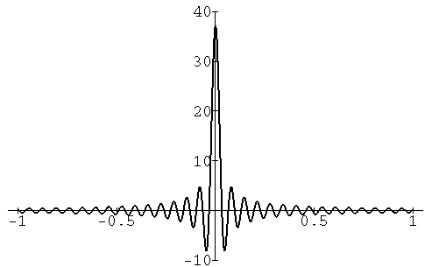
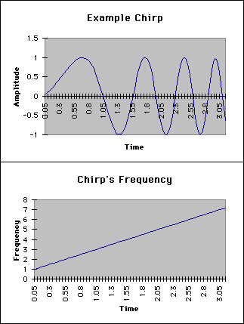
Range Compression
Linear Chirp Signal
Chirp autocorrelation Function
Matched Filtering
For ERS-1/2,
Pulse duration (T): 37.1 μs
Bandwidth : 15.5 MHz
Half power width of autocorrelation function: 0.065 μs
Pulse Compression Ratio: 575 (ERS-1/2)
Ground Range Resolution: 12.5 m
Input
Range FFT
Range Matched Filtering
Range iFFT
이 훈 열

Slide 16
Range Migration
Flight Path
Point Target
Linear
(Range Walk)
Quadratic
(Range Curvature)
Azimuth FFT
이 훈 열

Slide 17
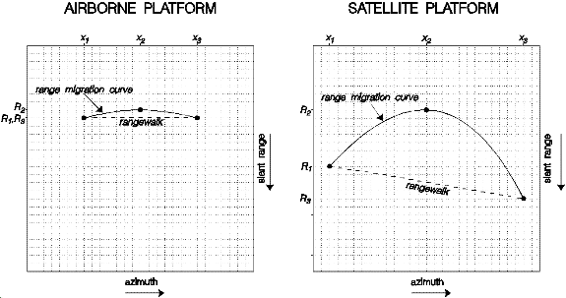
Left side: range mitigation curve and rangewalk for airborne SAR – consider earth flat and stationary , range mitigation curve relatively flat.
http://www.geo.uzh.ch/~fpaul/sar_theory.html

Slide 18
Right side: range mitigation curve and rangewalk for spaceborne SAR – have to take into account that earth is sphere and “moving” (from rotation of earth).
http://www.geo.uzh.ch/~fpaul/sar_theory.html

Slide 19
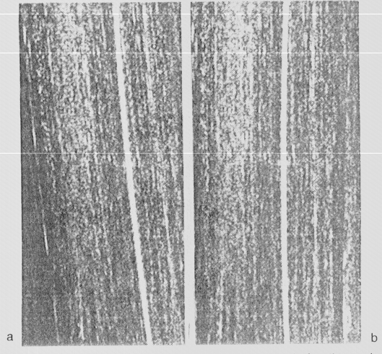
Range Migration Compensation
Range (R)
Azimuth (s)
After Range Walk Compensation
Range Migration
이 훈 열

Slide 20
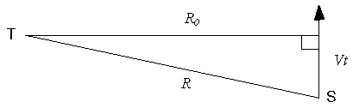
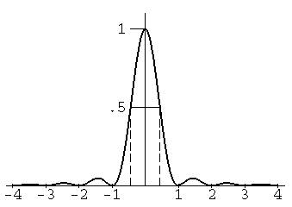
Azimuth Compression
Synthetic Aperture
Real Aperture
Doppler Shift (Linear Chirp Pulse)
λ: wavelength
L: Antenna length
For ERS-1/2,
Coherent Integration Time (S): 600 ms (5 km footprint)
Bandwidth: 1260 Hz
Half power width of autocorrelation function: 0.8 ms
Pulse Compression Ratio: 756 (ERS-1/2)
Azimuth Resolution: 5 m
Azimuth footprint width:
5 km (ERS-1/2)
Matched Filtering
Azimuth Matched Filtering
Output
이 훈 열

Slide 21
SAR Focusing – Point Target
azimuth
range
original
After range compression
After migration
After azimuth compression
이 훈 열

Slide 22
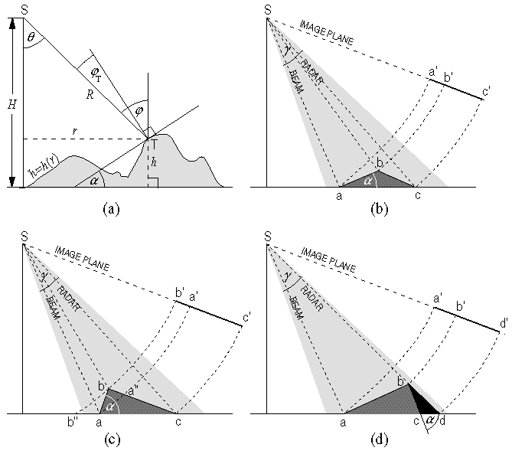
Geometric Distortion
Terrain Imaging Geometry
Foreshortening
Layover
Shadow
이 훈 열

Slide 23
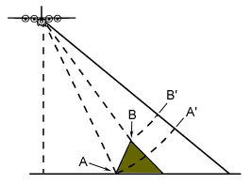
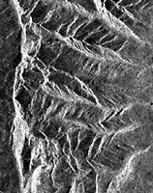
Radar Image Geometry - Layover
Layover occurs when the radar beam reaches the top of a tall feature before it reaches the base. The top of the feature is displaced towards the radar sensor and is displaced from its true ground position - it 'lays over' the base.
Murchison

Slide 24
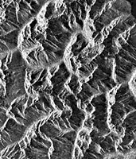
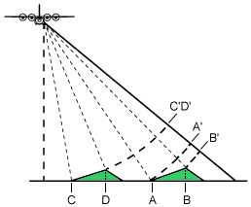
Foreshortening
Even if there is no layover, radar returns from facing steep slopes will make the terrain look steeper than it is. This is known as ‘foreshortening’. Features which show layover in the near range will show foreshortening in the far range.
Foreshortening occurs because radar measure distance in the slant-range direction such that the slope A-B appears as compressed in the image (A'B') and slope C-D is severely compressed (C'D')
Murchison

Slide 25
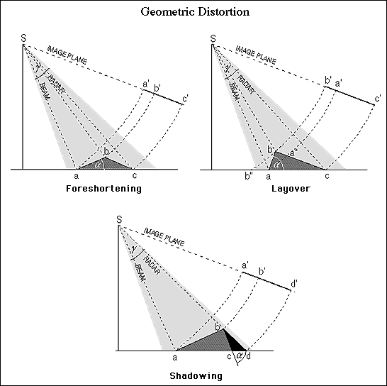
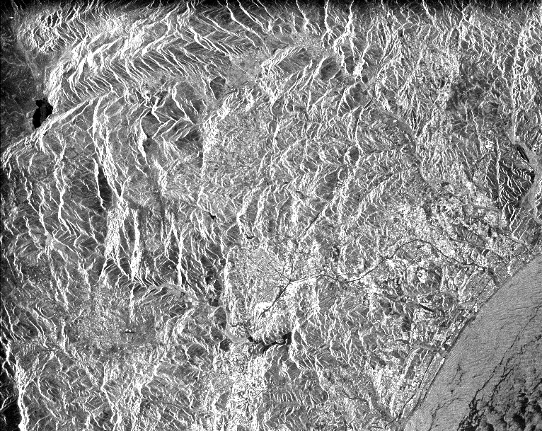
Fialko

Slide 26
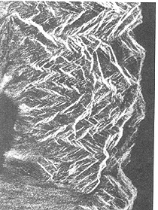
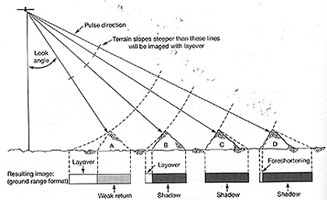
Topo irregularies can have a significant effect on the image. Slopes facing the radar are subject to a distorted appearance. The terms layover and foreshortening apply to this appearance. In most instances, layover and foreshortening produce the same end result visually.
http://rst.gsfc.nasa.gov/Sect8/Sect8_4.html

Slide 27
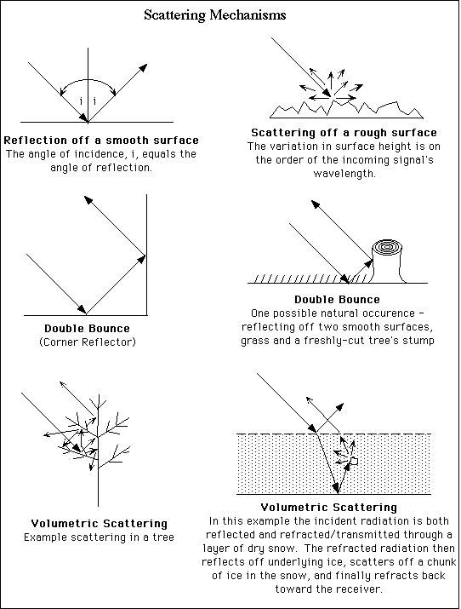
Scattering Mechanisms
이 훈 열

Slide 28
Rule of Thumb in SAR images
Backscattering Coefficient
Smooth – Black
Rough surface – white
Calm water surface – black
Water in windy day – white
Hills and other large-scale surface variations tend to appear bright on one side and dim on the other.
Human-made objects - bright spots (corner reflector)
Strong corner reflector- Bright spotty cross (strong sidelobes)
이 훈 열

Slide 29
1. Interferometric Synthetic Aperture Radar (InSAR or IFSAR)
Is a process whereby radar images of the same location on the ground are recorded by
  Two antennas of one platform separated by a few meters (single pass), or
  The same radar system at different times (multi-pass or repeat-pass)
Applications on
  Elevation (DEM) derivation (single or multi pass)
    Can be as accurate as DEM from traditional optical photogrammetric techniques. However, InSAR operate through clouds, day or night.
    The first worldwide DEM (99.97%) was acquired in 2000 by SRTM in 2000, not by the photogrammetry
  Surface displacement study (multi-pass only)
Hongjie

Slide 30
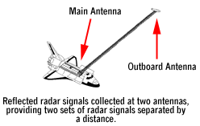
Examples
One SAR with 2 antennas (single-pass)
  AIRSAR/TOPSAR
    Along track interferometric mode (ATI) (L and C)
      Ocean current and waves
    Cross track interferometric mode (TXI) (L or C)
      DEM (3-5 m or 1 m)
  Shutter Radar Topographic Mission (SRTM)
    C band and X band antennas separated by 60 m
One SAR in different times (multi-pass)
  SIR-C
  ERS 1,2
Hongjie

Slide 31
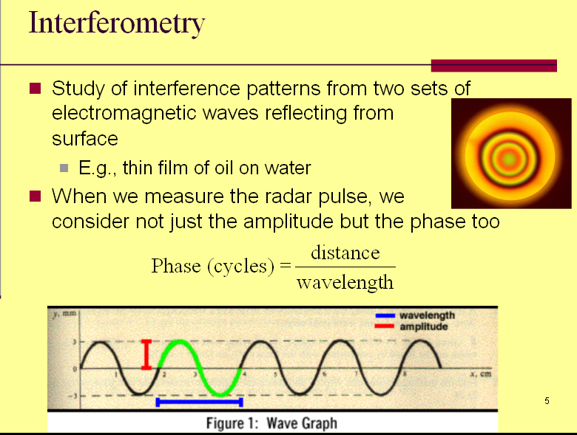
Phase is total number of cycles at any given distance (or target) from transmitter, including fractional part. One cycle of phase is equal to 360 degrees (or 2π).
Hongjie

Slide 32
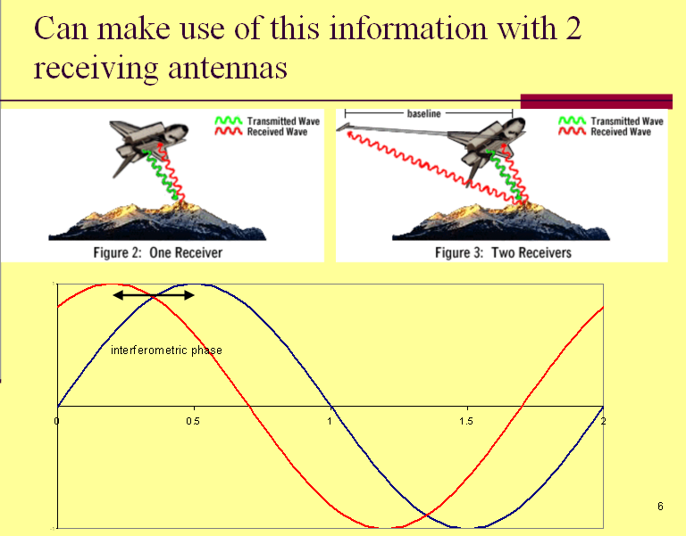
phase difference called “interferometric phase” -determined by subtracting measured phase at each end of baseline, is actually the distance difference from each receiver to same target.
Hongjie

Slide 33
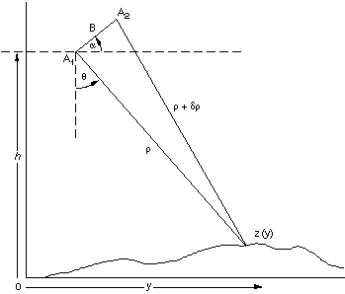
Calculate altitude
(1)
(2)
(3)
(4)
(Phase difference)
Hongjie
ϕ is the fractional phase (value 0-2π radians), λ is wavelength

Slide 34
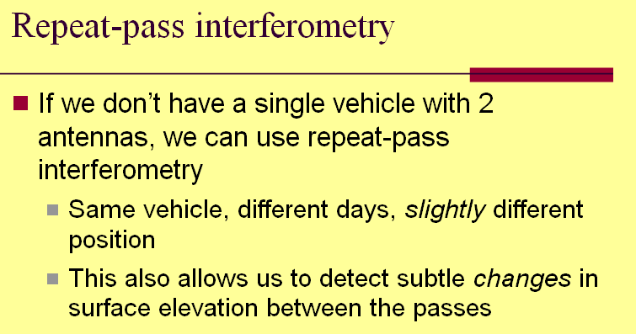
Hongjie

Slide 35
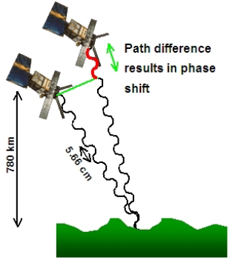
Hongjie

Slide 36
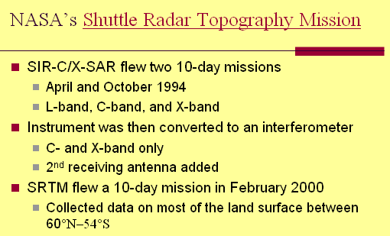
Both C (5.6 cm) and X (3 cm) bands in the Main Antenna transmit and receive radar signals, but in the Outboard Antenna only receive signals.
http://www2.jpl.nasa.gov/srtm/instr.htm
Hongjie

Slide 37
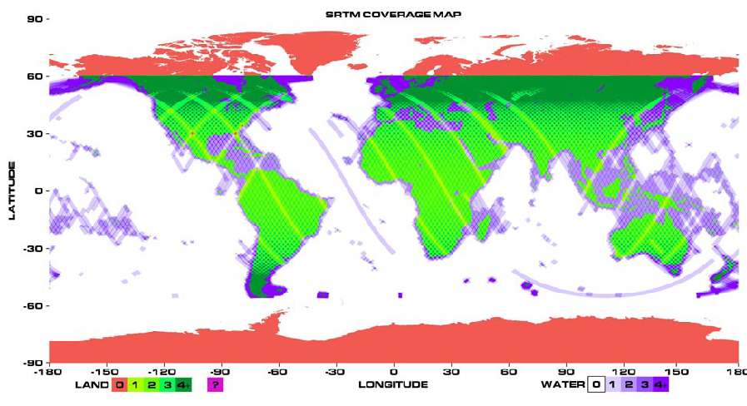
SRTM coverage map
To download from here http://seamless.usgs.gov/
Hongjie

Slide 38
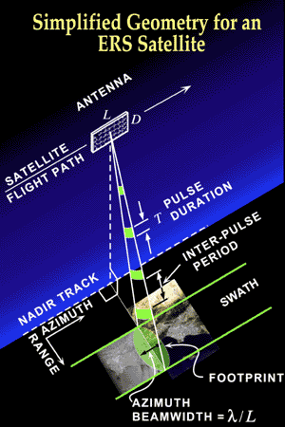
3-Dimensional view of InSAR geometry.
Graphics from nknown source

Slide 39
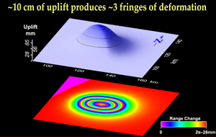
Colors on an interferogram map into elevation changes.
Fringes – each one signifies change of 1 wavelength.
Graphics from nknown source

Slide 40
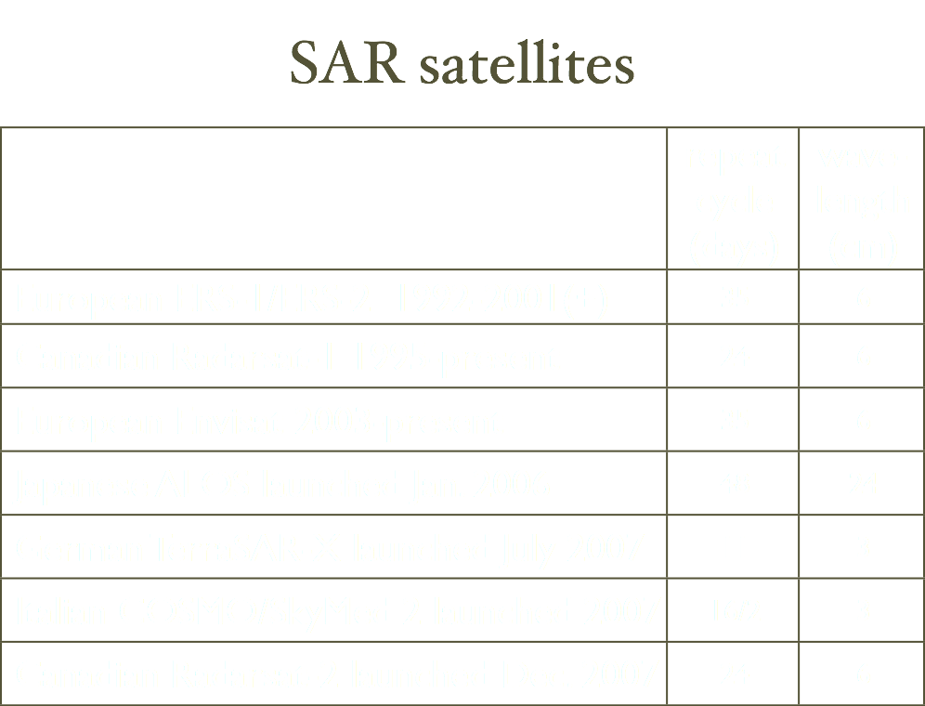
Eric Fielding

Slide 41
Side info: ASTER Global DEM
This is not from INSAR tech, but It has an along-track stereoscopic capability using its near infrared spectral band and its nadir-viewing and backward-viewing telescopes to acquire stereo image data with a base-to-height ratio of 0.6.
30 m in pixel size
30 m accuracy in horizontal and 20 m accuracy in vertical
Free downloaded from
  http://www.gdem.aster.ersdac.or.jp/
  https://wist.echo.nasa.gov/~wist/api/imswelcome/
Hongjie

Slide 42
Interferogram
The data obtained from the satellite is mainly used to create an interferogram like the one showed in figure 1. An interferogram is actually a combination of 2 images of the exact same area with a time elapse in between. When these images are overlaid the change in phase shift can be color coded and will then show the deformation of a given area.

Slide 43
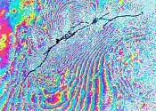
interferogram of the 1992 Lander’s Earthquake
Pablo, Mattioli,Jansma

Slide 44
Getting from raw satellite data to an interferogram is not a easy process. Luckily, there is a software program known as ROI_PAC or Repeat Orbit Interferometric Package which helps a lot with this procedure. Using this software package there are just a few simple steps that must be followed.
Acquire 2 frames of data collected at different times from the same location.
Acquire orbital data for orbits in question.
Acquire a digital elevation model for area in question
Set up environment variables
Condition the raw data
Run through ROI_PAC
Pablo, Mattioli,Jansma

Slide 45
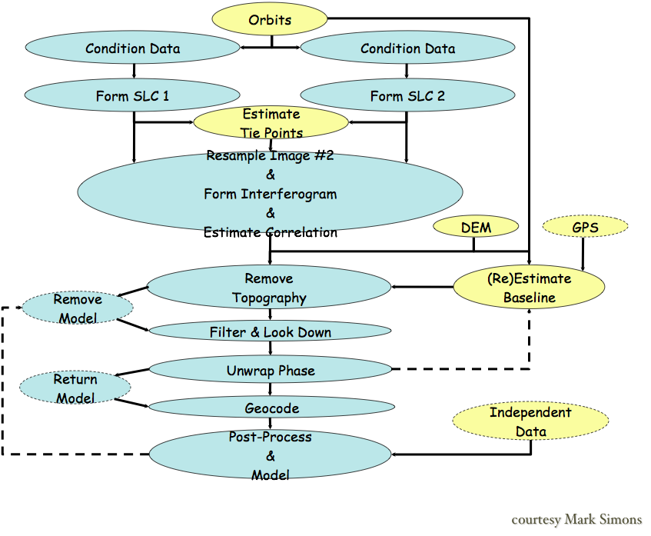
Eric Fielding

Slide 46
Mountainous terrain around
Long’s Peak, Colorado
Interferogram
José M. Bioucas-Dias

Slide 47
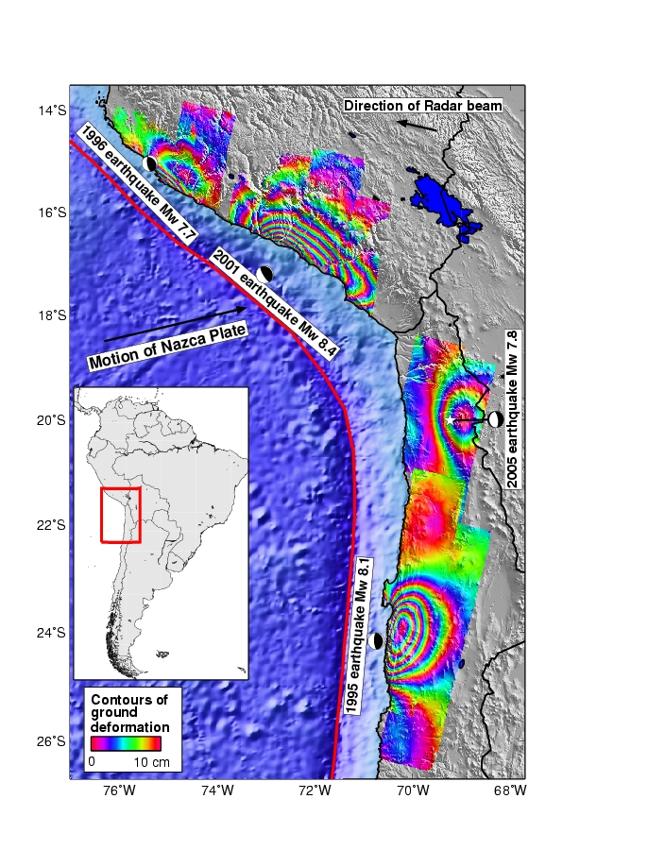
Matt Pritchard

Slide 48
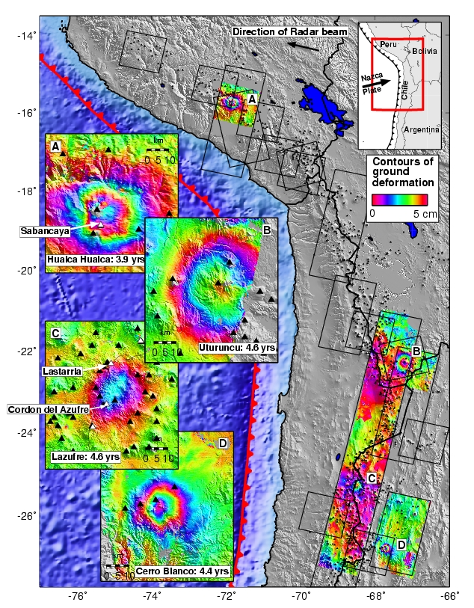
Matt Pritchard

Slide 49
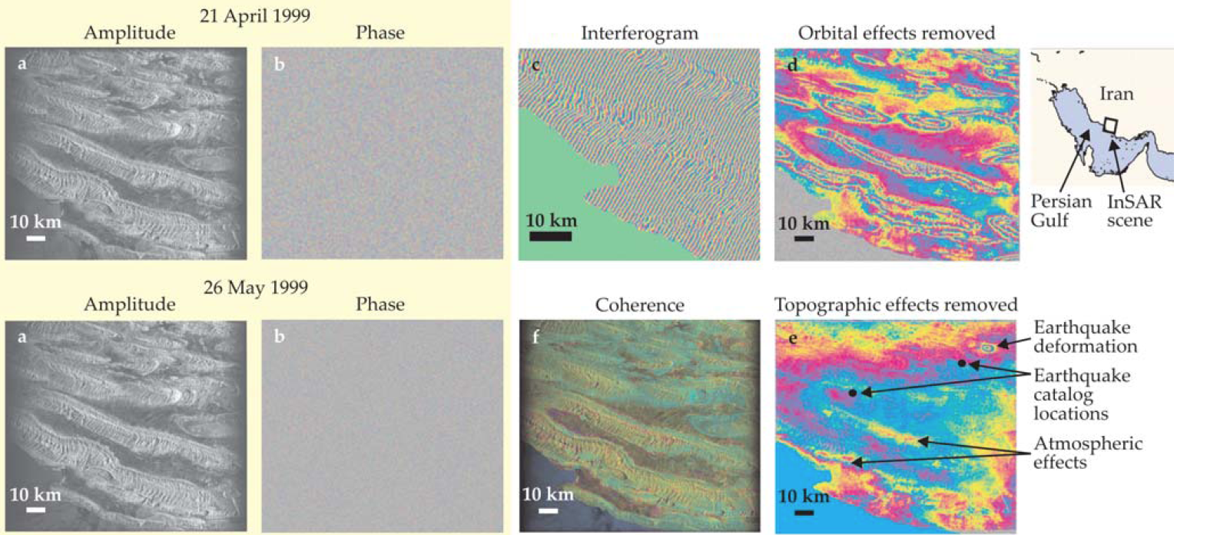
Using InSAR to improve earthquake locations (assuming it causes surface deformation).
Matt Pritchard, 2006

Slide 50
New techniques: Time series of interferograms
The Basic Idea…
Interferogram Number
Date
Matt Pritchard

Slide 51
New techniques: Time series of interferograms
The Basic Idea…
Interferogram Number
Date
A stack of interferograms provides multiple constraints on a
given time interval
Matt Pritchard

Slide 52
New techniques: Time series of interferograms
The Basic Idea…
Interferogram Number
Date
Goal: Solve for the deformation history that, in a least-squared sense, fits the set of observations (i.e., interferograms),
Many different methods (e.g., Lundgren et al. (2001), Schmidt & Burgmann, 2003), but SBAS (Berardino et al. (2002)) is perhaps most common one
Matt Pritchard

Slide 53
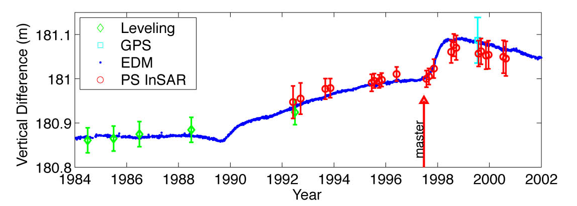
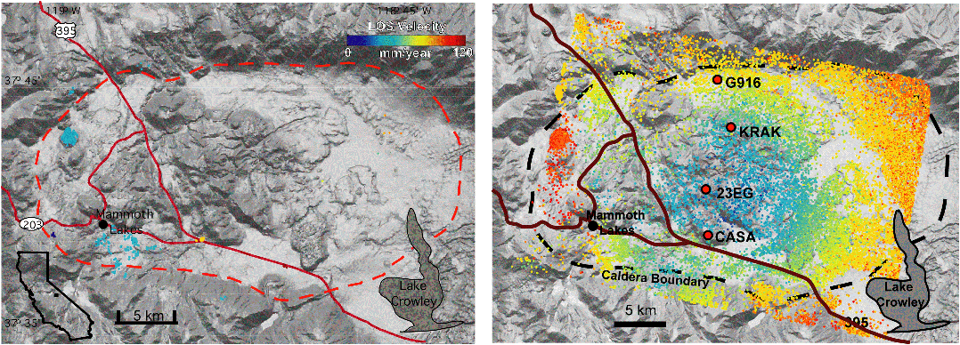
Persistent scatterers (PS or PSInSAR)
Select pixels with stable scattering behavior over time
Only focus on “good” pixels
InSAR
  Spatial coherence @ 1 time
  Need neighborhoods of good pts
PS
  Coherence @ 1 point
  Need > 15-20 scenes
Added bonus:
DEM errors!
Long Valley Caldera,
Hooper et al. 2004
Matt Pritchard
From: Rowena Lohman

Slide 54
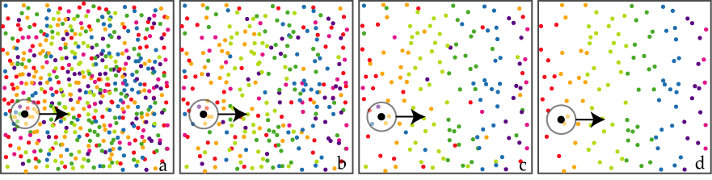
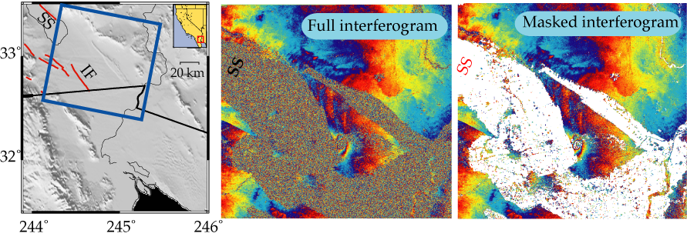
StaMPS method (Hooper et al., 2004)
Example: Imperial Valley, CA
Matt Pritchard
From: Rowena Lohman

Slide 55
InSAR can resolve surface displacements with ~cm precision, 10s m spatial resolution, and monthly temporal resolution using remote satellites
Global coverage; day/night, all-weather imaging capabilities

Slide 56
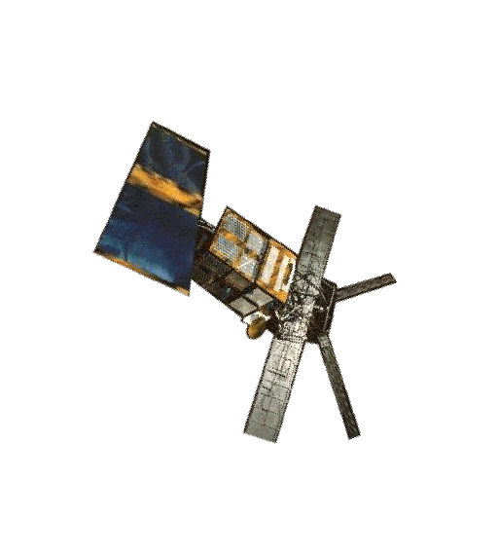
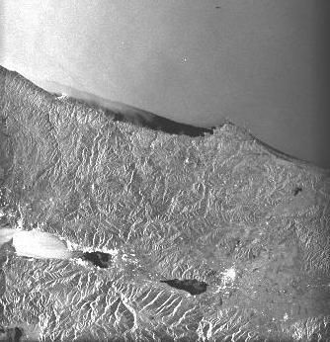

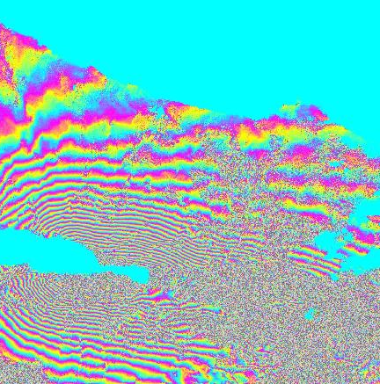

Image A - 12 August 1999
SAR image
Image B - 16 September 1999
Fialko

Slide 57
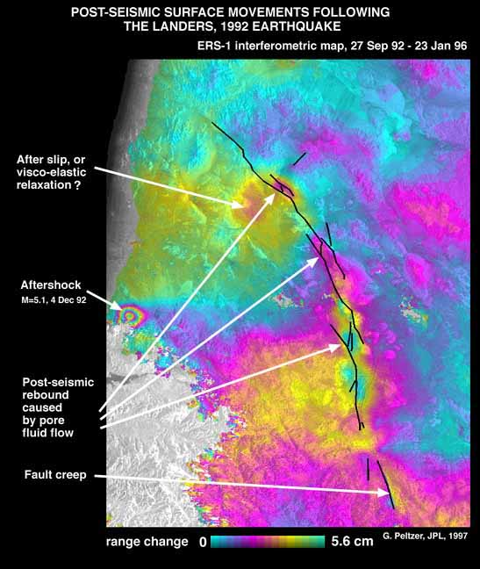
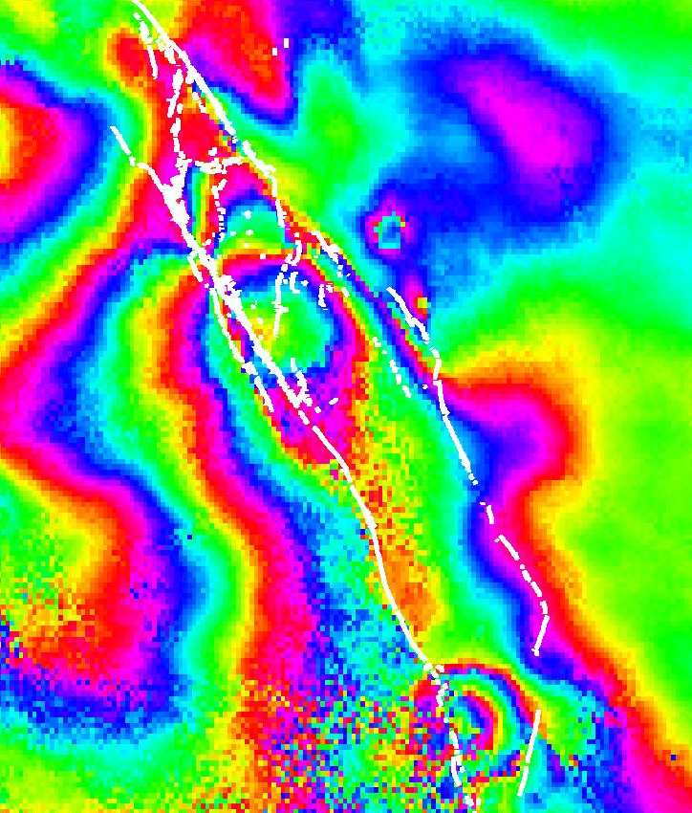
Postseismic - 1992 Landers
Peltzer et al., 1998
Up by 4 cm
Massonnet & Feigl, 1998
Releasing stepovers (pull aparts) rebound

Slide 58
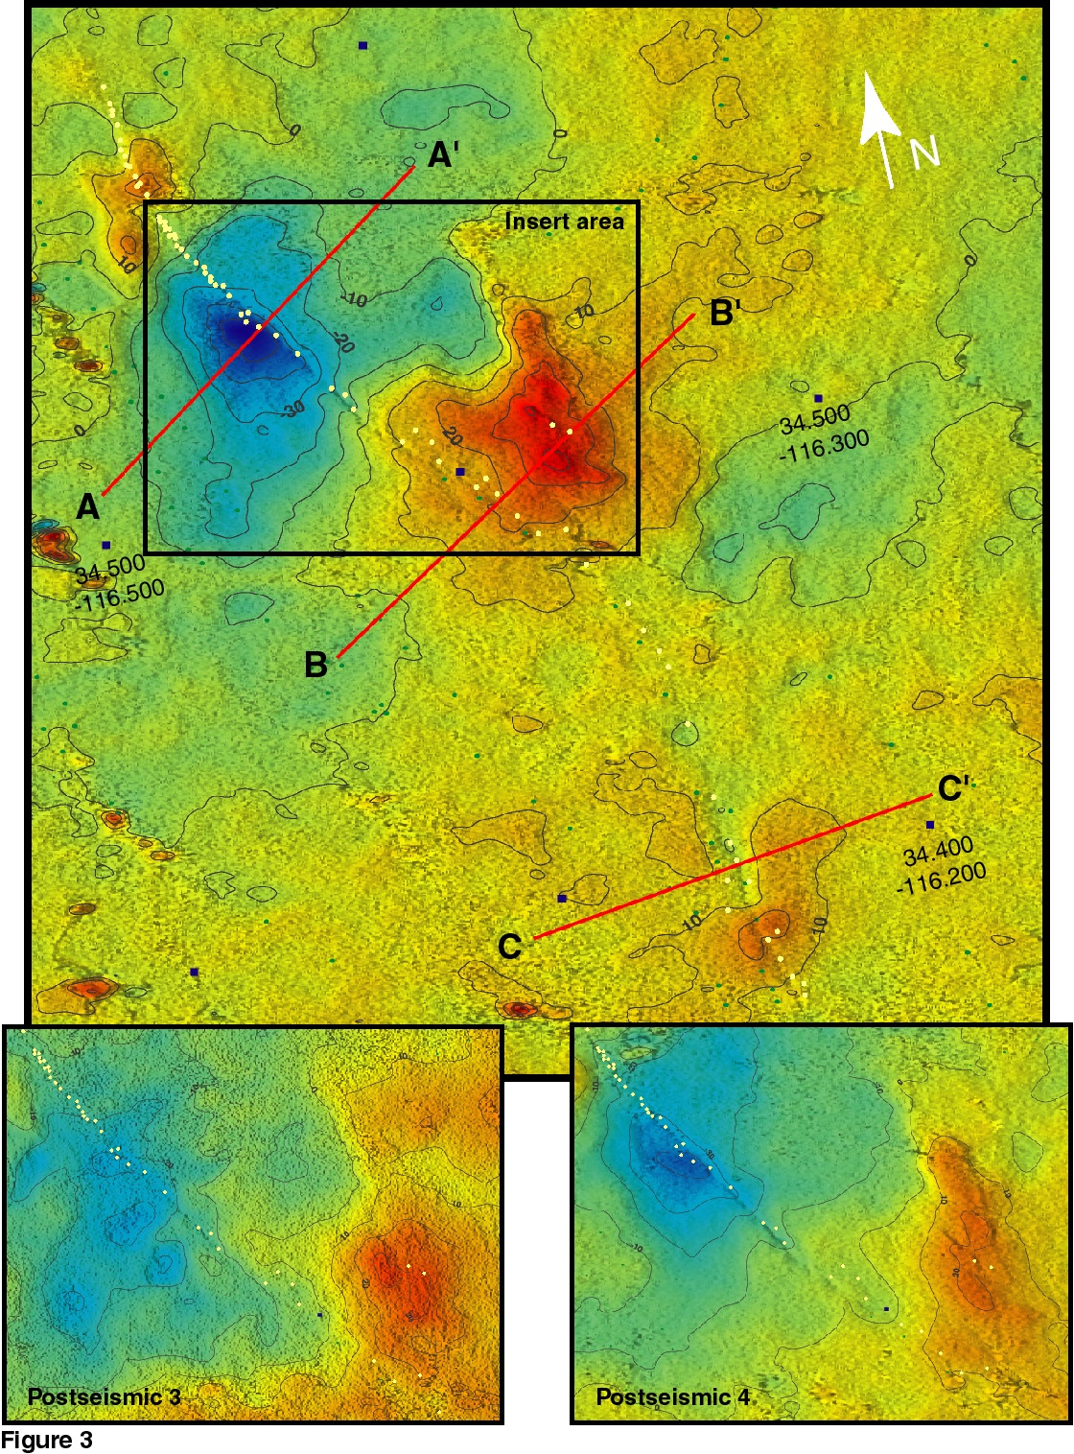
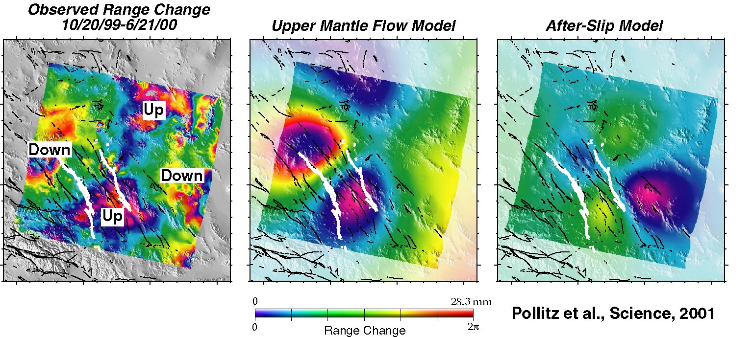
Postseismic - 1999 Hector Mine
Near field: Shallow afterslip and fault zone collapse?
Jacobs, A., Sandwell, D., Fialko, Y. and
L. Sichoix, BSSA, 2002.
Far field: Upper mantle relaxation?
Pollitz et al., Science, 2001

Slide 59
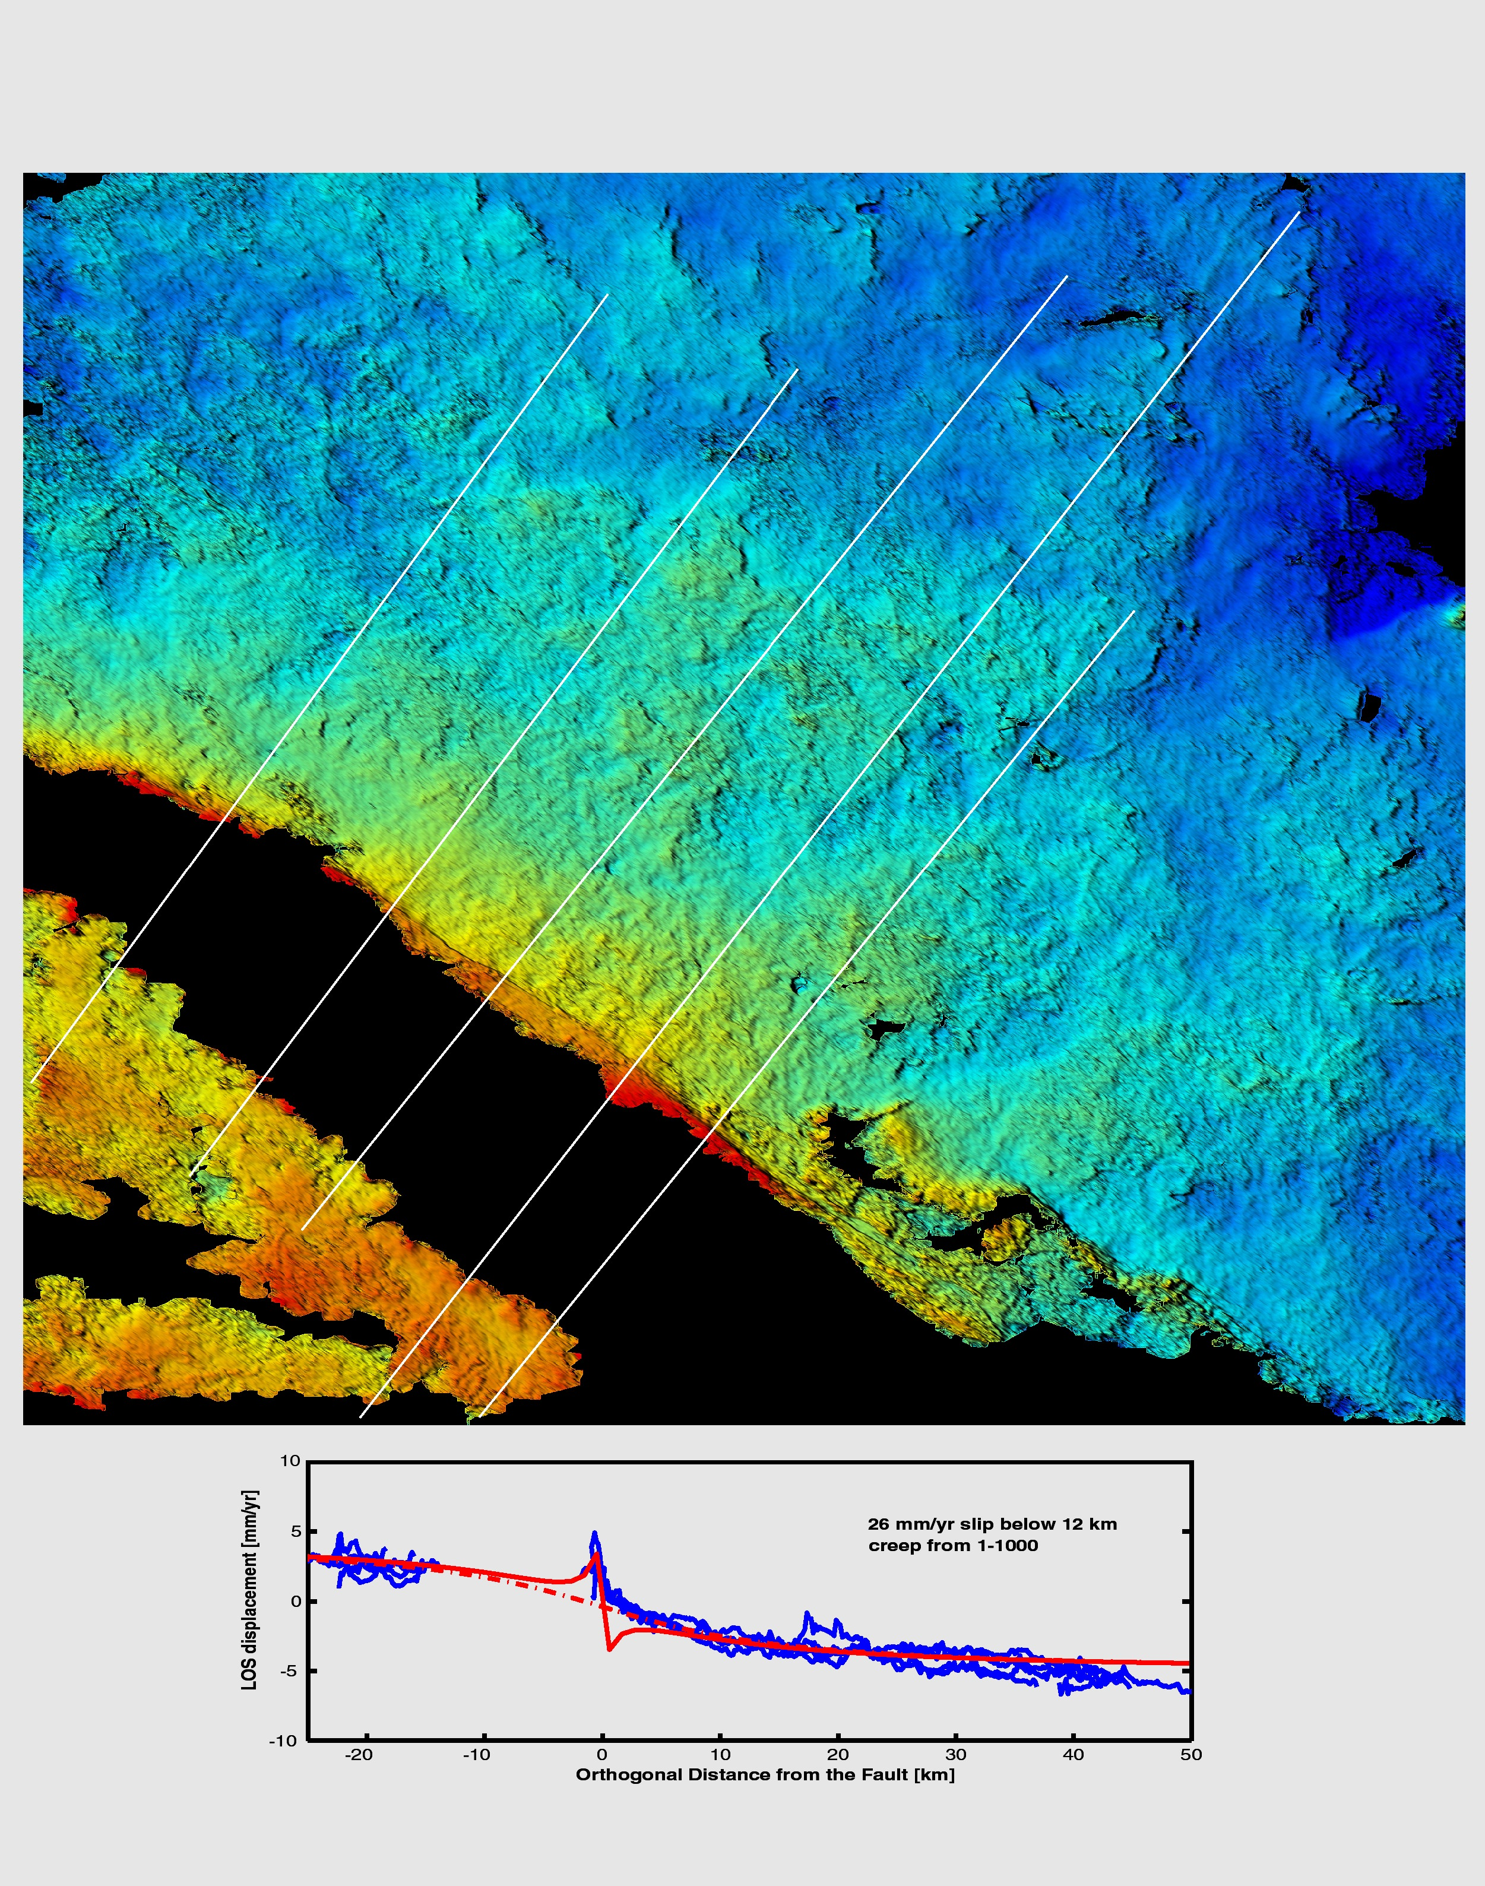
Interseismic - Southern SAF
(Lyons, S. and Sandwell, JGR, 2003)

Slide 60
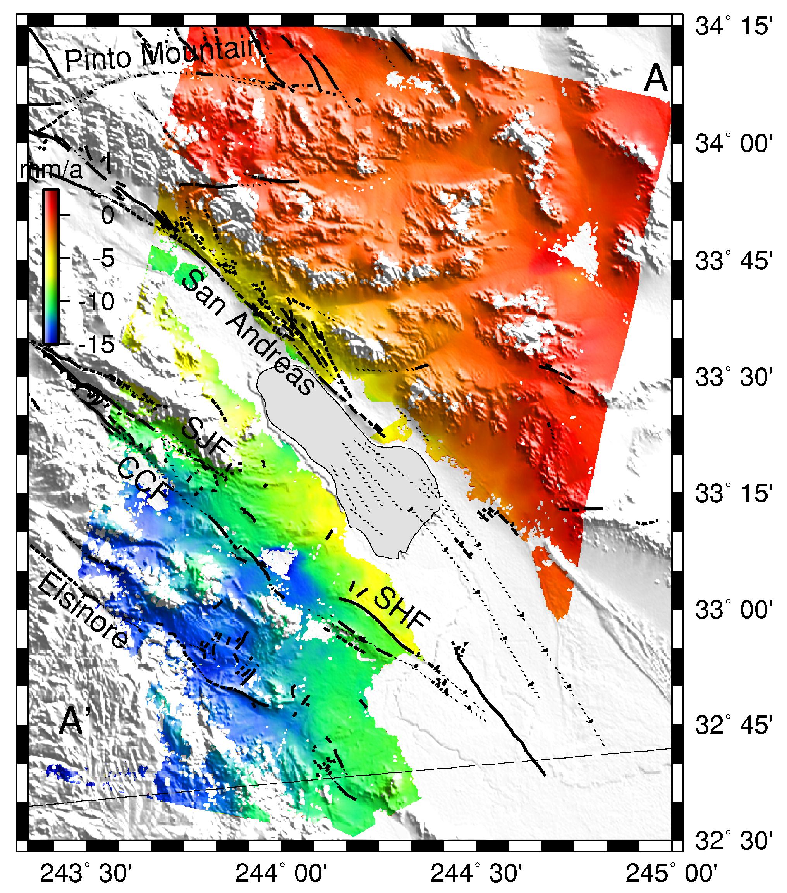
Fialko, Nature 2006
Line of sight
velocities from
stacked InSAR
data
35 interferograms
Epoch: 1992-2000

Slide 61

Fialko, Nature 2006
Line of sight
velocities from
stacked InSAR
data
35 interferograms
Epoch: 1992-2000

Slide 62


Slide 63

Interseismic - San Francisco Bay Area
(Burgmann et al., Science, 2000)
Eight-year interferogram showing:
  Elastic strain accumulation across San Andreas fault system
  Creep along Hayward fault
  Rebound of Santa Clara Valley from aquifer recharge
CF
HF
SAF
SCV

Slide 64
Magmatic activity: detection and interpretation
Location and geometry of magma reservoirs
Dynamics of magma supply
Precursory phenomena
  Intrusion
  Eruption
Fialko

Slide 65

Volcanic Inflation
Three Sisters,
Cascade Range
(Wicks et al., Science, 2002)

Slide 66
SIR-C image of Nile Paleochannel, Sudan
The top image is a photograph taken with color infrared. The radar image at the bottom is a SIR-C/X-SAR image. The thick, white band in the top right of the radar image is an ancient channel of the Nile that is now buried under layers of sand. This channel cannot be seen in the photograph and its existence was not known before this radar image was processed.
Murchison

Slide 67

Subsidence due to ground water withdrawal. (presentation has extreme vertical exaggeration)

Slide 68
Review: Will InSAR work for you?
What is the local rate of deformation?
  Sensitivity of single igram ~1cm
  How many years to get signal this big and will it be overcome by noise?
  Can you stack several igrams together?
What is the scale of deformation?
  Pixel size ~10m, but generally need to average many together
  Image size is ~100 km, but if too broad worry about precision of orbits
What is the local noise?
  How much vegetation/precipitation/water vapor/human cultivation?
  Can you only make igrams with data from the same seasons?
  Can you get L-band data and find persistent scatterers?
What data is available?
Is there data from multiple satellites and/or imaging geometries?
Is a digital elevation model available?
Do you need rapid response for hazard assessment?
Matt Pritchard

Slide 69
Review: How to set up InSAR capability?
1) Establish access to data
• Main sources: see next slide
• How? Can be purchased commercially. Lower cost/no-cost data available with restrictions. In Europe, through ESA. In U.S., through ASF and UNAVCO. Some foreign access is allowed to UNAVCO
Can useful interferograms be made with available data? Worry about ground conditions, radar wavelength, frequency of observations, perpendicular baseline, availability of advanced processing techniques
2) Purchase/Install software to process and visualize data
• Open source: ROI_PAC, DORIS, RAT and IDIOT (TU Berlin)
• Commercial: Gamma, TR Europa, Vexcel/Atlantis, DIAPASON, SARscape
3) Download/create DEM (SRTM is only +/- 60 degrees latitude, but ASTER G-DEM in 2009)
4) Download precise orbital information & instrument files (Only ERS & Envisat)
5) Interpret results, create stacks, time series, persistent scatterers. May need to buy/downoad/create new software
6) Publish new discoveries and software tools!
Matt Pritchard

Slide 70
For More Information:
Good overview of classical & space based geodesy (but no InSAR): John Wahr’s online textbook http://samizdat.mines.edu/geodesy
Introductions to InSAR:
  2 page overview from Physics Today http://www.geo.cornell.edu/eas/PeoplePlaces/Faculty/matt/vol59no7p68_69.pdf
  Overviews of applications: Massonnet & Feigl, Rev. Geophys., 1998; Burgmann et al., AREPS, 2000.
More advanced InSAR:
  The definitive SAR book: Curlander & Mcdonough, 1990
  More technical reviews: Rosen et al., IEEE 2000; Hanssen’s Radar Interferometry book, 2001; Simons & Rosen, Treatise on Geophysics, 2007;
  Time series analysis: Berardino et al., IEEE, 2002; Schmidt & Burgmann, JGR, 2003
  Persistent scatterers: Ferretti IEEE, 2001; Hooper et al., GRL, 2004; Kampes’ Persistent Scatterers book, 2006
Matt Pritchard

Slide 72





Absolute Phase Estimation
Phase Unwrapping (PU)
Phase Denoising (PD)
Estimation of
Estimation of
(wrapped phase)
José M. Bioucas-Dias

Slide 73

Absolute Phase Estimation in InSAR (Interferometric SAR)
InSAR Problem: Estimate φ₂- φ₁ from signals read by s₁ and s₂
José M. Bioucas-Dias

Slide 74

Differential Interferometry
Height variation
7 mm/year
-17 mm/year
José M. Bioucas-Diasç

Slide 75


Slide 78

Look Direction
http://edc.usgs.gov/Tectonic/InSAR.gif

