Slide 1
Global Seismology CERI-8105
Tu-Th 1:00-2:25pm
Lab - 3892 Central Ave. (Long building) , Room 110
-----------------------------------------------
Bob Smalley
Office: 3892 Central Ave, Room 103, 678-4929
Office Hours – when I’m in my office.
http://www.ceri.memphis.edu/people/smalley/CERI8105_GlobalSeismology.html
Tue., Sep 26, 2023 Meeting 9

Slide 2
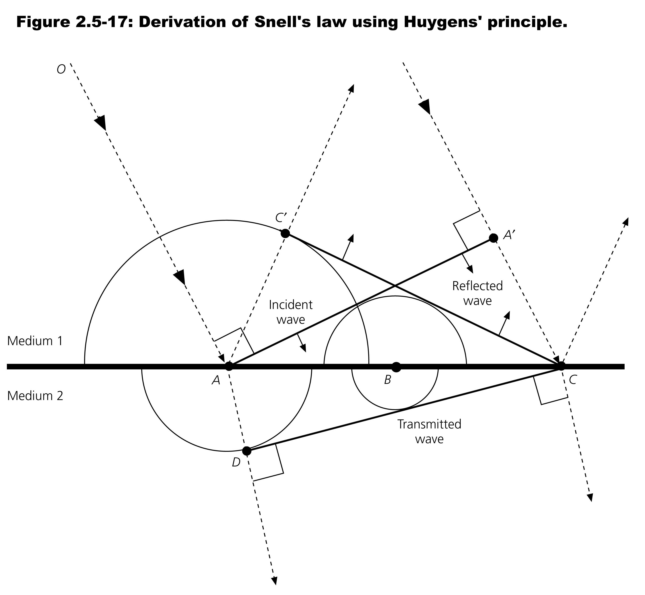

Slide 3
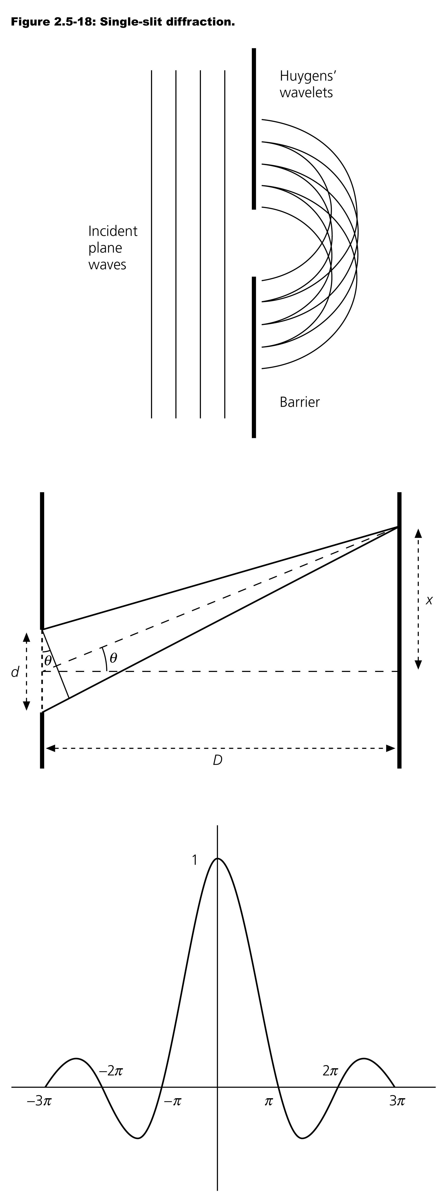


Slide 4
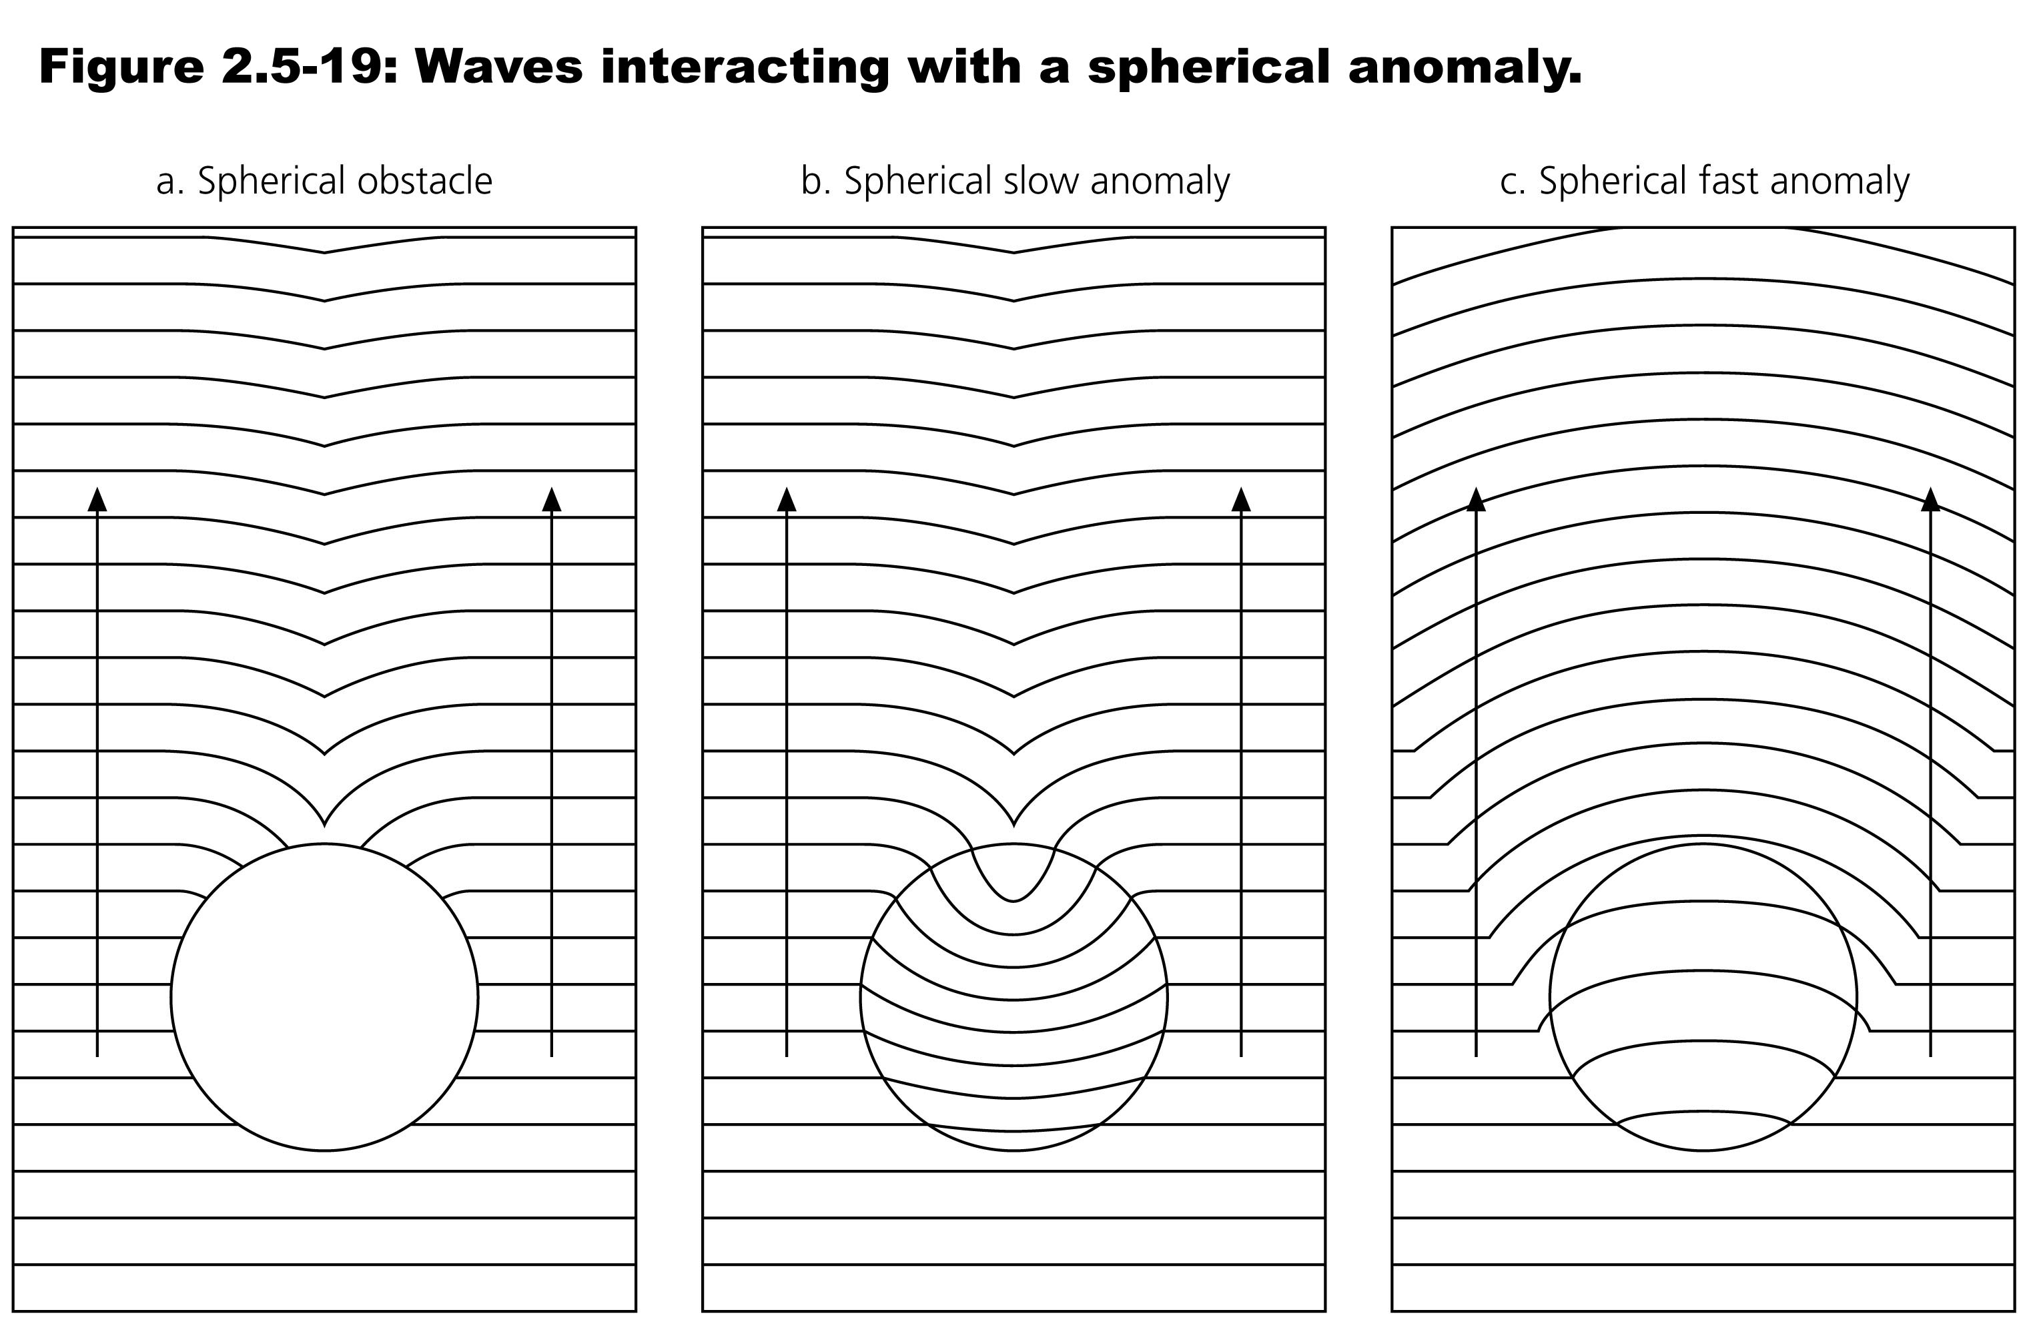
Notes:
Huyguen's principle shows how waves diffract around bodies.
a) liquid – sources from edge go out circularly
b) low vel zone – slows down inside – small effect coming out – hard to see
c) fast vel zone – speeds up inside, larger effect coming out – easy to see

Slide 5
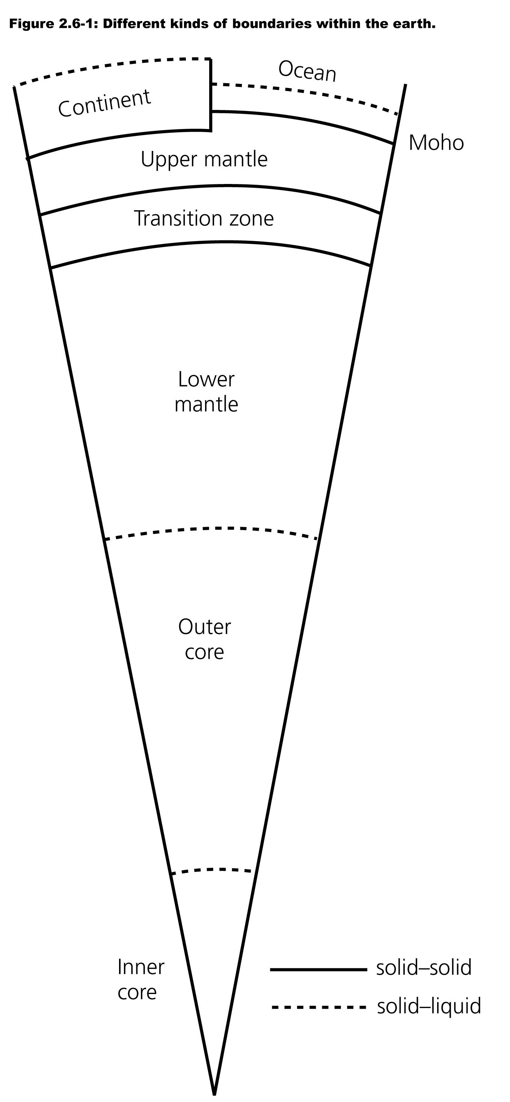

Slide 6
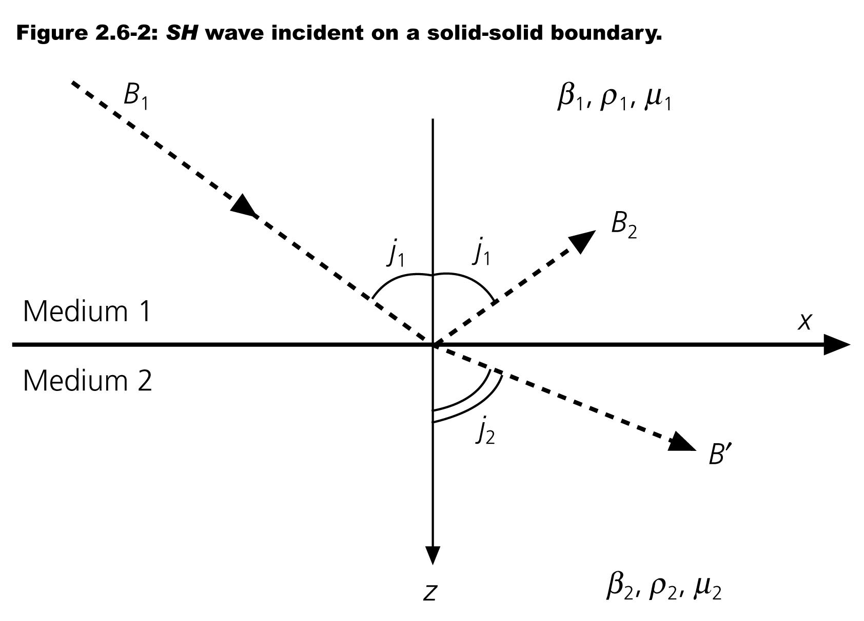


Slide 7


Slide 8


Slide 9
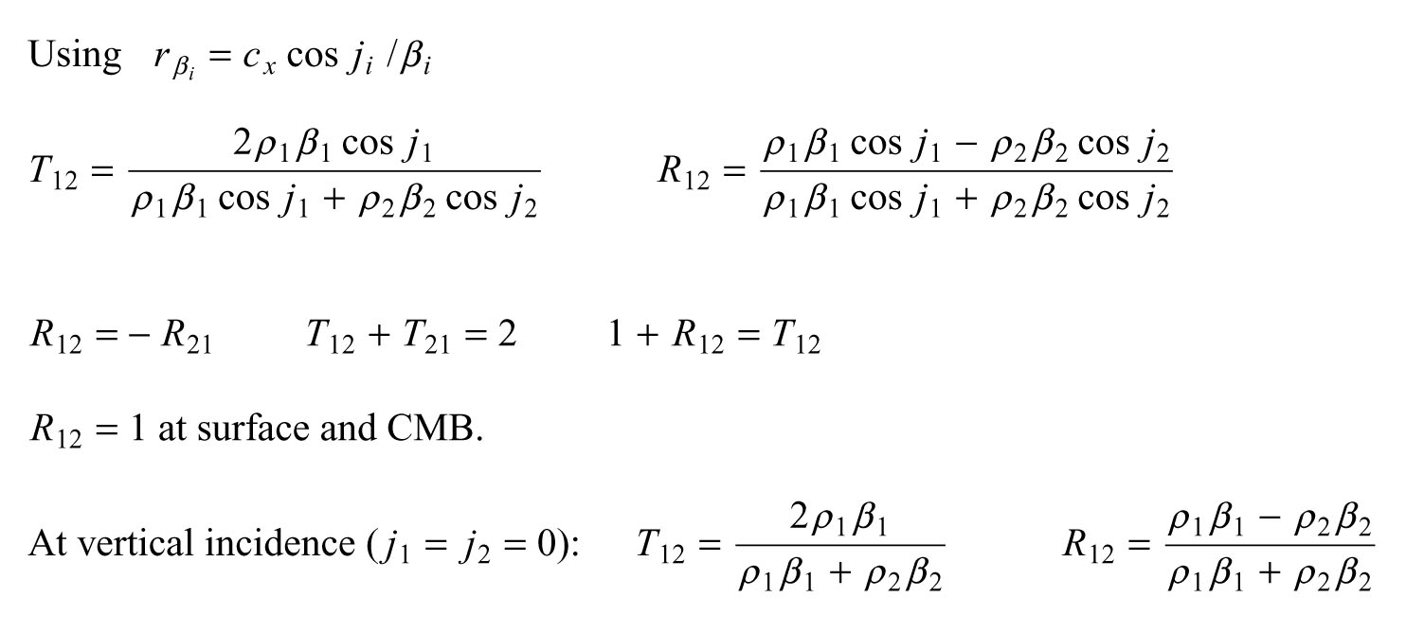

Slide 10
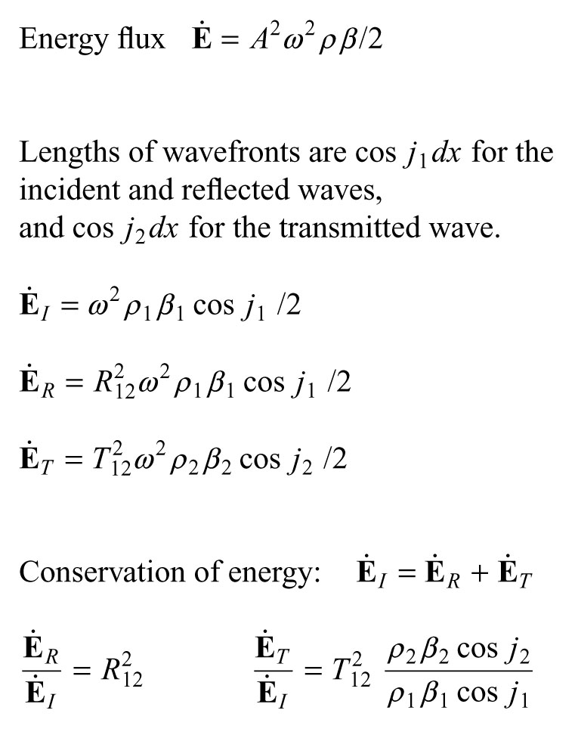
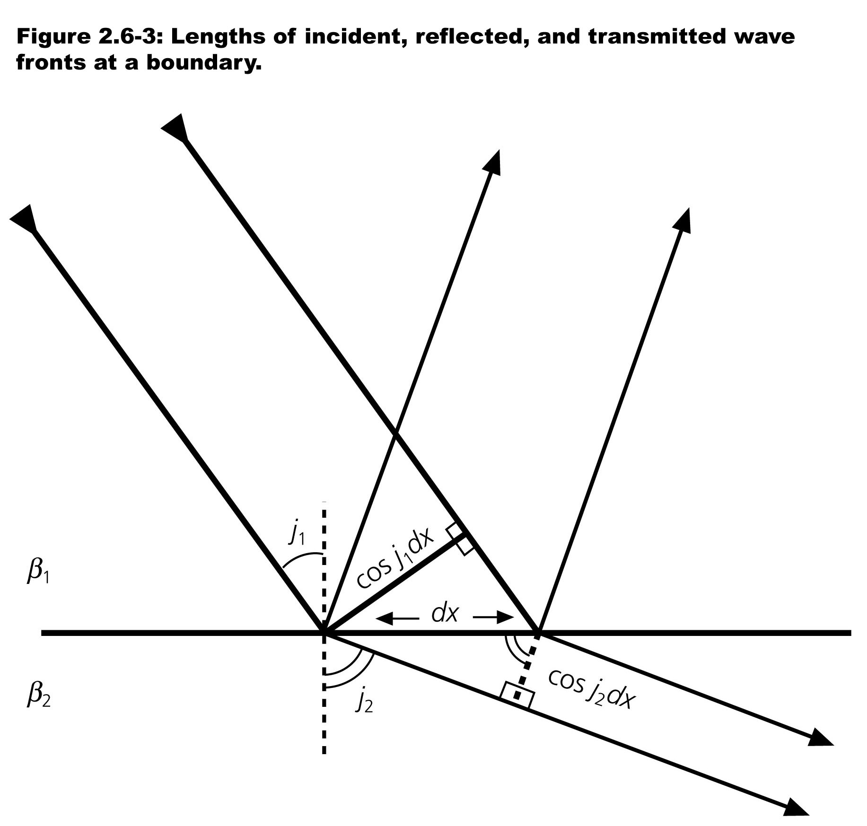
Notes:
For Et/Ei the material property and geometric terms are linear

Slide 11
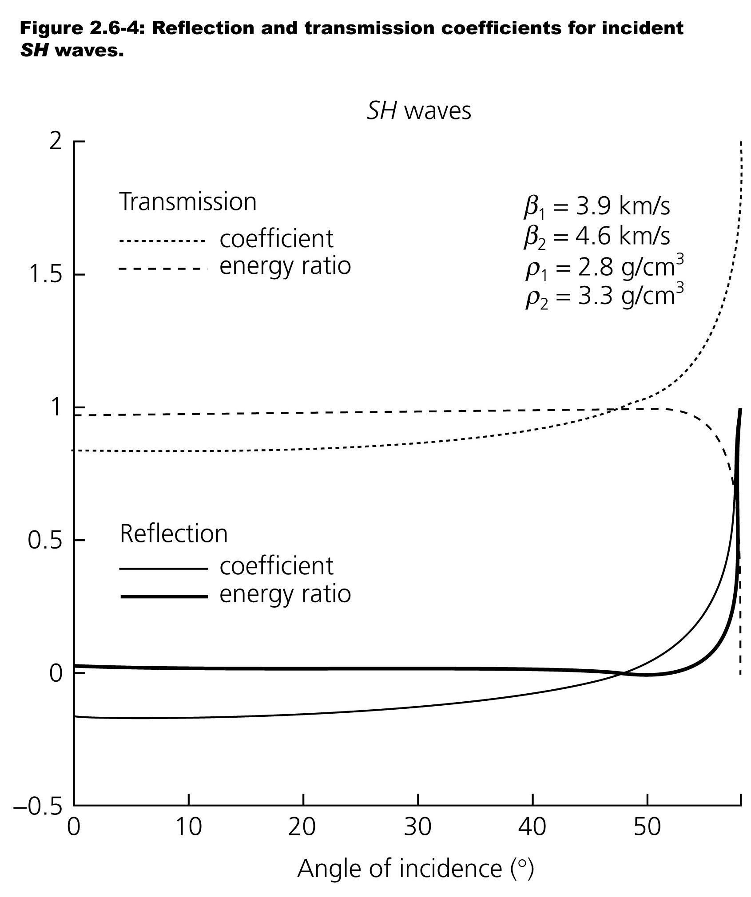
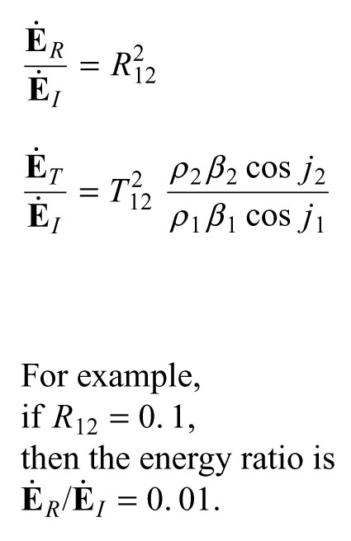

Slide 12
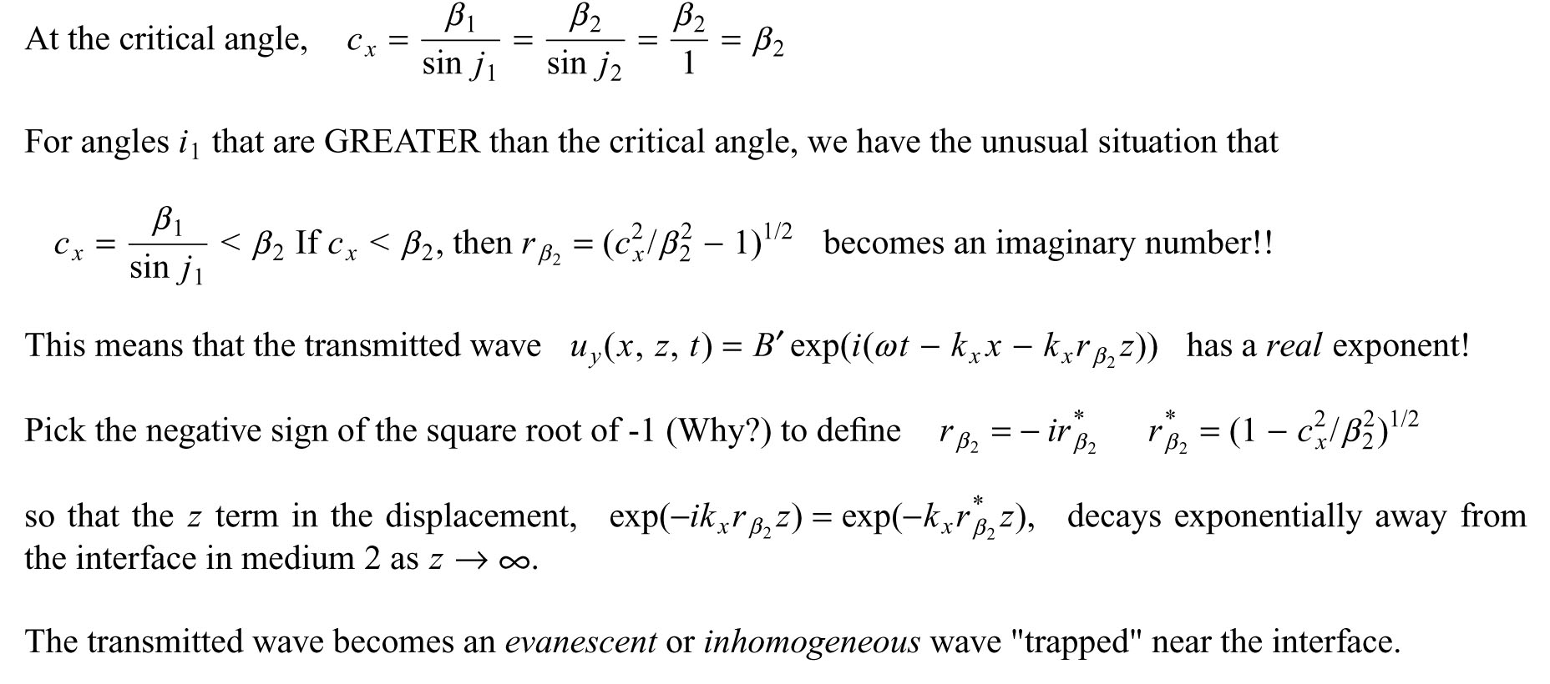

Slide 13
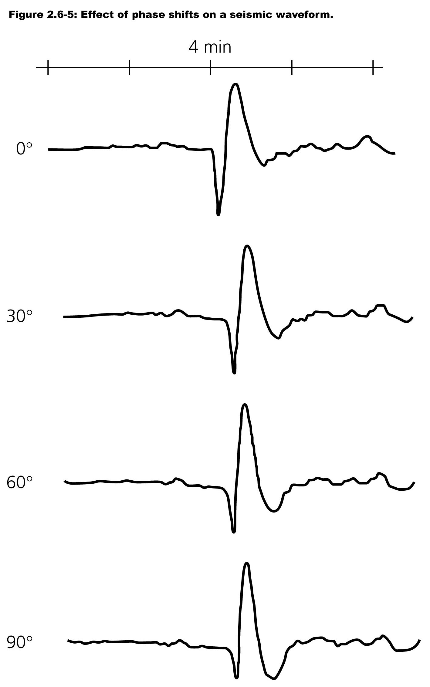
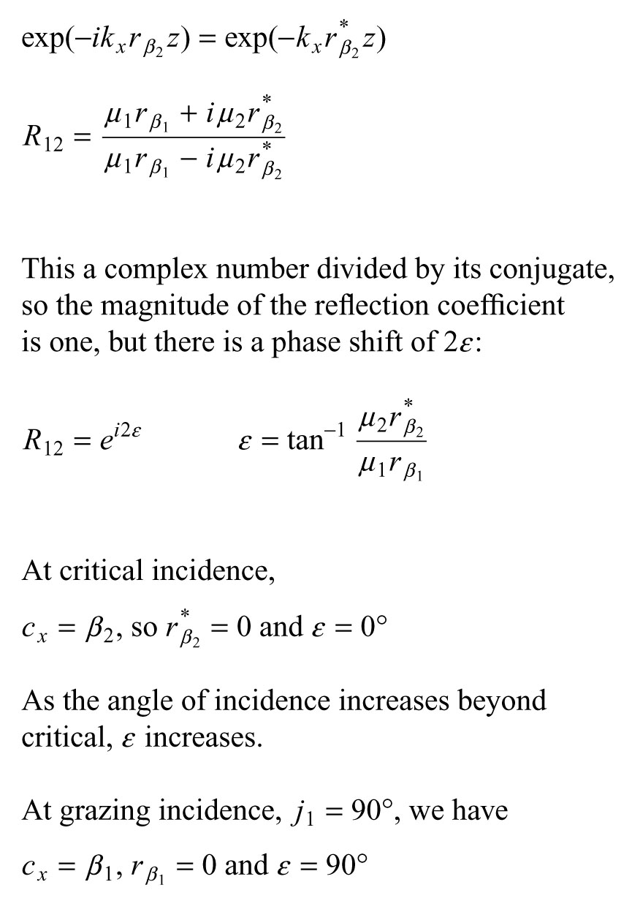

Slide 14
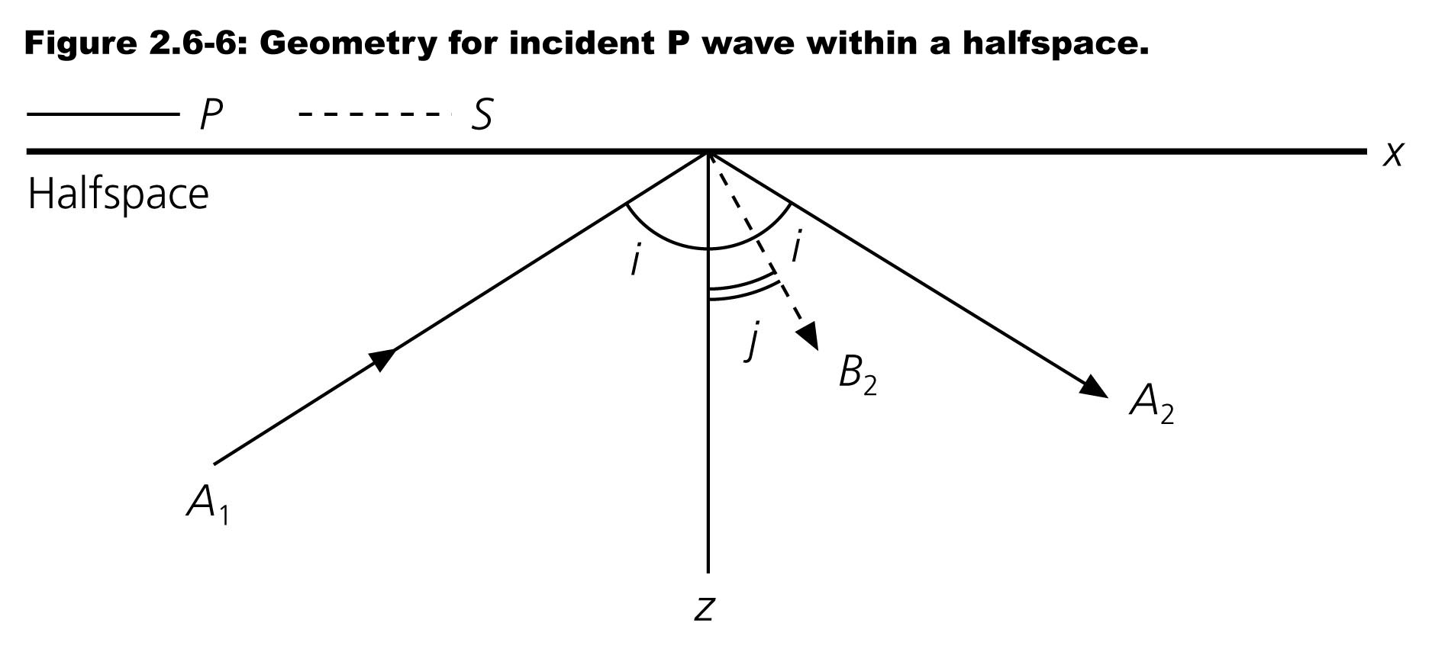
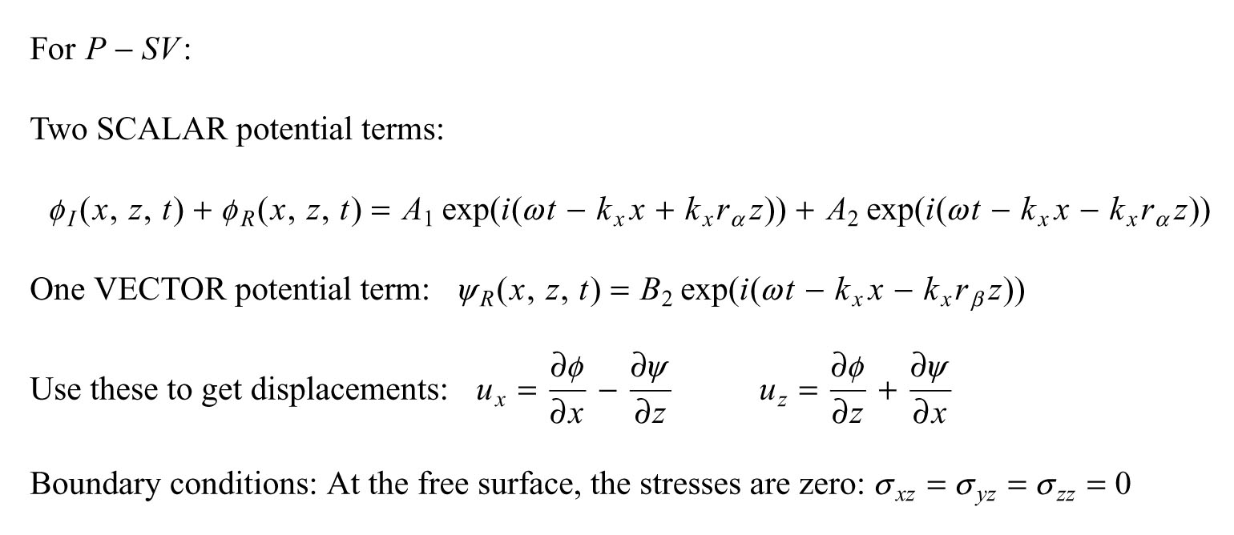

Slide 15
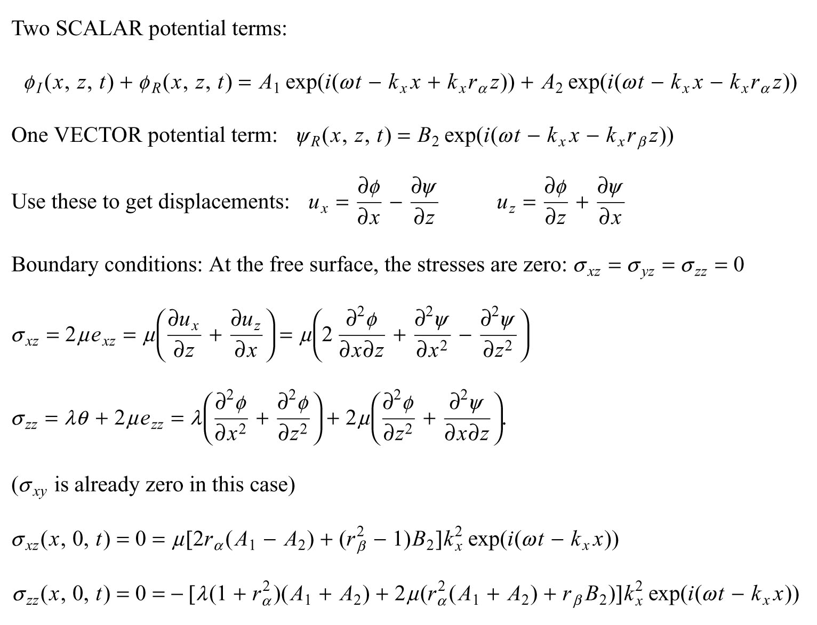

Slide 16
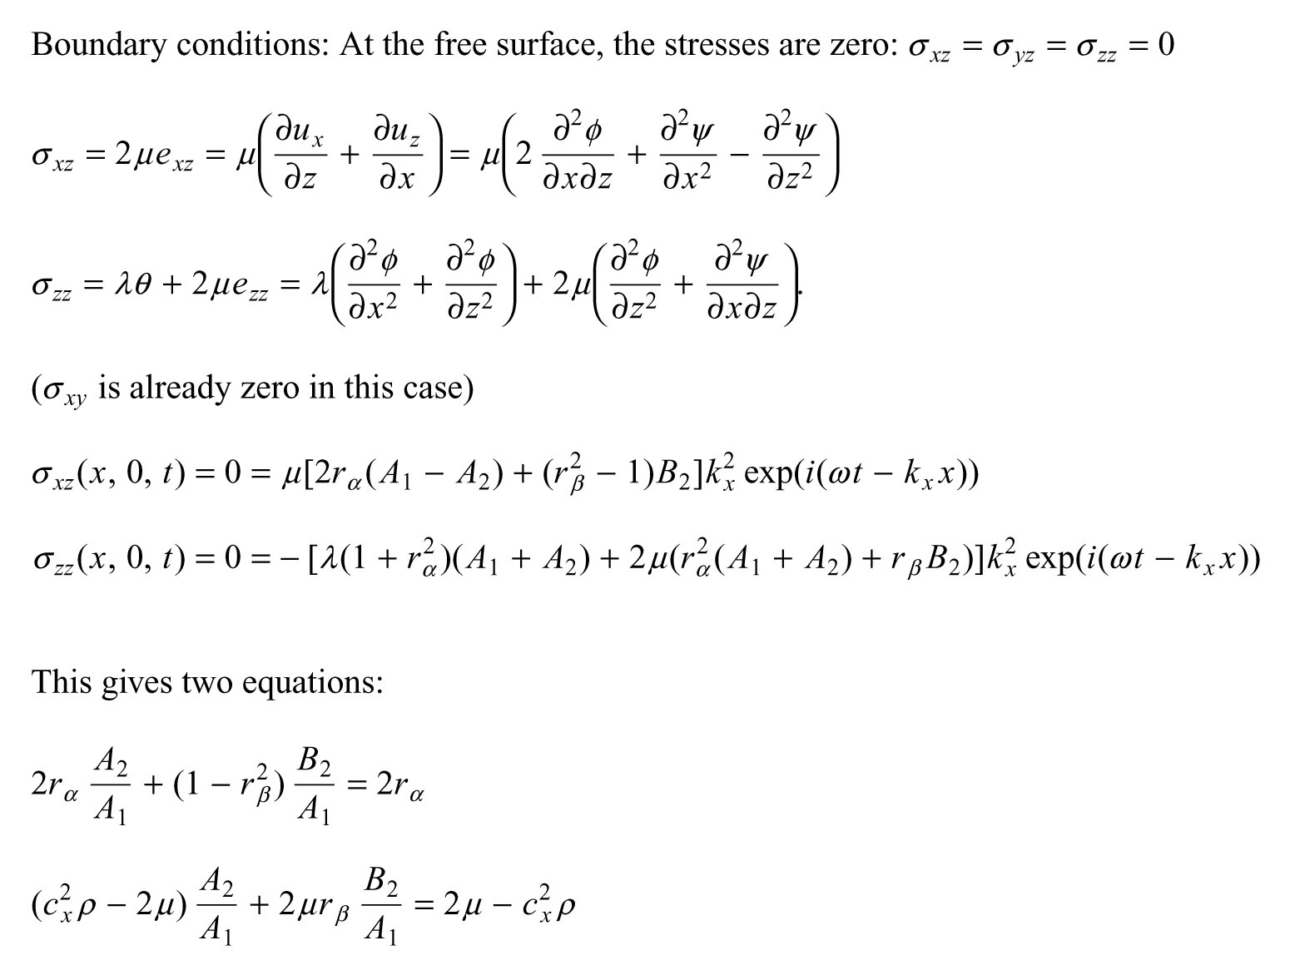

Slide 17
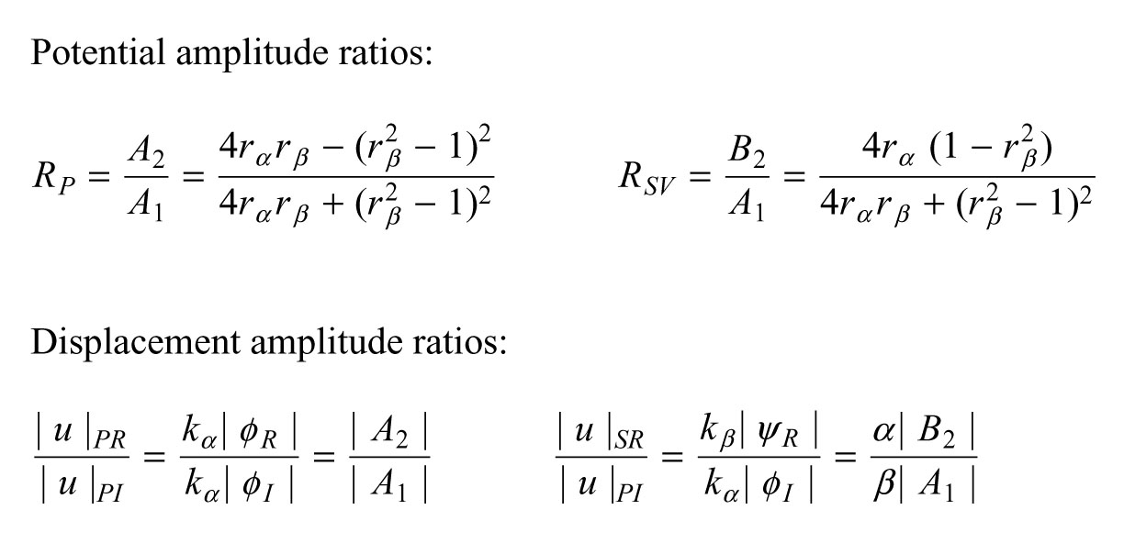

Slide 18
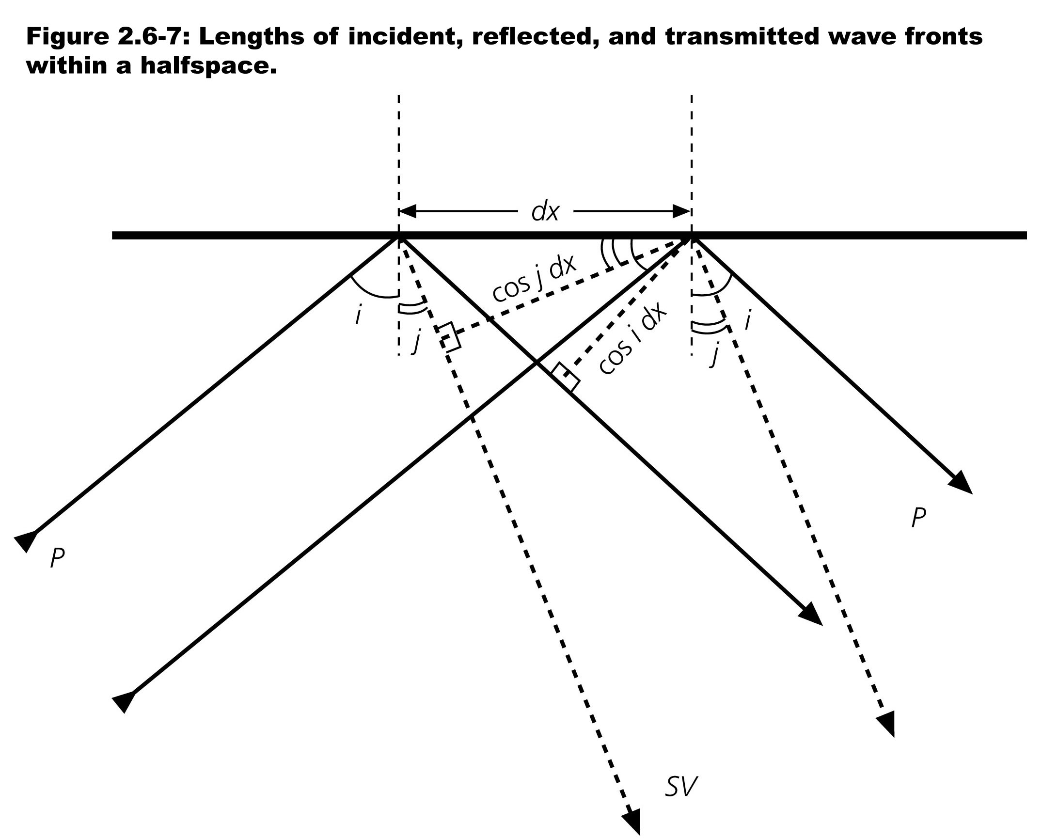


Slide 19
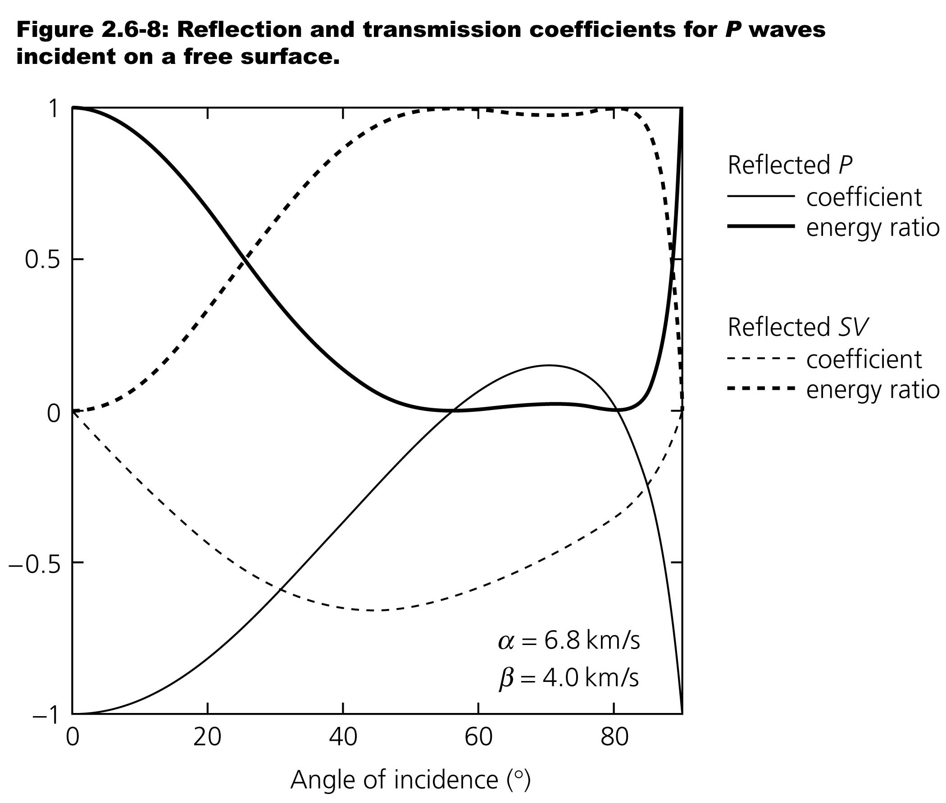

Slide 20
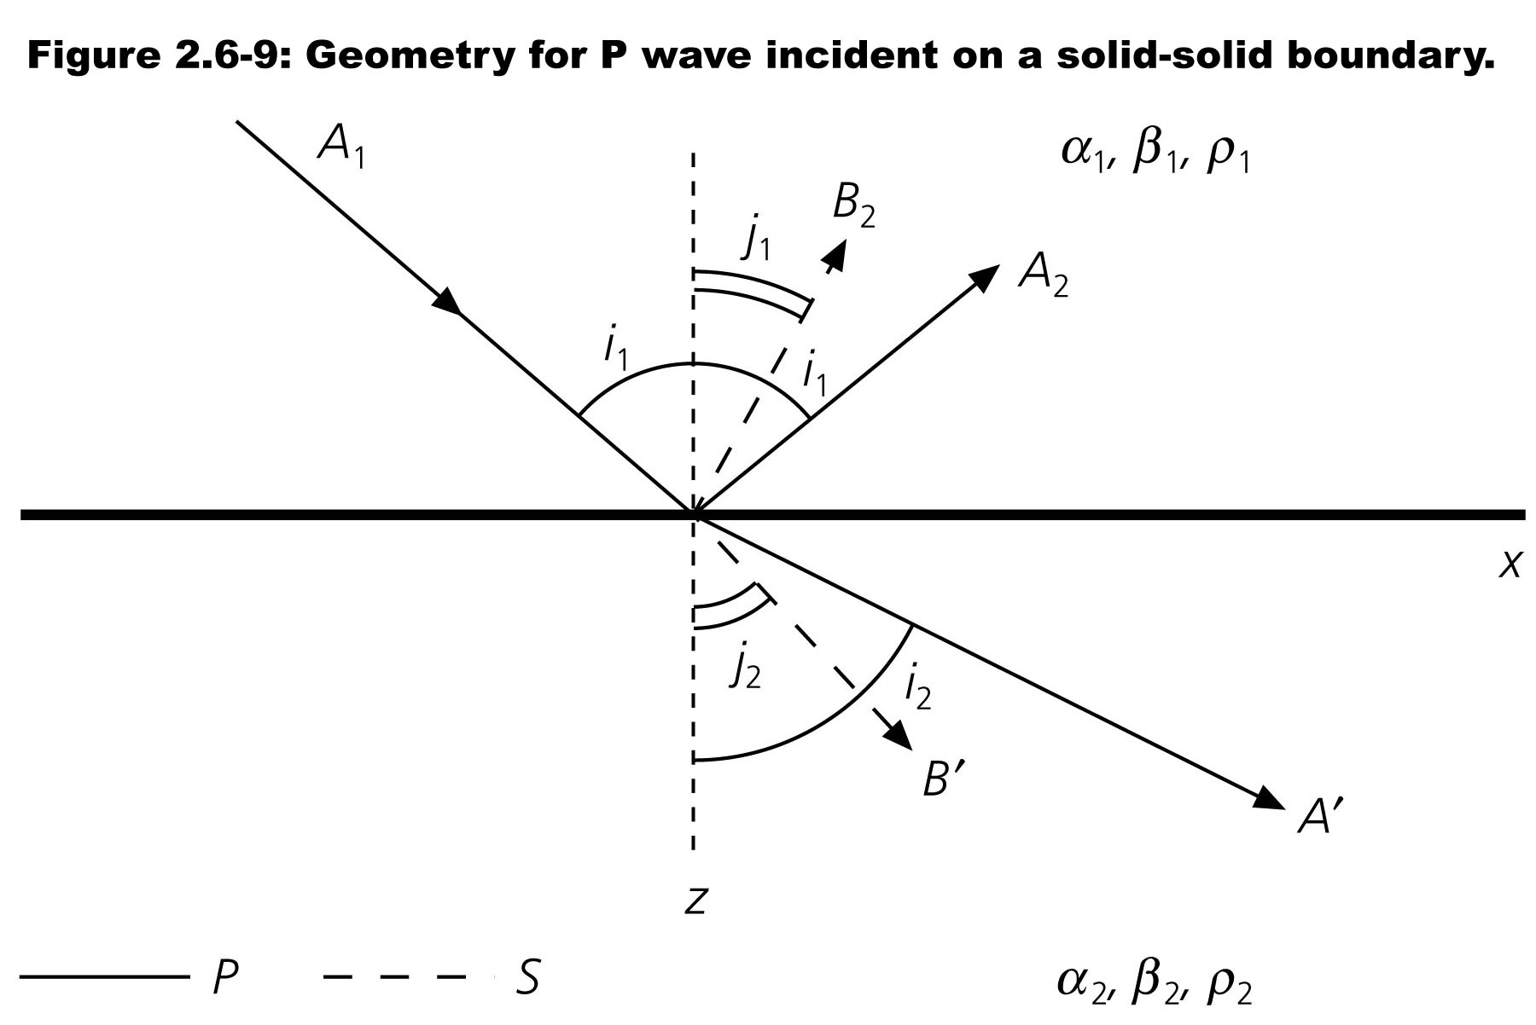
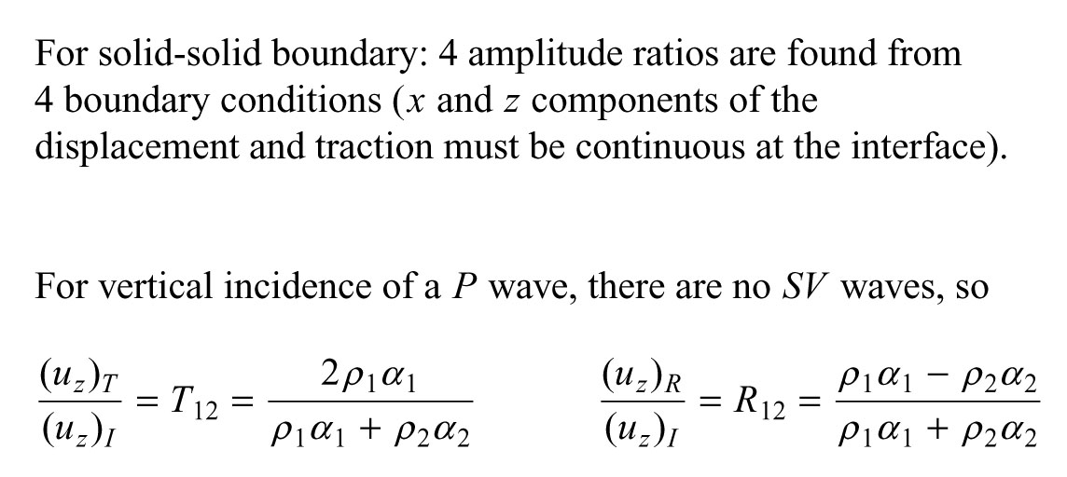

Slide 21
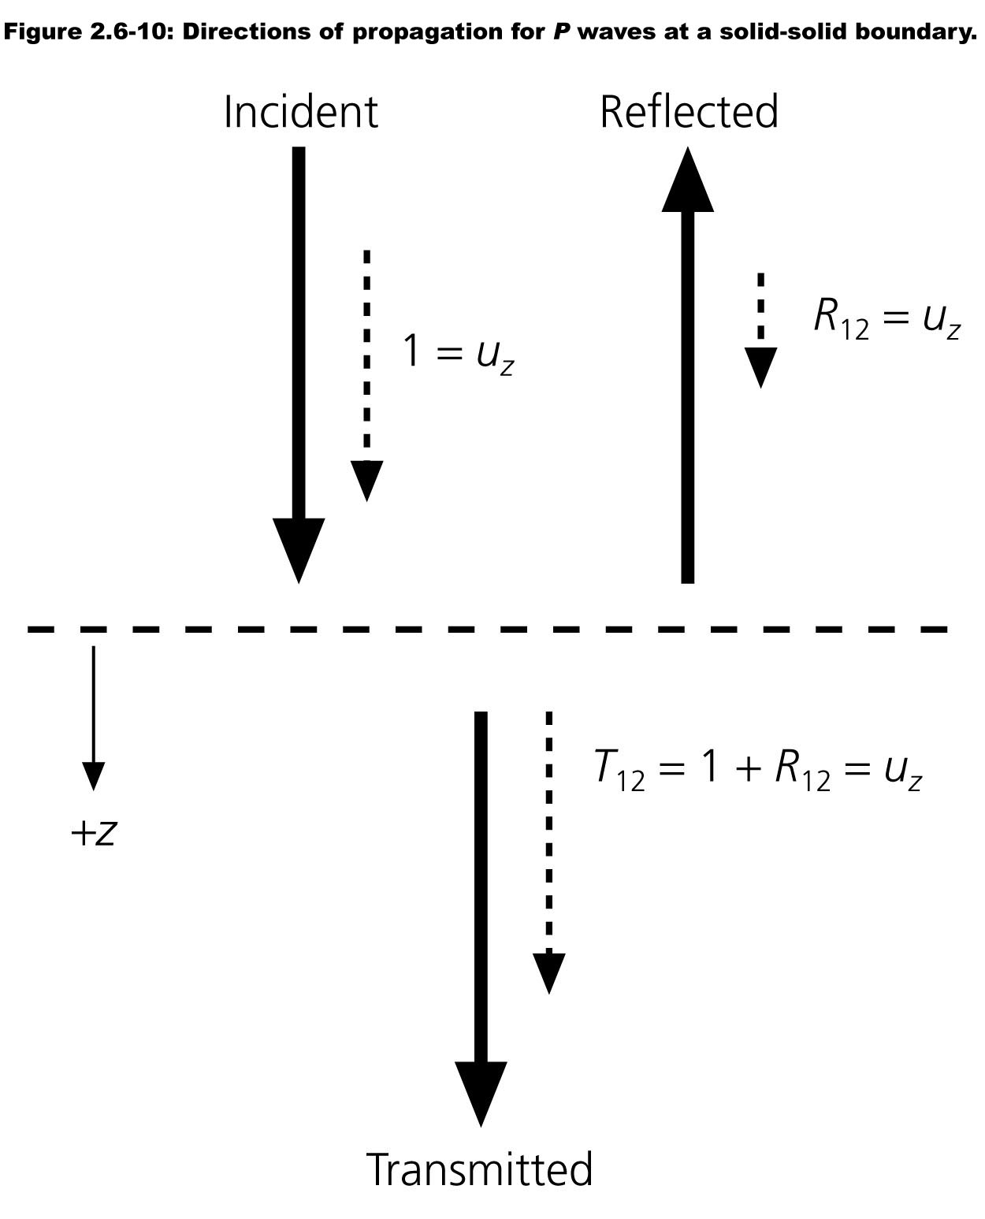

Slide 22
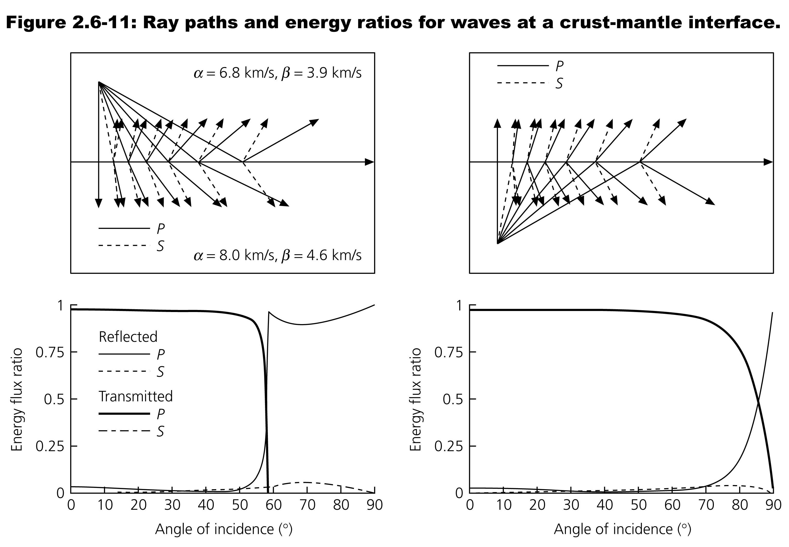


Slide 23
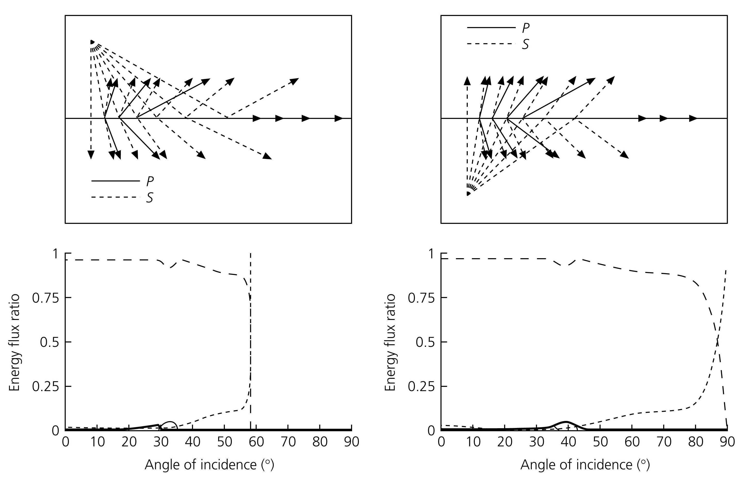
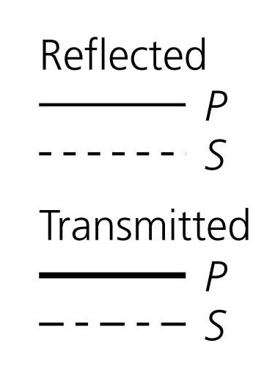

Slide 24
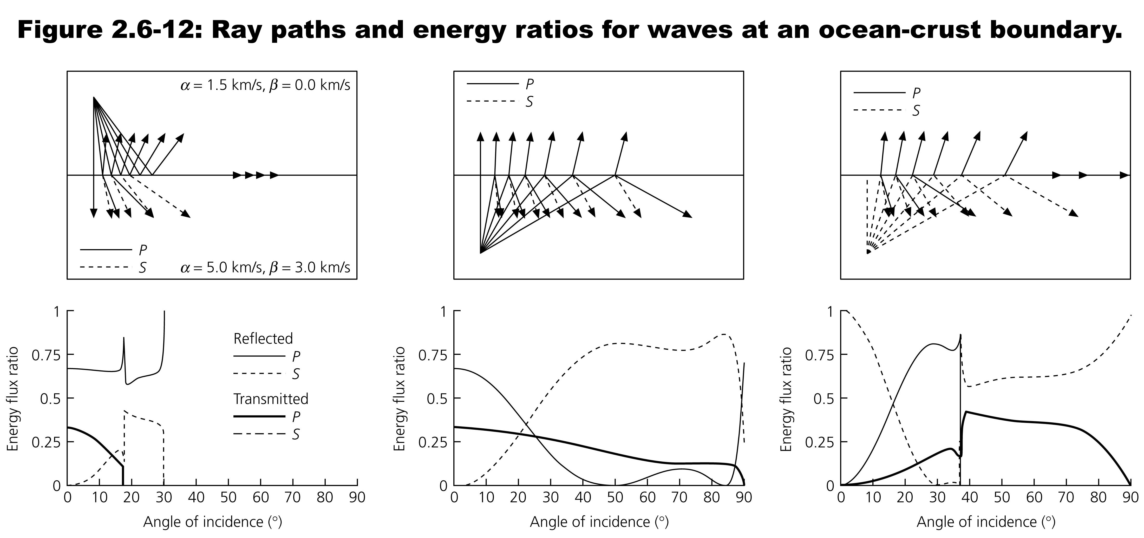

Slide 25
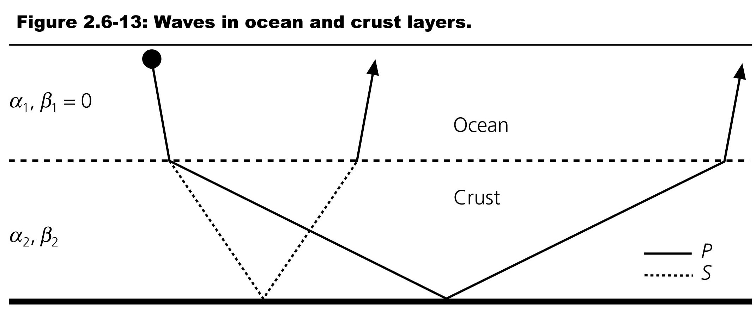

Slide 26
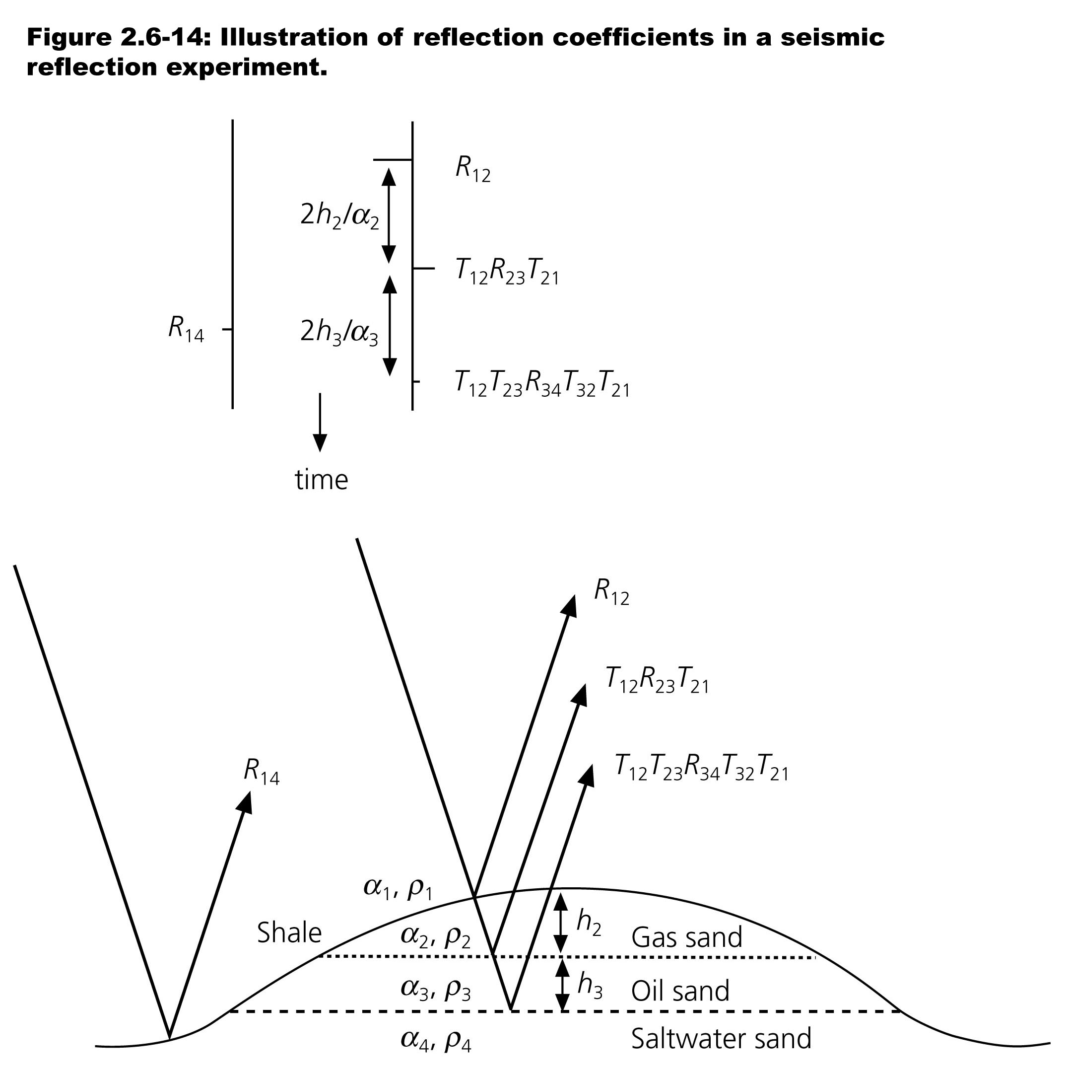

Slide 27
