Slide 1
Global Seismology CERI-8105
Tu-Th 1:00-2:25pm
Lab - 3892 Central Ave. (Long building) , Room 110
-----------------------------------------------
Bob Smalley
Office: 3892 Central Ave, Room 103, 678-4929
Office Hours – when I’m in my office.
http://www.ceri.memphis.edu/people/smalley/CERI8105_GlobalSeismology.html
Tue., Sep 21, 2023 Meeting 8

Slide 2
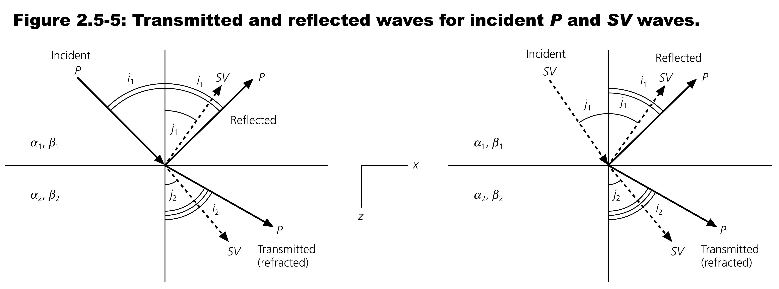
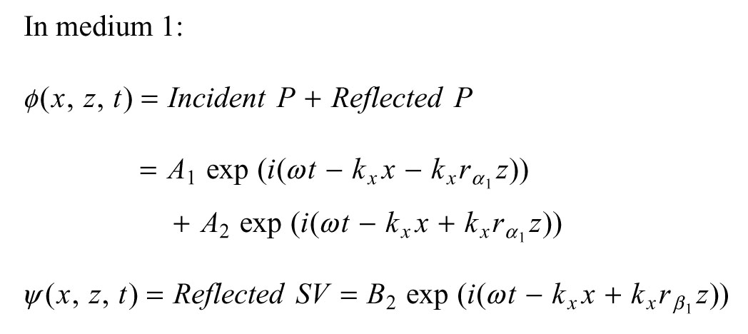
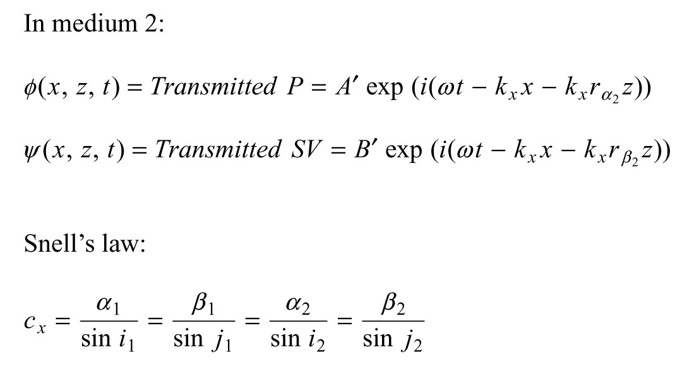

Slide 3
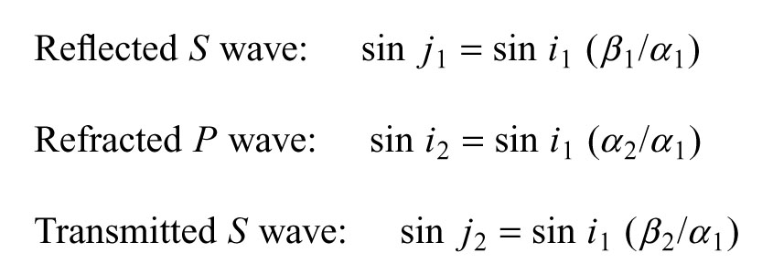

Slide 4
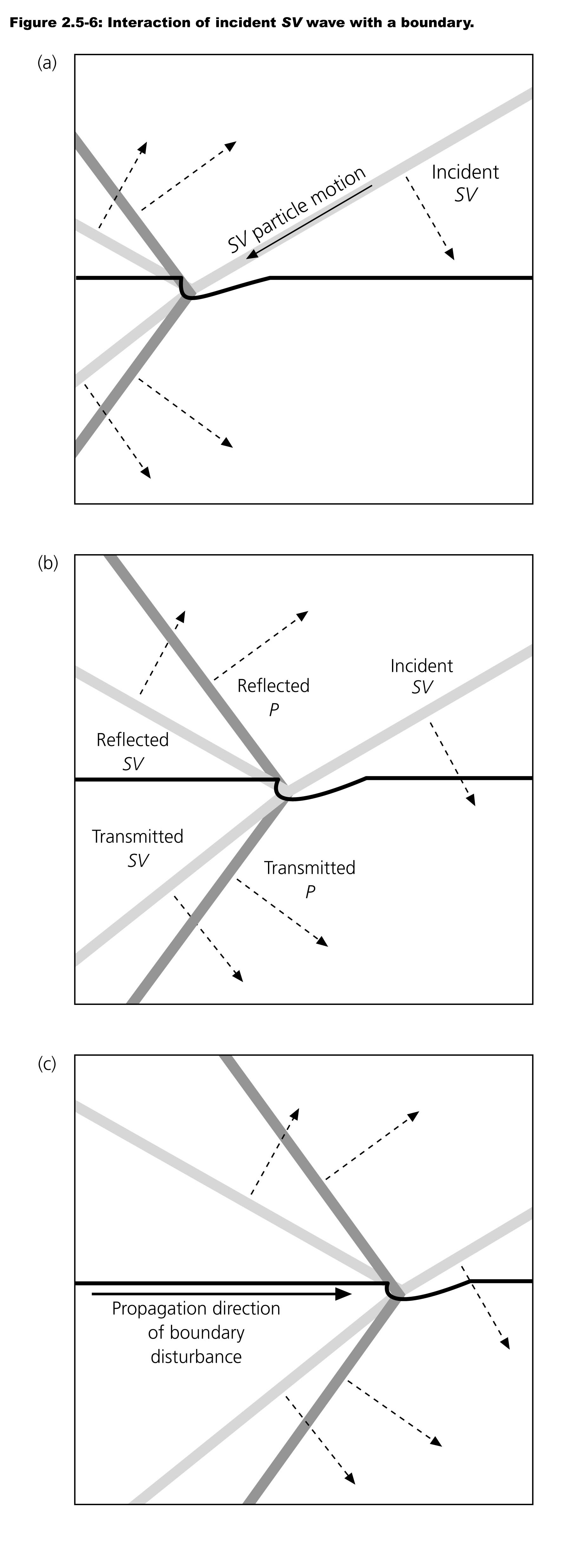

Slide 5
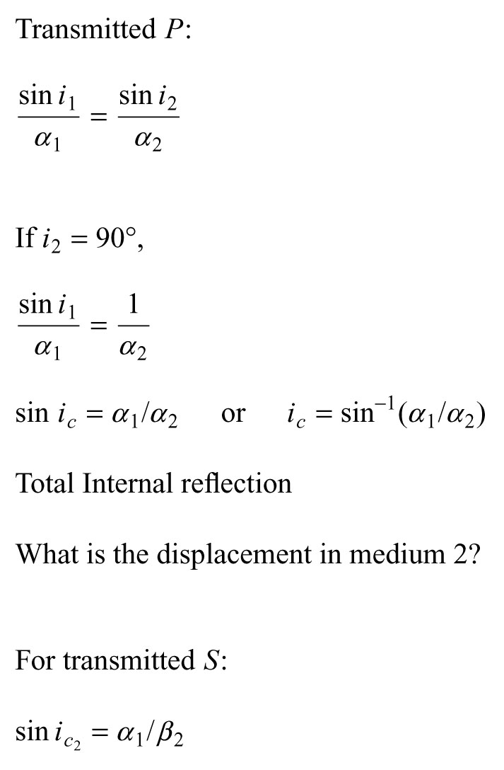
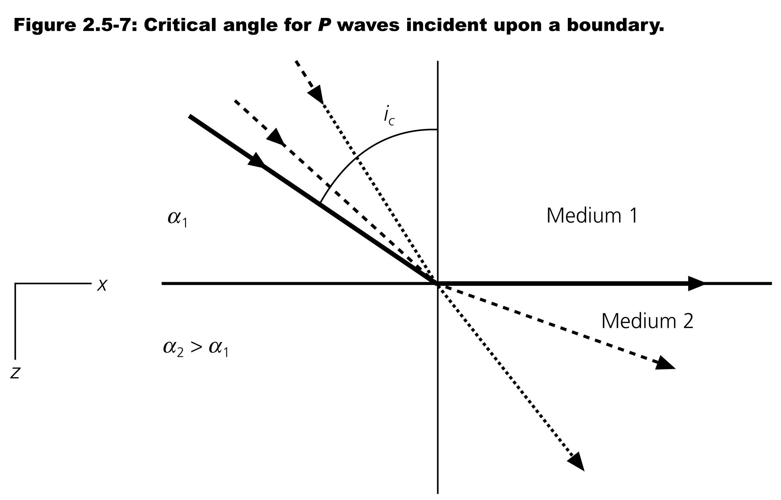

Slide 6
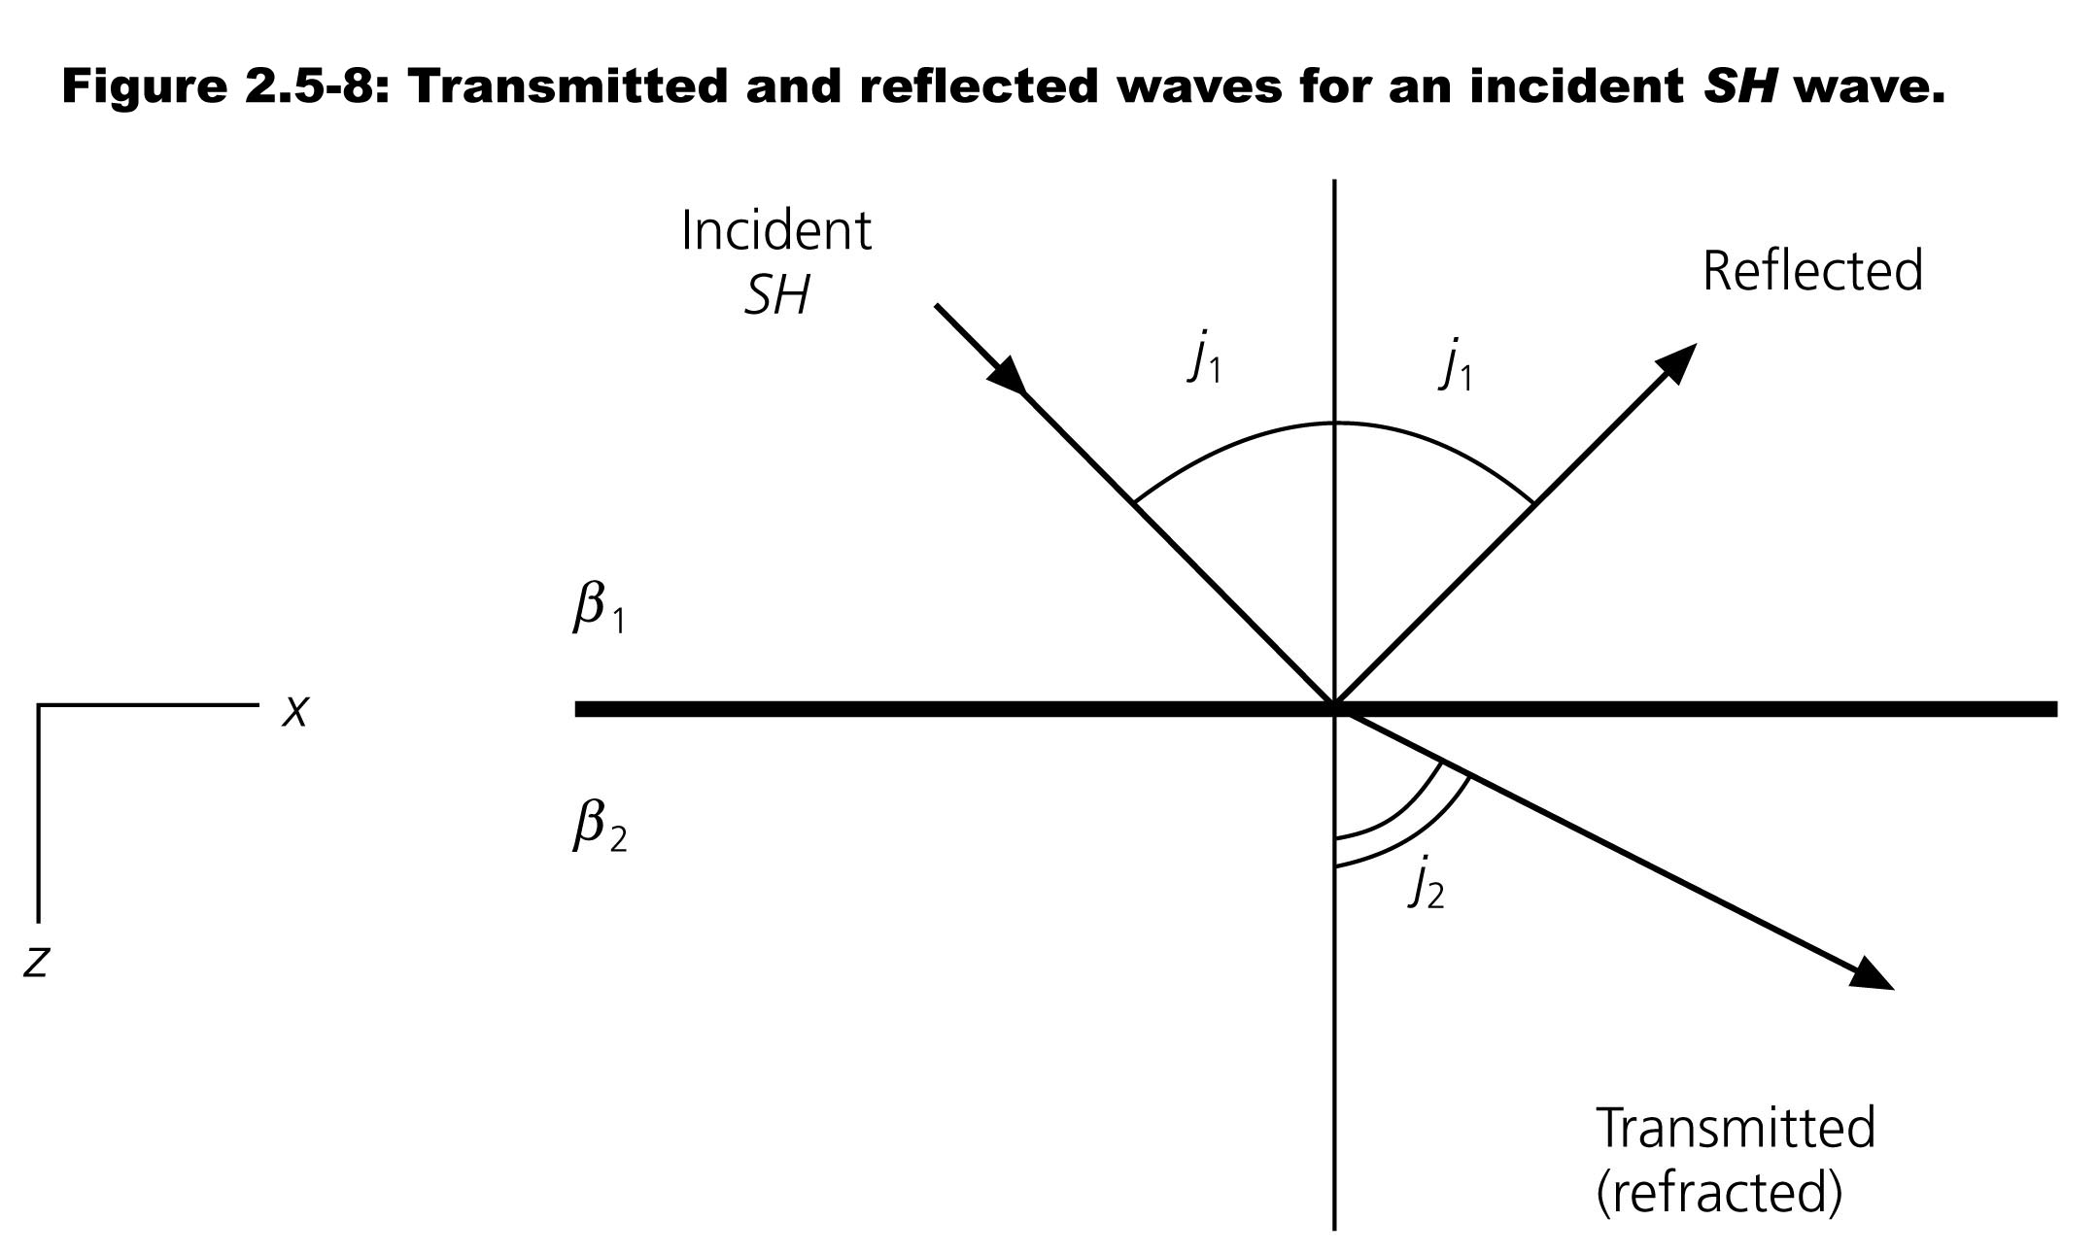
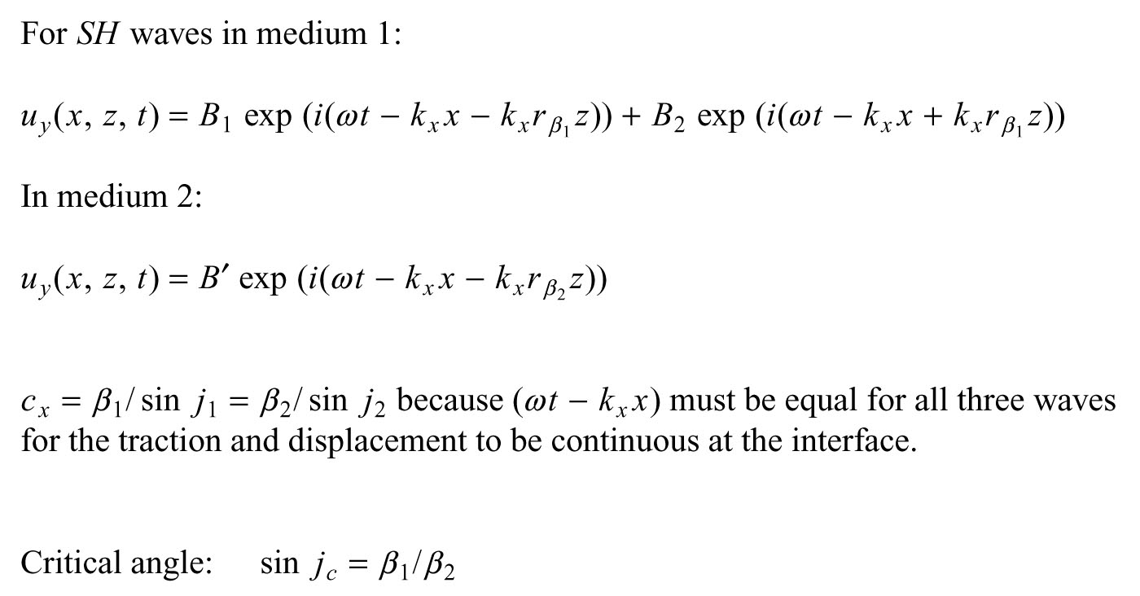

Slide 7
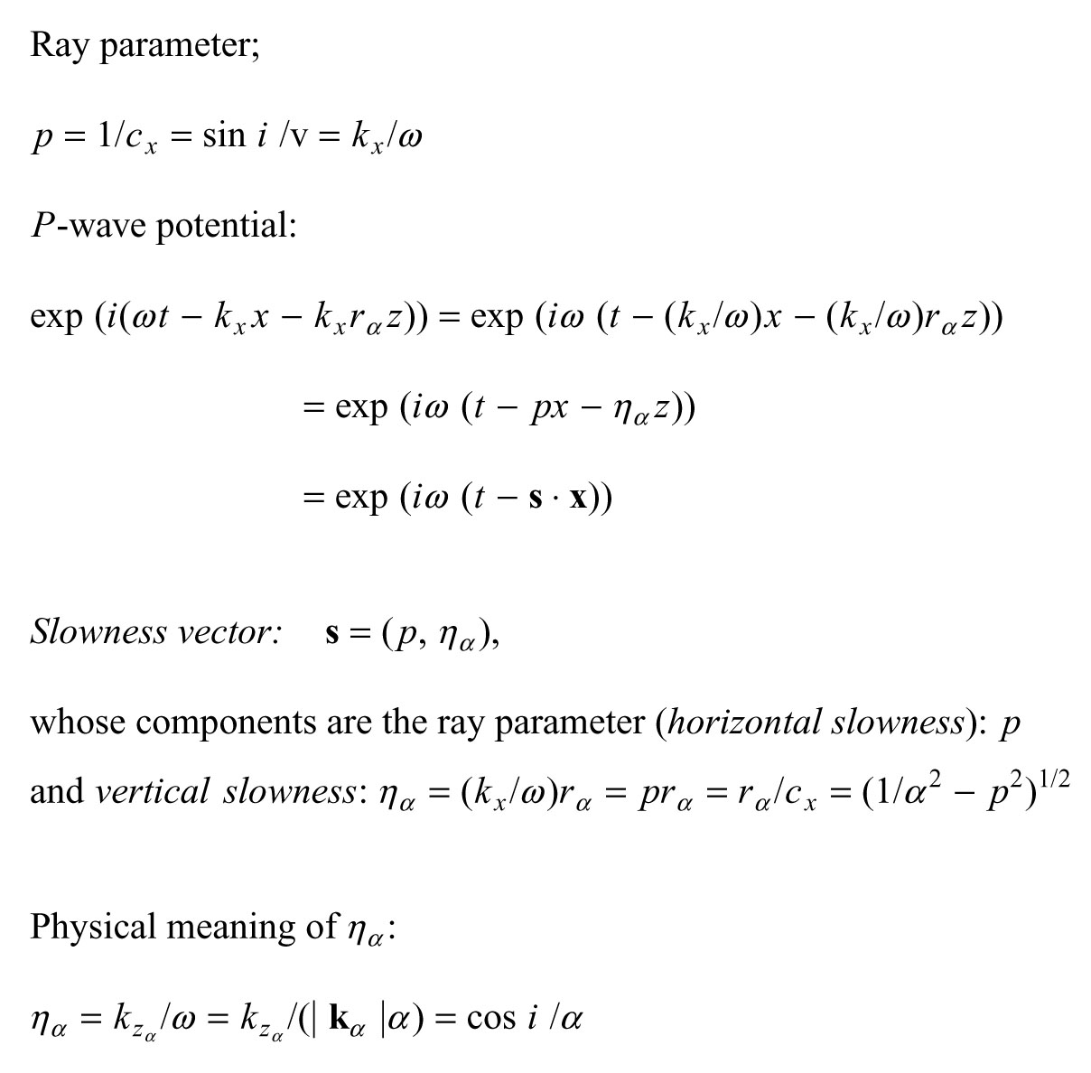

Slide 8
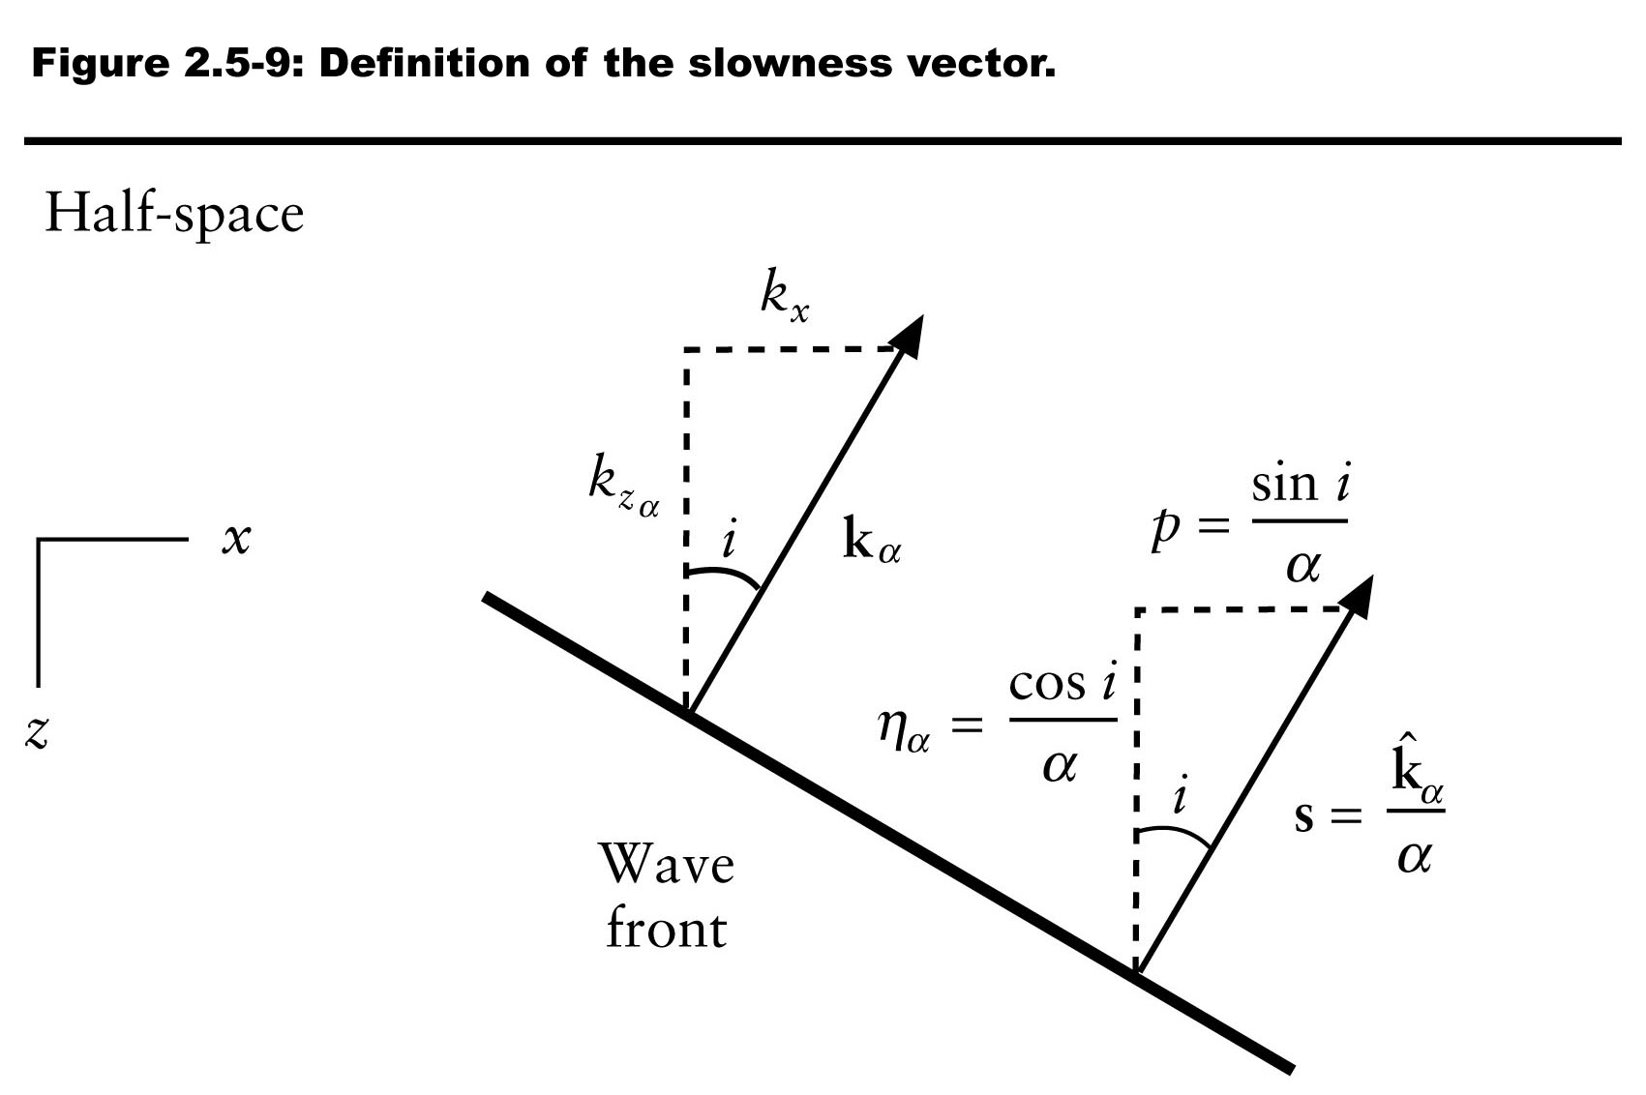

Slide 9
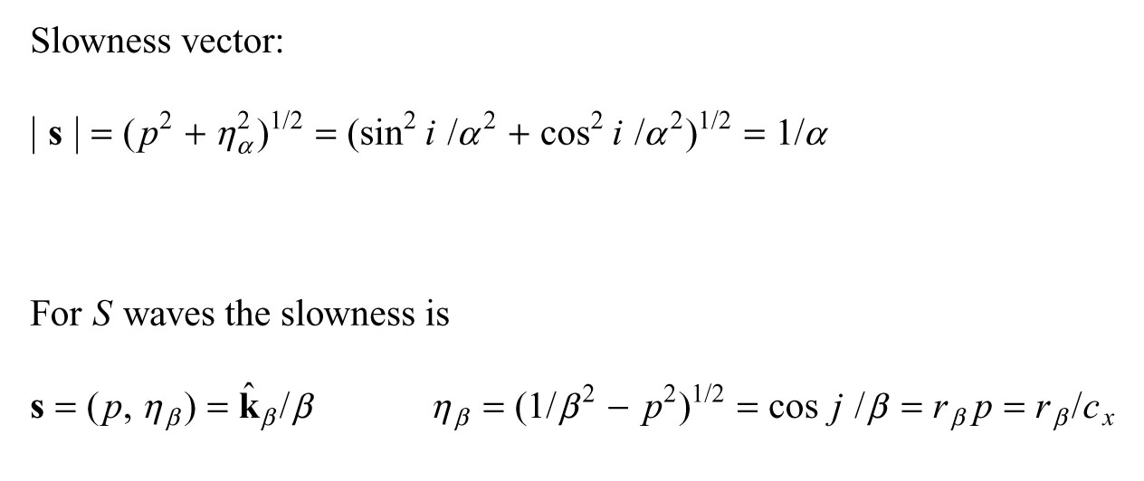
Why is the horizontal slowness (p) the same for P and S waves, but the vertical slowness different?
Because we have horizontal boundaries!

Slide 10
There has to be a continuity of motion along the boundary (e.g., the P waves leaving the boundary have to have the same frequency as the S waves arriving at the boundary).

Slide 11
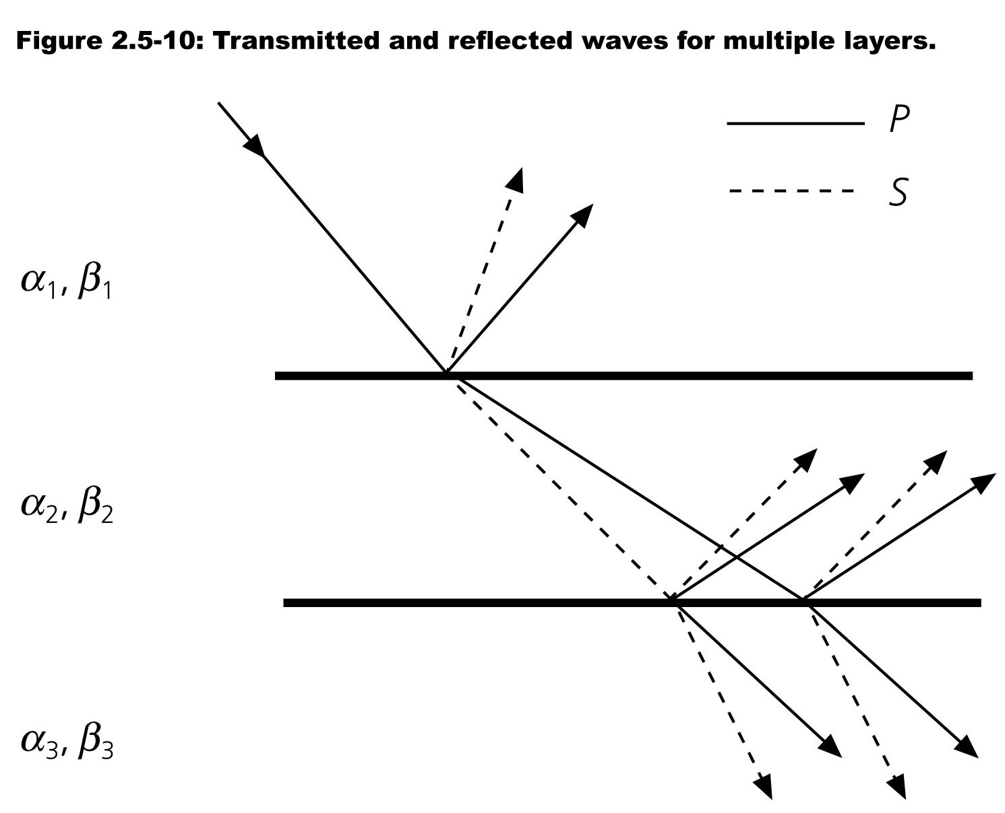

Slide 12
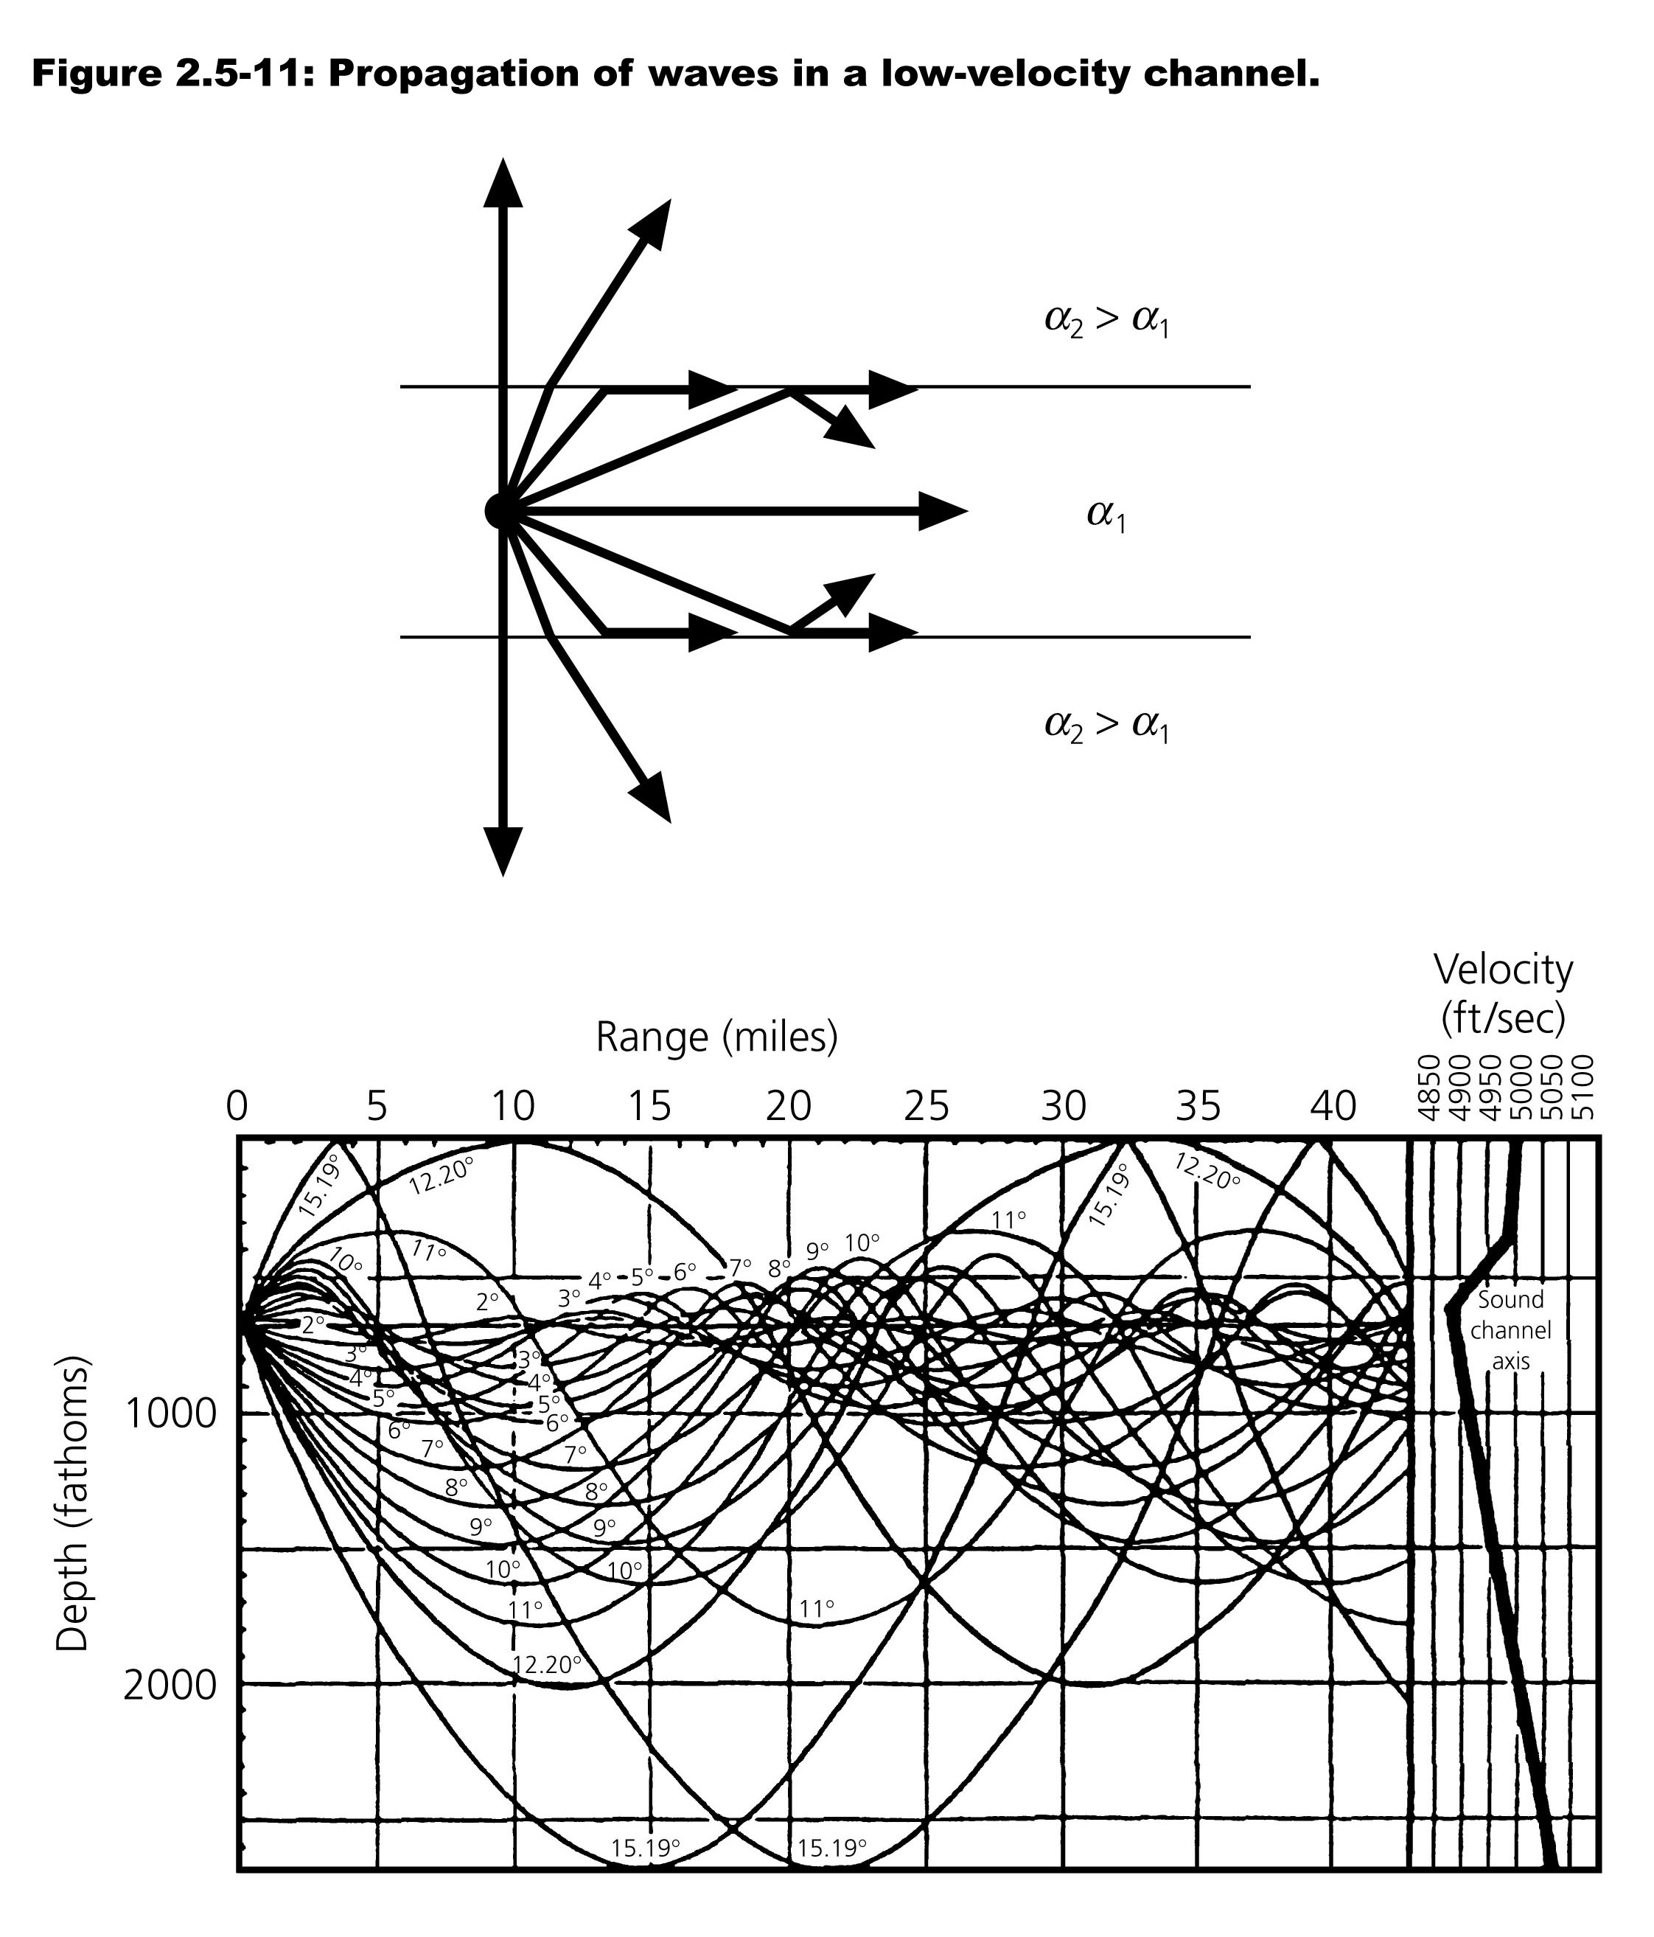

Slide 13
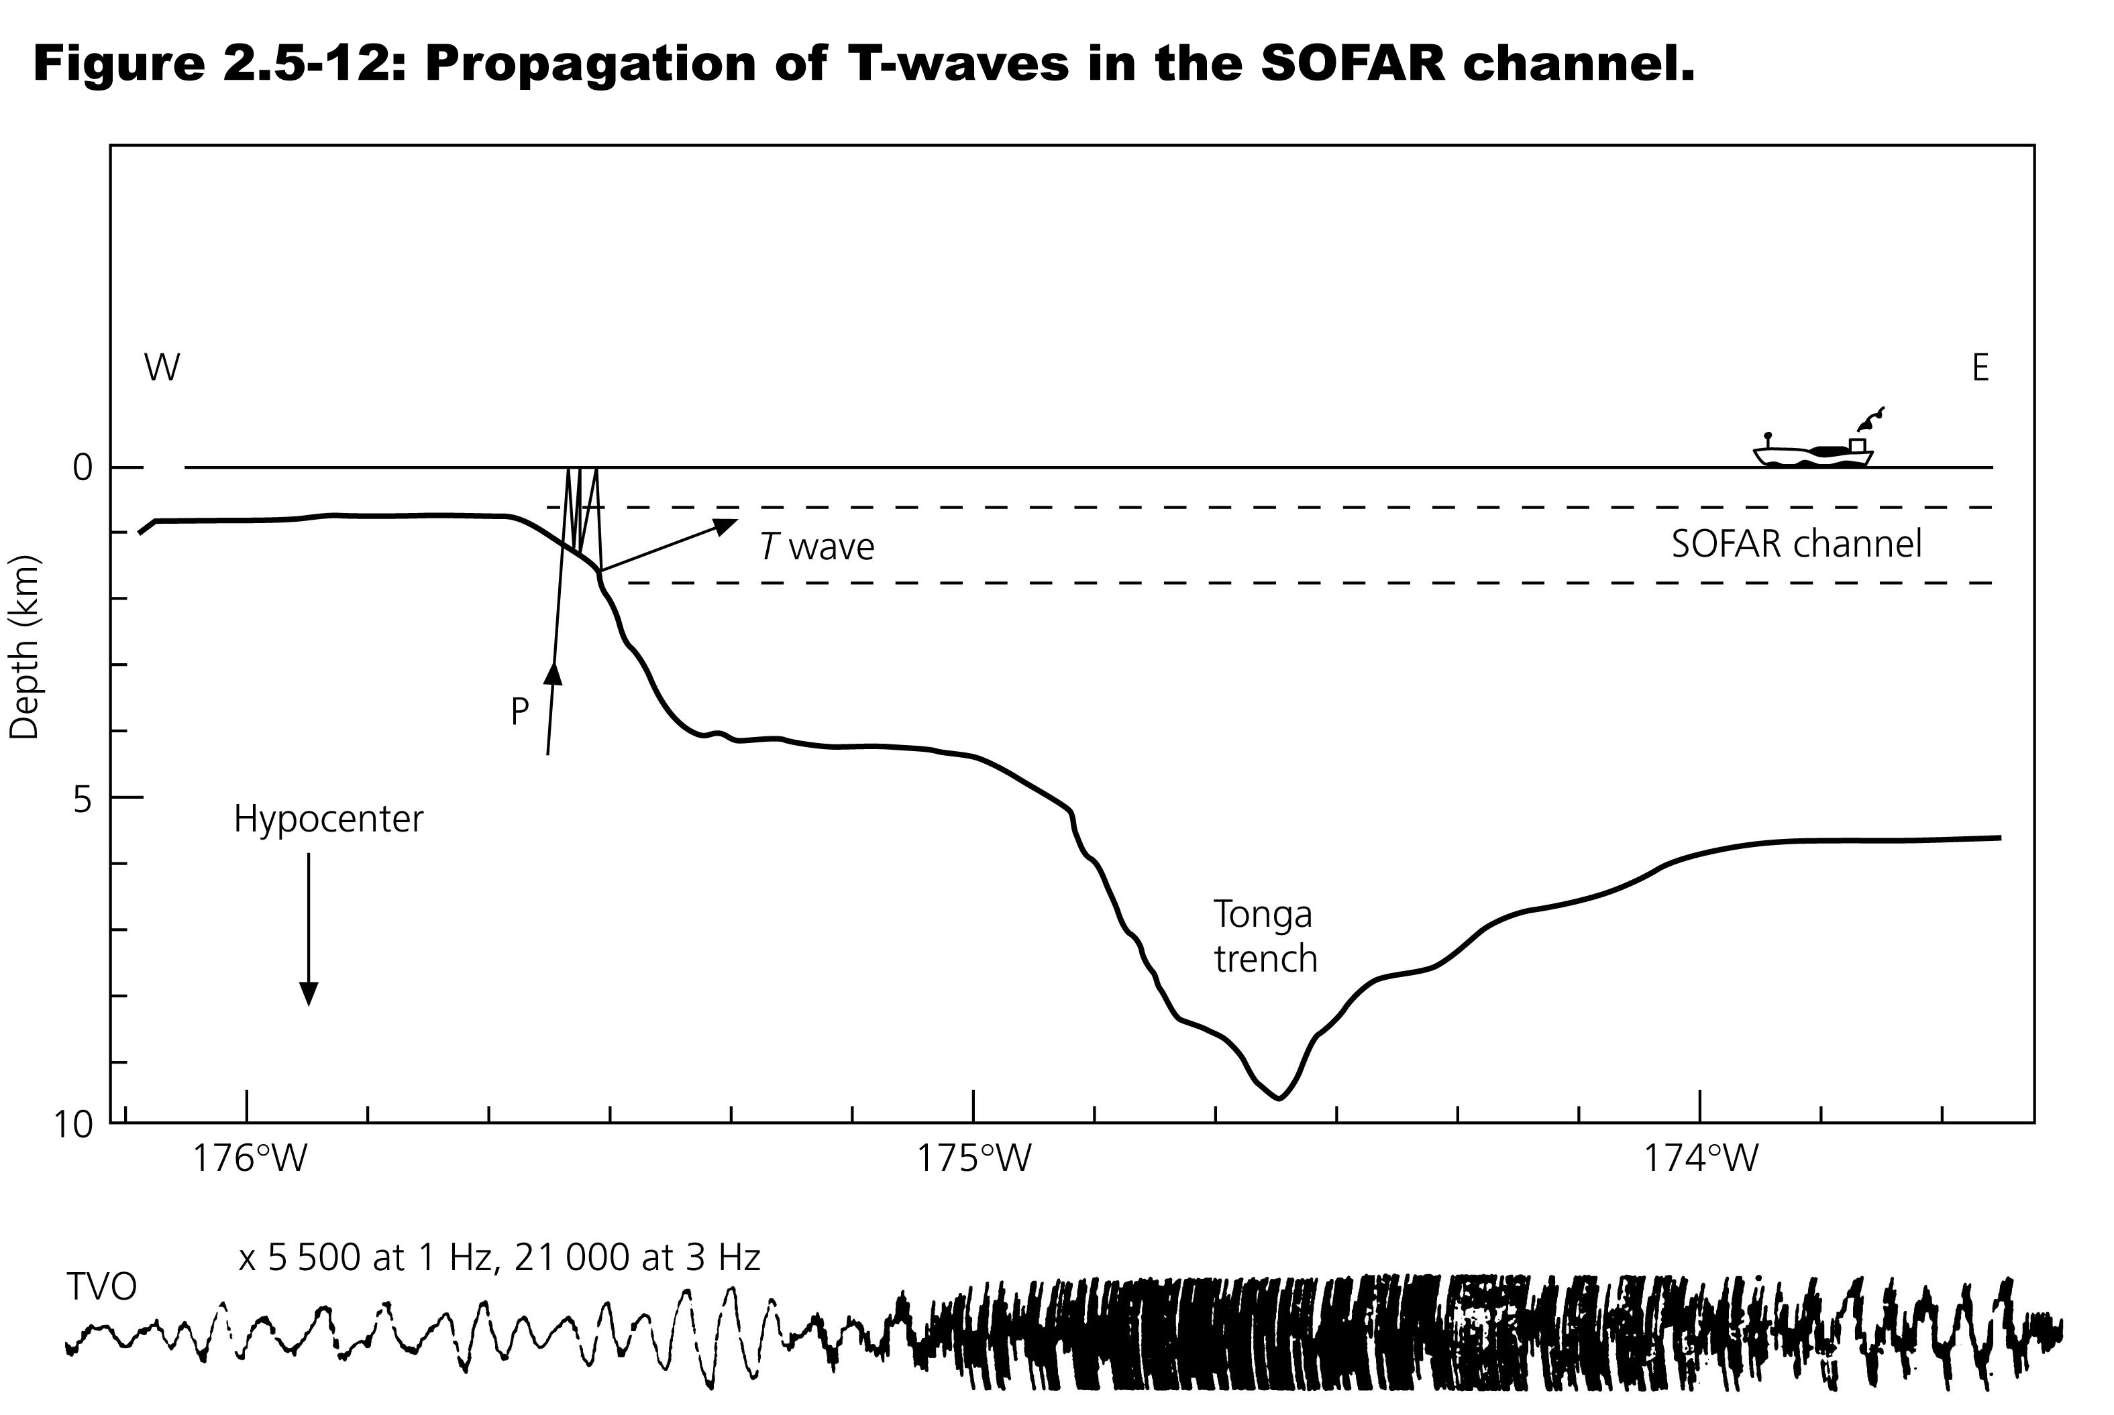

Slide 14
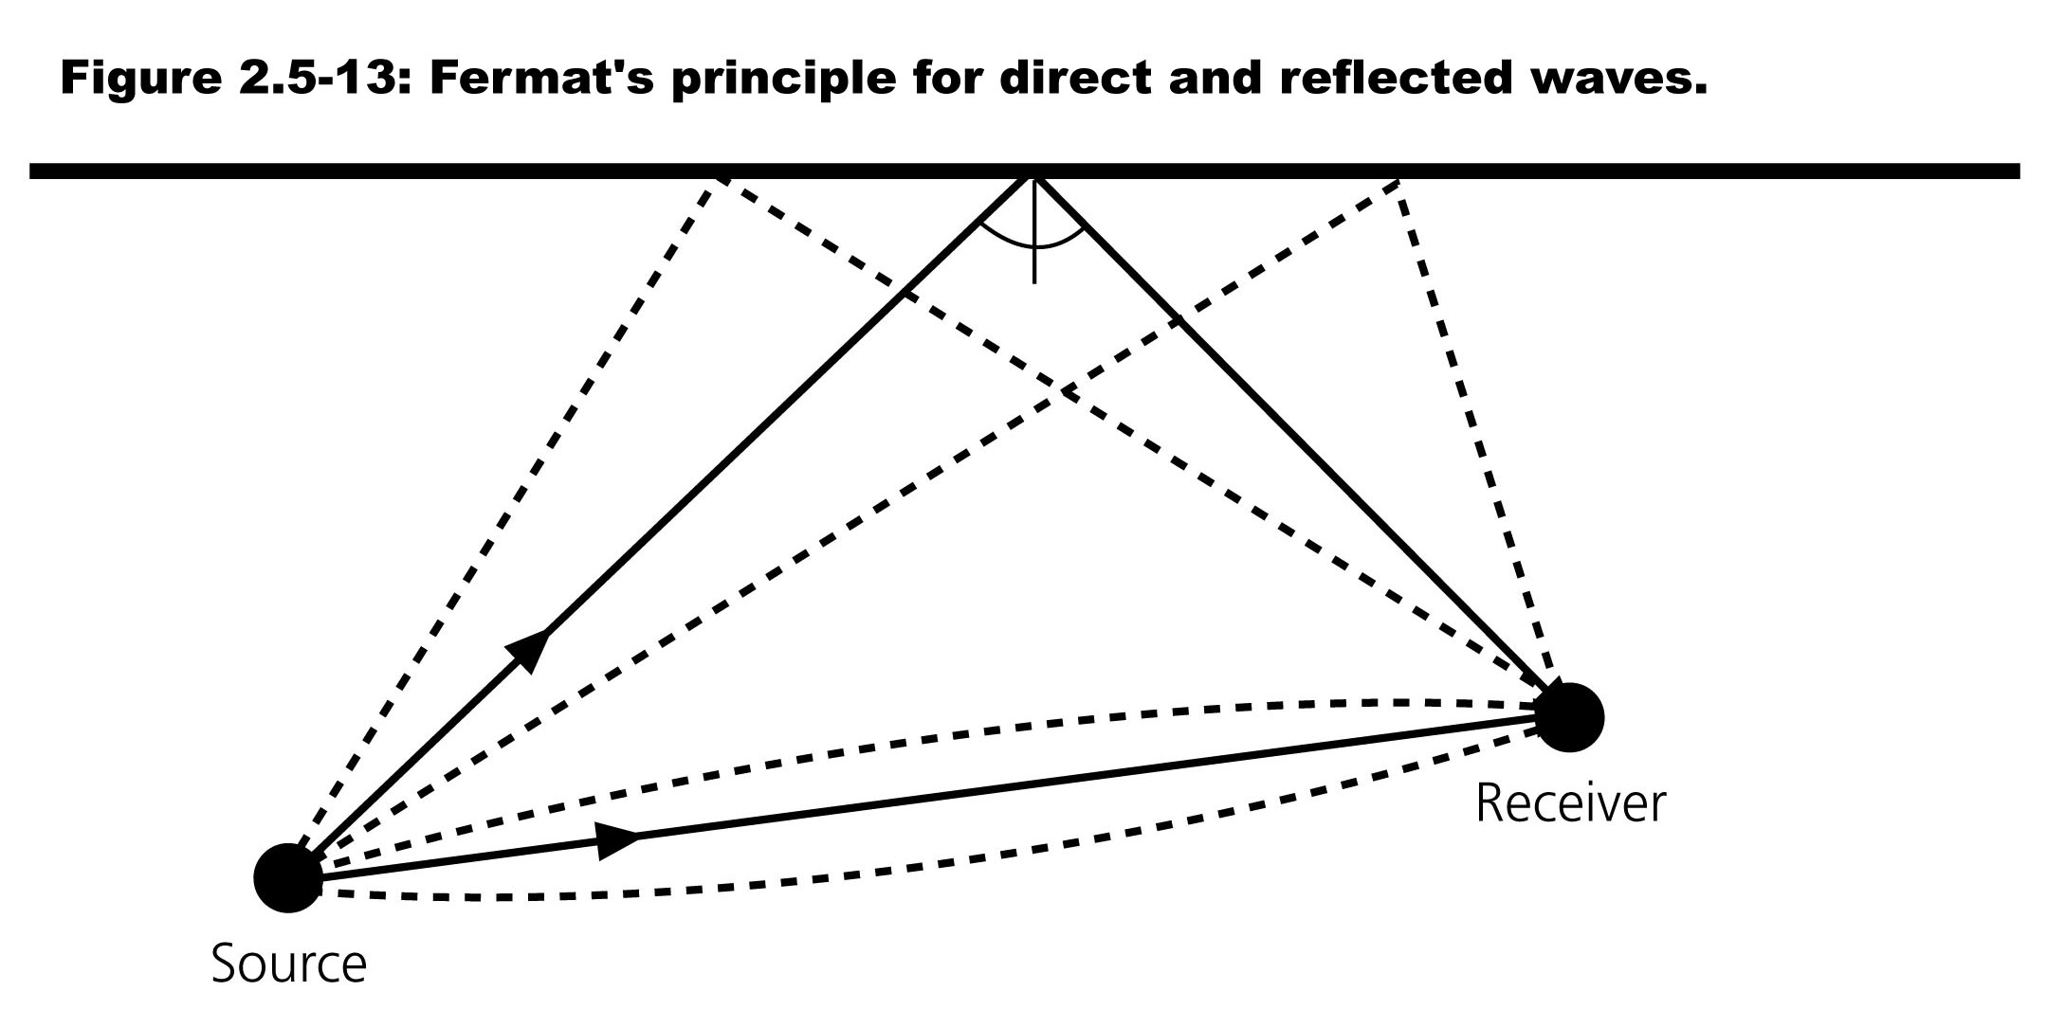

Slide 15
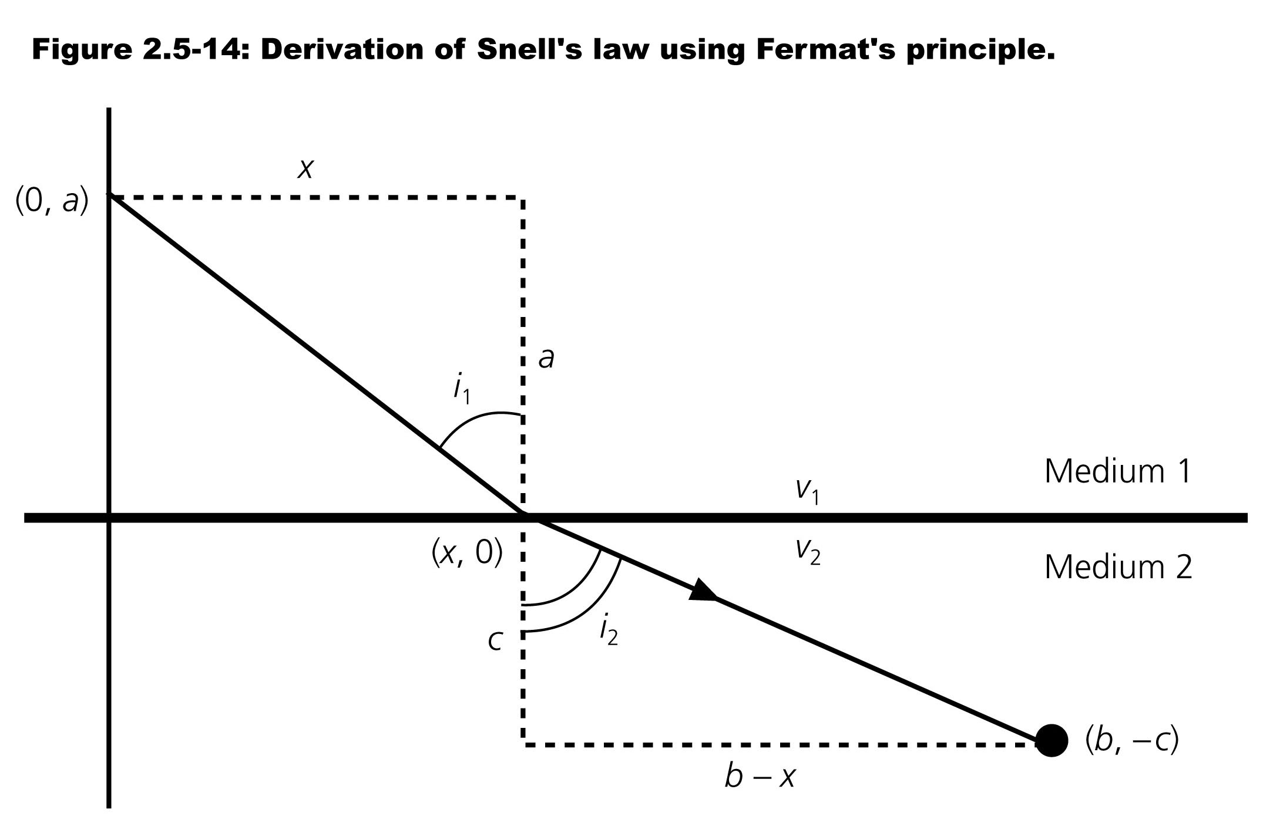
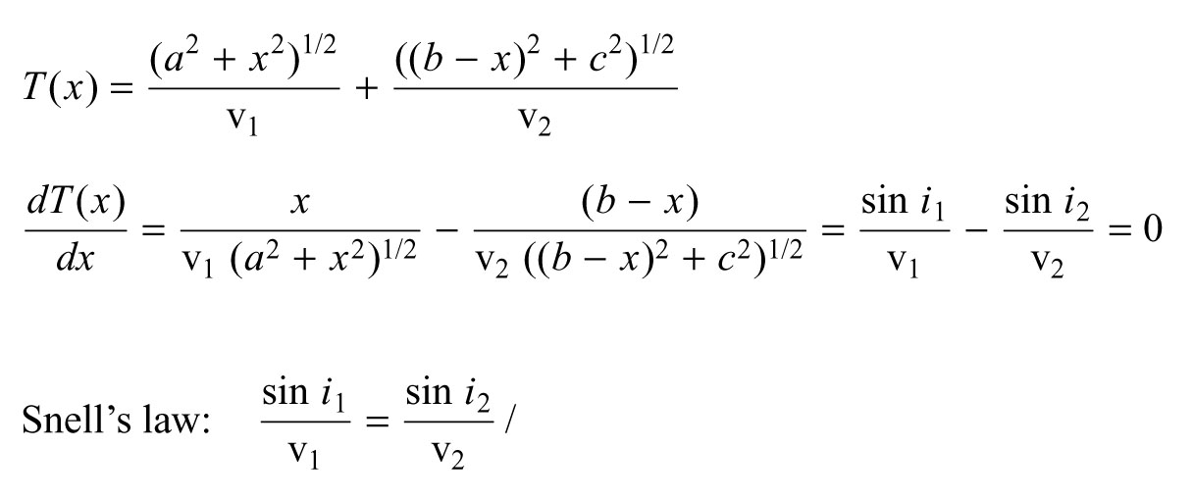

Slide 16
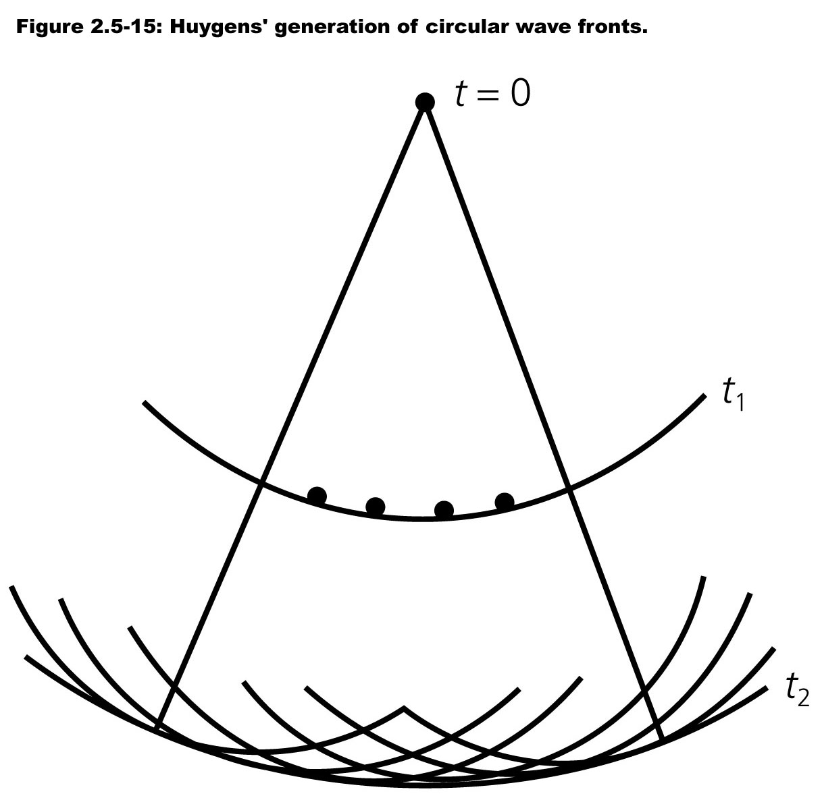

Slide 17
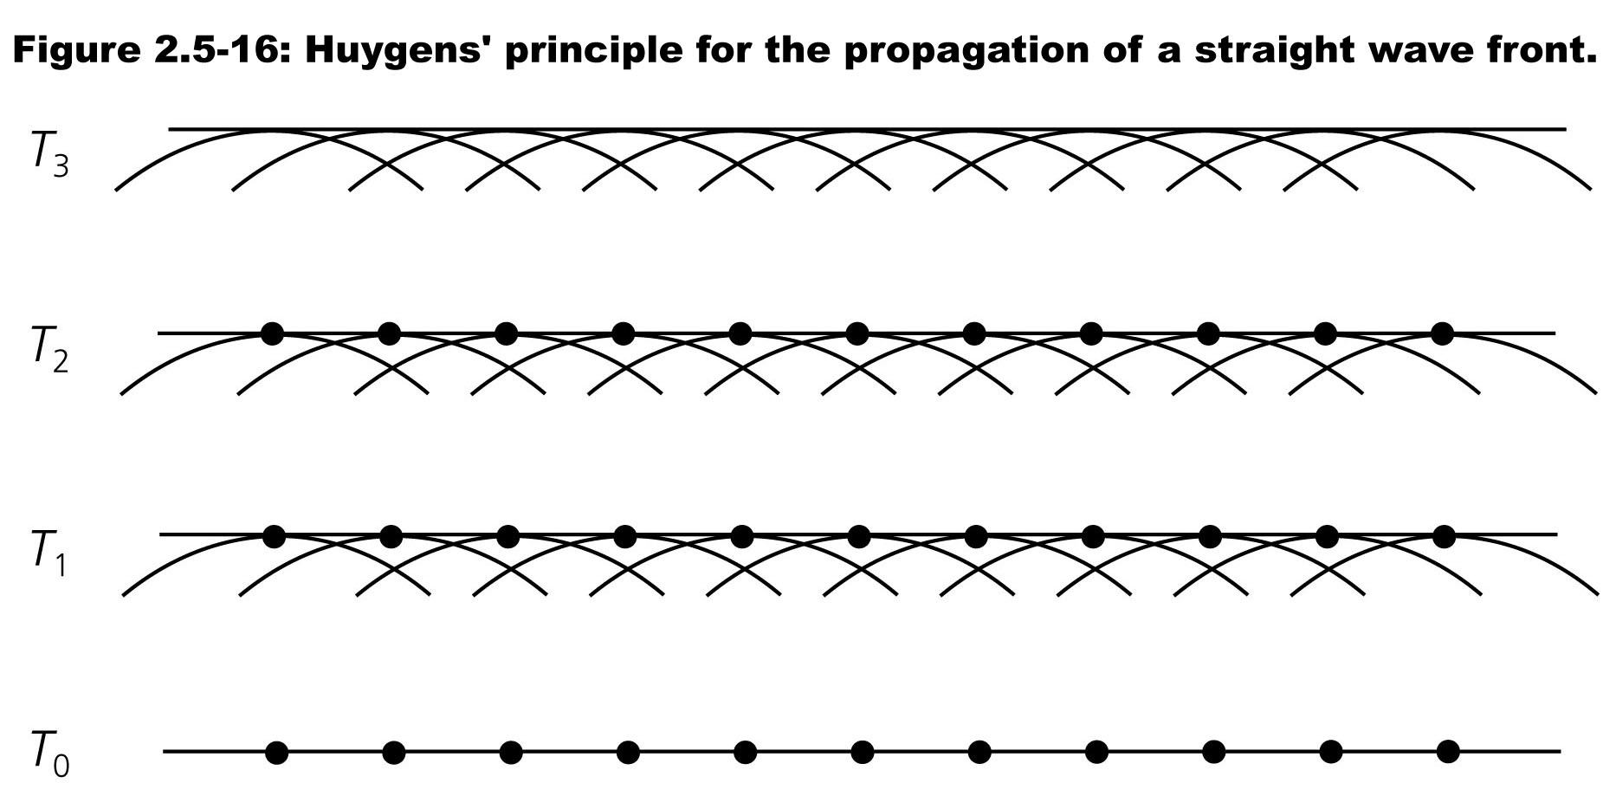

Slide 18
