Slide 1
Global Seismology CERI-8105
Tu-Th 1:00-2:25pm
Lab - 3892 Central Ave. (Long building) , Room 110
-----------------------------------------------
Bob Smalley
Office: 3892 Central Ave, Room 103, 678-4929
Office Hours – when I’m in my office.
http://www.ceri.memphis.edu/people/smalley/CERI8105_GlobalSeismology.html
Tue., Sep 19, 2023 Meeting 7

Slide 2
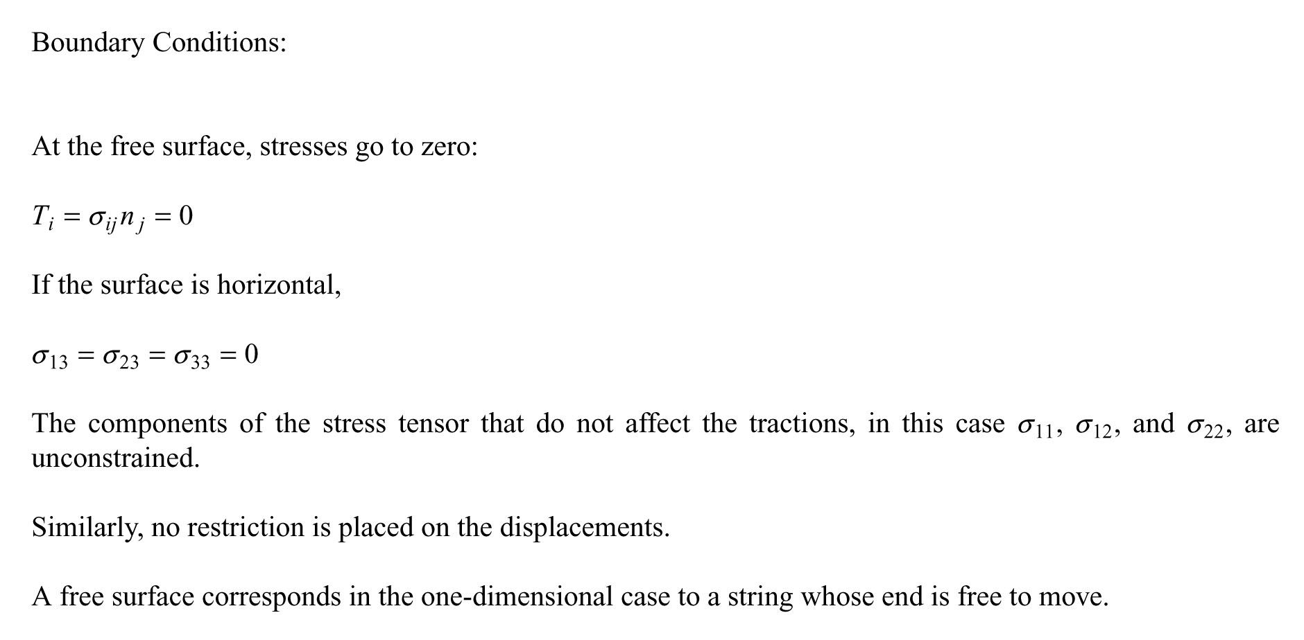

Slide 3
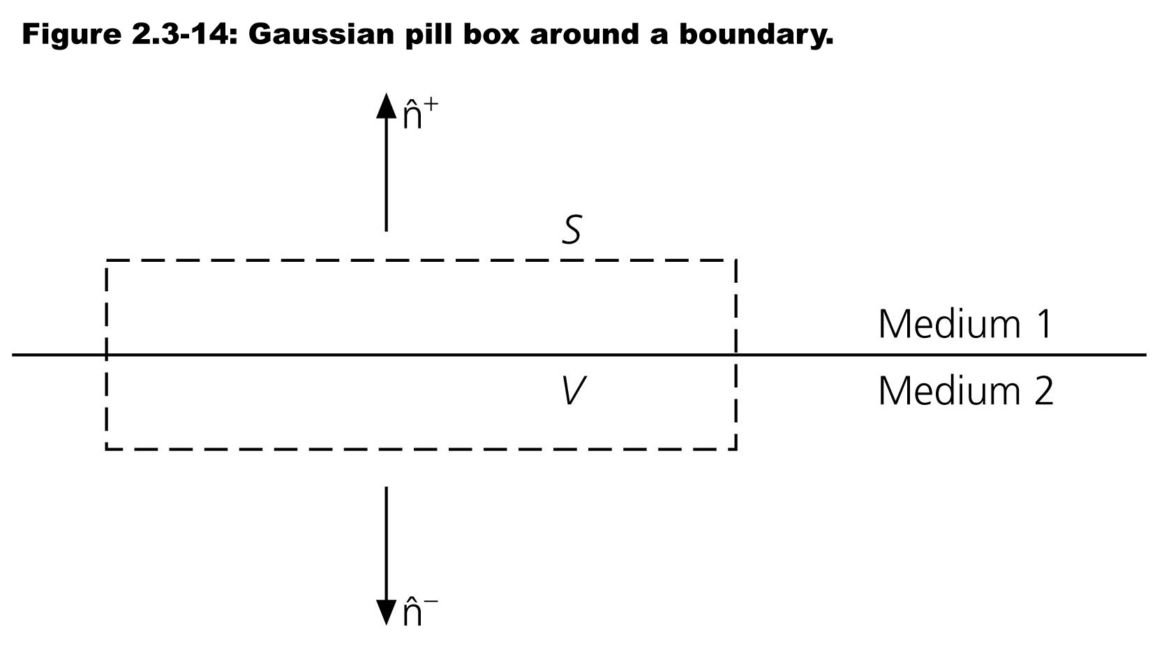
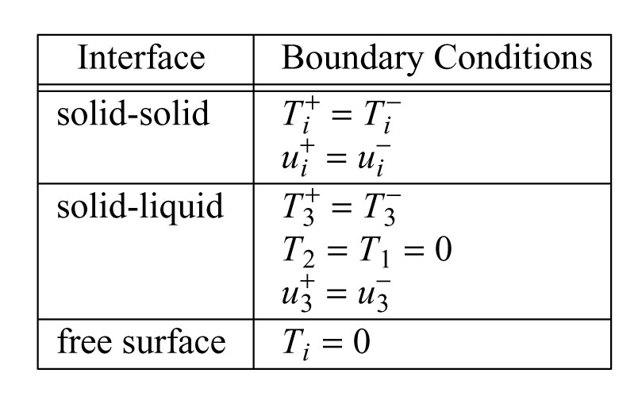

Slide 4
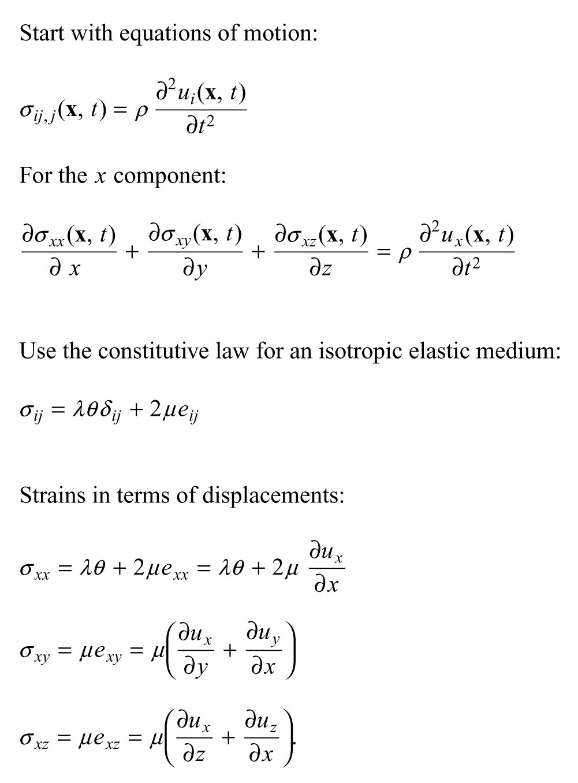
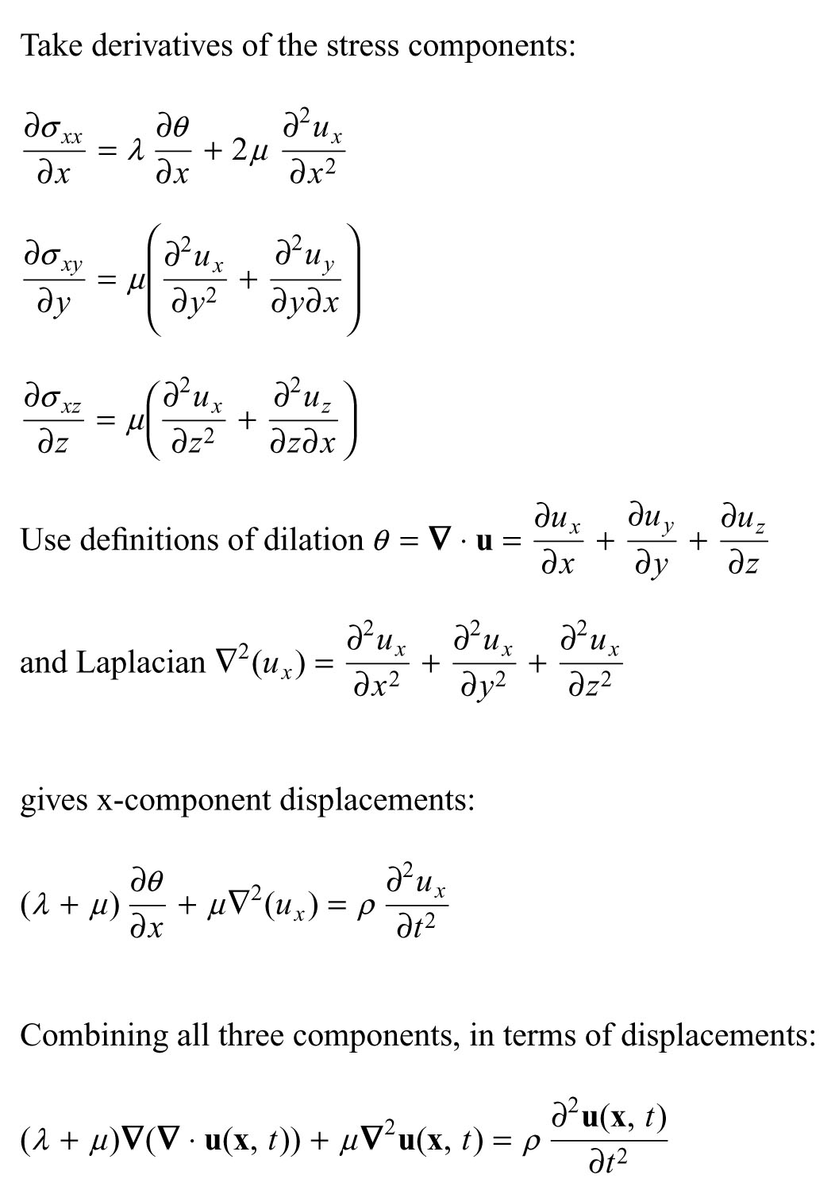

Slide 5
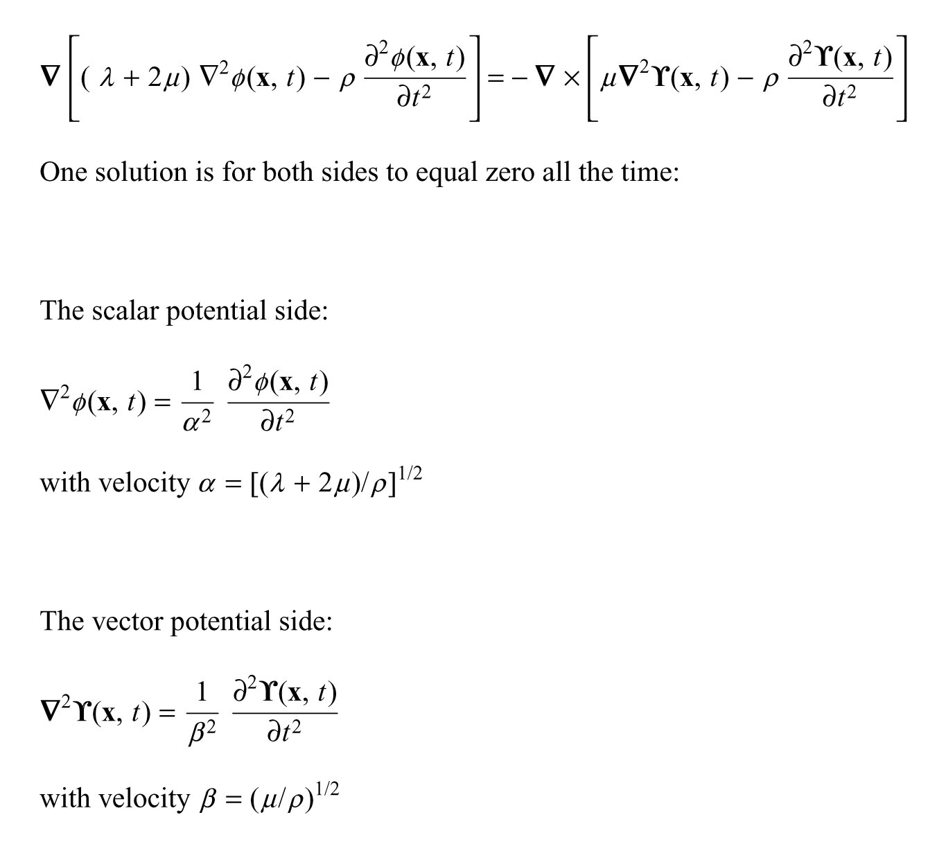
Notes:
Breaking it up simplifies things because the scalar potential for P waves has zero curl (no shear/rotation) and a volume change
While
The vector potential for S waves has zero divergence (constant volume) and only shear.
P started out for Primary but later became Pressure
S started out for Secondary but later became Shear

Slide 6
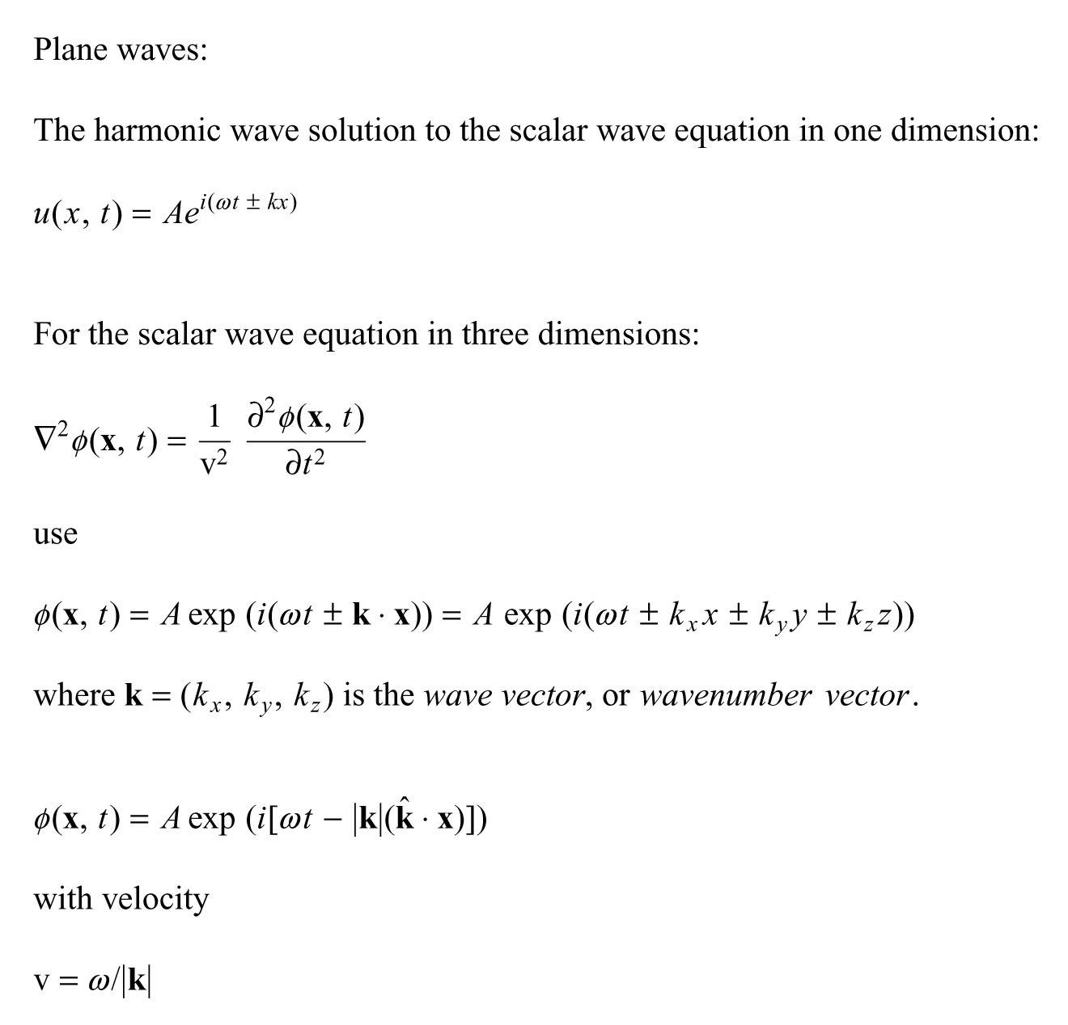
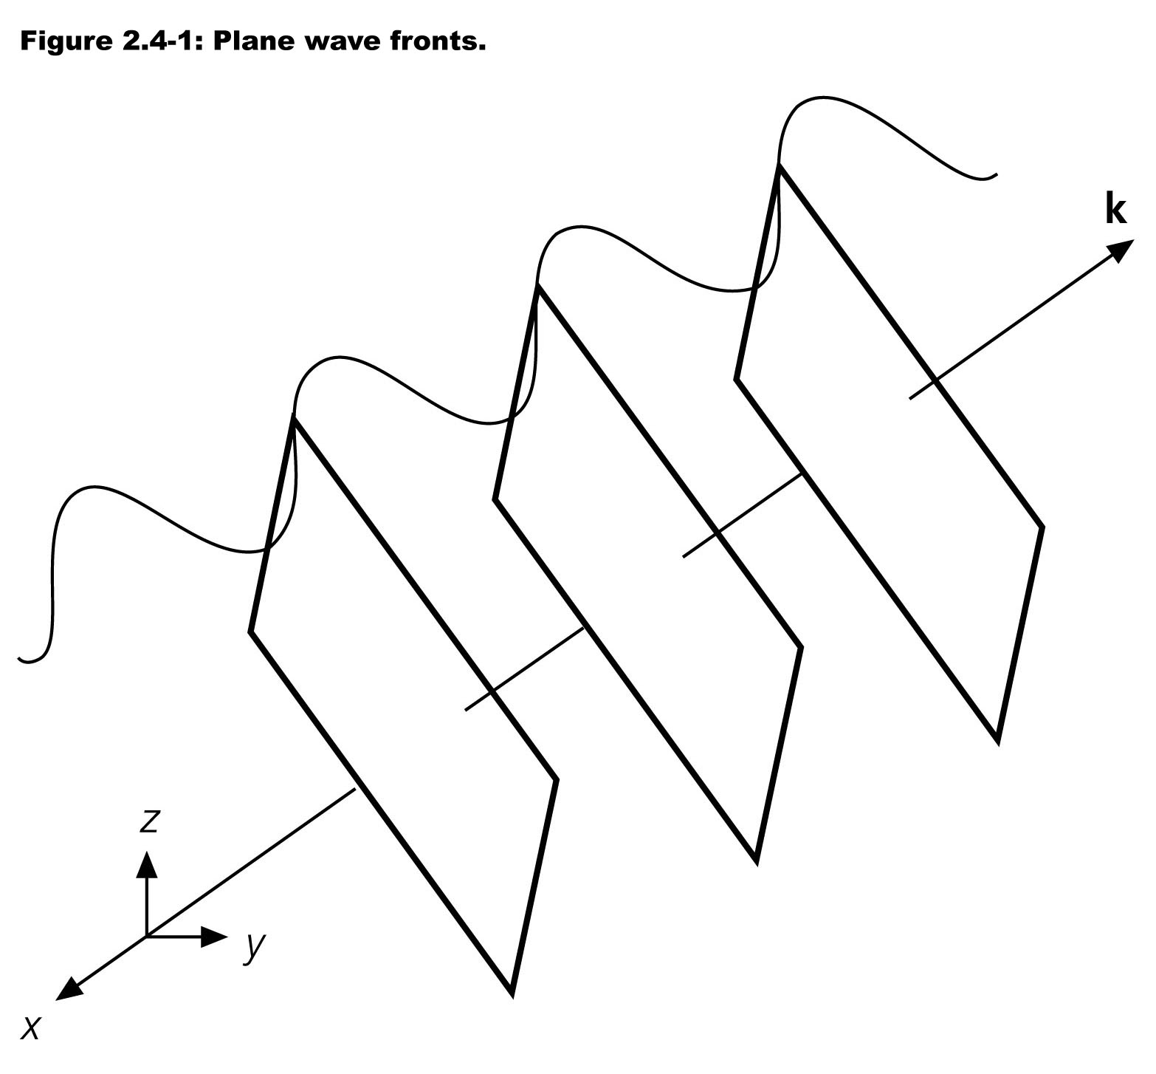

Slide 7
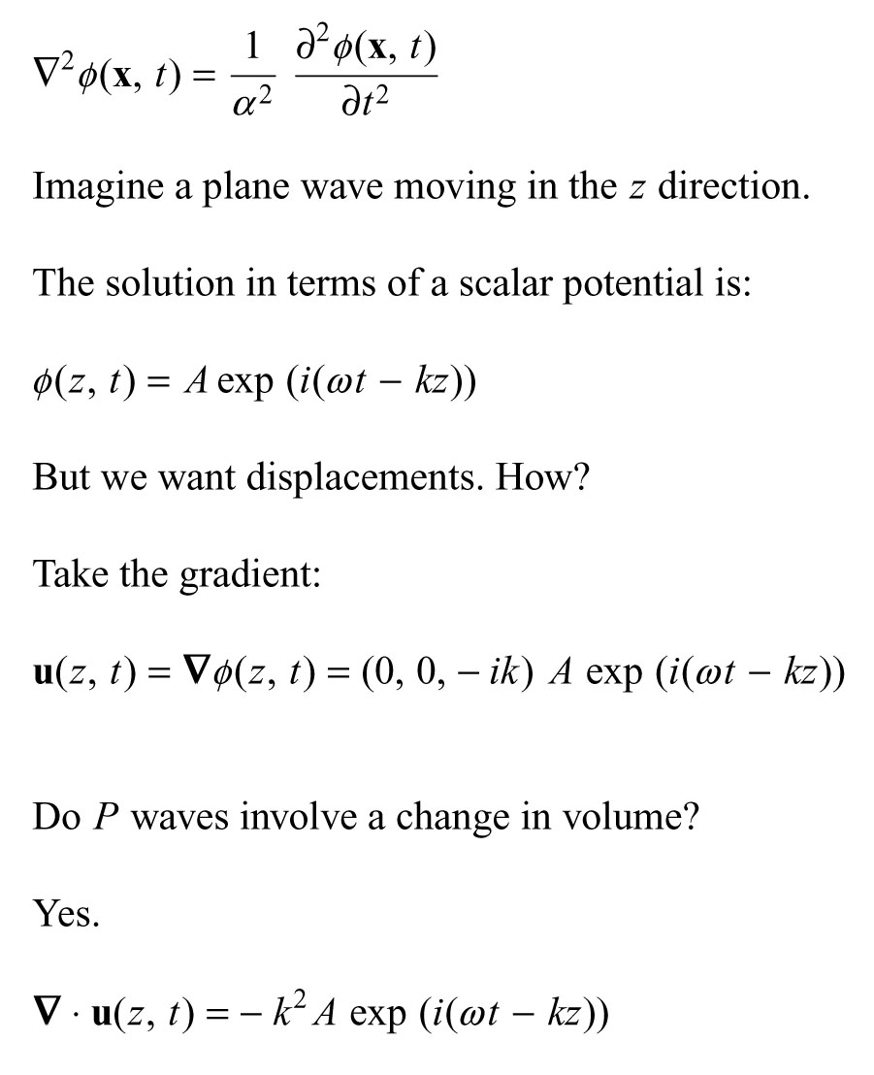
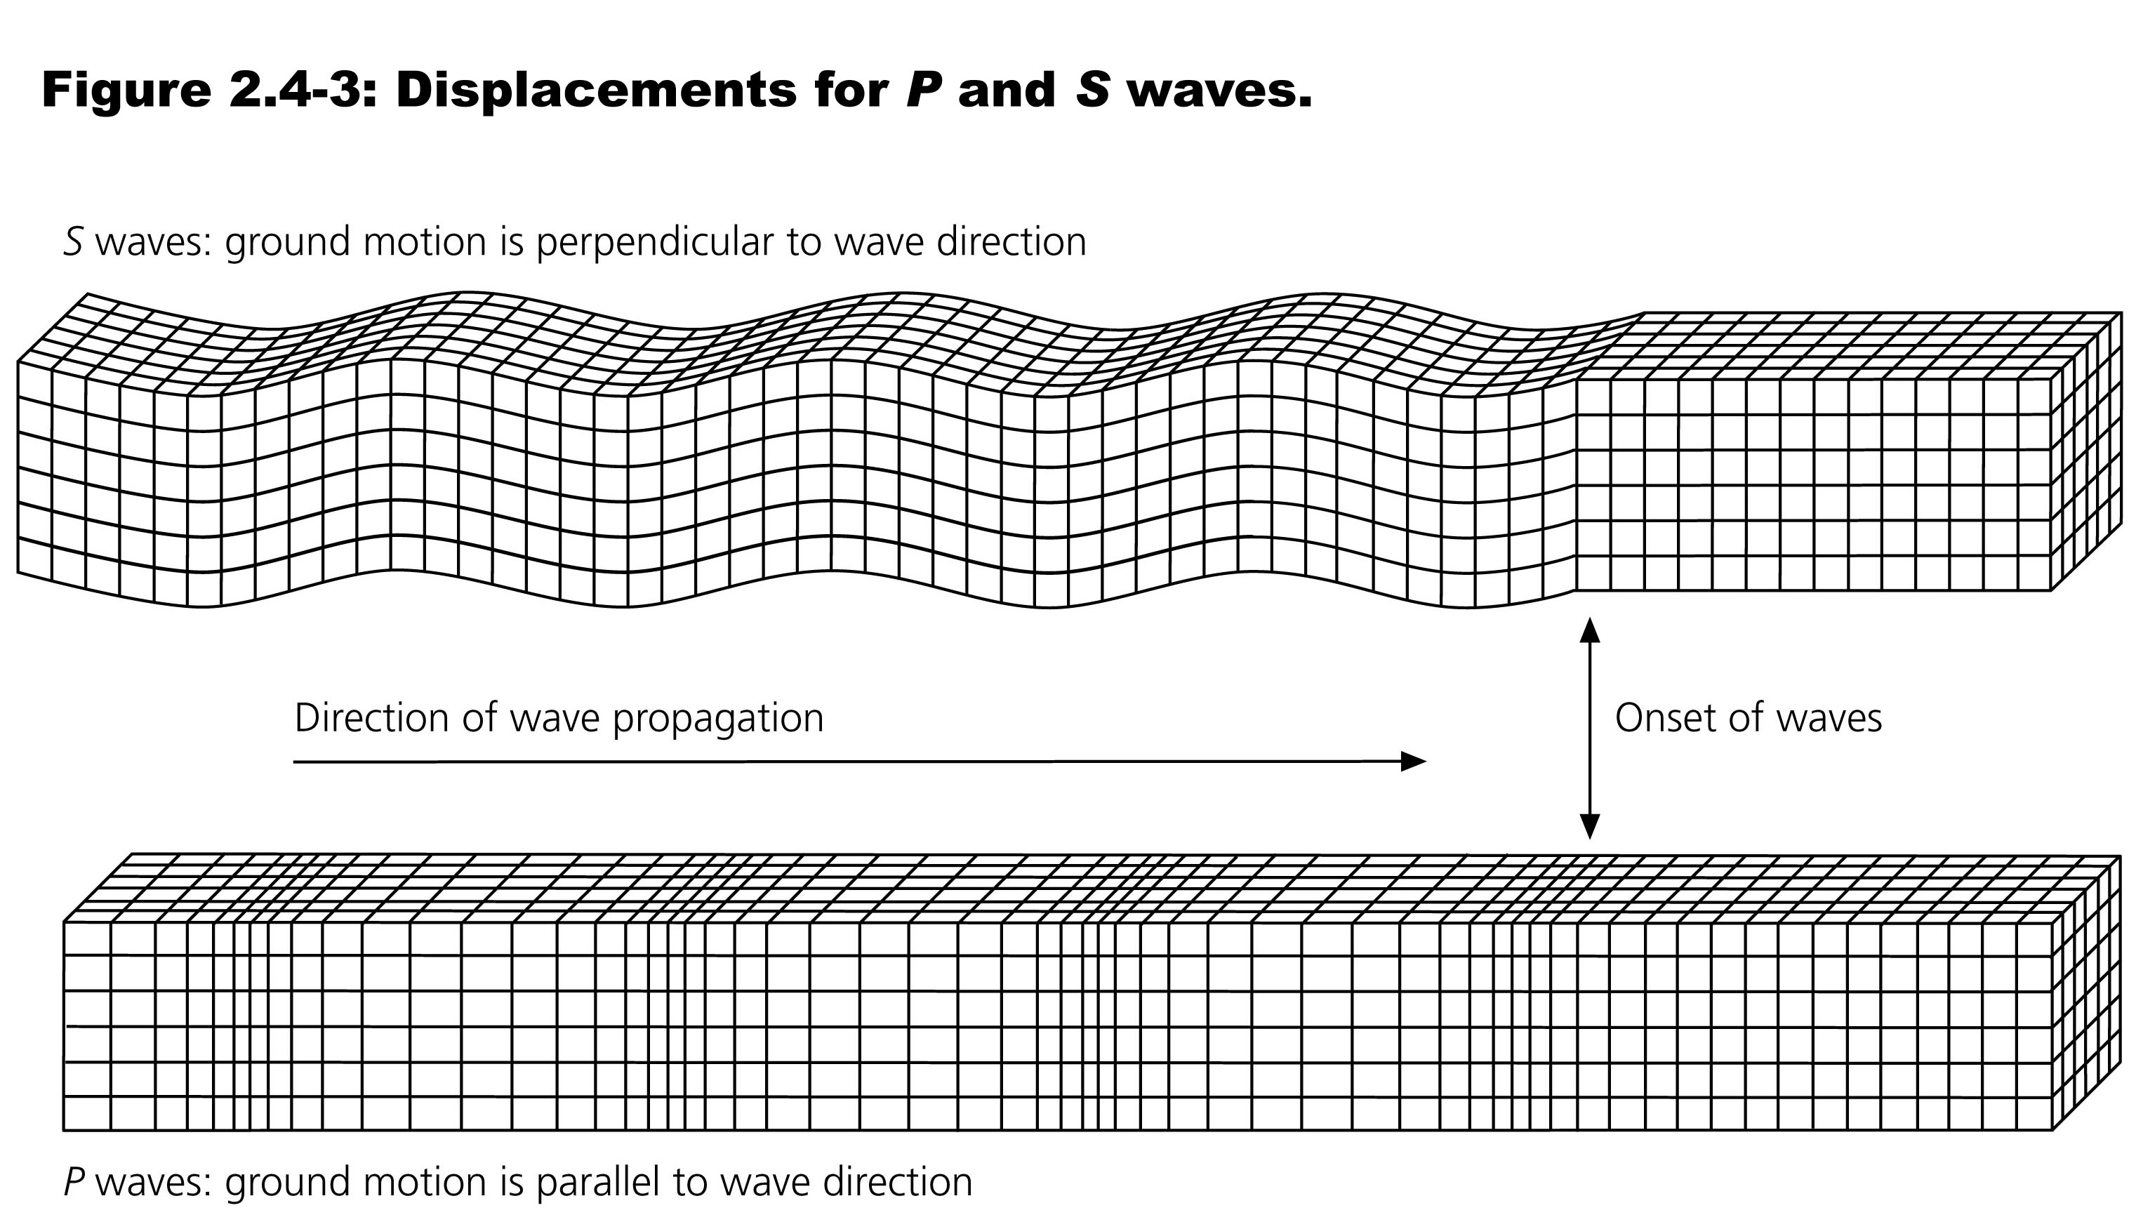

Slide 8
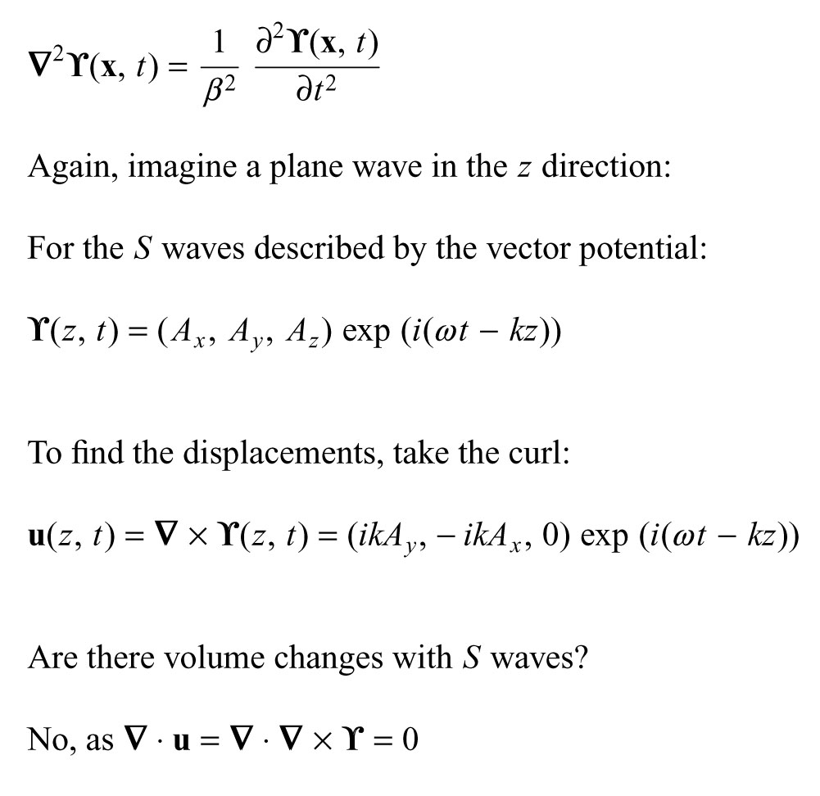

Slide 9
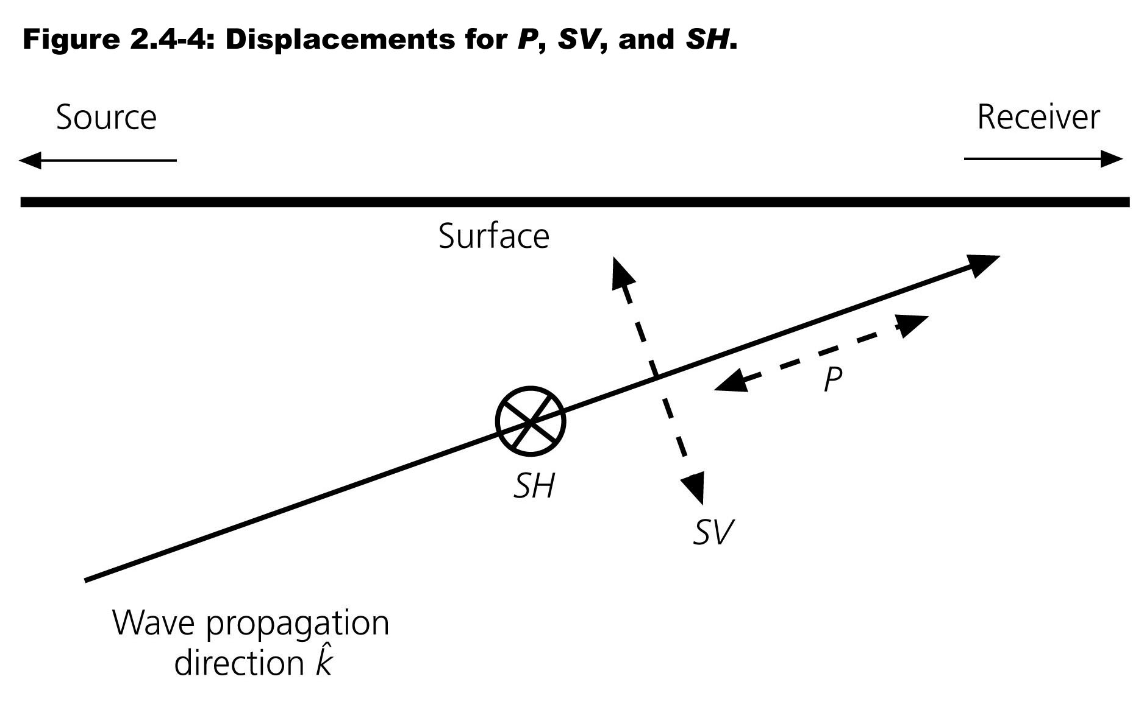

Slide 10
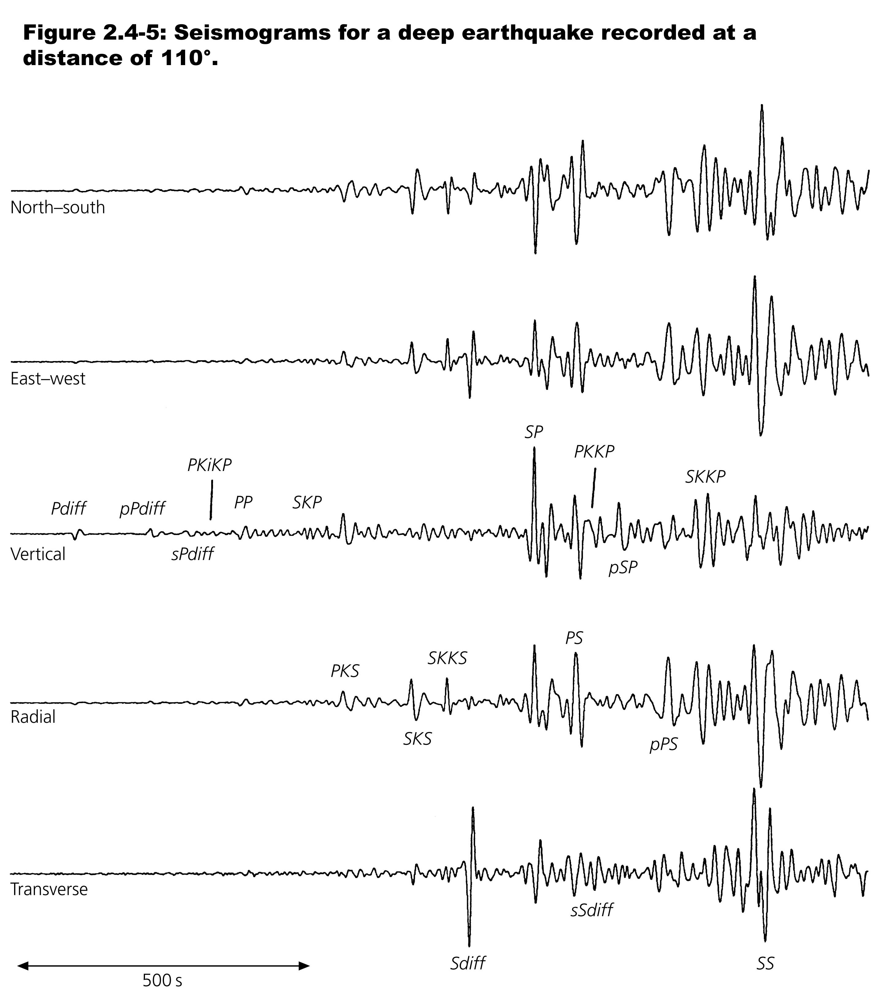
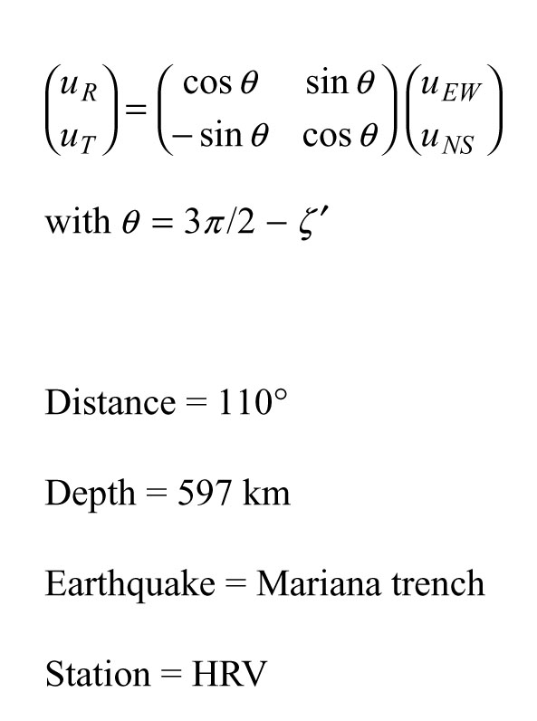

Slide 11
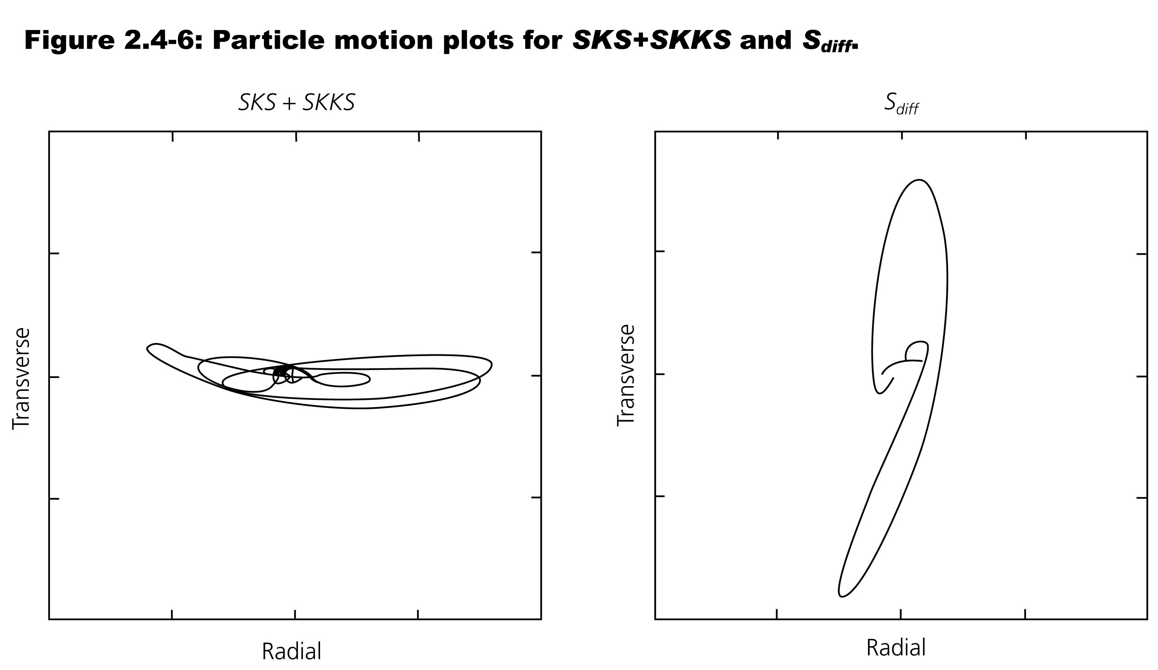

Slide 12
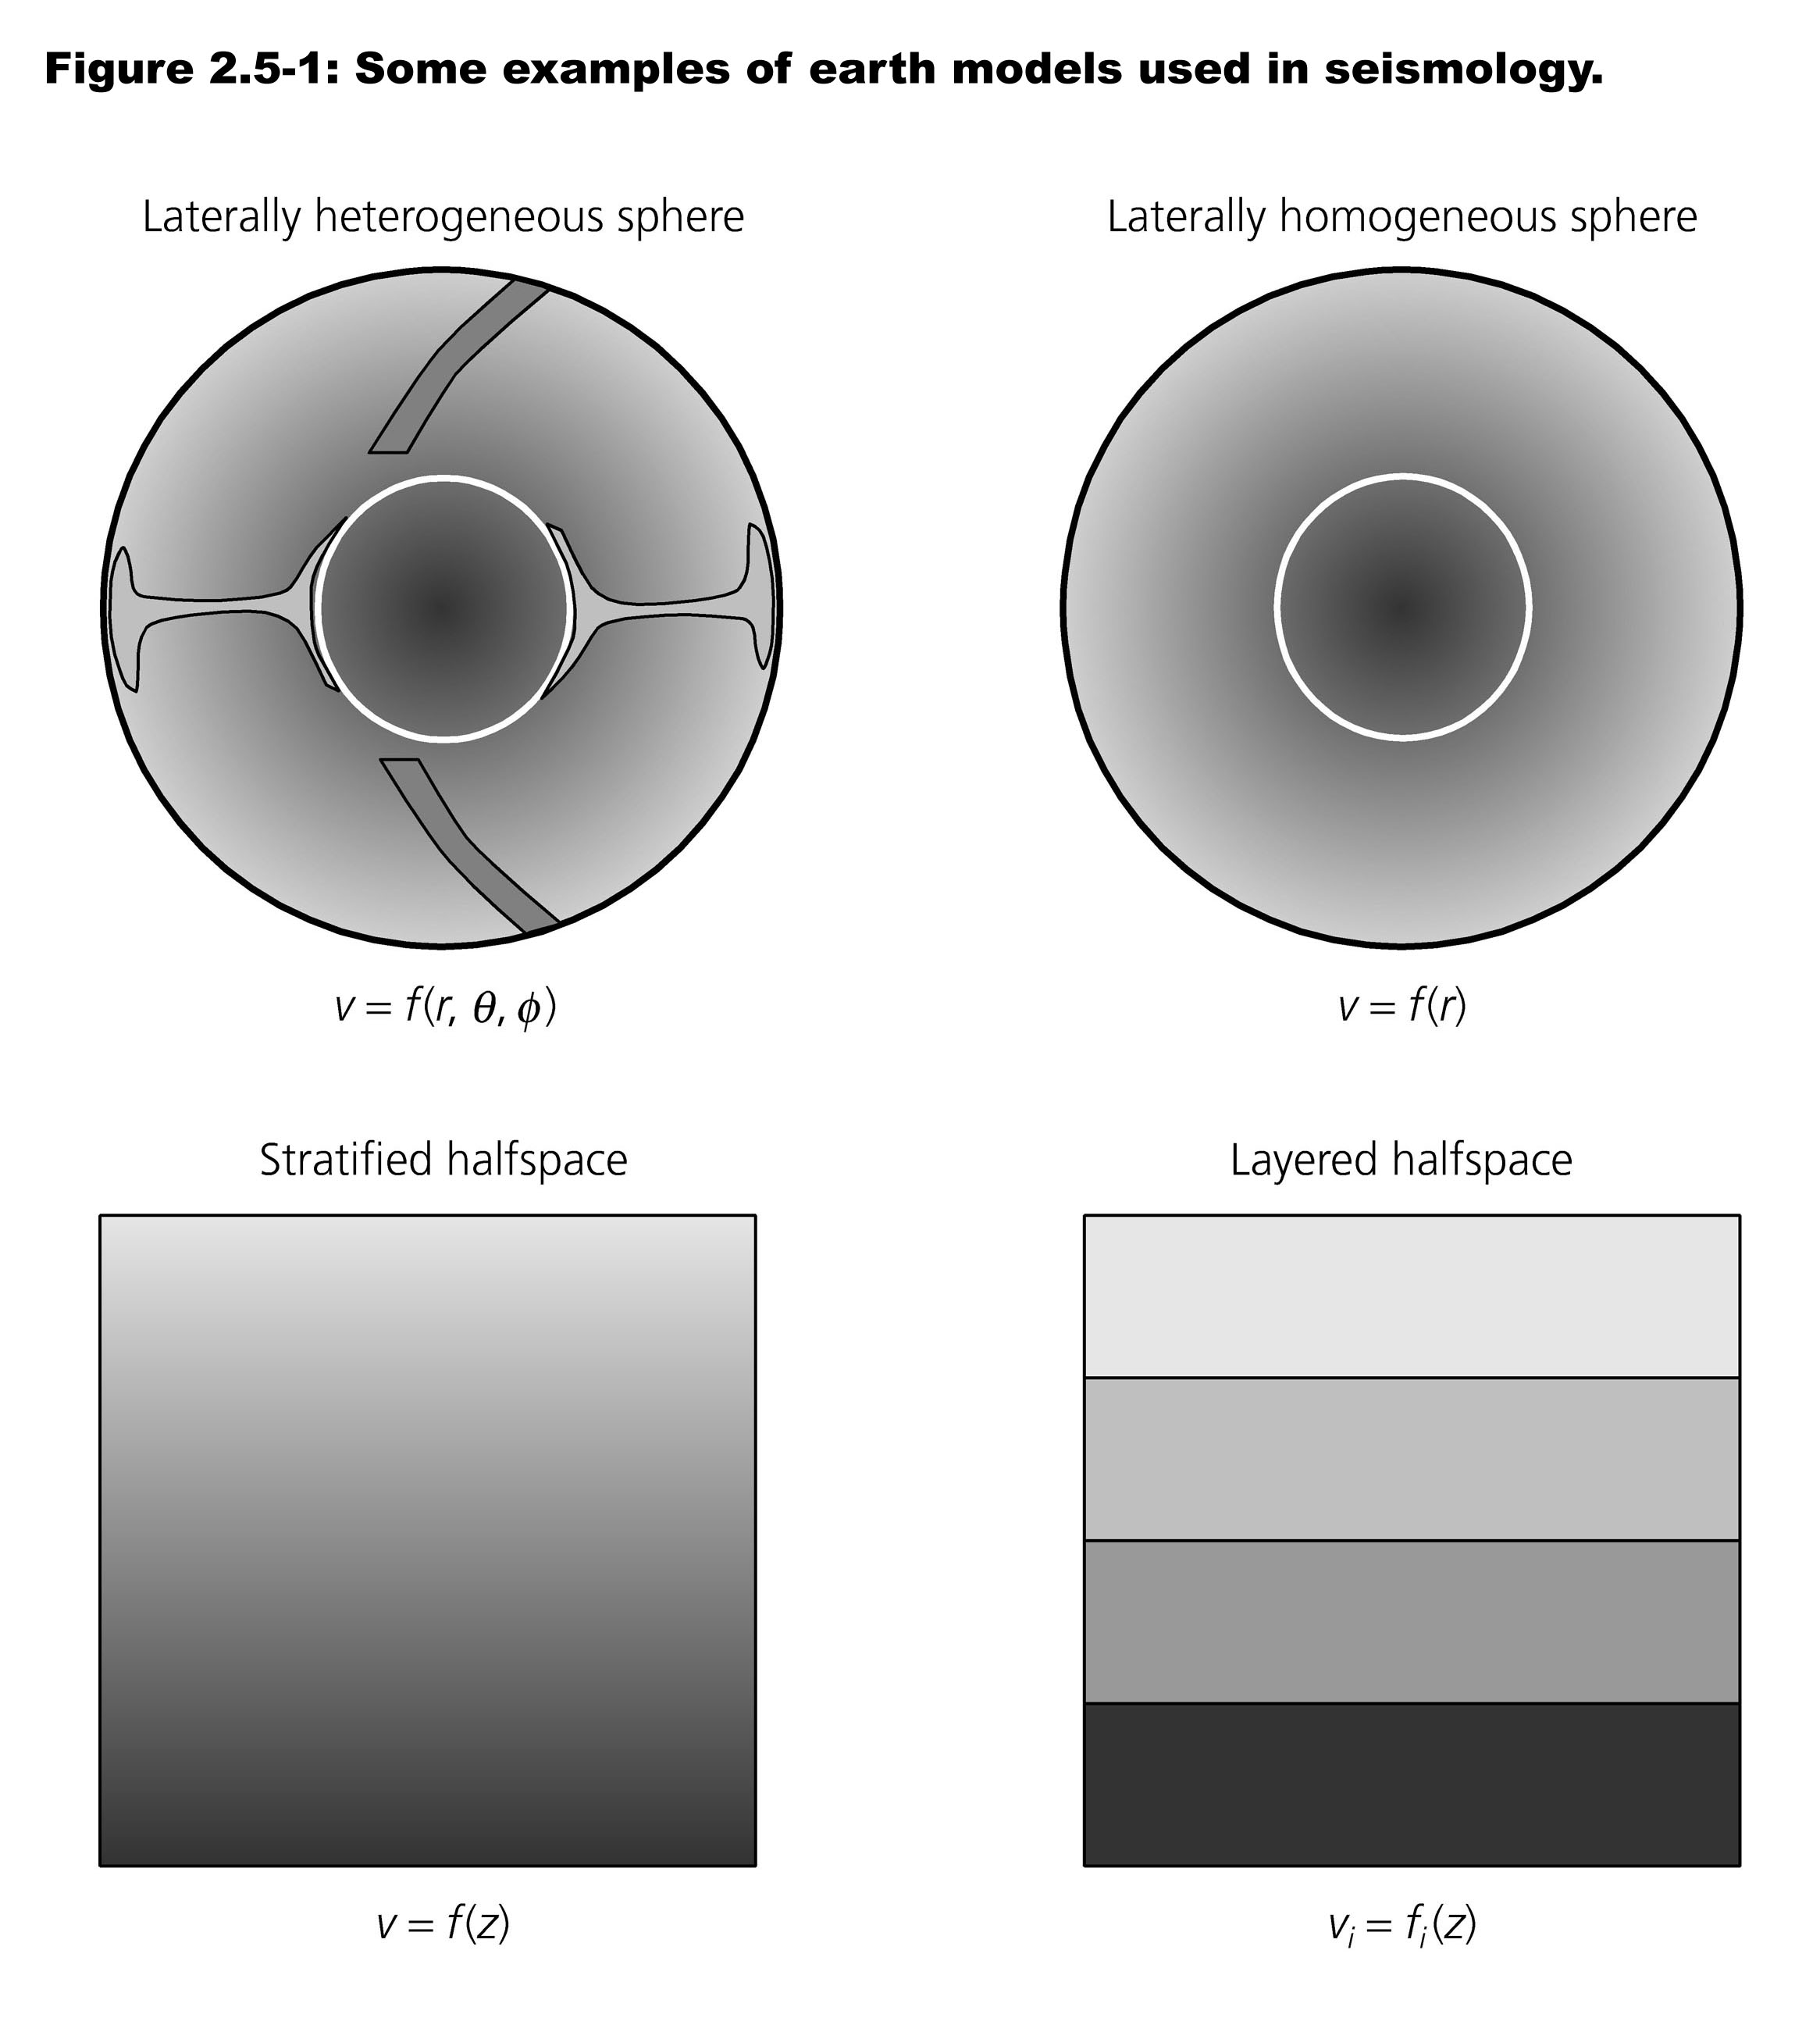
Notes:
Earth complicated – but can make simplifications that work.
Characterize internal structures by description as fn position. Velocity p and s and density.
Strongest and largest spatially - variation with depth. So 1st approx laterally homogeneous sphere
Fot small regions – halfspace.
Snooth variation or layers – both appropriate in different parts earth.
Eqns so far – homogeneous medium.
Advantage layered medium is can still use as long as match/patch across boundaries.
Another approx when they are plane waves, good far from source or in small volime.

Slide 13
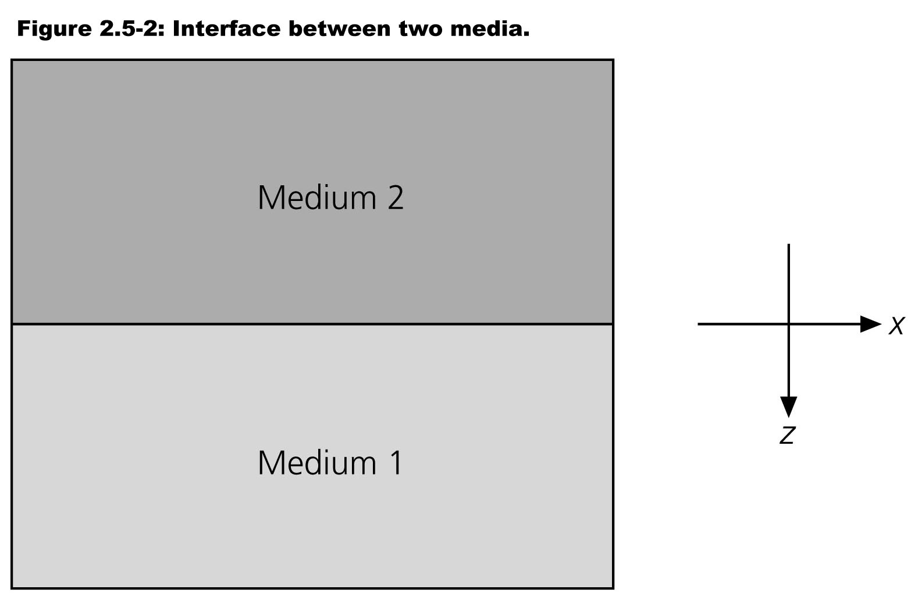
Use x,y,z for ease of intuition.
Let’s consider plane waves propagating in the x-z plane.
Notes:
What happens when plane wave hits boundary – both p and s.
Considerhorizontal surface between two half spaces and wave "ray" traveling in x-z plane, so potentials are only fns x and z.
Attractive feature of this is S waves separate into 2 polarizations – Sh and Sv.

Slide 14
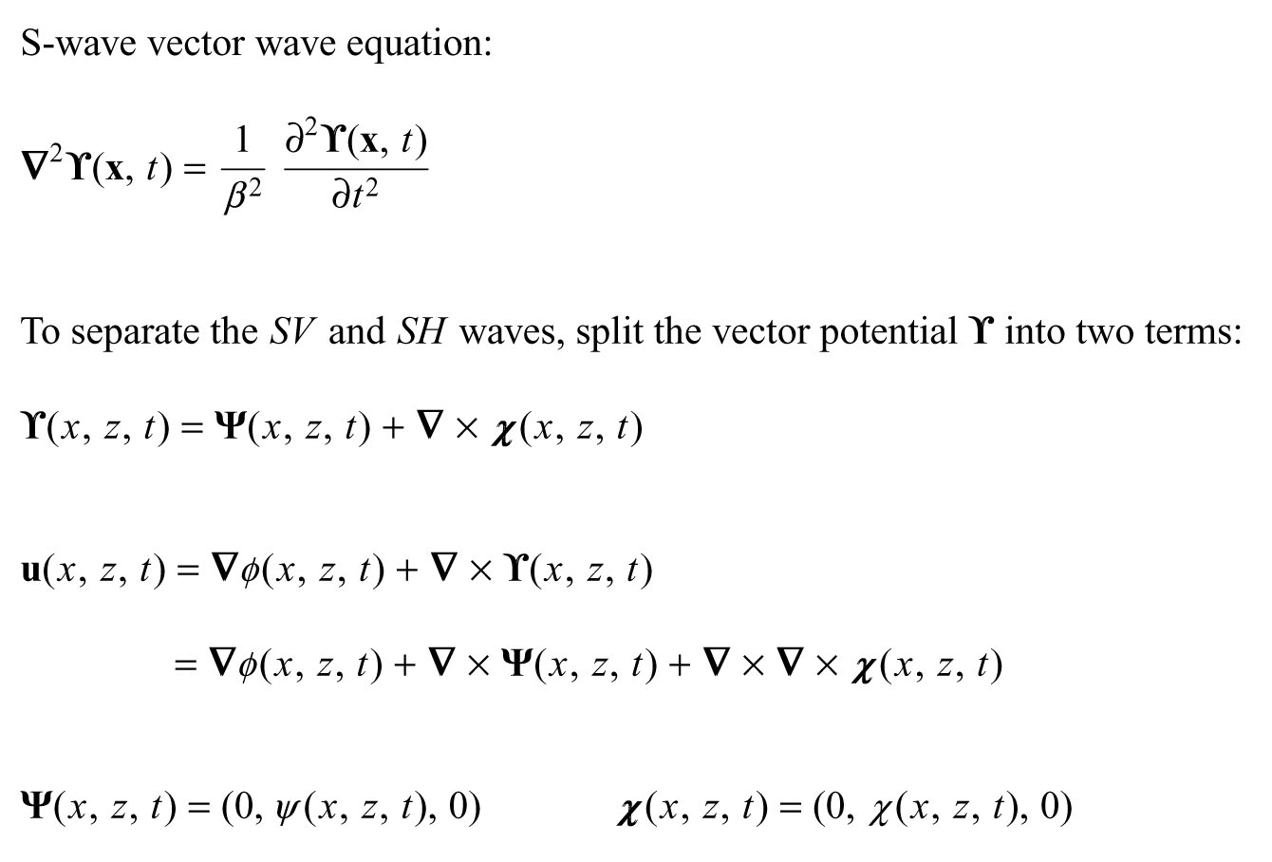
Notes:
Split vector potentias
Then get 3 terms for displacements
Nothing depends on y so all y derivatives are 0
Displacement vectors fn x,y,z

Slide 15
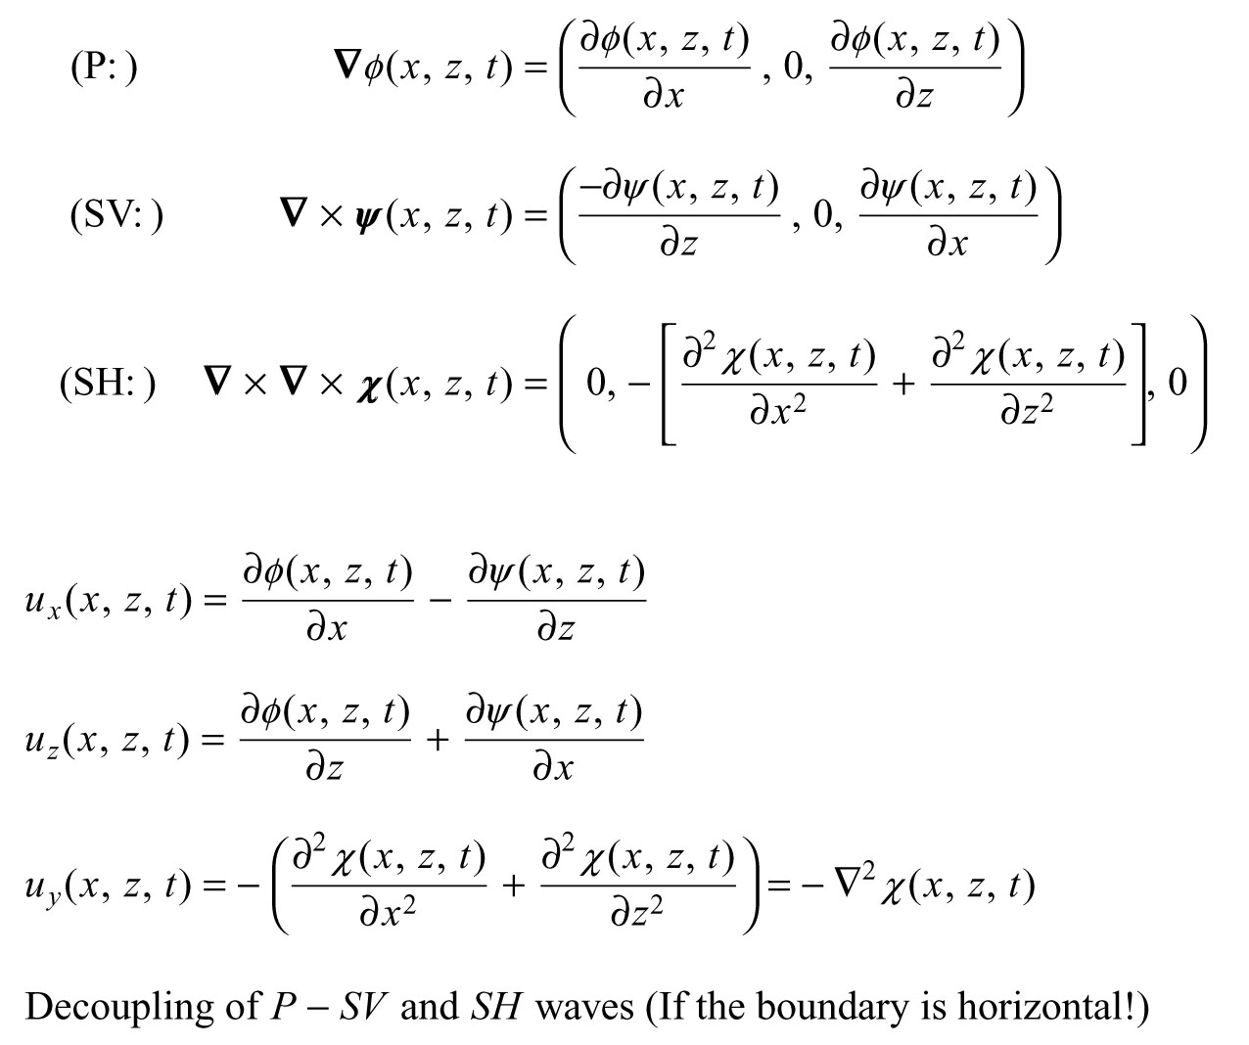
Notes:
P and Sv contribute to displacements in x and z direction only (1st and 3rd vector terms)
Sh contributes to displacements in the y direction only (2nd vector term)
Get "total" displacements in x, y and z. by grouping the vector terms
P and Sv are independent Sh
P and Sv form coupled system (both affect x and z displacements, but not y)
Sh decoupled (affects only y, not x and z)
Divergence of P wave potential not zero – volume change. Divergence of Sv and Sh wave potentials zero, no volume change

Slide 16
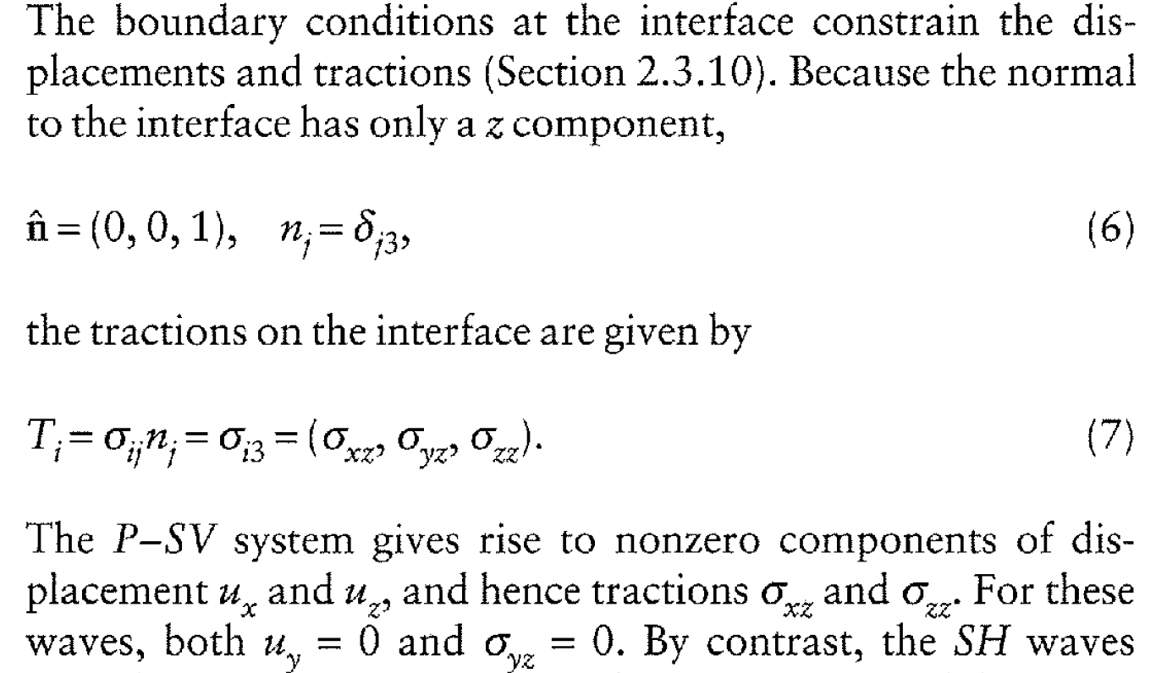
Notes:
P and S saves are coupled as they affect the same components of displacement and traction
Thus at interfaces P and S waves can convert to one another (they "must" to have the boundary conditions met – one wave in to bondary, 4 waves out – P and S reflected, and P and S refracted.
Dipping interfaces, whose normal is not in the plane of propagation (xz plane between source and receiver) cause problems as have new definition of Sv and Sh related to geometry of ray and interface.
(can be dipping as long as normal in plane of propagation and Sv, Sh polarizations maintained.)

Slide 17
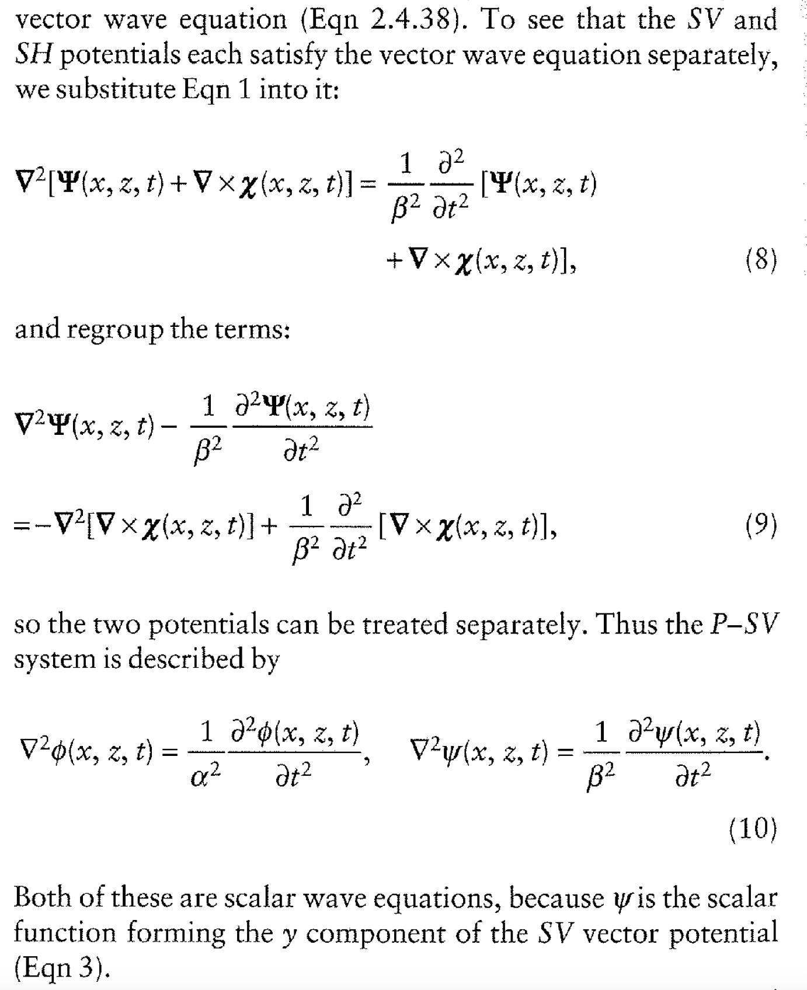
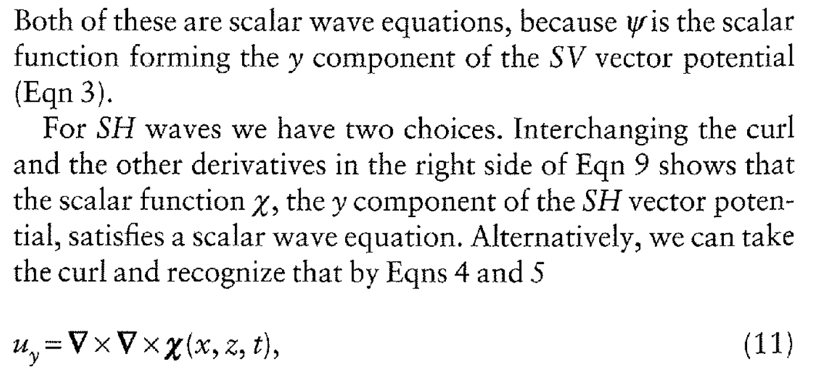
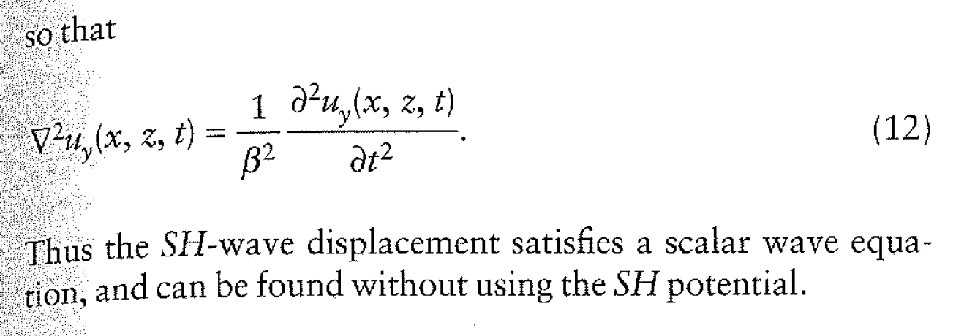
Notes:
Check that all the potentials satisify the wave equation – so we have 3 scalar wave equations.
Much simpler to solve scalar wave equation and then take divergence of P wave potential and curl of Sv and Sh wave potentials to get vector displacements

Slide 18
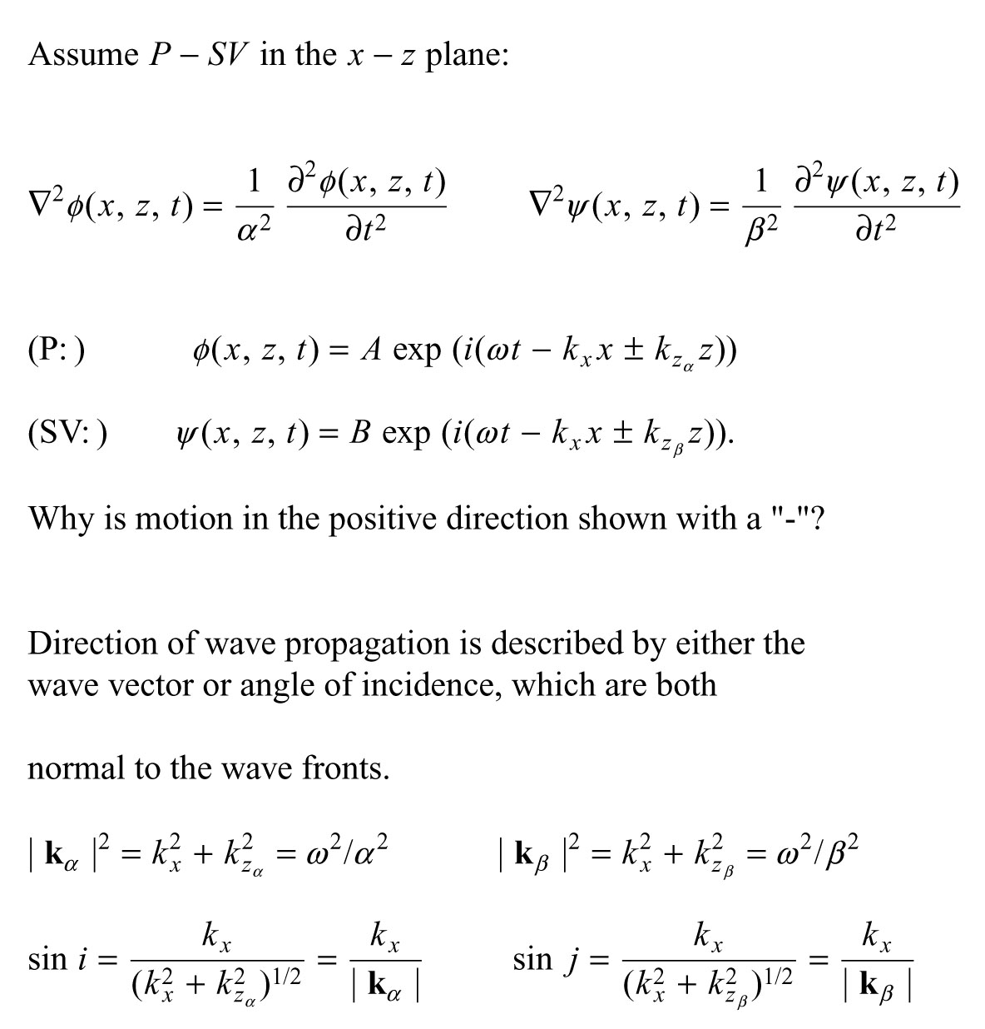
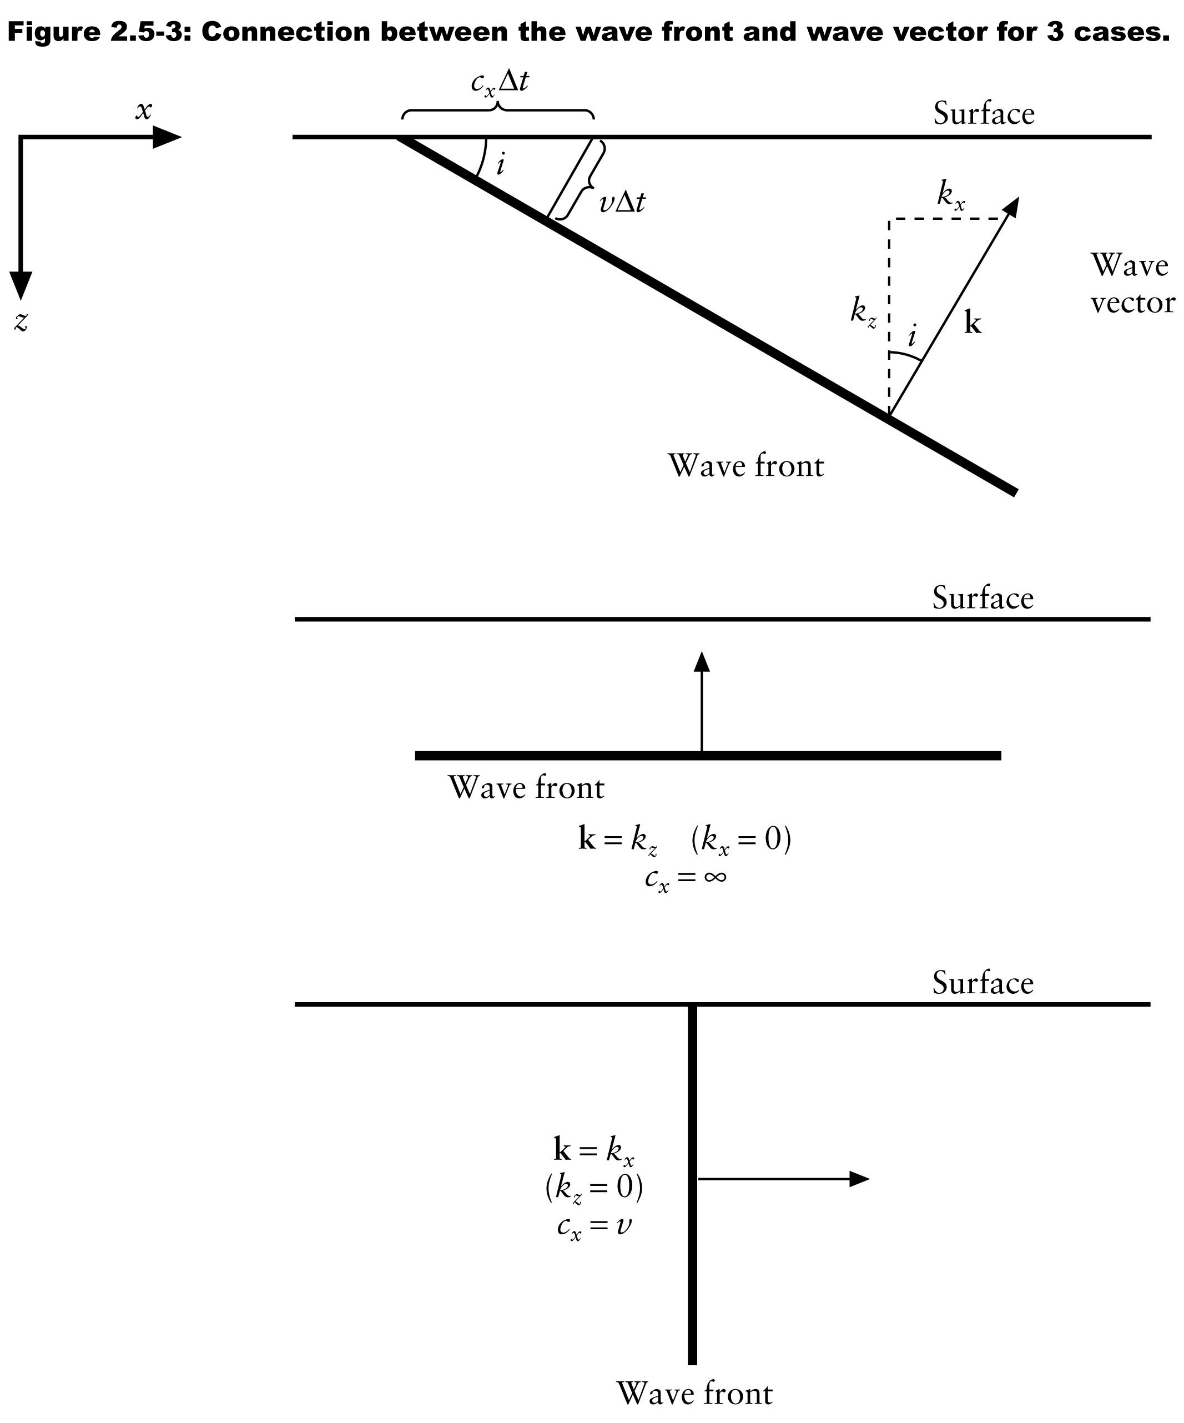
Notes:
Angle of incidence and apparent velocity
P-Sv propagating in x-z plane and their scalar potentials (can ignore Sh)
Consider plane waves propagating (ray) in x-z plane
Wavenumber k, wave vector (kx,kz) is perpendicular wavefront – parallel to ray
-kx going right, ±kz as transmitted going down and up
Need subscripts on kz for P (alpha) and S (beta) becaue will see they are different, but same kx (the incoming P and the outgoing P and Sv, transmitted and reflected, have to stay together on the boundary

Slide 19
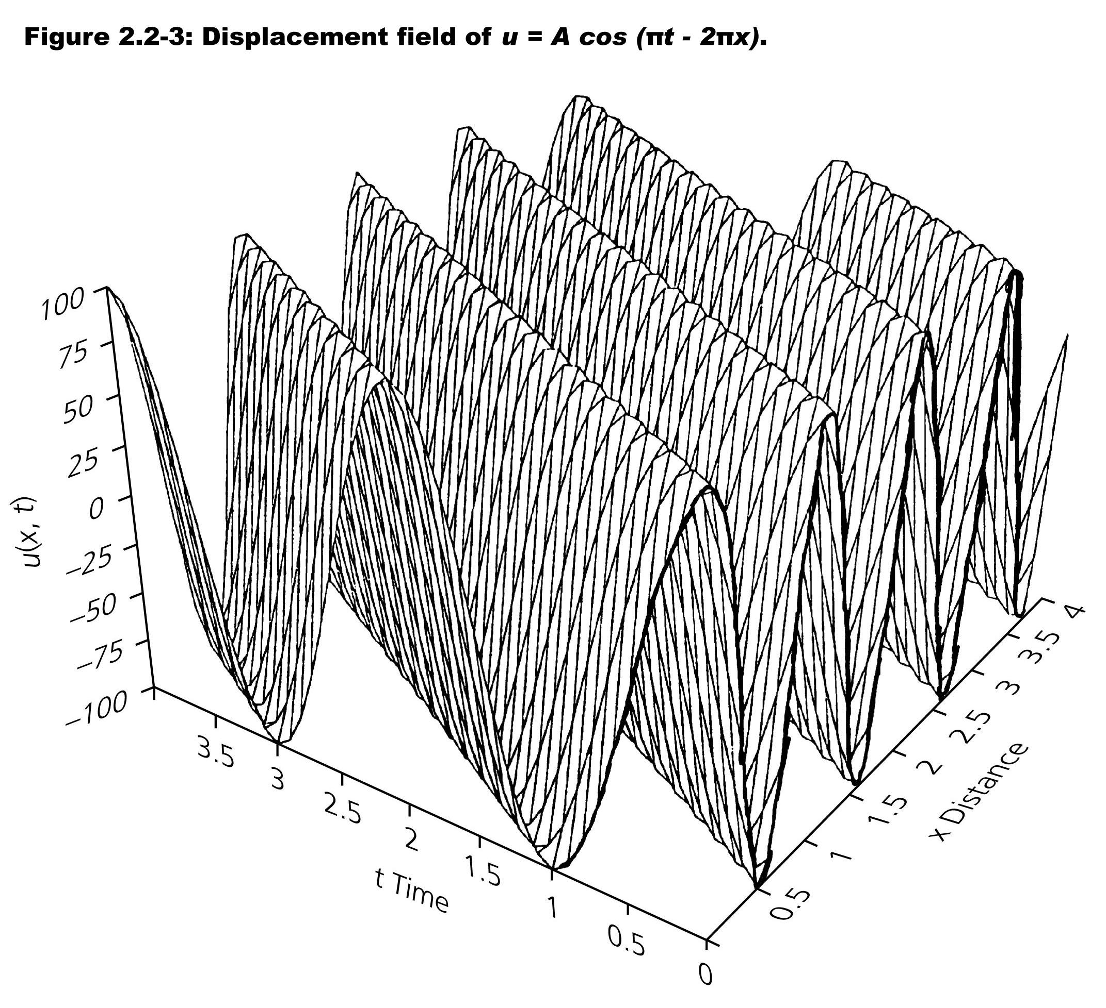

Slide 20
Notes:
Wave vector (ray) == angle incidence
Notice ka and kb, depend on P and S velocity respectively – so go different speeds, and therefore different directions
Usually think in terms of rays(perpendicular to wave front, where wave going) and ray path as it bends around

Slide 21
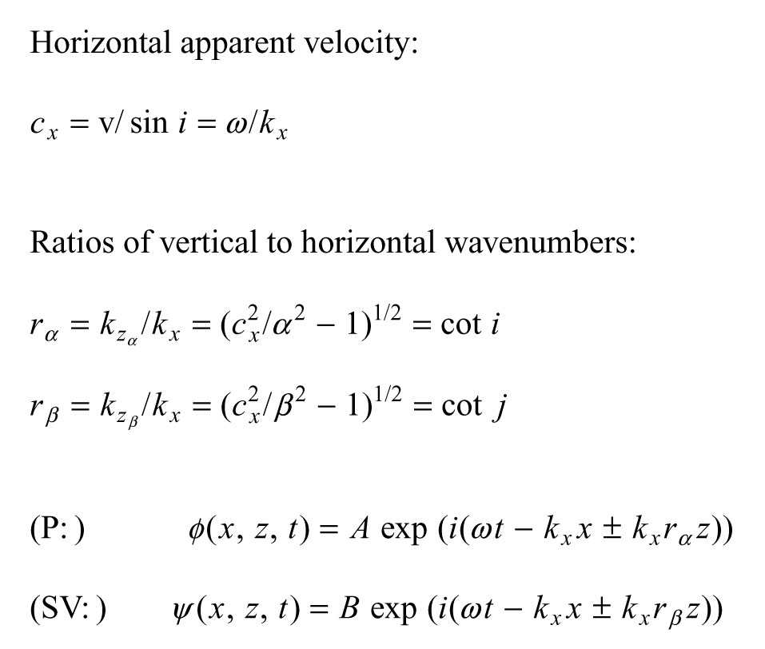
i=0
i=90
Notes:
Apparent velocity – velocity, c, observed at the surface – velocity appears to travel across surface
Cx=v/sin(i)
Apparent velocity always greater than actual velocity and max is infinity for wavefront parallel to surface or ray parallel to surface normal.
Incident angle measured from vertical wrt raypath, horizontal wrt plane wave front.

Slide 22
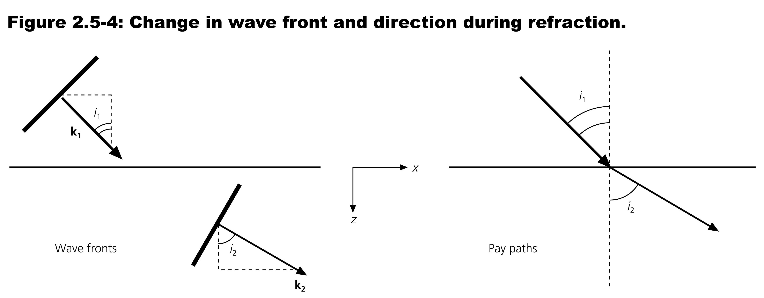
Which medium is faster?
Notes:
Faster bends away from normal (think critical angle/head waves), slower towards normal.

