Slide 1
Global Seismology CERI-8105
Tu-Th 1:15-2:40 pm
Lab - 3892 Central Ave. (Long building) , Room 110
-----------------------------------------------
Bob Smalley
Office: 3892 Central Ave, Room 103, 678-4929
Office Hours – when I’m in my office.
http://www.ceri.memphis.edu/people/smalley/CERI8105_GlobalSeismology.html
Tue., Nov 16, 2023 Meeting 23

Slide 2
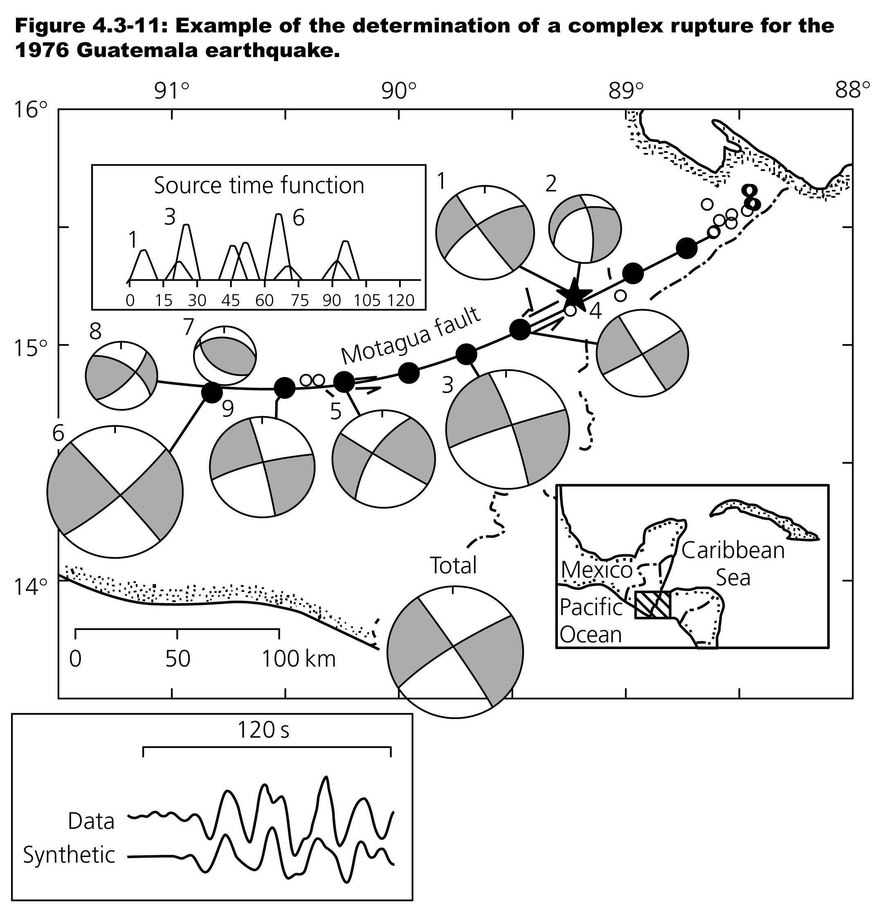
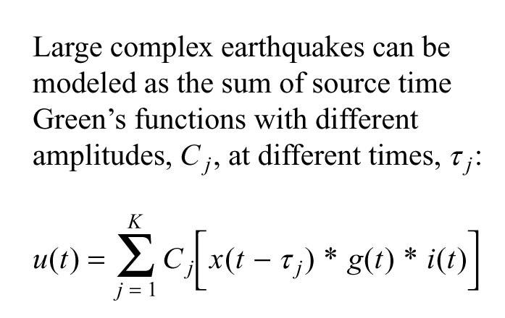

Slide 3
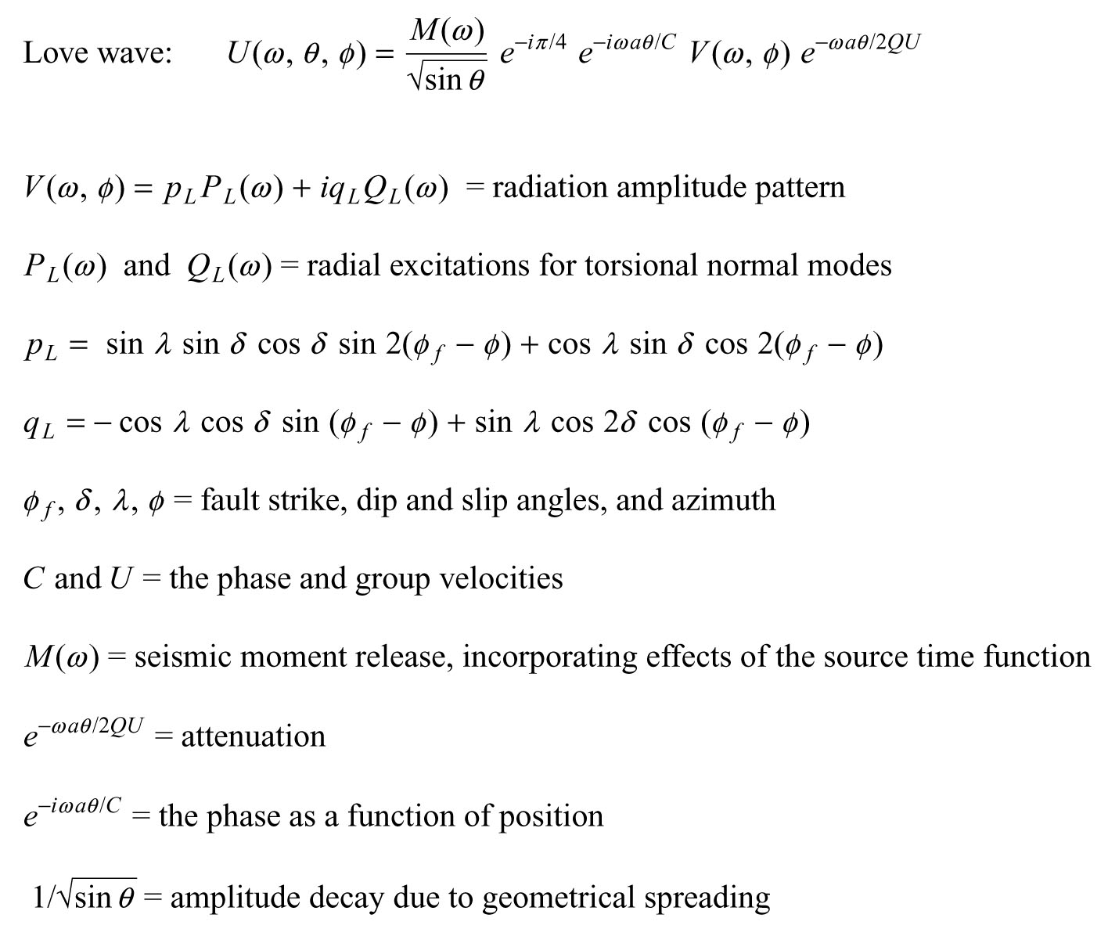

Slide 4
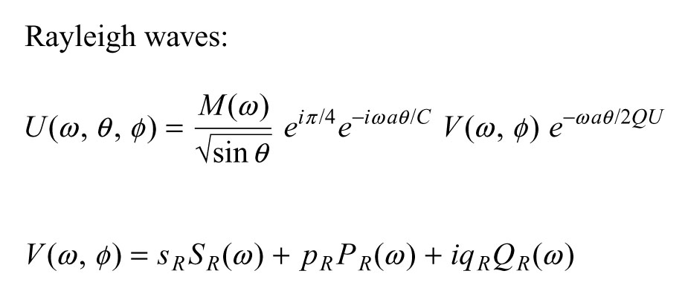

Slide 5
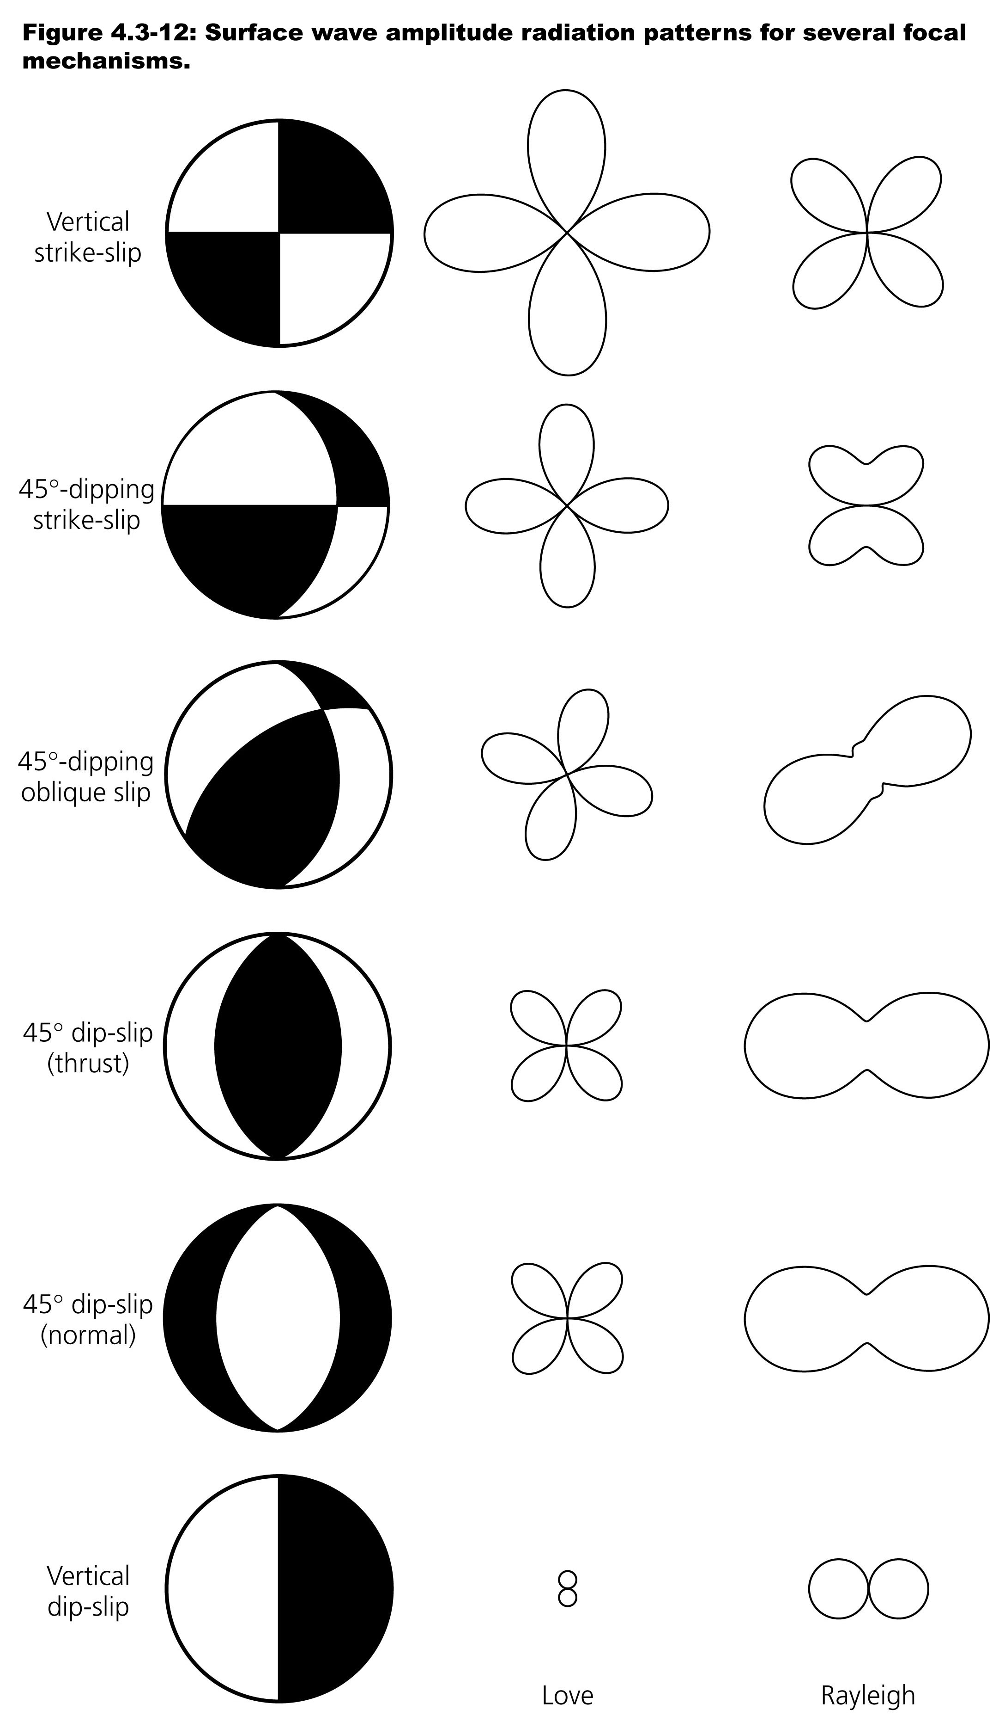

Slide 6
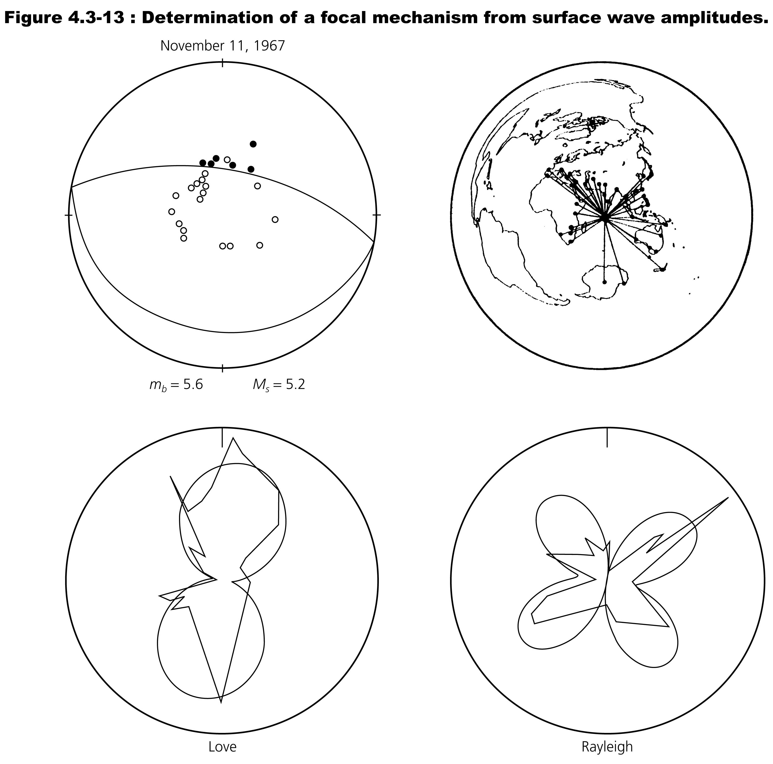

Slide 7
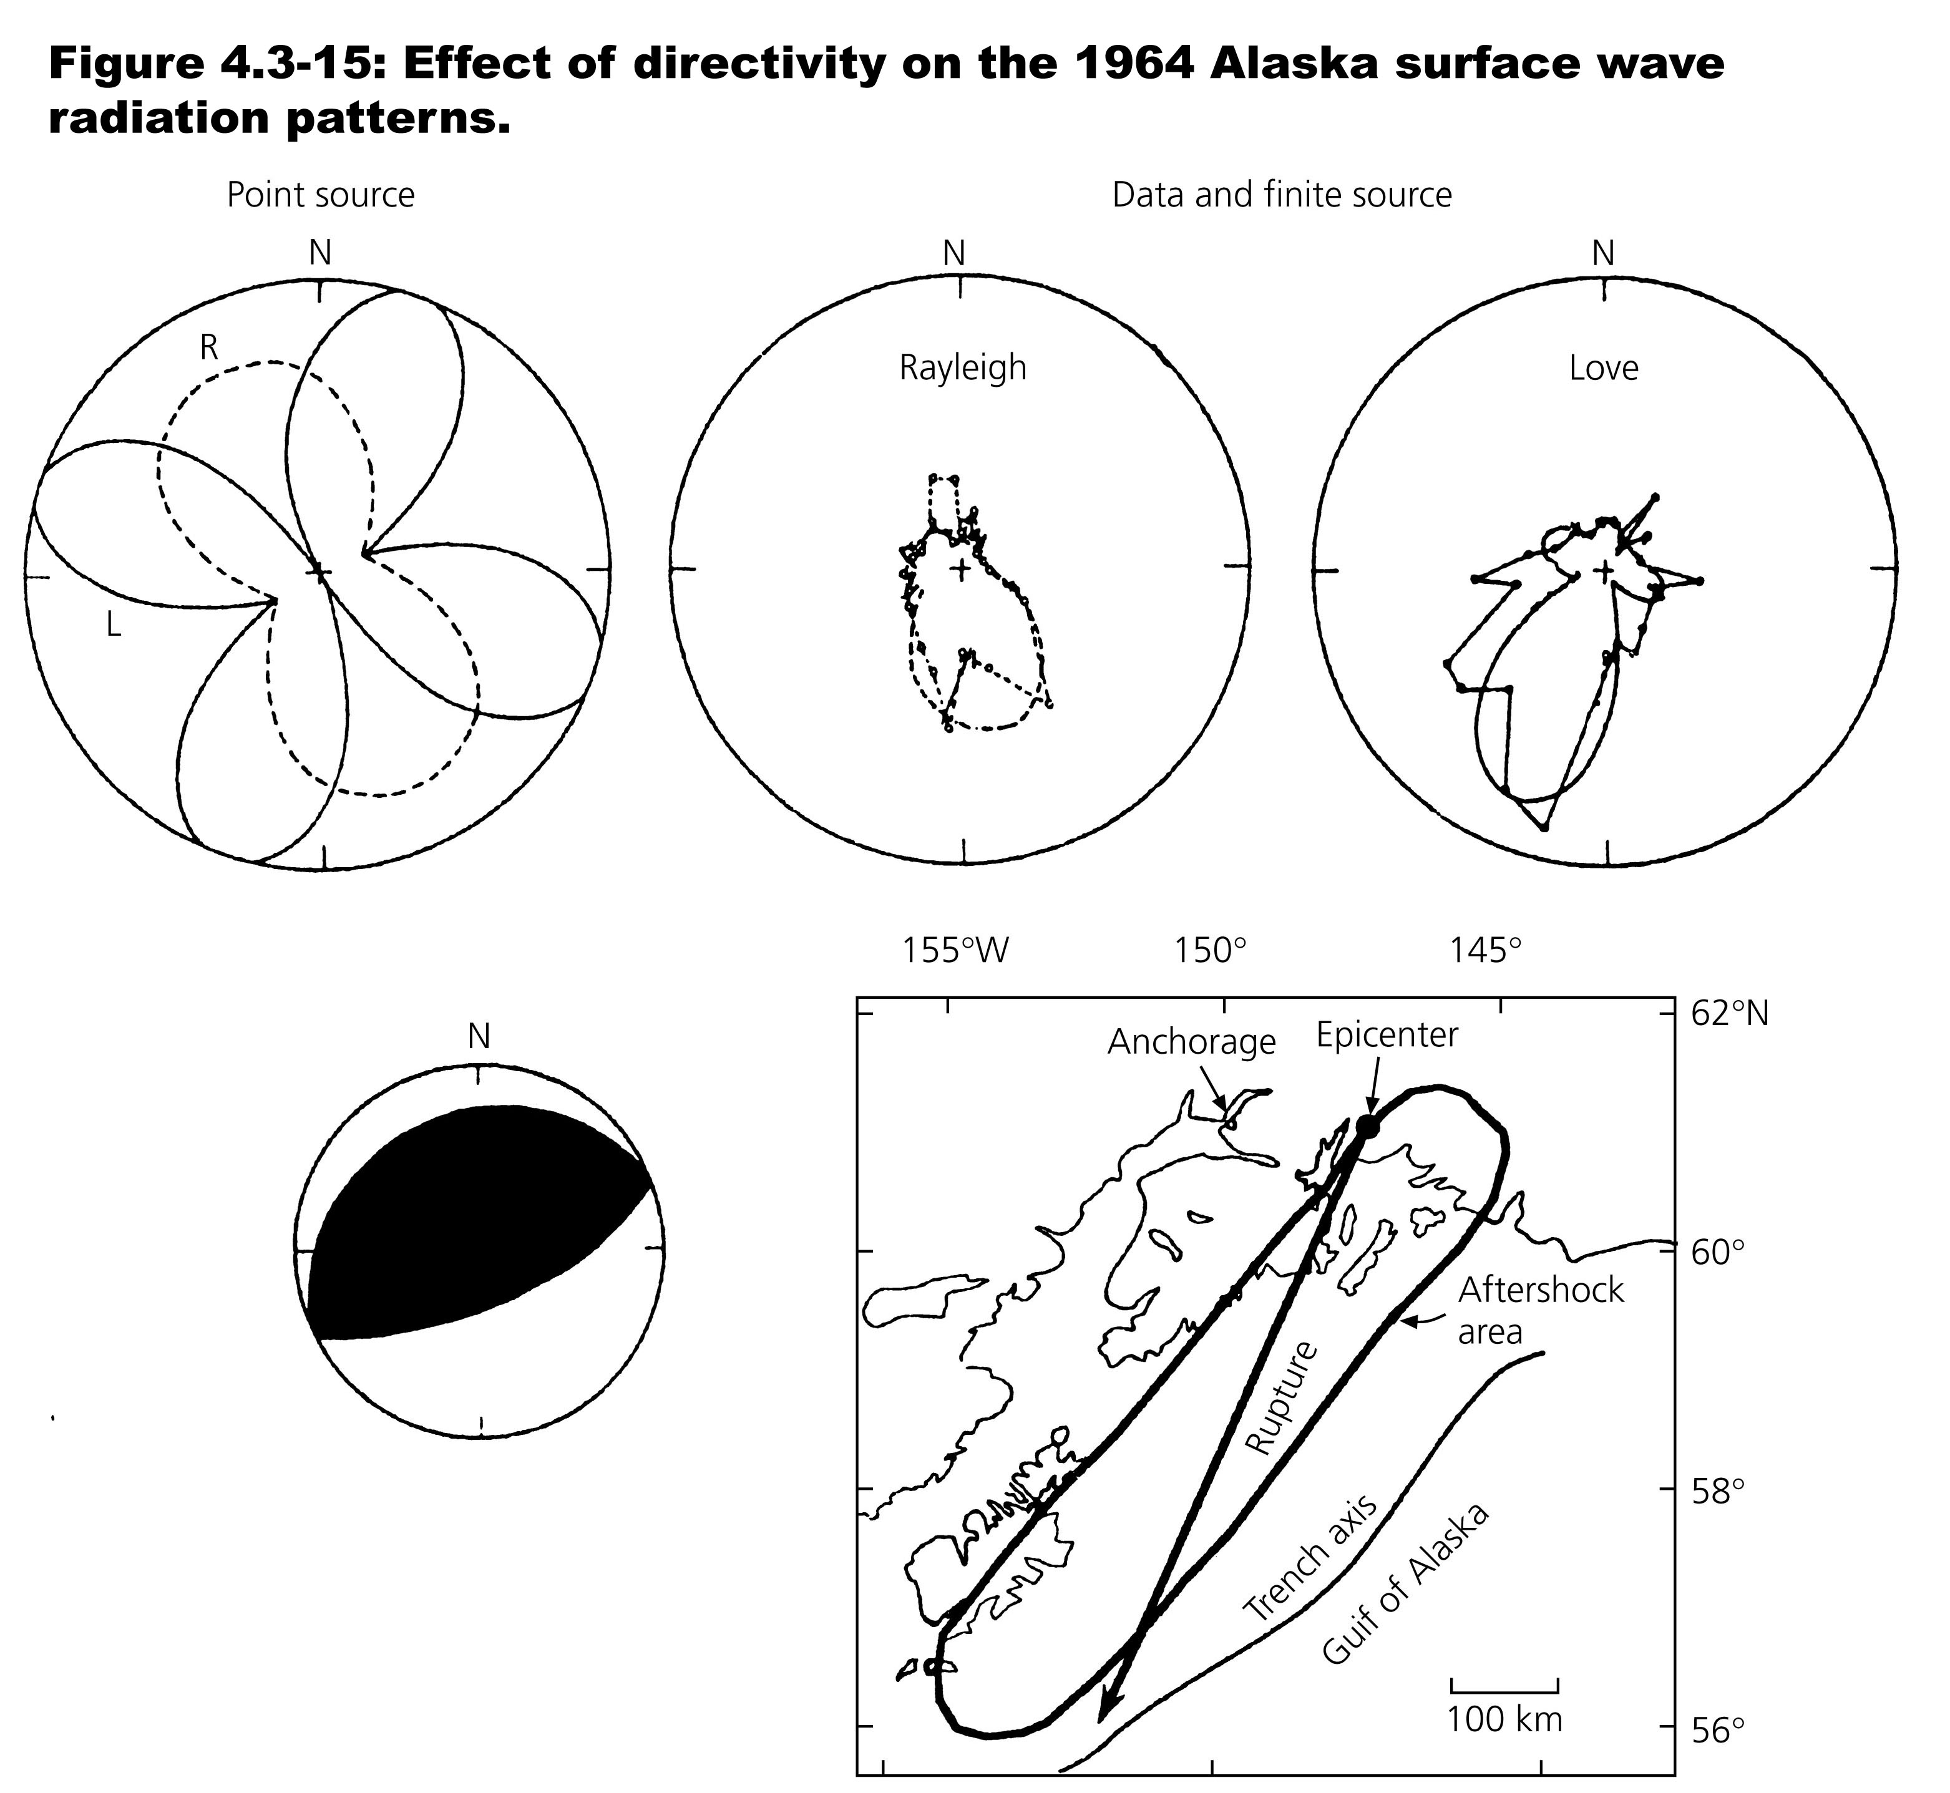

Slide 8
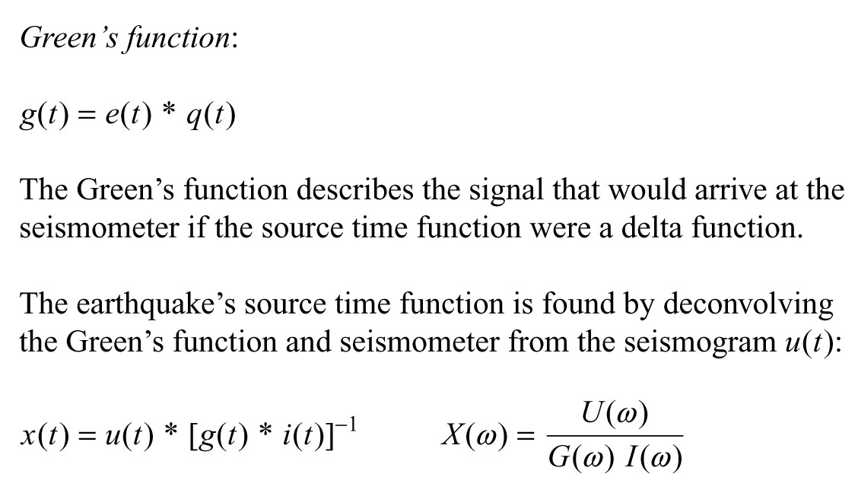

Slide 15
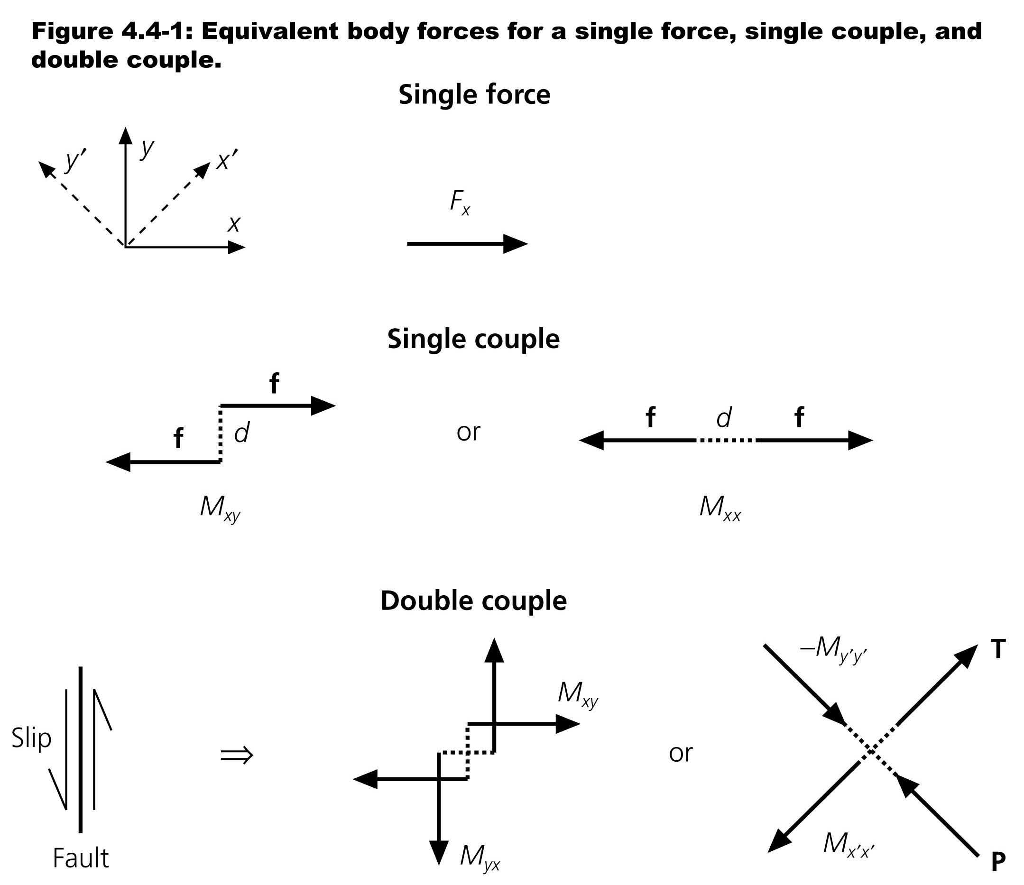

Slide 16
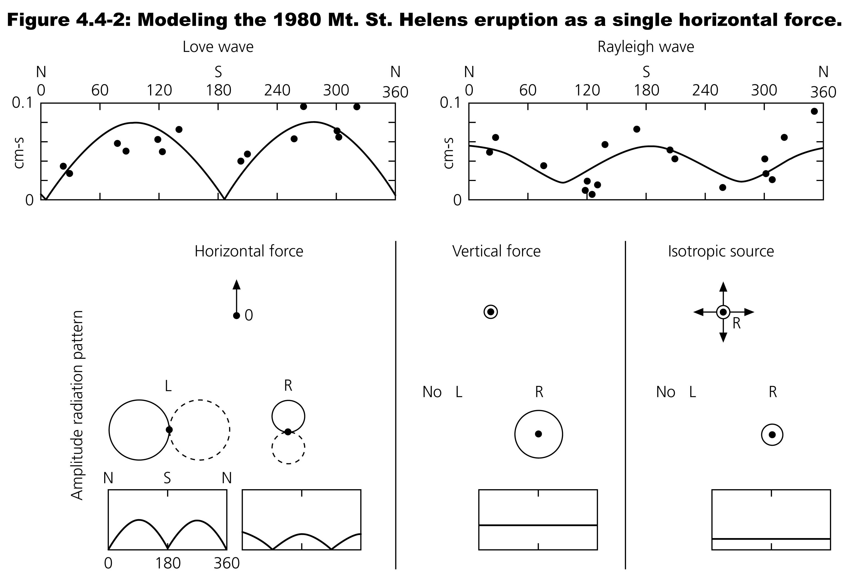

Slide 17
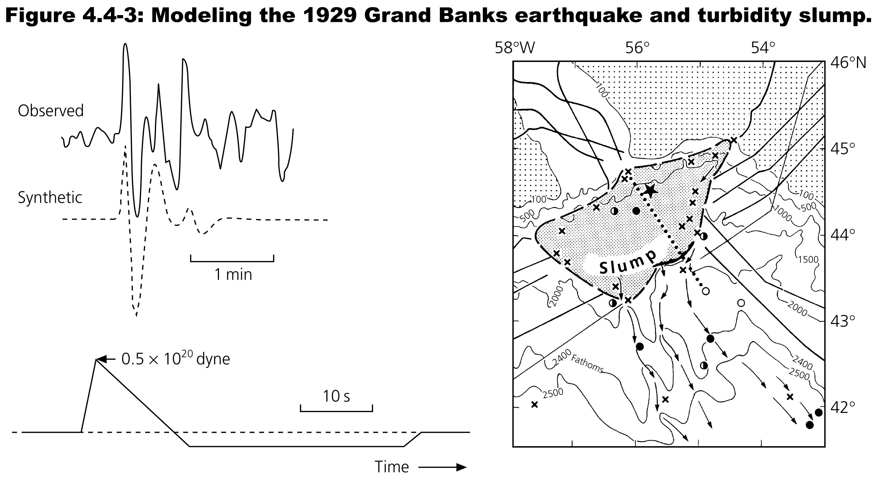

Slide 18
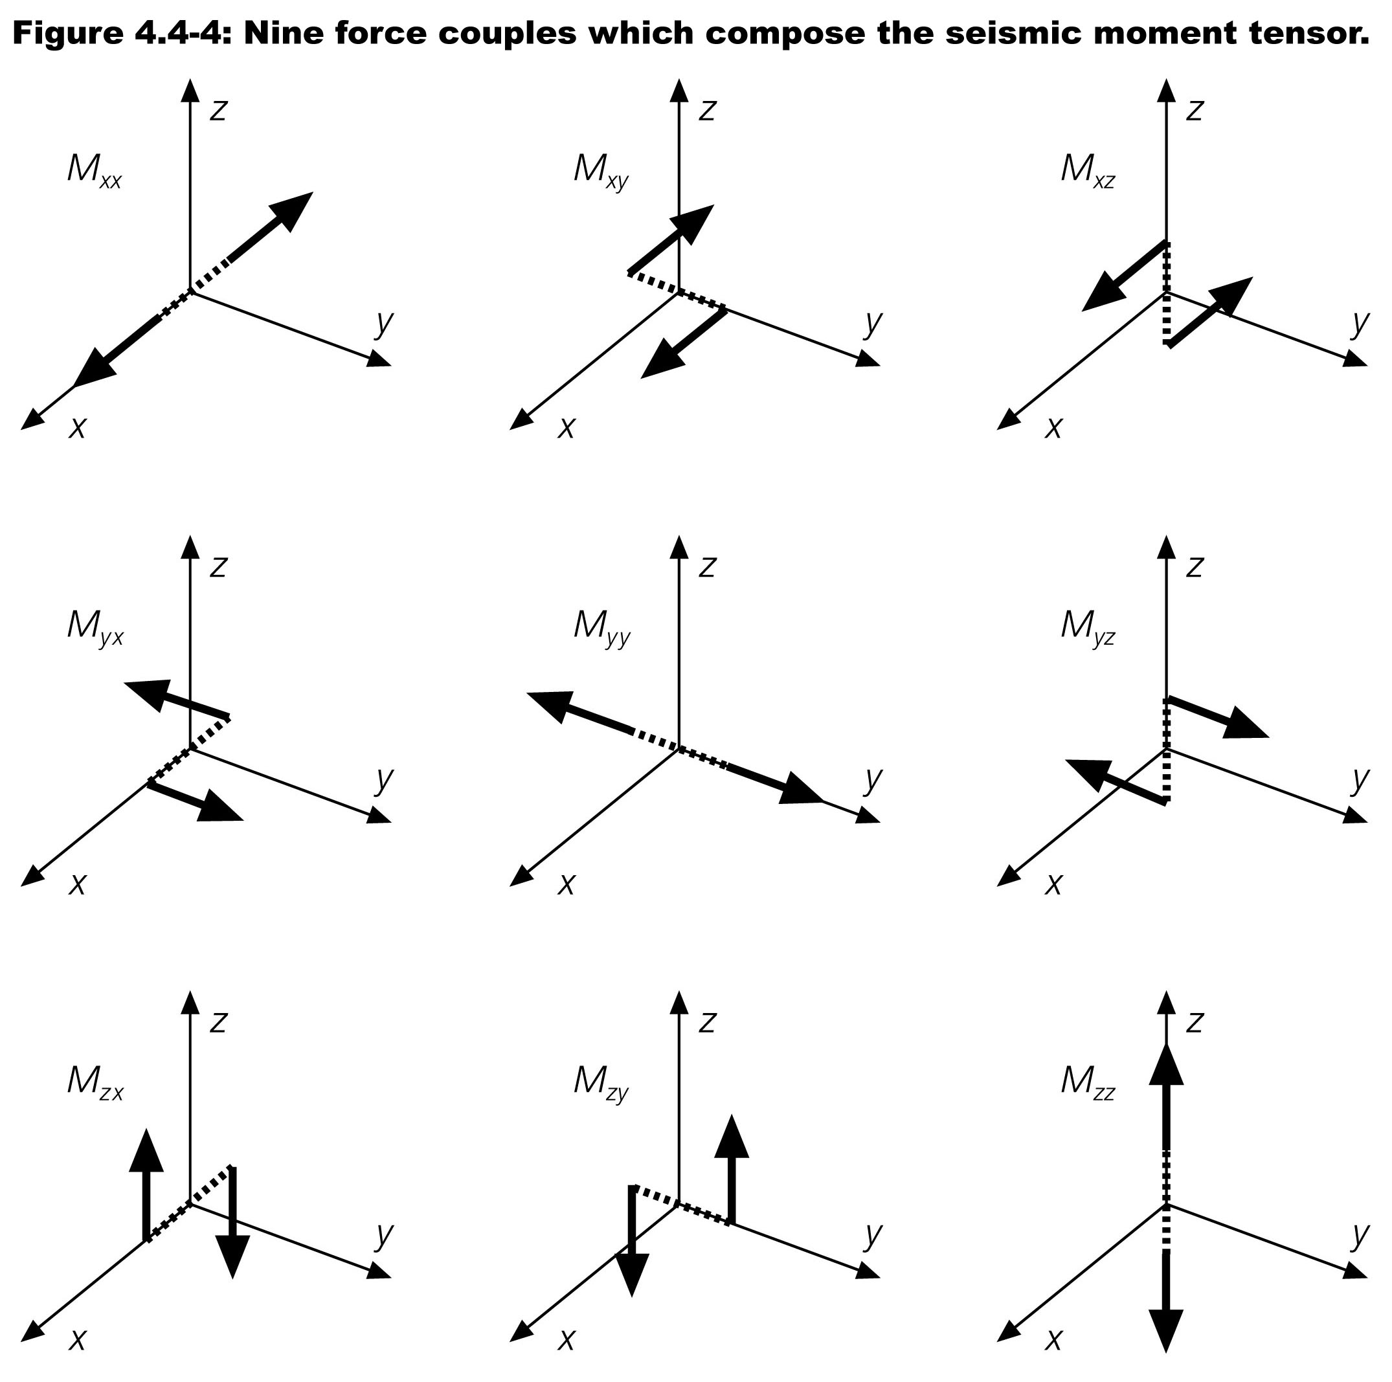

Slide 19
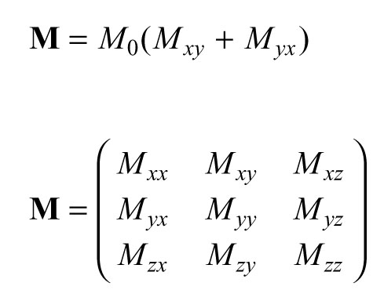
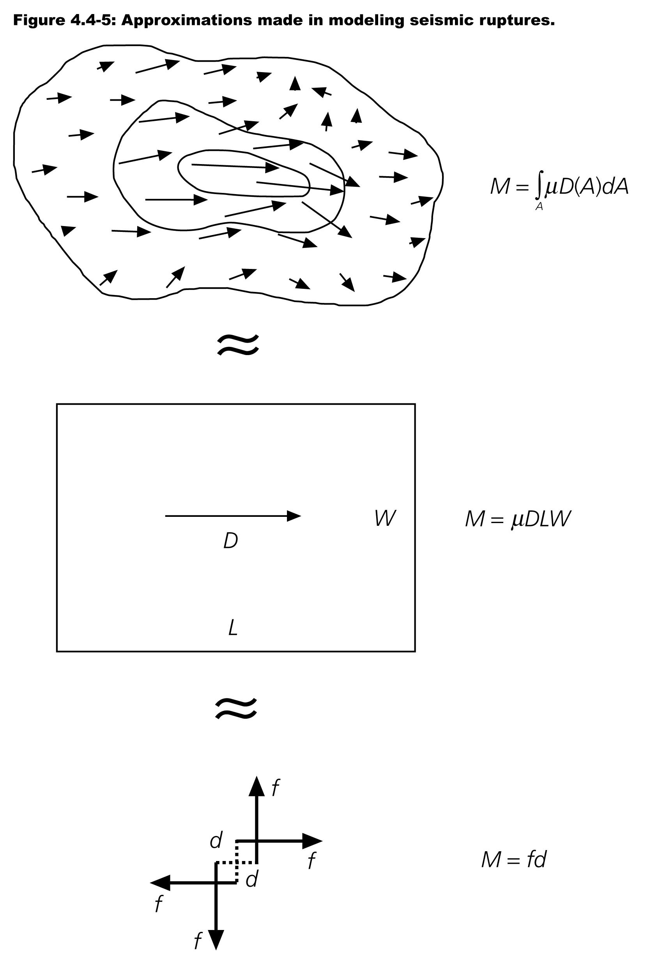

Slide 20
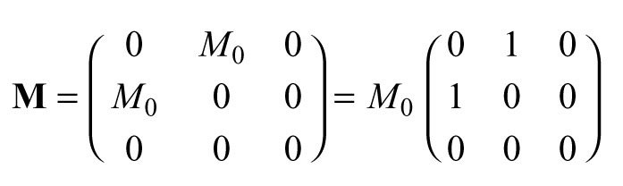

Slide 21
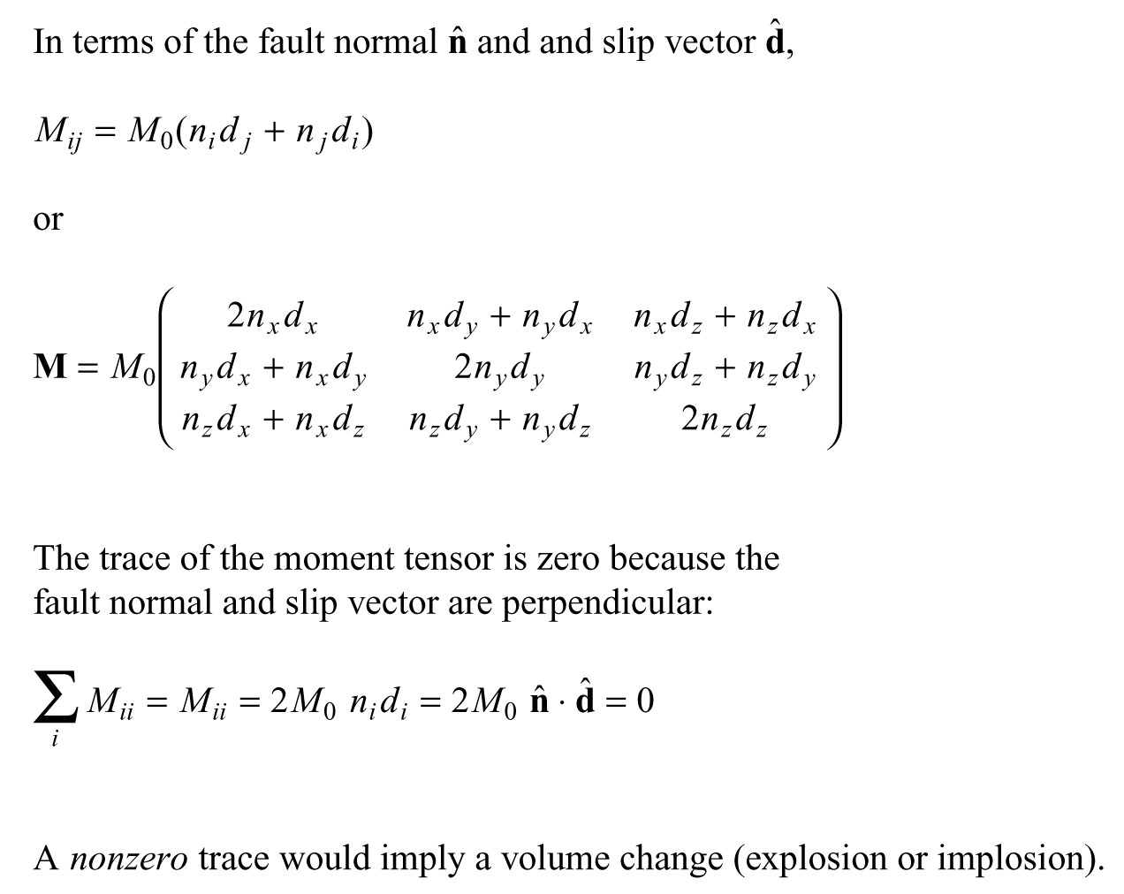

Slide 22
