Slide 1
Global Seismology CERI-8105
Tu-Th 1:15-2:40 pm
Lab - 3892 Central Ave. (Long building) , Room 110
-----------------------------------------------
Bob Smalley
Office: 3892 Central Ave, Room 103, 678-4929
Office Hours – when I’m in my office.
http://www.ceri.memphis.edu/people/smalley/CERI8105_GlobalSeismology.html
Tue., Nov 14, 2023 Meeting 22

Slide 2
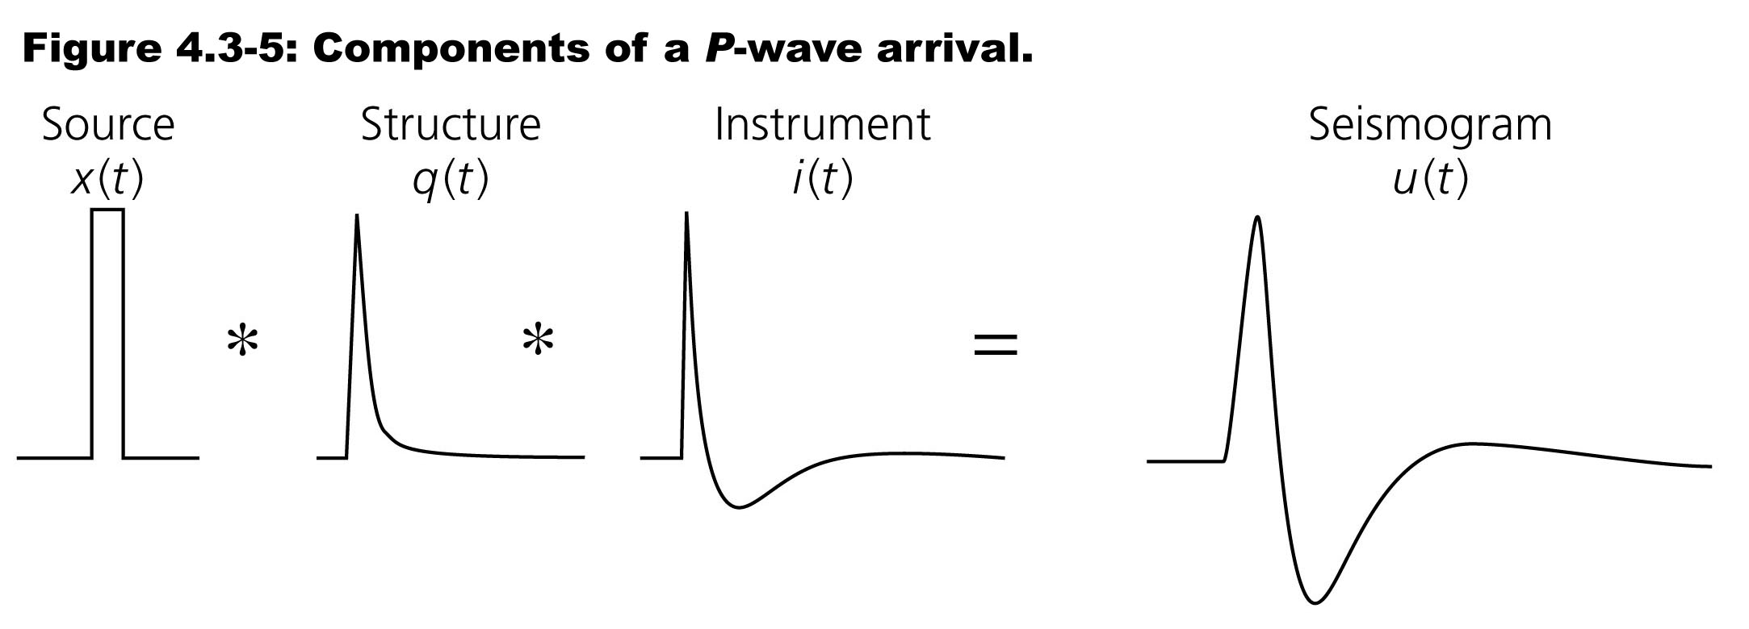
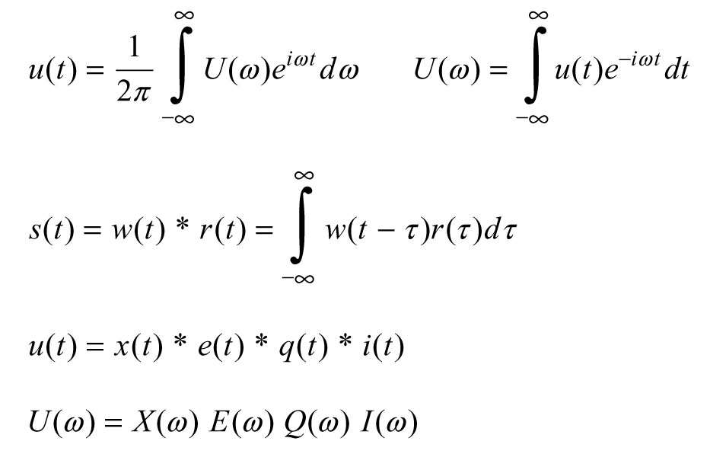
Waveform modeling
=e(t)
=Atten
Signal is composed of components combined by a series of convolutions.
Oftentimes easier to work in frequency (Fourier) domain where convolution is accomplished by multiplication (much easier and faster [with FFT] than doing in time domain)

Slide 3
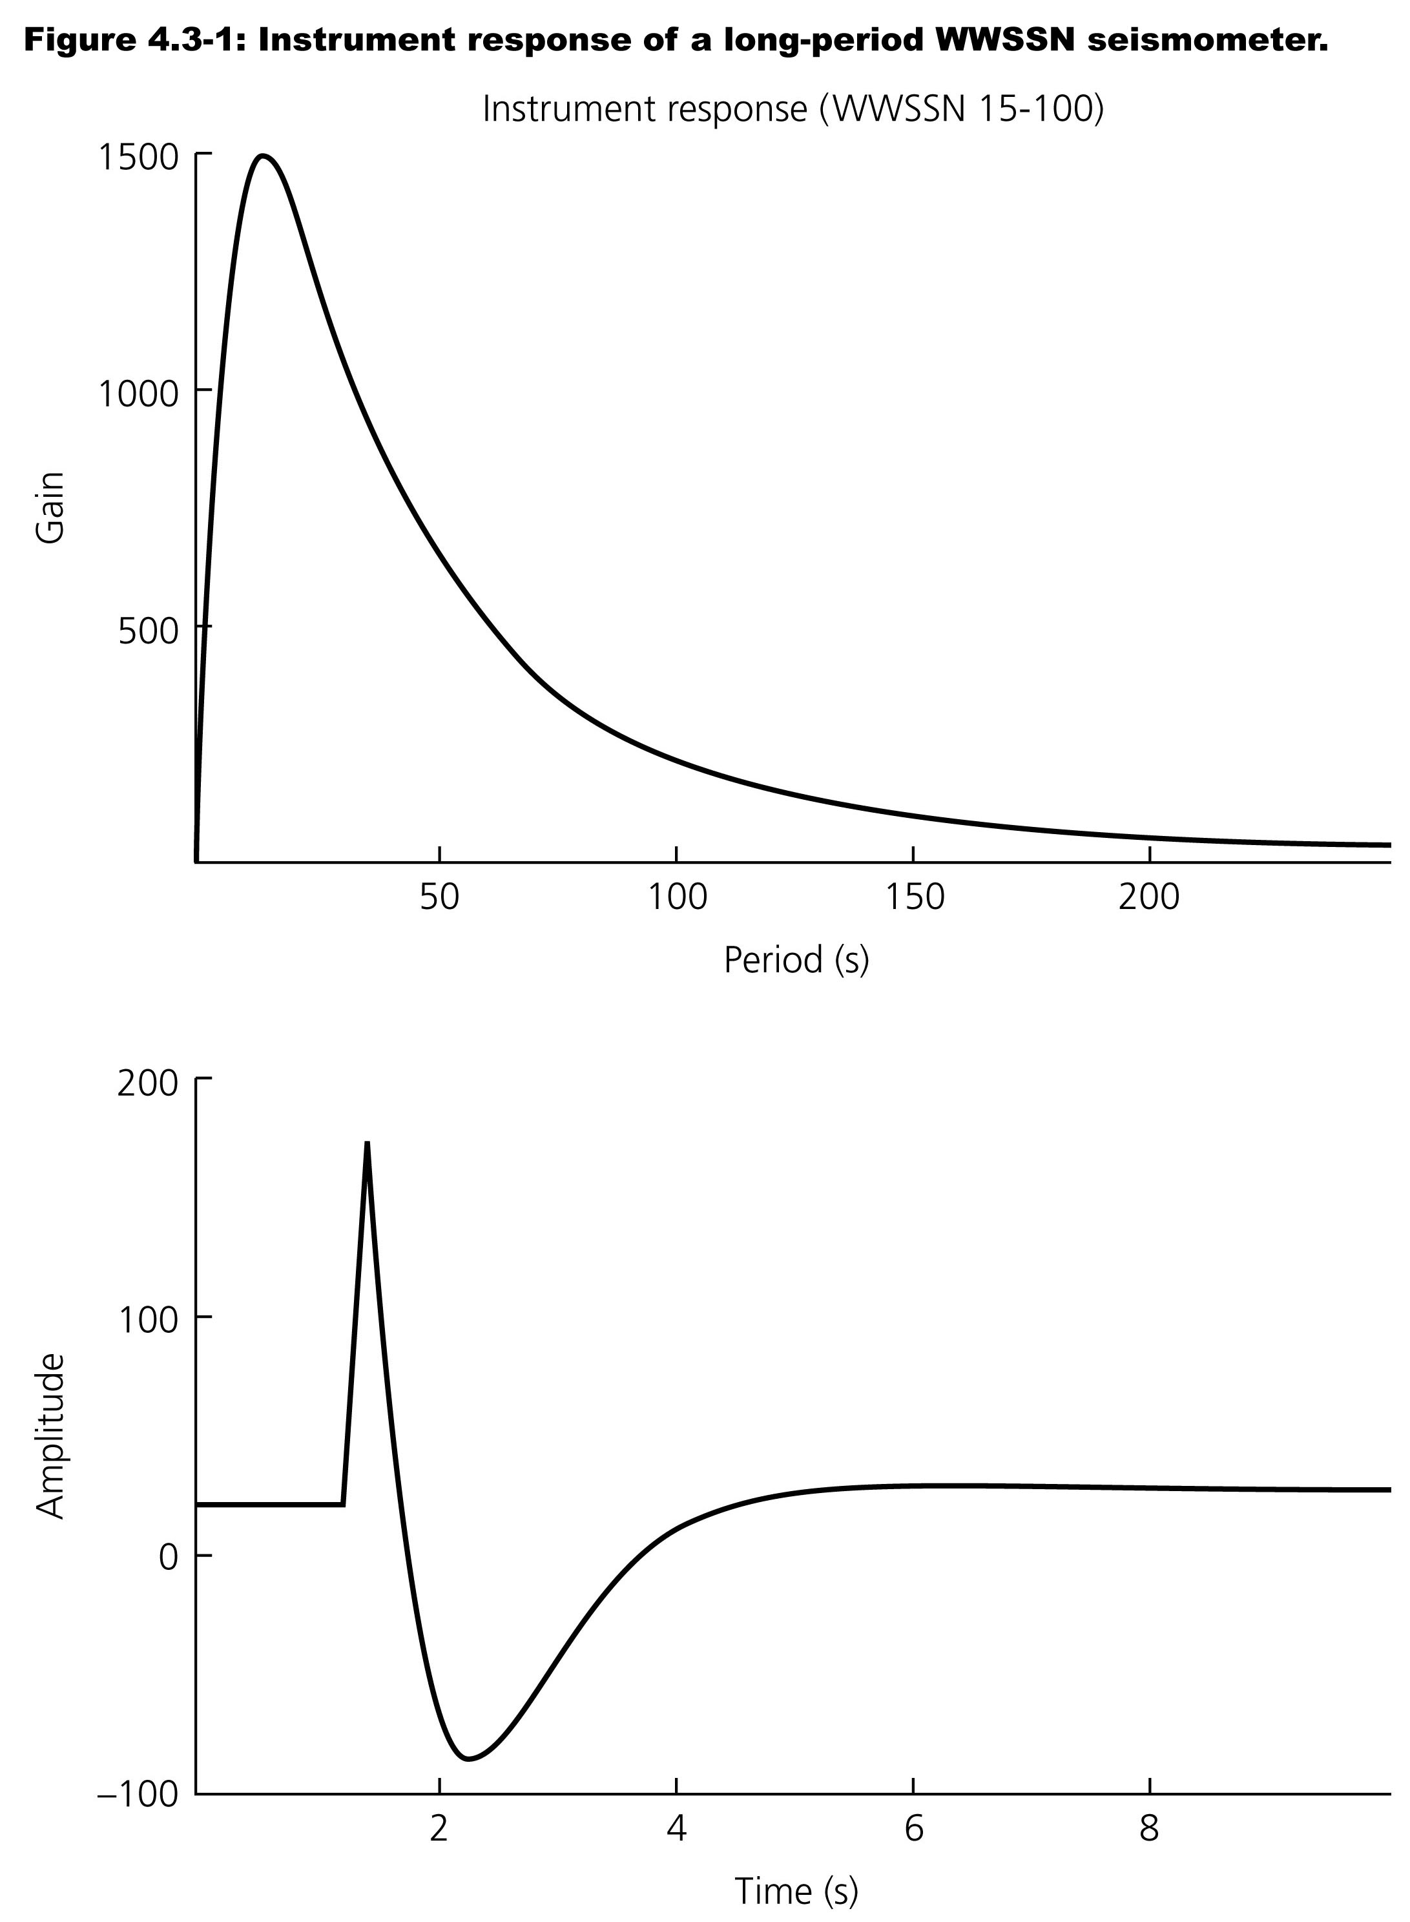
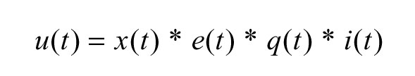

Slide 4
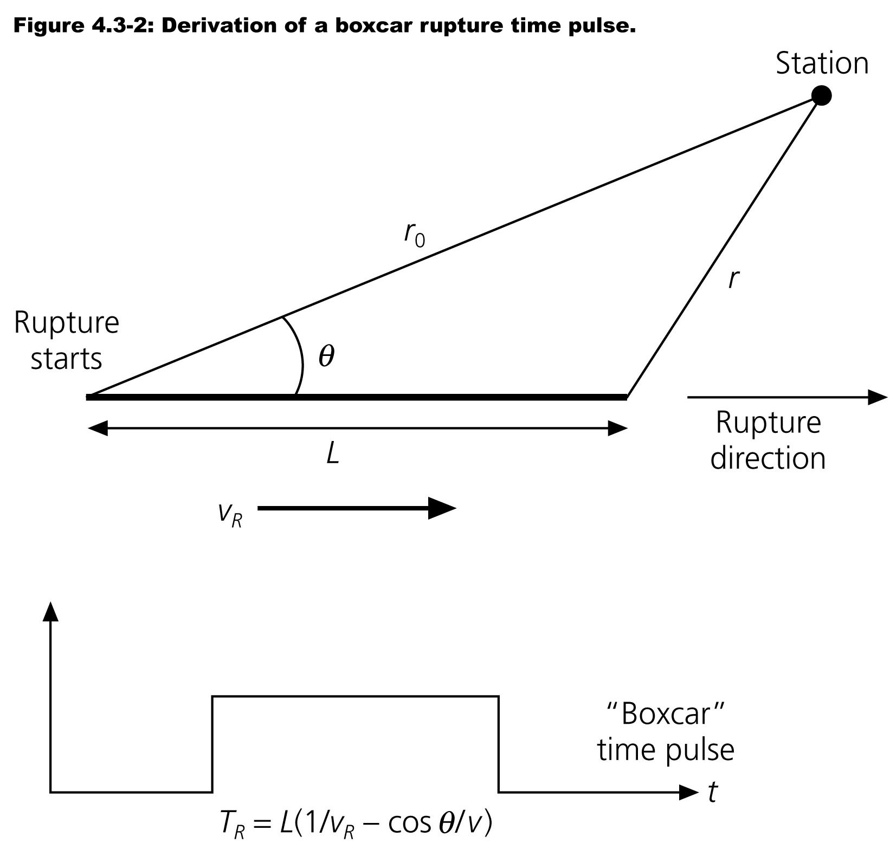
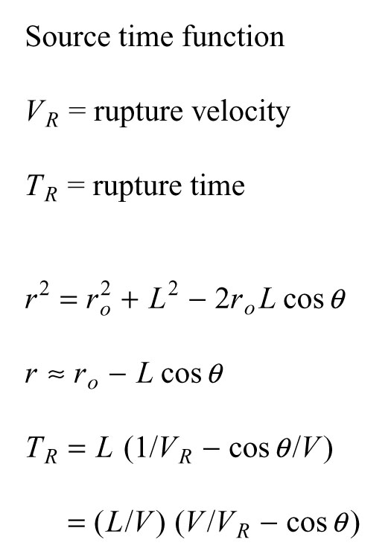

Slide 5
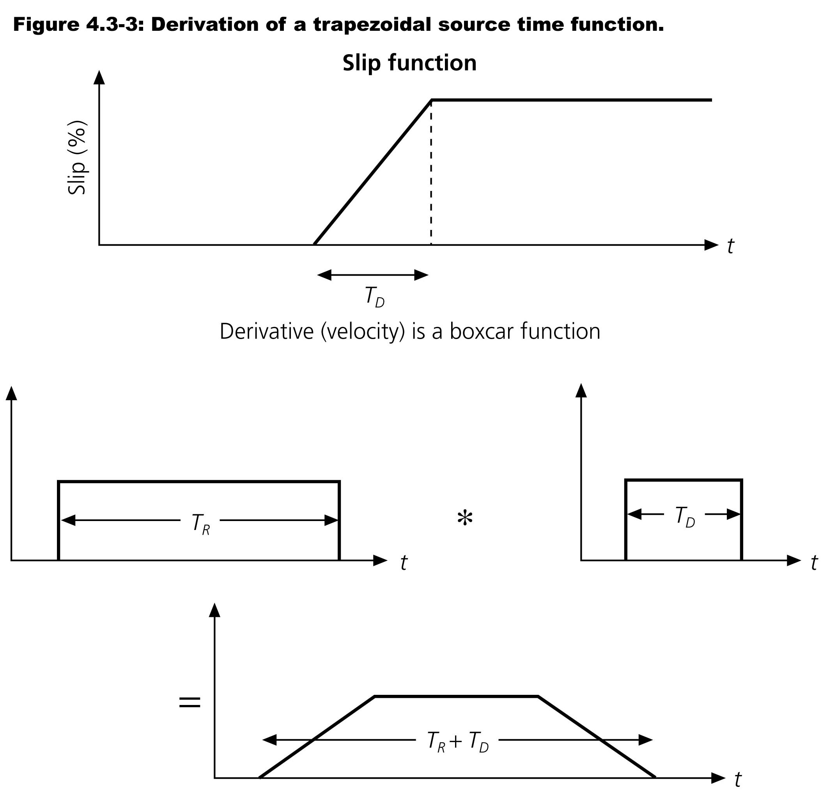

Slide 6
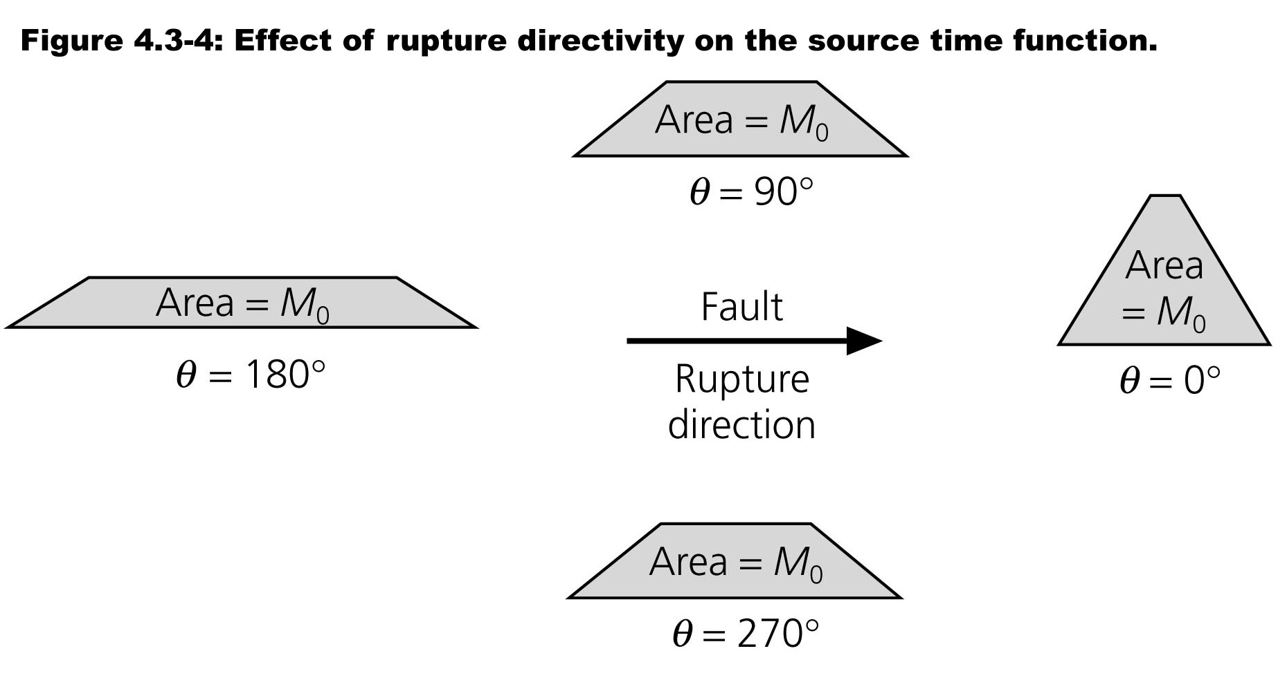

Slide 7
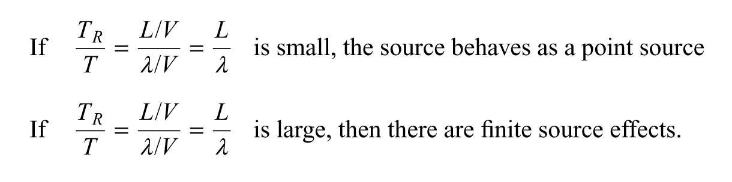

Slide 8
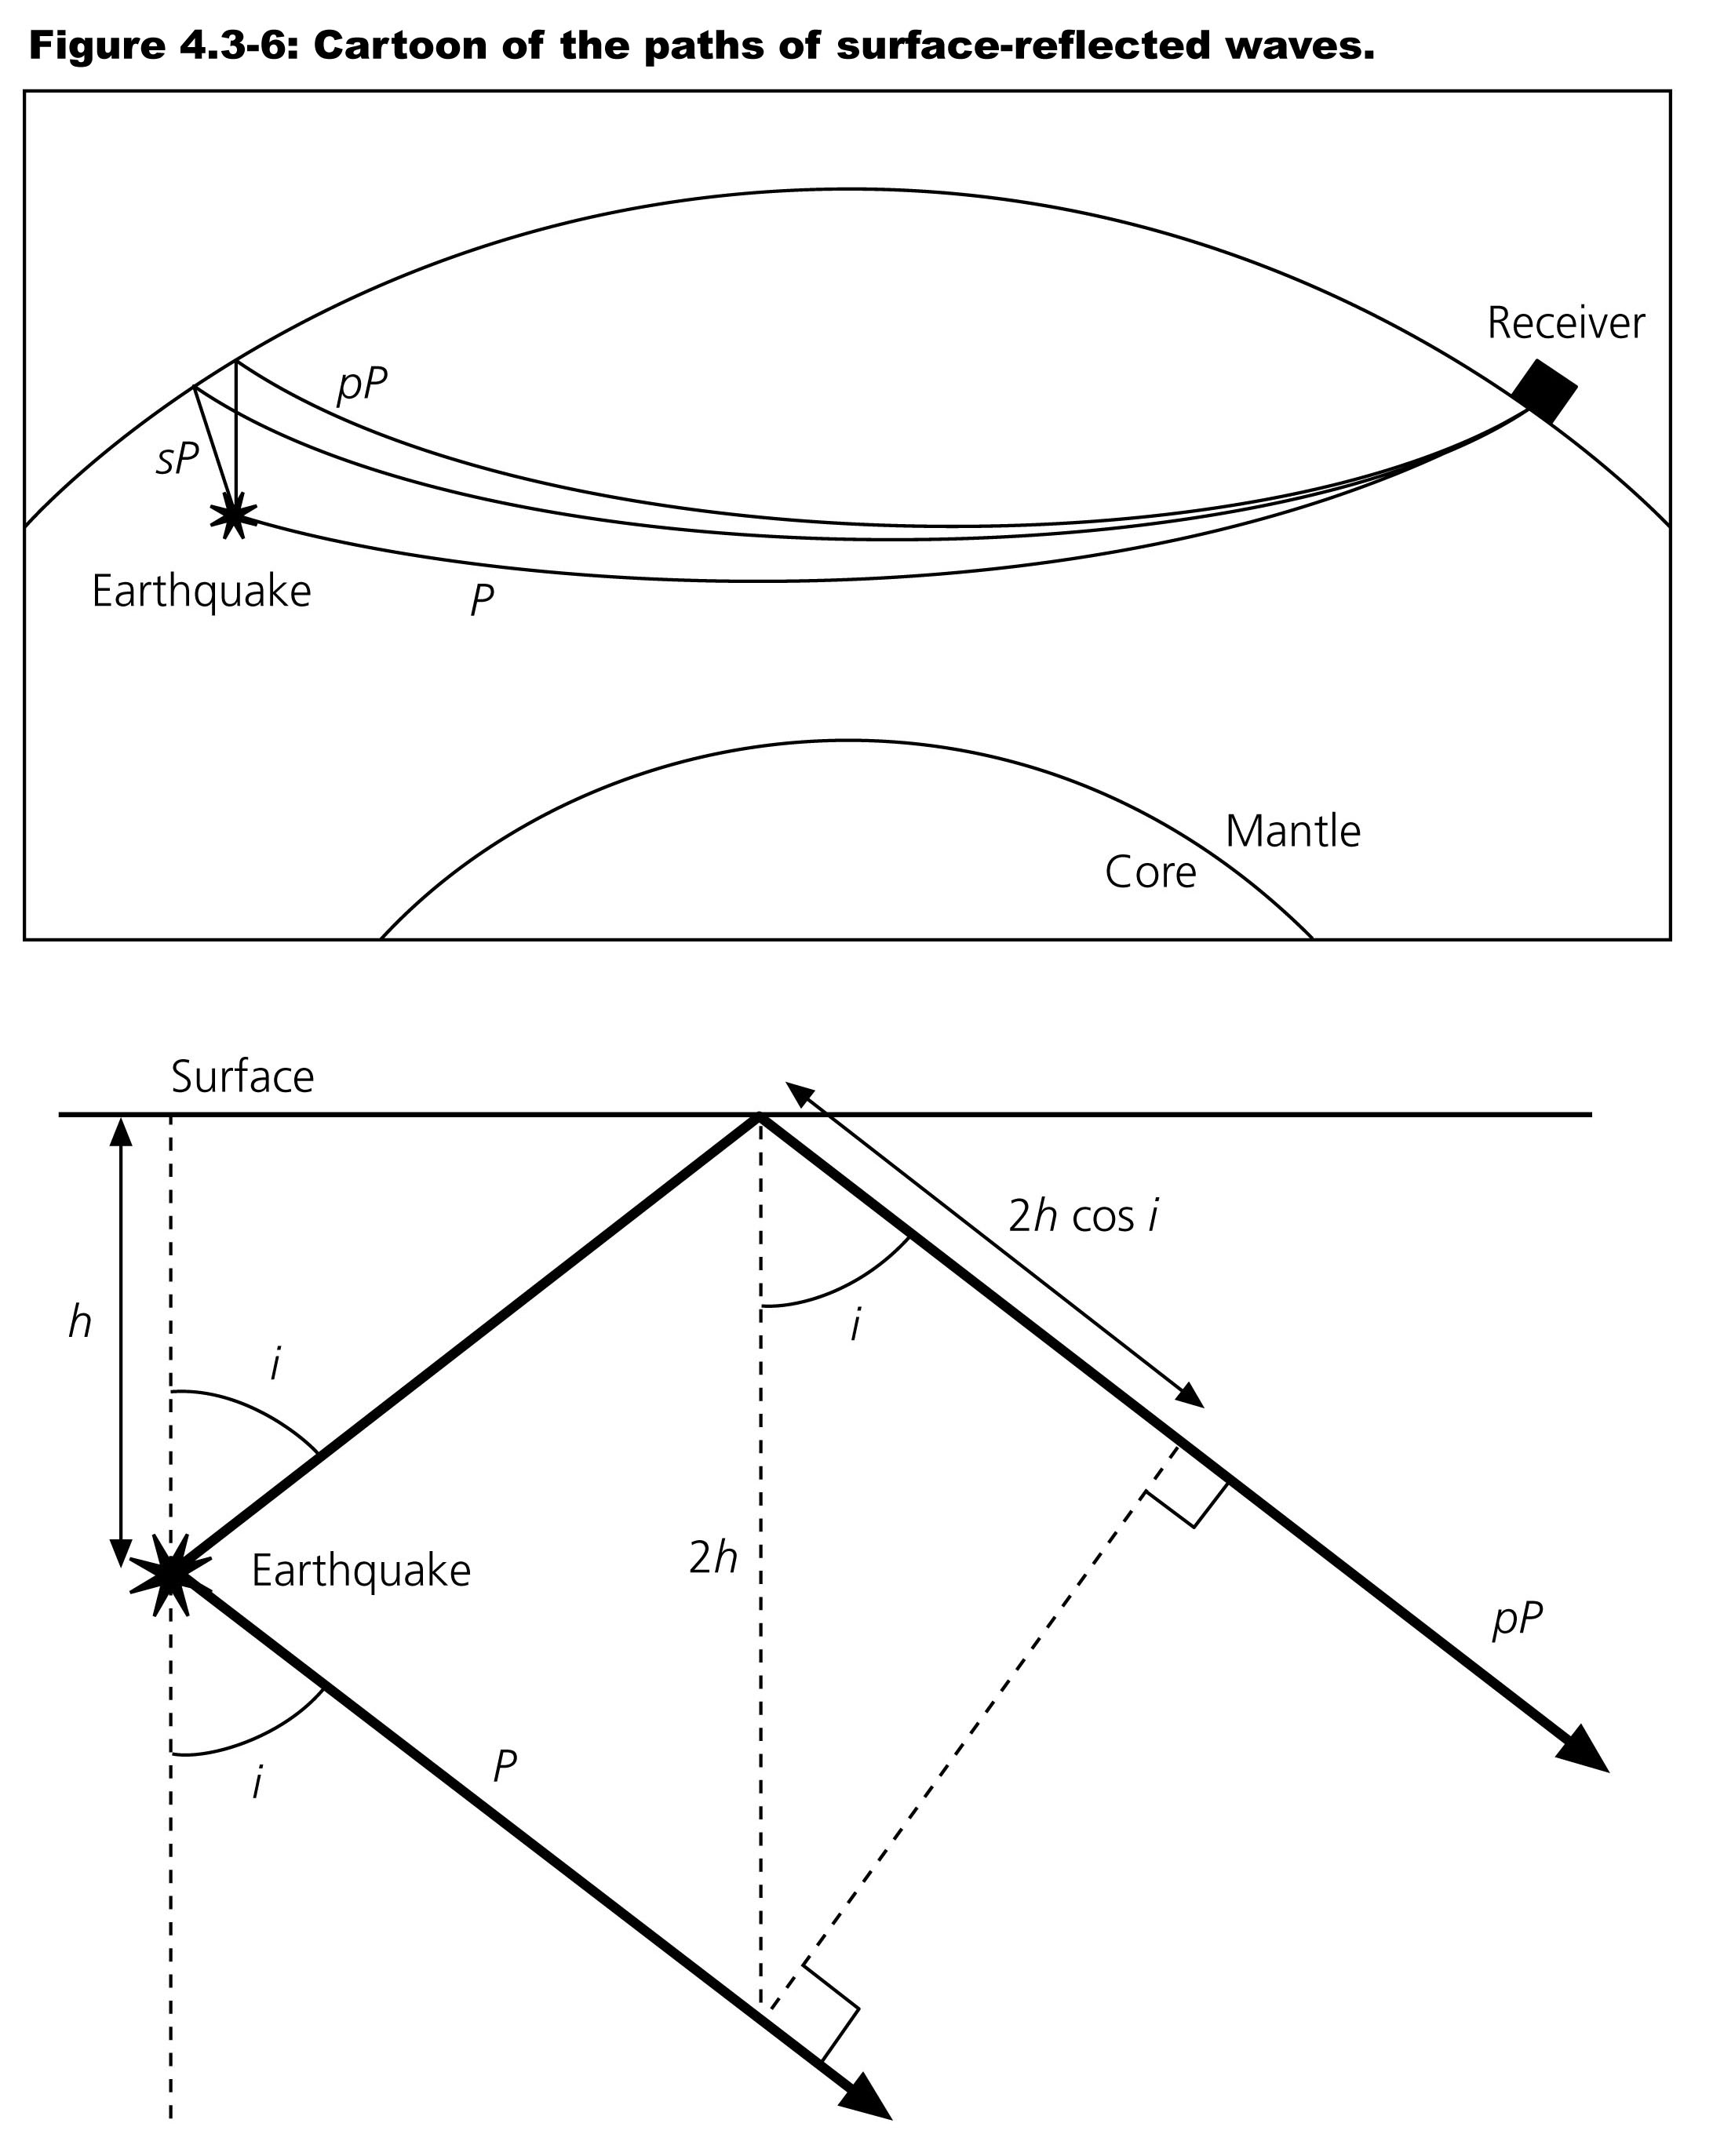
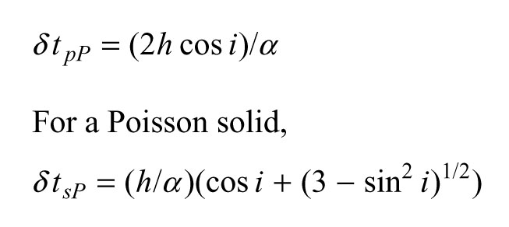

Slide 9
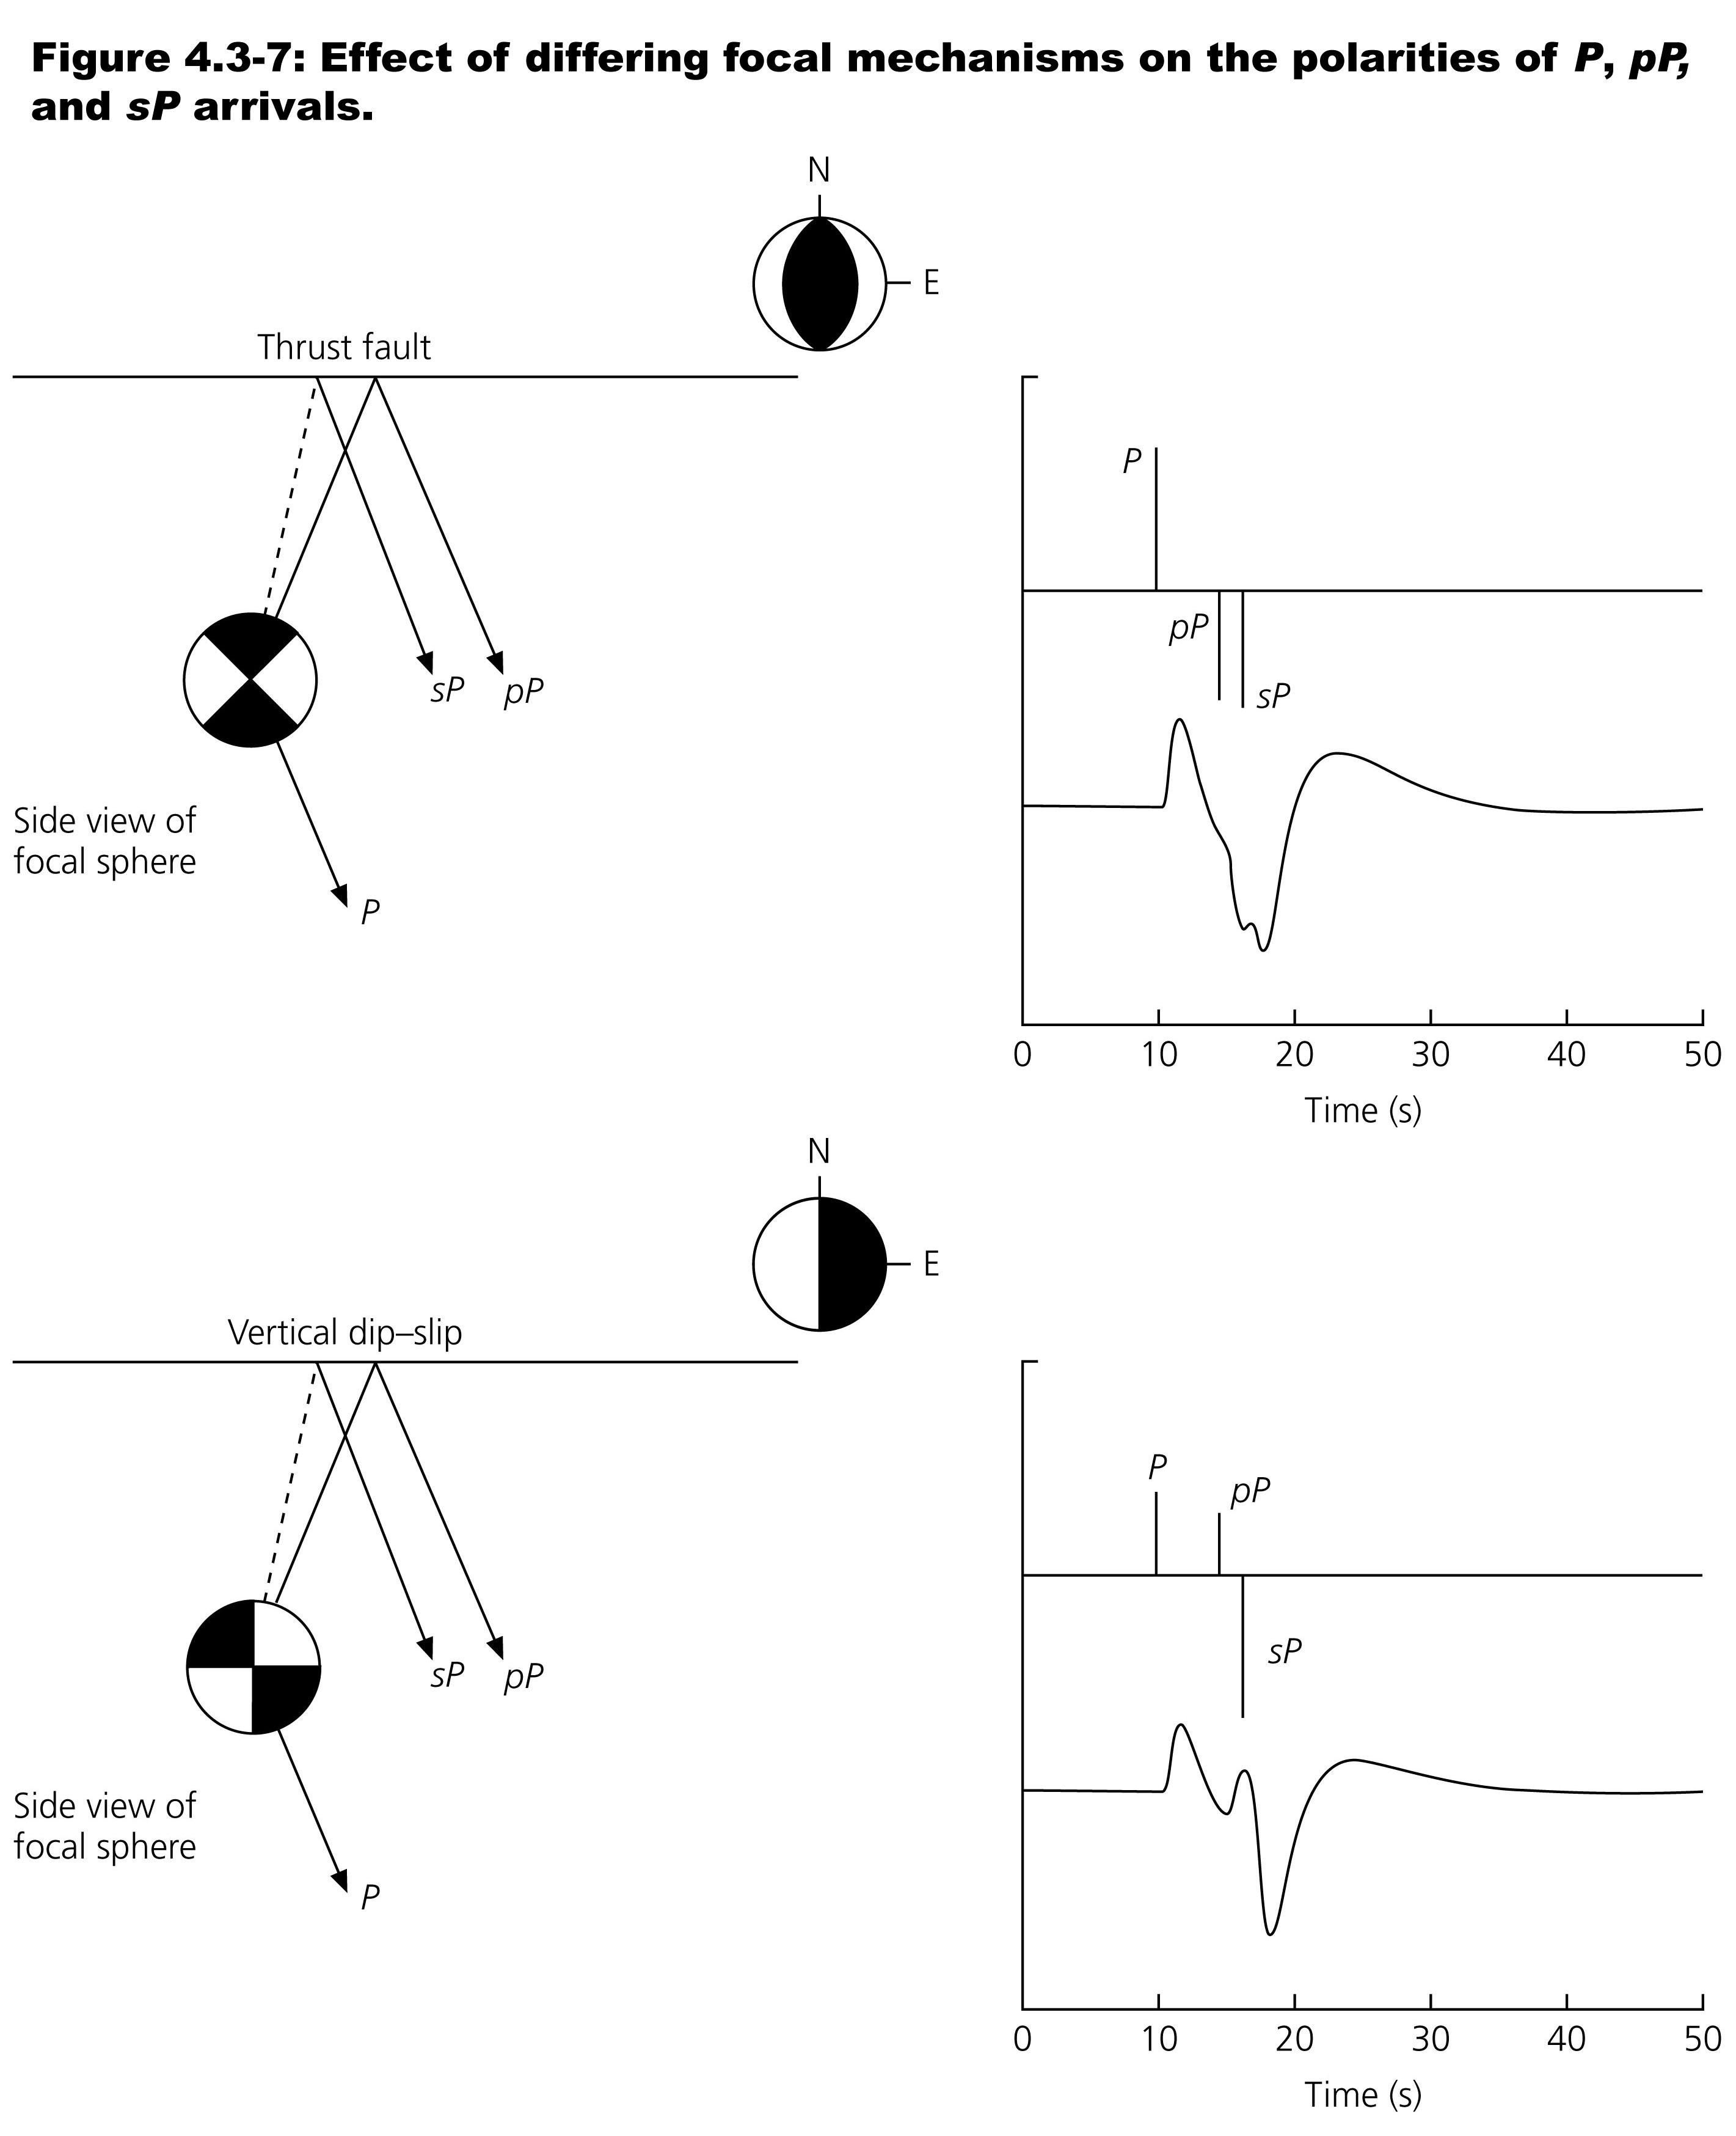

Slide 10
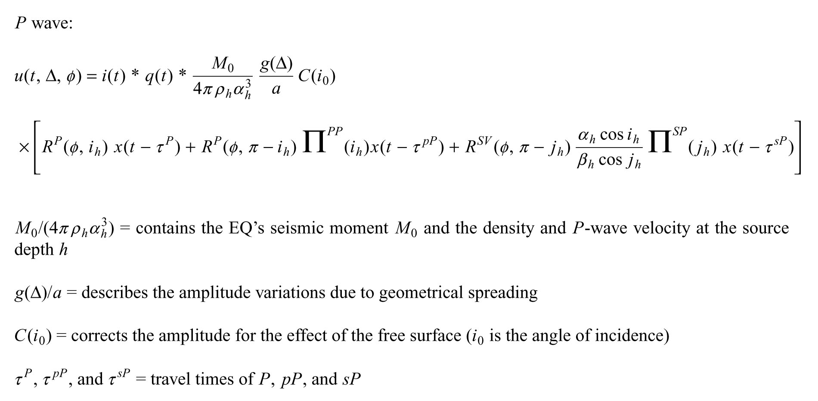

Slide 15
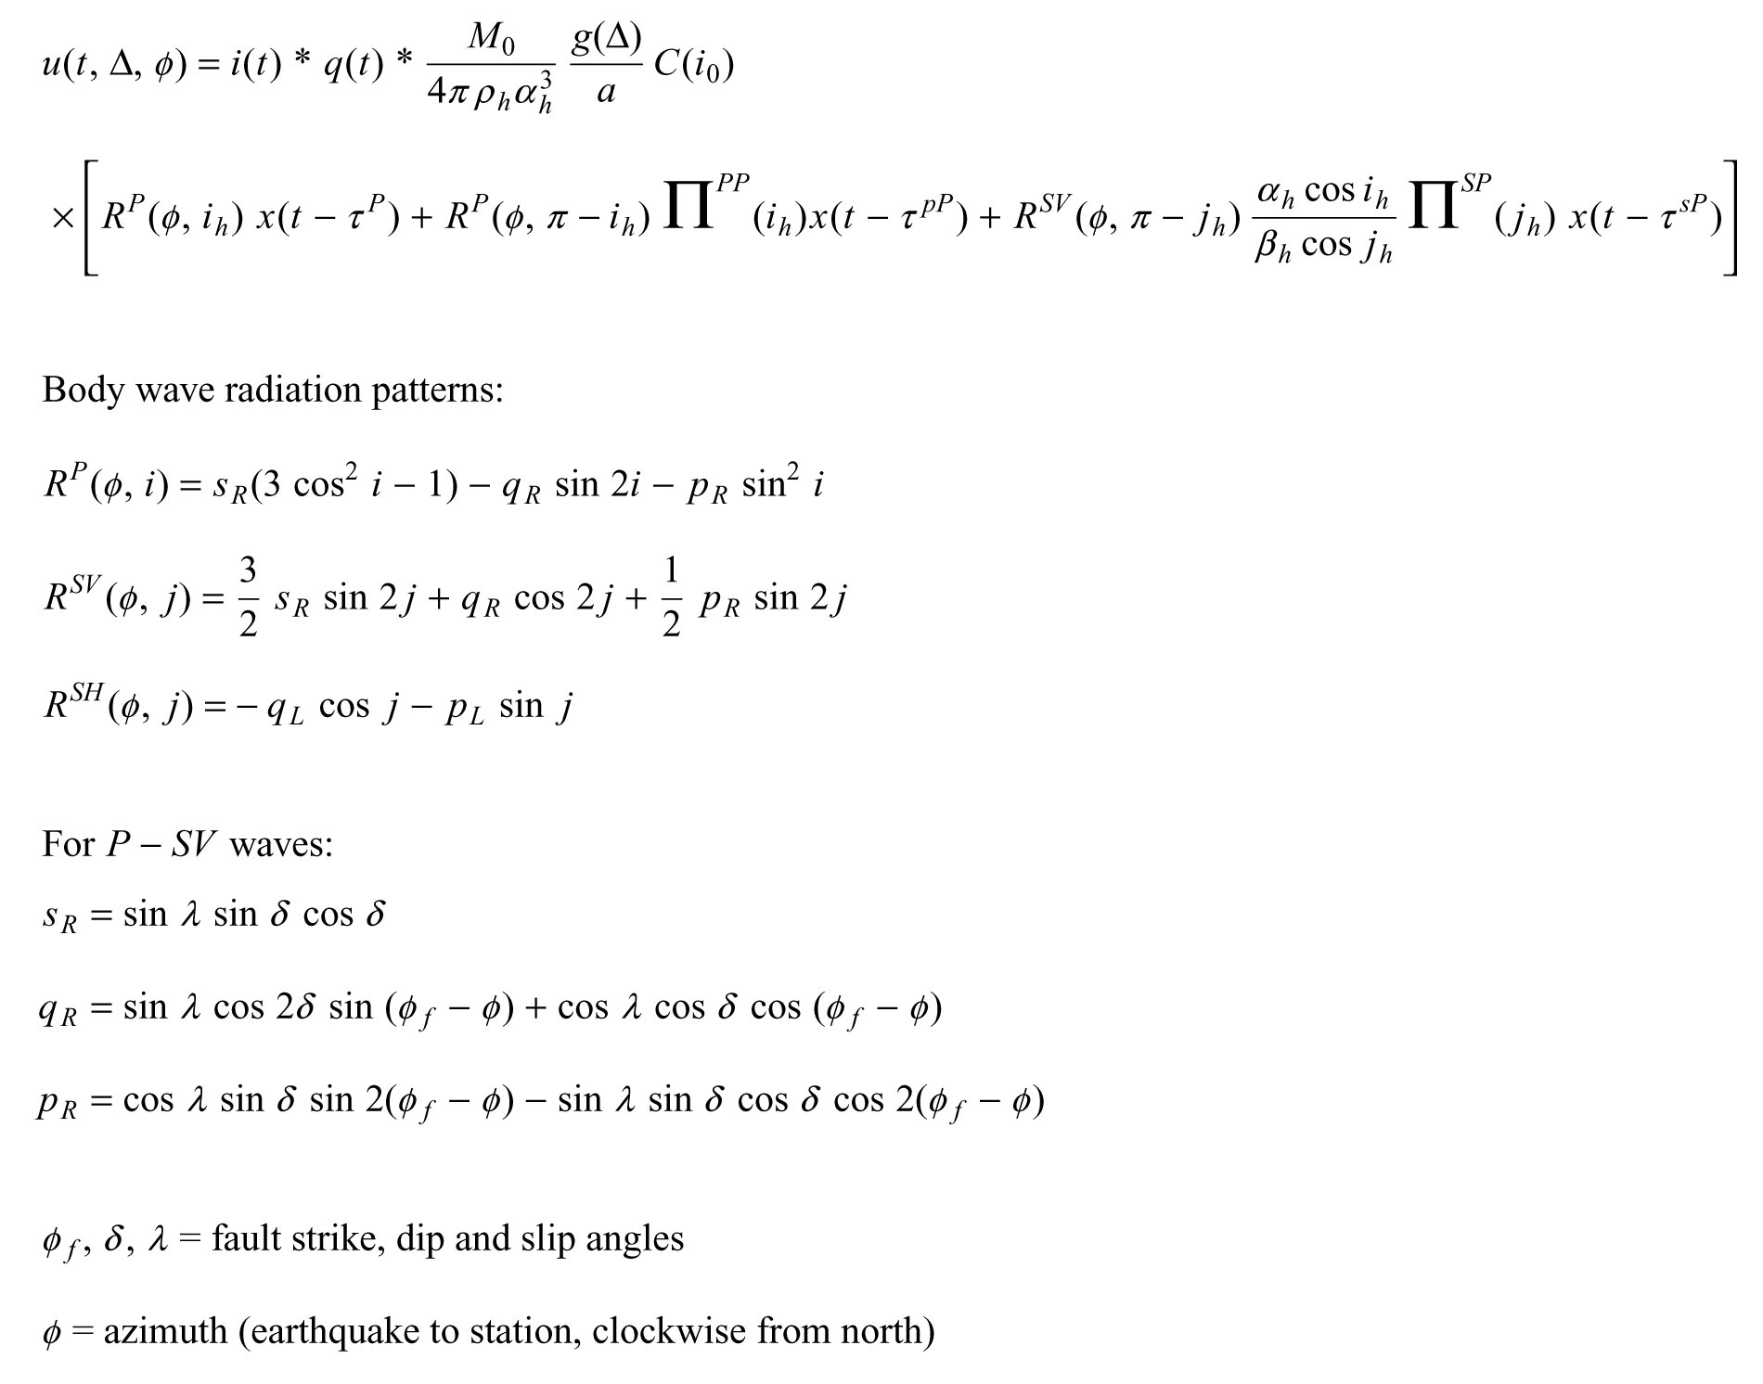

Slide 17
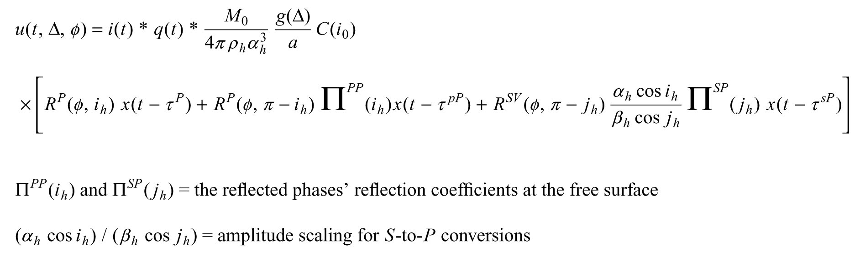

Slide 19
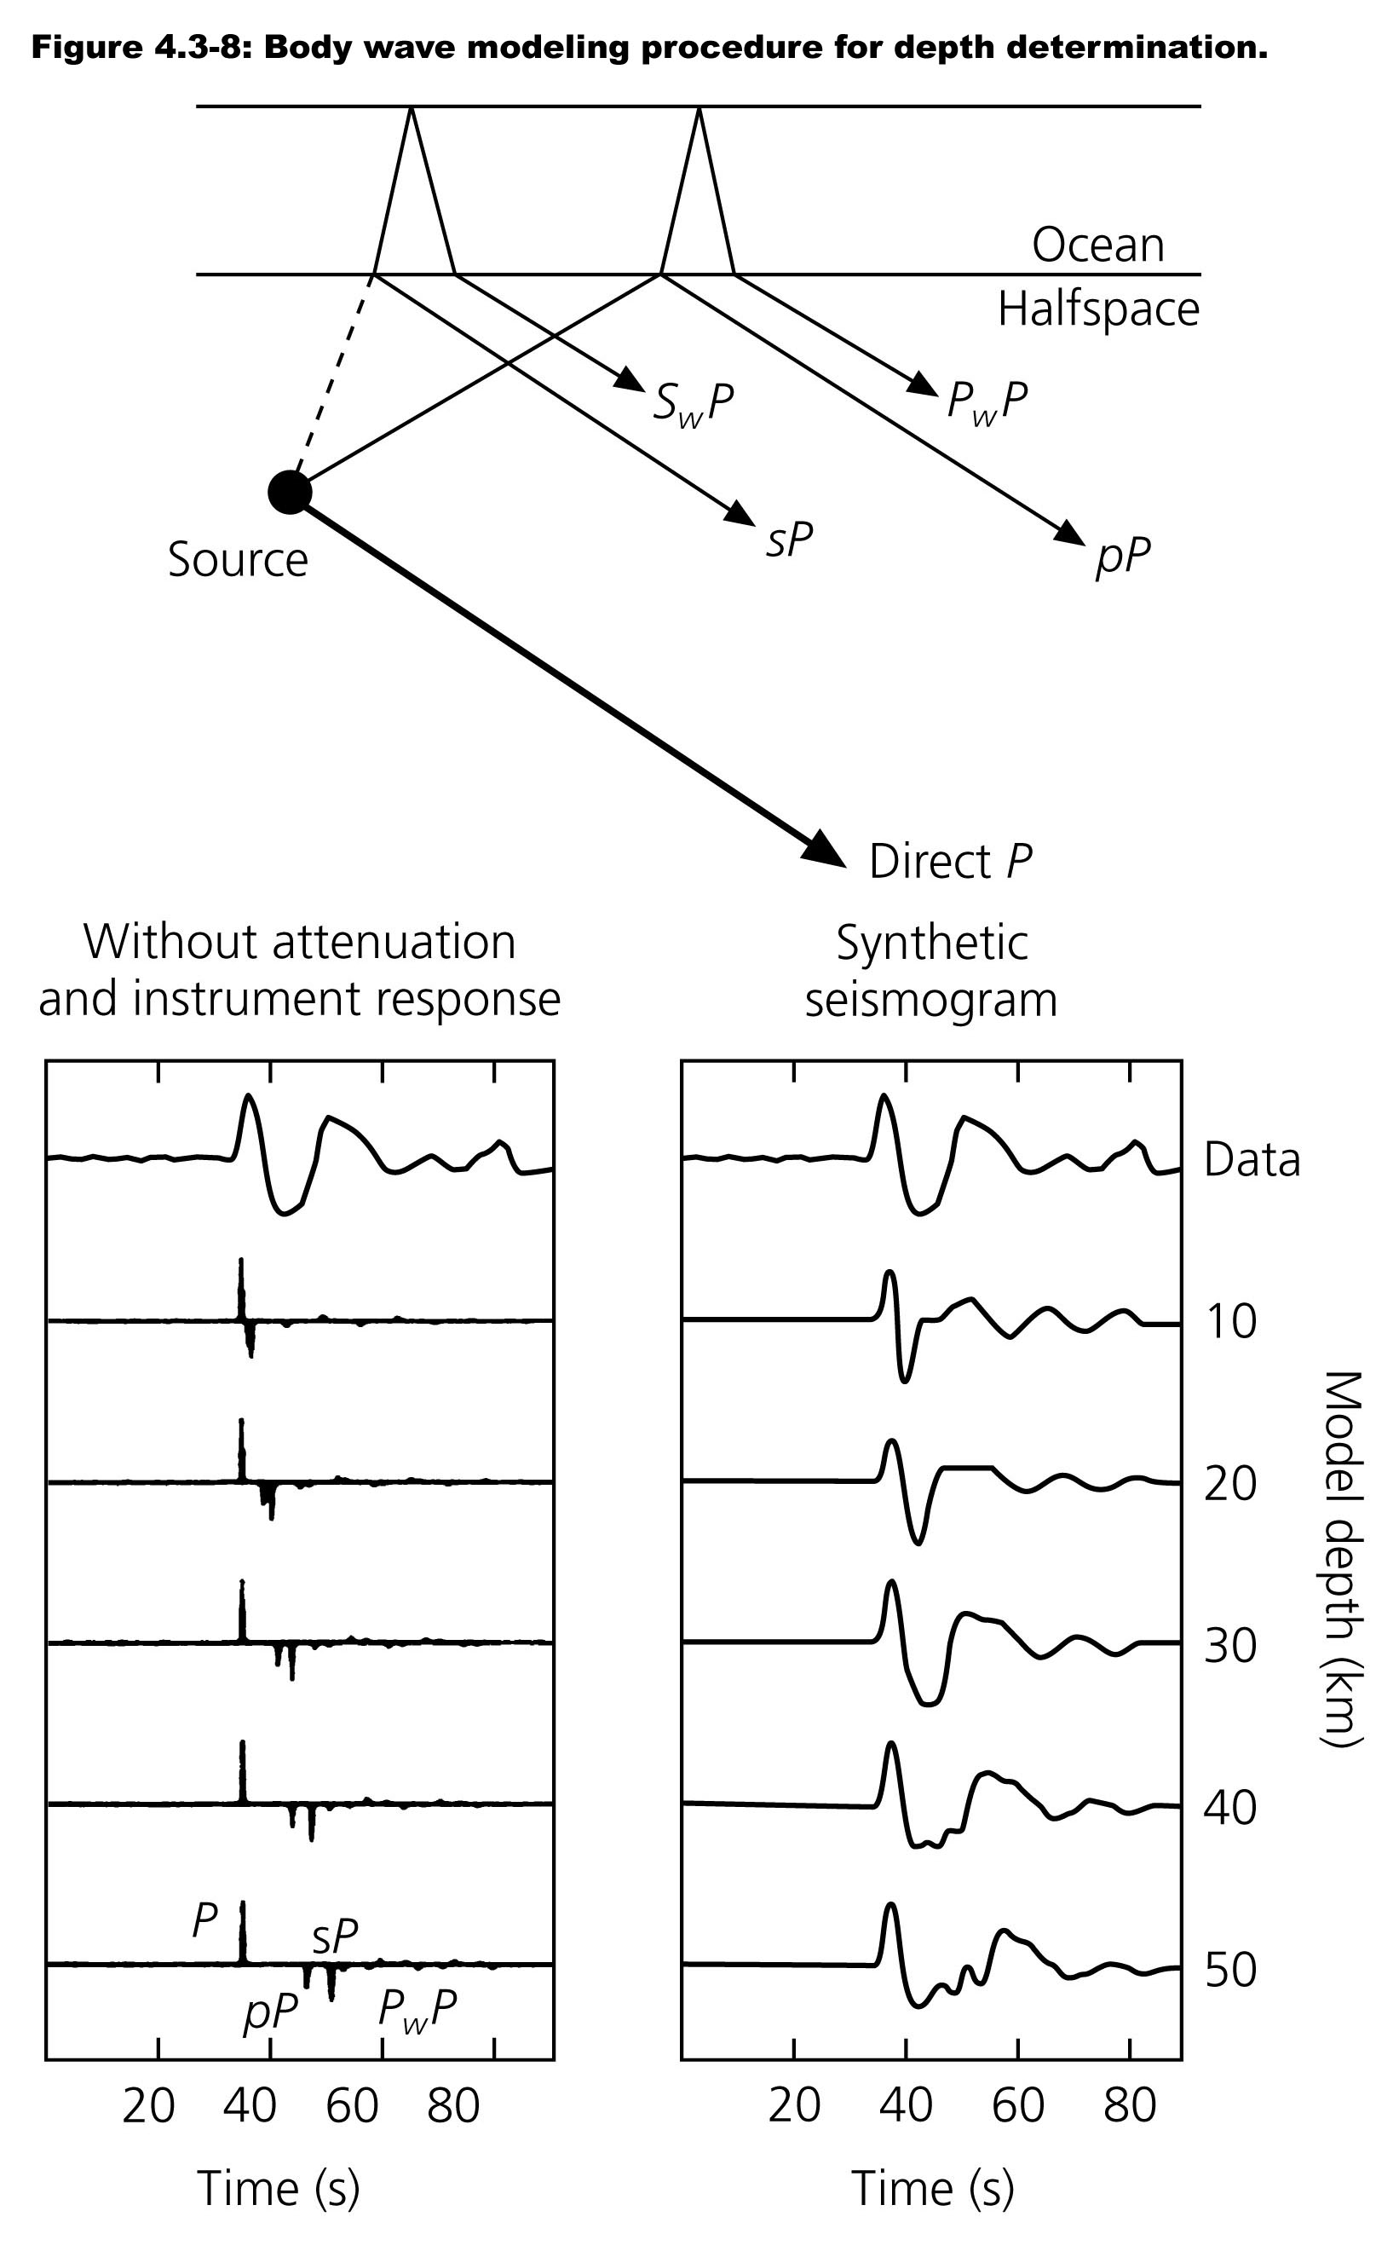

Slide 20
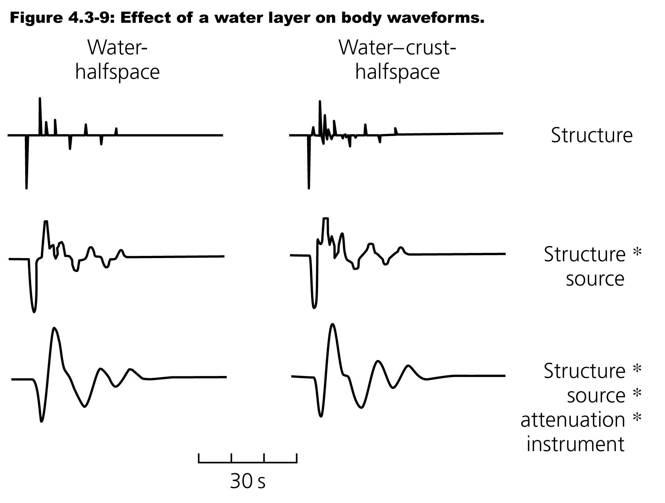

Slide 21
