Slide 1
Global Seismology CERI-8105
Tu-Th 1:00-2:25pm
Lab - 3892 Central Ave. (Long building) , Room 110
-----------------------------------------------
Bob Smalley
Office: 3892 Central Ave, Room 103, 678-4929
Office Hours – when I’m in my office.
http://www.ceri.memphis.edu/people/smalley/CERI8105_GlobalSeismology.html
Tue., Aug 29, 2023. Meeting 1.

Slide 2
Global Seismology CERI-8105
-----------------------------------------------
Textbook:
An Introduction to Seismology, Earthquakes, and Earth Structure
Seth Stein and Michael Wysession
Notes:
1 - Class info
2 - Textbook
3/4 - Other books – similar level
5 - Other books – intermediate level
6 - Other books – advanced level
7 - Grading – homeworks, project, class participation

Slide 3
Global Seismology CERI-8105
Other Books
-----------------------------------------------
Similar Level
Modern Global Seismology by Lay and Wallace
Introduction to Seismology by Shearer
Elementary Seismology by Richter (old, but very worth looking at for historical reasons)

Slide 4
Global Seismology CERI-8105
Other Books
-----------------------------------------------
Similar Level
Introduction to Seismology by Bath (old)
Introduction to the theory of Seismology by Bullen (old, horrid)

Slide 5
Global Seismology CERI-8105
Other Books
-----------------------------------------------
Intermediate
Elastic Wave Propagation and Generation in Seismology by Pujol
Lots of others

Slide 6
Global Seismology CERI-8105
Other Books
-----------------------------------------------
Advanced Level
Quantitative Seismology: Theory and Methods, two volumes by Aki and Richards
Seismic Waves and Sources by Ben-Menaham and Singh
Lots of others

Slide 7
Global Seismology CERI-8105
-----------------------------------------------
Homework (approximately) weekly
Project
-----------------------------------------------
Grading (+/-)
Homework – 40%
Class project – 50%
Class participation – 10%

Slide 8
What is seismology?
Simple answer
• The scientific study of earthquakes
The first use of the word was from 1851
(https://www.etymonline.com/word/seismology)
when it was coined from Ancient Greek:
σεισμός (seismós) meaning "earthquake"
and -λογία (-logía) meaning "study of”.
Notes:
What is seismology – simple answer – study of earthquakes
https://www.etymonline.com/word/seismology
https://en.wikipedia.org/wiki/Seismology#:~:text=Seismology%20(%2Fsa%C9%AAz%CB%88,Earth%20or%20other%20planetary%20bodies.
As Christos will be quick to point out, the word comes from Greek! But it did not exist in Greek till someone who was not Greek, and wanted to look intelligent, coined it from Greek.
Pp 9/10/11 - What is seismology – more complicated – everything “touched” by earthquakes (effects, what can be learned about earth and earth physics).

Slide 9
What is seismology?
More complicated answer
• Study of the generation and transmission of seismic (elastic) waves that travel through and around the Earth.
• Study of the properties of the medium (Earth) supporting the waves.
• Where, when, why, and anything about earthquakes.
Notes:
, the waves earthquakes send out, and related phenomena
(although the vast majority of “seismologists” never look at earthquakes!)

Slide 10
What is seismology?
More complicated answer
• The generation of other effects such as Tsunamis, sand blows, etc.
• Contribution to the long-term generation of other effects such as topography and geomorphology.
• The study and use of anthropomorphic sources (notably seismic reflection/refraction and nuclear explosions).

Slide 11
What is seismology?
More complicated answer
• Contributes to studies increasing protection of life and the built environment from earthquakes

Slide 12
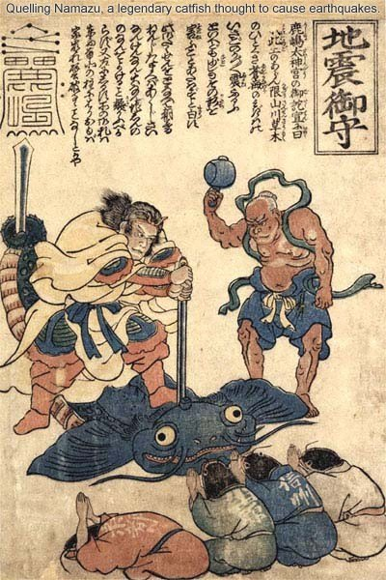
Some history of ideas about earthquakes
Earthquake Talisman
quelling giant catfish Namazu
Link for a list of other non-scientific explanations for earthquakes
folklore earthquake myths
Notes:
Earthquake Talisman
https://www.onmarkproductions.com/html/japan-tohoku-quake.html
Ideas about earthquakes through time
Earthquake Talisman
The deity Kashima Daimyōjin quelling Namazu, a giant catfish thought to cause earthquakes. Namazu is a giant catfish thought to live deep inside the earth. Its movements are said to cause earthquakes. According to Japanese legend, Namazu’s movements can be controlled by Kashima Daimyōjin, commonly by placing a large rock called the pivot stone (kanameishi) atop the creature or inside its mouth, or sometimes by stabbing it with a sword. Pictures (Namazu-e) depicting the catfish being killed or being personified appeared in large number after the Great Edo Earthquake of 1855. Most were unsigned. Above we see a 1855 woodblock print of Kashima Daimyōjin stabbing the catfish with his sword, assisted by a Buddhist deity with a mallet, while four fish-headed entities beg the catfish to stop its destructive thrashing. The names of various localities damaged in the 1855 earthquake (e.g., Shinshū near Nagano) are written on their robes.
Legends about Kashima Daimyōjin trace their origins to Kashima Jingū (in Ibaraki Prefecture). He is considered a manifestation of the shrine's central deity Takemikazuchi, who is considered a protector against earthquakes. Another deity thought to quell earthquakes is Jinushigami (lit. Landlord Deity or Land-Master Kami).

Slide 13
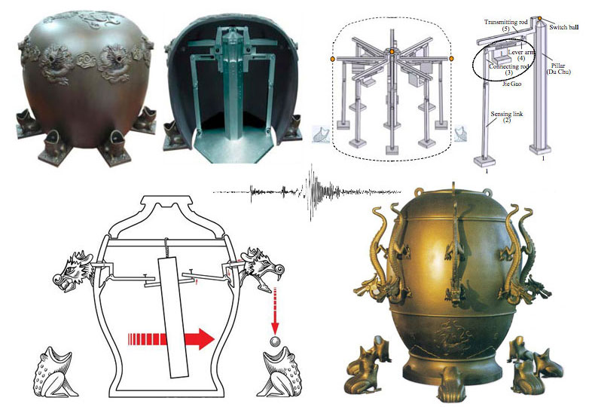
History of earthquake instruments
Earliest accepted description of earthquake detecting instrument (also provides data – the direction to it) is the Zhang Heng seismoscope from 132 AD.
There are no images or extant copies, but it is thought have looked something like this.
Notes:
first instruments to record earthquake
Early earthquake detecting device – no original examples exist, there are numerous “reconstructions” from various descriptions of the device.
Indicated there was an earthquake (possibly one too weak to feel as instrument had some amplification) and the direction towards the earthquake from which ball fell.

Slide 14
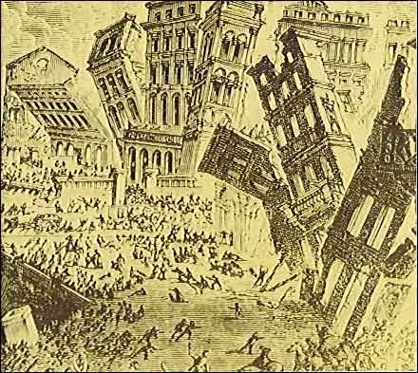
1755 Lisbon earthquake
initially published in Candide, by Voltaire
Notes:
https://pdhonline.com/courses/g175/g175_new.htm
Figure 1: Artistic rendition of the effects of the 1755 Lisbon earthquake (Source: United States Geological Survey, initially published in Candide, by Voltaire).
https://pdhonline.com/courses/g175/g175_new.htm
Lisbon eq beginning of scientific study of earthquakes with good description of what occurred
The scientific study of earthquakes is relatively new, and a reasonable understanding of their occurrence can only be traced back for a couple of hundred years. Prior to that time, the early historical record of earthquakes is cryptic at best because people did not understand the reason for their occurrence. In fact, there are very few factual descriptions of earthquakes prior to the 18th century because before then, people believed that an earthquake was a massive punishment imposed by the gods to punish the sinners and warn the unrepentant. During these early times, the occurrence of strong earthquakes usually triggered passionate discussions between philosophers and theologians resulting in lengthy and convoluted explanations about a long overdue and deserved retribution by God in response to the pervasive problems of evil in the world. The few that looked for natural causes for these unexplained phenomena reached equally strange conclusions. For example, an early popular theory postulated that earthquakes were caused by strong winds blowing out of deep caverns within the earth.
A drastic change in attitude regarding this issue can be traced back to a strong earthquake that occurred on All Saints’ Day, November 1, 1755, near Lisbon, Portugal. Just before 10 am, the city was shaken ferociously for several minutes. The convulsions were so great that the water was sucked out of the city’s harbor and returned soon thereafter as a fifty-foot wave that contributed greatly to the destruction of the city. The survivors that had fled to the waterside were drowned by the great waves that raced on them from the Atlantic. The motion of this first earthquake had not ceased for more than a few minutes when a second shock came, only slightly less severe than the first. A third and less severe final shock occurred about two hours later. The end of this mayhem reduced virtually every building within miles of the city center to rubble. Over 60,000 people lost their lives.
For the first time in history, however, we have detailed descriptive information of what happened, soon after the earthquake struck. All over Portugal priests were asked by their bishops to document their observations in as much detail as they could. Their records are still preserved and represent the first systematic effort in history to describe the effects of an earthquake as, or soon after, it occurred. One of the many archived contemporary descriptions is given below:
“The sea rose boiling in the harbor and broke up all the crafts harbored there. The city burst into flames, and ashes covered the streets and squares. The houses came crashing down, roofs piling up on foundations, and even the foundations were smashed to pieces.”
https://pdhonline.com/courses/g175/g175_new.htm

Slide 15
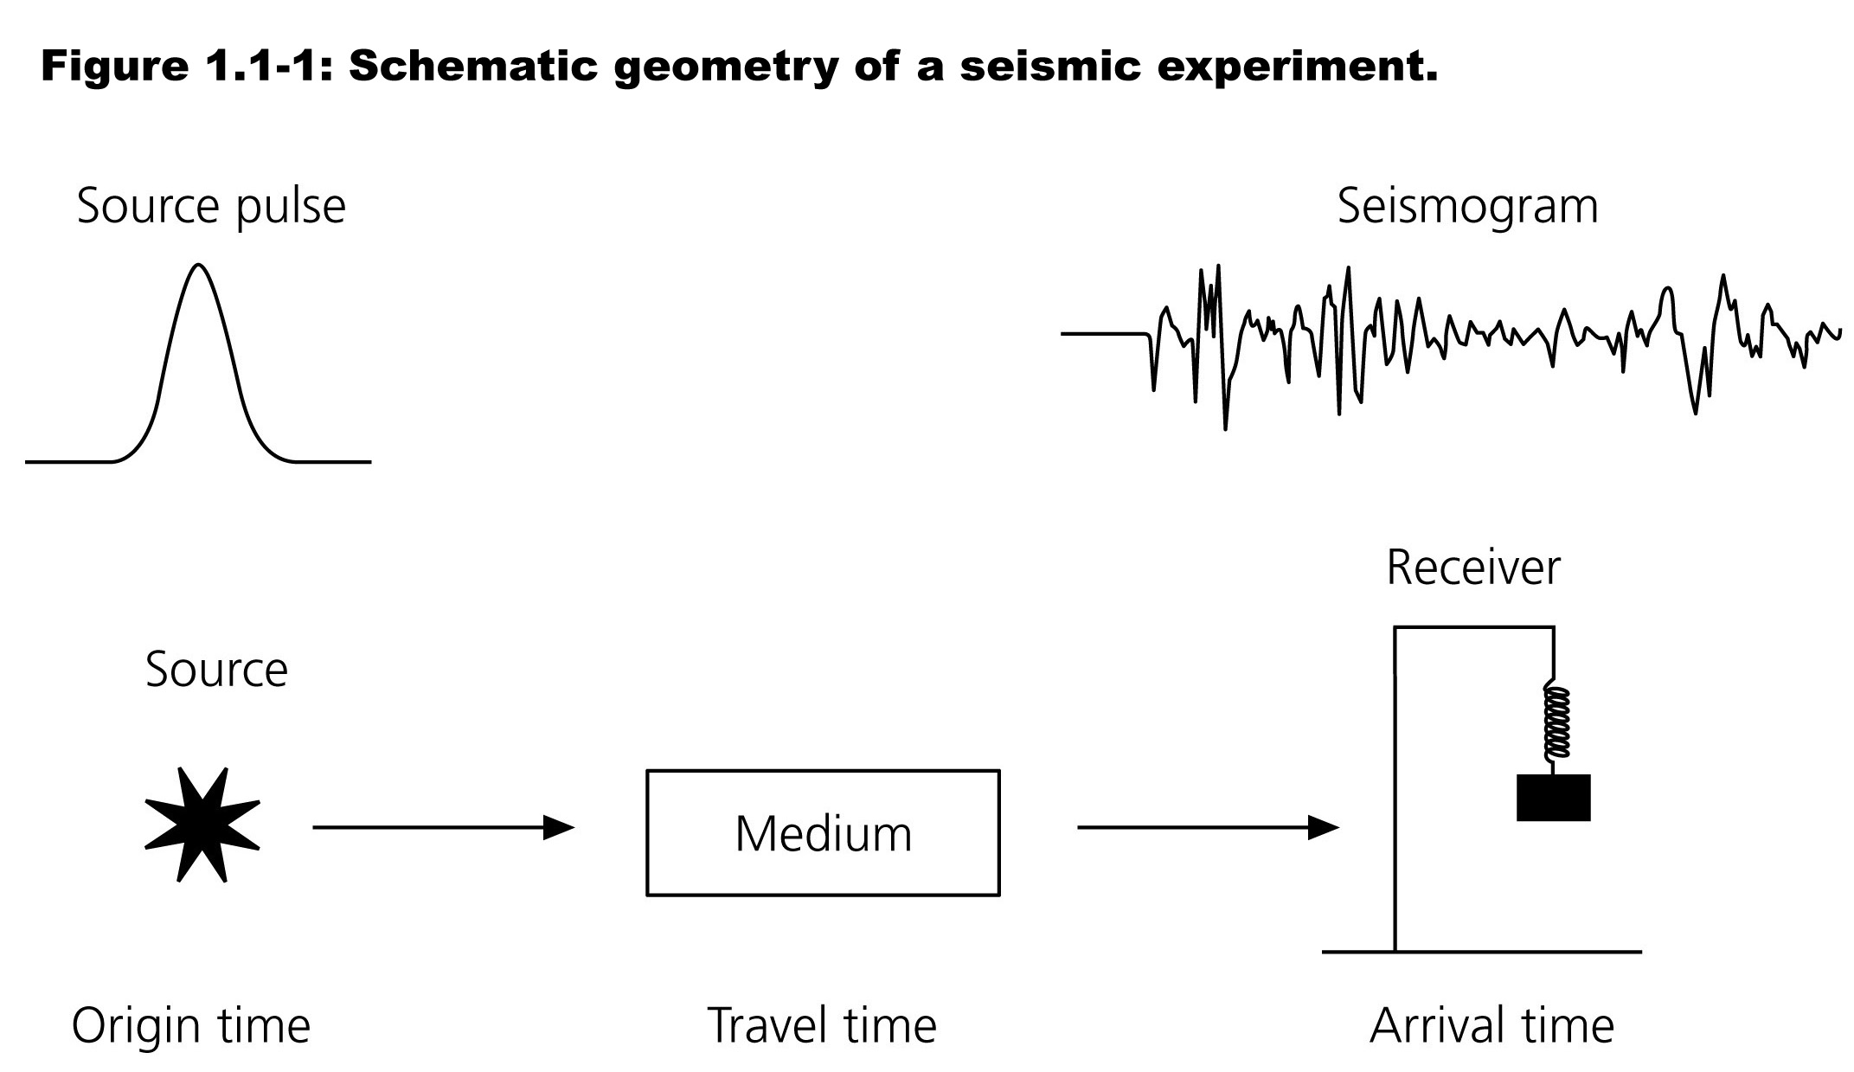
Basic idea is simple
Source makes elastic waves that travel through an elastic (mostly) medium (the earth) and are recorded by a seismometer.
Notes:
Model for seismic experiment:
Seismology allows us to “see” into the earth similarly to the way X-rays allow us to see into the human body and other objects.
Source – natural or artificial that propagate through a medium – the earth - and are recorded by a seismometer (or other instrument, such as GPS) as a seismogram – a record of position, velocity, or acceleration as a function of time.
The seismogram contains information about the source and the medium (near the source, along the path, and near the receiver)
Using a model of elastic wave propagation we can estimate the earthquakes location and depth, determine properties of the medium such as the wave speed as a function of the frequency and variations in the properties of the medium such as layers. Examining the signal we can estimate additional properties such as the type of faulting, attenuation, and infer other properties such as temperature and attenuation.
What are models in science?

Slide 16
The recordings (most useful if have multiple, spatially distributed recordings) provides information on:
Earthquake location.
Earthquake source (fault orientation, etc.).
Path the waves took and the properties of the medium along that path.
The last point is the most important, as it will allow us to ”see” most of the interior of the earth.
Notes:
(no figure) The recordings give us information about
The source of the waves – the earthquake - where it happened, what happened (fault orientation, dlip direction,slip information (slip vector as fn of position on fault and time, etc.)
What happened to the waves on the way from the earthquake to the station, what this tells us about the material along the path
The receiver area – local crustal structure, info for engineering seismology, hazard estimation, damage reduction, etc.

Slide 17
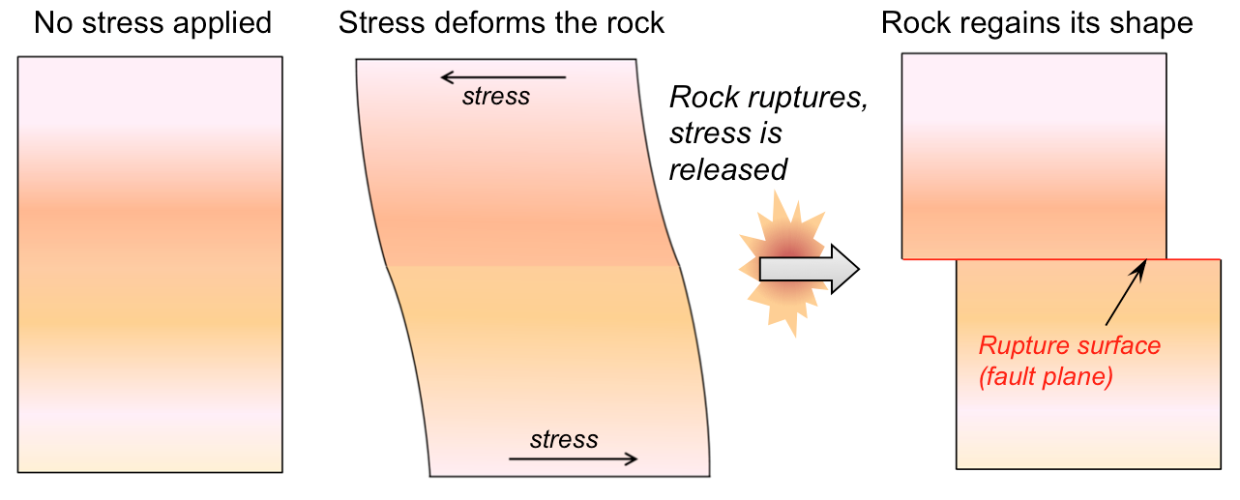
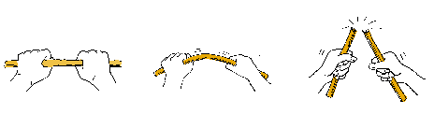
We will focus on a specific source: Earthquakes
What is an earthquake?
Earthquakes occur when rock ruptures (breaks), causing rocks on one side of the rupture, on a surface known as a fault, to move relative to the rocks on the other side.
Model rocks as elastic, they deform before breaking
Notes:
https://openoregon.pressbooks.pub/earthscience/chapter/9-1-what-is-an-earthquake-2/
elastic model for earthquakes – material deforms under stress up to its breaking strength, then it breaks (stick over knee, but not perfect) and earthquake cycle starts over (stick does not).

Slide 18
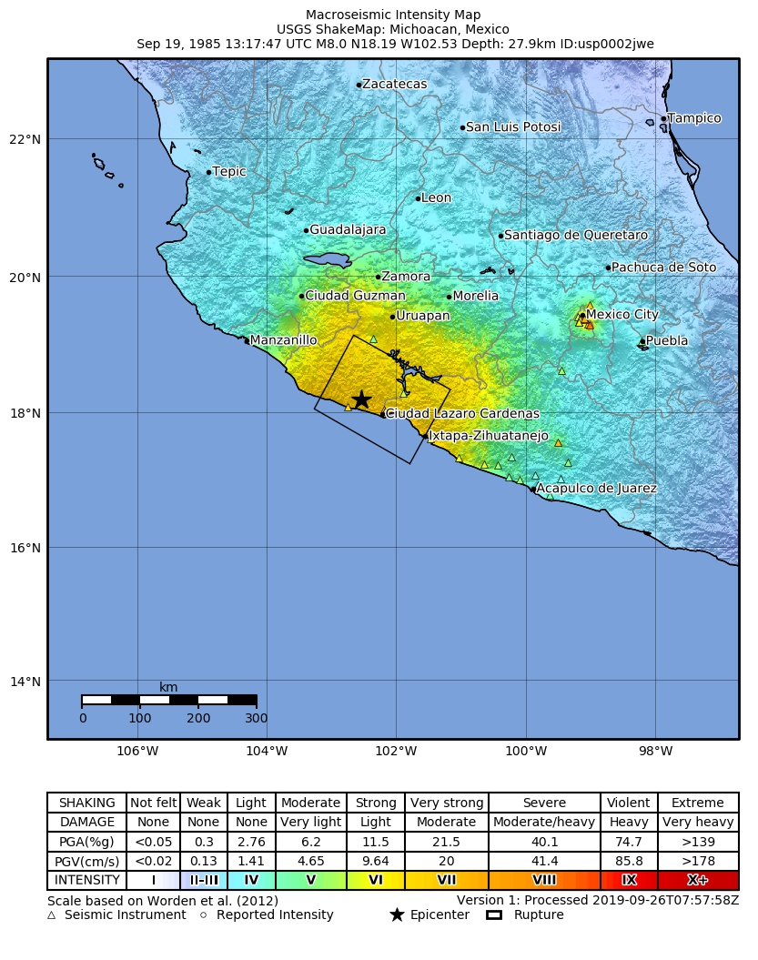
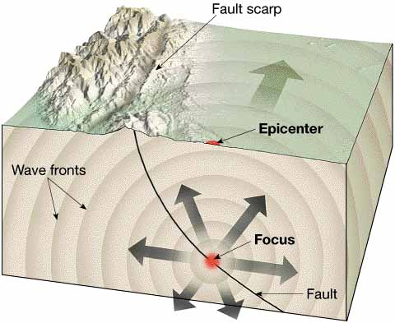
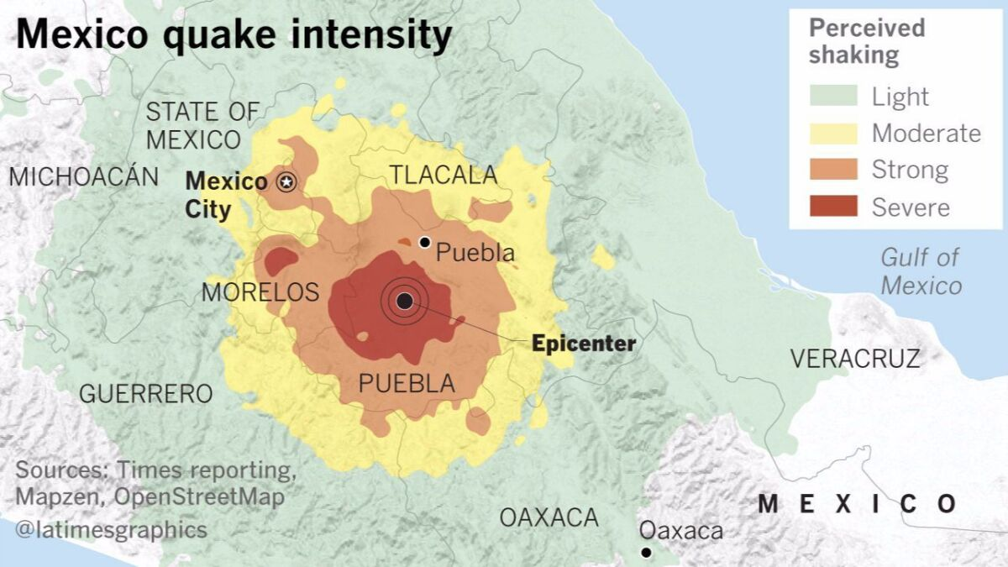
While an earthquake can cause local damage if the fault breaks the surface, most of the damage done by earthquakes is due to the generation of seismic waves that can cause damage over very large regions.
Notes:
https://openoregon.pressbooks.pub/earthscience/chapter/9-1-what-is-an-earthquake-2/
Location – lat,lon,dep
Source properties (fault geometry, amount slip, etc.)
When an earthquake happens the seismic waves it produces are recored on many seismometers around the world.

Slide 19
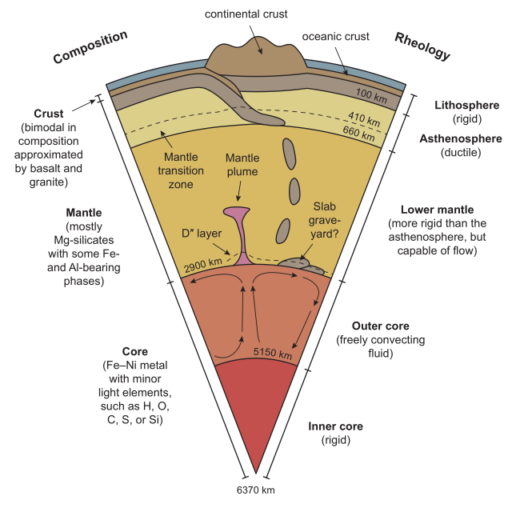
Much of what we know about the interior of the earth comes from seismology
Deepest hole ~13 km
Radius Earth 6371 km
We can only see 0.2% of way into the earth! - not very much
Notes:
Fig from - Richard M. Palin, M. Santosh, Wentao Cao, Shan-Shan Li, David Hernández-Uribe, Andrew Parsons,, Secular change and the onset of plate tectonics on Earth, Earth-Science Reviews, Volume 207, 2020, 103172, ISSN 0012-8252, https://doi.org/10.1016/j.earscirev.2020.103172. (https://www.sciencedirect.com/science/article/pii/S001282522030218X)
Seismology is the primary tool to study the interior of the earth as very little is accessible for direct observation
Deepest hole ~13 km
Radius Earth 6371 km
We can only see 0.2% of the way into the earth! - not very much
Some geological evidence from slightly deeper (kimberlites come from 150-450 km deep, also not super deep).
Deeper (notice the crust is not very deep, only ~6 times deeper than the deepest well) seismology allows inferences of chemical composition (mantle-silicate vs core outer core–liquid iron), changes in mineral structure (phase change, composition constant), and variations in temperature, density, mineral anisotropy, etc.
Structure of liquid outer and solid inner cores (although the earth’s moment of inertia told us that the earth did not have uniform density and density had to be larger towards the middle).
Inferences about chemical composition and mineral structure (same composition, but different structure).

Slide 20
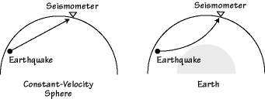
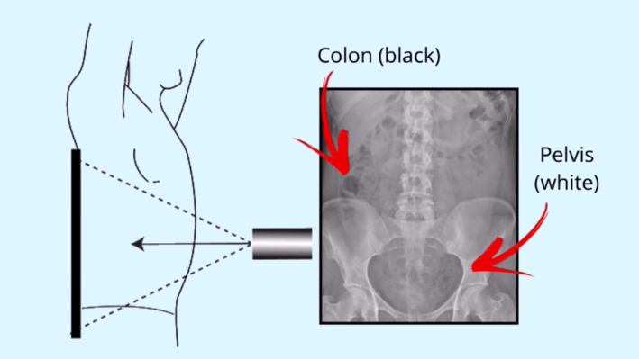
A common analogy is the seismology provides an X-Ray of the interior of the earth.
The analogy is not perfect as X-Rays generally travel in straight lines and the information comes from attenuation of the X-Rays as they pass through the body under study.
Notes:
How seismology looks into the earth
Llike (but not like) X-rays.
X-rays – information principally from absorption (attenuation, proportional to density of body parts).
Seismic (rays) – primary information from travel time, secondary from polarization, amplitude, absence/presnece, etc.

Slide 21
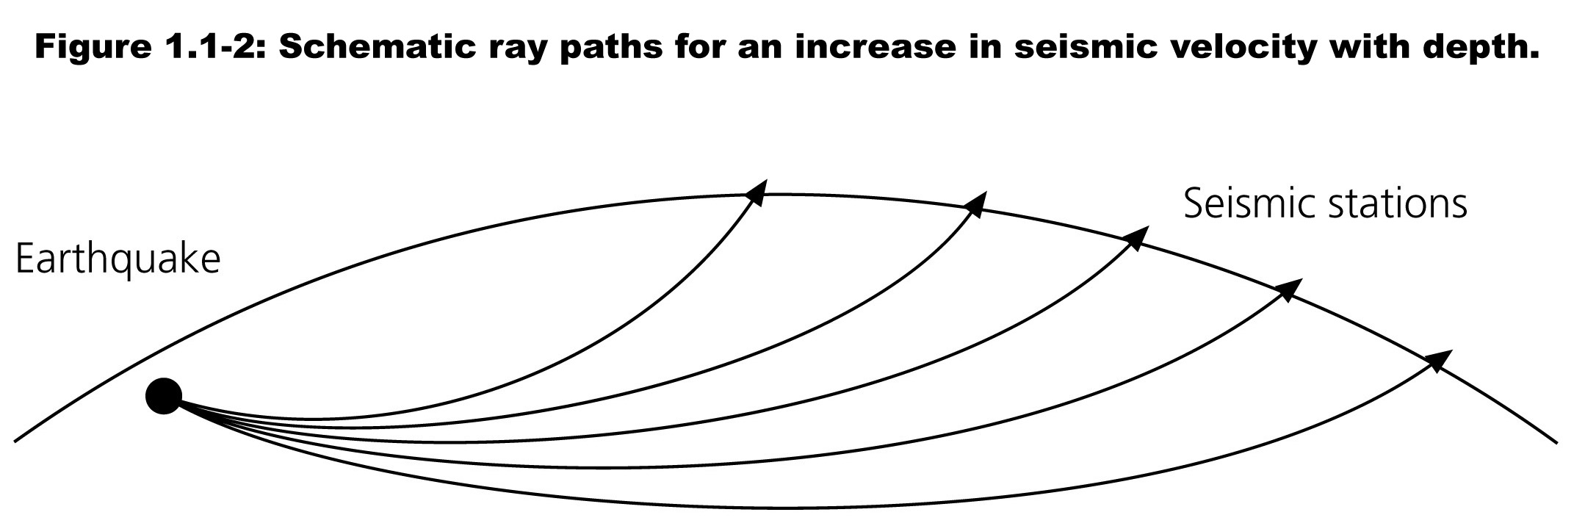
In the earth the most common observation is the travel time of the waves from the earthquake to the seismic station.
As the velocity generally increases with increasing depth in the earth the rays are bent.
Provides structure and existence of crust, upper and lower mantle, liquid outer and solid inner core inferred from the velocity structure.
Notes:
Much of what we know about the interior of the earth comes from indirect methods, principally seismology as seismic waves can sample most of the interior of the earth.
Seismology maps Earth’s interior in terms of the distribution of physical properties that affect the transmission of seismic waves giving us a picture of Earth’s structure.
Note the ray paths are curved – velocity is not constant, it increases with depth.

Slide 22
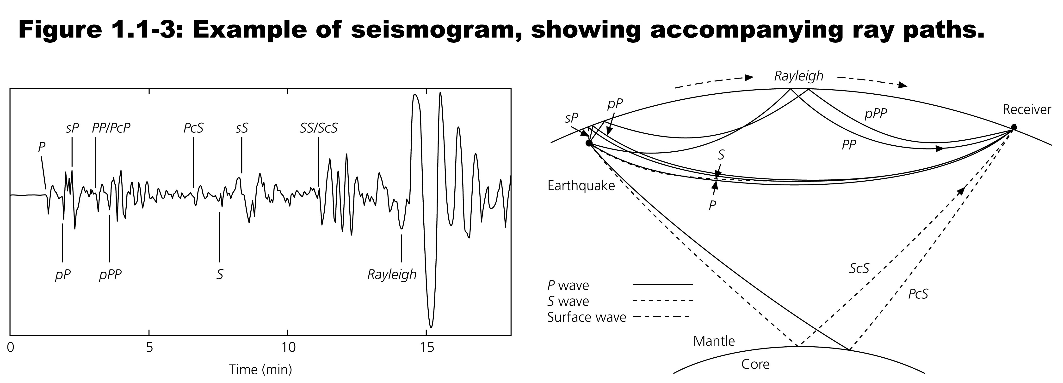
In addition to bending, “body” waves passing inside earth can reflect off boundaries, such as the core-mantle boundary, or the surface, providing more data about both the earthquake and the paths taken by the various waves.
Furthermore, there are waves that run along the surface, providing even more information.
Notes:
Many different waves, sampling different parts of the earth – can infer properties of the “medium”
The structure of the crust, lithosphere, mantle, outer and inner core are inferred from variations in seismic velocity and other propagation properties such as the fact that S waves don’t propagate through liquids.

Slide 23
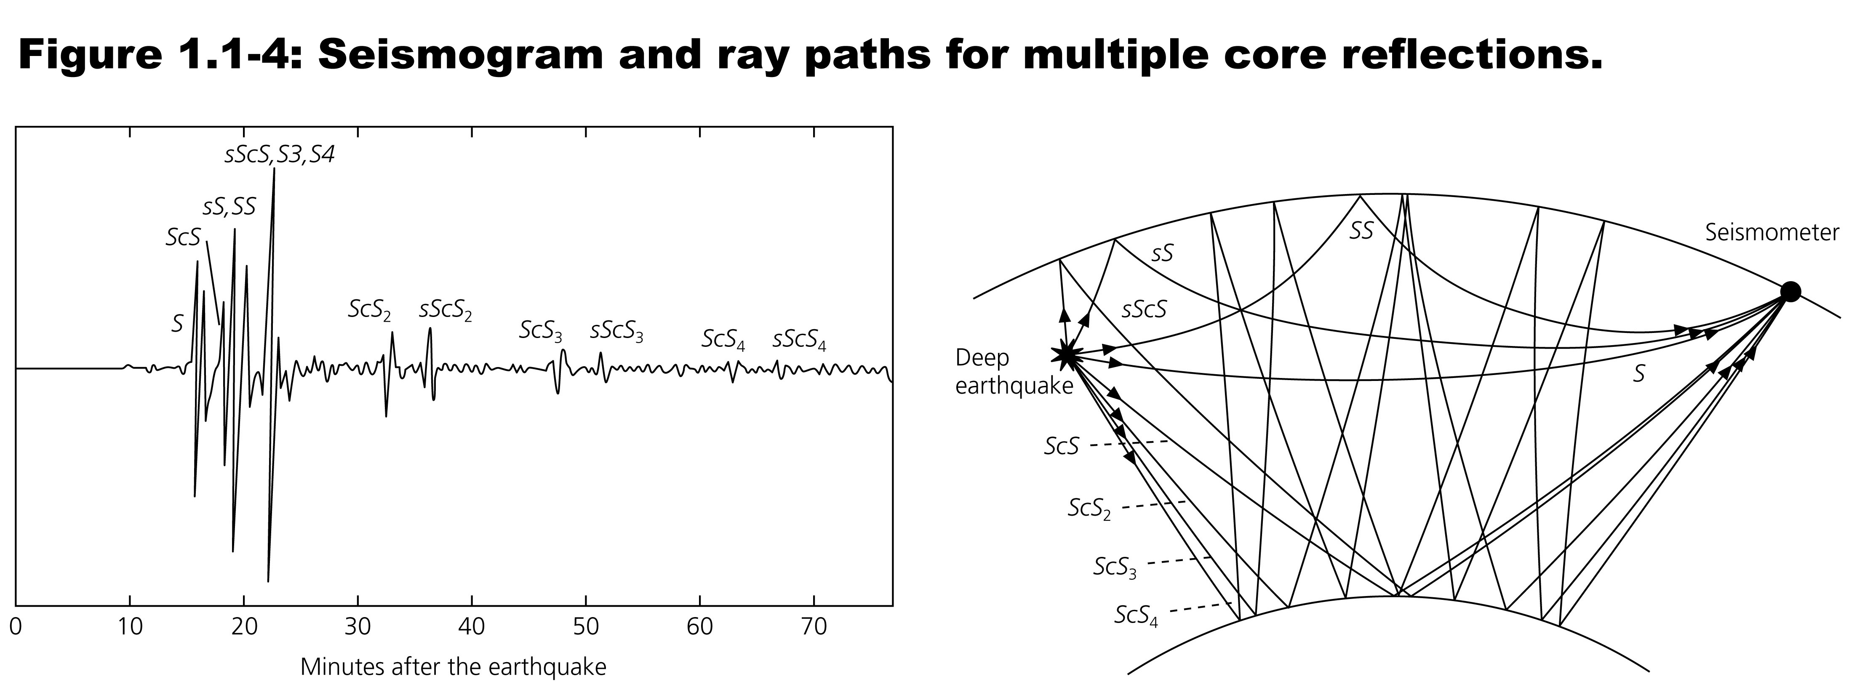
The paths can bounce between the core and surface multiple times.
Each of the pulses in the seismogram on the left is called a phase and the letters indicate the wave type (P and S for example) and something about its path.
The basic data is the arrival time of each phase.
Notes:
Seismograms provide timing information (when specific waves arrived), polarization (longitudinal P, in-plane S, Rayleigh, Love, anisotropy [shear wave splitting]), information about layers and properties (elastic or liquid), etc.

Slide 24
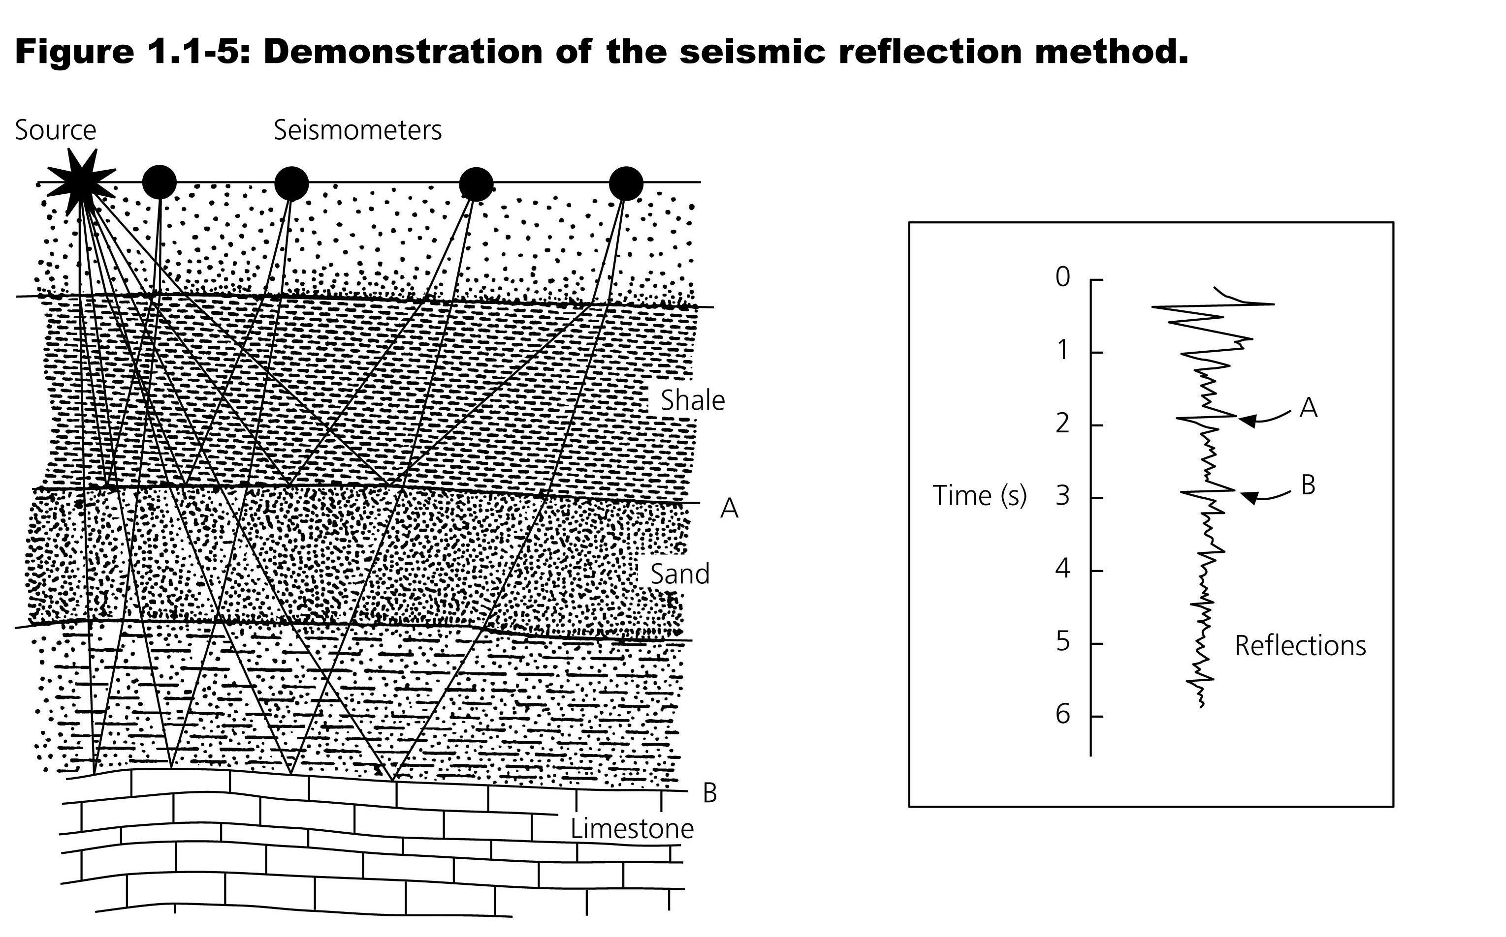
In addition to natural sources, we can also make seismic waves and record them.
One such technique is seismic reflection.
This is more like radar than X-Rays.
Notes:
In the crust seismology images layered and other structures defined by impedance changes, faults, and provides information on economic resources such as oil and gas. Seismology also images the base of the crust (5-10 km km in the oceans, 15-45 km in continents and up to 70/80 km beneath mountains).
More like radar, sonar, echo sounding than X-rays as send out signal and look for reflections/scattering coming back

Slide 25
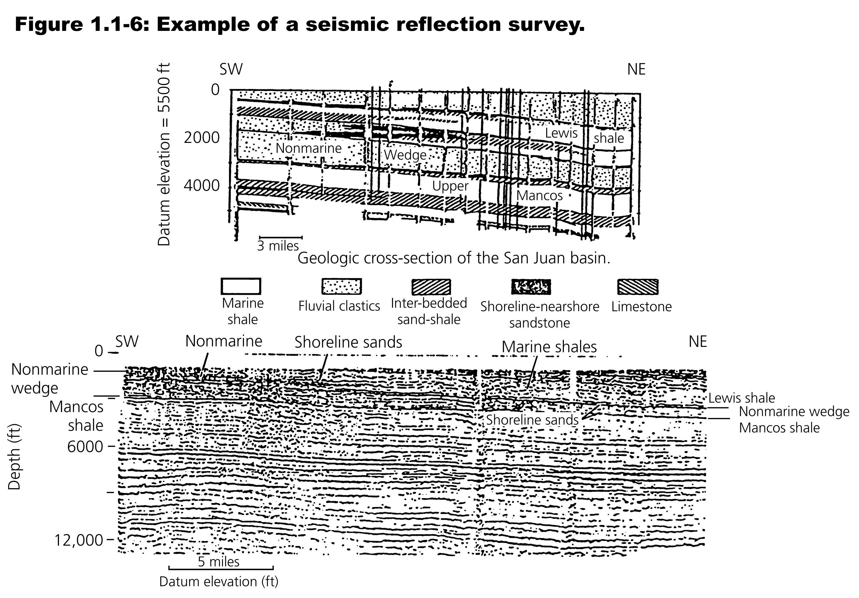
By recording many sources with many receivers, we can make an image that represents the structures in the shallow crust.

Slide 26
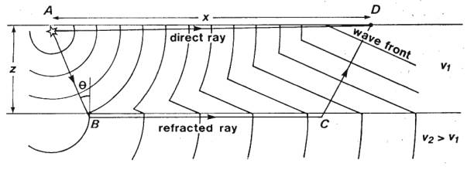
In this model the velocity of the layers is usually considered constant, with the velocity increasing as the layers go down, so rays are straight lines.
The wavefronts shown in the cross section are the “first” arrivals
Notes:
https://www.ukm.my/rahim/Seismic%20Refraction%20Surveying.htm

Slide 27
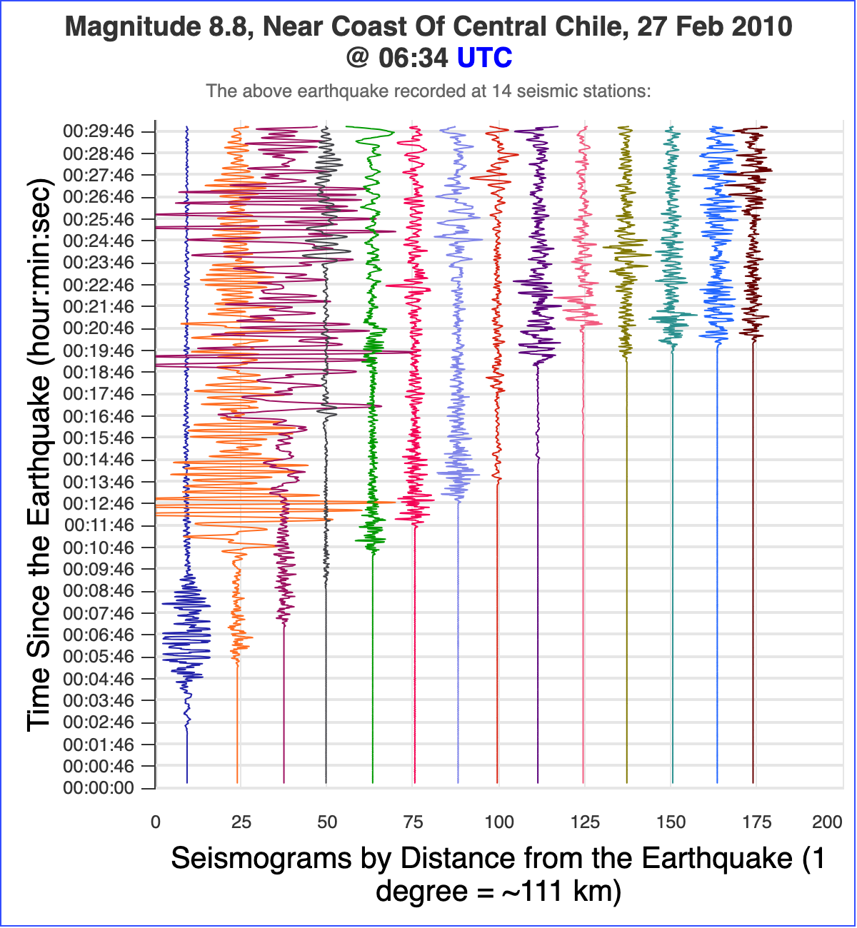
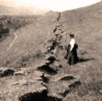
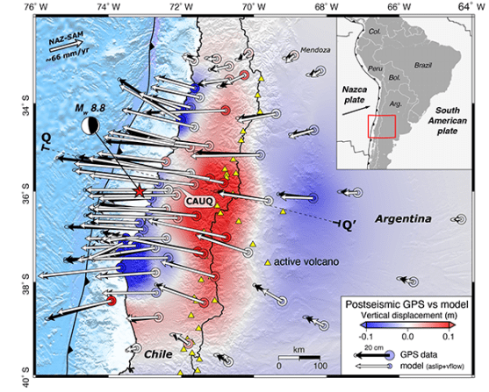
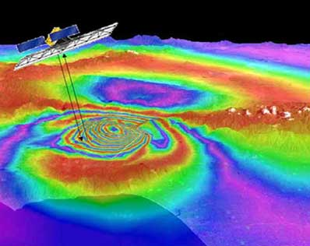
Seismology is the principal tool to study earthquakes.
Very few earthquakes produce directly observable surface rupture and can only be “observed” by the elastic waves (seismology) and permanent elastic deformation (Space Geodesy) they produce.
Notes:
Bray, Jonathan D. and Keith I. Kelson. “Observations of Surface Fault Rupture from the 1906 Earthquake in the Context of Current Practice.” Earthquake Spectra 22 (2006): 69 - 89. (but earlier ref from 1906)
http://ds.iris.edu/gsv/tsplotForID.phtml?evid=2844986&useCache=1&epo=0&caller=map&maxMag=10
https://eos.org/science-updates/using-earthquake-forensics-to-study-subduction-from-space
https://spaceflightnow.com/news/n0312/04earthquake/

Slide 28
When an earthquake occurs one of the first things we need to do is find out where it was (locate it).
If there is no observable surface rupture (true for most earthquakes) how do we do this?
Use seismic data.
The basic data is the arrival time of the seismic waves.

Slide 29
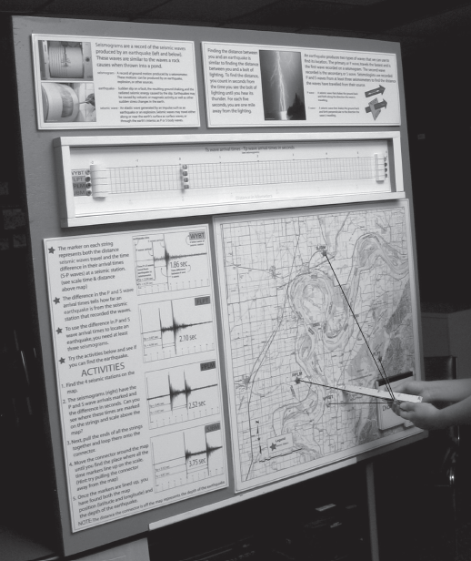
Analog earthquake location device.
Uses arrival time of the waves (set with the markers) on strings that go to the stations.
Join ends of strings, and when markers line up you have the location.

Slide 30
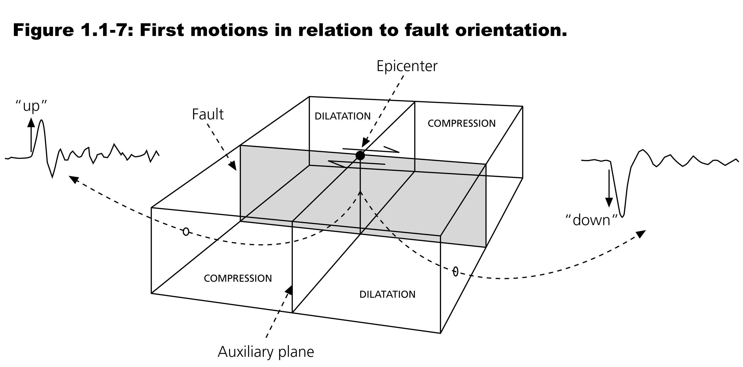
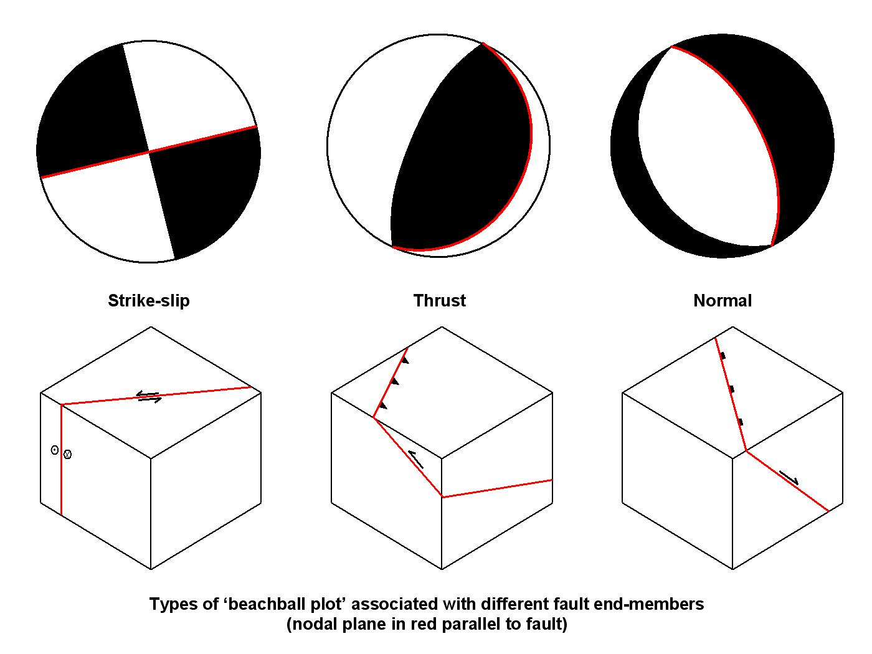
Seismology can also give us information on the faulting during the earthquake such as the orientation of the fault and the motions (direction and slip amounts) on the fault.
Notes:
By Mikenorton - Own work, CC BY-SA 3.0, https://commons.wikimedia.org/w/index.php?curid=4050395

Slide 31
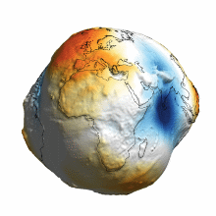
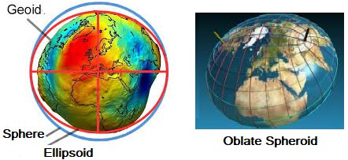
Scientific Models
Simplified abstract/conceptual representation of something – in science – usually a physical system.
Ex. various models of the earth from simple to more complex.
“real’ shape
Notes:
Jmaes Fitzpatric on https://www.quora.com/What-is-the-true-shape-of-the-Earth-geoid-or-ellipsoid
Models:
Simplified approximations
“Explain” major feathers
Refined through time
EX earth
– sphere is simplest, zeroth order shape of the earth – determined by (shear) strength of the material and gravity, when gets “big” enough takes spherical shape (minimum energy).
– not rigid, rotation causes deformation into ellipsoid
– “real” shape “defined” by gravity equipotential – shape solid earth, shape oceans – also a model as can’t determine gravity equipotential exactly.
– ¿best? description – oblate spheroid
Even more detail – earth deforms at time scales of seconds (earthquakes, earthquake waves, tidal deformation, elastic and viscoelastic response to surface loading, tectonic deformations (mountain building, plate tectonic movements), convection in mantle, fluid currents in outer core, etc.)

Slide 32
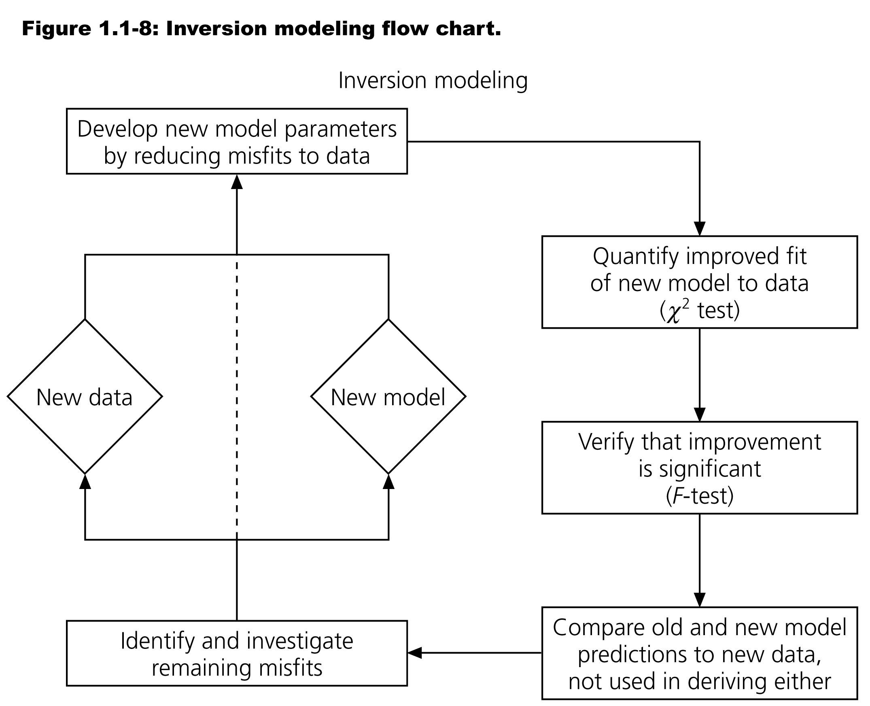
What are scientific models?
Notes:
Models: Science is concerned with discarding old models and making new ones
Multiple levels of simplicity – Ex/ 3D rupture – 2D rupture – elastic slip – rectangular fault – uniform rupture – double couple of forces
forward problems vs. inverse problems
Precision, accuracy, uncertainty – measurement uncertainties → 1 km uncertainty in EQ depth (no need to report greater precision) → actually more because of velocity uncertainties and EQ size (rupture area of a M6 is about 10 km)
Models improve with time because of new and better data, and clever new ways of doing things. There will always be room for improvement!

Slide 33
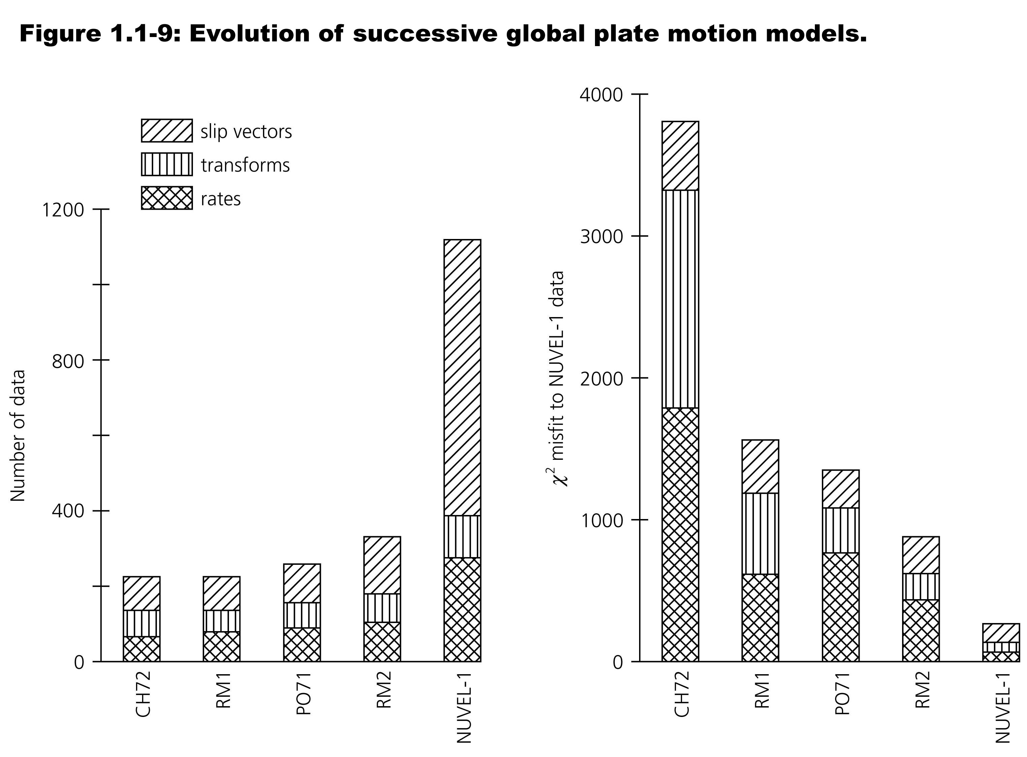
More data, more parameters (may) lead to better models.

Slide 34
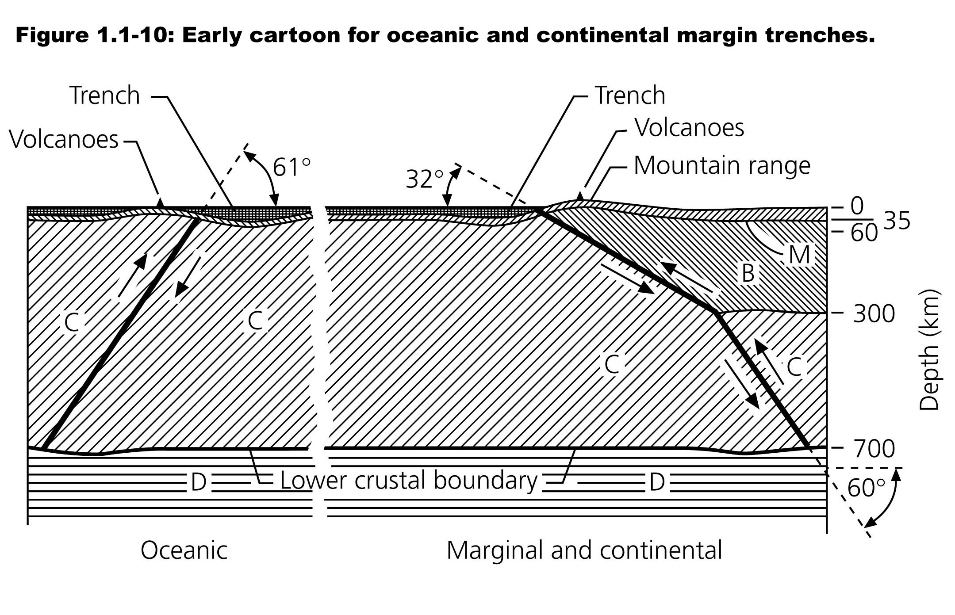
Pre plate tectonic cartoon model for oceanic and continental trenches observed at the surface plus
a small number of “Deep” earthquakes that define thrust faults through Earth’s “crust” to the maximum observed depth of earthquakes.
Notes:
Benioff, 1955 – didn’t make sense until ocean spreading ridges were discovered

Slide 35
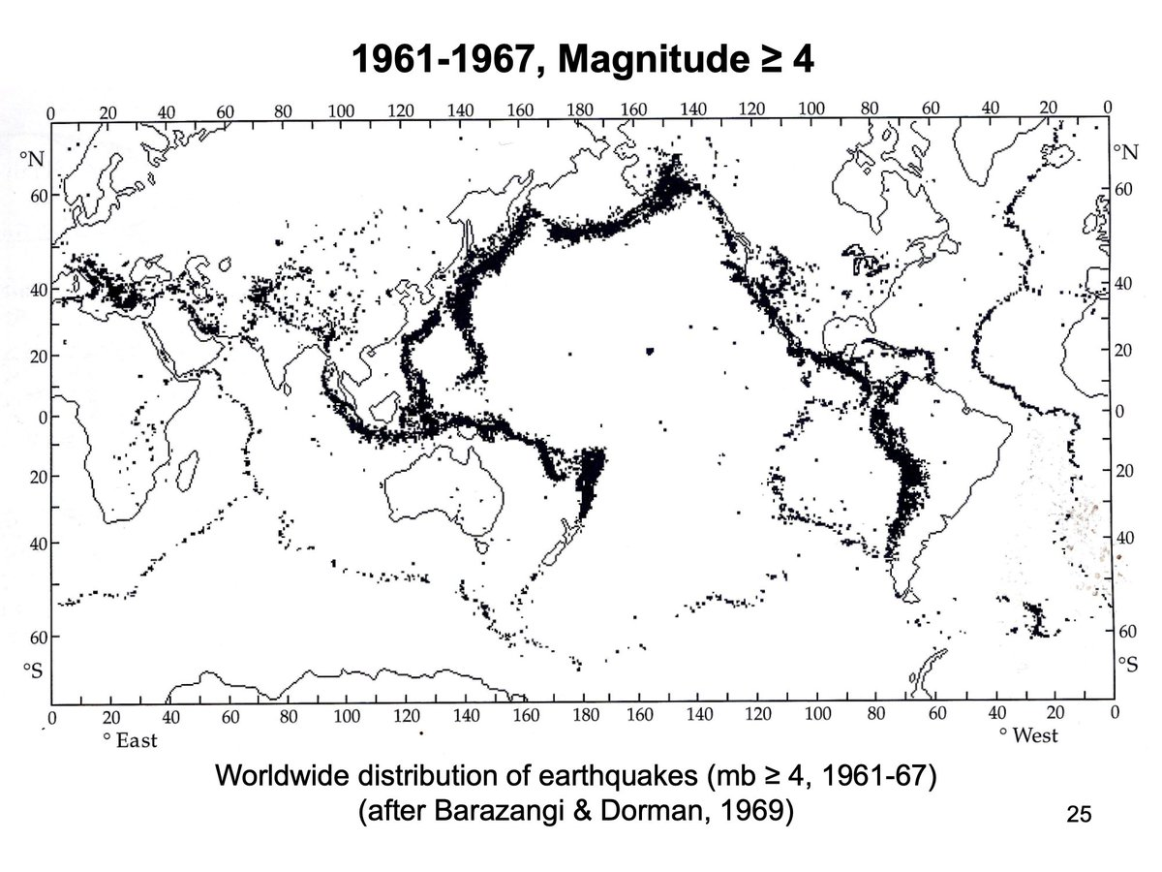
First global seismicity map produced by computer
~30,000 events over 6 years
Compare to Richter’s catalog of ~5000/~50 years

Slide 36
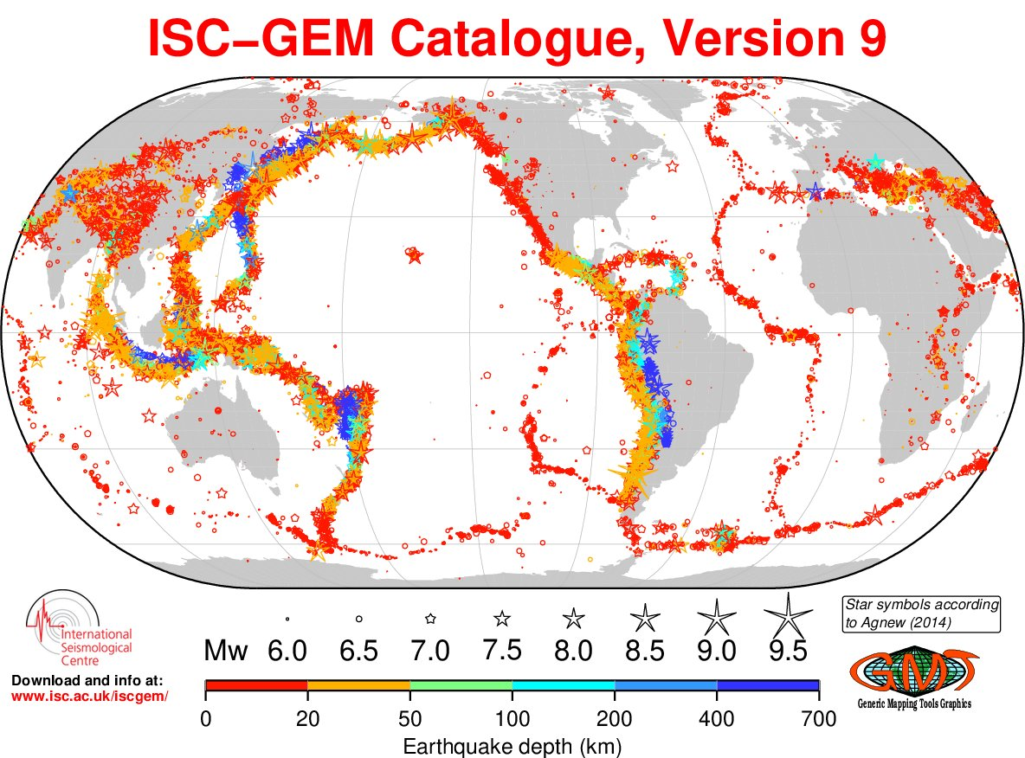

Slide 37
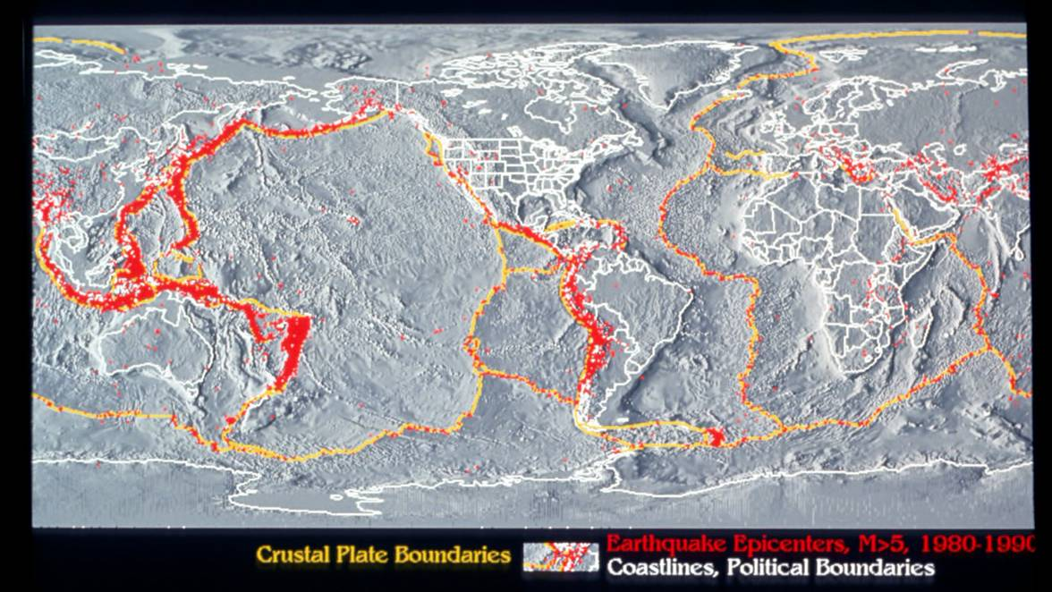
Explaining the pattern.
Earthquake and plate boundary map.
Most earthquakes are on plate boundaries.

Slide 38
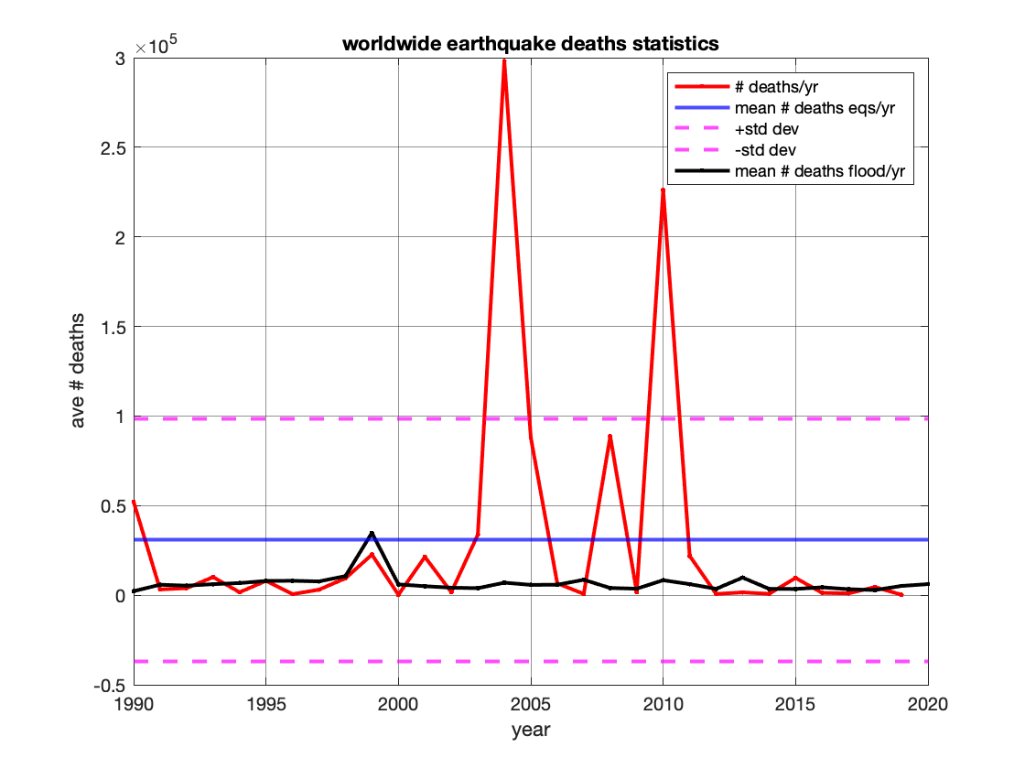
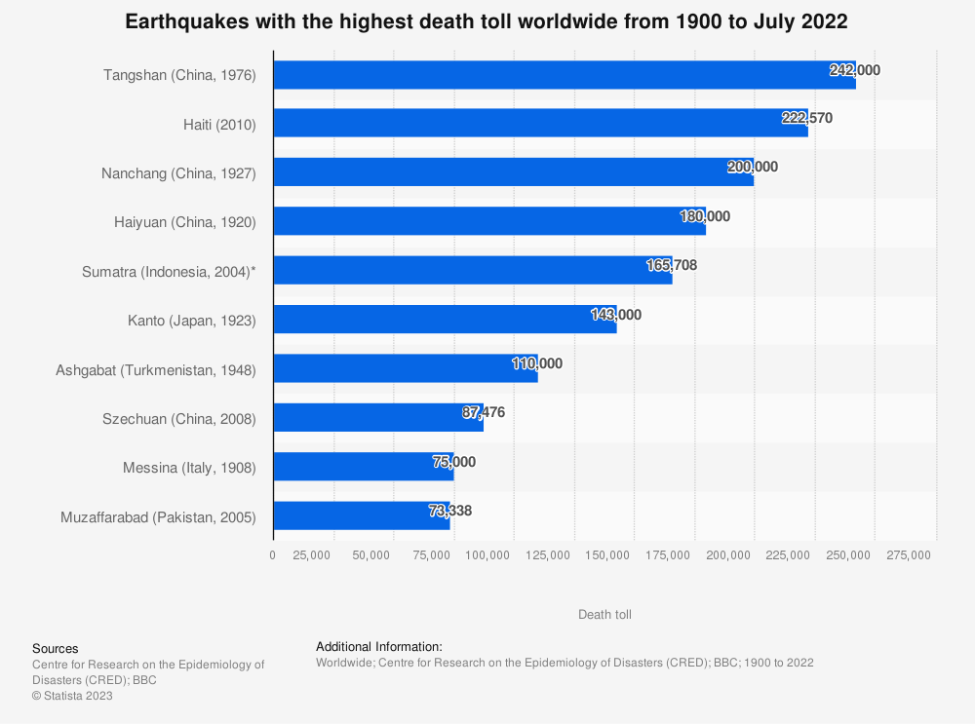
Earthquakes and society
Historically, droughts and floods were the most fatal disaster events.
Deaths from these events are now very low (black line) – the most deadly events today tend to be earthquakes (red line).
Notes:
Top left
Top right - https://www.statista.com/statistics/266325/death-toll-in-great-earthquakes/
Historically… - https://ourworldindata.org/natural-disasters#:~:text=Historically%2C%20droughts%20and%20floods%20were,today%20tend%20to%20be%20earthquakes.
Centre for Research on the Epidemiology of Disasters (CRED), & BBC. (June 22, 2022). Earthquakes with the highest death toll worldwide from 1900 to July 2022 [Graph]. In Statista. Retrieved June 23, 2023, from https://www.statista.com/statistics/266325/death-toll-in-great-earthquakes/
To get the really large number of deaths – need tsunami (Sumatra 2004, M9, 230K) or dense population/bad construction/poor government response (Tangshan, 1976, M7.6, 250-650K; Haiti, 2010, M7.0, Turkey 2023, M7.8 – corruption, could bribe out of meeting anti-seismic codes).
Earthquake disasters are not natural disasters, they are man-made disasters.
See
311 - The Tsunami The First 3 Days NHK WORLD-JAPAN On Demand
Take segments
https://www3.nhk.or.jp/nhkworld/en/ondemand/video/3016087/

Slide 39
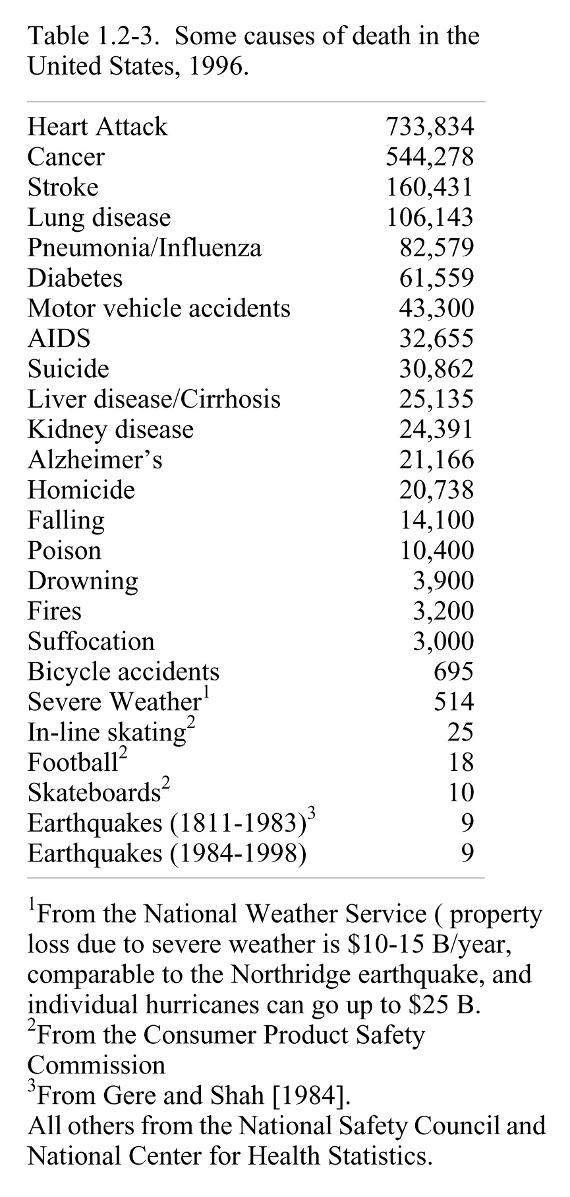

Slide 40
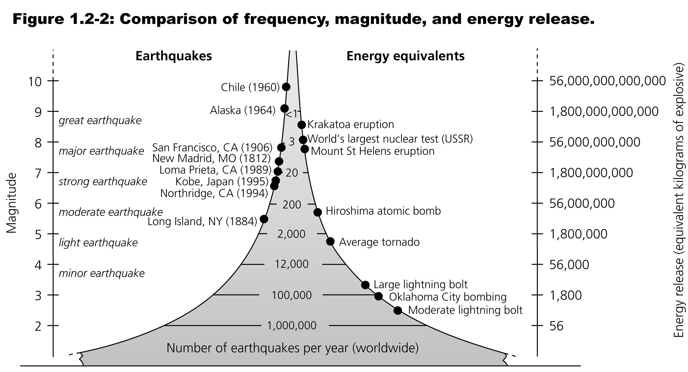
Notes:
1906 SF – 4 m of slip on 450-km long fault → 3 x 10**16 Joules of elastic energy – equivalent to a 7 Megaton bomb (Hiroshima was 0.012 Mt)
1960 Chile – 21 m of slip on a 800 km long fault → 10**19 J of elastic energy (more than a 2000 Mt bomb – larger than all nuclear bombs ever exploded – largest was a Soviet atmospheric test of 58 Mt)

Slide 41
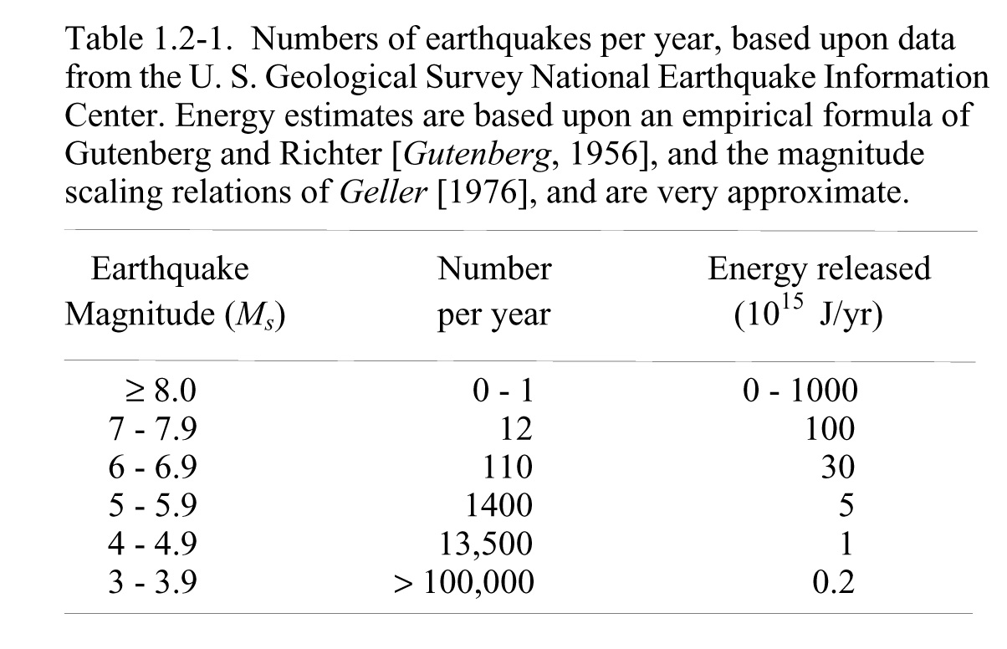

Slide 42
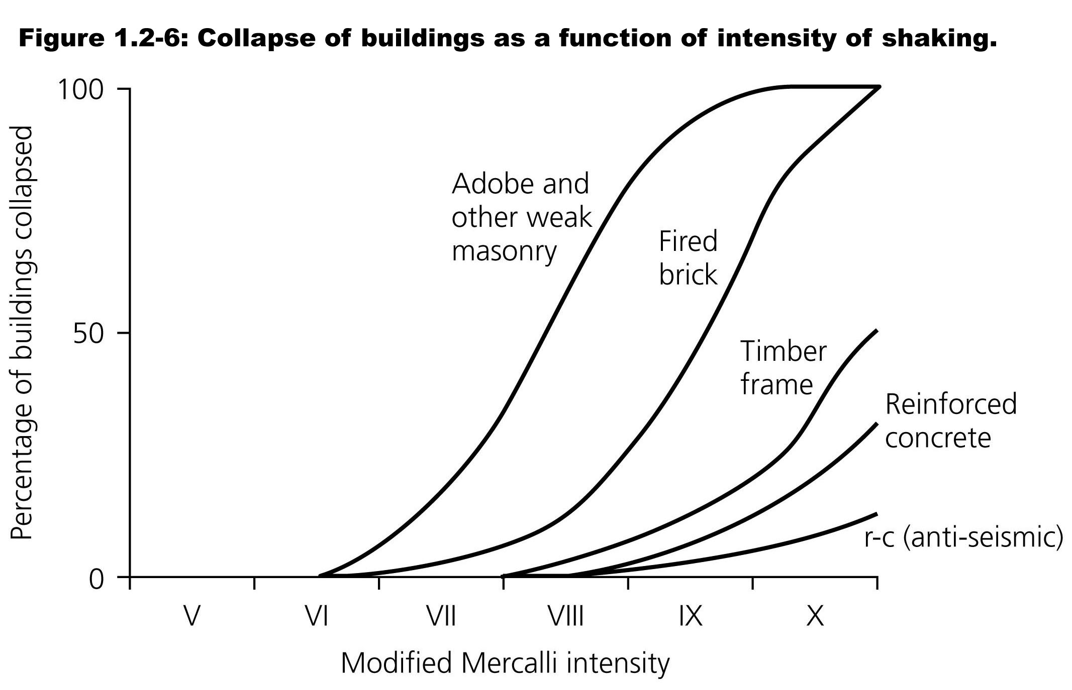

Slide 43
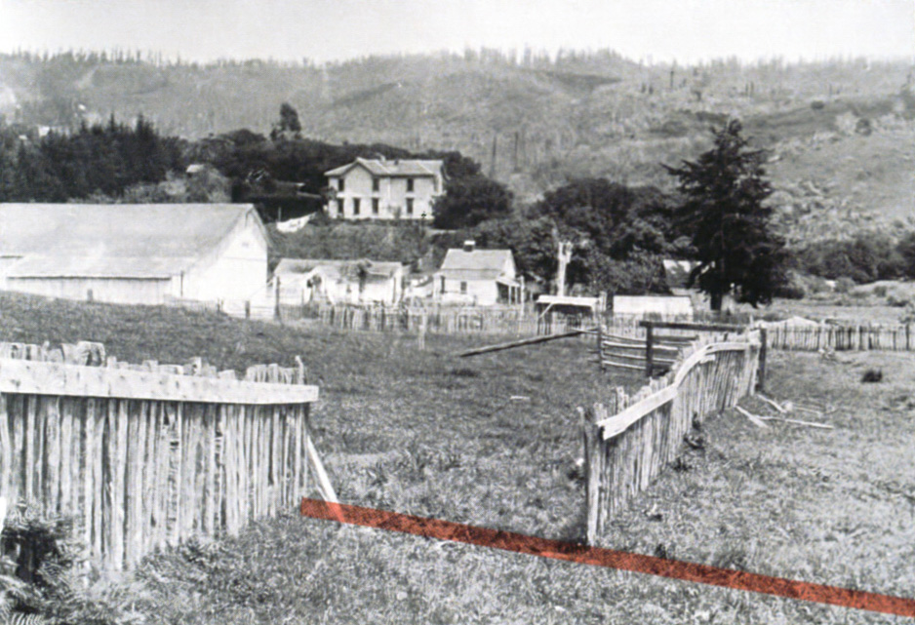

Slide 44
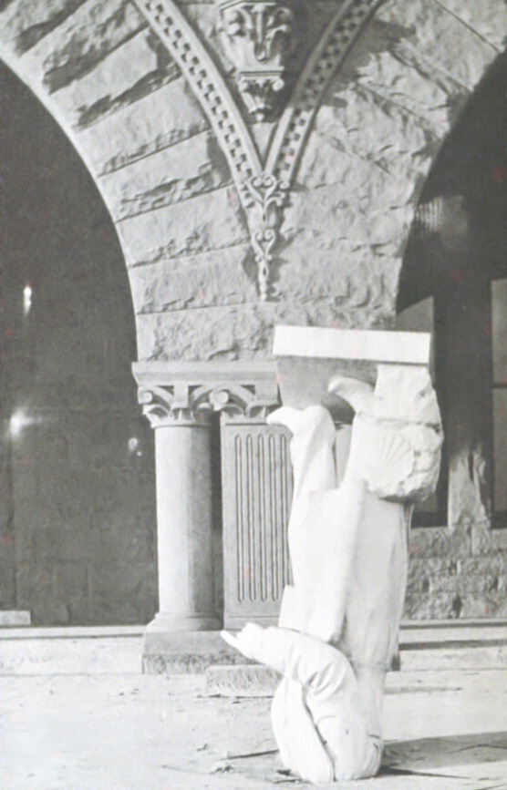

Slide 45
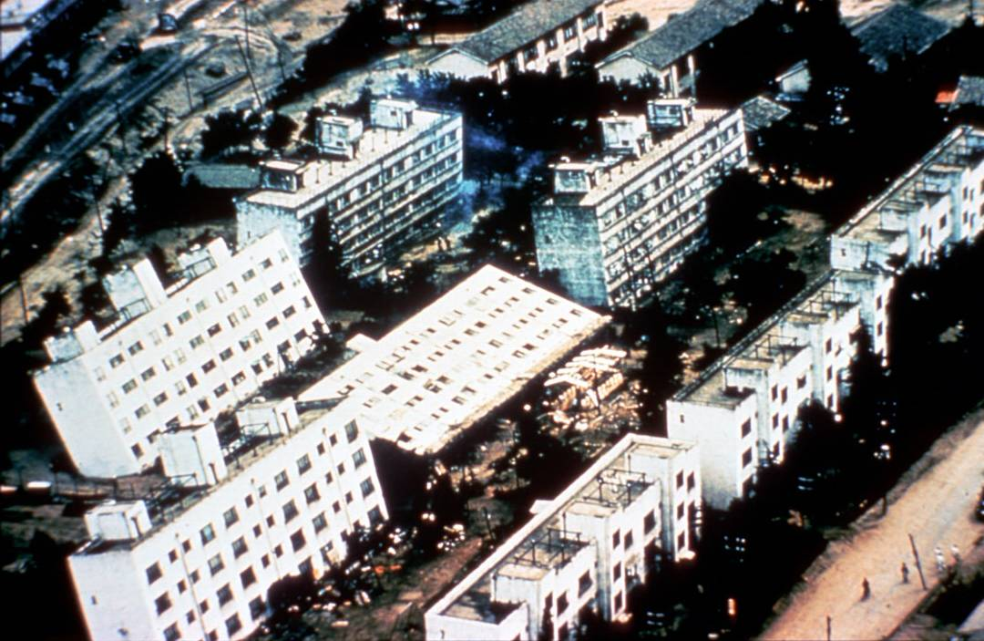

Slide 46
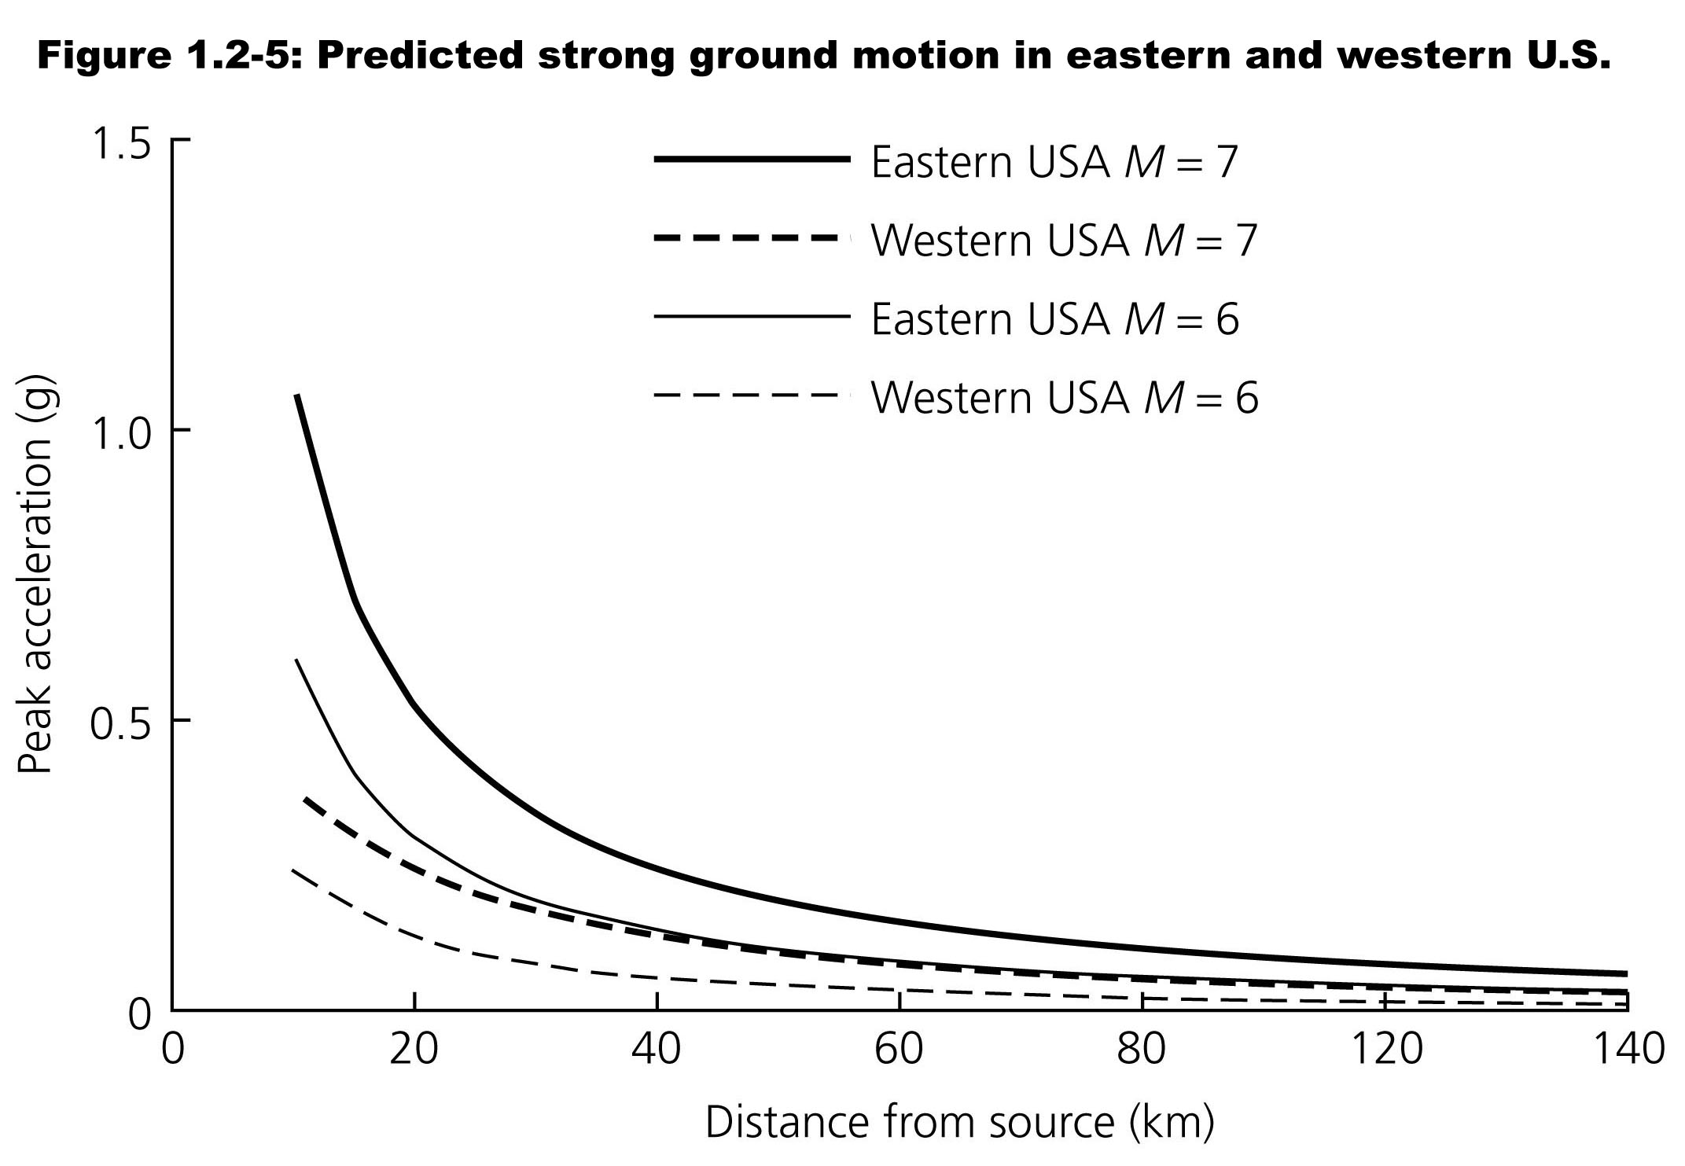

Slide 47
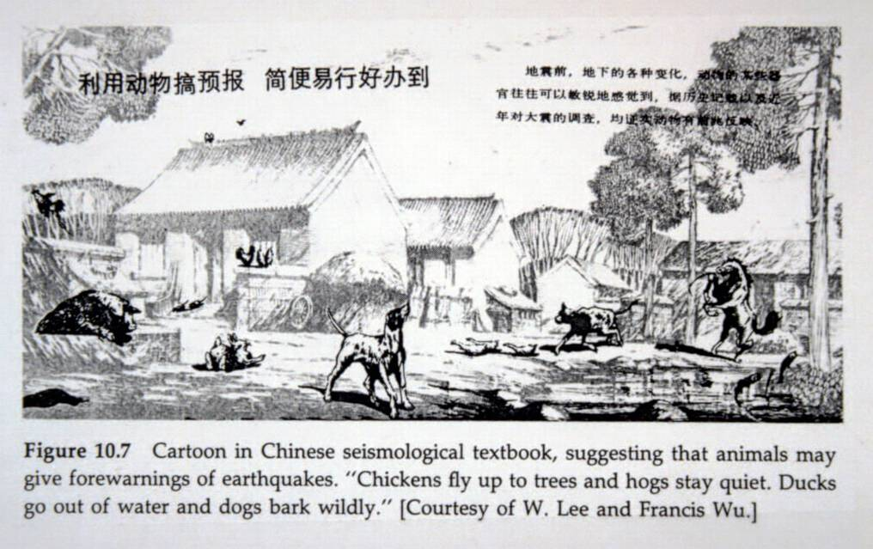
Notes:
Short term predictions / Forecasting / Real-time warnings
Volcano predicting is in good shape because of several observables

Slide 48
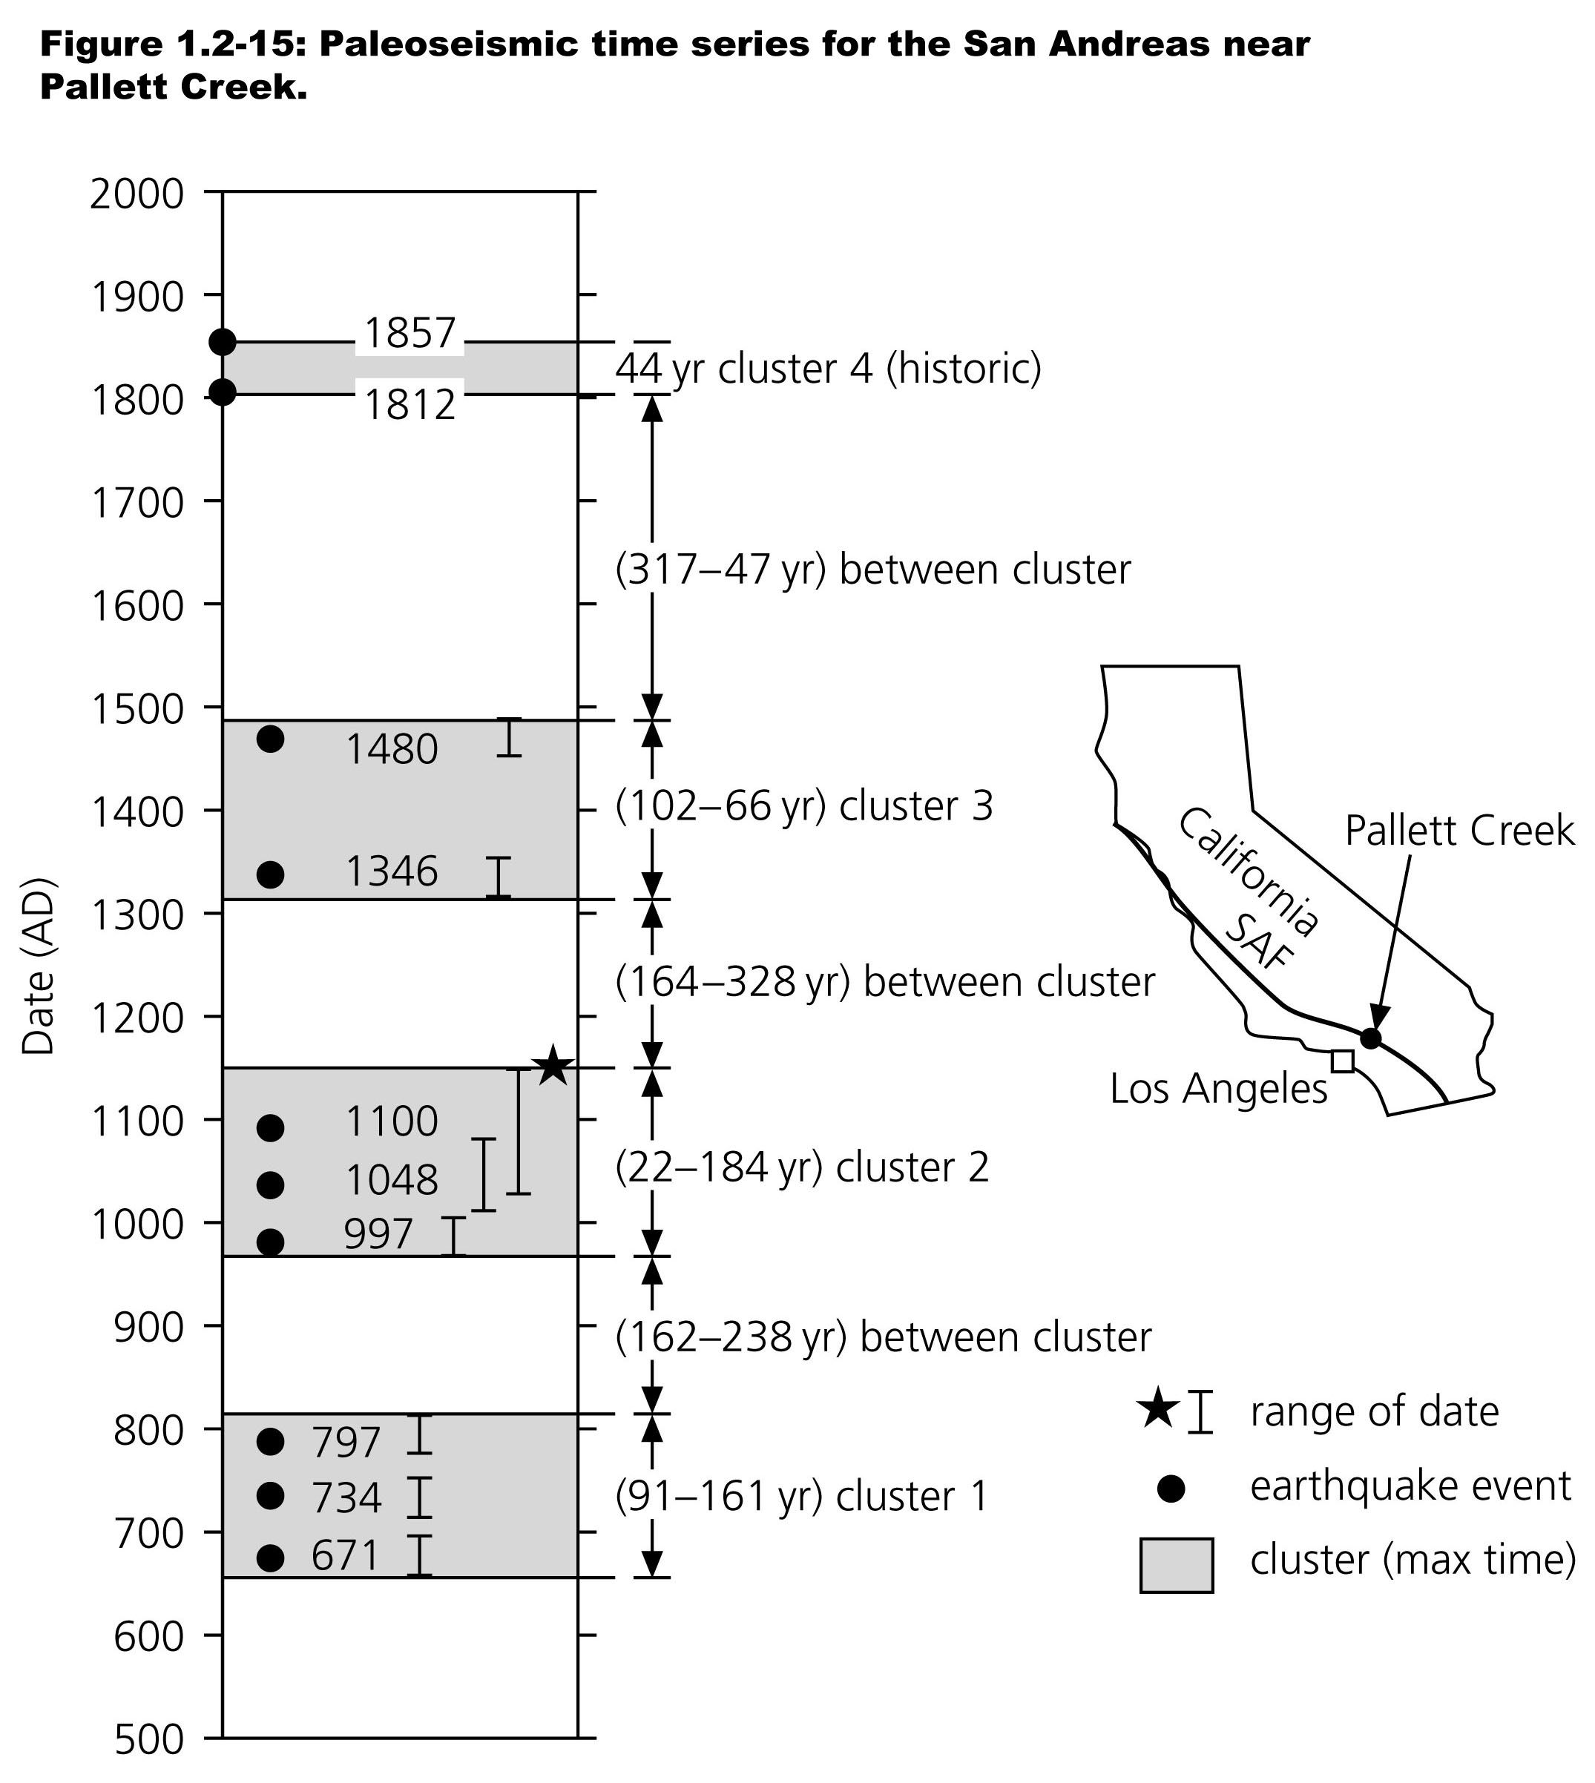
Notes:
Single events or clusters? We don’t know the rules by which earthquakes work

Slide 49
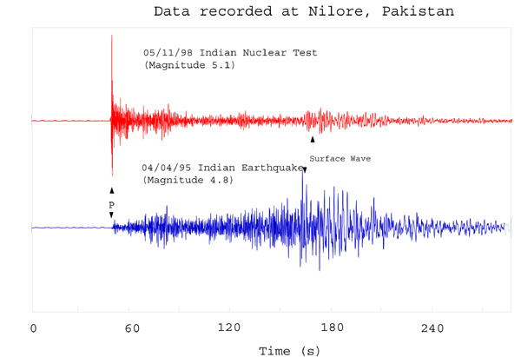

Slide 50
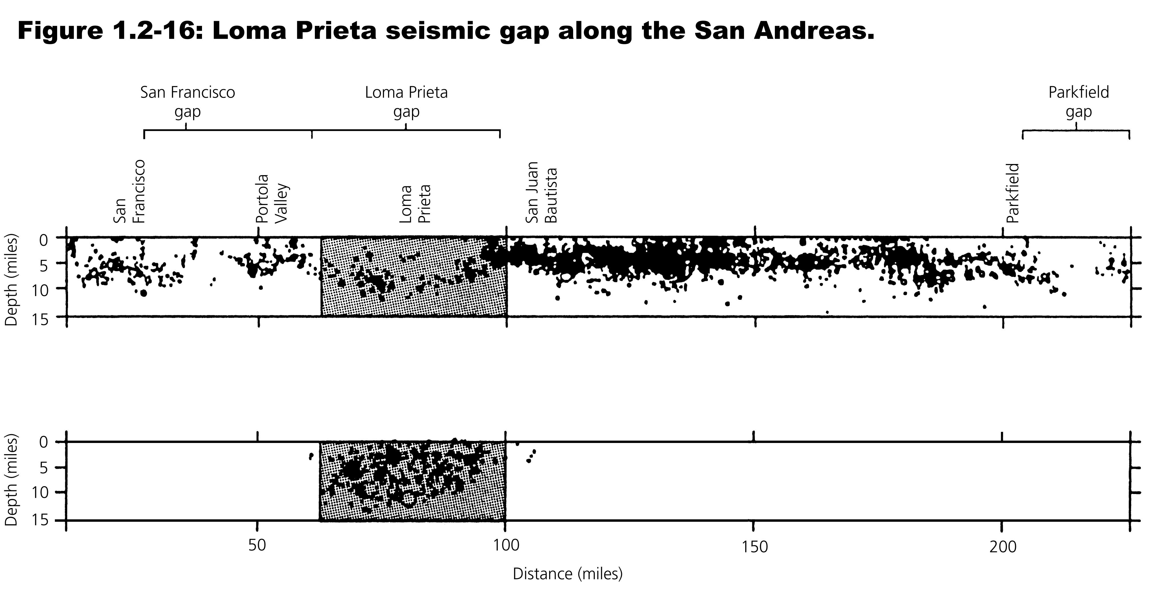
Notes:
Gap Hypothesis based on elastic rebound theory
Bear Gap Hypothesis – is it possible that earthquakes occur where earthquakes occur?

Slide 51
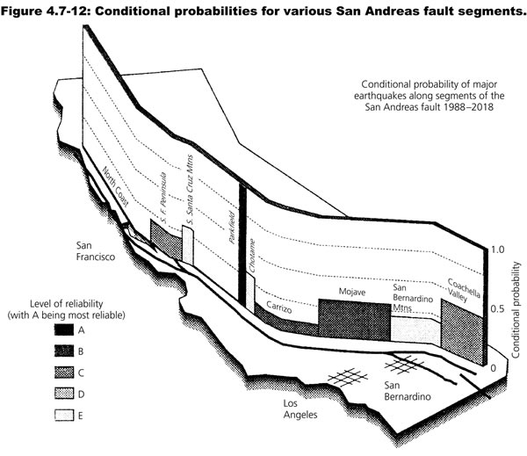

Slide 52
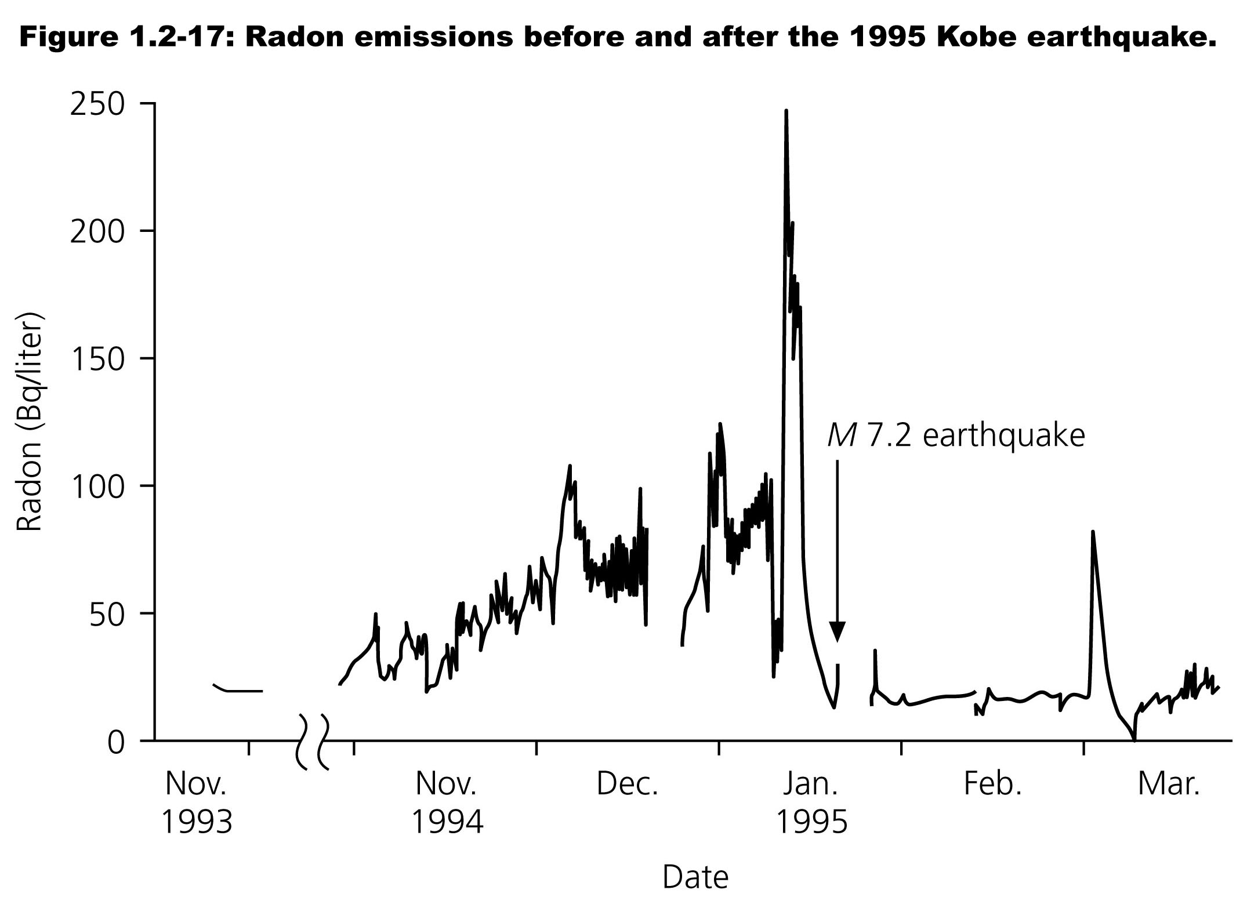

Slide 53
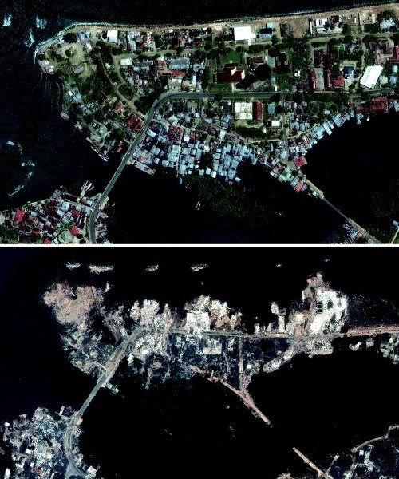
The shoreline of Banda Aceh, Indonesia is shown on June 23, 2004, above, and Dec. 28, 2004 below, after the tsunami struck.
DigitalGlobe ß

Slide 54





The Yomiuri Shimbun
Lift-Slab Pancake collapse
a man-made disaster
Notes:
Mustafa Karali / AP

