Slide 1
Global Seismology CERI-8105
Tu-Th 1:15-2:40 pm
Lab - 3892 Central Ave. (Long building) , Room 110
-----------------------------------------------
Bob Smalley
Office: 3892 Central Ave, Room 103, 678-4929
Office Hours – when I’m in my office.
http://www.ceri.memphis.edu/people/smalley/CERI8105_GlobalSeismology.html
Tue., Oct 31, 2023 Meeting 18

Slide 2
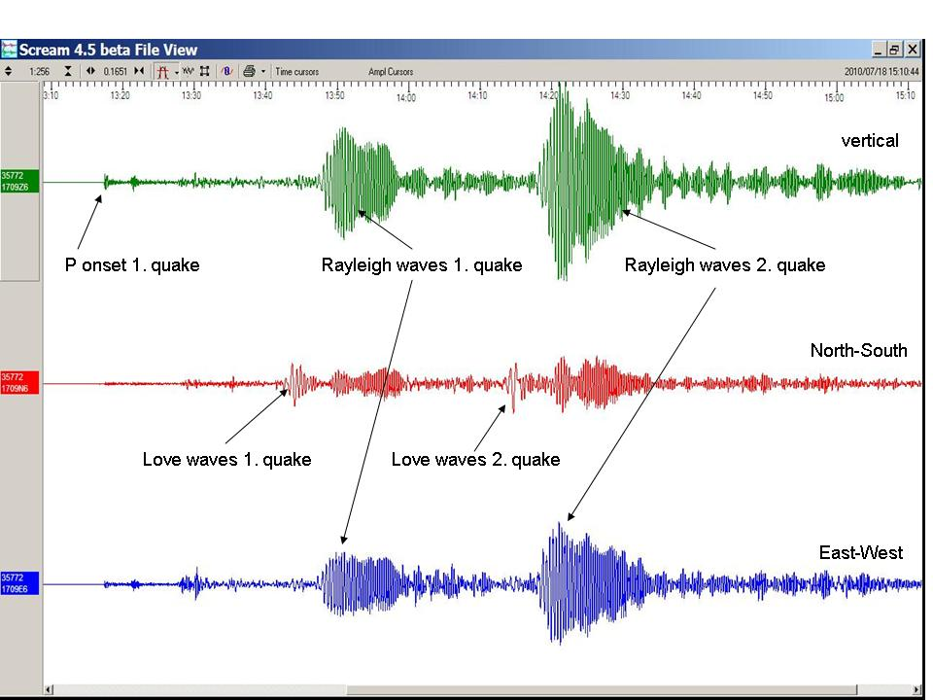
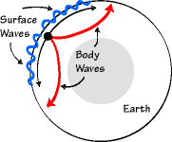
Seismic Waves
Body Waves
Surface Waves
P Waves
S Waves
Love (L) Waves
Rayleigh (R) Waves
SH waves
SV waves
Body waves travel through the interior of the Earth.
Surface waves: Their motion is restricted to near the ground surface.
Notes:
Surface/Body wave image - http://eqseis.geosc.psu.edu/cammon/HTML/Classes/IntroQuakes/Notes/waves and_interior.html
Table
Gohar Alam https://www.google.com/url?sa=t&rct=j&q=&esrc=s&source=web&cd=&cad=rja&uact=8&ved=2ahUKEwiem8zOpp6CAxXnl4kEHZodChAQFnoECCQQAQ&url=https%3A%2F%2Fwww.academia.edu%2F19873185%2FSeismic_Waves&usg=AOvVaw14i8ZJBW01MtJobHmg0EI5&opi=89978449
https://seismo.berkeley.edu/blog/2010/07/19/a-race-across-the-pacific-ocean.html – two earthquakes <30 minutes apart, propagation direction in San Francisco area directly east – naturally polarized into Love and Rayleigh. Also body waves (r-2) << amplitude than surface waves (r-1)

Slide 3
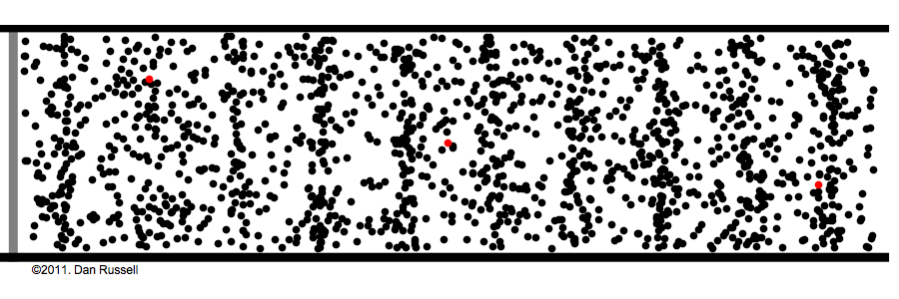
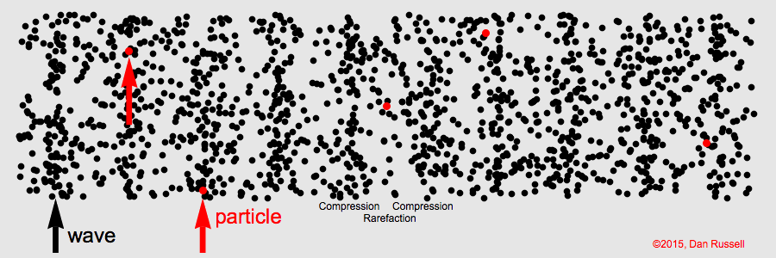
In longitudinal waves particle displacement is parallel to the wave propagation direction.
Particles do not move down the tube with the wave; they oscillate back and forth about their individual equilibrium positions.
Regions of compression and rarefaction are identified.
Longitudinal : P/Pressure/Compressional wave motions – particle vs. wave.
Notes:
https://www.acs.psu.edu/drussell/demos/waves/wavemotion.html

Slide 4
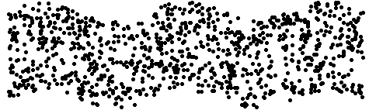
Particle displacement is perpendicular to wave propagation direction.
As with longitudinal waves, particles do not move along with the wave; they oscillate back can forth (transversly) about their individual equilibrium positions as the wave passes by.
Transverse: Shear and Love wave motions – particle vs. wave.
Notes:
https://www.acs.psu.edu/drussell/demos/waves/wavemotion.html

Slide 5
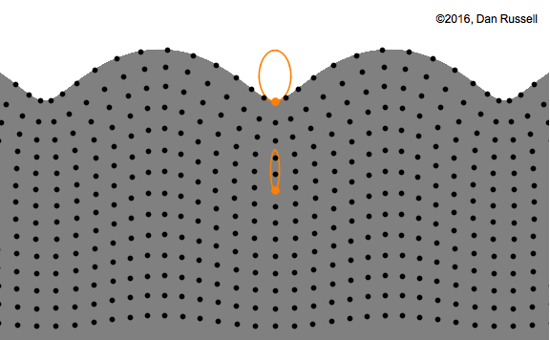
Rayleigh surface waves
Surface waves with both longitudinal and transverse motion. known as Rayleigh waves, exist in solids.
Particles in a Rayleigh wave move in elliptical paths, with the major axis perpendicular to the surface of the solid.
As the depth increases the "width" of the ellipse shrinks and it becomes more vertically elongated.
Notes:
https://www.acs.psu.edu/drussell/demos/waves/wavemotion.htm

Slide 6
Rayleigh surface waves
Surface waves with both longitudinal and transverse motion. known as Rayleigh waves, exist in solids.
At the surface, the Rayleigh wave horizontal particle motion is in the opposite direction as the wave propagation direction and is called "retrograde" motion.
Notes:
https://www.acs.psu.edu/drussell/demos/waves/wavemotion.html

Slide 7
Rayleigh surface waves
At a depth of >1/5th wavelength, however, the sense of Rayleigh wave rotation reverses into prograde motion.
Rayleigh waves cause the most damage during earthquakes. They travel slower than S, arrive later, with much greater amplitudes and are the waves most easily felt during an earthquake, involving both up-down and side-to-side motion.
Notes:
https://www.acs.psu.edu/drussell/demos/waves/wavemotion.html

Slide 8
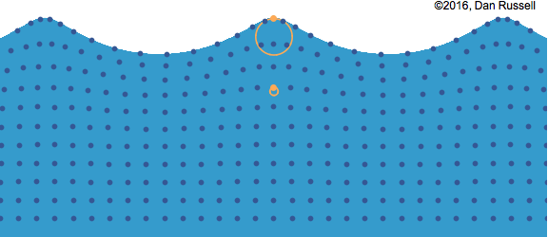
Water waves also involve a combination of both longitudinal and transverse motions, although their constitutive law is different as water does not support shear and the restoring force is gravity.
For waves whose wavelength is less that the water depth, the particles motion at the surface is in the same direction as the wave propagation.
As with Rayleigh waves, the radius of the circles decreases with depth.

Slide 9
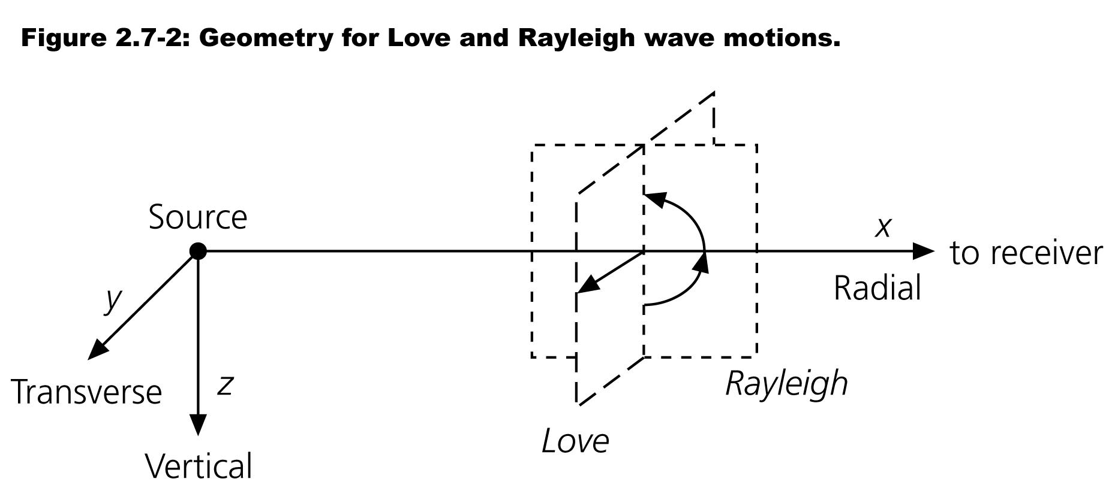

Slide 10
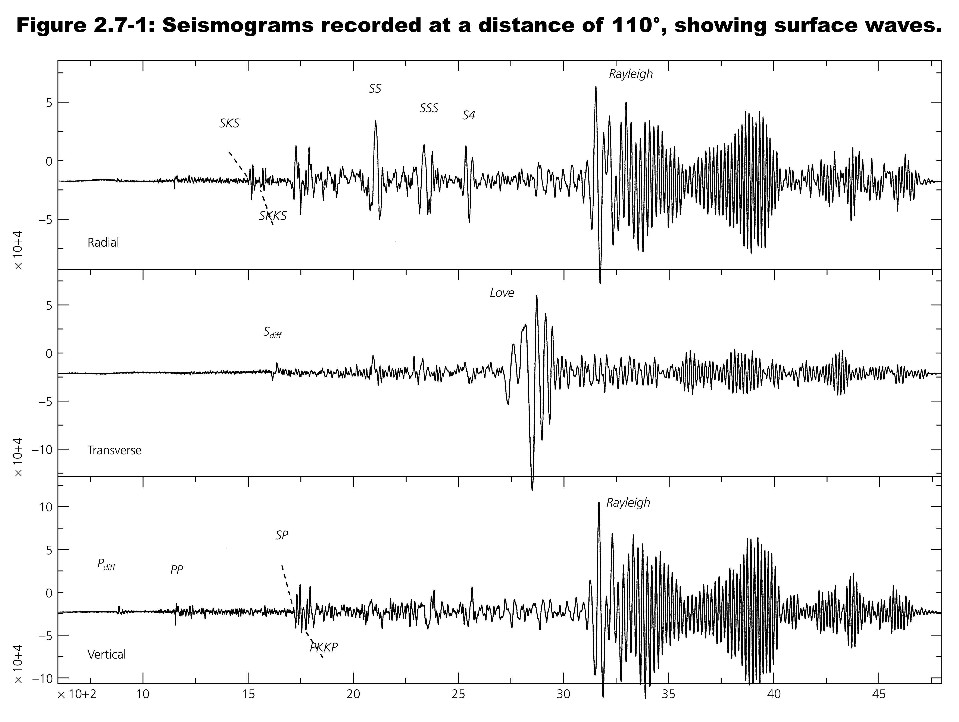

Slide 11
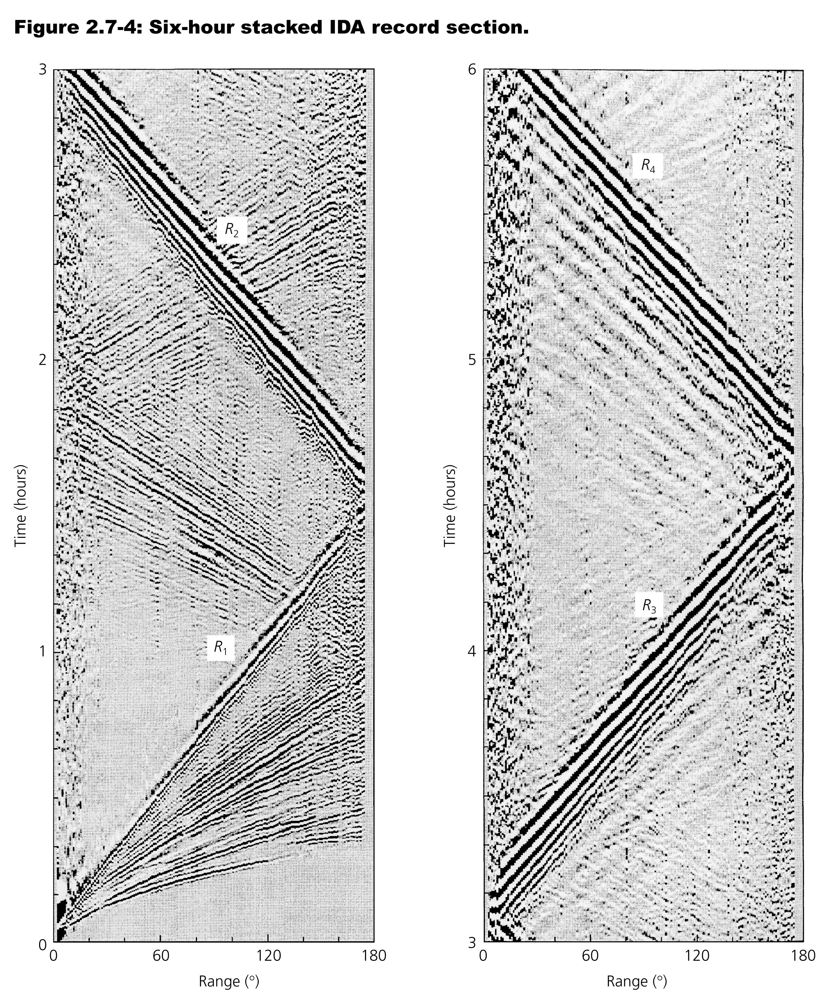
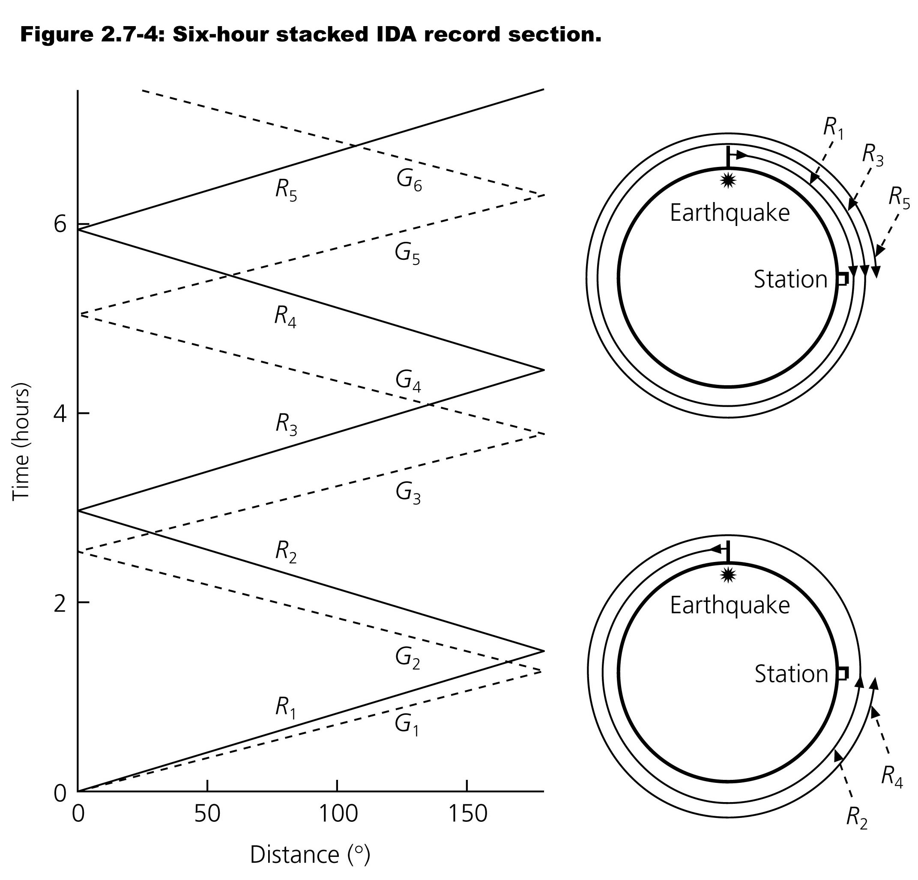
Figure 2.7-3: Surface waves circle the earth multiple times.

Slide 12

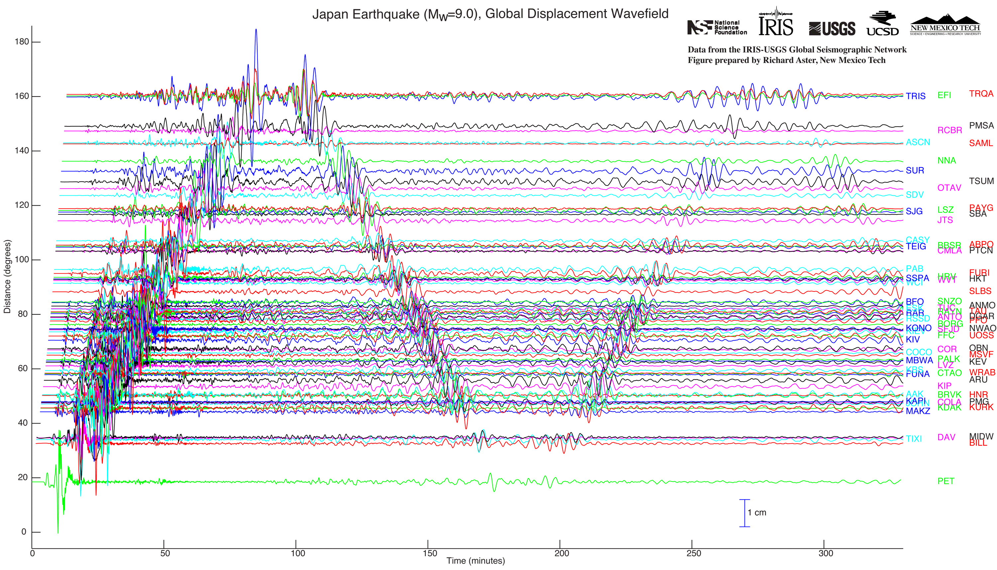
Magnitude 9.0 NEAR THE EAST COAST OF HONSHU, JAPAN
Friday, March 11, 2011 at 05:46:23 UTC
Seismic waves recorded around the world.

Slide 13
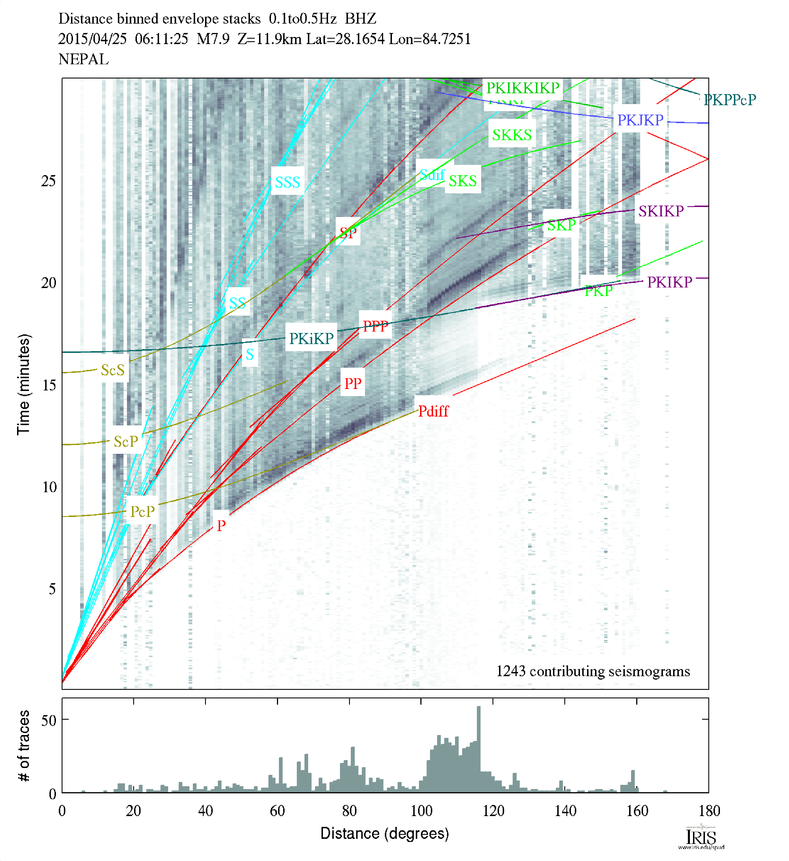
Seismic Data to Earth Structure

Slide 14
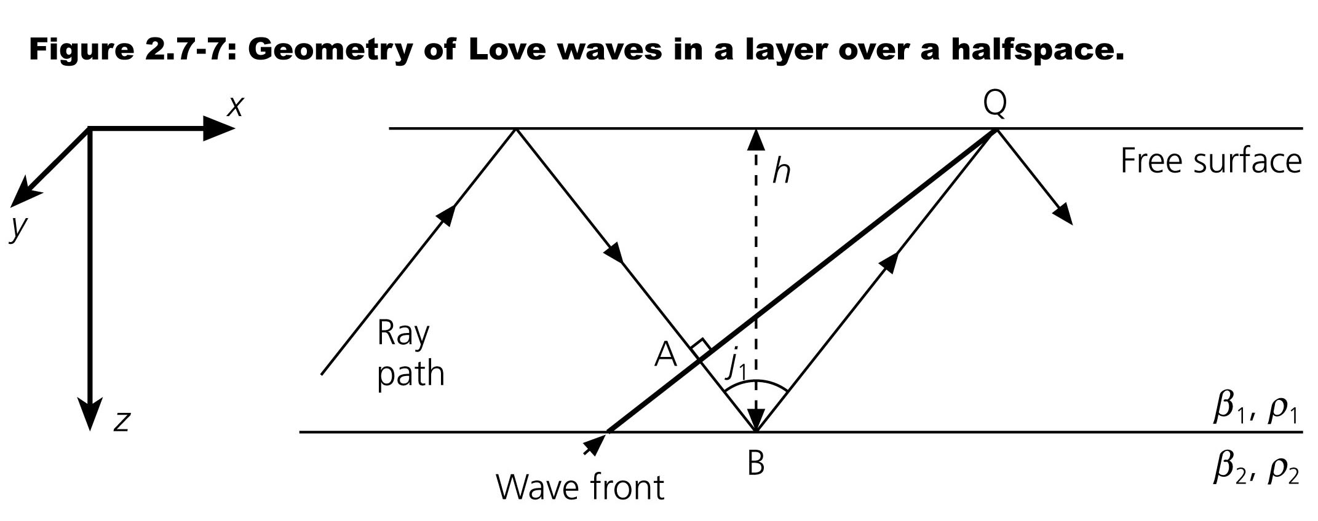
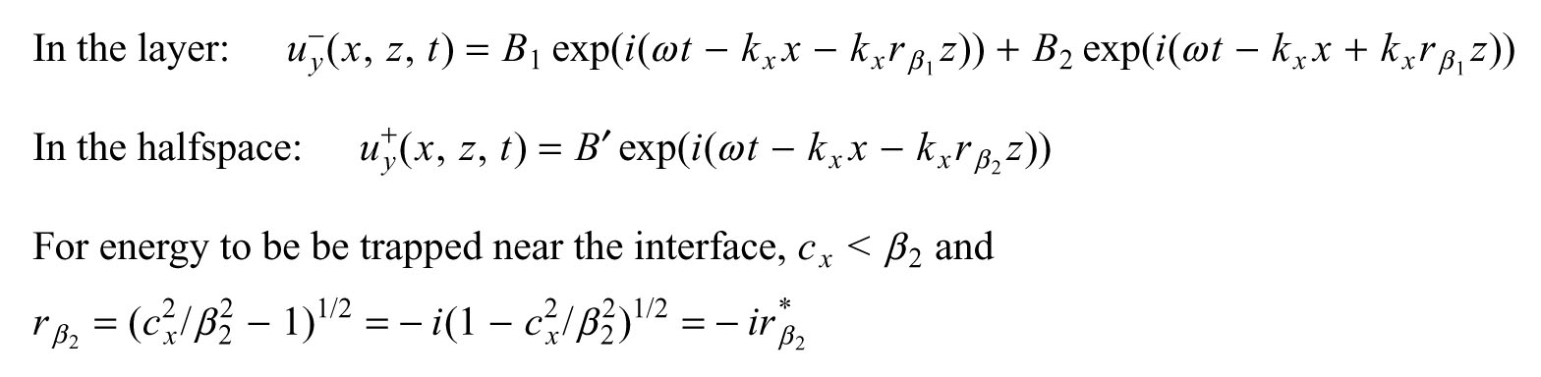
Notes:
In the layer we have up and downgoing waves

Slide 15
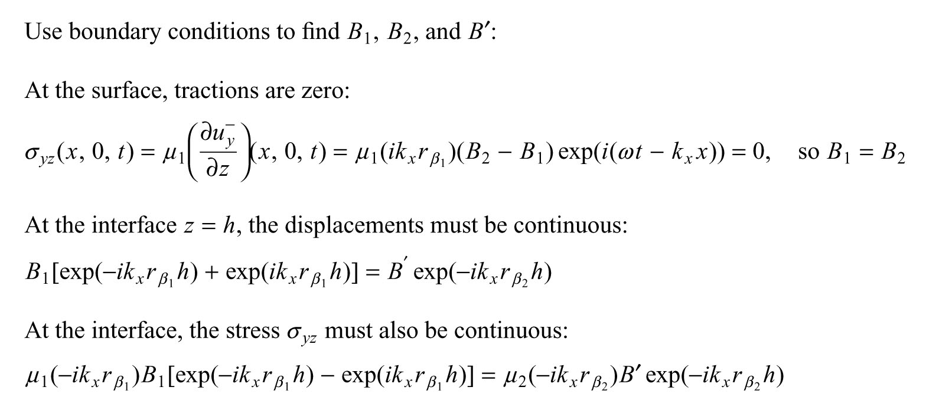

Slide 16
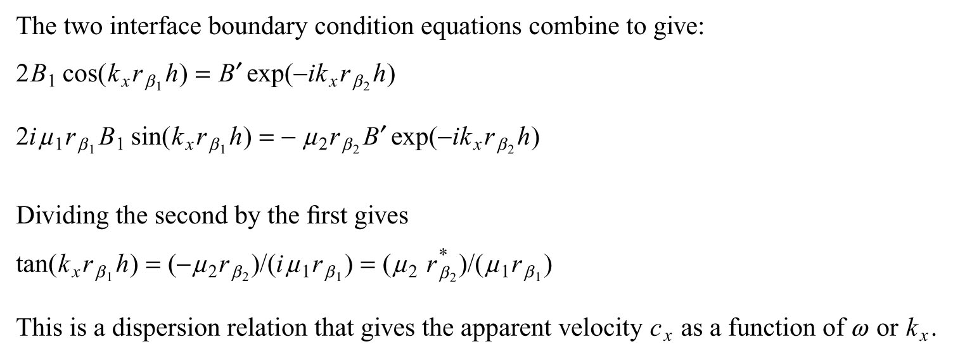

Slide 17
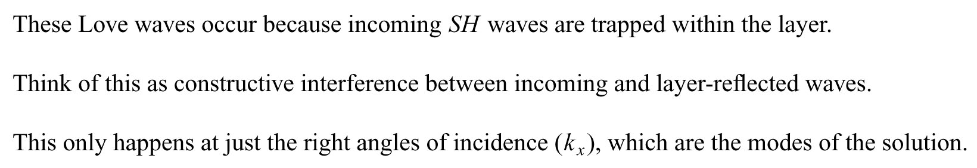

Slide 18
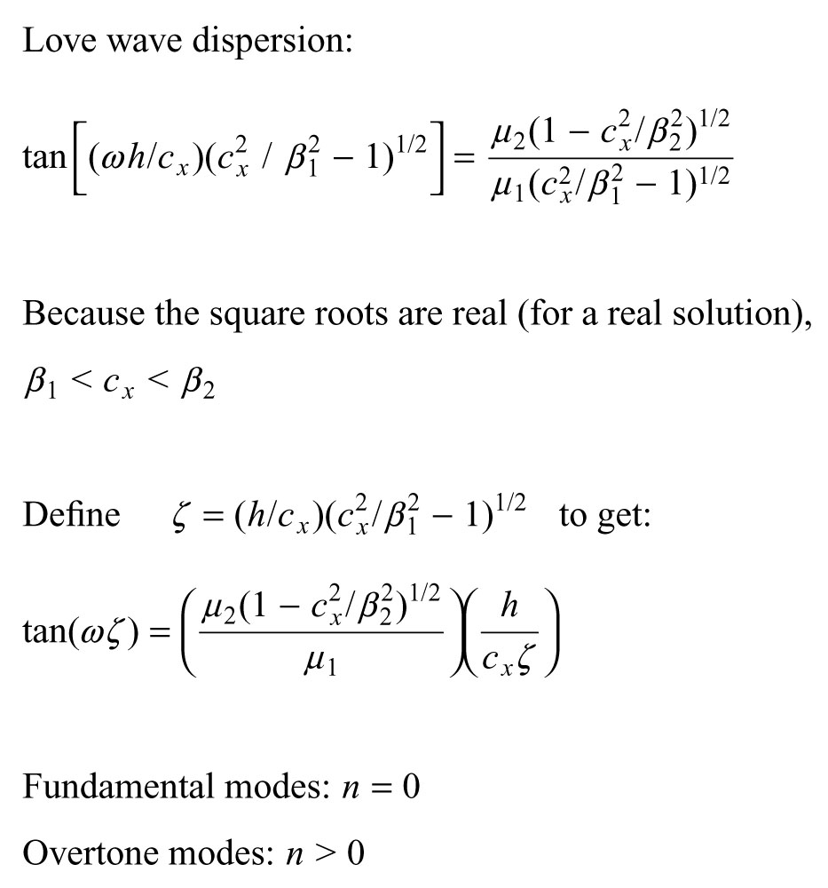
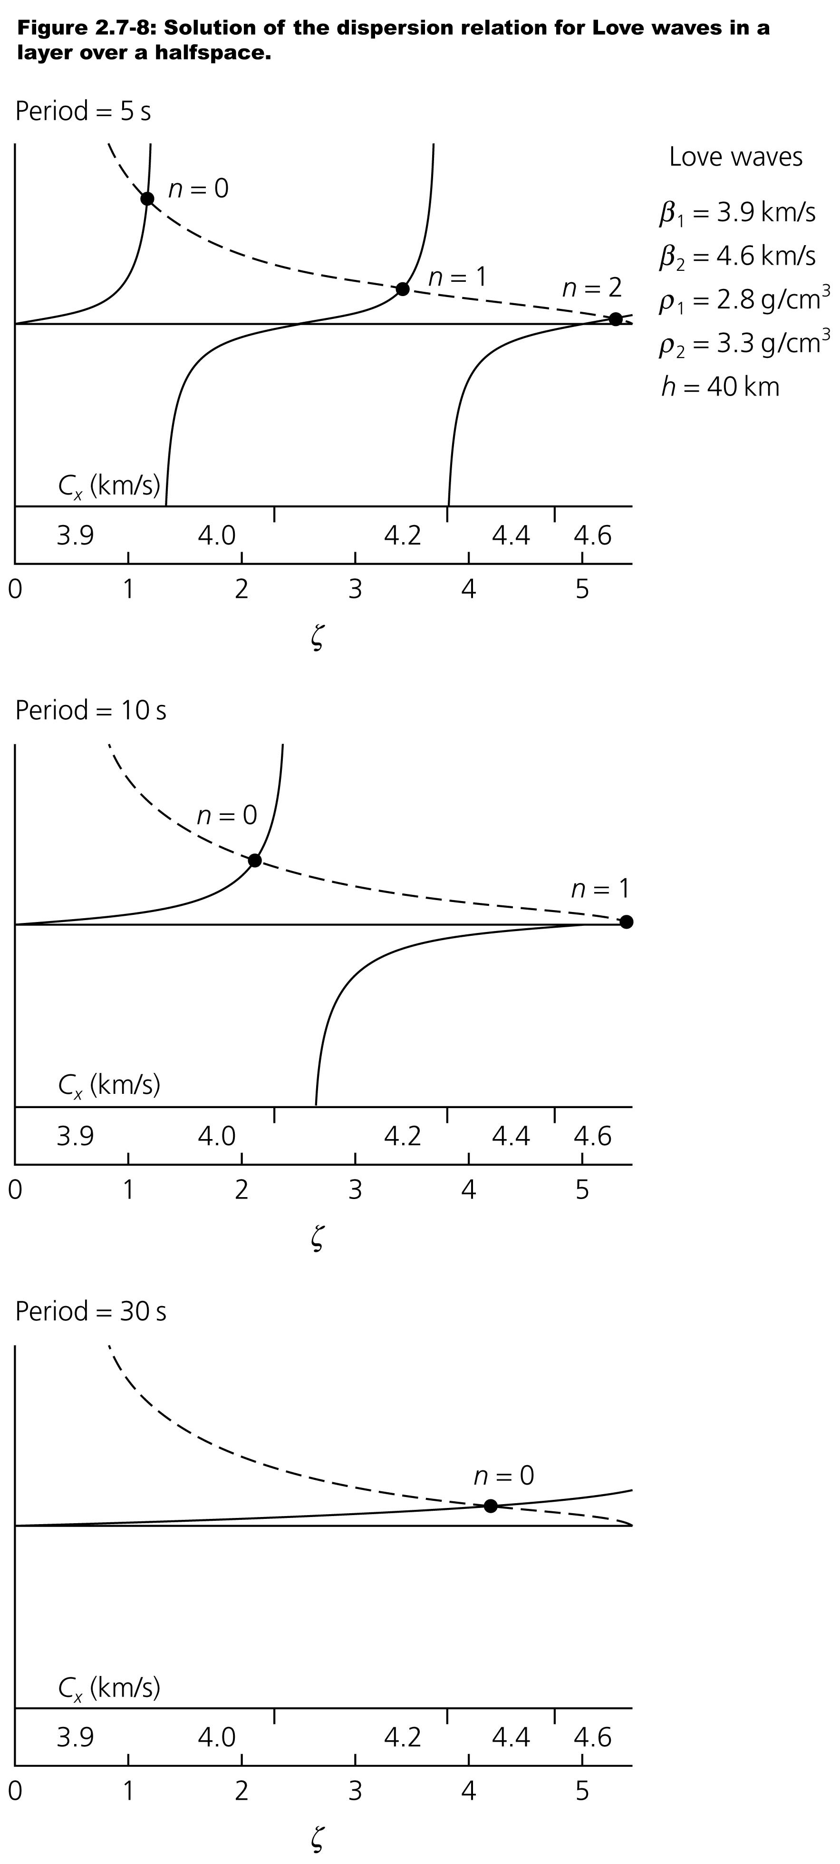

Slide 19
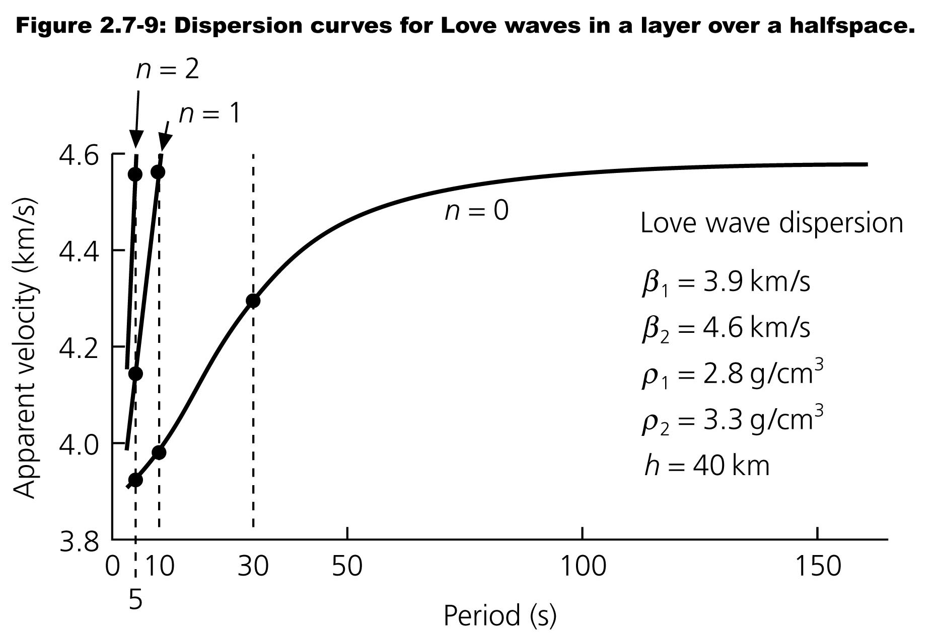
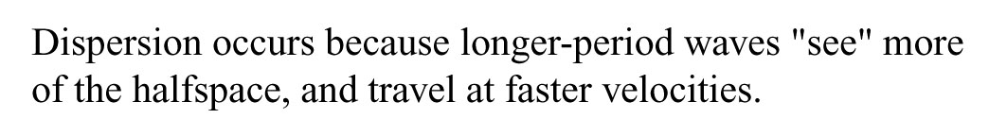

Slide 20
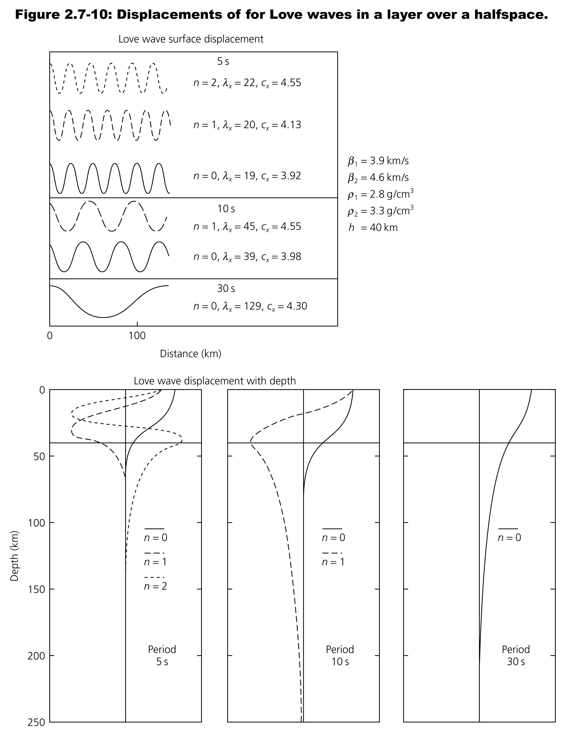
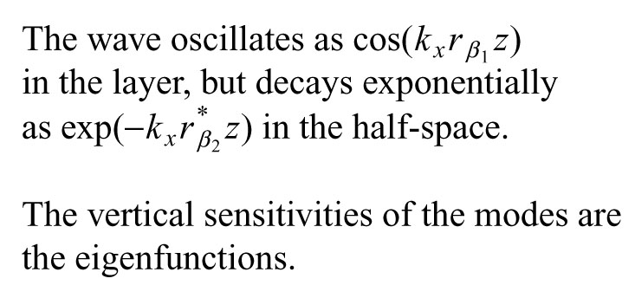

Slide 21
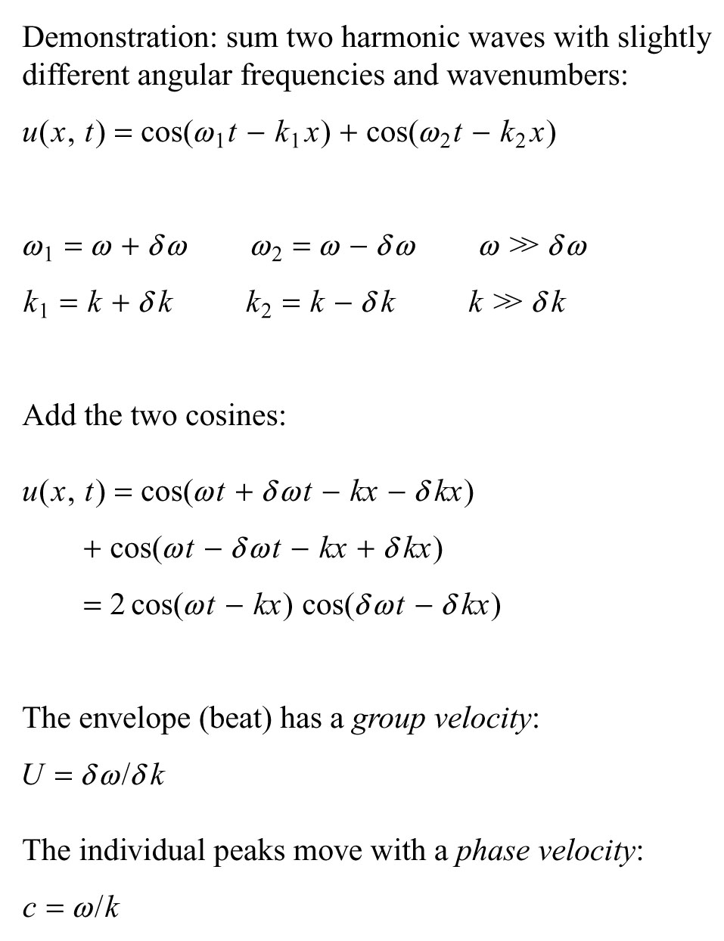
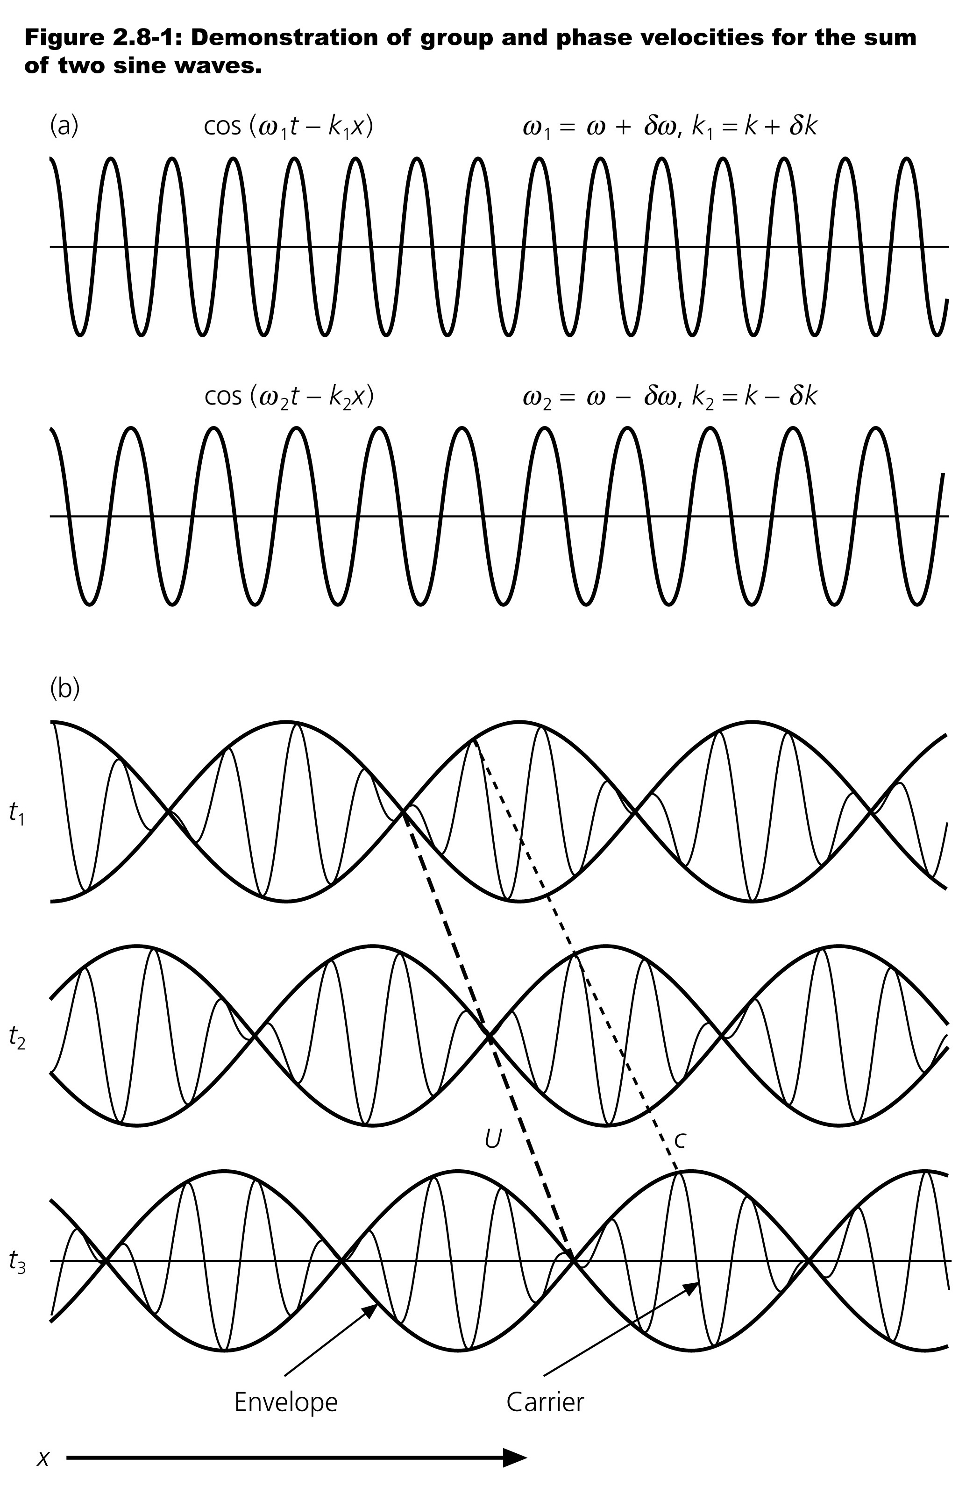

Slide 22
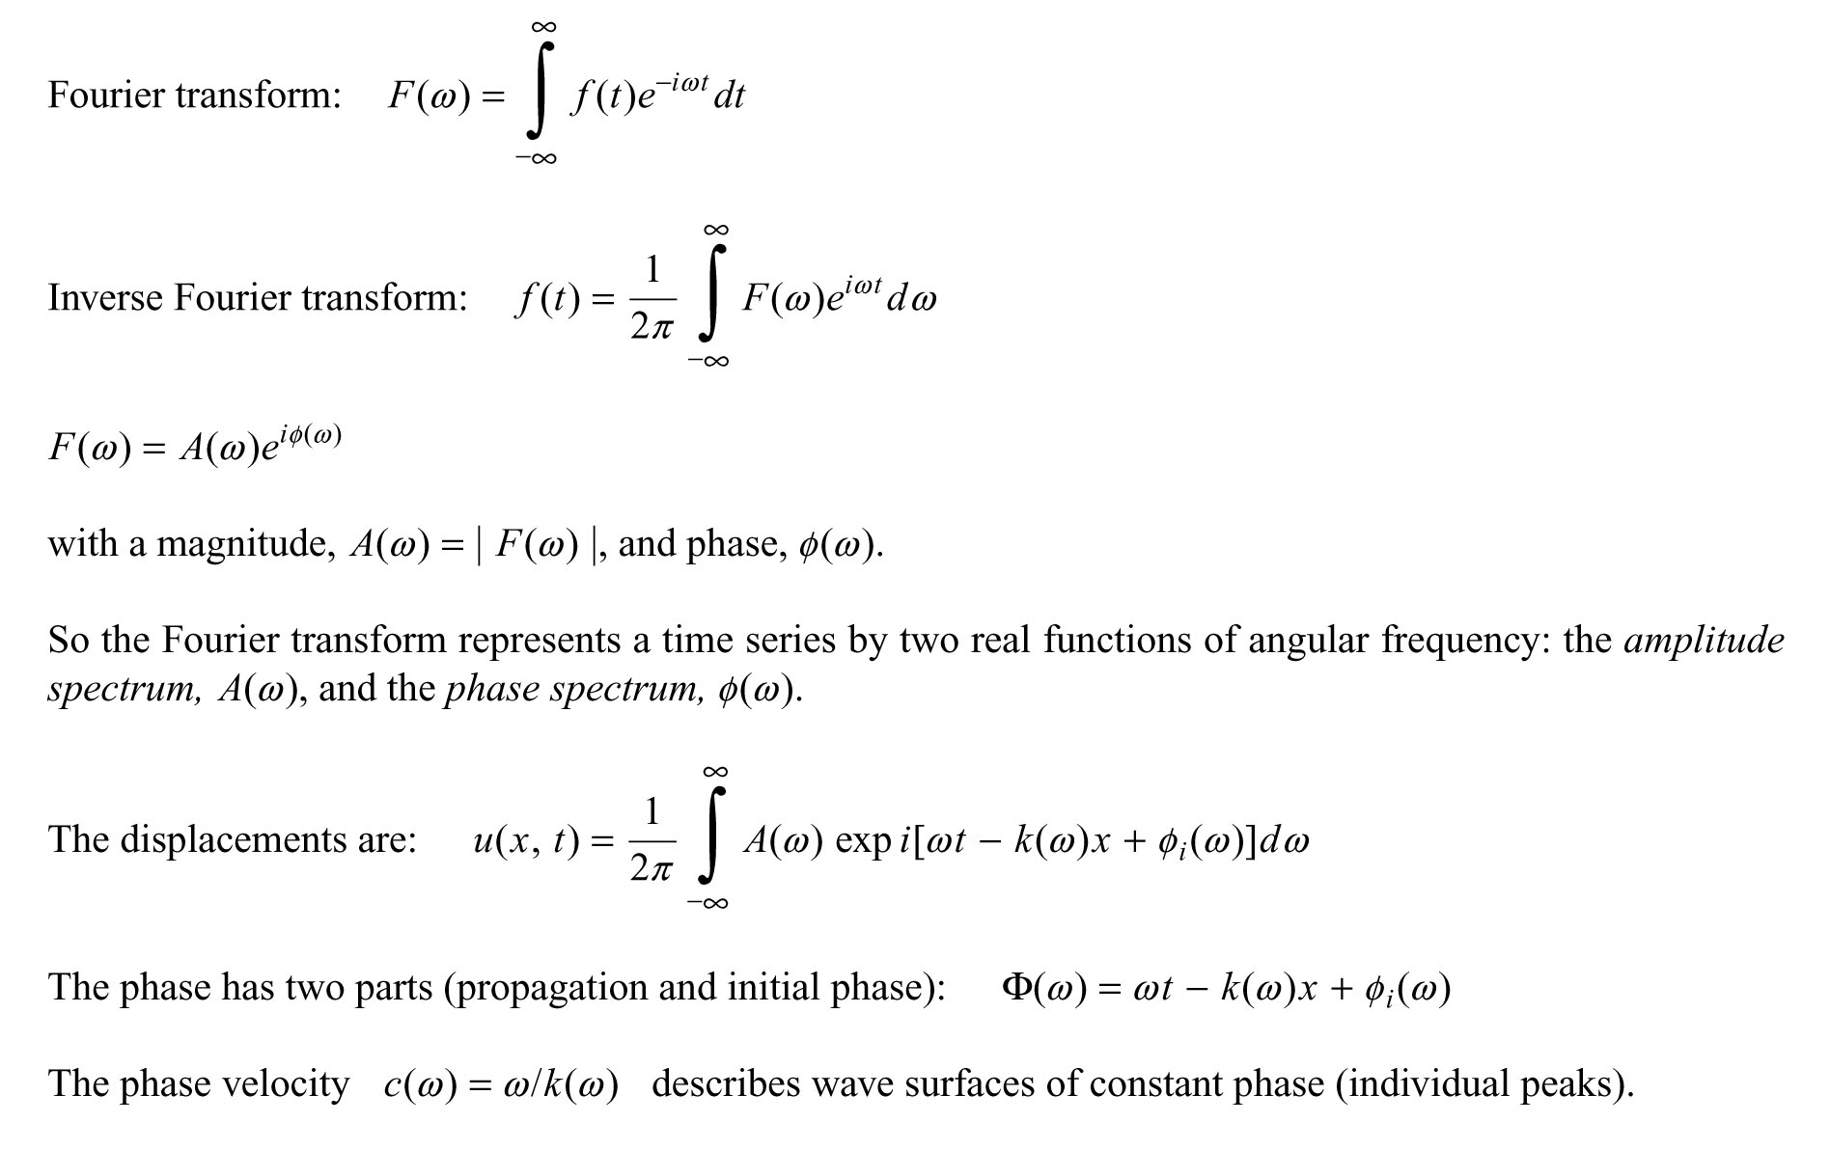

Slide 23
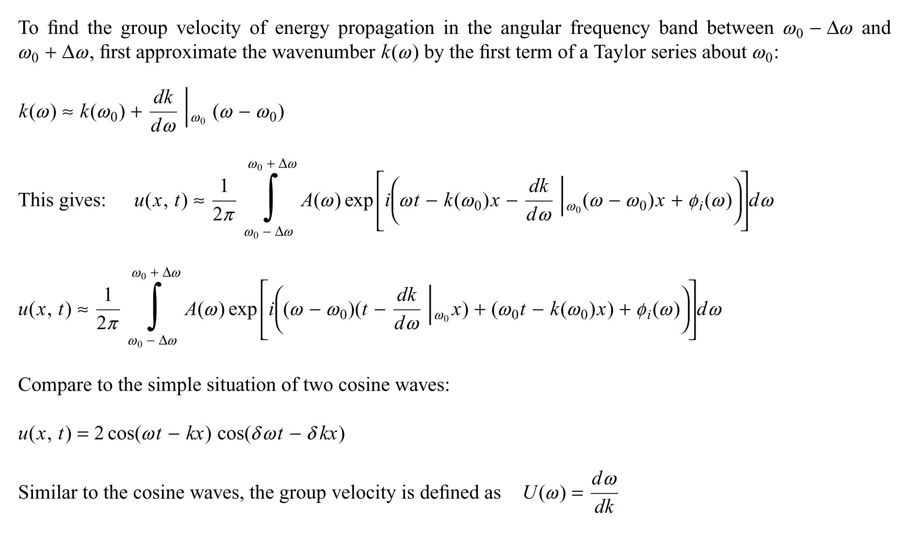

Slide 24
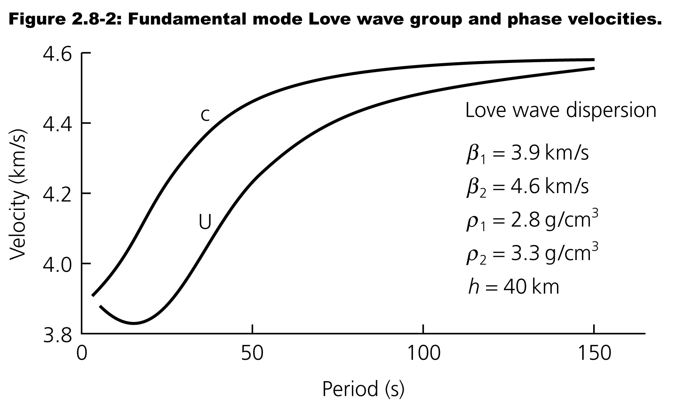
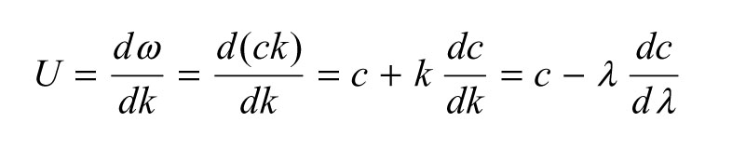

Slide 25
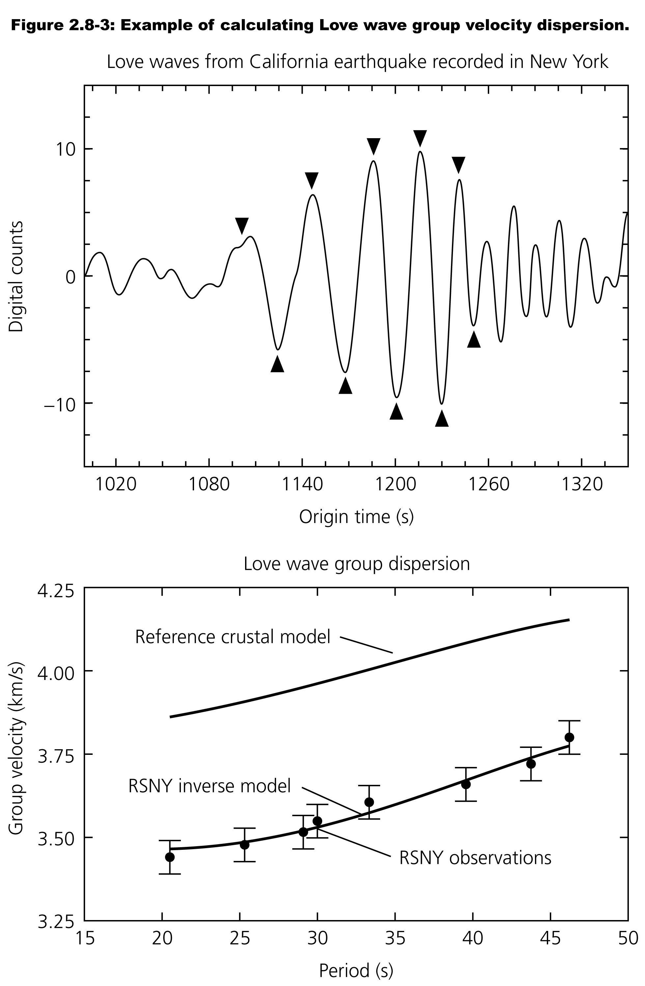

Slide 26
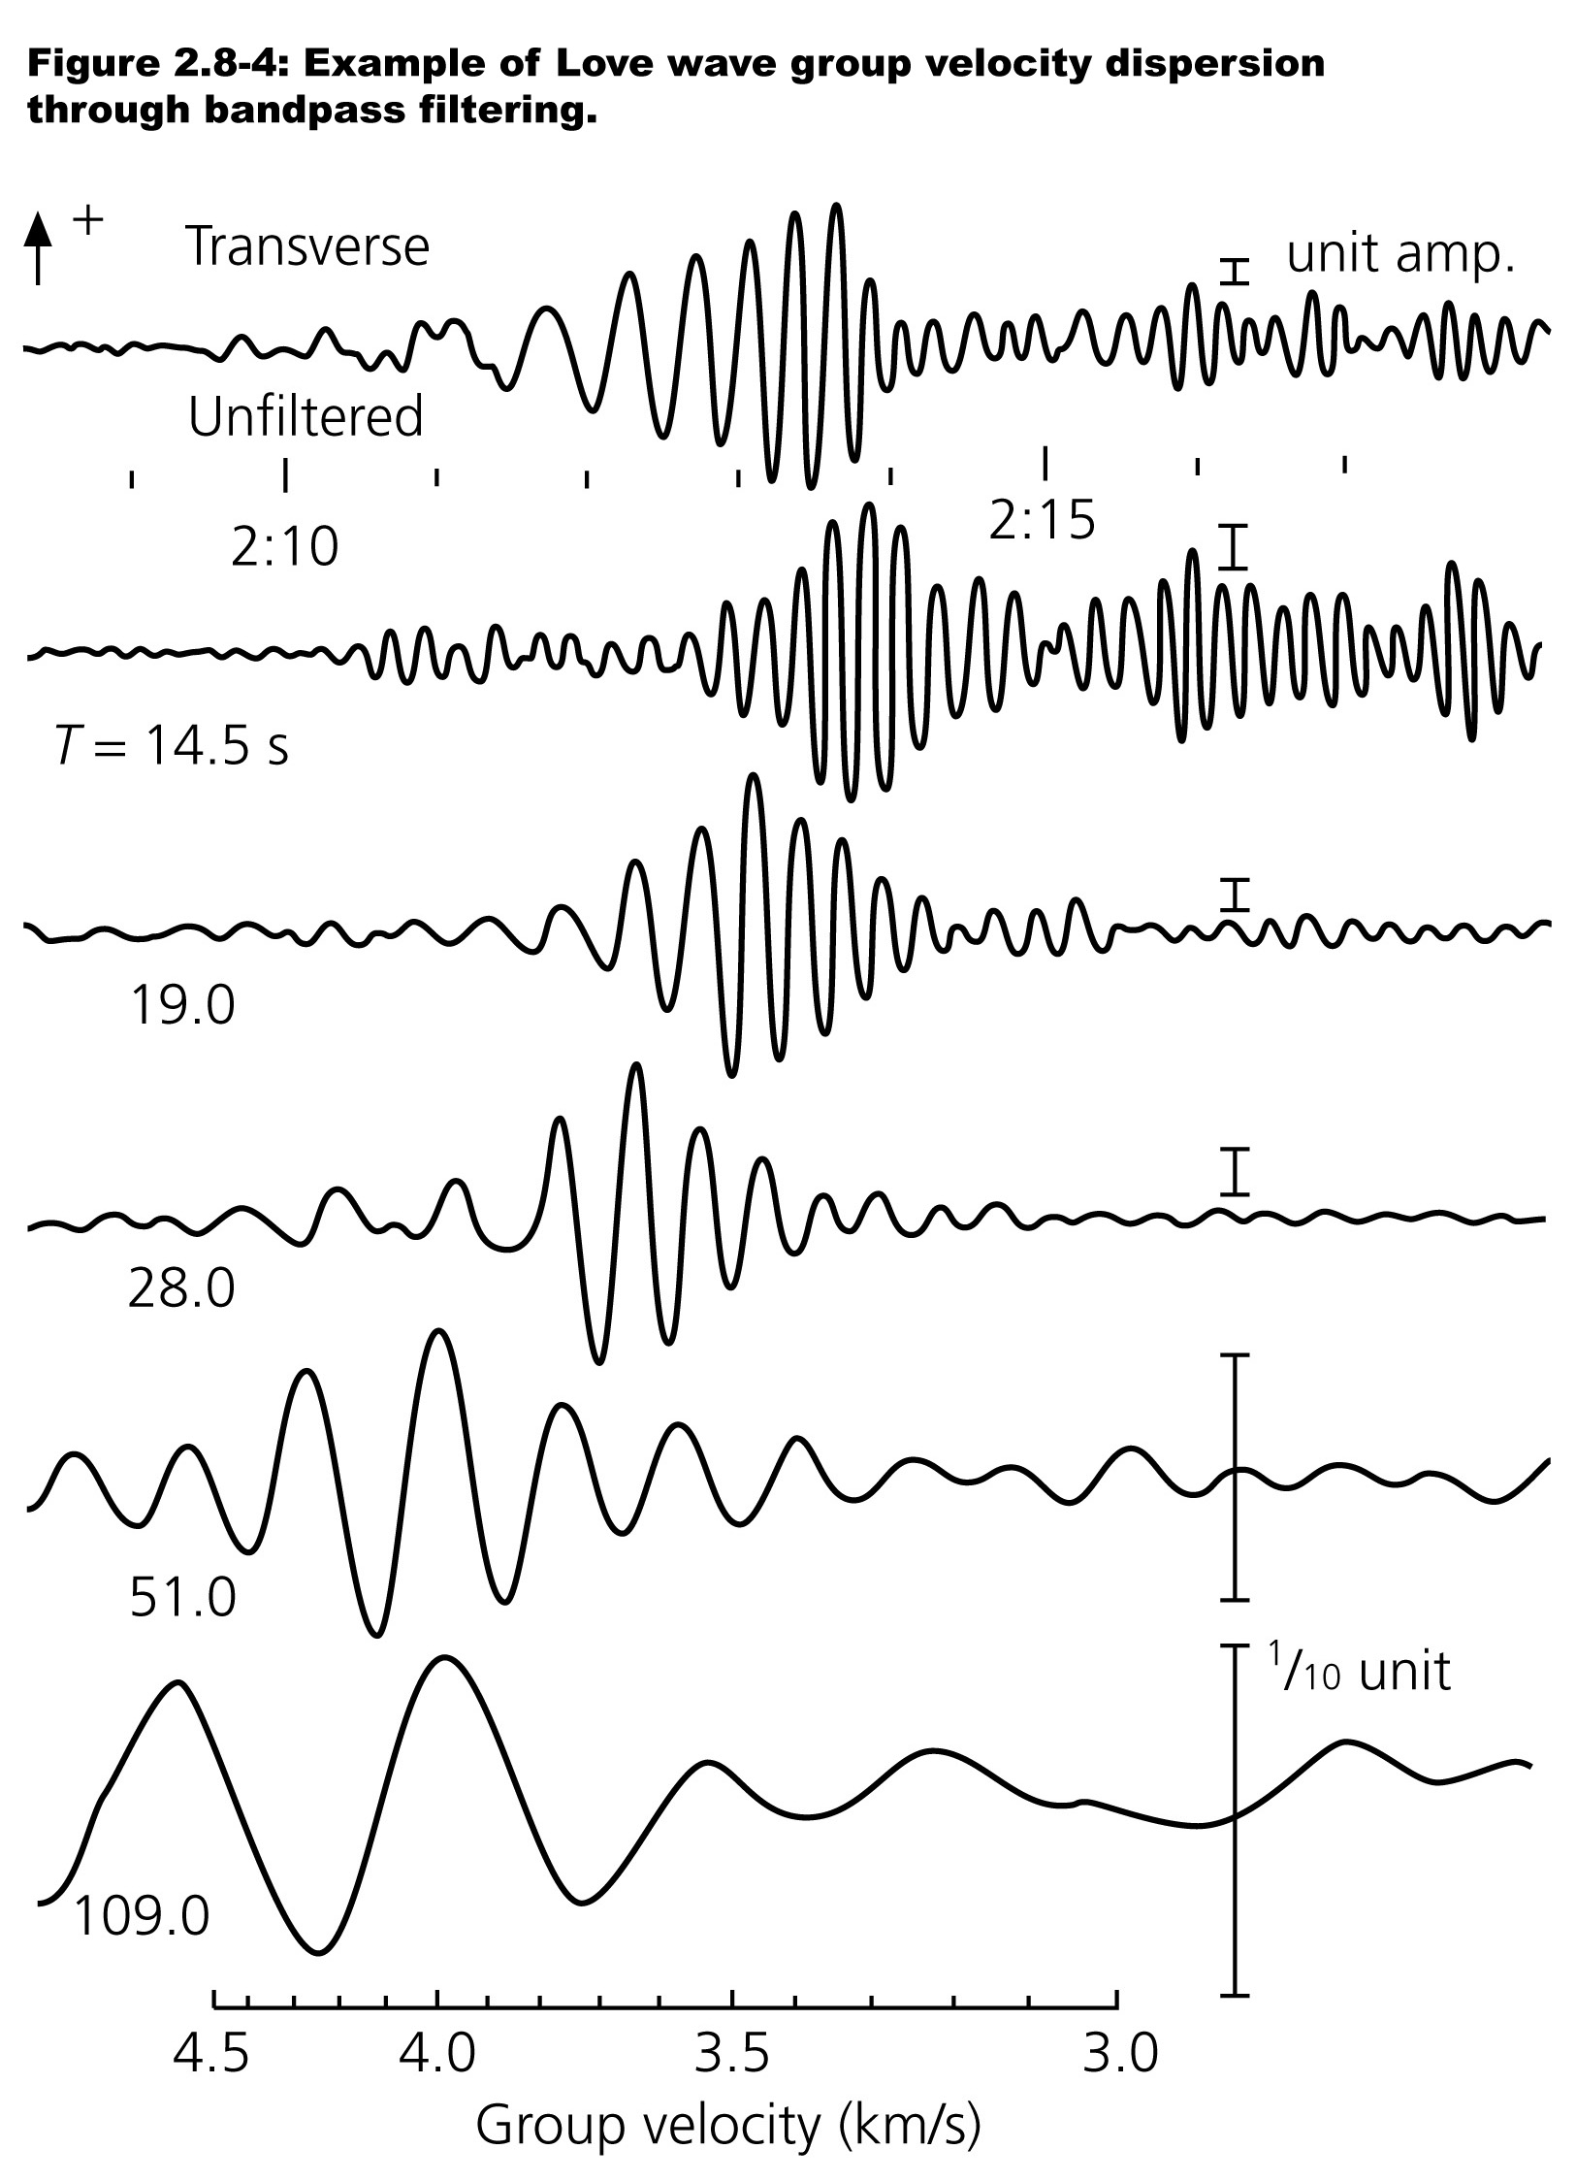

Slide 27
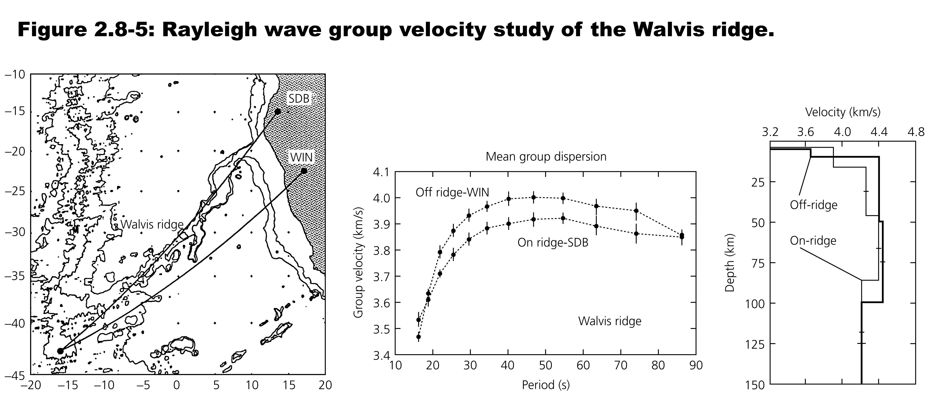

Slide 28
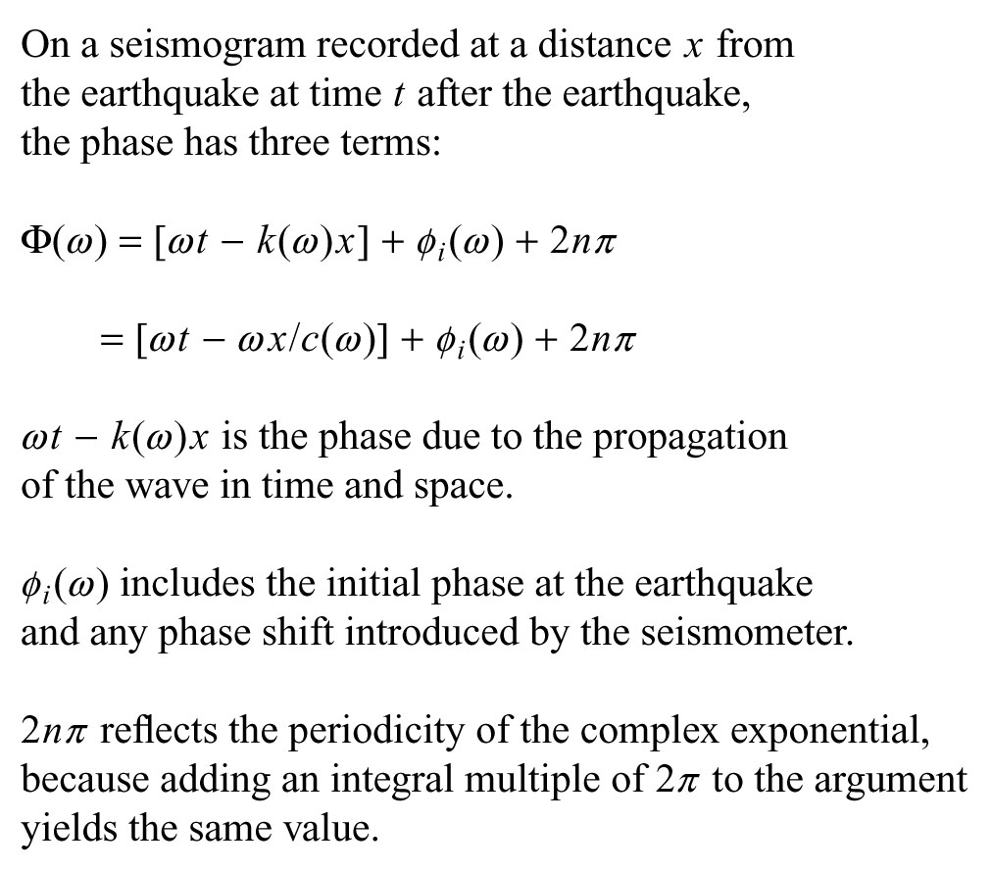
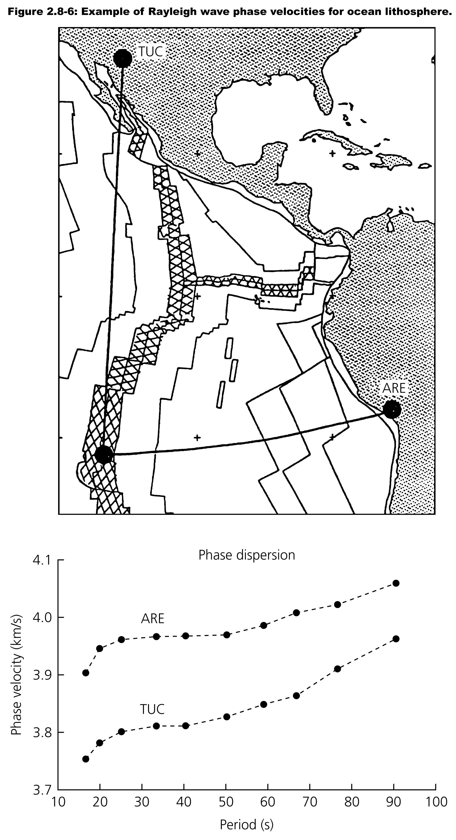

Slide 29
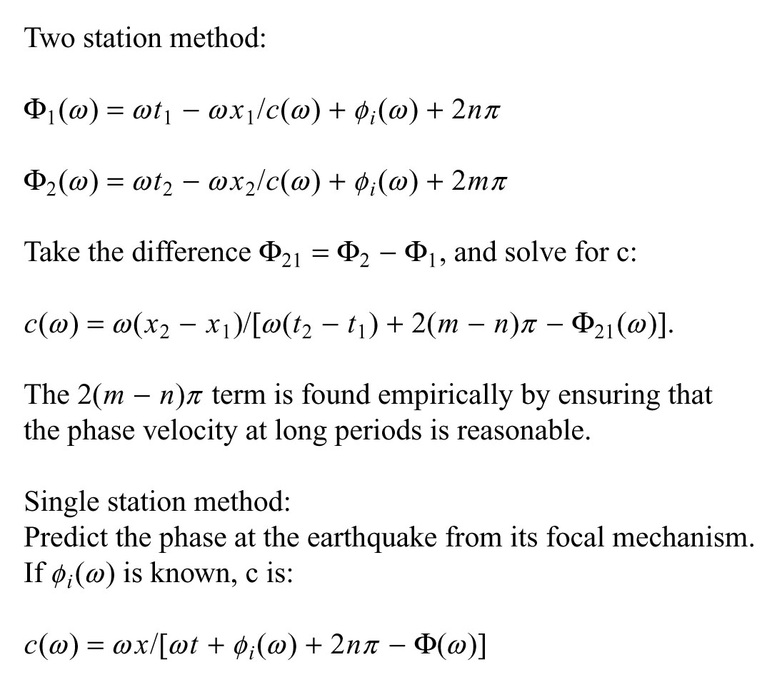

Slide 30
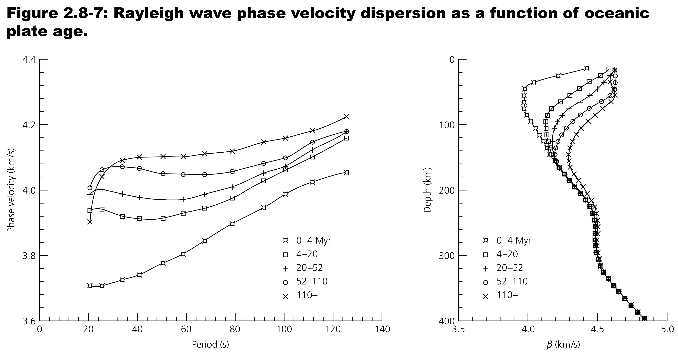

Slide 31
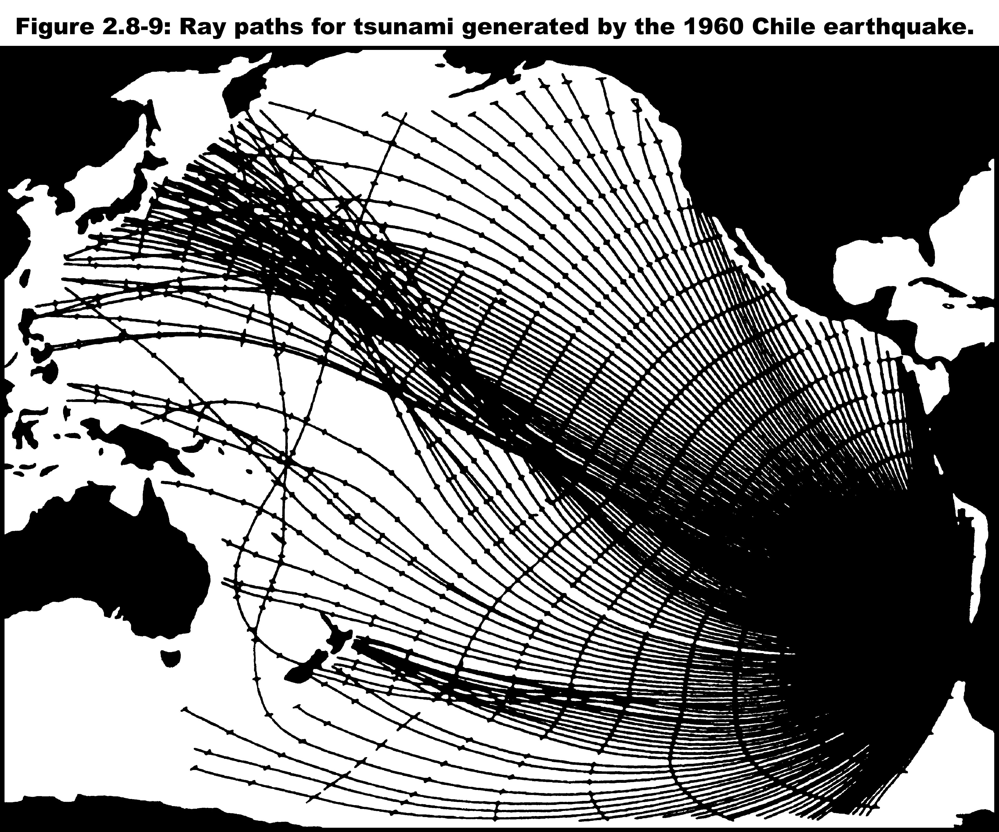

Slide 32
