Slide 1
Global Seismology CERI-8105
Tu-Th 1:00-2:25pm
Lab - 3892 Central Ave. (Long building) , Room 110
-----------------------------------------------
Bob Smalley
Office: 3892 Central Ave, Room 103, 678-4929
Office Hours – when I’m in my office.
http://www.ceri.memphis.edu/people/smalley/CERI8105_GlobalSeismology.html
Tue., Oct 10, 2023 Meeting 13

Slide 2
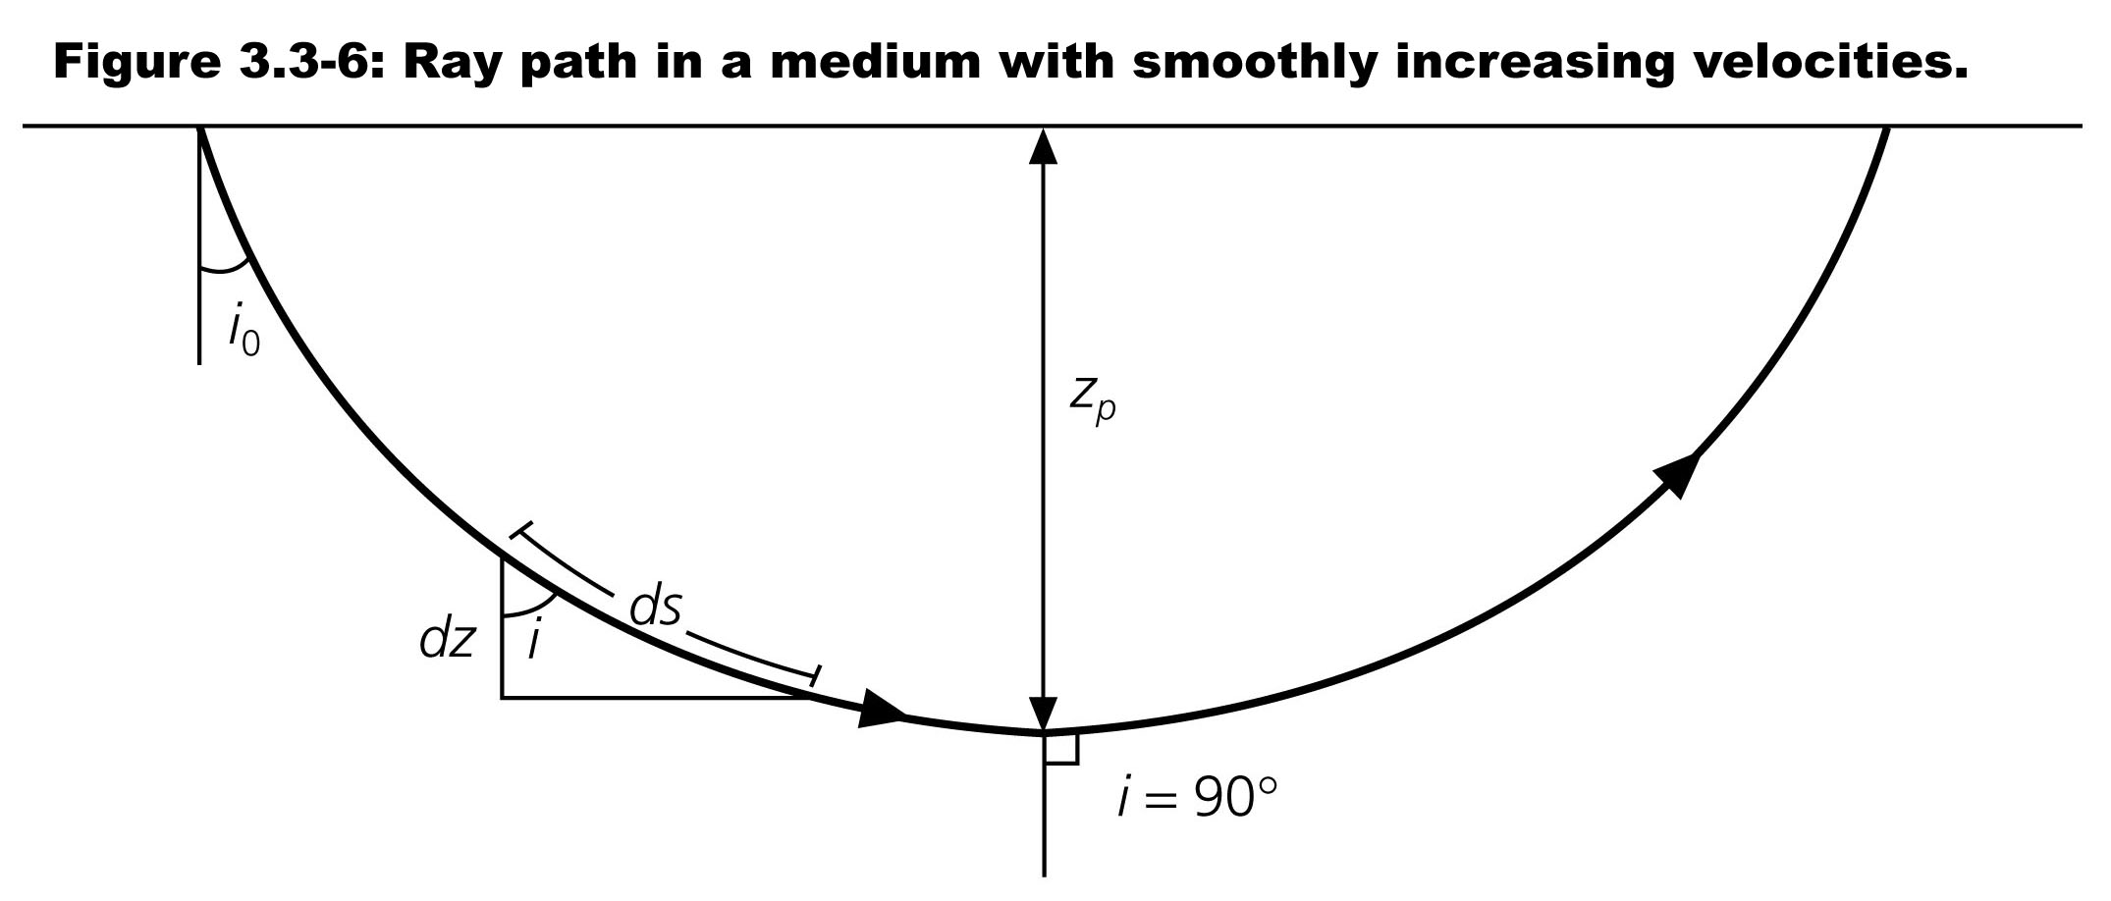
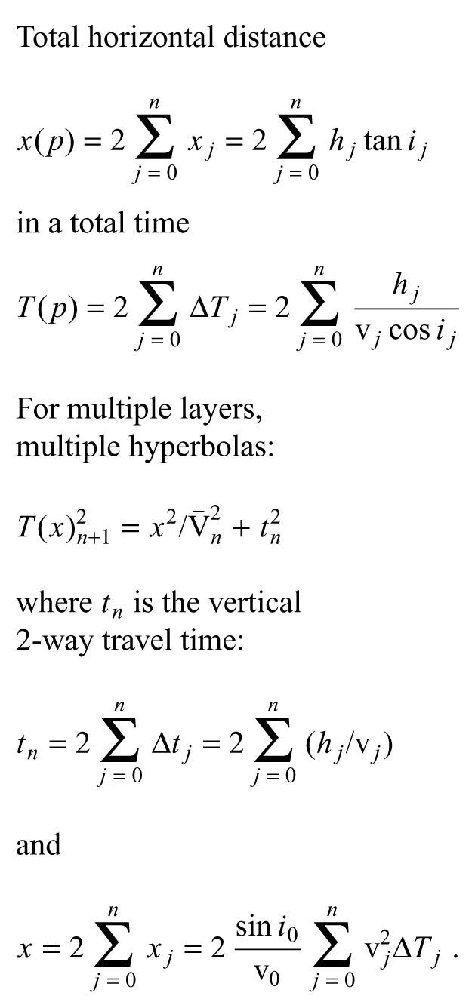
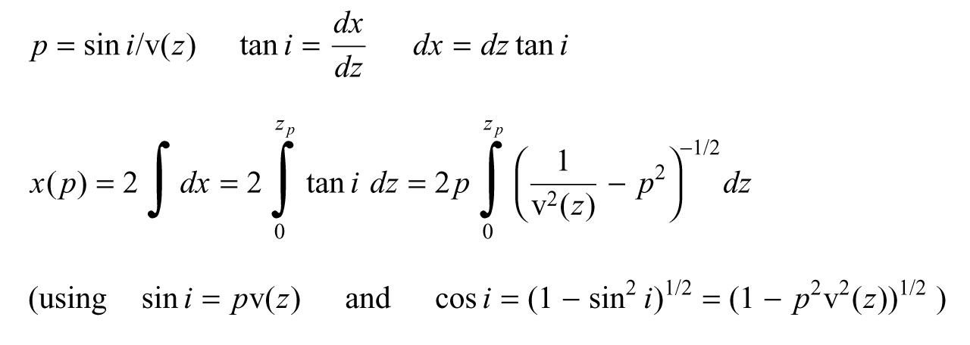

Slide 3
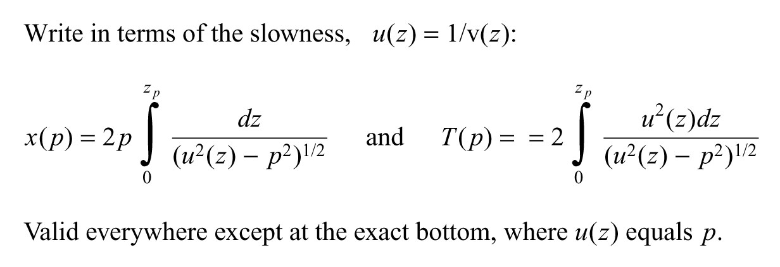

Slide 4
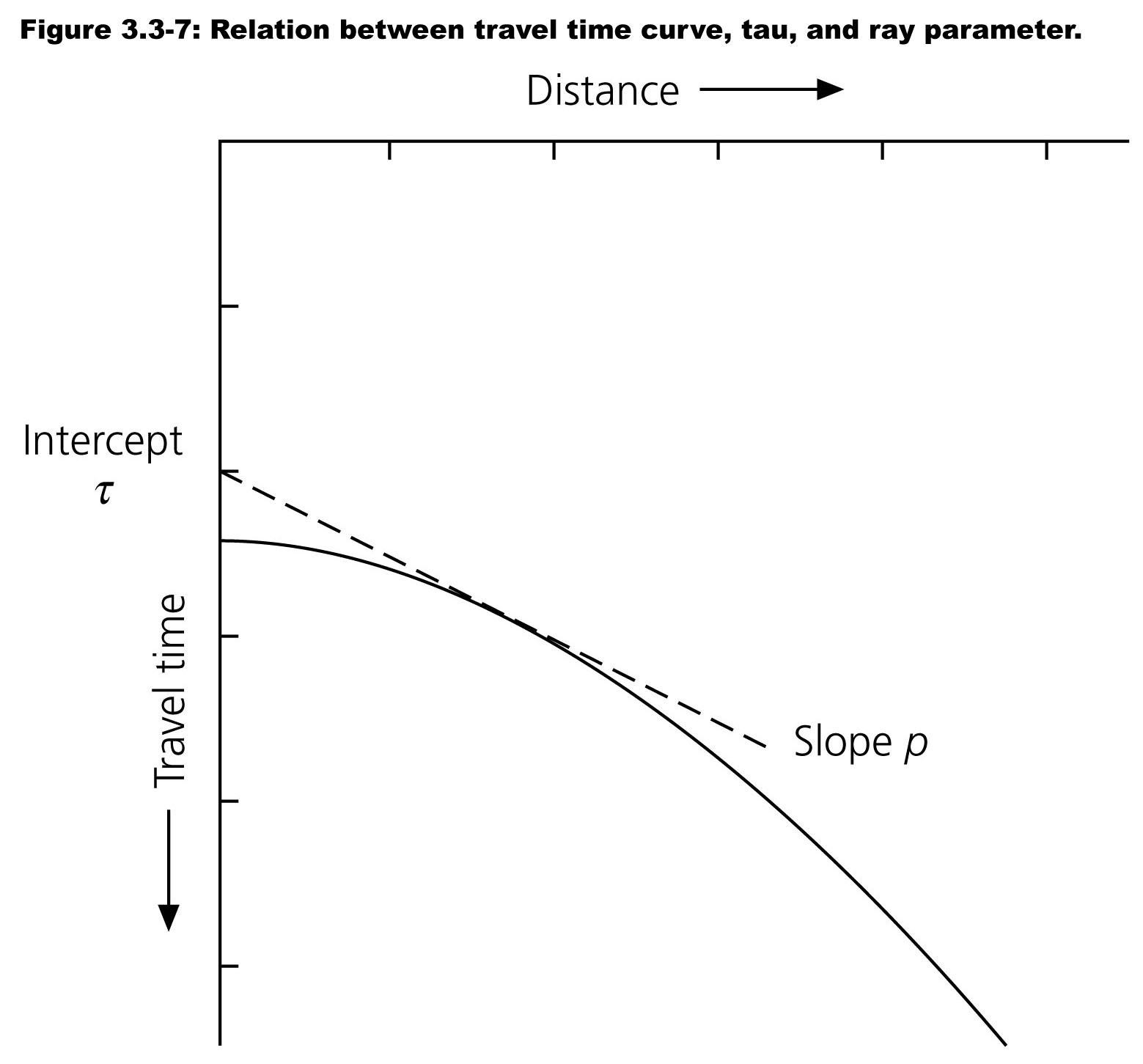
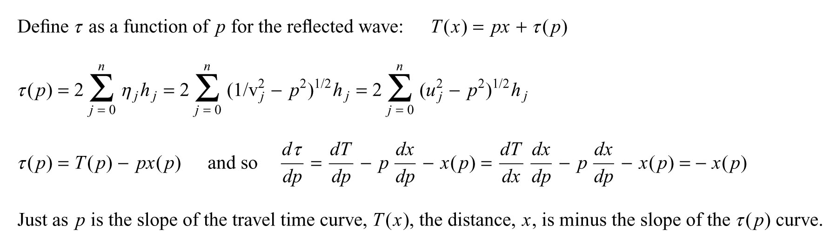
Relation between the travel time curve T(x) and the line tangential to a point on it, which has a slope, or slowness p, and a time axis intercept.
In general tau and p differ for differeent points on the travel time curve, so we can describe the curve by T and x, or tau and p.
Tau p is called the intercept slowness representation.

Slide 5
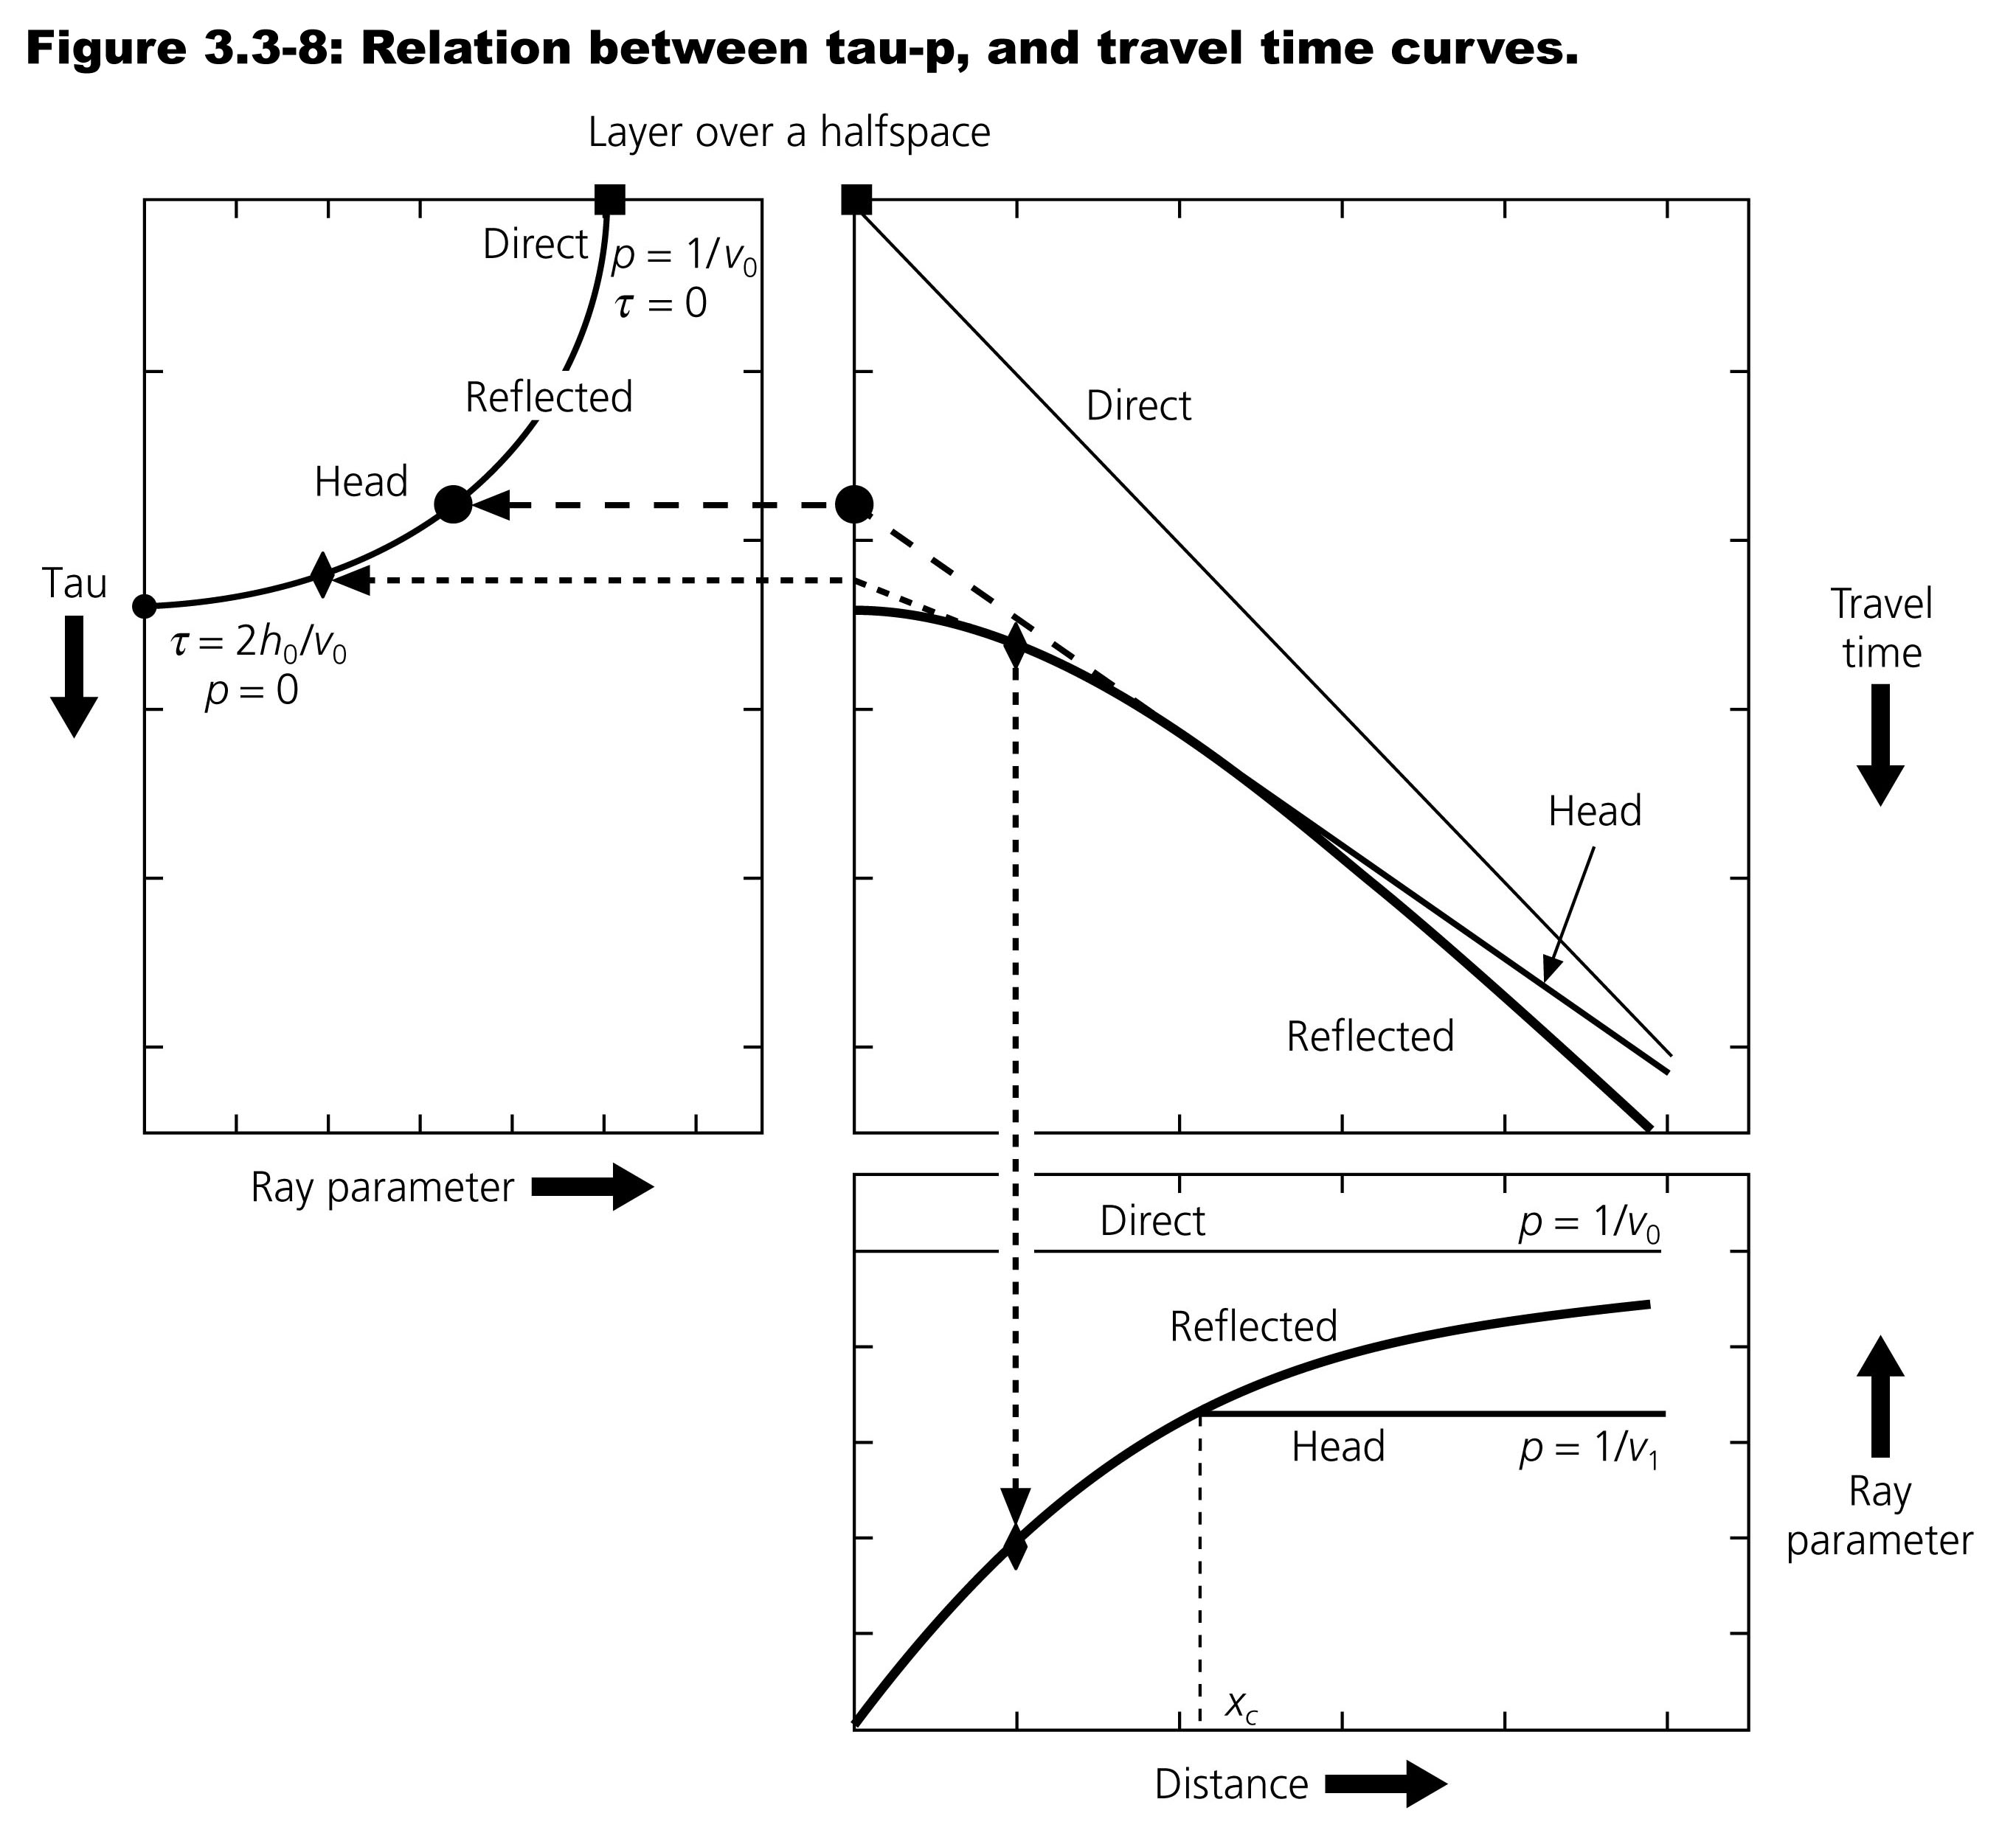
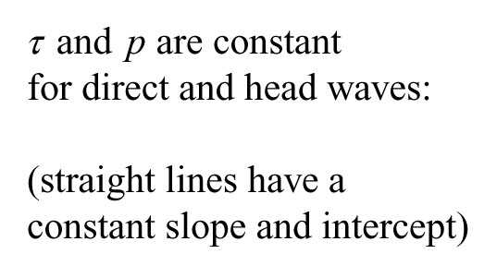
Travel time curves for T(x) for a layer over a half space and their representation in the tau p plane. Each point on the T(x) crve has a slope (ray parameter) p and intercept. The linear travel time curves for the direct an head waves each map into a point (square and circle) in the tau p plane. The hyperbolic travel time curve for the reflection maps into an ellipse in the tau p plane. Note how an arbritay point on the reflections travel time curve, marked by the diamond, maps into the other 2 curves.

Slide 6
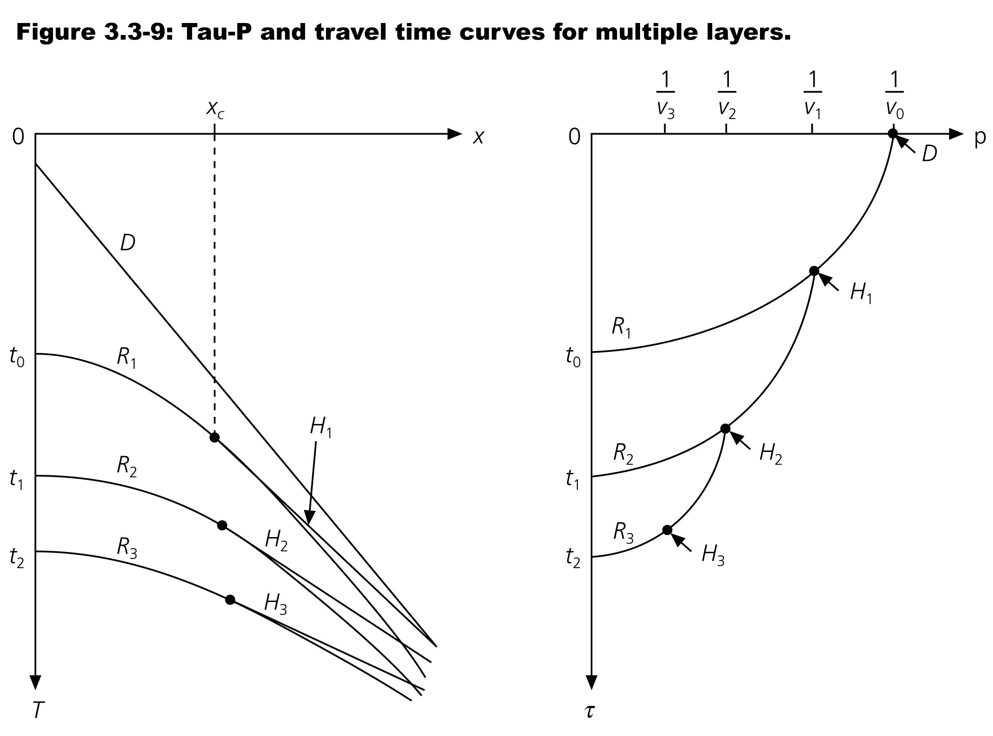

Slide 7
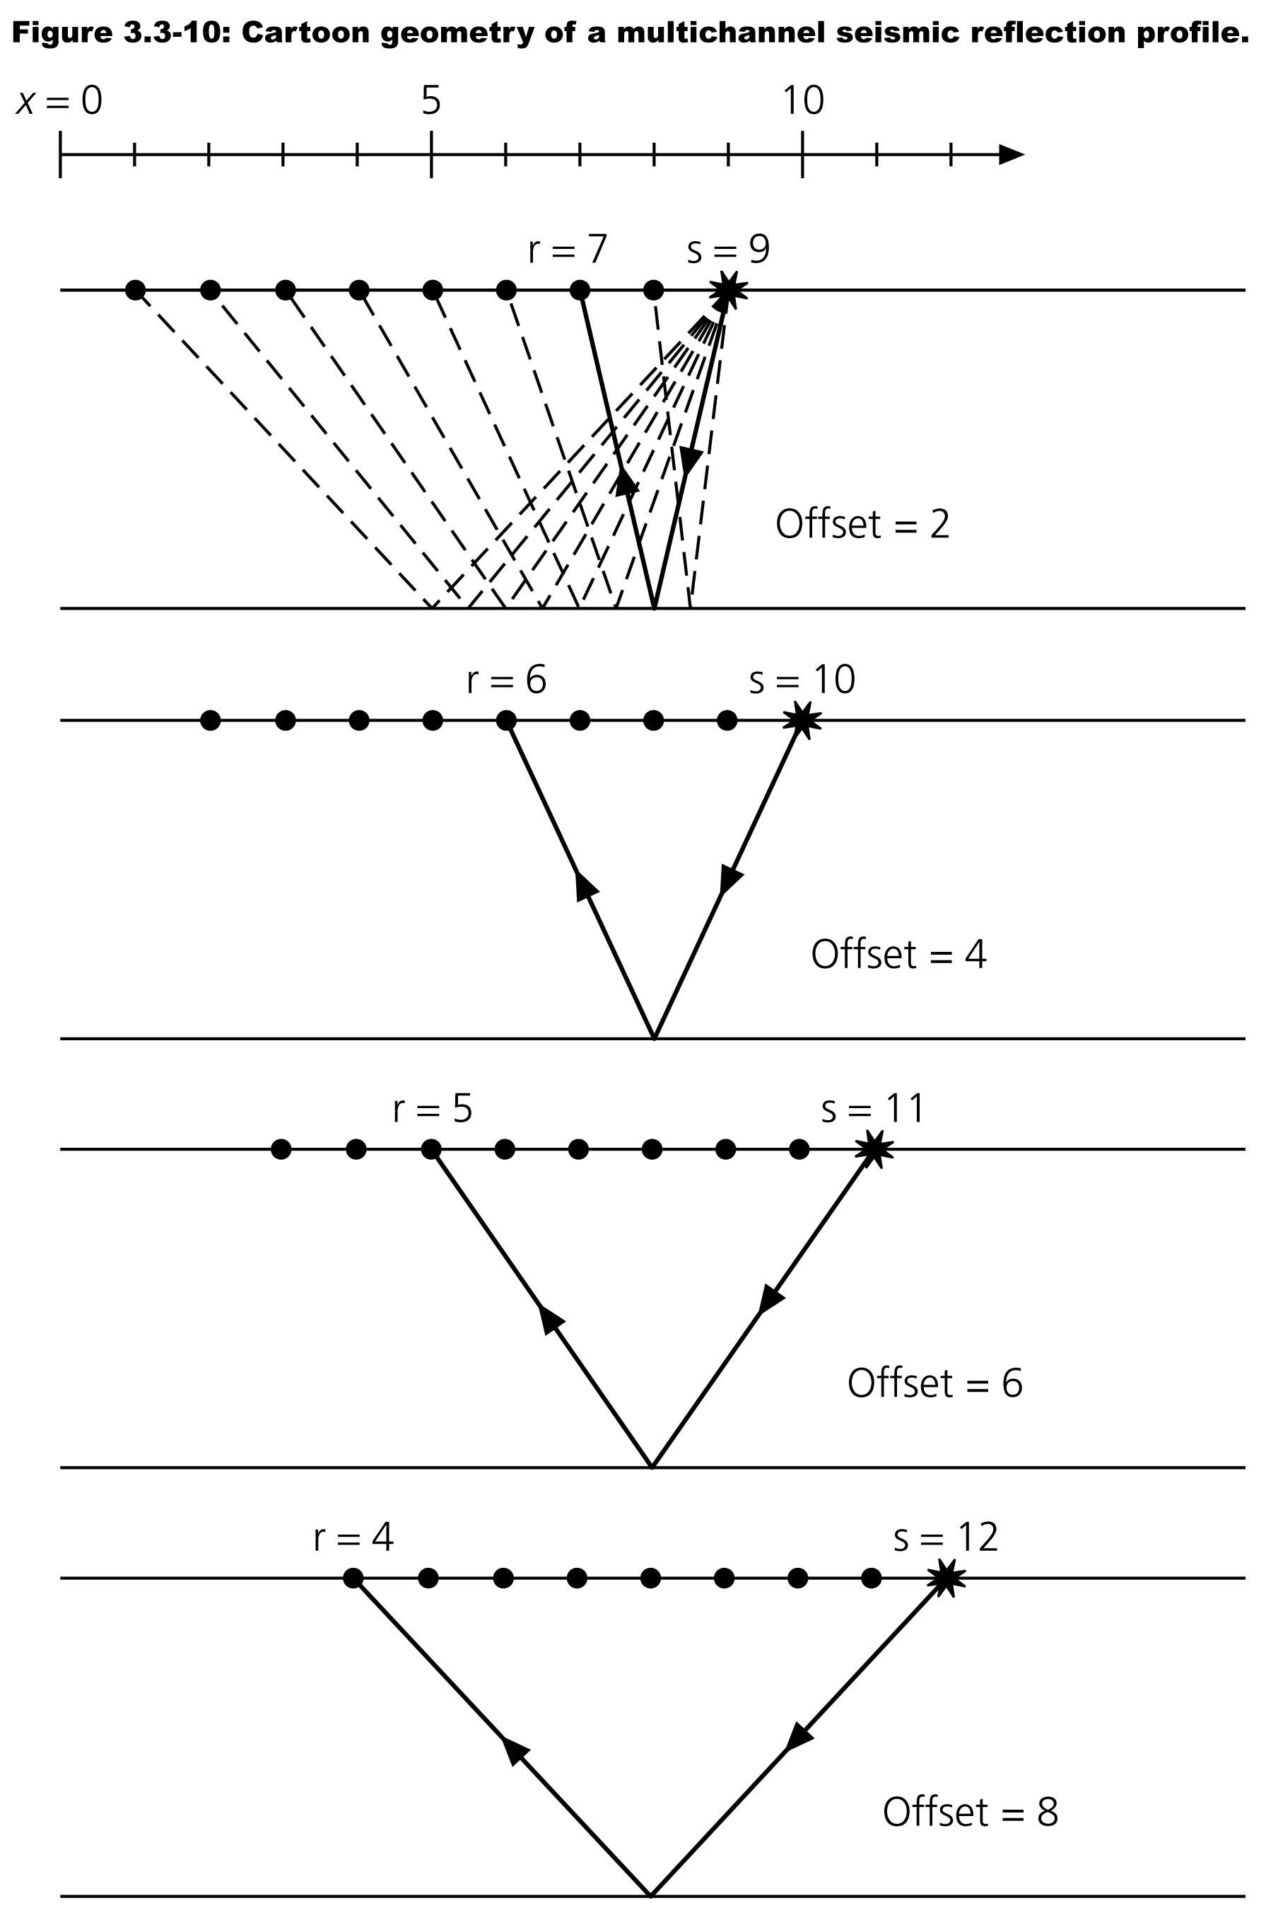

Slide 8
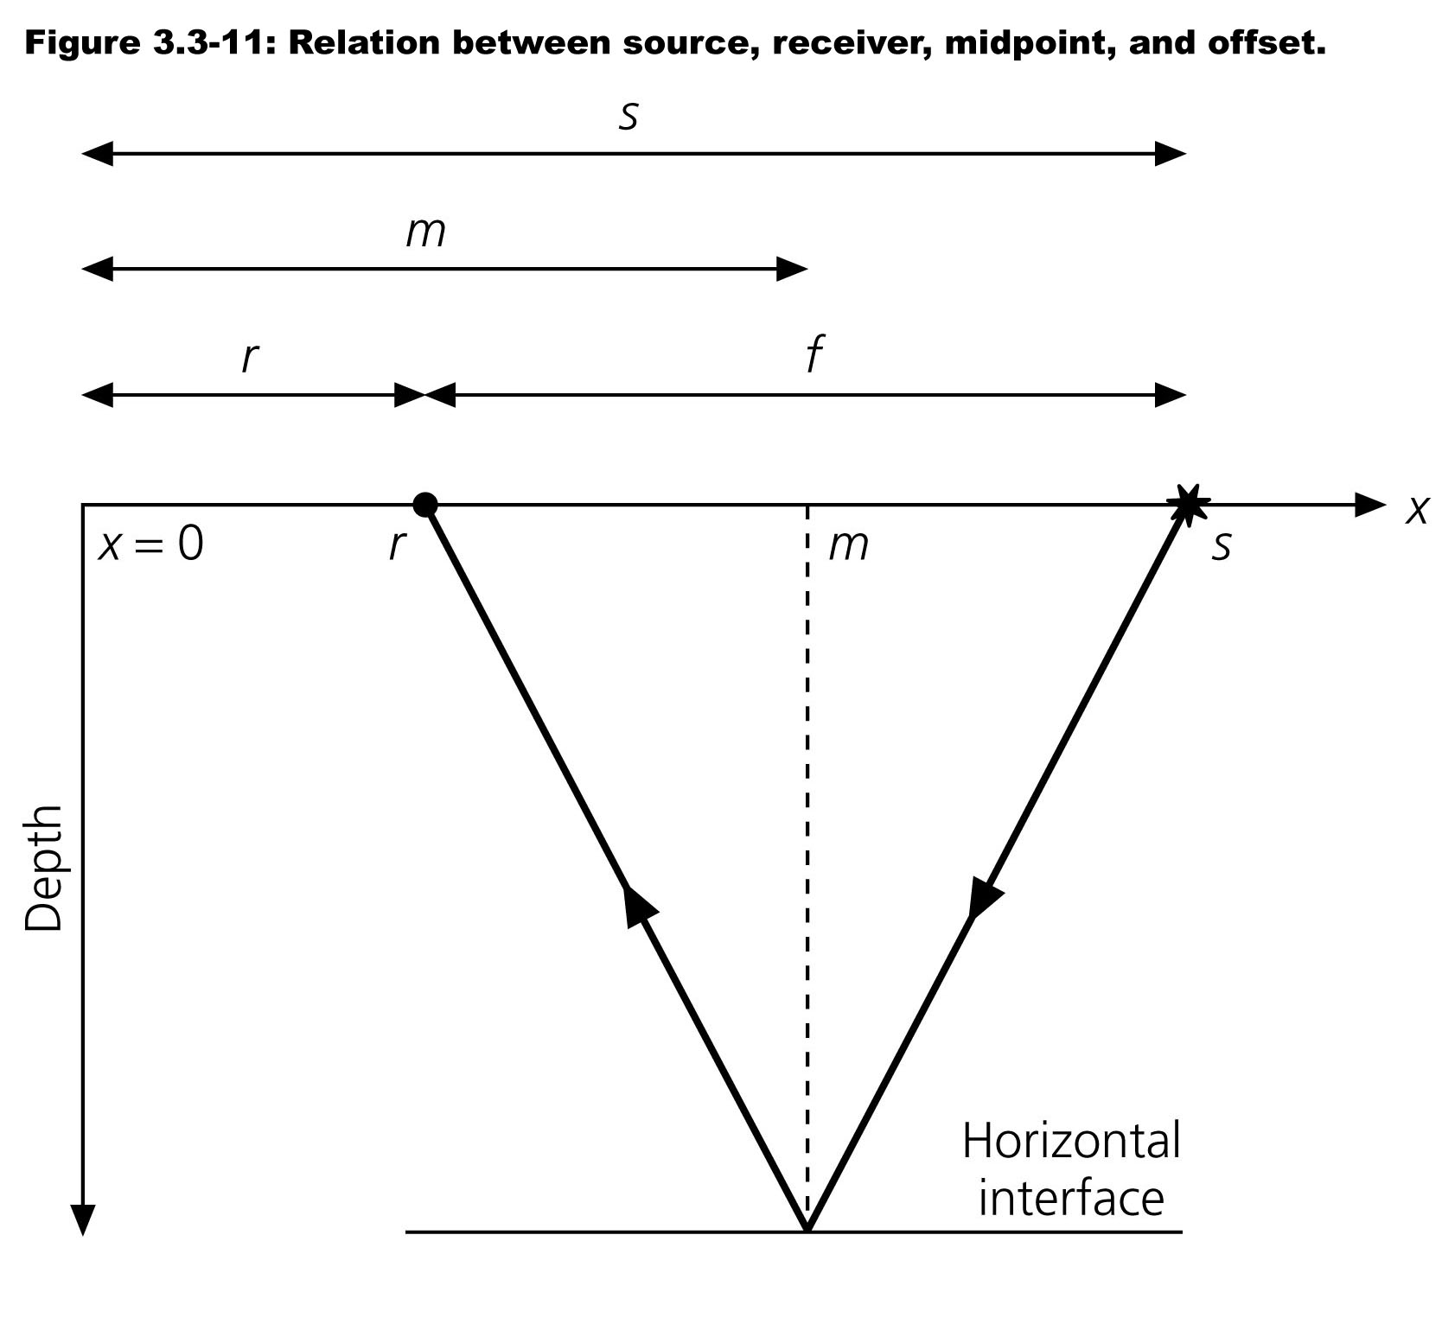

Slide 9
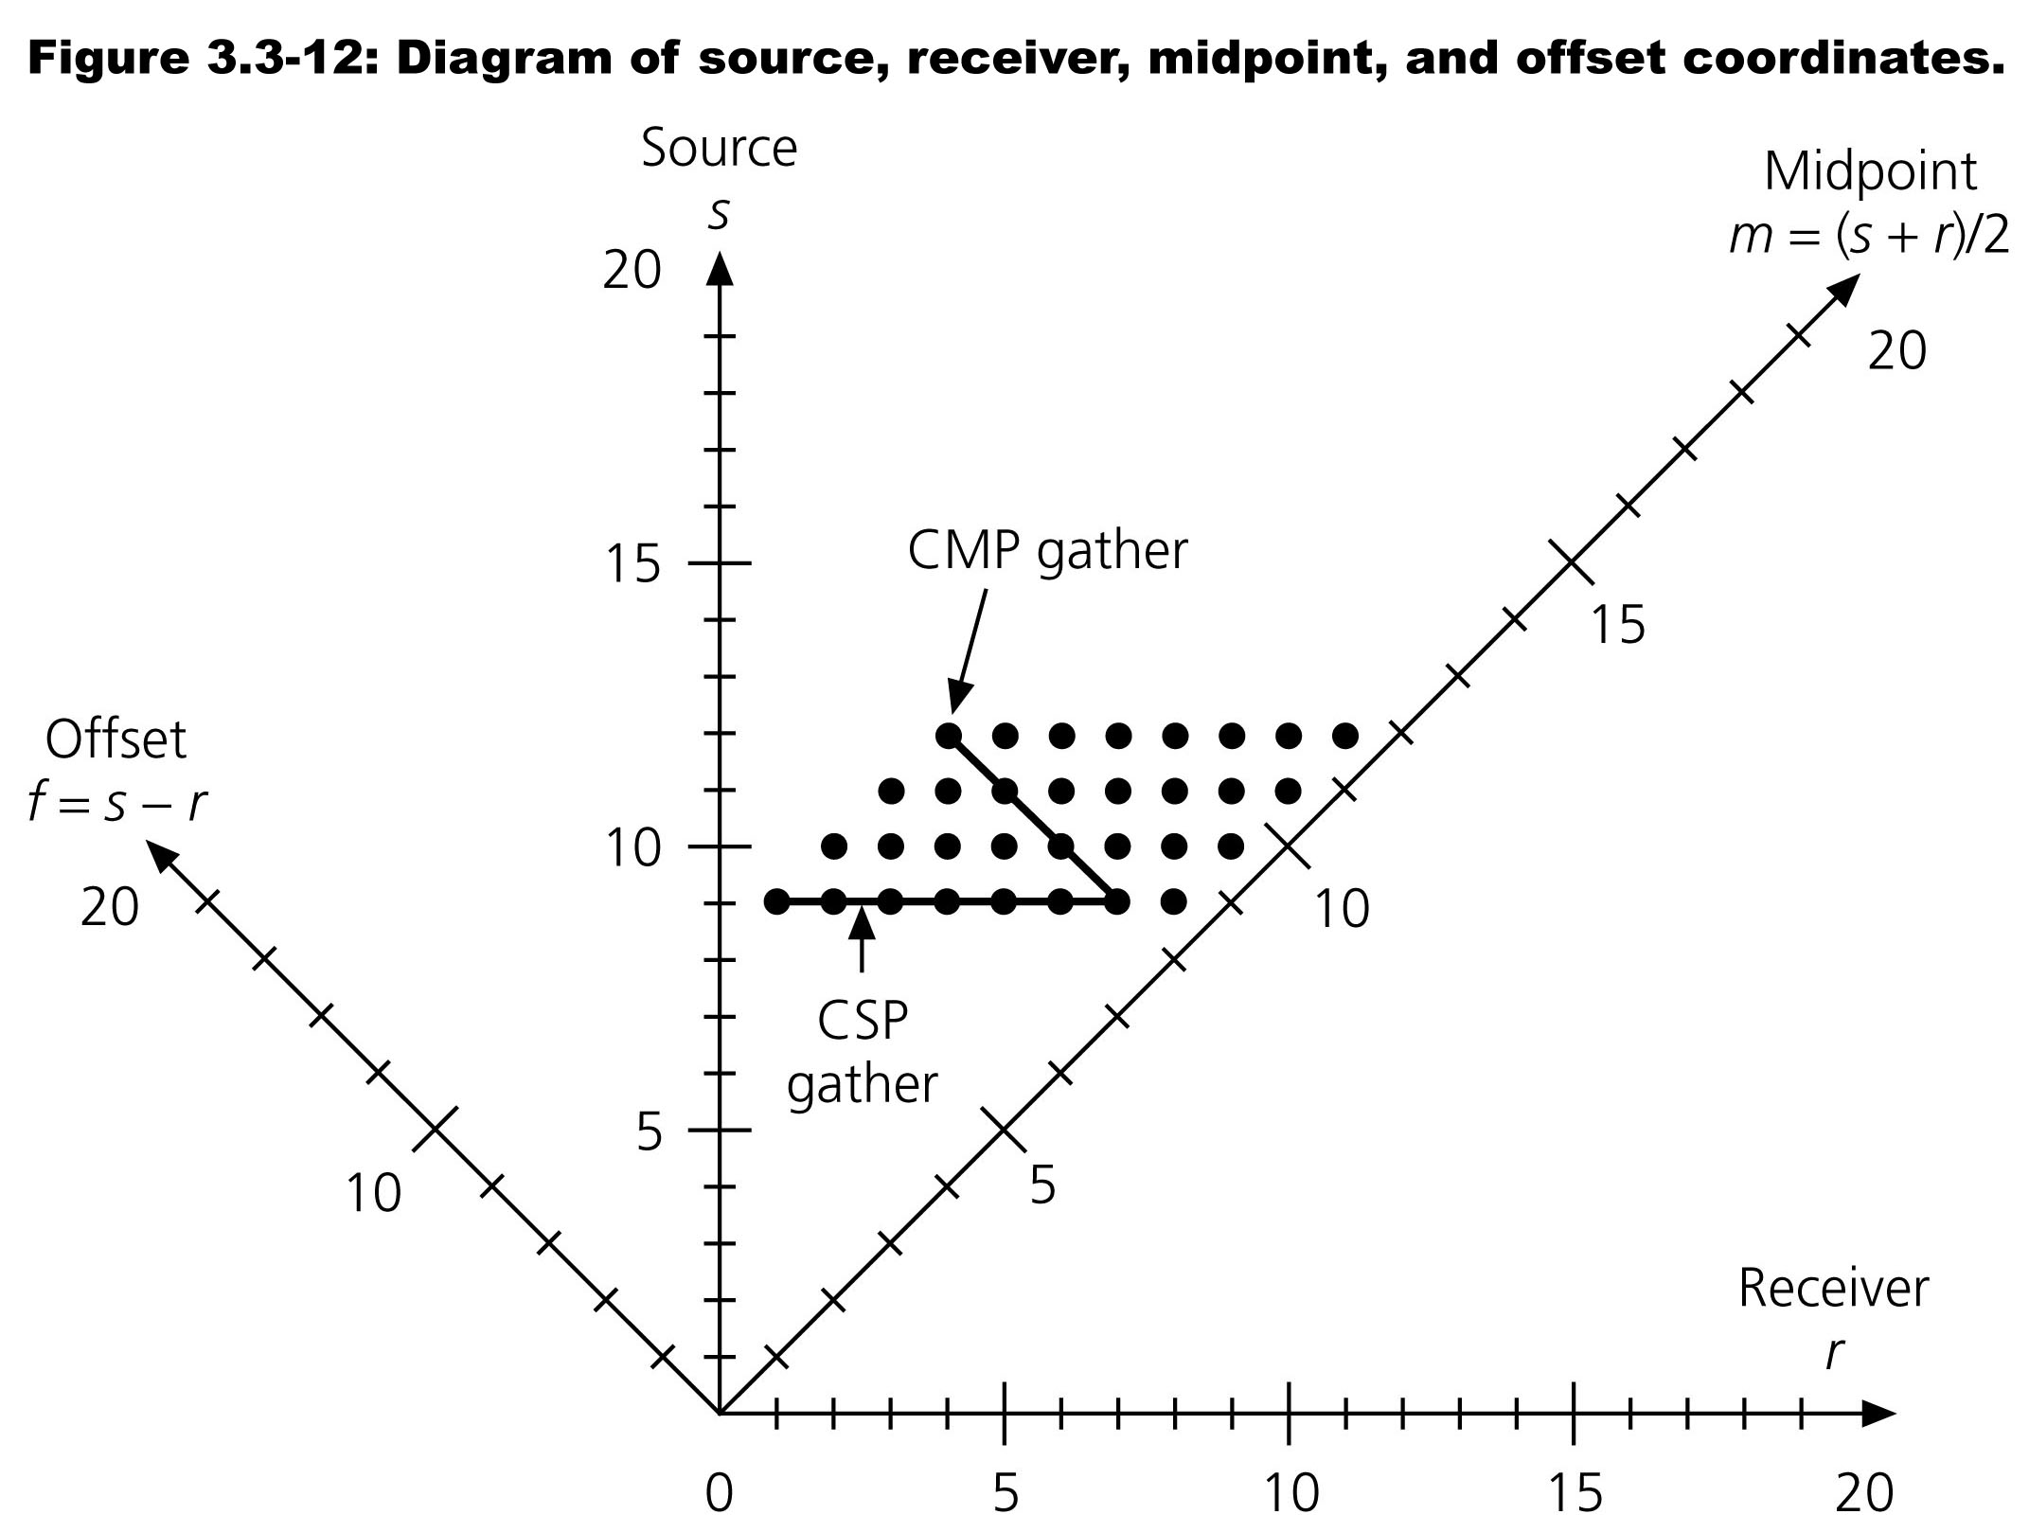

Slide 10
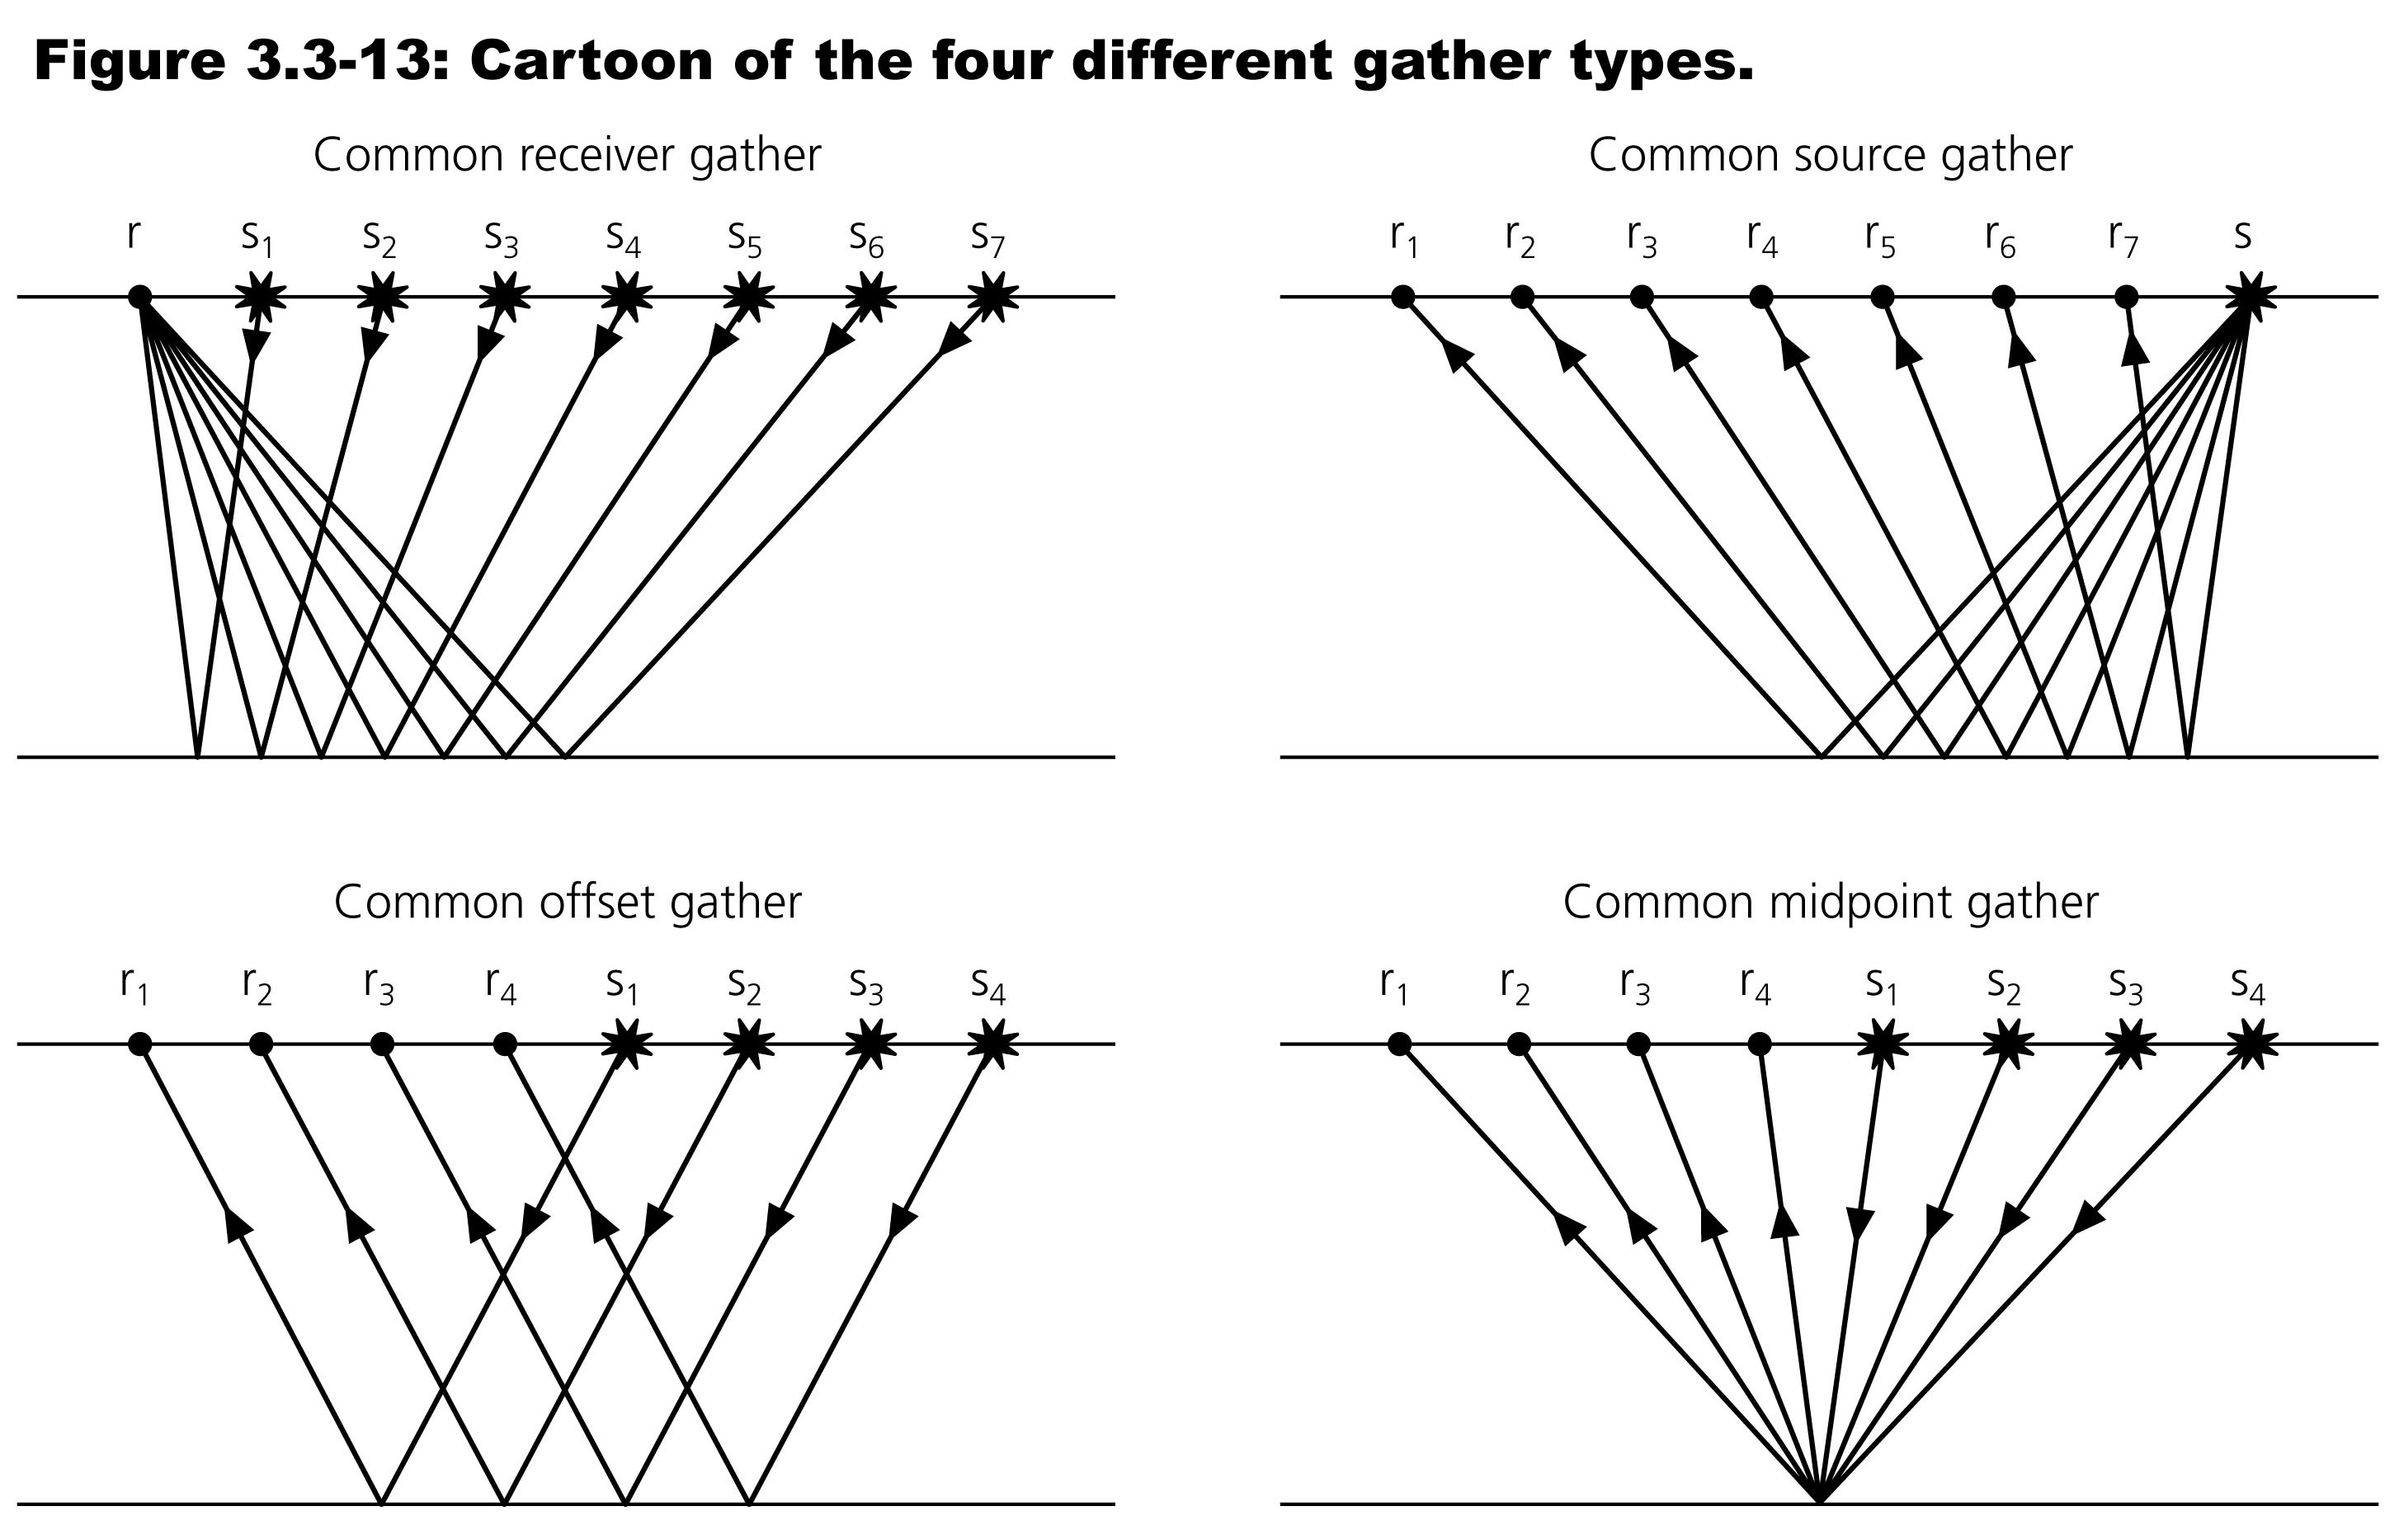

Slide 11
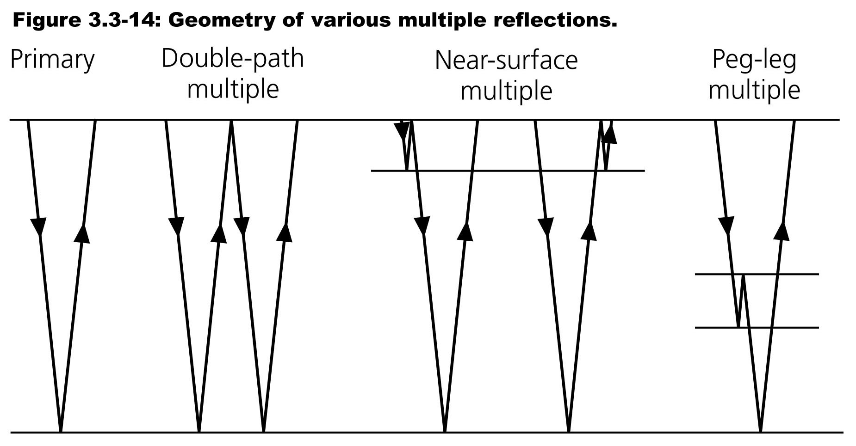

Slide 12
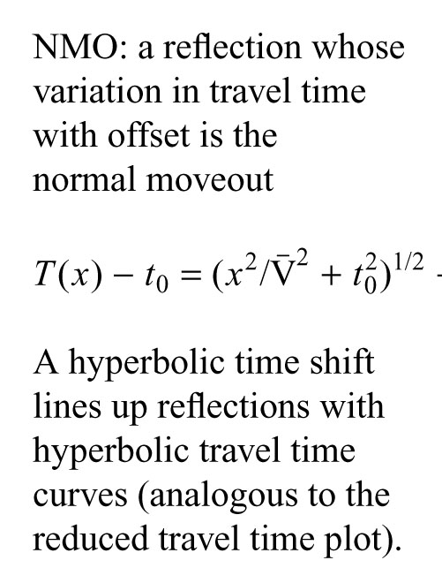
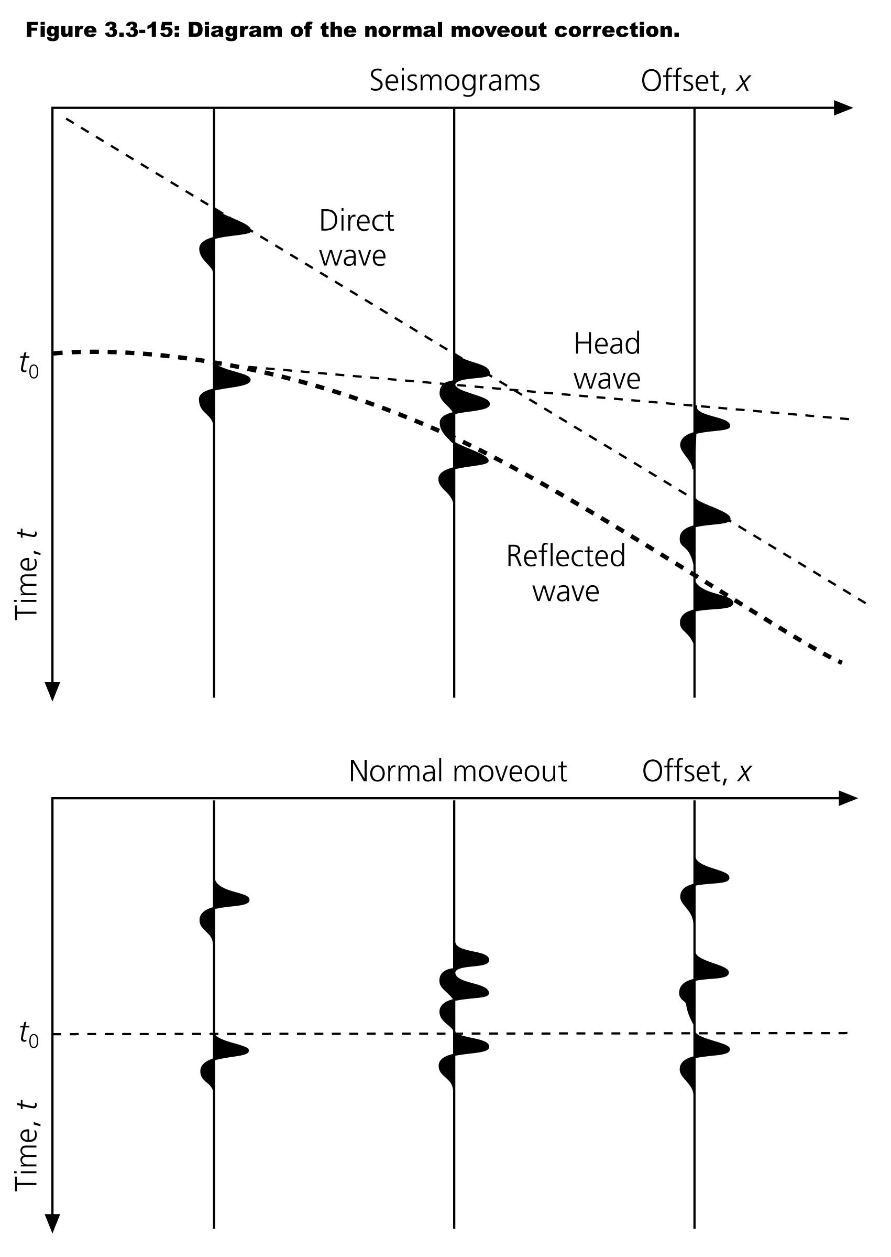

Slide 13
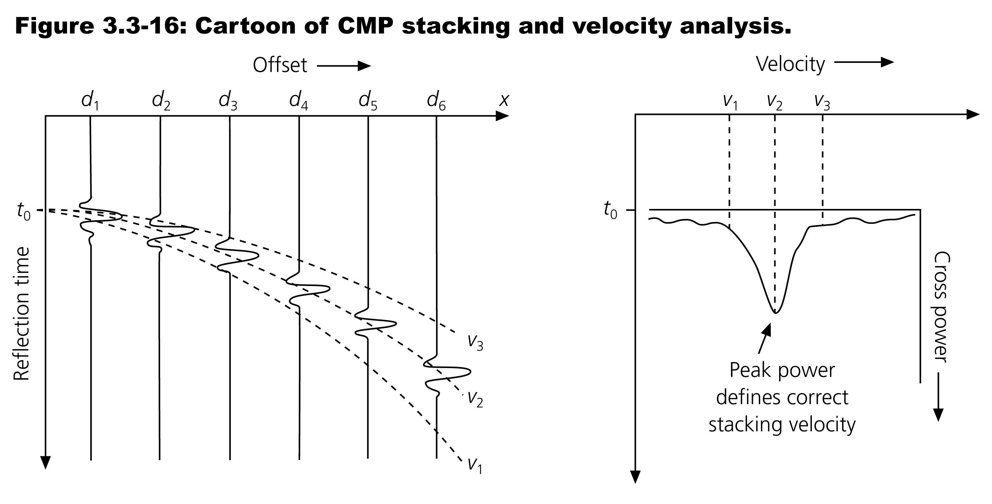

Slide 14
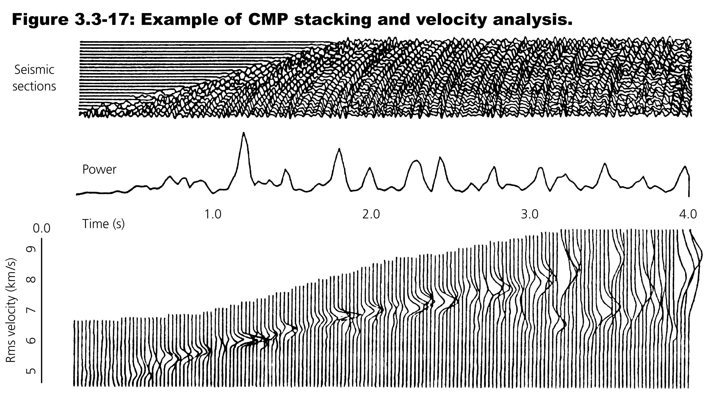

Slide 15
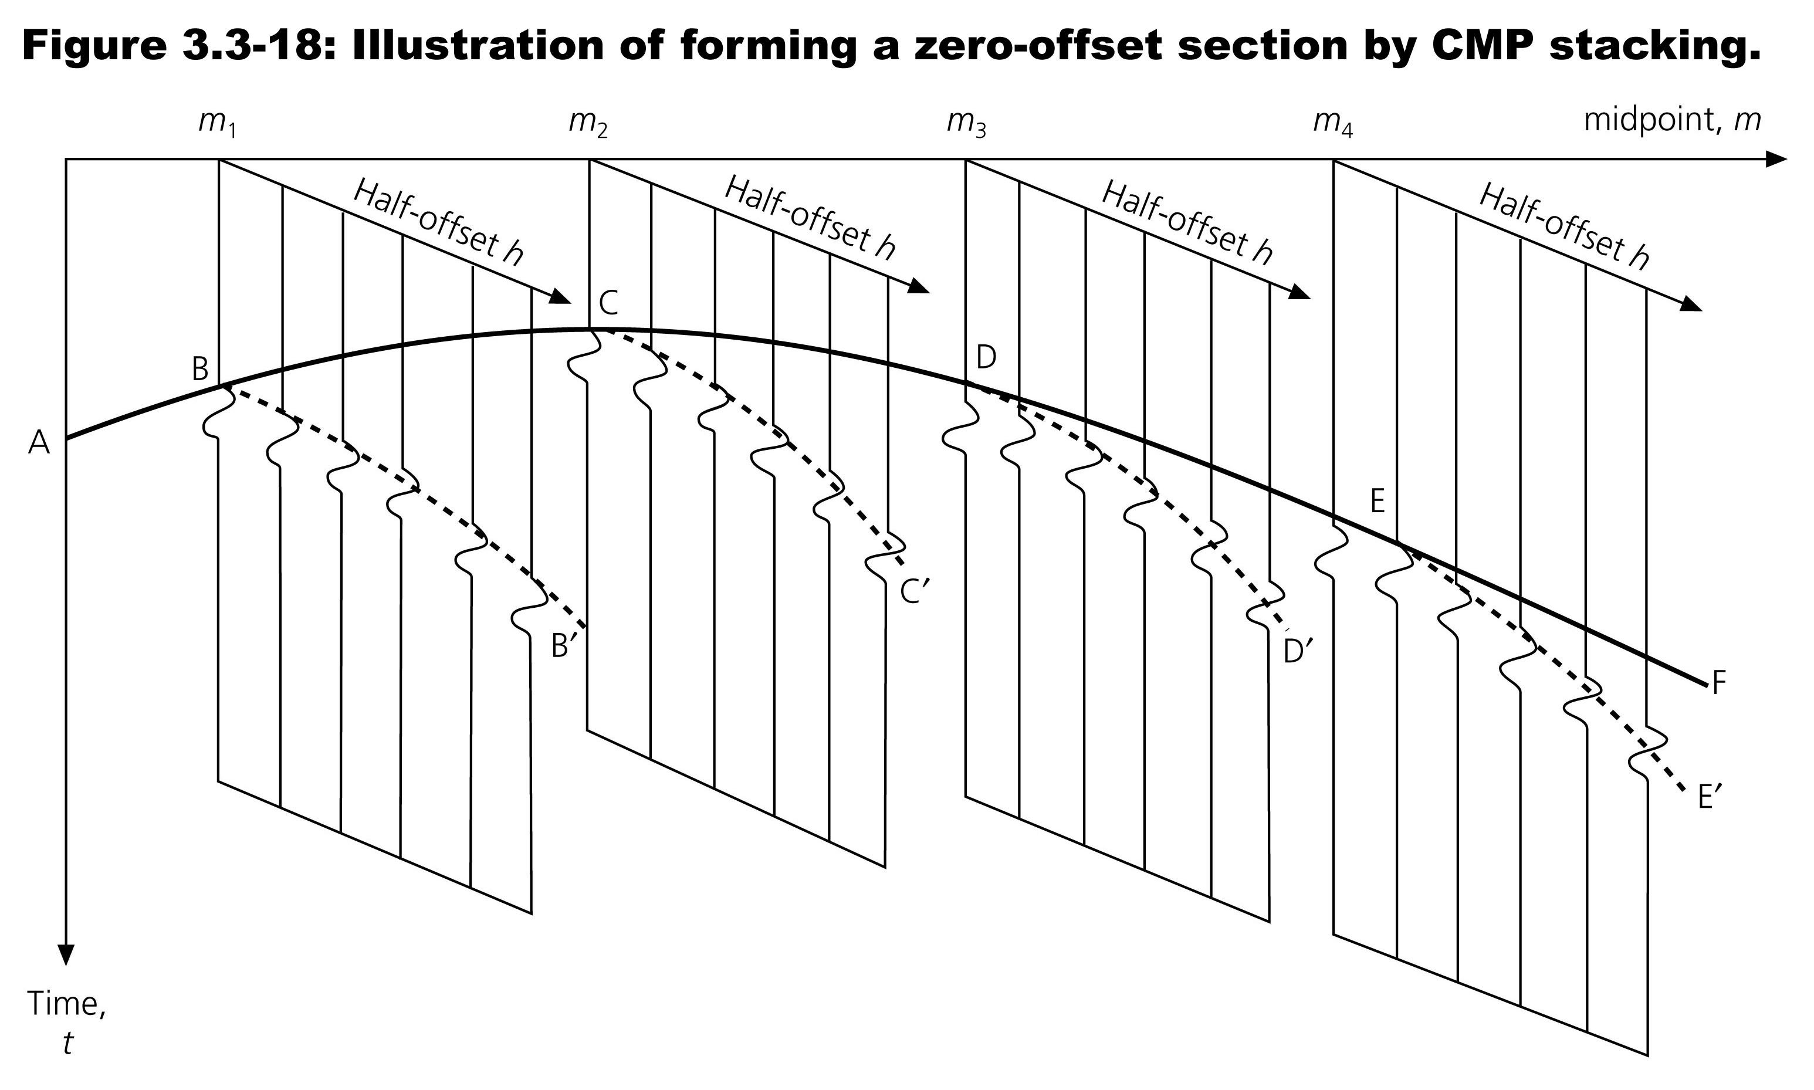

Slide 16
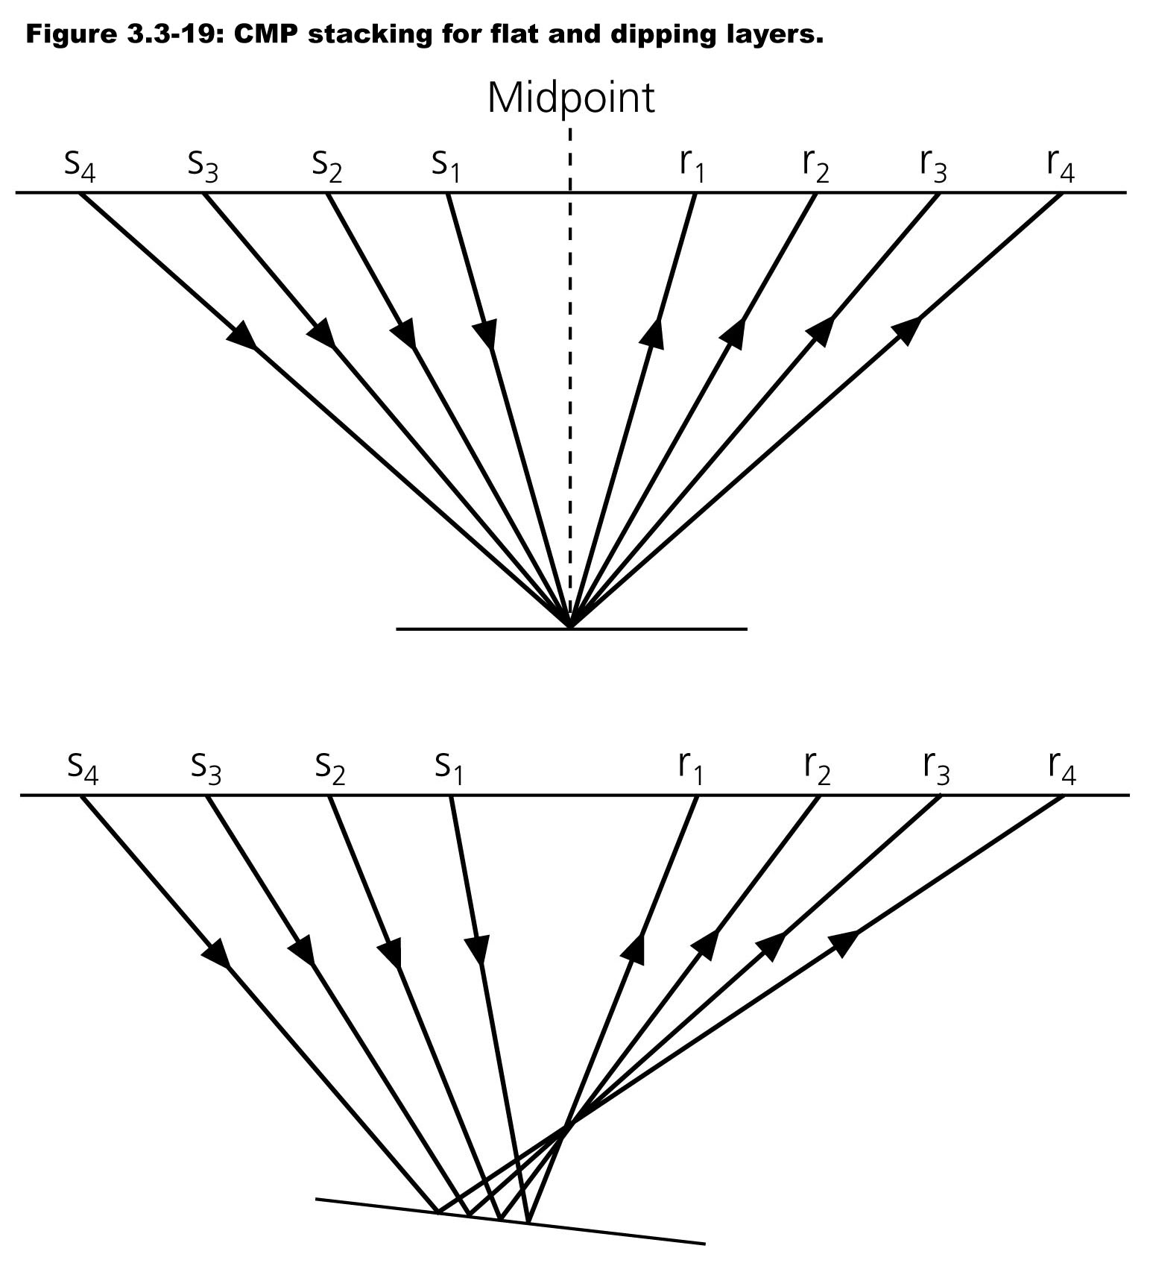

Slide 17
