Slide 1
CERI-8104 Data Analysis in Geophysics
Dr. Robert (Bob) Smalley
3892 Central Ave, Room 103
rsmalley@memphis.edu 678-4929
Fall 2023
Tu & Th 11:20 am -12:45 pm
Meeting 24 Tue. Nov 16, 2023
CERI New/Long Building: Student Computer Lab
Class webpage to be announced.
My homepage (has older versions of the course)
http://www.ceri.memphis.edu/people/smalley/

Slide 2
Solution to some of Anaconda Navigator mess
(lots and lots of packages installed, and lots of packages with radio boxes to install, jupyter stuff missing, etc.)
Run: conda clean -a
in the environment you want to clean up.

Slide 3
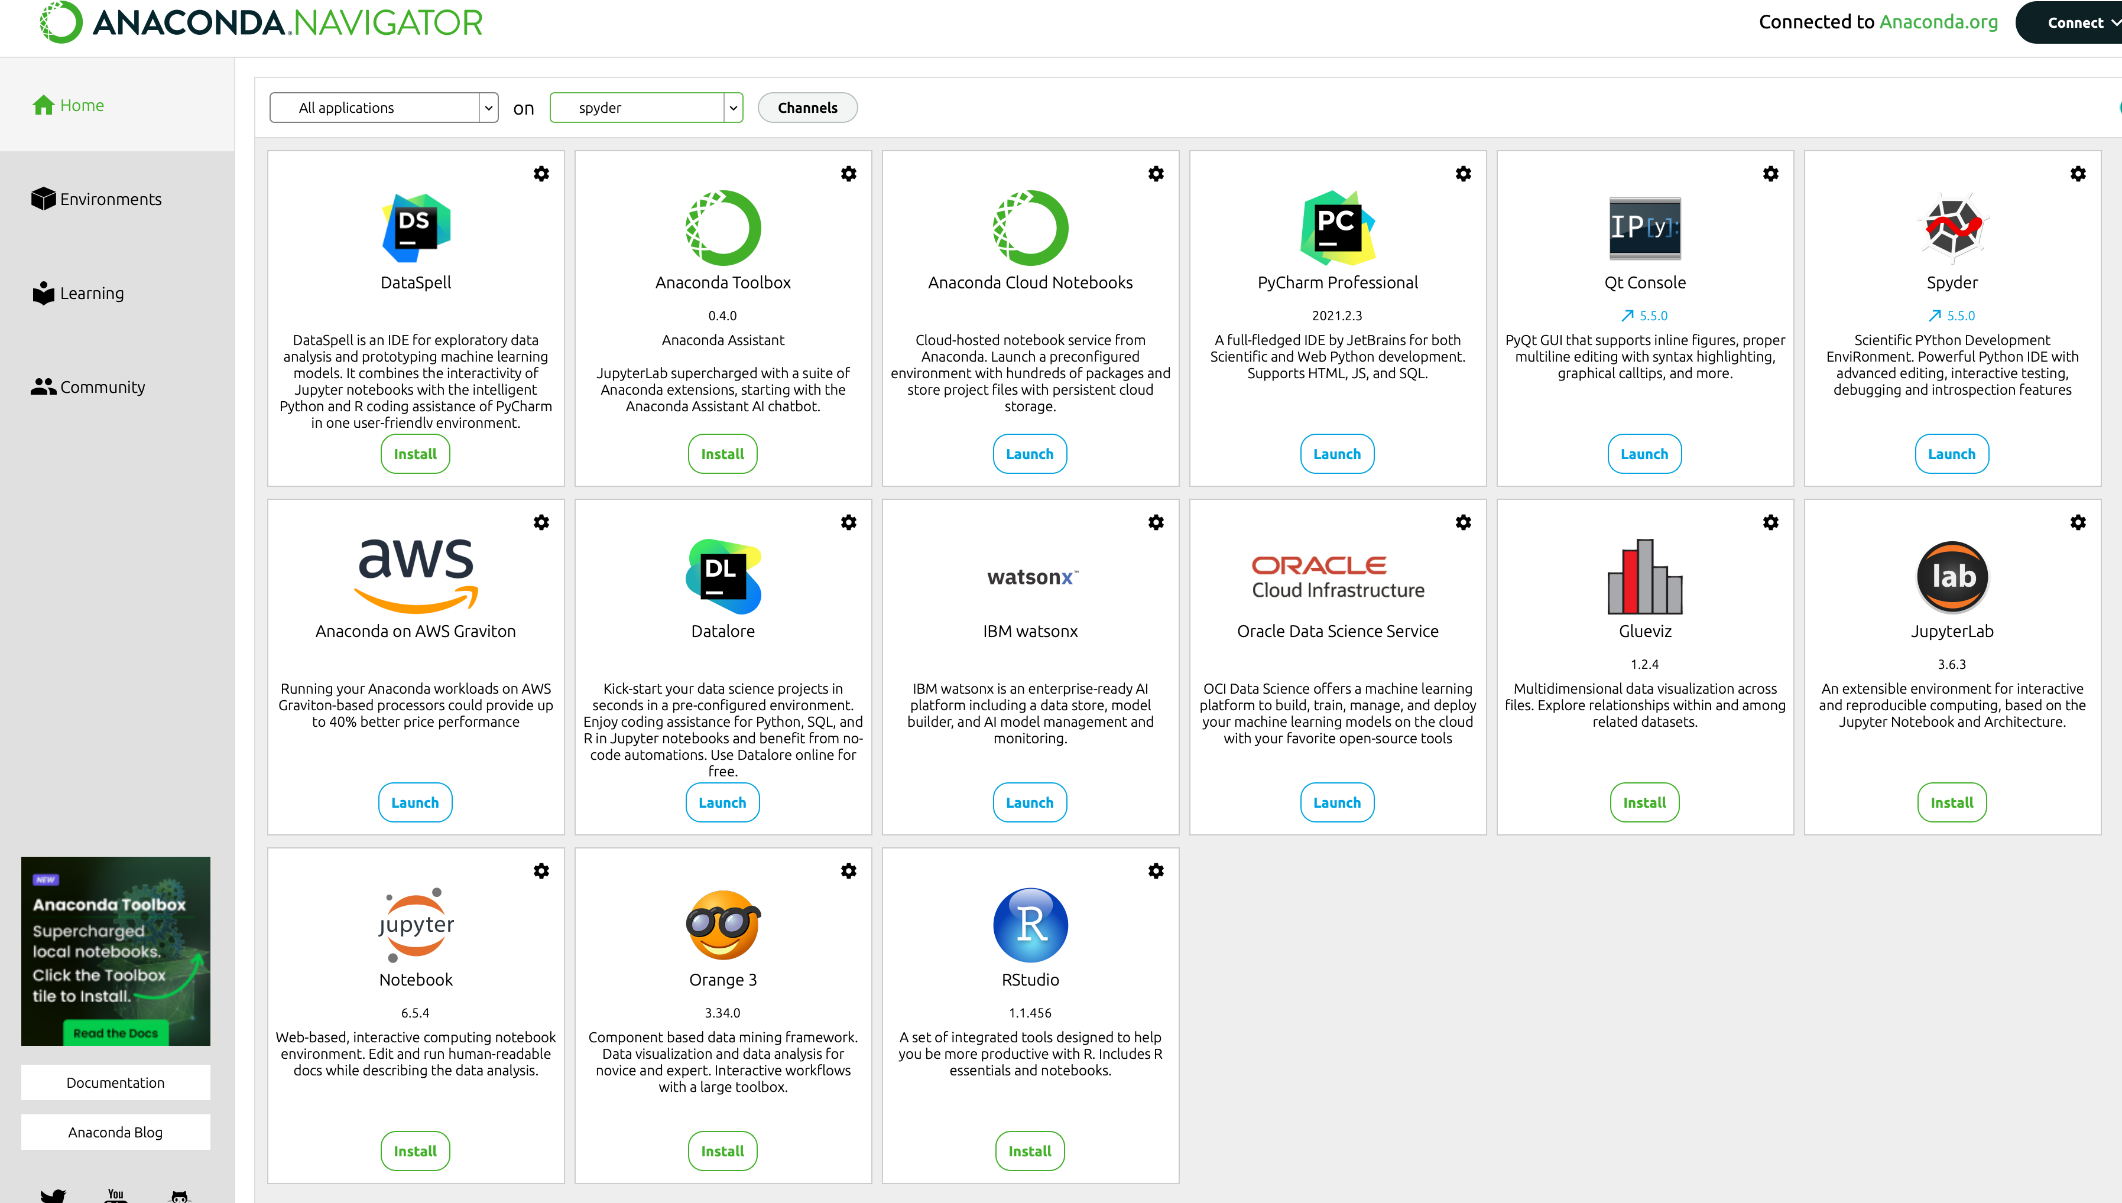
Anaconda Navigator now comes out like this.
And more good news, all new environments come out like this.
Notes:
If it has a radio button that says "Launch" it is installed.
If it has a radio button that says "Install" it is not installed yet, and you hit install (and wait) to install it.
As on your cell phone, there are a number you can't get rid of.

Slide 4
More info on Anaconda.
Anaconda is "old" and getting bloated.
That's why installations take so long, the dependencies are getting too long and complicated.
One has to follow recommendations, such as installing packages in their own environments rather than base.

Slide 5
More info on Anaconda.
One sometimes has to experiment to get things to work, eg.:
If you follow the web instructions to create an environment for pygmt and install pygmt in one step, you will get an environment without spyder, jupyter, etc.
When you go to install spyder (it is offered in Anaconda Navigator) it spends 30 minutes and finally tells you it is incompatible and cannot be installed.

Slide 6
More info on Anaconda.
The solution is to make the environment (you can call it pygmt as the name can be anything you want and calling it pygmt is useful to tell you the package associated with the environment).
If you had previously done the conda clean -a command, it will build future environments "clean".
It will not automatically install spyder and jupyter but will have them available to install.
Anaconda Navigator will look something like the next slide.

Slide 7
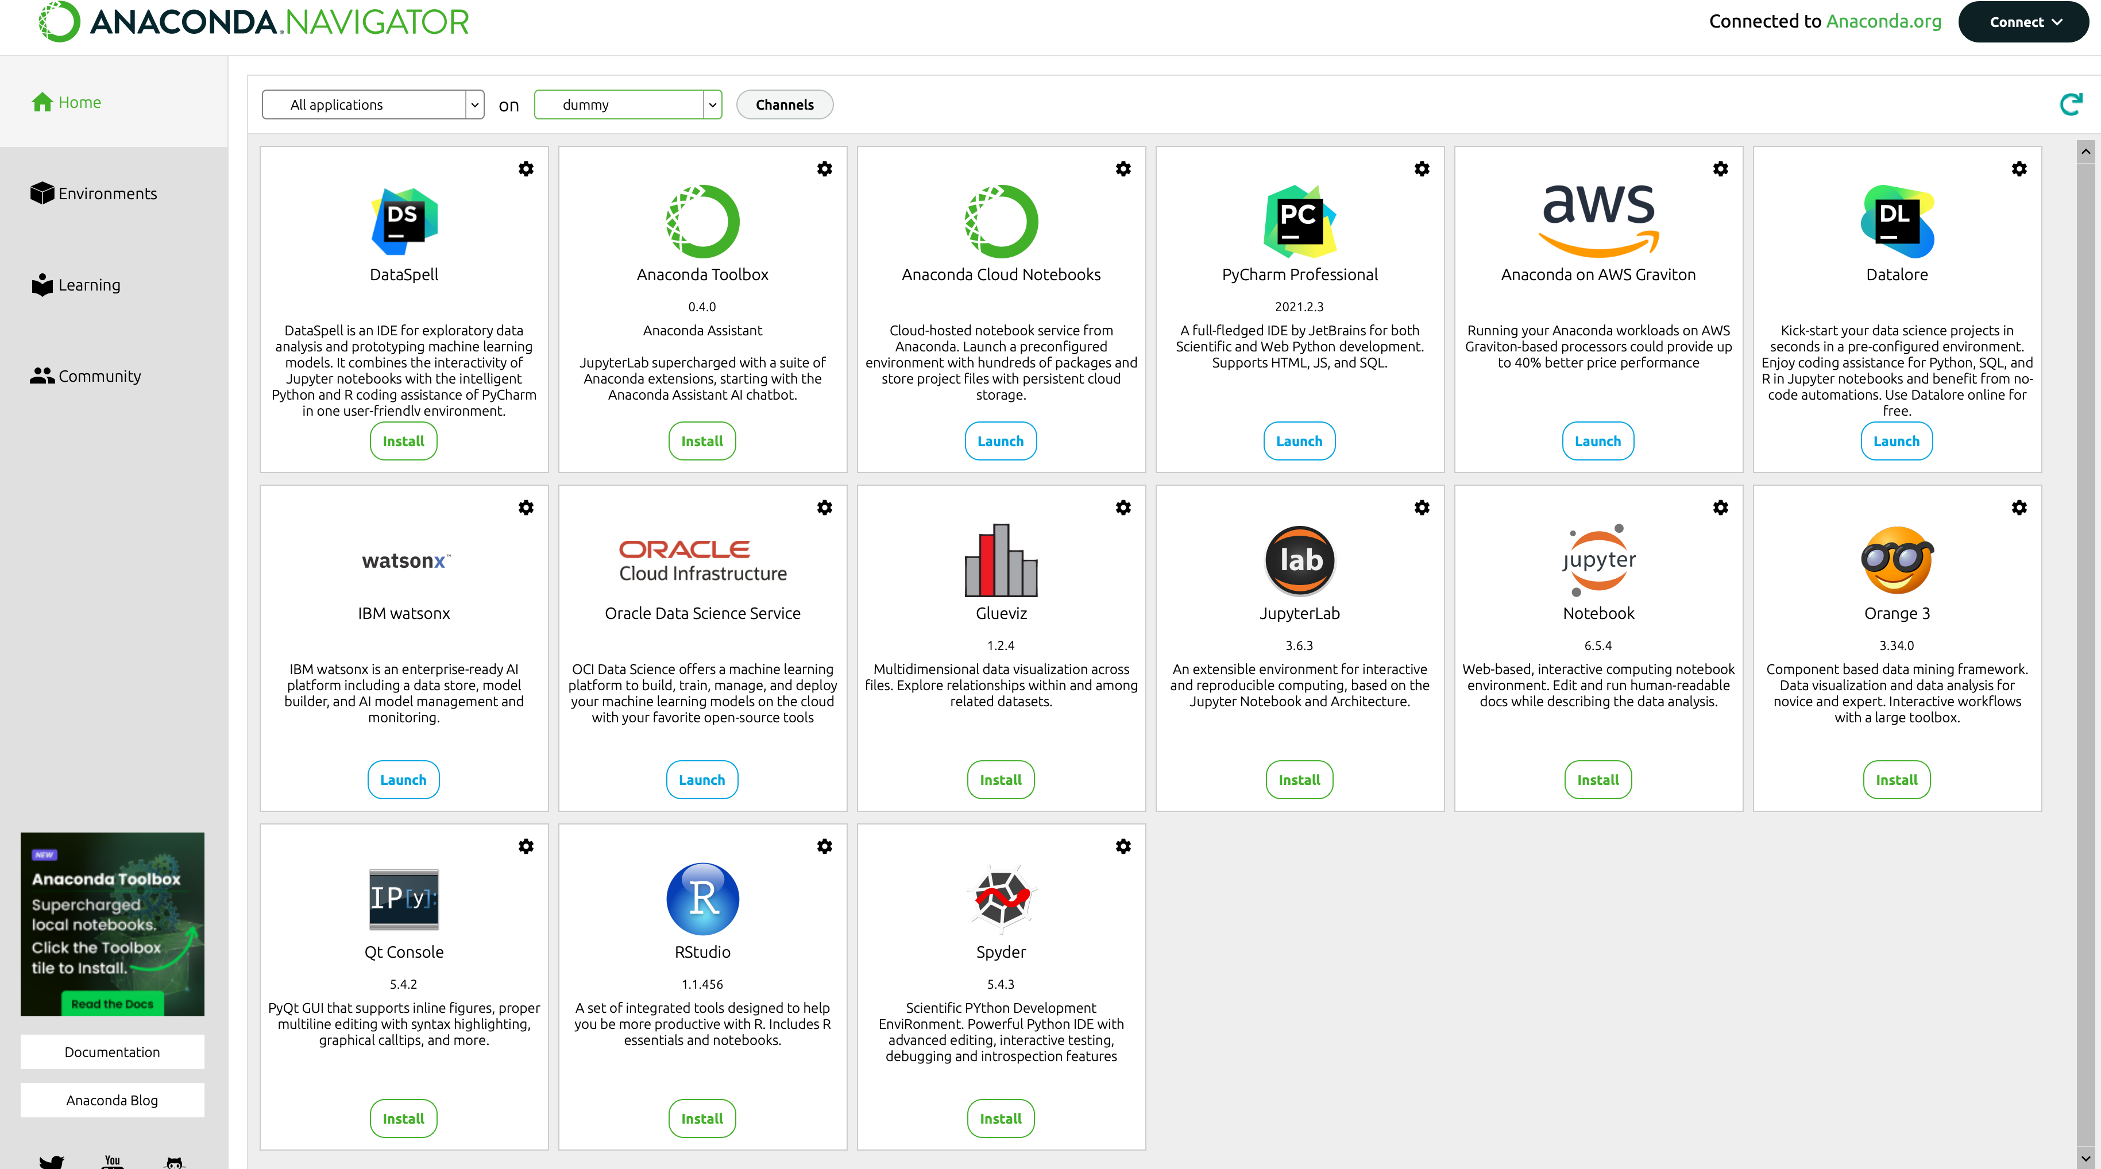
Offers packages to install, reasonable # of packages

Slide 8
More info on Anaconda.
Next install spyder and jupyter by clicking the radio buttons.
When that is done install pygmt.
You can do this by starting spyder (launch radio button) and typing
conda create --name pygmt
in the "console" (bottom right box where you can enter commands to be executed immediately)
Alternately you can activate the pygmt environment in a terminal and enter the conda create --name pygmt command there.

Slide 9
More info on Anaconda.
If you try to install pygmt in the same environment as obspy it breaks the environment.
The only solution I could find was to delete the obspy environment and remake it with just obspy (and Spyder and Jupyter)
And then do the same for pygmt.

Slide 10
The pygmt web page
installing pygmt
Has instructions on how to install pygmt under
Conda/Anaconda
BUT
It also has instructions on how to install it under another environment management tool –
Mamba.

Slide 11
AND it recommends using mamba as it is more stable and faster as it is not bloated like conda/anaconda.
(But mamba will get bloated by the time it is the same age. One of the reasons it is stable and faster is that is does not support as many packages and their dependencies, etc.)
The problem with this solution is that while environments are little walled off castles, environment managers are not, and conda and mamba conflict with one another.
So, you should only run one of them (they will sorta run together, but you will have random problems).

Slide 12
PyGMT requires Generic Mapping Tools (GMT) >=6.3.0 since there are many changes being made to GMT itself in response to the development of PyGMT, mainly the new modern execution mode.
Compiled conda packages of GMT for Linux, macOS and Windows are provided through conda-forge.
Advanced/masochist users can also build GMT from source instead.

Slide 13
PyGMT requires the following libraries to be installed:
numpy (>= 1.22)
pandas
xarray
netCDF4
Packaging
They are installed automatically when you run the command to install pygmt

Slide 14
First example from
global land-and-water map
import pygmt
fig = pygmt.Figure()
# Make a global Mollweide map with automatic ticks
fig.basemap(region="g", projection="W15c", frame=True)
# Plot the land as light gray, and the water as sky blue
fig.coast(land="#666666", water="skyblue")
fig.show()
pygmt is "Modern Mode" only.

Slide 15
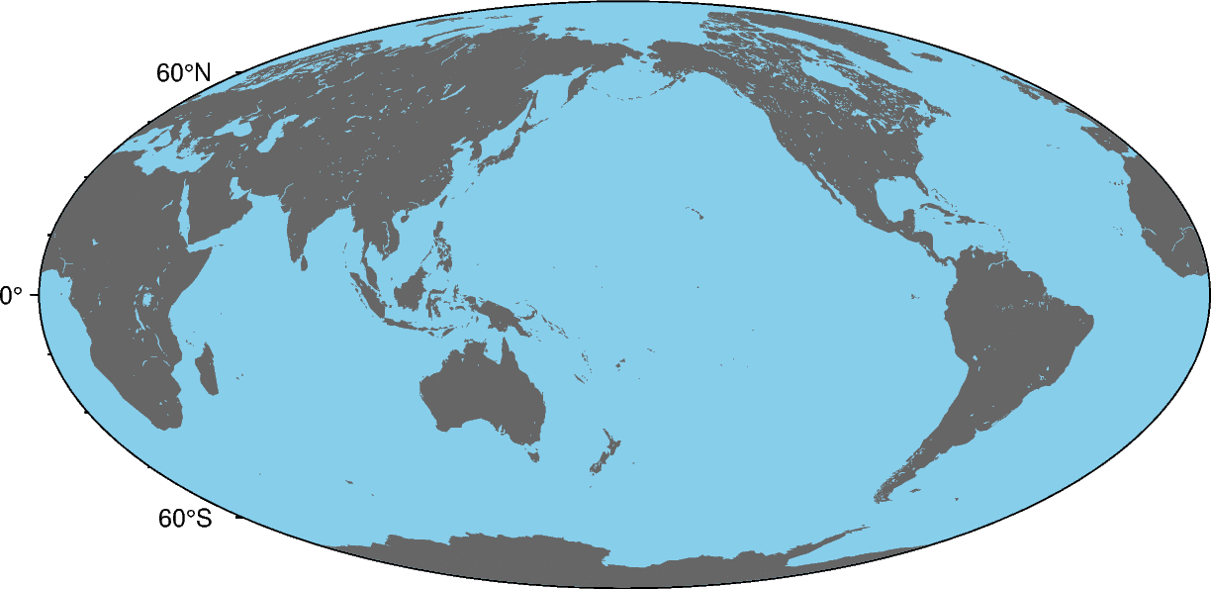
4 lines of code on previous page produces this plot

Slide 16
All the ways to do colors in GMT
Explanation of color codes in GMT
Colors can be specified in GMT as arguments to commands, generally as part of the -G or -W options to select polygon fill or outline pen.
Colors are also used in color palette tables (CPTs) that help convert numerical values to color.

Slide 17
gmtcolors
GMT allows several ways to represent a color:
Colorname
Specify colors by name.
All names are case-insensitive.

Slide 18
GMT can use 663 unique color names defined in this table.
file:///Users/smalley/Downloads/GMT_RGBchart.pdf
The following list contains the named colors that can be used in GMT and their equivalent color codes.
Also under
gmt misc
R/G/B | Color Name | R/G/B | Color Name | R/G/B | Color Name
255/250/250 | snow | 248/248/255 | ghostwhite | 255/250/240 | floralwhite
255/245/238 | seashell | 253/245/230 | oldlace | 250/240/230 | linen
250/235/215 | antiquewhite | 255/239/213 | papayawhip | 255/235/205 | blanchedalmond

Slide 19
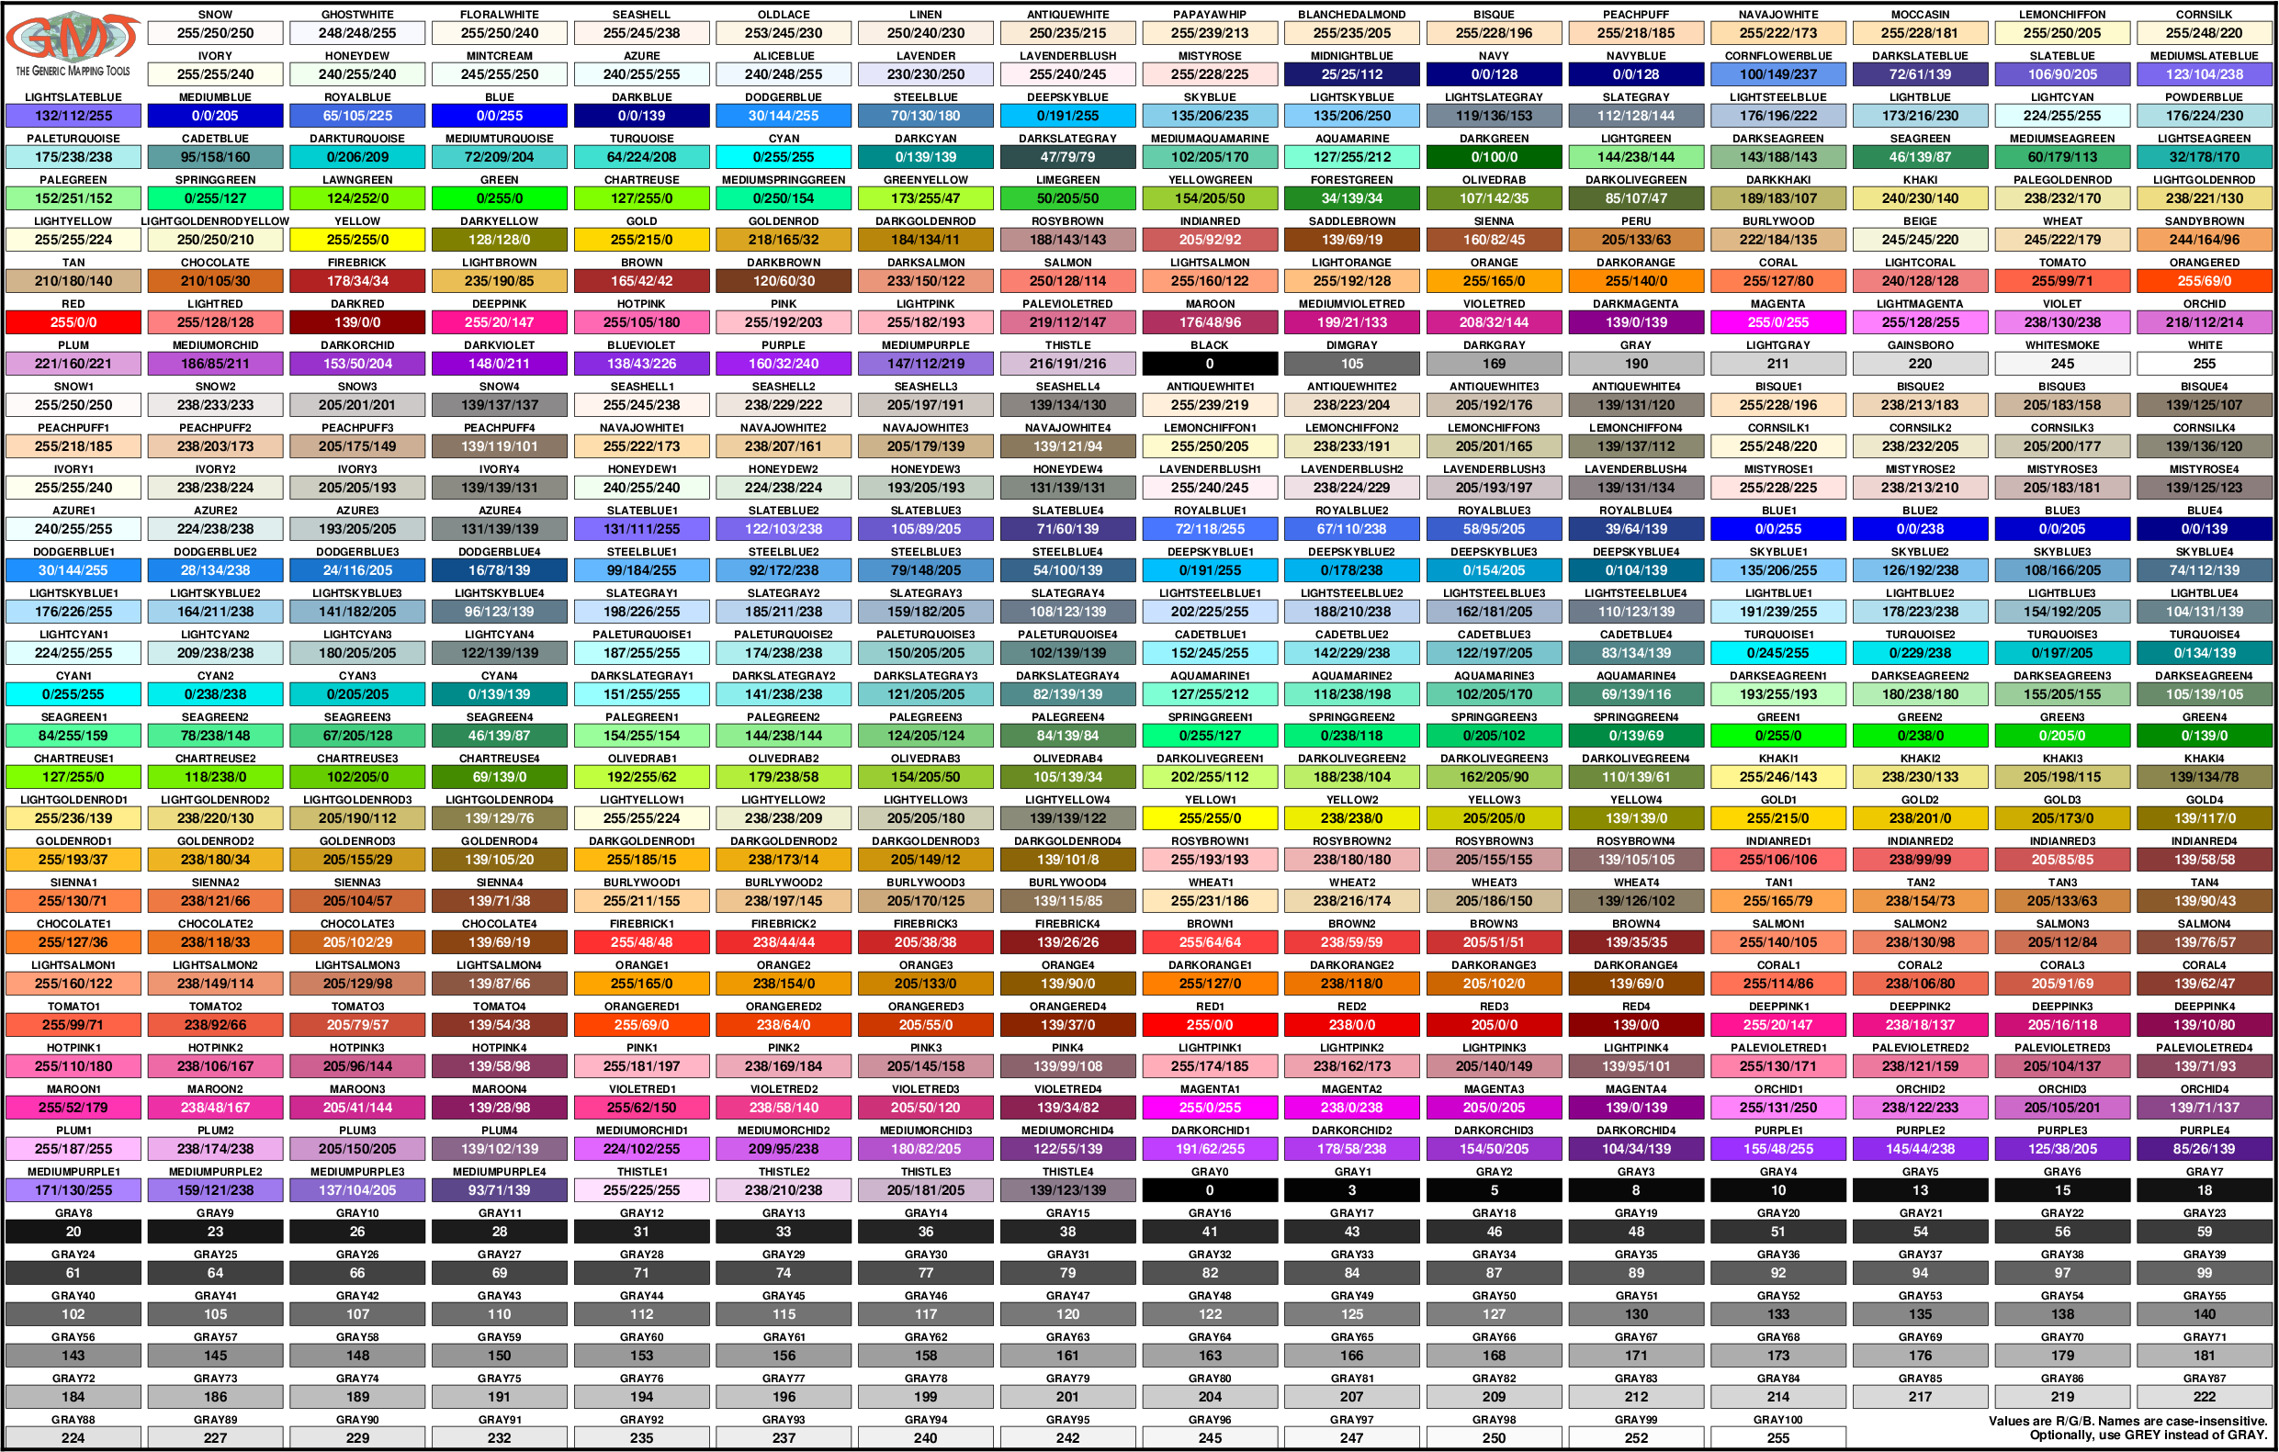

Slide 20
gmtcolors
R/G/B
Specify Red, Green, and Blue levels.
Each value is separated by a slash and is in the range from 0 (dark) to 255 (light).
This representation is used for transmitted light (color screens, looks great on screen, not so good when print).
The R/G/B values are given in the table on previous screen.
There are lots of web pages on R/G/B color on the web.

Slide 21
gmtcolors
#RRGGBB
Specify Red, Green, and Blue levels in the way that it is done in HTML (using Hexadecimal: 0, 1, 2, 3,…, 8, 9, A, B, …, E, F ).
Use two characters for each color channel, ranging from 00 (dark) to FF (light).
Upper and lower case are allowed.

Slide 22
gmtcolors
Graylevel
For shades of gray, R = G = B, and only one number needs to be used.
This representation is popular with black and white printers.

Slide 23
gmtcolors
H-S-V
Specify
Hue in the range 0 to 360 (degrees),
S saturation between 0 (not saturated) and 1 (fully saturated),
and value V between 0 (dark) and 1 (light).
Numbers are separated by hyphens.
This representation can be helpful when hue varies a lot.

Slide 24
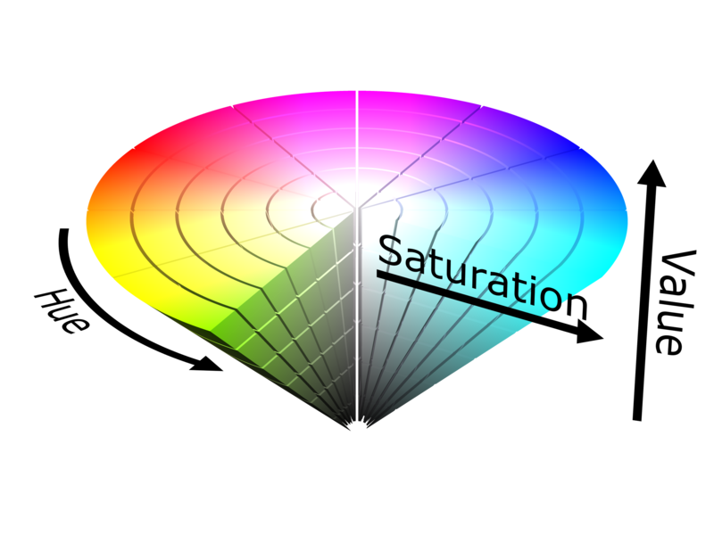
gmtcolors
H-S-V
https://www.e-education.psu.edu/geog486/node/606

Slide 25
gmtcolors
C/M/Y/K
Specify Cyan, Magenta, Yellow, and blacK.
Each number is in the range from 0 (no paint) to 100 (maximum paint).
This representation is used by most color printers (looks best on paper, not so good on screen).

Slide 26
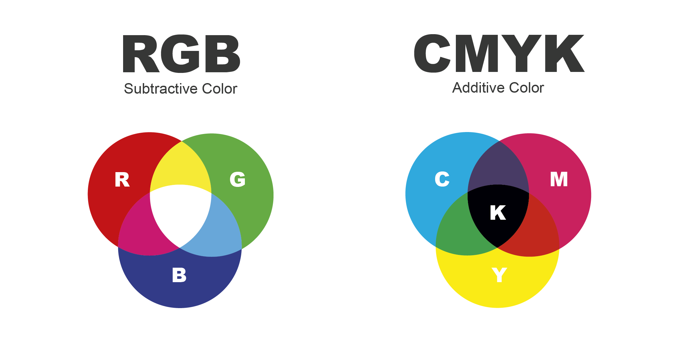
Y
B
Primary colors
C
R
M
C
Use right side for publication (printing) – reflected light (white light in, reflected colored light out, process of subtraction)
Use left for screen, projecting [light shows] – sum colors
https://www.printingcenterusa.com/blog/what-is-cmyk-and-why-is-it-used-for-printing/; labeled backwards on web page
Notes:
RGB does not look so good when printed, CMYK does not look so good on the screen. They have different "gamuts" (color ranges that can be shown)

Slide 27
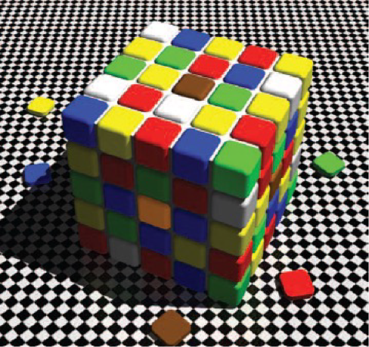
How we see color is subjective, not absolute.
Are the 3 center boxes, and the sample piece below all the same color
A) on a real Rubic's cube?
B) in the illustration to the left?
Purvis, Lotto, and undy, 2002
Notes:
Look up "what color

Slide 28
For a viral flame war over color perception, and some science on why, do a google search for "the dress that broke the internet"
See
https://en.wikipedia.org/wiki/The_dress
And hundreds of others.

Slide 29
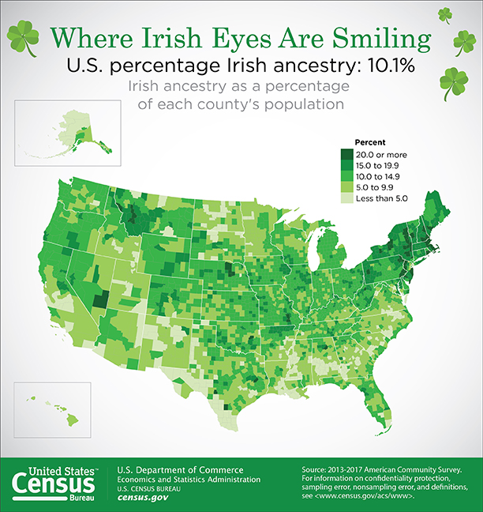
Graphic design is important
Ireland/Irish are associated with green.
(N. Ireland – part of Great Britan – is associated with orange. Don't wear orange on St. Patrick's day!)

Slide 30
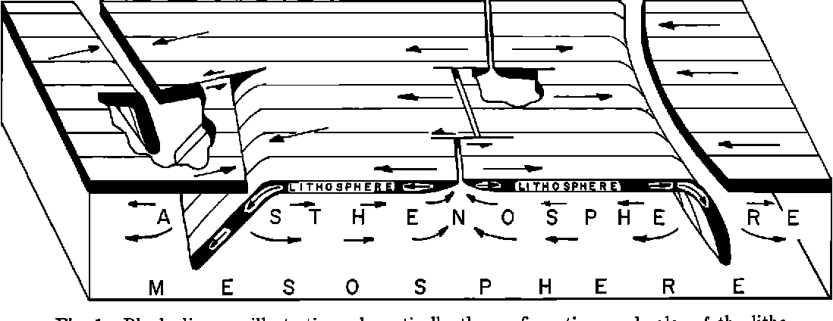
Graphic design is important
Clear concise figures are super important
Make your figures text-book quality (Isacks, Oliver, and Sykes, 1968)

Slide 31
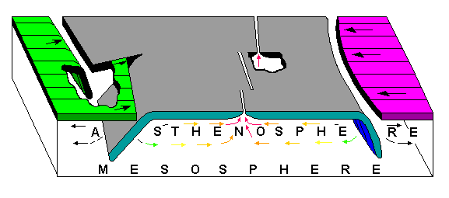
Modernized and expanded

Slide 32
"""
Political Boundaries
--------------------
The "borders" parameter of :meth:`pygmt.Figure.coast` specifies levels of political boundaries to plot and pen used to draw them. Choose from list of boundaries below:
**1** = National boundaries **2** = State boundaries in Americas **3** = Marine boundaries **a** = All boundaries (1-3)
For example, to draw national boundaries with a line thickness of 1p and black line color use ' borders="1/1p,black" '.
You can draw multiple boundaries by passing a list (underlined) to "borders". (also region)
"""
import pygmt
fig = pygmt.Figure()
# Make a Sinusoidal projection map of the Americas with automatic annotations,
# ticks and gridlines
fig.basemap(region=[-150, -30, -60, 60], projection="I-90/15c", frame="afg")
# Plot each level of the boundaries dataset with a different color.
fig.coast(borders=["1/0.5p,black", "2/0.5p,red", "3/0.5p,blue"], land="gray")
fig.savefig("borders_america.png")
fig.savefig("borders_america.jpg")
fig.savefig("borders_america.eps") #does not support straight ps
fig.savefig("borders_america.tif")
fig.show()
Notes:
Also does not support gif (is commercial, need to pay)

Slide 33
To save figures to files on disk
fig.savefig("central-america-shorelines.png")
Can save as
png
jpg
eps
tif

Slide 34
Note for experienced GMT users
You’ll probably have noticed several things that are different from classic command-line GMT.
Many of these changes reflect the new GMT modern execution mode that are part of GMT 6.
A few are PyGMT exclusive (like the savefig method).

Slide 35
Note for experienced GMT users
The name of method is coast instead of pscoast.
As a general rule, all ps* modules had their ps prefix removed.
The exceptions are:
psxy which is now plot,
psxyz which is now plot3d,
and psscale which is now colorbar.

Slide 36
Note for experienced GMT users
The arguments don’t use the GMT 1-letter syntax (R, J, B, etc).
We use longer aliases (names) for these arguments and have some Python exclusive names.
The mapping between the GMT arguments and their Python counterparts should be straight forward.

Slide 37
Note for experienced GMT users
2. Arguments like region can take lists as well as strings like 1/2/3/4.

Slide 38
Note for experienced GMT users
3. If a GMT argument has no options (like -B instead of -Baf), use a True in Python.
An empty string would also be acceptable.
For repeated arguments, such as -B+Loleron -Bxaf -By+lm, provide a list:
frame=["+Loleron", "xaf", "y+lm"].
Best is to search for examples of –B, is very complicated and poorly documented.

Slide 39
Note for experienced GMT users
4. There is no output redirecting to a PostScript file.
The figure is generated in the background and will only be shown or saved when you ask for it.
AND, you have to save it before you show it.

