Slide 1
CERI-8104 Data Analysis in Geophysics
Dr. Robert (Bob) Smalley
3892 Central Ave, Room 103
rsmalley@memphis.edu 678-4929
Fall 2023
Tu & Th 11:20 am -12:45 pm
Meeting 19 Thu. Nov 2, 2023
CERI New/Long Building: Student Computer Lab
Class webpage to be announced.
My homepage (has older versions of the course)
http://www.ceri.memphis.edu/people/smalley/

Slide 2
Look at
average.py
Introduce command “input” to read something from terminal. ” input” can put up a prompt, and it returns string, so you need to convert to the input to an appropriate type of number
Note that, unlike MATLAB, python does not print stuff out “automatically”, there is no equivalent to leaving the “;” off the end in MATLAB.
You have to print explicitly.
Notes:
Pretty simple and straightforward.

Slide 3
Look at
perfect_square.py
Introduces for loop and if statements.
Notice for and if statements end with a “:”
Notice indenting – this is a “feature” of python, code blocks are defined by indentation.
Also notice, there is no explicit end to a code block, the block ends by reducing the indentation by 1 (or more).
You can indent by whatever size you want (1 or more) but have to keep the closing indent same size as opening indent.
Notes:
Pretty simple and straightforward.

Slide 4
The three principal libraries for scientific number crunching and plotting are
SciPy (pronounced "Sigh Pie") contains modules for statistics, optimization, integration, linear algebra, Fourier transforms, signal and image processing, ODE solvers, and more.
NumPy (pronounced ”Num Pie") is an extension to Python, adding support for large, multi-dimensional arrays and matrices, along with a large library of high-level mathematical functions to operate on these arrays.
MatPlotLib is a plotting library for Python and its numerical mathematics extension NumPy.
Notes:
See https://www.quora.com/What-are-the-best-Python-mathematics-libraries for more libraries

Slide 5
The first thing one has to do is import them.
python_stuff:544 $ python
>>> import numpy as np
>>> import scipy
>>> import matplotlib as plt
You can see here that doing things interactively in Python is not the way to go.
There is no way to import these except typing them in each time
Better to use scripts and do the old
Edit-Run-Edit-Run- … dance

Slide 6
Next look at - matplotlib.pyplot –
a collection of command line functions that make matplotlib work like MATLAB.
Each pyplot function makes some change to a figure: e.g., creates a figure, creates a plotting area in a figure, plots some lines in a plotting area, decorates the plot with labels, etc.
matplotlib.pyplot preserves various states across function calls, so it keeps track of things like the current figure, plotting area, and the plotting functions are directed to the current axes
(please note that "axes" here and in most places in the documentation refers to the axes part of a figure and not the strict mathematical term for more than one axis).
Notes:
Based on https://matplotlib.org/3.1.1/tutorials/introductory/pyplot.html

Slide 7
Import and create alias so we don’t have to call matplotlib.pyplot.method to do a method (gets pretty long winded)
import matplotlib.pyplot as plt
Plot a list
plt.plot([1, 2, 3, 4])
Label it
plt.ylabel('some numbers’)

Slide 8
Not seeing anything?
You need to “show” it.
Python is not like MATLAB in this sense.
plt.show()
This also locks up the command line till you close the window
(no having plots laying around to look at later).

Slide 9
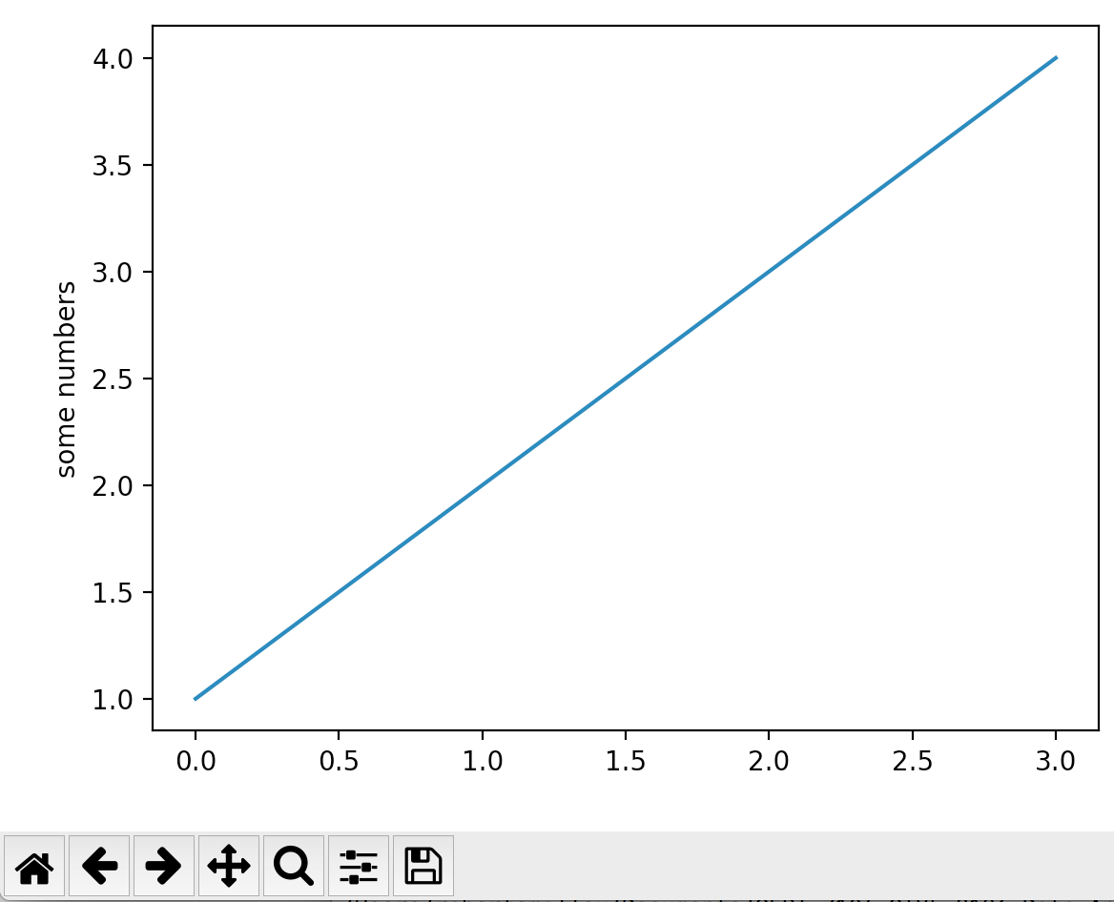
Notes:
To get out of plot() and return to prompt – if you can see the plot window close it (red filled circle with x), if can’t see plot window, select X-quartz and then select from the application menu “hide others”. Follow instructions for if you and see it (as you are).
Stuff at bottom – home returns to initial state, left and right arrows go between past and "future" views, up/down&left/right arrows to move it, mag glass to mag, slider bars to adjust aspect ratio, position on page, etc. disk to save

Slide 10
You may be wondering why the x-axis ranges from 0-3 and the y-axis from 1-4.
If you provide a single list or array to plot(), matplotlib assumes it is a sequence of y values, and automatically generates x values.
Since python ranges start with 0, the default x vector has the same length as y but starts with 0.
Hence the x data are [0,1,2,3].
Return to the Python prompt by closing the X-window
(click in the red X).

Slide 11
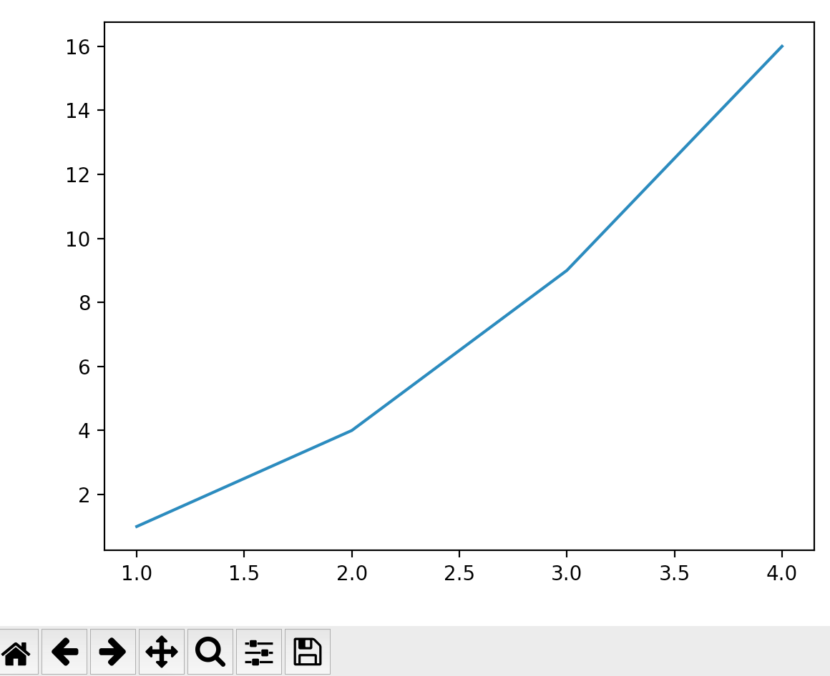
As in MATLAB, plot() can take an arbitrary number of arguments. For example, to plot x versus y, use:
import matplotlib.pyplot as plt
plt.plot([1, 2, 3, 4], [1, 4, 9, 16])
Notes:
Remember the “plt.show()”

Slide 12
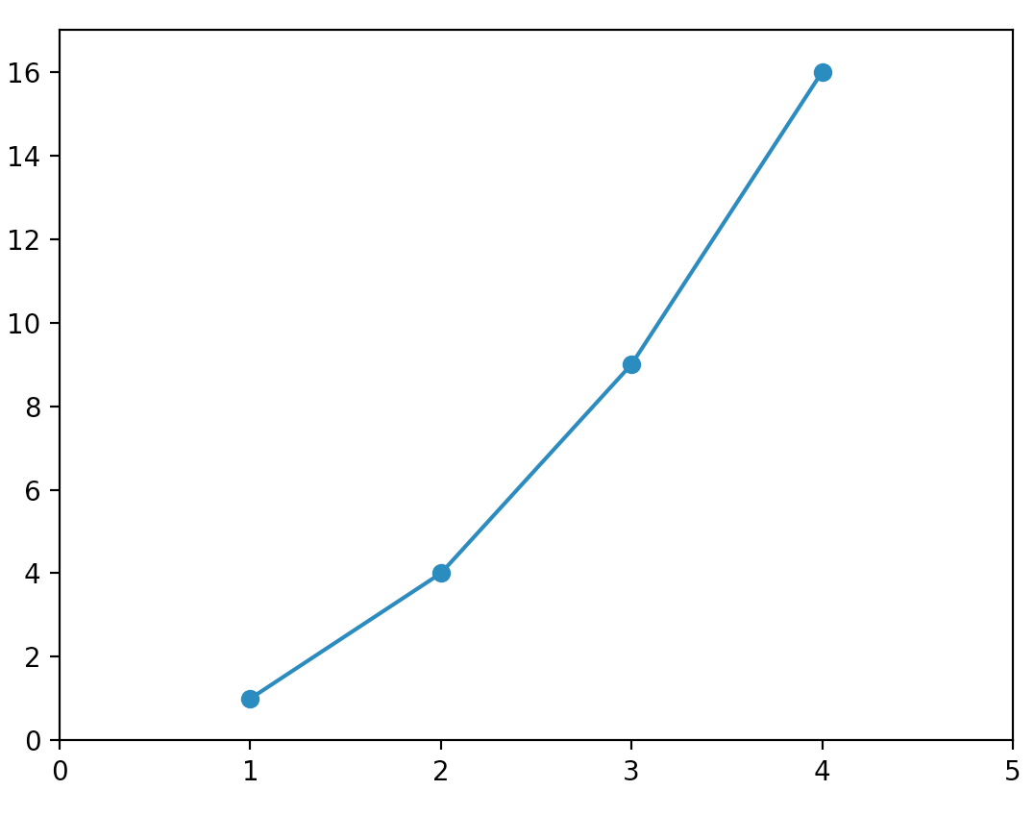
Optional 3rd argument: the format string that indicates the color and line type of the plot. Same as MATLAB.
import matplotlib.pyplot as plt
plt.plot([1, 2, 3, 4], [1, 4, 9, 16], '-o’)
plt.axis([0, 5, 0, 17])
Notes:
Remember the “plt.show()”
This same as MATLAB – add axis, etc, to current plot window with calls that modify the plot.
Each call “erases” the previous (plt.plot erases whole current plot, plt.axis erases current axis)

Slide 13
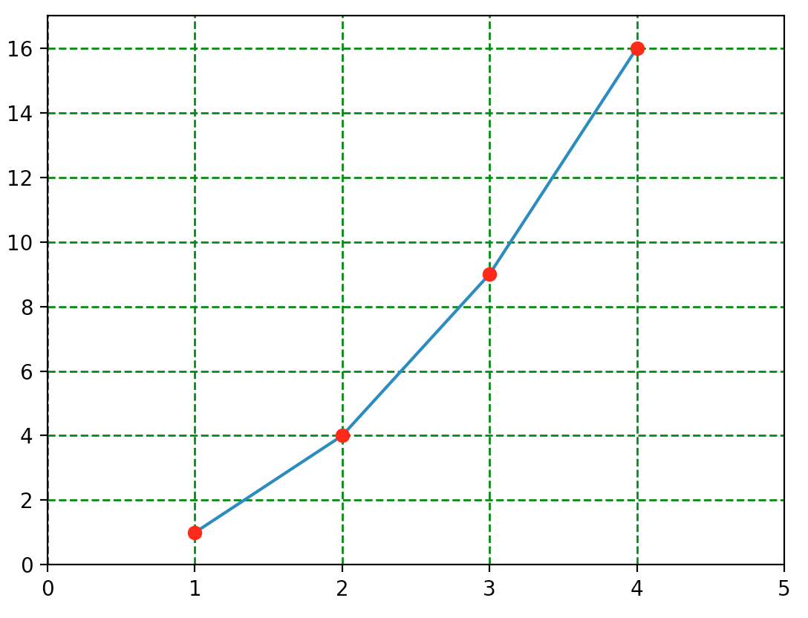
Different from MATLAB.
A new plot() call does not clear plot.
It plots over it (no “hold on” and “hold off”)
import matplotlib.pyplot as plt
X=[1, 2, 3, 4]
Y=[1, 4, 9, 16]
plt.plot(X, Y)
plt.axis([0, 5, 0, 17])
plt.plot(X,Y,'ro’)
plt.grid(color='g', linestyle='.', linewidth=1)
Notes:
Remember the plt.show()
Notice – do not need “hold” command – there is a deprecated hold command that still behaves properly (su[[psedly, I’ve not verified that).
Getting tired of typing the data so make lists.
Add grid

Slide 14
If matplotlib were limited to working with lists, it would be fairly useless for numeric processing.
Generally, you will use numpy arrays.
In fact, all sequences are converted to numpy arrays internally.
The next example illustrates plotting several lines with different format styles in one command using arrays.

Slide 15
Define array (look up numpy.arrange on web
np.arange(start, stop, delta))
goes from start to stop in steps of delta.
In this case math operates on vectors (but not exact same way as MATLAB, this is doing “.^”)
import matplotlib.pyplot as plt, numpy as np
# evenly sampled time at 200ms intervals
t = np.arange(0., 5., 0.2)
# red dashes, blue squares and green triangles
plt.plot(t,t,'r--',t,t**2,'bs',t,t**3,'g^')
plt.show()
Note t = np.arange(0., 5., 0.2)
>>> t
array([0. , 0.2, … , 4.6, 4.8])
Notes:
LOOK UP STUFF ON GOOGLE!!!
numpy.arange
numpy.arange([start, ]stop, [step, ]dtype=None) Return evenly spaced values within a given interval.
Values are generated within the half-open interval [start, stop) (in other words, the interval including start but excluding stop). For integer arguments the function is equivalent to the Python built-in range function, but returns an ndarray rather than a list.
When using a non-integer step, such as 0.1, the results will often not be consistent. It is better to use numpy.linspace for these cases.
numpy.linspace(start, stop, num=50, endpoint=True, retstep=False, dtype=None, axis=0)[source] Return evenly spaced numbers over a specified interval.
Returns num evenly spaced samples, calculated over the interval [start, stop].
The endpoint of the interval can optionally be excluded.
numpy.linspace says --- See also
arange Similar to linspace, but uses a step size (instead of the number of samples).
Note “closed” vs ”open” ends, start end is closed, stop end is open (does not include the stop value)
Here if X was a list X**2 falls over.

Slide 16
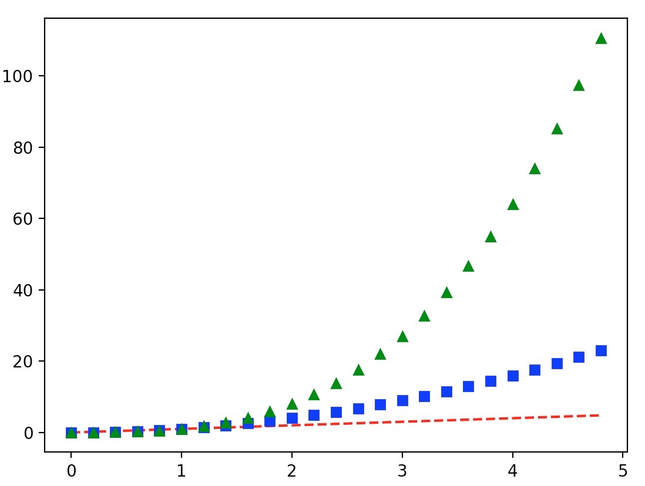
This is what we get

Slide 17
Working with multiple figures and axes
MATLAB, and pyplot, have the concept of the current figure and the current axes.
All plotting commands apply to the current axes.
The method gca() returns the current axes (a matplotlib.axes.Axes instance), and gcf() returns the current figure (matplotlib.figure.Figure instance).
Notes:
Normally, you don't have to worry about this, because it is all taken care of behind the scenes. Below is a script to create two subplots

Slide 18
Example of subplots with lots of new stuff
import numpy as np
import matplotlib.pyplot as plt
def f(t):
return np.exp(-t) * np.cos(2*np.pi*t)
t1 = np.arange(0.0, 5.0, 0.1)
t2 = np.arange(0.0, 5.0, 0.02)
plt.figure()
plt.subplot(211)
plt.plot(t1, f(t1), 'bo', t2, f(t2), 'k')
plt.subplot(212)
plt.plot(t2, np.cos(2*np.pi*t2), 'r--')
plt.show()
Notes:
What does this do?

Slide 19
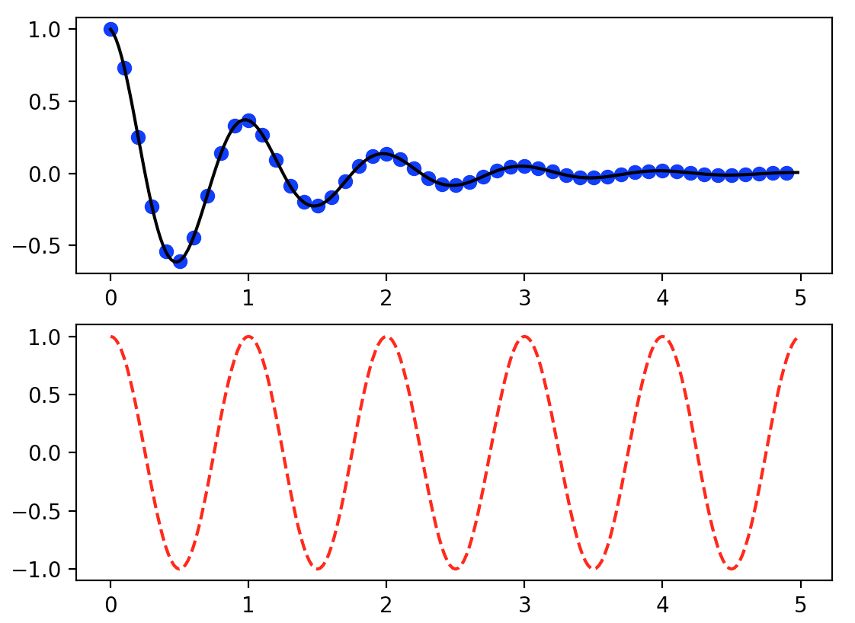
Run python mulplt.py

Slide 20
What does this do?
np.exp(-t) * np.cos(2*np.pi*t)
Is same as “.*” in MATLAB!
Notes:
What does this do?

Slide 21
Intro to NUMPY
NUMPY, Numerical Python, is a library consisting of multidimensional array objects and a collection of routines for processing those arrays.

Slide 22
Memory Layout of Multi-dimensional Arrays
Multidimensional arrays are stored as contiguous data in memory.
There’s freedom of choice in how to arrange the array elements in this memory segment.
Consider the case of a 2-dimensional array, w/ rows & columns:
One possible way to store this array as a consecutive sequence of values is to store the rows after each other (C and Python default), and another equally valid approach is to store the columns one after another (Fortran, MATLAB).
The former is called row-major format and the latter is column-major format.

Slide 23
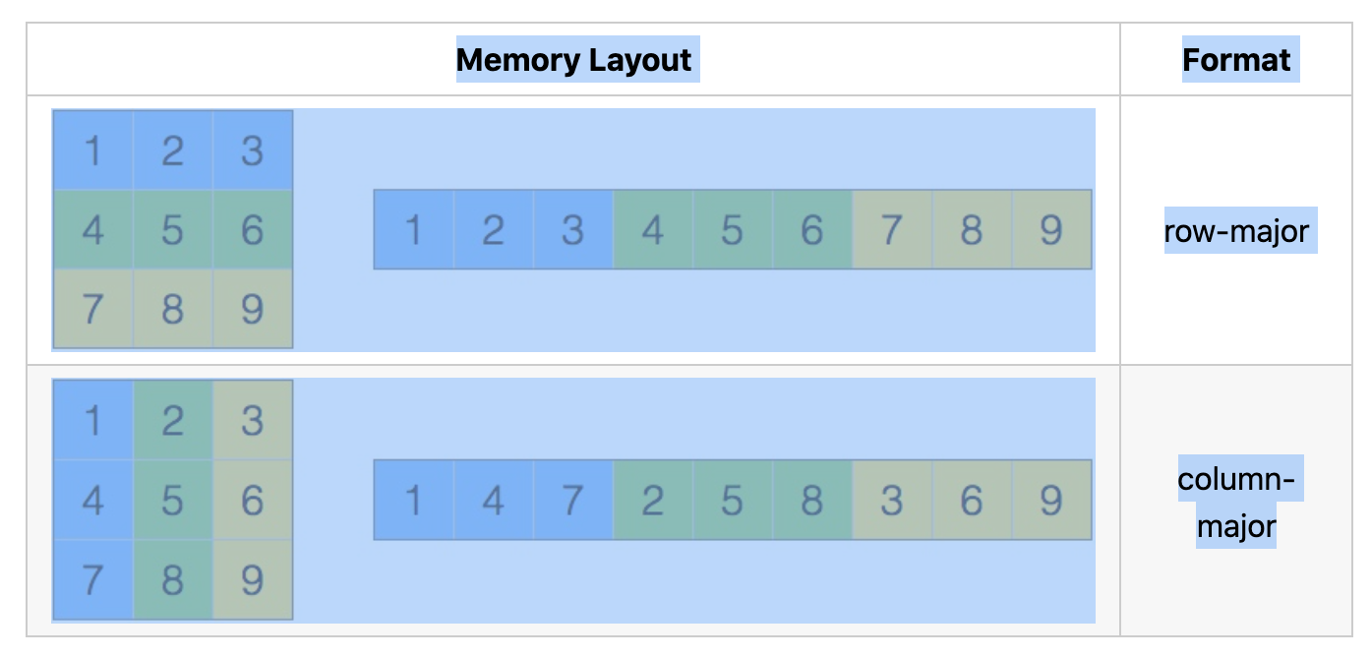
Which one to use, row-major or column-major, is a matter of convention.
They are equally good solutions – you just need to know which is being used.
Default in Python is row-major.

Slide 24
NUMPY Data Types (a few more than basic Python)
bool_ : Boolean (True or False), byte
int_ : Default integer (same as C long, int32 or int64)
intc : identical to C int (int32 or int64)
intp : Integer used for indexing (same as C ssize_t, int32 or int64)
int8 : Byte (-128 to 127)
int16 : Integer (-32768 to 32767)
int32 : Integer (-2147483648 to 2147483647)
int64 : Integer (-9223372036854775808 to 9223372036854775807)
uint8 : Unsigned integer (0-255)
uint16 : Unsigned integer (0 to 65535)
uint32 : Unsigned integer (0 to 4294967295)
uint64 : Unsigned integer (0 to 18446744073709551615)
Notes:
https://www.tutorialspoint.com/numpy/numpy_data_types.htm
size_t unsigned integer type of result of sizeof
sssize_t same as size_t buy signed, read “signed size_t”

Slide 25
Data Types
float_ : Shorthand for float64
float16 : Half precision float: sign bit, 5 bit exp, 10 bit mantissa
float32 : Single precision float : sign bit, 8 bit exp, 23 bit mantissa
float64 : Double precision float : sign bit, 11 bit exp, 52 bit mantissa
complex_ : Shorthand for complex128
complex64 : Complex number, composed of two float32 (real and imag)
complex128 : Complex number, two float64 (real and imag)
Pretty much covers all possibilities!
Notes:
https://www.tutorialspoint.com/numpy/numpy_data_types.htm
Same as Matlab, neither does quadruple precision

Slide 26
Data Types
NumPy numerical types are instances of dtype (data-type) objects, each having unique characteristics. The dtypes are available as np.bool_, np.float32, etc.
Data Type Objects (dtype)
A data type object describes interpretation of fixed block of memory corresponding to an array, depending on the following aspects −
Type of data (integer, float or Python object)
Size of data
Notes:
https://www.tutorialspoint.com/numpy/numpy_data_types.htm

Slide 27
In case of structured type, the names of fields, data type of each field and part of the memory block taken by each field.
If data type is a subarray, its shape and data type
Notes:
https://www.tutorialspoint.com/numpy/numpy_data_types.htm

Slide 28
Byte order (little-endian or big-endian)
The byte order is identified by prefixing '<' or '>' to data type.
'<' means that encoding is little-endian (least significant byte is stored in smallest address).
'>' means that encoding is big-endian (most significant byte is stored in smallest address).
Byte ordering is determined by the HARDWARE.
Notes:
https://www.tutorialspoint.com/numpy/numpy_data_types.htm

Slide 29
Endianness
Notes:
https://getkt.com/wp-content/uploads/2019/04/Origin-Of-words-of-endianness-Little-Endian-and-Big-Endian.jpg
Words Little Endian and Big Endian are originated from the 1726 novel Gulliver’s Travels by Jonathan Swift. In which civil war breaks out over whether the big end or the little end of the egg is proper to crack open. Words Little Endian and Big Endian are used to name two groups who fight over little end and big end of the egg is proper way to break egg receptively .
The novel further describes an intra-Lilliputian quarrel over the practice of breaking eggs. Traditionally, Lilliputians broke boiled eggs on the larger end; a few generations ago, an Emperor of Lilliput, the Present Emperor’s great-grandfather, had decreed that all eggs be broken on the smaller end after his son cut himself breaking the egg on the larger end. The differences between Big-Endians (those who broke their eggs at the larger end) and Little-Endians had given rise to “six rebellions… wherein one Emperor lost his life, and another his crown”. The Lilliputian religion says an egg should be broken on the convenient end, which is now interpreted by the Lilliputians as the smaller end. The Big-Endians gained favour in Blefuscu.
Excerpt of story from wiki Lilliput and Blefuscu

Slide 30
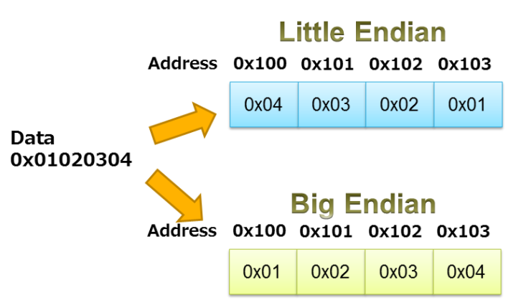
Endianness
How memory is “organized” for multi-byte entities
As in case of multidimensional array storage – there are 2 equally good solutions.
View memory as linear collection of storage locations (bytes), count position in memory from left or count from right.
Notes:
https://www.iar.com/knowledge/learn/programming/migration-techniques-for-different-endianness/

Slide 31
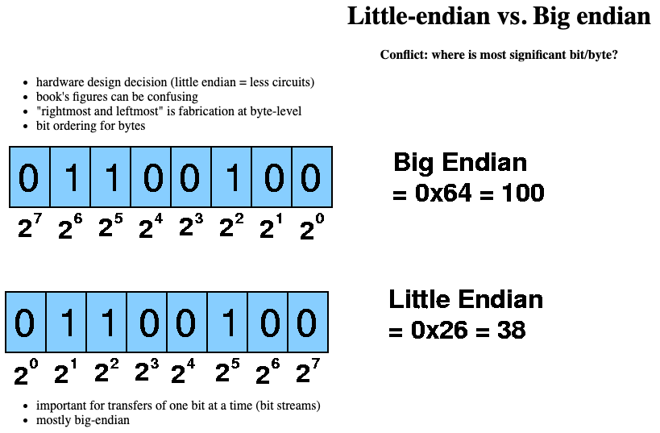
Endianness
How memory is “organized” for multi-byte entities
Count position in memory from left or count from right
Notes:
https://users.cs.fiu.edu/~prabakar/cda4101/Common/notes/lecture04.html

Slide 32
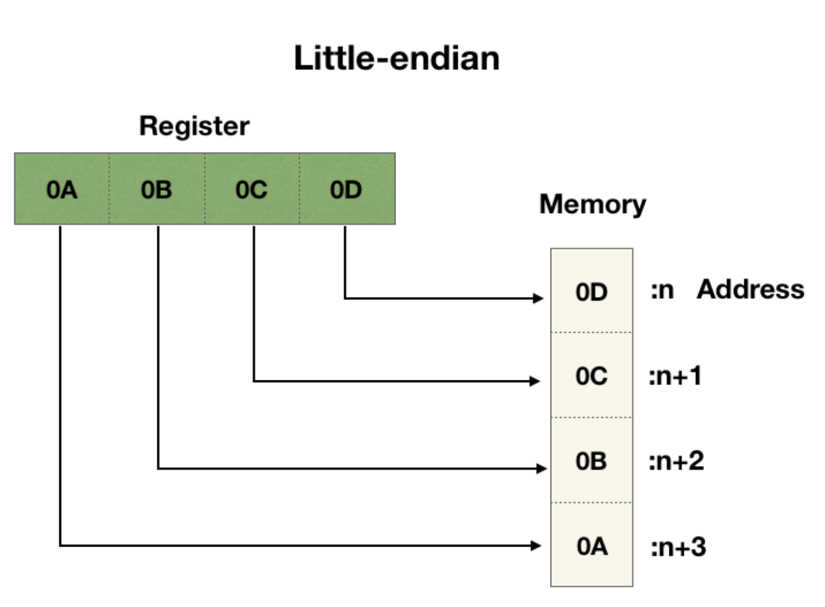
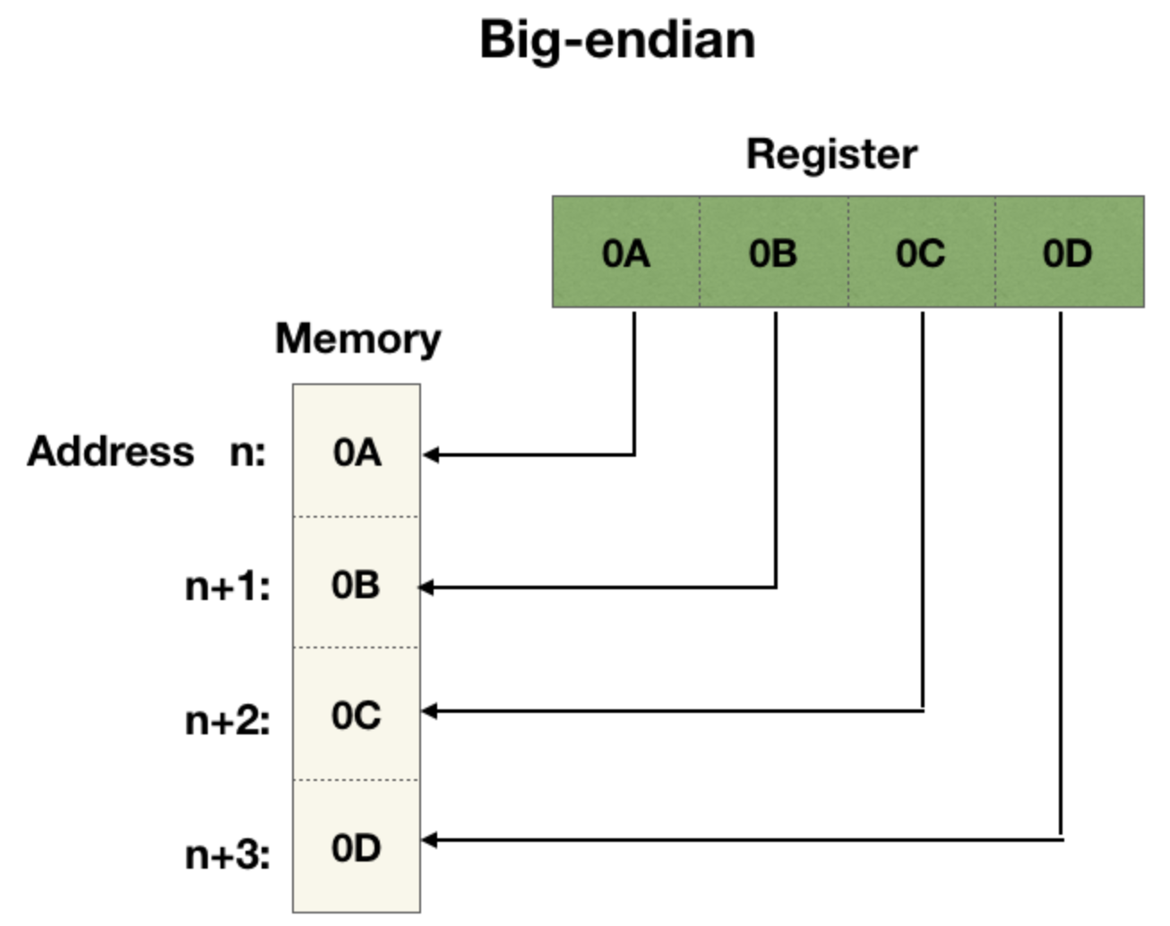
Notes:
https://levelup.gitconnected.com/little-endian-vs-big-endian-eb2a2c3a9135

Slide 33
Endianess is usually only an issue when moving data between machines of different endianesses.
Most modern processors are bi-endian, can take either natively (and can figure out which is which – especially with a hint [knowing what is the value stored in memory – you only get the correct value for one endianess])
Another issue, that rarely raises its head now, is floating point number formats (specifically IBM Hexadecimal and Decimal formats).
Most processors today use the IEEE standard (IBM supports 3 – IEEE plus its 2).
Notes:
https://levelup.gitconnected.com/little-endian-vs-big-endian-eb2a2c3a9135

Slide 34
A dtype object is constructed using the following syntax −
numpy.dtype(object, align, copy) The parameters are −
Object − To be converted to data type object
Align − If true, adds padding to the field to make it similar to C-struct
Copy − Makes a new copy of dtype object.
If false, the result is reference to builtin data type object
Notes:
https://www.tutorialspoint.com/numpy/numpy_data_types.htm

Slide 35
Example 1
# using array-scalar type
import numpy as np
dt = np.dtype(np.int32)
print(dt)
The output is as follows −
int32
Notes:
https://www.tutorialspoint.com/numpy/numpy_data_types.htm

Slide 36
Example 2
#int8, int16, int32, int64 can be replaced by equivalent string 'i1','i2','i4', etc.
import numpy as np
dt = np.dtype('i4')
print(dt)
The output is as follows −
int32
Notes:
https://www.tutorialspoint.com/numpy/numpy_data_types.htm

Slide 37
Example 3
# using endian notation
import numpy as np
dt = np.dtype('>i4’)
print(dt)
The output is as follows −
>i4
Notes:
https://www.tutorialspoint.com/numpy/numpy_data_types.htm

Slide 38
The following examples show the use of structured data type.
Here, the field name and the corresponding scalar data type is to be declared.
Example 4
# first create structured data type
import numpy as np
dt = np.dtype([('age',np.int8)])
print(dt)
The output is as follows −
[('age', 'i1')]
Notes:
https://www.tutorialspoint.com/numpy/numpy_data_types.htm

Slide 39
Example 5
# now apply it to ndarray object
import numpy as np
dt = np.dtype([('age',np.int8)])
a = np.array([(10,),(20,),(30,)], dtype = dt)
print(a)
The output is as follows −
[(10,) (20,) (30,)]
Notes:
https://www.tutorialspoint.com/numpy/numpy_data_types.htm

Slide 40
Example 6
# name can be used to access content of age column
import numpy as np
dt = np.dtype([('age',np.int8)])
a = np.array([(10,),(20,),(30,)], dtype = dt)
print(a['age'])
The output is as follows −
[10 20 30]
Notes:
https://www.tutorialspoint.com/numpy/numpy_data_types.htm

Slide 41
Example 7
The following examples define a structured data type called student with a string field 'name', an integer field 'age' and a float field 'marks’.
This dtype is applied to ndarray object.
import numpy as np
student = np.dtype([('name','S20'), ('age', 'i1'), ('marks', 'f4')])
print student
The output is as follows −
[('name', 'S20'), ('age', 'i1'), ('marks', '<f4')])
Notes:
https://www.tutorialspoint.com/numpy/numpy_data_types.htm

Slide 42
Example 8
import numpy as np
student = np.dtype([('name','S20'), ('age', 'i1'), ('marks', 'f4')])
a = np.array([('abc', 21, 50),('xyz', 18, 75)], dtype = student)
print(a)
The output is as follows −
[('abc', 21, 50.0), ('xyz', 18, 75.0)]
Notes:
https://www.tutorialspoint.com/numpy/numpy_data_types.htm

Slide 43
Each built-in data type has a character code that uniquely identifies it.
'b' − boolean
'i' − (signed) integer
'u' − unsigned integer
'f' − floating-point
'c' − complex-floating point
'm' − timedelta
'M' − datetime
'O' − (Python) objects
'S', 'a' − (byte-)string
'U' − Unicode
'V' − raw data (void)
Notes:
https://www.tutorialspoint.com/numpy/numpy_data_types.htm

Slide 44
Array Attributes
ndarray.shape
This array attribute returns a tuple consisting of array dimensions. It can also be used to resize the array.
Example 1
import numpy as np
a = np.array([[1,2,3],[4,5,6]])
print(a.shape)
The output is as follows −
(2, 3)
Notes:
https://www.tutorialspoint.com/numpy/numpy_array_attributes.htm

Slide 45
Array Attributes
Example 2
# this resizes the ndarray
import numpy as np
a = np.array([[1,2,3],[4,5,6]])
a.shape = (3,2)
print(a)
The output is as follows −
[[1, 2]
[3, 4]
[5, 6]]
Notice how it shows 2D arrays one set of [] for “outside” array, and one set of [] per row
Notes:
https://www.tutorialspoint.com/numpy/numpy_array_attributes.htm

Slide 46
Array Attributes
Example 3
NumPy also provides a reshape function to resize an array.
import numpy as np
a = np.array([[1,2,3],[4,5,6]])
b = a.reshape(3,2)
print(b)
The output is as follows −
[[1, 2]
[3, 4]
[5, 6]]
Notes:
https://www.tutorialspoint.com/numpy/numpy_array_attributes.htm

Slide 47
Array Attributes
ndarray.ndim
This array attribute returns the number of array dimensions.
Notes:
https://www.tutorialspoint.com/numpy/numpy_array_attributes.htm

Slide 48
Make evenly spaced array
Example 1
# an array of evenly spaced numbers
import numpy as np
a = np.arange(24)
print(a)
The output is as follows −
[0 1 2 3 4 5 6 7 8 9 10 11 12 13 14 15 16 17 18 19 20 21 22 23]
Notes:
https://www.tutorialspoint.com/numpy/numpy_array_attributes.htm

Slide 49
Example 2
# this is one dimensional array
import numpy as np
a = np.arange(24)
a.ndim
# now reshape it
b = a.reshape(2,4,3)
print b
# b is having three dimensions
The output is on next page −
Notes:
https://www.tutorialspoint.com/numpy/numpy_array_attributes.htm

Slide 50
Array Attributes
The output is
[[[ 0, 1, 2]
[ 3, 4, 5]
[ 6, 7, 8]
[ 9, 10, 11]]
[[12, 13, 14]
[15, 16, 17]
[18, 19, 20]
[21, 22, 23]]]
Notice how it shows 3D arrays one set [] (black) for “outside” array, one set [] (cyan) for each 2D and finally and one set [] (red) per row, gets uglier as dimensions get larger.
Notes:
https://www.tutorialspoint.com/numpy/numpy_array_attributes.htm

Slide 51
Array Attributes
numpy.itemsize
This array attribute returns the length of each element of array in bytes.
Example 1
# dtype of array is int8 (1 byte)
import numpy as np
x = np.array([1,2,3,4,5], dtype = np.int8)
print(x.itemsize)
The output is as follows −
1
Notes:
https://www.tutorialspoint.com/numpy/numpy_array_attributes.htm

Slide 52
Array Attributes
Example 2
# dtype of array is now float32 (4 bytes)
import numpy as np
x = np.array([1,2,3,4,5], dtype = np.float32)
print x.itemsize
The output is as follows −
4
Notes:
https://www.tutorialspoint.com/numpy/numpy_array_attributes.htm

Slide 53
NumPy - Array Creation Routines
numpy.empty
It creates an uninitialized array of specified shape and dtype. It uses the following constructor −
numpy.empty(shape, dtype = float, order = 'C')
The constructor takes the following parameters.
Shape - Shape of an empty array in int or tuple of int
Dtype - Desired output data type.
Optional
Order 'C' for C-style row-major array or
Order 'F' for FORTRAN style column-major array
Notes:
https://www.tutorialspoint.com/numpy/numpy_array_attributes.htm

Slide 54
Example
The following code shows an example of an empty array.
import numpy as np
x = np.empty([3,2], dtype = int)
print(x)
The output is as follows −
[[22649312 1701344351] [1818321759 1885959276] [16779776 156368896]]
Note − In this case the elements in an array show random values as they are not initialized to zero.
Many compilers/interpreters do not initialize to zero to save time, but this can cause big problems (you've been warned).
Notes:
https://www.tutorialspoint.com/numpy/numpy_array_attributes.htm

Slide 55
numpy.zeros
Returns a new array of specified size, filled with zeros.
numpy.zeros(shape, dtype = float, order = 'C’)
Example 1
# array of five zeros. Default dtype is float import numpy as np
x = np.zeros(5)
print(x)
The output is as follows −
[ 0. 0. 0. 0. 0.]
Notes:
https://www.tutorialspoint.com/numpy/numpy_array_attributes.htm

Slide 56
Example 3
# custom type import numpy as np
x = np.zeros((2,2), dtype = [('x', 'i4'), ('y', 'i4')])
print(x)
It should produce the following output −
[[(0,0)(0,0)] [(0,0)(0,0)]]
Notes:
https://www.tutorialspoint.com/numpy/numpy_array_attributes.htm

Slide 57
numpy.ones
Returns a new array of specified size and type, filled with ones.
numpy.ones(shape, dtype = None, order = 'C’)
Example 1
# array of five ones. Default dtype is float
import numpy as np
x = np.ones(5) print(x)
The output is as follows −
[ 1. 1. 1. 1. 1.]
Notes:
https://www.tutorialspoint.com/numpy/numpy_array_attributes.htm

Slide 58
Example 2
import numpy as np
x = np.ones([2,2], dtype = int)
print(x)
Now, the output would be as follows −
[[1 1] [1 1]]
Notes:
https://www.tutorialspoint.com/numpy/numpy_array_attributes.htm

Slide 59
NumPy - Array From Existing Data
numpy.asarray
This function is similar to numpy.array except for the fact that it has fewer parameters. This routine is useful for converting Python sequence into ndarray.
numpy.asarray(a, dtype = None, order = None)
The constructor takes the following parameters.
a - Input data in any form such as list, list of tuples, tuples, tuple of tuples or tuple of lists
dtype - By default, the data type of input data is applied to the resultant ndarray
Notes:
https://www.tutorialspoint.com/numpy/numpy_array_attributes.htm

Slide 60
Example 1
#convert list 2 ndarray
import numpy as np
x = [1,2,3]
a = np.asarray(x)
print(a)
Its output would be as follows −
[1 2 3]
Example 2
# dtype is set
import numpy as np x = [1,2,3]
a = np.asarray(x, dtype = float)
print(a)
Now, the output would be as follows −
[ 1. 2. 3.]
Notes:
https://www.tutorialspoint.com/numpy/numpy_array_attributes.htm

Slide 61
Example 3
# ndarray from tuple
import numpy as np
x = (1,2,3)
a = np.asarray(x)
print(a)
Its output would be −
[1 2 3]
Example 4
# ndarray from list of tuples
import numpy as np
x = [(1,2,3),(4,5)]
a = np.asarray(x)
print(a)
Here, the output would be as follows −
[(1, 2, 3) (4, 5)]
Notes:
https://www.tutorialspoint.com/numpy/numpy_array_attributes.htm

Slide 62
numpy.frombuffer
This function interprets a buffer as one-dimensional array. Any object that exposes the buffer interface is used as parameter to return an ndarray.
numpy.frombuffer(buffer, dtype = float, count = -1, offset = 0)
The constructor takes the following parameters.
Buffer - Any object that exposes buffer interface
Dtype - Data type of returned ndarray. Defaults to float
Count - The number of items to read, default -1 means all data
Offset - The starting position to read from. Default is 0
Notes:
https://www.tutorialspoint.com/numpy/numpy_array_attributes.htm

Slide 63
Example
The following examples demonstrate the use of frombuffer function.
import numpy as np
s = 'Hello World’
a = np.frombuffer(s, dtype = 'S1’)
print(a)
Here is its output −
['H' 'e' 'l' 'l' 'o' ' ' 'W' 'o' 'r' 'l' 'd']
Notes:
https://www.tutorialspoint.com/numpy/numpy_array_attributes.htm

Slide 64
numpy.fromiter
This function builds an ndarray object from any iterable object.
A new one-dimensional array is returned by this function.
numpy.fromiter(iterable, dtype, count = -1)
Here, the constructor takes the following parameters.
Iterable - Any iterable object
Dtype - Data type of resultant array
Count - The number of items to be read from iterator. Default is -1 which means all data to be read
Notes:
https://www.tutorialspoint.com/numpy/numpy_array_attributes.htm

Slide 65
Example 1
# create list object using range function
import numpy as np
list = range(5) print (list)
Its output is as follows −
[0, 1, 2, 3, 4]
Notes:
https://www.tutorialspoint.com/numpy/numpy_array_attributes.htm

Slide 66
Example 2
# obtain iterator object from list
import numpy as np
list = range(5)
it = iter(list)
# use iterator to create ndarray
x = np.fromiter(it, dtype = float)
print x
Now, the output would be as follows −
[0. 1. 2. 3. 4.]
Notes:
https://www.tutorialspoint.com/numpy/numpy_array_attributes.htm

Slide 67
NumPy - Array From Numerical Ranges
numpy.arange
This function returns an ndarray object containing evenly spaced values within a given range.
The format of the function is as follows −
numpy.arange(start, stop, step, dtype)
The constructor takes the following parameters.
Start - The start of an interval. If omitted, defaults to 0
Stop - The end of an interval (not including this number)
Step - Spacing between values, default is 1
Dtype - Data type of resulting ndarray. If not given, data type of input is used
Notes:
https://www.tutorialspoint.com/numpy/numpy_array_attributes.htm

Slide 68
Example 1
import numpy as np
x = np.arange(5)
print(x)
[0 1 2 3 4]
Example 2
import numpy as np
# dtype set
x = np.arange(5, dtype = float)
print(x)
[0. 1. 2. 3. 4.]
Notes:
https://www.tutorialspoint.com/numpy/numpy_array_attributes.htm

Slide 69
Example 3
# start and stop parameters set
import numpy as np
x = np.arange(10,20,2)
print(x)
[10 12 14 16 18]
Notes:
https://www.tutorialspoint.com/numpy/numpy_array_attributes.htm

Slide 70
numpy.linspace
This function is similar to arange() function. In this function, instead of step size, the number of evenly spaced values between the interval is specified.
The usage of this function is as follows −
numpy.linspace(start, stop, num, endpoint, retstep, dtype)
Notes:
https://www.tutorialspoint.com/numpy/numpy_array_attributes.htm

Slide 71
numpy.linspace continued
numpy.linspace(start, stop, num, endpoint, retstep, dtype)
The constructor takes the following parameters.
Start - The starting value of the sequence
Stop - The end value of the sequence, included in the sequence if endpoint set to true
num - number of evenly spaced samples generated. Default 50
Endpoint - True by default, hence the stop value is included in the sequence. If false, it is not included
Retstep - If true, returns samples and step between the consecutive numbers
Dtype - Data type of output ndarray
Notes:
https://www.tutorialspoint.com/numpy/numpy_array_attributes.htm

Slide 72
Example 1
import numpy as np
x = np.linspace(10,20,5)
print(x)
[10. 12.5 15. 17.5 20.]
Example 2
# endpoint set to false
import numpy as np
x = np.linspace(10,20, 5, endpoint = False)
print(x)
[10. 12. 14. 16. 18.]
Notes:
https://www.tutorialspoint.com/numpy/numpy_array_attributes.htm

Slide 73
Example 3
# find retstep value
import numpy as np
x = np.linspace(1,2,5, retstep = True)
print(x)
# retstep here is 0.25
(array([ 1. , 1.25, 1.5 , 1.75, 2. ]), 0.25)
Notes:
https://www.tutorialspoint.com/numpy/numpy_array_attributes.htm

Slide 74
numpy.logspace
This function returns an ndarray object that contains the numbers that are evenly spaced on a log scale.
Start and stop endpoints of the scale are indices of the base, usually 10.
numpy.logspace(start, stop, num, endpoint, base, dtype)
Notes:
https://www.tutorialspoint.com/numpy/numpy_array_attributes.htm

Slide 75
numpy.logspace
The constructor takes the following parameters.
Start - The starting value of the sequence
Stop - The end value of the sequence, included in the sequence if endpoint set to true
num - number of evenly spaced samples generated. Default 50
Endpoint - True by default, hence the stop value is included in the sequence. If false, it is not included
Base - Base of log space, default is 10
Dtype - Data type of output ndarray
Notes:
https://www.tutorialspoint.com/numpy/numpy_array_attributes.htm

Slide 76
Example 1
import numpy as np
# default base is 10
a = np.logspace(1.0, 2.0, num = 10)
print(a)
[ 10. 12.91549665 16.68100537 21.5443469 27.82559402 35.93813664 46.41588834 59.94842503 77.42636827 100. ]
Notes:
https://www.tutorialspoint.com/numpy/numpy_array_attributes.htm

Slide 77
Example 2
# set base of log space to 2
import numpy as np
a = np.logspace(1,10,num = 10, base = 2)
print(a)
[ 2. 4. 8. 16. 32. 64. 128. 256. 512. 1024.]
Notes:
https://www.tutorialspoint.com/numpy/numpy_array_attributes.htm

Slide 78
NumPy - Indexing & Slicing
Contents of ndarray object can be accessed and modified by indexing or slicing.
Three types of indexing methods are available − field access, basic slicing and advanced indexing.
A basic Python slice object is constructed by giving start, stop, and step parameters to the built-in slice function.
This slice object is passed to the array to extract a part of array.
Notes:
https://www.tutorialspoint.com/numpy/numpy_array_attributes.htm

Slide 79
Example 1
import numpy as np
a = np.arange(10)
s = slice(2,7,2)
print(a[s])
[2 4 6]
First, an ndarray object is prepared by arange()function.
Then a slice object is defined w. start, stop, and step values 2, 7, and 2 respectively.
When this slice object is passed to the ndarray, a part of it starting with index 2 up to 7 with a step of 2 is sliced.
The same result can also be obtained by giving the slicing parameters separated by a colon :
(start:stop:step)
directly to the ndarray object.
Notes:
https://www.tutorialspoint.com/numpy/numpy_array_attributes.htm

Slide 80
Example 2
import numpy as np
a = np.arange(10)
b = a[2:7:2]
print(b)
[2 4 6]
If only one parameter is given, a single item corresponding to the index will be returned.
If a : is inserted in front of it, all items from that index onwards will be extracted.
If two parameters (with : between them) is used, items between the two indexes (not including the stop index) with default step one are sliced.
Notes:
https://www.tutorialspoint.com/numpy/numpy_array_attributes.htm

Slide 81
Example 3
# slice single item
import numpy as np
a = np.arange(10) b = a[5]
print(b)
5
Example 4
# slice items starting from index
import numpy as np
a = np.arange(10)
print(a[2:])
[2 3 4 5 6 7 8 9]
Notes:
https://www.tutorialspoint.com/numpy/numpy_array_attributes.htm

Slide 82
Example 5
# slice items between indexes
import numpy as np
a = np.arange(10)
print(a[2:5])
[2 3 4]
The above description applies to multi-dimensional ndarray too.
Notes:
https://www.tutorialspoint.com/numpy/numpy_array_attributes.htm

Slide 83
Example 6
import numpy as np
a = np.array([[1,2,3],[3,4,5],[4,5,6]])
print(a)
# slice items starting from index
print 'Now we will slice the array from the index a[1:]'
print(a[1:])
[[1 2 3] [3 4 5] [4 5 6]]
Now we will slice the array from the index
a[1:] [[3 4 5] [4 5 6]]
Takes elements from 2nd row to end (as 2d matrix)
Notes:
https://www.tutorialspoint.com/numpy/numpy_array_attributes.htm

Slide 84
Slicing can also include ellipsis (…) to make a selection tuple of the same length as the dimension of an array.
If ellipsis is used at the row position, it will return an ndarray comprising of items in rows.
Example 7
# array to begin with
import numpy as np
a = np.array([[1,2,3],[3,4,5],[4,5,6]])
print 'Our array is:'
print(a)
print '\n'
Continued next page
Notes:
https://www.tutorialspoint.com/numpy/numpy_array_attributes.htm

Slide 85
# this returns array of items in the second column
print('The items in the second column are:')
print(a[...,1])
print('\n')
# Now we will slice all items from the second row
print('The items in the second row are:')
print(a[1,...])
print('\n')
# Now we will slice all items from column 1 onwards print('The items column 1 onwards are:')
print(a[...,1:])
Continued next page
Notes:
https://www.tutorialspoint.com/numpy/numpy_array_attributes.htm

Slide 86
The output of this program is as follows −
Our array is:
[[1 2 3] [3 4 5] [4 5 6]]
The items in the second column are:
[2 4 5]
The items in the second row are:
[3 4 5]
The items column 1 onwards are:
[[2 3] [4 5] [5 6]]
Notes:
https://www.tutorialspoint.com/numpy/numpy_array_attributes.htm

Slide 87
NumPy - Advanced Indexing
It is possible to make a selection from ndarray that is a non-tuple sequence, ndarray object of integer or Boolean data type, or a tuple with at least one item being a sequence object.
Advanced indexing always returns a copy of the data.
As against this, the slicing only presents a view.
There are two types of advanced indexing
− Integer and Boolean.
Notes:
https://www.tutorialspoint.com/numpy/numpy_array_attributes.htm

Slide 88
Integer Indexing
selects any arbitrary item in an array based on its N-dimensional index.
Each integer array represents the number of indexes into that dimension.
When the index consists of as many integer arrays as the dimensions of the target ndarray, it becomes straightforward.
In the following example, one element of specified column from each row of ndarray object is selected.
Hence, the row index contains all row numbers, and the column index specifies the element to be selected.
MATLAB frustratingly cannot do this!
Notes:
https://www.tutorialspoint.com/numpy/numpy_array_attributes.htm

Slide 89
Example 1
import numpy as np
x = np.array([[1, 2], [3, 4], [5, 6]])
y = x[[0,1,2], [0,1,0]]
print(y)
[1 4 5]
The selection includes elements at (0,0), (1,1) and (2,0) from the first array.
Makes pairs of (I,j)
Notes:
https://www.tutorialspoint.com/numpy/numpy_array_attributes.htm

Slide 90
Select elements placed at corners of a 4X3 array.
The row indices of selection are [0, 0] and [3,3] whereas the column indices are [0,2] and [0,2].
Example 2
import numpy as np
x = np.array([[ 0, 1, 2],[ 3, 4, 5],[ 6, 7, 8],[ 9, 10, 11]])
print('Our array is:')
print(x)
print('\n')
continued next page
Notes:
https://www.tutorialspoint.com/numpy/numpy_array_attributes.htm

Slide 91
rows = np.array([[0,0],[3,3]])
cols = np.array([[0,2],[0,2]])
y = x[rows,cols]
print('The corner elements of this array are:') print(y)
Our array is:
[[ 0 1 2]
[ 3 4 5]
[ 6 7 8]
[ 9 10 11]]
The corner elements of this array are:
[[ 0 2]
[ 9 11]]
The resultant selection is an ndarray object containing corner elements.
Notes:
https://www.tutorialspoint.com/numpy/numpy_array_attributes.htm

Slide 92
Advanced and basic indexing can be combined by using one slice (:) or ellipsis (…) with an index array.
The following example uses slice for row and advanced index for column.
The result is the same when slice is used for both.
But advanced index results in copy and may have different memory layout.
Notes:
https://www.tutorialspoint.com/numpy/numpy_array_attributes.htm

Slide 93
Example 3
import numpy as np
x = np.array([[ 0, 1, 2],[ 3, 4, 5],[ 6, 7, 8],[ 9, 10, 11]])
print('Our array is:')
print(x)
print('\n')
# slicing
z = x[1:4,1:3] print('After slicing, our array becomes:')
print(z)
print('\n')
# using advanced index for column
y = x[1:4,[1,2]]
print('Slicing using advanced index for column:')
print(y)
Notes:
https://www.tutorialspoint.com/numpy/numpy_array_attributes.htm

Slide 94
Our array is:
[[ 0 1 2]
[ 3 4 5]
[ 6 7 8]
[ 9 10 11]]
After slicing, our array becomes:
[[ 4 5]
[ 7 8]
[10 11]]
Slicing using advanced index for column:
[[ 4 5]
[ 7 8]
[10 11]]
Notes:
https://www.tutorialspoint.com/numpy/numpy_array_attributes.htm

Slide 95
Boolean Array Indexing
This type of advanced indexing is used when the resultant object is meant to be the result of Boolean operations, such as comparison operators.
Notes:
https://www.tutorialspoint.com/numpy/numpy_array_attributes.htm

Slide 96
Example 1
In this example, items greater than 5 are returned as a result of Boolean indexing.
import numpy as np
x = np.array([[ 0, 1, 2],[ 3, 4, 5],[ 6, 7, 8],[ 9, 10, 11]])
print('Our array is:')
print(x); print('\n')
# Now we will print the items greater than 5
print('The items greater than 5 are:')
print(x[x > 5])
Our array is:
[[ 0 1 2]
[ 3 4 5]
[ 6 7 8]
[ 9 10 11]]
The items greater than 5 are:
[ 6 7 8 9 10 11]
Notes:
https://www.tutorialspoint.com/numpy/numpy_array_attributes.htm

Slide 97
Example 2
Omit NaN (Not a Number) elements using ~ (complement operator).
import numpy as np
a = np.array([np.nan, 1,2,np.nan,3,4,5])
print(a[~np.isnan(a)])
[ 1. 2. 3. 4. 5.]
Notes:
https://www.tutorialspoint.com/numpy/numpy_array_attributes.htm

Slide 98
Example 3
How to filter out the non-complex elements from an array.
import numpy as np
a = np.array([1, 2+6j, 5, 3.5+5j])
print(a[np.iscomplex(a))]
[2.0+6.j 3.5+5.j]
Notes:
https://www.tutorialspoint.com/numpy/numpy_array_attributes.htm

Slide 99
NumPy – Broadcasting (Singleton expansion in MATLAB)
broadcasting refers to the ability of NumPy to treat arrays of different shapes during arithmetic operations. Arithmetic operations on arrays are usually done on corresponding elements. If two arrays are of exactly the same shape, then these operations are smoothly performed.
Example 1
import numpy as np
a = np.array([1,2,3,4])
b = np.array([10,20,30,40])
c = a * b
print(c)
[10 40 90 160]
Notes:
https://www.tutorialspoint.com/numpy/numpy_array_attributes.htm

Slide 100
Broadcasting is possible if the following rules are satisfied −
Array with smaller ndim than the other is prepended with '1' in its shape.
Size in each dimension of the output shape is maximum of the input sizes in that dimension.
An input can be used in calculation, if its size in a particular dimension matches the output size or its value is exactly 1.
If an input has a dimension size of 1, the first data entry in that dimension is used for all calculations along that dimension.
Notes:
https://www.tutorialspoint.com/numpy/numpy_array_attributes.htm

Slide 101
A set of arrays is said to be broadcastable if the above rules produce a valid result and one of the following is true −
Arrays have exactly the same shape.
Arrays have the same number of dimensions and the length of each dimension is either a common length or 1.
Array having too few dimensions can have its shape prepended with a dimension of length 1, so that the above stated property is true.
Notes:
https://www.tutorialspoint.com/numpy/numpy_array_attributes.htm

Slide 102
Example 2
import numpy as np
a = np.array([[0.0,0.0,0.0],[10.0,10.0,10.0],[20.0,20.0,20.0],[30.0,30.0,30.0]])
b = np.array([1.0,2.0,3.0])
print('First array:')
print(a) print('\n')
print('Second array:')
print(b) print('\n')
print('First Array + Second Array')
print a + b
First array:
[[ 0. 0. 0.]
[ 10. 10. 10.]
[ 20. 20. 20.]
[ 30. 30. 30.]]
Second array:
[ 1. 2. 3.]
First Array + Second Array
[[ 1. 2. 3.]
[ 11. 12. 13.]
[ 21. 22. 23.]
[ 31. 32. 33.]]
Notes:
https://www.tutorialspoint.com/numpy/numpy_array_attributes.htm

Slide 103
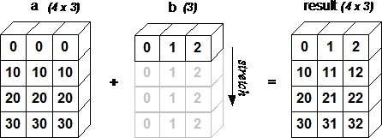
Figure demonstrating how array b is broadcast to become compatible with a. (Same as singleton expansion in MATLAB.)
The following figure demonstrates how array b is broadcast to become compatible with a.
Notes:
https://www.tutorialspoint.com/numpy/numpy_array_attributes.htm

Slide 104
NumPy - Iterating Over Array
NumPy contains an iterator object numpy.nditer.
It is an efficient multidimensional iterator object using which it is possible to iterate over an array.
Each element of an array is visited using Python’s standard Iterator interface.
Notes:
https://www.tutorialspoint.com/numpy/numpy_array_attributes.htm

Slide 105
create a 3X4 array using arange() function and iterate over it using nditer.
Example 1
import numpy as np
a = np.arange(0,60,5)
a = a.reshape(3,4)
print('Original array is:')
print(a)
print('\n')
print('Modified array is:')
for x in np.nditer(a):
print(x,end=" ") <<to supress <CR> at end, in python 2 done with “print x,”
Original array is:
[[ 0 5 10 15]
[20 25 30 35]
[40 45 50 55]]
Modified array is:
0 5 10 15 20 25 30 35 40 45 50 55
Notes:
https://www.tutorialspoint.com/numpy/numpy_array_attributes.htm

Slide 106
See
https://www.tutorialspoint.com/numpy/numpy_iterating_over_array.htm
For more on iteration order
Notes:
https://www.tutorialspoint.com/numpy/numpy_array_attributes.htm

Slide 107
Modifying Array Values
The nditer object has an optional parameter called op_flags.
Its default value is read-only, but can be set to read-write or write-only mode.
This will enable modifying array elements using this iterator.
Example
import numpy as np
a = np.arange(0,60,5)
a = a.reshape(3,4)
print('Original array is:')
print(a)
print('\n')
for x in np.nditer(a, op_flags = ['readwrite']):
x[...] = 2*x
print('Modified array is:')
print(a)
Notes:
https://www.tutorialspoint.com/numpy/numpy_array_attributes.htm

Slide 108
Original array is:
[[ 0 5 10 15]
[20 25 30 35]
[40 45 50 55]]
Modified array is:
[[ 0 10 20 30]
[ 40 50 60 70]
[ 80 90 100 110]]
Notes:
https://www.tutorialspoint.com/numpy/numpy_array_attributes.htm

Slide 109
External Loop
The nditer class constructor has a ‘flags’ parameter, which can take the following values
c_index - C_order index can be tracked
f_index - Fortran_order index is tracked
multi-index - Type of indexes with one per iteration can be tracked
external_loop - Causes values given to be one-dimensional arrays with multiple values instead of zero-dimensional array
Notes:
https://www.tutorialspoint.com/numpy/numpy_array_attributes.htm

Slide 110
Example
In the following example, one-dimensional arrays corresponding to each column is traversed by the iterator.
import numpy as np
a = np.arange(0,60,5)
a = a.reshape(3,4)
print('Original array is:’)
print(a)
print('\n’)
print('Modified array is:’)
for x in np.nditer(a, flags = ['external_loop'], order = 'F’):
print(x,end=" ")
Notes:
https://www.tutorialspoint.com/numpy/numpy_array_attributes.htm

Slide 111
Original array is:
[[ 0 5 10 15]
[20 25 30 35]
[40 45 50 55]]
Modified array is:
[ 0 20 40]
[ 5 25 45]
[10 30 50]
[15 35 55]
Notes:
https://www.tutorialspoint.com/numpy/numpy_array_attributes.htm

Slide 112
Broadcasting Iteration
If two arrays are broadcastable, a combined nditer object is able to iterate upon them concurrently.
Assuming that an array a has dimension 3X4, and there is another array b of dimension 1X4, the iterator of following type is used (array b is broadcast to size of a).
Notes:
https://www.tutorialspoint.com/numpy/numpy_array_attributes.htm

Slide 113
Example
import numpy as np
a = np.arange(0,60,5)
a = a.reshape(3,4)
print('First array is:'); print(a) print('\n')
b = np.array([1, 2, 3, 4], dtype = int)
print('Second array is:'); print(b)
print('\n'); print('Modified array is:')
for x,y in np.nditer([a,b]):
print("%d:%d" % (x,y),end=" ")
First array is:
[[ 0 5 10 15]
[20 25 30 35]
[40 45 50 55]]
Second array is: [1 2 3 4]
Modified array is:
0:1 5:2 10:3 15:4 20:1 25:2 30:3 35:4 40:1 45:2 50:3 55:4
Notes:
https://www.tutorialspoint.com/numpy/numpy_array_attributes.htm

Slide 114
NumPy - Array Manipulation
Several routines are available in NumPy for manipulating elements of ndarray objects.
Changing shape
reshape - Gives a new shape to an array without changing its data.
numpy.reshape(arr, newshape, order)
arr – array to be reshaped
newshape - int or tuple of int, compatible with original shape
order – 'C', 'F', 'A' means Fortran like order if an array is stored in Fortran-like contiguous memory, C style otherwise
Notes:
https://www.tutorialspoint.com/numpy/numpy_array_attributes.htm

Slide 115
NumPy - Array Manipulation
Changing shape
flat - A 1-D iterator over the array
This function returns a 1-D iterator over the array. It behaves similar to Python's built-in iterator.
b=a.flat
Notes:
https://www.tutorialspoint.com/numpy/numpy_array_attributes.htm

Slide 116
NumPy - Array Manipulation
Changing shape
flatten - Returns a copy of the array collapsed into one dimension
ndarray.flatten(order)
Notes:
https://www.tutorialspoint.com/numpy/numpy_array_attributes.htm

Slide 117
NumPy - Array Manipulation
Changing shape
ravel - Returns a contiguous flattened array
numpy.ravel(a, order)
Notes:
https://www.tutorialspoint.com/numpy/numpy_array_attributes.htm

Slide 118
NumPy - Array Manipulation
Changing shape
Transpose
transpose - Permutes the dimensions of an array
numpy.transpose(arr, axes)
axes -List of ints, corresponding to the dimensions. By default, the dimensions are reversed
Notes:
https://www.tutorialspoint.com/numpy/numpy_array_attributes.htm

Slide 119
NumPy - Array Manipulation
Changing shape
Transpose
ndarray.T – same as transpose
b=a.T
Notes:
https://www.tutorialspoint.com/numpy/numpy_array_attributes.htm

Slide 120
NumPy - Array Manipulation
Changing shape
Transpose
rollaxis - Rolls the specified axis backwards
numpy.rollaxis(arr, axis, start)
axis - Axis to roll backwards. The position of the other axes do not change relative to one another
start - Zero by default leading to the complete roll. Rolls until it reaches the specified position
Notes:
https://www.tutorialspoint.com/numpy/numpy_array_attributes.htm

Slide 121
NumPy - Array Manipulation
Changing shape
Transpose
swapaxes - Interchanges the two axes of an array
numpy.swapaxes(arr, axis1, axis2)
axis1 - int corresponding to the first axis
axis2 - int corresponding to the first axis
Notes:
https://www.tutorialspoint.com/numpy/numpy_array_attributes.htm

Slide 122
NumPy - Array Manipulation
Changing shape
Changing dimensions
broadcast - Produces an object that mimics broadcasting
b = np.broadcast(x,y)
Notes:
https://www.tutorialspoint.com/numpy/numpy_array_attributes.htm

Slide 123
NumPy - Array Manipulation
Changing shape
Changing dimensions
broadcast_to - Broadcasts an array to a new shape
numpy.broadcast_to(array, shape, subok)
Notes:
https://www.tutorialspoint.com/numpy/numpy_array_attributes.htm

Slide 124
NumPy - Array Manipulation
Changing shape
Changing dimensions
expand_dims - Expands the shape of an array
expands the array by inserting a new axis at the specified position
numpy.expand_dims(arr, axis)
Notes:
https://www.tutorialspoint.com/numpy/numpy_array_attributes.htm

Slide 125
NumPy - Array Manipulation
Changing shape
Changing dimensions
squeeze - Removes single-dimensional entries from the shape of an array
numpy.squeeze(arr, axis)
axis - int or tuple of int. selects a subset of single dimensional entries to remove
Notes:
https://www.tutorialspoint.com/numpy/numpy_array_attributes.htm

Slide 126
NumPy - Array Manipulation
Changing shape
Joining arrays
concatenate – Joins a sequence of arrays along an existing axis
numpy.concatenate((a1, a2, ...), axis)
Arrays must be of same type
axis – axis along which to join
Notes:
https://www.tutorialspoint.com/numpy/numpy_array_attributes.htm

Slide 127
NumPy - Array Manipulation
Changing shape
Joining arrays
stack – Joins a sequence of arrays along a new axis
numpy.stack(arrays, axis)
axis - Axis in the resultant array along which the input arrays are stacked
Notes:
https://www.tutorialspoint.com/numpy/numpy_array_attributes.htm

Slide 128
NumPy - Array Manipulation
Changing shape
Joining arrays
hstack – Stacks arrays in sequence horizontally (column wise)
Variant of numpy.stack function to stack into single array horizontally.
c = np.hstack((a,b))
Notes:
https://www.tutorialspoint.com/numpy/numpy_array_attributes.htm

Slide 129
NumPy - Array Manipulation
Changing shape
Joining arrays
vstack – Stacks arrays in sequence vertically (row wise)
Variant of numpy.stack function to stack into single array vertically.
c = np.vstack((a,b))
Notes:
https://www.tutorialspoint.com/numpy/numpy_array_attributes.htm

Slide 130
NumPy - Array Manipulation
Changing shape
Splitting Arrays – numpy.split
split - divides the array into subarrays along a specified axis
numpy.split(ary, indices_or_sections, axis)
indices_or_sections - Can be an integer, indicating the number of equal sized subarrays to be created from the input array.
If this parameter is a 1-D array, the entries indicate the points at which a new subarray is to be created.
axis default is 0.
Notes:
https://www.tutorialspoint.com/numpy/numpy_array_attributes.htm

Slide 131
NumPy - Array Manipulation
Changing shape
Splitting Arrays – numpy.split
numpy.hsplit is a special case of split() function where axis is 1 indicating a horizontal split regardless of the dimension of the input array.
Splits an array into multiple sub-arrays horizontally (column-wise)
b = np.hsplit(a,2)
Notes:
https://www.tutorialspoint.com/numpy/numpy_array_attributes.htm

Slide 132
NumPy - Array Manipulation
Changing shape
Splitting Arrays – numpy.split
numpy.vsplit is a special case of split() function where axis is 1 indicating a vertical split regardless of the dimension of the input array.
Splits an array into multiple sub-arrays vertically (row-wise)
b = np.hsplit(a,2)
Notes:
https://www.tutorialspoint.com/numpy/numpy_array_attributes.htm

Slide 133
NumPy - Array Manipulation
Changing shape
Adding / Removing Elements
numpy.resize - returns a new array with the specified size.
If the new size is greater than the original, it wraps till it fills elements up to the specified new size.
Notes:
https://www.tutorialspoint.com/numpy/numpy_array_attributes.htm

Slide 134
NumPy - Array Manipulation
Changing shape
Adding / Removing Elements
numpy.append
adds values at the end of an input array.
The non axis dimensions of the input arrays must match.
numpy.append(arr, values, axis)
axis – axis along which to append
Notes:
https://www.tutorialspoint.com/numpy/numpy_array_attributes.htm

Slide 135
NumPy - Array Manipulation
Changing shape
Adding / Removing Elements
numpy.insert
inserts values in the input array along the given axis and before the given index.
numpy.insert(arr, obj, values, axis)
obj - The index before which insertion is to be made
axis - The axis along which to insert.
Notes:
https://www.tutorialspoint.com/numpy/numpy_array_attributes.htm

Slide 136
NumPy - Array Manipulation
Changing shape
Adding / Removing Elements
numpy.unique
Returns an array of unique elements in the input array.
The function can be able to return a tuple of array of unique vales and an array of associated indices.
Nature of the indices depend upon the type of return parameter in the function call.
numpy.unique(arr, return_index, return_inverse, return_counts)
return_index - If True, returns the indices of elements in the input array
return_inverse - If True, returns the indices of unique array, which can be used to reconstruct the input array
return_counts - If True, returns the number of times the element in unique array appears in the original array
Notes:
https://www.tutorialspoint.com/numpy/numpy_array_attributes.htm

Slide 137
See:
https://www.tutorialspoint.com/numpy/numpy_binary_operators.htm
For binary operations
And:
https://www.tutorialspoint.com/numpy/numpy_string_functions.htm
For string functions.
Notes:
https://www.tutorialspoint.com/numpy/numpy_array_attributes.htm

Slide 138
NumPy - Mathematical Functions
Trigonometric Functions
np.sin(radians)
also cos, tan, arcsin, arccos, arctan, arctan2
numpy.degrees()
numpy.radians()
Rounding
numpy.around(): numpy.around(a,decimals)
numpy.floor(): returns the largest integer less than the input parameter
numpy.ceil(): returns the ceiling - the smallest integer i, such that i >= x
Notes:
https://www.tutorialspoint.com/numpy/numpy_array_attributes.htm

Slide 139
NumPy - Mathematical Functions
NumPy - Arithmetic Operations
numpy.add(arr1,arr2)
Also numpy.subtract(), _.multiply(), _.divide()
must be either of the same shape or should conform to array broadcasting rules.
numpy.reciprocal() : Returns the reciprocal of argument, element-wise. For INTEGERS with absolute values larger than 1, the result is always 0 because of the way in which Python handles integer division. For integer 0, an overflow warning is issued.
Notes:
https://www.tutorialspoint.com/numpy/numpy_array_attributes.htm

Slide 140
NumPy - Mathematical Functions
NumPy - Arithmetic Operations
numpy.power(arr1,arr2) : raises elements of arr1 to the power of the corresponding element in arr2.
numpy.mod(arr1,arr2) : returns the remainder of division of the corresponding elements in the input array. Same as numpy.remainder()
Notes:
https://www.tutorialspoint.com/numpy/numpy_array_attributes.htm

Slide 141
NumPy - Mathematical Functions
NumPy - Arithmetic Operations
a=complex(a,b)
numpy.real() − returns real part of complex data type argument.
numpy.imag() − returns imaginary part of complex data type argument.
numpy.conj() − returns complex conjugate, changes sign imaginary part.
numpy.angle(np.angle(a, deg = True)) − returns angle of the complex argument. Optional degree parameter. Default radians.
Notes:
https://www.tutorialspoint.com/numpy/numpy_array_attributes.htm

Slide 142
NumPy - Mathematical Functions
NumPy - Statistical Functions
numpy.amin(arr,axis) and numpy.amax(arr,axis) - return min/max array elements along specified axis.
numpy.ptp(, axis = n) - returns range (maximum-minimum) of values along an axis.
numpy.percentile(a, q, axis) – returns value below which a given percentage of observations in a group of observations fall. q: percentile to compute (between 0-100).
Notes:
https://www.tutorialspoint.com/numpy/numpy_array_attributes.htm

Slide 143
NumPy - Mathematical Functions
NumPy - Statistical Functions
numpy.median(a, axis = n) - returns median of values along an axis.
numpy.mean(a, axis = n) - returns arithmetic mean of values along an axis.
Notes:
https://www.tutorialspoint.com/numpy/numpy_array_attributes.htm

Slide 144
NumPy - Mathematical Functions
NumPy - Statistical Functions
numpy.average(a,weights = wts, axis = n) - returns weighted arithmetic mean of array using weights from a second array, along an axis.
Optionally return sum of weights.
Weighted average = (a*wts/sum(wts)) [element-by-element *]
np.std(a) – returns standard deviation
np.var(a) – return variance
Notes:
https://www.tutorialspoint.com/numpy/numpy_array_attributes.htm

Slide 145
NumPy - Mathematical Functions
NumPy - Sort, Search & Counting Functions
numpy.sort(a, axis, kind, order) - returns a sorted copy of the input array.
kind - Default is quicksort (others ‘mergesort’ and ‘heapsort’?)
order - If the array contains fields, the order of fields to be sorted
Notes:
https://www.tutorialspoint.com/numpy/numpy_array_attributes.htm

Slide 146
NumPy - Mathematical Functions
NumPy - Sort, Search & Counting Functions
numpy.argsort(a, axis) - Performs an indirect sort on input array, along the given axis and using a specified kind of sort to return the array of indices of data. Indices arra usyed to construct the sorted array.
import numpy as np
x = np.array([3, 1, 2])
print('Our array is:'); print(x); print('\n'); print('Applying argsort() to x:')
y = np.argsort(x)
print(y); print('\n'); print('Reconstruct original array in sorted order:'); print(x[y]); print('\n’)
print('Reconstruct the original array using loop:')
for i in y:
print (x[i],end=" ")
Notes:
https://www.tutorialspoint.com/numpy/numpy_array_attributes.htm

Slide 147
NumPy - Mathematical Functions
NumPy - Sort, Search & Counting Functions
numpy.lexsort() - performs an indirect sort using a sequence of keys. The keys can be seen as a column in a spreadsheet. The function returns an array of indices, using which the sorted data can be obtained. Note, that the last key happens to be the primary key of sort.
Notes:
https://www.tutorialspoint.com/numpy/numpy_array_attributes.htm

Slide 148
NumPy - Mathematical Functions
NumPy - Sort, Search & Counting Functions
import numpy as np
nm = ('raju','anil','ravi','amar')
dv = ('f.y.', 's.y.', 's.y.', 'f.y.')
ind = np.lexsort((dv,nm))
print('Applying lexsort() function:')
print(ind)
print('\n')
print('Use this index to get sorted data:')
print([nm[i] + ", " + dv[i] for i in ind])
Notes:
https://www.tutorialspoint.com/numpy/numpy_array_attributes.htm

Slide 149
NumPy - Mathematical Functions
NumPy - Sort, Search & Counting Functions
numpy.argmax(a, axis = n) and numpy.argmin(a, axis = n) - return the indices of maximum and minimum elements respectively along the given axis.
numpy.nonzero() – returns the indices of non-zero elements in the input array.
Notes:
https://www.tutorialspoint.com/numpy/numpy_array_attributes.htm

Slide 150
NumPy - Mathematical Functions
NumPy - Sort, Search & Counting Functions
numpy.where(a) - returns the indices of elements in an input array where the given condition is satisfied.
import numpy as np
x = np.arange(9.).reshape(3, 3)
print('Our array is:')
print(x)
print('Indices of elements > 3')
y = np.where(x > 3)
print(y)
print('get elements satisfying condition')
print(x[y])
Notes:
https://www.tutorialspoint.com/numpy/numpy_array_attributes.htm

Slide 151
NumPy - Mathematical Functions
NumPy - Sort, Search & Counting Functions
numpy.extract() - returns the elements satisfying any condition.
import numpy as np
x = np.arange(9.).reshape(3, 3)
print('Our array is:' )
print(x)
# define a condition
condition = np.mod(x,2) == 0
print('Element-wise value of condition')
print(condition)
print('Extract elements using condition')
print(np.extract(condition, x))
Notes:
https://www.tutorialspoint.com/numpy/numpy_array_attributes.htm

Slide 152
NumPy - Mathematical Functions
NumPy - Byte Swapping
See
https://www.tutorialspoint.com/numpy/numpy_byte_swapping.htm
If you need to do this.
Notes:
https://www.tutorialspoint.com/numpy/numpy_array_attributes.htm

Slide 153
NumPy - Mathematical Functions
NumPy - Copies & Views
No Copy
Simple assignments do not make the copy of array object.
Instead, it uses the same id() of the original array to access it.
The id() returns a universal identifier of Python object, similar to the pointer in C.
Furthermore, any changes in either gets reflected in the other.
For example, the changing shape of one will change the shape of the other too.
Notes:
https://www.tutorialspoint.com/numpy/numpy_array_attributes.htm

Slide 154
NumPy - Mathematical Functions
NumPy - Copies & Views
No Copy. (CAREFULL, WATCH OUT!!)
import numpy as np
a = np.arange(6)
print('Our array is:’); print(a)
print('Applying id() function:’); print(id(a))
print('a is assigned to b:')
b = a
print(b); print('b has same id():’); print(id(b)): print('Change shape of b:')
b.shape = 3,2
print(b)
print('Shape of a also gets changed:’); print(a)
Notes:
https://www.tutorialspoint.com/numpy/numpy_array_attributes.htm

Slide 155
NumPy - Mathematical Functions
NumPy - Copies & Views
View or Shallow Copy
ndarray.view(a) is a new array object that looks at the same data of the original array. Unlike the earlier case, a change in dimensions of the new array doesn’t change dimensions of the original.
import numpy as np
# To begin with, a is 3X2 array
a = np.arange(6).reshape(3,2)
print('Array a:’) ; print(a); print('Create view of a:')
b = a.view()
print(b); print('id() for both the arrays are different:')
print('id() of a:’); print(id(a)); print('id() of b:’); print(id(b))
# Change the shape of b. It does not change the shape of a
b.shape = 2,3
print('Shape of b:’); print(b); print('Shape of a:’); print(a)
Notes:
https://www.tutorialspoint.com/numpy/numpy_array_attributes.htm

Slide 156
NumPy - Mathematical Functions
NumPy - Copies & Views
Deep Copy
ndarray.copy() - creates a deep copy. It is a complete copy of the array and its data, and is independent of the original array.
import numpy as np
a = np.array([[10,10], [2,3], [4,5]])
print('Array a is:’); print(a); print('Create a deep copy of a:')
b = a.copy()
print('Array b is:’); print(b)
#b does not share any memory of a
print('Can we write b is a’); print(b is a); print('Change the contents of b:')
b[0,0] = 100
print('Modified array b:’); print(b); print('a remains unchanged:’); print(a)
Notes:
https://www.tutorialspoint.com/numpy/numpy_array_attributes.htm

Slide 157
NumPy - Mathematical Functions
NumPy - Matrix Library numpy.matlib
numpy.matlib.empty(shape, dtype, order) - function returns a new matrix without initializing the entries.
shape - int or tuple of int defining the shape of the new matrix
Dtype - Optional. Data type.
order - C or F
numpy.matlib.zeros(shape, dtype, order) - function returns the matrix filled with zeros.
numpy.matlib.ones(shape, dtype, order) - function returns the matrix filled with ones.
Notes:
https://www.tutorialspoint.com/numpy/numpy_array_attributes.htm

Slide 158
NumPy - Mathematical Functions
NumPy - Matrix Library numpy.matlib
numpy.matlib.eye(n, M,k, dtype)- returns matrix with 1 along the diagonal elements and the zeros elsewhere.
n - number of rows
M - number of columns, defaults to n
k - Index of diagonal
dtype - Data type
import numpy.matlib
import numpy as np
print(np.matlib.eye(n = 3, M = 4, k = 0, dtype = float))
print(np.matlib.eye(n = 3, M = 4, k = 1, dtype = float))
Notes:
https://www.tutorialspoint.com/numpy/numpy_array_attributes.htm

Slide 159
NumPy - Mathematical Functions
NumPy - Matrix Library numpy.matlib
numpy.matlib.identity(n, dtype) - function returns the Identity matrix of the given size.
numpy.matlib.rand(n, m) - function returns a matrix of the given size with random values.
Notes:
https://www.tutorialspoint.com/numpy/numpy_array_attributes.htm

Slide 160
NumPy - Mathematical Functions
NumPy - Matrix Library numpy.matlib
Note that a matrix is always two-dimensional, whereas ndarray is an n-dimensional array. The objects are inter-convertible.
import numpy.matlib
import numpy as np
i = np.matrix('1,2;3,4')
print(i)
j = np.asarray(i)
print(j)
k = np.asmatrix (j)
print(k)
Output
[[1 2]
[3 4]]
[[1 2]
[3 4]]
[[1 2]
[3 4]]
Notes:
https://www.tutorialspoint.com/numpy/numpy_array_attributes.htm

Slide 161
NumPy - Mathematical Functions
NumPy - Linear Algebra - numpy.linalg
numpy.dot(arr1,arr2) - function returns the dot product of two arrays.
For 2-D vectors, it is the equivalent to matrix multiplication.
For 1-D arrays, it is the inner product of the vectors.
For N-dimensional arrays, it is a sum product over the last axis of a and the second-last axis of b.
import numpy.matlib
import numpy as np
a = np.array([[1,2],[3,4]])
b = np.array([[11,12],[13,14]])
c=np.dot(a,b)
print(a)
print(b)
print(c)
(base) smalley@CERI-Smalley-16 topo % python z13.py
[[1 2]
[3 4]]
[[11 12]
[13 14]]
[[37 40]
[85 92]]
Notes:
https://www.tutorialspoint.com/numpy/numpy_array_attributes.htm

Slide 162
NumPy - Mathematical Functions
NumPy - Linear Algebra - numpy.linalg
import numpy.matlib
import numpy as np
a = np.array([[1,2],[3,4]])
b = np.array([[11,12],[13,14]])
c=np.dot(a,b)
print(a); print(b); print(c)
[[1 2]
[3 4]]
[[11 12]
[13 14]]
[[37 40]
[85 92]]
In MATLAB
>> a=[1 2;3 4];
1 2
3 4
>> b=[11 12; 13 14];
11 12
13 14
>> a*b
ans =
37 40
85 92
Notes:
https://www.tutorialspoint.com/numpy/numpy_array_attributes.htm

Slide 163
NumPy - Mathematical Functions
NumPy - Linear Algebra - numpy.linalg
numpy.vdot(a,b) - function returns dot product of the two vectors.
If the first argument is complex, then its conjugate is used.
If the argument id is multi-dimensional array, it is flattened.
import numpy as np
a = np.array([[1,2],[3,4]])
b = np.array([[11,12],[13,14]])
print(a);print(b);print(np.vdot(a,b))
Ouput
[[1 2]
[3 4]]
[[11 12]
[13 14]]
130
Notes:
https://www.tutorialspoint.com/numpy/numpy_array_attributes.htm

Slide 164
NumPy - Mathematical Functions
NumPy - Linear Algebra - numpy.linalg
numpy.inner(a, b) - function returns inner product of vectors for 1-D arrays. For higher dimensions, returns sum product over last axes.
import numpy as np
print( np.inner(np.array([1,2,3]),np.array([0,1,0])))
# Equates to 1*0+2*1+3*0
a = np.array([[1,2], [3,4]])
print('Array a:’) ; print(a)
b = np.array([[11, 12], [13, 14]])
print('Array b:’); print(b); print('Inner product:')
print(np.inner(a,b))
Array a:
[[1 2]
[3 4]]
Array b:
[[11 12]
[13 14]]
Inner product:
[[35 41]
[81 95]]
#matrix multiplication (all combos of row-column inner/dot products)
Notes:
https://www.tutorialspoint.com/numpy/numpy_array_attributes.htm

Slide 165
NumPy - Mathematical Functions
NumPy - Linear Algebra - numpy.linalg
numpy.matmul(a,b) - function returns the matrix product of two arrays.
While it returns a normal product for 2-D arrays, if dimensions of either argument is >2, it is treated as a stack of matrices residing in the last two indexes and is broadcast accordingly.
On the other hand, if either argument is 1-D array, it is promoted to a matrix by appending a 1 to its dimension, which is removed after multiplication.
Notes:
https://www.tutorialspoint.com/numpy/numpy_array_attributes.htm

Slide 166
NumPy - Mathematical Functions
NumPy - Linear Algebra - numpy.linalg
# For 2-D array, it is matrix multiplication
import numpy.matlib
import numpy as np
a = [[1,0],[0,1]]
b = [[4,1],[2,2]]
print(np.matmul(a,b))
# 2-D mixed with 1-D
import numpy.matlib
import numpy as np
a = [[1,0],[0,1]]
b = [1,2]
print(np.matmul(a,b))
print(np.matmul(b,a))
# one array having dimensions > 2
import numpy.matlib
import numpy as np
a = np.arange(8).reshape(2,2,2)
b = np.arange(4).reshape(2,2)
print(np.matmul(a,b))
[[4 1]
[2 2]]
[1 2]
[1 2]
[[[ 2 3]
[ 6 11]]
[[10 19]
[14 27]]]
>> a=[1 0; 0 1]
1 0
0 1
>> b=[4 1; 2 2]
4 1
2 2
>> a*b
4 1
2 2
>> a*repmat(b,2,1)
1 2
1 2
a=[[[0 1]
[2 3]]
[[4 5]
[6 7]]]
b=[[0 1]
[2 3]]
C(:,:,1) =
2 3
6 11
C(:,:,2) =
10 19
14 27
>> A(:,:,1) =[0 1; 2 3];
>> A(:,:,2) =[4 5; 6 7];
>> b=[0 1; 2 3];
>> c(:,:,1) = A(:,:,1) *b;
>> c(:,:,2) = A(:,:,2);
Notes:
https://www.tutorialspoint.com/numpy/numpy_array_attributes.htm
FINALLY – Python does something MATLAB does not – broadcasting/singleton expansion to multiply 3d NxMxO matrix by 2d NxM matrix

Slide 167
NumPy - Mathematical Functions
NumPy - Linear Algebra - numpy.linalg
import numpy as np
np.random.seed(42)
A = np.random.randint(0, 10, size=(3,3,2))
B = np.random.randint(0, 10, size=(3,2,4))
C = np.matmul(A,B)
print(”C=\n")
print(C)
F=A@B
print("F=\n")
print(F)
C=
[[[ 57 21 48 0]
[ 71 27 60 0]
[111 51 96 0]]
[[ 66 16 36 18]
[ 95 22 58 29]
[ 83 20 46 23]]
[[ 44 34 72 44]
[ 34 32 72 34]
[ 13 25 64 13]]]
F=
[[[ 57 21 48 0]
[ 71 27 60 0]
[111 51 96 0]]
[[ 66 16 36 18]
[ 95 22 58 29]
[ 83 20 46 23]]
[[ 44 34 72 44]
[ 34 32 72 34]
[ 13 25 64 13]]]
Notes:
https://www.tutorialspoint.com/numpy/numpy_array_attributes.htm
FINALLY – Python does something MATLAB does not – broadcasting/singleton expansion to multiply 3d NxMxO matrix by 2d NxM matrix

Slide 168
NumPy - Mathematical Functions
NumPy - Linear Algebra - numpy.linalg
More on this later!!
Notes:
https://www.tutorialspoint.com/numpy/numpy_array_attributes.htm
FINALLY – Python does something MATLAB does not – broadcasting/singleton expansion to multiply 3d NxMxO matrix by 2d NxM matrix

Slide 169
NumPy - Mathematical Functions
NumPy - Linear Algebra - numpy.linalg
NumPy – Determinant
np.linalg.det(a) - function calculates the determinant
Notes:
https://www.tutorialspoint.com/numpy/numpy_array_attributes.htm
FINALLY – Python does something MATLAB does not – broadcasting/singleton expansion to multiply 3d NxMxO matrix by 2d NxM matrix

Slide 170
NumPy - Mathematical Functions
NumPy - Linear Algebra - numpy.linalg
numpy.linalg.solve(A,B) - function solves Ax=B
import numpy as np
A= np.array([[1, 1, 2], [2, 5, 0],[2, 5, -1]])
B=np.array([6, -4, 27])
X=np.linalg.solve(A,B)
print('X=')
print(X)
CKB=A@X
print(‘CKB=')
print(CKB)
X=
[114.66666667 -46.66666667 -31. ]
A=
[[ 1 1 2]
[ 2 5 0]
[ 2 5 -1]]
B=
[ 6 -4 27]
CKB=
[ 6. -4. 27.]
x + y + z = 6
2y + 5z = -4
2x + 5y - z = 27
Notes:
https://www.tutorialspoint.com/numpy/numpy_array_attributes.htm
FINALLY – Python does something MATLAB does not – broadcasting/singleton expansion to multiply 3d NxMxO matrix by 2d NxM matrix

Slide 171
NumPy - Mathematical Functions
NumPy - Linear Algebra - numpy.linalg
numpy.linalg.inv(a) - function to invert matrix
Notes:
https://www.tutorialspoint.com/numpy/numpy_array_attributes.htm
FINALLY – Python does something MATLAB does not – broadcasting/singleton expansion to multiply 3d NxMxO matrix by 2d NxM matrix

Slide 172
NumPy - Mathematical Functions
More numpy.linalg functions
dot(a, b[, out])
linalg.multi_dot(arrays, *[, out])
outer(a, b[, out])
tensordot(a, b[, axes])
einsum(subscripts, *operands[, out, dtype, …])
einsum_path(subscripts, *operands[, optimize])
linalg.matrix_power(a, n)
kron(a, b)
linalg.cholesky(a)
linalg.qr(a[, mode])
linalg.svd(a[, full_matrices, compute_uv, …])
linalg.eig(a)
linalg.eigh(a[, UPLO])
linalg.eigvals(a)
linalg.eigvalsh(a[, UPLO])
linalg.norm(x[, ord, axis, keepdims])
linalg.cond(x[, p])
linalg.matrix_rank(M[, tol, hermitian])
linalg.slogdet(a)
trace(a[, offset, axis1, axis2, dtype, out])
linalg.tensorsolve(a, b[, axes])
linalg.lstsq(a, b[, rcond])
linalg.pinv(a[, rcond, hermitian])
linalg.tensorinv(a[, ind])
Notes:
https://www.tutorialspoint.com/numpy/numpy_array_attributes.htm
FINALLY – Python does something MATLAB does not – broadcasting/singleton expansion to multiply 3d NxMxO matrix by 2d NxM matrix

Slide 173
NumPy - Mathematical Functions
More numpy.linalg capability
Linear algebra on several matrices at once
Many of the linear algebra routines can compute results for several matrices at once, if they are stacked into the same array (3D).
This is indicated in the documentation via input parameter specifications such as a : (..., M, M) array_like.
This means that an input
array a.shape == (N, M, M)
is interpreted as a “stack” of N matrices, each of size M-by-M.
Notes:
https://www.tutorialspoint.com/numpy/numpy_array_attributes.htm
FINALLY – Python does something MATLAB does not – broadcasting/singleton expansion to multiply 3d NxMxO matrix by 2d NxM matrix

Slide 174
NumPy - Mathematical Functions
More numpy.linalg capability
Linear algebra on several matrices at once
Similar specification applies to return values, for instance the determinant has det : (...) and will in this case return an array of shape det(a).shape == (N,).
This generalizes to linear algebra operations on higher-dimensional arrays: the last 1 or 2 dimensions of a multidimensional array are interpreted as vectors or matrices, as appropriate for each operation.
(Cannot do natively in MATLAB, but there are a number of MATLAB packages available from the FileExchange that do this)
Notes:
https://www.tutorialspoint.com/numpy/numpy_array_attributes.htm
https://www.mathworks.com/matlabcentral/fileexchange/25977-mtimesx-fast-matrix-multiply-with-multi-dimensional-support
https://www.mathworks.com/matlabcentral/fileexchange/41663-multidimensional-matrix-multiplication

Slide 175
Subplots in Matplotlib
planning your plots
Two ways to make subplots
.add_subplot()
.subplot2grid()
First simpler, but it can’t do everything
Notes:
https://towardsdatascience.com/subplots-in-matplotlib-a-guide-and-tool-for-planning-your-plots-7d63fa632857

Slide 176
import matplotlib.pyplot as plt
def f(t):
return np.exp(-t) * np.cos(2*np.pi*t)
t1 = np.arange(0.0, 5.0, 0.1)
t2 = np.arange(0.0, 5.0, 0.02)
plt.figure()
plt.subplot(211)
plt.plot(t1, f(t1), 'bo', t2, f(t2), 'k') plt.subplot(212)
plt.plot(t2, np.cos(2*np.pi*t2), 'r--')
plt.show()
Notes:
What does this do?

Slide 177
import matplotlib.pyplot as plt
def f(t):
return np.exp(-t) * np.cos(2*np.pi*t)
t1 = np.arange(0.0, 5.0, 0.1)
t2 = np.arange(0.0, 5.0, 0.02)
plt.figure()
plt.subplot(211)
plt.plot(t1, f(t1), 'bo', t2, f(t2), 'k') plt.subplot(212)
plt.plot(t2, np.cos(2*np.pi*t2), 'r--')
plt.show()
Notes:
What does this do?

Slide 178
import matplotlib.pyplot as plt
def f(t):
return np.exp(-t) * np.cos(2*np.pi*t)
t1 = np.arange(0.0, 5.0, 0.1)
t2 = np.arange(0.0, 5.0, 0.02) plt.figure()
plt.subplot(211)
plt.plot(t1, f(t1), 'bo', t2, f(t2), 'k') plt.subplot(212)
plt.plot(t2, np.cos(2*np.pi*t2), 'r--') plt.show()
Notes:
we have already seen np.arrange – what does it do?
Type these two commands in and look at t1 and t2.
How long is each.
What is the maximum value for each?

Slide 179
import matplotlib.pyplot as plt
def f(t):
return np.exp(-t) * np.cos(2*np.pi*t)
t1 = np.arange(0.0, 5.0, 0.1)
t2 = np.arange(0.0, 5.0, 0.02)
plt.figure() #not really needed here
plt.subplot(211)
plt.plot(t1, f(t1), 'bo', t2, f(t2), 'k’) plt.subplot(212)
plt.plot(t2, np.cos(2*np.pi*t2), 'r--’)
plt.show()
Notes:
What does this do?
Subplot divides full figure area in to 2 rows, one column and takes first one (count is across rows and then increment down)
What is the difference between t1 and t2 (sampling interval over same range), f(t1) and f(t2)? Line looks continuous, dots are lower frequency ”sampling” of it. Line looks continuous, but it is not, it is the same as one with the dots. Probably another way to do this by decimating t2. Google it!

Slide 180
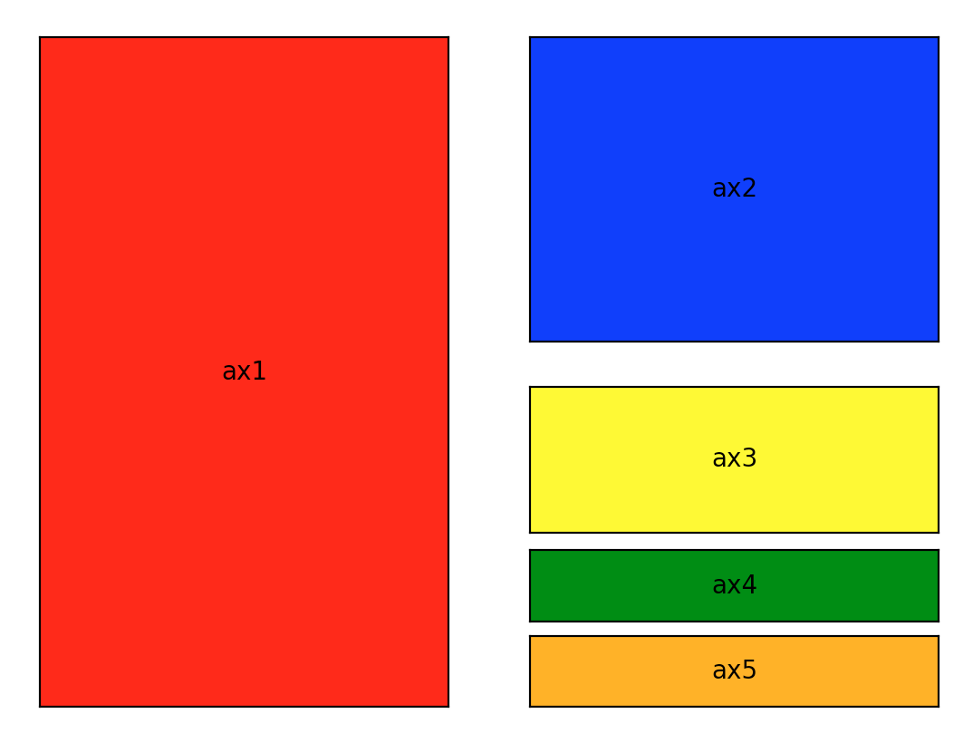
Defining subplot regions
Look at file subplotex1.py
That makes this figure.
Notes:
https://towardsdatascience.com/subplots-in-matplotlib-a-guide-and-tool-for-planning-your-plots-7d63fa632857
GUI from a “plot planner app”, but can’t find it.

Slide 181
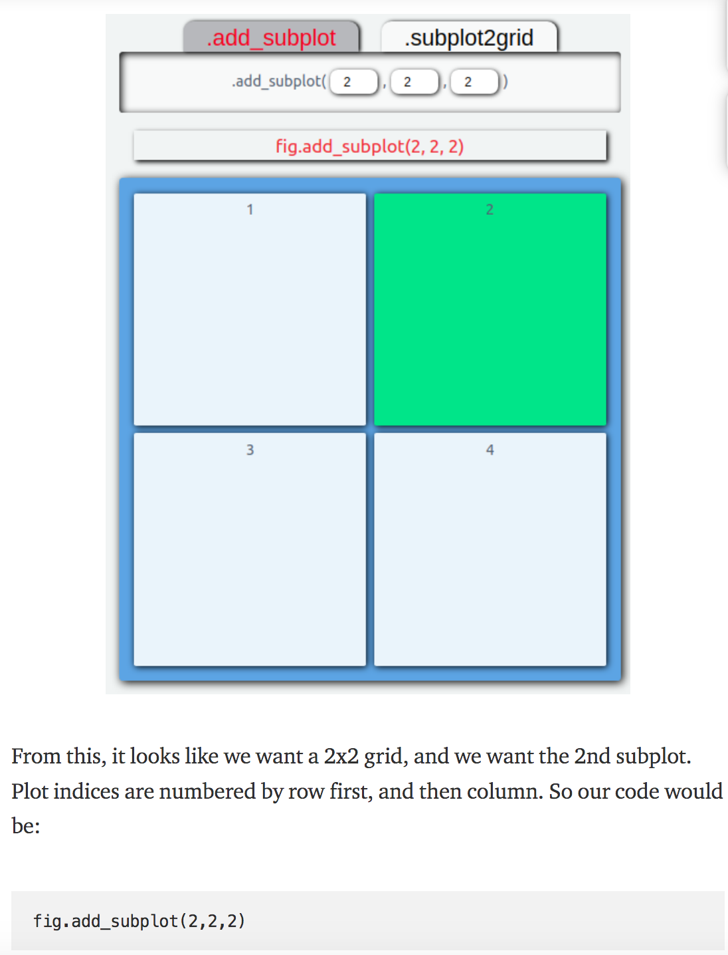
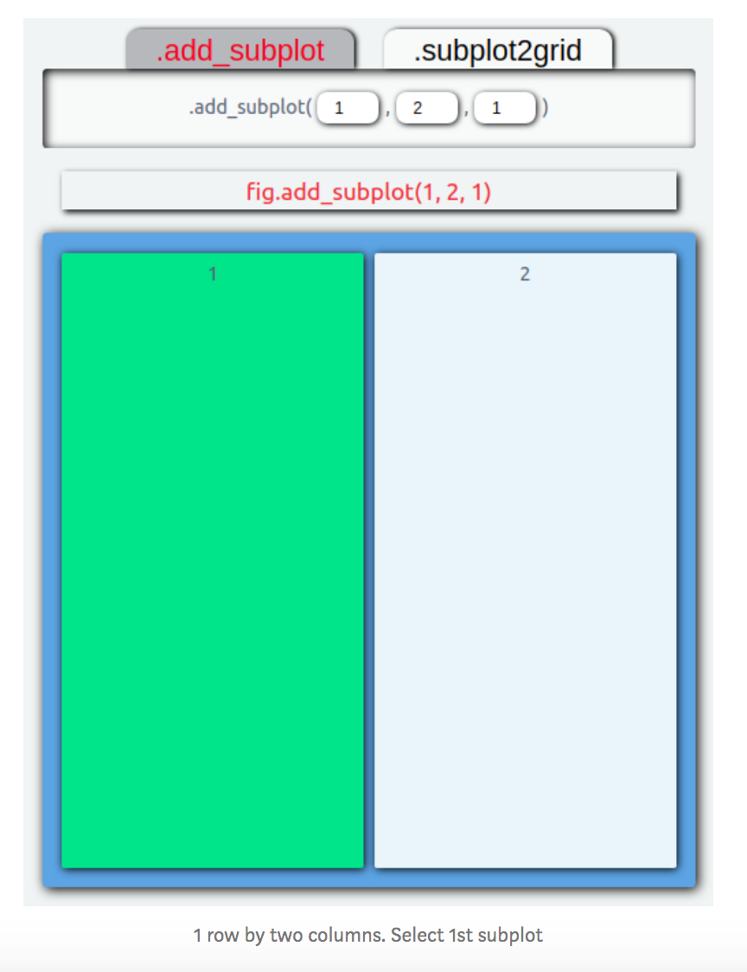
Defining subplot regions
Look at file subplotex1.py
NOTE – count from 1, not zero
Notes:
https://towardsdatascience.com/subplots-in-matplotlib-a-guide-and-tool-for-planning-your-plots-7d63fa632857
GUI from a “plot planner app”, but can’t find it.

Slide 182
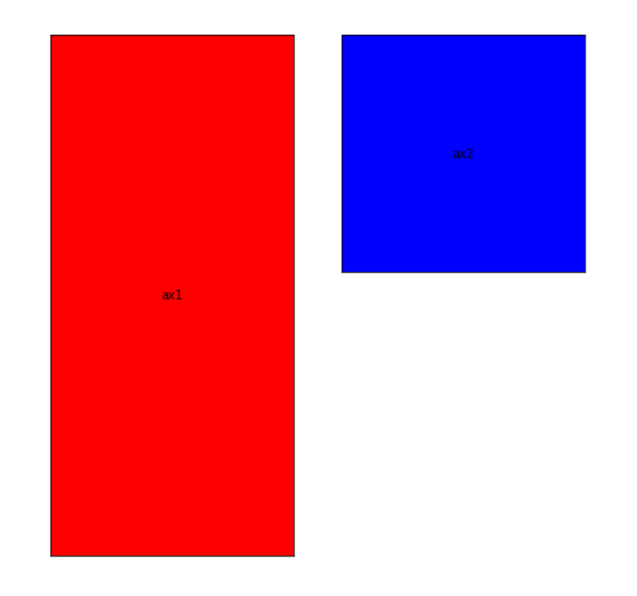
Defining subplot regions
Look at file subplotex1.py
Makes this so far
Notes:
https://towardsdatascience.com/subplots-in-matplotlib-a-guide-and-tool-for-planning-your-plots-7d63fa632857
GUI from a “plot planner app”, but can’t find it.

Slide 183
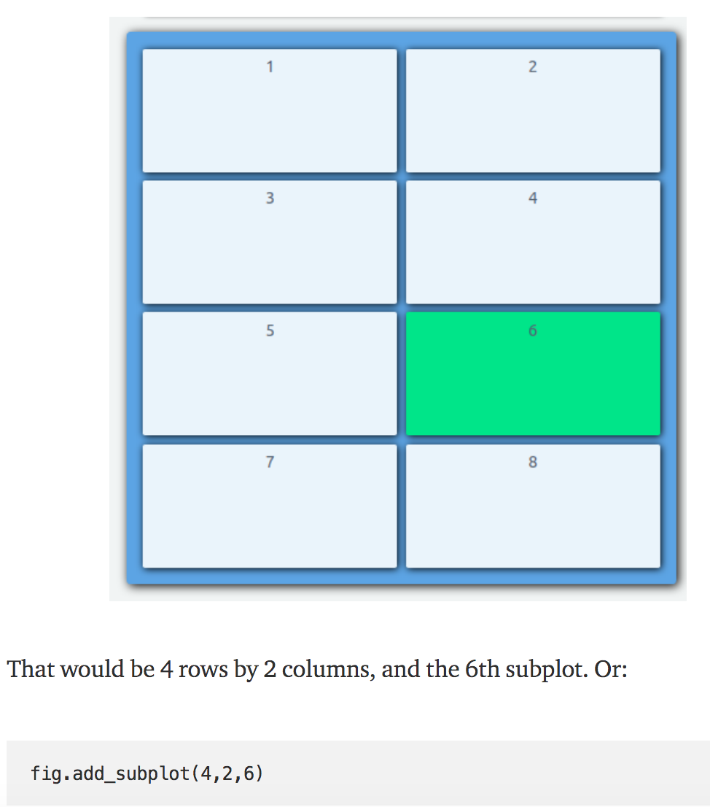
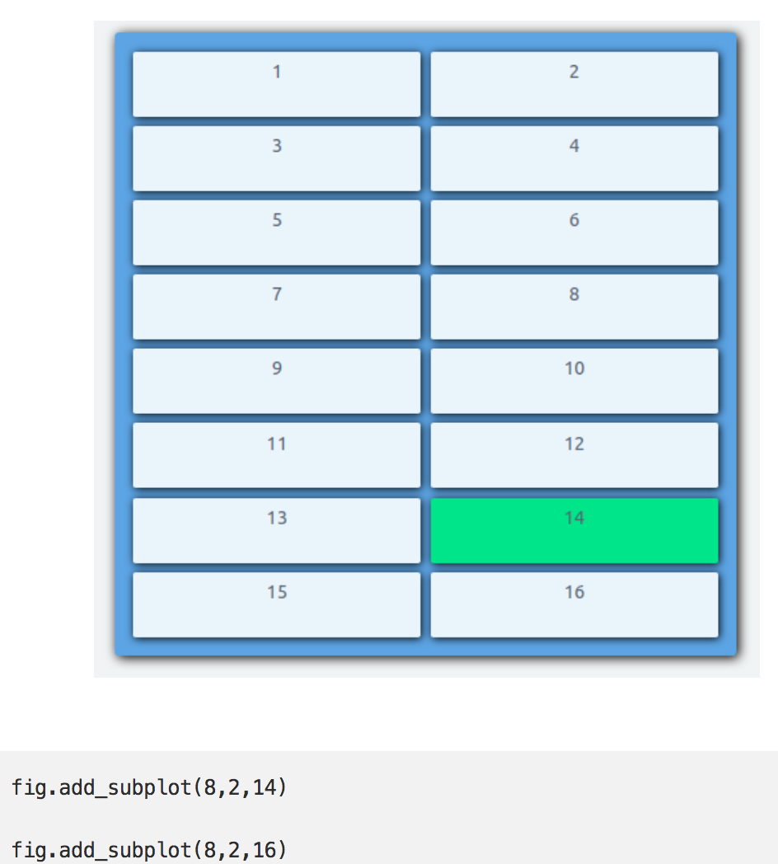
Defining subplot regions
Look at file subplotex1.py
Finish off
Notes:
https://towardsdatascience.com/subplots-in-matplotlib-a-guide-and-tool-for-planning-your-plots-7d63fa632857
Have to do last one twice to get both.

Slide 184
import matplotlib.pyplot as plt
def f(t):
return np.exp(-t) * np.cos(2*np.pi*t)
t1 = np.arange(0.0, 5.0, 0.1)
t2 = np.arange(0.0, 5.0, 0.02) plt.figure()
plt.subplot(211)
plt.plot(t1, f(t1), 'bo', t2, f(t2), 'k') plt.subplot(212)
plt.plot(t2, np.cos(2*np.pi*t2), 'r--')
plt.show()
Notes:
What does this do?
What subplot region selected?
What is plotted?

Slide 185
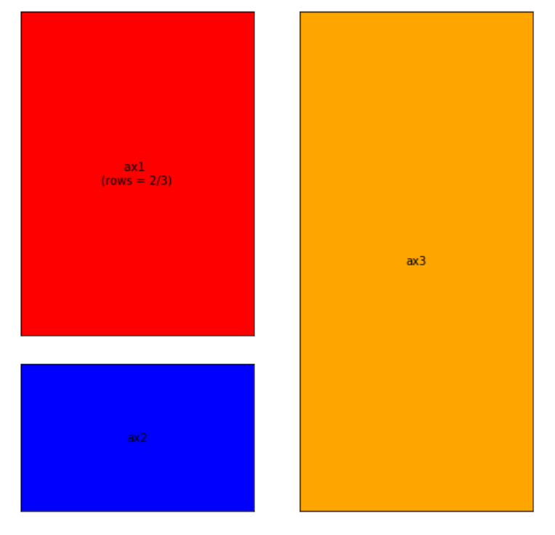
.add_subplot() has limitations.
For instance, every subplot you create can only take up one cell.
That means something like this isn’t possible with .add_subplot().
The problem here is that the red subplot takes up 2/3rds of the left-hand side.
Unfortunately, .add_subplot() can’t handle selecting 2/3rds of the figure area (2 cells).
Notes:
What does this do?

Slide 186
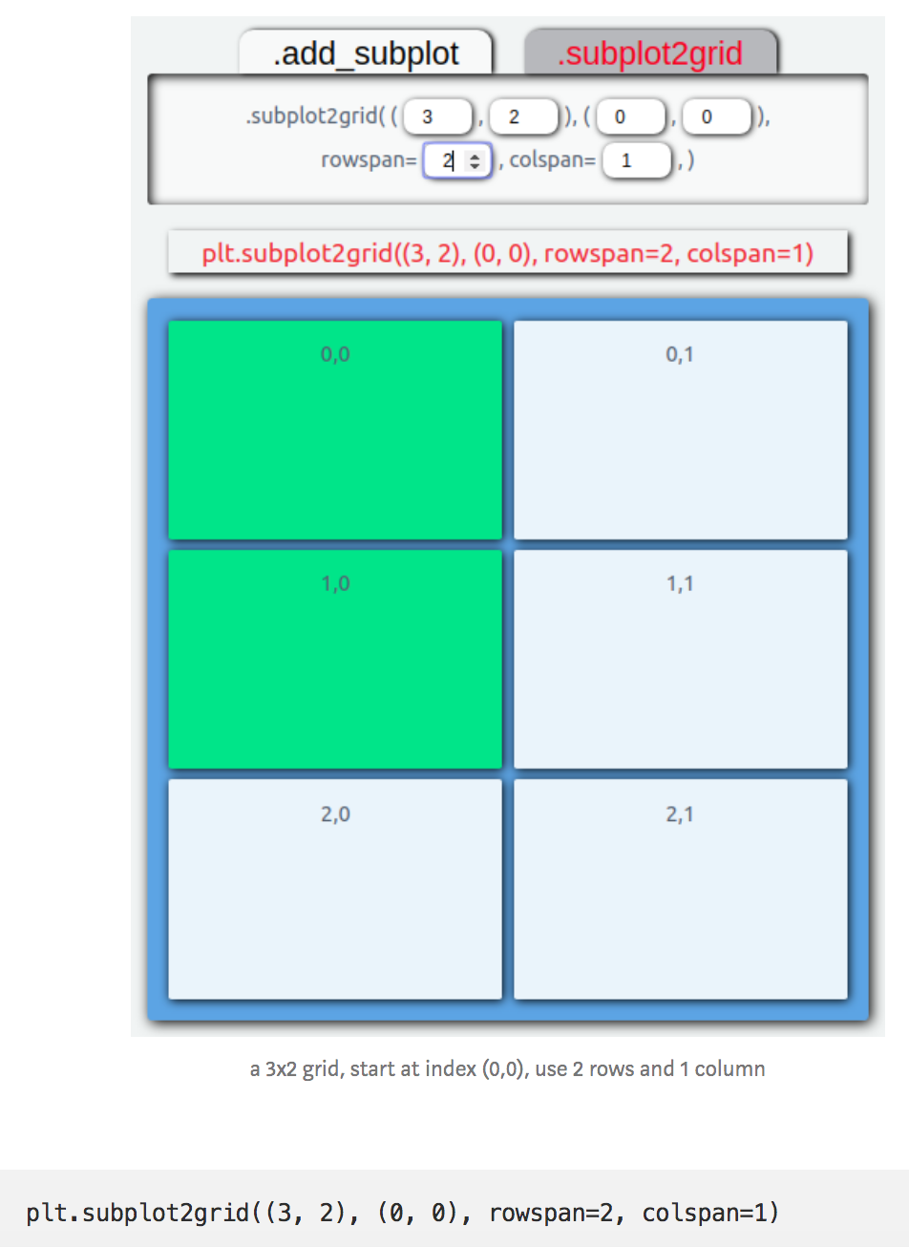
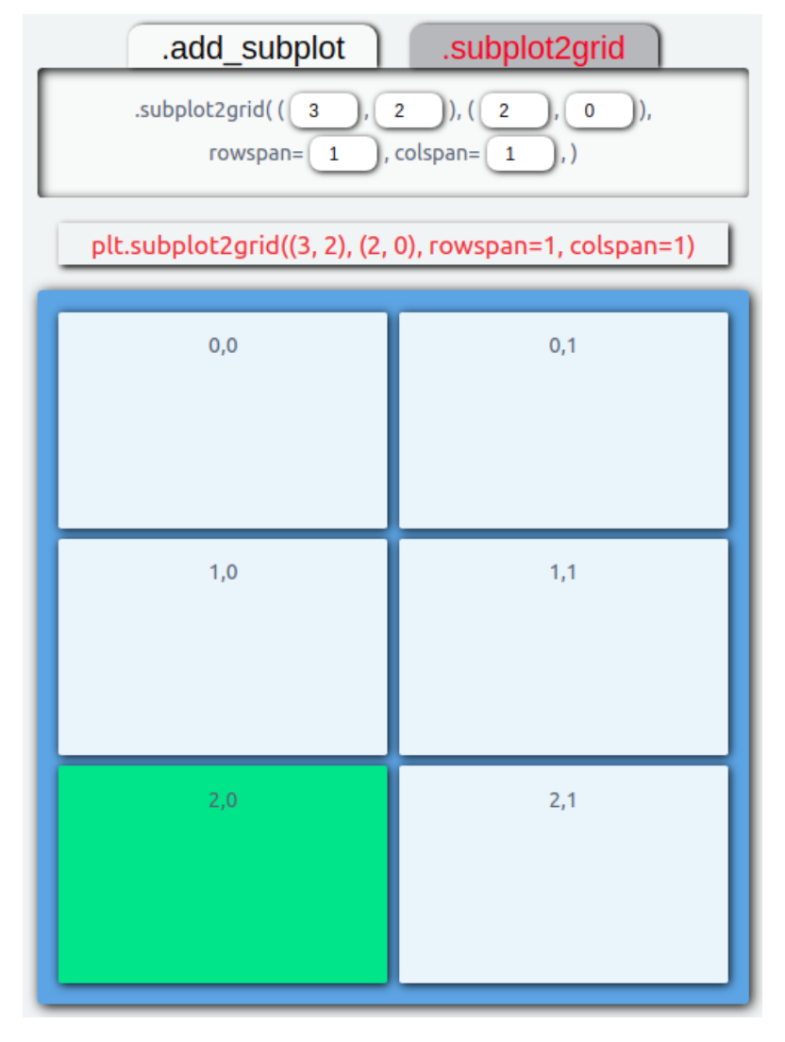
.subplot2grid()returns an axis object with the information about where the new subplot should be placed. It takes in two required positional arguments, shape, and loc.
For left-hand side
Note – counts from 0!
Notes:
Bottom – just change loc

Slide 187
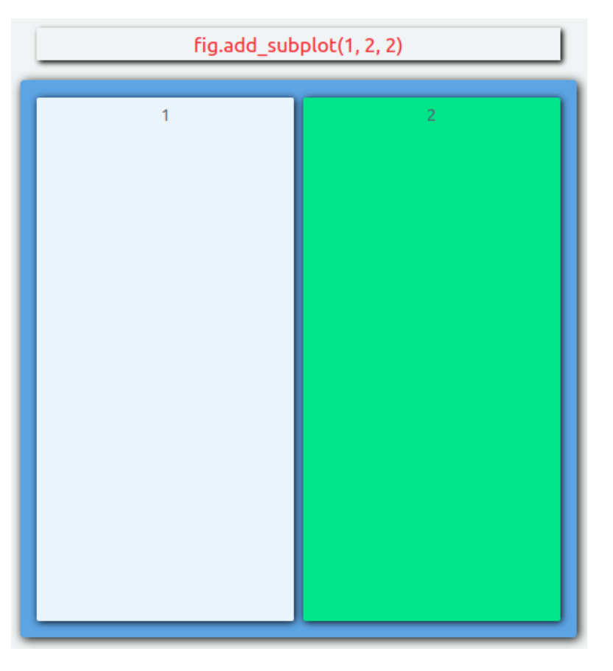
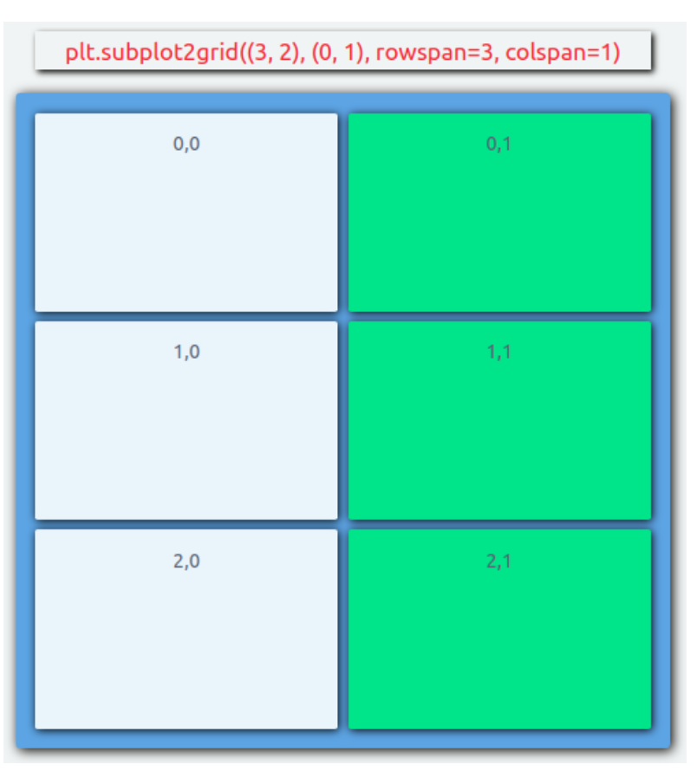
For right-hand side have 2 choices - .add_subplot or .subplot2grid
In this case, one on left is “cleaner” and recommended)
Notes:
Bottom – just change loc

Slide 188
For fun you could try to make this!

Slide 189
To see your python path
smalley@CERI-Smalley-16 CERI8104DataAnalF2021 % python
>>> for path in sys.path:
... print(path)
...
/Users/smalley/anaconda3/lib/python311.zip
/Users/smalley/anaconda3/lib/python3.11
/Users/smalley/anaconda3/lib/python3.11/lib-dynload
/Users/smalley/anaconda3/lib/python3.11/site-packages
/Users/smalley/anaconda3/lib/python3.11/site-packages/aeosa
>>>
Notes:
I;m skipping the junk that python prints out on startup
What does this do?

