Slide 1
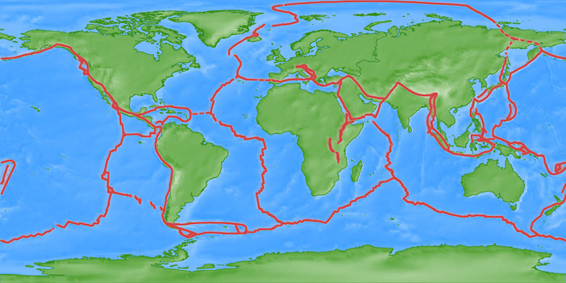
Triple junctions

Slide 2
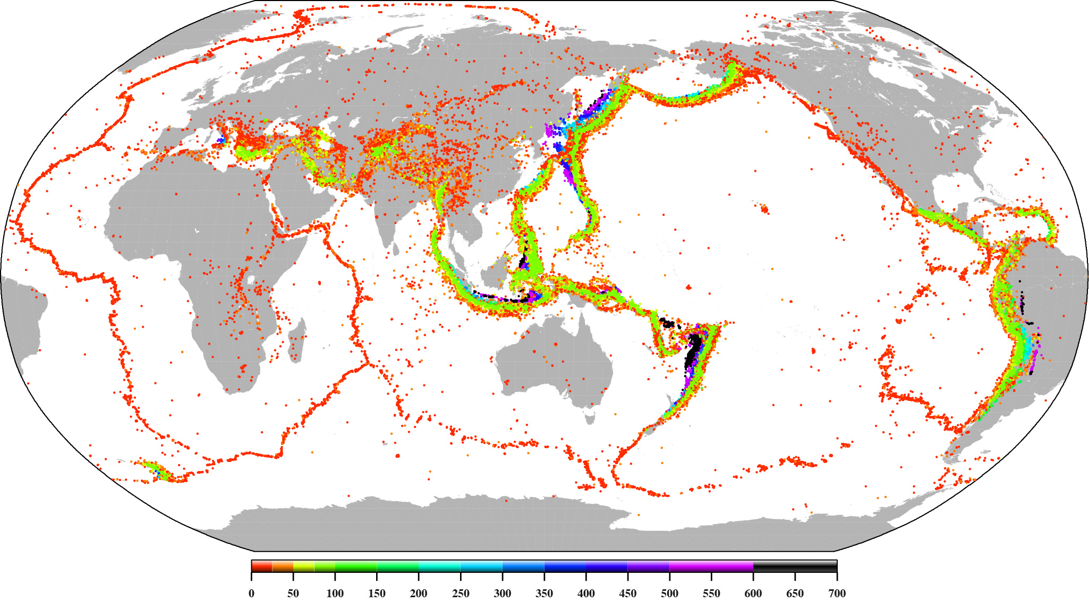

Slide 3
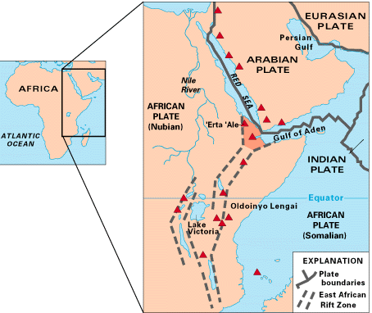

Slide 4
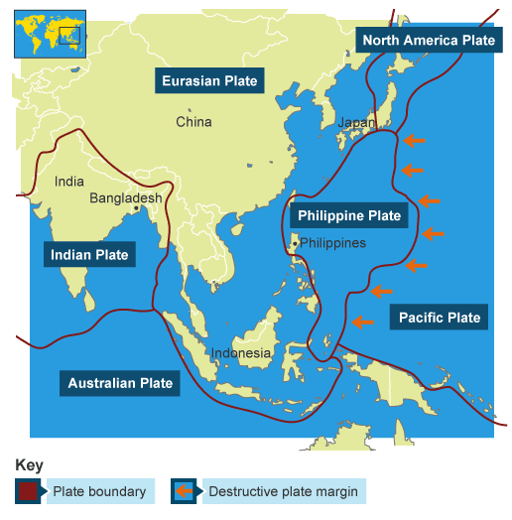

Slide 5
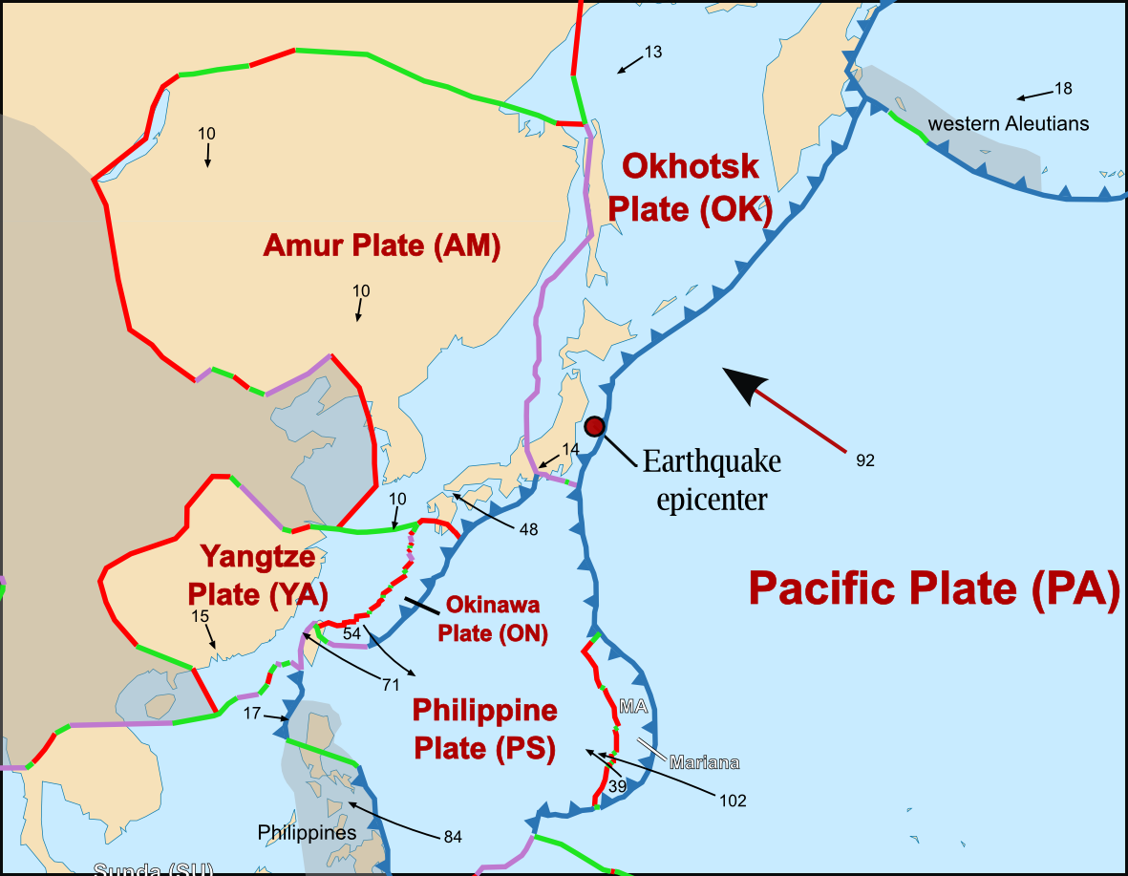

Slide 6
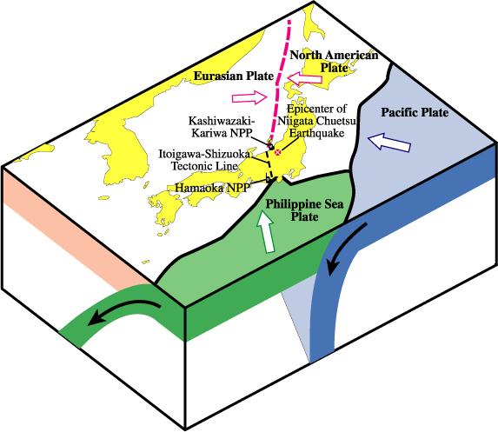

Slide 7
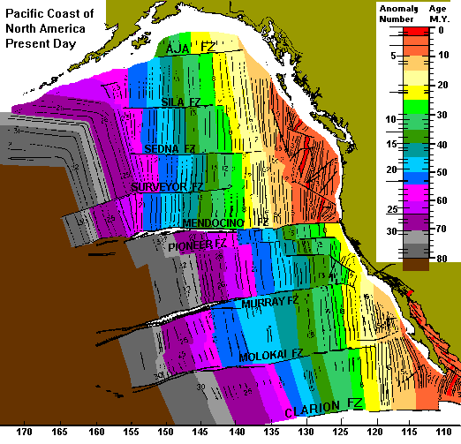
Provide insight
into prior plate
configurations

Slide 8
Movement of a TJ can change the type of plate boundary

Slide 9
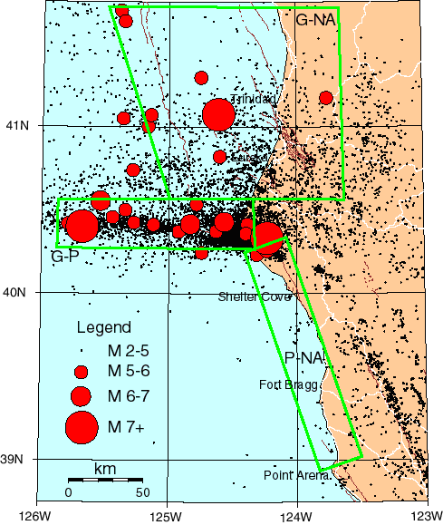
Mendocino TJ
An unstable TJ
can produce a
tectonic nightmare

Slide 10
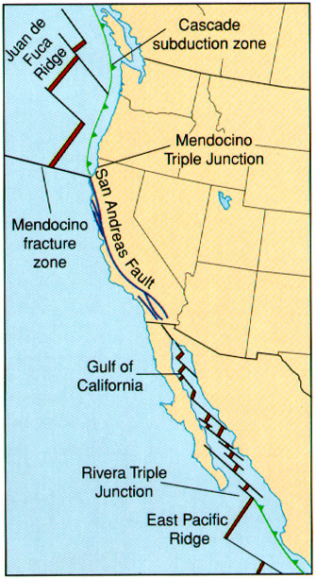
If “stable” they can provide a long
History of plate motion.

Slide 11
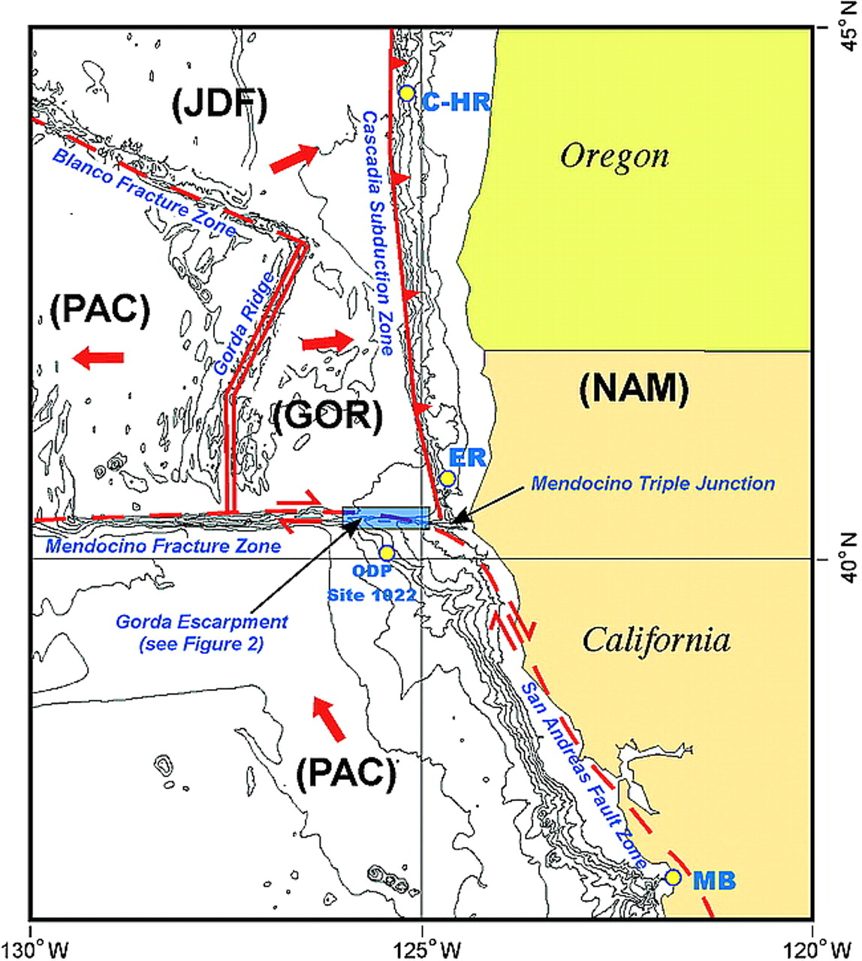

Slide 12
