Slide 1
Seismotectonics
CERI 7280
Class 8
Sep 16, 2016

Slide 3
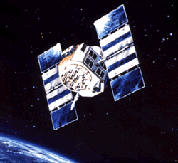
The Global Positioning System
(GPS)
A. Ganse, U. Washington , http://staff.washington.edu/aganse/

Slide 4
Introduction to GPS system
Positioning/navigation/time transfer system designed, built and funded by US DOD.
somewhat unforeseen and definitely unplanned
Explosion of civilian use based on technological/engineering developments

Slide 5

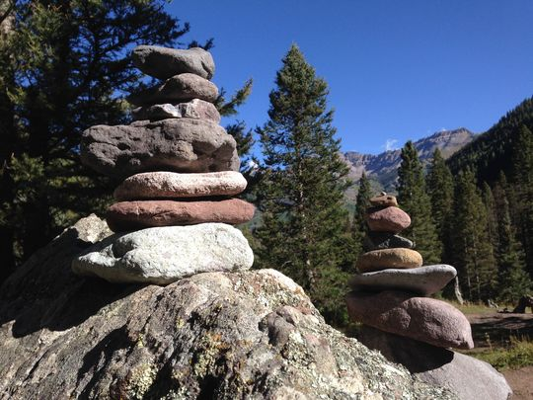
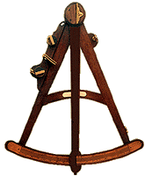
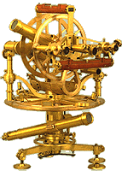


Brief History of Navigation
Stone age
Star age
Radio age
Satellite age
http://www.javad.com/index.html?/jns/gpstutorial/
Notes:
We still use the stone age technology, not so much the stars.

Slide 6
GPS positioning

Slide 7
GPS Uses Multi-Satellite Ranging
GPS is time of flight (range) system
(like locating earthquakes with P waves only)
Notes:
GPS uses ranging (distance measurements) to a number of satellites (at known positions) to calculate the position of the GPS antenna.
It is a “time of flight” – in seismology terms, a travel time – based system/calculation.

Slide 8
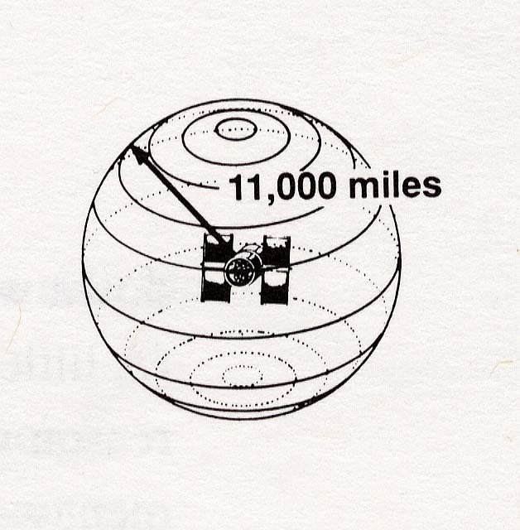
GPS is based on satellite ranging, i.e. distance from satellites
…satellites are precise reference points
…we determine our distance from them
Mattioli-http://comp.uark.edu/~mattioli/geol_4733.html and Trimble
Notes:
we will assume for now we know exactly where satellite is and how far away from it we are…
if we are lost and we know that we are 11,000 miles from satellite A… we are somewhere on a sphere whose middle is satellite A and diameter is 11,000 miles

Slide 9
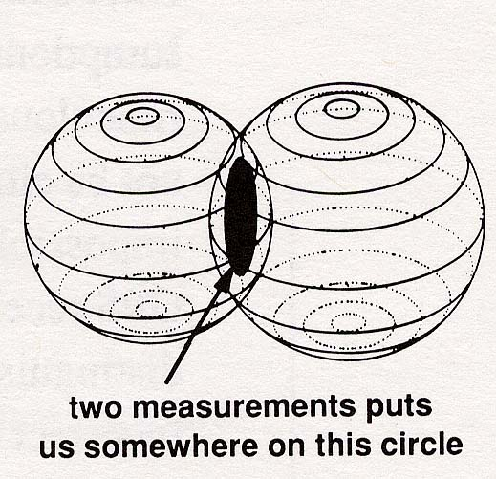
Mattioli-http://comp.uark.edu/~mattioli/geol_4733.html and Trimble
Notes:
Narrowing it down if we also know that we are 12,000 miles from satellite B …we can narrow down where we must be… the only place in universe that satisfies both conditions is on circle where two spheres intersect
(assuming our spheres don’t touch at only a point.)

Slide 10
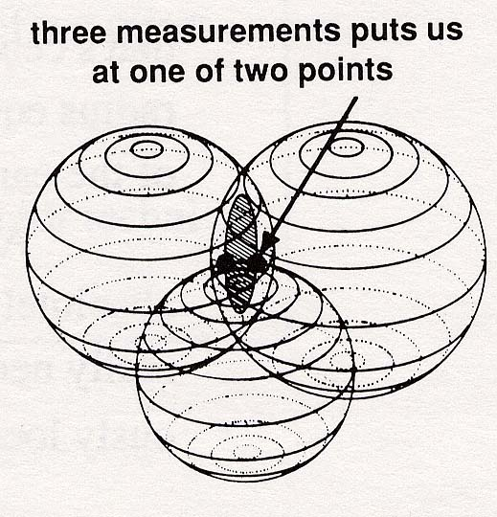
Mattioli-http://comp.uark.edu/~mattioli/geol_4733.html and Trimble
Notes:
Finally - if we also know that we are 13,000 miles from satellite C …our situation improves immensely… we are at the only place in universe that is at either of two points where three spheres intersect
Which point you are at is determined by “sanity” – 1 point obviously wrong.
this is basic principle behind GPS… …using satellites for trilaturation (not triangulation).

Slide 11
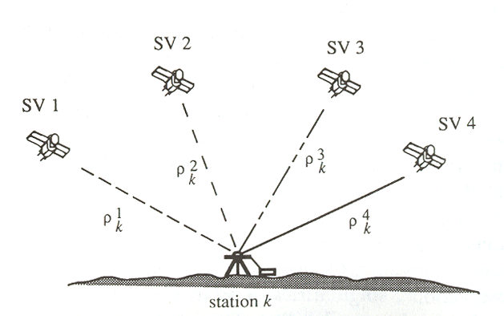
Pseudo range – measure time, not range.
Calculate range from r=ct
Blewitt, Basics of GPS in “Geodetic Applications of GPS”
Notes:
Tau is clock bias – at both satellite and receiver
Need good clocks – light goes .3 m per nanosecond.
Distance from time

Slide 12
From Pathagoras
Blewitt, Basics of GPS in “Geodetic Applications of GPS”
Notes:
(x^{S},y^{S},z^{S}) and τ^{S} known from satellite navigation message
(x^{R},y^{R},z^{R}) and τ^{R} are 4 unknowns
Assume c constant along path, ignore relativity.
For N satellites get N of these nonlinear equations, since 4 unknowns need at least 4 satellites.
With more than 4, do LS, get answer plus statistics
(another feathure that is not usually used in gps processing - is have some level of error correcting – for big errors. If have 5 satellites can know that you have a problem, if have 6 or more and one is really bad, can id bad one and throw it out in a rerun).
Complicating detail, satellite position has to be calculated at transmission time.
Satellite range can change by up to 60 m during the approximately 0.07 sec travel time from satellite to receiver.
Using receive time can result in 10’s m error in range.

Slide 13
GPS geometry
Raypaths (approximately) straight lines.
Really function of travel time (tt) but can change to psuedo-range.
(x_{sat1} , y_{sat1} ,t_{sat1} )
D_{rx,sat1} = F(τ)
(x_{rx} , y_{rx} , z_{rx} ,t_{rx} )

Slide 14
Note that GPS location is pretty much the same as the earthquake location problem.
(x_{stn1} , y_{stn1} ,t_{stn1} )
(x_{sat1} , y_{sat1} ,t_{sat1} )
d_{eq,1} = F(tt)
D_{rx,sat1} = F(tt)
(x_{rx} , y_{rx} , z_{rx} ,t_{rx} )
(x_{eq} , y_{eq} , z_{eq} ,t_{eq} )
See http://www.ceri.memphis.edu/people/smalley/ESCI7355/geodesy_ESCI7355_f2012_class_6.pdf for full gory details
Notes:
So use what we know about earthquake locating.
In a homogeneous half space – raypaths are straight lines, again function of travel time but can also look at distance.

Slide 15
Accuracy of GPS location is a function of the period of the signal you are using to measure time (the period of the “code”).
Practically precision is 5-10 m.
Notes:
The civilian “code” has a 1 ms period.
This limits the precision (theoretically) to a few meters (one can measure the ”time” of the code to about 1% of its period).
Can get a bit better with WAAS, a system that transmits some correction information (2 m).

Slide 16
BUT – can also use phase of carrier signal.
Using this can (theoretically) get mm precision.
Notes:
All math same – use measured phase instead of time and turn it into a distance.
Measure phase difference between whensignal left satellite and when arrived.
Have a few additional problems – there is a 2*pi uncertainty in the total phase.

Slide 17
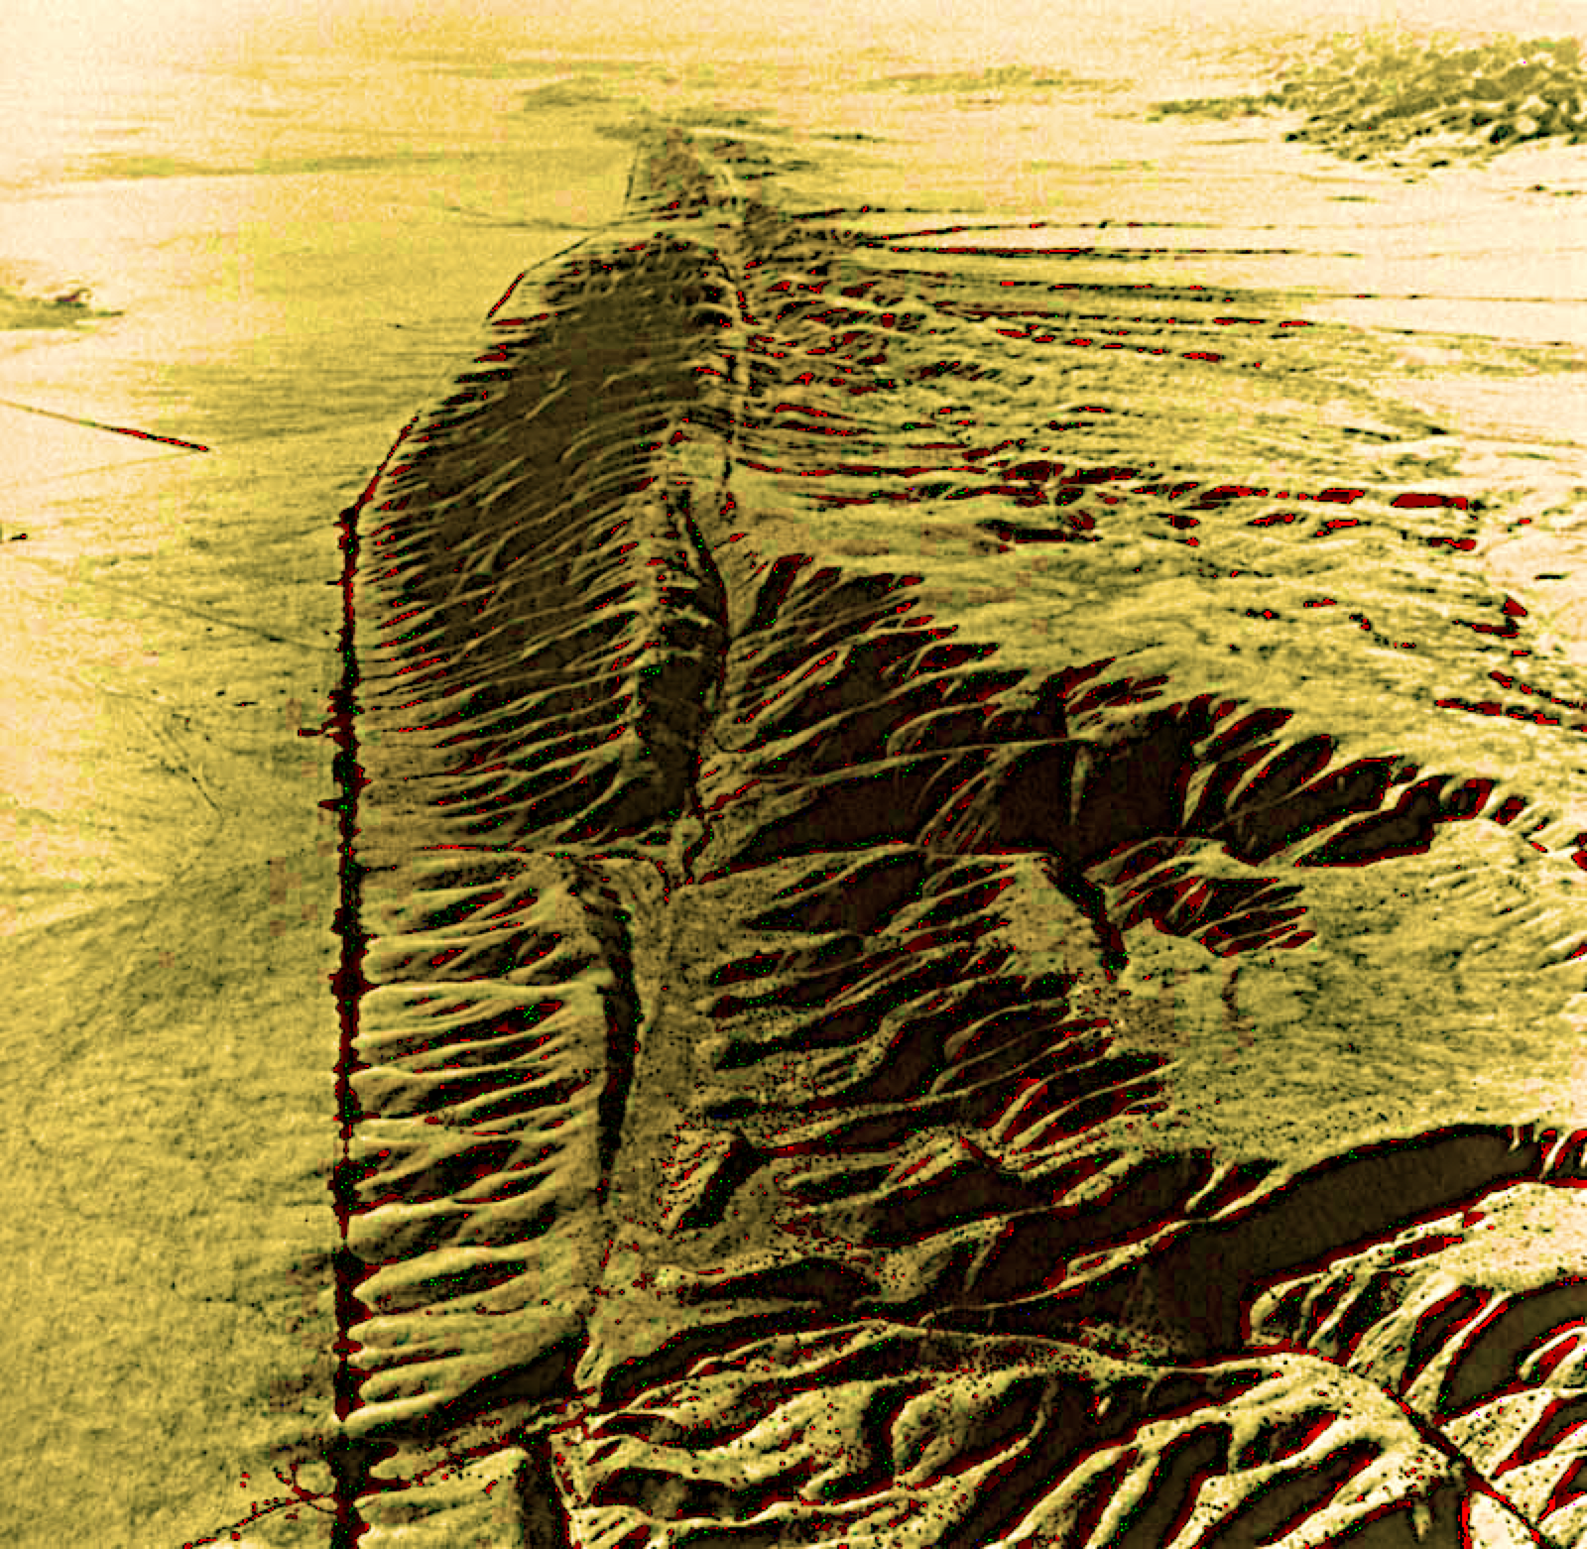
Blewitt, Basics of GPS in “Geodetic Applications of GPS”
From E. Calais
Notes:
Making a few reasonable assumptions we can interpret N geometrically to be the number of carrier wavelengths between the receiver (when it makes the first observation) and the satellite (when it transmitted the signal)
Another complication – have to correct for doppler shift.
But in the end – get back to earthquake location problem!

Slide 18
(some/selected) GPS applications
Plate Motions
Quantification of plate boundary (and other) deformations of (not so) “solid” earth.
Notes:
Plate motions
Coseismic
Interseismic
Loading (vertical)
tidal

Slide 19
Plate motions
NUVEL – geologic
GPS – non-geologic
Notes:
Geologic --- intimately tied to plates
Spreading rate and orientation (Ma ave)
Transform fault orientation (no rate info, Ma ave)
Earthquake Focal mechanism (problem with slip partitioning, 30 yr ave - actual)
GPS – non-geologic, measures movement of points, these “grouped” into plates.
Measures relative movement (20 yr ave – actual)
Can’t test (yet) plate stability assumption
GPS “tied” to Nuvel (but could be tied to anything – eg stars).
Spreading boundaries – if needed to make closed circuits – good data for plate motions over few million year average
Problem is not all plates have spreading boundaries, or their spreading boundaries are not connected in closed circuits (similarly GPS needs LAND, so GPS can’t help for completely suboceanic plates).
Transform boundaries – give small circles – can find pole of rotation position only, no rate info
Convergent boundaries – worst of all – eq slip vectors for direction (approximate, not always being parallel to plate motion) and rate (also approximate – from earthquake cycle)
Sometimes have to use "closure" to get with respect to some plate circuit.

Slide 20
What are limits on strain rates in
stable plate interiors -
bounded between
10⁻¹² -10⁻¹¹ and 10⁻¹⁰ year⁻¹.
THE PLATE TECTONIC APPROXIMATION: Plate Nonrigidity, Diffuse Plate Boundaries, and Global Plate Reconstructions
Richard G. Gordon
Annual Review of Earth and Planetary Sciences
Vol. 26: 615-642 (Volume publication date May 1998)
(doi:10.1146/annurev.earth.26.1.615)
Notes:
If strain faster – can't "play the tape backwards" for Plate Tectonics, shape changes too much to match up when close oceans. At least for last cycle (don’t have info on previous ones!).
10-19 – 10-17 sec-1
Pi * 10+7 sec in year!

Slide 21
picture of GPS site motions – shows plate motions
Notes:
Old results – but very illustrative selection of sites. New results have way too many vectors – is all black.
GPS system internally defined in an “inertial” frame of the satellite orbits.
In this figure we are seeing motion with respect to some “absolute” reference frame known as ITRF (International Terrestrial Reference Frame).
This frame is aligned to NUVEL1 NNR as best as possible so the motions look as close to NUVEL1 NNR as possible – in a LS sense)
ITRF does not know about “plates”, but we can “see” them by points that move “together”
NUVEL1 is all relative – movement of one plate with respect to another (that’s how the velocities are determined, through spreading, transform/fracture zones, earthquake slip –measurements across plate boundaries).
NUVEL1 uses Pacific as reference (so everything is relative to Pacific which has 0 rate and 0 azimuth in NUVEL1).
.
To get “abolute” NUVEL1 NNR (and 1a NNR), rotate all the NUVEL1 vectors relative to the Pacific plate hot-spot “plate” euler vector that you get from the Hawaiian and other Pacific hot spot tracks.
The hot spot sources (plumes) basically make a new “plate” and everybody has an euler pole with respect to the hotspot plate (which is now the 0 rate and 0 azimuth plate).
To get GPS to “agree” as best as possible with NUVEL1 and the hot spots, just rotate all the GPS vectors around the euler pole of the hotspots in the satellite frame (actually done other way around, invert for an euler pole that minimizes the difference of the relative velocities between each pair of plates for NUVEL1 NNR and ITRF. Could put GPS sites on all the islands in the Hawaii-Emperor and other seamount chains in the Pacific and find the pole with respect to the Pacific plate that they rotate around and then apply –w to everybody).

Slide 22
We now have to consider two distinct reference systems:
space-fixed (quasi) inertial system
2. Earth-fixed terrestrial system
-----------------
Both systems use center of earth and earth rotation in definition and realization
Notes:
Very important difference – except for measuring plate motions – is the type of reference system – mostly effects the vertical
GPS is geometric
“traditional” is “physical”, depends on GEOID
(Conventional Inertial System CIS)
(Astronomy, VLBI, ITRF are in this system)
Defined geometrically (mathematially)
(Conventional Terrestrial System CTS)
(NUVEL etc. sort of in this type)

Slide 23
Notes:
Not important for geological time scale plate movements – but dominates all surveying/geodetic measurements
GPS reference frame is geometric – position on, and height with respect to, an “ellipsoid” that is the best fit ellipsoid to the whole earth. This is why GPS altitude is “off”, sometimes by quite a bit.
“traditional” reference frame is “physical”, usually heavily dependent on vertical which depends on gravity/GEOID (=equipotential surface)
Can be quite hard to consistently convert between them.

Slide 24
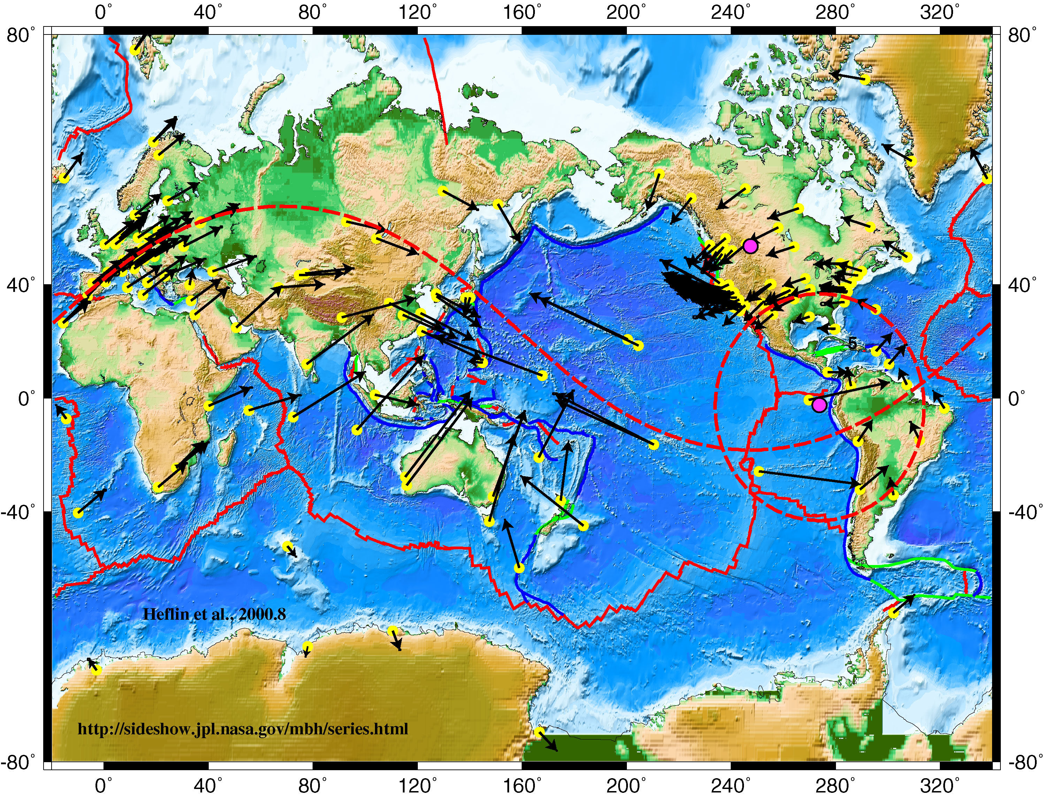
Velocities of IGS global tracking GPS sites in ITRF.
Notes:
No plates here – just movement of gps sites – but shows where the plates are (at least some of them – eg N. Am. Europe/N Asia, Australia, S. Am, Africa).
Small “circles” for N. American and European poles shown.
N. Am. One looks like small circle, European one does not not, but it is, map is in a Mercator projection.
Velocities are tangent to small circles (look like windshield wiper streaks).

Slide 25
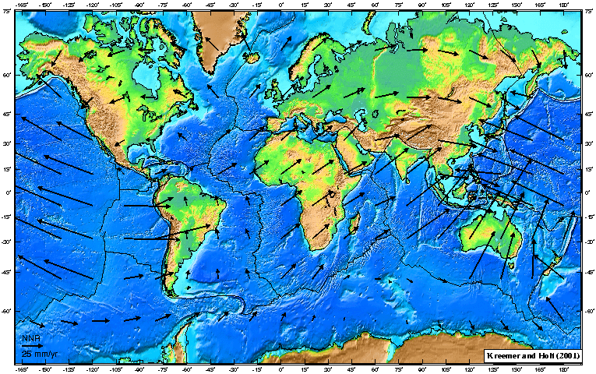
Gridded view of GPS defined plate velocities in ITRF
(approximates NUVEL, but does not “look like” NUVEL because NUVEL shows relative motions)
Notes:
Should look like NUVEL.

