Slide 1
Seismotectonics
CERI 7280
Class 7
Sep 13, 2016

Slide 2


Slide 3
Clean up from previous class(es)
Notes:
Russo and Silver 1994

Slide 4
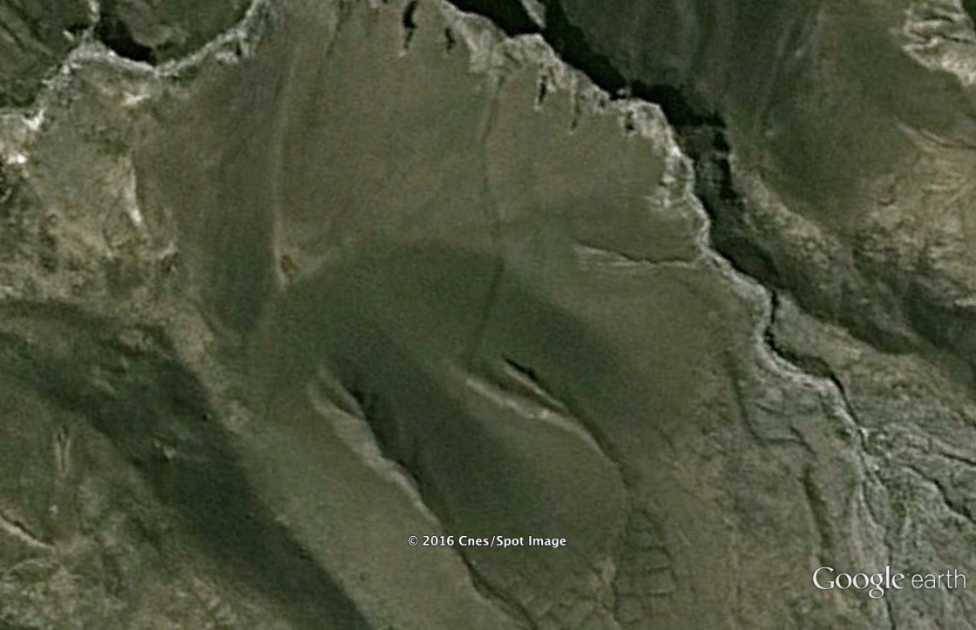
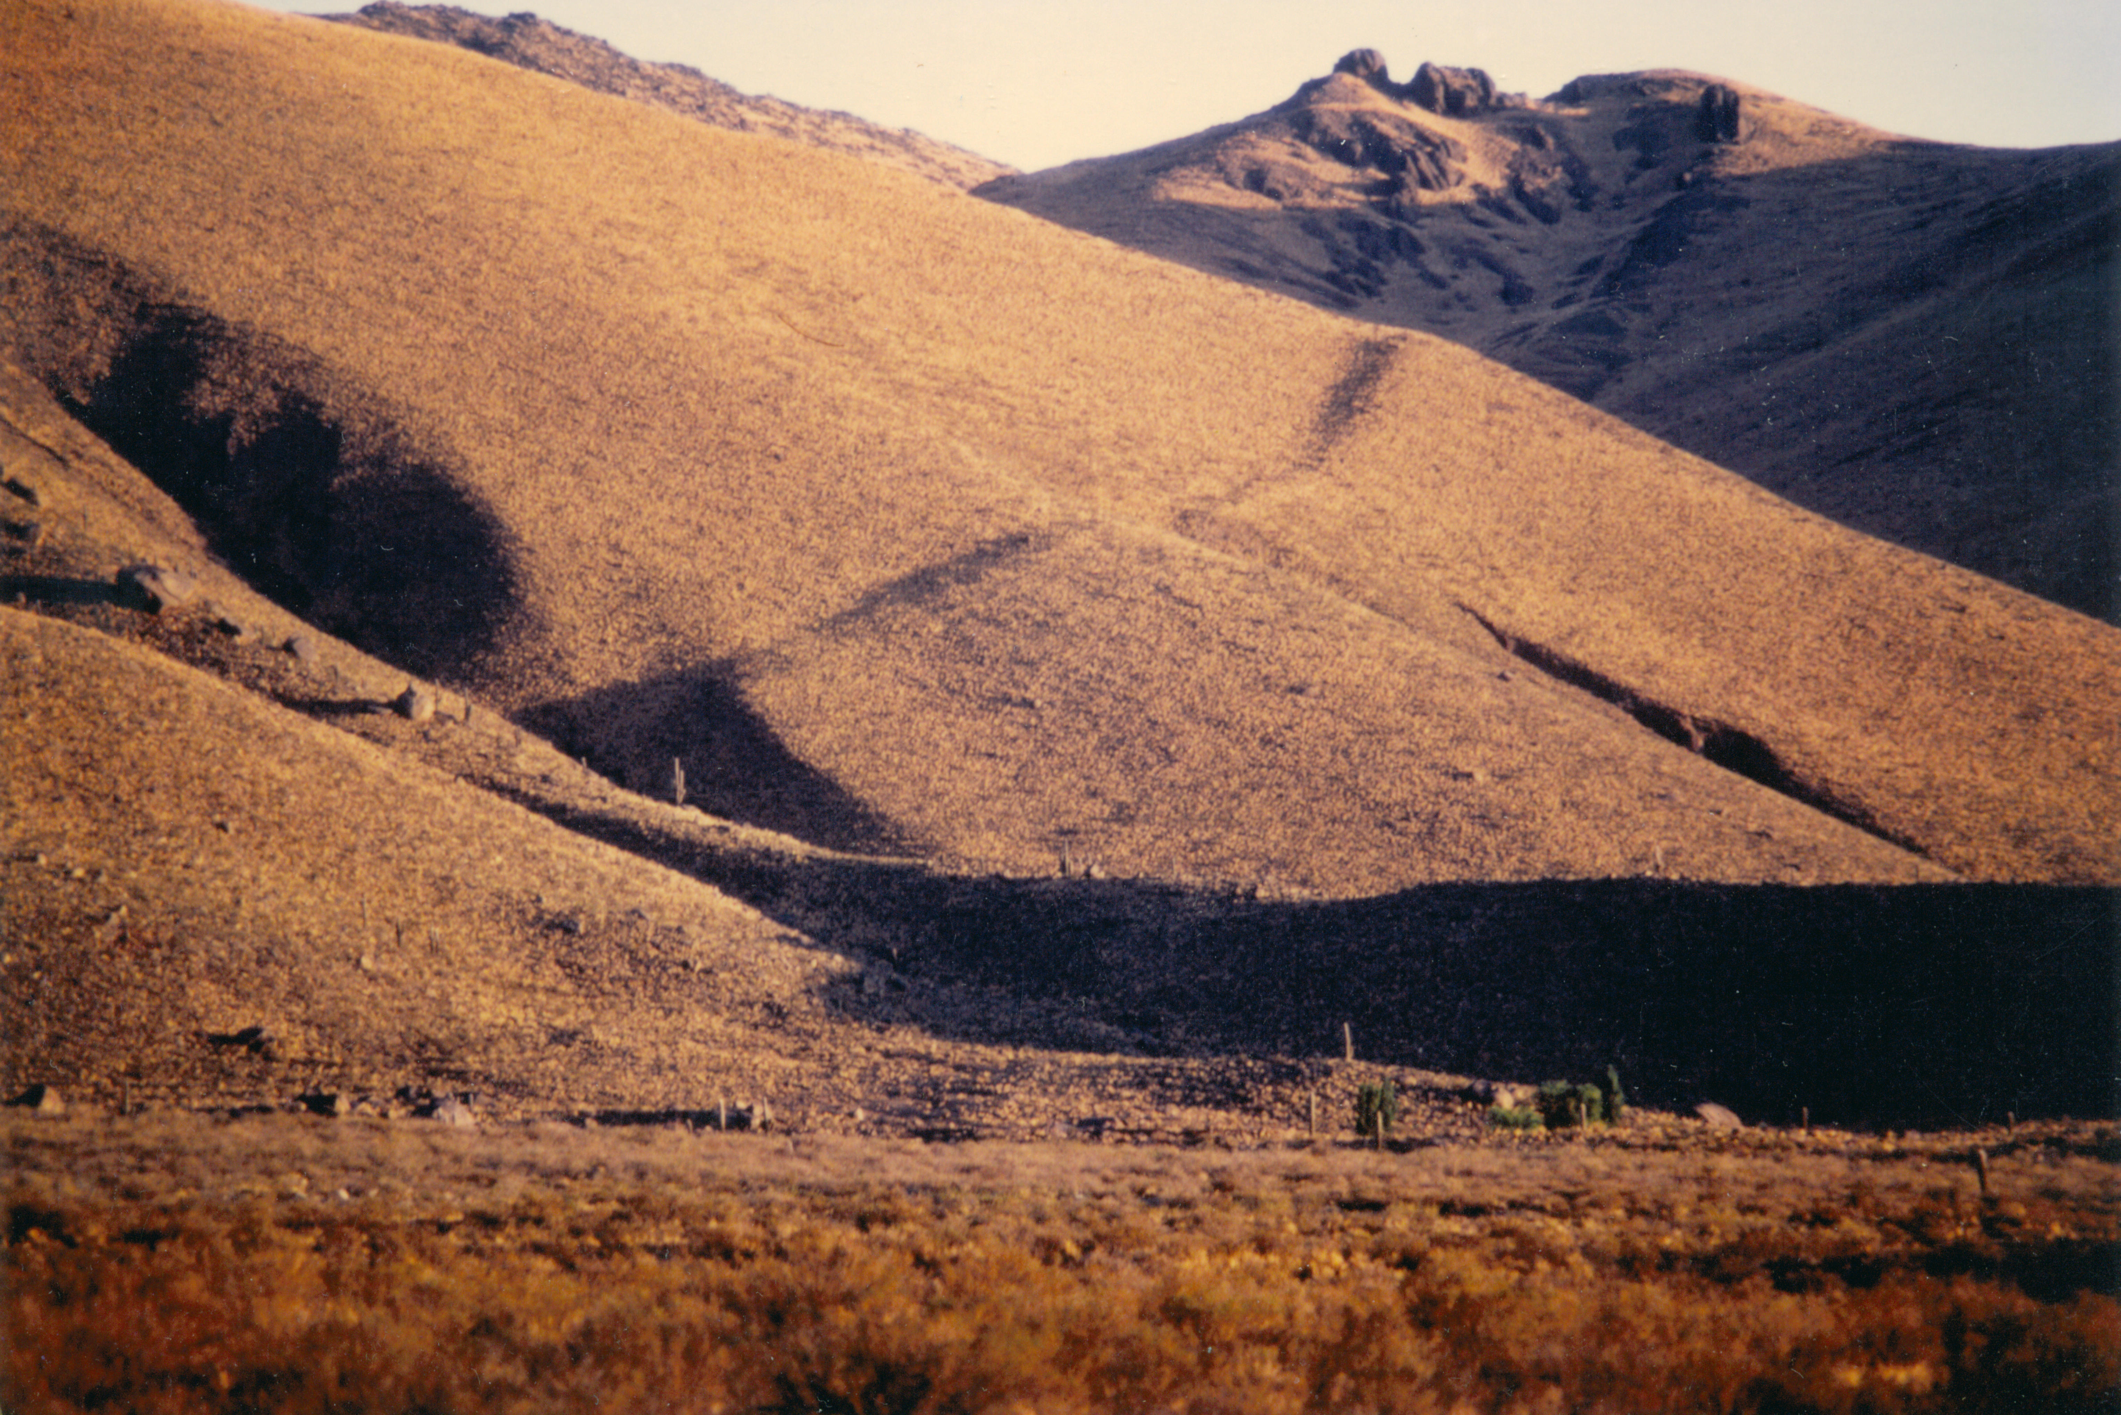
Notes:
Fualt scarp in Catamarca, Argentina

Slide 5
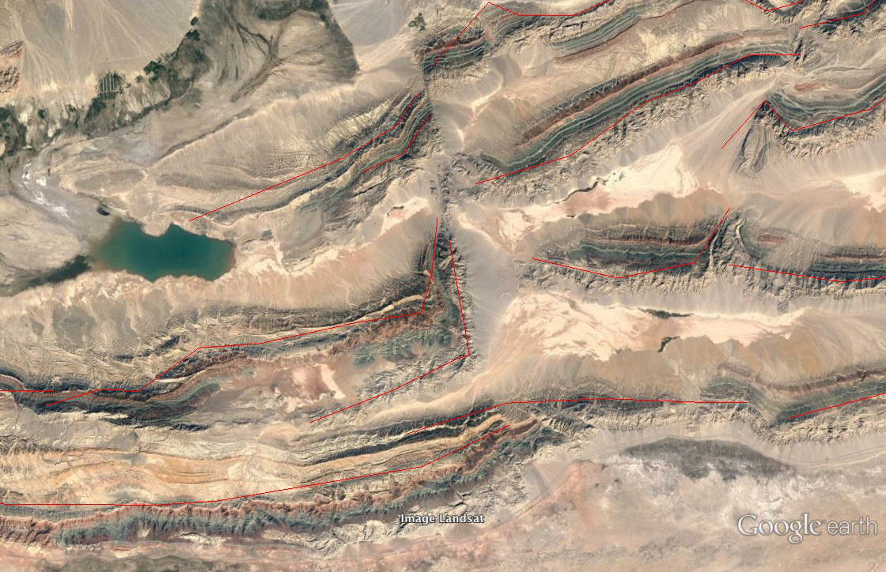
Notes:
piqiang fault - beautiful strike slip displacement of thin skinned thrusts
40° 15.568'N, 77° 39.812'E
Landsat image

Slide 6
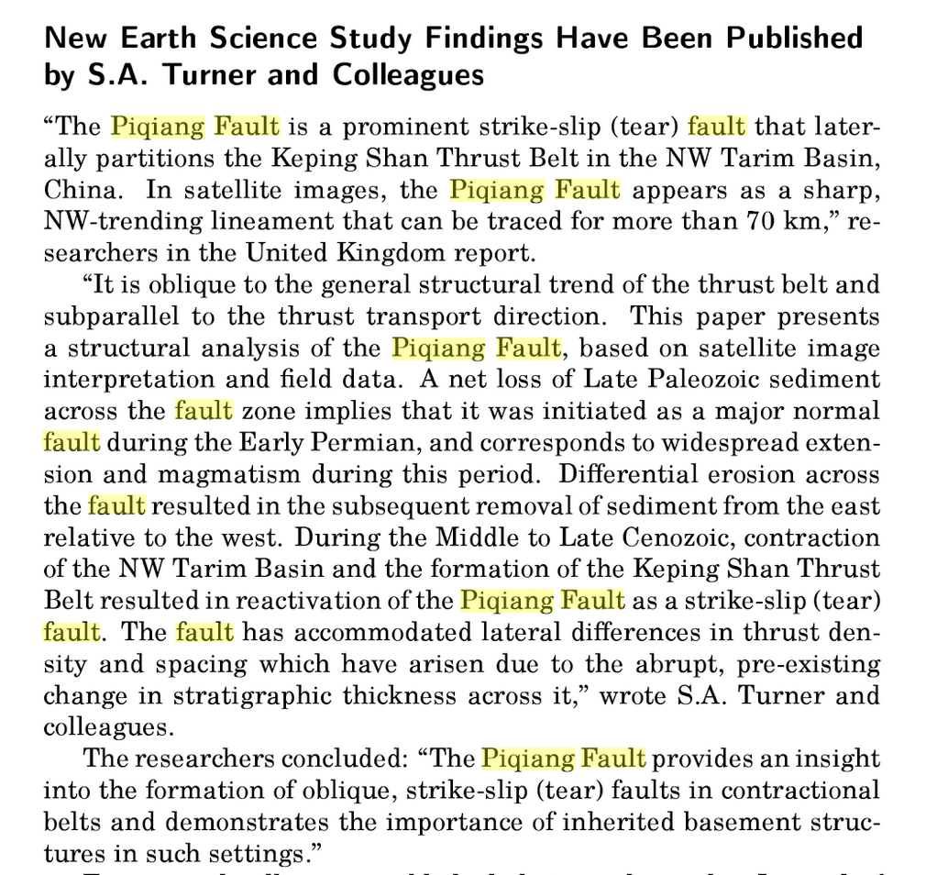

Slide 7
Notes:
Sebastian A. Turner, Jian G. Liu, John W. Cosgrove, Structural evolution of the Piqiang Fault Zone, NW Tarim Basin, China, Journal of Asian Earth Sciences, Volume 40, Issue 1, 4 January 2011, Pages 394-402, ISSN 1367-9120, http://dx.doi.org/10.1016/j.jseaes.2010.06.005. (http://www.sciencedirect.com/science/article/pii/S1367912010001999) Keywords: Piqiang Fault; Tarim Basin; Tear fault; Structural inheritance
Piqiang Fault is a “tear-fault” (strike-slip, but not transform because movement is as appears) due to along strike variation in thrust faults of Keping Shan thrust belt.

Slide 8
Notes:
Sebastian A. Turner, Jian G. Liu, John W. Cosgrove, Structural evolution of the Piqiang Fault Zone, NW Tarim Basin, China, Journal of Asian Earth Sciences, Volume 40, Issue 1, 4 January 2011, Pages 394-402, ISSN 1367-9120, http://dx.doi.org/10.1016/j.jseaes.2010.06.005. (http://www.sciencedirect.com/science/article/pii/S1367912010001999) Keywords: Piqiang Fault; Tarim Basin; Tear fault; Structural inheritance
Geology left, landsat image right.

Slide 9
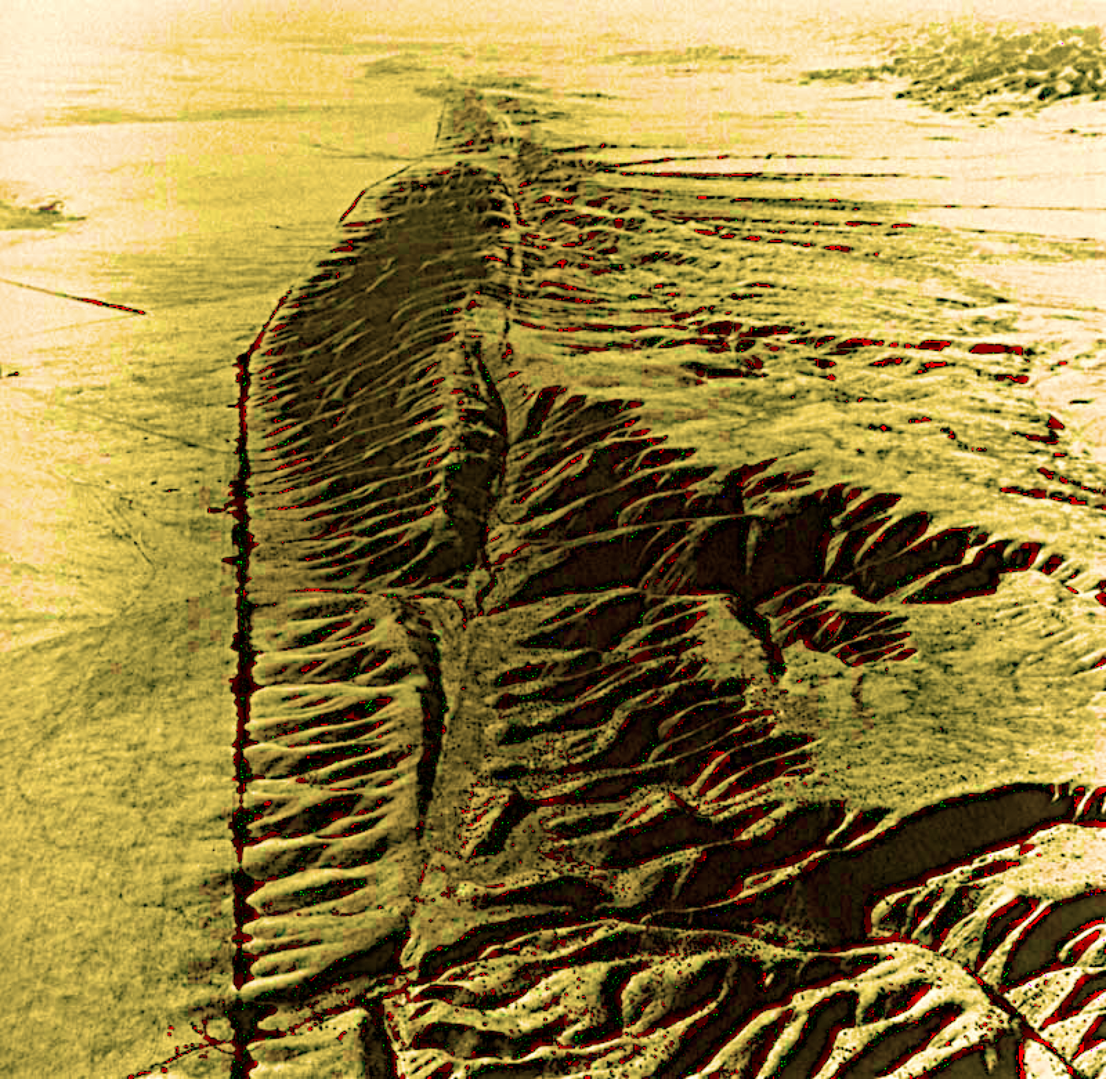
Notes:
Sebastian A. Turner, Jian G. Liu, John W. Cosgrove, Structural evolution of the Piqiang Fault Zone, NW Tarim Basin, China, Journal of Asian Earth Sciences, Volume 40, Issue 1, 4 January 2011, Pages 394-402, ISSN 1367-9120, http://dx.doi.org/10.1016/j.jseaes.2010.06.005. (http://www.sciencedirect.com/science/article/pii/S1367912010001999) Keywords: Piqiang Fault; Tarim Basin; Tear fault; Structural inheritance
Tear fault

Slide 10
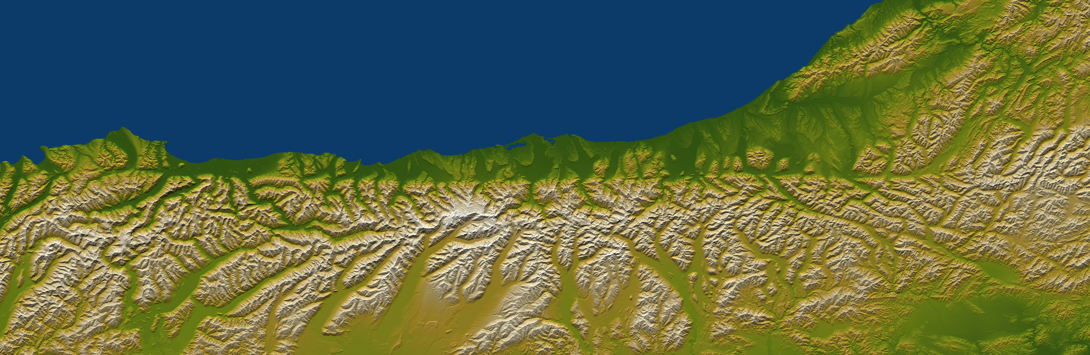
Notes:
Color shaded topography of the Alpine Fault in New Zealand, SRTM data.

Slide 11
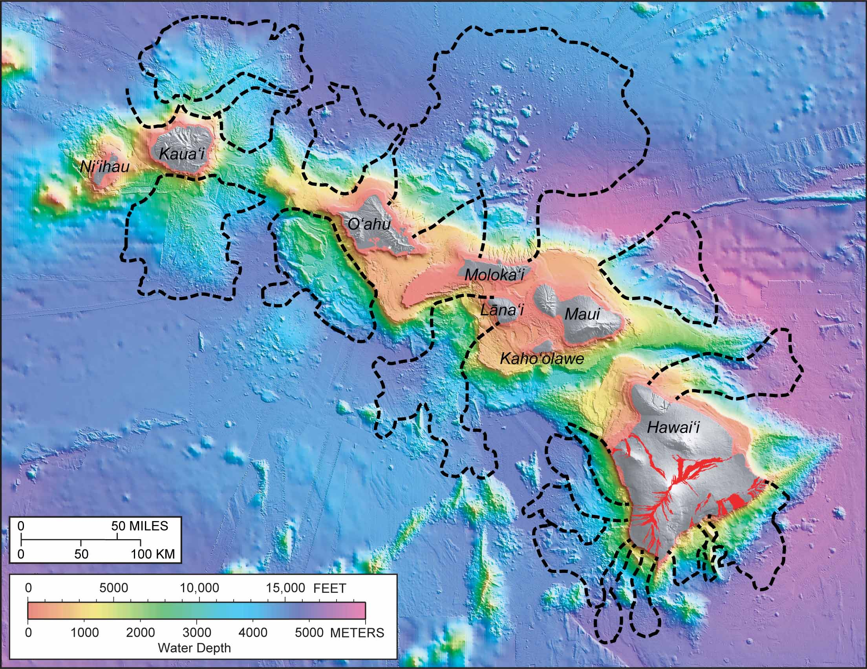
Notes:
http://hvo.wr.usgs.gov/volcanowatch/view.php?id=212
http://hvo.wr.usgs.gov/volcanowatch/uploads/image1-212.jpg
Slip-sliding away—Disassembling Hawaiian volcanoes
James Moore
From web page
In 1964, irregular submarine topography north of Oʻahu and Molokaʻi was identified in newly available maps of the sea floor made by the U.S. Navy. James Moore, then Scientist-in-Charge at the USGS Hawaiian Volcano Observatory, suggested that this odd bathymetry might reflect massive landslides originating from those islands.
Moore's interpretation was disputed for more than 20 years until comprehensive mapping of the sea floor around the entire State of Hawaii was completed in the late 1980s. It turned out that Moore was right. Large—even catastrophic—submarine landslide structures litter the sea floor around the Hawaiian Islands. In fact, 17 major landslides have been identified off the shores of the main Hawaiian Islands. Fortunately, these slides are exceedingly rare—occurring, on average, only once every 350,000 years.
The largest landslides constitute significant portions of the islands from which they originated. Imagine if 10 percent of one of the islands suddenly collapsed into the ocean! Such an event would displace a huge amount of water and cause a large tsunami. Deposits of coral and sand have been found up to several hundred meters (approximately 1,000 ft) above sea level on several of the Hawaiian Islands. Catastrophic landslides are believed to have generated gigantic tsunami waves that washed ashore and left these deposits behind.

Slide 12
(makes Andes)
(both b and c make d)
Husson et al., 2012
Notes:
Husson et al. 2012, Multiagent simulation of evolutive plate tectonics applied to the thermal evolution of the Earth
Fig 3
Figure 3. Structural criterion for the trench migration process in various contexts (the direction of subduction is defined as positive for all velocities). (a) When the upper plate is driven by ridge push, we assume a compressive regime and trench migration is subsequently prescribed by the upper plate motion: Vt = Vup. When the upper plate is driven by a slab pull, we assume an extensive regime, and a new ridge is created: this occurs for subduction initiation of (b) the lower plate or (c) the upper plate. (d) In both cases, a ridge is created and the trench undergoes a roll back motion. This structural criterion is independent of continents, presented here in grey.
Note – is there a “reference frame” here or just relative velocities.

Slide 13
Notes:
Schellert 2008 Subduction zone trench migration: Slab driven or overriding-plate-driven?
Fig. 1. Schematic cross-sections of subduction illustrating the two end members of the migrating trench model and the static trench model. (A) Initial setting.
Note that all velocities are in an arbitrary hotspot reference frame (S on right). Convention is that extension, trench retreat and trench-directed motion for the plates are positive.

Slide 14
Notes:
Schellert 2008 Subduction zone trench migration: Slab driven or overriding-plate-driven?
The slab-driven migrating trench model, with (B) rollback of the slab inducing trench retreat and overriding plate extension, (C) roll-forward of the slab inducing trench advance
and overriding plate shortening,
B) Upper plate = ref = vel =0.Subducting plate moving forward (S to S’) and sinking/rolling back at trench faster than the subducting plate speed.
C) Upper plate = ref = vel = 0. Now subducting plate moving in (S to S’) faster than hinge is moving (back along subducting slab) so subducting slab moves both along its length and “in” driving shortening in the upper plate.

Slide 15
Notes:
Schellert 2008 Subduction zone trench migration: Slab driven or overriding-plate-driven?
The overriding-plate-driven migrating trench model, with (F) overriding plate motion away from the trench inducing trench advance and overriding
plate extension, (G) trenchward overriding plate motion inducing trench retreat and overriding plate shortening,
F) Here the upper plate is moving away to left at O to O’’ . Subducting plate “sucked” forward as O to O’ going faster than (S to S’ less T’-T).
G) Same but now convergent (net of V_hop1 and V_hop2 i to left)

Slide 16
Notes:
Schellert 2008 Subduction zone trench migration: Slab driven or overriding-plate-driven?
The static trench model, with (J) overriding plate motion away from the trench inducing overriding plate extension, (K) trenchward overriding plate motion inducing overriding plate shortening,
Here subducting plate behaves like conveyor belt over fixed roller – extension or compression exist at surface depending on direction of the plate motions,

Slide 17
Russo and Silver, 1994
Notes:
Russo and Silver, 1994
Nazca slab rolls back – due to relative convergence between S. Am. and Nazca plates.

Slide 18
S
N
Russo and Silver, 1994
Russo and Silver, 1994
Notes:
Russo and Silver, 1994
Nazca plate rolls back, “squeegees” mantle material out around edges. (note view direction)

Slide 19
Russo and Silver, 1994
Russo and Silver, 1994
Notes:
Russo and Silver 1994
Nazca plate rolls back, “squeegees” mantle material out around edges. (note view direction)
Controversial – or better view – proposed something (mantle flow into Caribbean and Scotia) to test.
Seismic experiment in Patagonia and S. Shetland islands to look for mantle flow (from shear wave splitting – seismic bi-refringence – flow lines up minerals, are bi-refringent) – did not find anything.

Slide 20
Notes:
Russo el at 2010
Enter the subducted chile rise, and slab window – lets astheneosphere escape
(S. Am. going under at 7 cm/yr, Antarctica going under at 2 cm/yr – big difference, so not much squeegee action from Antarctica, lots from S. Am.)
New idea, do end run through slab window.

Slide 21
Notes:
Russo et al 2010
Shear wave splitting results – line up in slab window, show flow.
Hess found that the slow shear waves propagated perpendicular to the plane of slip and the higher velocity component was parallel to it.

Slide 22
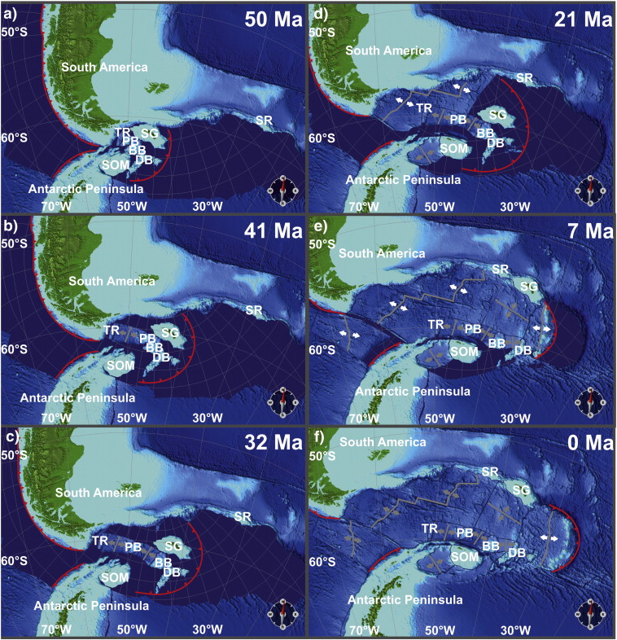
Notes:
Nerlich et al., 2013, The Scotia Sea gateway: No outlet for Pacific mantle
Before separation of S. Am from Antarctica ~30-40 mya, the Ande continued south from southern end of S. America along what is now the Antarctic Peninsula – the Antarctandies.
I think the join was “starighter” than shown. The Antarctic peninsula had its current shape, but the southernmost part of S. Am. sheared and rotated. Look symmetric, but were not formed same way!
Notice lots little microplates getting ripped out of southernmost S. Am. and the northernmost Antartic peninsula. Label show their names.
Dark blue are are current Scotia/S. Sandwich plates. Notice rapid displacement – by rollback - of trench to east.
Initially Scotia plate grows with a spreading center ~ diagonally across it, then ~6 my ago a ridge jump to form the South Sandwich Plate kills the old spreading center (looks “fresh” in topography but little to no seismicity or volcanism).

Slide 23
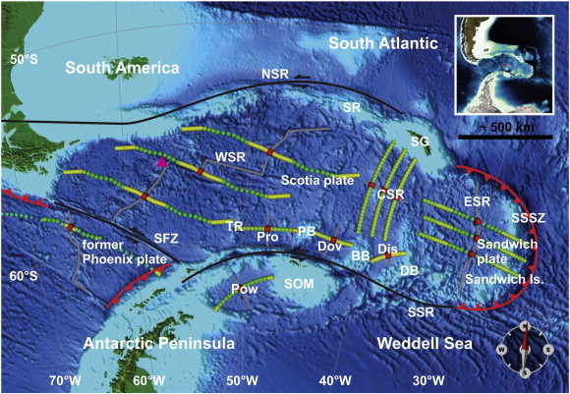
Notes:
Nerlich et al., 2013, The Scotia Sea gateway: No outlet for Pacific mantle
Major features – NSR, SSR, and SFZ – North and South Scotia Ridges, and Shackleton Fracture Zone – all left lateral strike slip. Subduction along S. Am. transitions into strike slip across the Drake Passage. WSR is the west Scotia Ridge – dead since ~6 mya. CSR is the Central Scotia Ridge – also dead – note its spreading direction is perpendicular to that of the WSR. The CSR also seems to have the oldest sea floor in the Scotia Sea – seems to be a part of whatever was there when the Drake Passage opened. ESR is the East Scotia Ridge now spreading rapidly. SSSZ is the South Sandwich Subduction Zone that is rolling back very rapidly.
South Georgia Island traveled to current position on east side of WSR, but exact path not known.
South Orkney came out of Antarctic Peninsula.
Also have remains of former Phoenix plate and its subduction zone with active back arc spreading behind

Slide 24
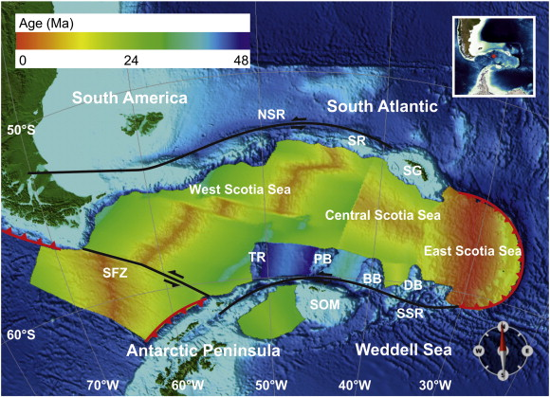
Notes:
Nerlich et al., 2013, The Scotia Sea gateway: No outlet for Pacific mantle
Sea floor age – can see dead spreading very well.
Nerlich result – no mantle return flow through Scotia sea (no high on west to low on east hydraulicly supported dynamic topography.

Slide 25
All vectors with respect to stable S. America defined by GPS
Notes:
GPS site on Candlemass Island on South Sandwich Microplate going 6.5 cm/yr to ESE.
Active spreading across the Bransfield Strait

Slide 26
Absolute Plate Motion
Notes:
Beth Christensen
ch08ESHskinner
absolute plate motion
establish using fixed points
hot spots
small geographic area where heating and igneous activity occur within the crust
e.g. Yellowstone, Hawaii, numerous others
Idea is that the hot spots are “fixed” with respect to the mantle and ?core?
Whether or not an absolute reference frame for plate motions can be defined is still a hotly debated topic.
What do we mean by “fixed” – we only have ~280 my year record of plate movements. So I suggest we see if the hotspots remain relatively fixed over a Wilson cycle.
This topic needs a whole course!!!

Slide 27
Notes:
Figure from Jason Morgan’s 1971 four page Nature paper “establishing” a 3 hot-spot absolute reference frame for pacific. “Thick lines” from solid dots show the movement of the plate with respect to the hot spot (there are also supposed to be “regular” velocities on the figure, but the figure is too degraded to tell what is what).

Slide 28
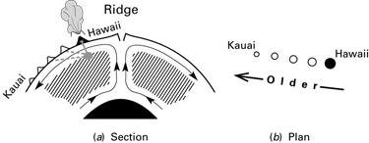
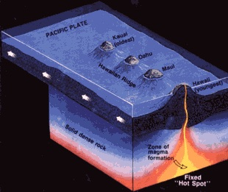
Notes:
Idea that there is some “fixed” source of hot material that comes up to surface to feed “hotspot”
Immediate problem – source – similar to whole vs layered mantle convection have deep vs shallow source camps.
Easier to “fix” if deep since can “connect” to CMB, harder in convection cell to “fix” absolutely.

Slide 29
Actually many problems
• One at geologic/plate tectonic time scale. This is the one we will concentrate on.
• One at instantaneous (human) time scale.
Notes:
We will mostly look at first – at this time scale worried about how plates have moved through time and relationship of this movement to rest of earth. Almost completely a horizontal movement problem. Happy if we are within the ballpark.
Second one, is first on steriods – has how plates moving now with same problems, PLUS all the stuff we can measure with respect to defining a reference frame for all studies of the earth – e.g. consider solid earth tides, gia, mass redistribution (snow load moves center of mass of earth, glaciers, lakes, rivers), etc. There is no “solid” earth.

Slide 30
Actually many problems
• Establishing a no-net rotation frame. Has to be with respect to something (hotspots usual choice).
• Establishing a no-net torque frame (not the same, except under certain conditions). Again has to be with respect to something.
Notes:
Lots of solutions to this

Slide 31
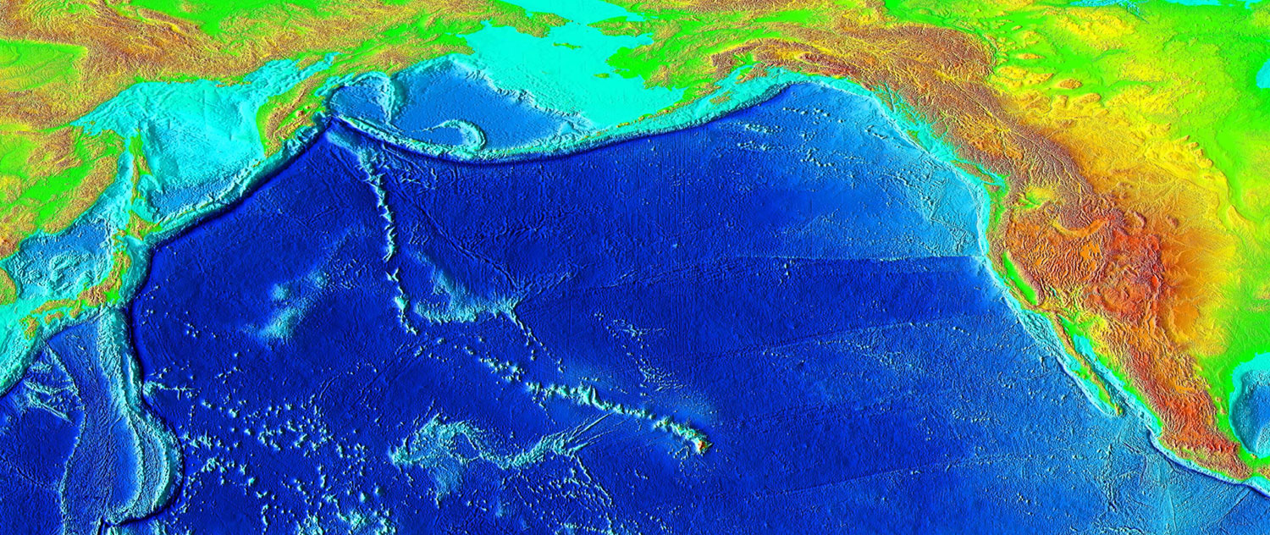
Notes:
Hot spot poster child, everybody’s favorite hot-spot track – Hawaii-Emperor seamount chain

Slide 32
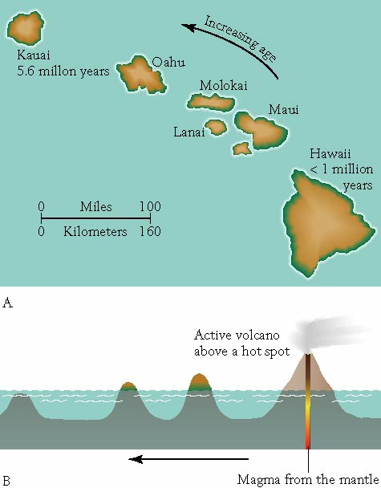
Plate Motion
Notes:
Beth Christensen
ch08ESHskinner.ppt
Hawaiian hot spot
thermal plume creates volcano
plate moves away from plume
stranded volcano cools, leaves a chain
chain indicates direction and rate
Figure not too specific about source of magma

Slide 33
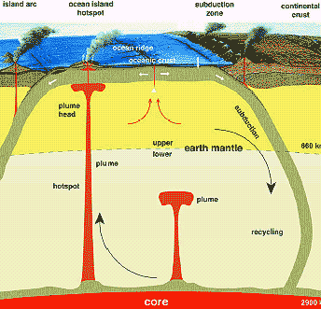
Earth structure: Seismic discontinuities
It has been suggested, based on tomography (i.e., seismic imaging), that the D’’ is a slab graveyard and/or plume factory
Figure from: http://www.avh.de/kosmos/titel/2002_011.htm
Notes:
Ziv Alon, tectonics_lec_01.ppt

Slide 34
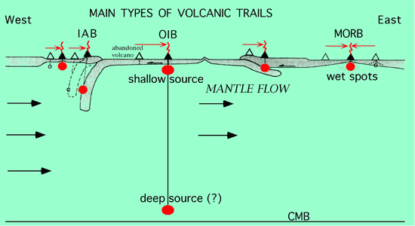
Notes:
http://www.mantleplumes.org/Hotspots.html
Carlo Doglioni & Marco Cuffaro
Different types of basalts – and their possible sources
Deep Plumes or Shallow Upwellings? Fixed or Unfixed?
Decoupling in the Asthenosphere
Most volcanoes of world associated with ridges that produce 21 km^3 magma/yr
Famous ring-of-of Fire arcs (most books, web pages, class notes say 65-75% of volcanoes of world are in volcanic arcs , completely forget ridges –they are only talking about subaerial volcanoes) produce 0.14-0.9 km^3 magma/yr
5% of volcanoes off plate boundaries (hot spots)

Slide 35
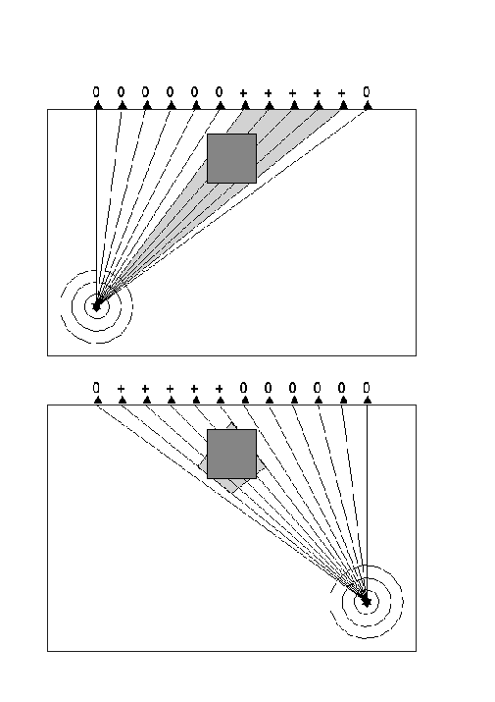
Earthquake 1
Earthquake 2
Notes:
John Brodholt, University College London
Lecture9.ppt
Seismic tomography: sample the same place with seismic waves from different direction allows you to work out 3-D shape of seismic anomalies.

Slide 36
^{D. Zhao}
^{Gondwana Research (2007)}
Notes:
John Brodholt, University College London
Lecture9.ppt

Slide 37
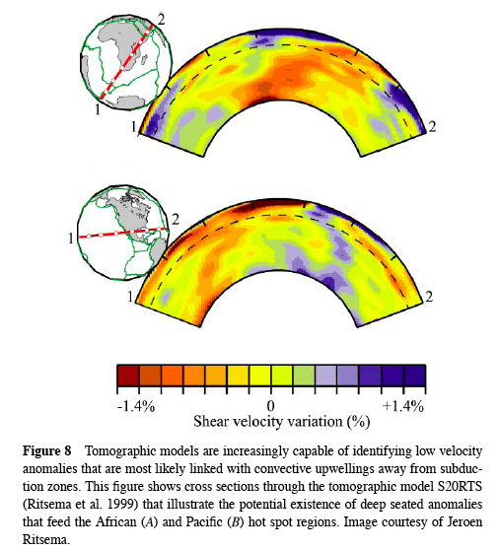
Notes:
John Brodholt, University College London
Lecture9.ppt

Slide 38
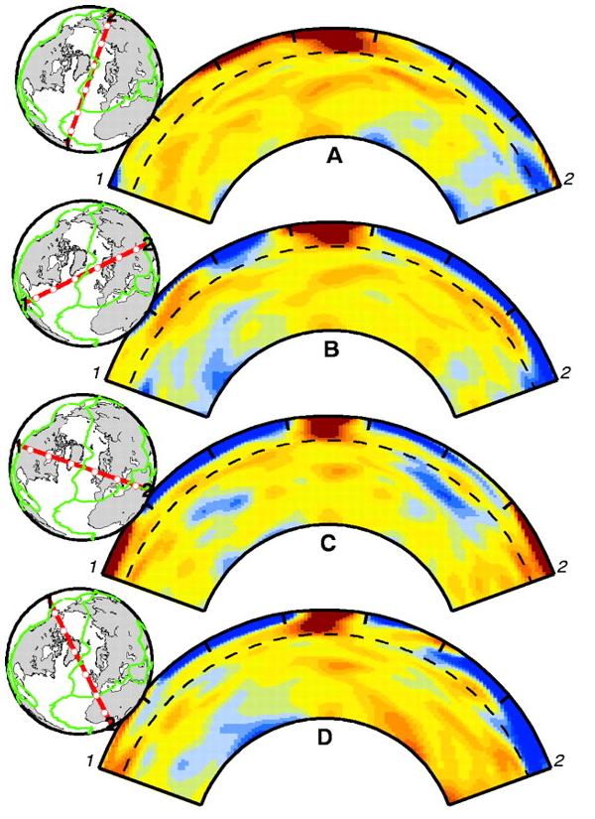
Definite slow (= hot) region below Iceland.
Doesn’t seem to go through into lower mantle.
Notes:
John Brodholt, University College London
Lecture9.ppt

Slide 39
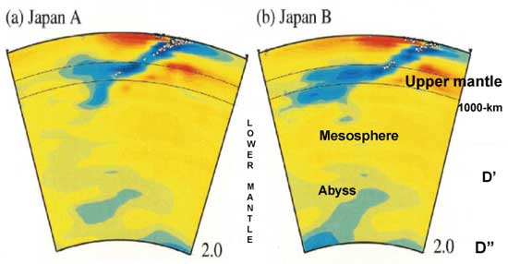
Earth structure: Seismic discontinuities
Do ascending slabs cross the upper-lower mantle boundary?
Figure from Fukao et al., 2001
Blue = fast anomaly = dense = cold
Red = slow anomaly = buoyant = hot
Notes:
Ziv Alon, tectonics_lec_01.ppt

Slide 40
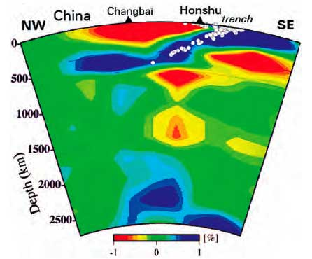
Earth structure: Seismic discontinuities
Currently, it seems that the answer to this fundamental question is in the eye of the beholder. (learn more at: http://www.mantleplumes.org/TomographyProblems.html )
Figure from Zhao et al., 2004
Notes:
Ziv Alon, tectonics_lec_01.ppt

Slide 41
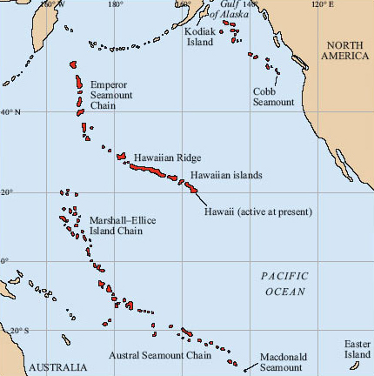
Notes:
http://www.open.edu/openlearn/science-maths-technology/science/geology/plate-tectonics/content-section-4.2
Figure 23: Map showing three of the major seamount and island chains in the Pacific Ocean. These are the Kodiak Island-Cobb Seamount Chain in the northeastern Pacific, the Marshall-Ellice Islands-Austral Seamount Chain of the southern Pacific, and the well-known Hawaiian Ridge-Emperor Seamount Chain in the central Pacific. The Hawaiian Islands are located at the southeastern end of the Hawaiian Ridge.
The usual interpretation of the bend is that the motion of the Pacific Plate changed with respect to a fixed hot spot.
BUT – there are are also models that suggest the hot spot was moving southward before the bend and stopped.
Note that the various hotspot tracks in the Pacific are not completely compatible – are similar.
What about hotspots in the Atlantic, or other global distribution? Are they all fixed with respect to one another?

Slide 42
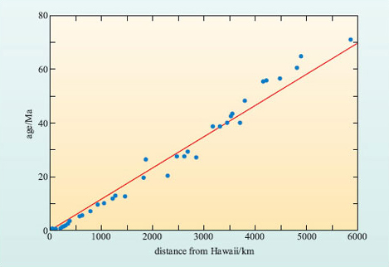
Notes:
http://www.open.edu/openlearn/science-maths-technology/science/geology/plate-tectonics/content-section-4.2
Careful interpretation of the age progression along the Hawaii-Emperor chain suggests that this change in direction occurred 43-50 Ma ago, which ties in with a series of tectonic adjustments around the world, including the start of continental collision between India and Asia.

Slide 43
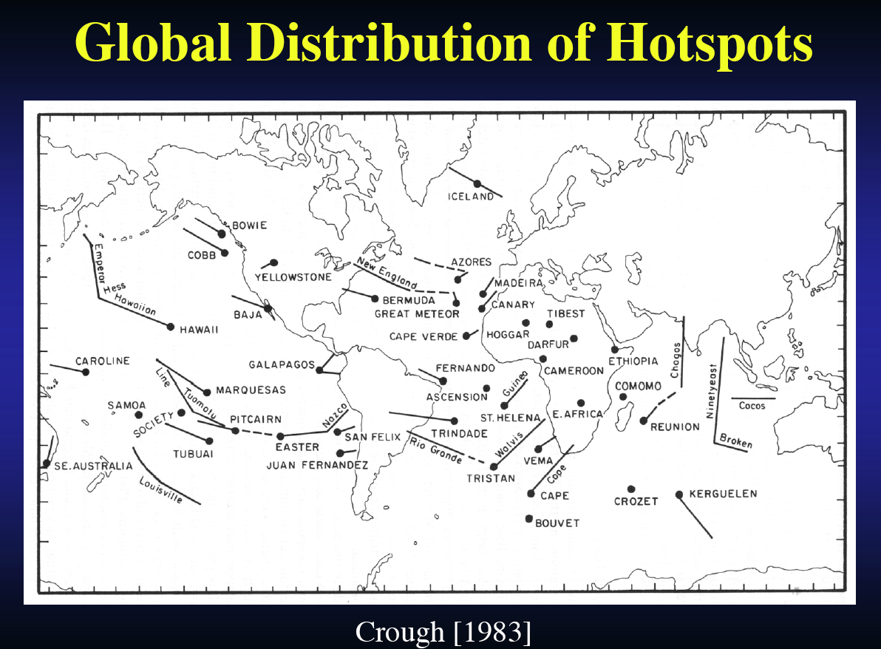
Notes:
John Brodholt, University College London
Lecture9.ppt

Slide 44
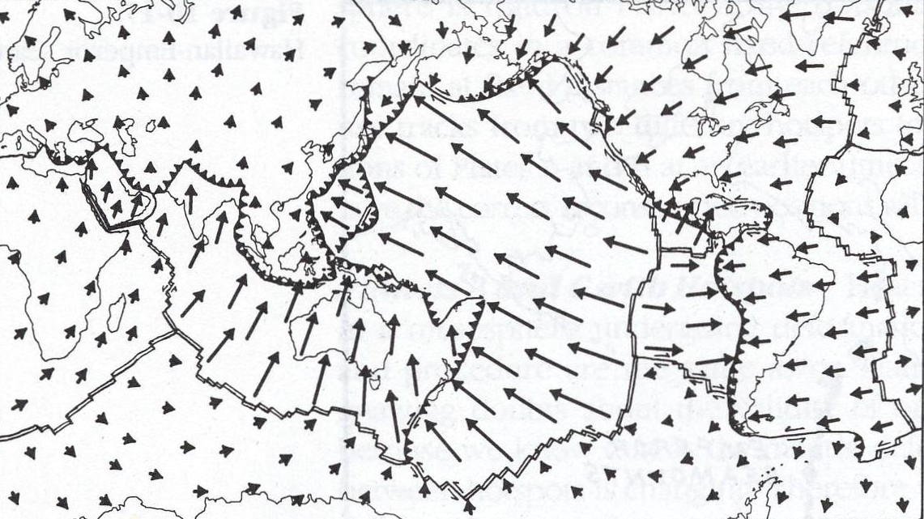
Absolute Plate Motion
Using No-Net Rotation condition and Hot Spots as absolute reference frame.
Notes:
http://ffden-2.phys.uaf.edu/211_fall2002.web.dir/Cheryl_Robar/Phys211%20Folder/velocity.htm
Determining plate Velocity
Using the no net torque approach, the first step to determining plate velocities is deciding on an absolute reference frame. A good reference frame to use is one in which there is no net rotation of the plates, therefore the net torque acting on the plates is zero. (If there is a net torque than the angular velocity changes – so if angular velocity is constant – any value, including zero – there is no net torque. Is not symmetric, no net torque does not imply no net rotation, implies constant rotation).
If the drag coefficient is constant, the net torque is zero (Sleep and Fujita, equation 7.29).
Now the absolute velocity of one plate can be determined and the relative velocities of the other plates can be determined from that. One problem with this method (no net rotation/torque part) is that it depends on the locations of plate boundaries, i.e. the shape of the plates, and motions at a specific time. Therefore, this method relies on accurate interpretations about plate geometry from the past (can’t go back farther than Pangea, don’t know plate shapes for previous Wilson cycles/Supercontinent cycles).
Today, scientists are also using GPS (global positioning system) to help in determining plate velocities.
Another method used to determine plate velocities is to use the hot spot method. In this method the reference frame is a hot spot. A hot spot will be stationary (assumed) relative to the mantle as the plate above passes by.
Effectively adding a plate – made up of the hotspots, or some subset of the hotspots. Get each plate relative to the “absolute” (not moving) hot spots. All relative plate motions between plates unchanged.

Slide 45
Notes:
http://www.open.edu/openlearn/science-maths-technology/science/geology/plate-tectonics/content-section-4.2
Figure 25 Map showing present-day motion of lithospheric plates (indicated by arrows) relative to hot spots (i.e. true plate motion). The lengths of the arrows indicate the amount of movement that would occur over a period of 50 Ma and the figures represent the current mean true plate speed.
From http://www.dpc.ucar.edu/VoyagerJr/pt_t3.html
(a little confusing as NNR definition not very clear)
We'll be using a special reference frame, referred to as the no-net-rotation (NNR) reference frame. NNR is the motion of each plate with respect to the weighted average of all of the world's plate velocities. It's sometimes referred to as absolute plate motion, since it appears to approximately represent the motions of the surface plates with respect to the Earth's deep interior. It closely resembles the apparent motion of the world's plates with respect to hot spot volcanoes.
Absolute plate motion: The motion of a plate with respect to hot spots, which appear to be at relatively fixed locations with respect to the Earth's mantle.
From http://www.encyclopedia.com/doc/1O13-absoluteplatemotion.html
AILSA ALLABY and MICHAEL ALLABY. "absolute plate motion." A Dictionary of Earth Sciences. 1999. Encyclopedia.com. 12 Sep. 2016 <http://www.encyclopedia.com>.
absolute plate motion The motion of a lithospheric plate (see LITHOSPHERE) with respect to a fixed frame of reference. Various frames of reference have been used, including those defined by hot spots, no net torque of all the plates, and palaeomagnetic (see PALAEOMAGNETISM) Euler poles (see POLE OF ROTATION).
Except no-net-toruqe does not define an absolute reference frame.
More recent “reference frames” – shear wave splitting, ridge azimuths and spreading directions, including plate boundary deforming zones in the no-net-torque/no-net-rotation calculation (is like a balanced cross section, if don’t include these zones with their varying velocities it is wrong [if cross section is not balanced is wrong], but including them does not make it correct – is still probably wrong)
See Kreemer and Holt, 2002, A no-net-rotation model of present-day surface motions, Geophys. Res. Lett, 28, 4407-4410, 10.1029/2001GL013232, for No-net rotation condition formula shown.

Slide 46
Even more problems
• Evidence that lithosphere has a westward drift.
Notes:
Lots of solutions to this

Slide 47
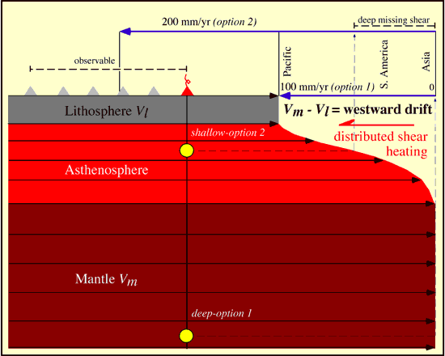
Notes:
http://www.mantleplumes.org/Hotspots.html
Carlo Doglioni & Marco Cuffaro
Decoupling of lithosphere
Figure 3 The Hawaiian volcanic track indicates that there is decoupling between the magma source and the lithosphere, which is moving relatively toward the WNW. If the source is below the asthenosphere (e.g., in the sub-asthenospheric mantle, option 1), the track records the entire shear between lithosphere and mantle. In the case of an asthenospheric source for the Hawaiian hotspot (option 2), the volcanic track does not record the entire shear between the lithosphere and sub-asthenospheric mantle, since part of it operates below the source (deep missing shear). Moreover the larger decoupling implies larger shear heating, which could be responsible for the scattered, punctiform Pacific intraplate magmatism (after Doglioni et al., 2005). [see also Hawaii and Mantle Temperature pages.]

Slide 48
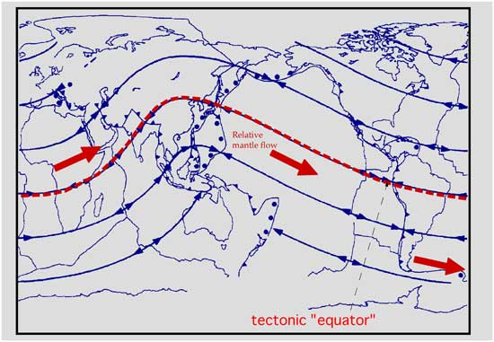
Notes:
http://www.mantleplumes.org/Hotspots.html
Carlo Doglioni & Marco Cuffaro
The No-Net-Rotation Reference Frame
The NUVEL 1 model (DeMets et al., 1990) and the Space Geodesy ITRF2000 and NASA databases (Heflin et al., 2005) provide information on plate motions. They are based on the artificially imposed assumption of a no-net-rotation (NNR) reference frame, i.e., plates are imagined to move relative to a fixed Earth center, and the lithosphere does not move relative to the underlying mantle, or the sum of its movements is zero. However we know the lithosphere does move relative to the sub-asthenospheric mantle, and this is not only suggested by the Hawaiian and similar volcanic tracks, but it is also kinematically required by the relative migration of plate margins. The ITRF2000 reference frame (e.g., Heflin et al., 2005) is excellent for describing relative plate motions, and it is also considered to be an absolute reference frame (relative to the GPS satellite constellation and the Earth’s center of mass). However, when magmatic sources are included in the kinematic analysis, the movement of the lithosphere relative to the mantle must be taken into account in an "absolute" plate motions analysis, and the NNR must be abandoned.
estward Drift of the Lithosphere
When plate motions are measured in the hotspot reference frame, the lithosphere shows a net “westward” drift (Bostrom, 1971; O'Connell et al., 1991; Ricard et al., 1991). This “westward” drift persists also when plate motions are computed relative to Antarctica (Le Pichon, 1968; Knopoff & Leeds, 1972), which lies on a plate with almost no subducting slab and is thus often considered to be probably stationary, or moving only slowly, with respect to underlying mantle. However most of the hotspots used are neither fixed, nor do they represent a fixed reference frame, because they are located on plate margins such as moving ridges (e.g., Galapagos, Easter Island, Iceland, and Ascension), transform faults (e.g., Reunion) or continental rifts (e.g., Afar), all of which are features that are moving relative to one another and relative to the mantle. Nevertheless, Gripp & Gordon (2002) computed a net rotation of the lithosphere of 49 mm yr⁻¹ (0.44 ± 0.11 deg Myr⁻¹ about a pole of 56°S, 70°E). The WNW-motion of the Pacific plate relative to the underlying mantle is inferred from the Hawaiian and other major intraplate hotspot tracks (e.g., Marquesas, Society, Pitcairn, Samoan and MacDonald), which show an average velocity of about 103-118 mm yr⁻¹. They also move along the same trend (290°-300°, WNW) and therefore they are the only hotspots that appear to be coherently fixed relative to one another, representing an apparently reliable reference frame for absolute plate motions.

Slide 49
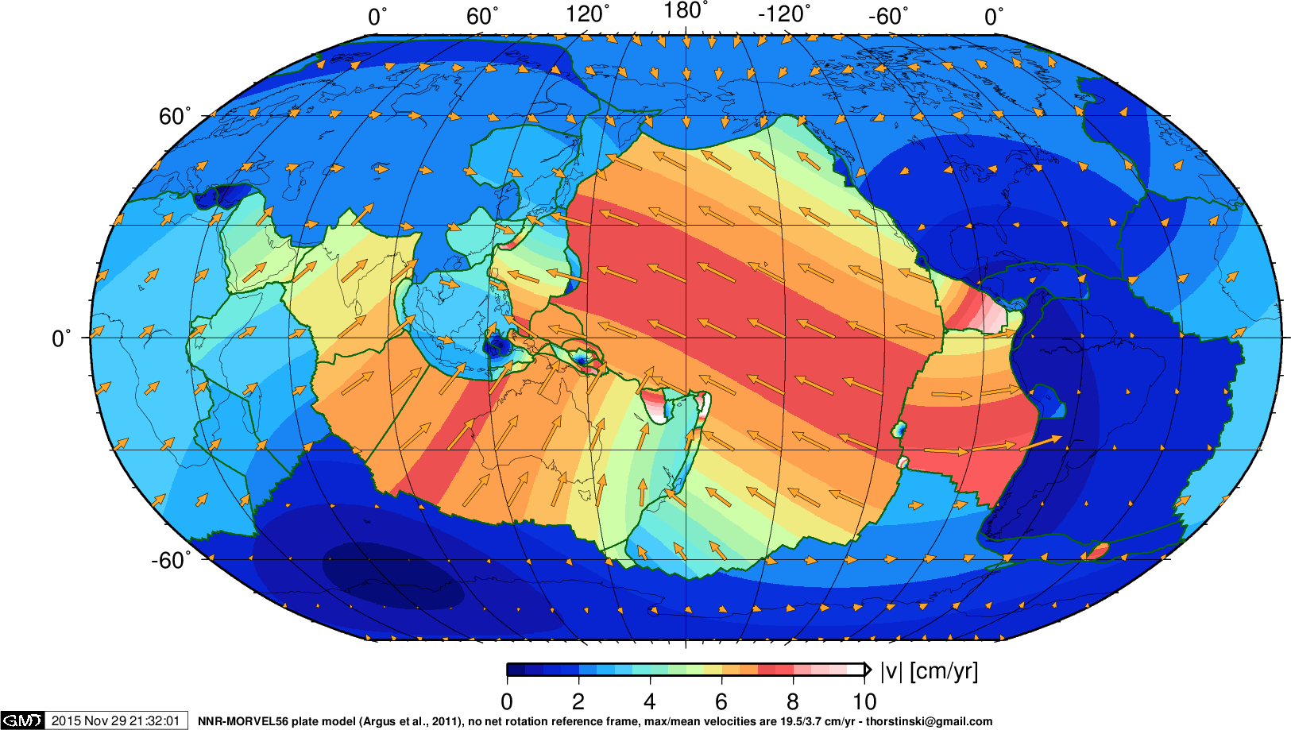
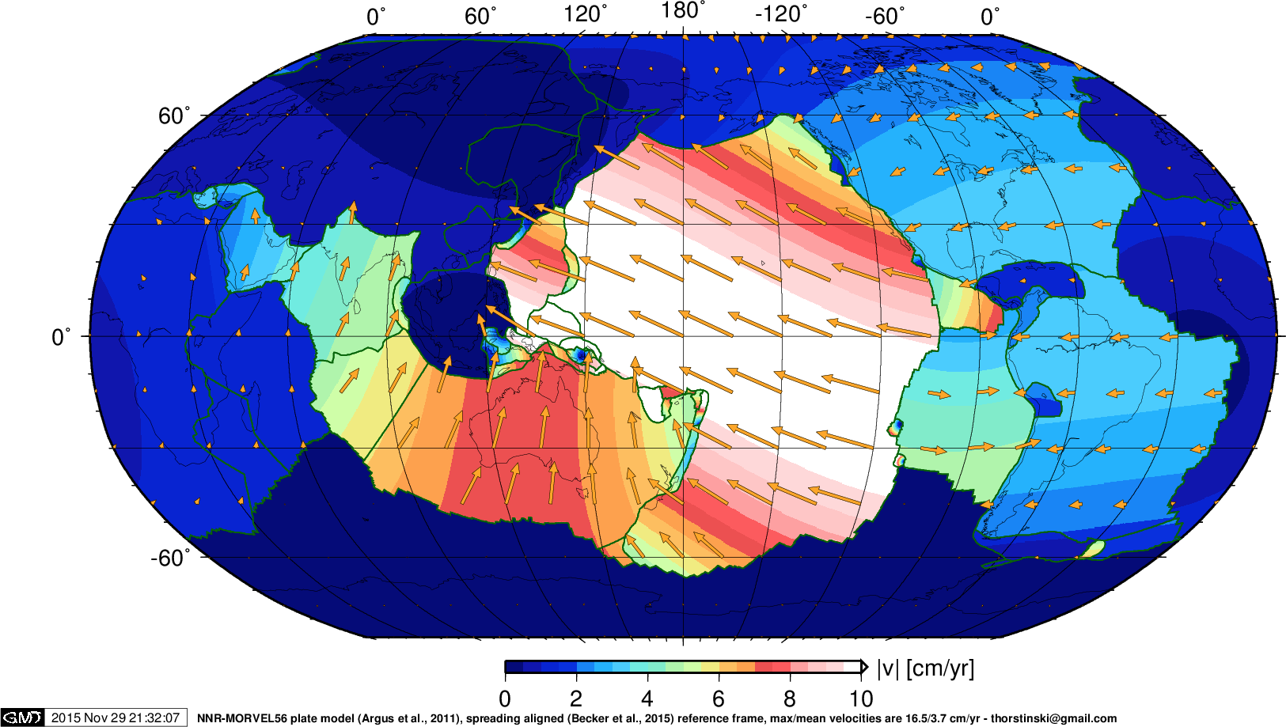
Spreading-aligned, absolute plate motion reference frame
Nuvel 1
Spreading aligned
Notes:
http://www-udc.ig.utexas.edu/external/becker/sa_reference_frame.html
Spreading-aligned, absolute plate motion reference frame
In Becker et al. (2015), we argue that optimizing the match of absolute plate motions to spreading orientations provides for an improved absolute plate motion (APM) reference frame that can satisfy a number of constraints, hotspot motions, and matches azimuthal anisotropy very well. Its net rotation amount is also broadly consistent with geodynamic estimates (e.g., Becker, 2006).
This new, spreading-aligned plate motion reference frame can be computed by adding a net rotation with Euler pole of 63.9E, 61.2S, 0.277 deg/Myr to a no-net-rotation (NNR) model. For our study, we used the NNR-MORVEL56 velocities of Argus et al. (2011).

Slide 50
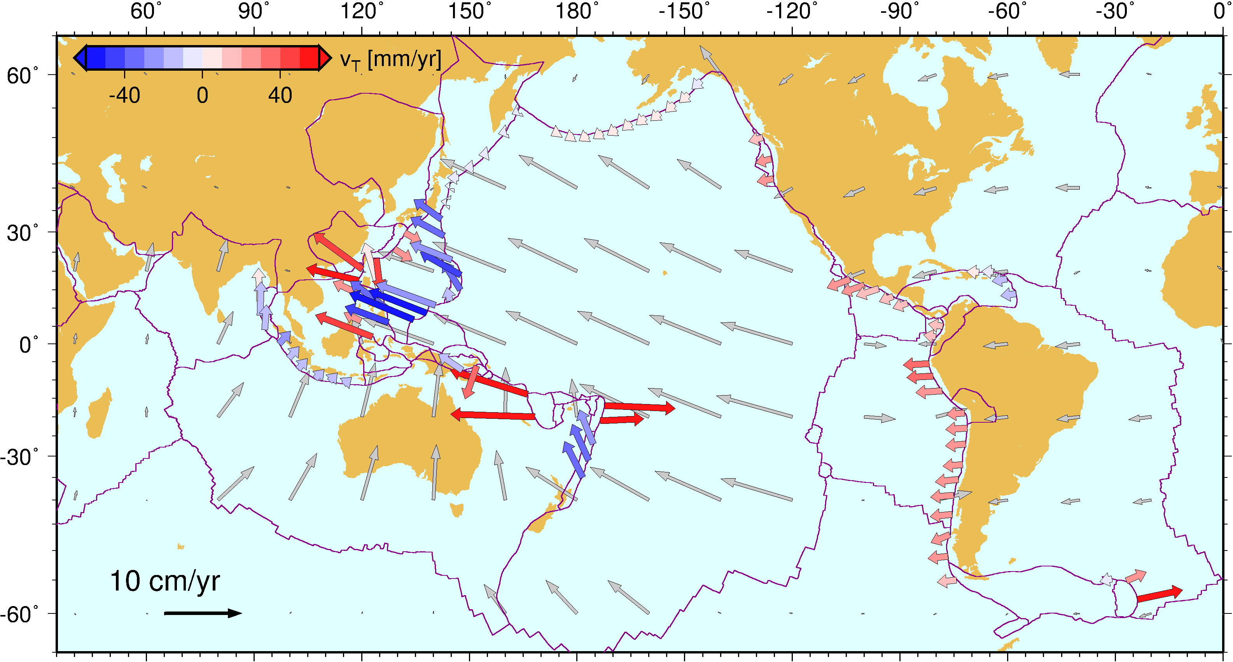
Notes:
http://www-udc.ig.utexas.edu/external/becker/sa_reference_frame.html
Spreading-aligned, absolute plate motion reference frame
Among the predictions of the new spreading-aligned APM model are a clearer separation of relative trench motions, as shown for Heuret et al. (2005) rollback/advance estimates in the new reference frame (blue = advancing, red = retreating trench wrt. subducting plate – roll back). Also see the discussion of reference frames for trench motions in Becker and Faccenna (2009).

