Slide 1
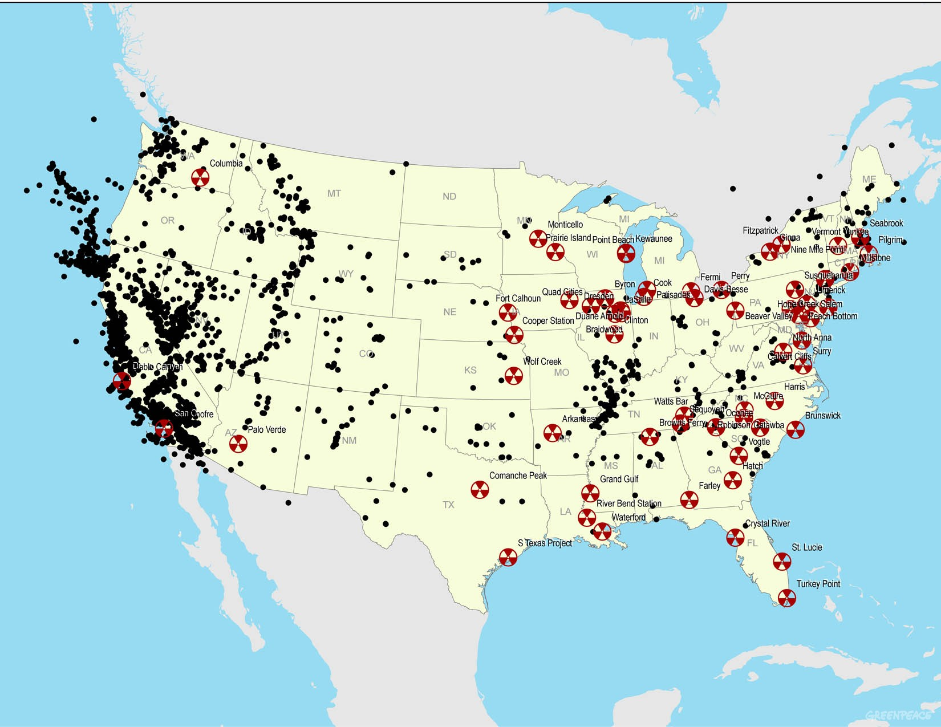
Central and Eastern US Earthquakes Overview
Chris Powell
Center for Earthquake Research and Information

Slide 2
Consensus opinions from the 2009 USGS workshop:
CEUS seismicity concentrates in distinct zones and there are no zones
that have escaped detection.
Tectonic inheritance plays an important role in the location of intraplate
seismic zones; most intraplate seisimic zones are associated with rifted crust.
The presence of inherited structure may be necessary but not sufficient for the
existence of an intraplate seismic zone.
Earthquake activity in the CEUS may migrate from place to place.
Felt earthquakes can probably occur anywhere.
Plate boundary mechanisms may not apply – Unlike plate boundary regions
where the rate and size of seismic activity is directly correlated with plate interaction,
seismic activity in the CEUS is probably related to the regional stress fields, with
the earthquakes concentrated in regions of crustal weakness.

Slide 3
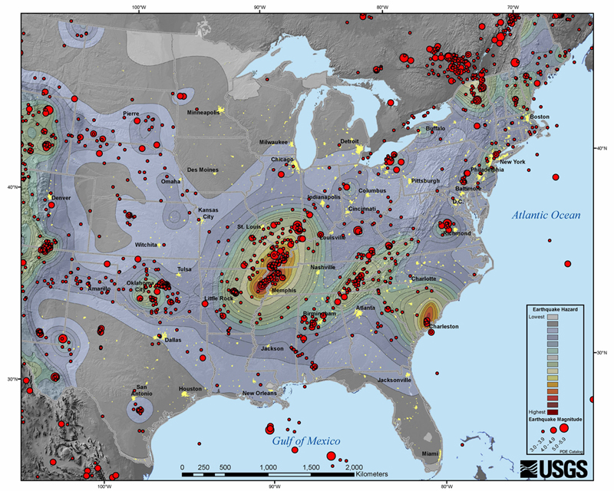
Most earthquakes ≥ 3 occur in distinct zones
Charlevoix
WQ
WVS
CVA
NMSZ
ETSZ
Charleston
Notes:
WQ western Quebec, WVS Wabash Valley, CVA central VA,

Slide 4
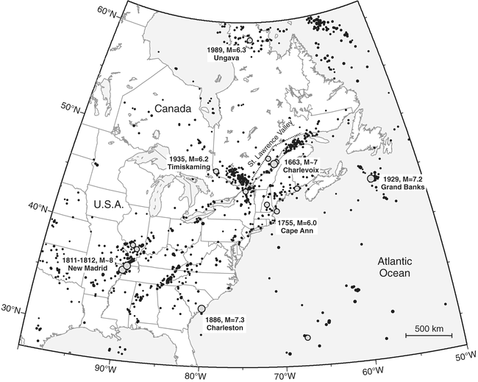
Larger magnitude
earthquakes
Major exception
ETSZ
Notes:
5.8 Mineral VA earthquake

Slide 5
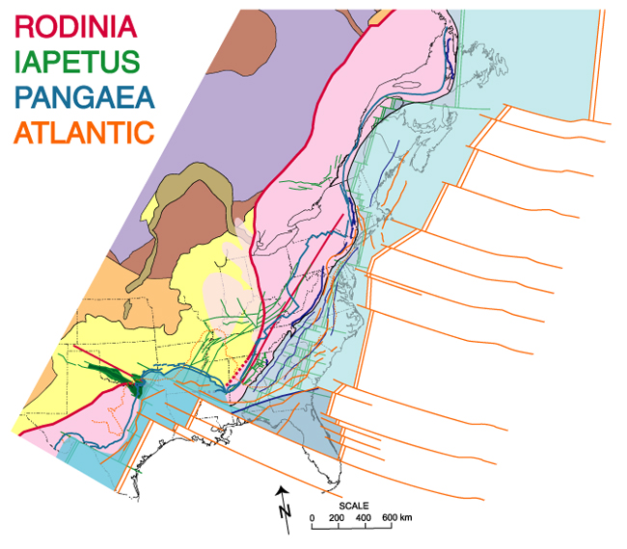
•Proterozoic orogens (1.9-1.6 Ga)
•Anorogenic Granite-Rhyolite (1.5-1.3 Ga)
•Grenville orogen (1.4-1.0 Ga), assembly of Rodinia
•Iapetan continental rift (750-530 Ma) and break-up of Rodinia;
Laurentian continental margins
•Appalachian-Ouachita orogen (338-270 Ma), assembly of Pangaea
•Opening of Atlantic Ocean and Gulf of Mexico (230-205 Ma) and
break-up of Pangaea; North American continental margins
•Beginning of Atlantic Ocean closure??
Tectonic inheritance plays an important
role in the location of intraplate seismic
zones.
Two Complete Wilson cycles and
the beginning of a third
Thomas 2005

Slide 6
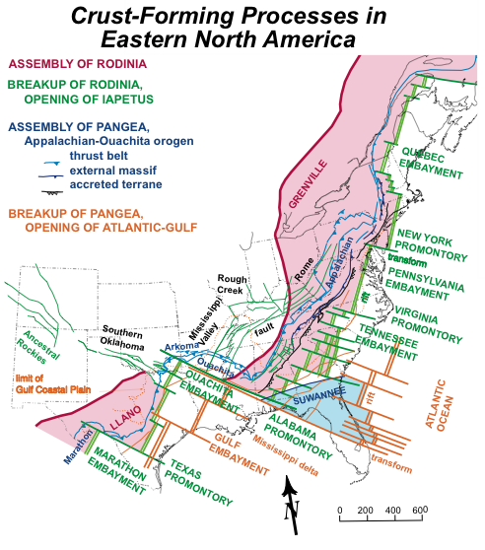
Many seismic zones
are associated with
rifted crust.
Exceptions:
W Quebec
ETSZ
From Bill Thomas

Slide 7
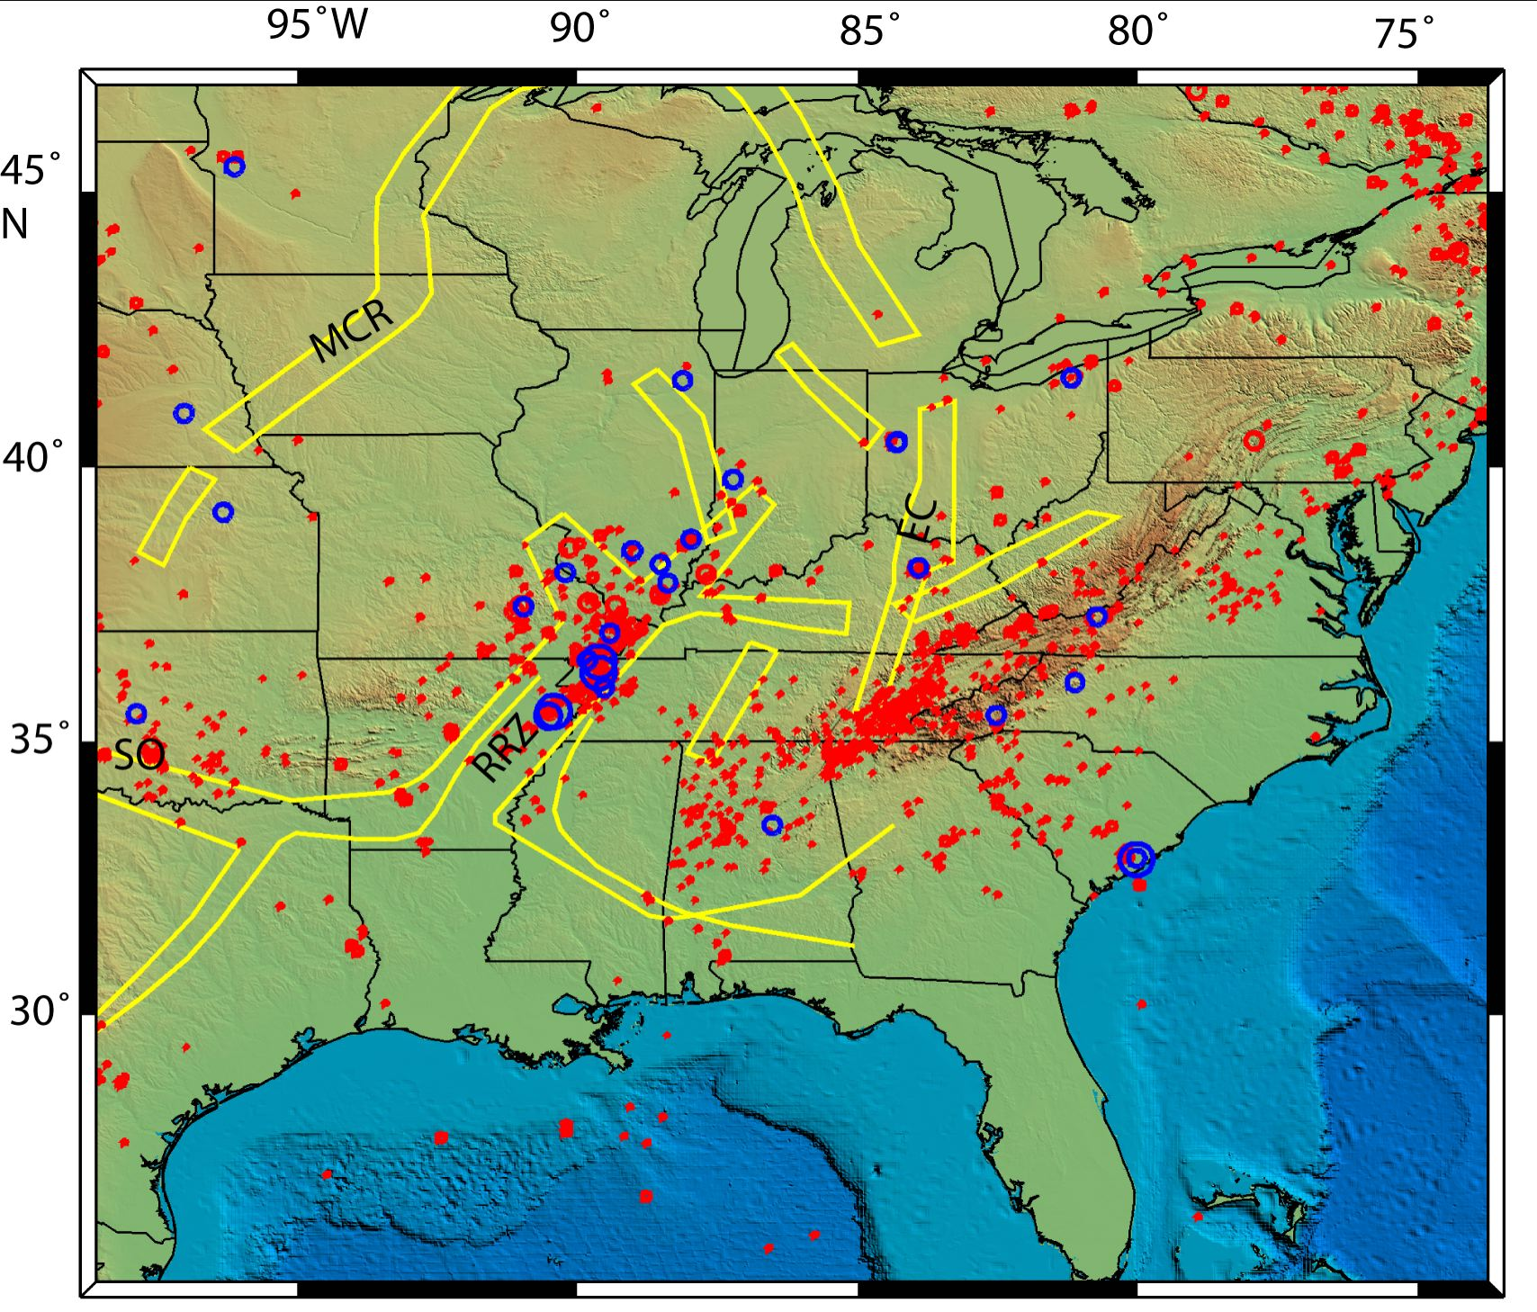
The presence of inherited structure may be necessary but not sufficient for the
existence of an intraplate seismic zone.
Many more structural features than seismic zones. MCR for example.
Prominent structural features may be seismogenic along only part of their length.

Slide 8
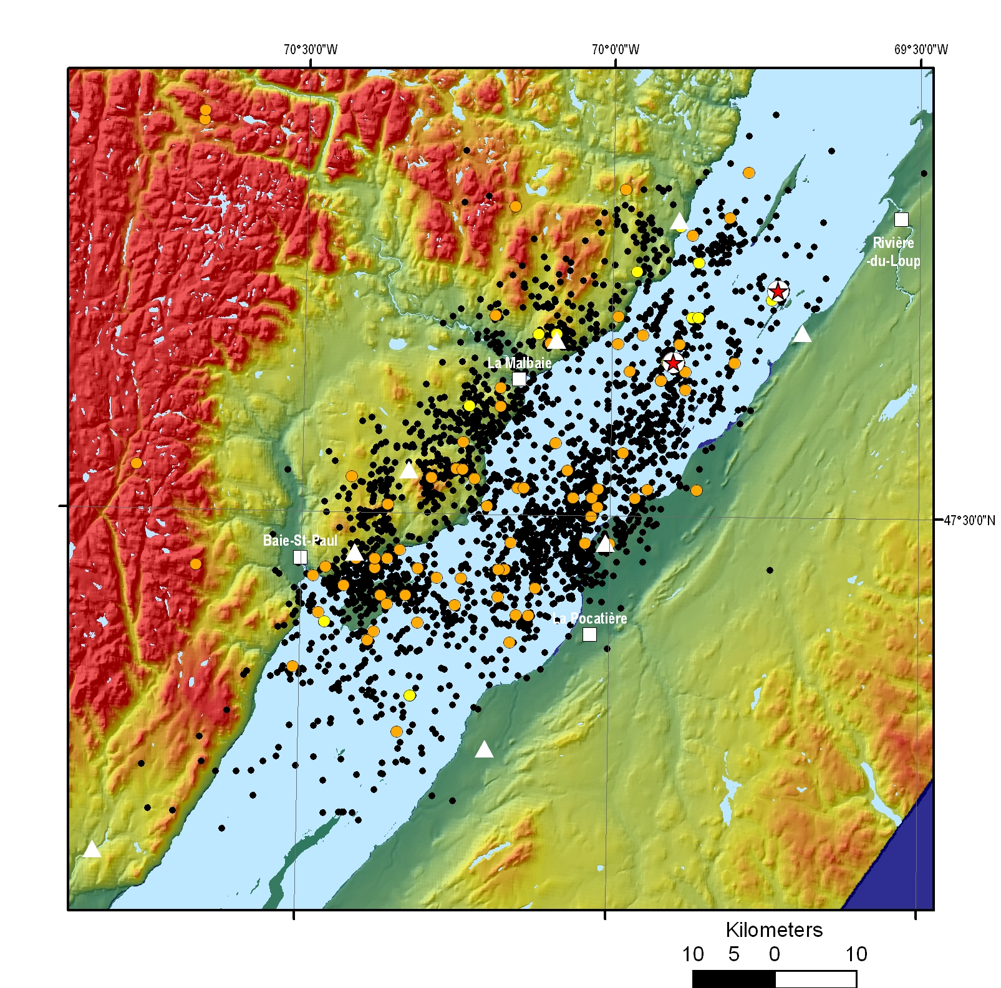
What other factors may be facilitating the presence of an intraplate seismic zone?
Compositional anomalies?
NMSZ (abundant quartz, mafic pillow)
Additional structural weakening?
Charlevoix (meteorite impact)
ETSZ (releasing bend in a shear zone)
CVA (shallow thrust faults?)
Presence of fluids in the crust?
NMSZ
Association with major rivers?
NMSZ, Wabash Valley, ETSZ, Charlevoix
Favorable orientation in the present-day stress field?
NMSZ, Wabash Valley, ETSZ, Western Quebec, CVA?
Thinned lithosphere (plume passage)?
NMSZ, Western Quebec, PA through New England seismicity
Elevated topography?
ETSZ
Charlevoix rift structure + impact structure

Slide 9
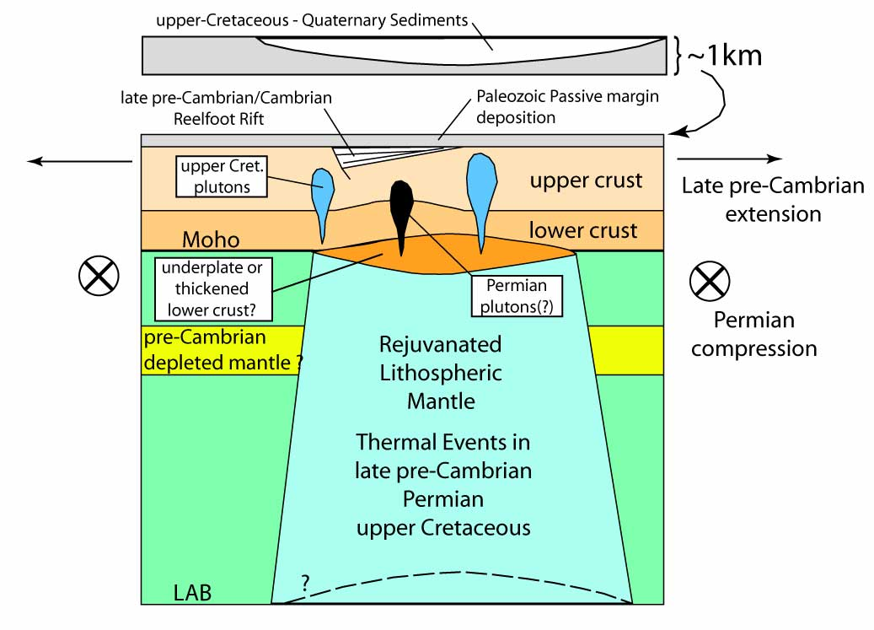
NMSZ Pieces of the Puzzle
west
east
Notes:
Seismic targets include crustal thickness, the extent of the “Rift Pillow”, and the extent of the “depleted mantle layer” – is there a hotspot track in the lithosphere?
HEATHER, SUE HOUGH, MORGAN PAGE, AKRAM

Slide 10
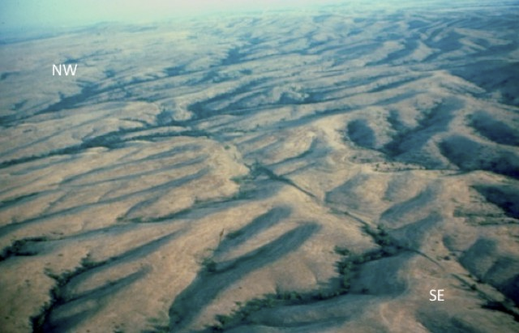
Earthquake activity in the CEUS may migrate from place to place.
Seismically inactive structural features may have been active in the past.
Inactive Meer’s fault in Oklahoma ~50 km long.

Slide 11
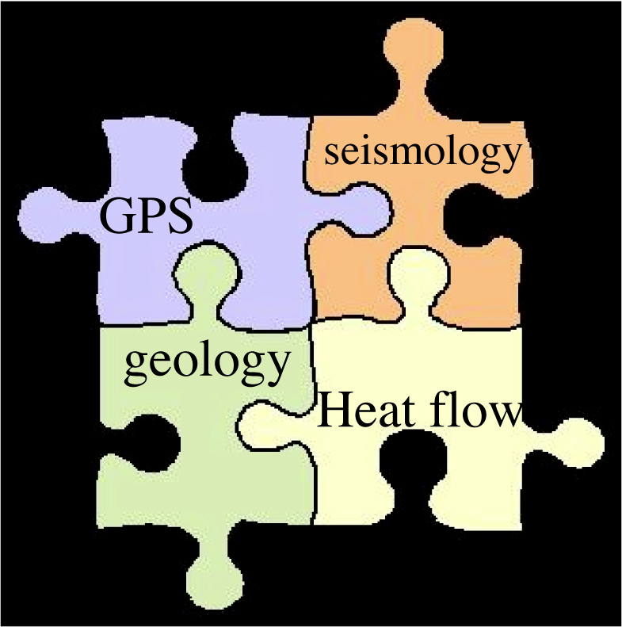
What is our biggest challenge?
We do not understand the causal mechanisms for CEUS intraplate earthquake activity.
Plate boundary mechanisms may not apply – Unlike plate boundary regions where the
rate and size of seismic activity is directly correlated with plate interaction, seismic
activity in the CEUS is probably related to the regional stress fields, with the earthquakes
concentrated in regions of crustal weakness.
Lithospheric structure and mantle flow patterns probably strongly influence stresses,
strain rates and surface motions in the CEUS.
Thorough understanding of problem will require input from many different sources.

Slide 12
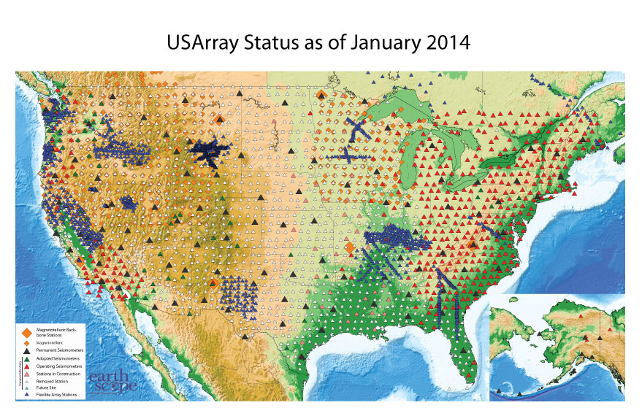
USArray and FlexArray experiments – our opportunity to determine lithospheric structure
Quebec-Maine Array
SPREE
OIINK
MAGIC
NELE
ENAM
SESAME
SIDECAR
SUGAR
Notes:
SPREE – mid continent rift zone; OIINK – Wabash Valley, ILL basin; MAGIC – mantle flow below the east coast relationship to topography; ENAM- onshore offshore crust and mantle structure refraction on land; SUGAR refraction Suwanee terrane across the S Georgia basin rift; SESAME BB terrane accretion and crustal growth in the S. Appalachians; SIDECAR BB lithospheric structure associate with the Rio Grande rift; Quebec-Maine array – lithospheric structure across three major tectonic boundaries

Slide 13
P-wave velocity
anomalies
Biryol et al. (2016)

Slide 14
Biryol et al. (2016)

Slide 15
What additional research/resources do we need to make breakthroughs in our
understanding of why intraplate seismic zones exist and the hazard they pose?
More interdisciplinary research – solution of these problems will require input from
many sources.
Better delineation of inherited structure in the crust and lithosphere.
Better delineation of flow patterns in the mantle that affect stresses, strain rates and
surface motions in the CEUS.
Continued GPS monitoring in the CEUS.
Better instrumentation is needed to further our understanding of wave propagation and
earthquake source physics in the CEUS. This may involve installation of borehole networks
and clusters of surface arrays.

